Slide 1
Kriging
Aug22
March23
Sept22
Apr23
Oct22
May23
Nov22
June23
Dec22
July23
Jan23
Aug23
Feb23
Depth 6m
Distance 350m
Vs (m/s)

Slide 2
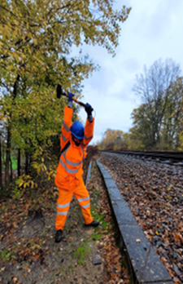
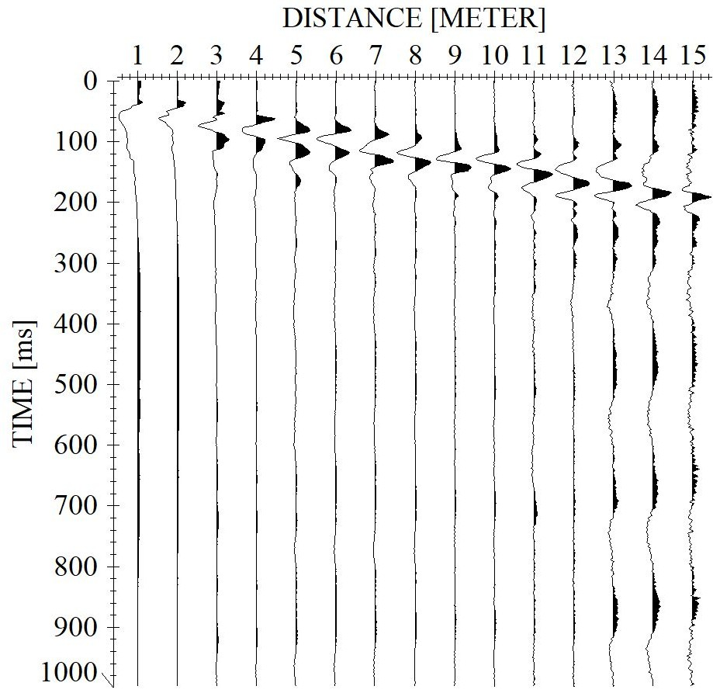
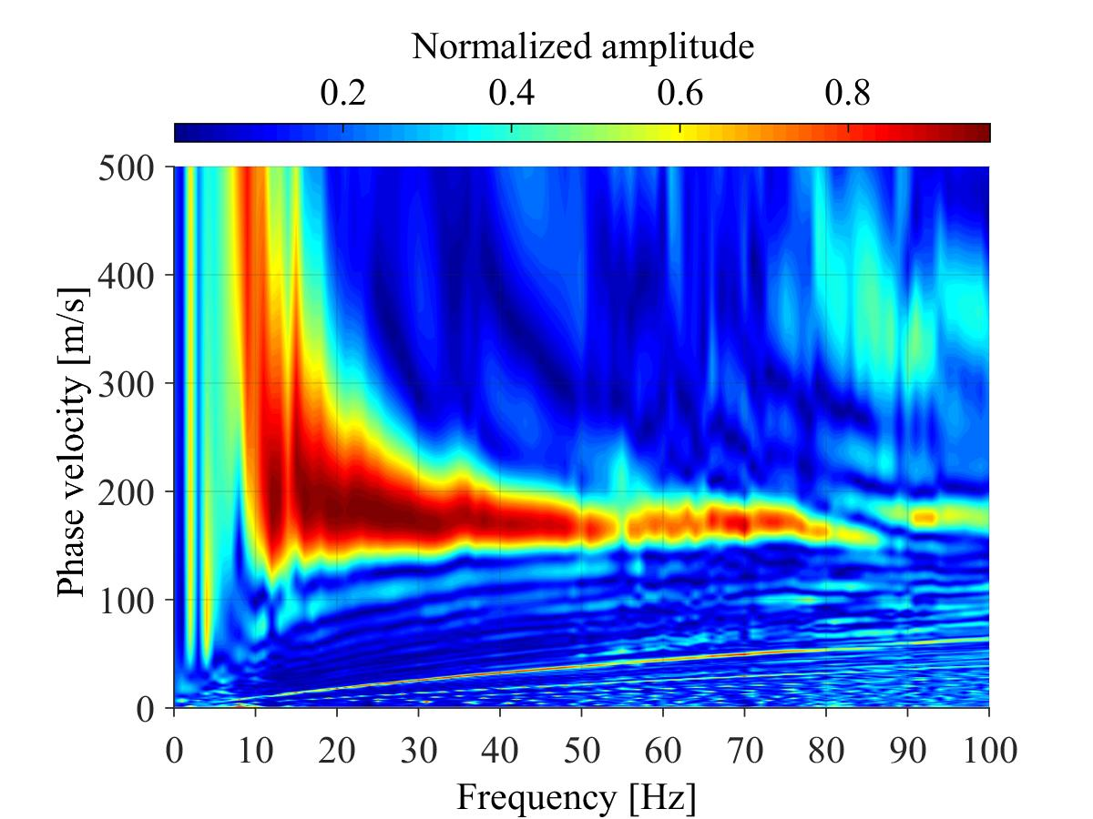
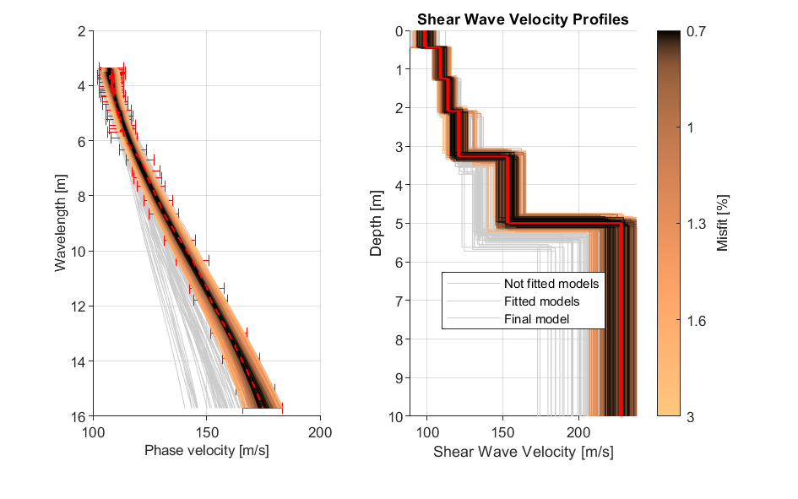
Methodology (Active seismic survey)
The various stages involved in producing a 2D MASW profile
Generate vertical ground motion with an impulse source
Record seismic data with fibre-optic cable
Pick dispersion curve
Inversion of the picked dispersion curve
0
Combine 1D inversions to build a 2D Vs profile
2022_08_24
-2
Depth (m)
-4
0
50
100
150
200
250
300
350
Distance (m)
Vs (m/s)

Slide 3
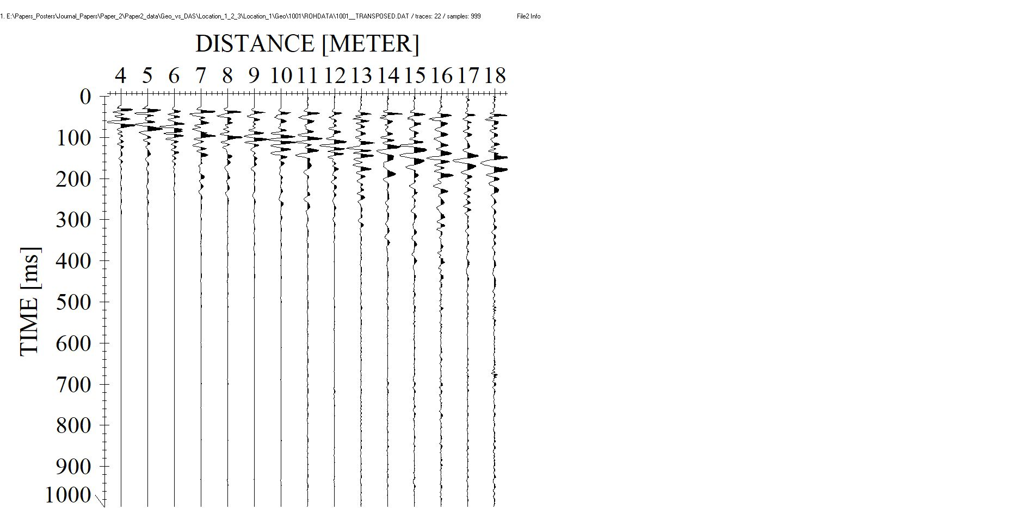
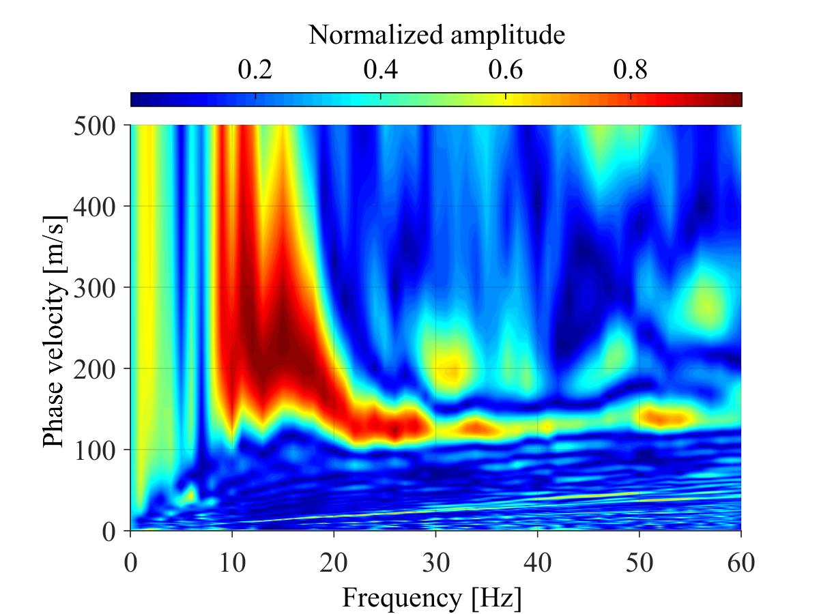
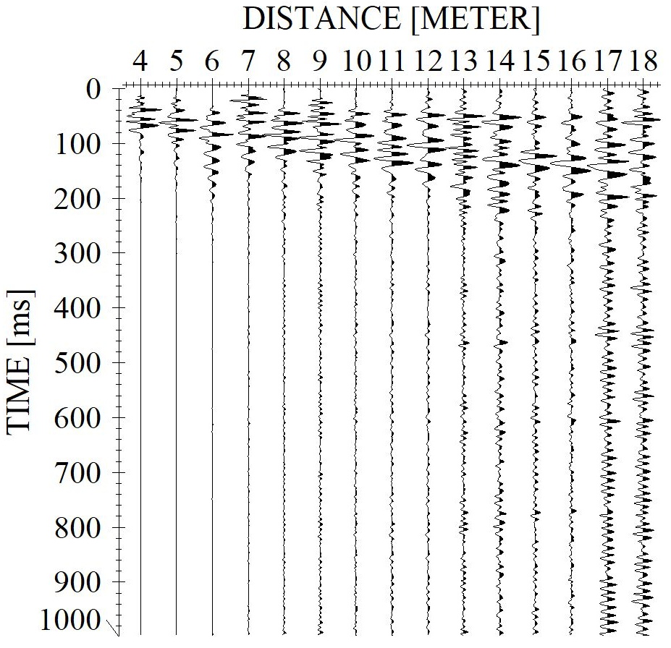
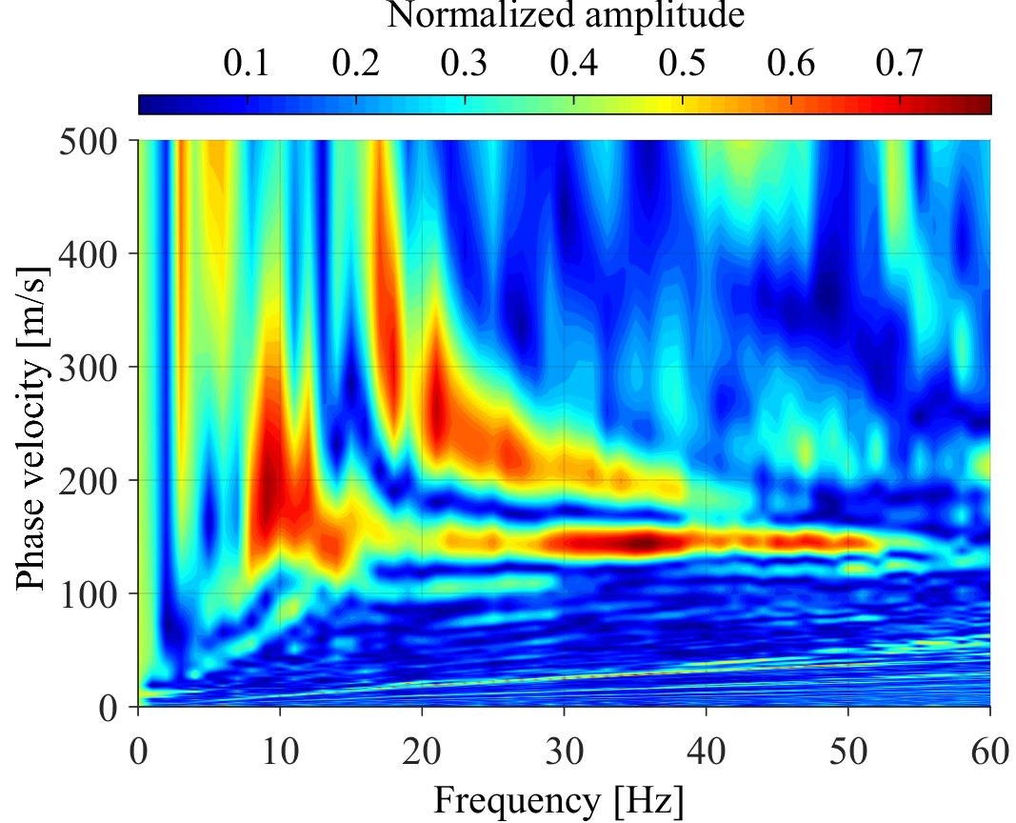
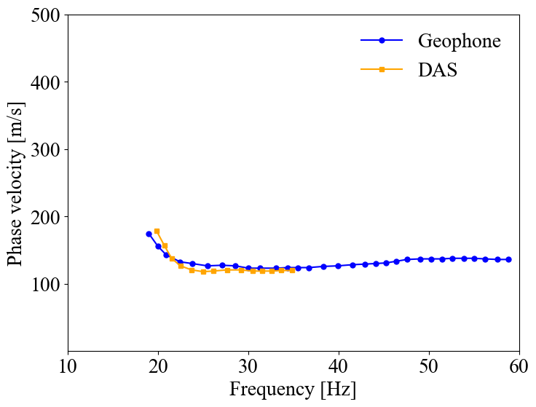
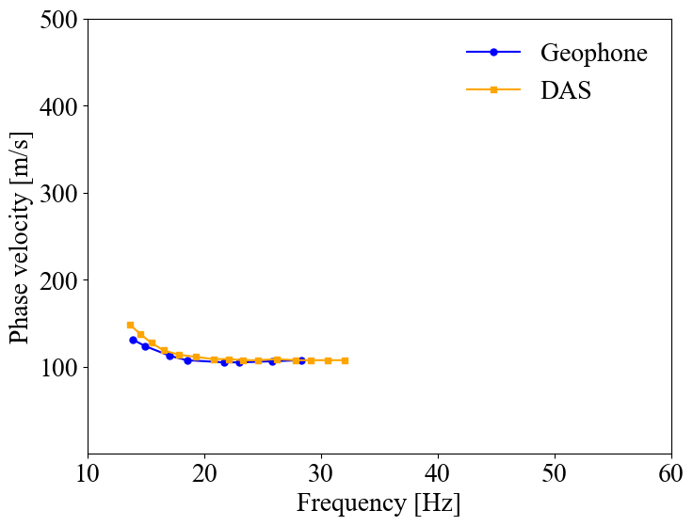
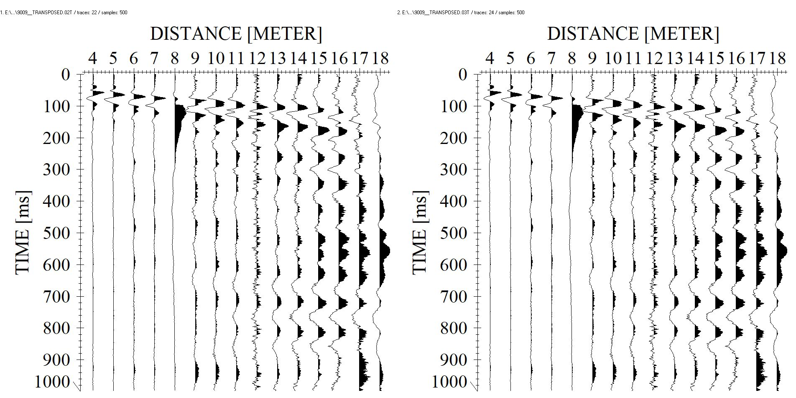
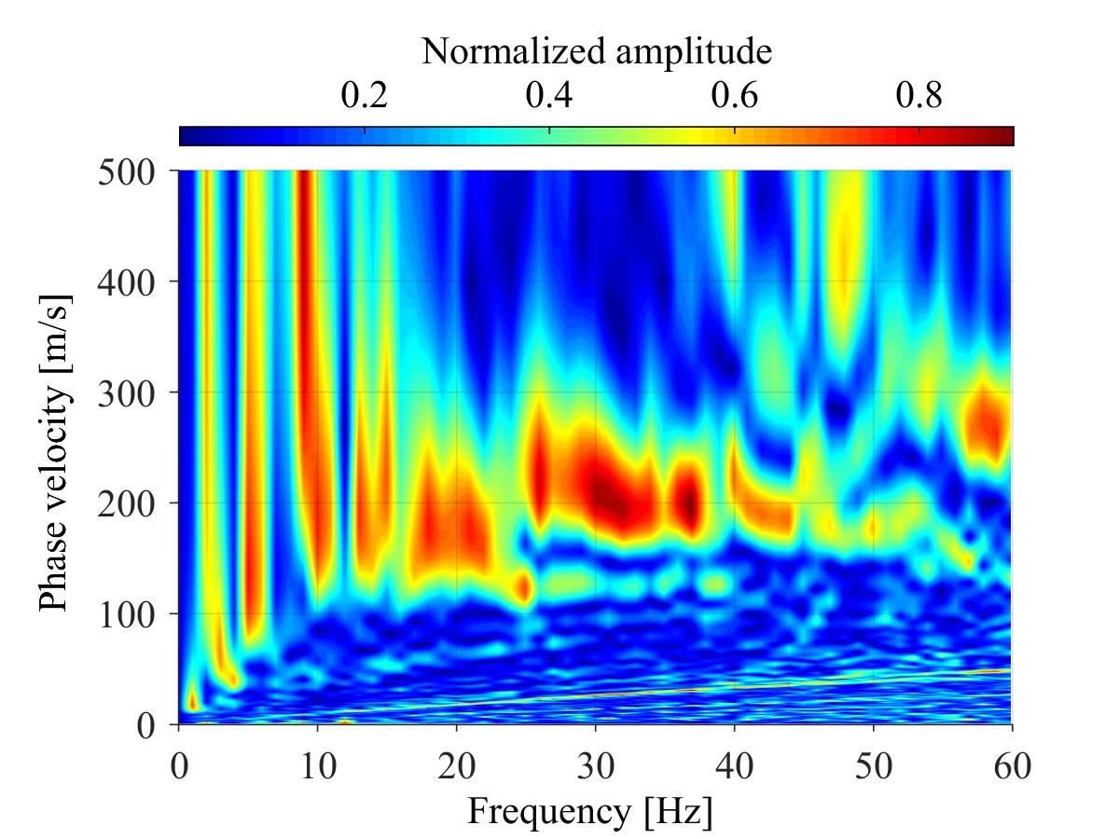
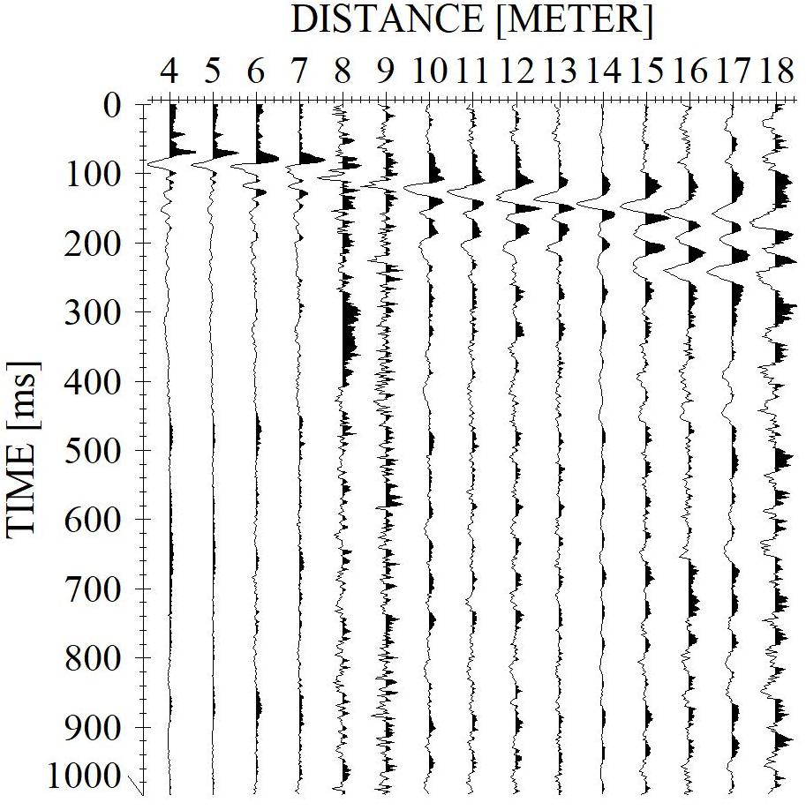
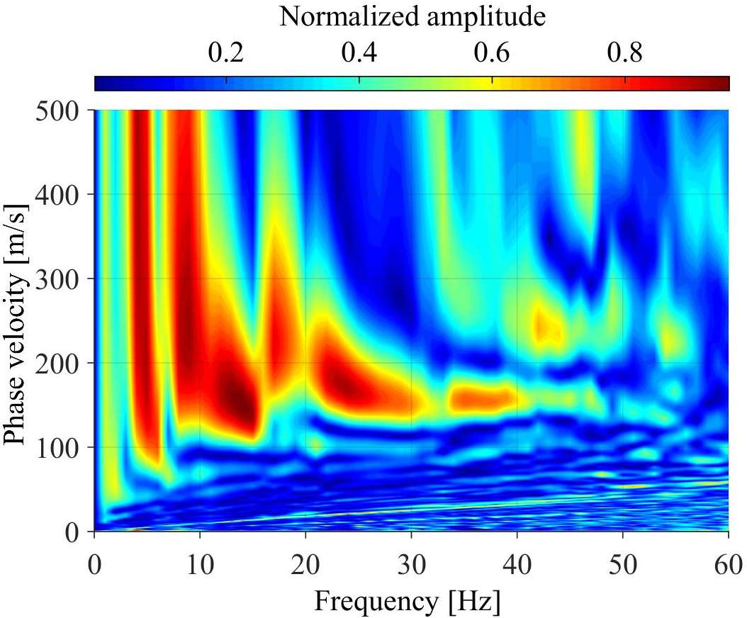
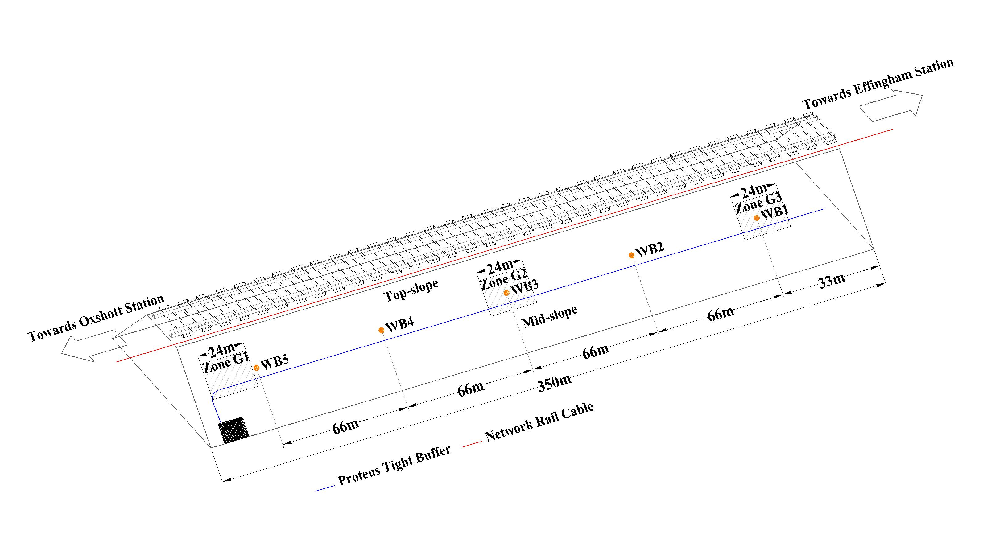
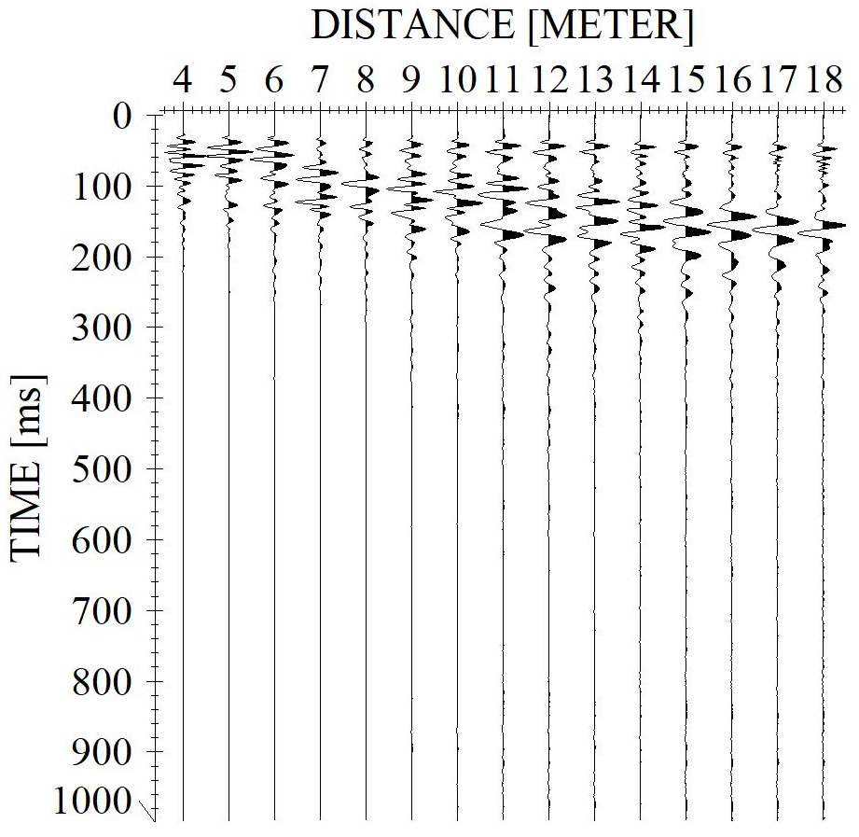
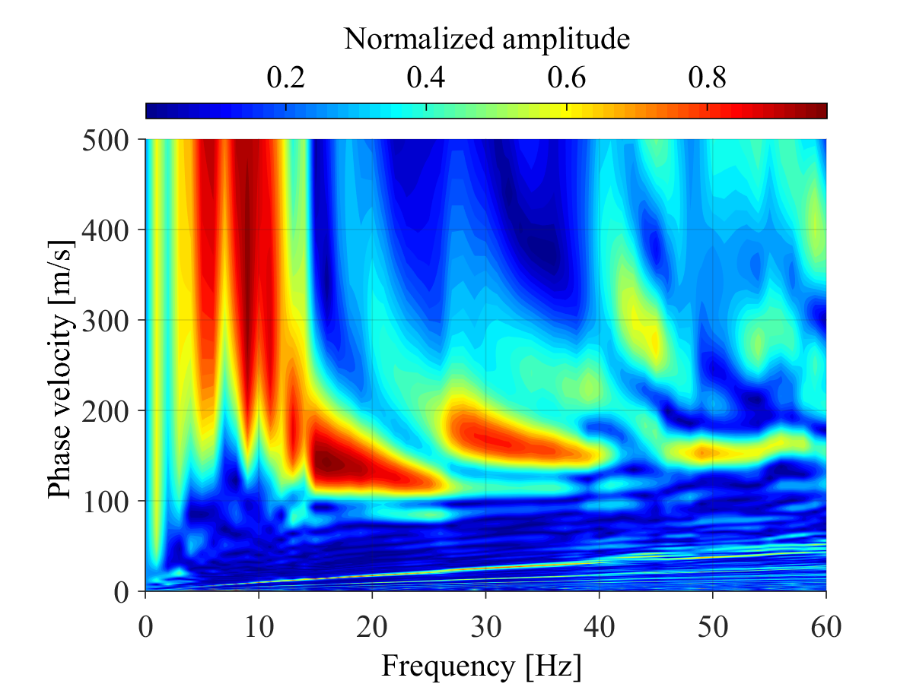
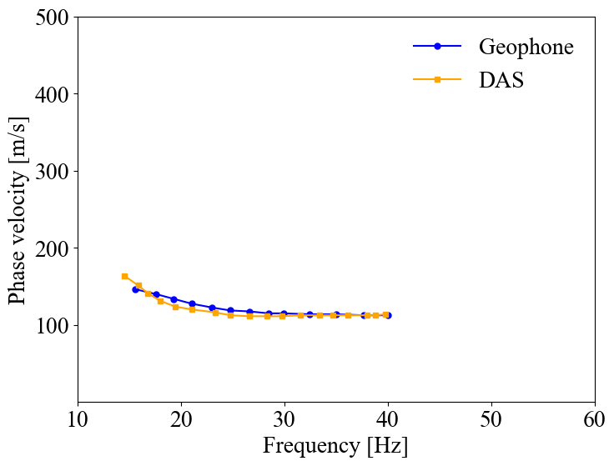
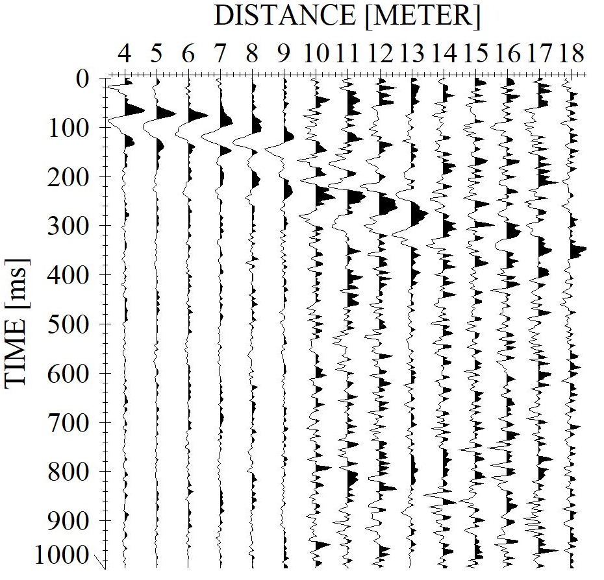
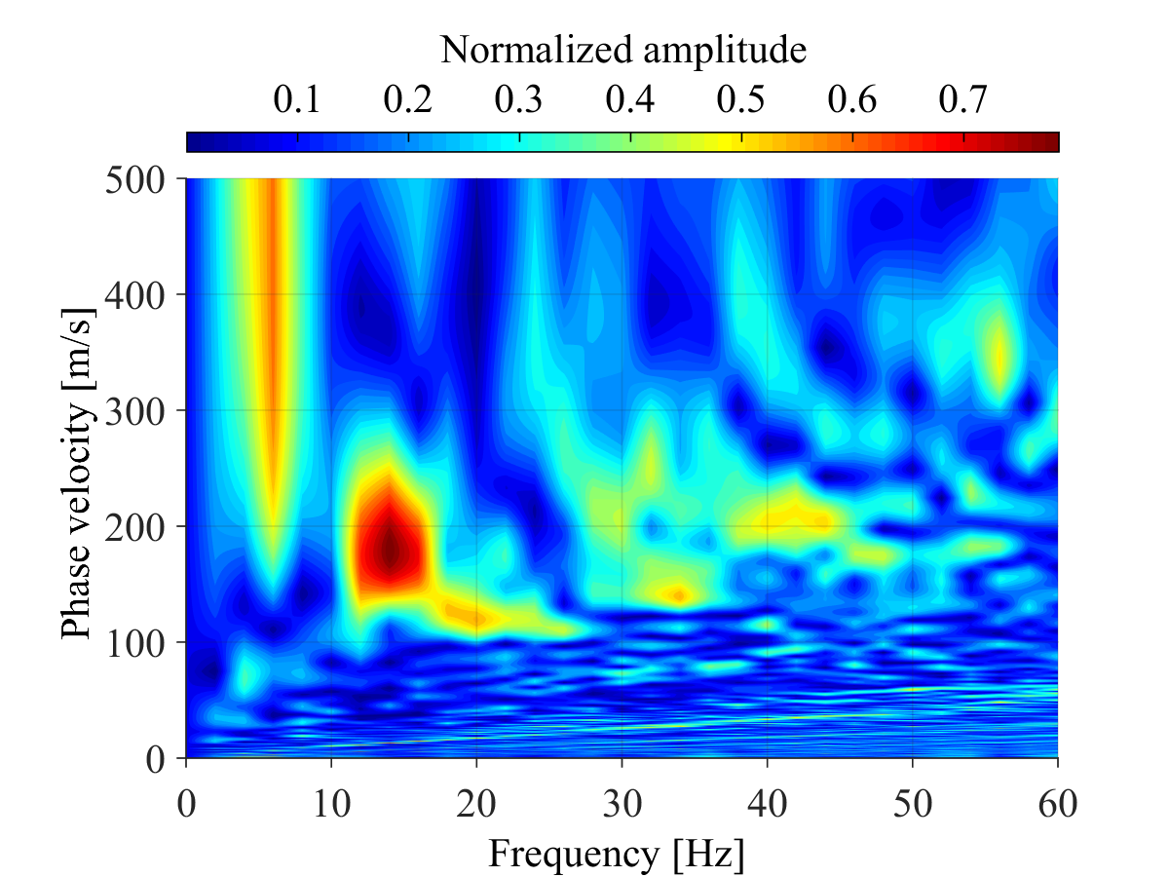
DAS vs Geophones comparison
Comparison of DAS and Geophones Seismic Data
Zone G2
Zone G1
Geophone
Geophone
DAS
DAS
Zone G3
Geophone
DAS

Slide 4
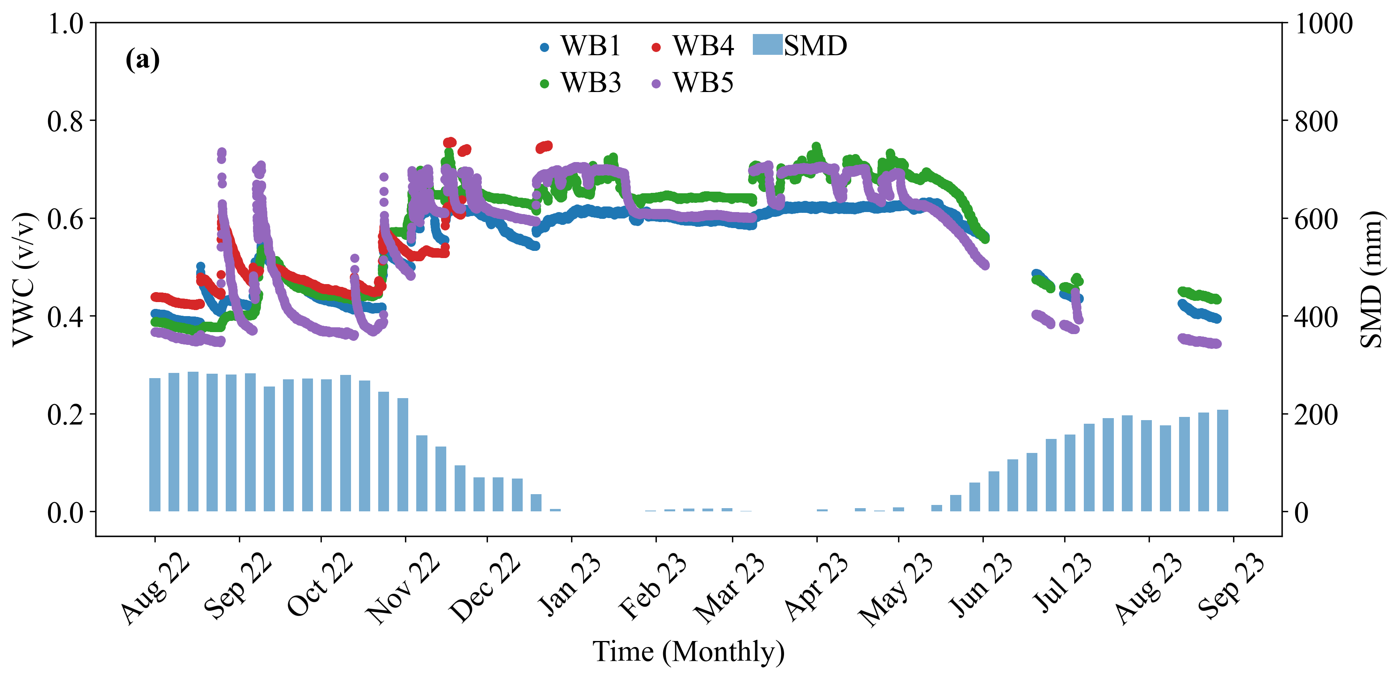
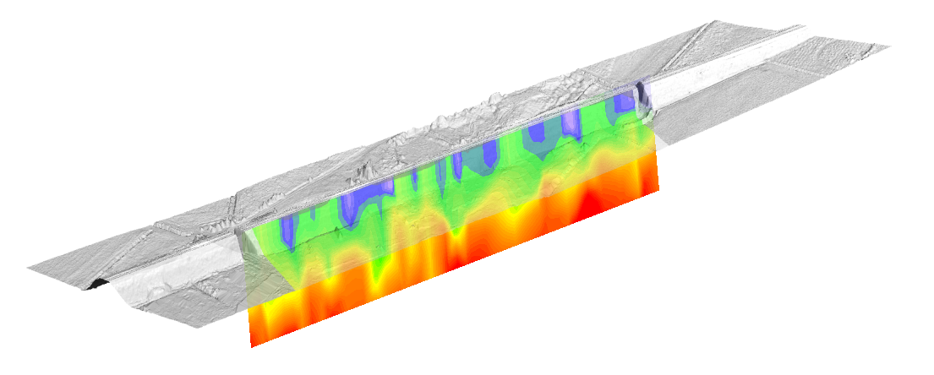


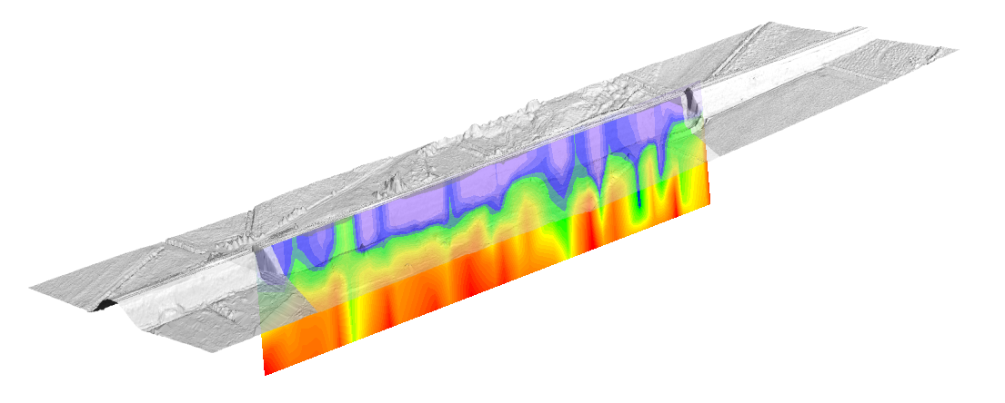
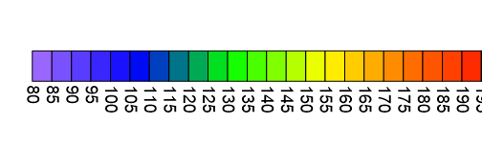
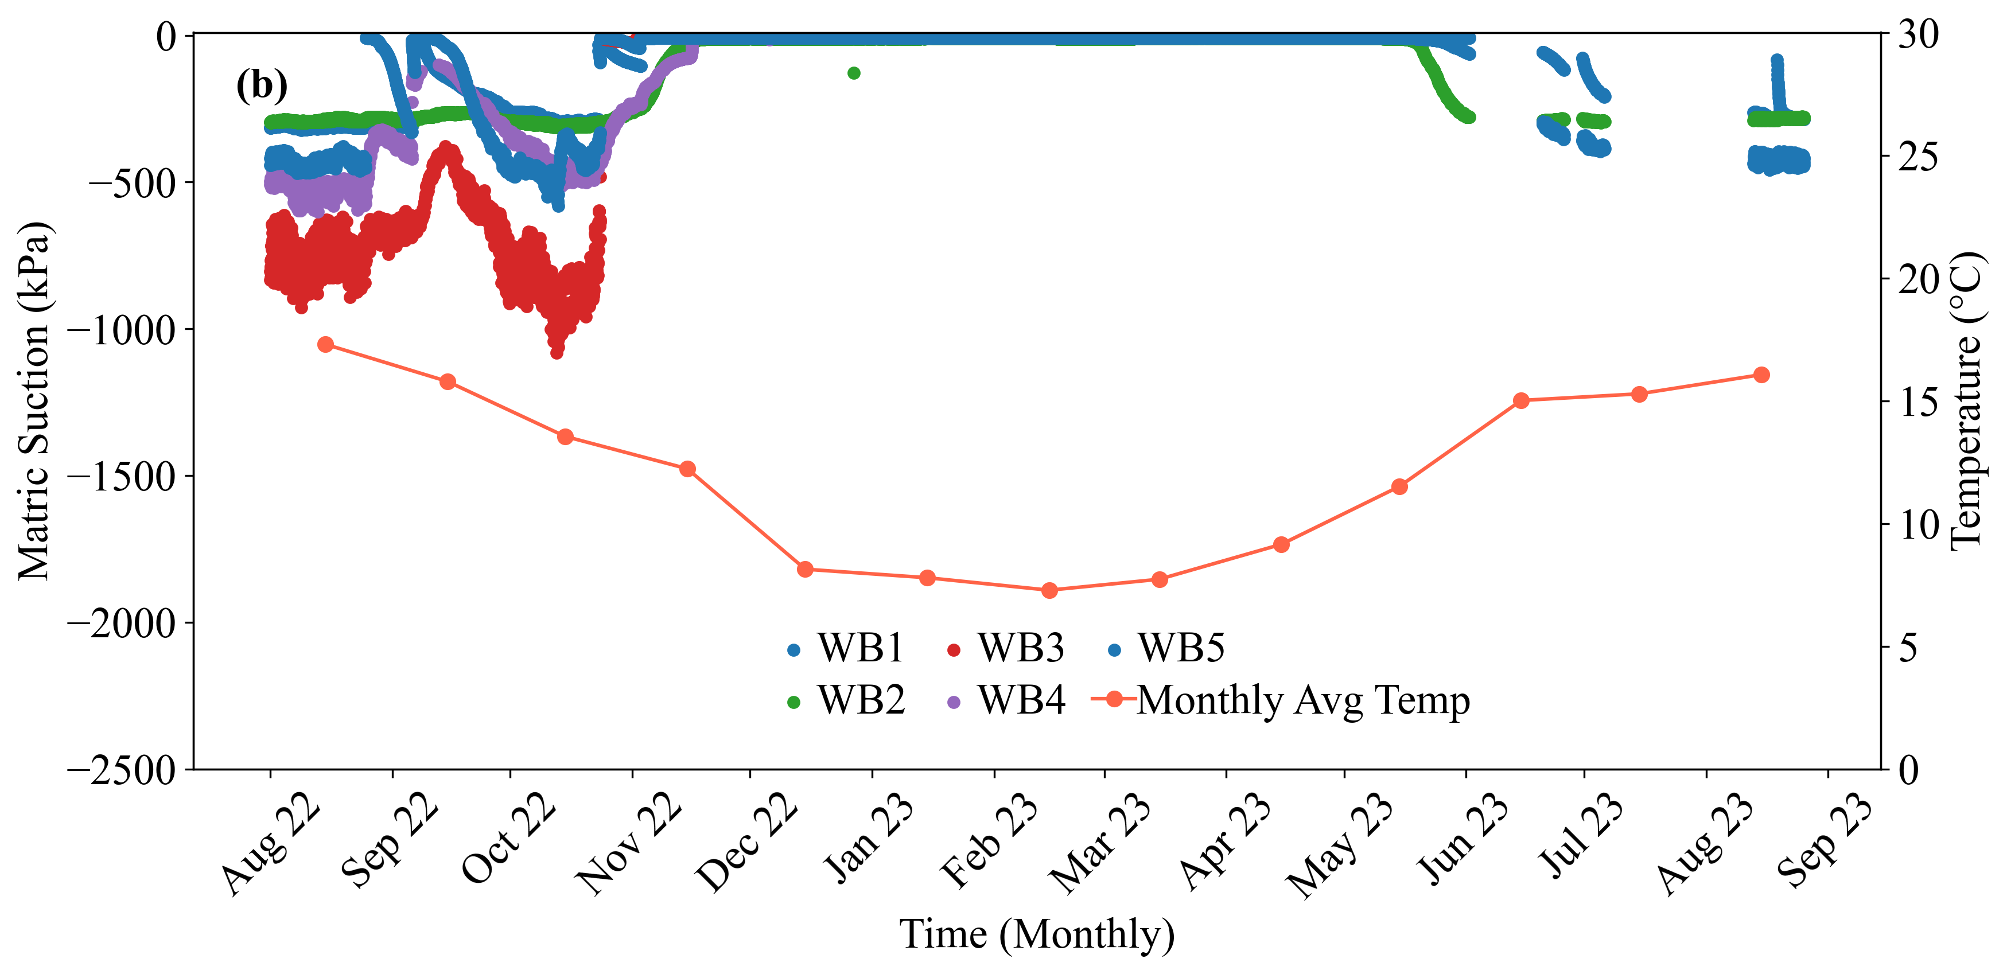
DAS Active Survey with Sensor Data (Aug 2022–Aug 2023)
Sensors data and DAS active survey results both showing the same seasonal trend
OPERATIONAL SLOPE BEHAVIOR
FAILURE
STABLE
SERVICIBILITY
Vs (m/s)
Sensor data between Aug 2022 and Aug 2023

