Slide 1
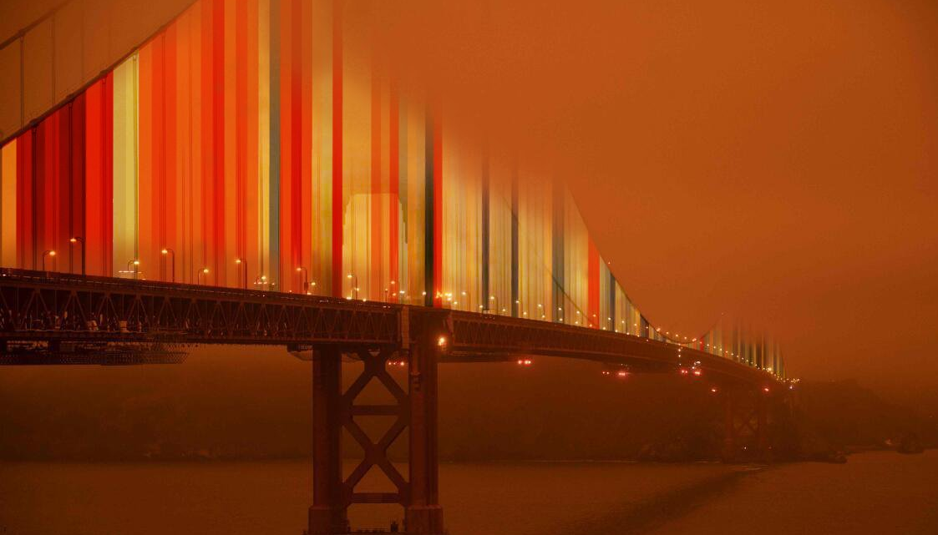


Will you live an unprecedented life?
Luke Grant, Wim Thiery, Inne Vanderkelen,
Lukas Gudmundsson, Erich Fischer & Sonia Seneviratne
(Photo: Alexander Radtke)

Slide 2
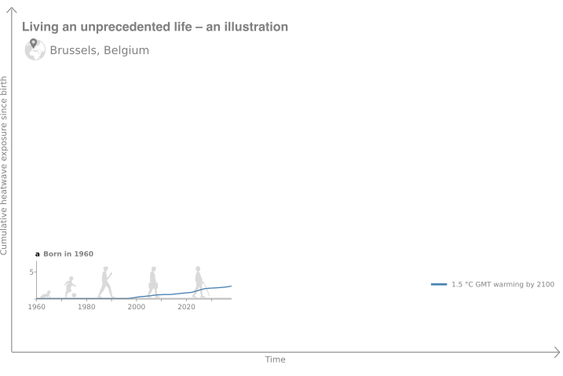

3
Notes:
These chocolates are from Brussels, as is my family. Who of you was born in or around Brussels or has children born there?
My mother was born in 1960 in the ISIMIP pixel containing Brussel.
Here we plot the cumulative heatwave exposure since birth for people born in Brussels in 1960. The blue line shows that, in a world which warms to 1.5 degrees in 2100, this group will experience 3 heatwaves in their lifetimes.

Slide 3
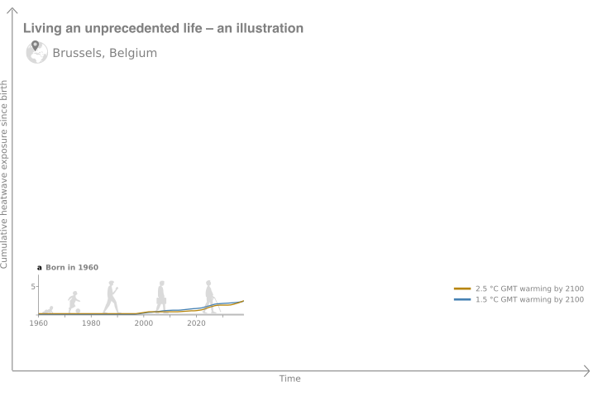
3
Notes:
We can repeat this for a 2,5°C warming pathway

Slide 4
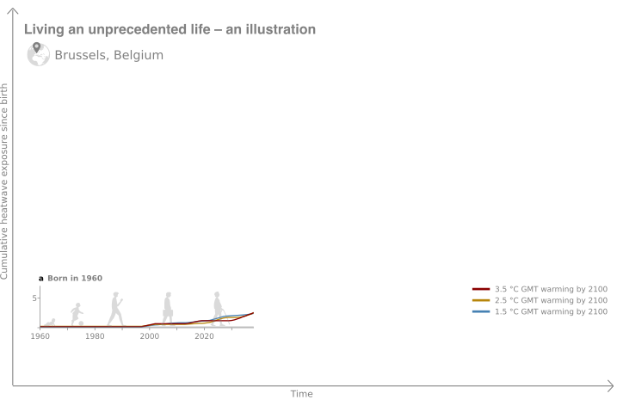
3
Notes:
And a scenario leading to 3,5°C of warming by 2100
The lifetime exposure to heatwaves is hardly different between those three scenarios.

Slide 5
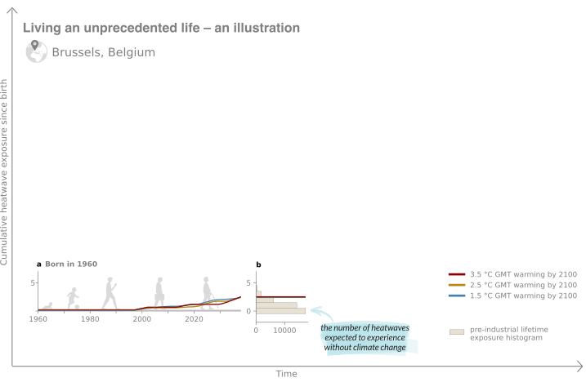
Notes:
We then compare this projected lifetime exposure to the distribution expected under pre-industrial climate conditions.
On this graph, you can see that the lifetime exposure for people that are today 65 years old, still falls within that distribution.

Slide 6
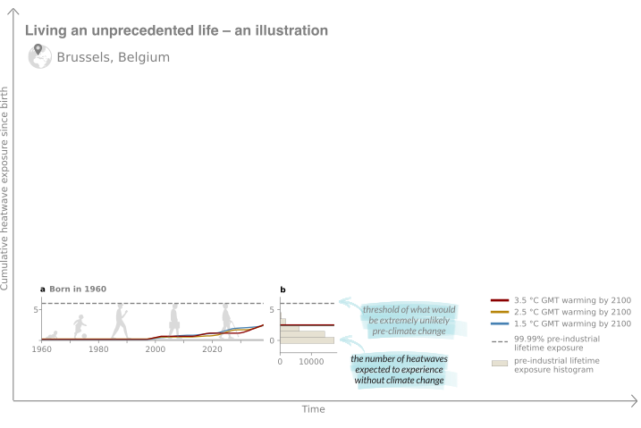
6
Notes:
In a next step, we calculate the 99,99th percentile from the pre-industrial control distribution. In the case of Brussels, this is 6 heatwaves across a lifetime.
Exceeding that threshold implies that you have less than 1 in 10 000 chance of experiencing that many heatwaves across your lifetime in a world without climate change.
This threshold is not exceeded for the 1960 birth cohort in Brussels.

Slide 7
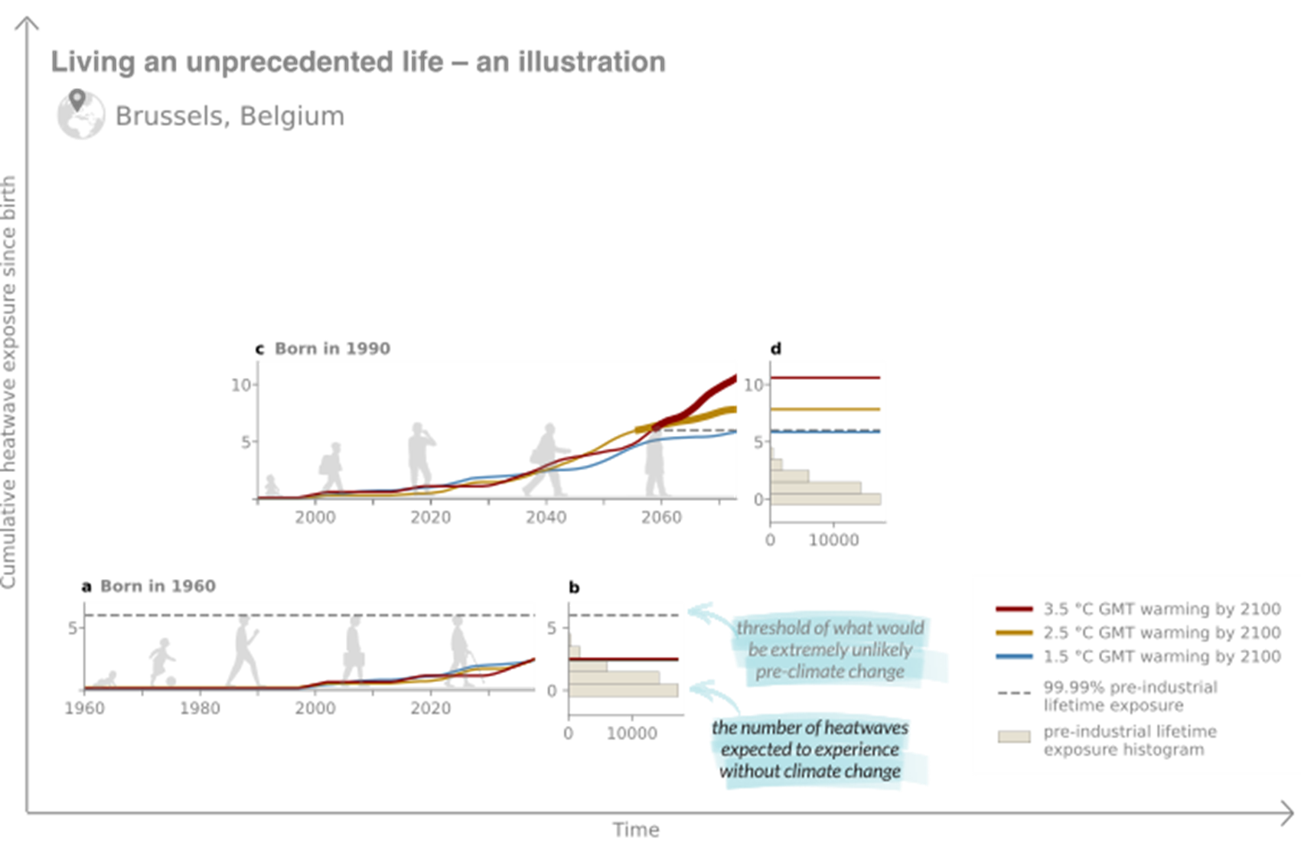
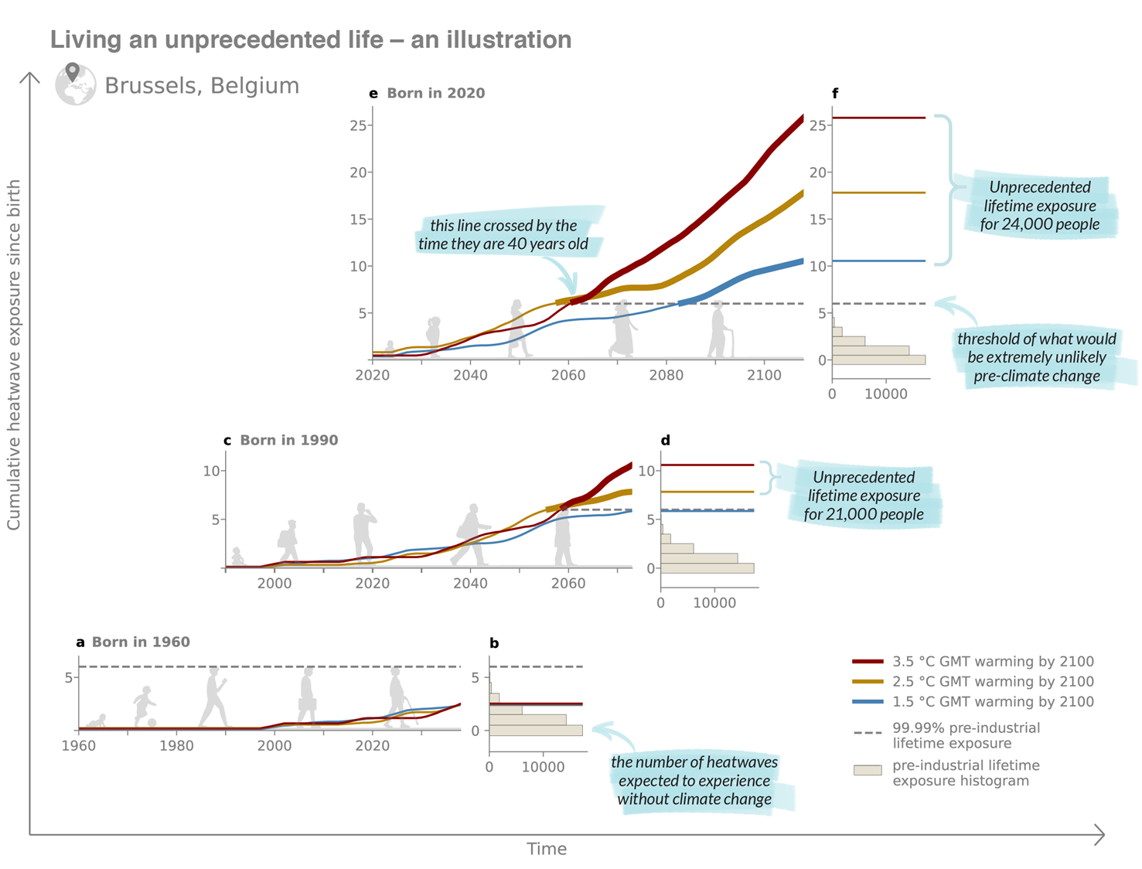
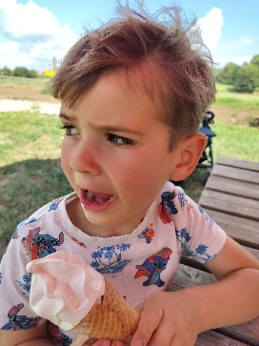

Notes:
Let’s now look at the people born in 1990, roughly the year when my younger brother was born
If we look at this generation, things start to change: This time, the threshold is exceeded in 2 out of the 3 warming pathways.
We call this living an unprecedented life. It means that your lifetime exposure emerges from natural variability and beyond doubt bears the mark of climate change.
You may spot that I then left some space above here, for the birth cohort of my youngest son. However, it’s not enough space.

Slide 8
Notes:
When we look at the children born in 2020, I feel like Al Gore who climbs a lift to get to the top of the screen.
The numbers largely exceed the threshold (go through the roof) and Children born in 2020 in Brussels will live an unprecedented life in terms of heatwave exposure regardless of the scenario.
We then count the number of people per birth cohort that reach this status. For example, In this location, 21,000 people born in1990 will live an unprecedented life under the two high warming pathways, and 24 000 children born in 2020 will live an unprecedented life in each of the scenarios.
For this generation, we also find that the age of emergence can be as young as 40 years of age.
( In the 1.5 °C pathway, the 2020 birth cohort is projected to experience nearly 11 heatwaves, yet this increases to 18 and 26 heatwaves in pathways reaching 2.5 °C and 3.5 °C, respectively, by the end of the Century)

Slide 9
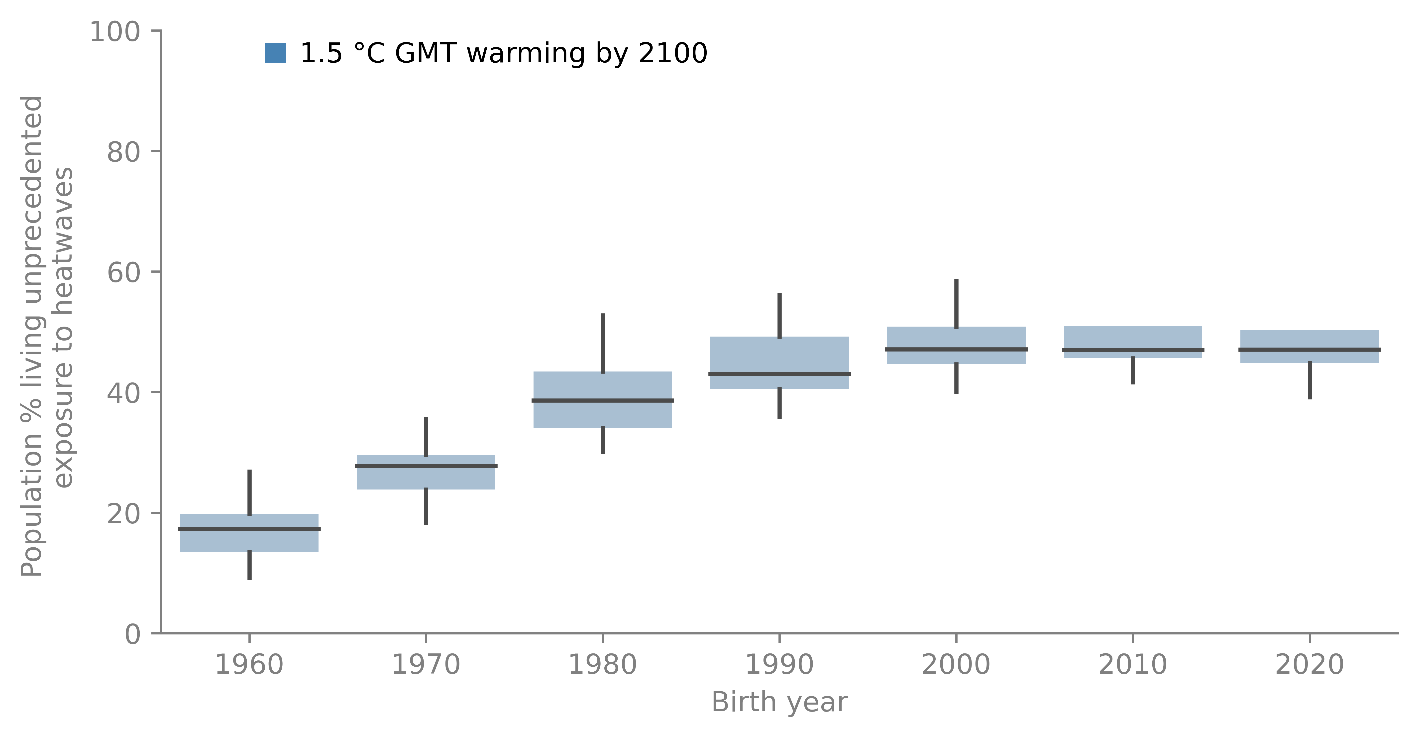
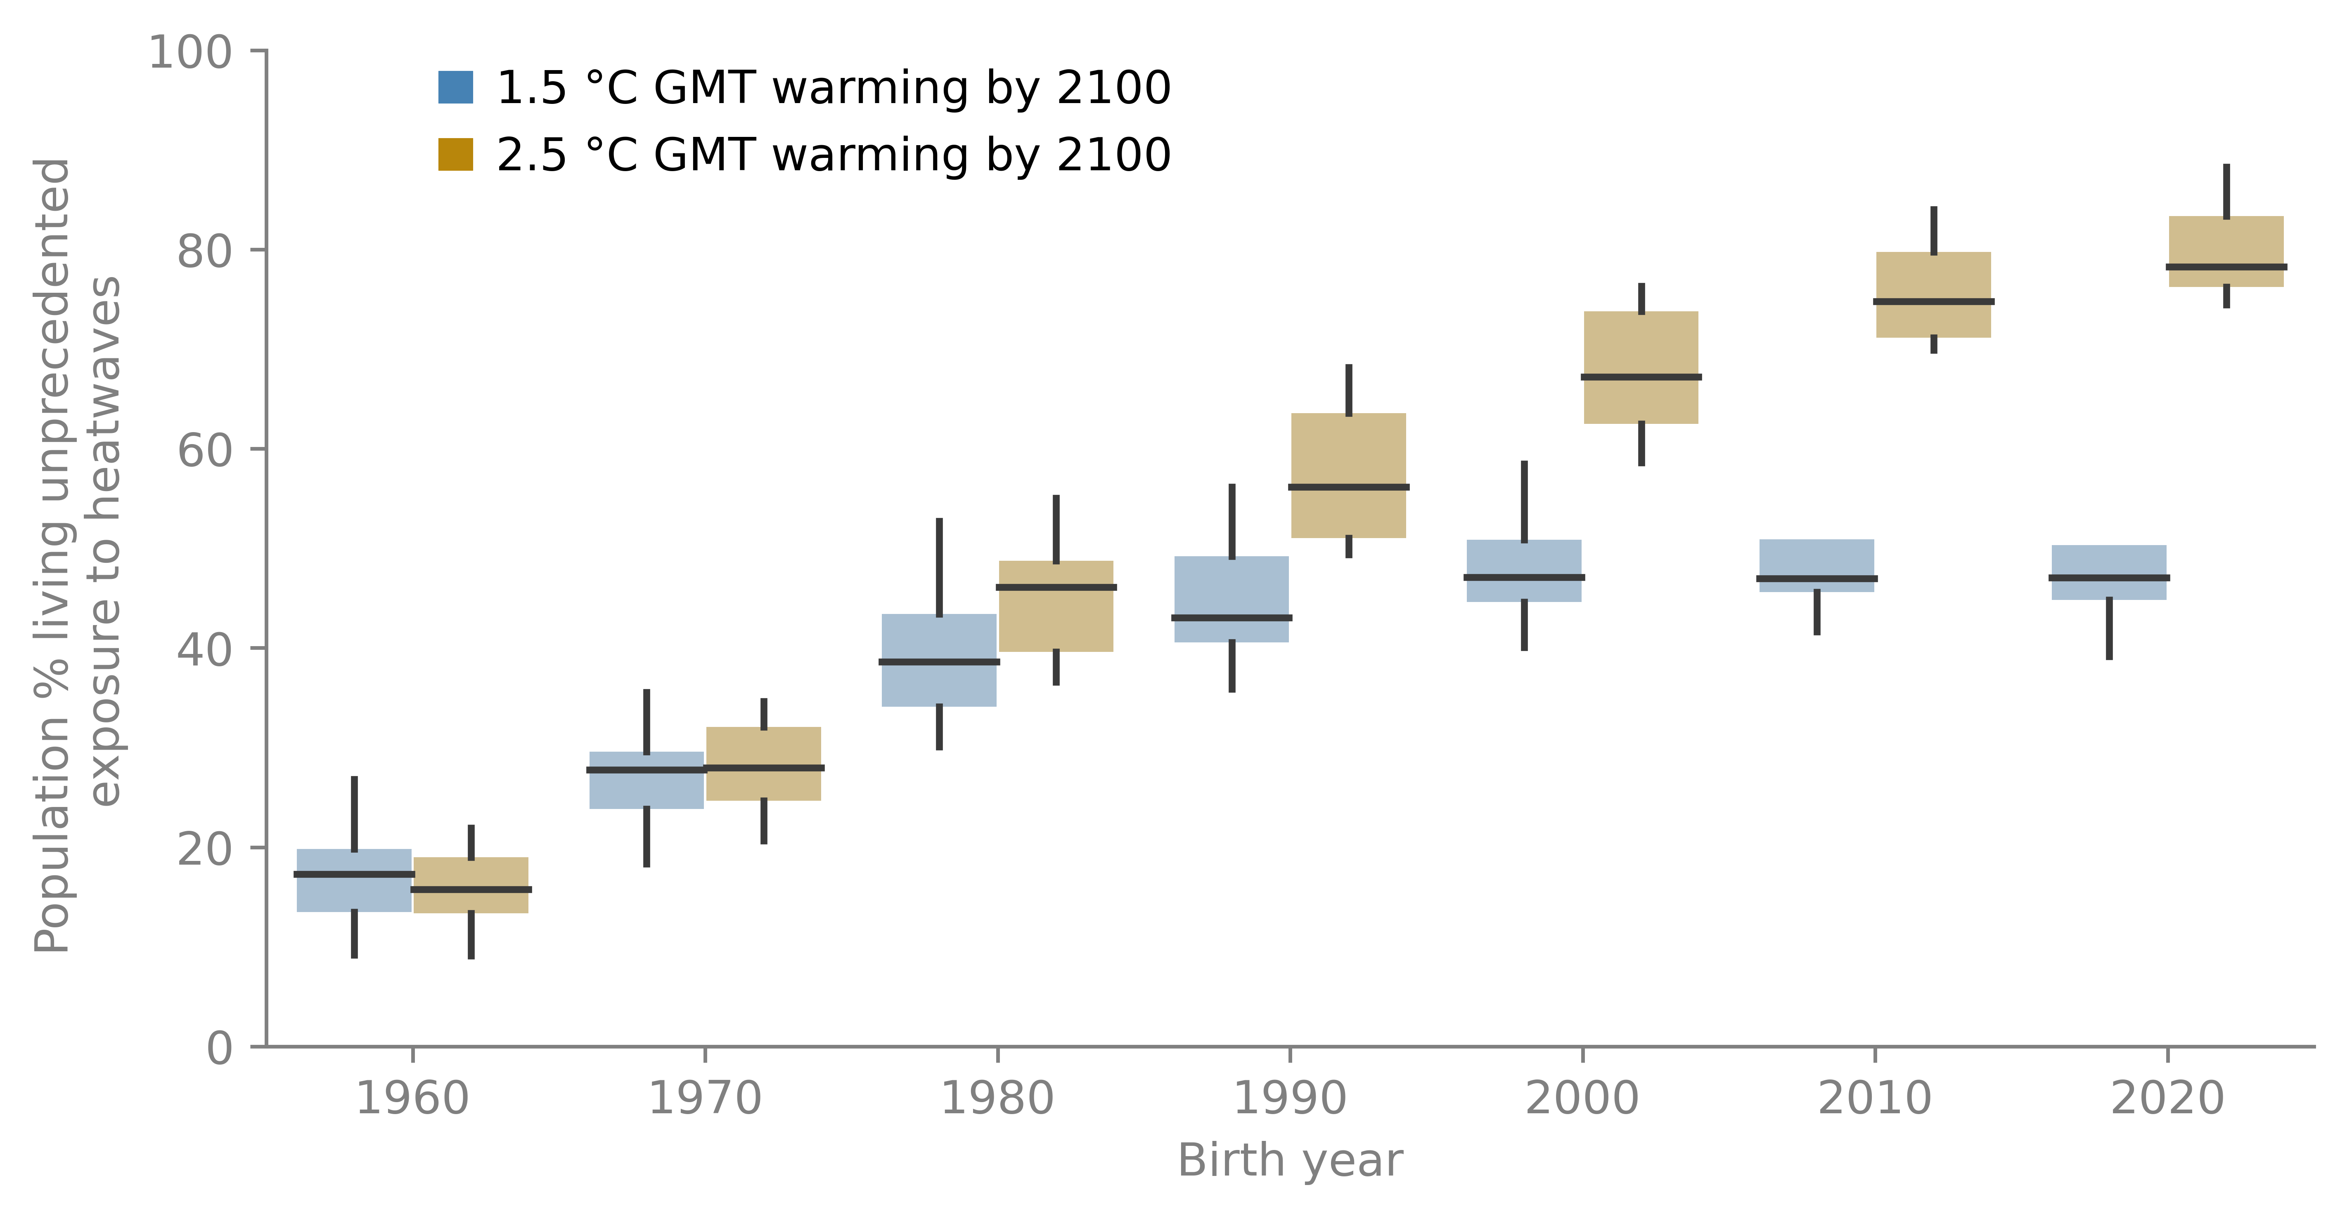
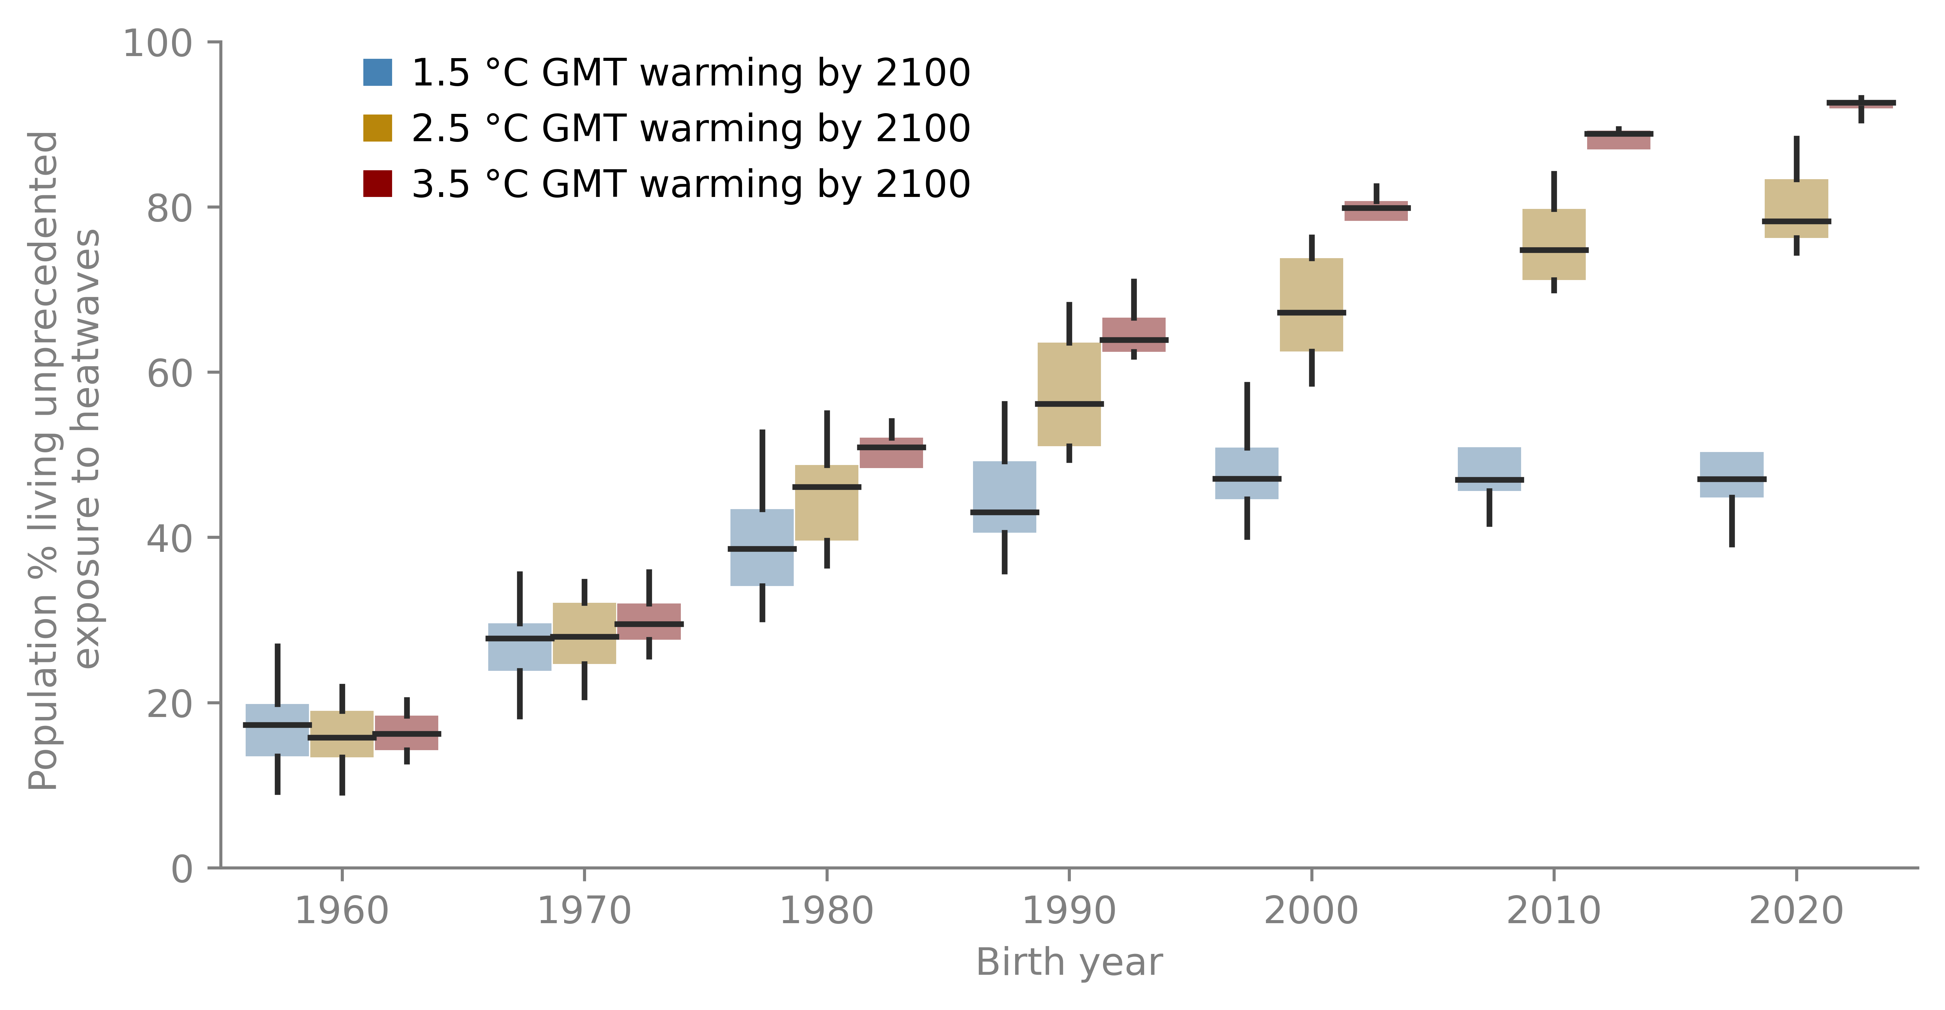
Fraction of global population facing unprecedented heatwave exposure
92%
78%
52%
Notes:
In a next step, we repeat this analysis for every generation and grid cell and project the population fraction of each birth cohort experiencing unprecedented exposure to heatwaves across the globe.
In a 1.5 °C pathway, the fraction of the population living an unprecedented life in terms of heatwave exposure stabilizes for younger birth cohorts, reaching 52% for the 2020 birth cohort
The fraction increases under the 2,5°C warming pathway, leading up to 78% of all children born in 2020 to face an unprecedented lifetime status.
Finally, under 3,5°C warming, nearly all children born today will face unprecedented lifetime exposure to heatwaves.
92%, that is 111 million children out of the 120 million children born 2020. This is for one single birth year.

Slide 10
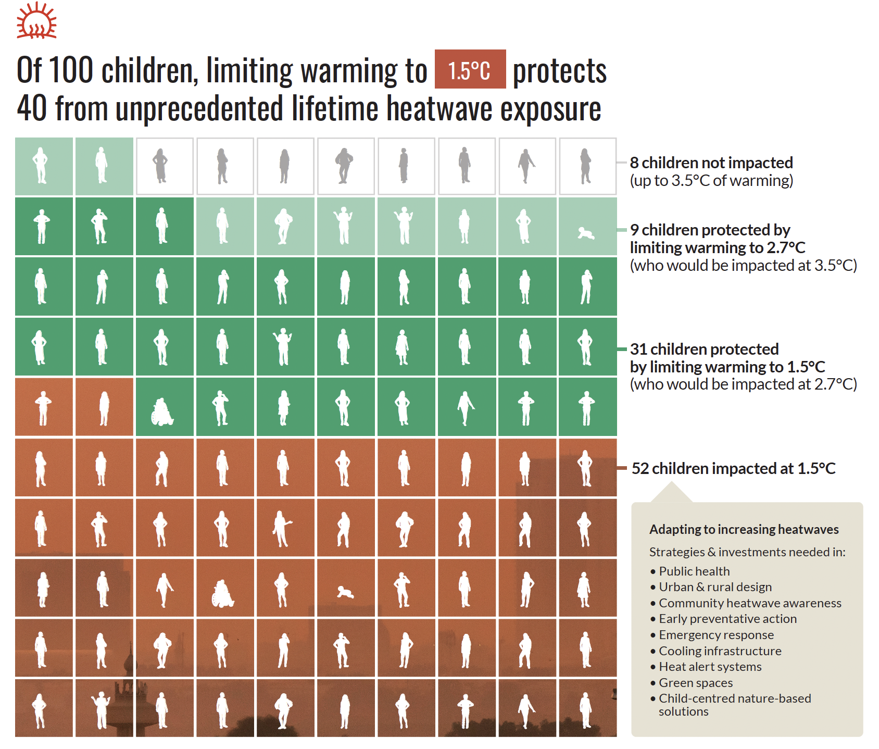
(Save the Children, 2025)
Notes:
Now that’s a pessimistic message, but one can also turn this around. If we take a 2,7°C warming pathway, which roughly corresponds to current policies according to the latest UNEP Gap report, and compare that to a 1,5°C-compatible warming pathway, we can compute the difference in
We find that 31% of children born in 2020 can be spared from facing unprecedented lifetime exposure if global warming is limited to 1,5°C instead of current pledges. It’s even 40% if you compare that to a high warming scenario.
This shows that limitating global warming to 1,5°C, or close to it, would protect a large share of current young generations.

Slide 11
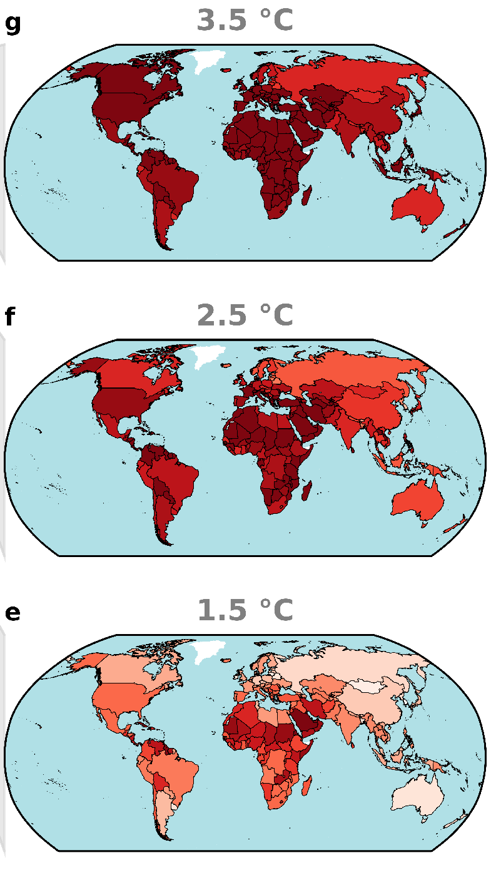
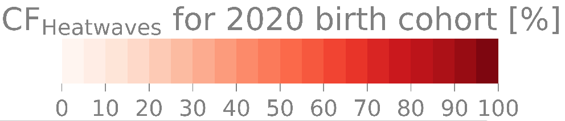
Fraction of global population facing unprecedented heatwave exposure
Notes:
If you look at this spatially, the exposed fraction for the 2020 birth cohort is highest in the tropics at low GMT pathways,
yet this spatial pattern disappears under the higher warming scenarios as the maps saturate, implying that nearly all children everywhere around the world start facing unprecedented lifetime exposure to heatwaves

Slide 12
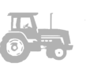
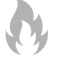
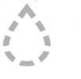
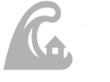
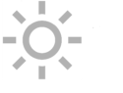
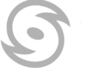
Six impact categories 15 ISIMIP2b models, 273 global-scale projections
(Lange et al., 2020 EF)
Notes:
Thanks to the ISIMIP impact model data base, we can now do this analysis for 6 extreme event categories
So far we focused only on heatwaves, but in our study, we performed these calculations for wildfires, crop failures, droughts, river floods, heatwaves, and tropical cyclones.
In addition, we expand this analysis from 3 to 21 warming pathways that span the full range of possible warming levels by 2100.
Our consistent approach across these different climate extremes allows us to develop the same type of figure for each of these six categories
In total 273 global-scale impact projections considered.
Those projections were derived with 15 models which you might have heard from: WaterGap, CLM, Orchidee, JULES, PCRGLOB, LPJmL, LPJ-GUESS,… All these simulations are publicly available through the Earth System Grid Federation
Categories have been defined by Stefan Lange, output from ISIMIP2b models have been harmonised, to form one gridded variable: land Fraction Affected by extreme event. This variable is available on annual time scales
This allows us to develop the burning ember figure for each of these categories

Slide 13
Fraction of global population facing unprecedented exposure to climate extremes
Notes:
Now, for each combination of birth year and 2100 global warming level, we can assess the cohort fraction, or CF, that will experience unprecedented lifetime exposure to heatwaves.
Thanks to the ISIMIP global-scale impact projections, we can now repeat this assessment for 5 additional climate extremes.
This is the result. The color bar ranges differ, but they all highlight that the younger you are and the higher the warming, the higher the fraction of your generation that will live an unprecedented life.
Crop failures are the second worst hazard in this calculation, with around 30 % (29%) of the 2020 birth cohort in a 3.5-degree world. This is followed by river floods, for which around 15% (14%) faces unprecedented lifetime exposure.
the rest of the hazards are geographically limited, heatwave emergence exceeds all other hazards in this population fraction.
For example, Tropical cyclones are constrained by circulation patterns. Floods are river-oriented, but we build cities around rivers. It is therefore worthwhile to visualize where emergence occurs.

Slide 14
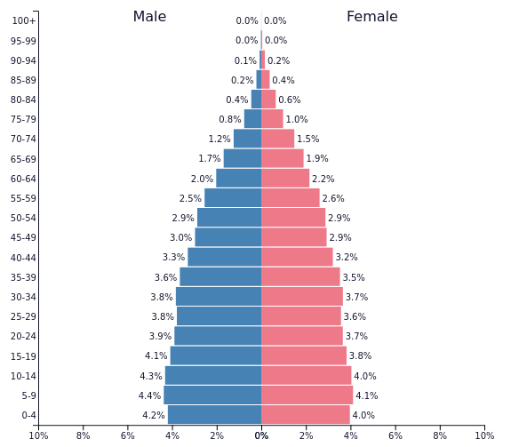
You know this one from high school the age pyramid
(https://www.populationpyramid.net/)
Notes:
You may remember this graph from high school. This is the age pyramid, with the fraction of the total population by age group, with male on the keft and female on the right.
However, the issue with current population projections is that they are blind for climate change.

Slide 15
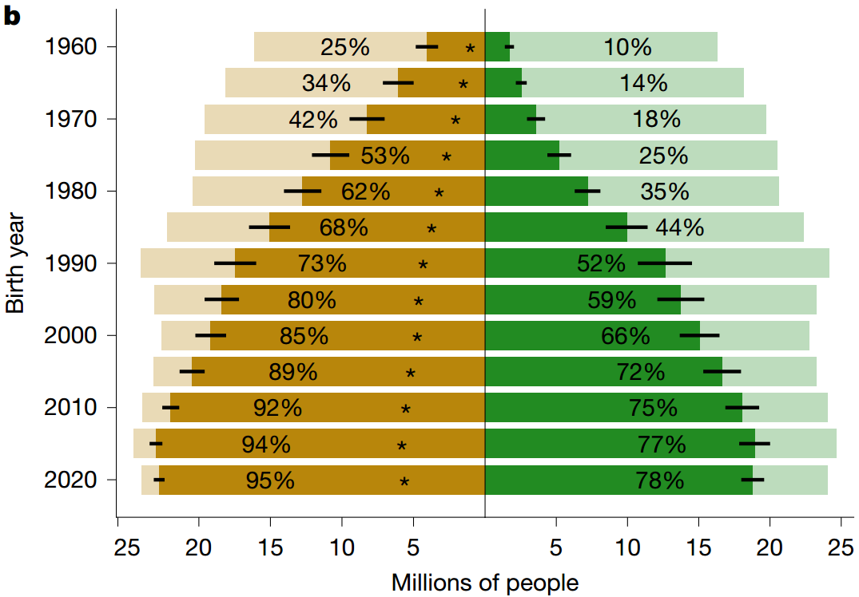
You normally don’t know this one from high school the unprecedented life pyramid
20% highest deprivation
20% lowest deprivation
total
unprecedented
Notes:
We bring in climate change into the picture and construct the unprecedented lifetime age pyramid.
And we go one step further by considering vulnerability
We identify the 20% of each birth cohort that are socioeconomically most vulnerable, and least vulnerable, building on the Global gridded relative deprivation index.
We then visualize the fraction, of each group expected to face unprecedented lifetime exposure to heatwaves under a pathway leading to 2,7°C, roughly aligned with currently policies.
The results confirm that younger generations have a higher chance of living an unprecedented life in terms of heatwave exposure .
But we also find that for each birth cohort, the most vulnerable have a consistently higher chance of being in that situation compared to the least vulnerable.

Slide 16
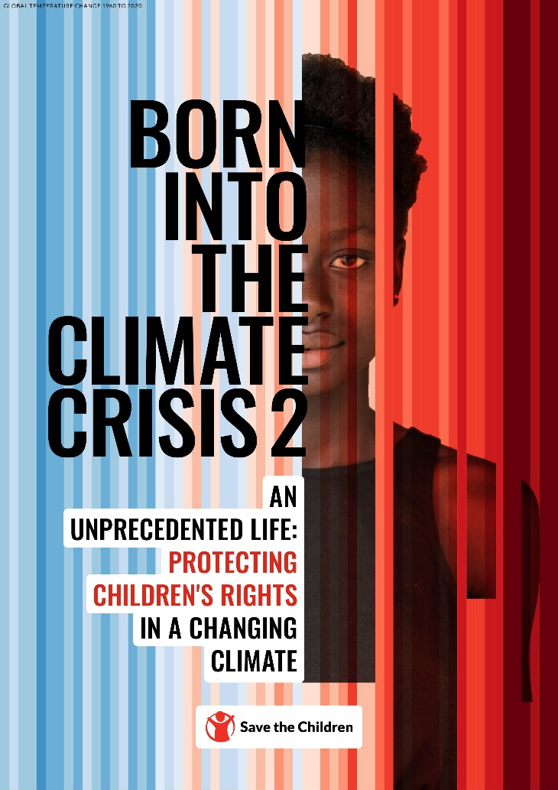

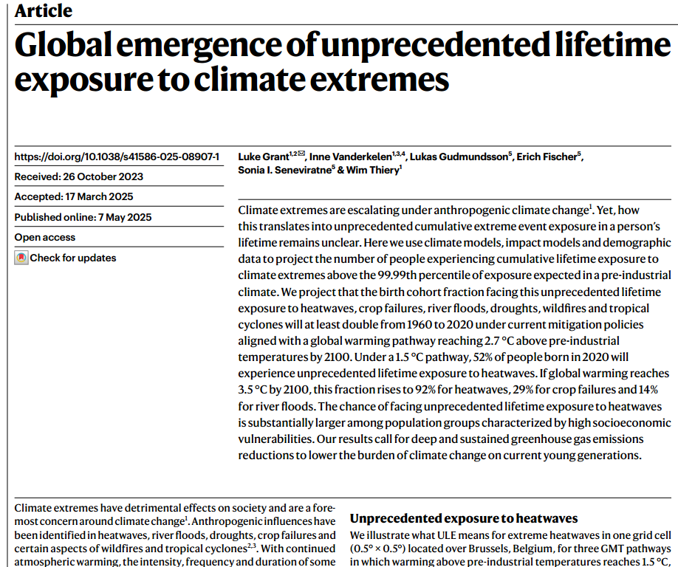
outcomes
Notes:
The article appeared last year, on the same day Save the Children launched a report detailing our findings and linking it with testimonies from children living the most hard-hit regions and concrete policy advice.

Slide 17

Yggdrasil
(source: Patrika; alphacoders.com)
Notes:
In the last part of my talk, I would like to illustrate how this type of information can be used
For this, let me take you to Norway, and more specifically to Nordic Mythology
This is Yggdrasil. Yggdrasil is one of the foundations of Nordic mythology. It was the mighty world tree whose trunk rose at the geographical center of the cosmos. The rest of that cosmos was built around it and held together by its branches and roots. The well-being of the cosmos depended on the well-being of that tree of life.
The descendants of the Norsemen today seem to take a slightly more creative approach to that symbolism.

Slide 18
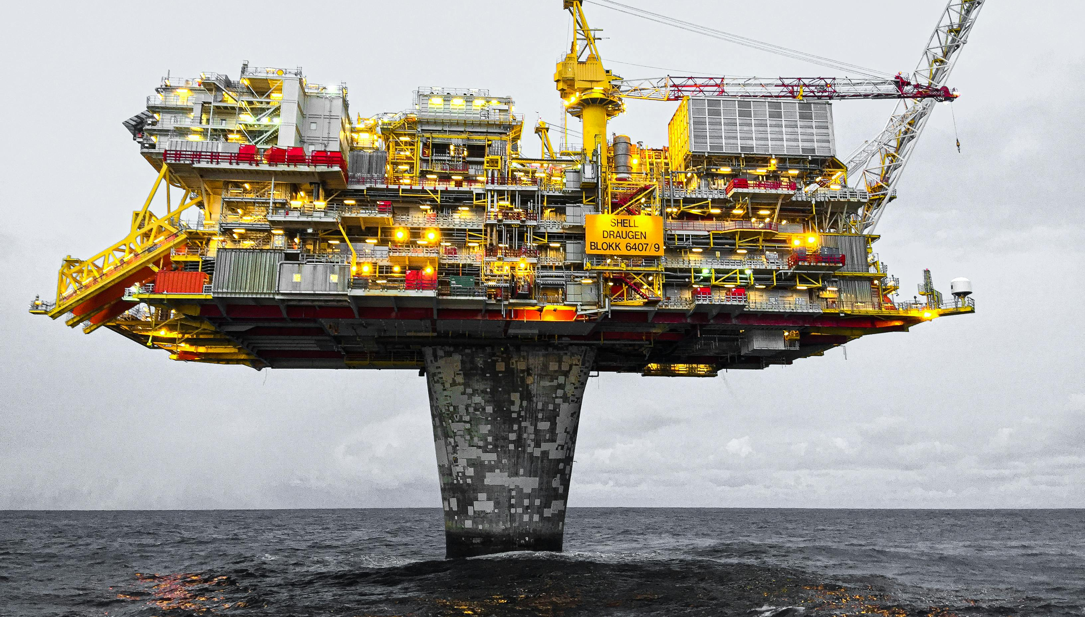
(source: Jan-Rune Smenes Reite; Pexels.com)
Notes:
Because Yggdrasil is also the name of one of three oil and gas fields that were recently discovered in the North Sea.
In recent years, the Norwegian government had granted exploitation licenses to these three fields.
Yet Greenpeace did not agree with this decision and sued the state of Norway. The main argument of Greenpeace is that Norway did not perform a proper environmental risk assessment in which they calculate the impacts from burning these fossil fuels. According to previous court rulings, Norway is obliged to perform such a risk assessment.

Slide 19
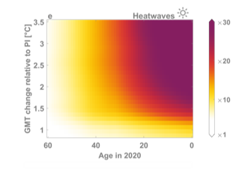
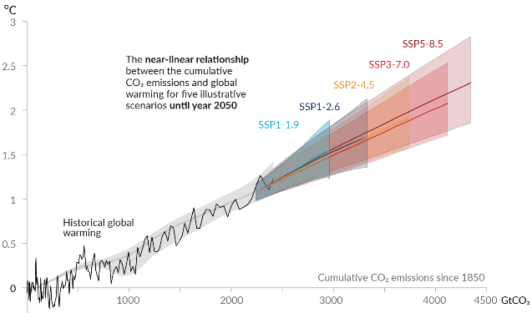

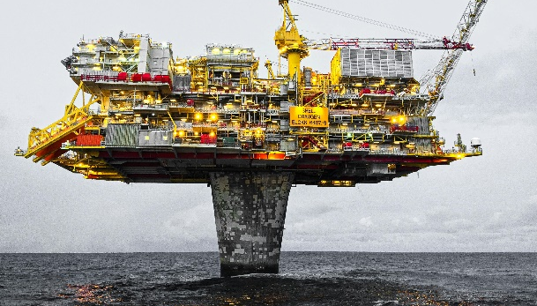




Results applied to this situation
emissions
TCRE
(IPCC, 2021)
exposure slope
(Thiery et al., 2021 Science)
cohort size
(UN WPP)
$$0.464 {Gt CO}_{2}eq$$
X
$0.45 x {10}^{−3 }\frac{℃}{{Gt CO}_{2}eq}$
X
$10.4 \frac{heatwaves}{℃}$
X
$$131 702 400 children$$
285 397 children born in 2020 will experience one extra heatwave
Notes:
In the testimony I had to give in front of the Court in Oslo, I presented the following calculation:
We start off with emission values. This are the estimated emissions from the 3 oil and gas fields combined. I did not calculate this number; I received it and use it as input in my calculation.
The next step is to translate these emissions to global warming levels. For this, I rely on one of the latest IPCC reports. IPCC reports represent the gold standard of scientific knowledge about climate change. Hundreds of leading climate scientists from around the world work for years on these reports, and they are critically reviewed by the scientific community. The summaries of these reports are unanimously approved sentence per sentence by all governments of the world, including the Norwegian.
Th IPCC Report from 2021 reaffirms with high confidence that there is near-linear relationship between cumulative anthropogenic CO2 emissions and the global warming they cause. Each 1000 GtCO2 of cumulative CO2 emissions is assessed to cause a best estimate of 0,45°C increase in global surface temperature. This quantity is referred to as the transient climate response to cumulative CO2 emissions (TCRE).
The third step is to calculate what this amount of global warming implies for an average member of a particular generation. For this I rely on my own study presented to you in the previous slides. By computing the linear slope of lifetime exposure as a function of global mean temperature, Per degree of additional global warming, children born in 2020 will experience on average around 10,4 additional heatwaves across their lifetime (Thiery et al., 2021 Science)
Finally, I extracted the number of children born in 2020 from a UN database, finding that 131 702 400 Children were born in 2020
Once I obtained these numbers, I multiply them. When you do that, you can see that the units cancel out, notably GtCO2eq and the global warming level. We are left with the units heatwaves and children. We find that on average, 285 397 Children born in 2020 will experience one extra heatwave if the emissions of the three oil and gas fields were to be generated as reported.

Slide 20
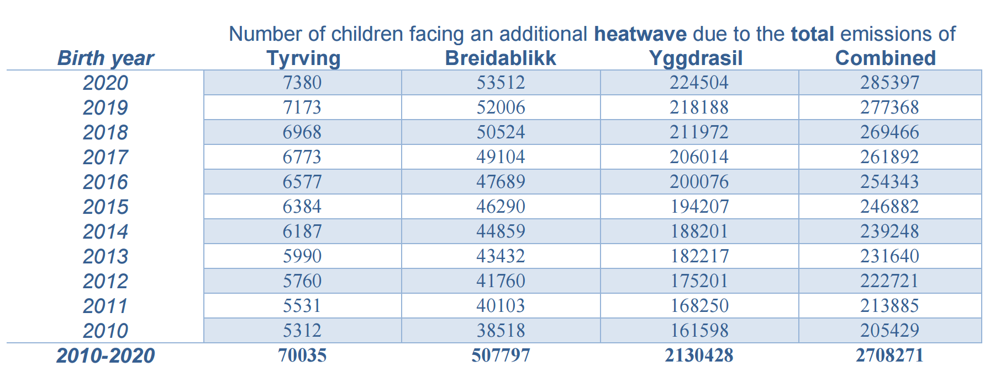
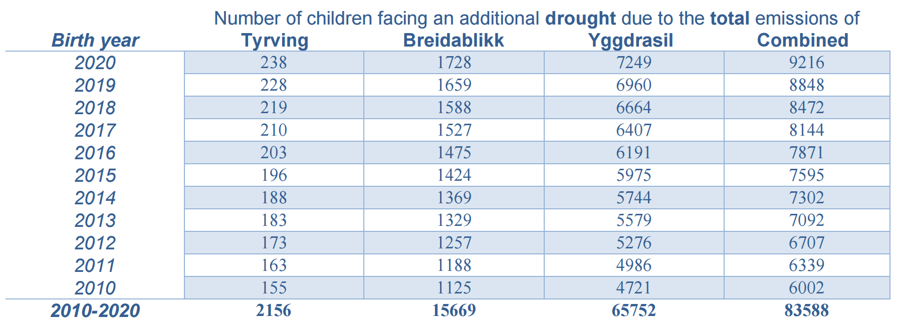
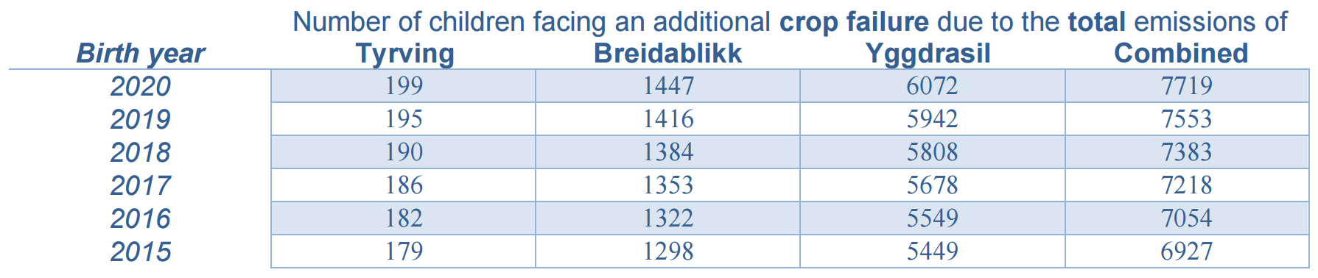
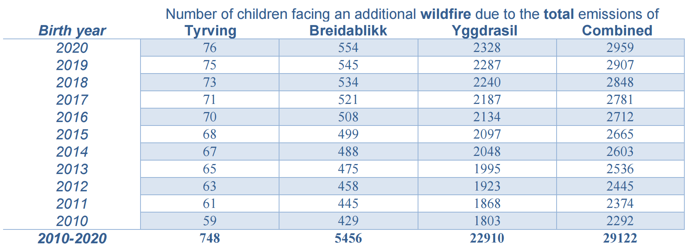
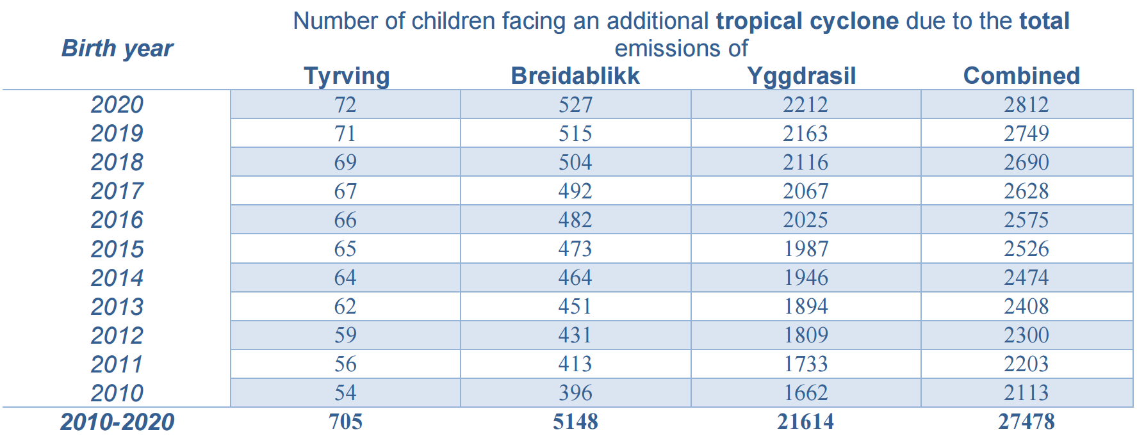
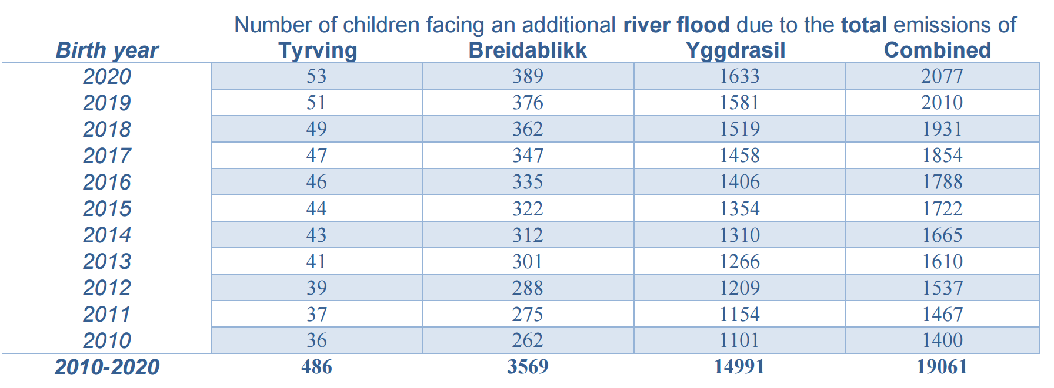
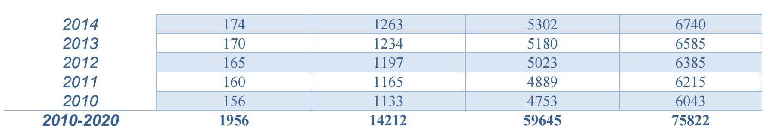
Results applied to this situation
Notes:
These are the results: for every combination of birth year and oil and gas field, I computed the number of children that will face one extra heatwave across their lifetime; The results are shown in this table.
And then we have one table for each climate extreme. All of these are provided in the report that I wrote and that was submitted to court.
(Note that these numbers slightly differ from the numbers communicated during my intervention as expert witness in first instance, because (i) the emission estimates I received as input were updated following new information about production, and (ii) I now use a more accurate number for the Transient Climate Response to Cumulative Emissions (TCRE): 0.45°C per 1000 Gt CO₂eq instead of 0.5°C per 1000 Gt CO₂eq (the latter number was used in first instance and is a rounding of the former).)

Slide 21
Key summary statistics
2 708 271 children born in the years 2010 to 2020 are expected to face one additional heatwave in their lifetime due to the total emissions of Tyrving, Breidablikk, and Yggdrasil combined
Analogously:
83 588 children are expected to face one additional drought
75 822 children are expected to face one additional crop failure
29 122 children are expected to face one additional wildfire
27 478 children are expected to face one additional tropical cyclone
19 061 children are expected to face one additional river flood
Notes:
Instead of going over every number, I hereby present some key summary statistics. These are for me the main results from this analysis.

Slide 22

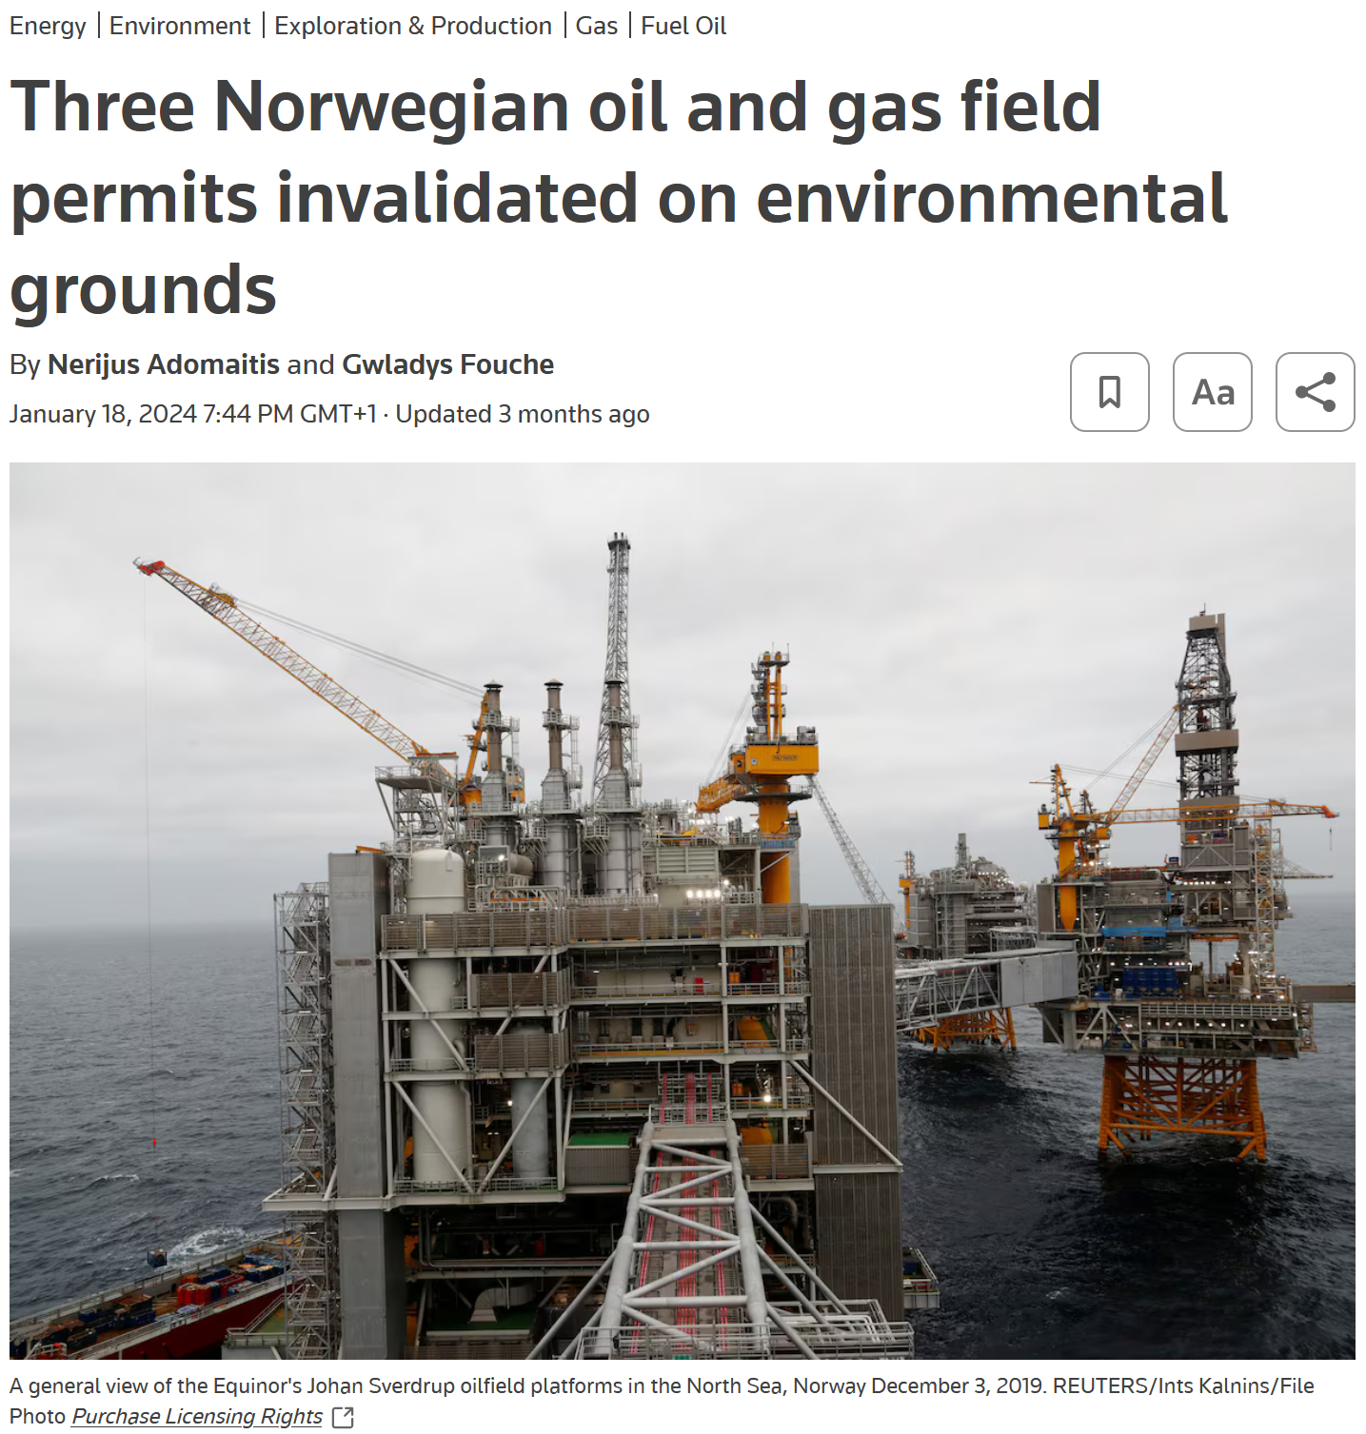
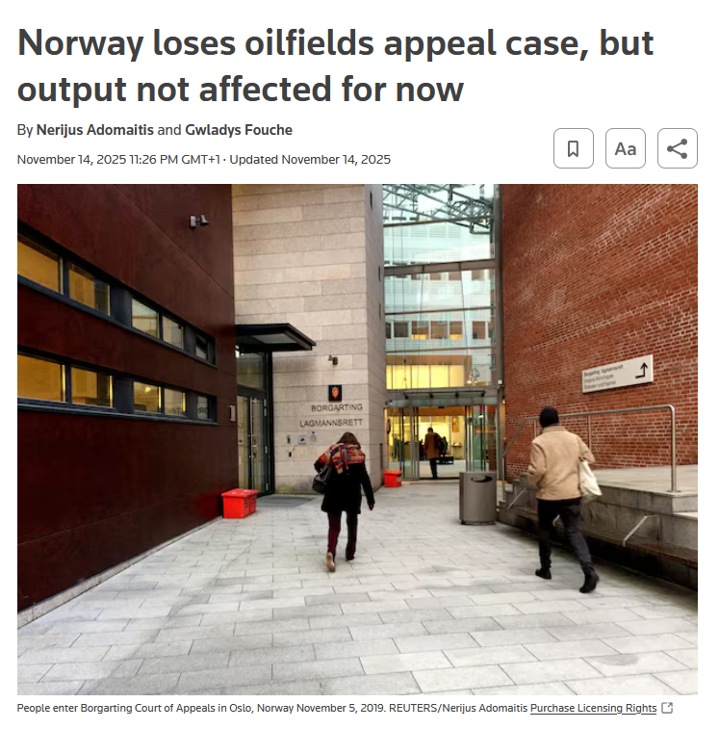
Notes:
I’m just going to leave this one here
I think we are just at the beginning of a wave of lawsuits, whereby from now on every new fossil fuel project will be litigated. As climate scientists, we will have to think our role in this, both collectively and individually.
But if anything is emerging from the first series of court cases, is that the engagement of experts is important to provide courts with the right scientific information.

Slide 23


Thanks! Questions?
@WimThiery
23
23
(Jersey warming stripes vandalised, © bailiwickexpress.com)
(2017 Italy drought, imaggeo.egu.eu)
Notes:
I thank you for your attention
(https://www.bailiwickexpress.com/jsy/news/artist-teases-new-look-vandalised-climate-change-mural/)

Slide 24
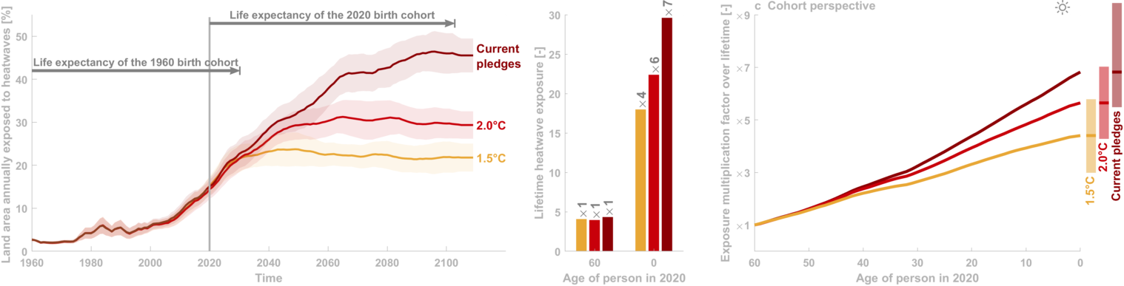

The idea Integrate exposure of an ‘average person’ to extreme events across lifetime
(Thiery et al, 2021 Science)
Notes:
This example shows how we climate scientists typically study the effects of climate change: you have a diagram, with time on the x-axis, and land area annually exposed to an extreme heatwave on the y-axis. In recent decades, the land area exposed to heatwaves has been gradually increasing.
As climate scientists, we then usually project how this variable evolves under different climate change scenarios: under a 1.5°C global warming pathway, around 20% of the land area will annually experience such heatwave by 2100. Under 2.0°C, this increases to around 30%, and under current pledges, we end up above 40%.
However, this approach does not allow us to quantify what climate change means today for a real person living in a real location. For a 60-year-old, who will on average live until the 2030s, or for newborns, who will be around when one of these future scenarios become the reality.
In this study, we calculated the total number of heatwaves that a person will experience across their lifetime. This gives us this second panel
The results show that a 60-year-old wil experience around 4 extreme heatwaves across their lifetime, and that this largely exposure is independent of the future warming scenario we will follow.
A newborn, in contrast, will experience 17 extreme heatwaves under a 1.5°C warming pathway and almost 30 extreme heatwaves under current policy pledges. In contrast to the lifetime exposure of the 60-year old, the exposure of a newborn is strongly dependent on the scenario.
However, the absolute values are subjective to the extreme event definition (if we would have taken a one in 10 year instead of a one in 100 year heatwave as our definition, these results would have been different). Therefore, it is preferable to analyze the relative change, by computing the exposure multiplication factors: How much more extreme events will a newborn experience compared to a 60-year-old?
Thanks to this approach we can directly compare generations to each other: under 1,5°C global warming, the 2020 birth cohort will face 4 times more heatwaves compared to the 1960 birth cohort. Under 2,0°C global warming, this is 6 times more, and under current pledges, grandchildren will face 7 times more heatwaves compared to their grandparents. We call these numbers the exposure multiplication factors.
In this study, we perform this analysis for every generation born between 1960 and 2020, for every country in the world. This way, we can plot the exposure multiplication factor as a function of age.
These results emerge from combining 5 sources of data.

Slide 25
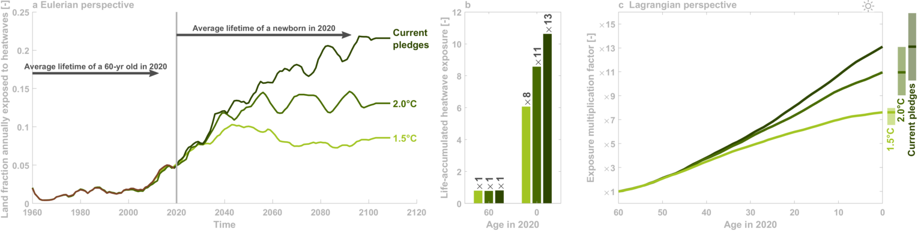
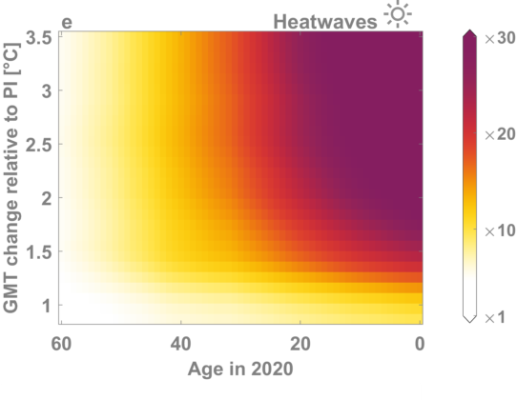
Burning embers for the kids
(Thiery et al, 2021 Science)
Notes:
So, then we get a plot with age on the x-axis, and the global warming level on the y-axis
We can fill up this space with our exposure multiplication factor values, and then we get this result: for every combination of age and global warming level, we get a color that represent how many more heatwaves you’ll face relative to a person living in a world without climate change.
In this panel you can now look up your own age of that of your beloved ones, to find out how many more heatwaves you and your relatives will experience.
Reference for the exposure multiplication factor is now person with year-1960 life expectancy living under picontrol climate.
Let’s take one example: under 3.5°C of global warming, Newborns will face 44 times more heatwaves which is far beyond the scale shown here.
(Not a real Burning Embers since we do not include vulnerability (or at least only indirectly by considering different income categories as a proxy for vulnerability).)
(Same colours as real burning ember but had to make choices regarding the transitions: a linear colour scale, in this case between x1 (white) and x30 (purple).)

Slide 26
3
(Grant et al., 2025 Nature)
Notes:
Here we plot the cumulative heatwave exposure since birth for people born in Brussels in 1960. The blue line shows that, in a world which warms to 1.5 degrees in 2100, this group will experience 3 heatwaves in their lifetimes.

Slide 27
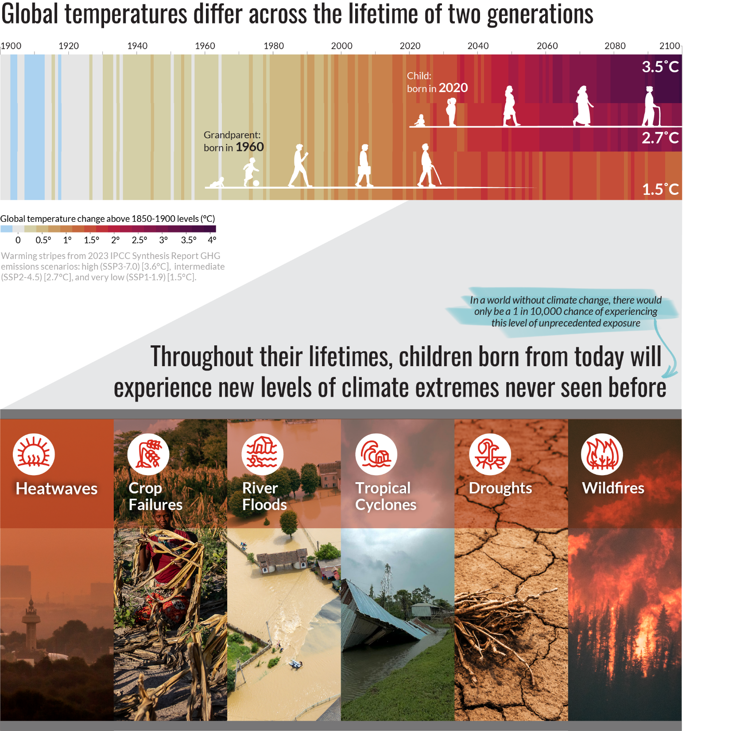
(Save the Children, 2025)

Slide 28
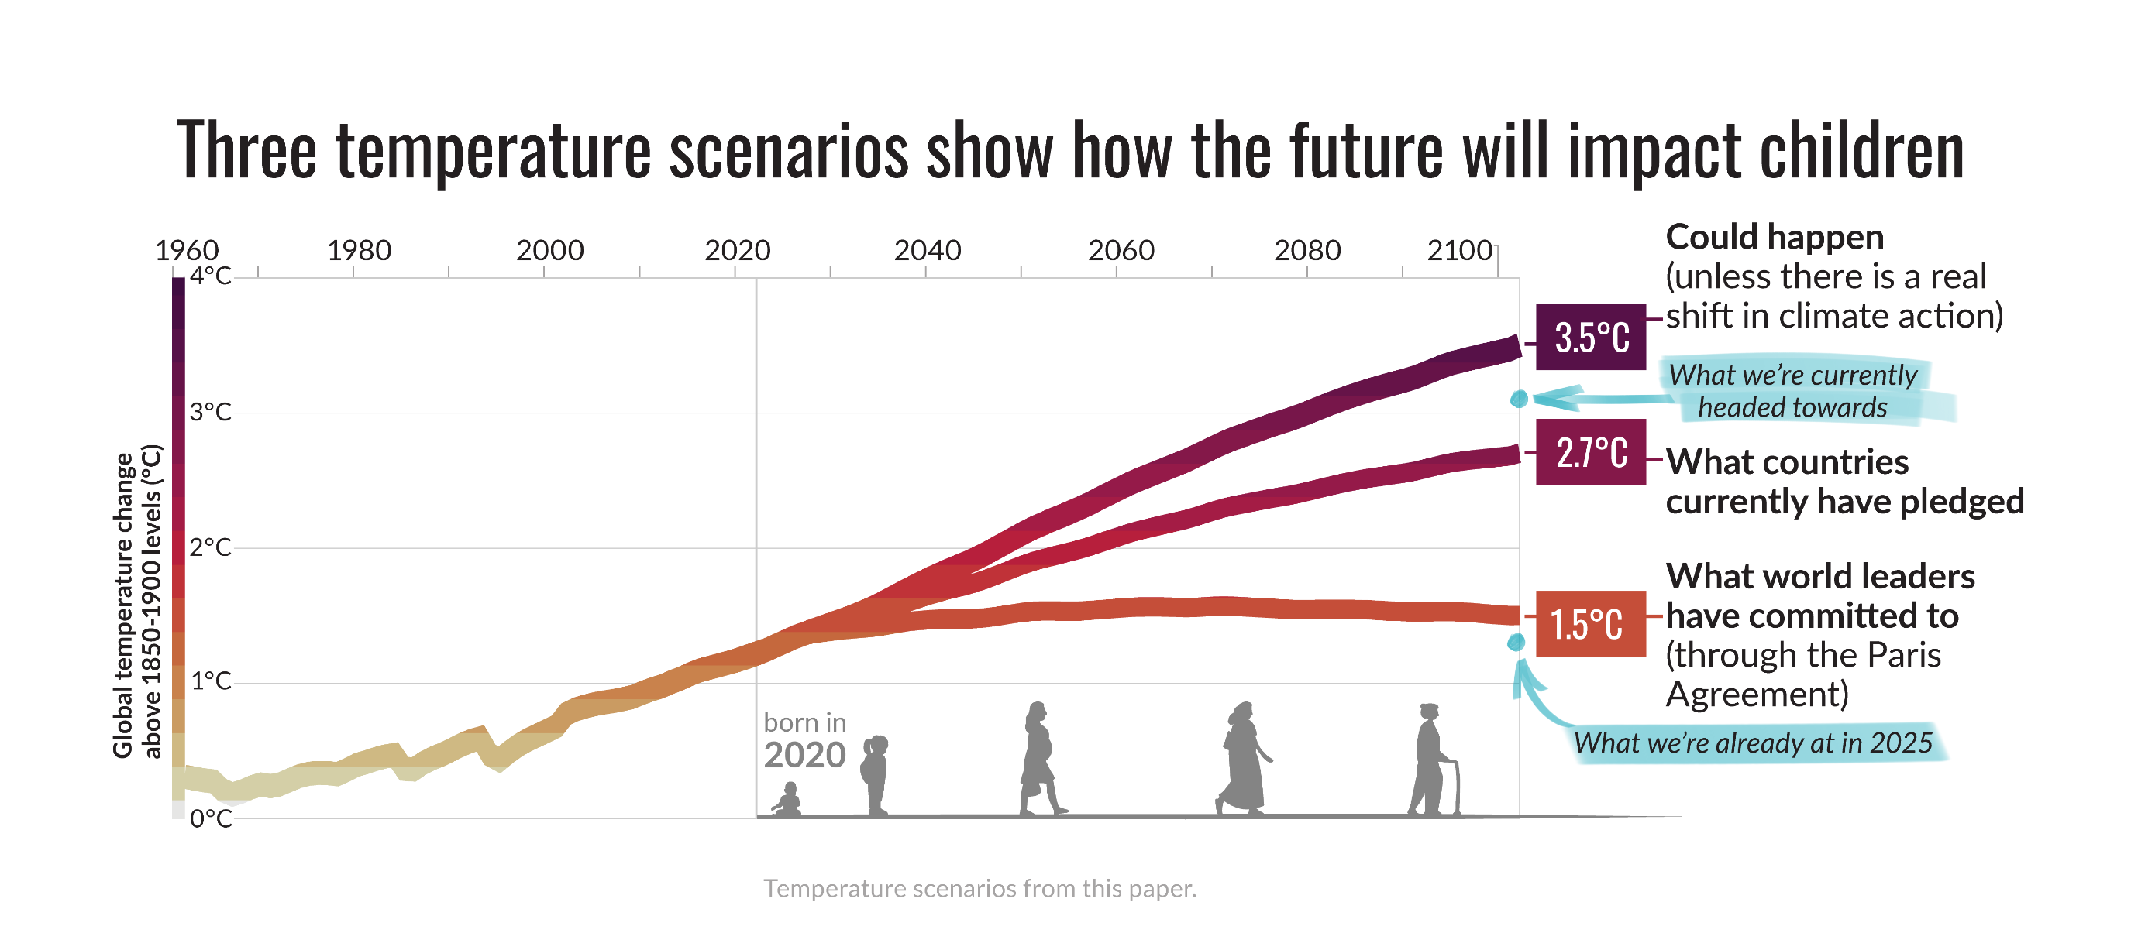
(Save the Children, 2025)

Slide 29
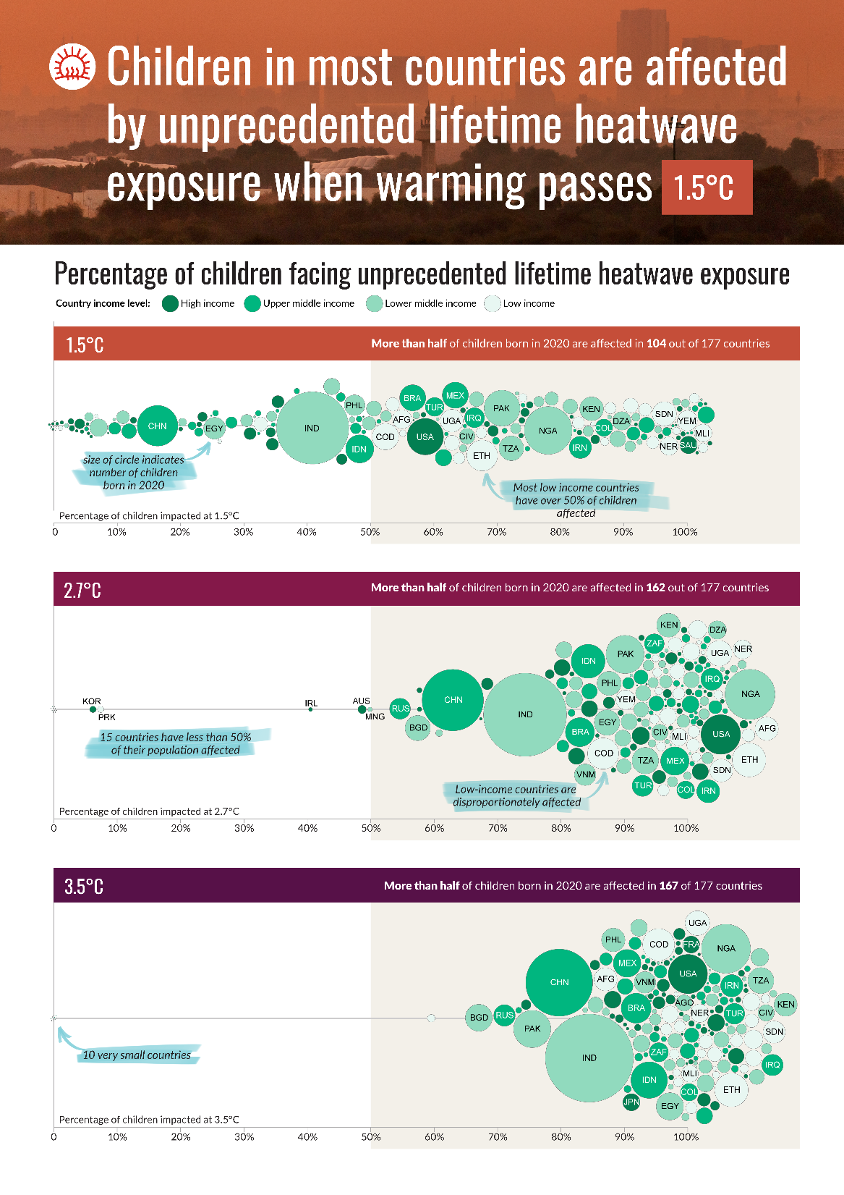
(Save the Children, 2025)

Slide 30
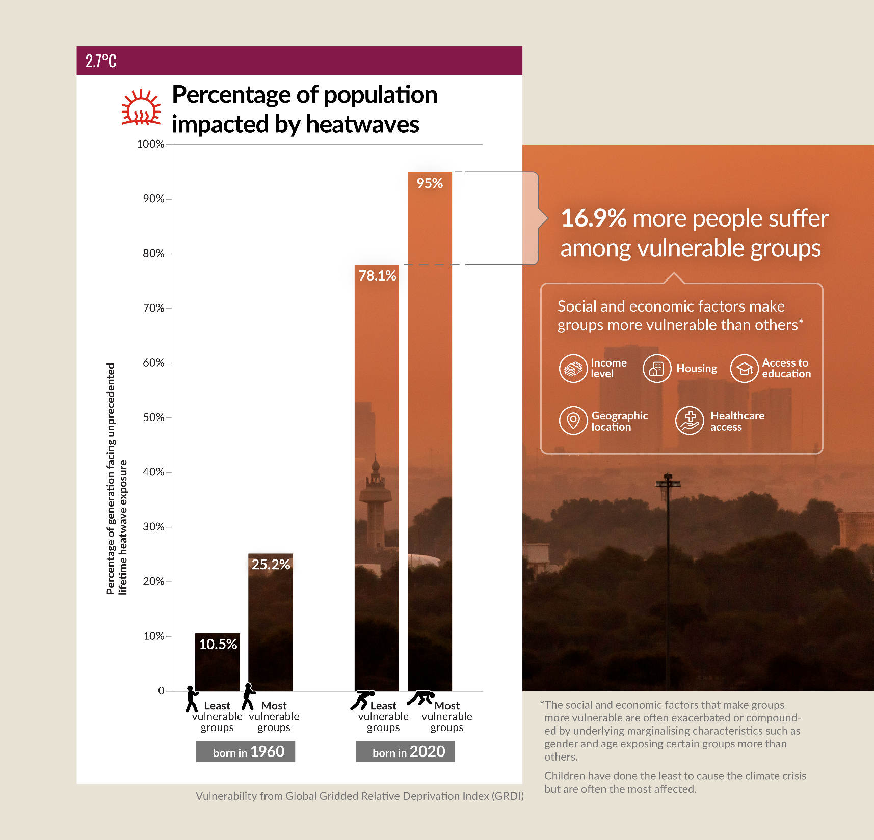
(Save the Children, 2025)

