Slide 1
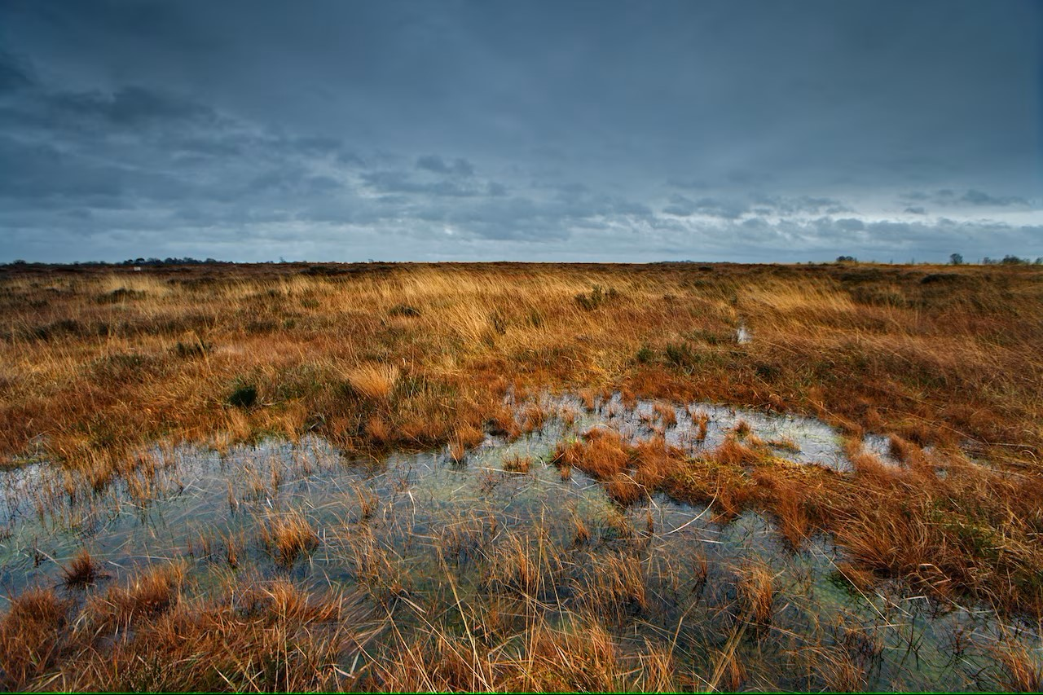

Spatial Classification Of Peatland Status Using Remote Sensing And Random Forest (RF) Emmanuel Aduse Poku University of Stavanger EGU 2026

Slide 2
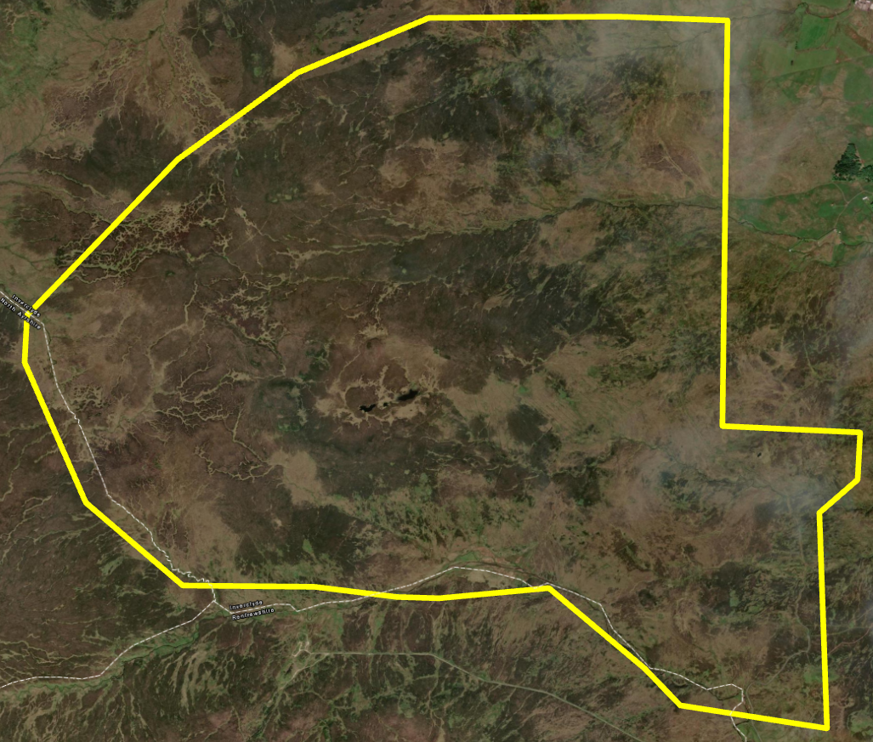
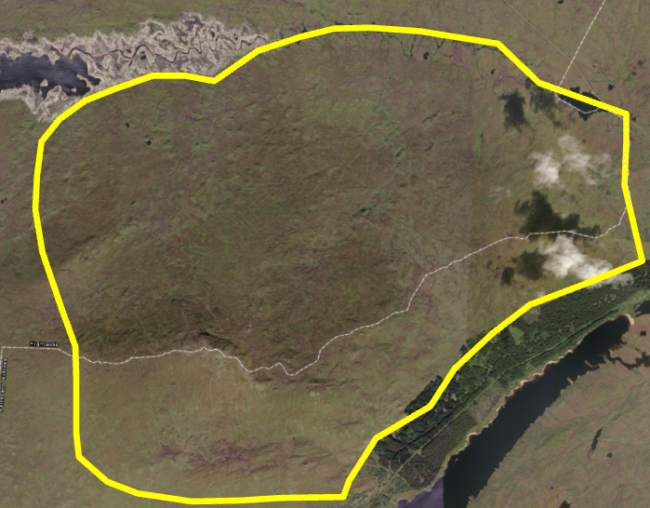
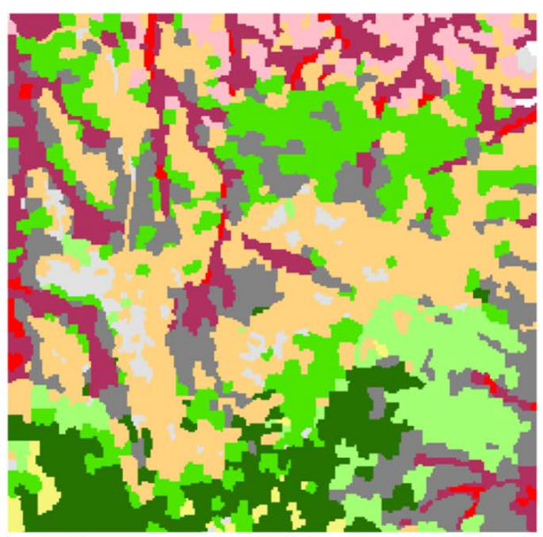
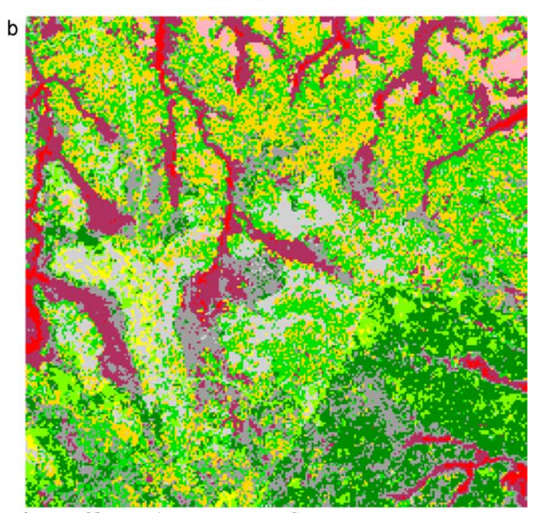
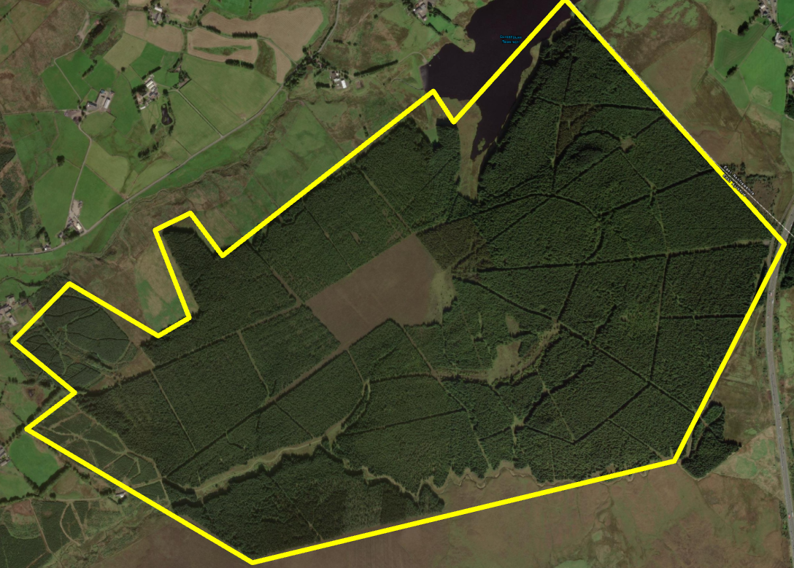
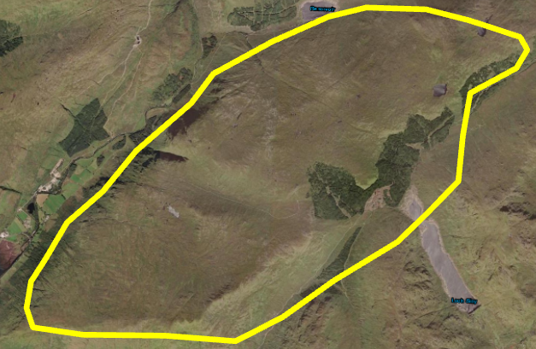
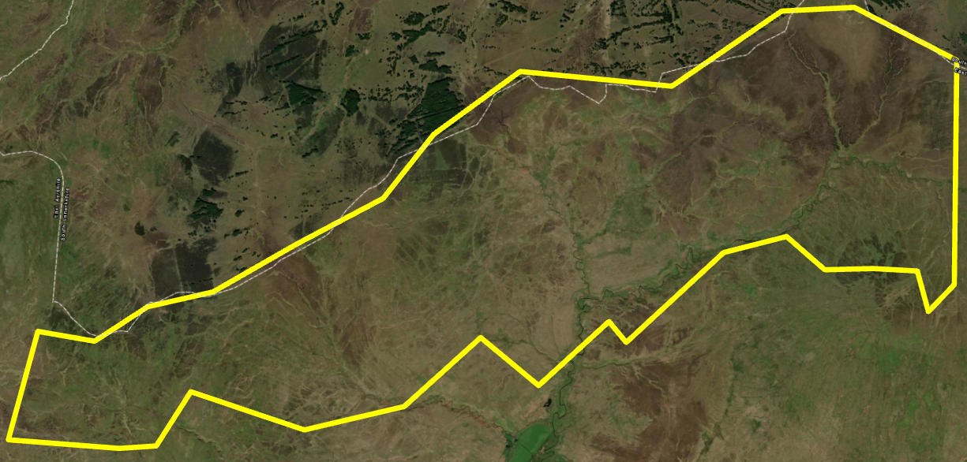
Introduction and Problem
Traditional Remote Sensing classification is inadequate for peatland classification
Drained
Near Natural
Forested
Eroding
Object-based Pixels-based
(Whiteside, et al,. 2011)
Modified
QUESTIONS…Can We…??
Leverage complex surface signatures to train a Random Forest model for spatial peat status classification???
Notes:
Peatlands are difficult to monitor because they are remote and appear homogeneous in satellite data, making reliable classification challenging—especially in regions like Norway where large areas remain unmapped

Slide 3
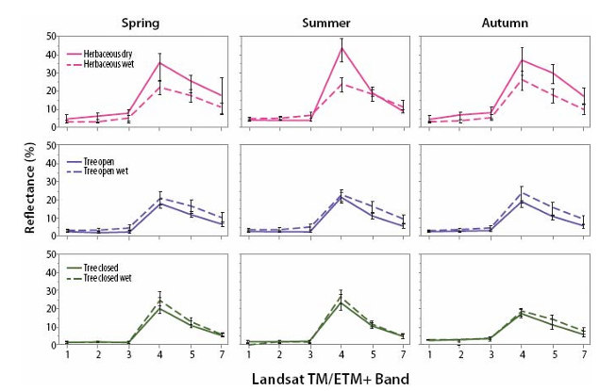
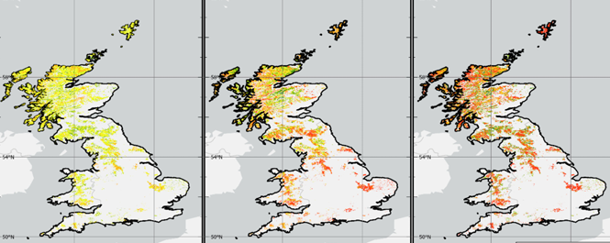
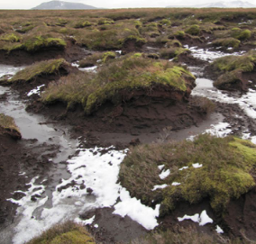
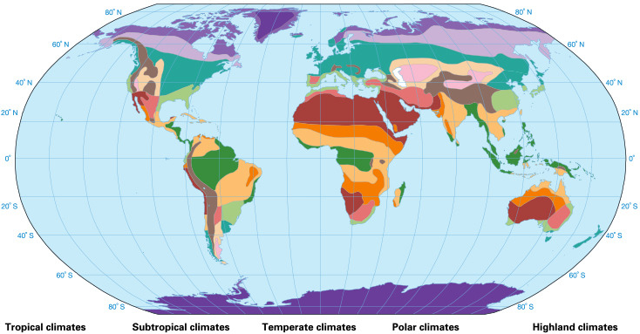
Importance of this work and approach
We can..Monitor changes in peatlands for degradation and recovery at relatively lower cost
Then How…?
Spectral Reflectance - useful for peatland mapping – (Krankina et al,. 2008 ).
Land Surface Temperature (LST) – Peat Health, (Worall et .,al 2025).
Terrane - peat erosion – (Gallego-Sala et al.,2013).
Climate (Minasny et al.,2019).

Slide 4
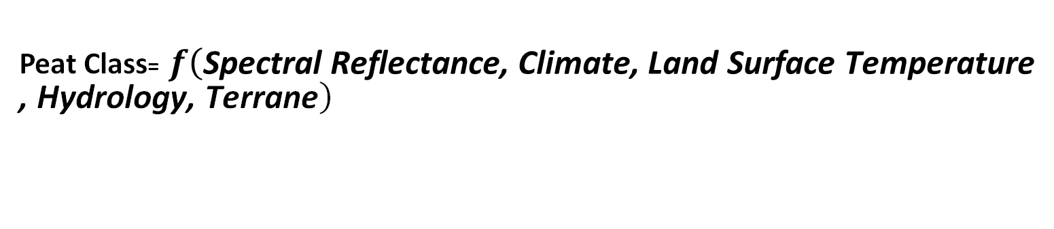
Questions
Peat Class= $f\left(\text{Spectral} \text{Reflectance}\text{, }\text{Climate}\text{, }\text{Land} \text{Surface} \text{Temperature} \text{, }\text{Hydrology}\text{, }\text{Terrane}\right)$
Train Random Forest Classifier using a set of proxies related to peat characteristics over Scottish peatlands
Predict INSIDE data domain??
Predict OUTSIDE data domain (eg. Norway)??
Assess UNCERTAINTIES across domains??
How to IMPROVE classification??
Aim

Slide 5
DATA
Landsat 8-9 (USGS)
SRTM DEM – (Pope et. al,. 2017)
Climate Data- from UK MET, Hollis et al. (2019)
Peat Classification (NatureScot 2023)
Methodology
Notes:
Peatlands are difficult to monitor because they are remote and appear homogeneous in satellite data, making reliable classification challenging—especially in regions like Norway where large areas remain unmapped

Slide 6
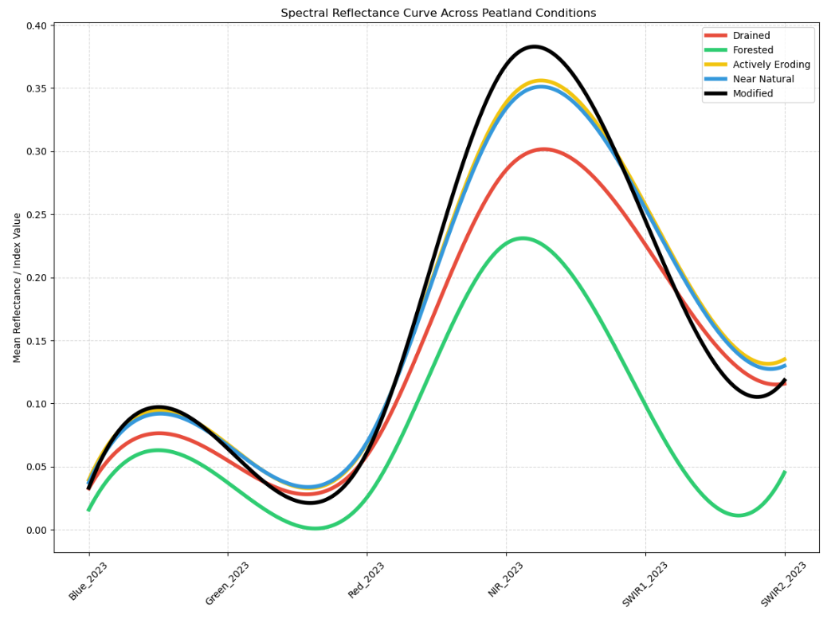
What are predictor signatures over peatlands – Spectral Reflectance?
Forested shows lower mean spectral reflectance at Infrared region of the EM Spectrum
Methodology
Mean % spectral reflectance curve of 5 peat classes
Notes:
This is the spectral reflectance curves showing separation among the five peatland types, each exhibiting distinct magnitude of mean reflectance in the infrared region, while forested display lower mean reflectance, likely due to denser canopy structure and higher absorption.

Slide 7
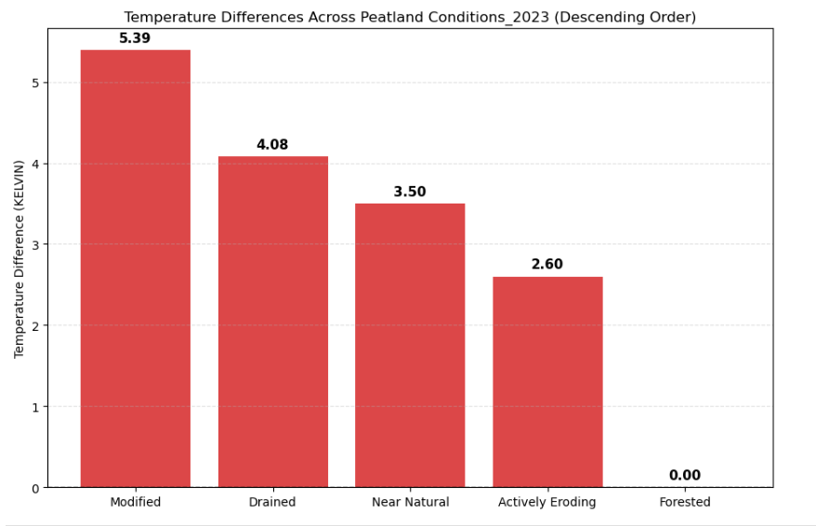
What are predictor signatures over peatlands - LST?
Thermal Emission differs over each peatland
Forested peatland exhibit coldest thermal signature
Methodology
Modified exhibits warmest signature
Mean LST differences among peatland classes (Normalised To Highlight LST Differences)
Notes:
This is the normalize LST of the 5 peatlands and forested is the least warm and modified the highest.

Slide 8
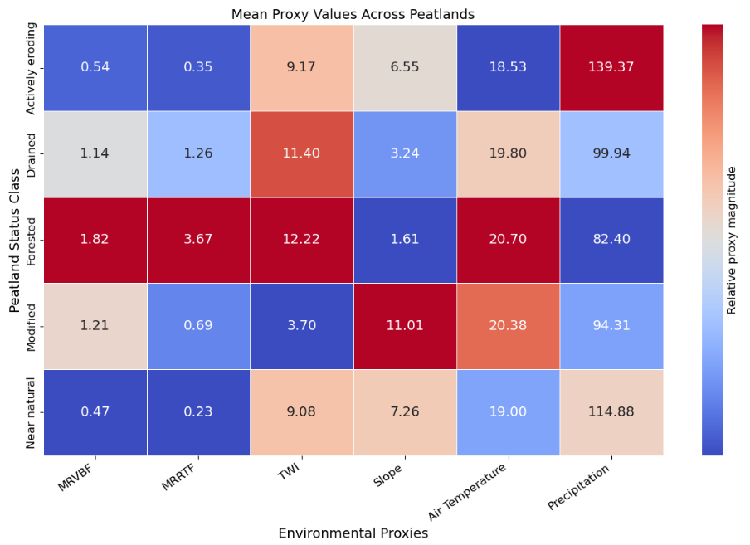
What are predictor signatures over peatlands – Climate and Terrane?
Eroded and Near Natural peatland receives more rainfall
Forested peatland at warm region and shows distinct hydrological signature
Methodology
Terrane Hydrology and Climate of different peat
Notes:
For climate and terrane. The Eroded and the natural peatland receives more precipitation. The forested occurs at a regions with different terrane attribute and even occurs at a region of much higher mean air temperature. Given that there is a separation the physical characteristics of these peatlands we can train an ML-Model to make predictions.

Slide 9
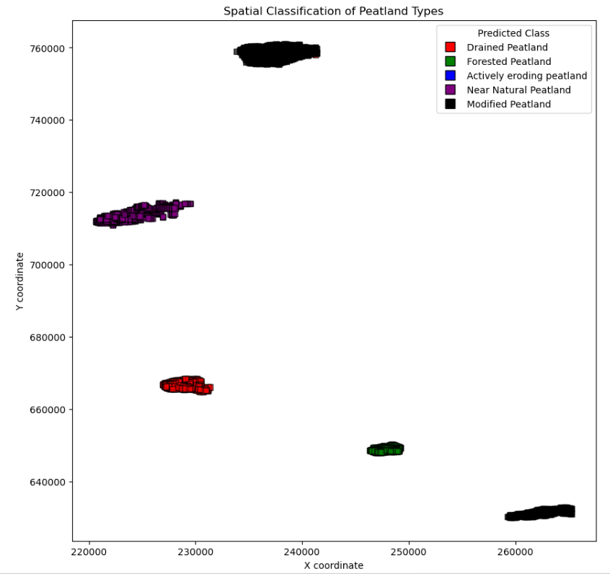
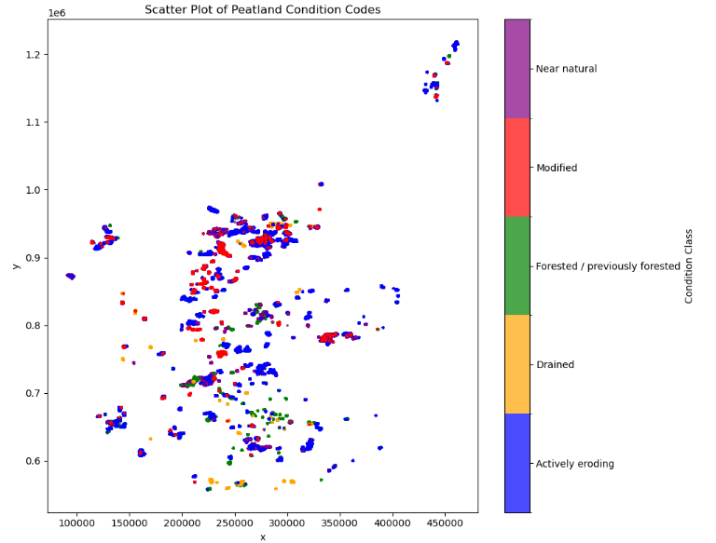

Random Forest Model – Local & National Scale
5 Peatlands (Local)
National
Predictors
Air Temperature & Precipitation
Land Surface Temperature
Predict peatland class per 100 m resolution
Local Scale: Total of 42.01 ${km}^{2}$ classified peatlands.
National Scale: Total of 1,184.74 ${km}^{2}$ classified peatlands.
Spectral Reflectance
Terrane and Hydrology
RF
200 Trees
SHAP
70:15:15
Training :Testing : Validation
Result
Trained Model
Peat Class Map Scotland
Peat Class Map Norway
Notes:
We train the model at Local scale, consisting of 5 Independent peatlands and also expanded over a larger expanse of increased heterogeneity.

Slide 10
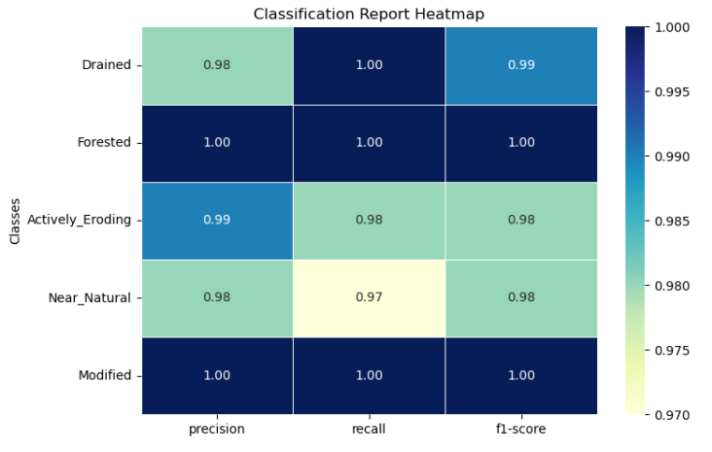
Random Forest Model – Local Scale
All Peatlands are well predicted
Result
OVERALL F1 SCORE: 99%
Notes:
Our results shows that the model predicts peatland classes very well for the 5 peatlands with he highest in Forested and the modified peatland. An overall F1 score of 99% shows the good performance of the model.

Slide 11
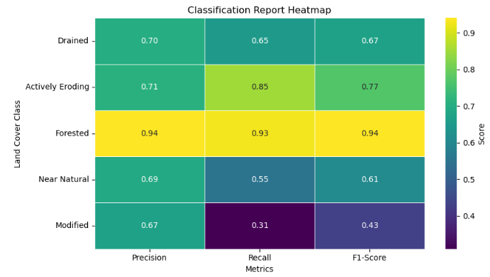
Methodology – Train: Random Forest Model – National
Forested and
Eroded Peatland well Predicted
Drained and Near Natural peatland moderately predicted
Results
Modified less predicted
OVERALL F1 SCORE : 72%
Notes:
On broader scale of increase heterogeneity, the model performs quite well. With highest F1 core in Forested and Eroding Peatland whiles the others are moderately calssified. A total F1 Score of 72% shows a good peformace of the model.

Slide 12
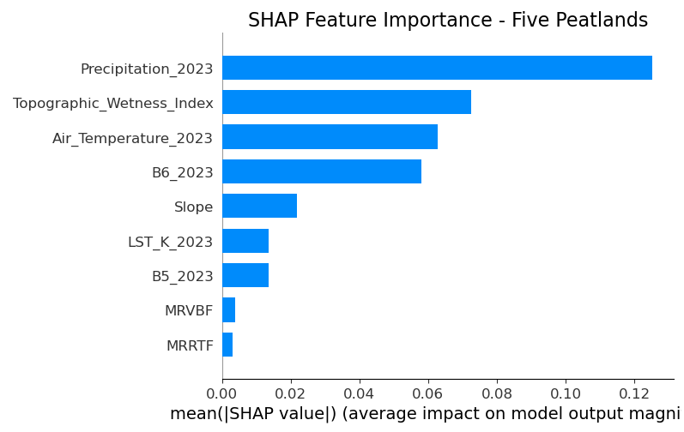
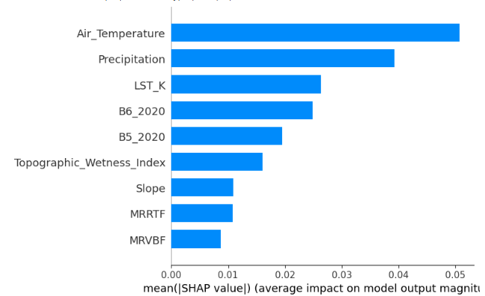
Model Interpretation (SHAP Contributions)
5 - Peatlands
National
Result
All predictor groups contributes to classifying peat status
Each class is controlled by different combination of predictors
Notes:
The predictors a good discrimnator of peatland status and they are wel leveraged by the model for prediction both at Local and Natioal scale. Since our model performed well, we use it to predict over a larger scale

Slide 13
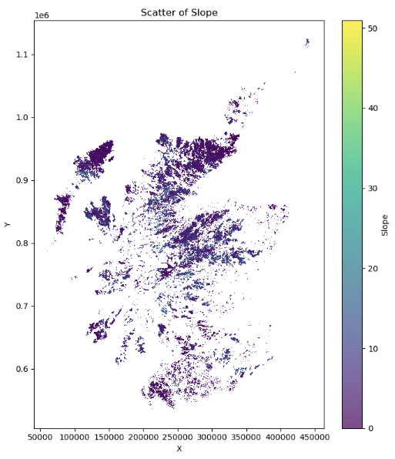
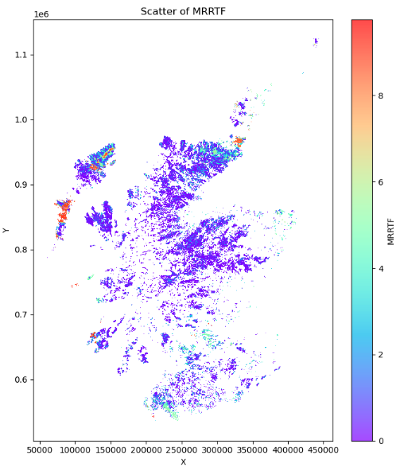
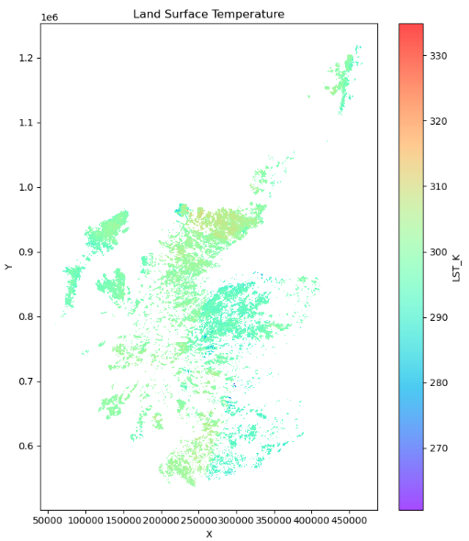
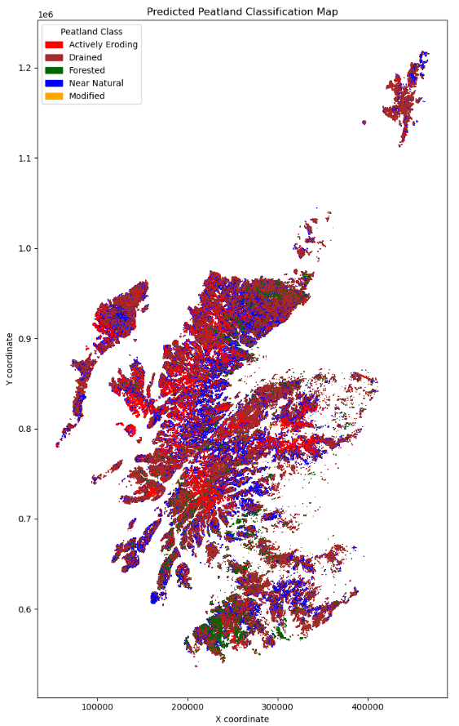
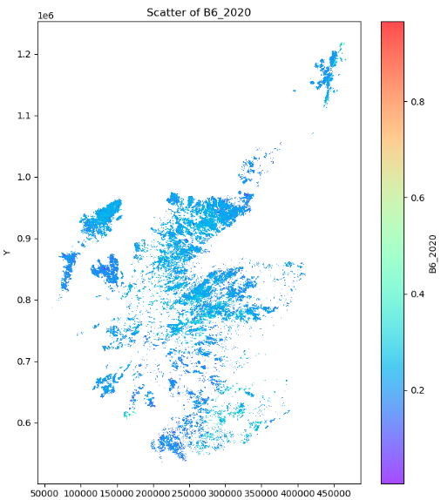
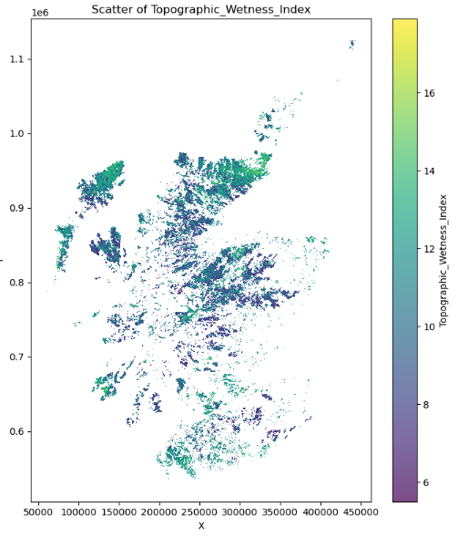
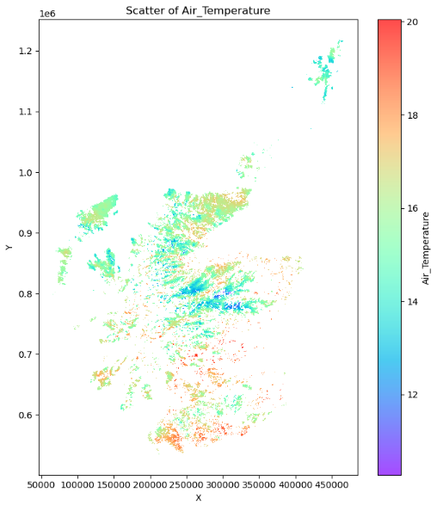
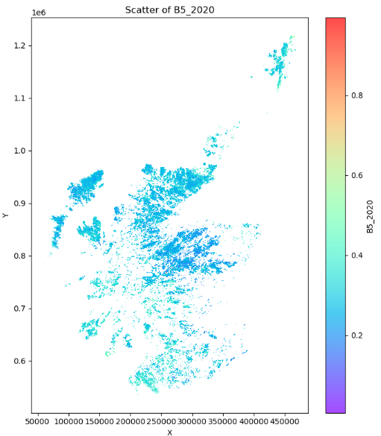
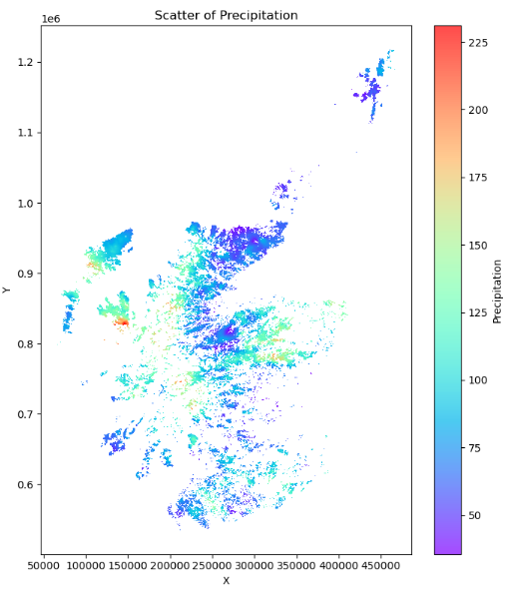
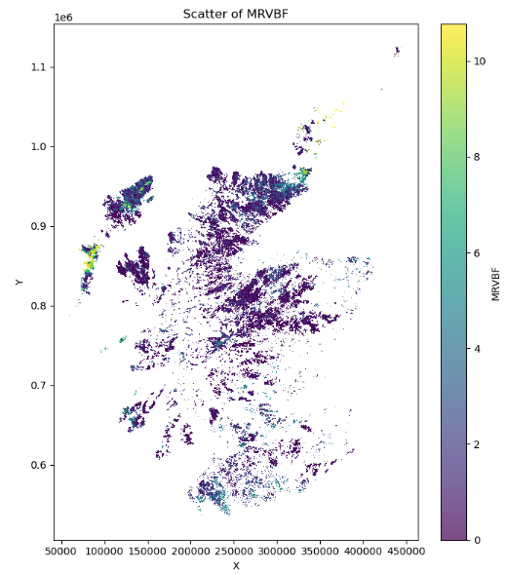
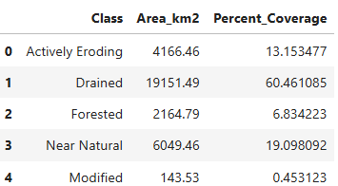
Prediction Inside Trained Data DOMAIN
Scotland – Carbon Map (31,675.73 ${km}^{2}$)
Notes:
A 31,600 Km sqaure area(Carbon Map) in scotland is classified here.

Slide 14
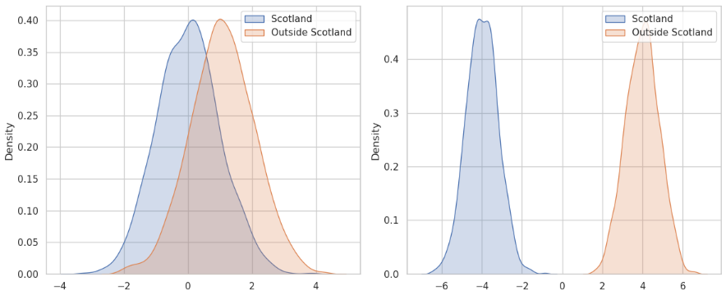
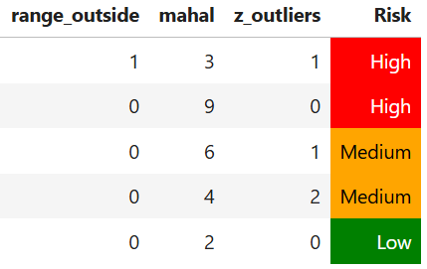

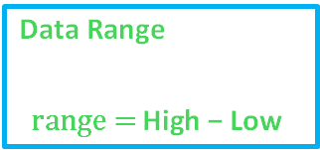

Uncertainties – (Model Algorithm & Spatial Predictions)
Prediction-Classification is not absolute but based on Class probabilities
Random Forest Predict within data domains – Uncertainty outside/inside
Data Domain Shift Uncertainties
Class probabilities
Used in class predictions
Discussion
Proxy Range: Mahalanobis Distance
$$D_{M}\left(x\right)=\sqrt{{\left(x−μ\right)}^{T}Σ^{−1}\left(x−μ\right)}$$
Where:
$x$= feature vector of a sample
$μ$= mean vector of training data
$Σ$= covariance matrix of training data
$Σ^{−1}$= inverse covariance matrix
Z-score Proxy Outliers
$$\text{z}\text{=}\frac{x −u}{o}\text{​ }$$
Data Range
$$\text{r}\text{ange}\text{ = }\text{High} \text{− }\text{Low}\text{​ }$$
Combines the shift in data range to estimate uncertainty
Notes:
Some uncertainties are associated with this classification appraoches due to the RF algorithm itself and data shift during spatial prediction.

Slide 15
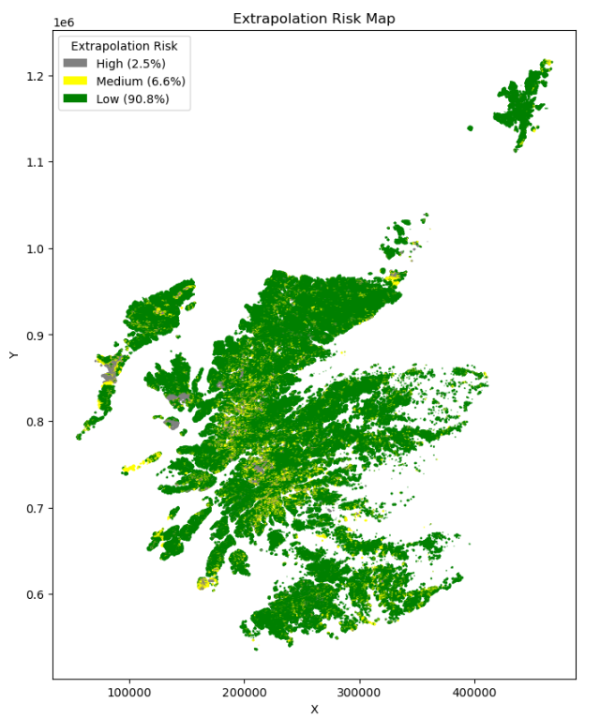
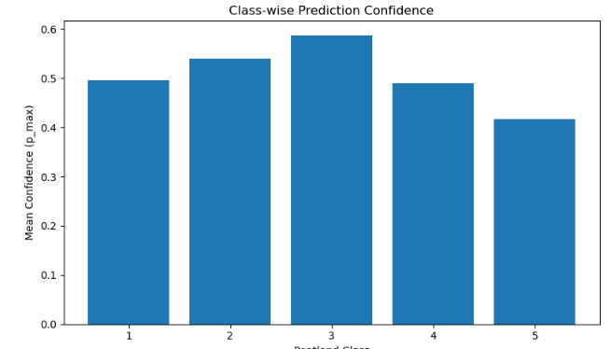
Uncertainty - Data Distribution (Class Confidence and Within Domain)
Discussion
Eroding
Drained
Forested
Near
Natural
Modified
Class Probability Uncertainty
Inside Domain Uncertainty
Notes:
Class uncertainty map suggest that the RF algorithm predicts forested peatland to about 60% confidence on the average. Within same data domain the model can predict to about 91% confidence. Can we predict on another region outside our trained data domain? Of course we can but this is of higher uncertainty due to data shift

Slide 16
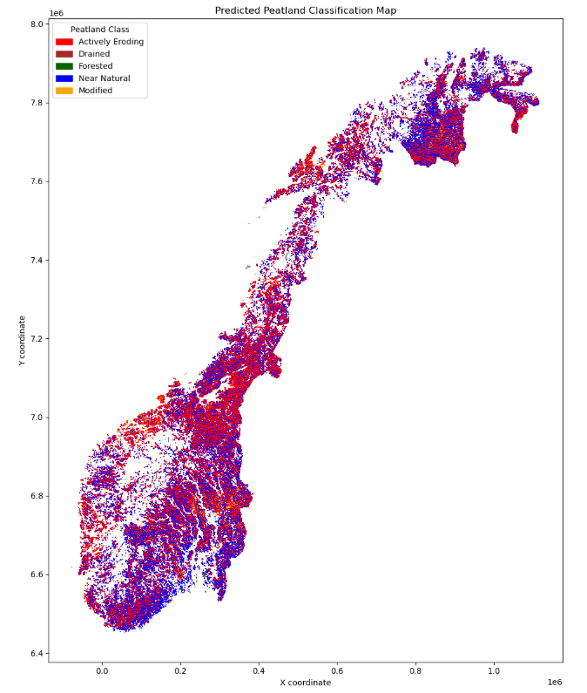
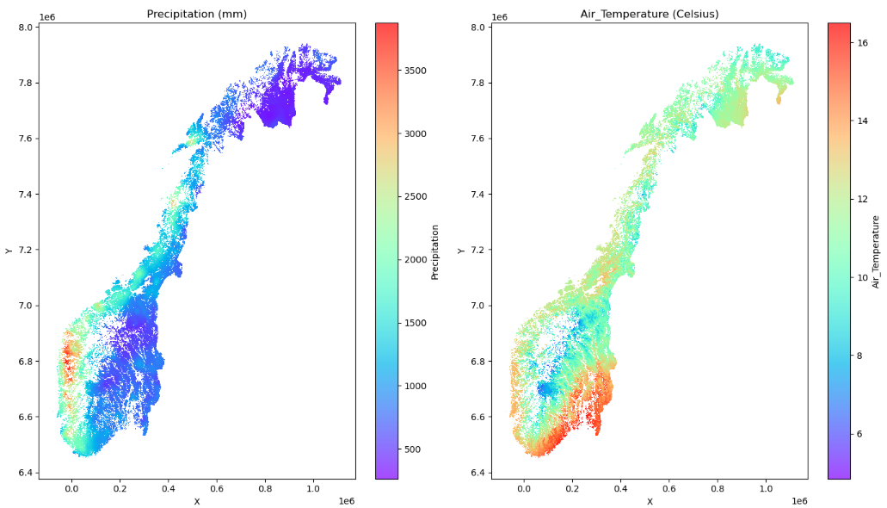
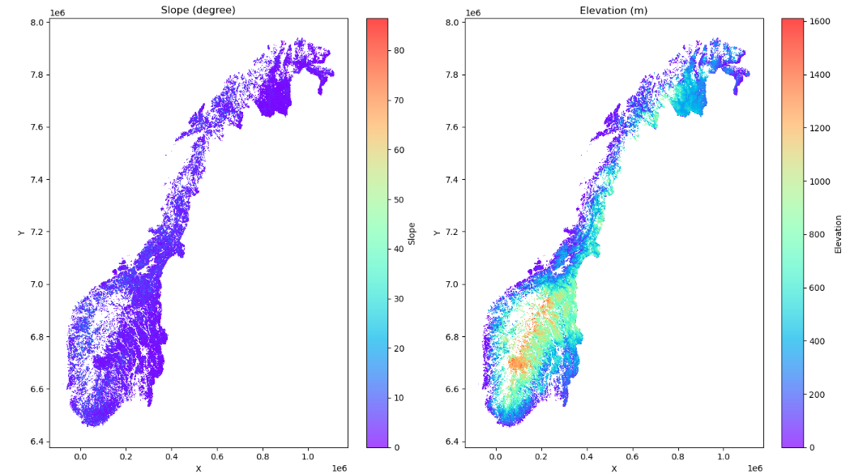
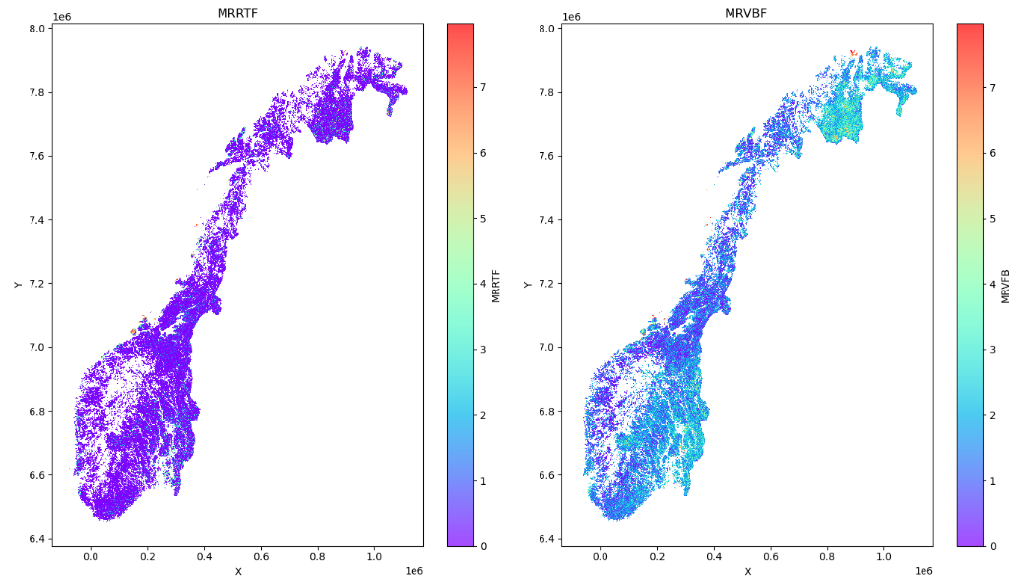
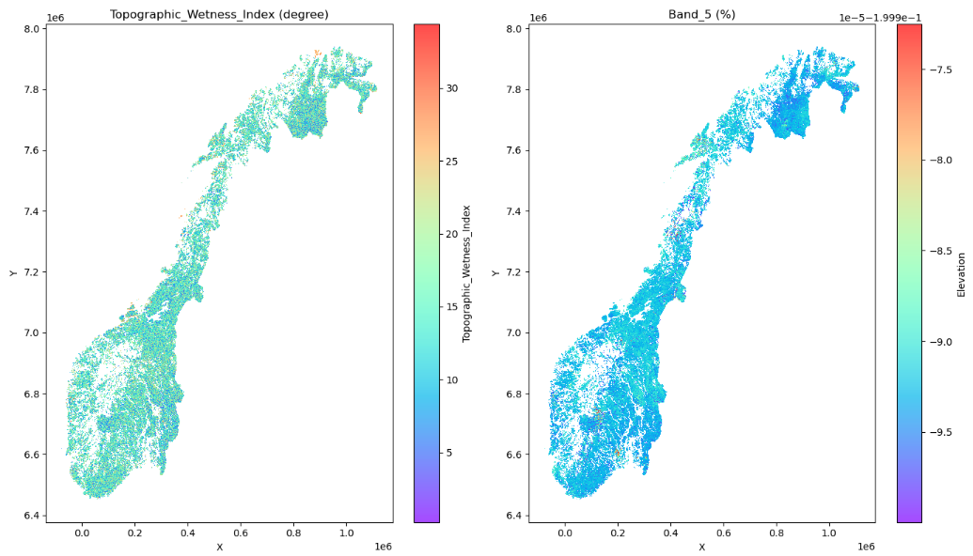
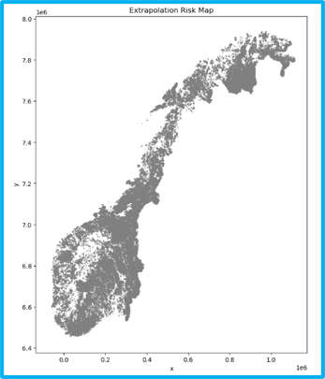
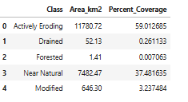
Prediction Outside Data DOMAIN ??
Peat Status Class of AR50 Map of Norway
Uncertainty Map
Results
Notes:
We used the framework to predict Norwegian Peatland using the AR 50 Map. Our result shows that.

Slide 17
Implications of this work
A trained RF could classify peatland status using Spectral Reflectance, Climate, Terrane, Hydrology and Land Surface Temperature signature.
It could spatially predict very well in similar domain.
Uncertainties may be high outside data domain even in similar peatland regime.
Domain training and robust feature engineering would improve accuracy and reduce uncertainty.
Conclusion

Slide 18
Next…..
Higher Resolutions data 10m, 5m, 1m?
Share with mapping agencies to validate model results.
Deploy framework on peatlands, especially those in the higher latitudes.
Conclusion
Notes:
These results are promising for peat classification efforts.

Slide 19
Supporting Literature
Gallego-Sala, A., Colin Prentice, I. Blanket peat biome endangered by climate change. Nature Clim Change 3, 152–155 (2013). https://doi.org/10.1038/nclimate1672
Worrall, F., Gibson, H. S., Hopkins, J., Young, J., Lyndsay, D., & Lopez-Soldana, G. (2025). Using earth observation to develop a health index for peatlands. Science of The Total Environment, 970, 178956.
Krankina, O. N., Pflugmacher, D., Friedl, M., Cohen, W. B., Nelson, P., & Baccini, A. (2008). Meeting the challenge of mapping peatlands with remotely sensed data. Biogeosciences, 5(6), 1809-1820.
Minasny, Budiman, et al. "Digital mapping of peatlands–A critical review." Earth-Science Reviews 196 (2019): 102870.
Whiteside, T. G., Boggs, G. S., & Maier, S. W. (2011). Comparing object-based and pixel-based classifications for mapping savannas. International Journal of Applied Earth Observation and Geoinformation, 13(6), 884-893.
References

