Slide 1
Robustness of the South American monsoon system to an AMOC collapse in a kilometer-scale atmosphere-only model
Keno Riechers
EGU General Assembly 2026

Slide 2
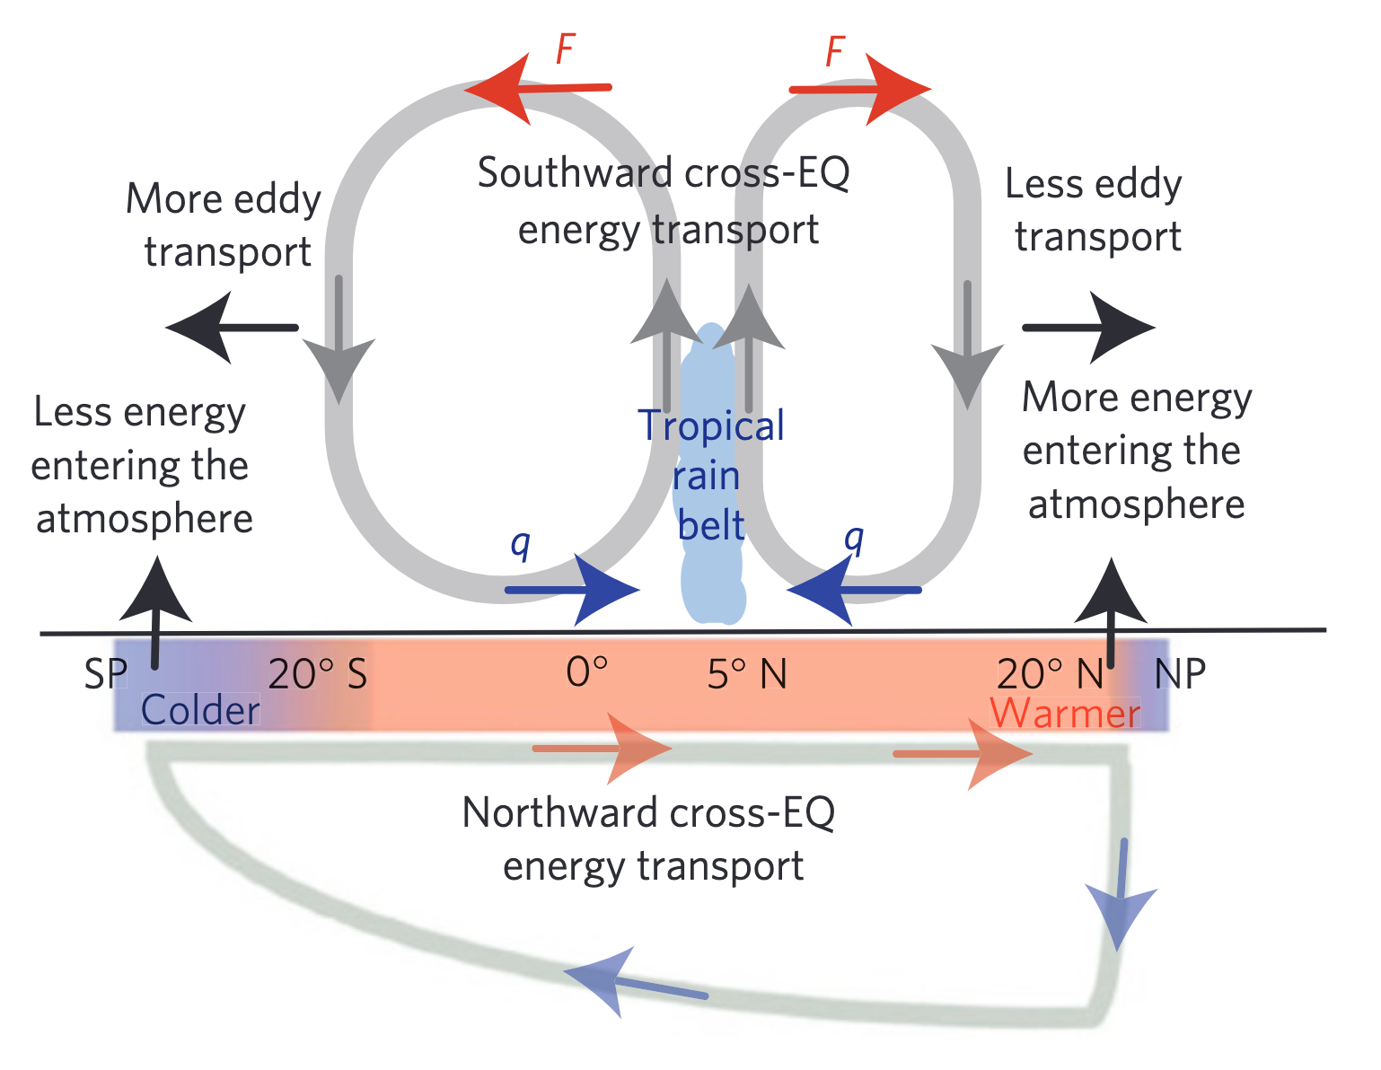
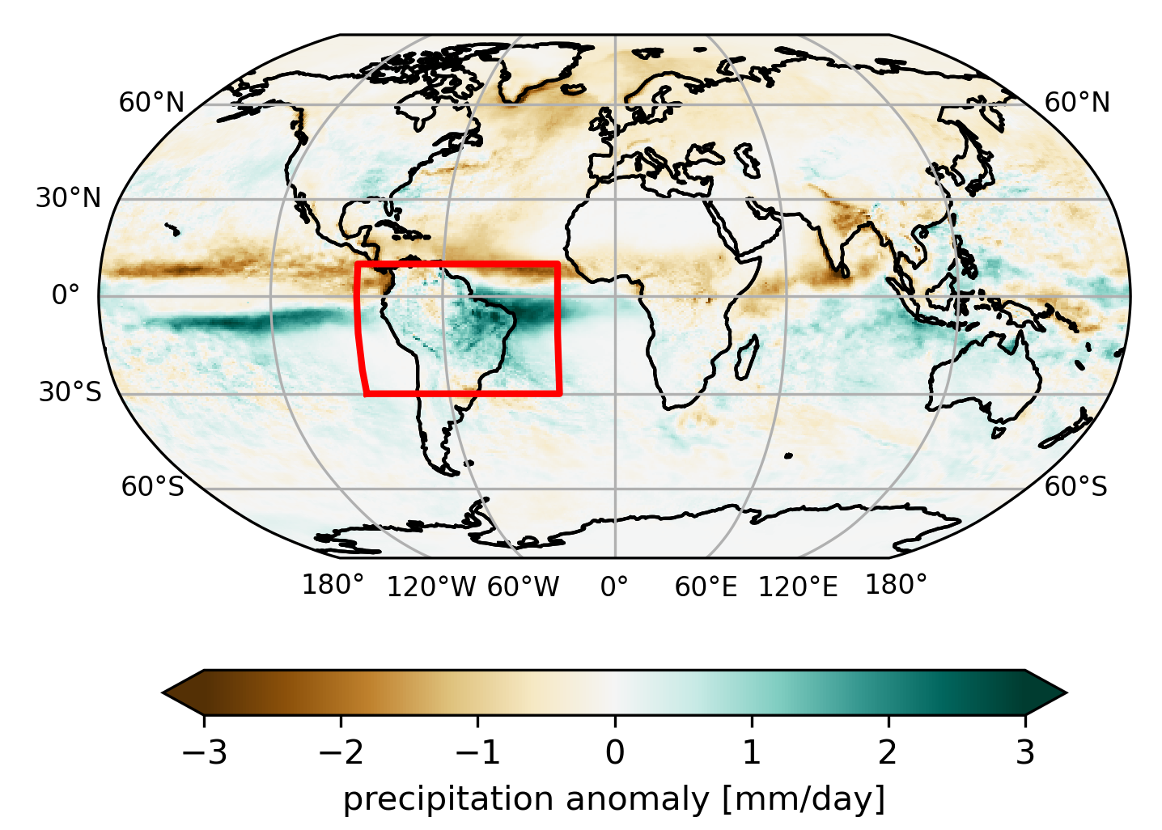
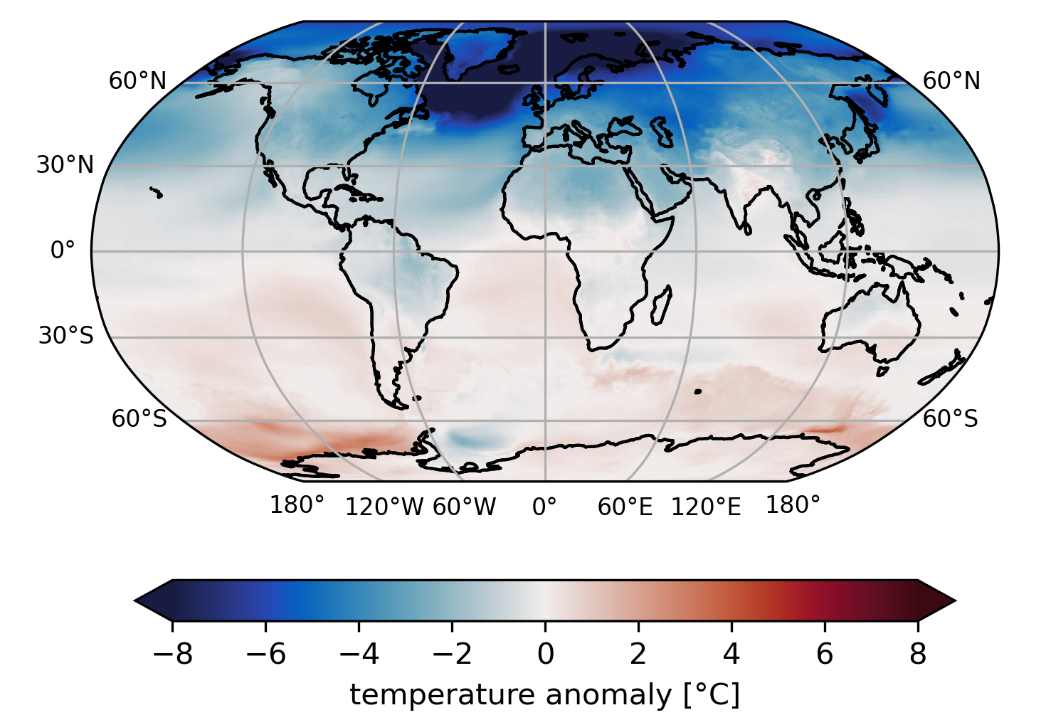
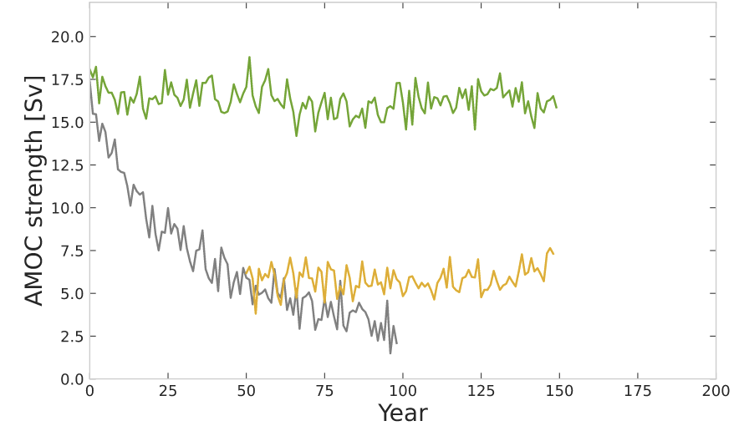
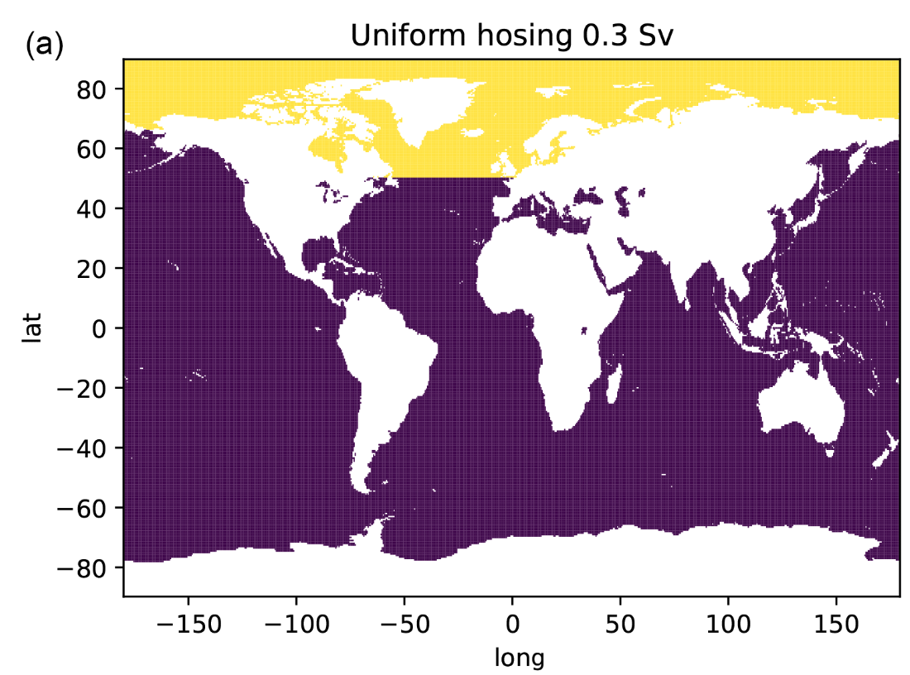
Atlantic meridional overturning circulation (AMOC)
And Intertropical Convergence ZONE (ITCZ)
(Jackson et al., 2023)
South
North
(Ben‐Yami et al., 2024)
Equator

Slide 3

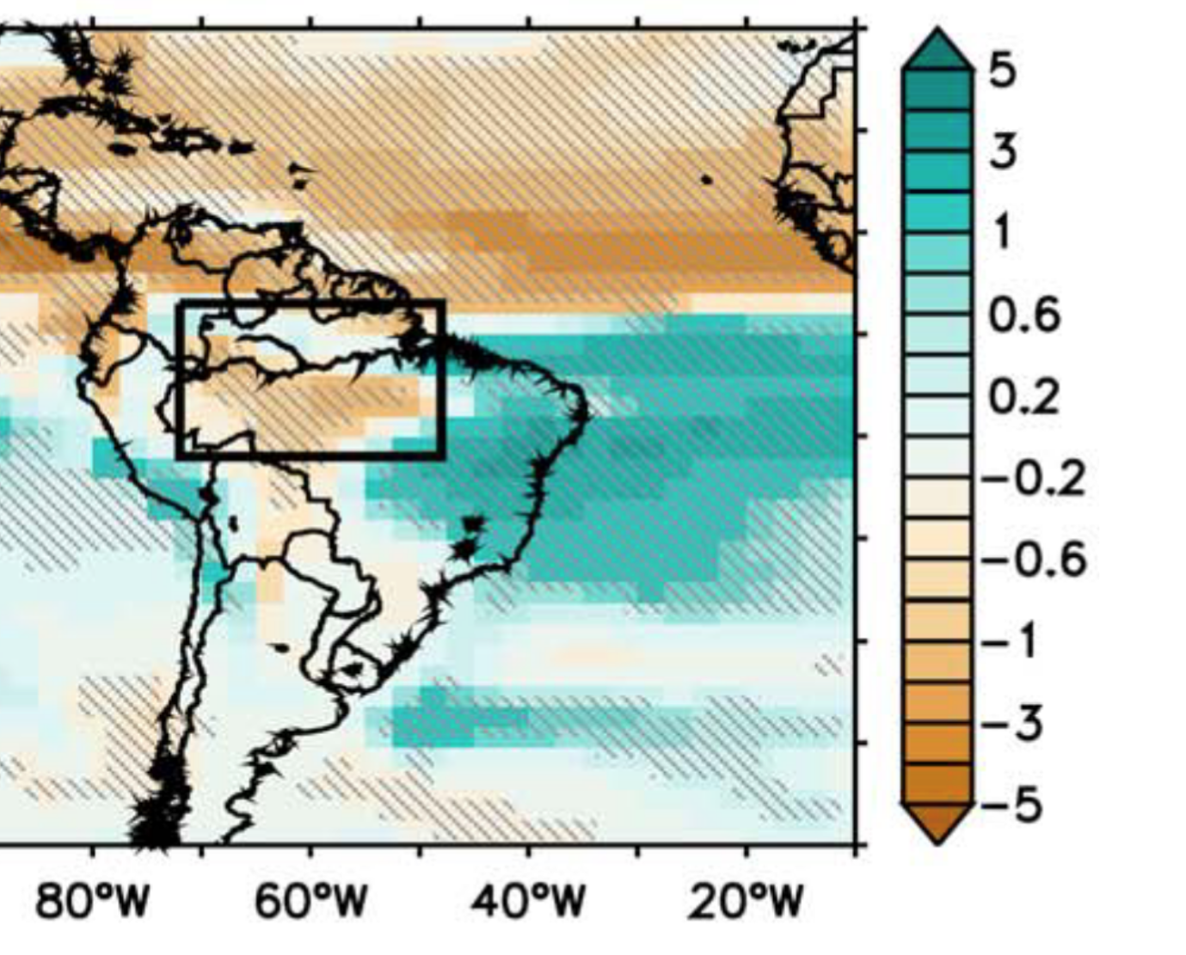
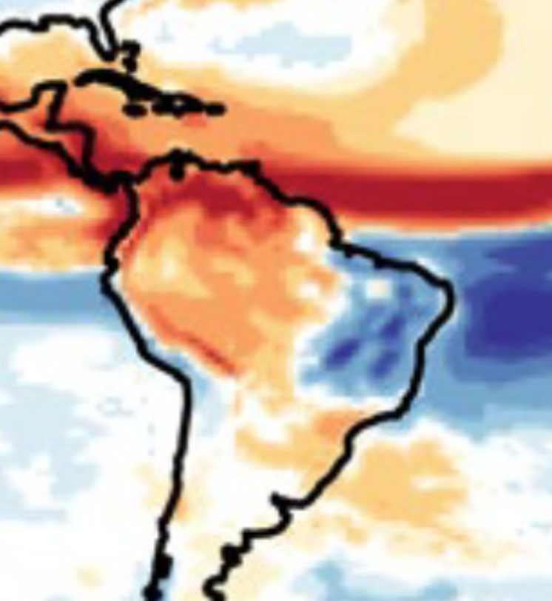
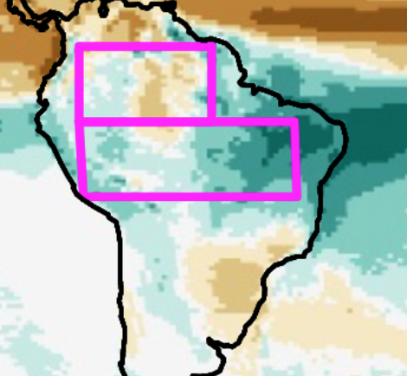
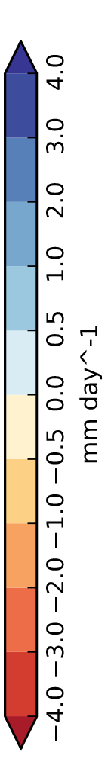
Model Uncertainty over South America
SST & Sea Ice
Horizontal Resolution:
>200 km
~100 km
~ 100 km
atmosphere
10km resolution
convection permitting
?
(Parsons et al., 2014)
(Jackson et al., 2015)
(Ben‐Yami et al., 2024)
Notes:
200 km corresponds to 2x2° grid in case of van Westen and 2° latitude 2.5° longitude. For Zhang and Parson
HadGem models are N216, meaning 0.83 Lon and 0.55 lat. is a bit coarser: 1.25 x 0.9

Slide 4
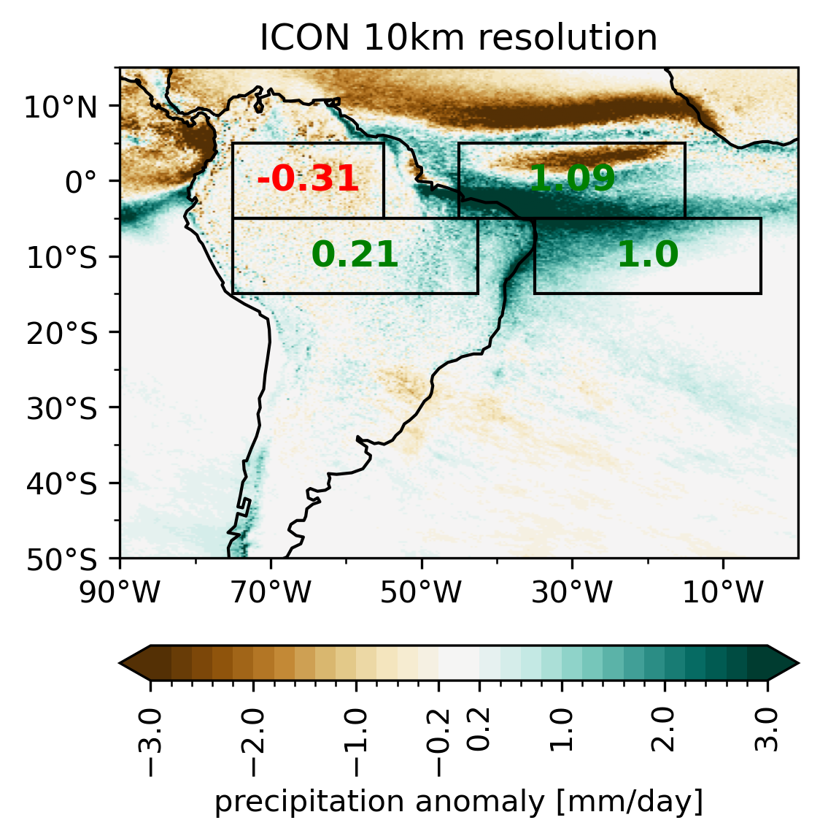
Model Uncertainty over South America
>200 km
~100 km
(Parsons et al., 2014)
(Jackson et al., 2015)
~ 100 km
(Ben‐Yami et al., 2024)
Notes:
200 km corresponds to 2x2° grid in case of van Westen and 2° latitude 2.5° longitude. For Zhang and Parson
HadGem models are N216, meaning 0.83 Lon and 0.55 lat. is a bit coarser: 1.25 x 0.9

Slide 5
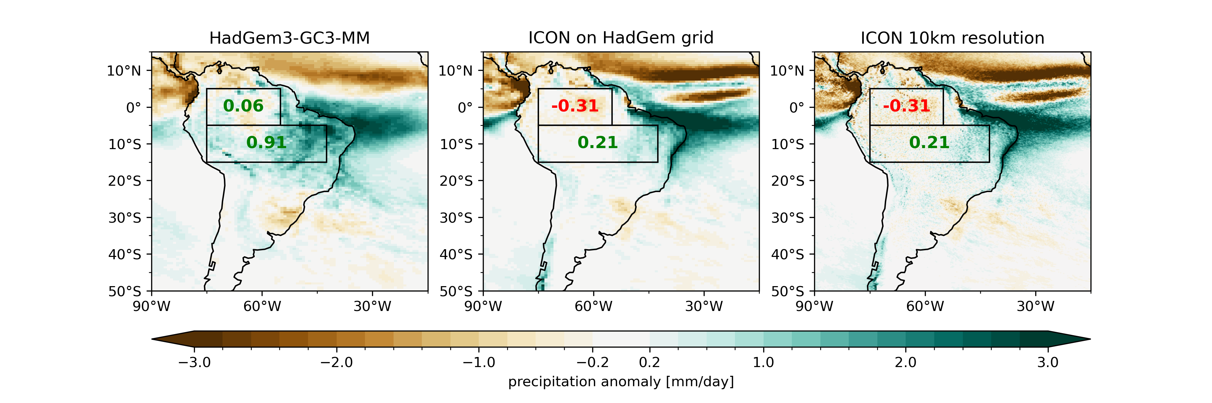
Attenuated land response
Remove boxes
Key conclusions from this figure should be qualitative resemblance

Slide 6
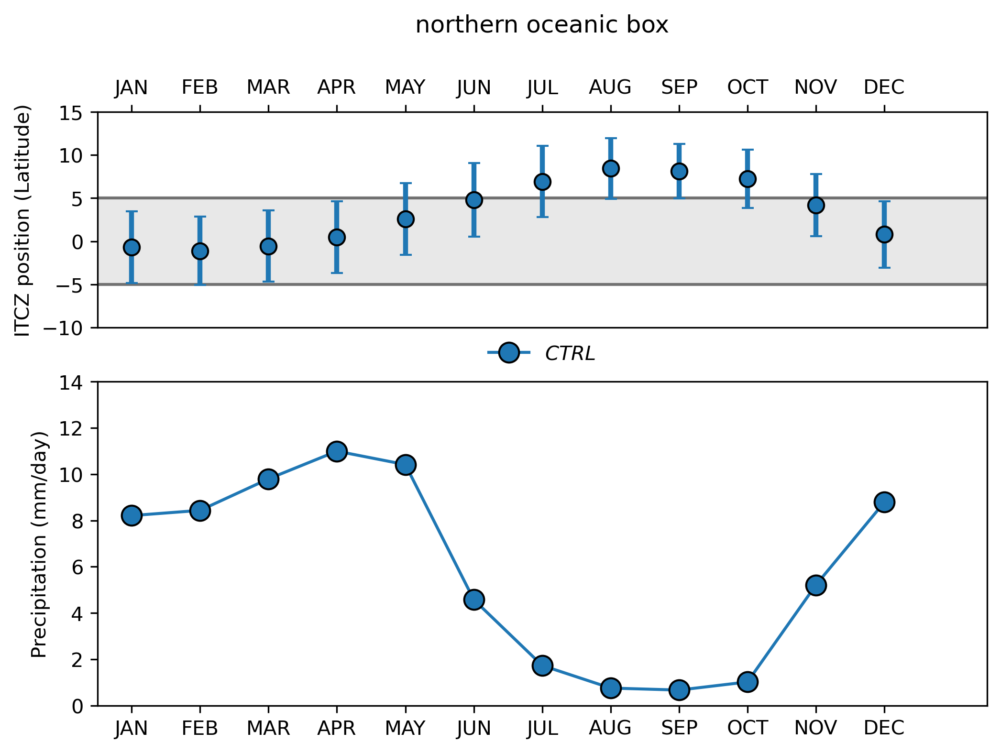
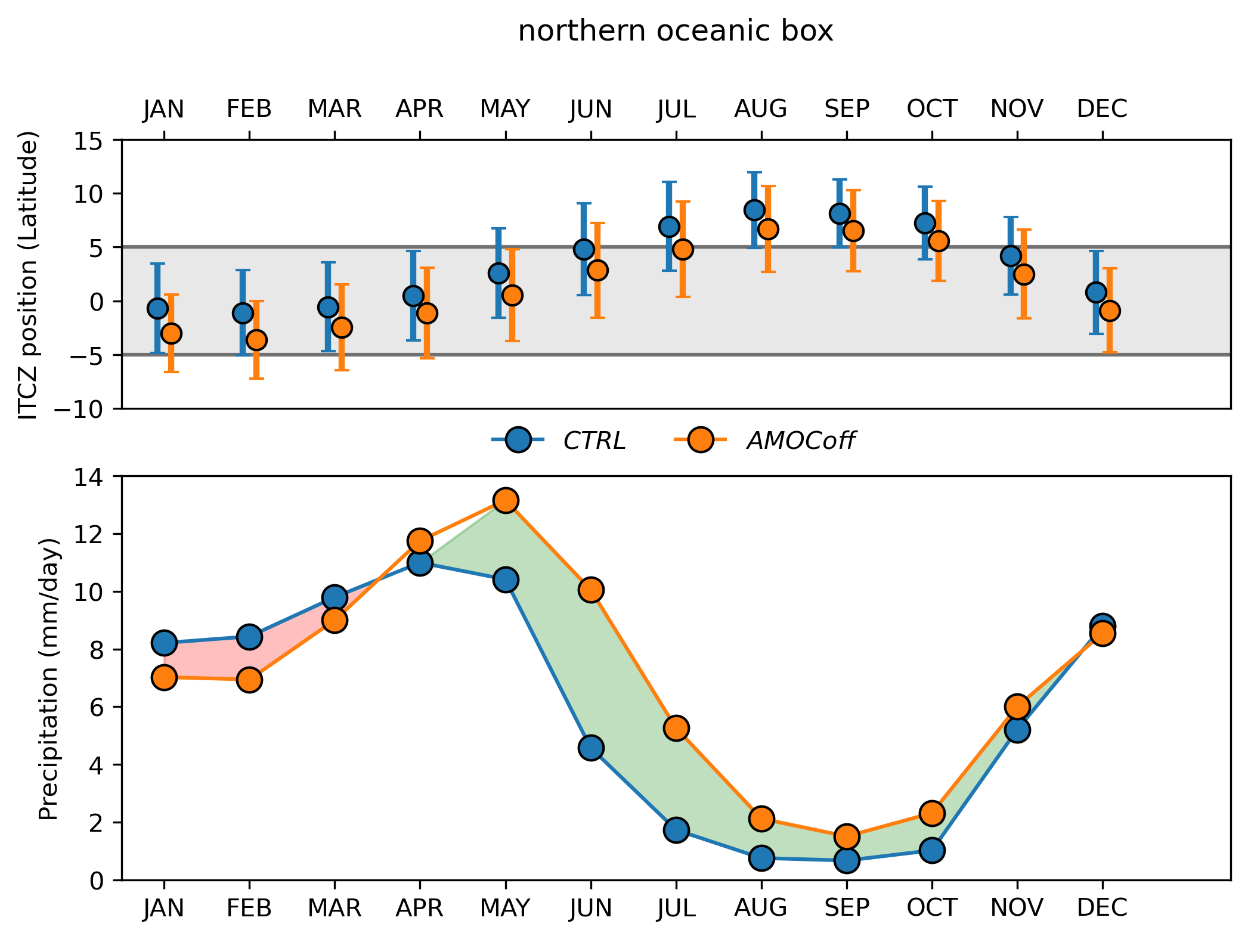
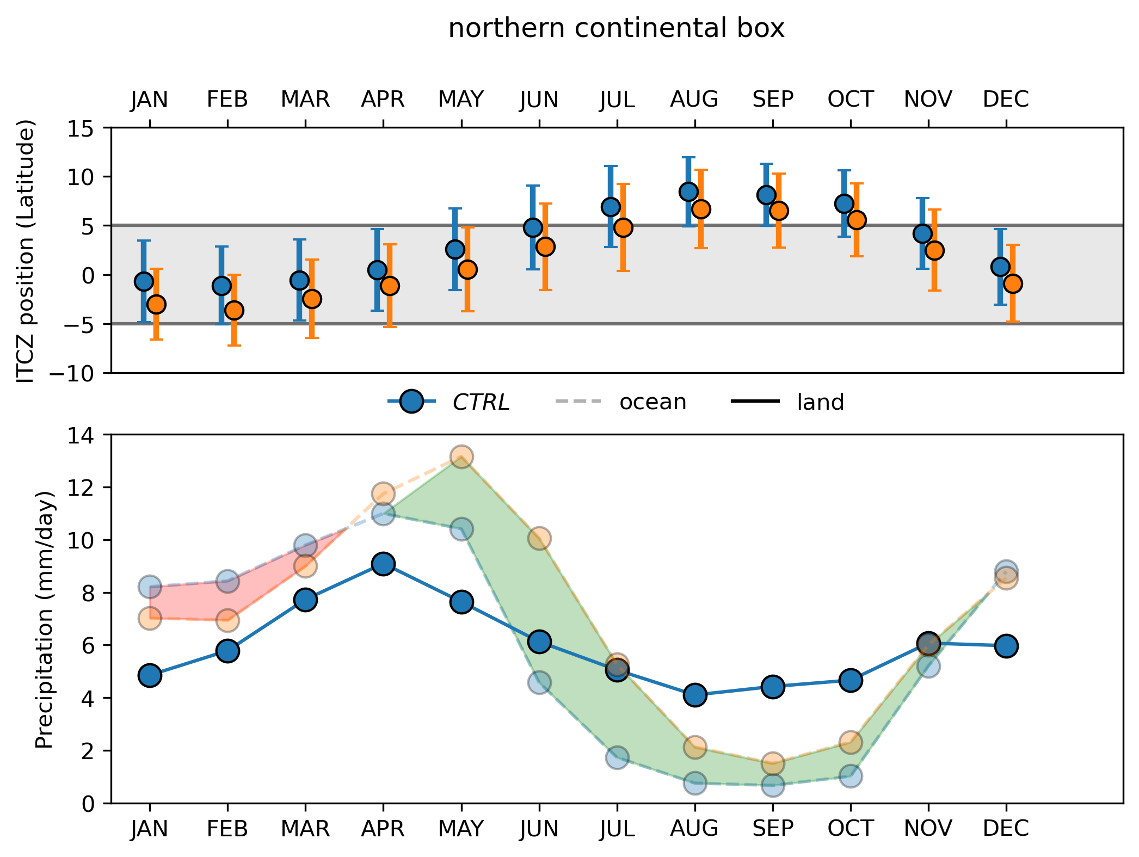
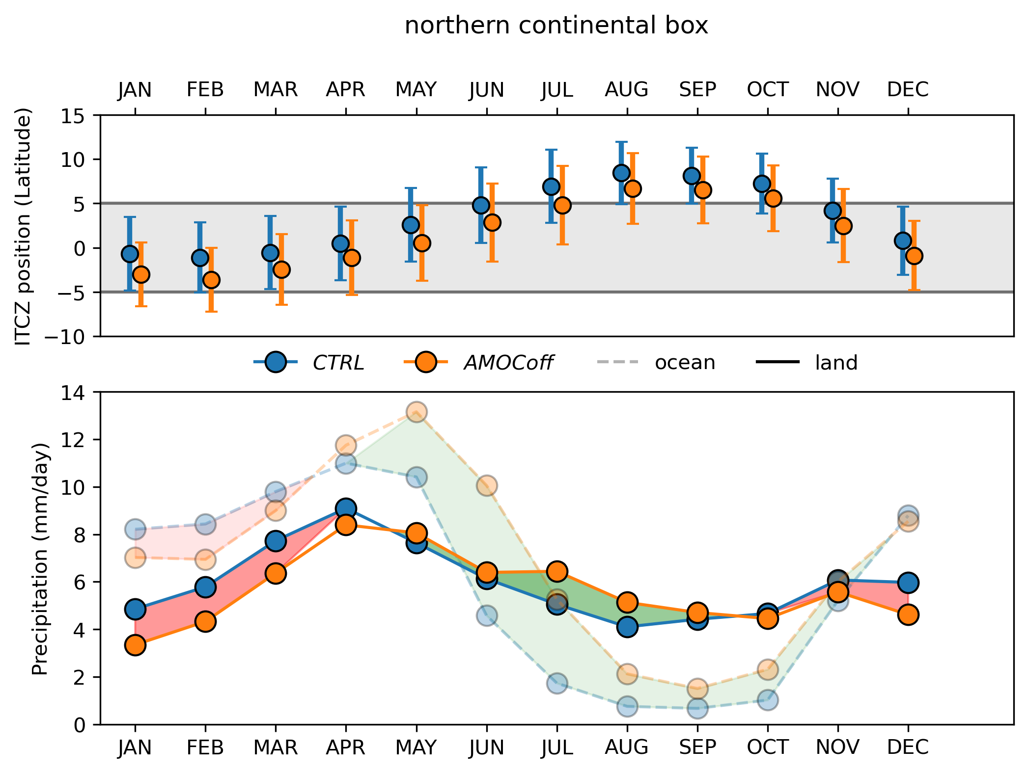
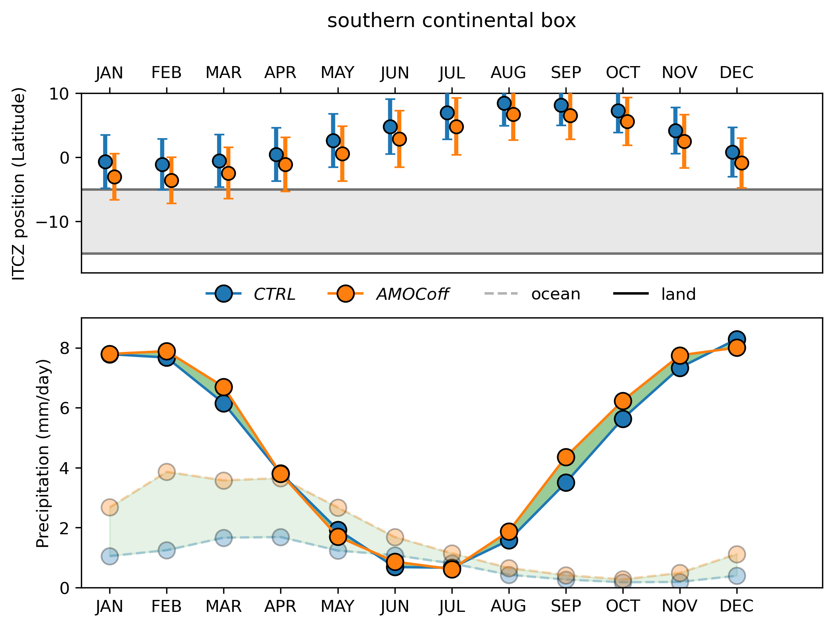
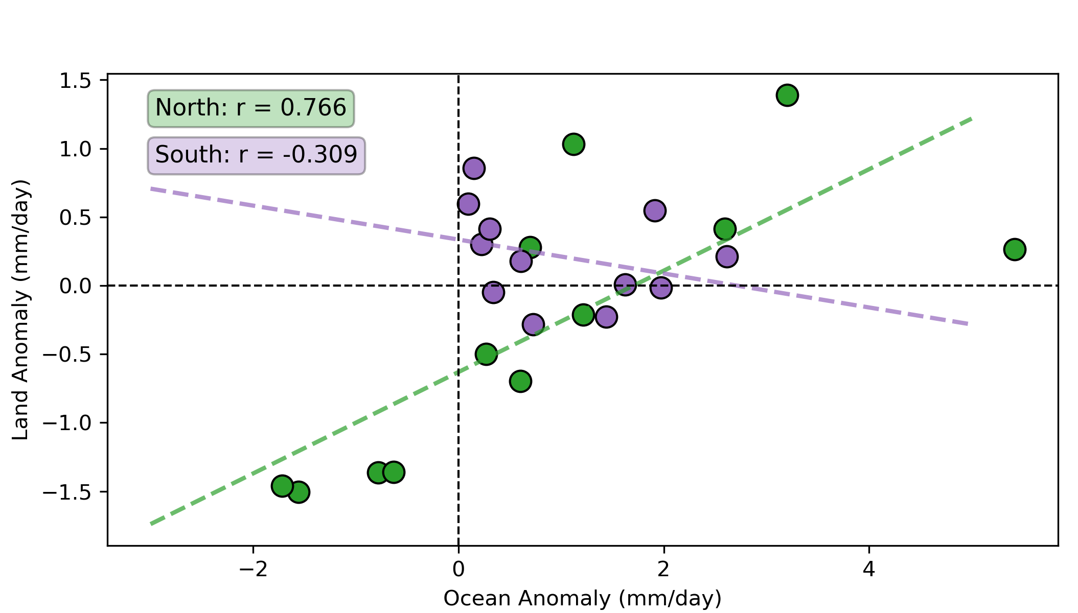
Annual Cycle

Slide 7
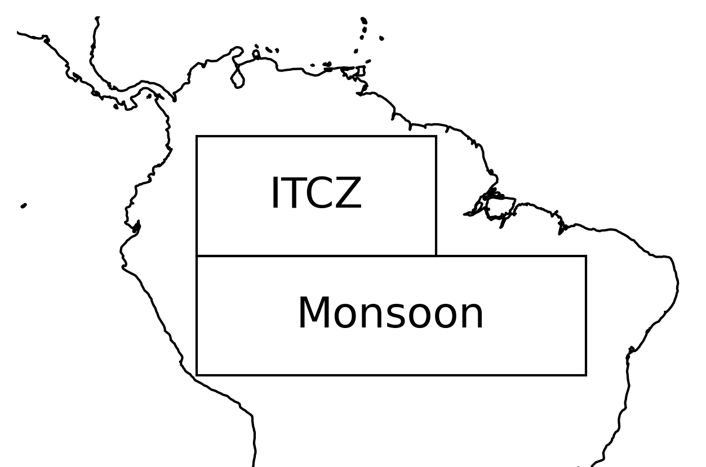
Conclusions
Precipitation anomaly explained by southward shift of the ITCZ
No change in precipitation. Monsoon remains largely unaltered under AMOC shutdown.

Slide 8
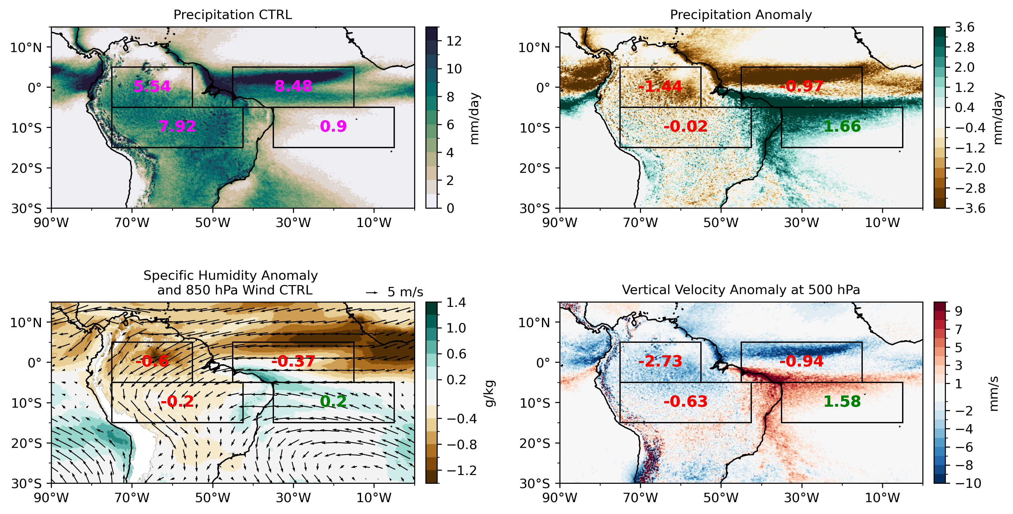
DJF

Slide 9
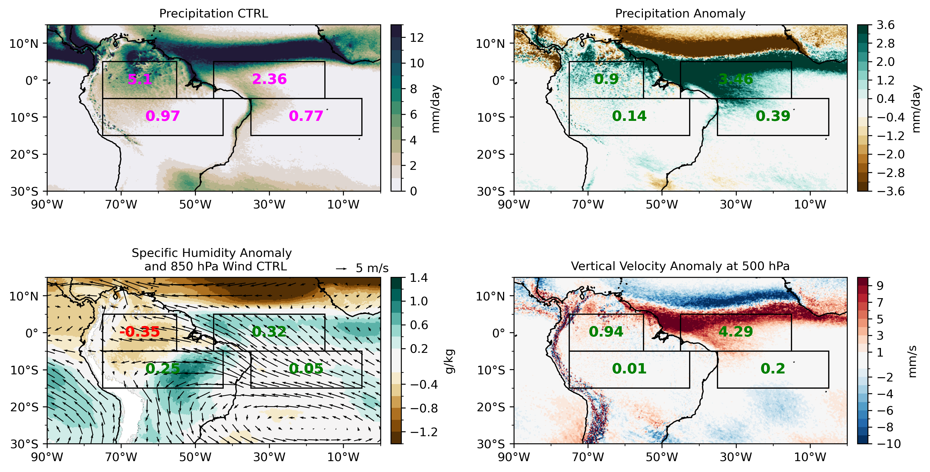
JJA

