Slide 1

Deriving the conditional distribution of soil moisture and its use in estimating memory in the water-soil system
Takahiro Furuya, M. Evren Soylu, Weiqiang Jing, Elisa Arnone, Rafael Bras
Notes:
The guidelines for making the 2-minute introduction and follow-up presentation slides are at https://www.egu26.eu/authors/presenters/pico_presenter_guidelines.html.
The QR code is downloaded from our abstract page https://meetingorganizer.copernicus.org/EGU26/EGU26-14482.html (the right-most symbol at the bottom right corner). A QR code for the presentation’s abstract is encouraged to be attached when the authors participate Outstanding Student and PhD candidate Presentation (OSPP) Award.

Slide 2
Motivation
- the importance of soil moisture -
Soil moisture is a primary water source for plants and soil microorganisms.
People use soil moisture information in
  irrigation strategies [Cardenas B., 2015, Mninder Singh, 2024]
  predicting soil-borne plant diseases [Jian, 2021]
  Enhancing agroecosystem model accuracy [Soylu, 2024]
In general circulation and weather forecast models, soil moisture serves as “a vital link between the atmosphere, plants, and the subsurface” [Rohmati, 2024].

Slide 3
Motivation 2
- randomness of soil moisture dynamics -
Soil moisture dynamics can be seen as a stochastic process driven mainly by the randomness of precipitation and Potential Evapotranspiration (PET).
  Precipitation is commonly modeled as a Poisson process (interarrival times and storm intensities follow exponential distributions. Storm durations are often assumed to be zero) [Cordova and Bras, 1981; Milly, 1993; Laio et al., 2001].
  PET is arguably less important than precipitation for soil moisture dynamics [Rhenals and Bras, 1981; Orth et al., 2012]. A constant value [Milly, 1993] or measured PET [Cordova and Bras, 1981; Laio et al., 2001] is often used.
For its randomness, soil moisture uncertainty is expressed in the form of Probability Distribution Functions (PDFs).
Notes:
[Cordova and Bras, 1981] model storm durations, storm intensities, and storm interarrival times as exponential distributions. The storm durations are used to calculate the infiltration amount and the infiltration is assumed to occur instantaneously (eq. (24) (storm duration pdf) is used to derive eq. (33) (infiltration equation) + ”since the storm is assumed to occur as an instantaneous pulse at the end of the time interval delta t”). This storm duration assumption (used in infiltration but the infiltration occurs instantaneously at the end of each time step) is the same as my assumption (precipitation is assumed to be a rectangular pulse and infiltration is assumed to occur at the end of each rainy day instantaneously).
[Milly, 1993] follows almost the same assumptions, except that he does not model storm durations. He assumes instantaneous storm pulses, so no storm durations.
[Laio et al., 2001] use the same assumption as Milly (1993), where he assumes zero storm durations and exponential distributions for storm depths and storm interarrival times.

Slide 4
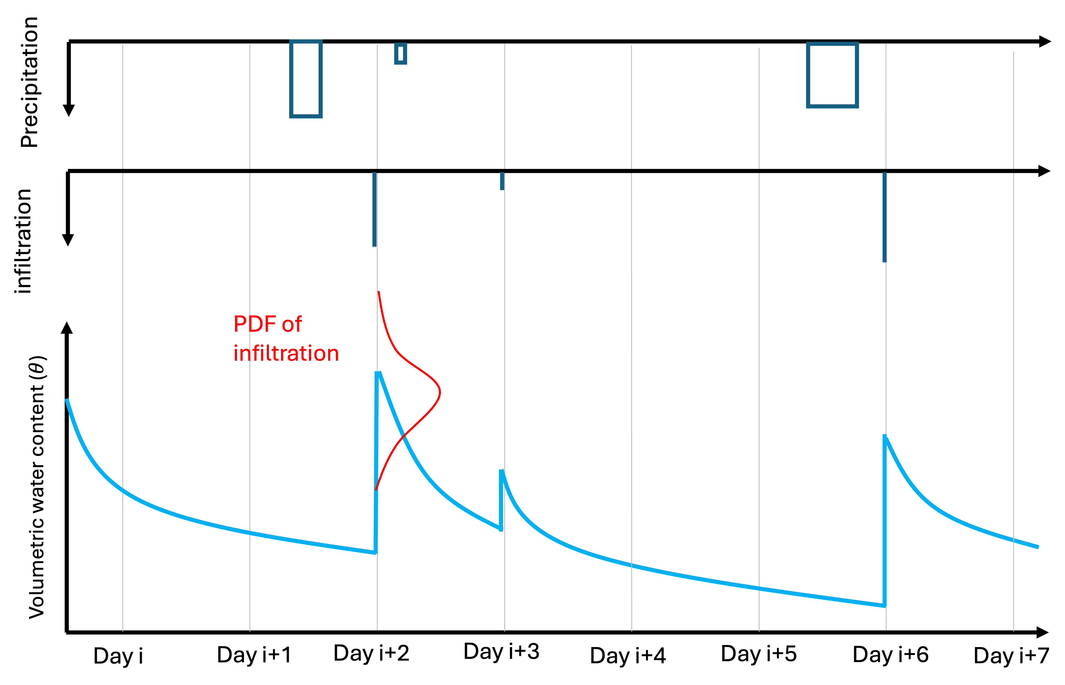
Motivation 3
- key assumptions: instantaneous infiltration and deterministic drying process -
We use two key assumptions: instantaneous infiltration and deterministic drying process [Cordova and Bras, 1981; Laio et al., 2001].
Due to the stochastic nature of precipitation, the depth of infiltration is expressed by a PDF.
Given PET, drying process is deterministic.

Slide 5
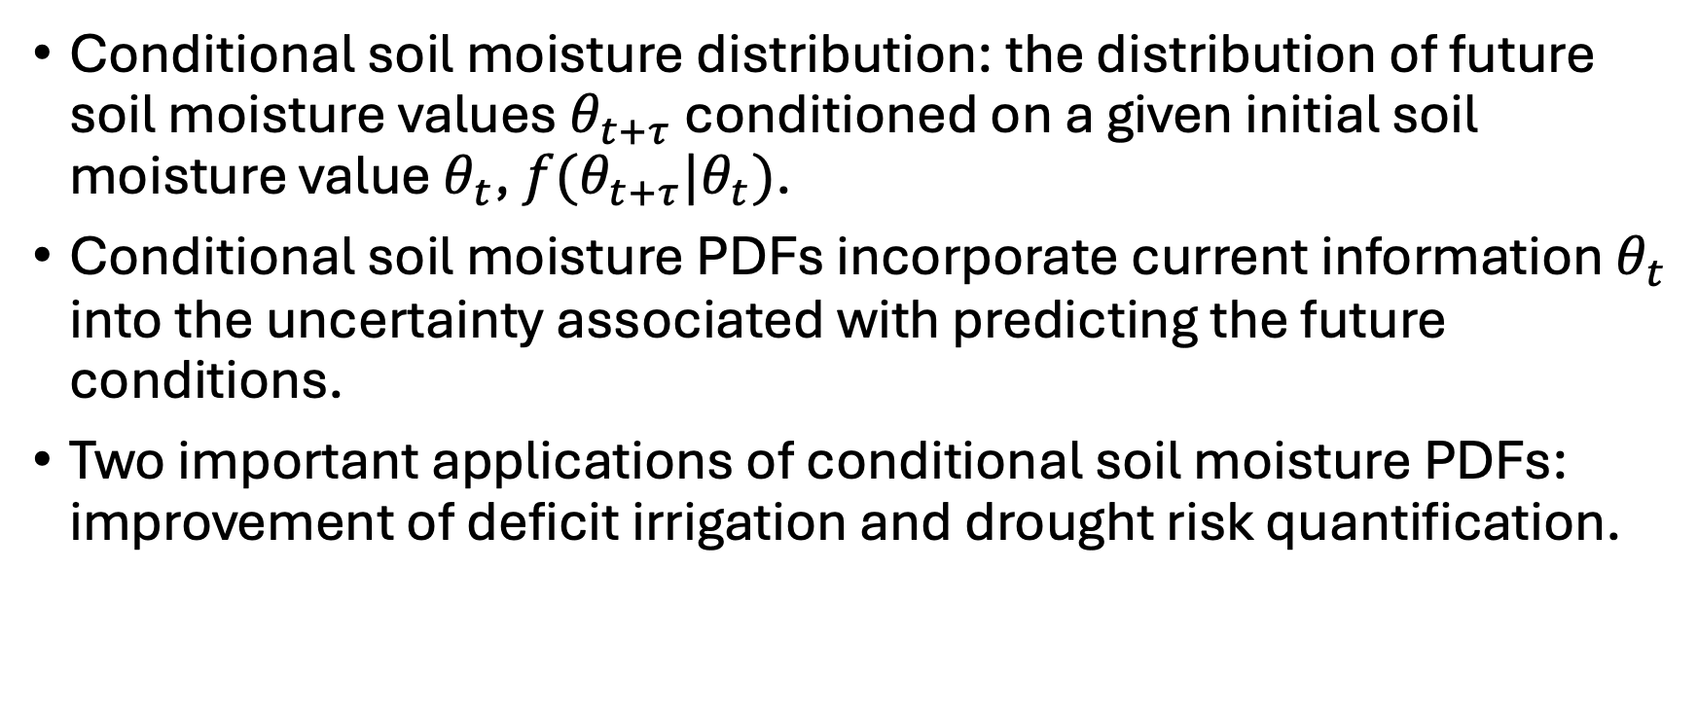
Motivation 4
- conditional soil moisture distribution -
Conditional soil moisture distribution: the distribution of future soil moisture values $θ_{t+τ}$ conditioned on a given initial soil moisture value $θ_{t}$, $f(θ_{t+τ}|θ_{t})$.
Conditional soil moisture PDFs incorporate current information $θ_{t}$ into the uncertainty associated with predicting the future conditions.
Two important applications of conditional soil moisture PDFs: improvement of deficit irrigation and drought risk quantification.

Slide 6
Goal of our study
To derive the conditional soil moisture PDFs globally.
  Based on the formulations in [Cordova and Bras, 1981; Laio et al., 2001]
  [Cordova and Bras, 1981] derive the mean and variance of conditional soil moisture distribution at one site.
  Gridded satellite datasets (Global Precipitation Mission (GPM) Integrated Multi-satellite Retrievals for GPM (IMERG) and Soil Moisture Active Passive (SMAP)) enables global simulations of soil moisture dynamics.

Slide 7
Analysis overall flow
Data Curation
SMAP
Daily / half-hourly IMERG
Modified ERA5
CPC temperature
SMAP , daily / half-hourly IMERG, ERA5
Daily IMERG, CPC
Stochastic Weather Generator (WeaGETS)
Model Calibration
Parameter soil_type and ZR (rooting depth)
Bucket Model
2,000-year daily precipitation and PET
2,000-year daily soil moisture
Bias Correction
CDF-matching between 2,000-year data and SMAP
Derivation of joint, conditional and marginal PDFs

Slide 8
Bucket model
Dry days
rainy days
Soil moisture (saturation degree)
days
1
Call soildecay() function
Dry days and rainy days use different processes

Slide 9
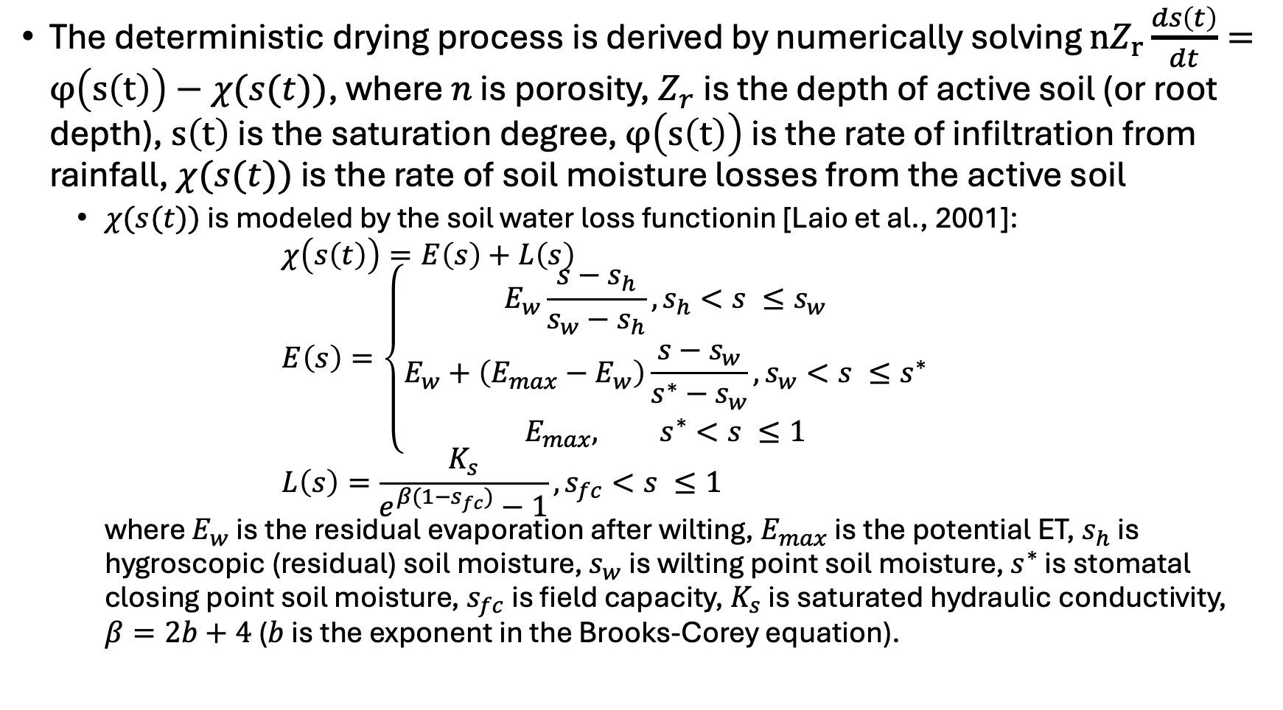
Bucket model, dry process
The deterministic drying process is derived by numerically solving ${nZ}_{r}\frac{ds\left(t\right)}{dt}=φ\left(s\left(t\right)\right)−χ(s(t))$, where $n$ is porosity, $Z_{r}$ is the depth of active soil (or root depth), $s\left(t\right)$ is the saturation degree, $φ\left(s\left(t\right)\right)$ is the rate of infiltration from rainfall, $χ(s(t))$ is the rate of soil moisture losses from the active soil
  $χ(s(t))$ is modeled by the soil water loss functionin [Laio et al., 2001]:
  $χ\left(s\left(t\right)\right)=E\left(s\right)+L\left(s\right)$
  $E\left(s\right)=\left\{\begin{aligned}E_{w}\frac{s−s_{h}}{s_{w}−s_{h}}, s_{h}<s ≤s_{w} \\ E_{w}+\left(E_{max}−E_{w}\right)\frac{s−s_{w}}{s^{∗}−s_{w}}, s_{w}<s ≤s^{∗} \\ E_{max}, s^{∗}<s ≤1\end{aligned}\right.$
  $L\left(s\right)=\frac{K_{s}}{e^{β(1−s_{fc})}−1}, s_{fc}<s ≤1$
  where $E_{w}$ is the residual evaporation after wilting, $E_{max}$ is the potential ET, $s_{h}$ is hygroscopic (residual) soil moisture, $s_{w}$ is wilting point soil moisture, $s^{∗}$ is stomatal closing point soil moisture, $s_{fc}$ is field capacity, $K_{s}$ is saturated hydraulic conductivity, $β=2b+4$ ($b$is the exponent in the Brooks-Corey equation).

Slide 10
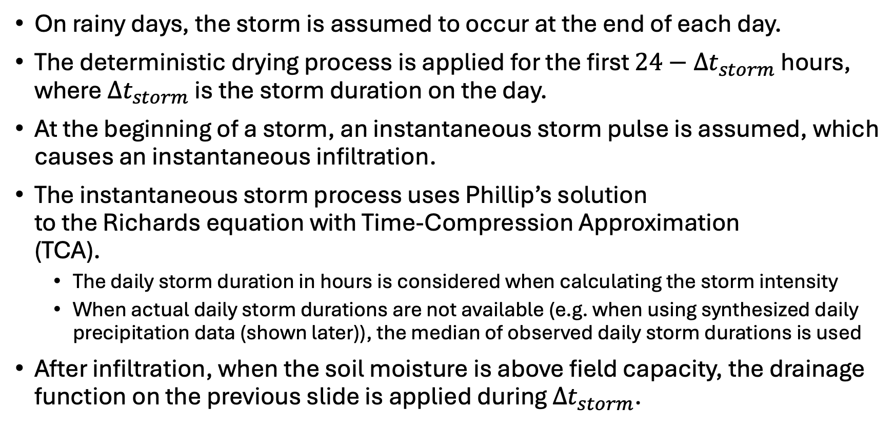
Bucket model, rainy days
On rainy days, the storm is assumed to occur at the end of each day.
The deterministic drying process is applied for the first $24−{Δt}_{storm}$ hours, where ${Δt}_{storm}$ is the storm duration on the day.
At the beginning of a storm, an instantaneous storm pulse is assumed, which causes an instantaneous infiltration.
The instantaneous storm process uses Phillip’s solution
to the Richards equation with Time-Compression Approximation
(TCA).
  The daily storm duration in hours is considered when calculating the storm intensity
  When actual daily storm durations are not available (e.g. when using synthesized daily precipitation data (shown later)), the median of observed daily storm durations is used
After infiltration, when the soil moisture is above field capacity, the drainage function on the previous slide is applied during ${Δt}_{storm}$.

Slide 11
Dataset day definition
GPM & ERA5 day (accumulation)
0:00 a.m.
0:00 a.m.
UTC time (GMT+0)
6:00 a.m.
6:00 p.m.
Iowa local time (GMT+6)
SMAP snapshot timing
GPM precipitation and ERA5-based PET daily data are daily accumulations in UTC time zone
SMAP is snapshots at 6 a.m./p.m. in local solar
  SMAP snapshots that fall in the same UTC day are averaged
    To increase the number of data points (many AM/PM values are missing)

Slide 12
CDF matching
CDF value
CDF-matching (histogram matching) is applied to the bucket model time series
1
CDF of historical observations
CDF of future model output
Bias-corrected value
0.3
10
25

Slide 13
How do we combine different criteria model calibration?
Two criteria:
  How close is the marginal distribution of the bucket model to the marginal distribution of SMAP? (pairwise distance)
  RMSE between the bucket model time series and SMAP time series
We can automate this decision process by the Weighted Aggregated Sum Product Assessment (WASPAS)

Slide 14
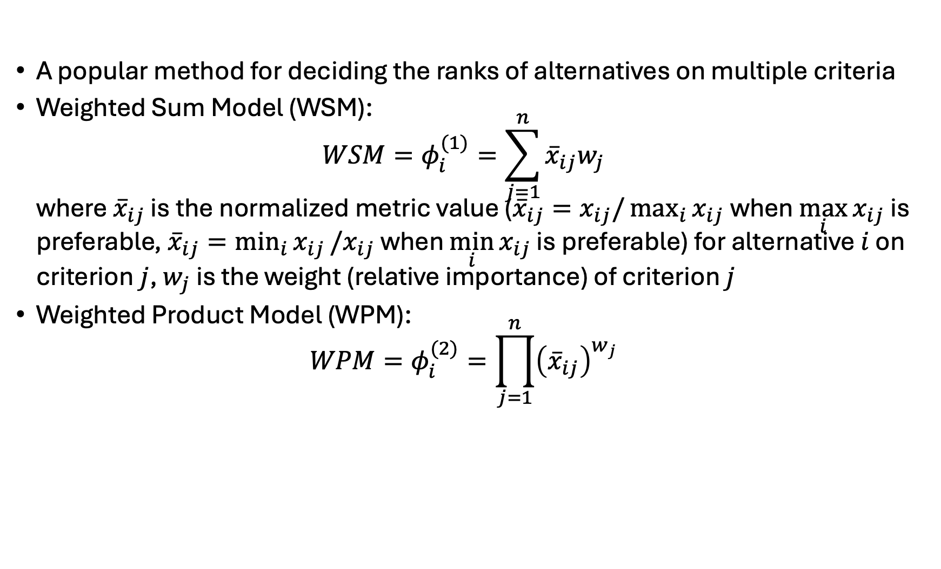
Weighted Aggregated Sum Product Assessment (WASPAS)
A popular method for deciding the ranks of alternatives on multiple criteria
Weighted Sum Model (WSM):
$WSM=φ_{i}^{(1)}=\sum_{j=1}^{n}{{\overline{x}}_{ij}w_{j}}$
where ${\overline{x}}_{ij}$ is the normalized metric value (${\overline{x}}_{ij}=x_{ij}/\max_{i}{x_{ij} }$when $\max_{i}{x_{ij} }$is preferable, ${\overline{x}}_{ij}=\min_{i}{x_{ij}}/x_{ij}$ when $\min_{i}{x_{ij}}$ is preferable) for alternative $i$ on criterion $j$, $w_{j}$ is the weight (relative importance) of criterion $j$
Weighted Product Model (WPM):
$WPM=φ_{i}^{(2)}=\prod_{j=1}^{n}{{\left({\overline{x}}_{ij}\right)}^{w_{j}}}$
Notes:
Normalization method changes depending on whether the criteria is a beneficial criterion or not (see section 2.4.2 of the paper A robust integrated Bayesian multi-model uncertainty estimation framework (IBMUEF) for quantifying the uncertainty of hybrid meta-heuristic in global horizontal irradiation predictions)

Slide 15
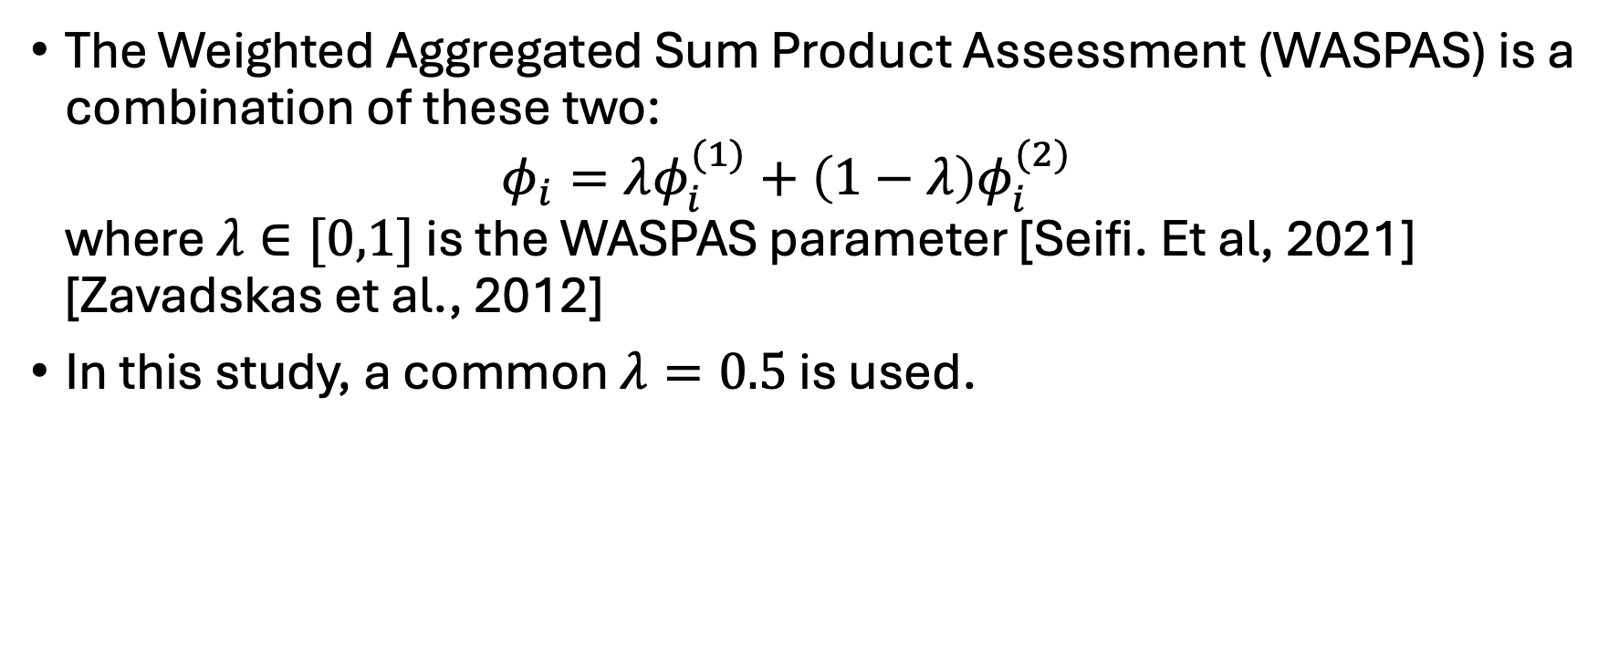
Weighted Aggregated Sum Product Assessment (WASPAS) (cont.)
The Weighted Aggregated Sum Product Assessment (WASPAS) is a combination of these two:
$φ_{i}=λφ_{i}^{(1)}+\left(1−λ\right)φ_{i}^{(2)}$
where $λ∈[0,1]$ is the WASPAS parameter [Seifi. Et al, 2021] [Zavadskas et al., 2012]
In this study, a common $λ=0.5$ is used.

Slide 16
Rainfall model: WeaGETS
A stochastic weather generator that generates daily precipitation as well as daily minimum and maximum temperatures based on historical precipitation and temperature inputs.
The occurrence of wet and dry days is determined using a second-order Markov chain.
Precipitation amounts on wet days are modeled using an exponential distribution.

Slide 17
Model calibration
Data Curation
SMAP
Daily / half-hourly IMERG
Modified ERA5
CPC temperature
SMAP , daily / half-hourly IMERG, ERA5
Daily IMERG, CPC
Stochastic Weather Generator (WeaGETS)
Model Calibration
Parameter soil_type and ZR (rooting depth)
Bucket Model
2,000-year daily precipitation and PET
2,000-year daily soil moisture
Bias Correction
CDF-matching between 2,000-year data and SMAP
Derivation of joint, conditional and marginal PDFs

Slide 18
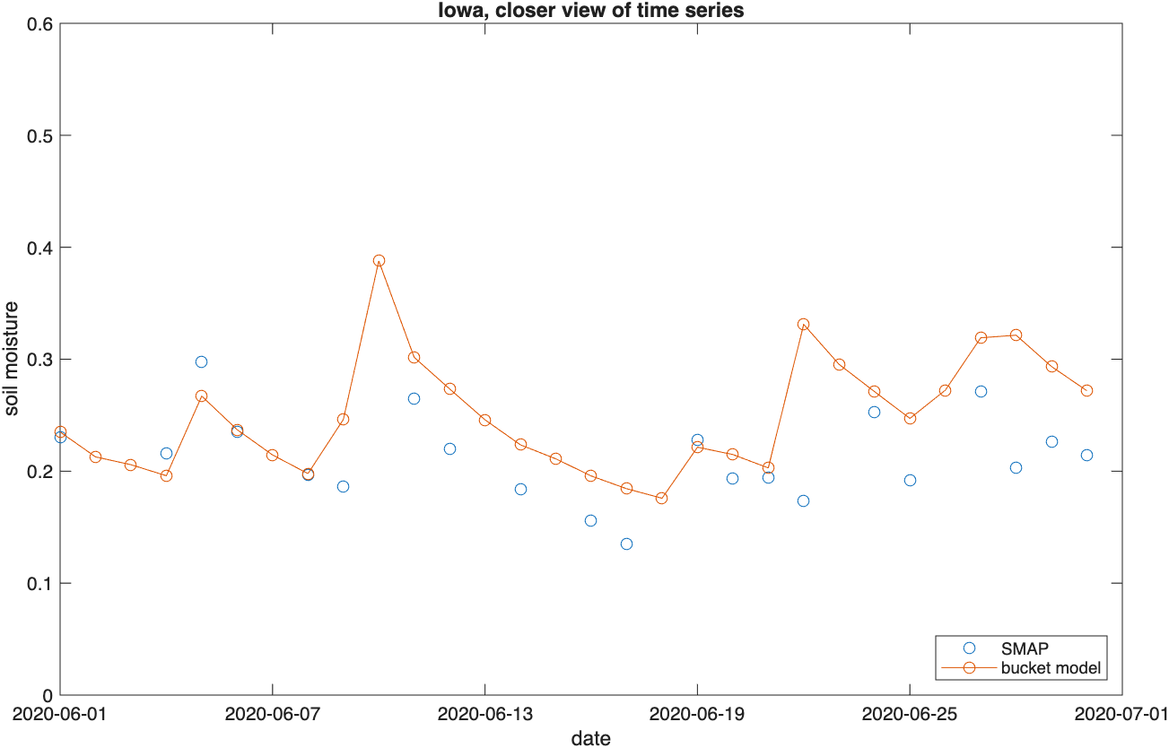
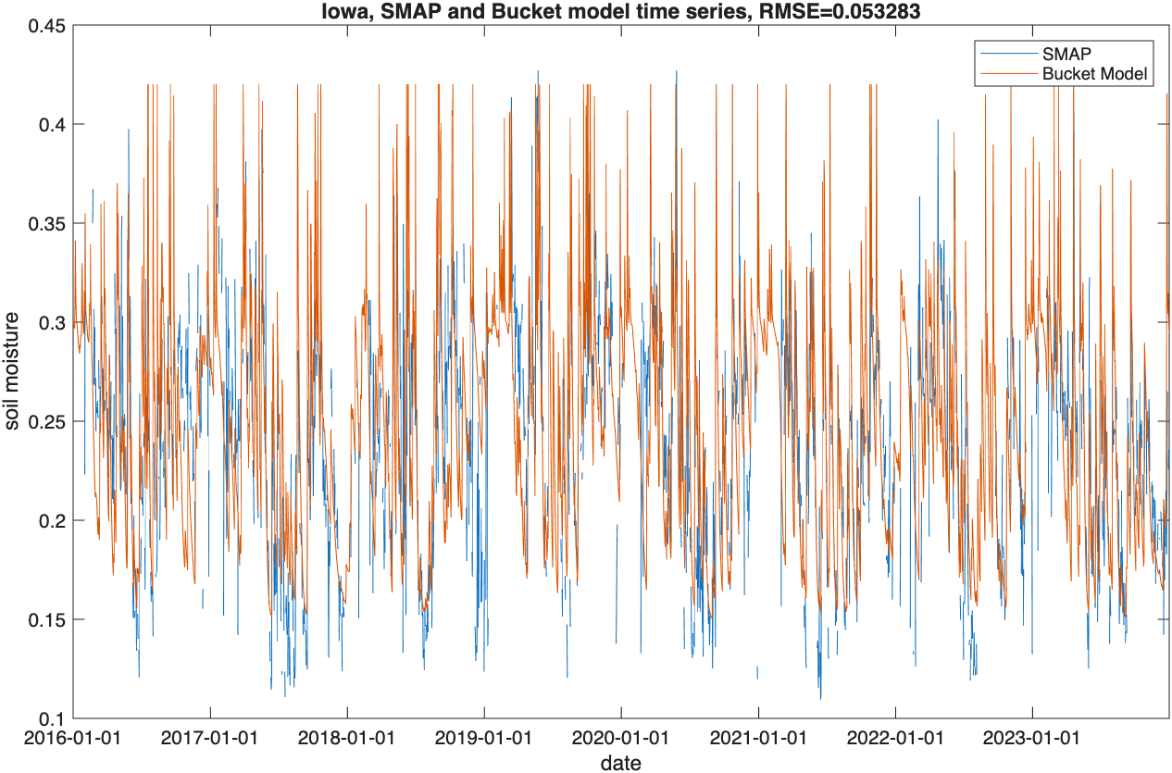
Iowa time series at the best parameter set (soil_type=6 (sandy clay loam), ZR=0.2)

Slide 19
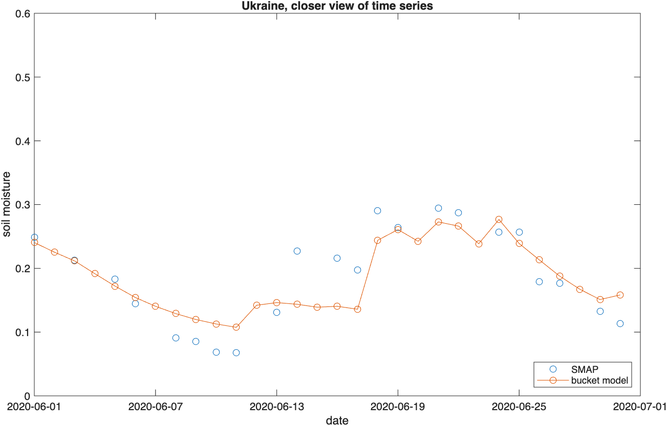
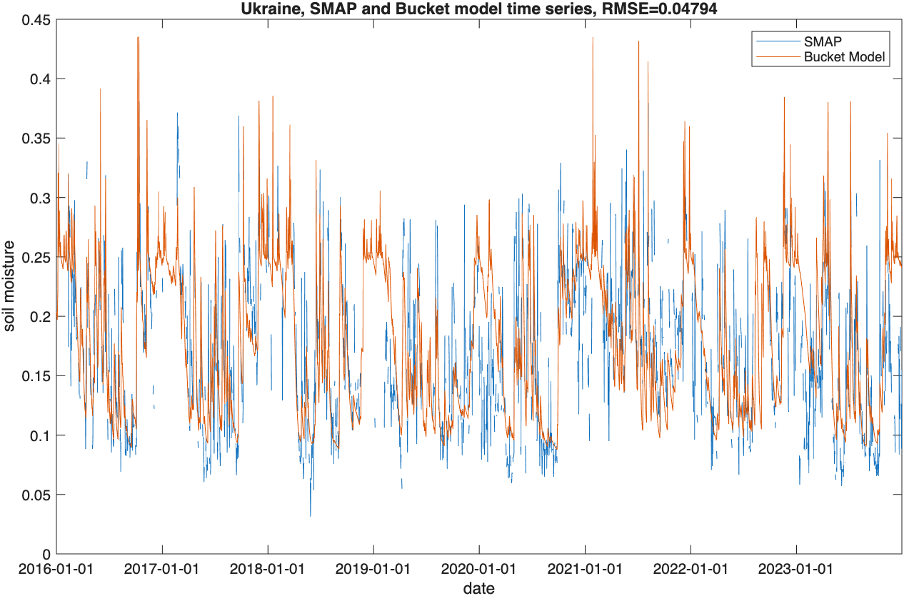
Ukraine time series at the best parameter set (soil_type=3 (sandy loam), ZR=0.2)

Slide 20
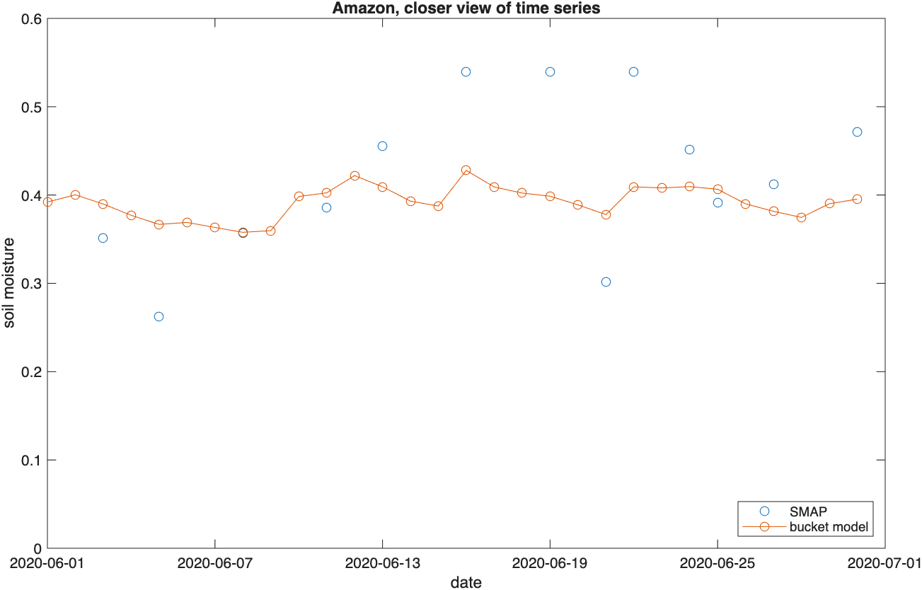
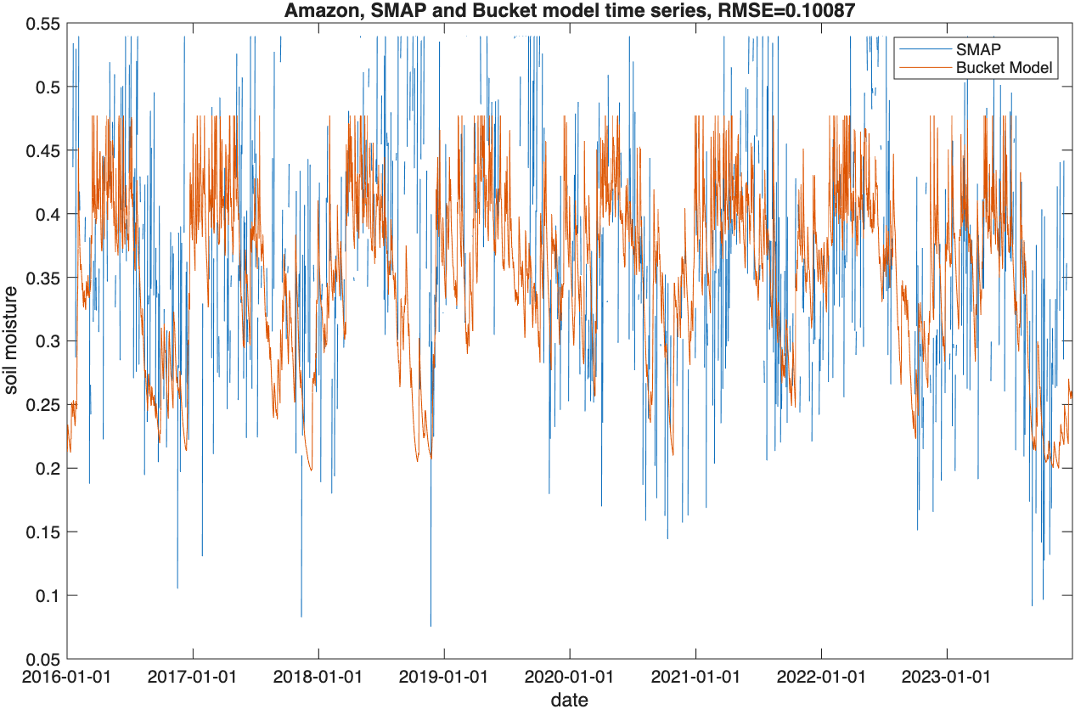
Amazon time series at the best parameter set (soil_type=7 (silty clay loam), ZR=0.5)

Slide 21
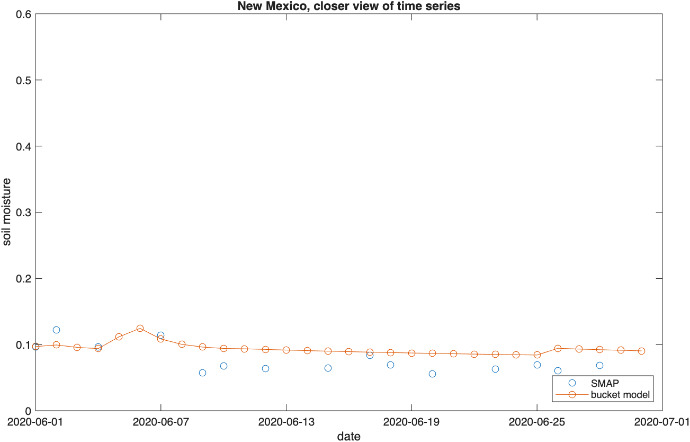
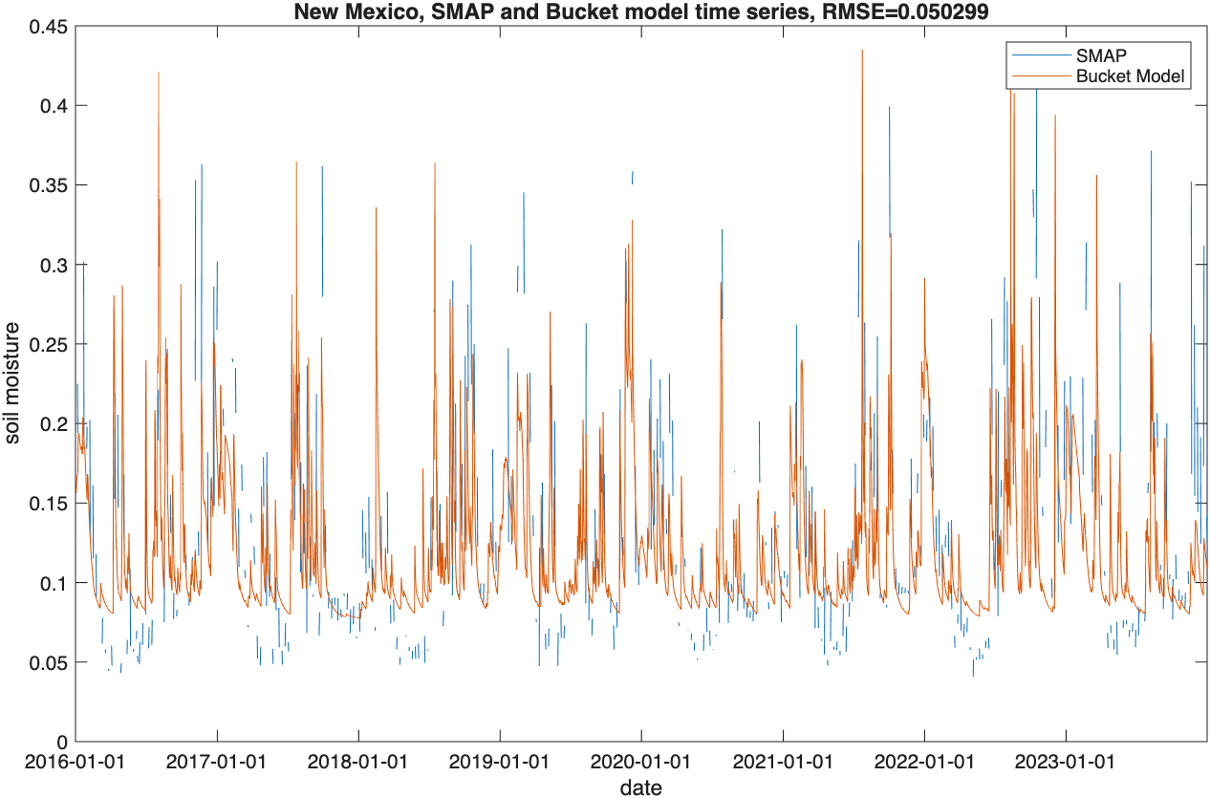
New Mexico time series at the best parameter set (soil_type=3 (sandy loam), ZR=0.1)

Slide 22
Generation of 2,000-year daily precipitation and PET
Data Curation
SMAP
Daily / half-hourly IMERG
Modified ERA5
CPC temperature
SMAP , daily / half-hourly IMERG, ERA5
Daily IMERG, CPC
Stochastic Weather Generator (WeaGETS)
Model Calibration
Parameter soil_type and ZR (rooting depth)
Bucket Model
2,000-year daily precipitation and PET
2,000-year daily soil moisture
Bias Correction
CDF-matching between 2,000-year data and SMAP
Derivation of joint, conditional and marginal PDFs

Slide 23
Synthetic climate data generation
CPC min/max daily temperature data: from 2001 through 2023
GPM IMERG daily precipitation data: from 2001 through 2023

Slide 24
Synthesis of 2,000-year daily soil moisture
Data Curation
SMAP
Daily / half-hourly IMERG
Modified ERA5
CPC temperature
SMAP , daily / half-hourly IMERG, ERA5
Daily IMERG, CPC
Stochastic Weather Generator (WeaGETS)
Model Calibration
Parameter soil_type and ZR (rooting depth)
Bucket Model
2,000-year daily precipitation and PET
2,000-year daily soil moisture
Bias Correction
CDF-matching between 2,000-year data and SMAP
Derivation of joint, conditional and marginal PDFs

Slide 25
Bias correction using CDF-matching
Data Curation
SMAP
Daily / half-hourly IMERG
Modified ERA5
CPC temperature
SMAP , daily / half-hourly IMERG, ERA5
Daily IMERG, CPC
Stochastic Weather Generator (WeaGETS)
Model Calibration
Parameter soil_type and ZR (rooting depth)
Bucket Model
2,000-year daily precipitation and PET
2,000-year daily soil moisture
Bias Correction
CDF-matching between 2,000-year data and SMAP
Derivation of joint, conditional and marginal PDFs

Slide 26
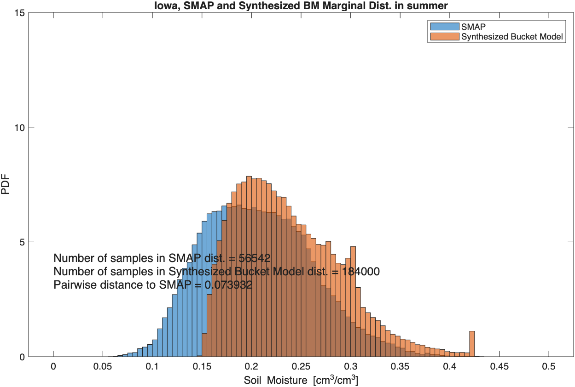
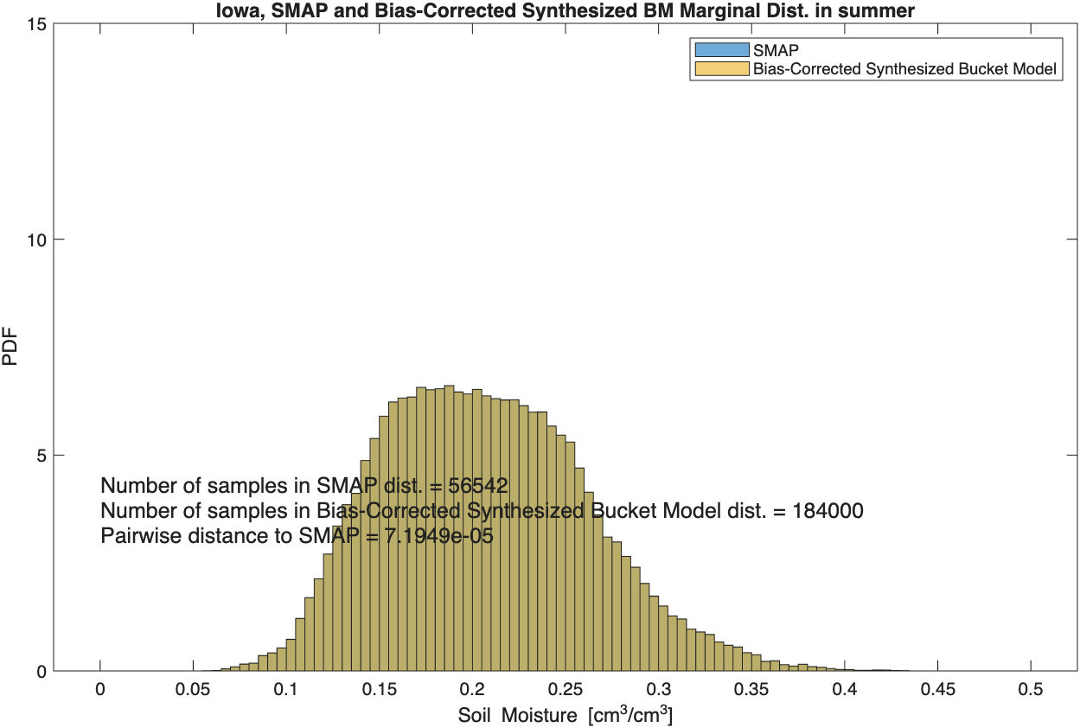
Iowa, bias-corrected marginal dist. in summer
Before CDF-matching
After CDF-matching
Bias-corrected marginal dist. almost perfectly matched SMAP marginal dist., due to the large sample size of synthesized data

Slide 27
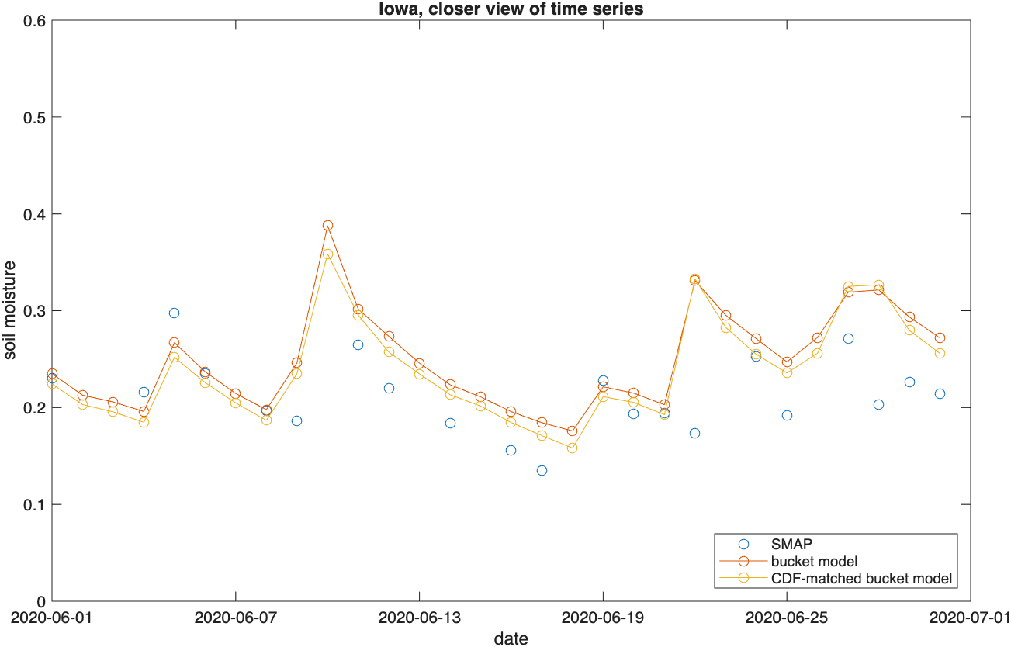
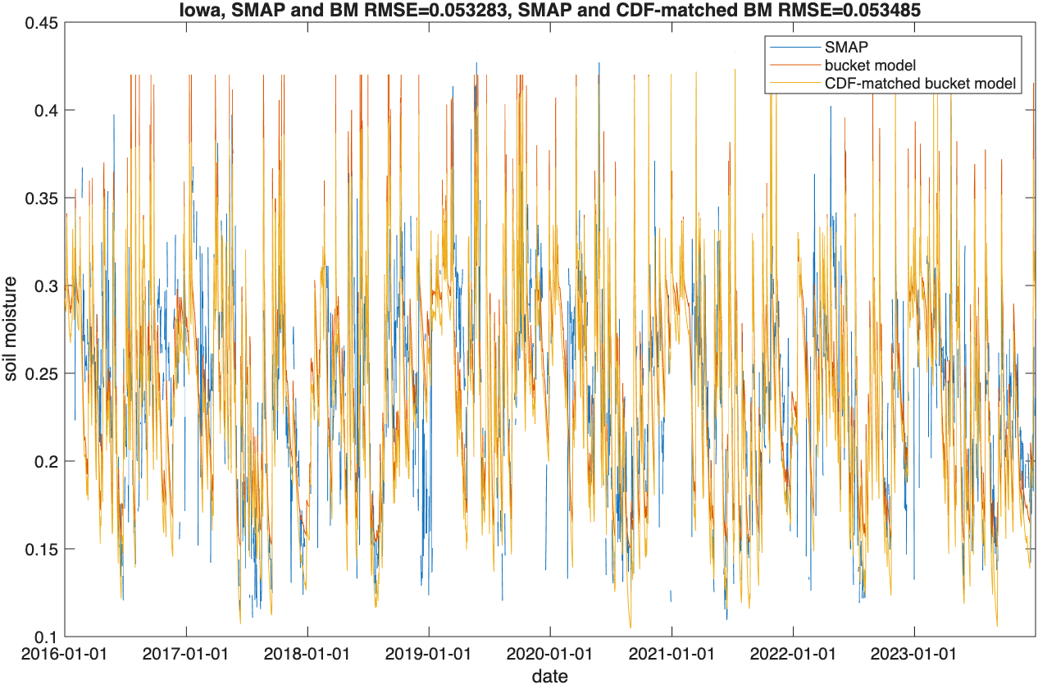
Iowa, bias-corrected time series at the best parameter set (soil_type=6 (sandy clay loam), ZR=0.2)

Slide 28
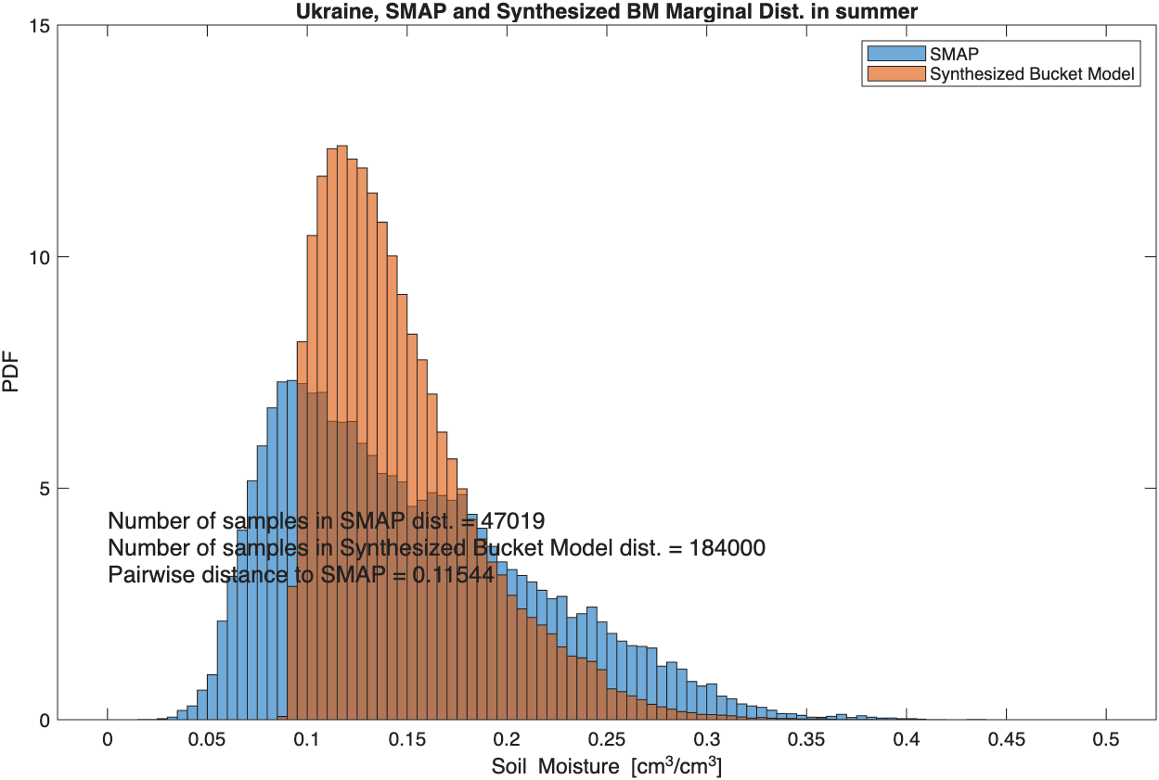
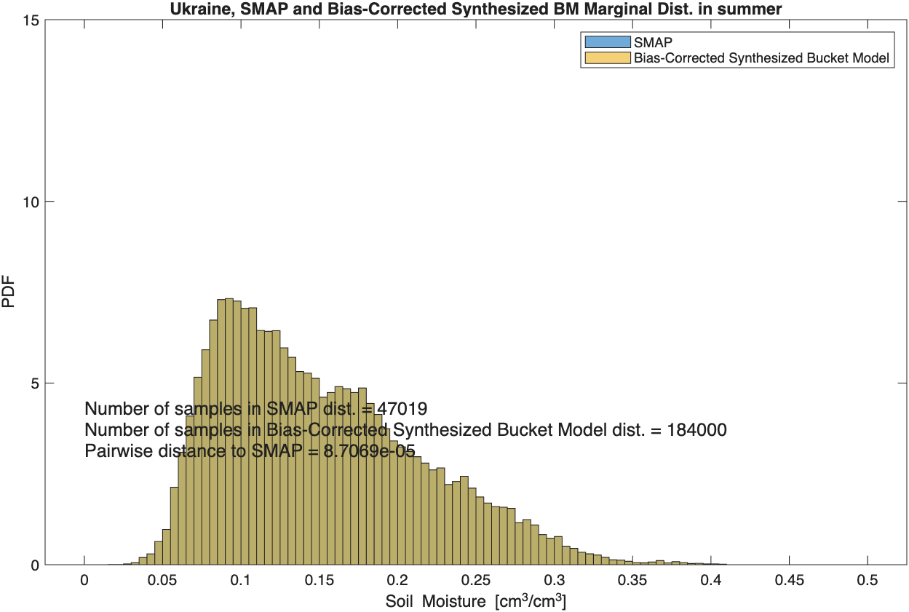
Ukraine, bias-corrected marginal dist. in summer
Before CDF-matching
After CDF-matching
Bias-corrected marginal dist. almost perfectly matched SMAP marginal dist., due to the large sample size of synthesized data

Slide 29
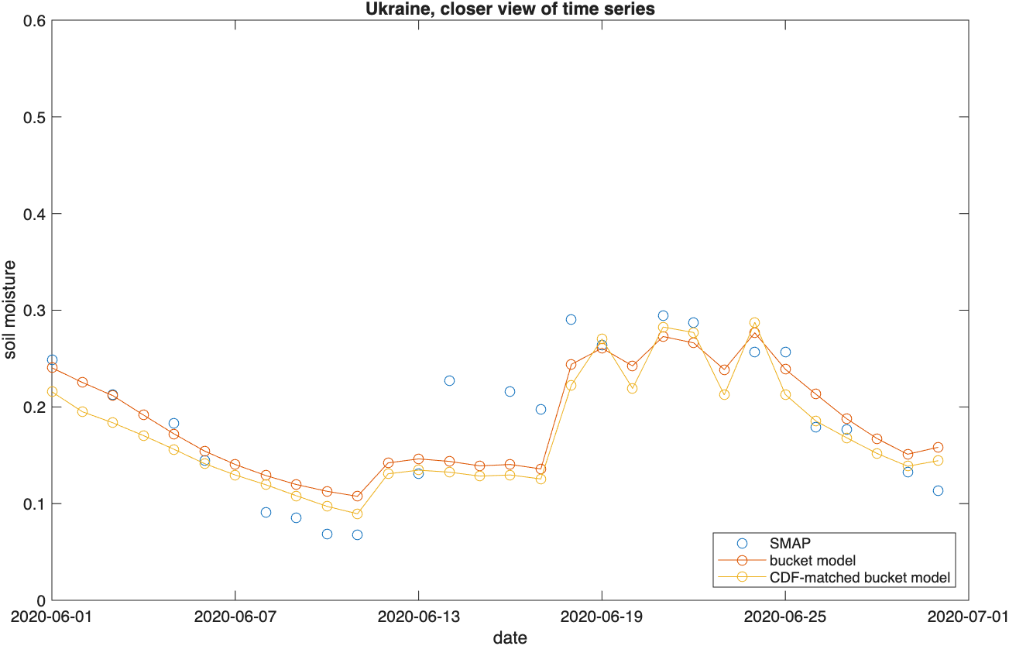
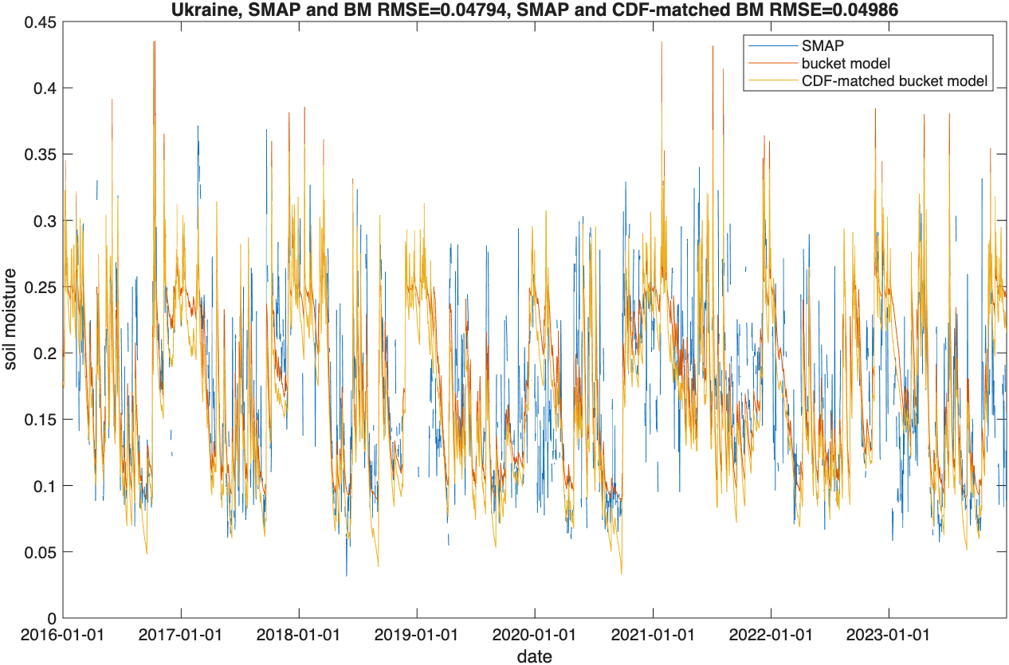
Ukraine, bias-corrected time series at the best parameter set (soil_type=3 (sandy loam), ZR=0.2)

Slide 30
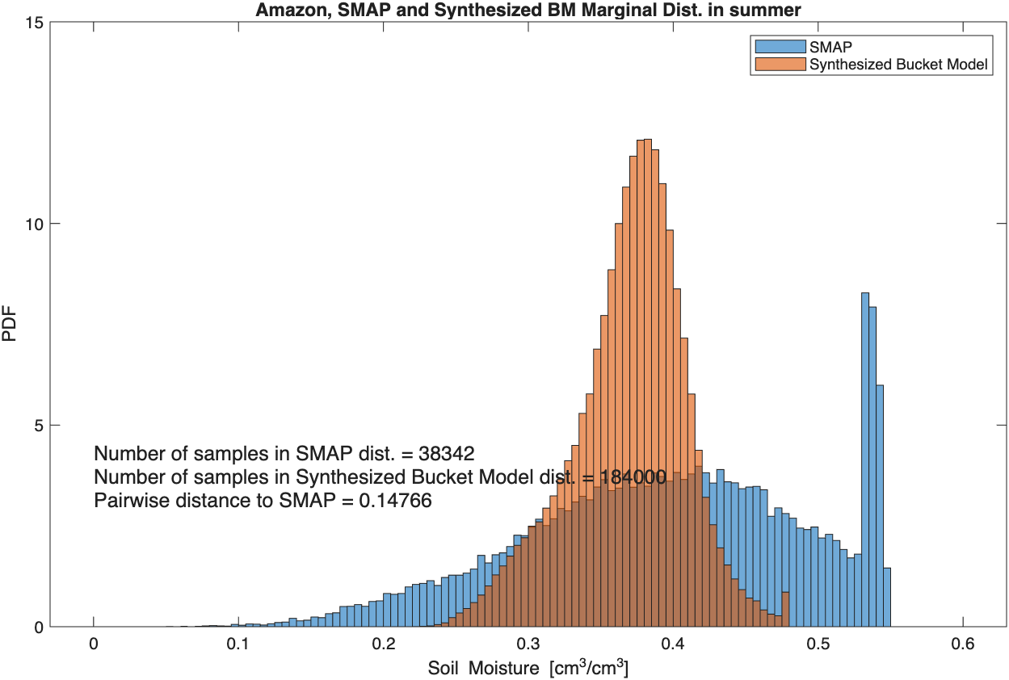
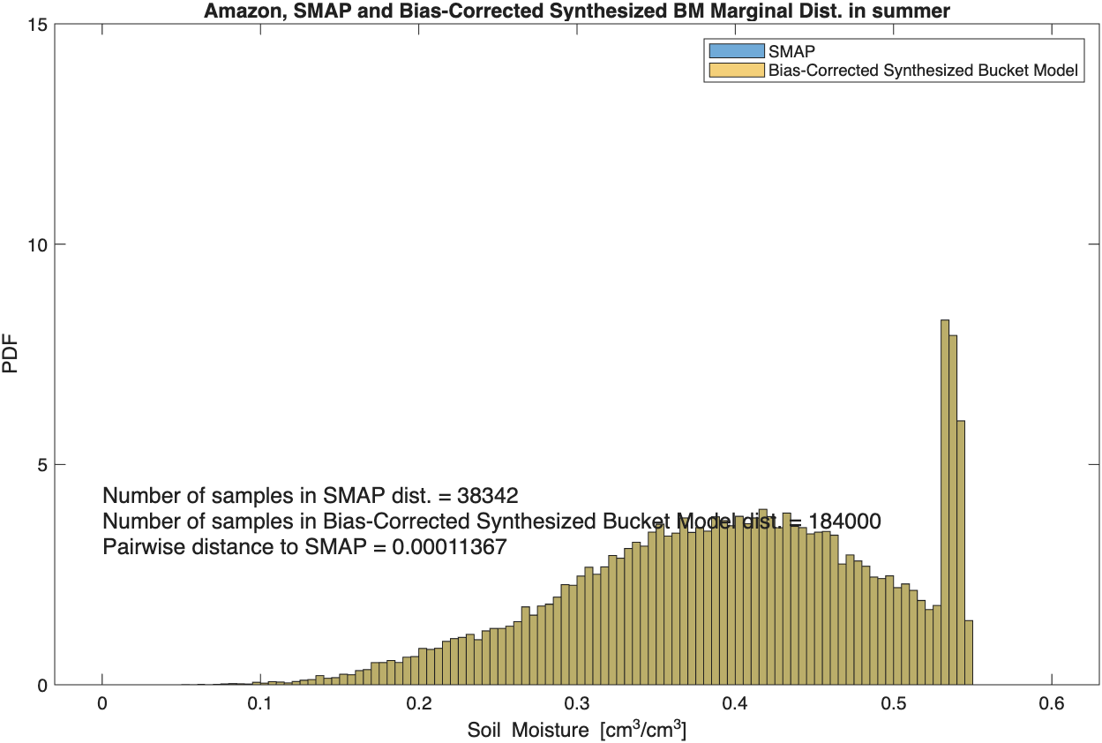
Amazon, bias-corrected marginal dist. in summer
Before CDF-matching
After CDF-matching
Bias-corrected marginal dist. almost perfectly matched SMAP marginal dist., due to the large sample size of synthesized data

Slide 31
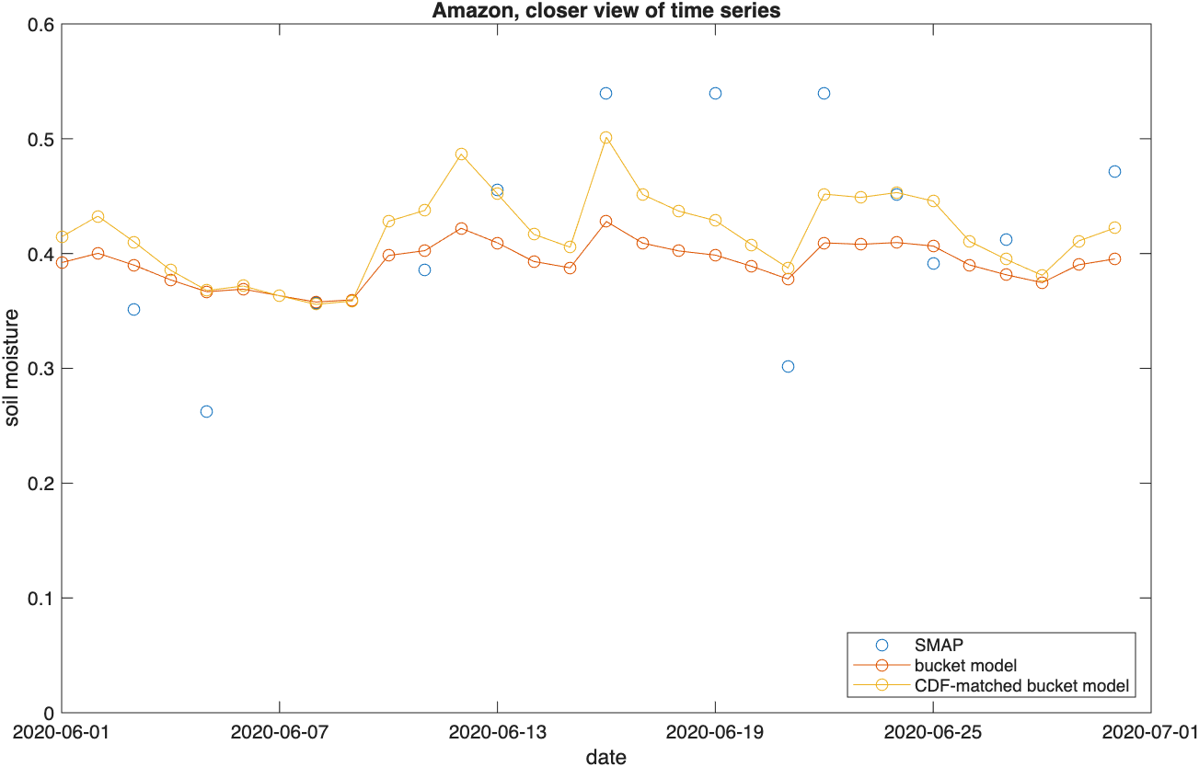
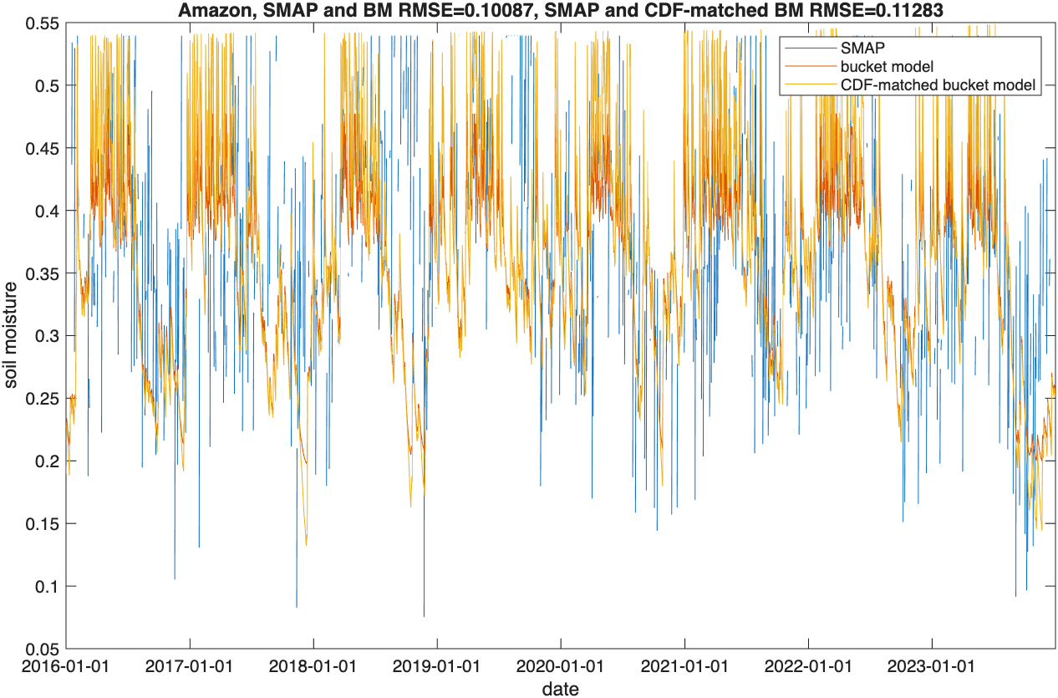
Amazon, bias-corrected time series at the best parameter set (soil_type=7 (silty clay loam), ZR=0.5)

Slide 32
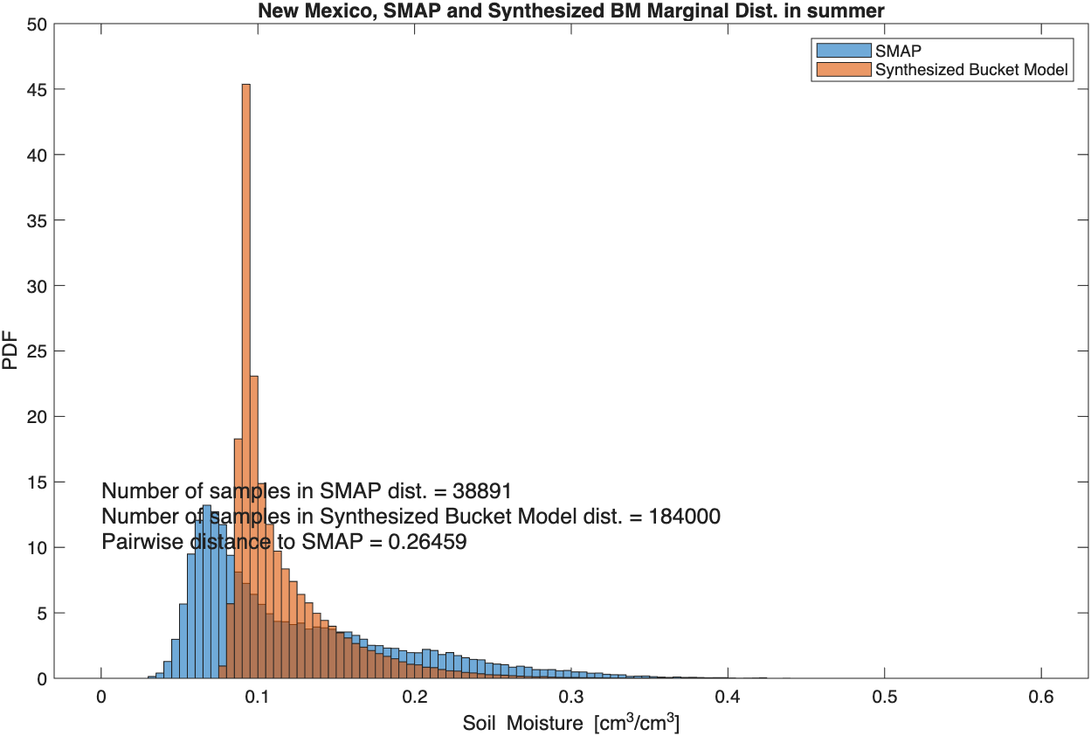
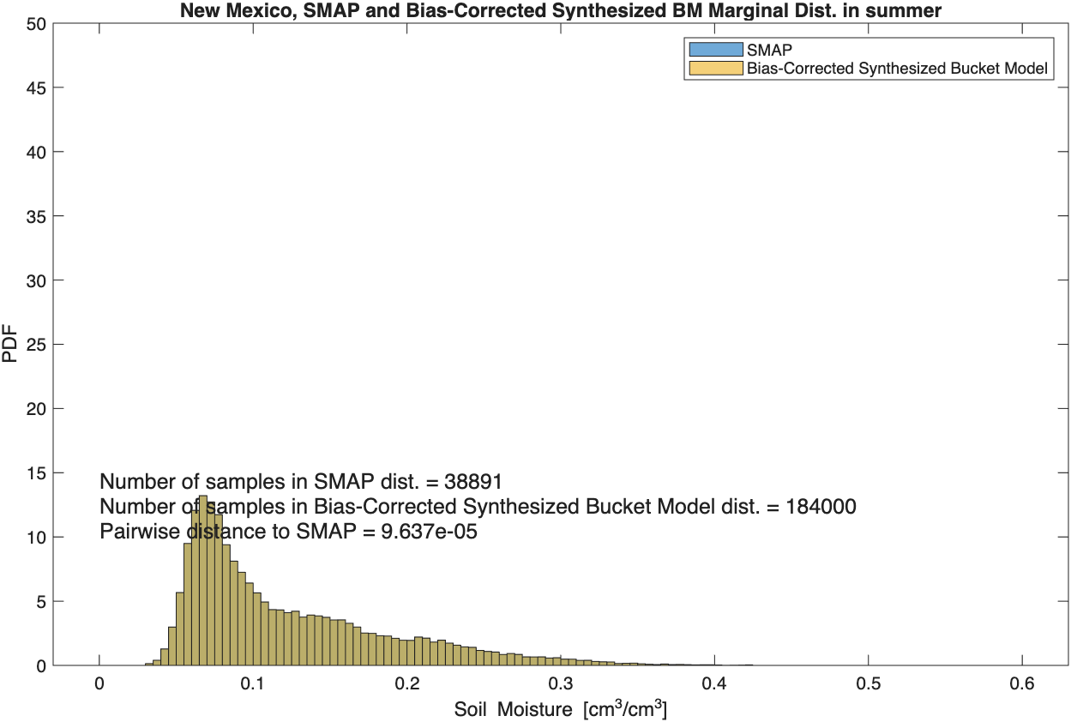
New Mexico, bias-corrected marginal dist. in summer
Before CDF-matching
After CDF-matching
Bias-corrected marginal dist. almost perfectly matched SMAP marginal dist., due to the large sample size of synthesized data

Slide 33
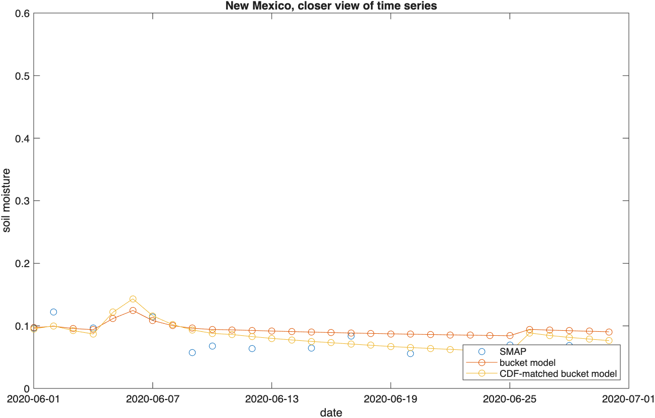
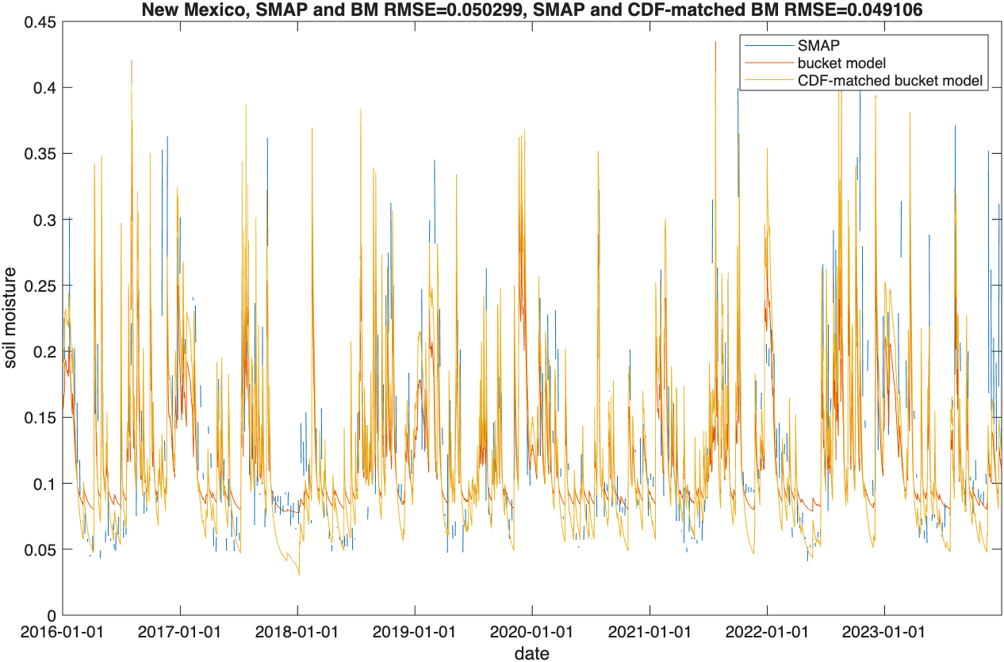
New Mexico, bias-corrected time series at the best parameter set (soil_type=3 (sandy loam), ZR=0.1)

Slide 34
Derivation of joint, conditional, and marginal PDFs
Data Curation
SMAP
Daily / half-hourly IMERG
Modified ERA5
CPC temperature
SMAP , daily / half-hourly IMERG, ERA5
Daily IMERG, CPC
Stochastic Weather Generator (WeaGETS)
Model Calibration
Parameter soil_type and ZR (rooting depth)
Bucket Model
2,000-year daily precipitation and PET
2,000-year daily soil moisture
Bias Correction
CDF-matching between 2,000-year data and SMAP
Derivation of joint, conditional and marginal PDFs

Slide 35
Monthly and seasonal precipitation and PET at the Iowa site
Monthly and seasonal precipitation
Monthly and seasonal PET

Slide 36
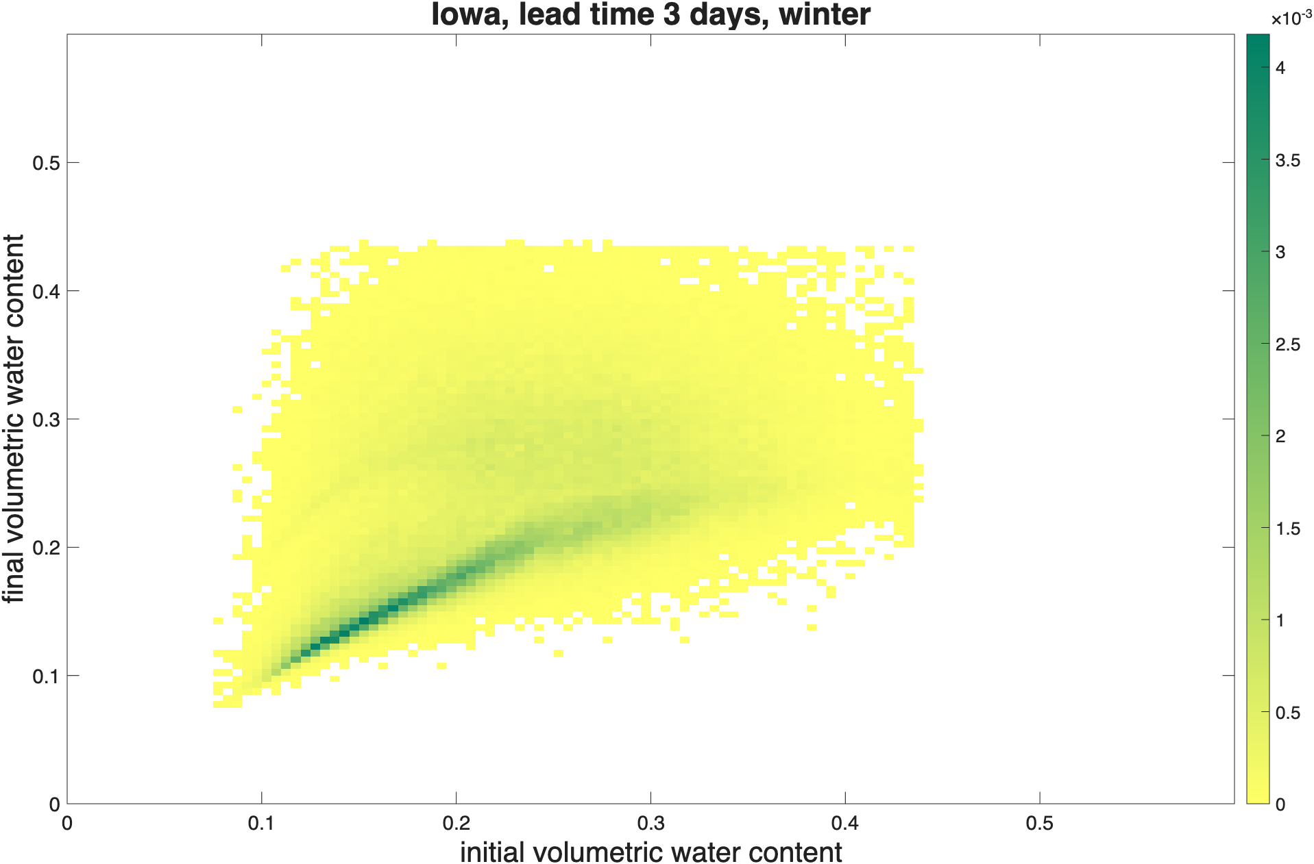
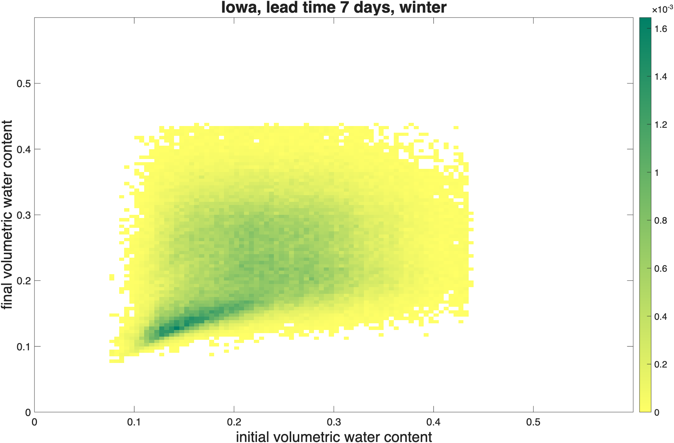
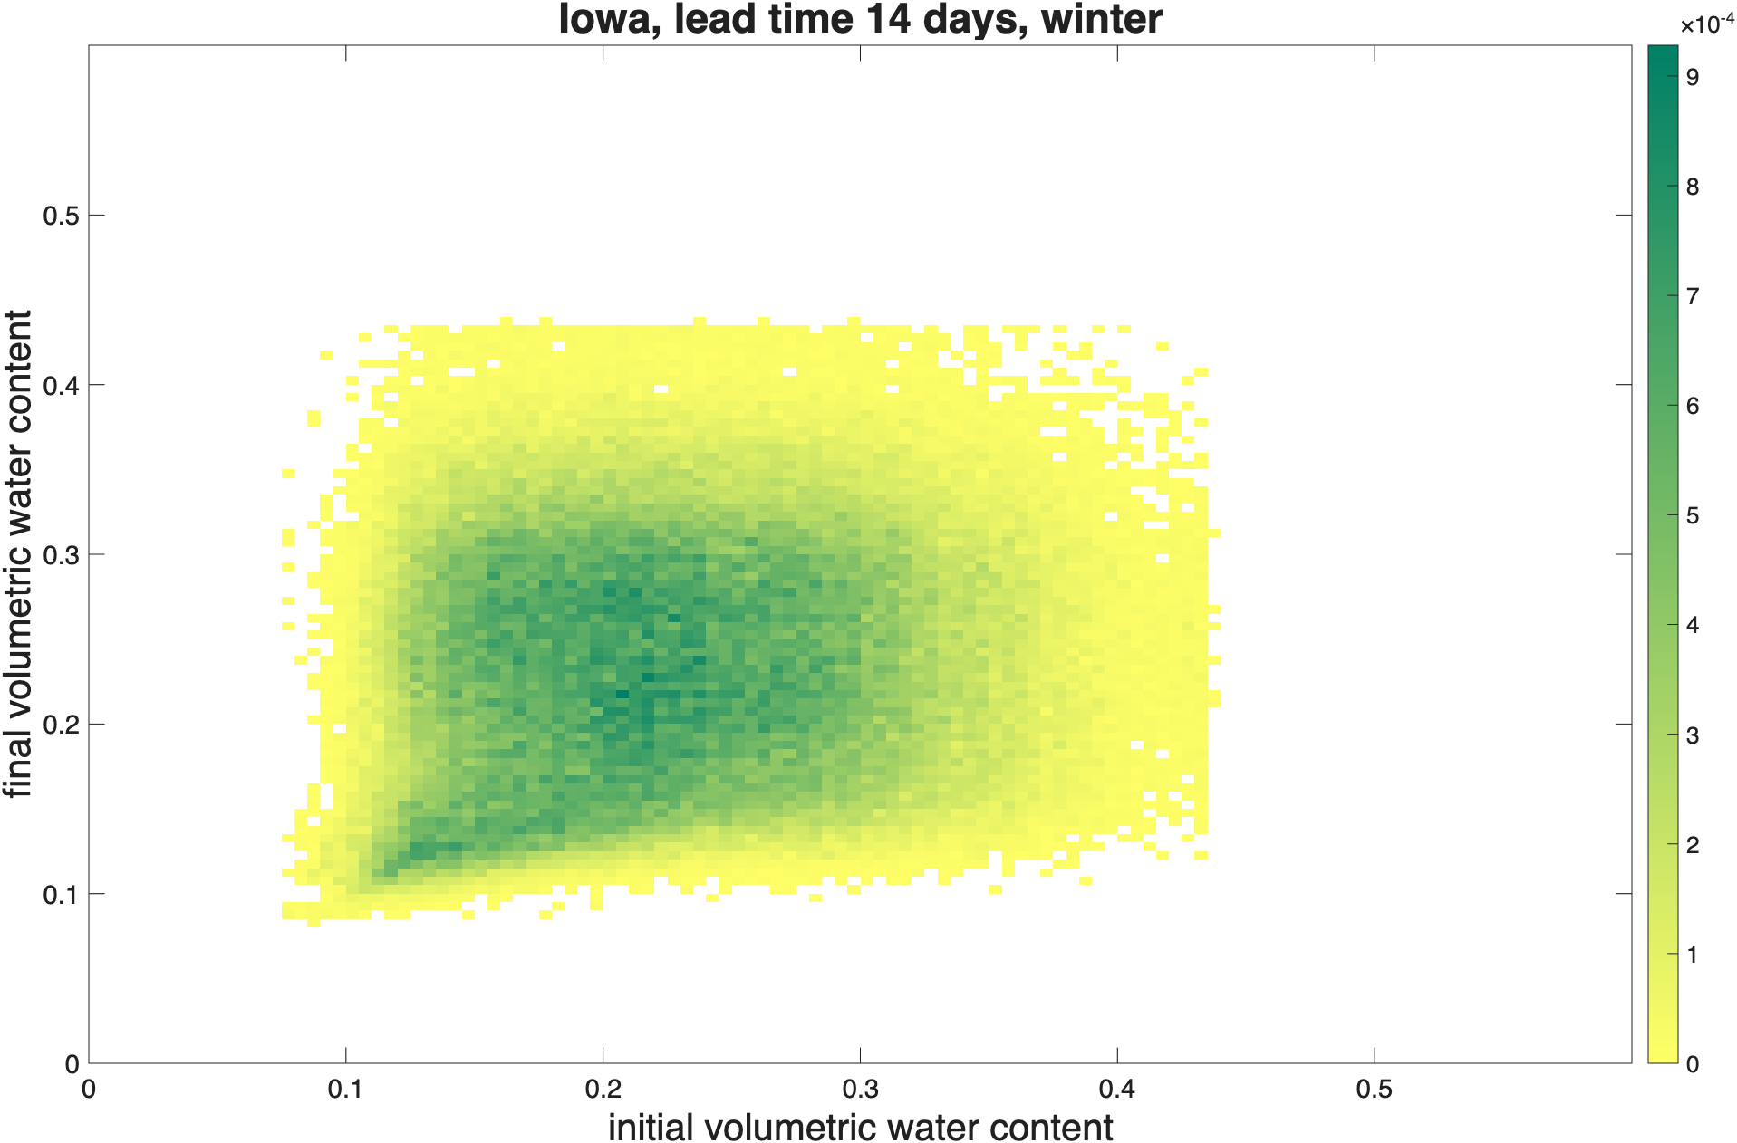
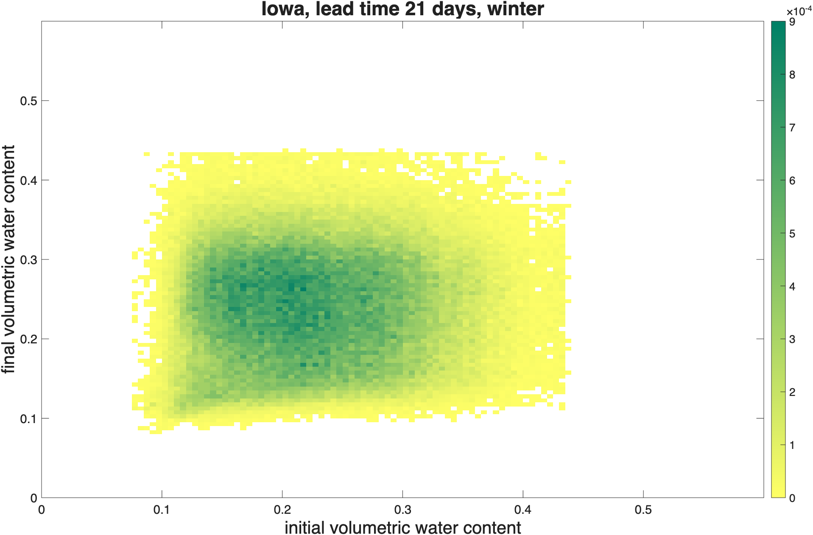
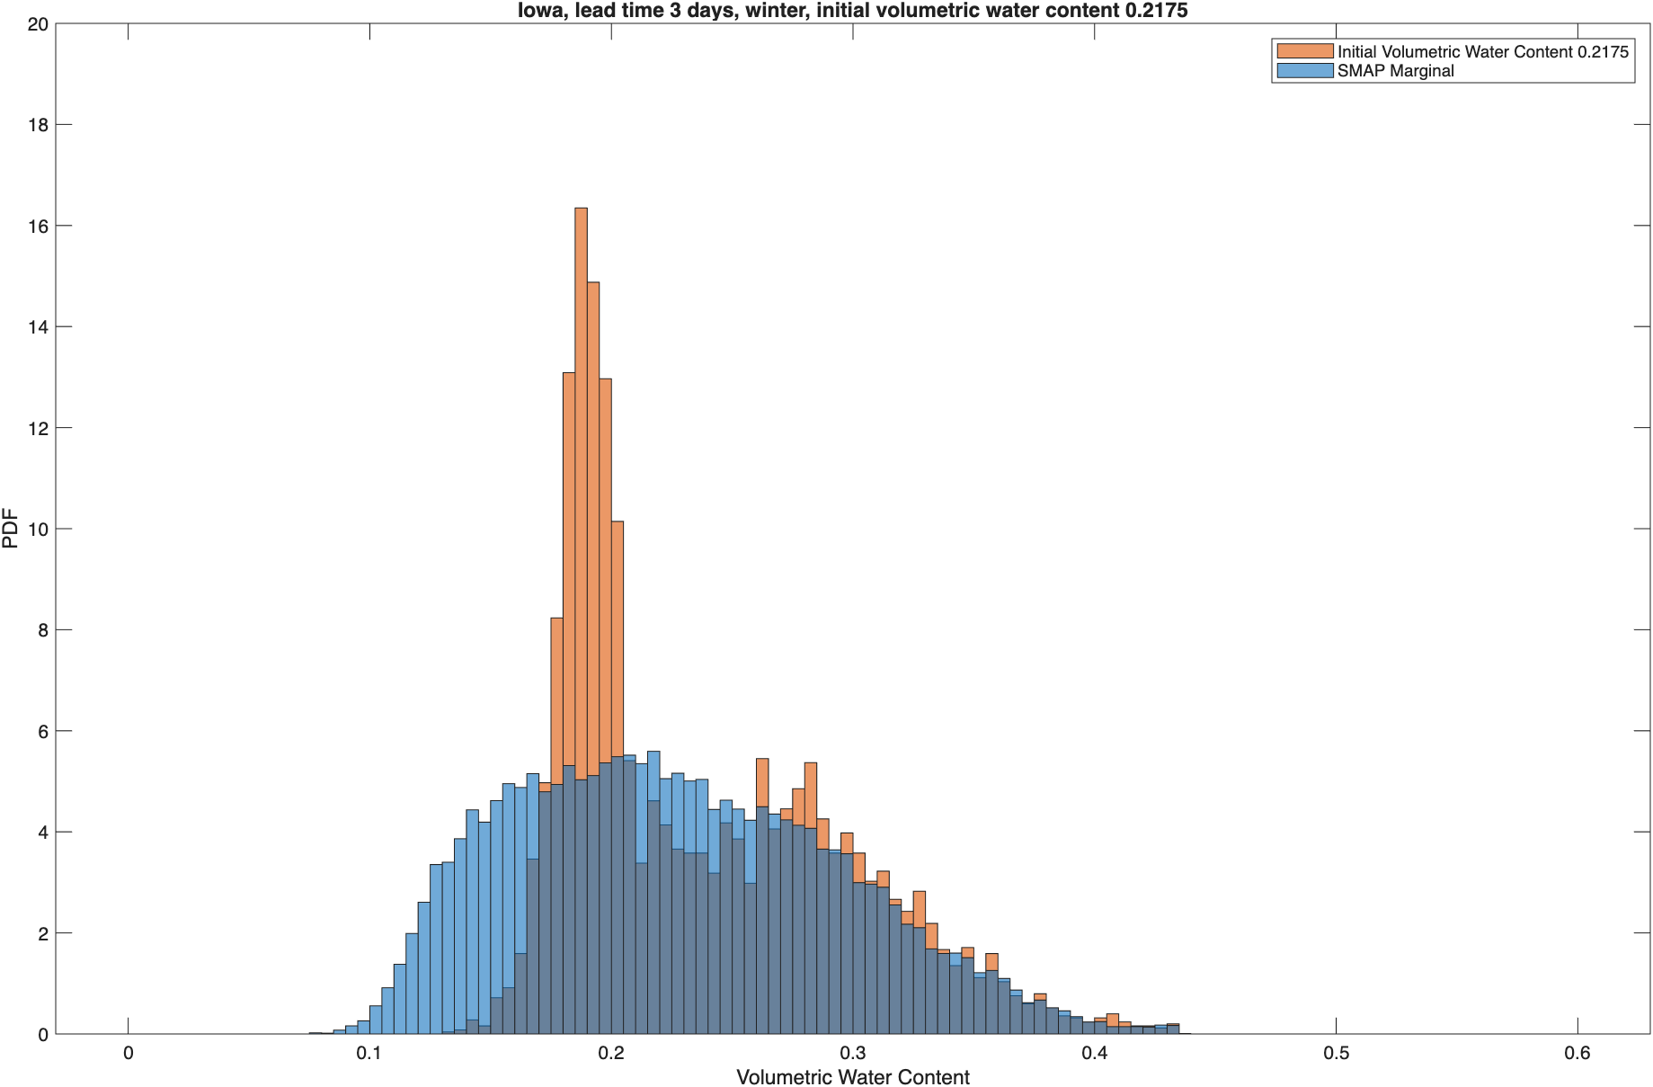
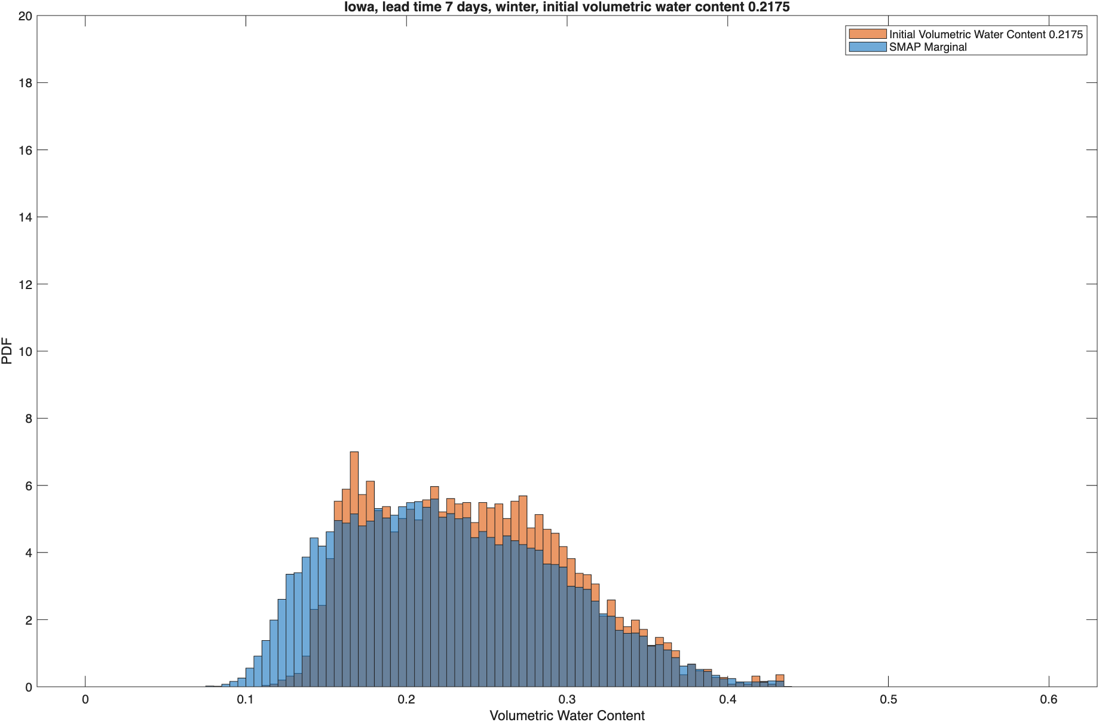

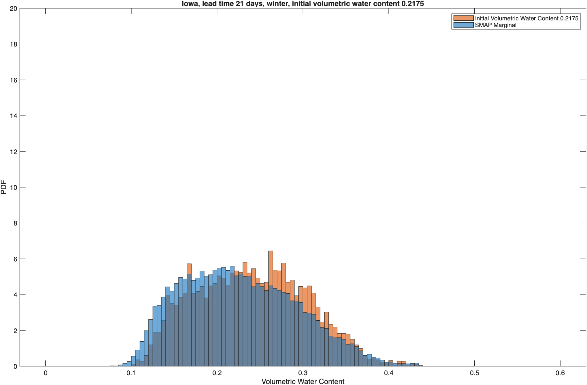
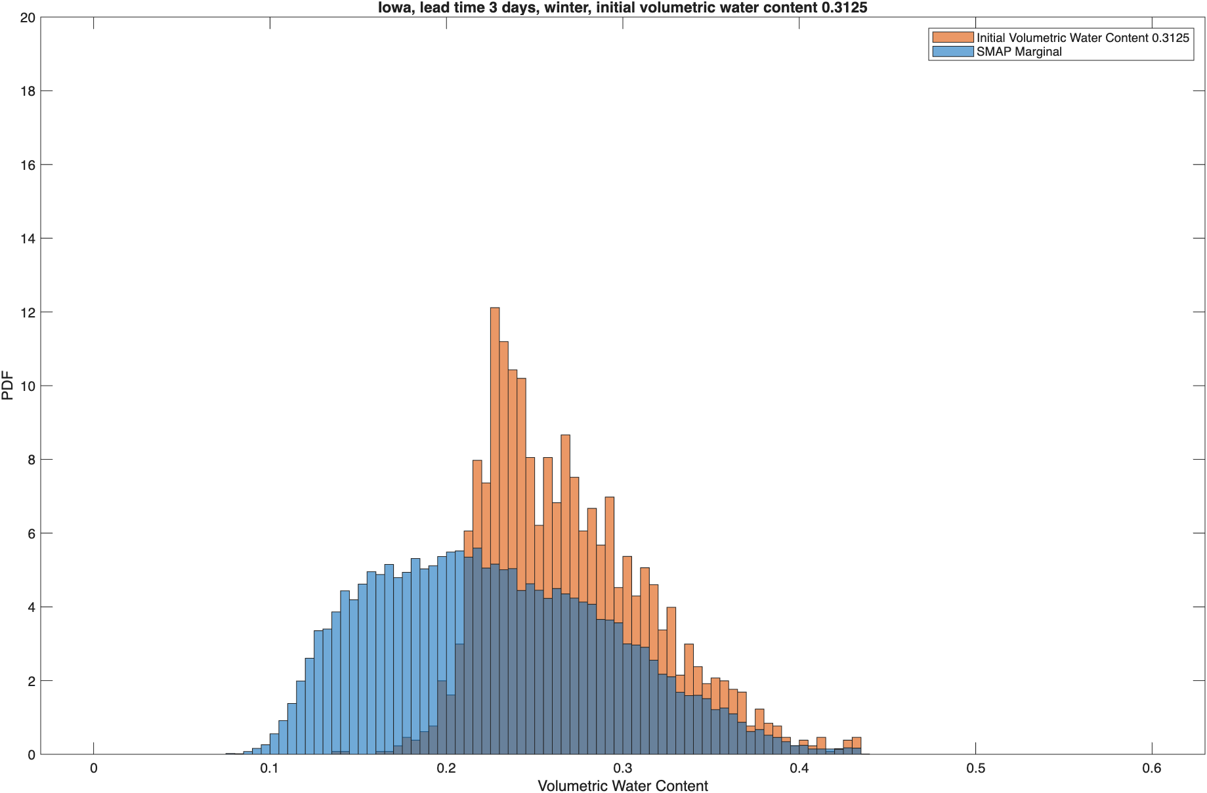
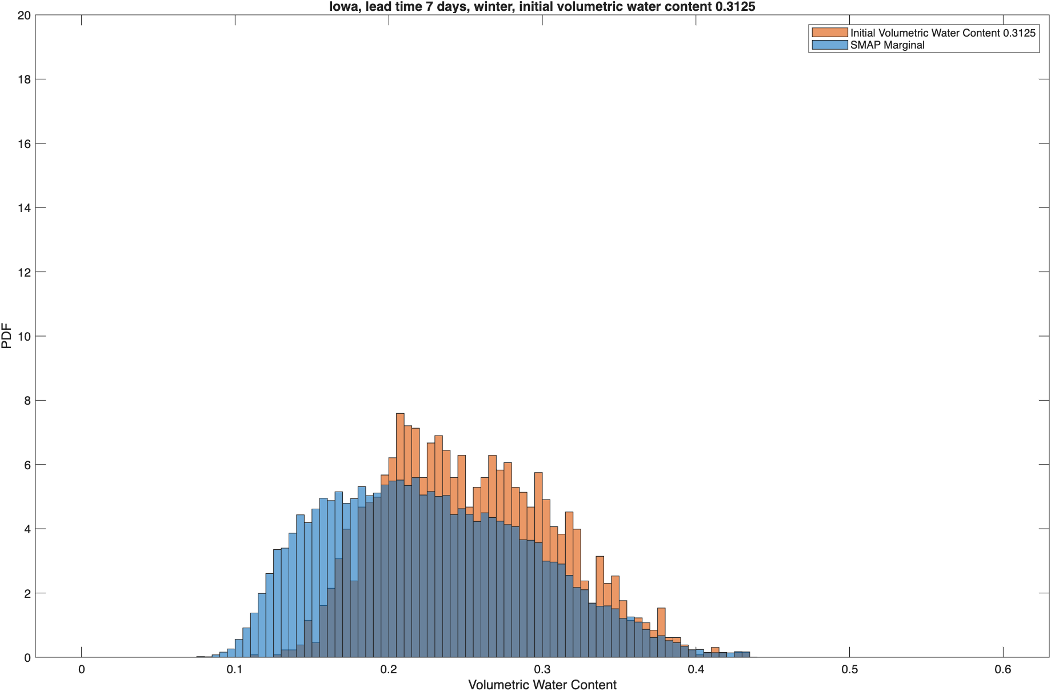
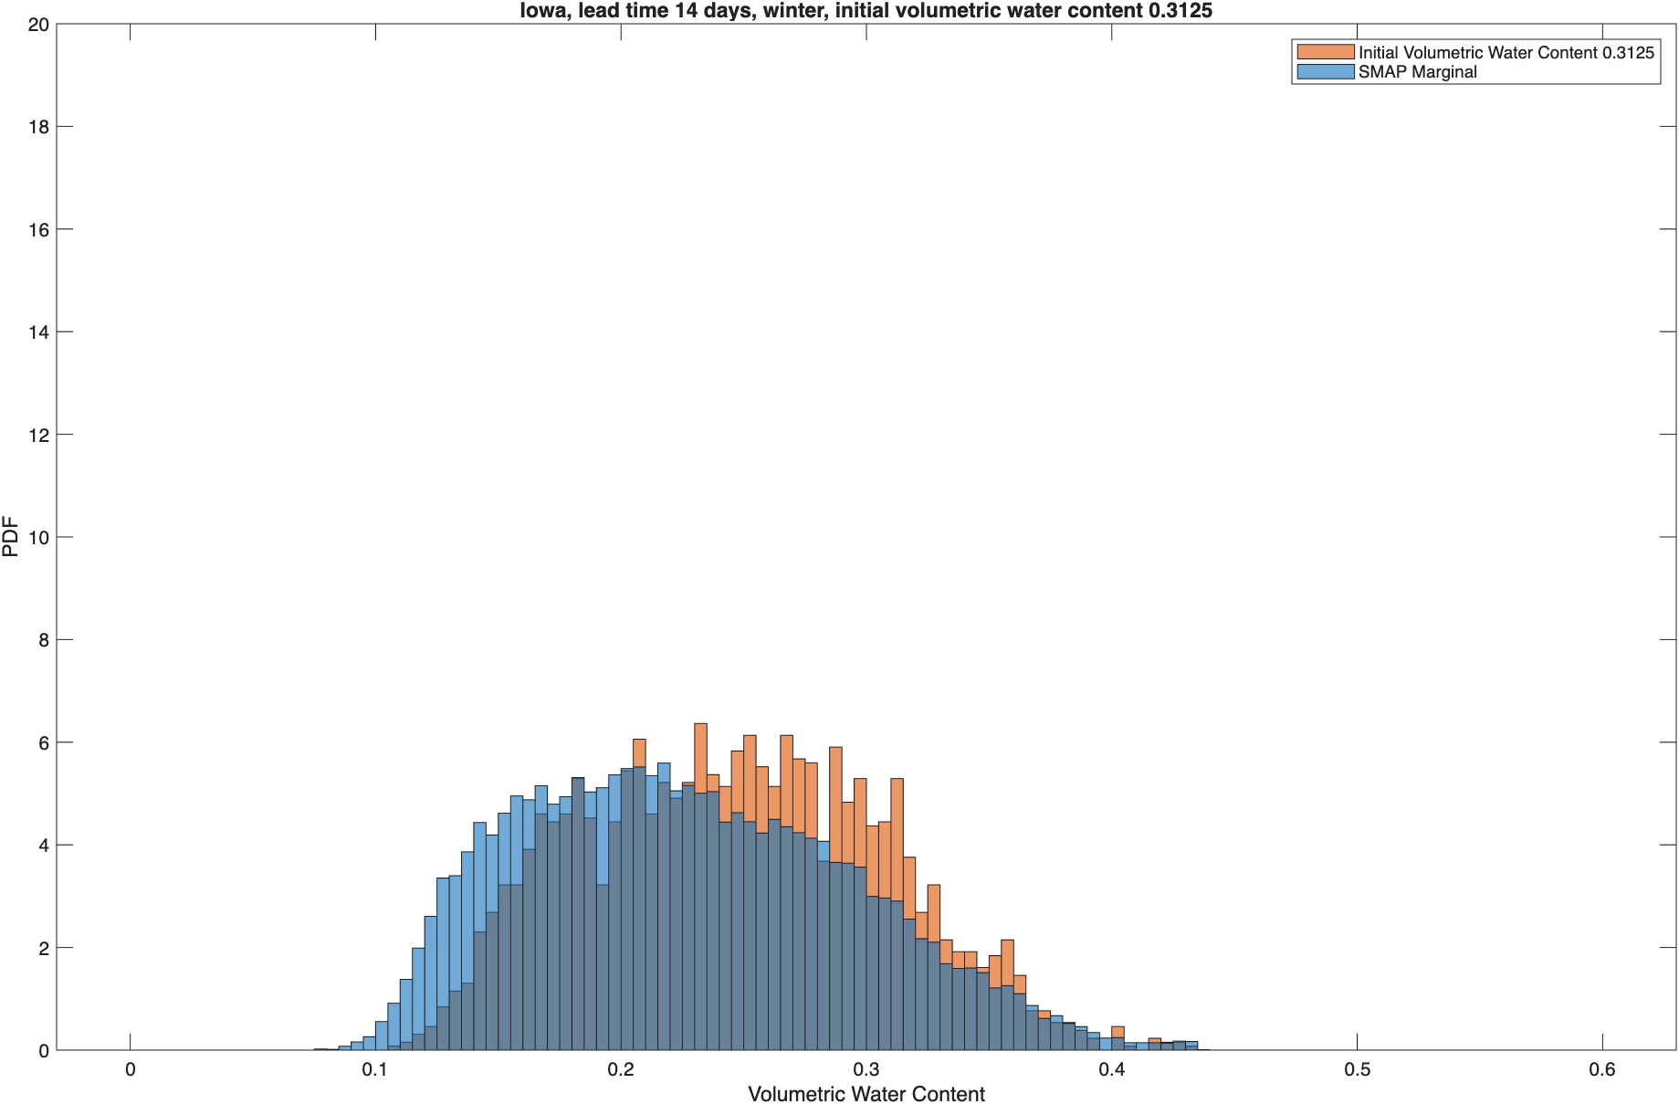

Iowa Soil Moisture Probability Distributions: Winter
3-day Lead
7-day Lead
14-day Lead
21-day Lead
Winter
Initial VWC 0.22
Initial VWC 0.31
Notes:
Due to frozen ground, it is hard to model soil moisture dynamics in winter.

Slide 37
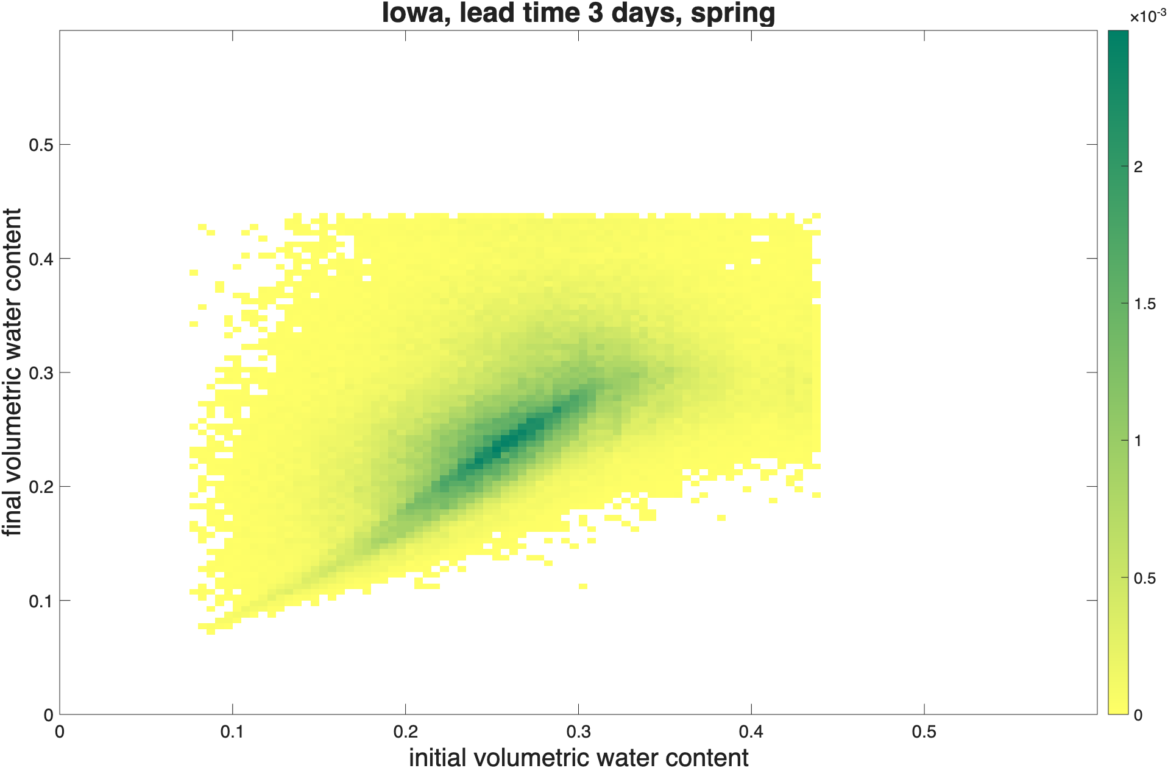
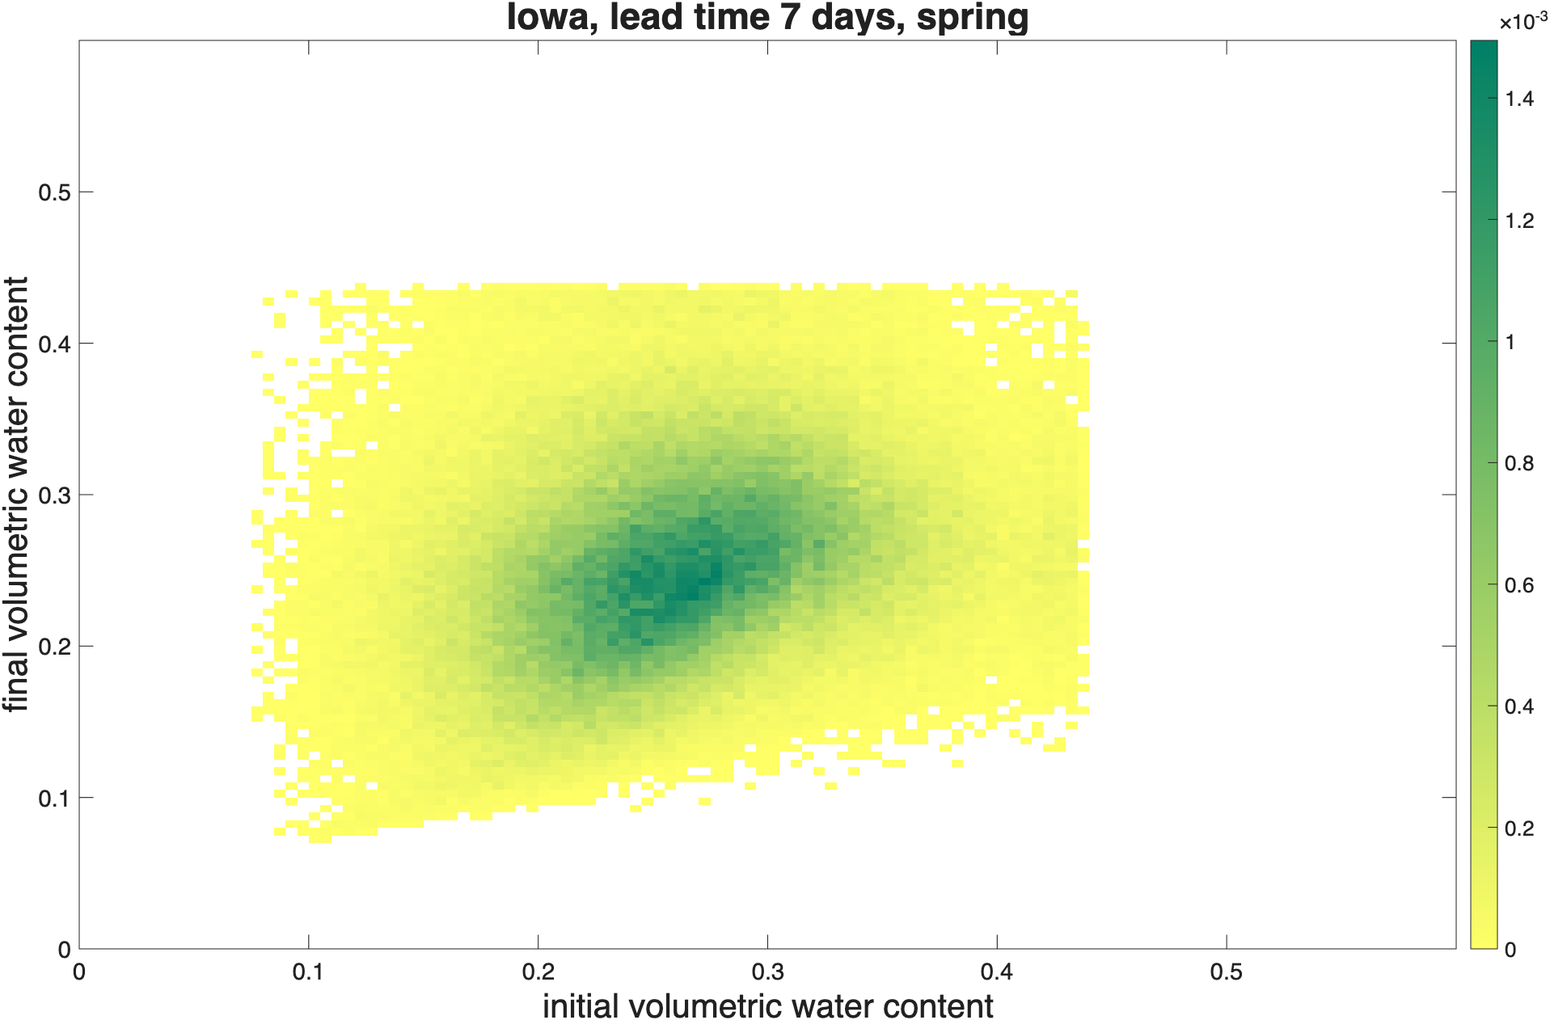
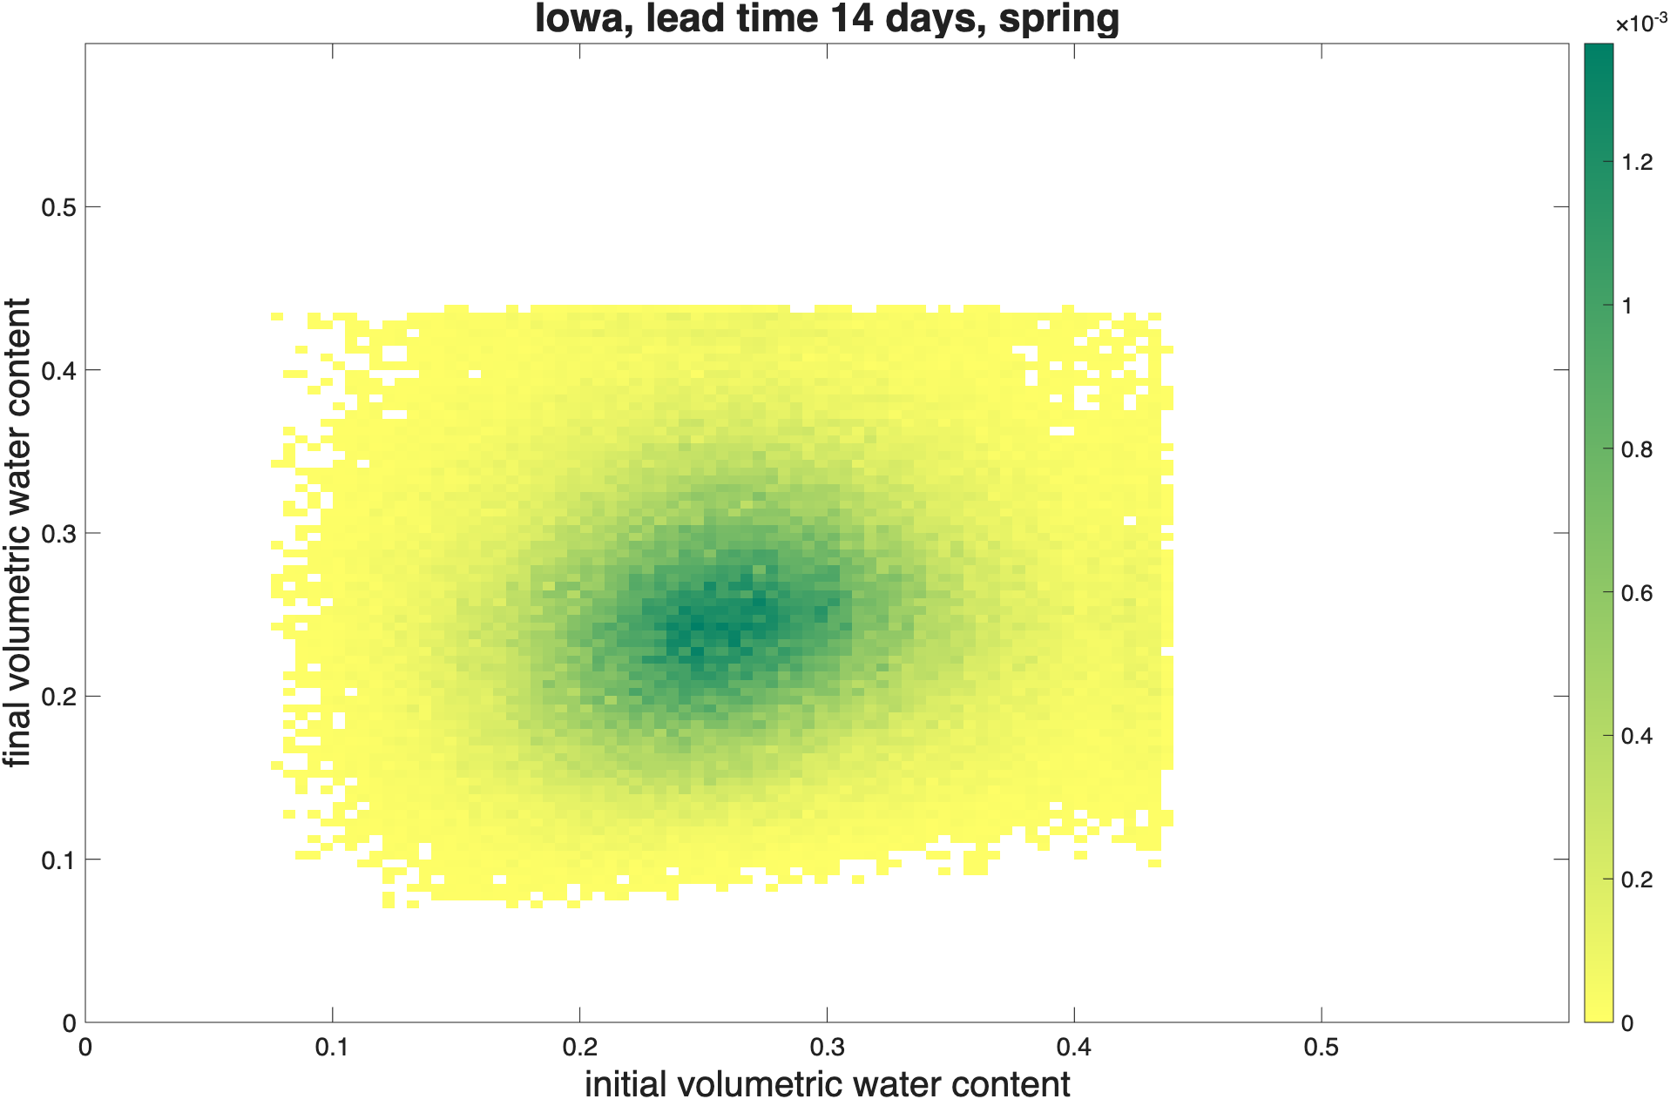
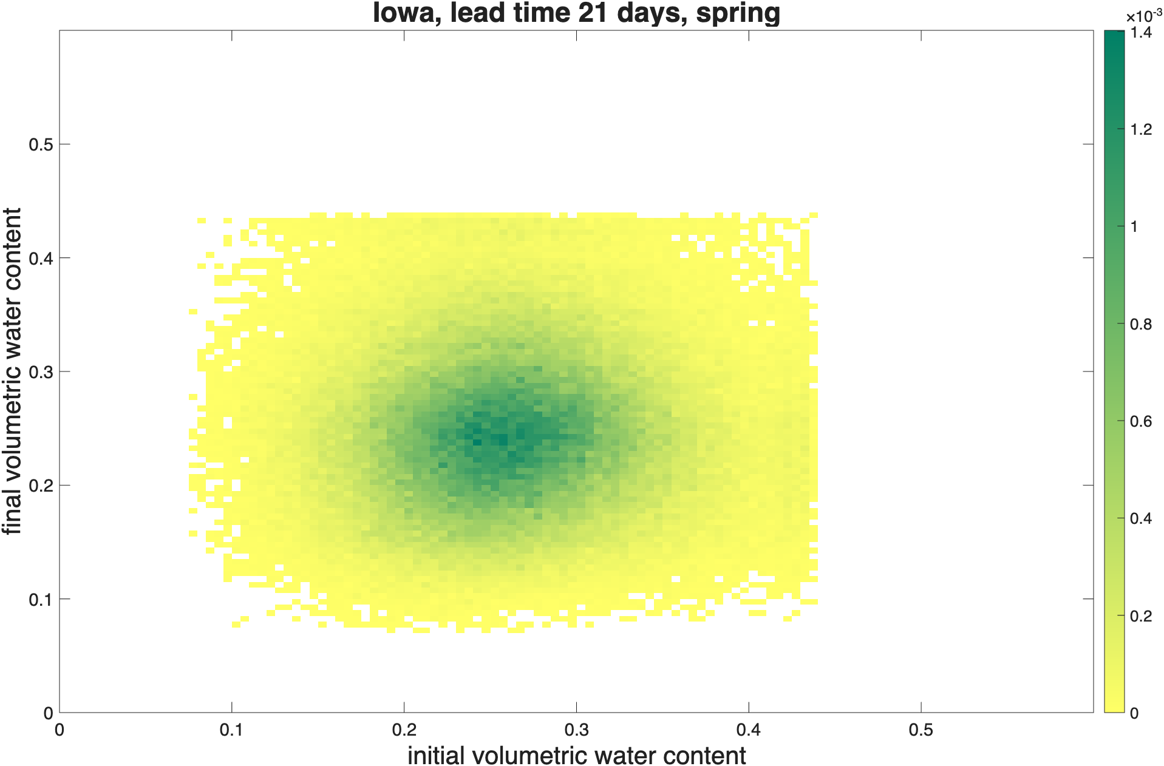
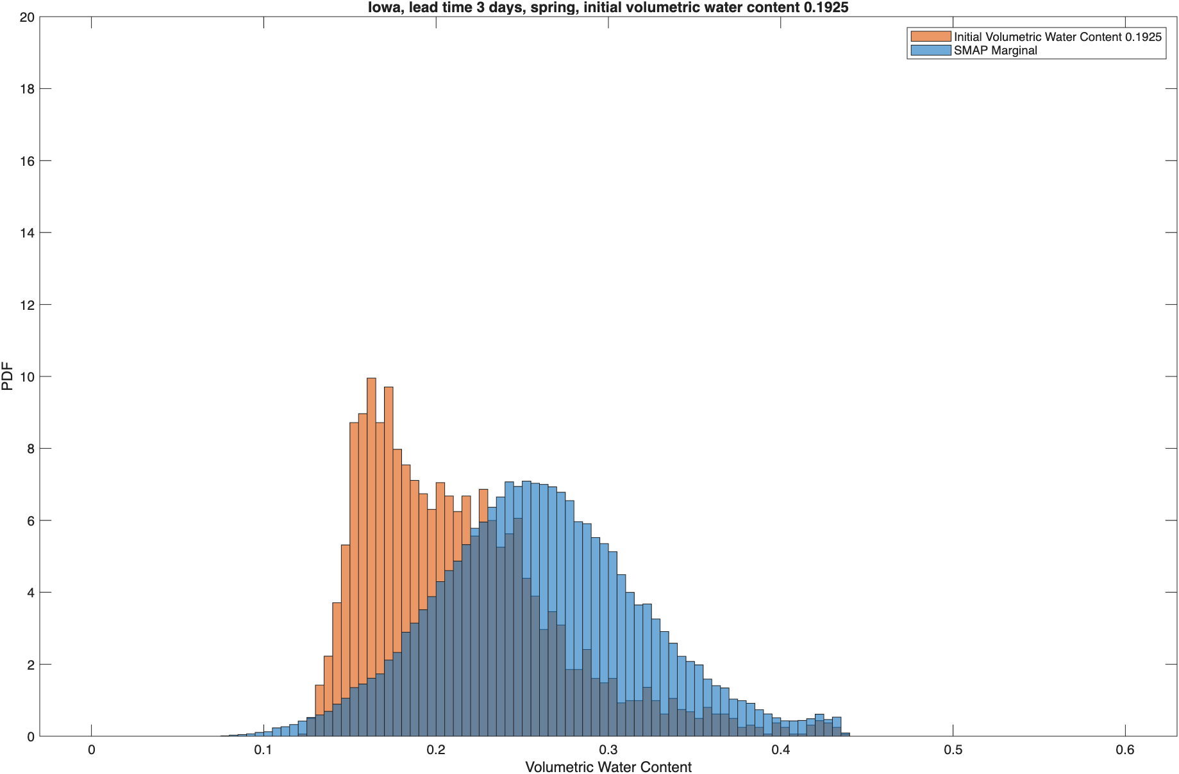
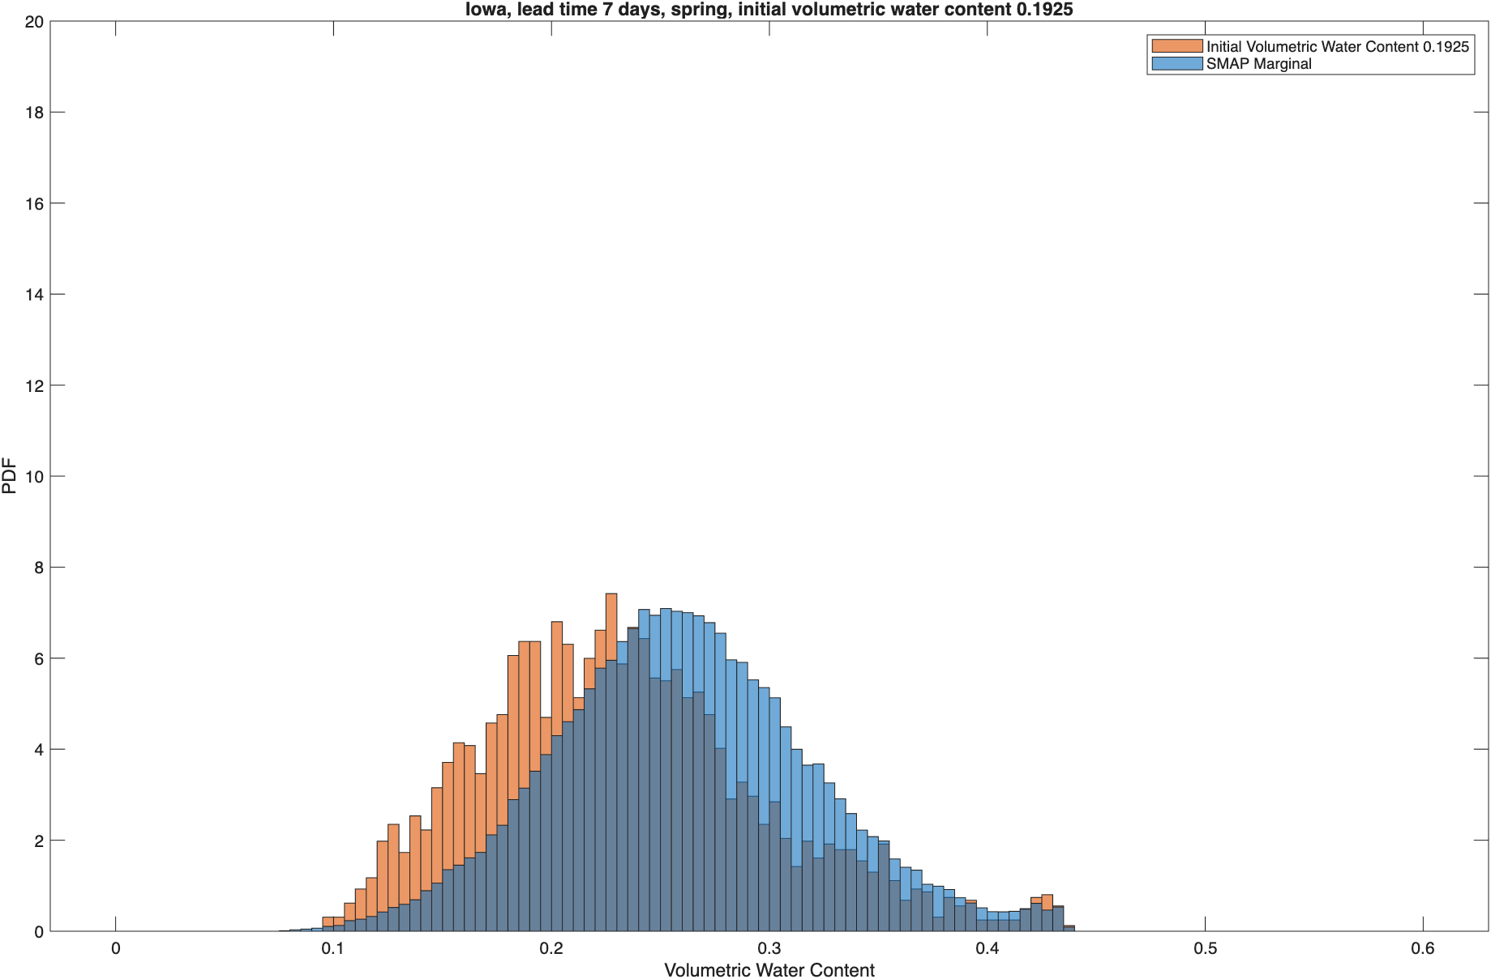
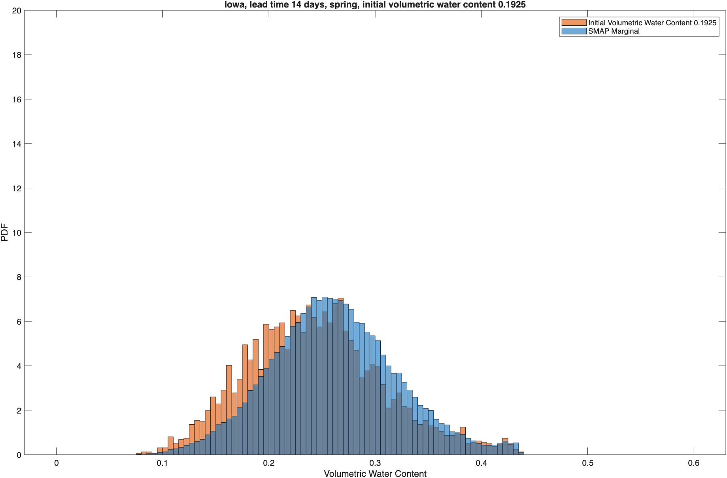
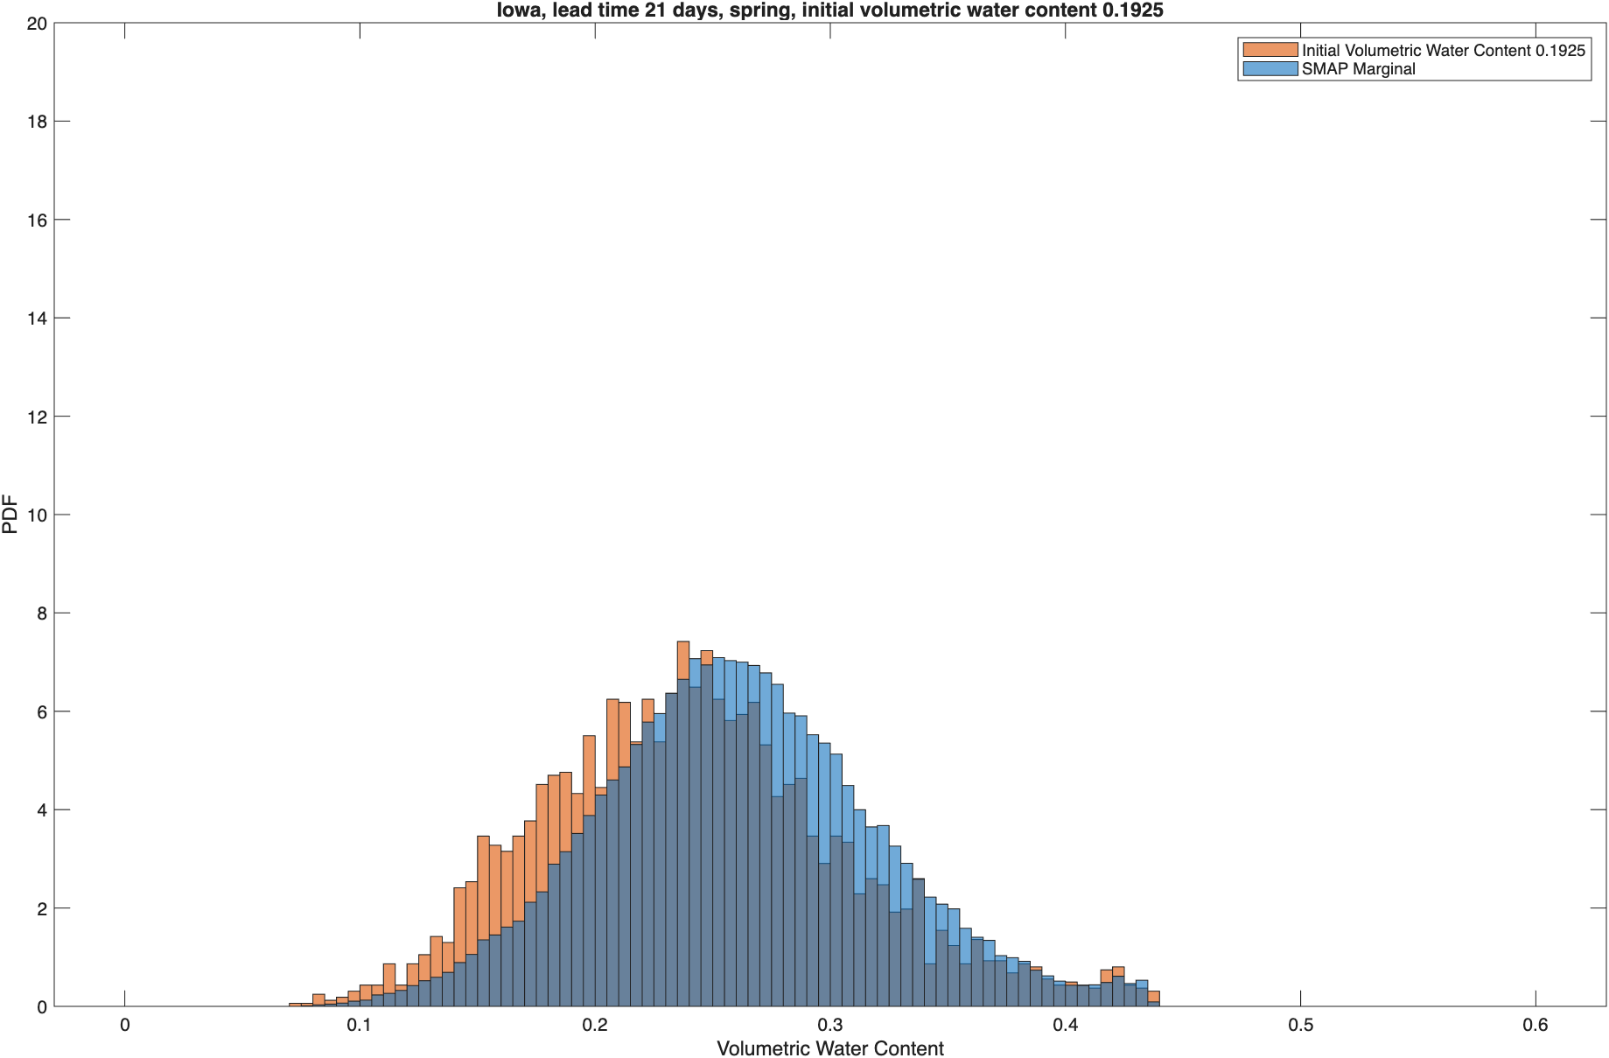
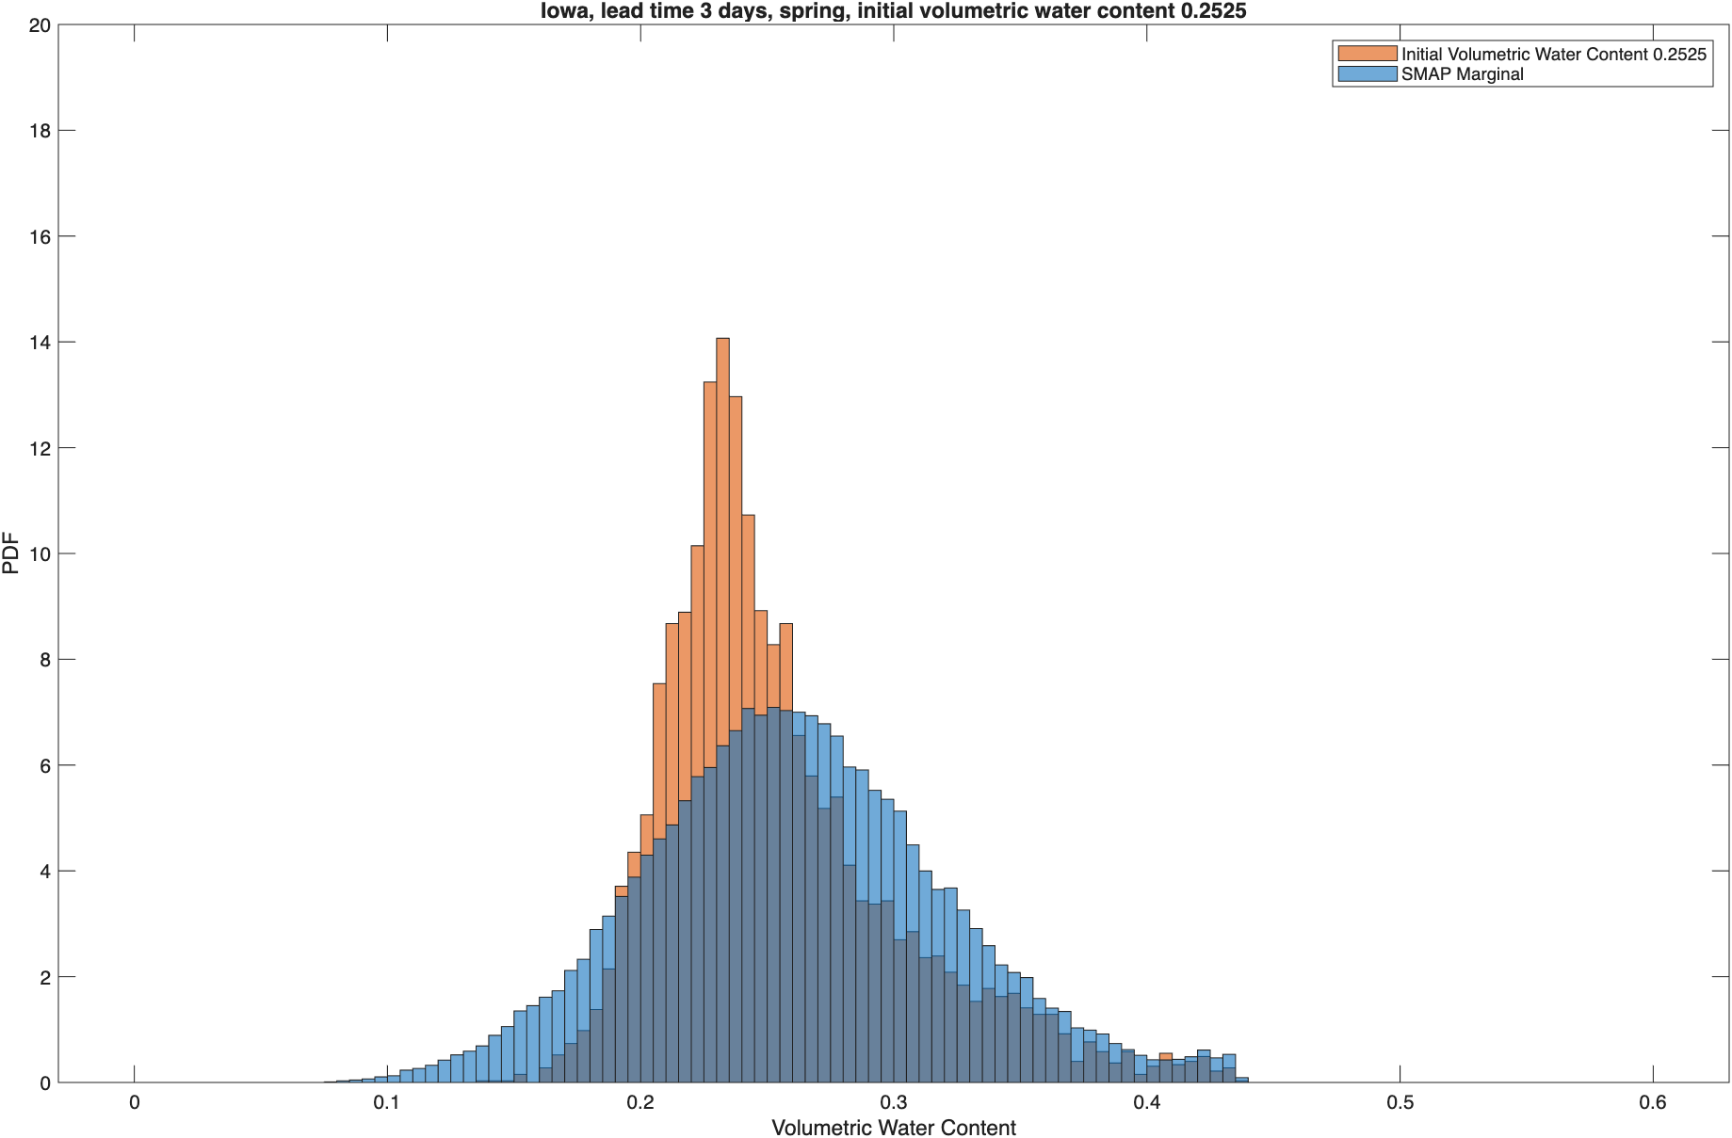
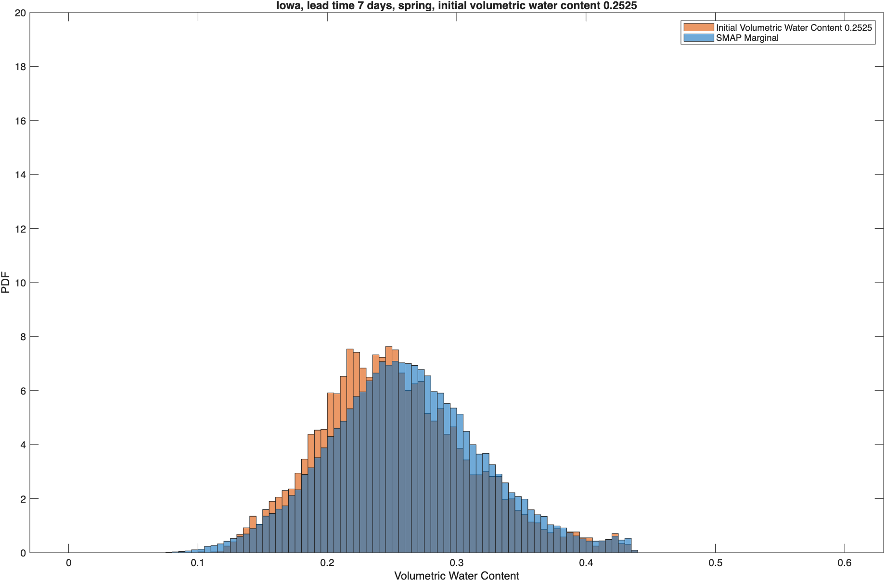


Iowa Soil Moisture Probability Distributions: Spring
3-day Lead
7-day Lead
14-day Lead
21-day Lead
Spring
Initial VWC 0.19
Initial VWC 0.25

Slide 38












Iowa Soil Moisture Probability Distributions: Summer
3-day Lead
7-day Lead
14-day Lead
21-day Lead
Summer
Initial VWC 0.13
Initial VWC 0.19

Slide 39












Iowa Soil Moisture Probability Distributions: Fall
3-day Lead
7-day Lead
14-day Lead
21-day Lead
Fall
Initial VWC 0.25
Initial VWC 0.30

Slide 40
Monthly and seasonal precipitation and PET at the Ukraine site
Monthly and seasonal precipitation
Monthly and seasonal PET

Slide 41












Ukraine Soil Moisture Probability Distributions: Winter
3-day Lead
7-day Lead
14-day Lead
21-day Lead
Winter
Initial VWC 0.09
Initial VWC 0.13
Notes:
Due to frozen ground, it is hard to model soil moisture dynamics in winter.

Slide 42












Ukraine Soil Moisture Probability Distributions: Spring
3-day Lead
7-day Lead
14-day Lead
21-day Lead
Spring
Initial VWC 0.14
Initial VWC 0.22

Slide 43












Ukraine Soil Moisture Probability Distributions: Summer
3-day Lead
7-day Lead
14-day Lead
21-day Lead
Summer
Initial VWC 0.09
Initial VWC 0.19

Slide 44












Ukraine Soil Moisture Probability Distributions: Fall
3-day Lead
7-day Lead
14-day Lead
21-day Lead
Fall
Initial VWC 0.07
Initial VWC 0.09

Slide 45












Amazon Soil Moisture Probability Distributions: Winter
3-day Lead
7-day Lead
14-day Lead
21-day Lead
Winter
Initial VWC 0.23
Initial VWC 0.32

Slide 46












Amazon Soil Moisture Probability Distributions: Spring
3-day Lead
7-day Lead
14-day Lead
21-day Lead
Spring
Initial VWC 0.39
Initial VWC 0.48

Slide 47












Amazon Soil Moisture Probability Distributions: Summer
3-day Lead
7-day Lead
14-day Lead
21-day Lead
Summer
Initial VWC 0.42
Initial VWC 0.53

Slide 48












Amazon Soil Moisture Probability Distributions: Fall
3-day Lead
7-day Lead
14-day Lead
21-day Lead
Fall
Initial VWC 0.22
Initial VWC 0.31

Slide 49












New Mexico Soil Moisture Probability Distributions: Winter
3-day Lead
7-day Lead
14-day Lead
21-day Lead
Winter
Initial VWC 0.08
Initial VWC 0.19

Slide 50












New Mexico Soil Moisture Probability Distributions: Spring
3-day Lead
7-day Lead
14-day Lead
21-day Lead
Spring
Initial VWC 0.06
Initial VWC 0.08

Slide 51












New Mexico Soil Moisture Probability Distributions: Summer
3-day Lead
7-day Lead
14-day Lead
21-day Lead
Summer
Initial VWC 0.07
Initial VWC 0.10

Slide 52












New Mexico Soil Moisture Probability Distributions: Fall
3-day Lead
7-day Lead
14-day Lead
21-day Lead
Fall
Initial VWC 0.09
Initial VWC 0.11

Slide 53
Result summary
  Convergence to the SMAP marginal distributions is observed at all four sites in all seasons.
  Convergence can take more than 21 days (e.g., Ukraine in spring).
    Soil moisture memory can be more than several months (e.g., [Shinoda et al., 2011]).
  Both wetting and drying processes are visualized
    At the Amazon site in fall, low precipitation and high PET, the drying process is smooth, but it takes more time to converge to the wet domain.
  Soil moisture memory (SMM) is determined by an initial condition, soil type, precipitation, and PET.
    Both precipitation and evapotranspiration contribute to the loss of SMM.
    Precipitation increases soil moisture abruptly, while evapotranspiration reduces it gradually.
    Precipitation likely has the dominant control on SMM while PET has ”only a minor influence on soil moisture persistence” ([Orth et al., 2012]).
Notes:
Shinoda, M., & Nandintsetseg, B. (2011). Soil moisture and vegetation memories in a cold, arid climate. Global and Planetary Change, 79(1–2), 110–117. https://doi.org/10.1016/j.gloplacha.2011.08.005
Orth, R. and Seneviratne, S. I. (2012). Analysis of soil moisture memory from observations in europe. Journal of Geophysical Research: Atmospheres, 117(D15).

Slide 54
Future work
Continue improving the water balance (bucket) model.
  Incorporate exfiltration from shallow groundwater
Estimate conditional soil moisture distributions at the global scale.
  The current methodology does not scale due to its high computational cost.
  We seek to approximate conditional soil moisture distributions using parametric (e.g., beta distributions) or nonparametric (copula) methods combined with machine learning.

