Slide 1




Climate Change Perceptions and Resilience Readiness among Agricultural Practitioners in Greece: Evidence from a National Survey Dataset
Maria Vasiliki Kanellaki¹, Eleni Kritidou², Anastasios Perdios³, Stergios Emmanouil⁴, Maria Margarita Ntona¹, Alexandra Aspioti⁵, Maria Nefeli Georgaki⁶, and Athanasios V. Serafeim⁵
¹Department of Geology, Aristotle University of Thessaloniki, Thessaloniki, 54636, Greece
²Department of Geography, University of Zurich, Zurich, 8057, Switzerland
³Department of Civil Engineering, University of Patras, Patras, 26500, Greece
⁴Department of Civil, Environmental and Construction Engineering, University of Central Florida, Florida, FL 32816, USA.
⁵Department of Civil Engineering, University of the Peloponnese, Patras, 26334, Greece
⁶Department of Chemical Engineering, Aristotle University of Thessaloniki, 54124 Thessaloniki, Greece
EGU General Assembly 2026

Slide 2
Scope of the current work
The acceleration of the climate crisis poses significant and multilayered challenges to Mediterranean societies, whose complex socio-economic structure, ecological stability, and cultural heritage, are increasingly affected by expanding climatic perturbations.
Greece, due to its socio-geographic heterogeneity offers a highly compelling case for an investigation of social resilience and adaptive capacity among Agricultural Practitioners in response to climate change.
Conduction of an on-going large-scale survey to explore the adaptation potential of Greek society, aiming to provide insights concerning community perspectives and social dynamics.
Thus far, the survey encompasses more than 1100 responses across a variety of urban, rural, and insular contexts.
The findings of this effort seek to provide the foundation for identifying systemic barriers and leveraging emerging opportunities to enhance societal resilience to the climate crisis in Greece.

Slide 3
Sample information
Preliminary Demographic Overview (N = 1123)
📊
Sample Distribution in District Areas
District Area | Sample
Region of Western Greece | 105
Region of Attica | 370
Region of Central Macedonia | 211
Region of Peloponnese | 59
Region of Central Greece | 57
Region of Eastern Macedonia and Thrace | 54
Region of Epirus | 35
Region of Crete | 62
Region of Western Macedonia | 29
Region of South Aegean | 33
Region of Ionian Islands | 26
Region of Thessaly | 71
Region of North Aegean | 21

Slide 4
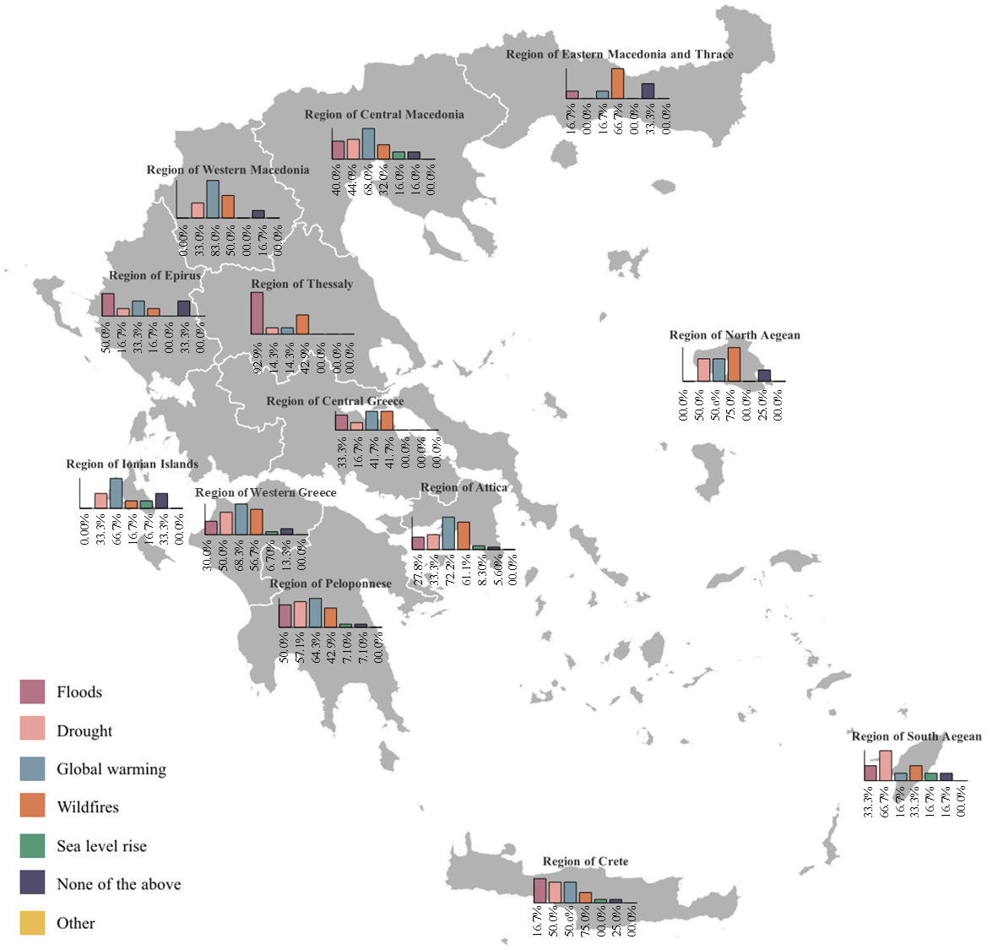
Experience of extreme climatic events
If “Yes”
Almost everyone that believes in climate crisis has experienced at least an extreme climatic event.
The majority referred to global warming and wildfires and in many cases droughts.

Slide 5
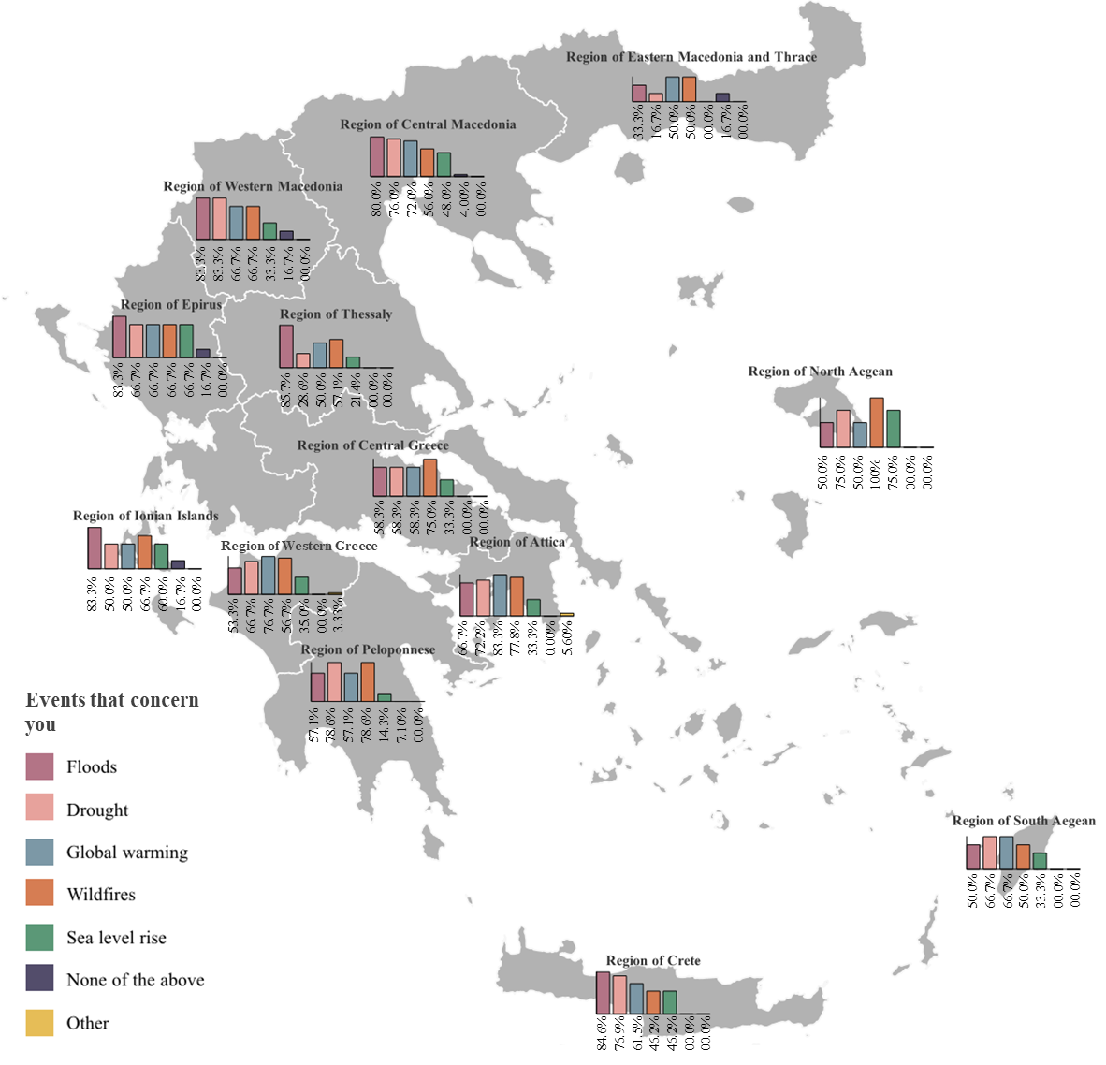
Vulnerability to extreme climatic events

Slide 6
Willingness to adapt more friendly practices
If “No” or “Not Sure”
If “Yes” or “Maybe”

Slide 7
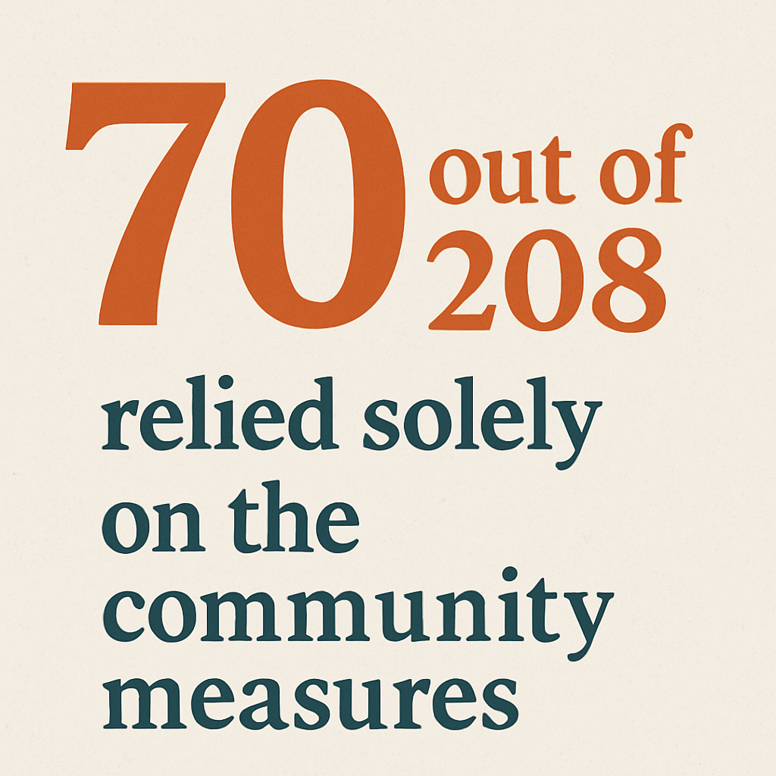
Personal Precautionary measures

Slide 8
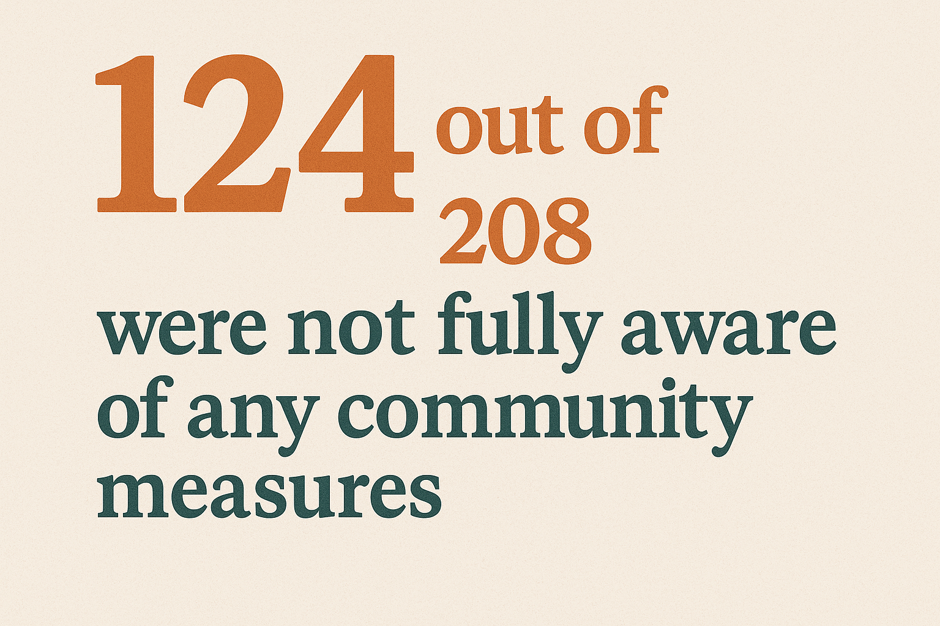
Community Precautionary Measures
If “Yes”

Slide 9
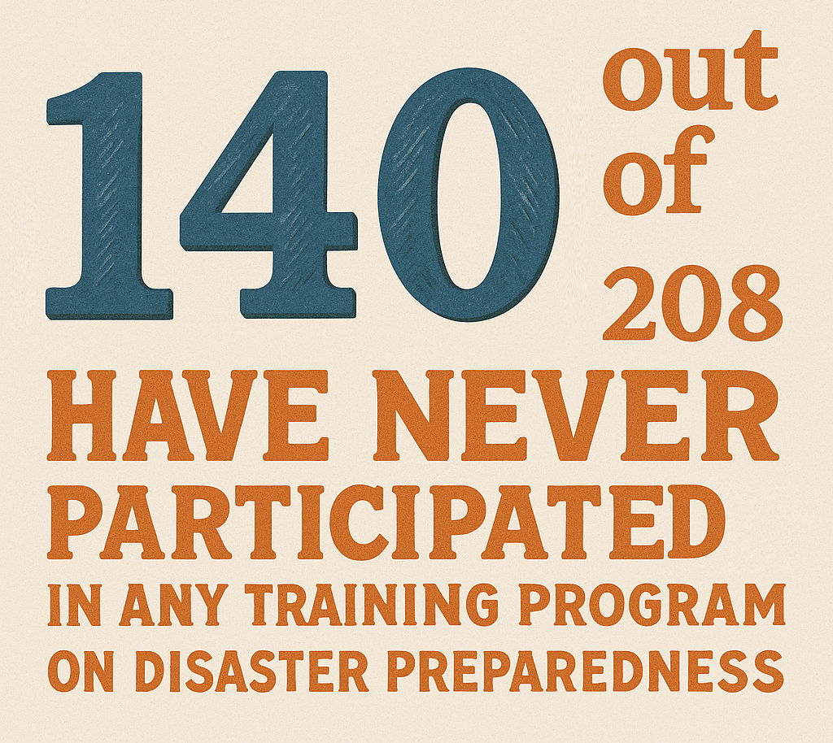
Training programs about disaster preparedness

Slide 10
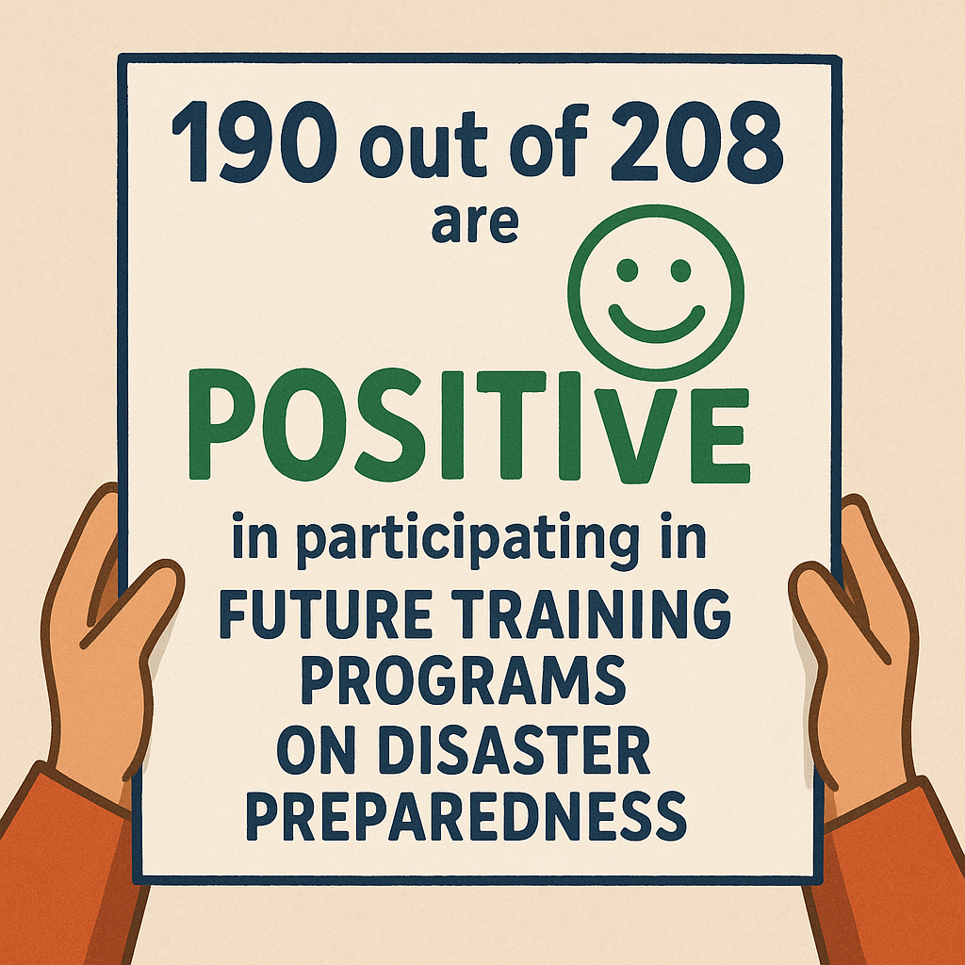
Training programs about disaster preparedness

Slide 11
Conclusions
Gaps in Community Awareness
There exists a concerning knowledge gap regarding local resilience measures: 124 respondents were unaware of any community-level initiatives, while only 70 relied exclusively on such measures. This highlights a critical need for enhanced outreach and visibility of grassroots interventions.
Urban-Rural & Age-Based Disparities
Preliminary findings reveal stark regional and demographic contrasts in both awareness and preparedness. Younger participants (<34) relied heavily on social media (≈60%) as their primary source of information, raising questions about the credibility and accessibility of risk communication tools across different populations.
Strong Interest in Capacity Building
Despite limited prior engagement (140 out of 208 participants reported no past participation in disaster preparedness training) a notable 91% expressed willingness to engage in future programs.
Path Forward: Community-Driven Resilience
These results underscore the need for specific training and adaptation policies based on local perceptions to enhance the resilience of the agricultural communities of the Mediterranean region. This can be done by capitalizing the use of national perception data to inform the development of an evidence-based climate change adaptation strategy to address the resilience gap in rural livelihoods.

Slide 12


