Slide 1
EarthCODE
EarthCODE - Transforming Earth Observation Research into Action-Ready Information through Open Science
EGU26
Earth Science Collaborative Open Development Environment
Notes:
ME, ESA, Data, then earthcode ..
I'm Dean, I'm a Data Scientists from Lampata, we're a small geospatial R&d company in cambride
Today I'll be presenting some work we're doing with the European Space Agency through one of their programmes for Open Science - EarthCODE
Talking about – how we're describing and combining data on EarthCODE Using the pangeo stack
So first a bit of background on EarthCODE

Slide 2
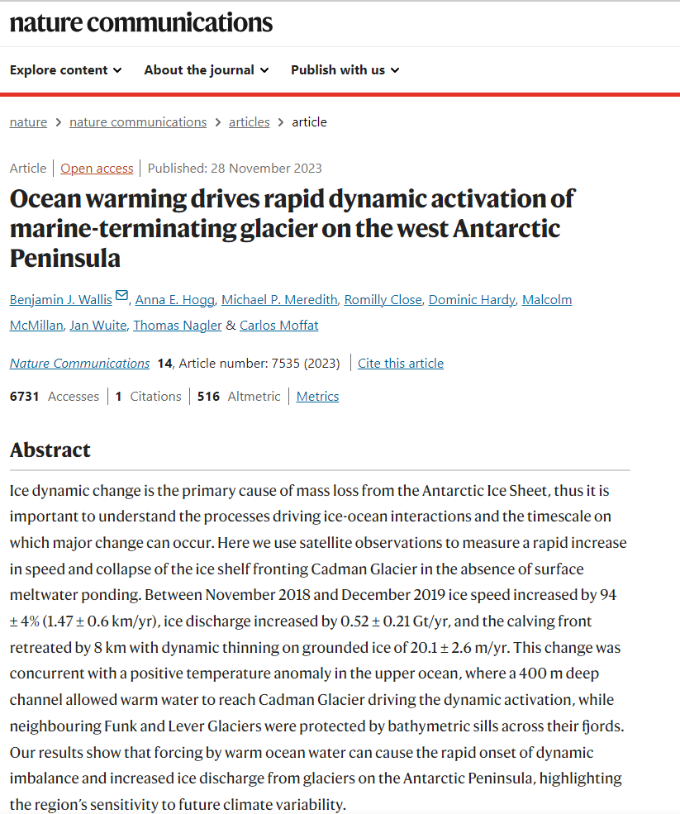
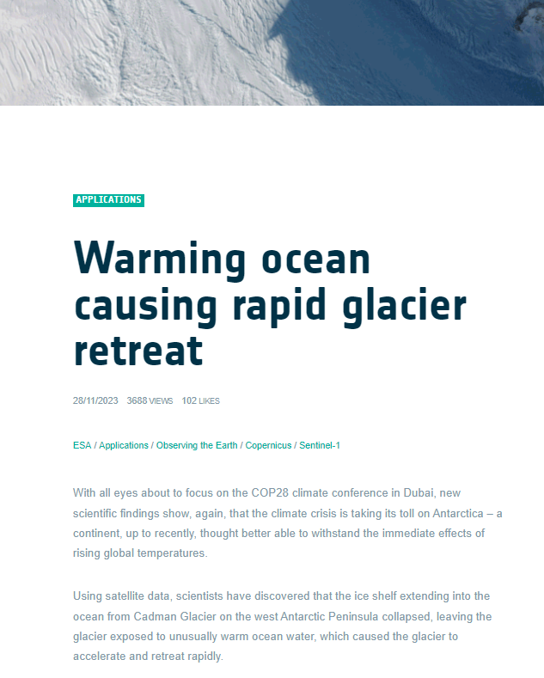

Increase use of your research data
Is research data always usable?
Innovative datasets and products are being continuously created to deliver new insights and enrich knowledge about our planet…
“research data” = includes data in its strict sense, as well as metadata, workflow, methods, algorithms and documentation related to that data.
Notes:
We all agree that on institutional level we're not making the most of our research investments
Innovative datasets and products are constantly emerging, offering fresh insights into our planet.
Data, workflows, code are typically not as well described or readily available as papers
But these digital objects are shifting now to becoming first class citizens in the new research ecosystem of FAIR and Open Science
This makes it easy for innovators and scientists to find, integrate, access and use the research and develop the next ground breaking innovations or science
And on the other end helps it helps individual researcher's research get to more people and have bigger impact
What's needed is a FAIR and Open Science ecosystem to support these digital objects
Importantly, the principles apply not only to ‘data’ in the conventional sense, but also to the algorithms, tools, and workflows that led to that data
So what does that ecosystem look like?

Slide 3


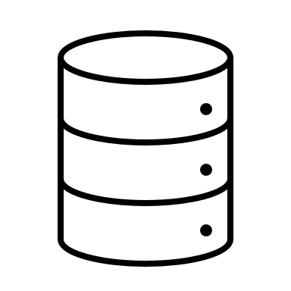



FAIR, High-Quality Digital Objects
FAIR Open Science Experiments
Product
Workflows
Compute
Open Science Catalogue – STAC Metadata
Open Science Catalogue – OGC API – Records Metadata
Partner EO Platforms integrated with EarthCODE
Data​ stored on ESA PRR
Notes:
Output / Input Data is somewhere in the web, Tools are open and the compute platforms are available
it’s the infrastructure for running the tools on the data
cloud rather than you downloading the data to execute your workflows
This is where EarthCODE comes in...
---
• • It’s also important to consider that we need these platforms to be interoperable and form an ecosystem of FAIR platforms wherein I can make calls from one platform to another and execute research code published from others
Specifically, ESA defines the gap and need as the ability to:
1. Access and process satellite and in-situ data in collaborative cloud environments
2. Develop and publish reusable code and workflows
3. Validate outputs and share reproducible results
4. Collaborate across institutional, disciplinary, and national boundaries.

Slide 4
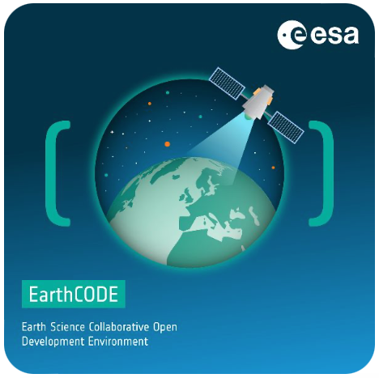
What is EarthCODE?
Earth Science Collaborative Open Development Environment
EarthCODE is a hub for research management, dissemination, community engagement, and learning.
Support ESA Earth Science research communities in adopting FAIR and Open Science
Accelerate scientific discovery through digital innovation (help researchers use cloud solutions)
Ensure long-term persistence and reuse of research (ethically)
Collaborate on research and Learn Open Science practices
earthcode.esa.int
Notes:
this is where EarthCODE comes in..
It is an ESA inititiative - As part of the larger picture of initiatives for implementing the ESA 2024 strategy for Open Science
EarthCODE stands for Earth Science Collaborative Open Development Environment
Supports the ESA Science research communities in adopting FAIR and Open Science and to put these principles in practice
And providing a ecosystem of integrated EO platforms for researchers to do their science on
---
and has been thought as an initiative to support ESA Science research communities in adopting FAIR and Open Science and to put these principles in practice. As a result their scientific outputs will be FAIR, Open, and long-term discoverable and reusable. As a research outputs we refer to data, but also their metadata, software, methods, algorithms and documentation related to that data.

Slide 5
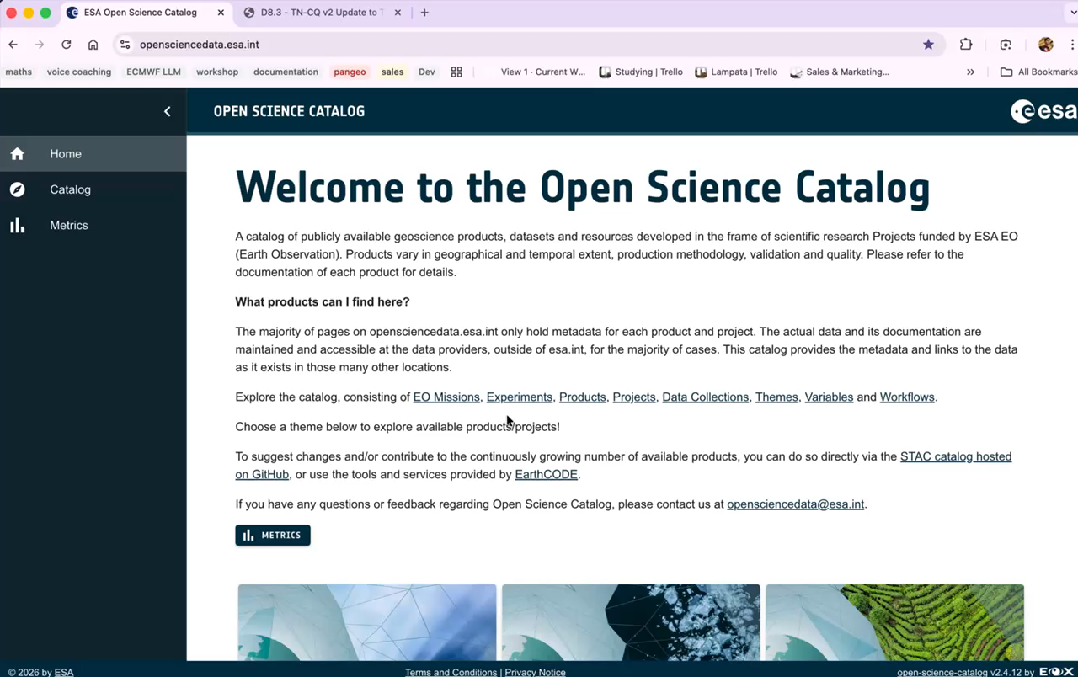
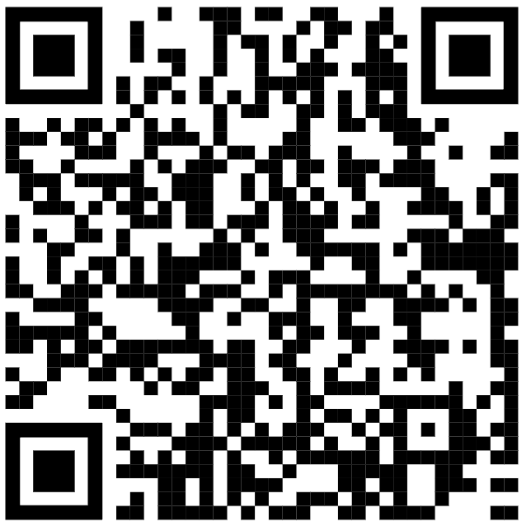
Notes:
The front-end of what you'll see on EarthCODE is the Open Science Catalog – where the data is stored
Firstly it's all via a STAC catalog and collections – stored on github
There's a convenient front-end to explore the data
The metadata:
Richly described (themes, missions, variables, and so on)
Follow CF conventions
Aims to have the full execution chain – workflows that produced the data
For the data:
Typically Cloud-formats
Specifically Zarr for multi-dimensional data
COG for scenes
Parquet for vector/in-situ data and tabular data

Slide 6
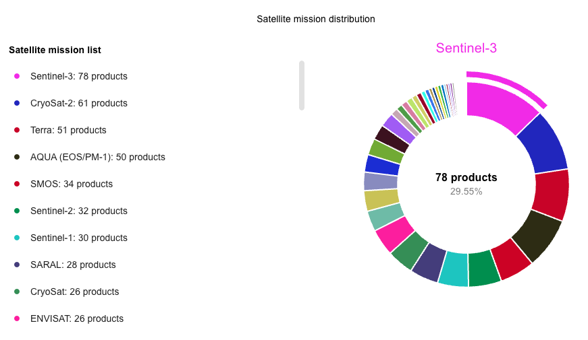
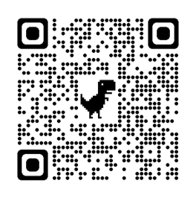
There's Approximately 300 Products on the OSC!
Notes:
At the moment there are approximately 300 products in the open science catalog
Some are used commonly by the community,
Some are combined typically
as it to view and model different variables and run experiments
There's though no common workflow, data or best practice for this
so

Slide 7
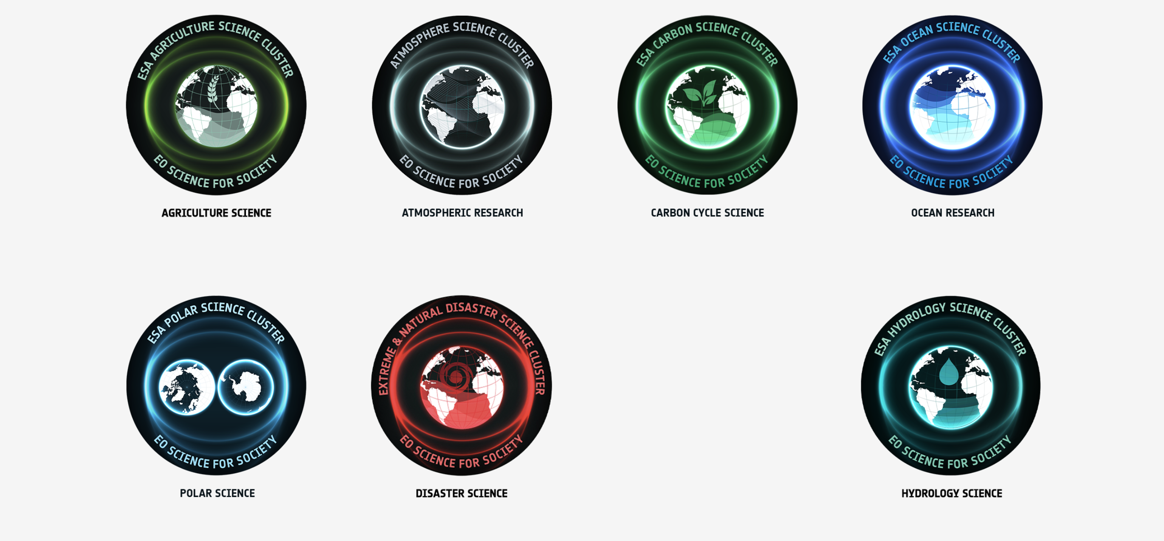
Data Collections for ESA Science Clusters
Notes:
As part of a recent initiative on EarthCODE
started combining data into thematic collections useful for researchers
This is a community led initiative by the clusters
We're doing two things
first gathering the data and describing it richly
Then aligning and combing the data in different ways

Slide 8
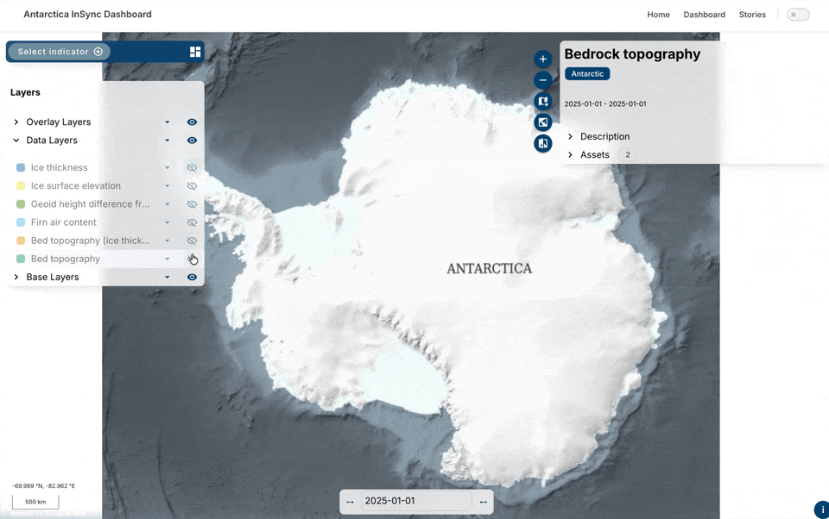
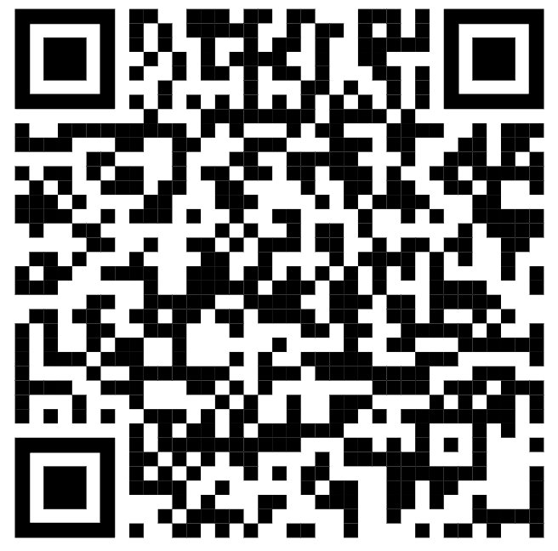
Data Visualization Using eodash
Notes:
An early example of this is the work we've done with the polar science community
The idea was to make sure the data is easily interoprable with different tools – for example here eodash is used to visualize the zarr
Which you can access via the qr code
We combined datasets such as Ice shelf Basal Melt, ground lines, subglacial lakes and others
These were community led - as in data was selected and designed through community consultation sessions with the polar sciences community
-------

Slide 9
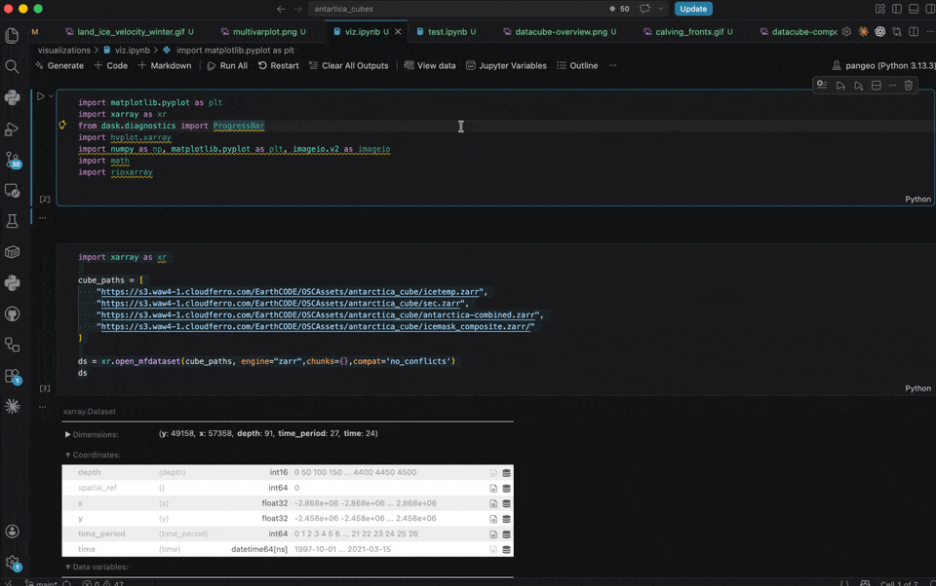
Data
Notes:
The key idea is to make the data really easy to access and use a
For ESA and Larger scientific community
As you can see it's pretty much a one liner to load the data
And then exploring scenarios such as looking at basal melt and calving fronts for example is aiming to make it as simple as possible

Slide 10
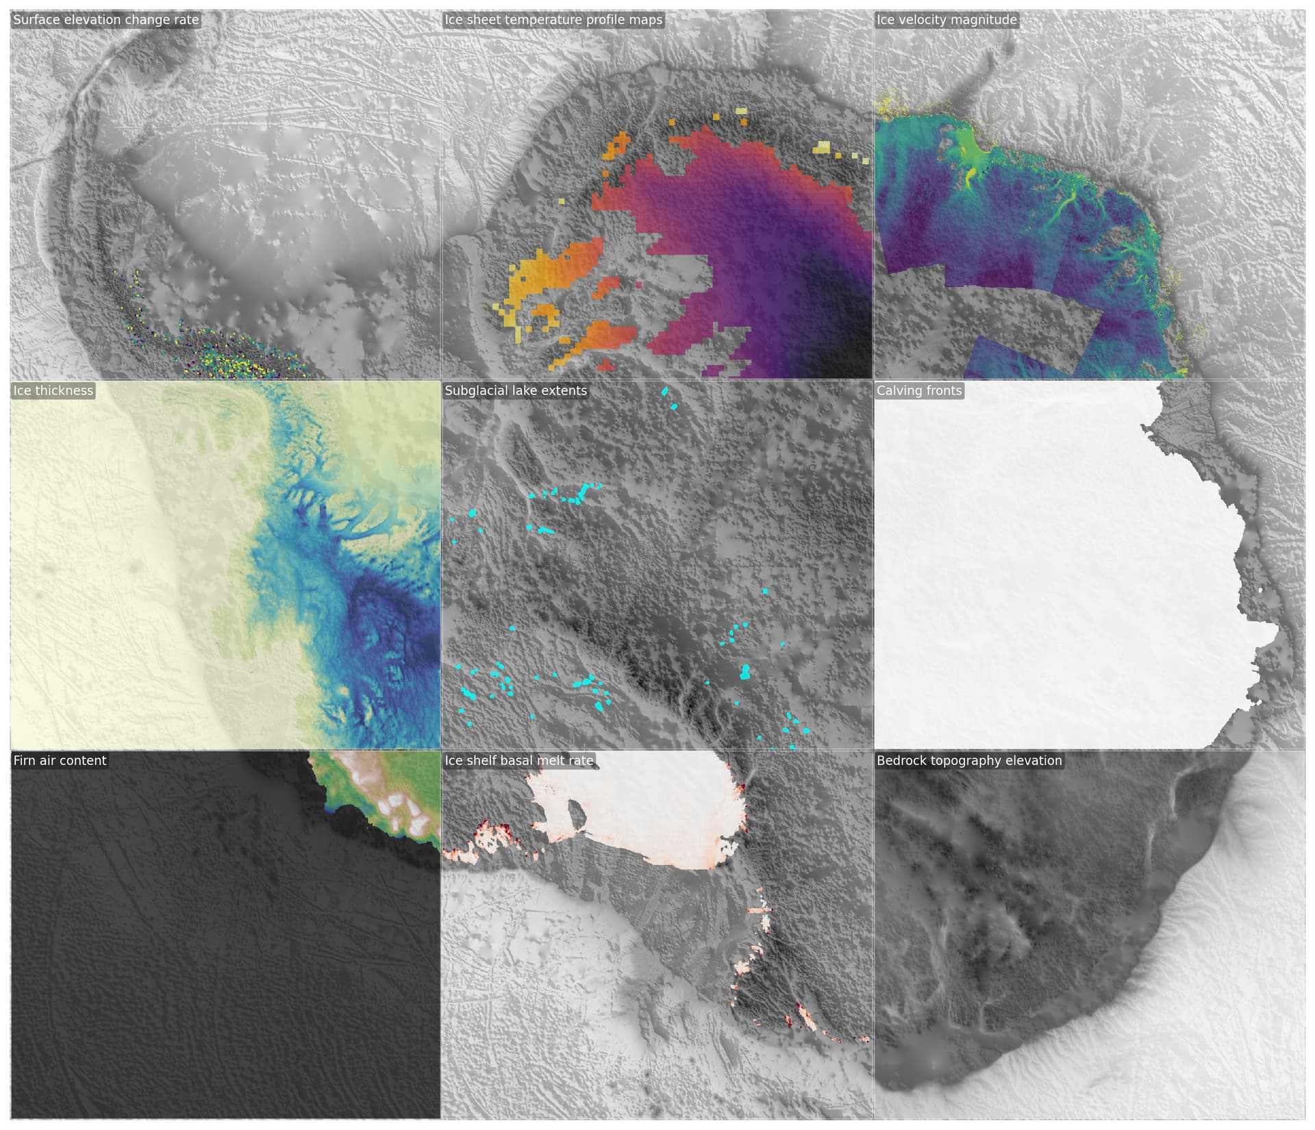
Design
Original Cloud Optimized Data
  Zarr for multi-dimensional data, Parquet for vectors, COG for scenes
  Useful for deep research on a particular variable / variables
Combined Data Cube
100x100m Grid in EPSG:3031 Polar projection
Community led standards
Useful for exploration, ML, applications, visualization
Notes:
We've essentially designed it as two different sets of data – we hold the original data but cloud-optimised and enriched – and then we further combine into a cube
Learning from and with the community:
Rich metadata is super useful, helps saves a lot of time (e.g. what does this column mean), without having to go back and forth with documentation guides
Scientists find the really useful bit that data access is straight forward, all the data is in one place and you don’t need to make random accounts
Visualizing/Exploring the data if it’s not somehow preprocessed is hard
Scientists want the data in original formats and access to that to do science -really adding too many distortions by up/downsampling/etc
Having all the data in the same place is important for studying phenomena/etc
DOI’s are important so people know what data you mean
Deciding on licensing is actually hard for quite a few people

Slide 11
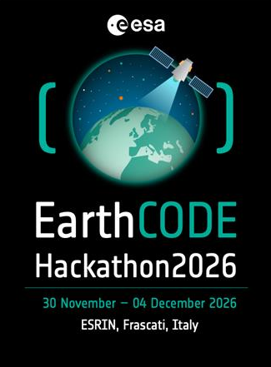
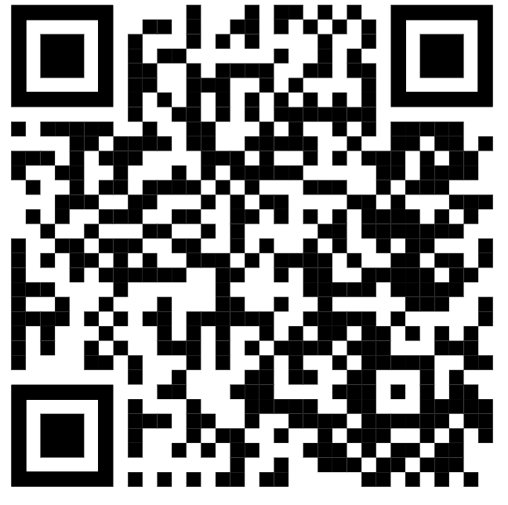
Data Collections Coming Soon!
Notes:
In the future we'll continue work on these and dev one for each cluster
All of these will be publically accessible on EarthCODE via the OSC
ESA is planning bigger engagements around a hackathon this year to develop these by themes

Slide 12



Get Involved
ESA Funded Research Project
Scientists & Developers
Platform Providers
Use EarthCODE to publish your work, to find and reuse scientific data and reuse workflows through integrated platforms.
Scientists and Developers can search and find openly available data and workflows. They can contribute new open FAIR tools or workflows and engage with the community.
Providers offer integrated EO cloud infrastructure and open FAIR tools for researchers to enable FAIR and Open Science.
Notes:
you can get involved - Who’s EarthCODE for
Community you can get involved is profiles

Slide 13
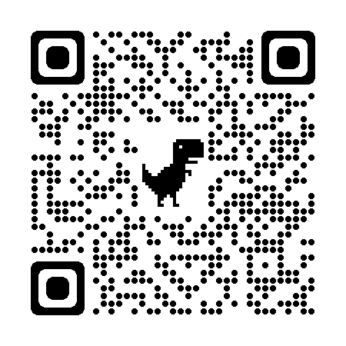

EarthCODE Portal
Contact us:
earth-code@esa.int
earthcode.esa.int

