Slide 1
A Novel Model of Canadian Wildfire Risk for Climate Assessments
Edward Kearns, Kate Fuller, Philip Cunningham, Marco Maneta, Brian Zambri, Wade Ross, and Mike Amodeo
Any information presented by Kate is based on her personal work and perspective. It does not incorporate or represent any proprietary data, research, or conclusions from First Street.

Slide 2
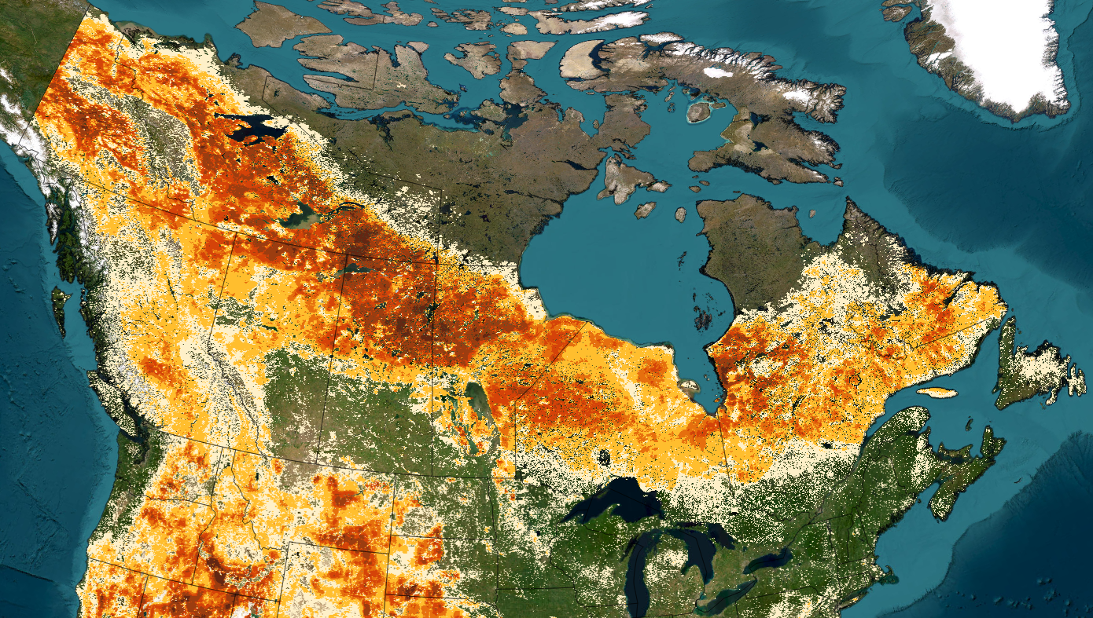
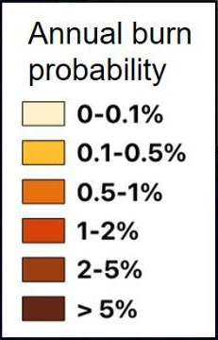
Burn probability

Slide 3
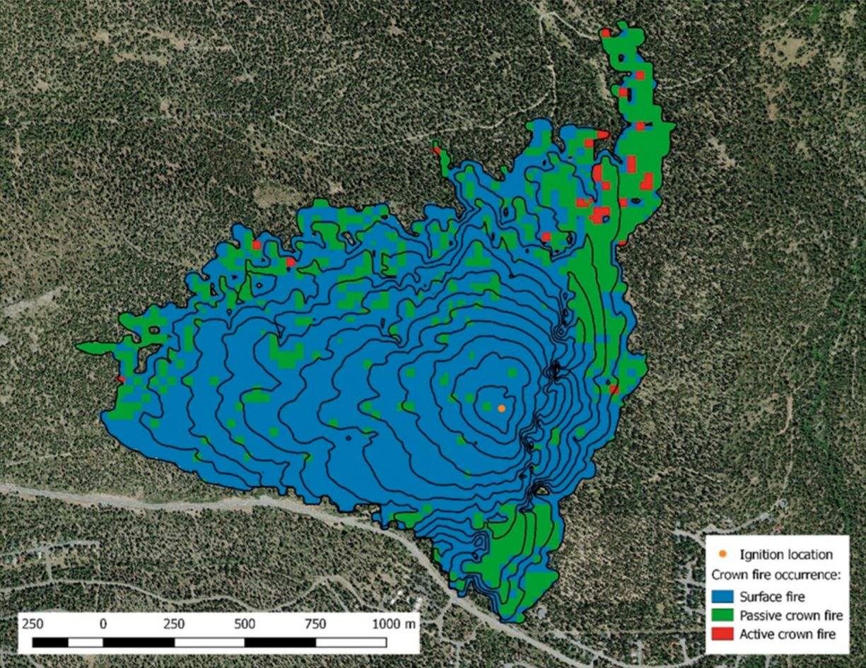
ELMFIRE
ELMFIRE
Open-source (Lautenberger 2013)
Rothermel-based surface fire spread
Passive and active crown fires
Ember lofting, spotting
Novel inputs
Ignitions
Fuels
Monte carlo simulations
Run ELMFIRE for 10,000 years of ignitions
Number of fires / 10,000 = burn probability (%)
14.7 million fires simulated
Meteorology perturbed
Historical
SSPs 126, 245, 585
Years 2055 and 2100
Kearns et al. 2022

Slide 4
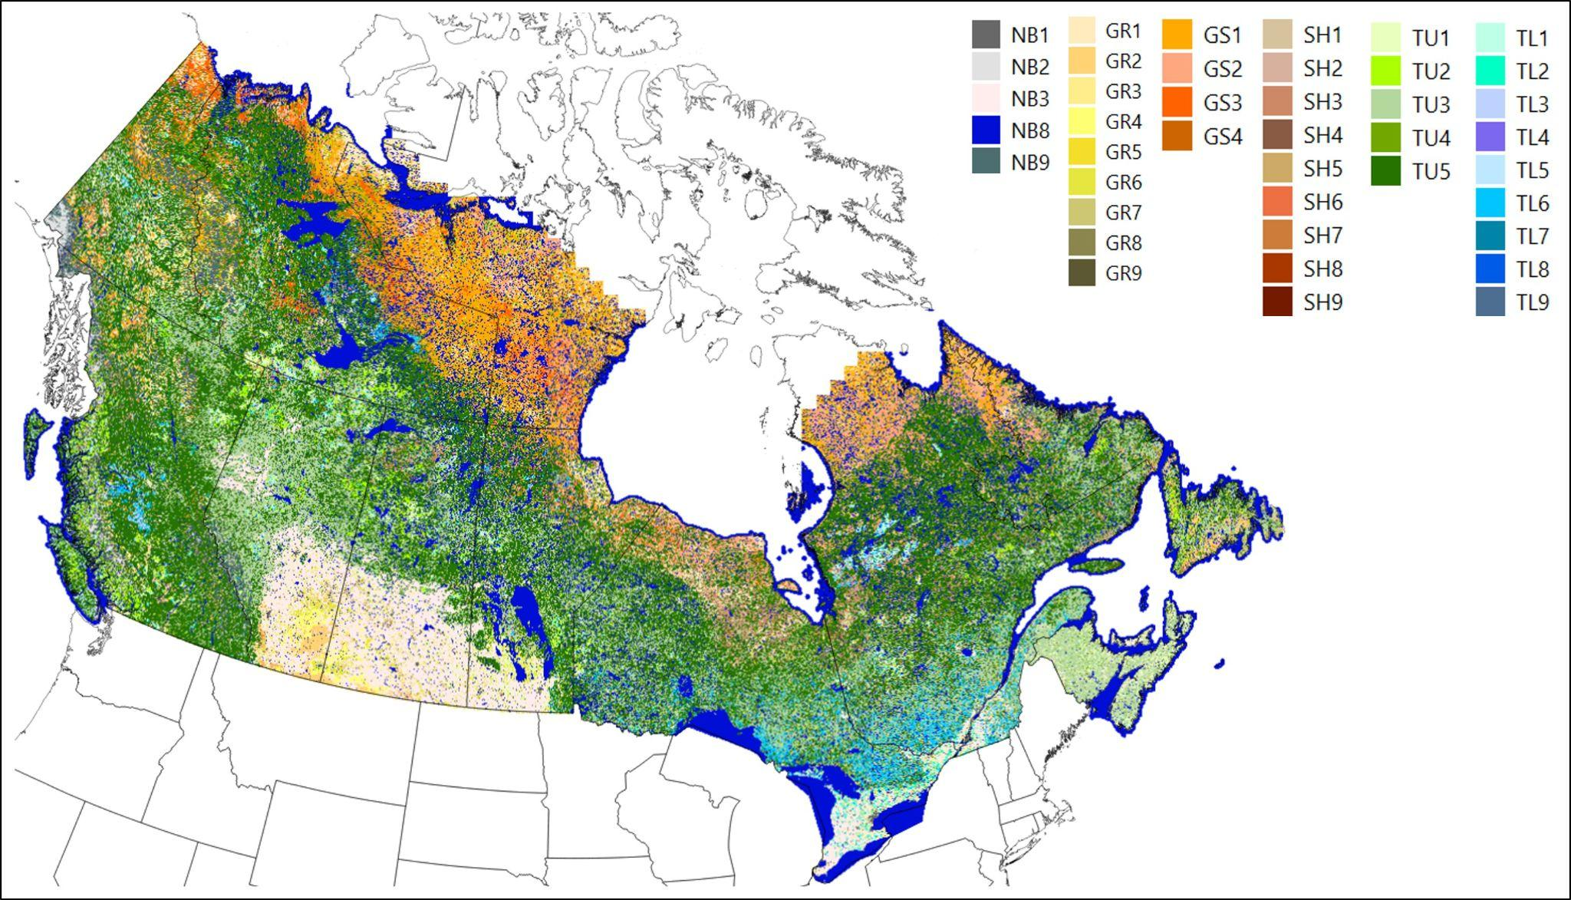
Novel inputs- fuels
Canopy height and cover available from SCANFI
CBH and CBD modeled using NFI and SCANFI
FM40 forest types interpreted from Canadian data sources, vegetation descriptions, spatial datasets
FM40 grass, grass-shrub, and shrub types modeled using LANDFIRE
Disturbance transitions created from ecological inference and FVS zones on the Canadian border
WUI fuels -> GS1

Slide 5
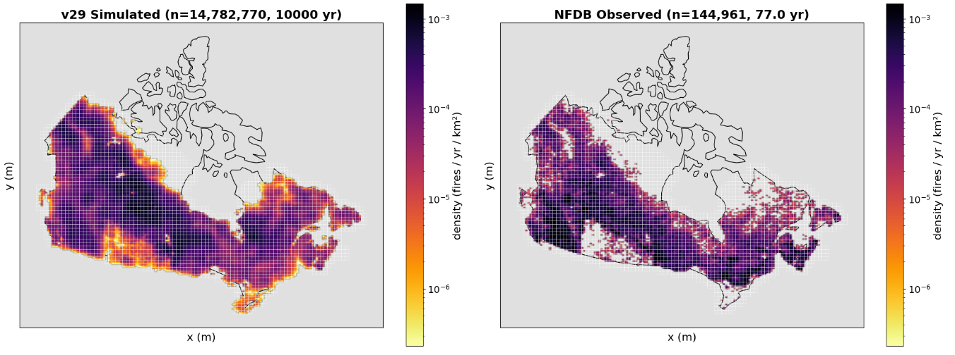
Novel inputs- ignitions
Ignition density grid generated using kernel density estimated

Slide 6
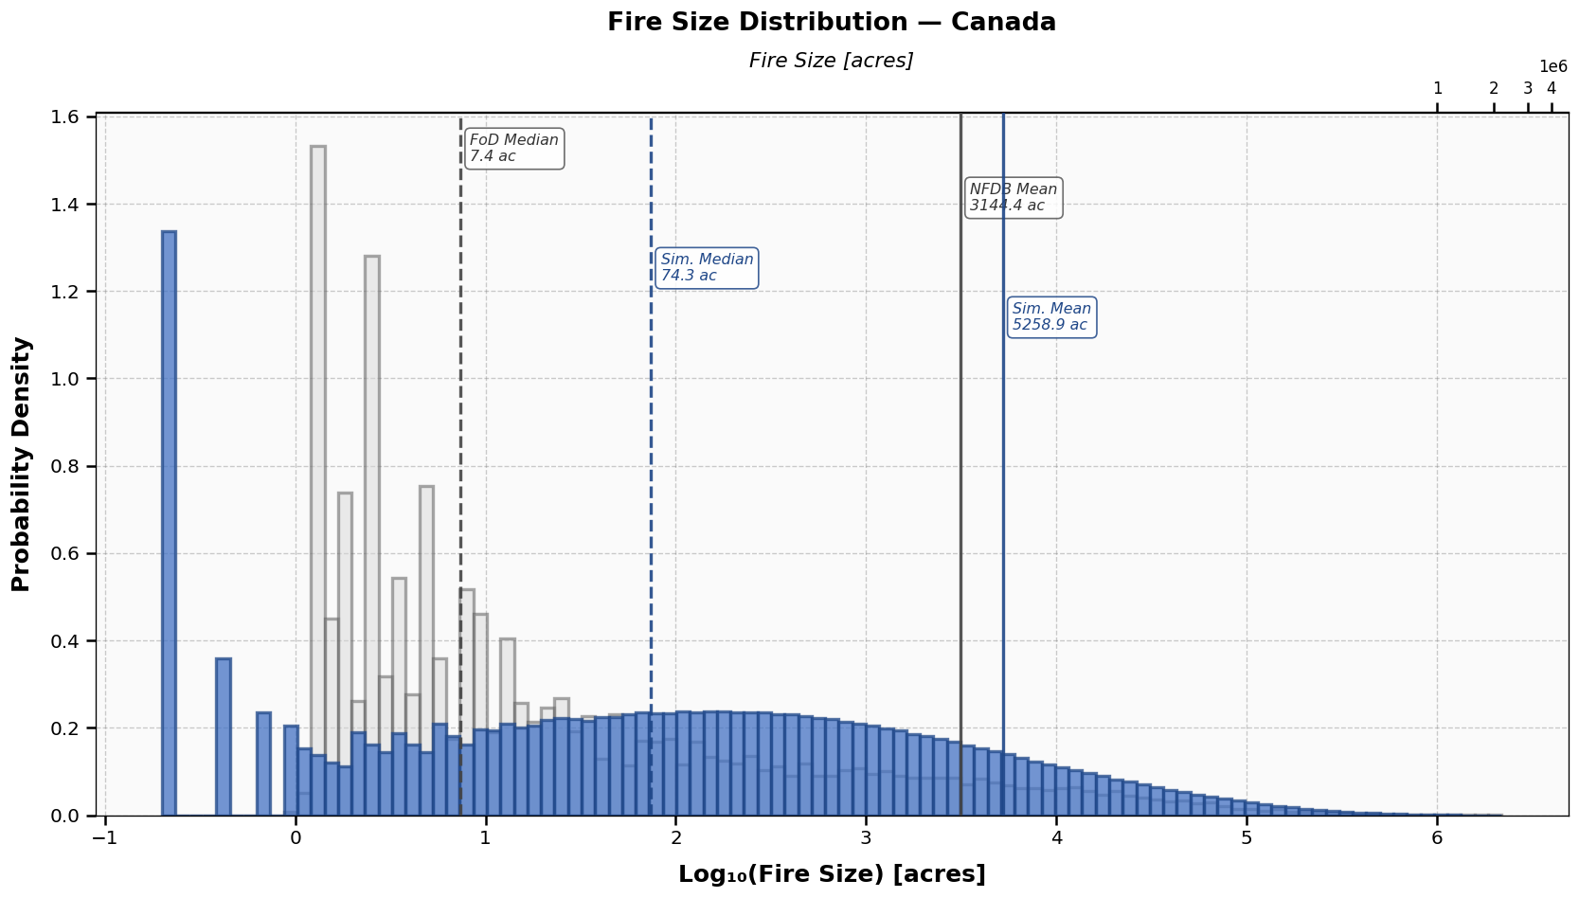
Novel inputs- ignitions
Max fire duration distribution estimated from historical observations
NFDB
Simulated

Slide 7
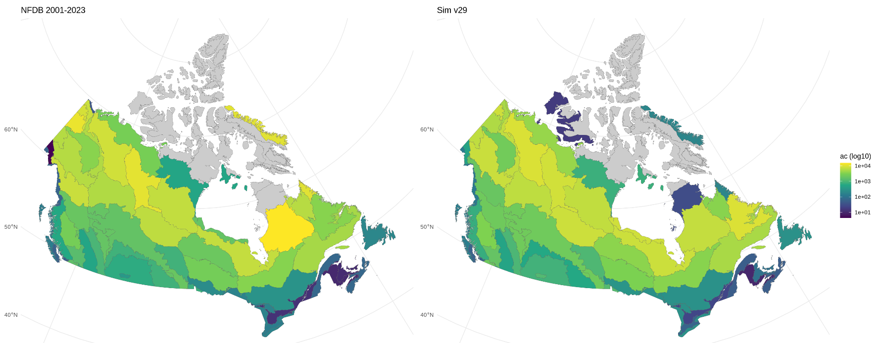
Ignitions calibration
Ignition rate and fire duration distributions estimated from historical observations
Tuned iteratively by ecoregion (pyrome)
Simulated

Slide 8
Final product
First of its kind wall-to-wall wildfire risk mapping
Future climate projections to 2100
Increased burned area and a greater number of impacted assets under more severe climate scenarios

Slide 9
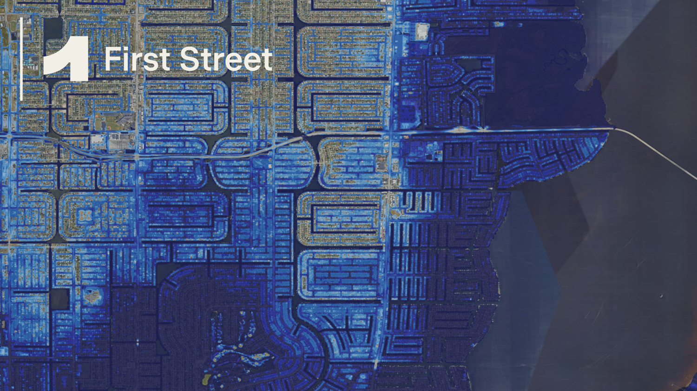
Thank you
John Abatzoglou
Robert Ziel
See other EGU talks from First Street:
EGU26-15187
EGU26-14018
Request full methodology document here: https://firststreet.org/research-library/global-wildfire-model-methodology

