Slide 1




Developing a Gauge–Radar Merged Precipitation Dataset (1 hour and 1 km) for Great Britain: GRaD-GB (1H1K)
Xiaobin Qiu, Amy C. Green, Stephen Blenkinsop, and Hayley J. Fowler
Email: Xiaobin.Qiu@newcastle.ac.uk
Wechat: xiaowo616563

Slide 2
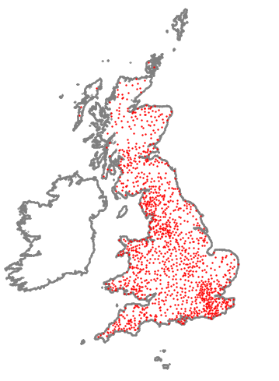
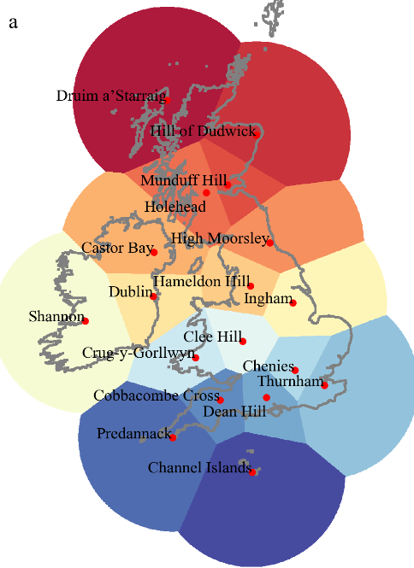
Developing a Gauge–Radar Merged Precipitation Dataset (1 hour and 1 km) for Great Britain: GRaD-GB (1H1K)
Xiaobin Qiu, Amy C. Green, Stephen Blenkinsop, and Hayley J. Fowler
1. The Problem
We lack reliable gridded precipitation data for tracking extreme rainfall in Great Britain
Rain gauge:
Highly accurate at the point scale
Too sparse for continuous national coverage
Weather radar:
Good spatial coverage (1 km )
Beam blockage, ground clutter and electronic noise
The opportunity:
Blended datasets can capitalize on the complementary strength of both sources to close this data gap

Slide 3
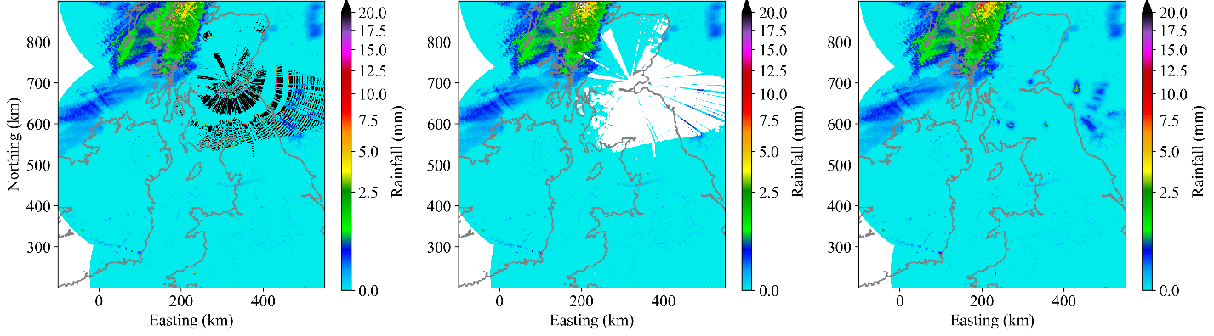
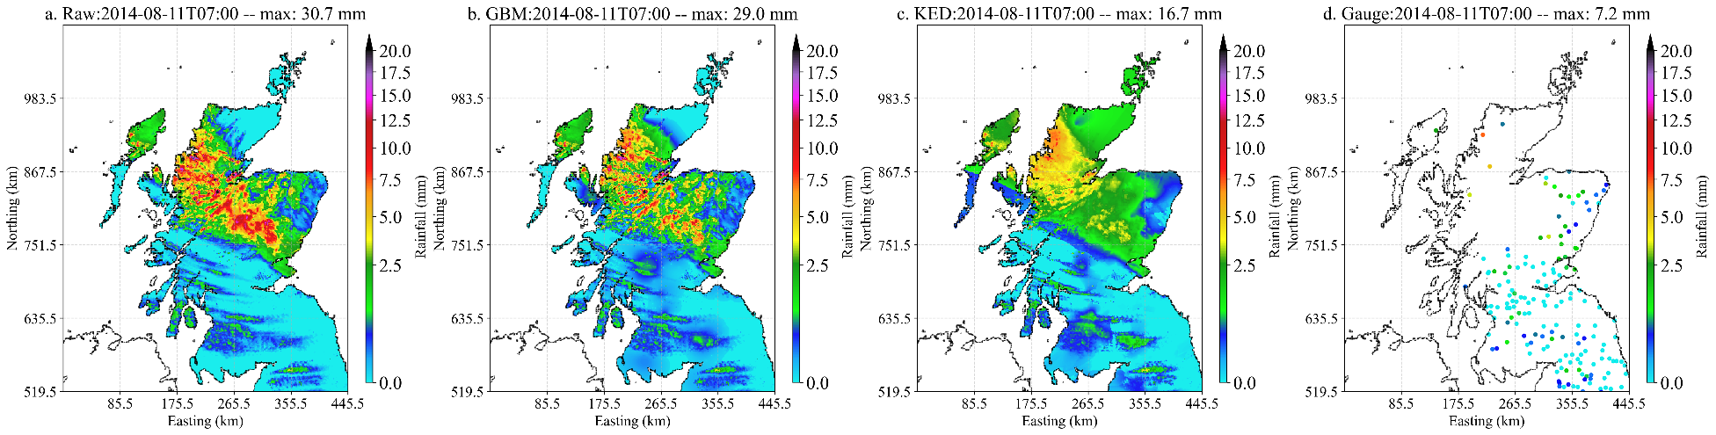
Developing a Gauge–Radar Merged Precipitation Dataset (1 hour and 1 km) for Great Britain: GRaD-GB (1H1K)
Xiaobin Qiu, Amy C. Green, Stephen Blenkinsop, and Hayley J. Fowler
2. The Method
A dual–engine pipeline: Holistic Radar Quality Control combined with the Gauss Blending Method
Engine 1: Rule-Based Radar QC Framework
Engine 2: Gauss Blending Method (GBM)
Raw Radar Rainfall → Remove Bad Rainfall → Corrected Rainfall
Radar Rainfall + Gauge Rainfall → Blended Rainfall
Detects beam blockage and bad pixels using continuity and uniqueness assumptions of rainfall field.
Replaces bad data using the Gauss Interpolation Method.
Without requiring ancillary datasets.
Adapts the Gauss-Seidel numerical technique to seamlessly merge spatial radar structures with gauge data. Simple, highly efficient, avoiding over-smoothing.

Slide 4
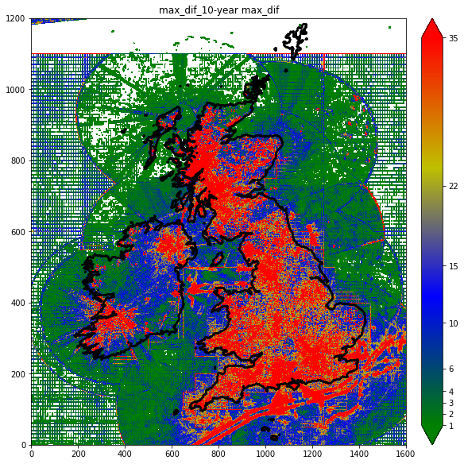
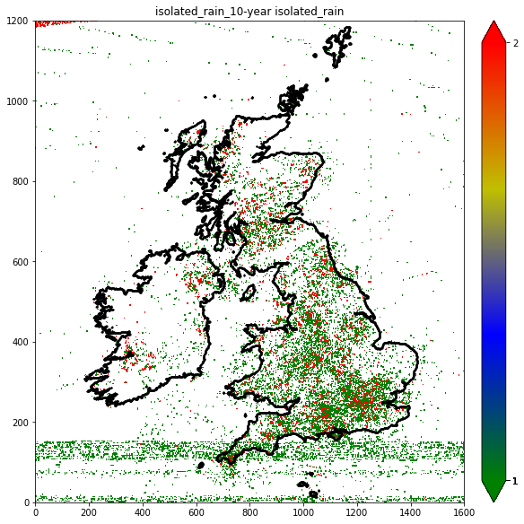
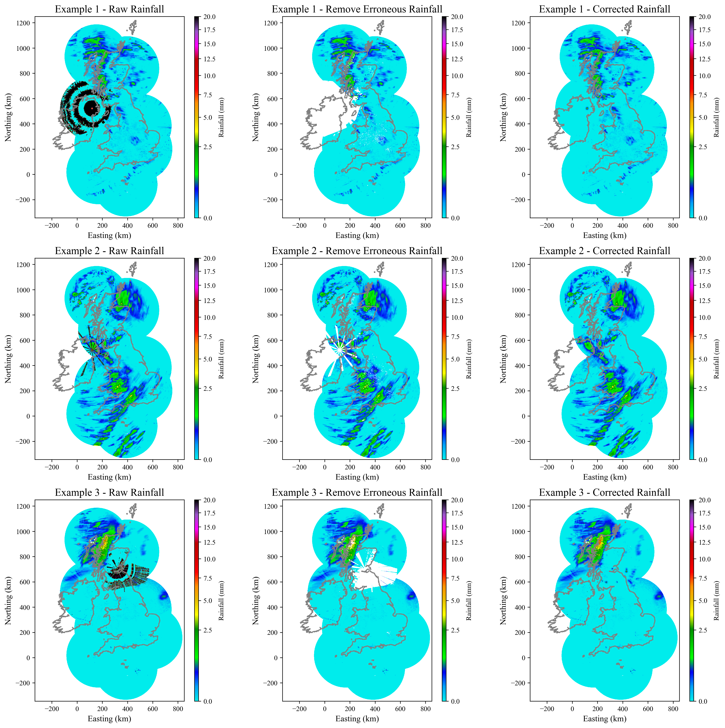
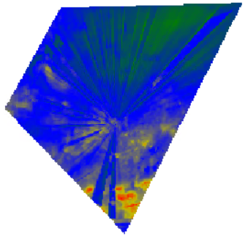
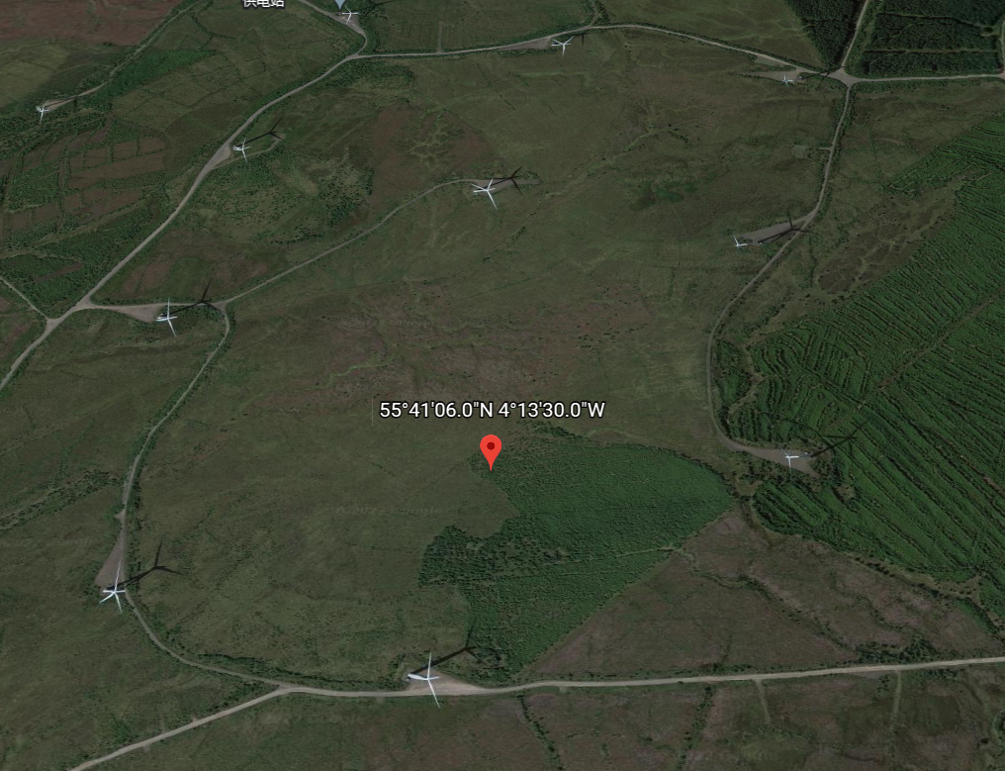
Developing a Gauge–Radar Merged Precipitation Dataset (1 hour and 1 km) for Great Britain: GRaD-GB (1H1K)
Xiaobin Qiu, Amy C. Green, Stephen Blenkinsop, and Hayley J. Fowler
2. The Method
2.1 Quality issues for radar rainfall (bad rainfall)
Radar beam blockage
Ground clutter (wind farm)
Ship Traffic
Electronic noise
Radar malfunction

Slide 5
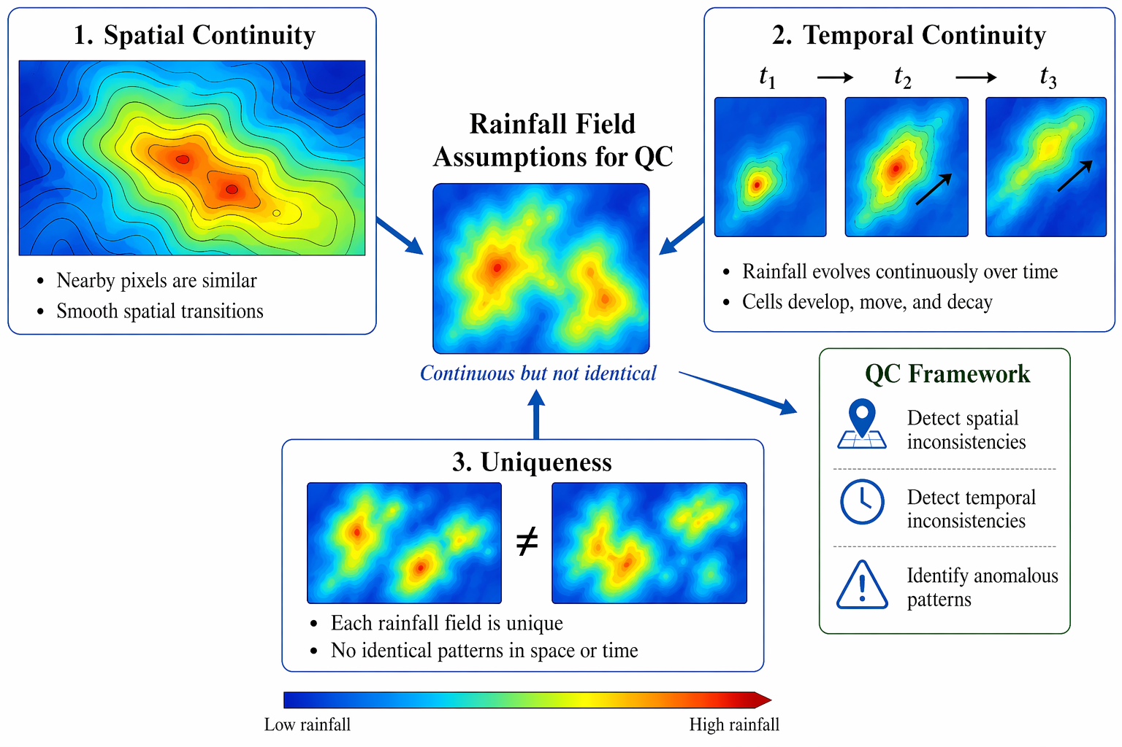
Developing a Gauge–Radar Merged Precipitation Dataset (1 hour and 1 km) for Great Britain: GRaD-GB (1H1K)
Xiaobin Qiu, Amy C. Green, Stephen Blenkinsop, and Hayley J. Fowler
2. The Method
2.2 Three assumptions for radar rainfall fields (normal rainfall)
Rainfall fields are schematic representations for illustration purposes only, generated by ChatGPT.

Slide 6
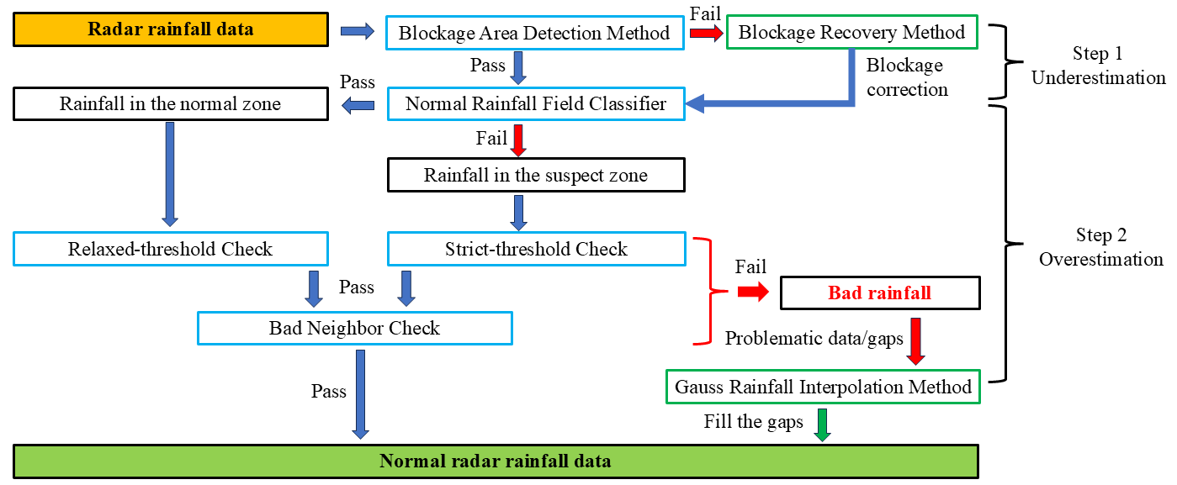
Developing a Gauge–Radar Merged Precipitation Dataset (1 hour and 1 km) for Great Britain: GRaD-GB (1H1K)
Xiaobin Qiu, Amy C. Green, Stephen Blenkinsop, and Hayley J. Fowler
2. The Method
2.3 Quality Control Framework for Radar Rainfall

Slide 7
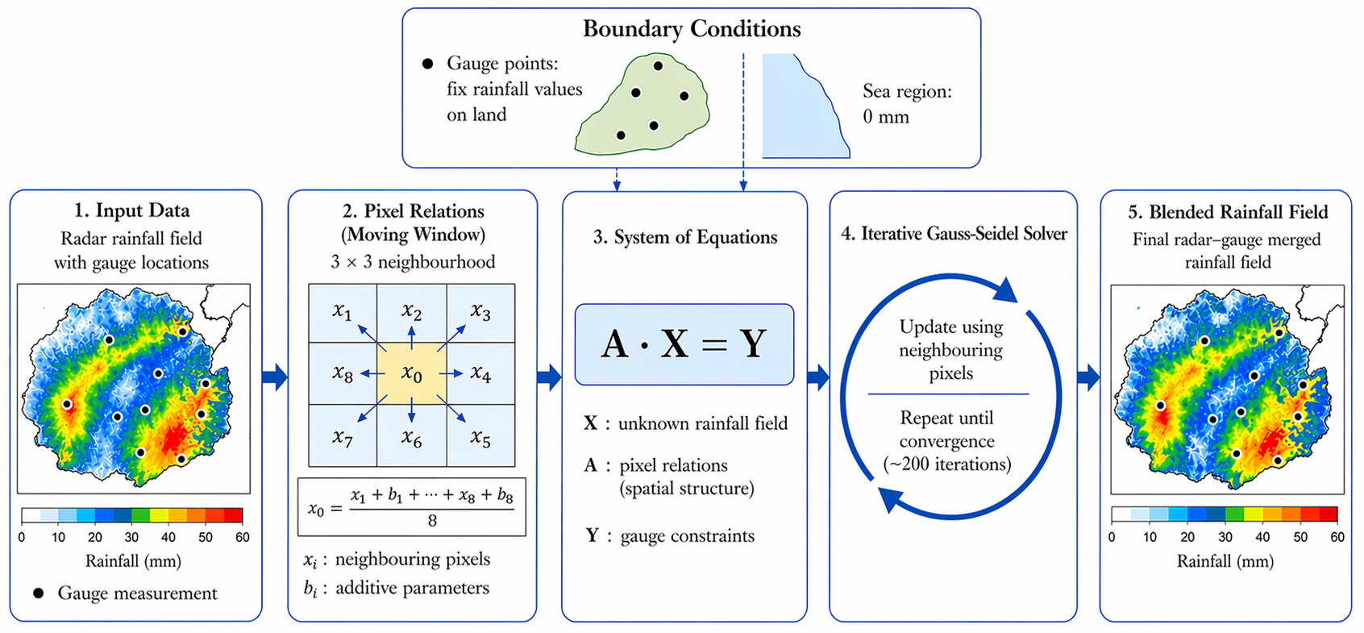
Developing a Gauge–Radar Merged Precipitation Dataset (1 hour and 1 km) for Great Britain: GRaD-GB (1H1K)
Xiaobin Qiu, Amy C. Green, Stephen Blenkinsop, and Hayley J. Fowler
2. The Method
2.4 Gauss Blending Method to emerge gauge and radar rainfall
Rainfall fields are schematic representations for illustration purposes only , generated by ChatGPT

Slide 8
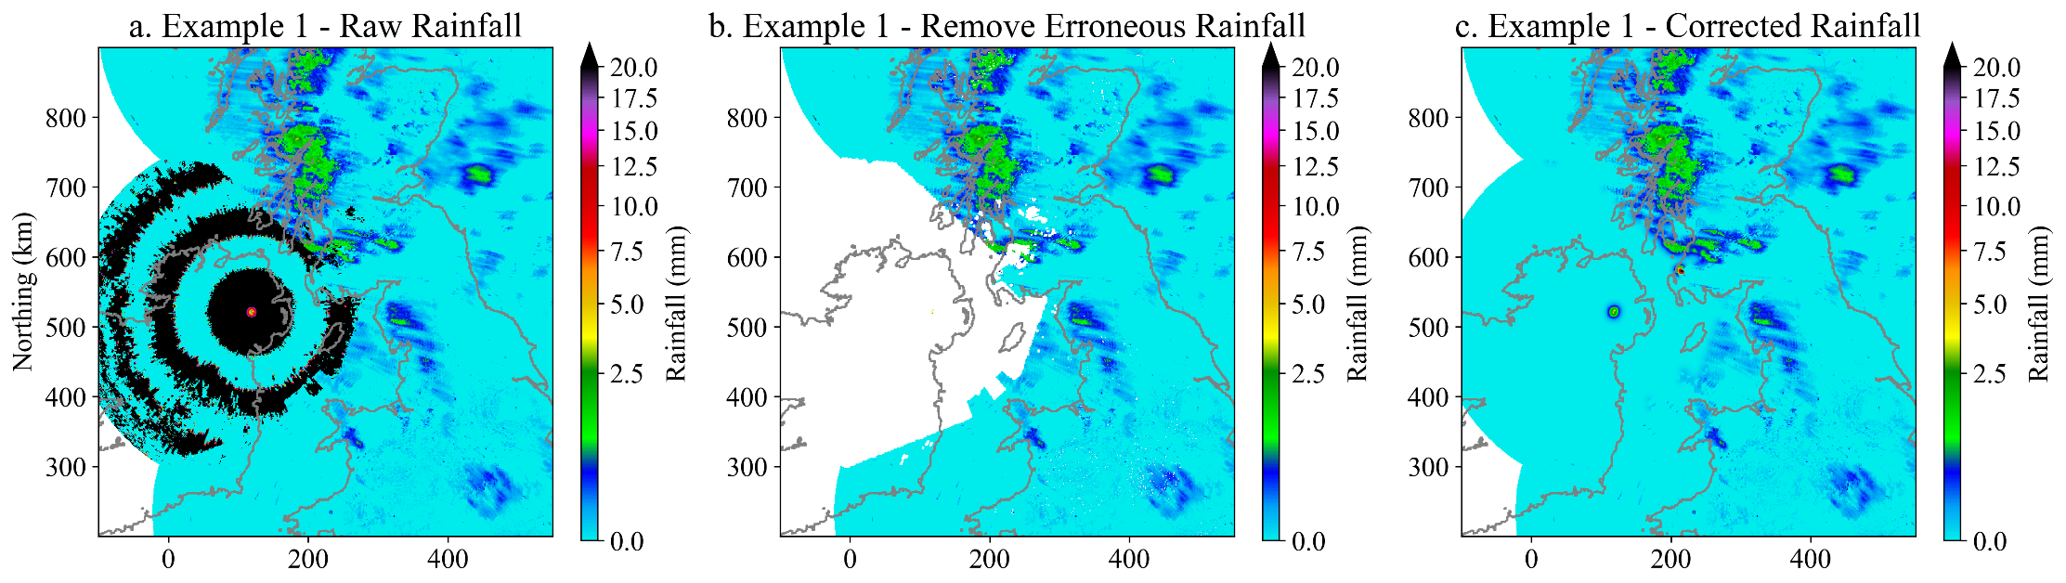
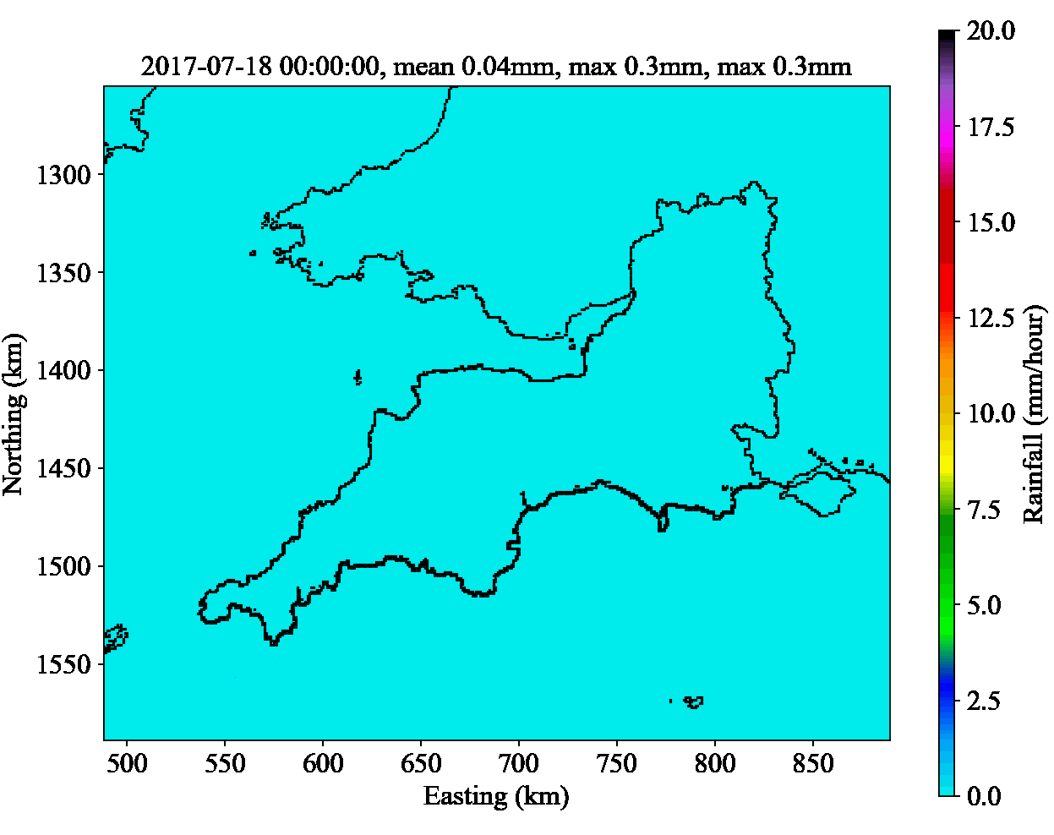
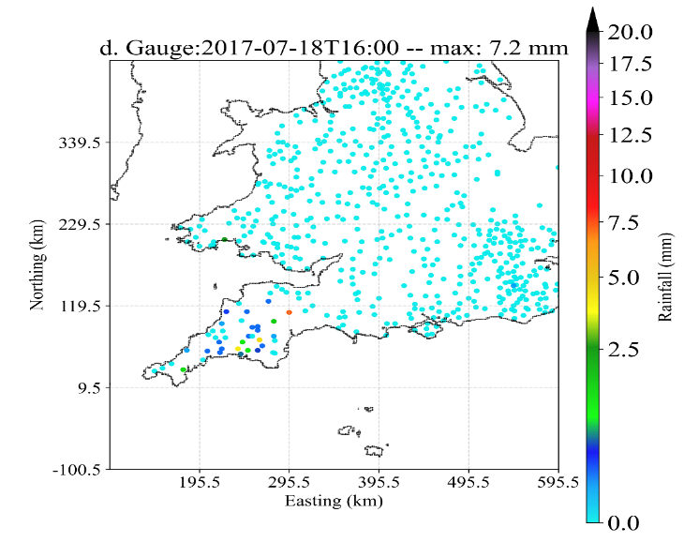
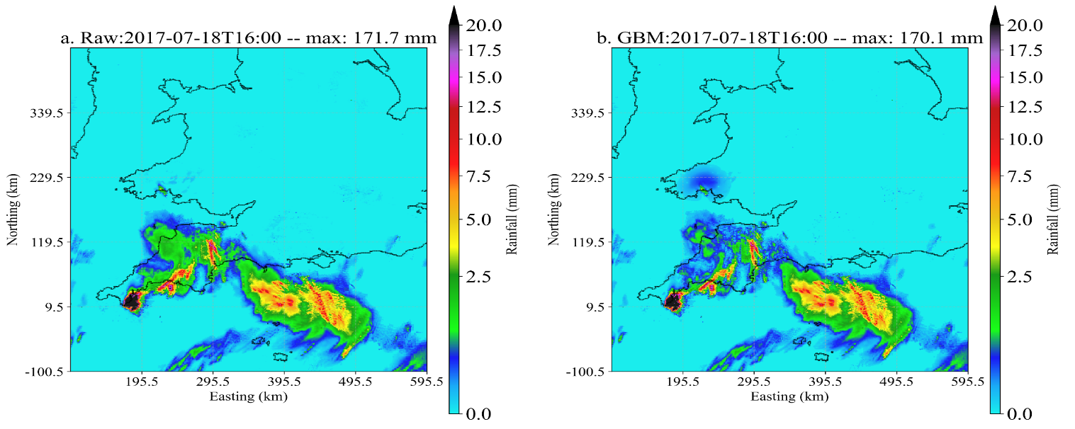
Developing a Gauge–Radar Merged Precipitation Dataset (1 hour and 1 km) for Great Britain: GRaD-GB (1H1K)
Xiaobin Qiu, Amy C. Green, Stephen Blenkinsop, and Hayley J. Fowler
3.Results & Impact
(1) Quality Control of Radar Rainfall Data
(3) GRaD-GB (1H1K): Gauge–Radar Precipitation Dataset (1 hour and 1 km) for Great Britain (2006-2023)
(2) Blending Radar and Gauge Rainfall
The most intense rainfall ever recorded in the UK (July 18, 2017, Coverack)

Slide 9
Developing a Gauge–Radar Merged Precipitation Dataset (1 hour and 1 km) for Great Britain: GRaD-GB (1H1K)
Xiaobin Qiu, Amy C. Green, Stephen Blenkinsop, and Hayley J. Fowler
3.Results & Impact
Proven Accuracy
Radar QC Framework: effectively detect problematic radar rainfall and improve its accuracy.
GRaD-GB (1H1K): A new hourly, 1-km gauge–radar merged dataset spanning 2006–2023.
Why it Matters: A good dataset for tracking storm life cycles, managing flood risk, and driving hydrological modelling.
Group 1: QC Framework Impact
▼ 29%
Reduction in Radar RMSE
▲ 31%
Increase in Correlation (CC)
Group 2: Final GBM Blending Impact
▼ 14.5%
Improvement in RMSE & MAE
▼ 22%
Reduction in Mean Relative Error

Slide 10
Developing a Gauge–Radar Merged Precipitation Dataset (1 hour and 1 km) for Great Britain: GRaD-GB (1H1K)
Xiaobin Qiu, Amy C. Green, Stephen Blenkinsop, and Hayley J. Fowler
References
Qiu, X., Green, A.C., Blenkinsop, S., Fowler, H.J., 2026a. Quality control of the composite radar quantitative precipitation estimation product for Great Britain. Journal of Hydrology 666, 134755. https://doi.org/10.1016/j.jhydrol.2025.134755
Qiu, X., Green, A.C., Blenkinsop, S., Fowler, H.J., 2026b. Developing a radar-rain gauge hourly blended precipitation dataset for Great Britain using the Gauss Blending Method. Journal of Hydrology 668, 134954. https://doi.org/10.1016/j.jhydrol.2026.134954
Contact
Xiaobin Qiu
Post-doc researcher
School of Engineering, Co-Centre for Climate + Biodiversity + Water
Newcastle University, UK
Email: Xiaobin.Qiu@newcastle.ac.uk
Wechat: xiaowo616563

Slide 11
Developing a Gauge–Radar Merged Precipitation Dataset (1 hour and 1 km) for Great Britain: GRaD-GB (1H1K)
Xiaobin Qiu, Amy C. Green, Stephen Blenkinsop, and Hayley J. Fowler
Thank you

