Slide 1




A Robust Depth-Duration-Frequency Model of Extreme Rainfall, Applied to Past and Future Climates in Ireland
Enda O’Brien, Paul Nolan Irish Centre for High-End Computing
Paraic Ryan, Jingyu Wang University College, Cork
Carla Mateus Maynooth University

Slide 2
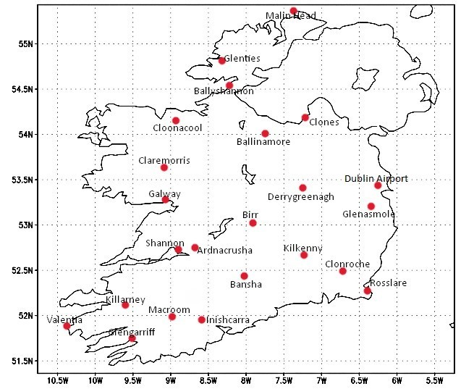
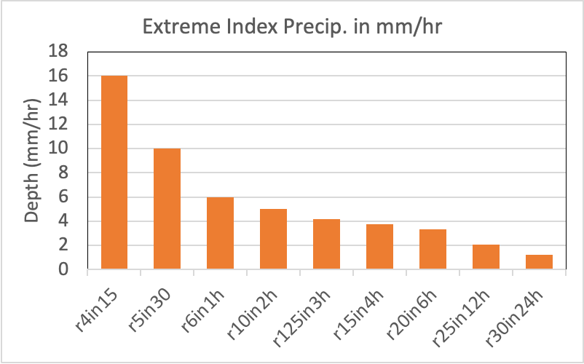
Station observations are available for 9 “intense rainfall” metrics, over 30 – 60 years, from (at least) 24 stations:
Rain Metric | Meaning
r4in15 | > 4mm in 15 minutes
r5in30 | > 5 mm in 30 minutes
r6in1h | > 6mm in 1 hour
r10in2h | > 10mm in 2 hours
r125in3h | > 12.5mm in 3 hours
r15in4h | > 15mm in 4 hours
r20in6h | > 20mm in 6 hours
r25in12h | > 25mm in 12 hours
r30in24h | > 30mm in 24 hours
When expressed in a common unit of mm/hr, the shorter events are more extreme.

Slide 3
Objectives
What general useful information can be extracted from those data about the nature of such intense events (e.g., return periods)?
How can such information be projected into the future, e.g., by using downscaled regional climate model output?
N.B.: These 9 metrics are all “peak over threshold” (POT) values. Theories of POT statistics are well-developed (e.g., see “Introduction to Statistical Modeling of Extreme Values” book by Stuart Coles).
For concise and useful background info, see the POT references at: https://en.wikipedia.org/wiki/Extreme_value_theory
Worth keeping in mind: this work is analogous to estimating the likelihood of Germany beating Brazil 7-1 in a World Cup semi-final.

Slide 4
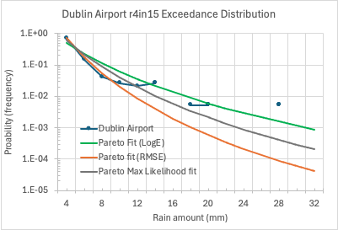
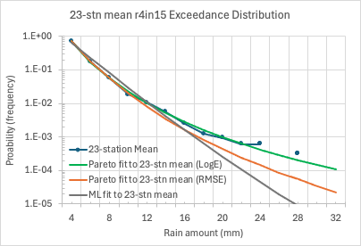
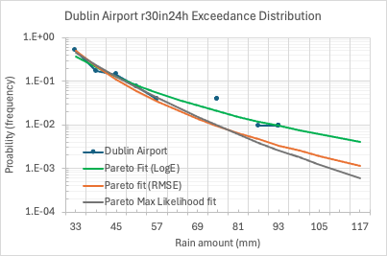
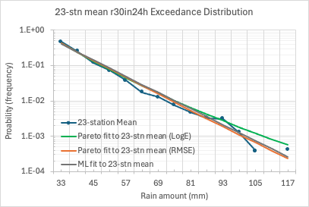
Dublin Airport 15-minute & 1-day exceedances & approximations
14 July 1967
15 Aug. 2022
15-minute events (r4in15)
The station data (blue circles) are approximated by Generalized Pareto Distributions (GPDs, smooth curves), showing different ways to find the optimal GPD fits.
1-day events (r30in24h)
11 June 1993
The left 2 panels use single-station data only, while the right 2 panels use 23-station pooled or aggregated data.
Single-station data is sparser and so smooth GPD fits to it can be less reliable.

Slide 5
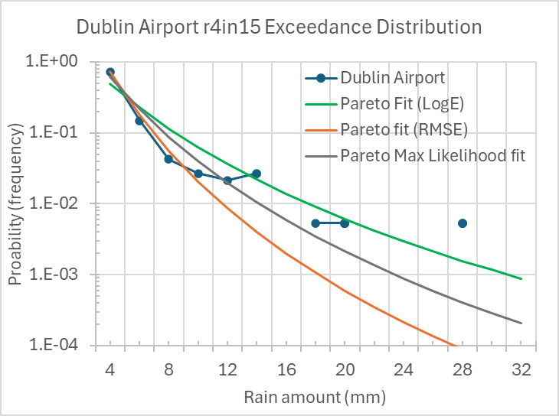
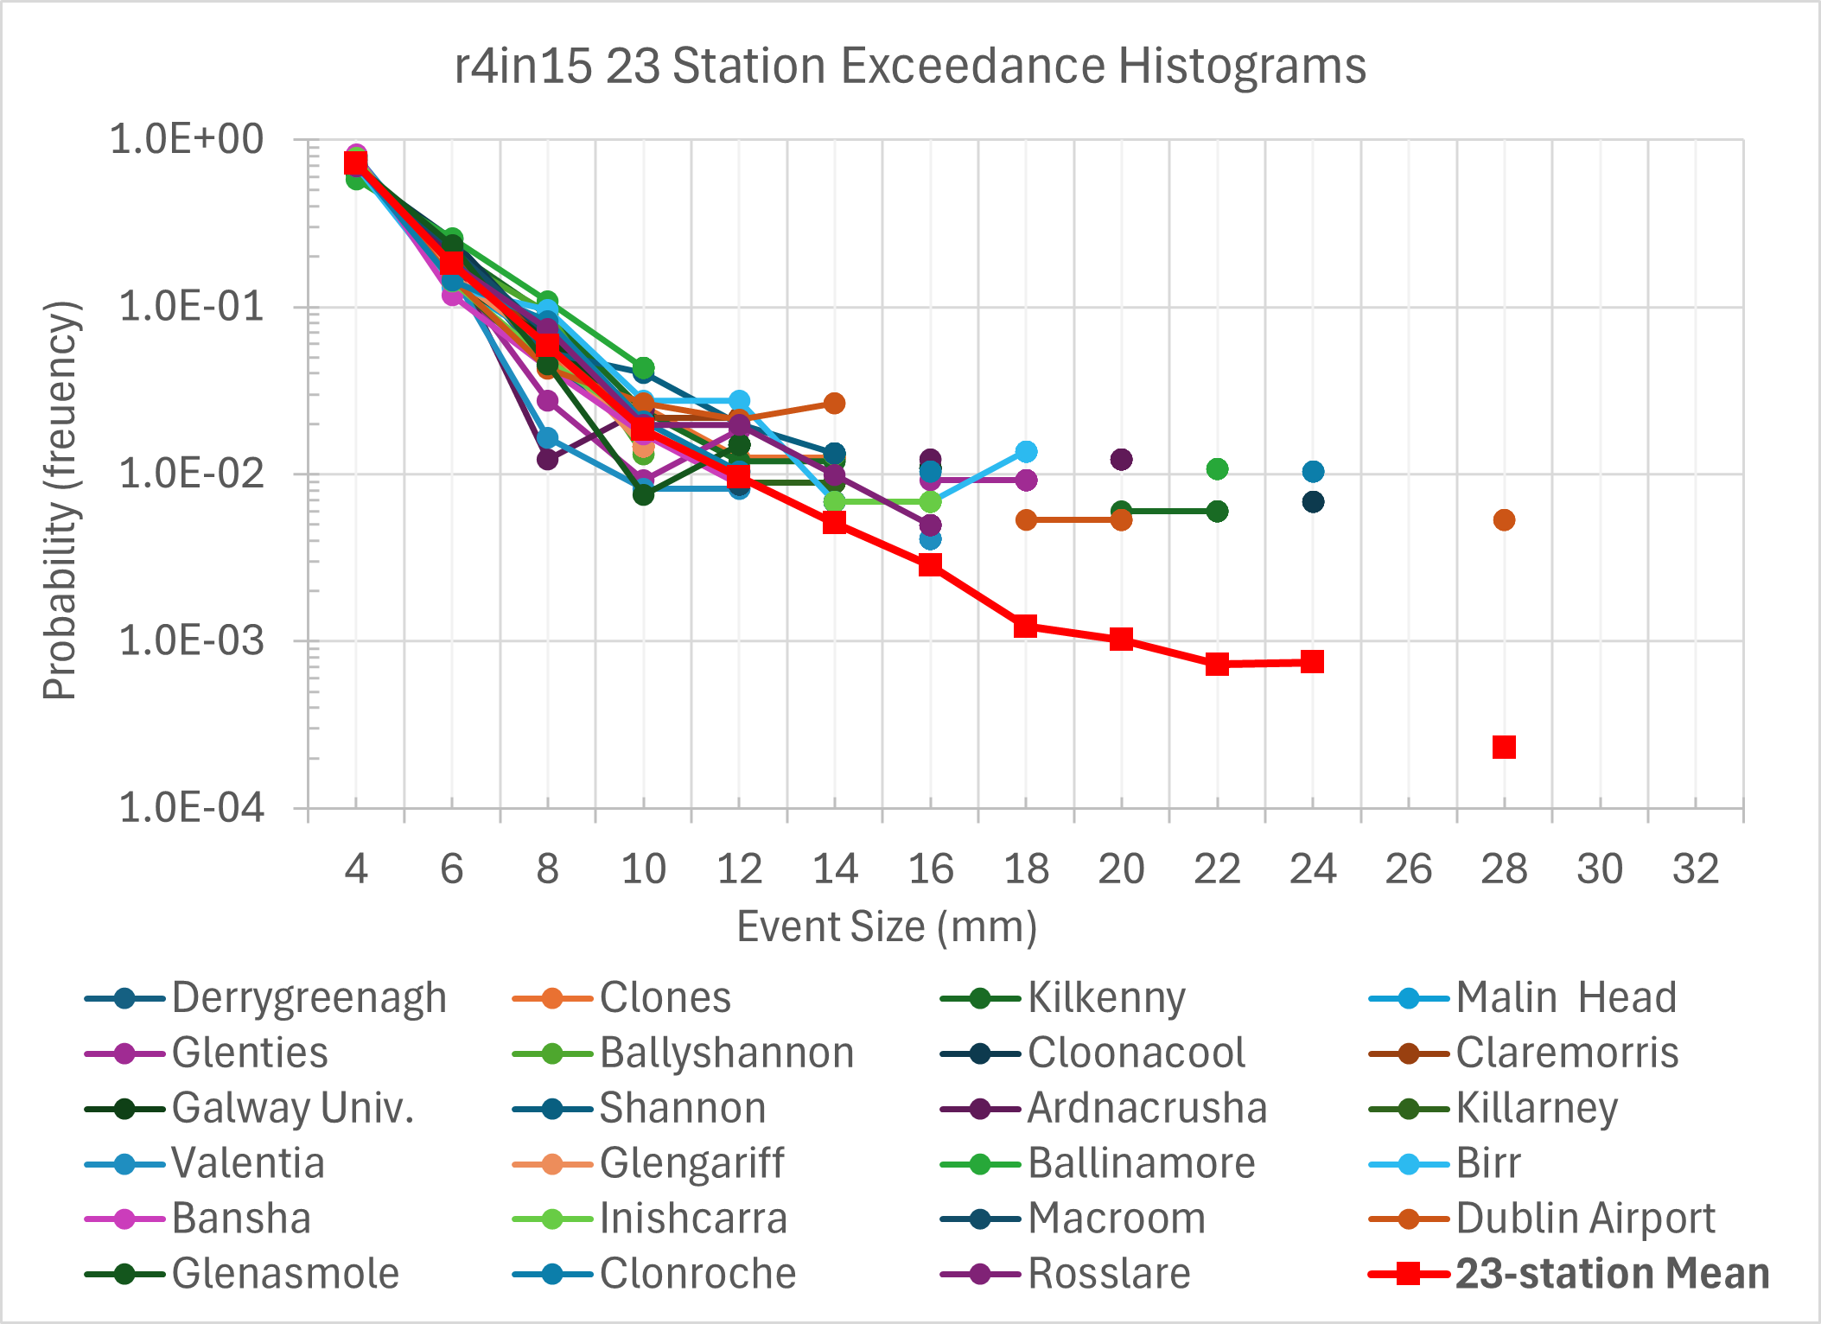
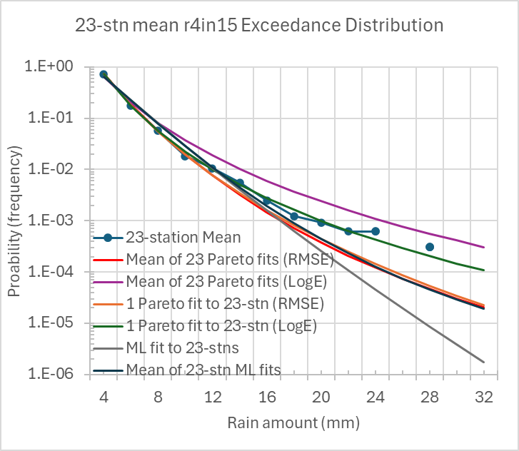
15-minute Event Exceedances (and GPD fits)
23-station mean exceedance curve is a good proxy for exceedances in general: exceedance behaviour is not station-specific.
In a finite observed period (~30-60 years), an extreme event that occurs just once is likely to be assigned an artificially large probability (and an artificially short return period). This anomaly is especially likely when nearby bin-sizes report no events at all.
The parameterized GPD fits should (ideally) correct such over- or under-representation in the observed data.
The parameterized GPD fits should also (ideally) capture some general underlying “asymptotic limit” of the data.
Several different fitting algorithms are possible: (Minimize errors in data or in Log(data) or with Maximum Likelihood method) x (1 GPD fit to 23-station mean or mean of 23 GPD fits)
Our preferred Pareto fit is by minimizing the error to the log(data). Gives more weight to (sparse) data in tails.
23-station data is aggregated first, then a GPD curve is fitted to that larger data-set. Otherwise, each station-specific GPD fit might be misled by sparse data for that station. (~ to a nation-wide vote vs. a 50-state electoral college for US election).
Notes:
There could be a case for simply taking the spread between the means of 23 RMSE and RMS-LogE fits. One undervalues the tails, the other overvalues them.
However, green curve in top=-right plot (1 Pareto fit to 23-station data using Log(data) ) seems to do pretty well.

Slide 6
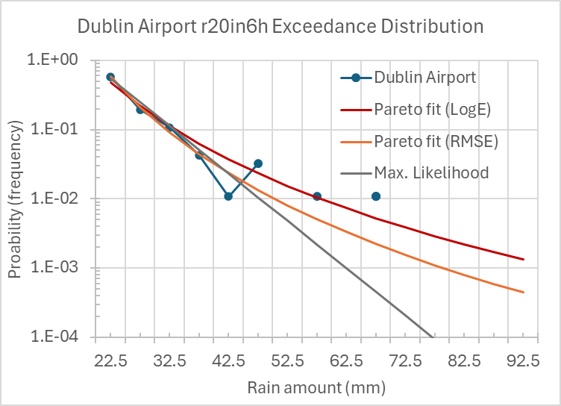
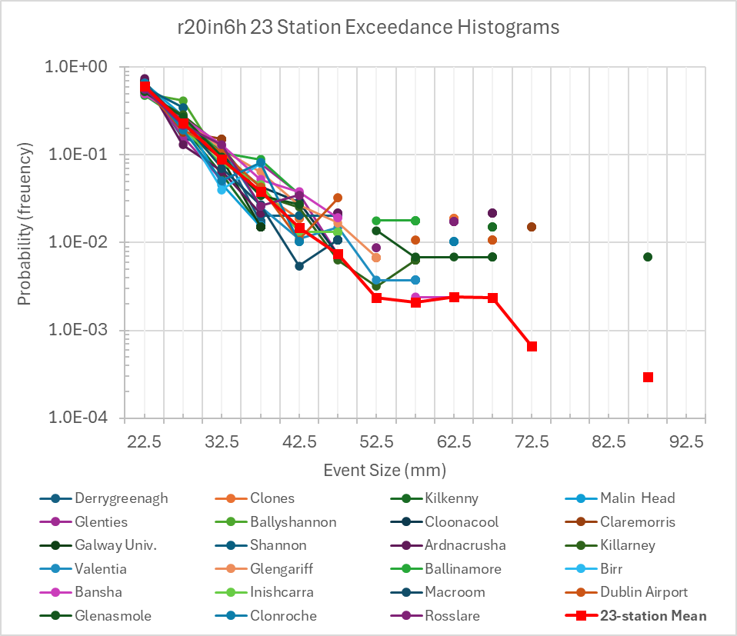
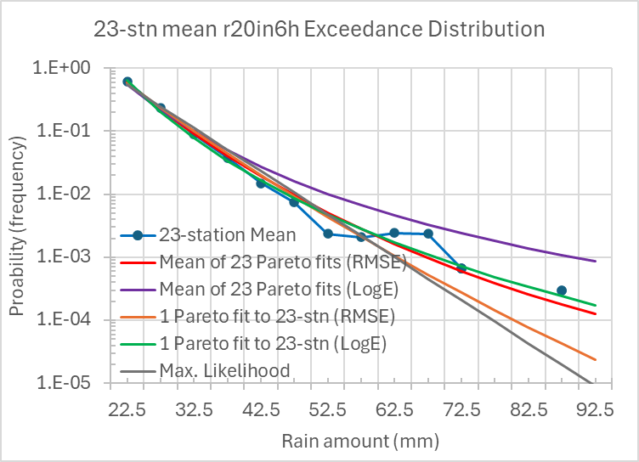
6-hour Event Exceedances (and Pareto fits)
As for 15-minute events, the 23-station mean is again a reasonable proxy for 6-hr event exceedances in general.
Same argument applies as for the 15-minute and other metrics: in a finite observed period, an extreme event that occurs just once is likely to be assigned an artificially large probability (and an artificially short return period). This happens e.g., when a 100-year event occurs in a particular 30-year period – while neighbouring “bins” report no events at all.
The parameterized GPD fits try to account for these observed features.
Minimizing differences with Log(data) gives more weight to values in tail.
For 23-stations, best fit here (as for 15-minute events) is the single GPD fit to all 23-station data, using Log(data) instead of (data) to optimize fit (green curve in top-right chart).

Slide 7
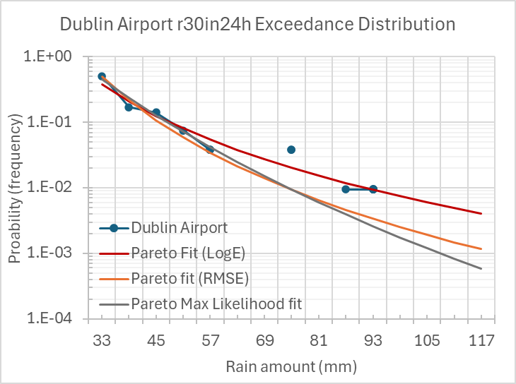
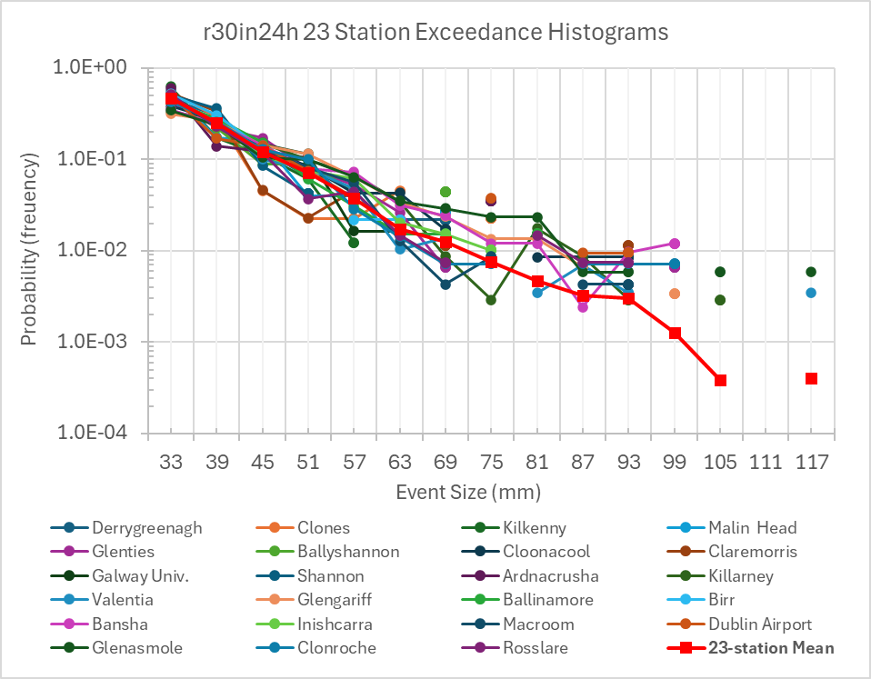
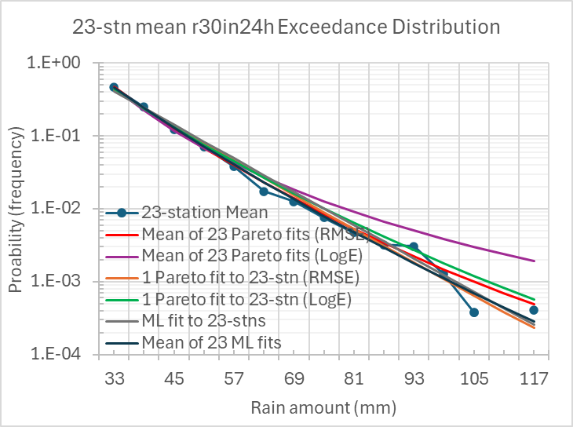
24-hr Event Exceedances (and Pareto fits)
As for 15-minute events, the 23-station mean is again a good proxy for 24-hr event exceedances in general.
Same argument applies as for the 15-minute and other metrics: in a finite observed period, an extreme event that occurs just once is likely to be assigned an artificially large probability (and an artificially short return period). This happens e.g., when a 100-year event occurs in a particular 30-year period – while neighbouring “bins” report no events at all.
The parameterized GPD fits try to account for these observed features.
Note the logarithmic y-axes.
Minimizing differences with Log(data) gives more weight to values in tail.
For 23-stations, “theoretical” best fit (as for other metrics) is the single GPD fit to all 23-station data, using Log(data) instead of (data) to optimize fit (green curve in top-right chart).

Slide 8
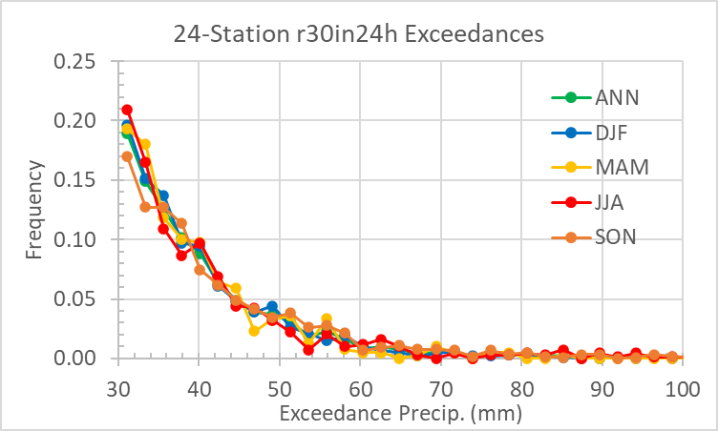
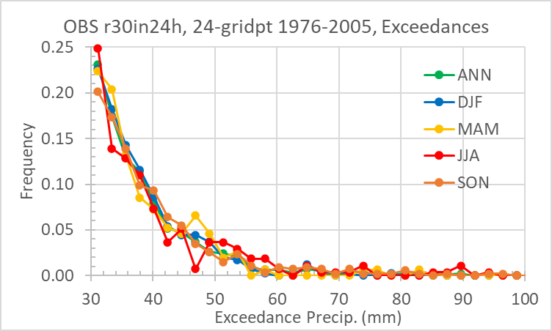
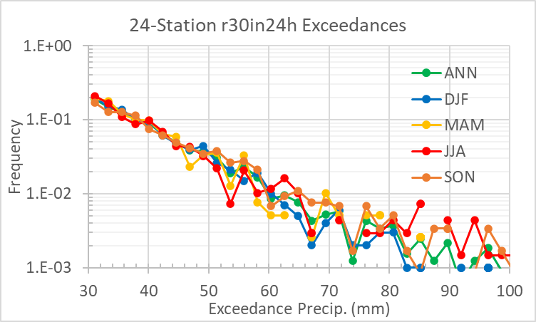
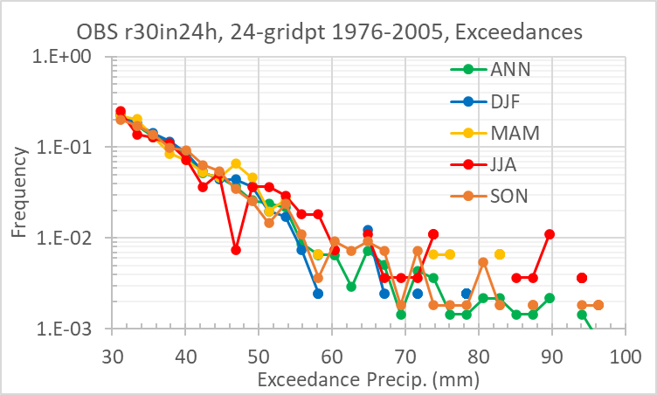
24-hr Exceedance Distributions from 24 Station data (left), and 24-gridpoints (right)
Distribution does not change as more events are included (e.g., seasonal to annual)
Very little seasonal dependence
(Linear axis)
(Log axis)

Slide 9
Some technical meta-data re. exceedances:
(mm) | r4in15 | r5in30 | r6in1h | r10in2h | r125in3h | r15in4h | r20in6h | r25in12h | r30in24h
Bin Min. | 4.0 | 5.0 | 6.0 | 10.0 | 12.5 | 15.0 | 20.0 | 25.0 | 30.0
Bin Max. | 34.0 | 35.0 | 51.0 | 55.0 | 72.5 | 75.0 | 95.0 | 115.0 | 120.0
Bin size | 2.0 | 2.0 | 3.0 | 3.0 | 4.0 | 4.0 | 5.0 | 6.0 | 6.0
No. bins | 15 | 15 | 15 | 15 | 15 | 15 | 15 | 15 | 15
All station data fit within these bin boundaries (e.g., there is no r30in24h event recorded > 120mm)
Those bin values are used to compute the various GPD fits.
Same bin values are used for all stations (and later, for all model output as well).
For number distributions, a max. of 20 per 3-yr period is enough for most metrics at most stations, though Glengariff had at least one 3-yr period with 50 r30in24h events. E.g., Killarney had a mean of 28.5 r30in24h events per 3-yr period – or an average of 1 event every 5 weeks or so.

Slide 10
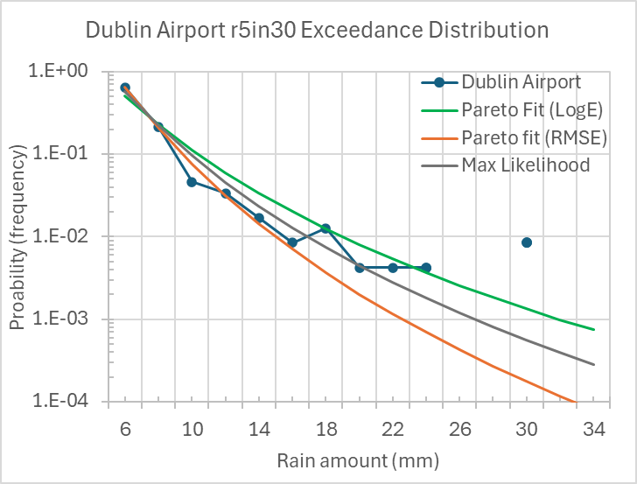
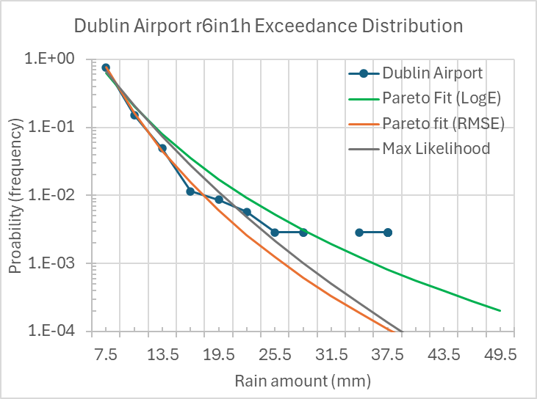
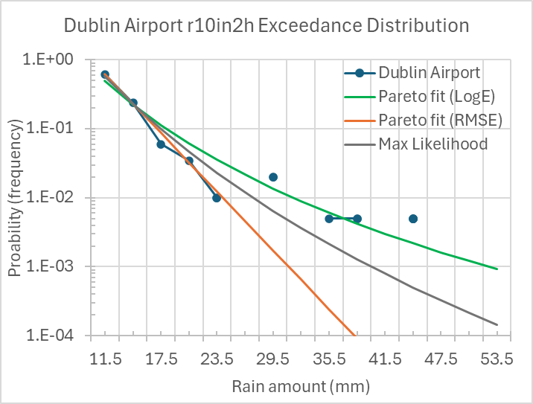
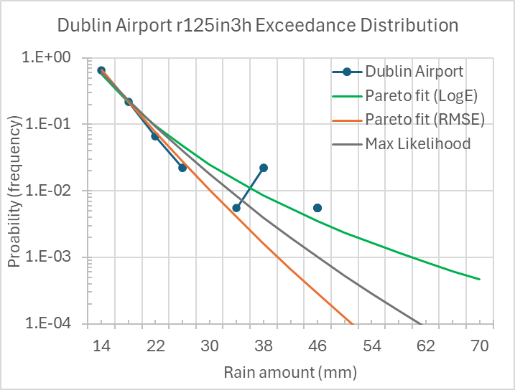
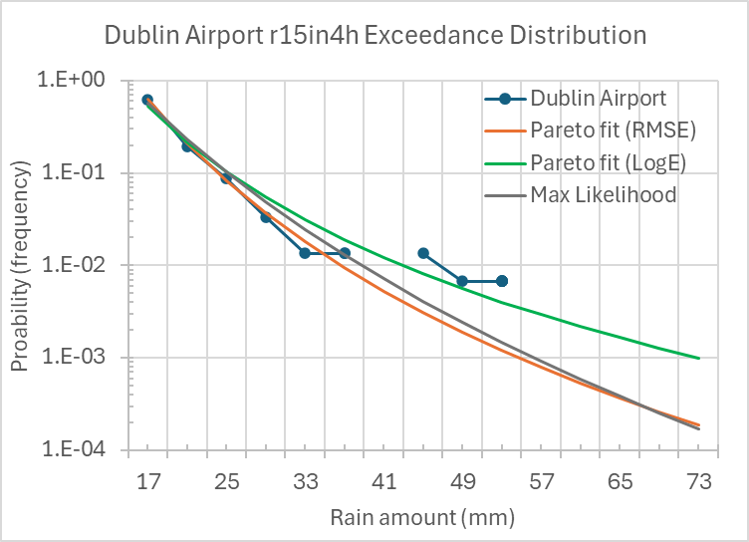
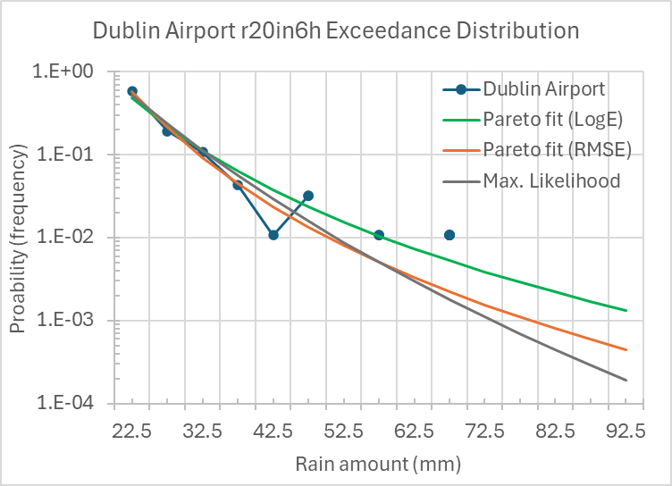
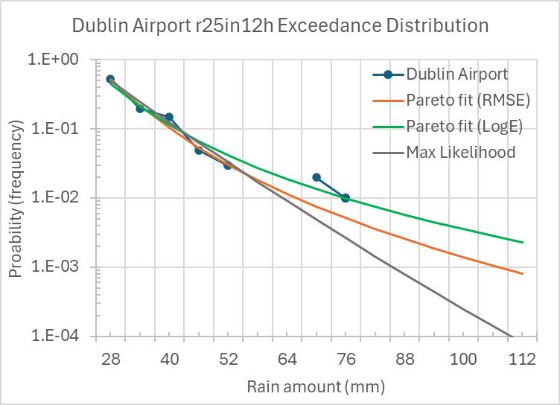
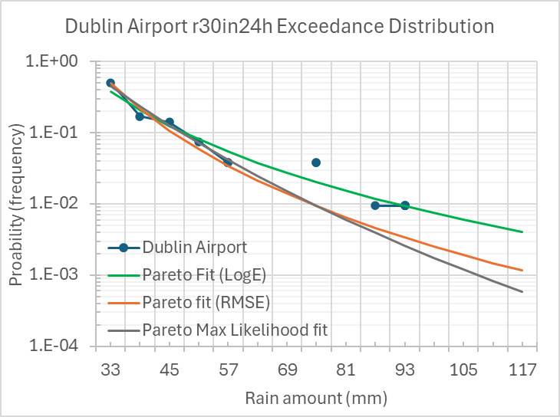
Dublin Airport Exceedances & Pareto Fits for all 9 metrics
Max Likelihood is theoretically the most accurate GPD fit – but appears to undervalue data in the tails(?)
Best GPD fit to tails is one that minimizes RMSE of Log(data) – green curves here.
GPD fit that minimizes RMSE of data is ~comparable to Max Likelihood.

Slide 11
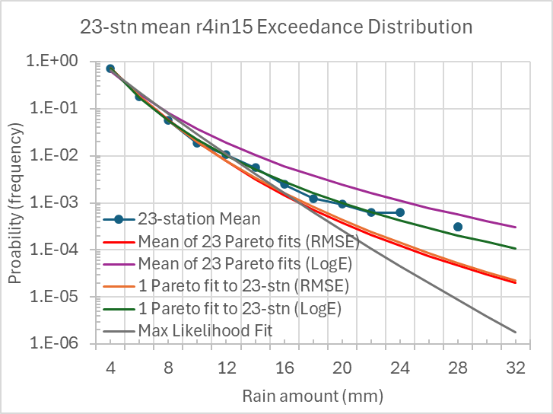
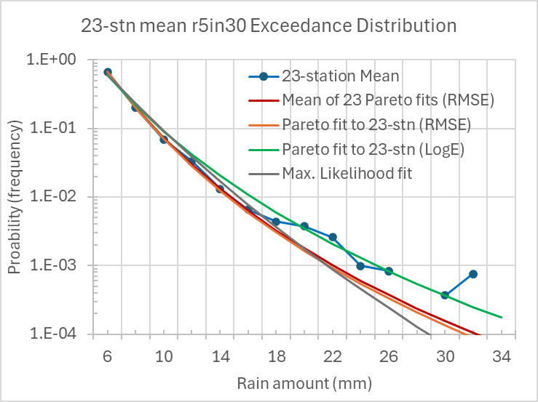
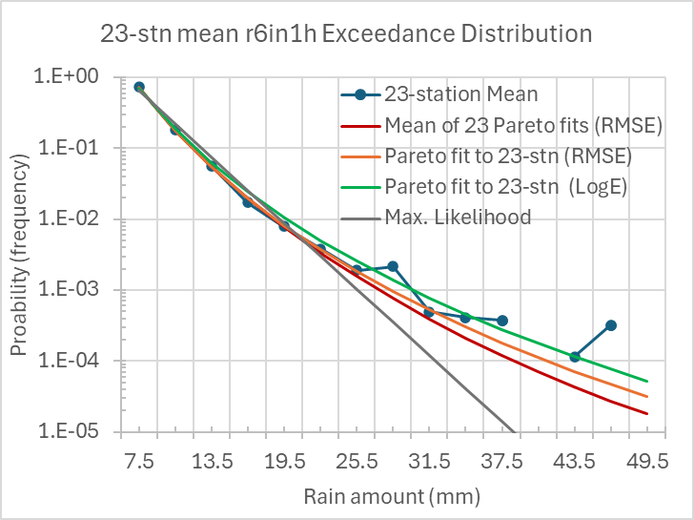
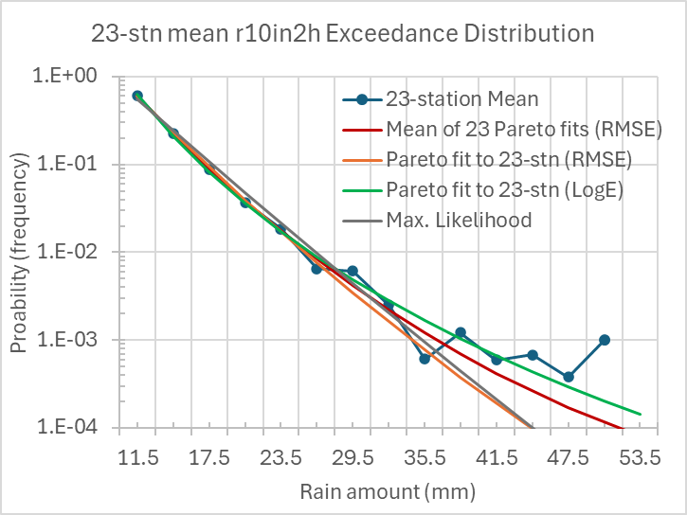
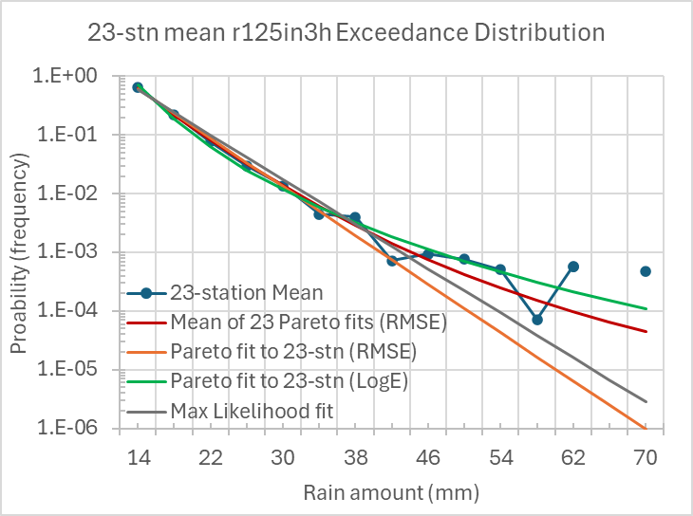
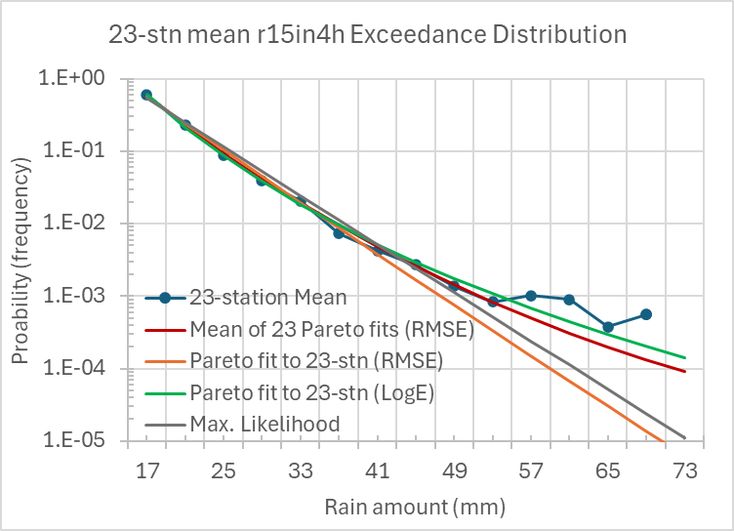
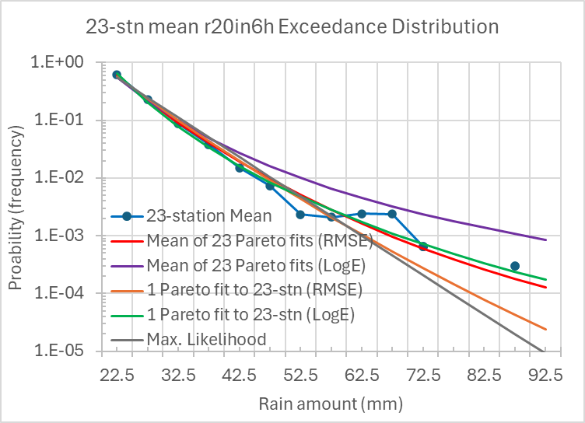
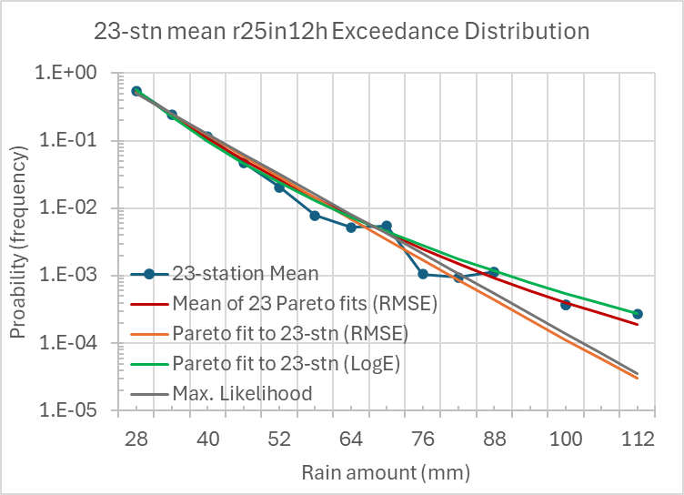
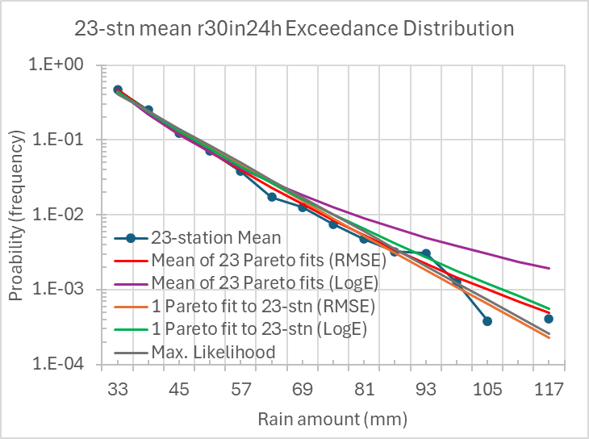
23-Station Mean Exceedances & Pareto Fits for all 9 metrics
Max Likelihood is theoretically the most accurate GPD fit – but appears to undervalue data in the tails(?)
Best GPD fit to tails is one that minimizes RMSE of Log(data) – green curves here.
GPD fit that minimizes RMSE of data is ~comparable to Max Likelihood.
Single fit to all 23-station data makes more sense than mean of 23 fits to each station separately (certainly for the LogE fit)

Slide 12
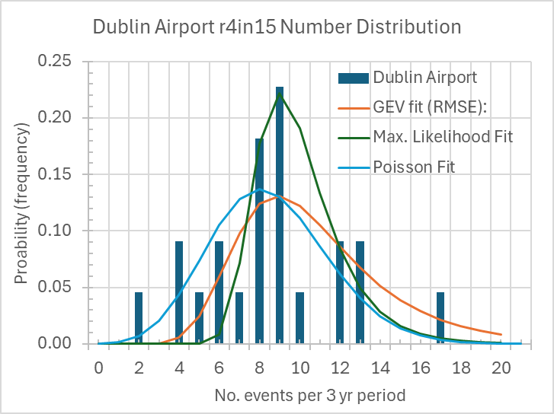
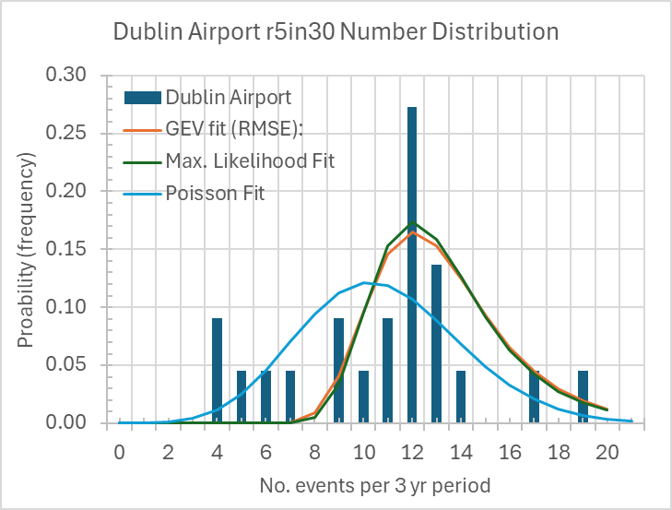
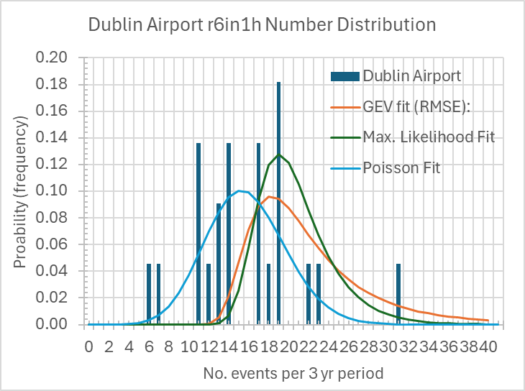
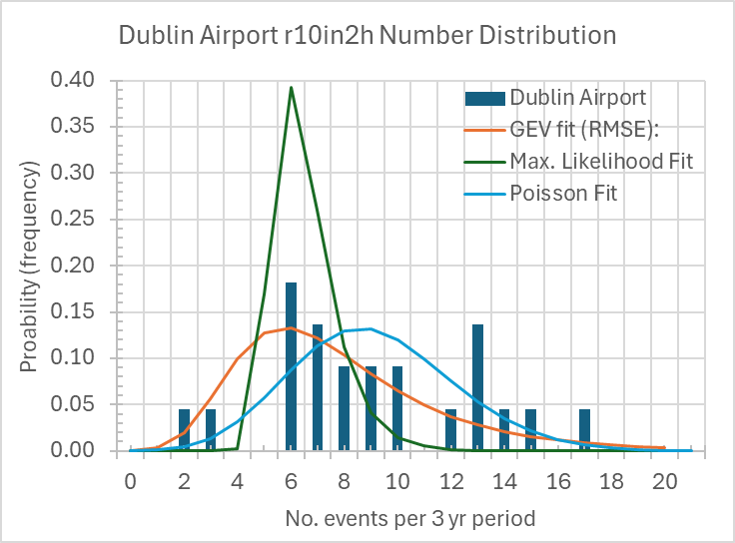
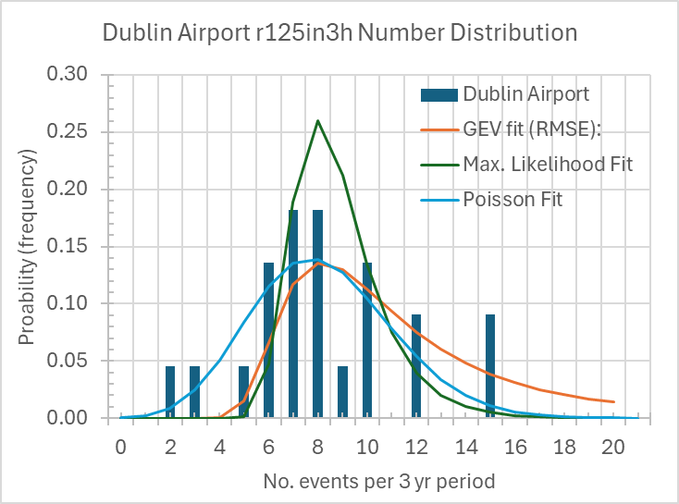
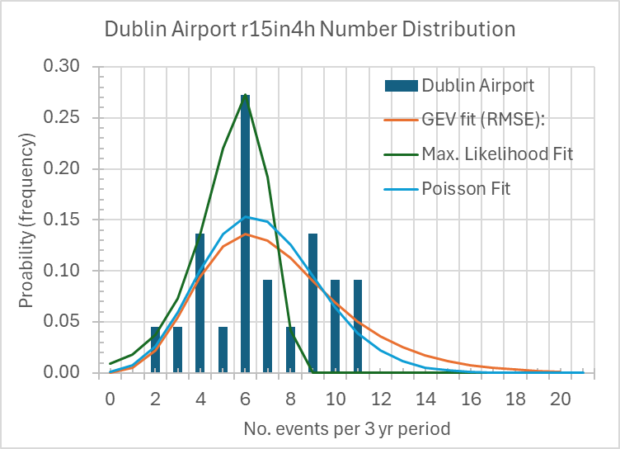
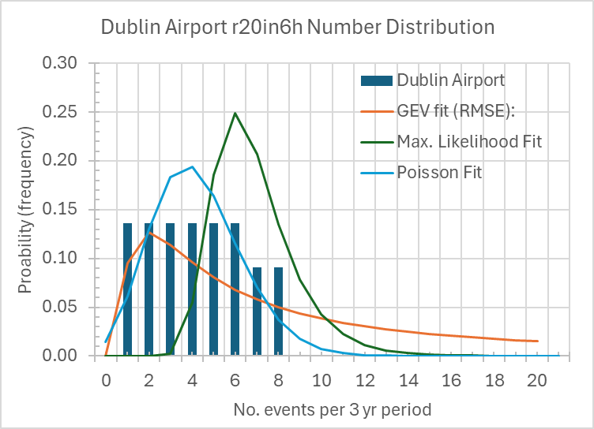
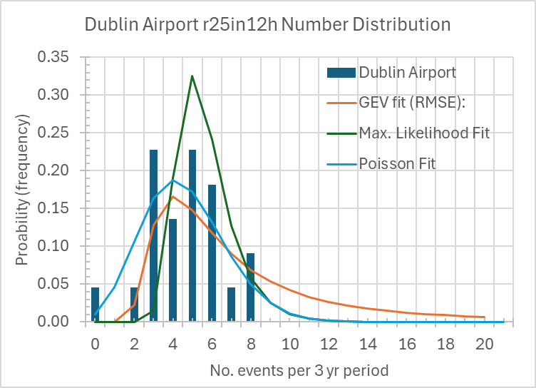
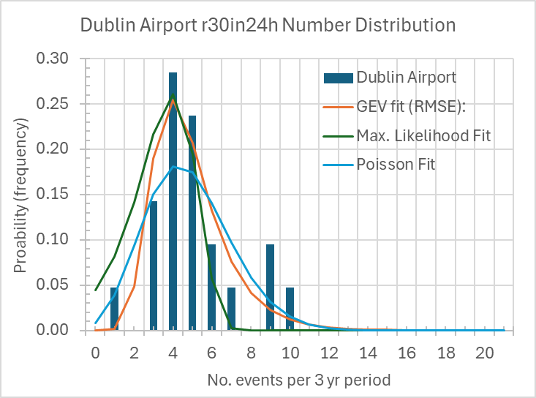
Dublin Airport Event Number Distributions (all 9 metrics)
(Note different x-axis scale for r6in1h.
Dublin Airport has 21 complete samples of 3-year periods (~1958-2022) – plus 1 partial sample.
Number-count distributions per 3-yr period are well modeled by Poisson (simple 1-parameter) or GEV (more general 3-parameter) distributions.
For return periods, however, all that really matters is the mean no. of events per fixed time period, and exceedance (Pareto) distn.
Notes:
GEV is “Generalized Extreme Value”.

Slide 13
Depth-Duration-Frequency (DDF) model
Duration dimension provided by 9 sub-daily periods (from 15 mins to 24 hours).
Goal: relationship between event size (depth) and return period (frequency).
Assume:
Number-counts are unique to each station
POT exceedances fall along a GPD (well established).
Exceedances are independent of location, so they can be pooled. This rests on empirical justification only – but to a good approximation.
Return period (in years) is then computed as:
Ret_period(event_size) = [(events/year)*Prob(event_size)]⁻¹
Station-specific
number count
Station-independent
exceedance distribution

Slide 14
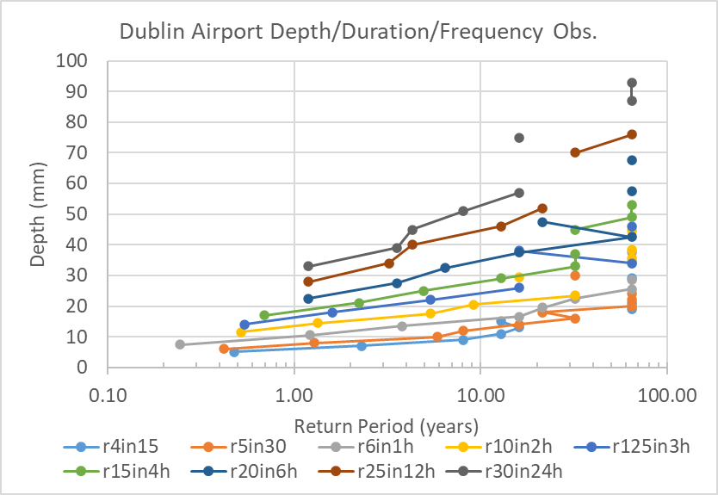
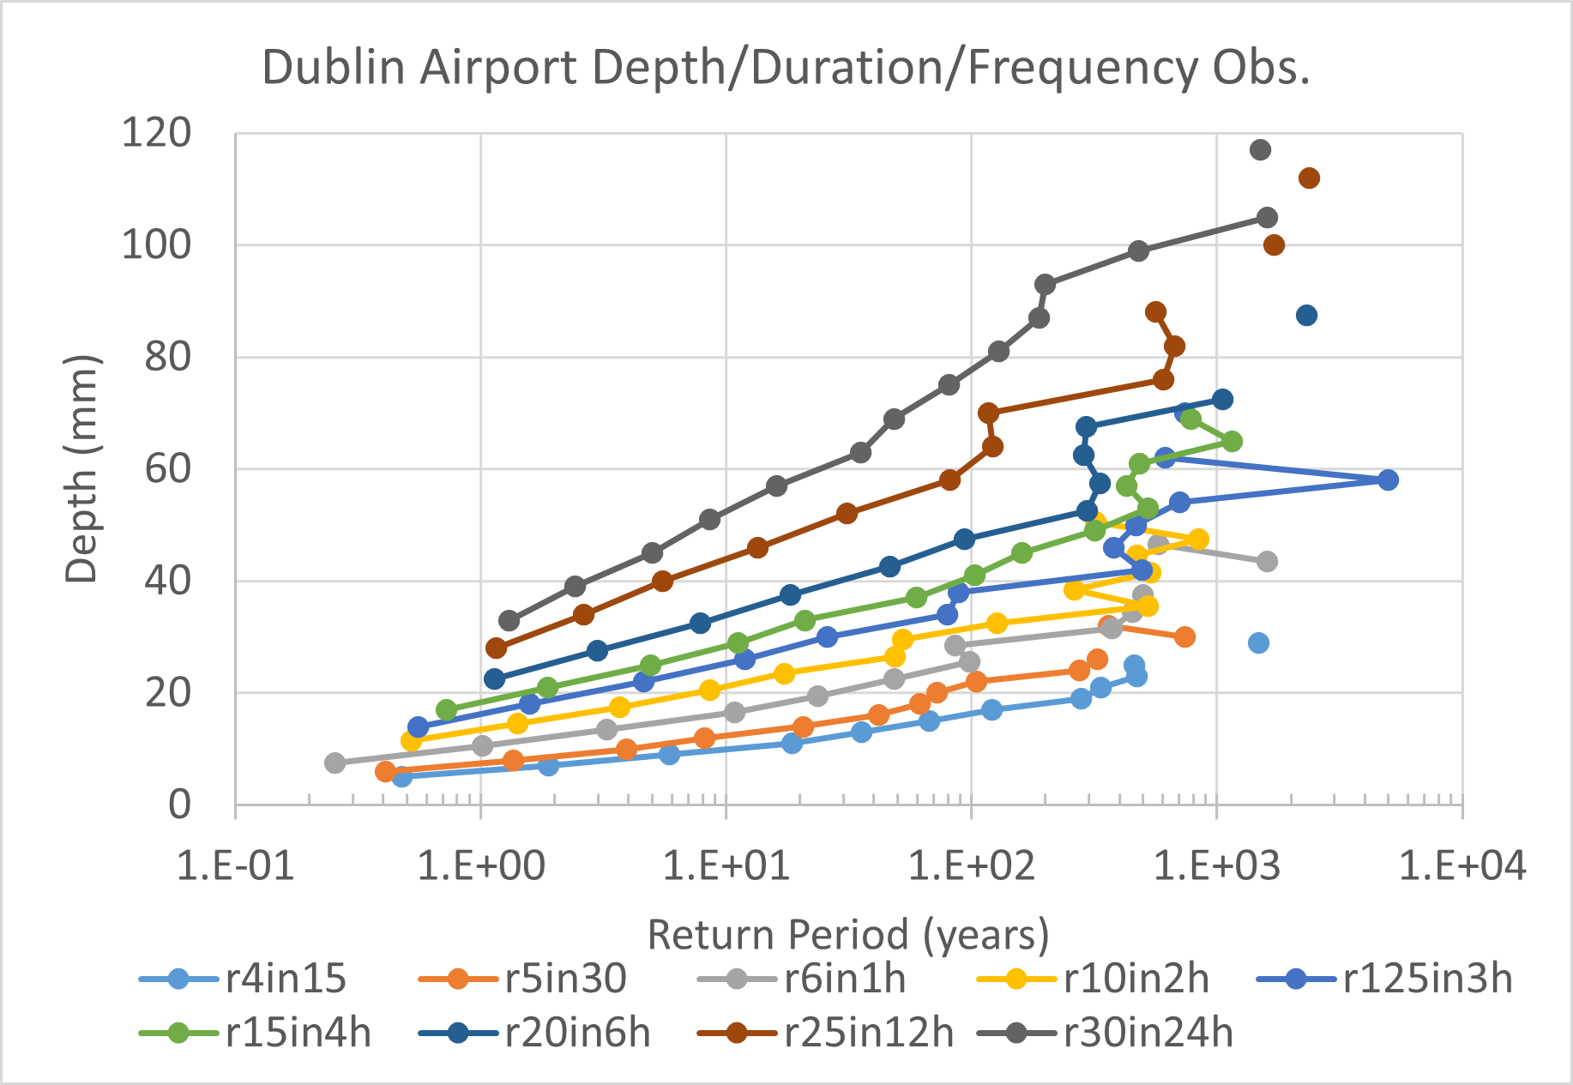

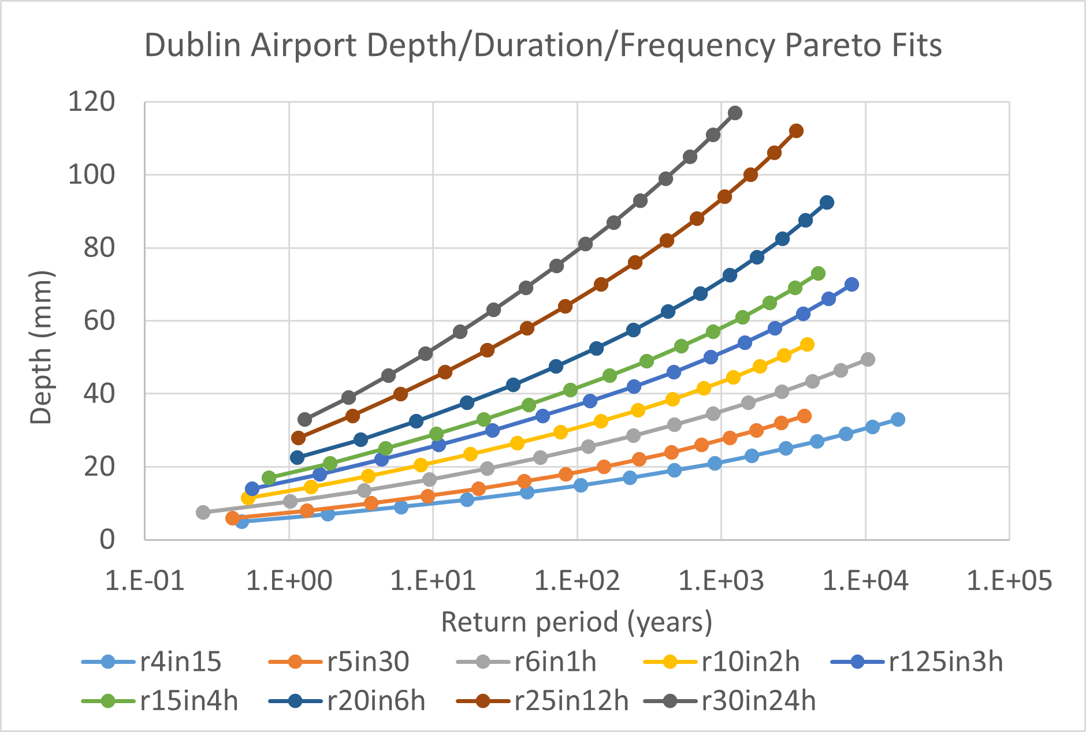
Dublin Airport Return Periods
(Using exceedances for Dublin Airport only)
(Using 23-station mean exceedances)
The vertical line of points at ~64 years return period above is an artifact of just one event occurring within these bin-sizes during the observed period (i.e., ~64 years). The “natural” return period of such events is possibly much longer.
A corollary is that for some (esp. larger) bin sizes, no events at all occurred during the 64 years.
Top right panel uses 23-station mean exceedances, with Dublin Airport occurrence frequency.
Bottom right panel uses 23-station mean Pareto fits, with Dublin Airport occurrence frequency.
(Using 23-station mean GPD fits)

Slide 15
Dublin Airport Return Periods
As copied from previous slide: the left panel is computed using the 23-station average observed exceedances along with Dublin Airport occurrence frequency.
The right panel is computed using the 23-station average GPD exceedance fits, along with Dublin Airport occurrence frequency.
These plots will possibly (most likely…) change in future climates.

Slide 16
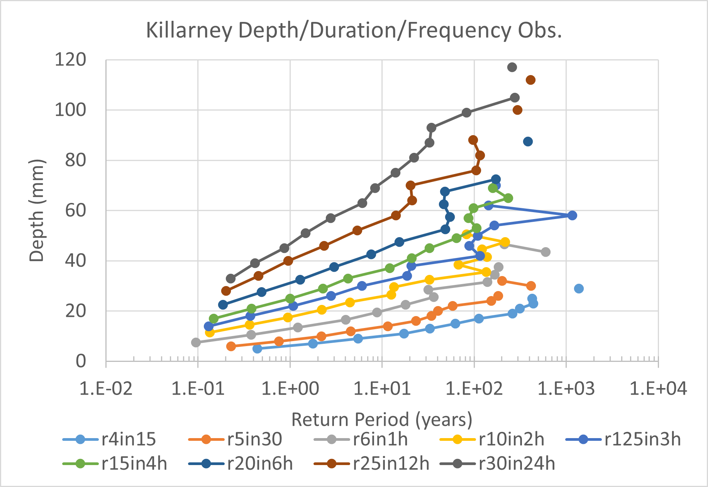
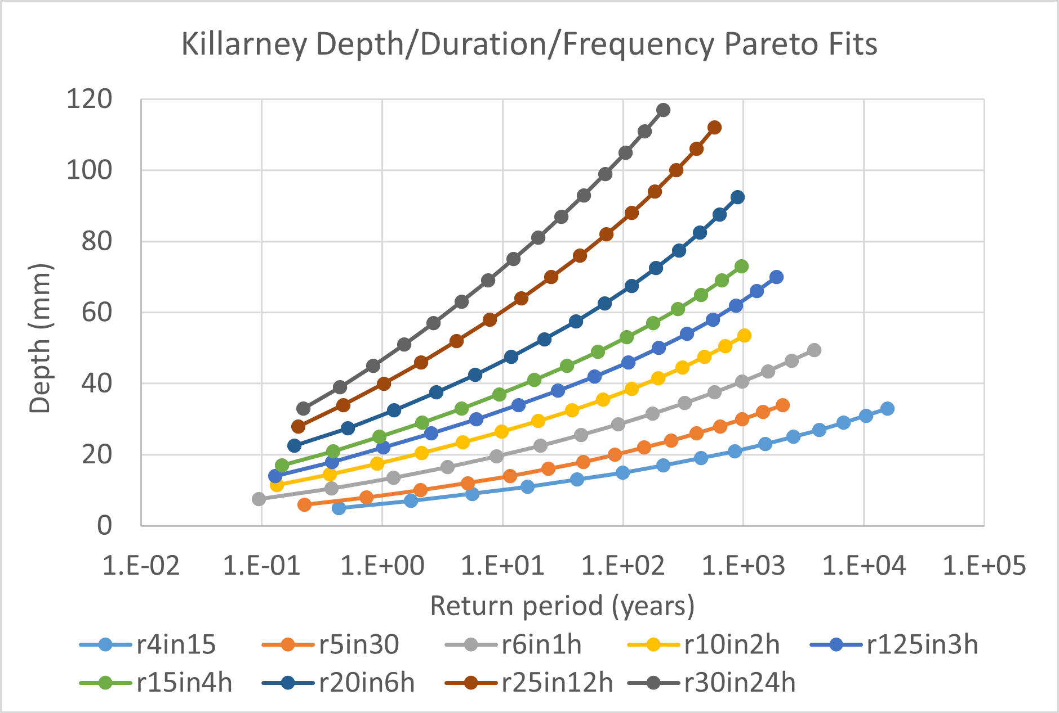
Killarney Return Periods
Killarney is much wetter, with much shorter return periods than Dublin!
Left panel uses the 23-station mean observed exceedances, with Killarney occurrence frequency.
Right panel uses the 23-station mean GPD exceedance fits, with Killarney occurrence frequency.
These plots will possibly (most likely) change in future climates.

Slide 17

Summary Event Counts from Station Obs. & Model Projections
Box-and-whisker summaries of event count data for (a) Dublin Airport and (b) Killarney from the 6-member RCM ensemble for historical (1976-2005, orange boxes), and end-century (2071-2100) periods under both RCP45 (grey boxes) and RCP85 (yellow boxes) scenarios, and for each of the 4 resolved duration/threshold metrics. The asterisks represent the observed counts from the complete station records.
Dublin Airport historical simulations produce more events than observed for 6, 12, and 24-hour metrics, possibly reflecting a positive bias.
Killarney historical simulation “envelope” includes observed counts for all metrics; no evidence of bias here.
Main feature though is that RCP45 by end-century produces more events than were simulated during historical period, and RCP85 produces even more.

Slide 18
Future Exceedances
The GPD distributions for intense rainfall exceedances are highly reproducible (i.e., from station to station, and from season to season), for each metric within the observed station data.
There is no need to assume that these distributions will remain constant as the climate changes in future – but we can test this using model output.
Number distributions, are both highly station-dependent and season-dependent; these are expected to change as the background climate changes.
Consequently, the return periods (and depth/duration/frequency plots) are also likely to change.
Can use 3-hourly output from a 6-member ensemble of CMIP5 simulations downscaled over Ireland to directly project 3, 6, 12 and 24-hr events, but the other shorter-duration metrics (r4in15, etc.) must be estimated indirectly (see following slides…)

Slide 19
So much for station observations…
Next, apply the DDF model to future climate projections…
Input data: 6-member ensemble of CMIP5 global simulations dynamically downscaled over Ireland
Each model has 3-hourly output
Use “delta change” method as bias-correction to project future changes at each grid point:
future = obs-past*(model-future/model-past)
Use mean changes from 3 to 24-hour events (all relatively uniform) to estimate changes to sub-3-hourly events.
Results available for (rcp45, rcp85) x (2021+, 2041+, 2071+) and all 9 duration metrics.
Paper published in Weather and Climate Extremes (2026):
(https://doi.org/10.1016/j.wace.2026.100862)

Slide 20




Dublin Airport Past & Future Return Periods from EC-Earth
The GPD (LogE) distributions (grey, red curves) remain a good fit to the various data (light blue, orange circles).
Return periods shorten mainly because future event counts increase by ~50% or more (causing left-shift from grey to red curves).
Exceedance distributions (& assoc. GPD fits) also change from past to future – they acquire longer tails, appear steeper here, and thus have even shorter return periods.
Notes:
The EC-EARTH output is from the precip. values saved every 3 hours. The 2 simulations considered are for the historical period 1976-2005 and the future period 2071-2100 under the RCP8.5 emission scenario.

Slide 21




Killarney Past & Future Return Periods from EC-Earth
The GPD (LogE) distributions (grey, red curves) remain a good fit to the various data (light blue, orange circles).
Return periods shorten mainly because future event counts increase by ~50% or more (causing left-shift from dark blue to red curves).
Exceedance distributions (& assoc. GPD fits) also change from past to future – they acquire longer tails, appear steeper here, and thus have even shorter return periods.
Notes:
The EC-EARTH output is from the precip. values saved every 3 hours. The 2 simulations considered are for the historical period 1976-2005 and the future period 2071-2100 under the RCP8.5 emission scenario.

Slide 22




Dublin Airport Past & Future Return Periods from CNRM-CM5
The GPD distributions (dark blue, red curves) remain a good fit to the various data (light blue, orange curves).
Return periods shorten mainly because future event counts increase by ~50% or more (causing left-shift from dark blue to red curves).
Exceedance distributions (& assoc. GPD fits) also change from past to future – they acquire longer tails, appear steeper here, and thus have even shorter return periods.
Notes:
The EC-EARTH output is from the precip. values saved every 3 hours. The 2 simulations considered are for the historical period 1976-2005 and the future period 2071-2100 under the RCP8.5 emission scenario.

Slide 23




Number count changes from past to future (Dublin Airport, EC-Earth)
Dublin Airport | Mean no. events per 3-year period
 | r125in3h | r20in6h | r25in12h | r30in24h
Station data (1958-2022) | 8.4 | 4.3 | 4.7 | 4.9
EC-Earth (1976-2005) | 7.5 | 4.6 | 5.7 | 5.6
EC-Earth (rcp85, 2071-2100) | 12.7 | 7.2 | 8.0 | 8.4
EC-Earth % change: | 69.3% | 56.5% | 40.3% | 50.0%

Slide 24




Number count changes from past to future (Killarney, EC-Earth)
Killarney | Mean no. events per 3-year period
 | r125in3h | r20in6h | r25in12h | r30in24h
Station data (1968-2004) | 36.0 | 26.4 | 27.2 | 28.6
EC-Earth (1976-2005) | 38.7 | 26.1 | 28.5 | 28.2
EC-Earth (rcp85, 2071-2100) | 66.4 | 43.8 | 42.4 | 40.2
EC-Earth % change: | 71.6% | 67.8% | 48.8% | 42.6%

Slide 25


Obs. & Ensemble mean Projections (rcp85, 2071-2100)
Projections are for 2071-2100 under RCP8.5 emissions
Return periods becomes shorter in the future according to all models.
Event sizes are amplified in future for longer return periods (i.e., not uniform amplification!)
Same shapes, different scales for both Dublin airport and Killarney

Slide 26









Obs. & Ensemble mean, Dublin Airport Projections (LogE)
Observations (red curves) are for 1976-2005
Projections (black curves) are for 2071-2100 under RCP8.5 emissions
Cone of Uncertainty (i.e., spread among all ensemble member projections shown as grey shading) increases for longer return periods.
Return periods becomes shorter in the future according to all models.
GPD fits here use RMSE minimization of Log(data).

Slide 27


Obs. & Ensemble mean, Dublin Airport Projections (LogE)
9 observed return period metrics:
9 projected return period metrics:
(a)
(b)

Slide 28




Obs. & Ensemble mean, Killarney Projections (LogE)
Projections are for 2071-2100 under RCP8.5 emissions
Return periods becomes shorter in the future according to all models.
Pareto fits here use RMSE minimization of Log(data).
Curves mainly shifted downwards (from greater numbers), but with some change in shape too (change in exceedance distribution).
Cone of Uncertainty (i.e., spread among all ensemble member projections) increases for longer return periods.

Slide 29









Obs. & Ensemble mean, Killarney Projections (LogE)
Observations (red curves) are for 1976-2005
Projections (black curves) are for 2071-2100 under RCP8.5 emissions
Cone of Uncertainty (i.e., spread among all ensemble member projections shown as grey shading) increases for longer return periods.
Return periods becomes shorter in the future according to all models.
GPD fits here use RMSE minimization of Log(data).

Slide 30


Obs. & Ensemble mean, Killarney Projections (LogE)
9 observed return period metrics:
9 projected return period metrics:
(a)
(b)

Slide 31

3-hour event counts (>12.5 mm): past & future projected, & change ratio
Counts are normalized to number per 3-years.
Projections are for 2071-2100 under RCP45
Biggest changes (bottom right) occur where number counts are lowest (midlands, northeast).
Number counts increase (change ratio >1) everywhere

Slide 32



6-hour event counts (>20 mm): past & future projected, & change ratio
Counts are normalized to number per 3-years.
Projections are for 2071-2100 under RCP45
Biggest changes (bottom right) occur where number counts are lowest (midlands, northeast).
Number counts increase (change ratio >1) everywhere
(a)
(b)
(c)

Slide 33



12-hour event counts (>25 mm): past & future projected, & change ratio
Counts are normalized to number per 3-years.
Projections are for 2071-2100 under RCP45
Biggest changes (bottom right) occur where number counts are lowest (midlands, northeast).
Number counts increase (change ratio >1) everywhere
(a)
(b)
(c)

Slide 34



24-hour event counts (>30 mm): past & future projected, & change ratio
Counts are normalized to number per 3-years.
Projections are for 2071-2100 under RCP45
Biggest changes (bottom right) occur where number counts are lowest (midlands, northeast).
Number counts increase (change ratio >1) everywhere
(a)
(b)
(c)

Slide 35

Historical and projected return periods for 3-hr events of size ~30 mm
Projections are for 2071-2100 under RCP45
Colours in log₁₀ units (i.e., exponent n when years are expressed as 10^{n}).
Historical return periods range from < 10 yrs in SW to > 100 yrs in NE.
Return periods shorten everywhere by end century (2071-2100).
Bottom right is (b)/(a), showing return periods ~2 times shorter under rcp45 by end of century.

Slide 36

Historical and projected return periods for 6-hr events of size ~42 mm
Projections are for 2071-2100 under RCP45
Colours in log₁₀ units (i.e., exponent n when years are expressed as 10^{n}).
Historical return periods range from < 10 yrs in SW to > 100 yrs in NE.
Return periods shorten everywhere by end century (2071-2100).
Bottom right is (b)/(a), showing return periods ~2 times shorter under rcp45 by end of century.

Slide 37

Historical and projected return periods for 12-hr events of size ~82 mm
Projections are for 2071-2100 under RCP45
Colours in log₁₀ units (i.e., exponent n when years are expressed as 10^{n}).
Historical return periods range from < 10 yrs in SW to > 100 yrs in NE.
Return periods shorten everywhere by end century (2071-2100).
Bottom right is (b)/(a), showing return periods ~2 times shorter under rcp45 by end of century.

Slide 38

Historical and projected return periods for 24-hr events of size ~87 mm
Projections are for 2071-2100 under RCP45
Colours in log₁₀ units (i.e., exponent n when years are expressed as 10^{n}).
Historical return periods range from < 10 yrs in SW to > 100 yrs in NE.
Return periods shorten everywhere by end century (2071-2100).
Bottom right is (b)/(a), showing return periods ~2 times shorter under rcp45 by end of century.

Slide 39
Open Questions
How justified is it to pool or aggregate station data?
Increases sample counts, makes it easier to find GPD fits to POT exceedances
But is it okay to change e.g., a 60-year event (based on single-station data) to a 600-year event (based on pooled station data)?
Exceedances tend to “converge” as more stations (or grid points) are pooled; does that reflect the validity of pooling, or nothing special?
Pooling every grid point provides the smoothest exceedance distribution – but loses event independence (some events are inevitably counted more than once). Is that a worthwhile trade-off?
(My tentative answer is “yes” to all the above)
Model ensembles as proxies for pooling should help…

Slide 40
How do TRANSLATE return period estimates converge as more stations (or grid-points) are added to the aggregated exceedances?

Slide 41


Exceedances & GPD fits to 11 “Western” and 11 “Eastern” stations
The pooled exceedances from 11 western stations and 11 eastern stations are indistinguishable.
Raw data
GPD fits
Each data point or curve here is based on the ensemble mean of 6 models over historical period 1976-2005.
Exceedances feed into return periods, but return periods depend on event counts, and are unique to each station.

Slide 42





Convergence with pooled stations (3-hr events)
Probability is the fraction of all events within each bin-size.
3-hr event histograms from historical model runs, pooling data from 1, 11, 23, and 48 stations (and even all 729 land grid-points).
Convergence of the model histograms extends to larger event sizes as more stations are pooled, though data from very large event sizes remains “noisy”.
Histograms for 85, 180 and 729 points are almost indistinguishable.
1-Station
11-Station
24-Station
48-Station

Slide 43





Convergence with pooled stations (3-hr events)
Probability is the fraction of all events within each bin-size.
3-hr event GPD fits to histograms from historical model runs, pooling data from 1, 11, 24, and 48 stations (then 85-, 180-, and all 729 grid-points).
Convergence of the GPD fits extends to larger event sizes as more stations are pooled, though raw data from very large event sizes remains “noisy”.
Distributions from 85, 180 and 729 gridpoints are almost indistinguishable.
1-Station
11-Station
24-Station
48-Station

Slide 44


Convergence with pooled stations (3-hr events)
As more stations are pooled in the calculation of exceedance probabilities, the GPD fits to the exceedance histograms seem to asymptote to a single “general” curve.
Considering just the probability of the event sizes in the largest “bin” (68.5-72.5 mm), the models converge both internally and (to a lesser extent) among each other as more stations are pooled (or aggregated) in calculating exceedance probabilities.

Slide 45





Convergence with pooled stations (24-hr events)
Probability is the fraction of all events within each bin-size.
24-hr event histograms from historical model runs, pooling data from 1, 11, 23, and 48 stations (and even all 729 land grid-points).
Convergence of the model histograms extends to larger event sizes as more stations are pooled, though data from very large event sizes remains “noisy”.
Histograms for 85, 180 and 729 points are almost indistinguishable.
1-Station
11-Station
24-Station
48-Station

Slide 46





Convergence with pooled stations (24-hr events)
Probability is the fraction of all events within each bin-size.
24-hr event GPD fits to histograms from historical model runs, pooling data from 1, 11, 24, and 48 stations (and all 729 grid-points).
Convergence of the GPD fits extends to larger event sizes as more stations are pooled, though raw data from very large event sizes remains “noisy”.
Distributions from 85, 180 and 729 gridpoints are almost indistinguishable.
1-Station
11-Station
24-Station
48-Station

Slide 47


Convergence with pooled stations (24-hr events)
As more stations are pooled in the calculation of exceedance probabilities, the GPD fits to the exceedance histograms seem to asymptote to a single “general” curve.
Considering just the probability of the event sizes in the largest “bin” (114-120 mm), the models converge both internally and (to a lesser extent) among each other as more stations are pooled (or aggregated) in calculating exceedance probabilities.

Slide 48


Bootstrap-based Confidence Intervals
These data are from Dublin Airport 3-hr events (r125in3h) only.
Red square to left and black curve above are “best GPD fit” to all obs. data
Blue points to left are GPD fits to 10,000 “bootstrapped”, or randomly selected (with replacement) sets of same no. of values from the obs. data
Percentile curves or confidence intervals (above) are obtained from those 10,000 fits separately for each depth “bin”.
Those confidence intervals widen substantially for larger, rarer events!
Only the base estimate (black curve above) is a true “probability” distn.

Slide 49


TRANSLATE POT Approach
The 2 fundamental but distinct statistics are:
Event Counts
Easy to count
Modelled by Poisson Distribution
Specific to each location
Exceedance probabilities
Based on binned exceedance histograms
Modelled by Generalized Pareto Distribution (GPD)
Assumed independent of location
Become smoother with station “pooling” or “aggregating”
Everything else can be obtained from the above:
Cumulative probabilities
Return periods (binned or cumulative).

Slide 50

Dublin Airport, 3-hr Event Return Period Estimates
The red squares are the raw single-station obs.
The black curves are the best GPD fits, for single-station only (solid black) and 23 pooled stations (dashed black).
The orange curves span the 96-percentile confidence interval; solid for single-station, dashed for 23 pooled stations.
Current Met Éireann estimates (blue curve) are within “single-station” 96% envelope.
The single-station estimates are dominated by the biggest outliers (by construction, really) – to the extent that some smaller single-station obs. are outside the 96% envelope.
The 96-percentile range is much smaller for the 23-station aggregate than for the single-station estimate.
This still begs the question as to whether pooling like this is valid or not.

