Slide 1
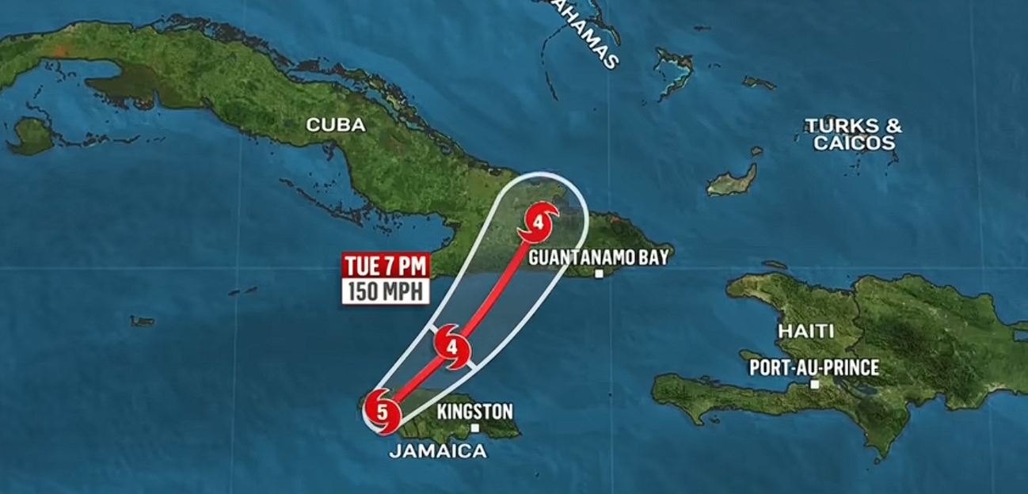


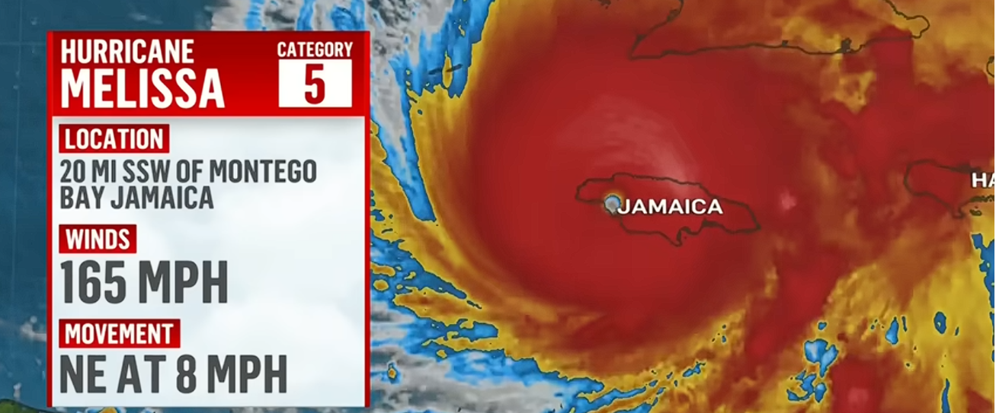

Hurricane Melissa brings heavy rain to Kingston, Jamaica
Sensitivity of Extreme Hurricane Precipitation to WRF Microphysics and Grid Spacing: Hurricane Melissa (2025) Landfall over Jamaica
EGU General Assembly 2026 · Vienna, Austria
Tahmida Sarker Muna¹, Paul W. Miller¹, and Nazla Bushra^{1,2}
¹ Department of Oceanography and Coastal Sciences, Louisiana State University, Baton Rouge, 70803, USA
²Louisiana Office of State Climatology, Department of Oceanography and Coastal Sciences, Louisiana State University, Baton Rouge, 70803, USA
Hurricane Melissa brings heavy rain to Kingston, Jamaica

Slide 2
Simulation Purpose
1. To evaluate the sensitivity of WRF microphysical parameterizations (WSM6 and Morrison) in simulating the extreme rainfall and spatial distribution of precipitation associated with the landfall of Hurricane Melissa over Jamaica
2. Validate the WRF simulations output against IMERG data and CHIRPS satellite precipitation data
Sensitivity of Extreme Hurricane Precipitation to WRF Microphysics and Grid Spacing: Hurricane Melissa (2025) Landfall over Jamaica

Slide 3
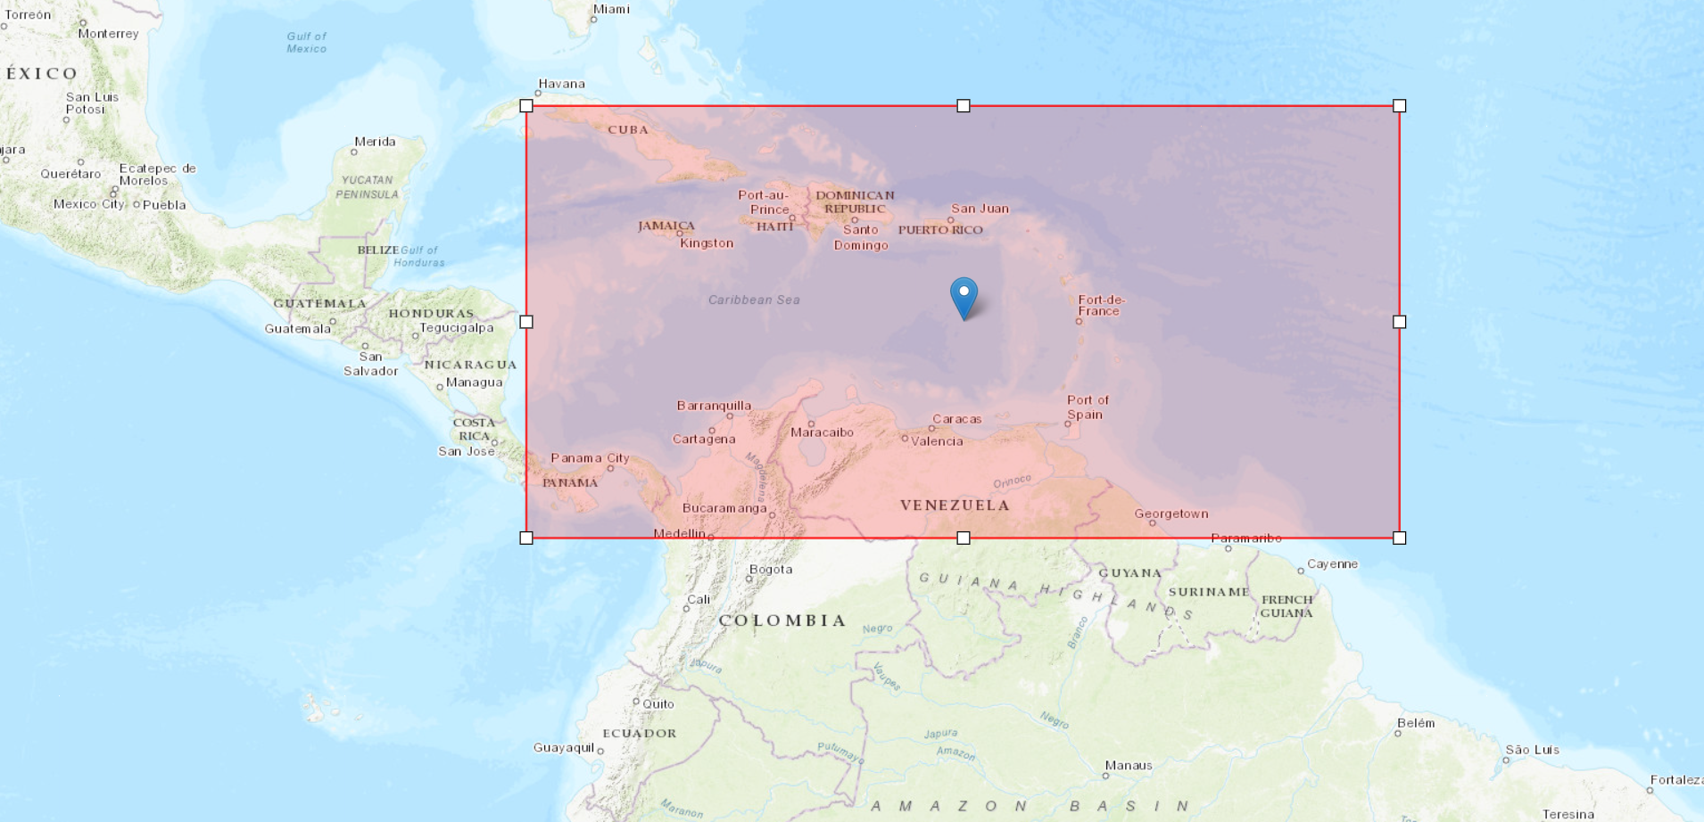
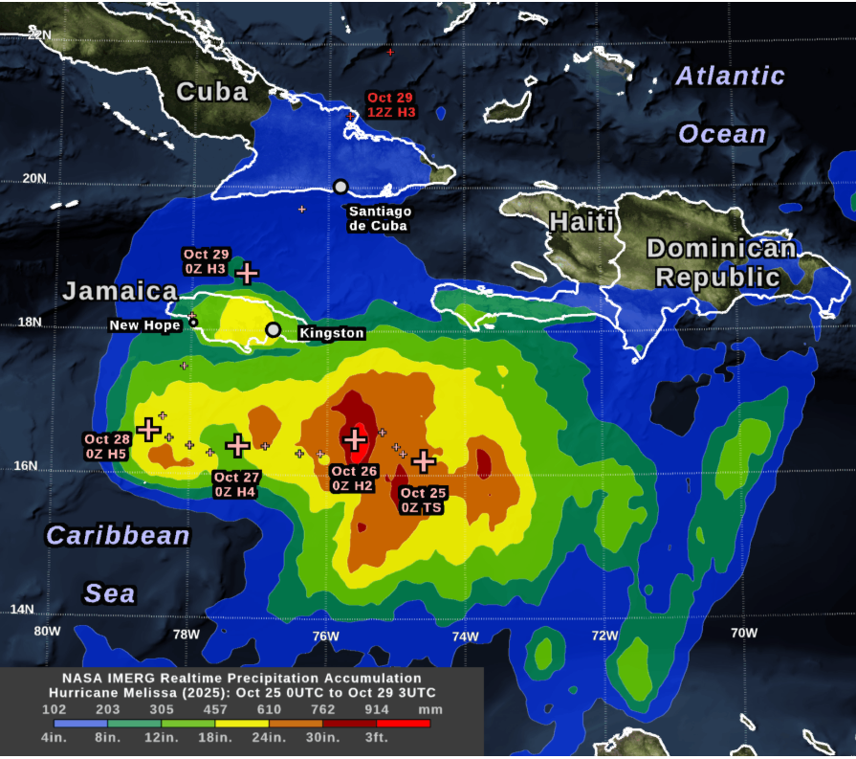
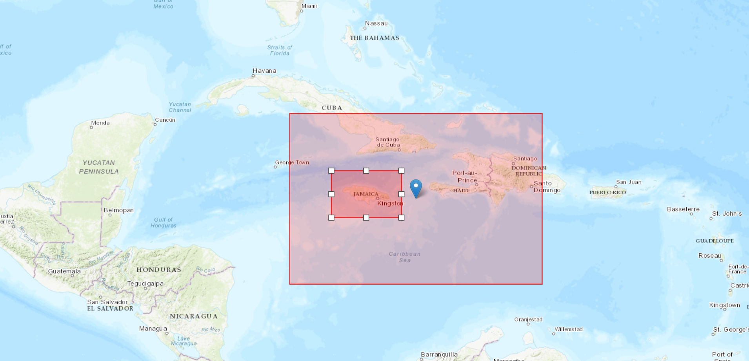
Simulation Design: Domain
Domain Setup 1 ( 9km )
Large rainfall accumulation from Hurricane Melissa (2025)
Domain Setup 2 ( 9km, 3km )
Large enough to capture full spatial evolution of the rainfall
Nested grid resolves finer scale processes
Sensitivity of Extreme Hurricane Precipitation to WRF Microphysics and Grid Spacing: Hurricane Melissa (2025) Landfall over Jamaica

Slide 4
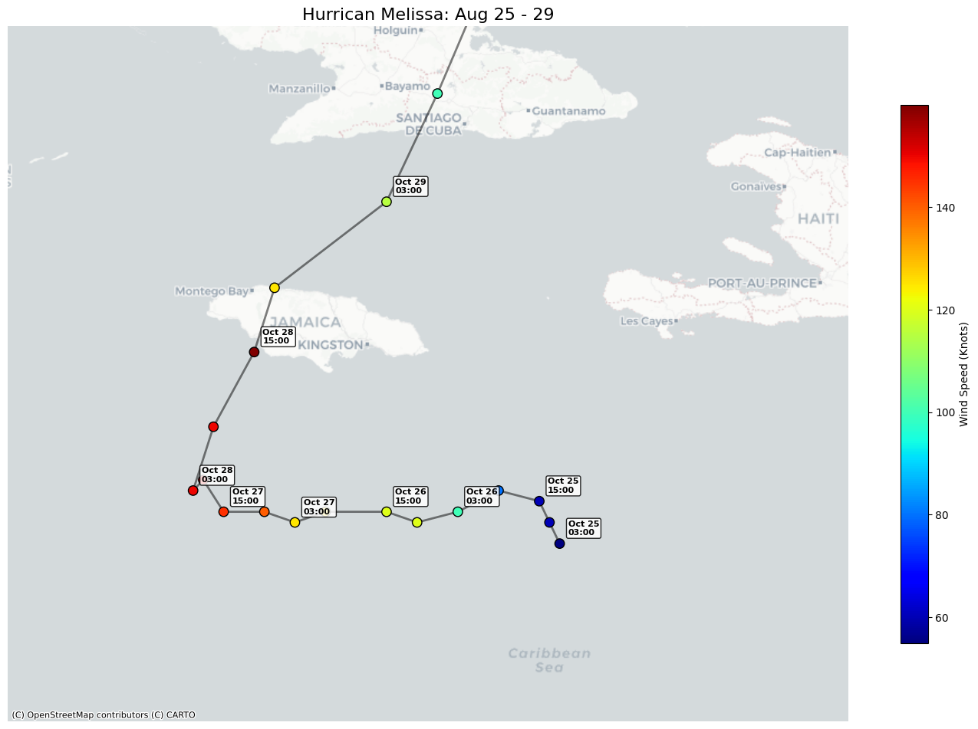
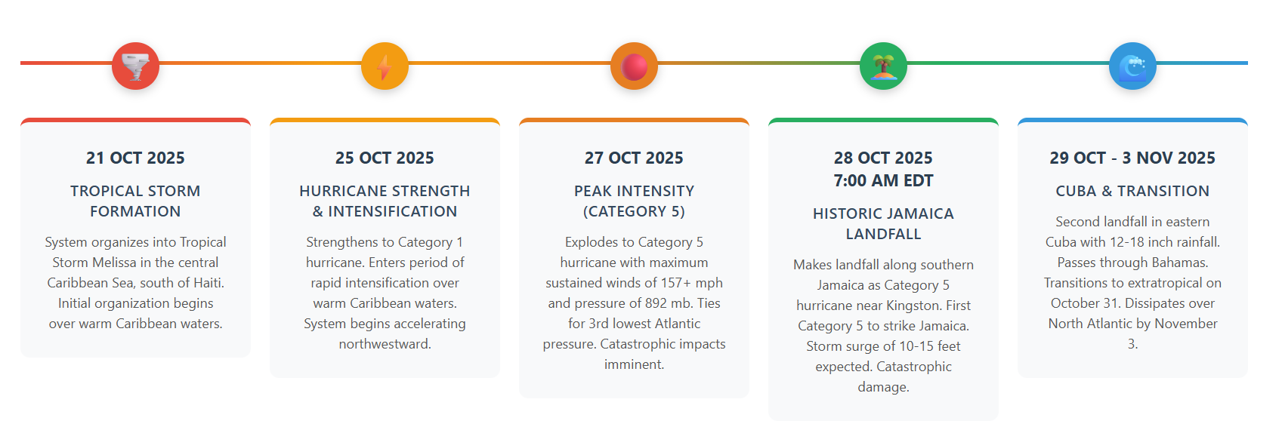
Simulation Design: Timeline
Hurricane Melissa Track : 25 October 2025- 30 October 2025
Simulation Timeline including spin-up:
25 October 2025- 30 October 2025
Sensitivity of Extreme Hurricane Precipitation to WRF Microphysics and Grid Spacing: Hurricane Melissa (2025) Landfall over Jamaica

Slide 5
Simulation Design: Total Simulations
Domain Setup 1
Domain Setup 2
Simulation 1: WSM6 MP Scheme
Simulation 2: Morrison MP Scheme (rhog = 900)
Simulation 3: WSM6 MP Scheme
Simulation 4: Morrison MP Scheme (rhog = 900)
Total 4 Simulations
Sensitivity of Extreme Hurricane Precipitation to WRF Microphysics and Grid Spacing: Hurricane Melissa (2025) Landfall over Jamaica

Slide 6
Simulation Design: Other Configuration
Namelist Parameter | Value | Physical Scheme / Description
bl_pbl_physics | 1 | Yonsei University (YSU) PBL Scheme
sf_surface_physics | 2 | Unified Noah Land Surface Model
ra_lw_physics | 4 | RRTMG Longwave Radiation
ra_sw_physics | 4 | RRTMG Shortwave Radiation
cu_physics | 1 | Kain-Fritsch Cumulus (Domain 1 Only)
sf_sfclay_physics | 1 | Revised MM5 Surface Layer
radt | 9 | Radiation Time Step (minutes)
num_soil_layers | 4 | Standard Soil Layers for Noah LSM
isfflx / ifsnow | 1 | Surface fluxes & Snow cover effects ON
Domain Settings | Value
Grid Spacing | 9 km (parent), 3 km (nested)
Run Time | 120 hours (5 days)
Grid Dimension | 418 × 208 cells
Vertical Levels | 50 layers
Boundary Conditions | GFS 0.25° analyses
Timestep | 54s (adaptive)
Write Output | Every 3 hours
Sensitivity of Extreme Hurricane Precipitation to WRF Microphysics and Grid Spacing: Hurricane Melissa (2025) Landfall over Jamaica

Slide 7
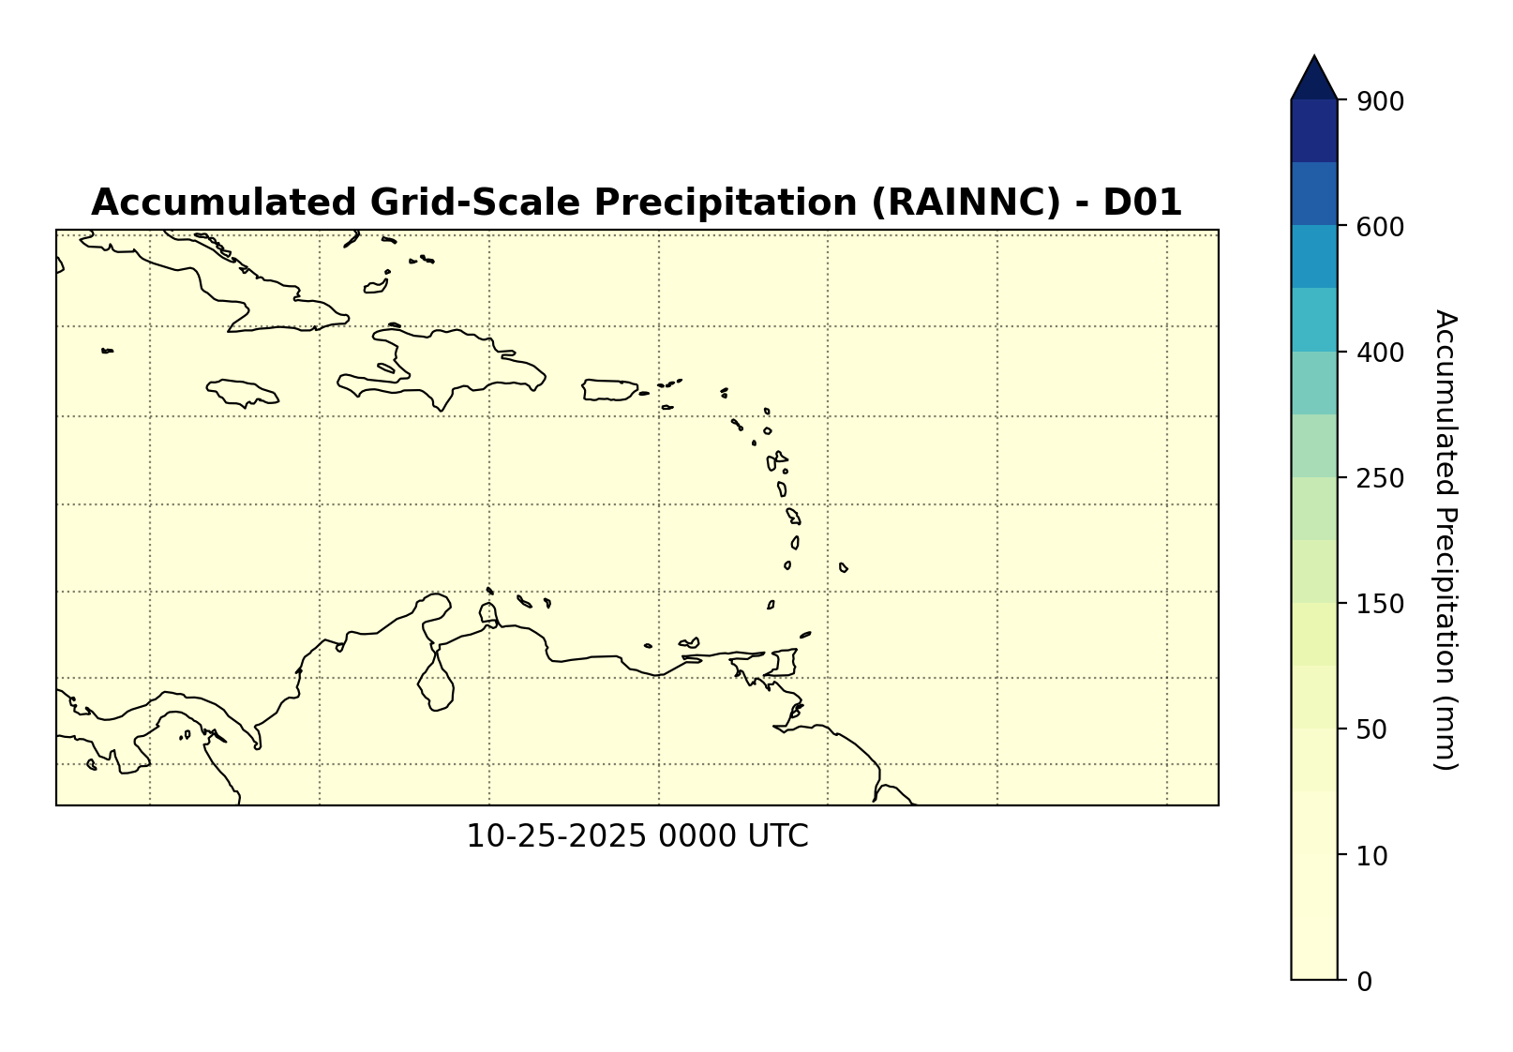
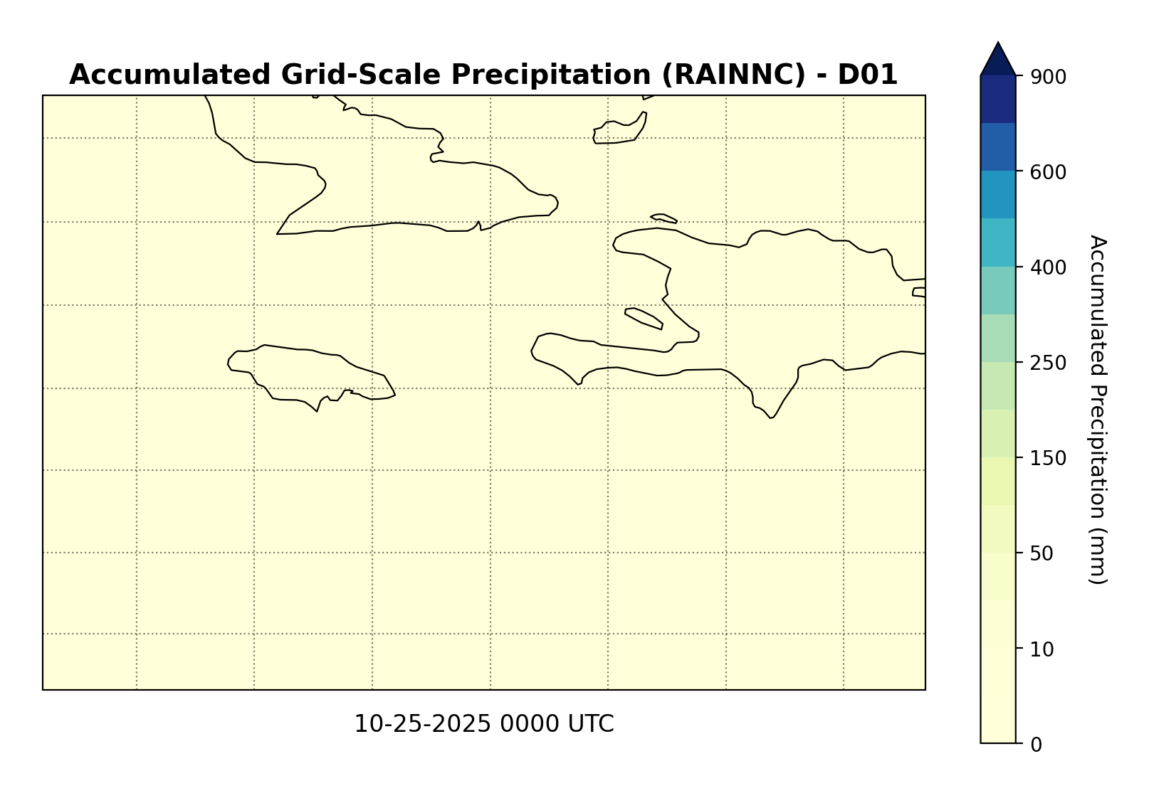
Simulation Output
Different Domains
Simulation 1_ WSM6_9km_Single Domain
Simulation 3_ Morrison_9km_Parent Domain
Sensitivity of Extreme Hurricane Precipitation to WRF Microphysics and Grid Spacing: Hurricane Melissa (2025) Landfall over Jamaica

Slide 8
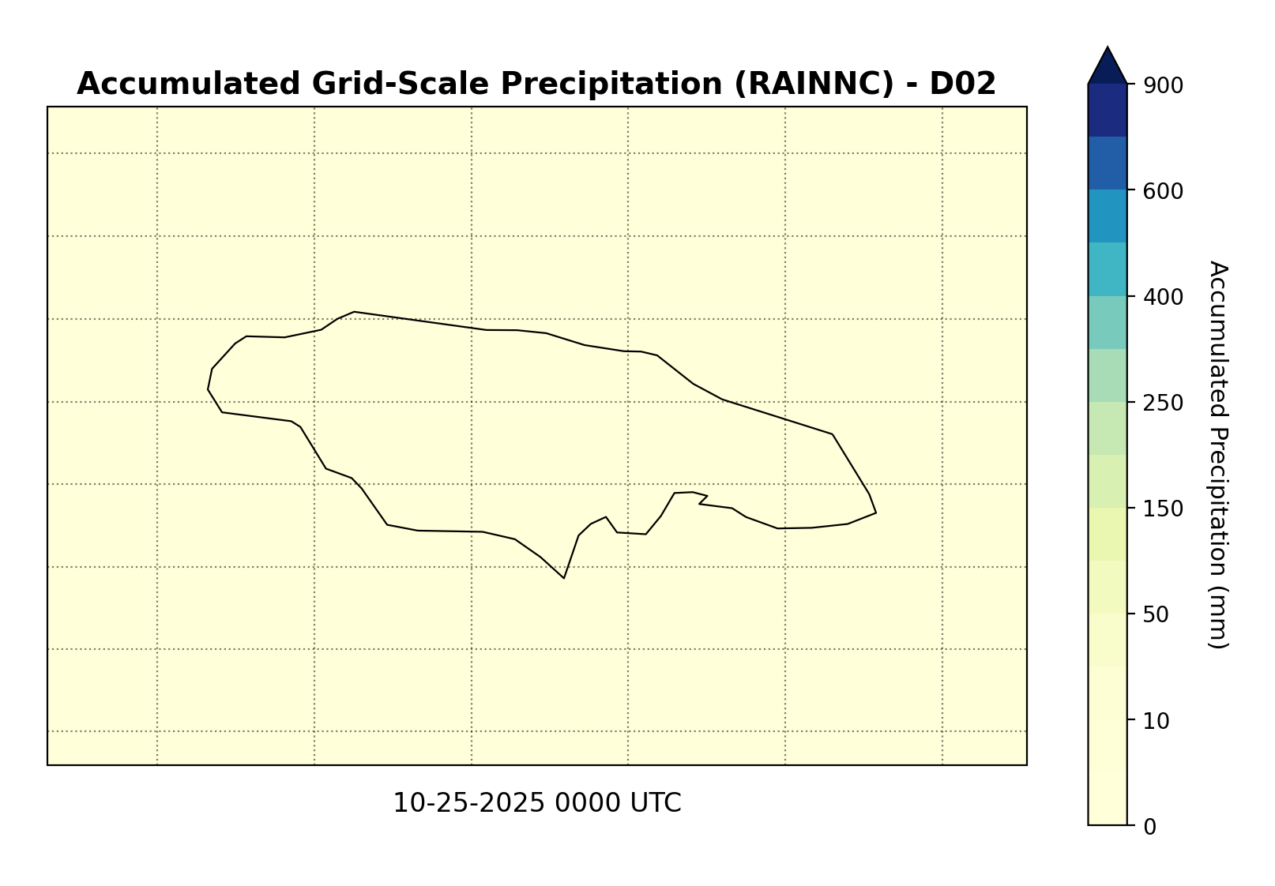
Simulation Output
Different MP Schemes
Simulation 3_ WSM6_3km_Nested Domain
Simulation 3_ Morrison_3km_Nested Domain
Sensitivity of Extreme Hurricane Precipitation to WRF Microphysics and Grid Spacing: Hurricane Melissa (2025) Landfall over Jamaica

Slide 9
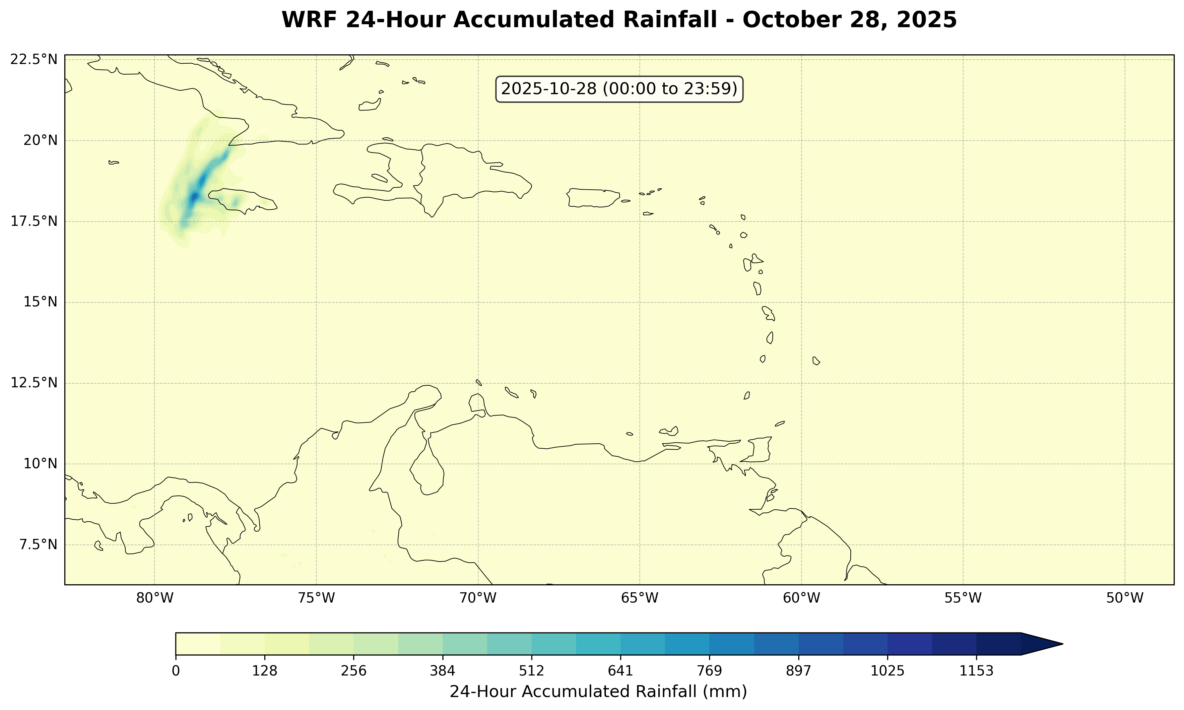
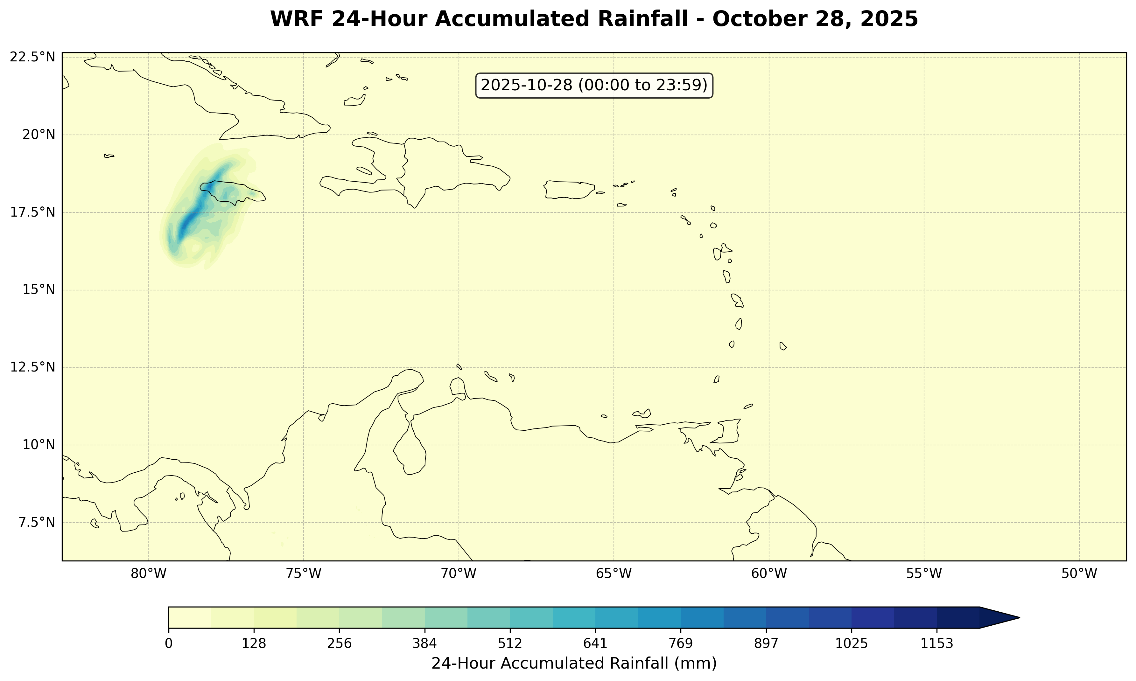
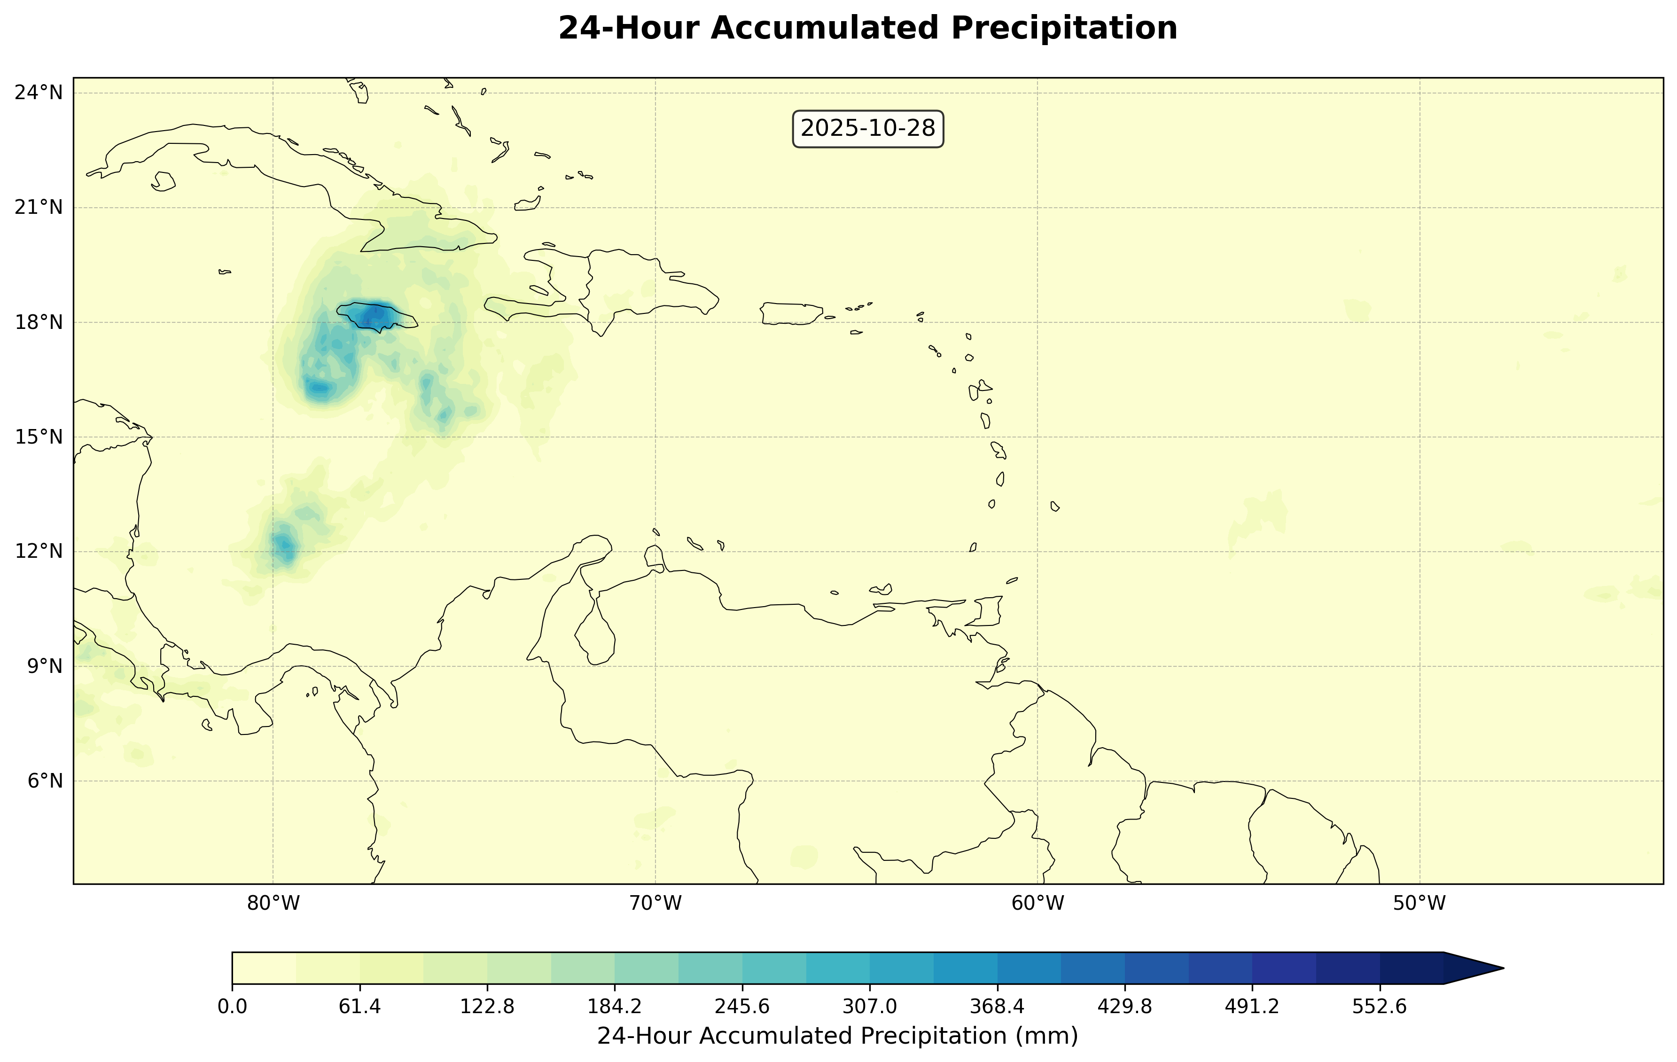
Analysis: Spatial Pattern
Target: How well the simulations reproduce the spatial structure of the rainfall field
Domain Setup 1 ( 9km )
Simulation 1_ WSM6_9km _Single Domain
Simulation 2_ Morrison_9km _Single Domain
IMERG 24-h_10km_Precipitation Accumulation

Slide 10
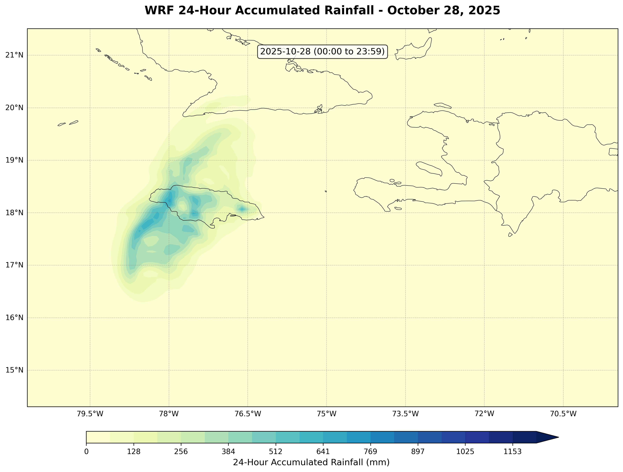
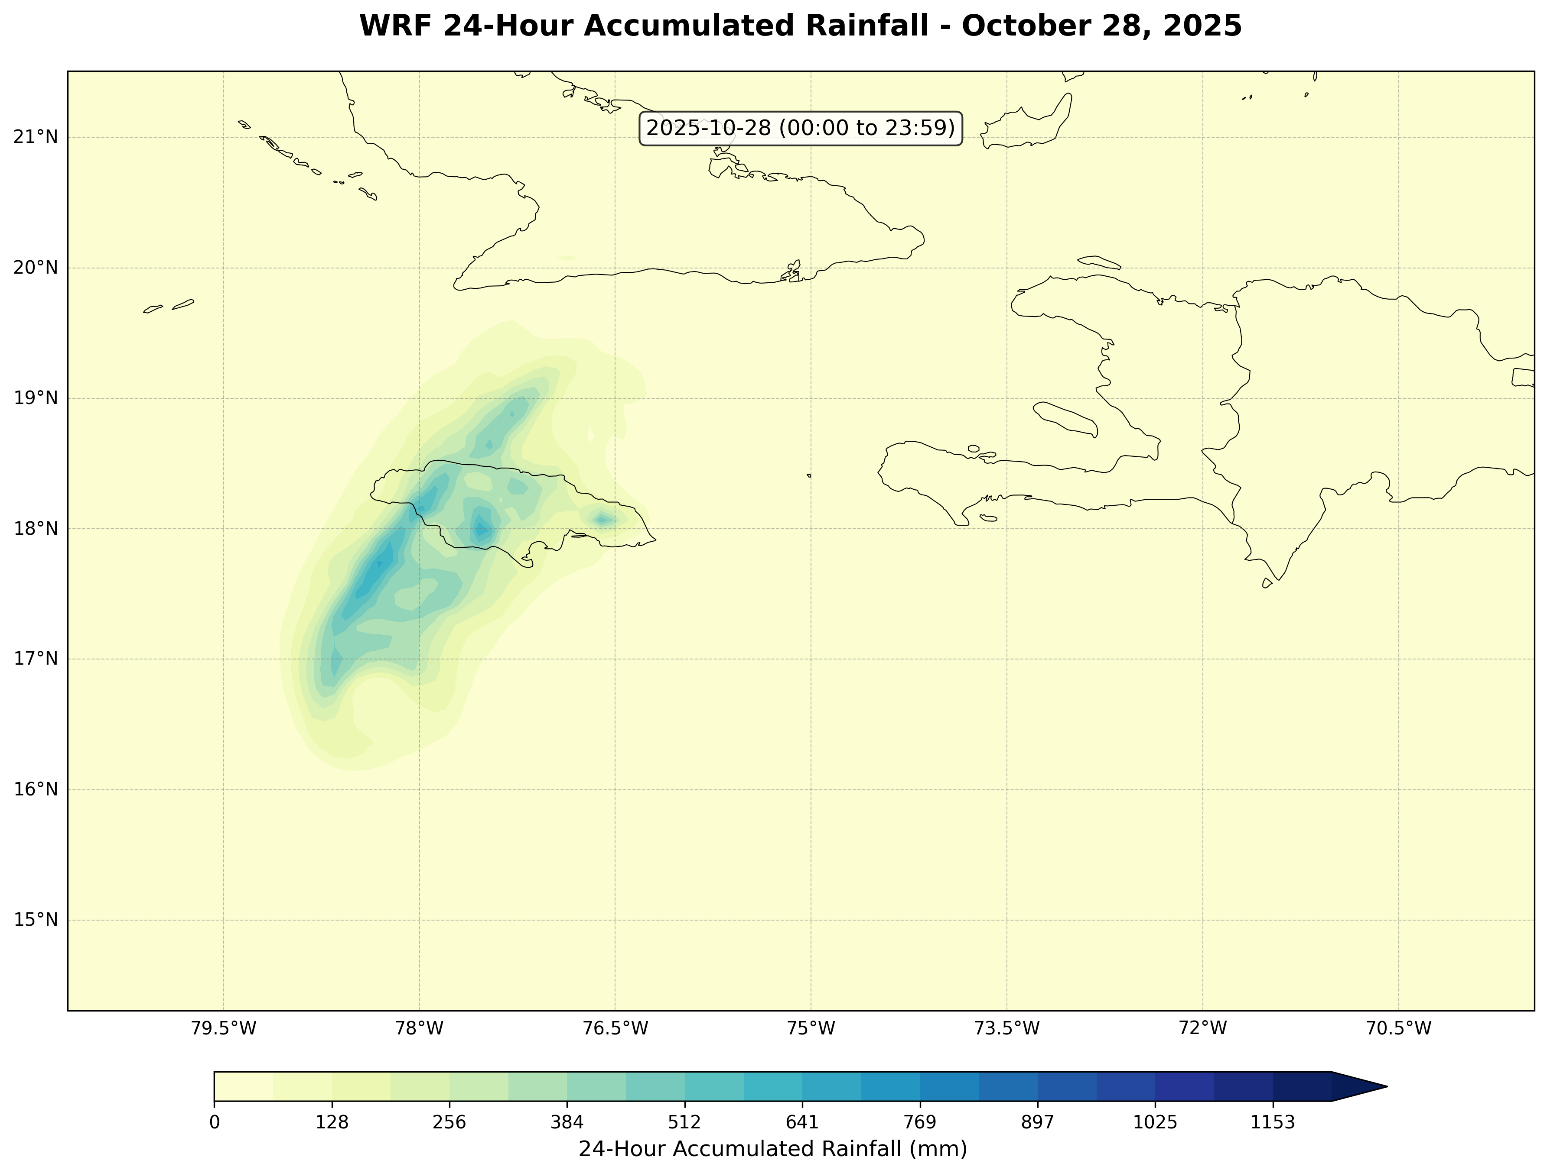
Analysis: Spatial Pattern
Target: How well the simulations reproduce the spatial structure of the rainfall field
Domain Setup 2 ( 9km, 3km )
Simulation 3_ WSM6_9km _Parent Domain
Simulation 4_ Morrison_9km _Parent Domain
IMERG 24-h_10km_Precipitation Accumulation

Slide 11
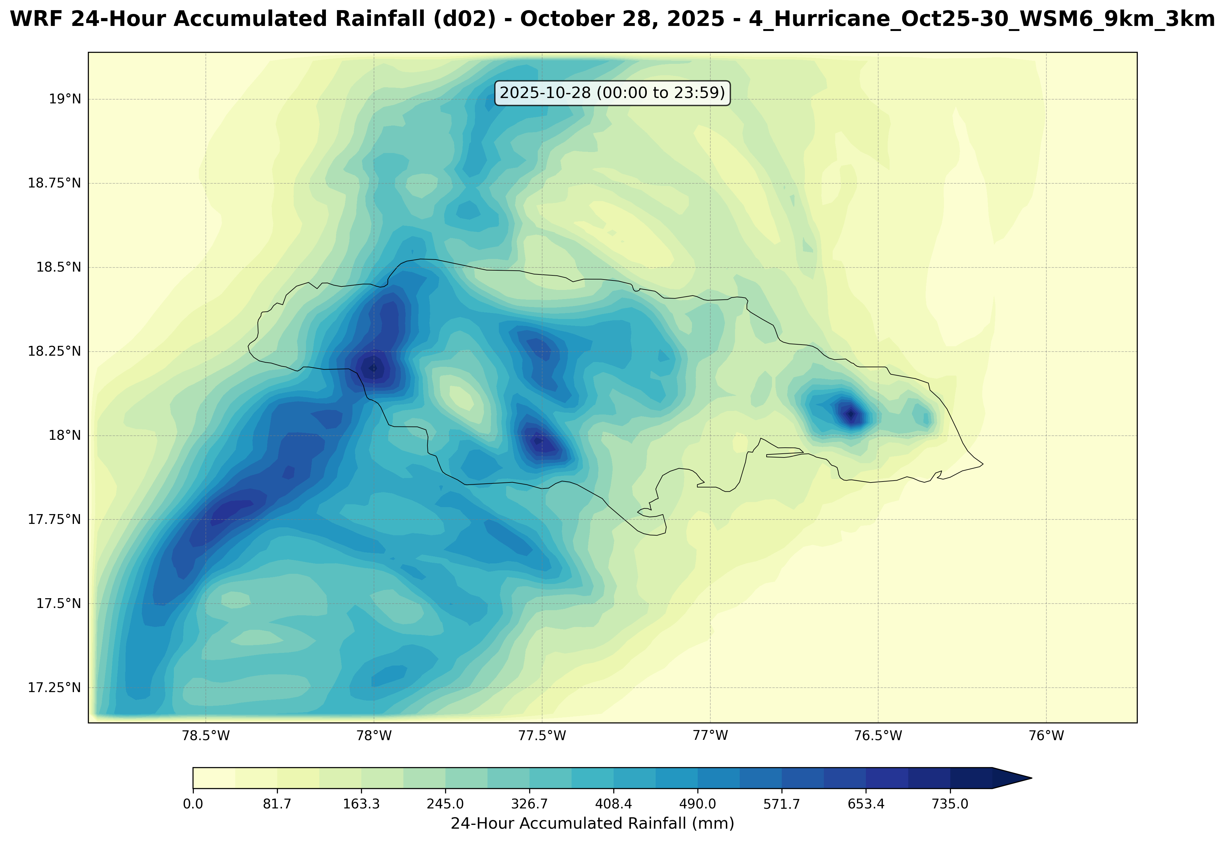
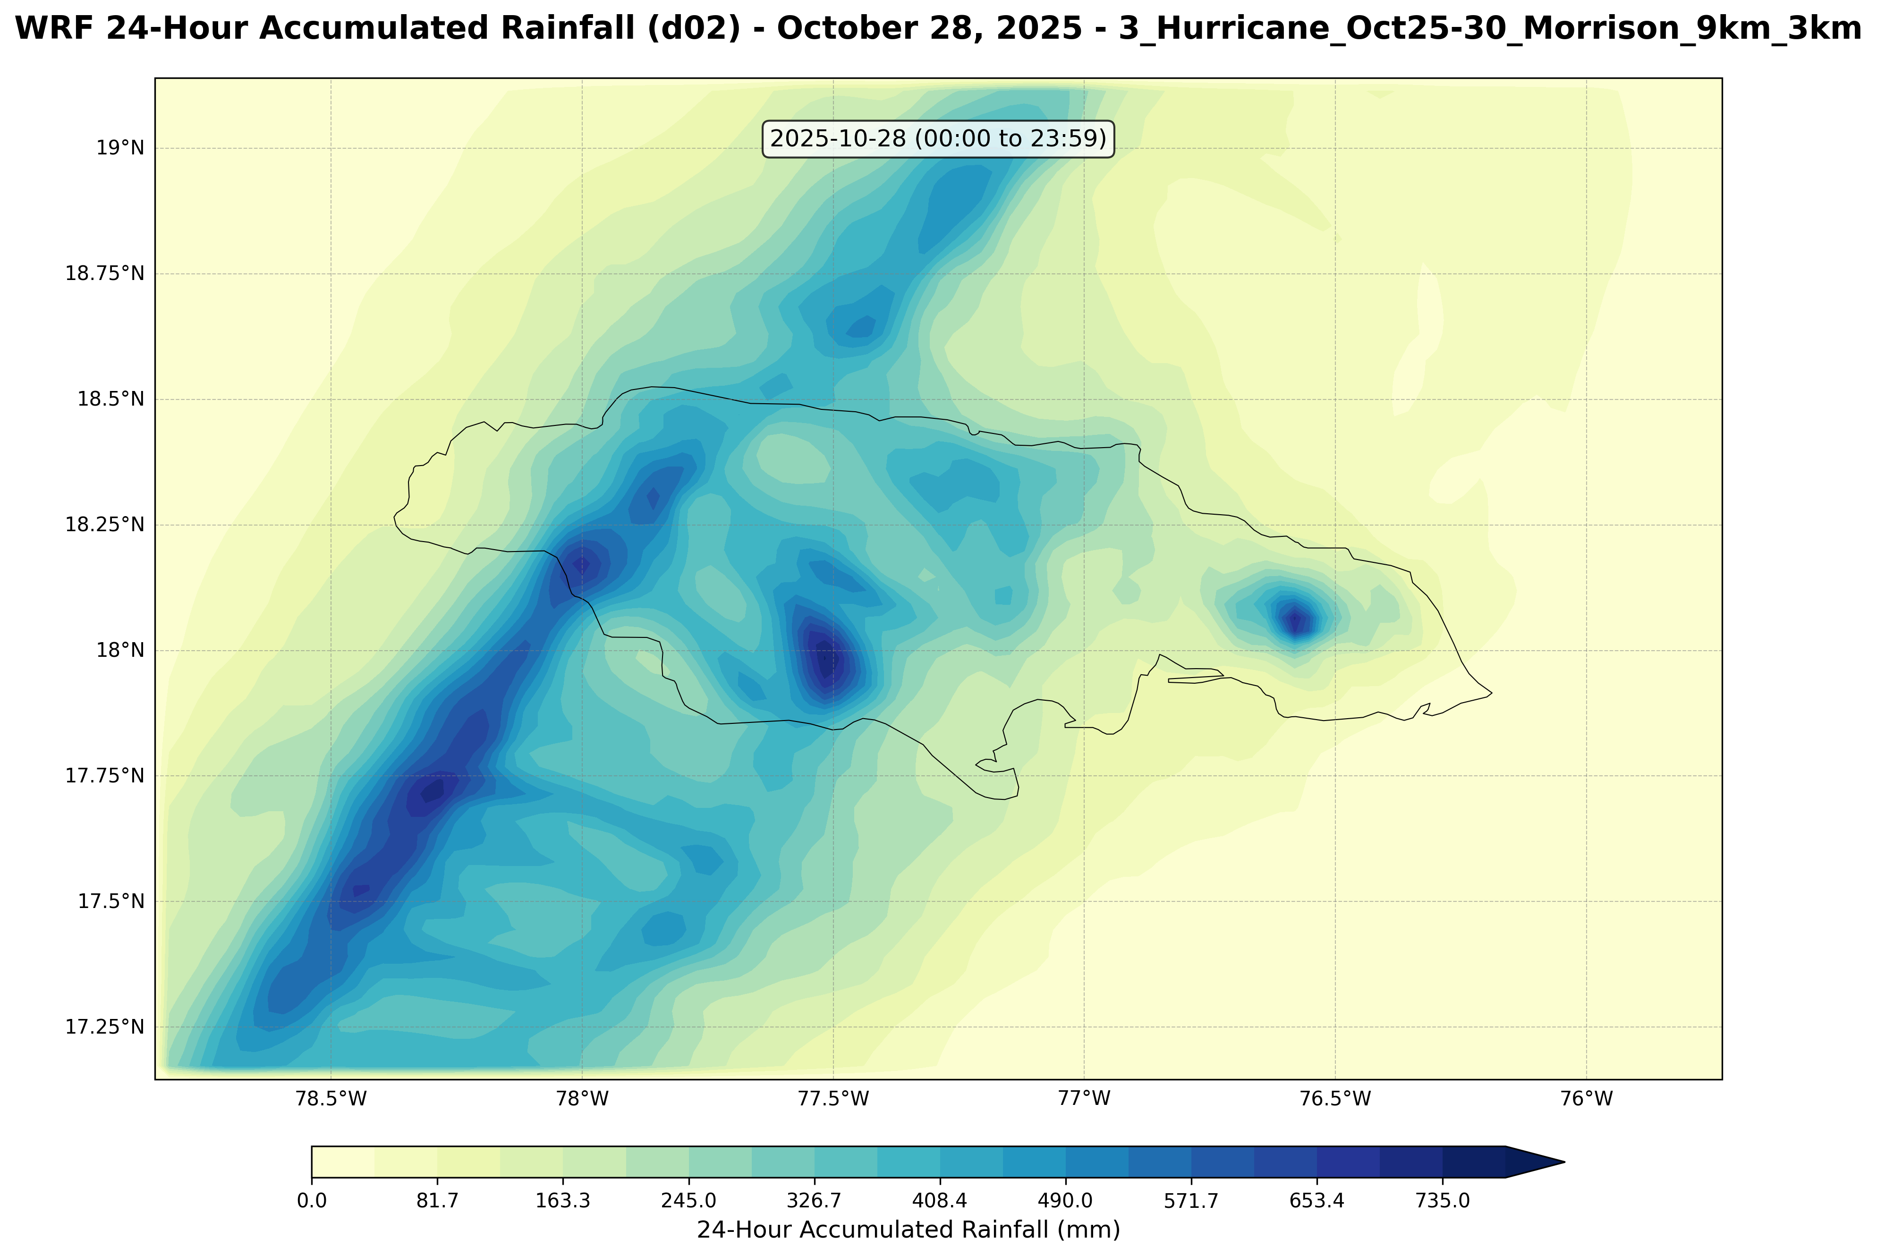
Analysis: Spatial Pattern
Target: How well the simulations reproduce the spatial structure of the rainfall field
Domain Setup 2 ( 9km, 3km )
Simulation 3_ WSM6_3km _Nested Domain
Simulation 4_ Morrison_9km _Nested Domain
IMERG 24-h_10km_Precipitation Accumulation

Slide 12
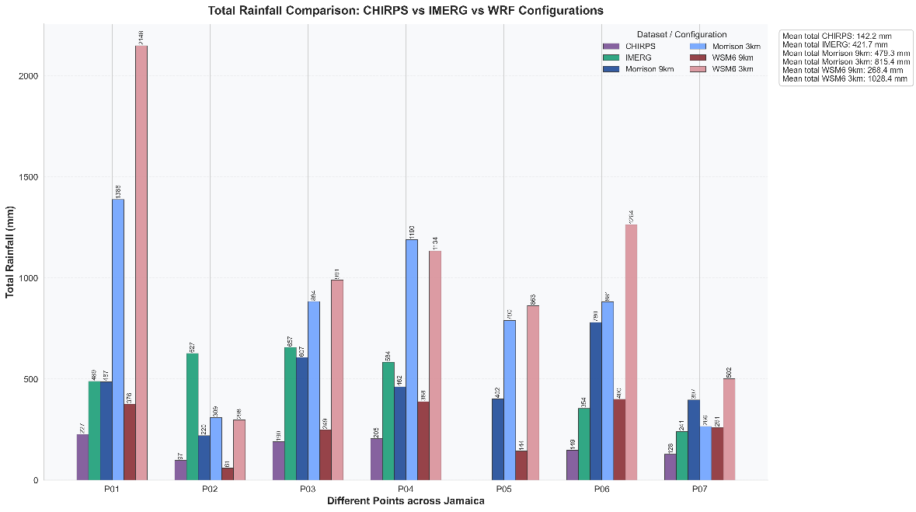
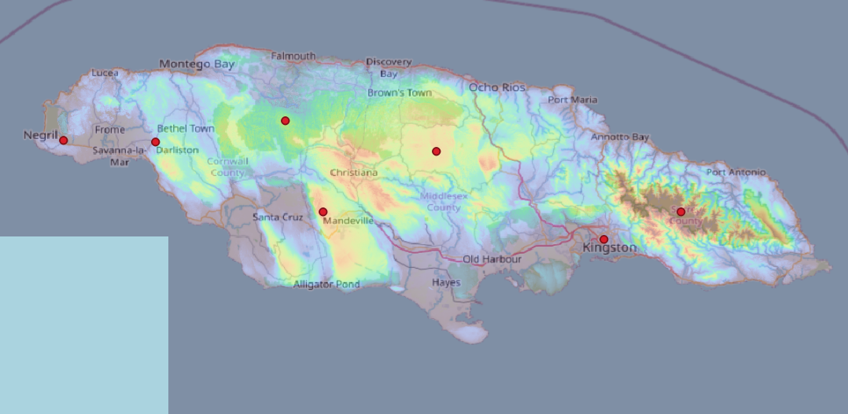
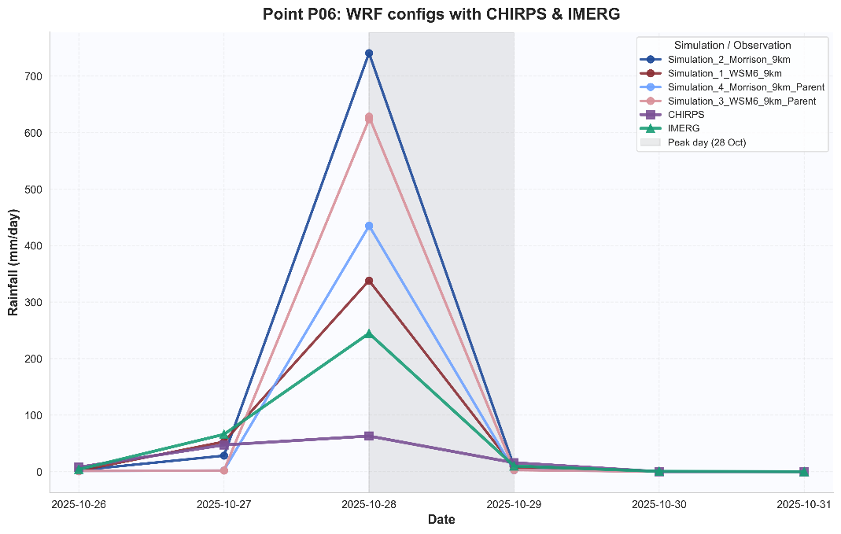

Analysis: Rainfall Intensity
Target: How well the simulations reproduce the magnitude
Of rainfall intensity?
P07
P06
P05
P03
P04
P01
P02
Sensitivity of Extreme Hurricane Precipitation to WRF Microphysics and Grid Spacing: Hurricane Melissa (2025) Landfall over Jamaica

Slide 13
Conclusion and Future Direction
Different Resolution
Nested 3km domain dramatically improves precipitation representation compared to 9km parent domain, capturing spatial structure and intensity variations that match satellite observations.
2. Morrison Vs. WSM6
Morrison double-moment scheme produces precipitation amounts closer to IMERG/CHIRPS observations, while WSM6 single-moment tends to overestimate extreme rainfall in nested domains.
3. Peak Timing Captured
All simulations accurately predict the October 28 rainfall peak coinciding with Jamaica landfall, demonstrating correct track and intensity evolution despite differences in absolute amounts.
4. Future Work
      - Different domains size
      Different Microphysics scheme
      Different Land use Experiment on precipitation intensity
Sensitivity of Extreme Hurricane Precipitation to WRF Microphysics and Grid Spacing: Hurricane Melissa (2025) Landfall over Jamaica

