Slide 1

Can Roads Designed Yesterday Survive Tomorrow?
Adapting asset management for climate change
Opio Pamela Acheng May 06, 2026
May 06, 2026

Slide 2
Introduction

Slide 3
Today’s argument
The problem
Existing Asset Management tools built for a stable climate.
The evidence
Uganda case study, 90 km, 50 years.
The framework
A dual-mode extension — direct & delayed failures.
Notes:
Road Agencies use Road Asset Management tools to predict deterioration, schedule interventions and allocate the available resources. However, these tools are built for a stable climate not capturing climate-related deterioration.

Slide 4
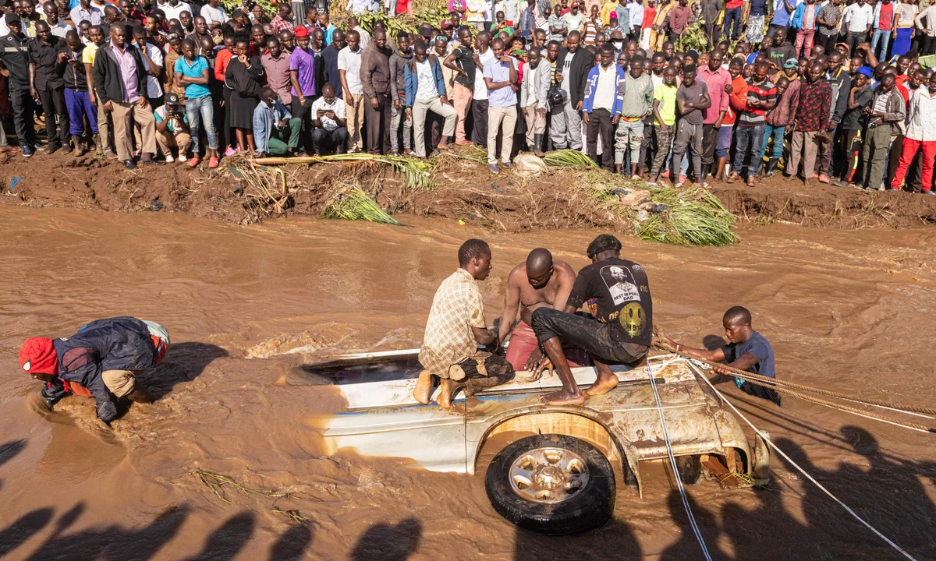
WHY THIS MATTERS
A single flood event on 90.3km road
$1.8M
in detour costs
$112,000/km
Flooding of Nabuyonga River
courtesy: The Guardian 2022
direct damages.

Slide 5
Built for yesterday’s climate And the tools we use to plan roads cannot see any of this

Slide 6
Can Roads Designed Yesterday Survive Tomorrow?
Adapting asset management for climate change
Opio Pamela Acheng May 06, 2026
May 06, 2026

Slide 7
Tools used today
Available
HDM-4 · dTIMS · RONET
Do
Time-based deterioration. Schedule. Allocate.
Miss
Climate stress. Compound damage.
Real-world deterioration.
Notes:
HDM-4, dTIMS, RONET — these are the planning workhorses used by 1,000+ road agencies worldwide. They schedule maintenance and allocate budgets using time-based deterioration models calibrated on stable-climate data. The gap: they assume next decade's weather looks like last decade's. They miss the accelerating damage from heat, flood, and compound stressors — and they systematically underestimate real-world deterioration on roads exposed to a changing climate.

Slide 8
HDM-4
A gold standard.
Highway Development & Management Model.
1,000+ agencies. Two decades of trust.
Notes:
HDM-4 — the Highway Development and Management Model. Developed in the early 2000s by the World Bank with HDM Global. The default tool across low- and middle-income road agencies. It does deterioration prediction, intervention scheduling, and budget allocation in one integrated framework. Calibrated for a stationary climate.

Slide 9
Built before climate adaptation existed
01 Static climate.
Yesterday’s weather projects tomorrow.
02 Damage modelling missing.
Catastrophic events not captured.
03 No cascades.
Network disruption ignored.
Notes:
Three reasons HDM-4 wasn't built to see this. Static climate assumptions: future deterioration is projected from yesterday's weather records. Inadequate damage modelling: catastrophic events are poorly captured at the asset level. No cascading impacts: network disruption and indirect economic losses — the dominant term in real lifecycle cost — are ignored entirely.

Slide 10
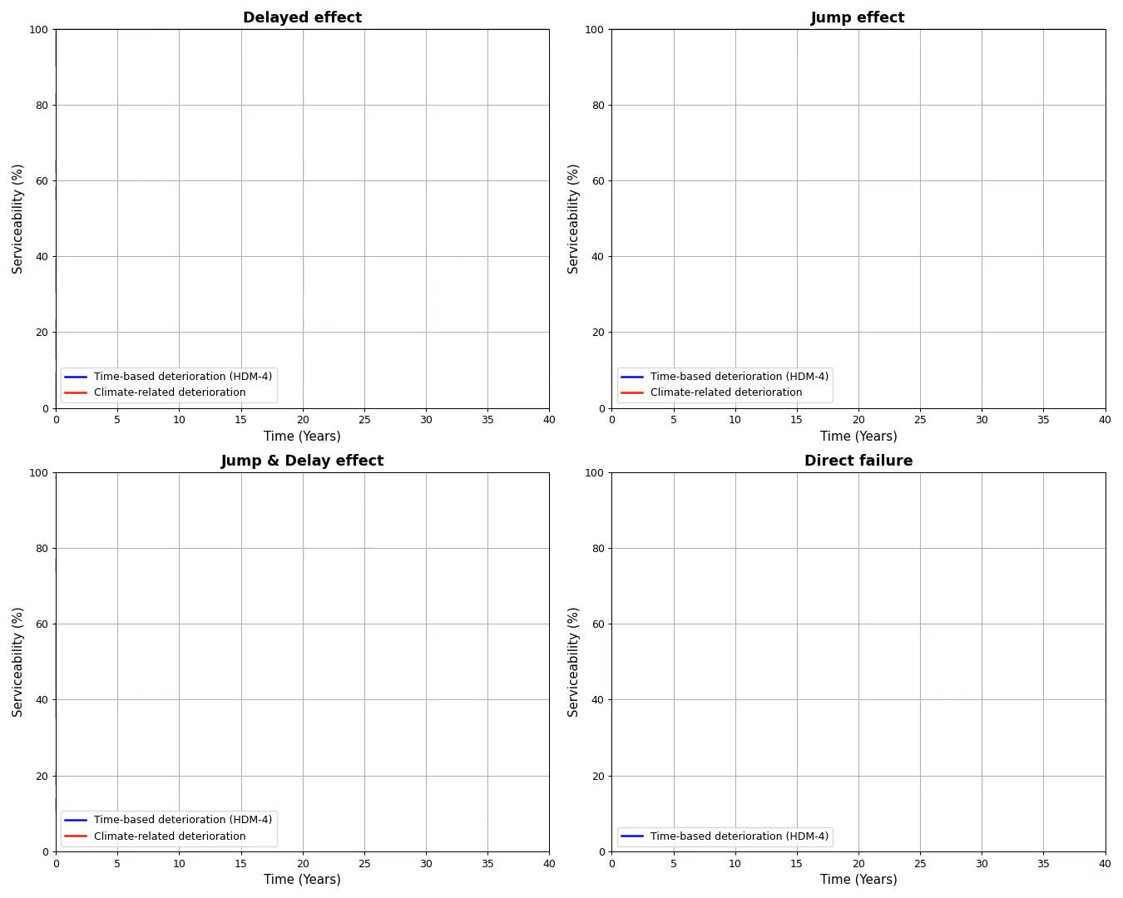
Four climate-related failure modes
Addressed Delayed effect · Direct failure
Out of scope Jump · Jump & delay
Notes:
Four failure modes under climate stress. (1) Delayed effect — chronic stressors accelerate the smooth decay curve. Years of repeated extreme heat softens asphalt binder, so rutting appears earlier (2) Jump effect — a single event drops capacity, then decay resumes its old slope. A major flood saturates and weakens the road's subgrade, permanently lowering its structural capacity even after the surface is repaired, so it never returns to its original design strength. (3) Jump and delay — sudden drop plus accelerated post-event decay. A flood scours the pavement base (the jump), and the now-weakened structure deteriorates 1.4× faster under normal traffic afterward (the delay). (4) Direct failure — catastrophic event drives serviceability to zero. HDM-4 handles 1 and 4 if you extend it. Modes 2 and 3 — the most realistic real-world signatures of climate-driven damage — are out of scope of this work.

Slide 11
Solution: A dual-mode framework

Slide 12
Two complementary approaches
DIRECT FAILURE . SUDDEN
Resilience Module
DELAYED FAILURE . PROGRESSIVE
Climate Shift factors
Direct failure
Delayed effect
Notes:
TAM is the strategic, systematic process for managing road assets through their full lifecycle — operate, maintain, upgrade, expand. The point I want to make: TAM is a decision framework. It's only as good as the deterioration models it sits on top of. If those models are blind to climate, every TAM decision downstream — schedule, budget, priority — inherits that blindness.

Slide 13
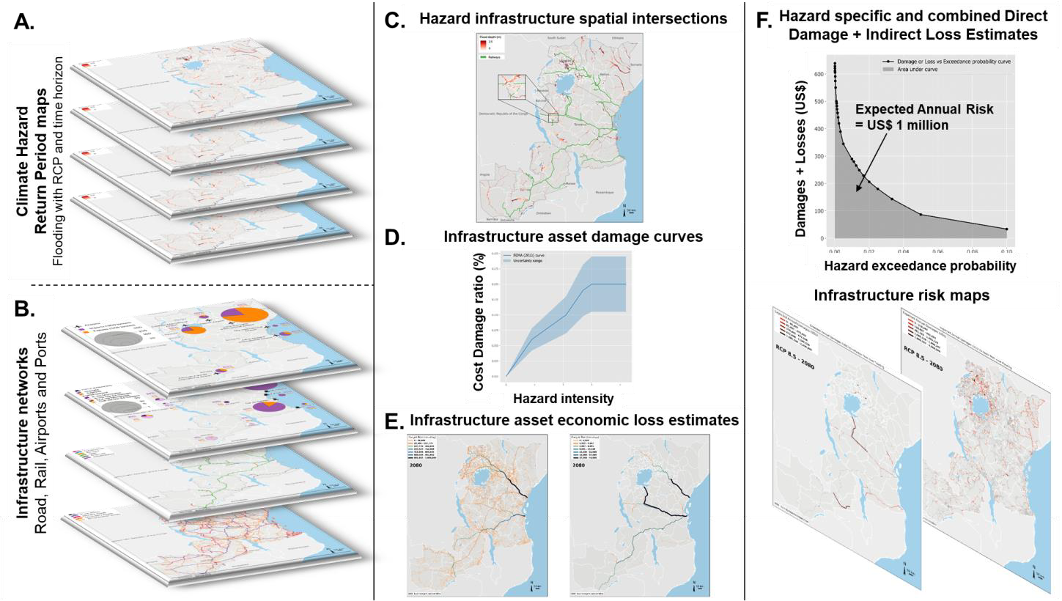
DIRECT FAILURE. Resilience Module
Source: Hickford et al. 2022

Slide 14
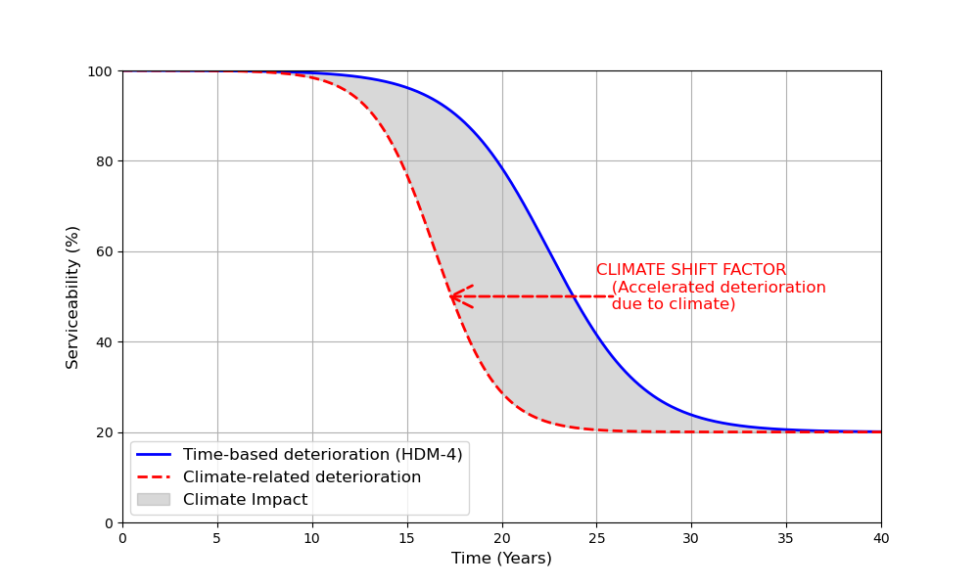
DELAYED EFFECT. Climate Shift factors
Notes:
(1) Delayed effect — chronic stressors accelerate the smooth decay curve. Extreme Heat, Flooding events

Slide 15
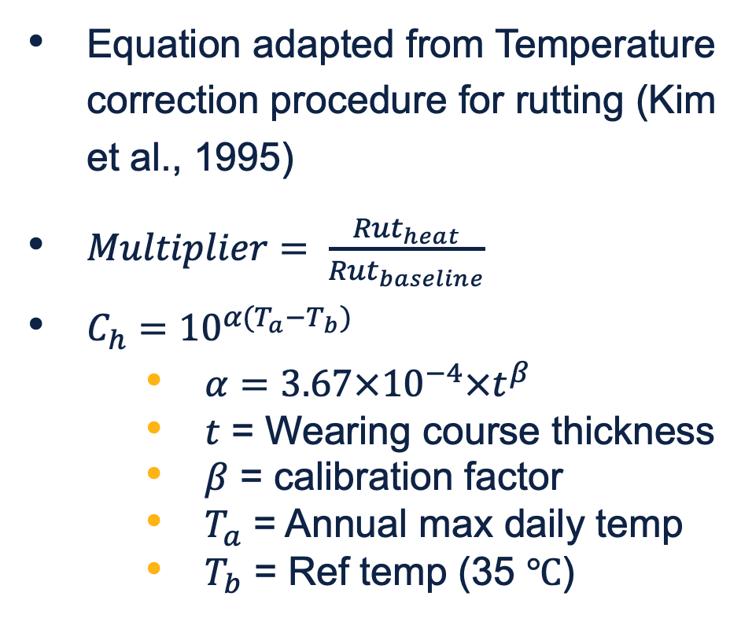
DELAYED EFFECT. Climate Shift factors
Extreme Heat
Equation adapted from Temperature correction procedure for rutting (Kim et al., 1995)
$Multiplier= \frac{{Rut}_{heat}}{{Rut}_{baseline}}$
$C_{h}={10}^{α(T_{a}−T_{b})}$
$α=3.67×{10}^{−4}×t^{β}$
$t$ = Wearing course thickness
$β$ = calibration factor
$T_{a}$ = Annual max daily temp
$T_{b}$ = Ref temp (35 $℃$)
Notes:
where $α$ the calibration factor can be adjusted based on pavement characteristics. In the original Kim model, the calibration factor is expressed as $3.67×{10}^{−4}×t^{1.4635}$ where $t$ represents the pavement thickness and 1.4635 is a fixed empirical exponent. However, recognising that pavement response to temperature varies with age due to material aging, traffic densification, and structural changes overtime, this study replaced the fixed exponent 1.4635 with an age-dependent calibration factor $β$ determined through model fitting.

Slide 16
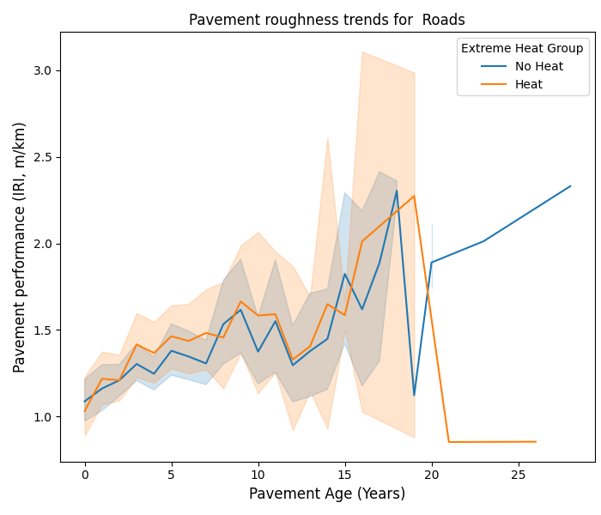
DELAYED EFFECT. Climate Shift factors
Extreme Heat

Slide 17
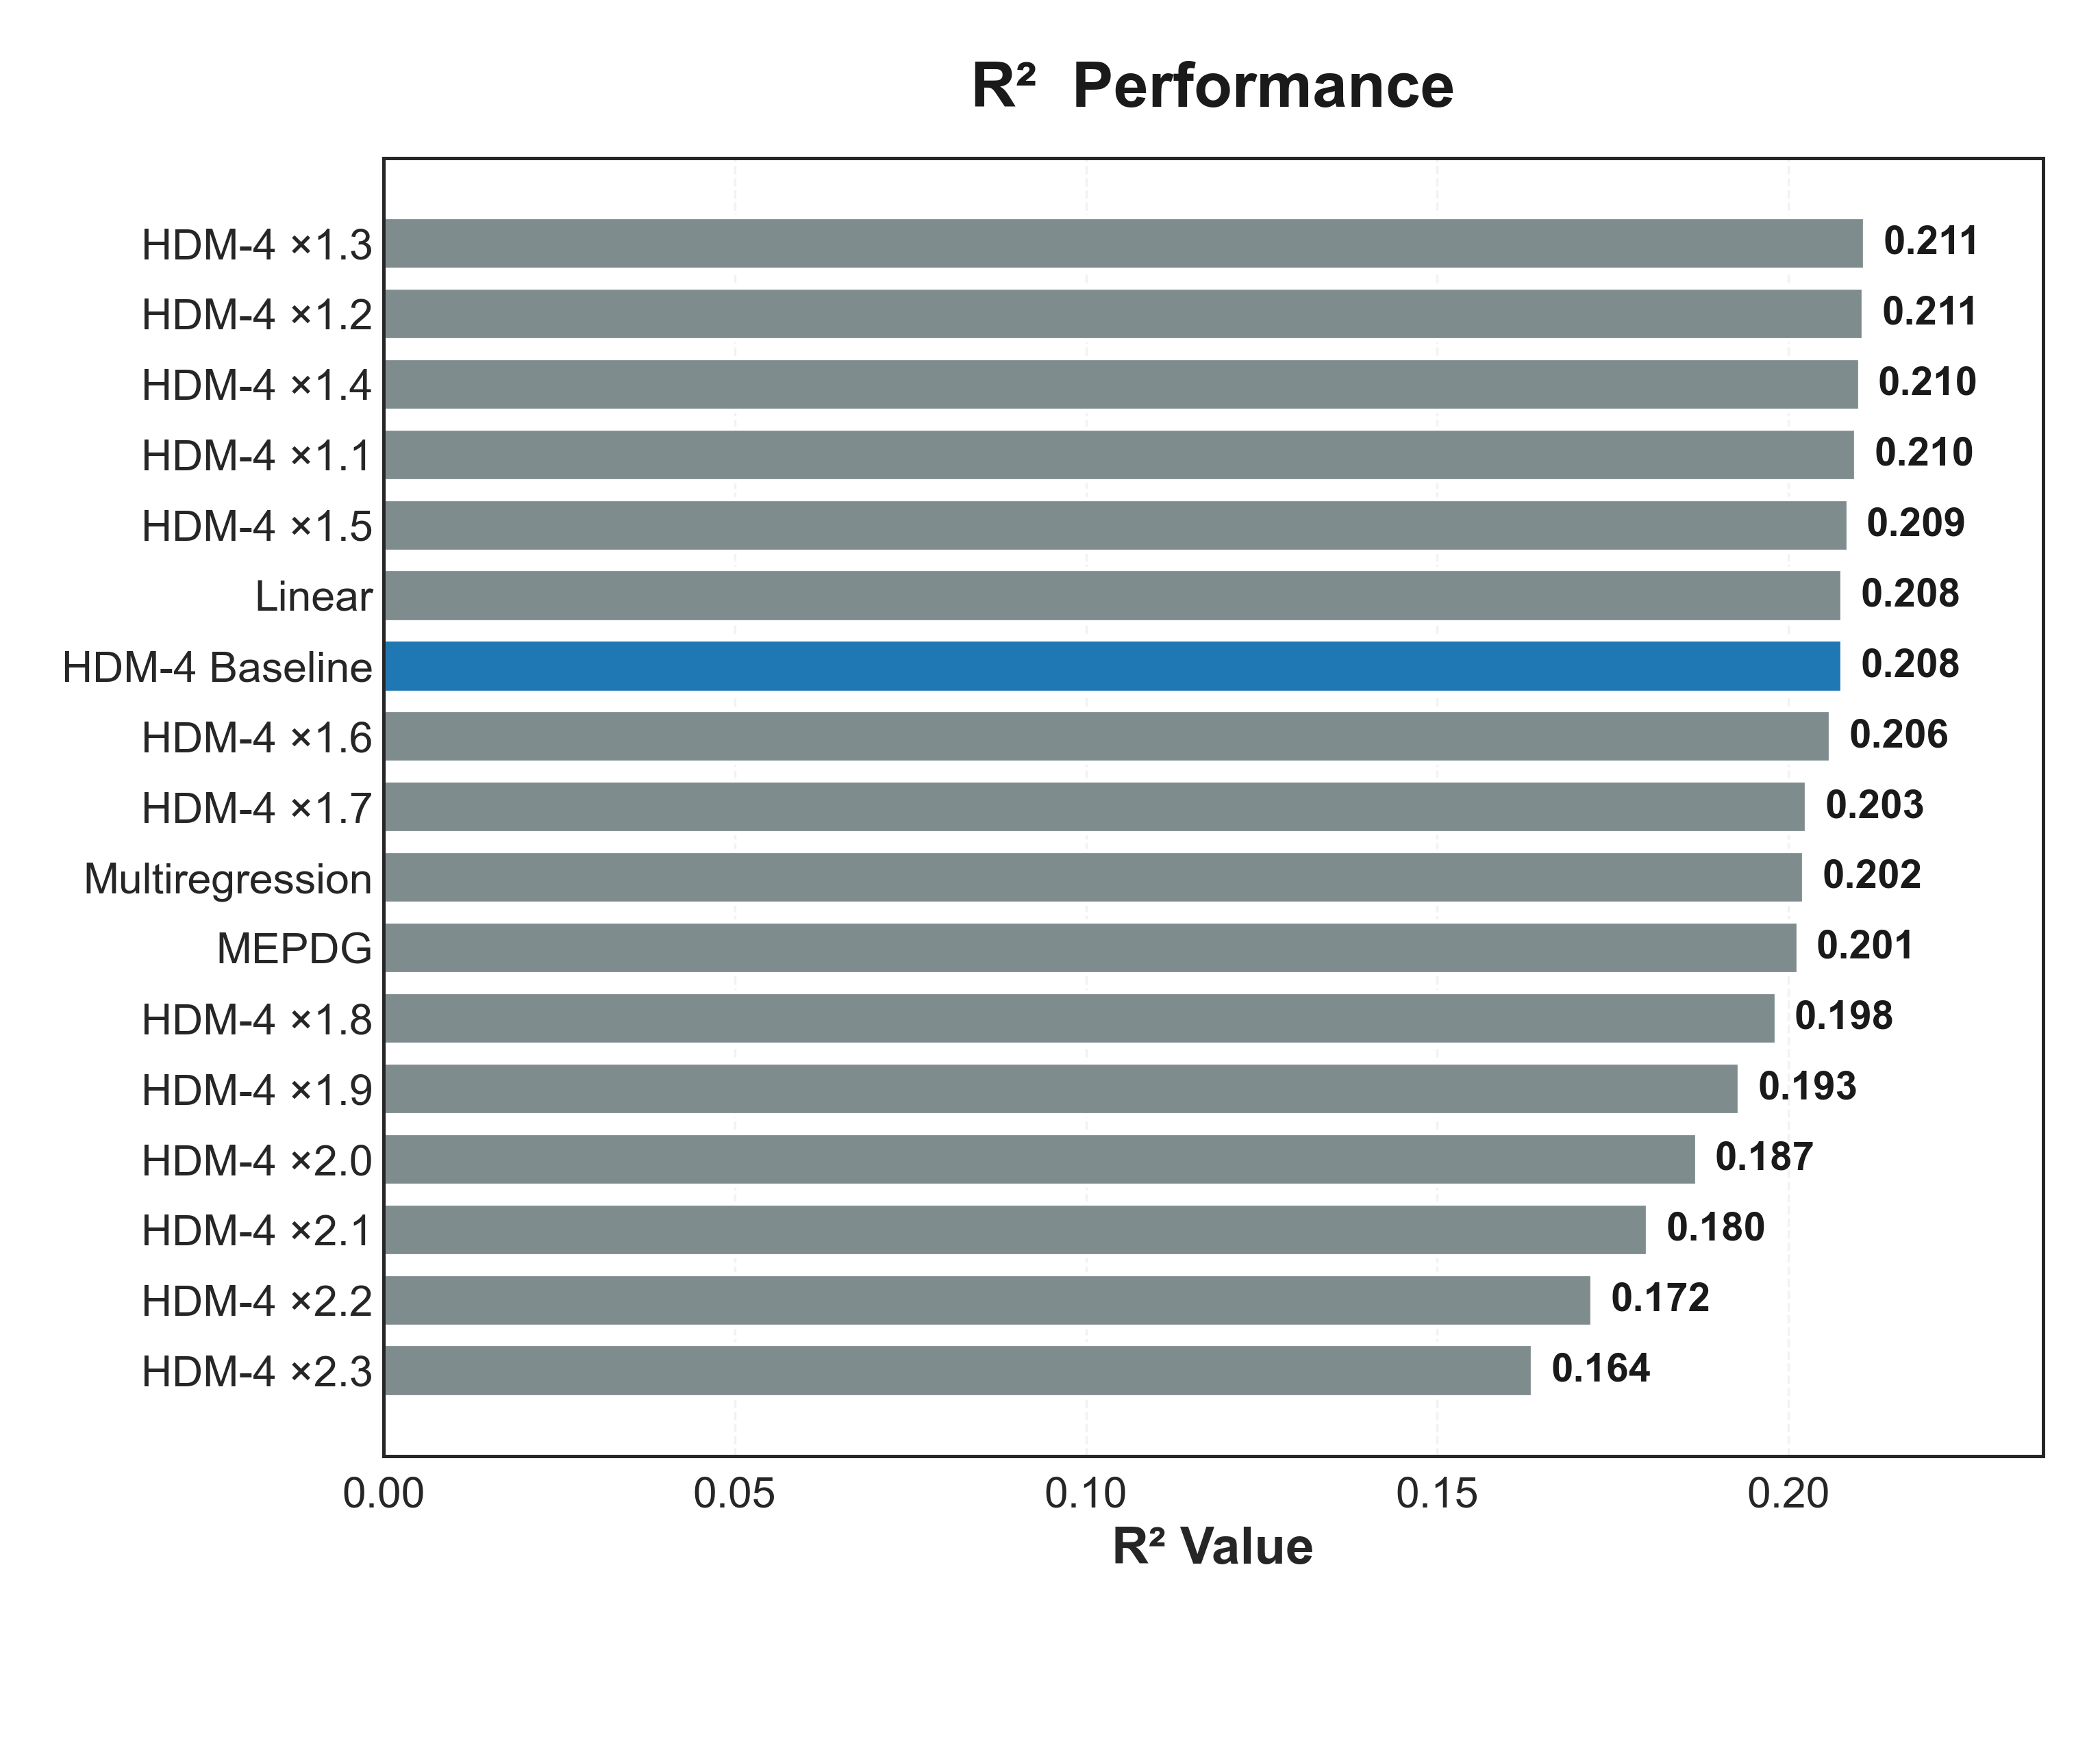
DELAYED EFFECT. Climate Shift factors
Flooding
Notes:
We used the FHWA long term pavement performance data to evaluate the models. Assumptions were made for HDM-4 calibration for US data and then different models were developed for the climate shift factor and compared against the long-term pavement performance data

Slide 18
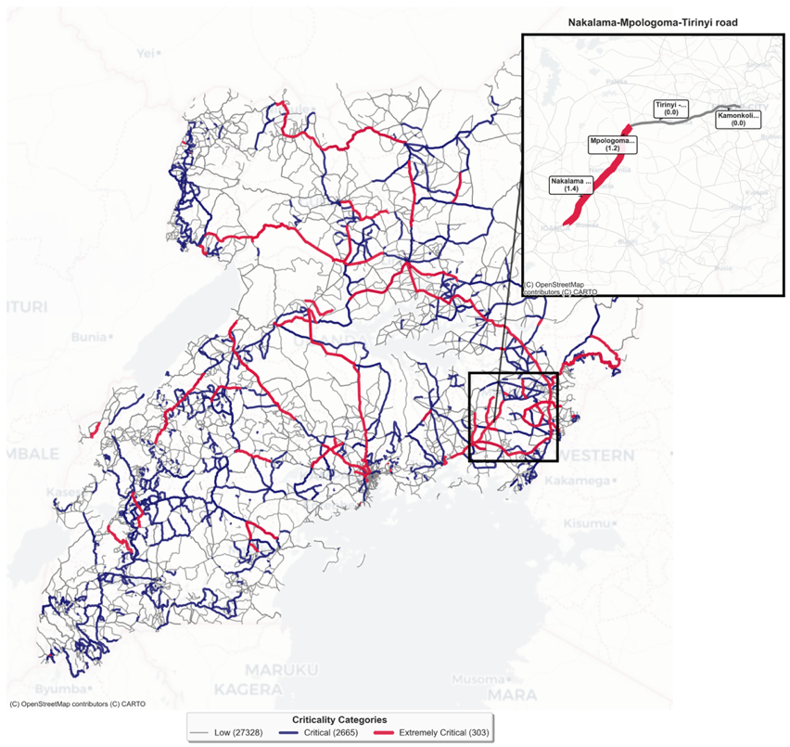
The Application
Nakalama–Tirinyi–Mbale, Uganda
90 km
Paved primary · freight link to Kenya
Recurrent flooding
20-year horizon

Slide 19
Two approaches
Resilience module
The rare, big events.
Climate-shift factors
The slow grind.
Notes:
Two complementary extensions. The resilience module prices the rare-but-big events using probabilistic risk modelling. The climate-shift factors bend the deterioration curve to reflect chronic stressors. Together they cover failure modes 1 and 4. Modes 2 and 3 remain open research.

Slide 20
Resilience module
Pricing the rare, big events
Hazard × Vulnerability × Exposure
Outputs: EAD, EAEL.
Notes:
Resilience module. Standard probabilistic risk modelling: Hazard × Vulnerability × Exposure. Hazard from climate projections. Vulnerability from asset fragility curves. Exposure from the network model. Outputs: Expected Annual Damage (direct repair cost) and Expected Annual Economic Loss (user-side disruption from closures and detours).

Slide 21
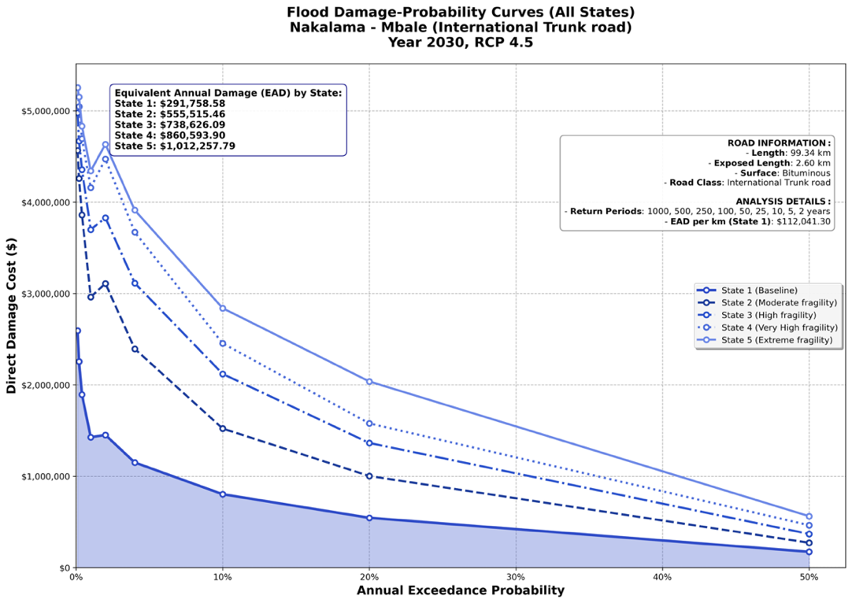
The cost gap HDM-4 misses $112,041/km for damage state 1 under RCP4.5, 2030
Expected Annual Damage
Repair and replacement under a representative climate event.
Notes:
Expected Annual Damage: $112,000 per year from a representative climate event on this corridor. This is the direct repair-and-replacement cost — culvert washouts, pavement edge failures, slope repairs. HDM-4 baseline doesn't see this number at all.

Slide 22
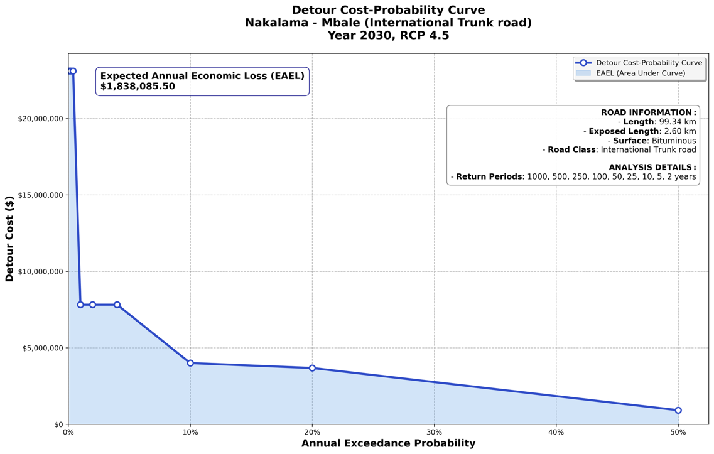
Resilience module
Pricing the rare, big events $1,838,086 EAEL under RCP4.5, 2030
Notes:
Resilience module. Standard probabilistic risk modelling: Hazard × Vulnerability × Exposure. Hazard from climate projections. Vulnerability from asset fragility curves. Exposure from the network model. Outputs: Expected Annual Damage (direct repair cost) and Expected Annual Economic Loss (user-side disruption from closures and detours).

Slide 23
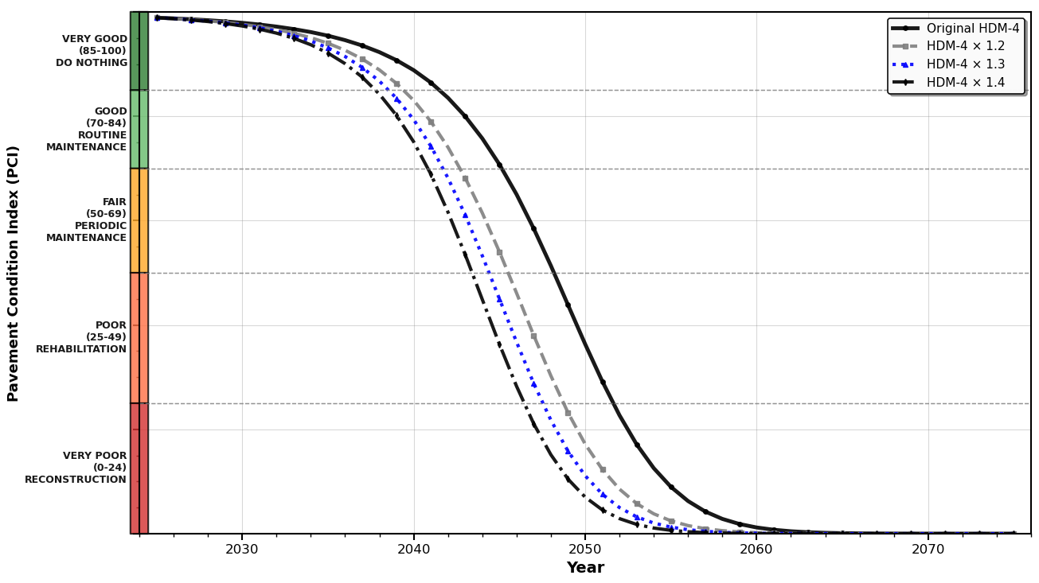
Climate-shift factors
Bending the deterioration curve Acceleration 1.2 – 1.4x faster pavement deterioration
Notes:
Climate-shift factors. Empirically calibrated multipliers applied to HDM-4 deterioration coefficients. Drivers captured: rising mean temperatures cause rutting and bleeding; higher rainfall intensity causes cracking and stripping; freeze-thaw frequency causes potholes and fatigue. The multipliers are calibrated against observed condition data on the case-study corridor.

Slide 24
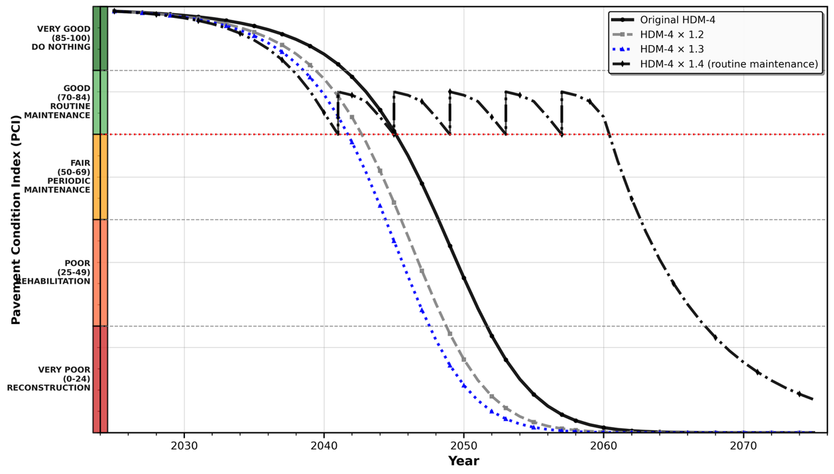
Scheduling 6 Years earlier
Notes:
Climate-shift factors. Empirically calibrated multipliers applied to HDM-4 deterioration coefficients. Drivers captured: rising mean temperatures cause rutting and bleeding; higher rainfall intensity causes cracking and stripping; freeze-thaw frequency causes potholes and fatigue. The multipliers are calibrated against observed condition data on the case-study corridor.

Slide 25
Comprehensive Economic analysis
 | No adaptation | With adaptation
Routine maintenance | SN1 | SN4
Periodic maintenance | SN2 | SN5
Rehabilitation | SN3 | SN6
Notes:
Climate-shift factors. Empirically calibrated multipliers applied to HDM-4 deterioration coefficients. Drivers captured: rising mean temperatures cause rutting and bleeding; higher rainfall intensity causes cracking and stripping; freeze-thaw frequency causes potholes and fatigue. The multipliers are calibrated against observed condition data on the case-study corridor.

Slide 26
Comprehensive Economic analysis
Notes:
Climate-shift factors. Empirically calibrated multipliers applied to HDM-4 deterioration coefficients. Drivers captured: rising mean temperatures cause rutting and bleeding; higher rainfall intensity causes cracking and stripping; freeze-thaw frequency causes potholes and fatigue. The multipliers are calibrated against observed condition data on the case-study corridor.

Slide 27
HDM4 misses 22% costs $1.8 mil disruption costs
Notes:
Climate-shift factors. Empirically calibrated multipliers applied to HDM-4 deterioration coefficients. Drivers captured: rising mean temperatures cause rutting and bleeding; higher rainfall intensity causes cracking and stripping; freeze-thaw frequency causes potholes and fatigue. The multipliers are calibrated against observed condition data on the case-study corridor.

Slide 28
Where adaptation money returns the most

Slide 29
Unless our planning tools learn to see what’s coming.
Roads designed for yesterday’s climate won’t survive tomorrow.

Slide 30
Contributions
Diagnosed where HDM-4 fails under climate stress — four failure modes, two unaddressed.
Built a dual-mode extension: resilience module + climate-shift factors.
Quantified the gap on 92 km in Uganda: 1.4× faster decay, 6 yrs sooner, $1.84M/yr in user costs HDM-4 misses.
Reordered intervention priorities — drainage and slope protection ahead of overlay.
Pamela Opio Acheng · University of Oxford · EGU26-15482
Adapting Transportation Asset Management Tools for Climate Change

