Slide 1


Revisiting the Extreme 1959 Western North Pacific Tropical Cyclone Season: The Effects of Environmental Conditions and Sea Surface Temperatures
Xu Chen and Masaki Satoh
AORI, The University of Tokyo
Final Submission Version
March 8, 2026

Slide 2
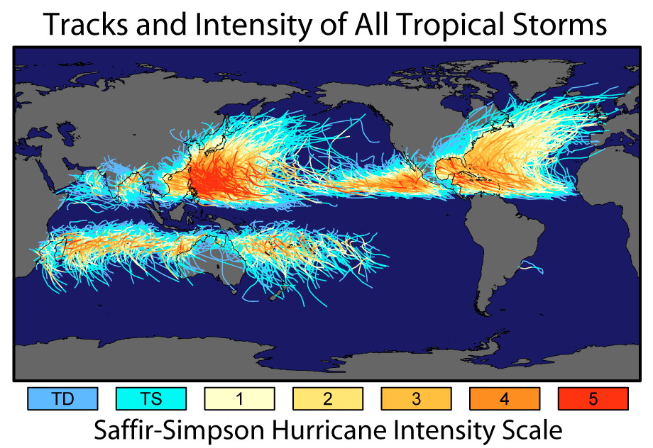
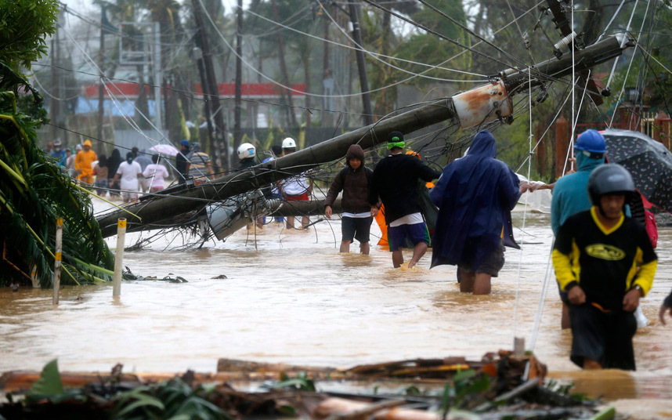
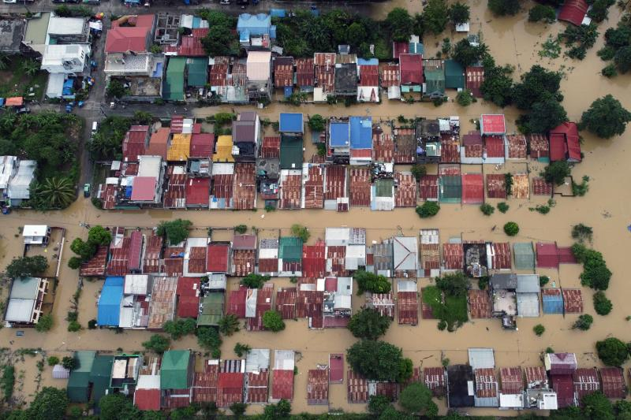
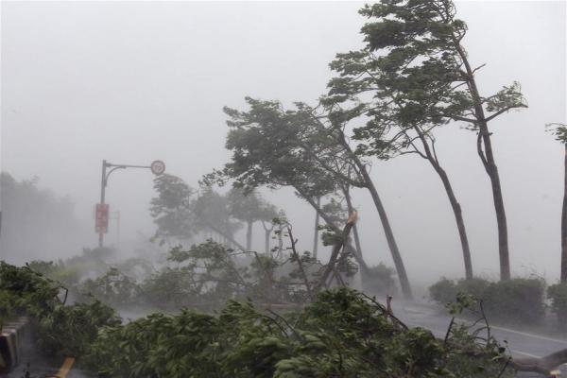
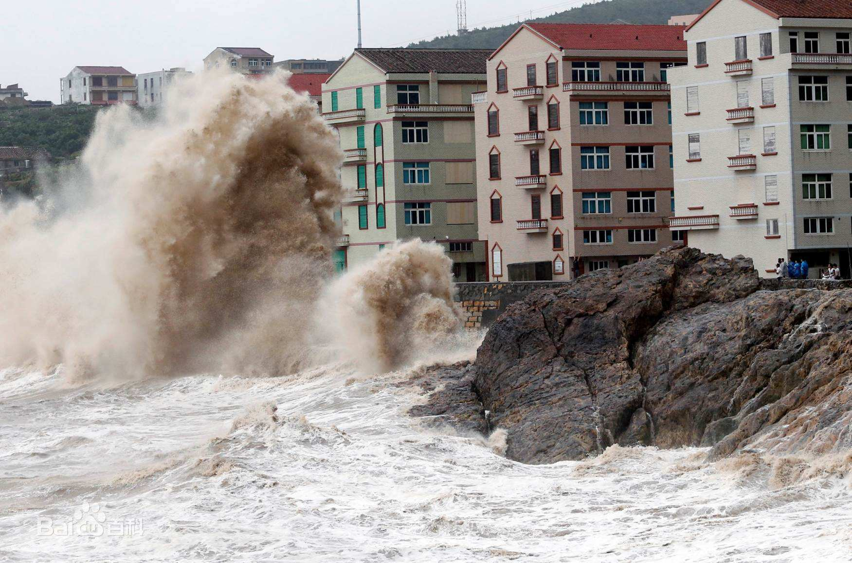
§Research Background
Track & Intensity
Disasters
WNP
NASA
Tropical cyclones (TCs) over the western North Pacific are frequent & intense
TCs can lead to direct and secondary disasters, causing huge losses

Slide 3
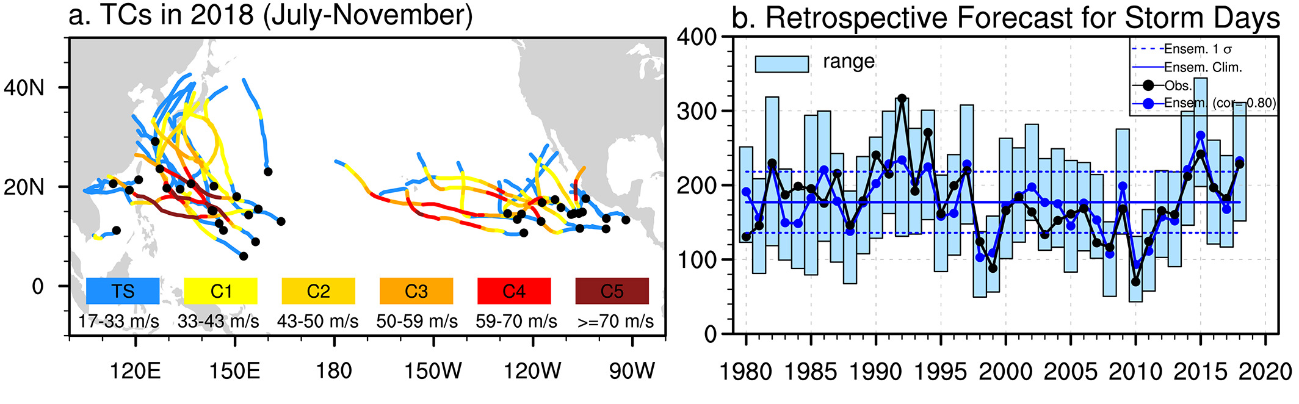
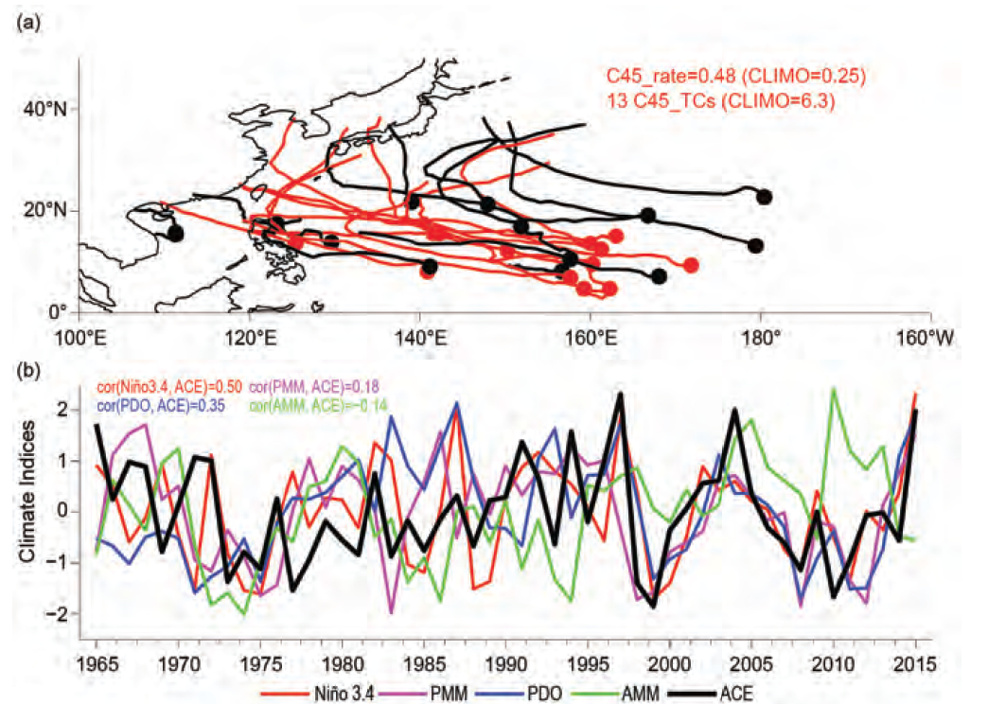
§Previous Research on Extreme TC Season
Research on extreme TC season:
2015: ENSO (Zhang et al. 2016)
2018: PMM (Qian et al. 2019; Gao et al. 2020)
2018 Season
Qian et al. (2019)
2015 Season
But previous research focus on:
The satellite era after 1980s
What about extreme season before 1970s?
Model simulation: ACE, TC frequency
What about TC intensity distribution?
Zhang et al. (2016)

Slide 4
§Before the Satellite Era: 1959 TC Season
1st in history!
Highest C5 TC percentage!

Slide 5
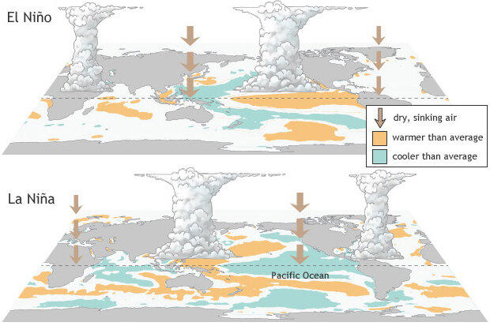
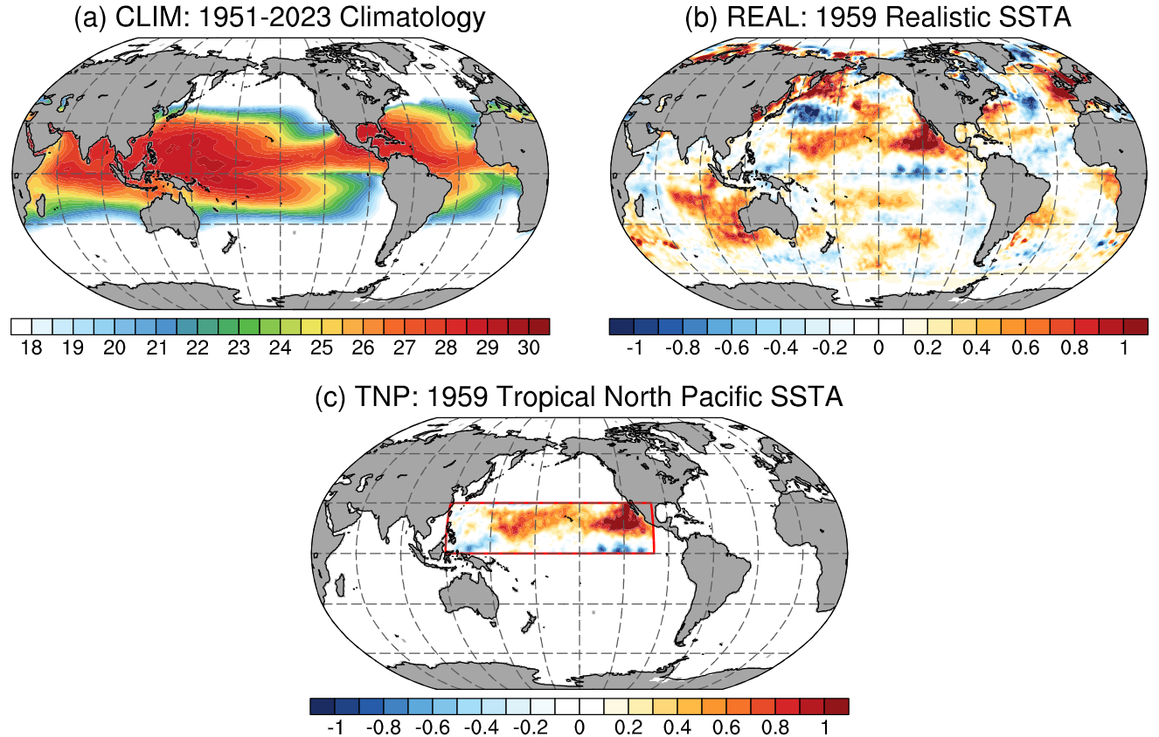
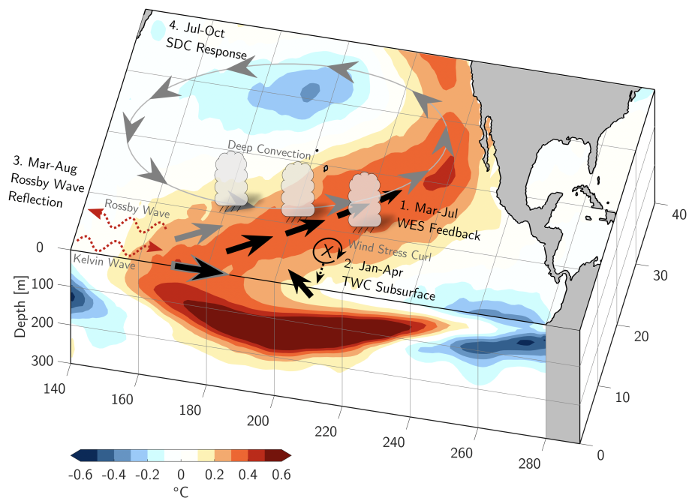
§Effects of Sea Surface Temperature
ENSO: Intensity; Genesis; ENSO flavors (e.g., Chan 2000; Kim et al. 2011, 2013)
PMM: Genesis; Frequency (Wu et al. 2018)
NOAA
CPC
Effects of Tropical Central Pacific?

Slide 6
§Scientific Questions
Why LMI in 1959 has significantly increased?
Do other TC features, including genesis positions and rapid intensification, play a role in increasing LMI?
How can large-scale circulations influence TC features?
What is the underlying physical mechanism of SST anomaly affecting these large-scale circulations?

Slide 7
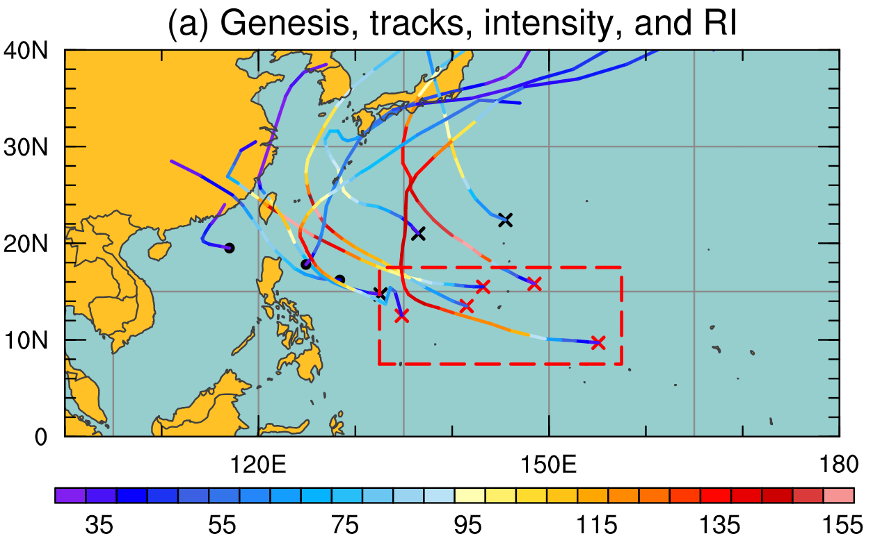
§Effects of Genesis & Rapid Intensification
Red box (7.5–17.5°N, 132.5–157.5°E) to the east of the Philippines is very important
Red & black markers: C5 & non-C5 TCs
Cross & dot markers: RI & non-RI TCs
Red box: main genesis region for C5 TCs
Genesis effect: Category 5 TCs all generated in red box
RI effect: 8 out of 11 TCs underwent RI, all near red box

Slide 8
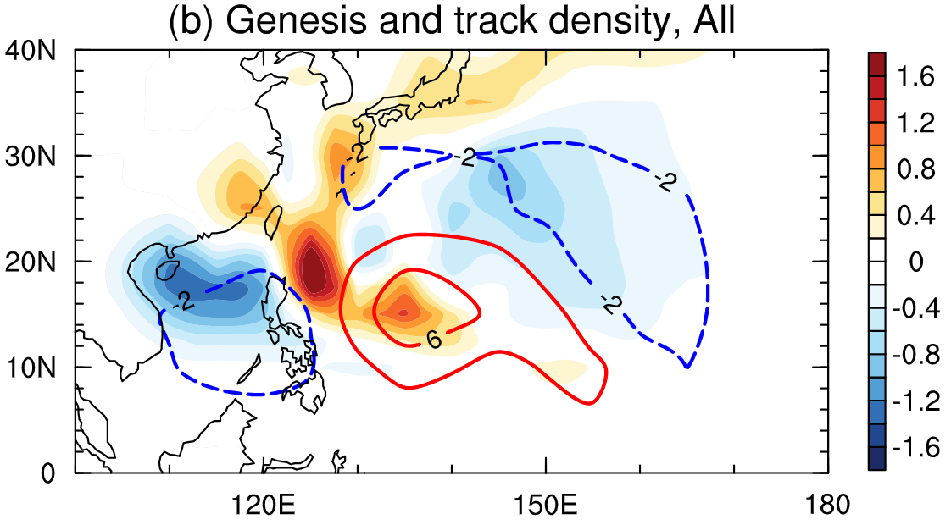
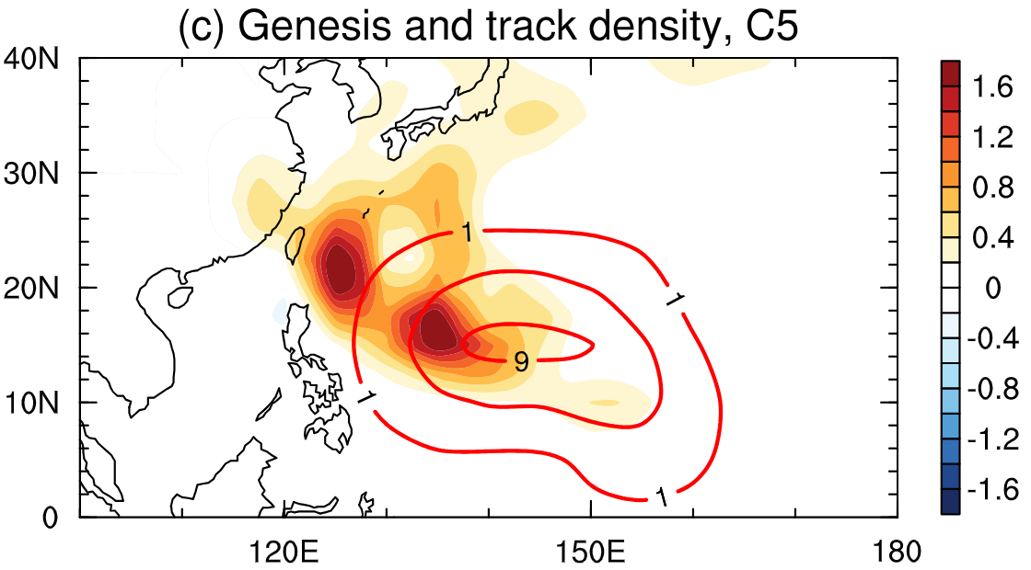
§Effects of Genesis Positions
Better conditions
& higher LMI?
TCs tend to generated over the open basin east to the Philippines
Largest anomalies of genesis density of all and C5 TCs overlapped
More TCs formed in red box (6 vs. 3.75)
TCs here are stronger (114.62 vs. 84.11)
Enhanced LMI in 1959

Slide 9
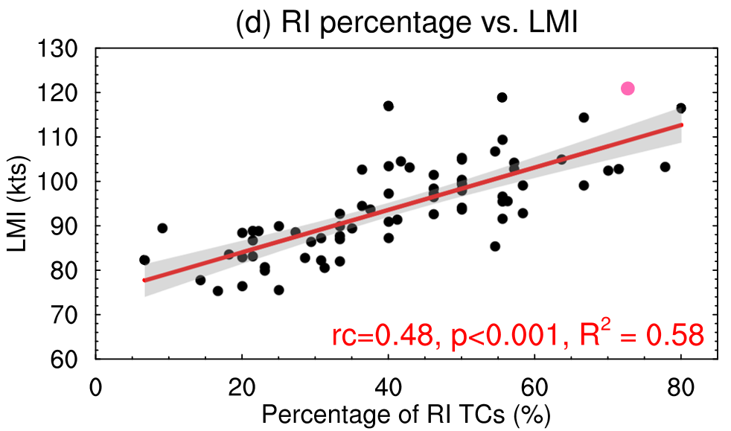
§ Effects of Rapid Intensification
(1) More TCs underwent RI
(8 for clim. vs. 3.73 in 1959)
(2) RI is well correlated with LMI (R²=0.58, p<0.001)
Enhanced LMI in 1959
Pink & black scatters: 1959 & other year values
Gray intervals: 95% confidence levels of regression line

Slide 10
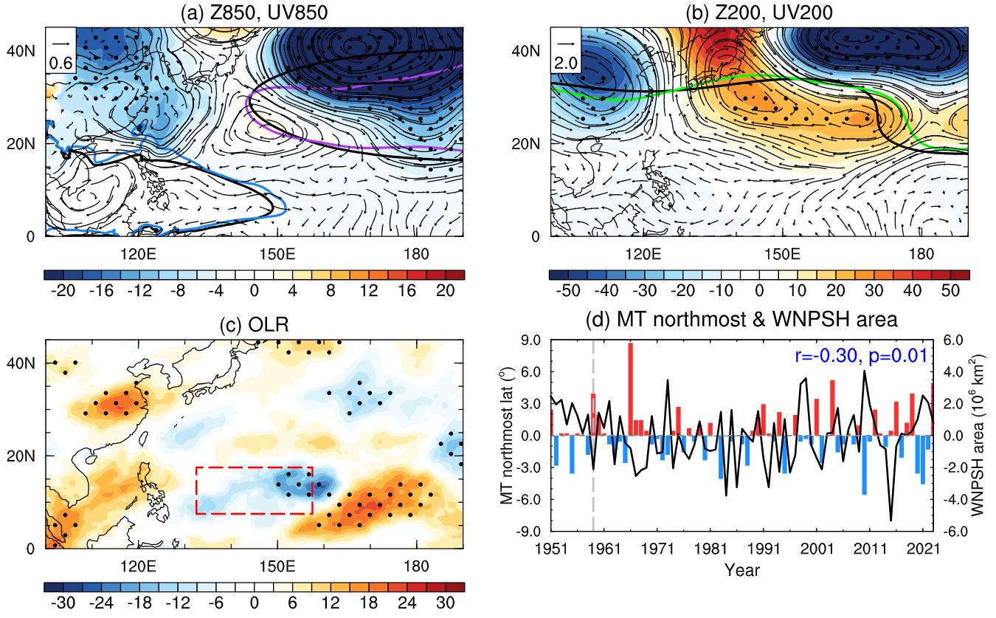
§Characteristics of Large-scale Circulation
How do large-scale circulation affect TC genesis and RI?
Enhanced northward monsoon trough
Weakened sub-high
Eastward tropical upper-tropospheric trough (TUTT)
Black contour: 1951-2023
Colored contour: 1959
Dots: 90% confidence level

Slide 11
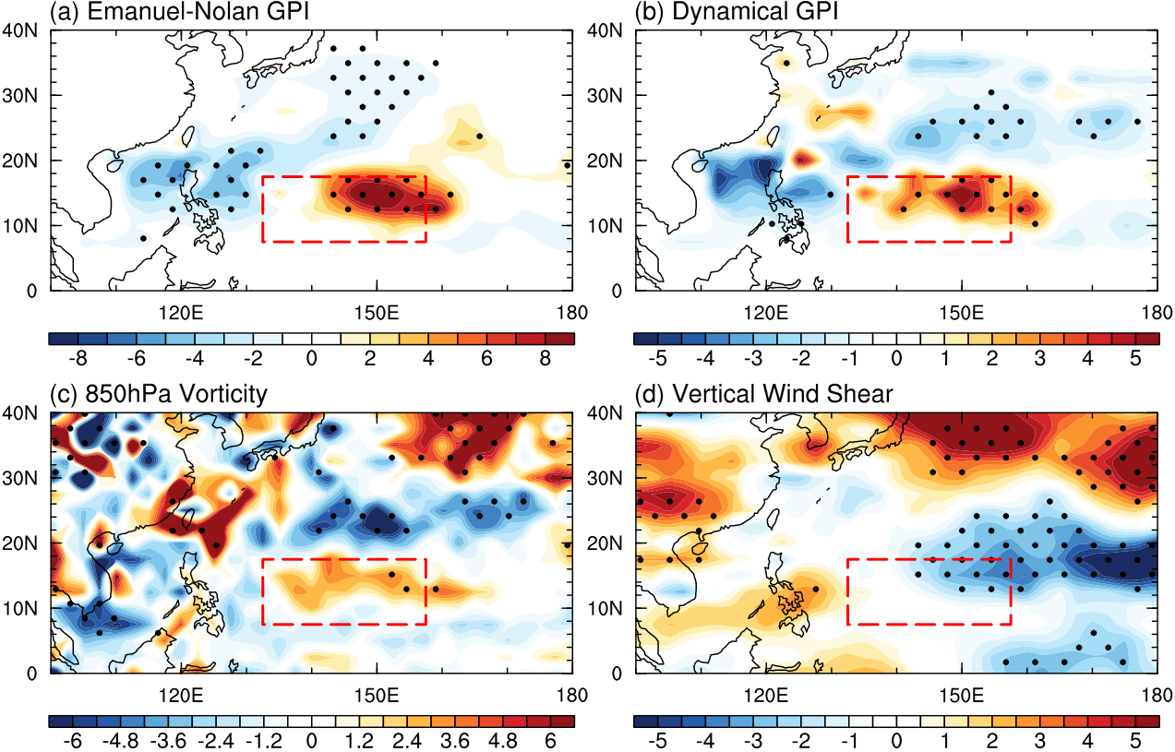
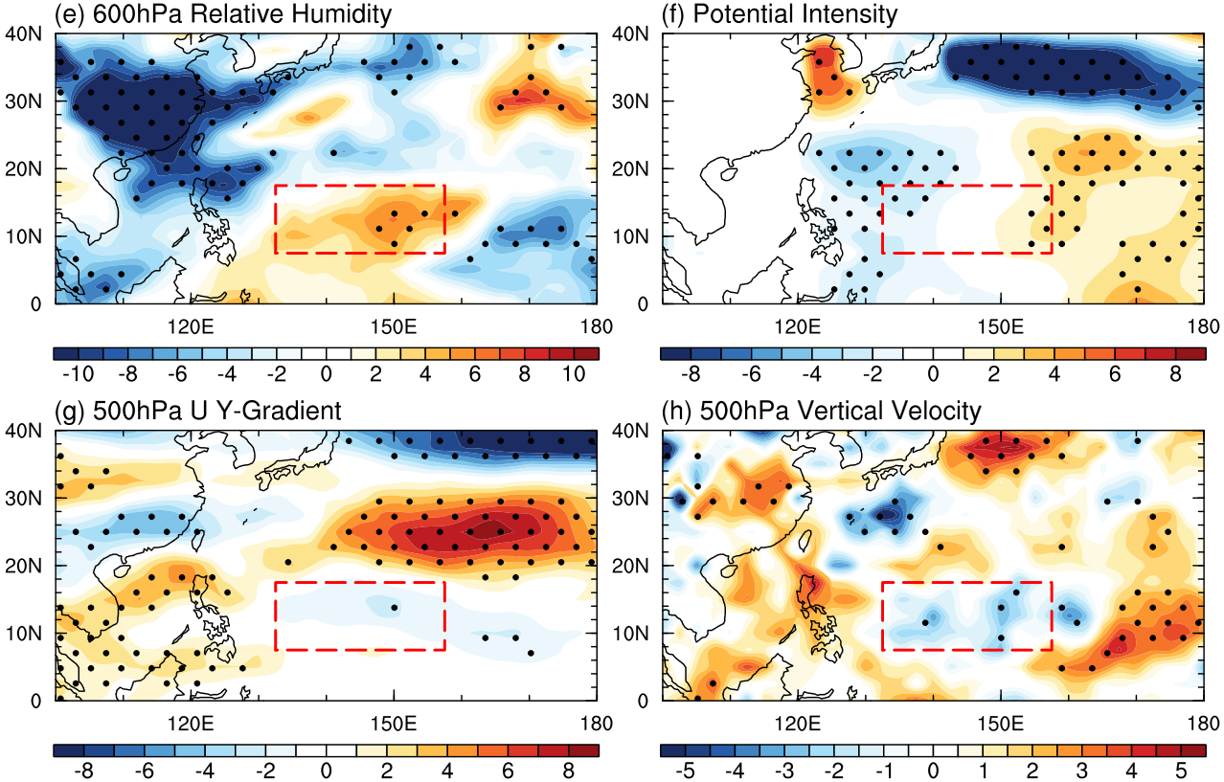
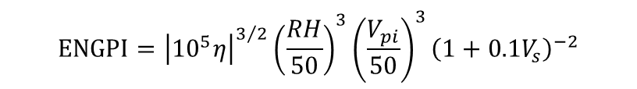
§Explanation for Genesis Positions
Large-scale circulation → Environmental conditions → TC genesis
$$ENGPI={\left|{10}^{5}η\right|}^{3/2}{\left(\frac{RH}{50}\right)}^{3}{\left(\frac{V_{pi}}{50}\right)}^{3}{\left(1+0.1V_{s}\right)}^{−2}$$
$$DGPI={\left|2+0.1V_{s}\right|}^{−1.7}{\left(5.5−{10}^{5}\frac{∂u}{∂y}\right)}^{2.3}{\left(5−20ω\right)}^{3.3}{\left(5.5+\left|{10}^{5}η\right|\right)}^{2.4}e^{−11.8}−1$$
Emanuel and Nolan (2004)
Wang and Murakami (2020)
Monsoon
TUTT
Monsoon + Sub-high
Monsoon

Slide 12
§Explanation for Rapid Intensification
What factors may increase the frequency of rapid intensification?
JTWC STIPS: Knaff et al. (2020)
JMA TIFS: Shimada (2022)
Variables | Description
SST (°C) | SST around TC center (r = 0 – 50 km)
VWS (m s⁻¹) | 850 – 200 hPa vertical wind shear (r = 0 – 500 km)
DIV (s⁻¹) | 200 hPa divergence (r = 0 – 1000 km)
RH (%) | 600 hPa relative humidity (r = 200 – 800 km)
Variables | 1951-2023 | 1959 | Anomaly
SST (°C) | 28.69 | 28.94 | +0.26 (p=0.18)
VWS (m s⁻¹) | 14.95 | 14.62 | -0.33 (p=0.31)
DIV (s⁻¹) | 12.46 | 12.54 | +0.07 (p=0.94)
RH (%) | 67.16 | 72.08 | +4.91 (p<0.01)
Relative humidity

Slide 13
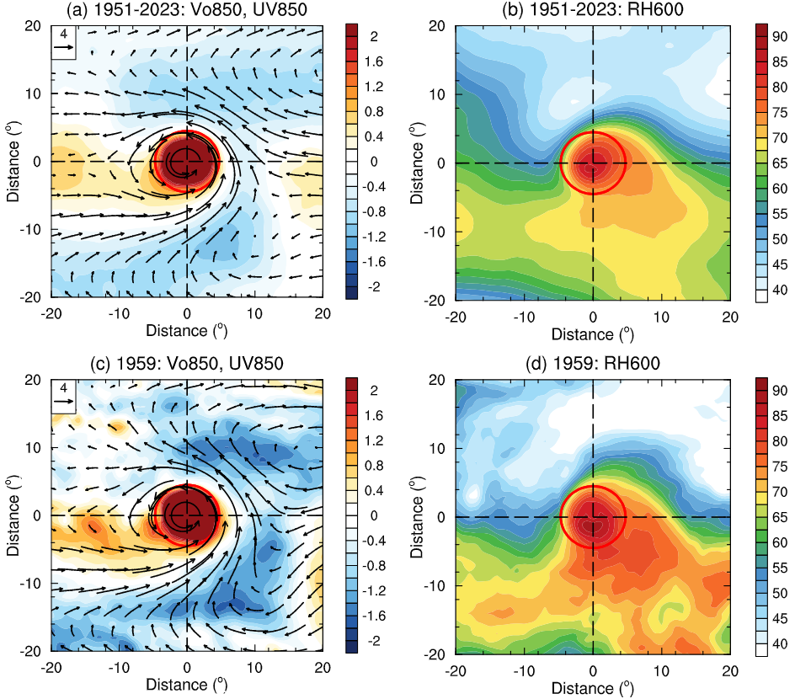
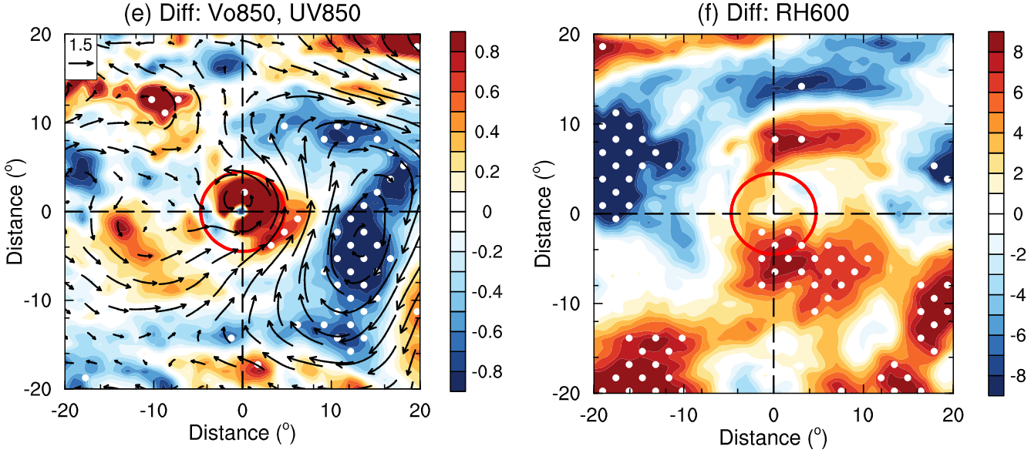
§ Monsoon Enhances Relative Humidity
Monsoon → humidity
Red contour: 500 km from TC center, represents the approximate boundary for TC circulation
Dots: 90% confidence level

Slide 14
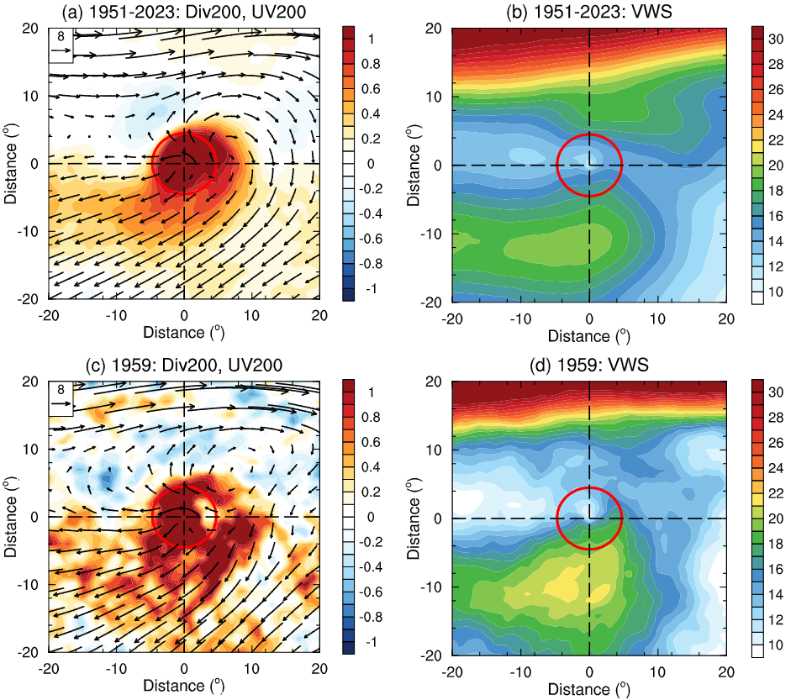
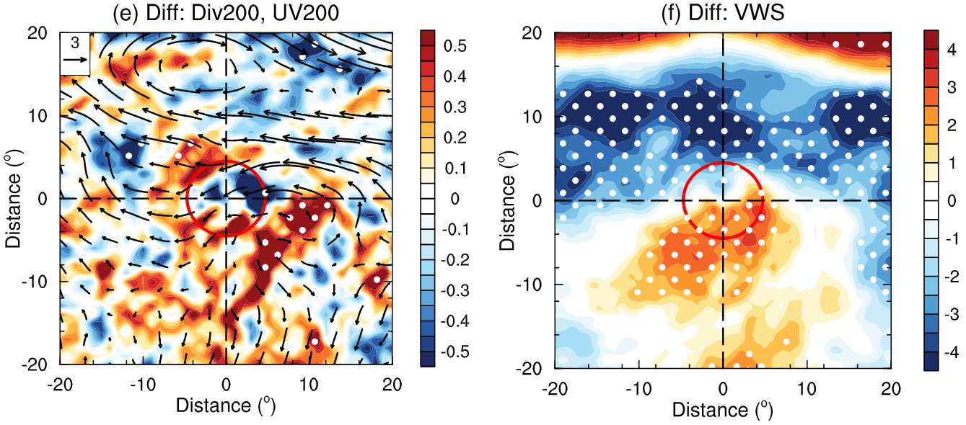
§ Upper-level Conditions & Wind Shear
High divergence, weak wind shear
Red contour: 500 km from TC center, represents the approximate boundary for TC circulation
Dots: 90% confidence level

Slide 15
§Impacts of Sea Surface Temperature?
Name | Explanation
CLIM | 1951-2023 Climatology SST
REAL | CLIM SST + 1959 Global SSTA
TNP | CLIM SST + North Pacific SSTA
Basic settings
Resolution: 28km (GL08), 78 levels
Analysis period: 1959/08/01 – 10/31
Spin-up period: 1959/07/01 – 07/31
Ensemble: start from 00:00UTC – 09:00UTC, totally 10 members
Slab ocean model with SST nudging
Parameterization
Cumulus: CHIKIRA scheme (Chikira and Sugiyama 2010)
Microphysics: as Takasuka et al. (2024)

Slide 16
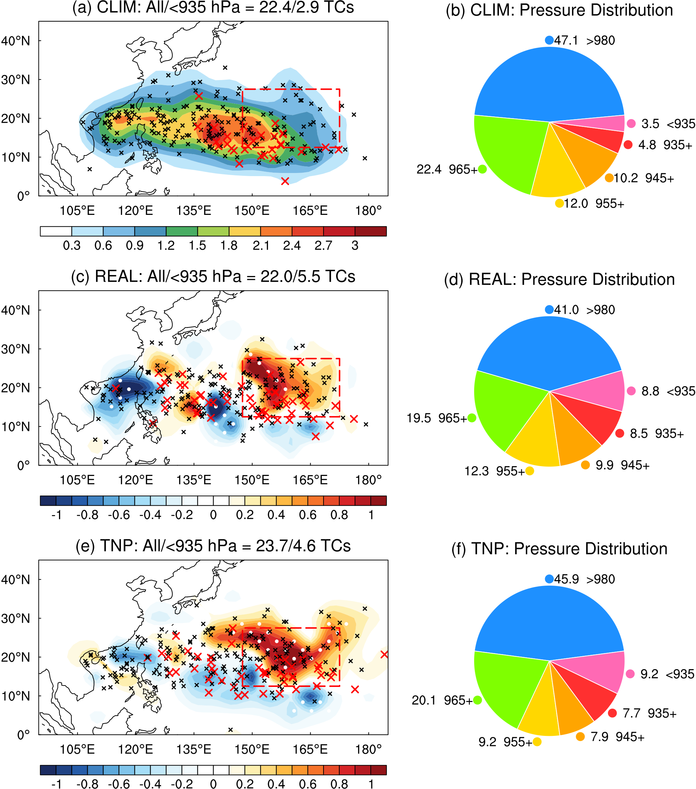
§NICAM: Reproduction of 1959 TCs
Can NICAM reproduce realistic extreme TCs as in 1959?
High proportions of extreme TCs are reproduced in REAL and TNP
Tropical North Pacific warming could play an important role

Slide 17
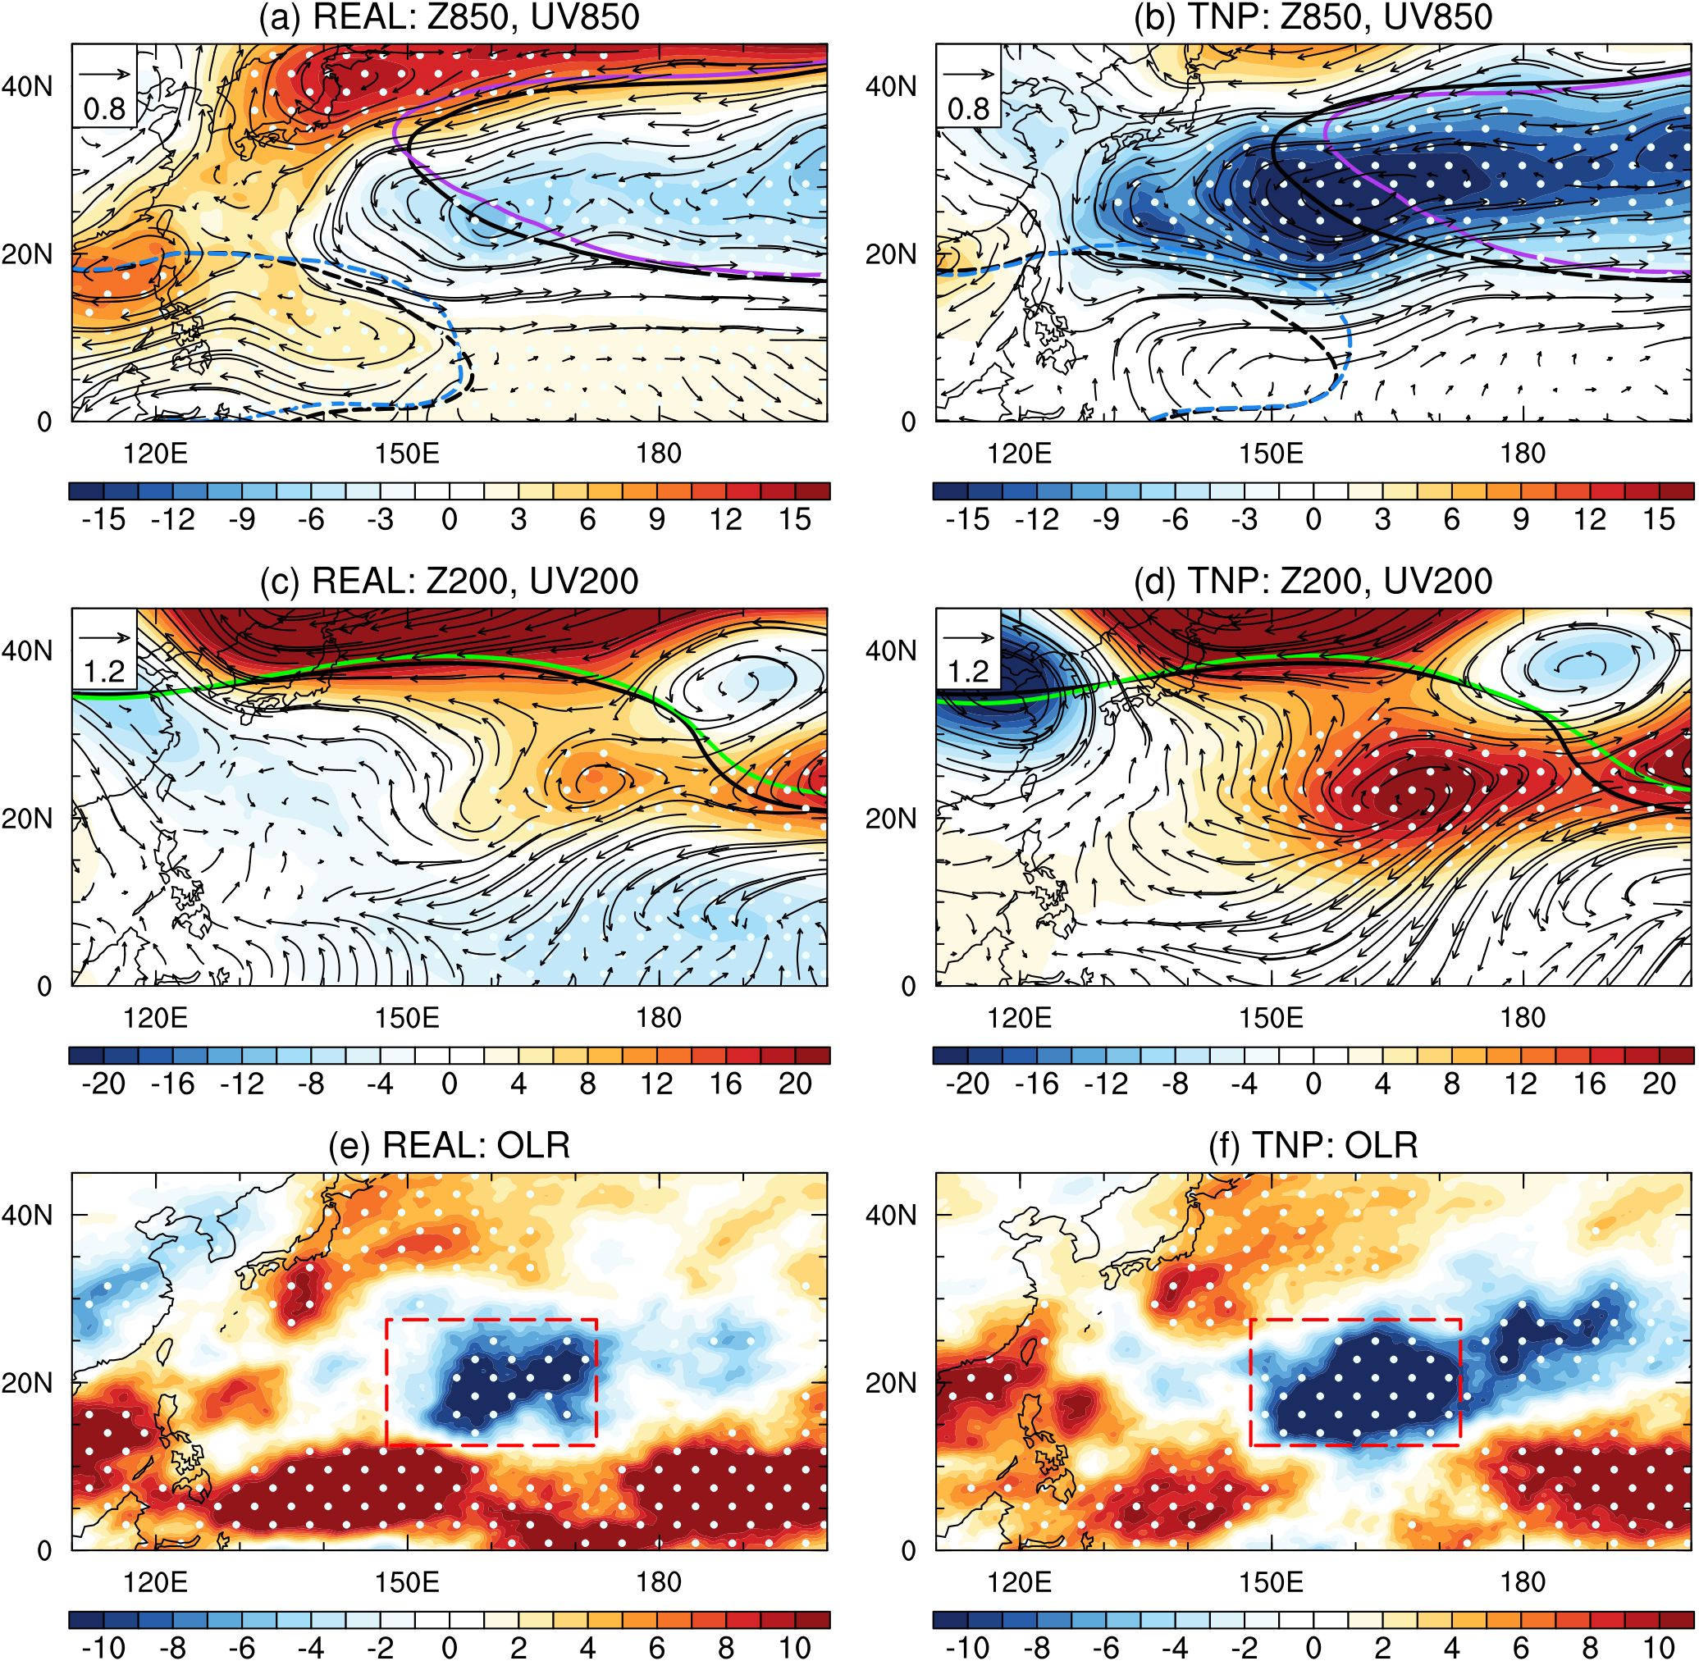
§SST Anomaly in Which Basin is Most Crucial?
Enhanced monsoon trough
Weak subtropical high
Eastward shift of TUTT
North Pacific SST is important
Matsuno-Gill response:
Low-level cyclonic, upper-level anticyclonic circulations northwest to the SST heating

Slide 18
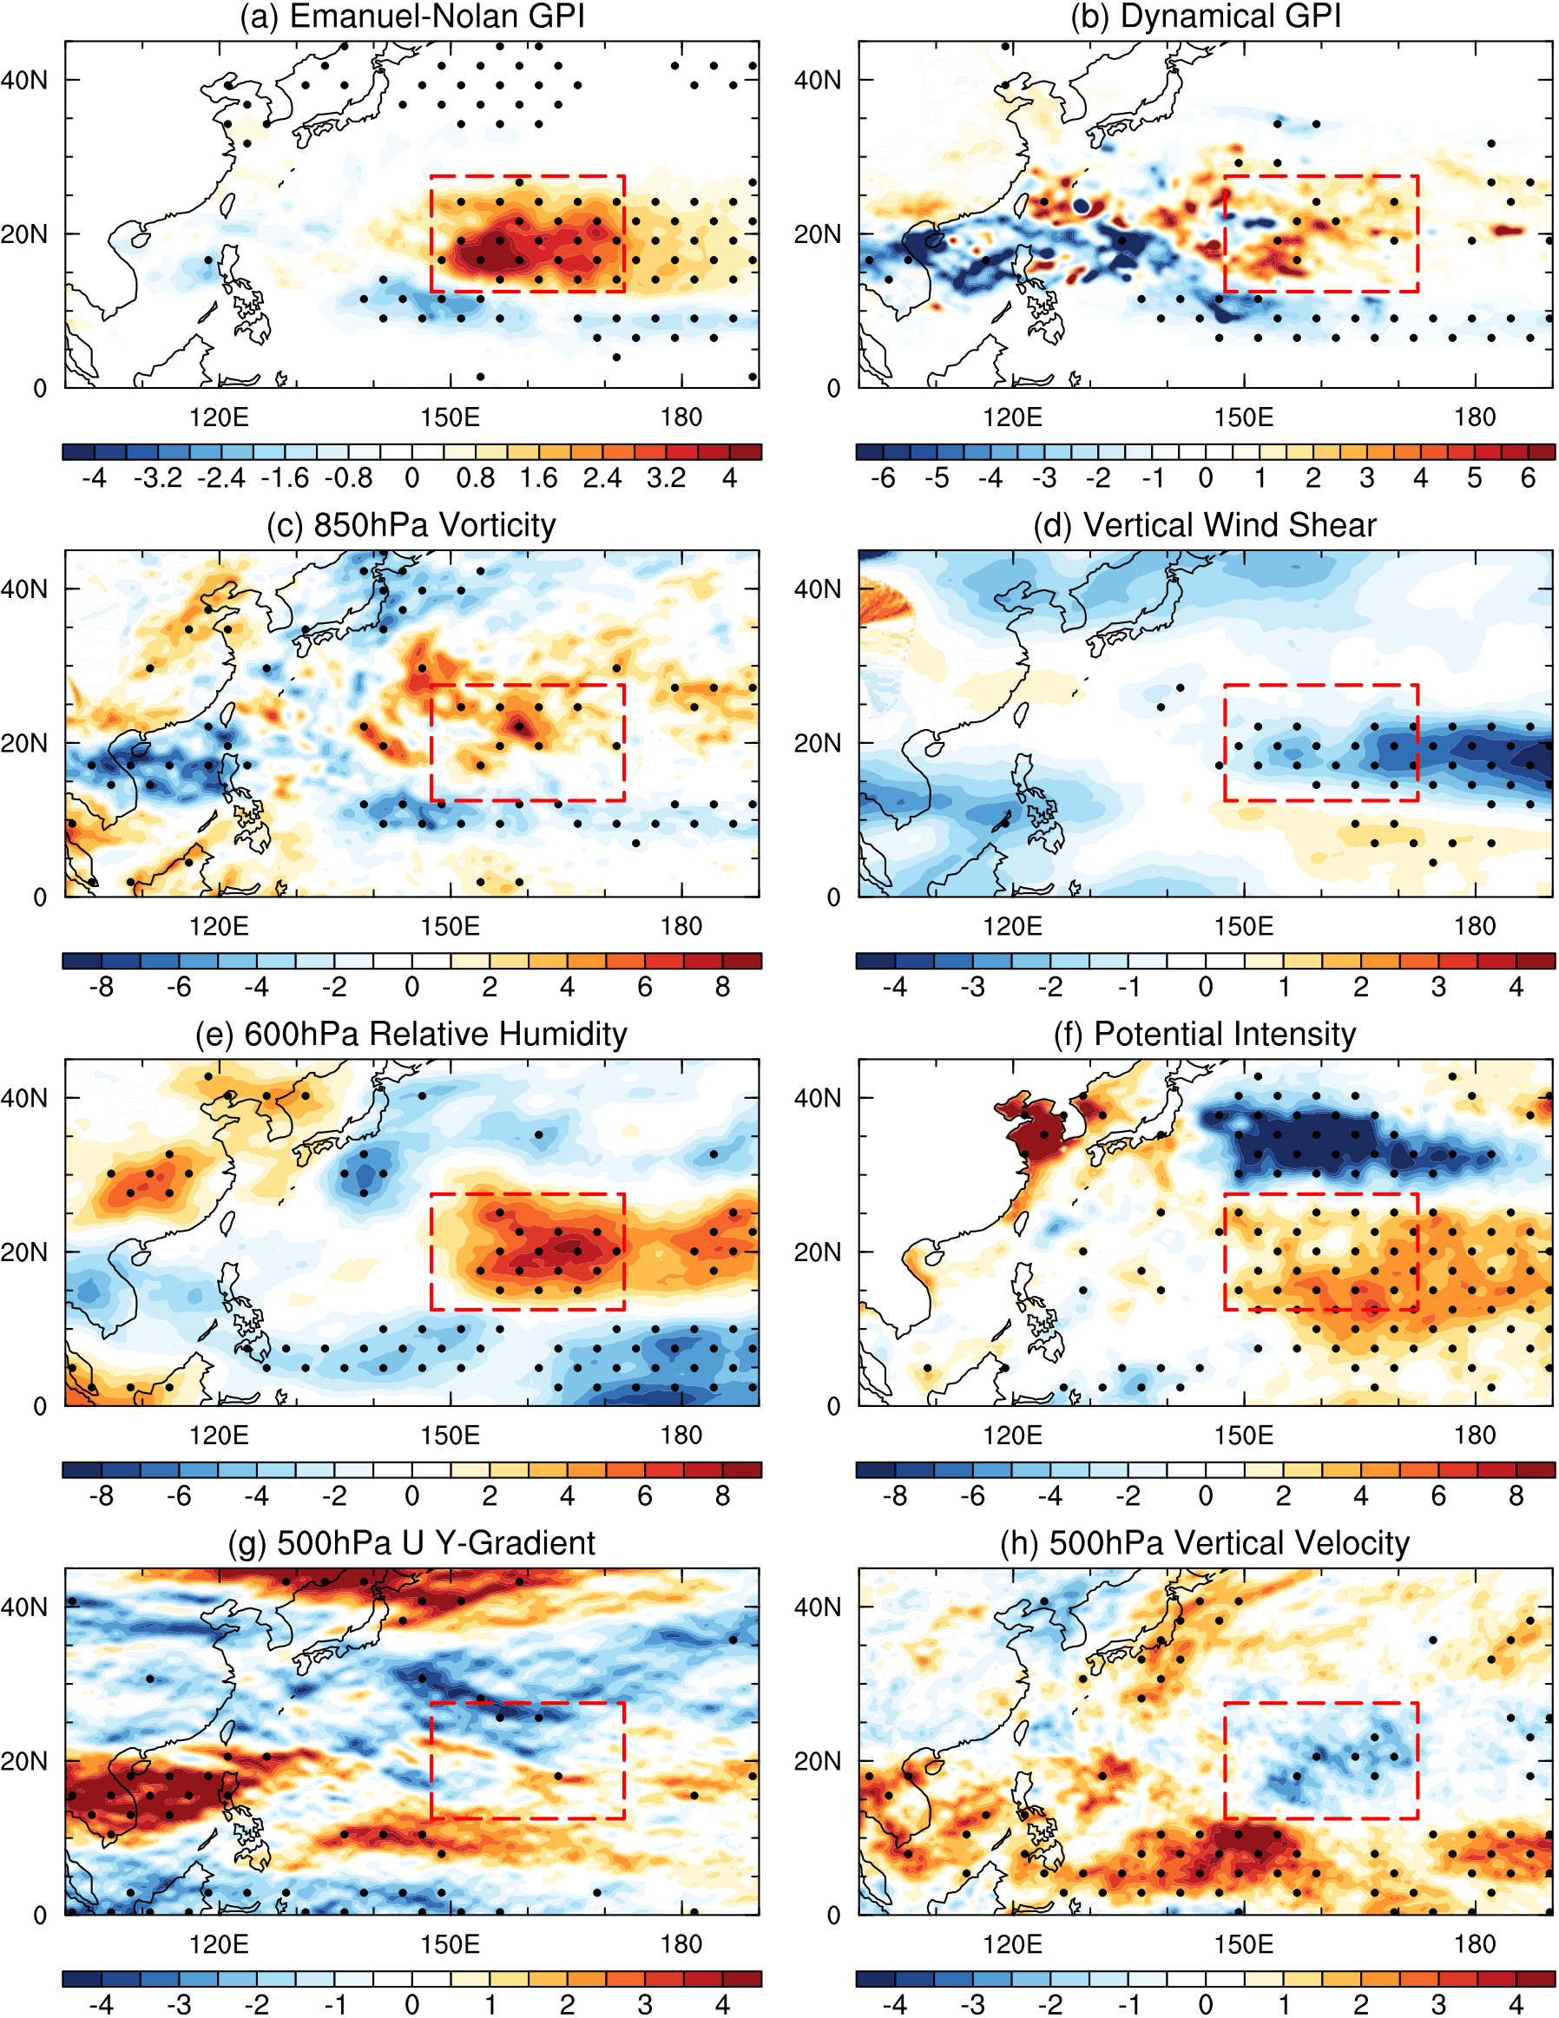
§Simulated GPI & DGPI in REAL Experiment
Simulated GPI & DGPI well aligns with the TC genesis in the REAL exp
The impact of TC formation on LMI is similar as in observation

Slide 19
§Conclusions & Discussions
In 1959, SST warming in the tropical North Pacific leads to enhanced monsoon trough, weak subtropical high, and eastward shift of TUTT, and the most relevant physical mechanism is the Matsuno-Gill response.
Changes in these large-scale circulations affect environmental conditions including vorticity, humidity, vertical wind shear, and vertical motion.
Favorable conditions result in the shift of genesis positions and increase the frequency of RI, leading to higher LMI in that year.
Composites of TC nearby environments in the simulations, which may be important for the TC intensification, still need verification.

Slide 20
Thanks for your attention!
Xu Chen and Masaki Satoh
AORI, The University of Tokyo
Final Submission Version
March 8, 2026

