Slide 1
Fluvial Flood Risk Using InSAR-Updated DEMs Post- Earthquake
Nariman H. Al Amry, Elizabeth K. Carter | Syracuse University
Supplementary Slides.

Slide 2
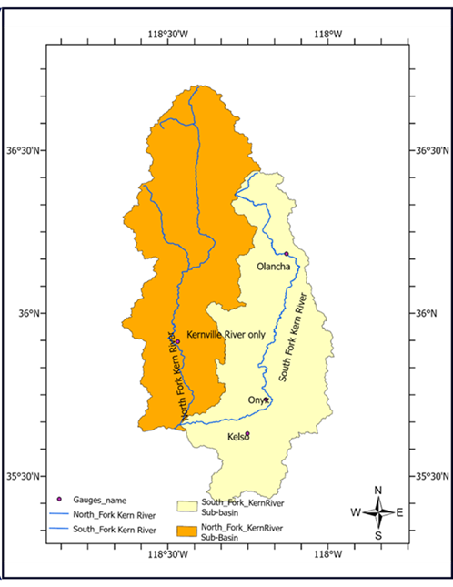
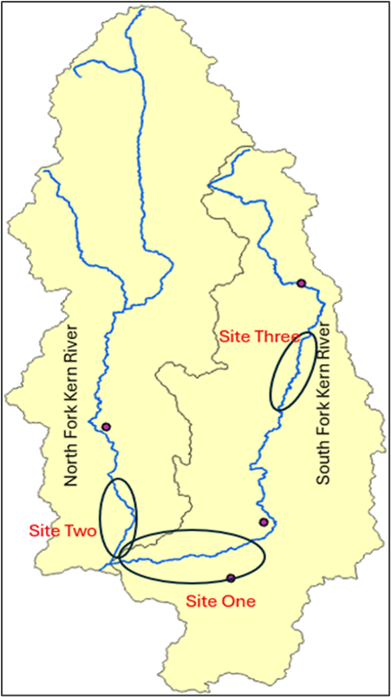
Study Area.
North and South Kern River Forks.

Slide 3
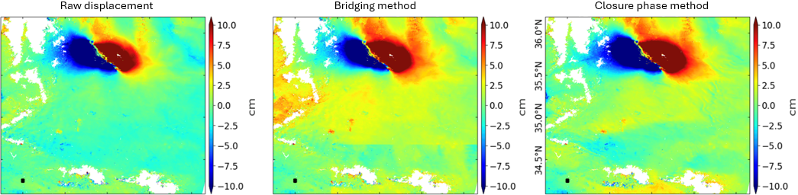
InSAR DEM Update Workflow.
90 Sentinel-1 interferograms, descending track over the Ridgecrest area from May 2019 to May 2020
Correcting for systematic phase contributions.
Maximum uplift 123cm, maximum subsidence -95cm.
Validation of InSAR LOS Velocities Using GNSS with R² = 0.85

Slide 4
HEC-RAS model:
Topographic data: NED 10m DEM :
1. pre-earthquake DEM
2. Post-earthquake DEM
Manual digitizing of vector layers ( river centerlines, flow paths, cross sections ) in RAS Mapper
Flood Frequency analysis for maximum discharge using streamflow gauges along the North & South Forks of the Kern River.
Return periods scenarios (5, 10, 25, 50, and 100 years) and Log Pearson type III as the optimal model.

Slide 5
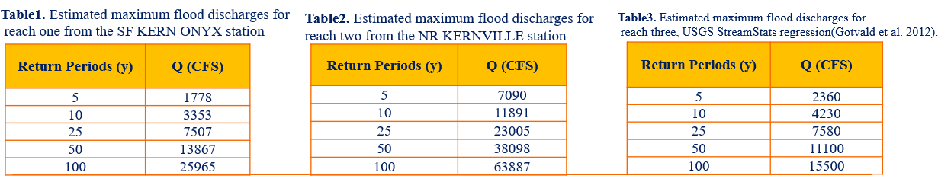
Flood Frequency Results:

Slide 6
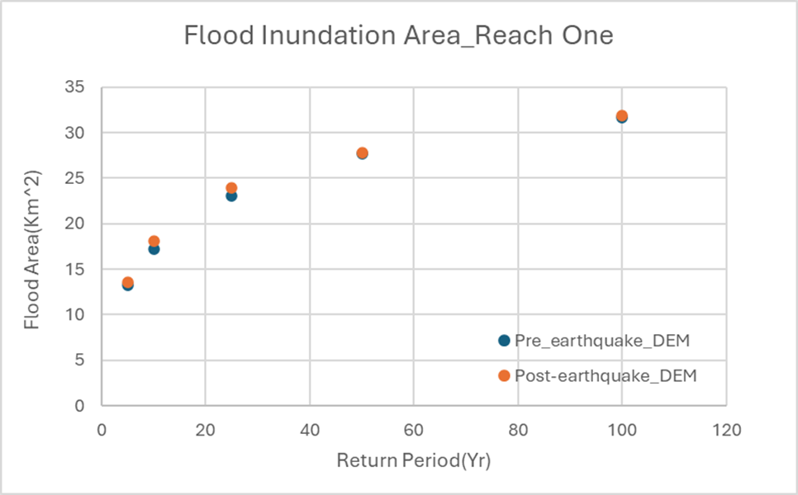
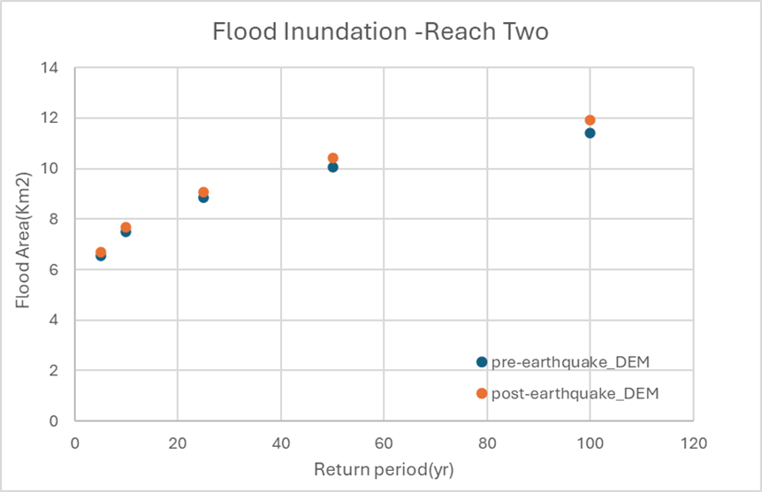
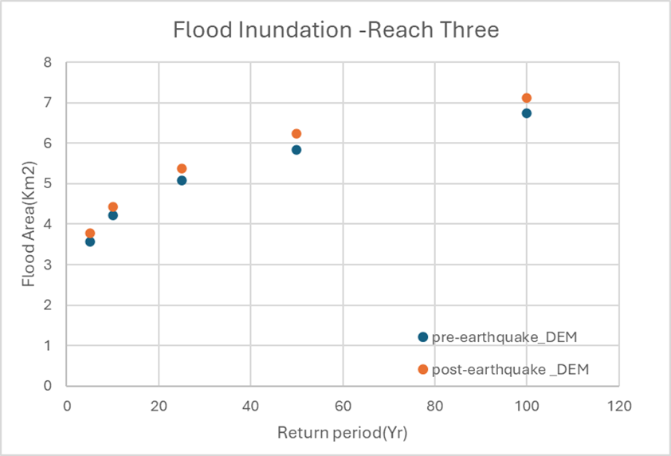
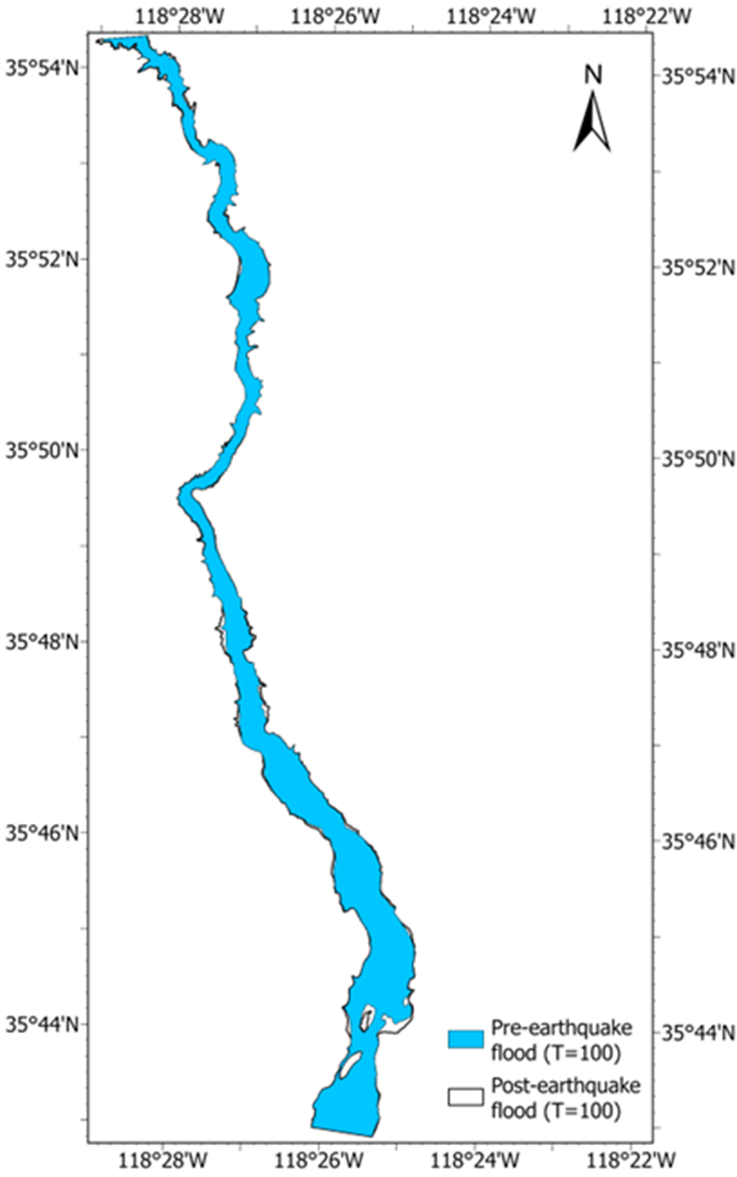
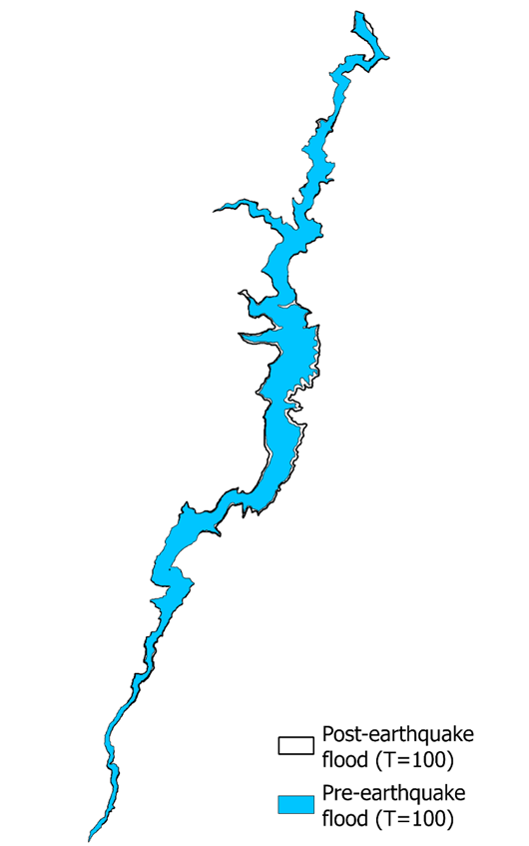
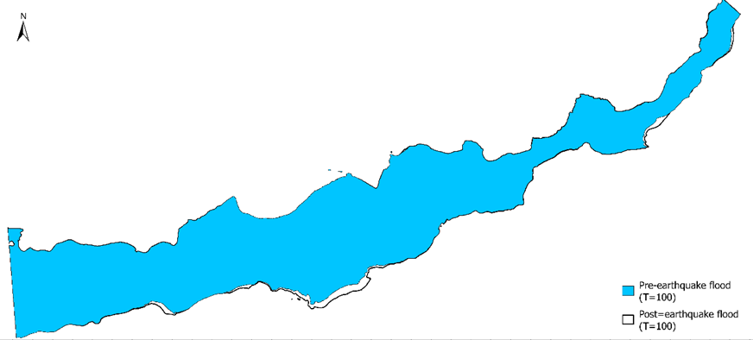
HEC-RAS Flood Modeling.
Higher flood extents in the post-EQ DEM than in the pre-EQ DEM across all three study reaches.

