Slide 1
Cascading failures of index insurance, cooperation, and levees in coastal Bangladesh: agent-based modeling and global sensitivity analysis FOR STOCHASTIC MODELS
Woi Sok (Woi) Oh, Ph.D.
Assistant Professor
Department of Systems Design Engineering
Faculty of Engineering
University of Waterloo
Collaborators:
Kyungmin Sung (KEI)
Fernando Santos (UvA)
Kelsea Best (OSU)
Simon Levin (Princeton University)
Daniel Rubenstein (Princeton University)
Presented at the TU Delft, Nov 17th 2025

Slide 2
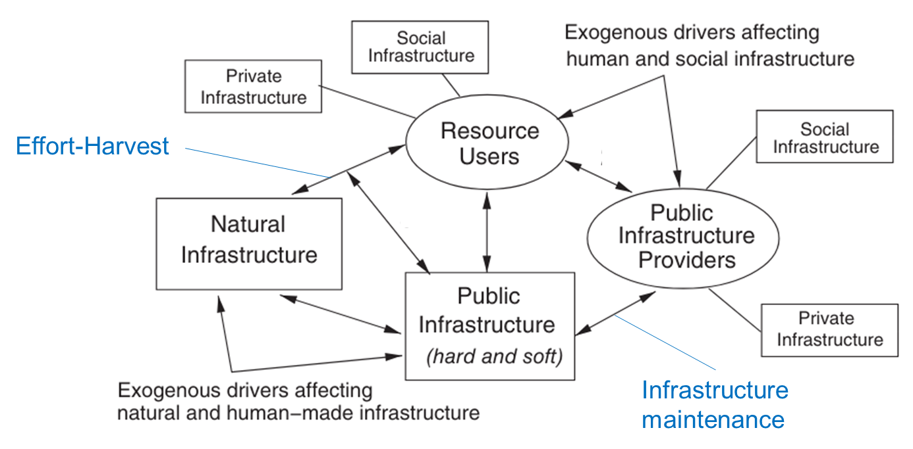
FRAMING SUSTAINABLE WATER RESOURCE MANAGEMENT
1
2
A framework from Muneepeerakul, R., & Anderies, J. M. (2017) , Anderies et al. (2004)
1. Muneepeerakul, R., & Anderies, J. M. (2017). Strategic behaviors and governance challenges in social‐ecological systems. Earth's Future, 5(8), 865-876.
2. Anderies, J. M., Janssen, M. A., & Ostrom, E. (2004). A framework to analyze the robustness of social-ecological systems from an institutional perspective. Ecology and society, 9(1).

Slide 3
FRAMING SUSTAINABLE WATER RESOURCE MANAGEMENT
Hard infrastructure: physical infrastructure, e.g., dam, road, levee …
Soft infrastructure: intangible infrastructure, e.g., norms, institutions …
1
2
A framework from Muneepeerakul, R., & Anderies, J. M. (2017) , Anderies et al. (2004)
1. Muneepeerakul, R., & Anderies, J. M. (2017). Strategic behaviors and governance challenges in social‐ecological systems. Earth's Future, 5(8), 865-876.
2. Anderies, J. M., Janssen, M. A., & Ostrom, E. (2004). A framework to analyze the robustness of social-ecological systems from an institutional perspective. Ecology and society, 9(1).

Slide 4
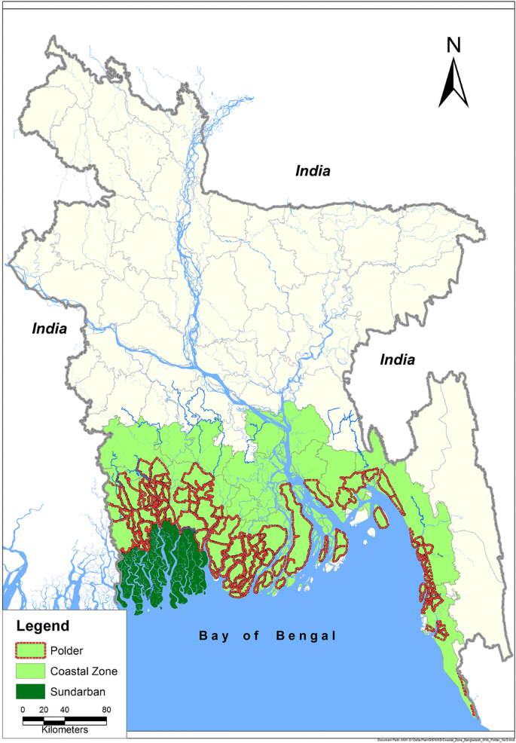
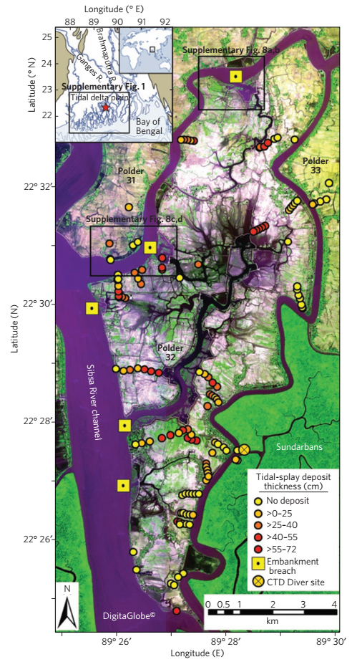
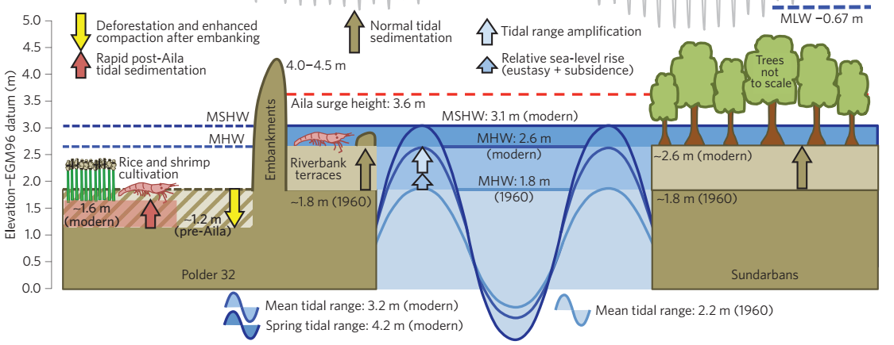
PHYSICAL INFRASTRUCTURE: LEVEES IN COASTAL BANGLADESH
4
from Auerbach et al. (2015)
3
Map from Yadav et al. (2020)
3. Yadav, S., Mondal, M. K., Shew, A., Jagadish, S. K., Khan, Z. H., Sutradhar, A., ... & Chandna, P. (2020). Community water management to intensify agricultural productivity
in the polders of the coastal zone of Bangladesh. Paddy and Water Environment, 18, 331-343.
4. Auerbach, L. W., Goodbred Jr, S. L., Mondal, D. R., Wilson, C. A., Ahmed, K. R., Roy, K., ... & Ackerly, B. A. (2015). Flood risk of natural and embanked landscapes on the
Ganges–Brahmaputra tidal delta plain. Nature Climate Change, 5(2), 153-157.

Slide 5
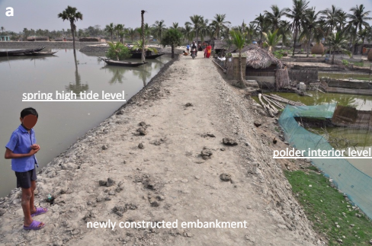
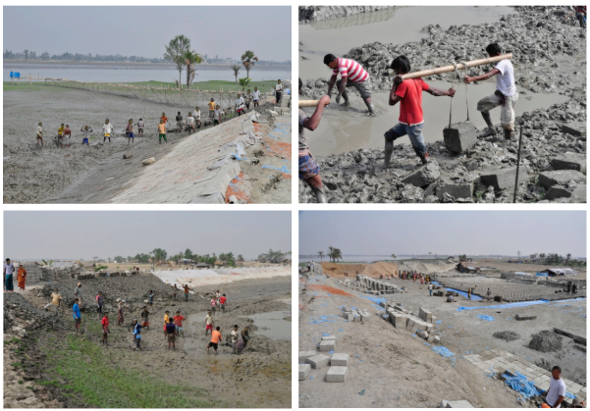
INFORMAL INSTITUTION: COOPERATION FOR LEVEE MAINTENANCE
4
from Auerbach et al. (2015)

Slide 6

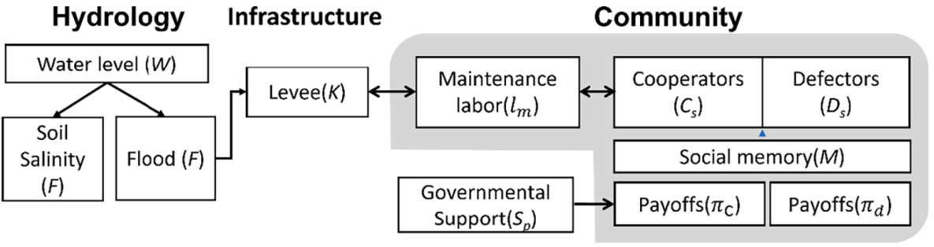
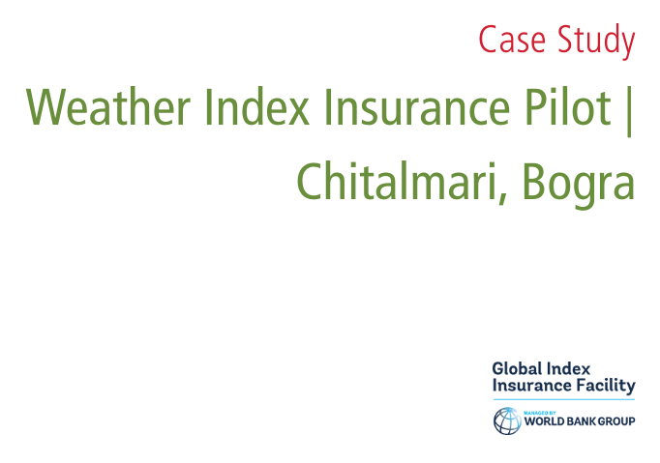
FORMAL INSTITUTION: INDEX INSURANCE
5
Sung et al. (2022)
5. Sung, K., Kim, Y., & Yu, D. (2022). Spatially explicit agent-based approach for human–flood interaction modeling under external support.
Journal of Hydrology, 612, 128175.

Slide 7
PROBLEM DESIGN
Existing work has examined how government supports build system sustainability.
  However, self-organization of levee maintenance suggests that there will not be enough government supports in these communities.
Mathematical models are used to understand index insurance and risk transfer strategies.
  We still lack empirical applications of such models in case studies.
Agent-based models produce useful information for water resource management.
  We need sophisticated tools to fully interpret ABM outcomes.

Slide 8
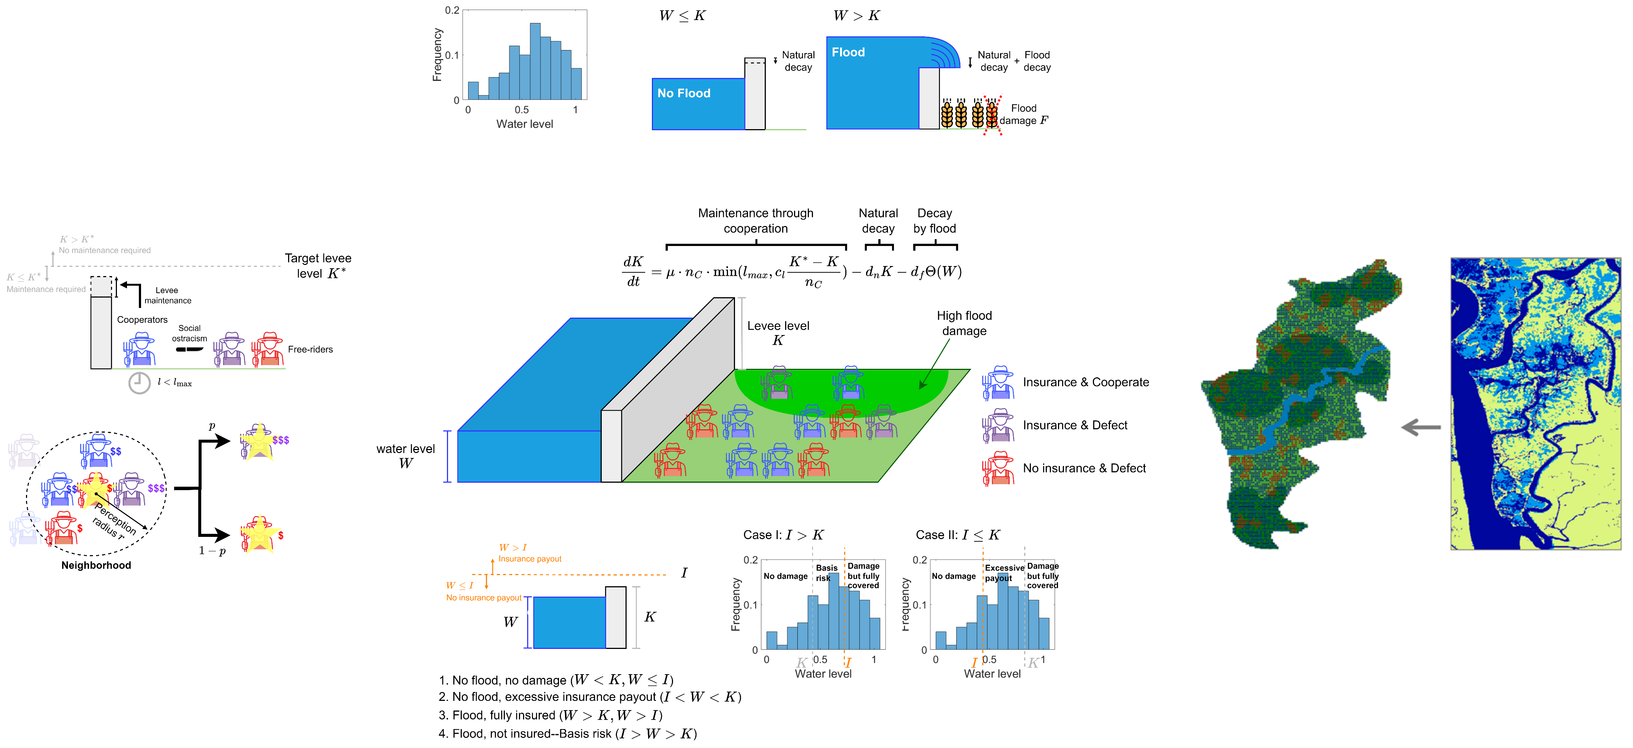
AN OVERVIEW OF AN AGENT-BASED MODEL

Slide 9
PHYSICAL INFRASTRUCTURE MODULE

Slide 10
GIS ENVIRONMENT MODULE

Slide 11
HYDROLOGY MODULE

Slide 12
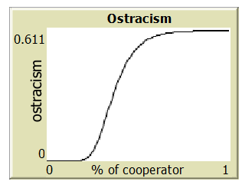

STRATEGIC DECISION MODULE
Insurance premium
Crop profit
(without harm)
Opportunity cost from
levee maintenance
Insurance premium
Crop profit
(without harm)
Social ostracism from
cooperators
Crop profit
(possible harms)
Social ostracism from
cooperators
$$w=he^{te^{gf_{c}}}$$
Notes:
Gompertz growth function

Slide 13
INDEX INSURANCE MODULE

Slide 14
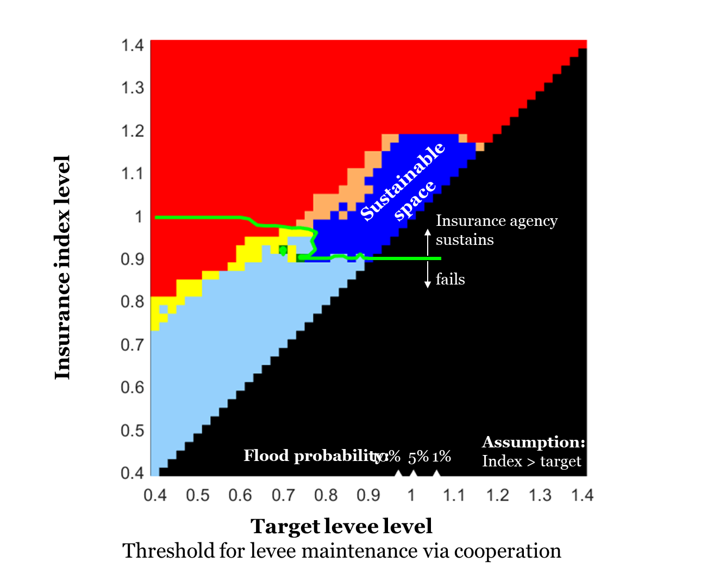
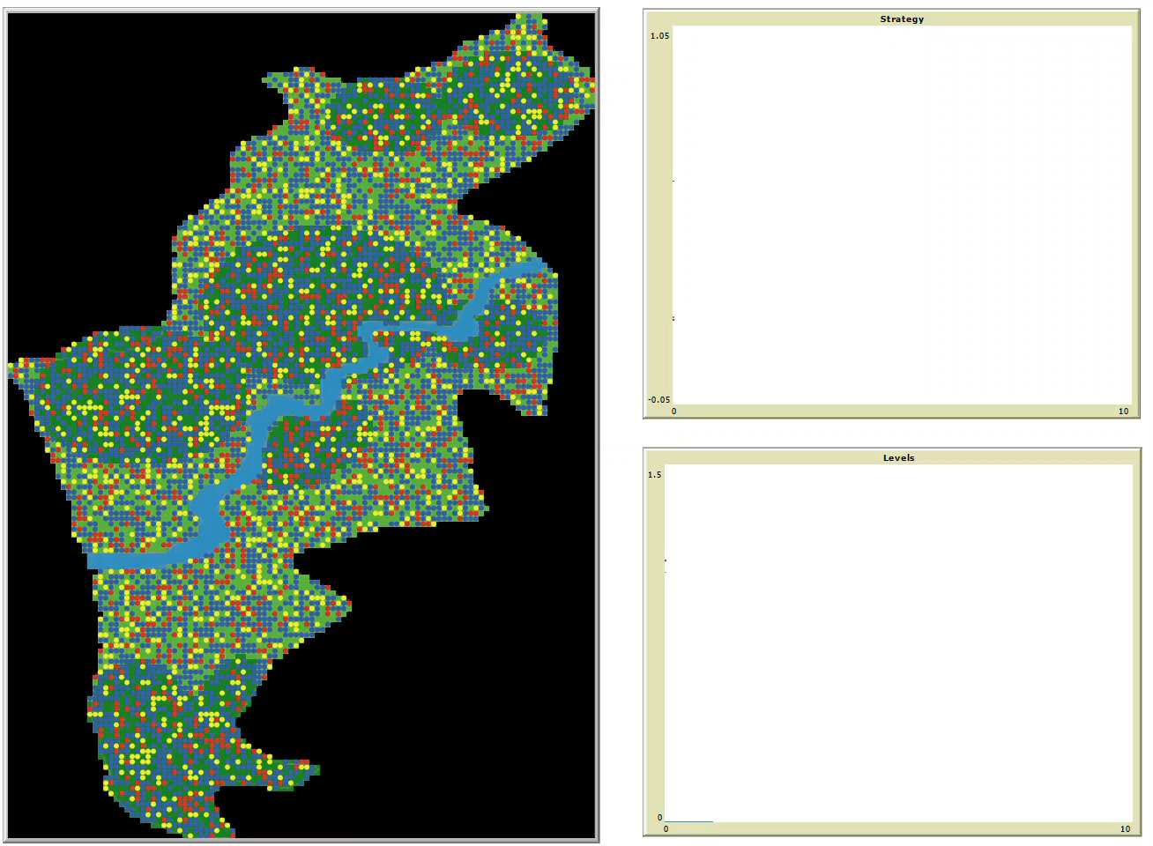
PRELIMINARY RESULTS
Initial condition:
Insurance & cooperate = 0.6
Insurance & defect = 0.2
No insurance & defect = 0.2
Case I: Sustainable case
Index level
Levee level
Target levee
Water level

Slide 15
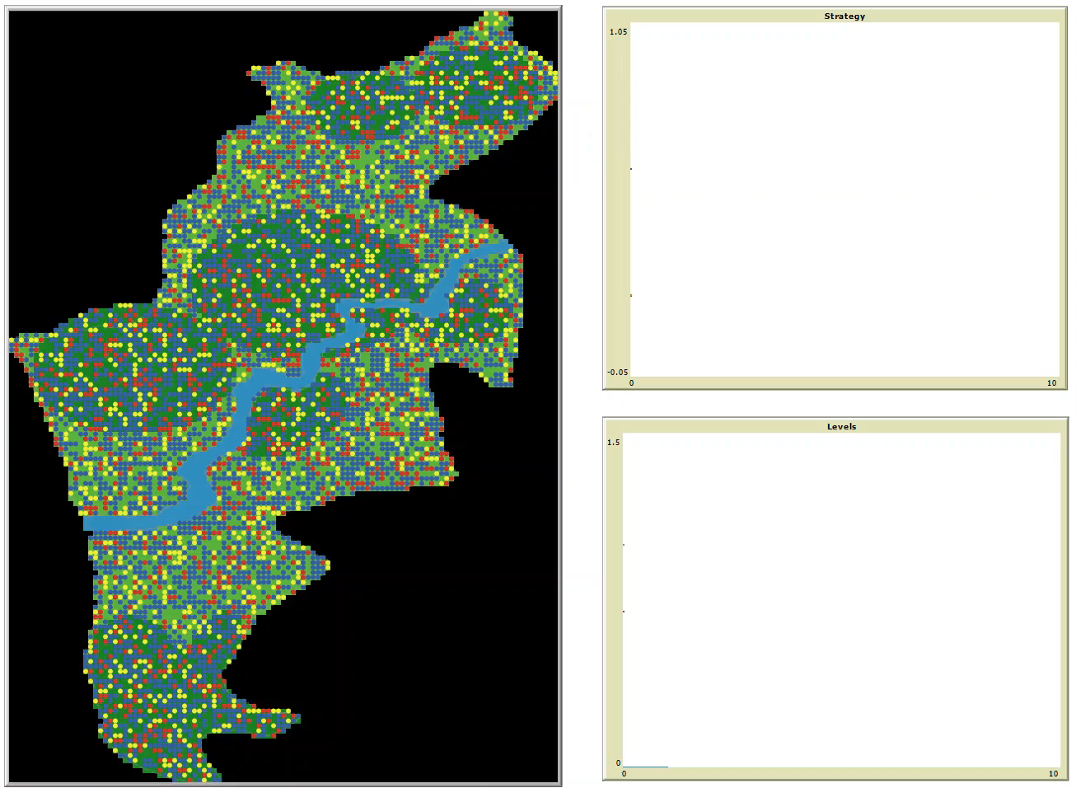
PRELIMINARY RESULTS
Initial condition:
Insurance & cooperate = 0.6
Insurance & defect = 0.2
No insurance & defect = 0.2
People do not participate in insurance
and levee maintenance
Case II: Failure case
Index level
Levee level
Target levee
Water level

Slide 16
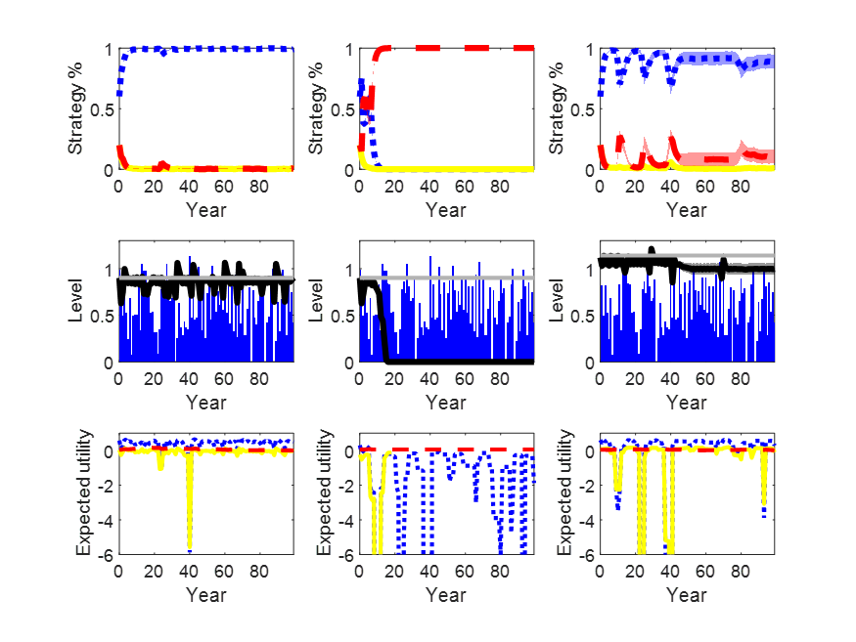
PRELIMINARY RESULTS
Insurance & cooperate
Insurance & defect
No insurance & defect
Target levee level
Levee level
Water level

Slide 17
GLOBAL SENSITIVITY ANALYSIS
Sensitivity analysis
How sensitive the output of a model is with respect to elements of the model that are subject to uncertainty
Global sensitivity analysis
Sensitivity analysis through which all model factors are varied. Allows for direct and interactive effects to be identified.
 | Classic SA | Global SA
Model | Linear Monotonic additive | No assumptions
No. of factors | O-A-T | All together
Factor range | Local (derivative) | Whole PDF
Interactions | No | Yes

Slide 18
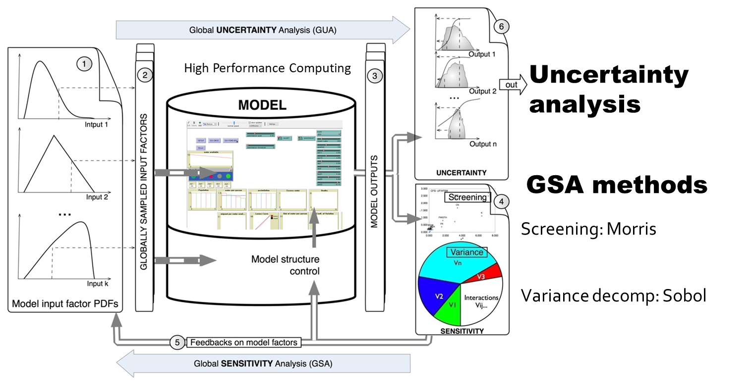
GLOBAL SENSITIVITY ANALYSIS FRAMEWORK

Slide 19
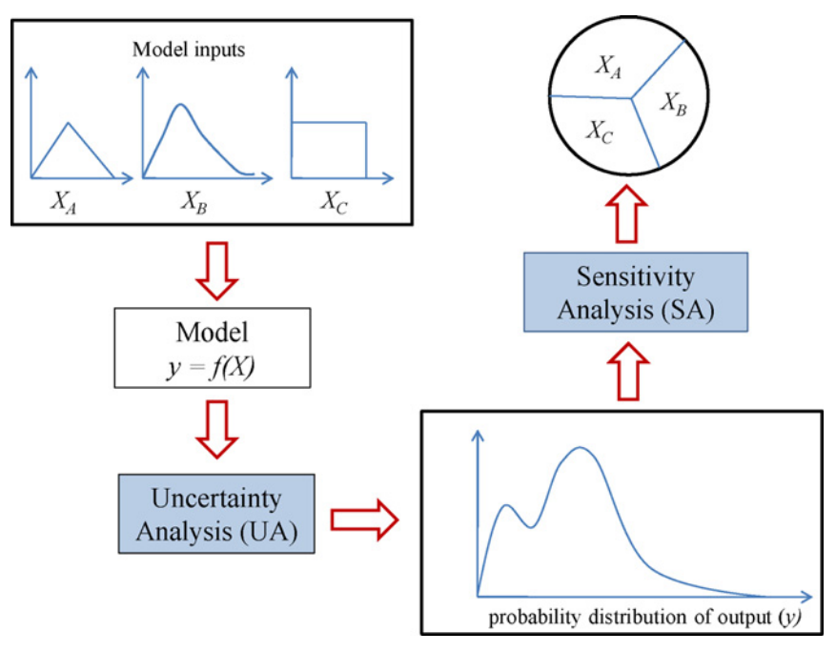
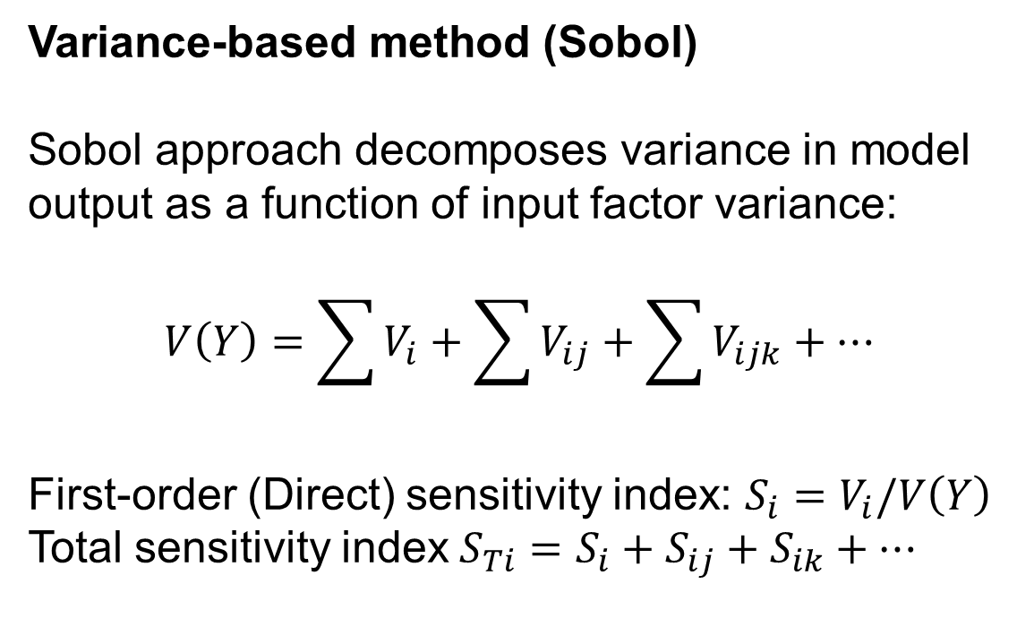
SOBOL APPROACH
Variance-based method (Sobol)
Sobol approach decomposes variance in model output as a function of input factor variance:
$$V\left(Y\right)=\sum{V_{i}}+\sum{V_{ij}}+\sum{V_{ijk}}+…$$
First-order (Direct) sensitivity index: $S_{i}=V_{i}/V\left(Y\right)$
Total sensitivity index $S_{Ti}=S_{i}+S_{ij}+S_{ik}+…$

Slide 20
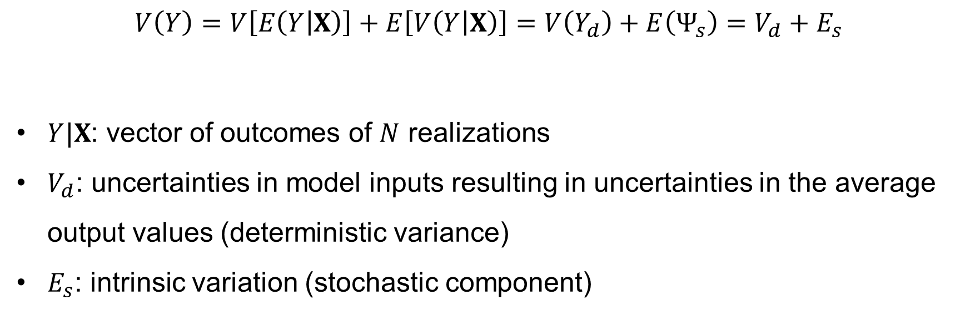
SOBOL APPROACH FOR ABMS
$$V\left(Y\right)=V\left[E\left(Y | X\right)\right]+E\left[V\left(Y | X\right)\right]=V\left(Y_{d}\right)+E\left(Ψ_{s}\right)=V_{d}+E_{s}$$
$Y|X$: vector of outcomes of $N$ realizations
$V_{d}$: uncertainties in model inputs resulting in uncertainties in the average output values (deterministic variance)
$E_{s}$: intrinsic variation (stochastic component)
5
Carmona-Cabrero et al. (2024)
5. Carmona-Cabrero, Á., Muñoz-Carpena, R., Oh, W. S., & Muneepeerakul, R. (2024). Decomposing Variance Decomposition for Stochastic Models: Application to a Proof-Of-Concept
Human Migration Agent-Based Model. Journal of Artificial Societies and Social Simulation, 27(1).

Slide 21
SOBOL APPROACH FOR ABMS
$$V\left(Y\right)=V\left[E\left(Y | X\right)\right]+E\left[V\left(Y | X\right)\right]=V\left(Y_{d}\right)+E\left(Ψ_{s}\right)=V_{d}+E_{s}$$
$Y|X$: vector of outcomes of $N$ realizations
$V_{d}$: uncertainties in model inputs resulting in uncertainties in the average output values (deterministic variance)
$E_{s}$: intrinsic variation (stochastic component)
5
Carmona-Cabrero et al. (2024)
5. Carmona-Cabrero, Á., Muñoz-Carpena, R., Oh, W. S., & Muneepeerakul, R. (2024). Decomposing Variance Decomposition for Stochastic Models: Application to a Proof-Of-Concept
Human Migration Agent-Based Model. Journal of Artificial Societies and Social Simulation, 27(1).

Slide 22
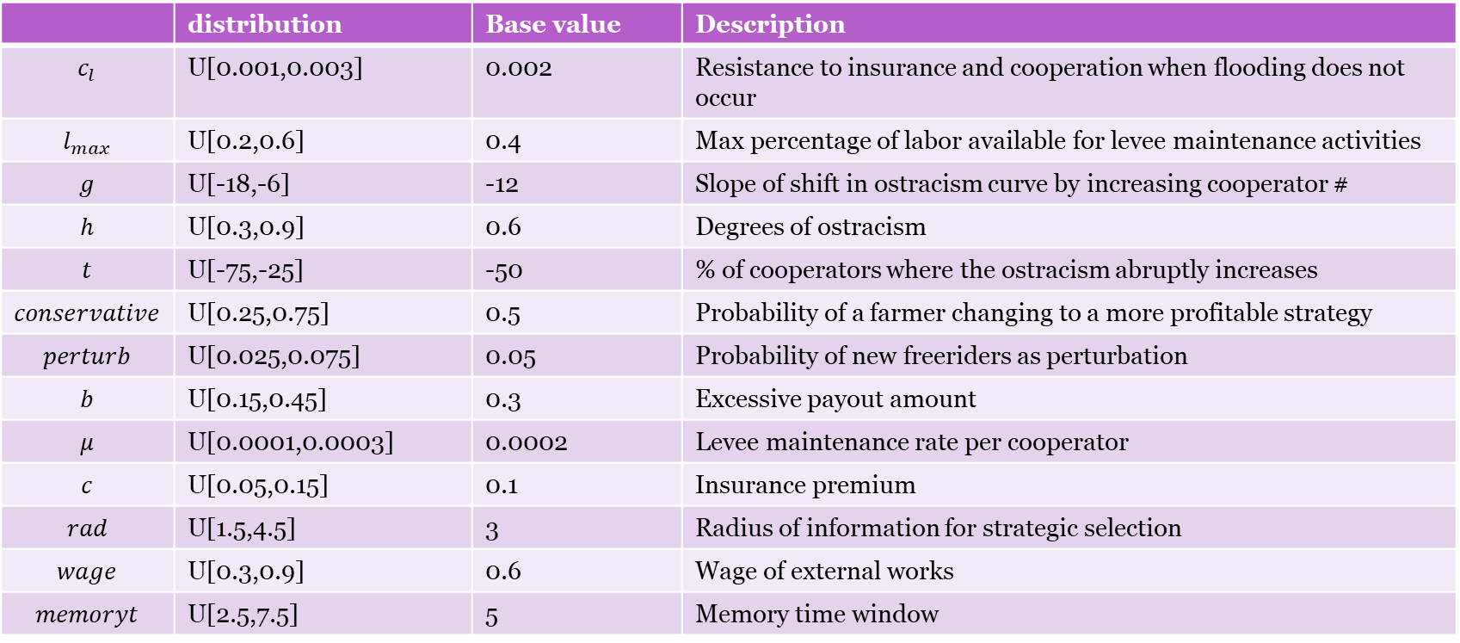
SOBOL GSA SETTING
 | distribution | Base value | Description
$$c_{l}$$ | U[0.001,0.003] | 0.002 | Resistance to insurance and cooperation when flooding does not occur
$$l_{max}$$ | U[0.2,0.6] | 0.4 | Max percentage of labor available for levee maintenance activities
$$g$$ | U[-18,-6] | -12 | Slope of shift in ostracism curve by increasing cooperator #
$$h$$ | U[0.3,0.9] | 0.6 | Degrees of ostracism
$$t$$ | U[-75,-25] | -50 | % of cooperators where the ostracism abruptly increases
$$conservative$$ | U[0.25,0.75] | 0.5 | Probability of a farmer changing to a more profitable strategy
$$perturb$$ | U[0.025,0.075] | 0.05 | Probability of new freeriders as perturbation
$$b$$ | U[0.15,0.45] | 0.3 | Excessive payout amount
$$μ$$ | U[0.0001,0.0003] | 0.0002 | Levee maintenance rate per cooperator
$$c$$ | U[0.05,0.15] | 0.1 | Insurance premium
$$rad$$ | U[1.5,4.5] | 3 | Radius of information for strategic selection
$$wage$$ | U[0.3,0.9] | 0.6 | Wage of external works
$$memoryt$$ | U[2.5,7.5] | 5 | Memory time window

Slide 23
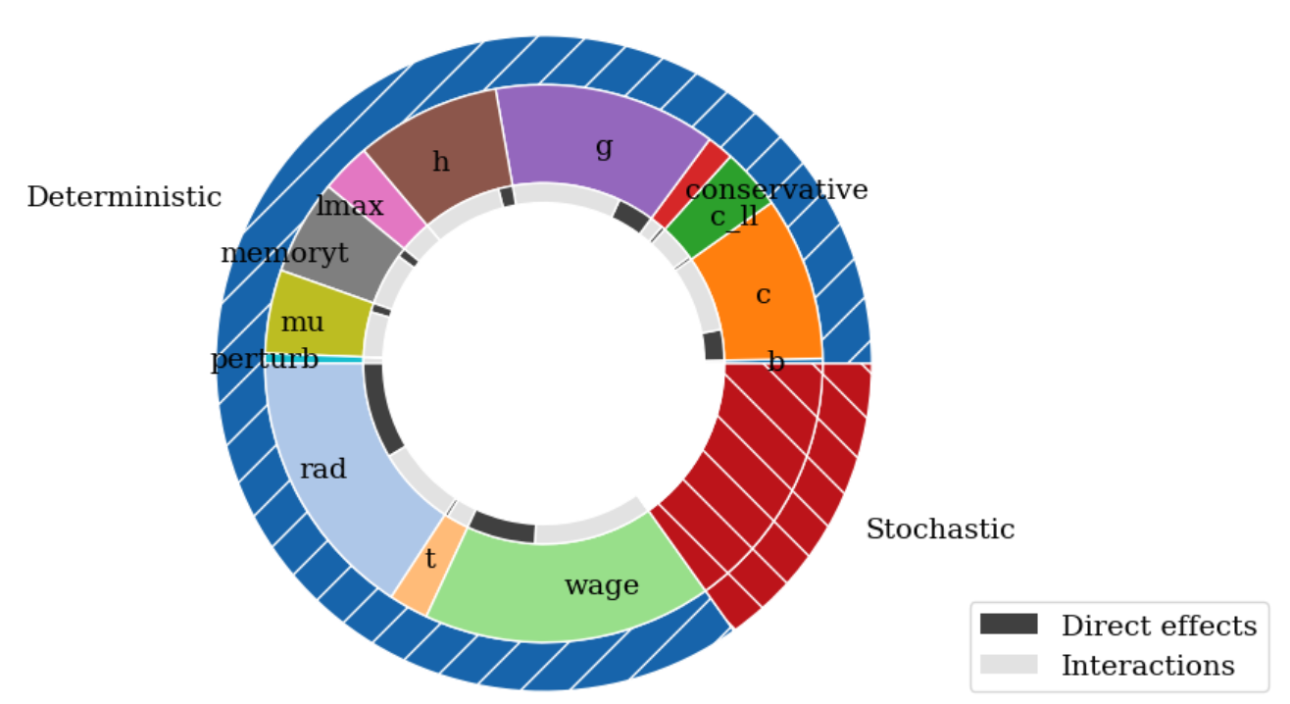
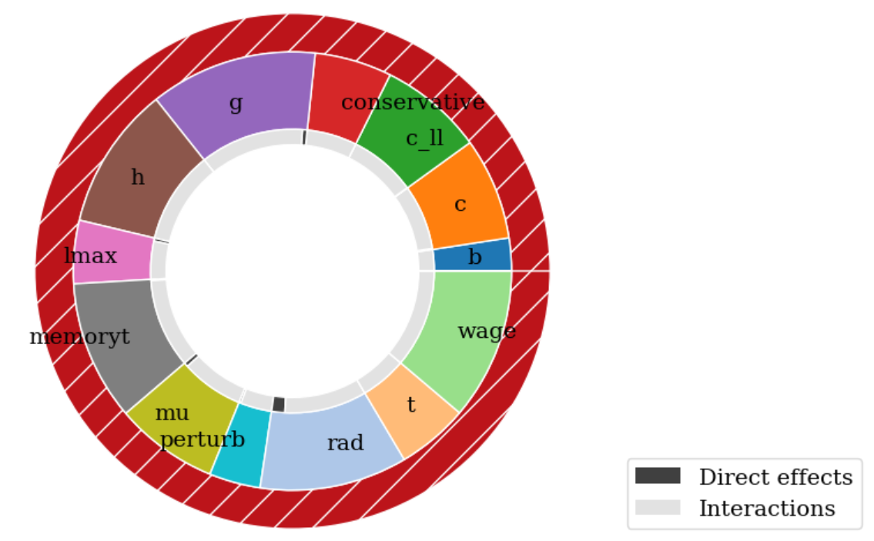
GSA RESULTS
Output: whether a system is sustainable in the long term (binary)
Cooperators are greater than 90%
Levee is maintained within 90% of target level
Insurance agencies does not get into huge debt
GSA samples
= 1024 * (13 inputs +2) * 25 realizations

Slide 24
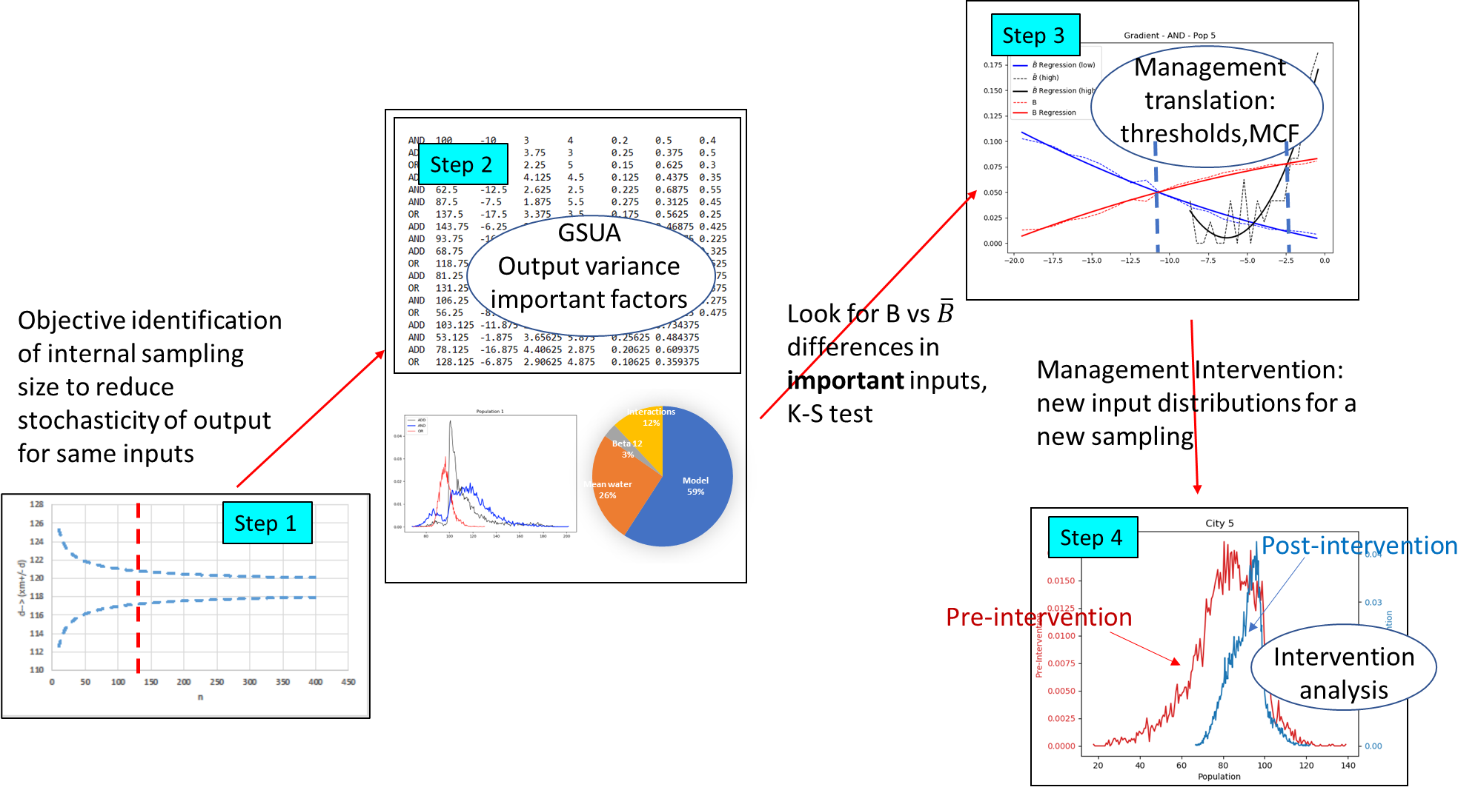
GLOBAL SENSITIVITY ANALYSIS FOR ABMS

Slide 25
FUTURE STEPS
Monte-Carlo Filtering for policy designs
Adding climate change into ABM
  Temporal fit between social and climate dynamics
“Collective” index insurance modeling
GSA for multiple ABMs

Slide 26


Thank you!
GSA paper
GSA code
* Fully funded PhD position available!
I am hiring a prospective PhD student interested in modeling and analyzing interplays between climatic/hydrological/environmental factors and human displacement from complex systems approaches. If you are interested, please send an email to me.
For more chats, reach out to:
woisok.oh@uwaterloo.ca
https://woisokoh.com

