Slide 1
A near real-time flood depth estimation system for practical disaster management applications
EGU26-15958
MRI Research Associates, Inc. (MRA)
Monday, 4 May 2026, 08:35
Hideaki Kitauchi, Satoshi Izumoto, Akihiro Nagao, Masato Nakamura
Corresponding author: Hideaki Kitauchi, hideaki_kitauchi@mri-ra.co.jp

Slide 2
EGU26-15958: A near real-time flood depth estimation system for practical disaster management applications
ABSTRACT
For local governments, it is essential to quickly and accurately understand the extent of flooding damage caused by typhoons, linear rainbands, or other heavy rainfall events in order to make critical decisions such as broadcasting evacuation notices or requesting emergency assistance to national government. In recent years, various systems have been developed to quickly predict and assess flood damage, but high implementation costs, computational demands, or operational complexity have become barriers to widespread adoption. Here, we develop a flood depth estimation system that keeps implementation as well as computational costs down while meeting practical needs of disaster management applications.
Using actual flood measurements obtained by low-cost water level sensors and digital elevation model (DEM), the system estimates flooded areas and depths in near real-time based on the sum of the measured flood depth and the ground elevation at each sensor location and visualize them quickly on the system. The system also includes features designed for convenience during imminent disasters, such as alerting every evacuation warning level, regularly saving and exporting flood depth maps and logs.
Additionally, estimating flood areas from past heavy rainfall events and validating these estimates, we assess the system accuracy. By involving disaster management personnels in using the system, we build a solution that is easy to operate even in the field during emergencies.

Slide 3
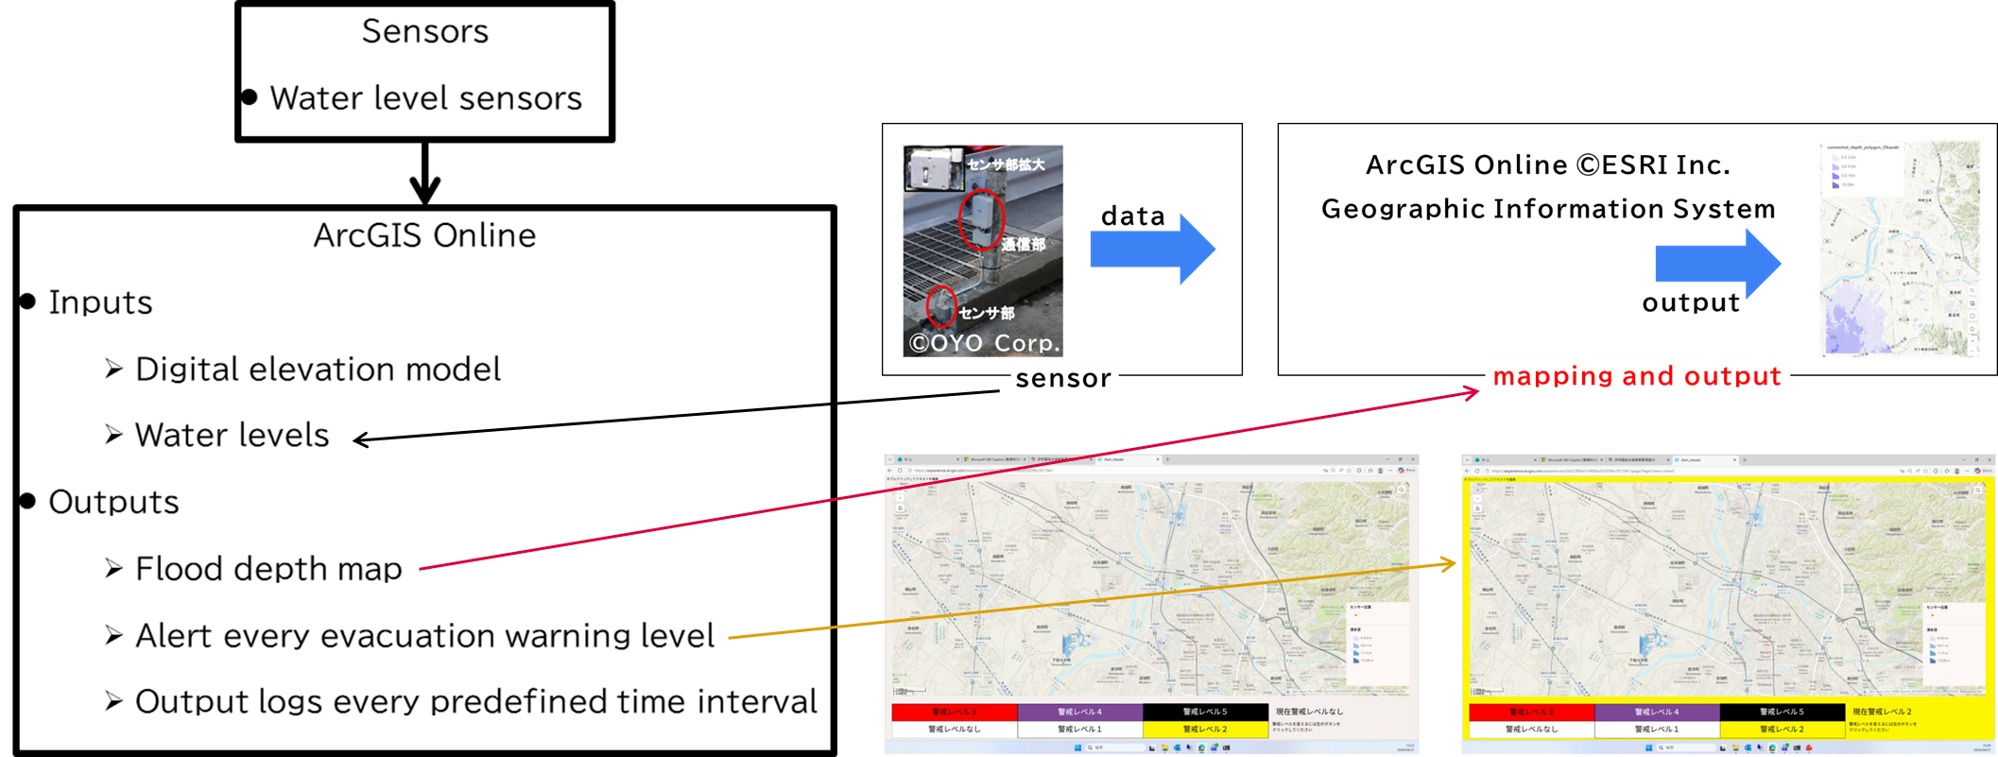
EGU26-15958: A near real-time flood depth estimation system for practical disaster management applications
A schematic diagram of the system
If a water-level sensor detects inundation, the system estimates flooded (connected) area and depth, in near real-time, below the sum of the measured flood depth and the ground elevation by use of digital elevation model (DEM) and visualize them quickly.
The system also includes features designed for convenience during imminent disasters:
Alert every evacuation warning level
Output flood depth maps and logs every predefined time interval

Slide 4
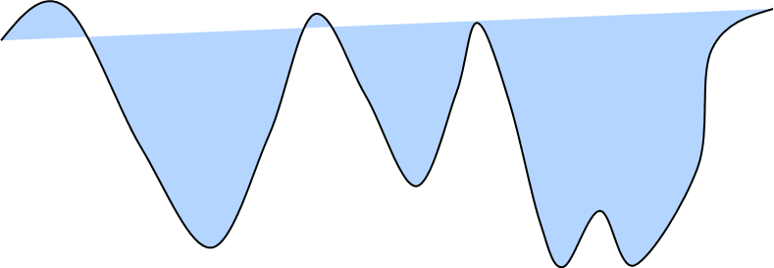
EGU26-15958: A near real-time flood depth estimation system for practical disaster management applications
Method: Estimation of flooded area and depth
If a water-level sensor detects inundation, the system estimates flooded (connected) area and depth below the sum of the measured flood depth and the ground elevation.
ground
sensor
IDEHARA, A. and K, Hirano (2020):防災科学技術研究所研究報告第85号；1地点の情報にもとづく即時的な浸水域推定手法；Quick Estimation Method of Flood Inundation Mapping using Single Point Information

Slide 5
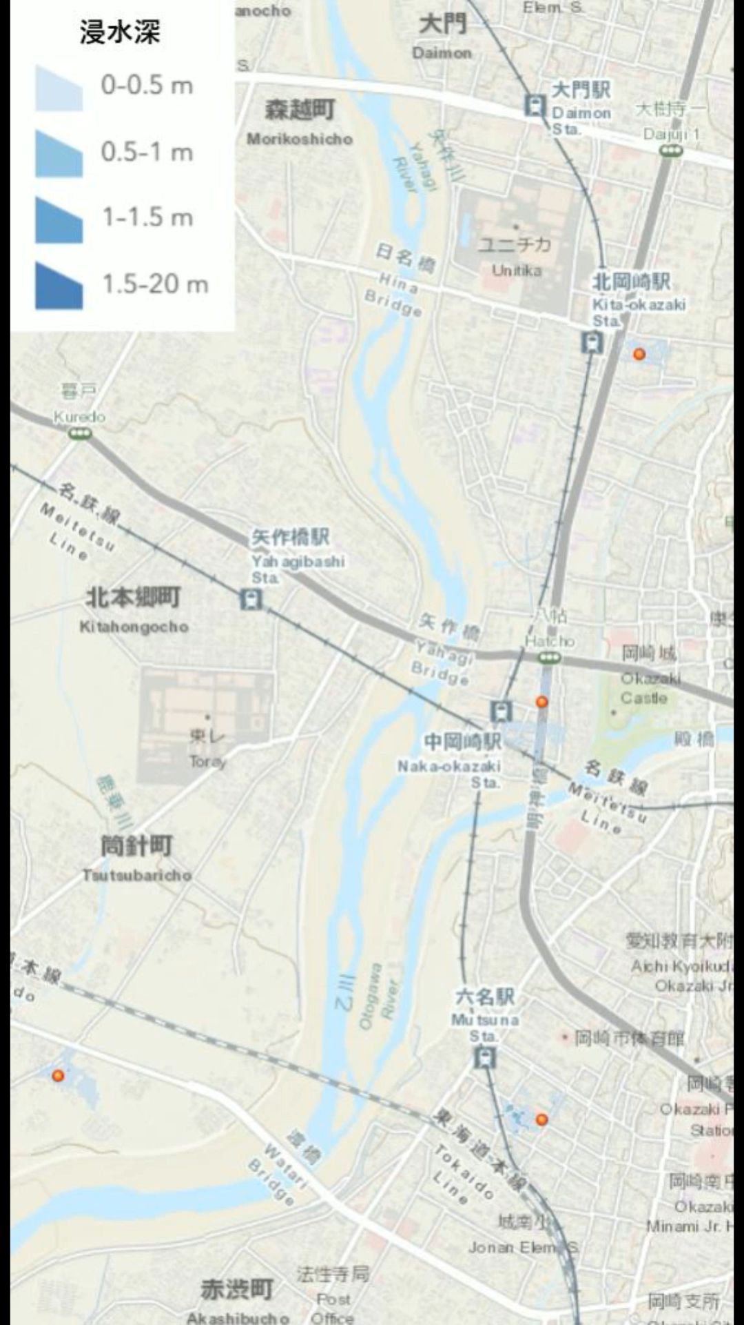
EGU26-15958: A near real-time flood depth estimation system for practical disaster management applications
An example of flooded areas and depths in Okazaki, Aichi, Japan
depth
sensor

Slide 6
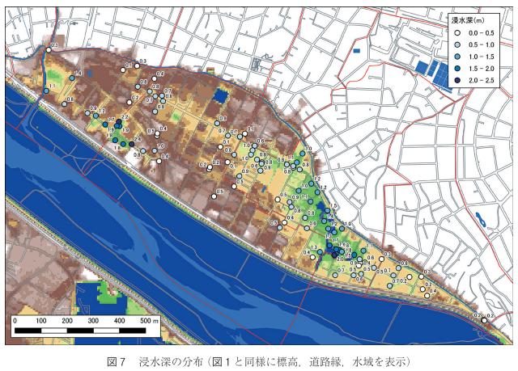
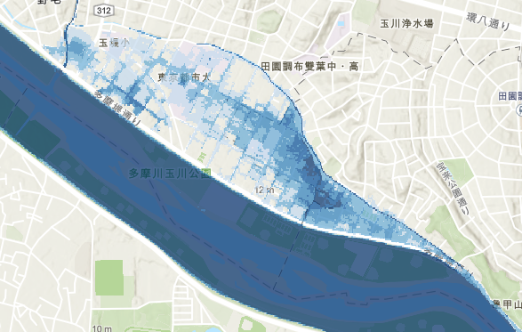

EGU26-15958: A near real-time flood depth estimation system for practical disaster management applications
Validation: Comparison between a past event and the estimation
The estimation generally consistent with the past event.
(a) Past event
(b) Estimation
浸水深
浸水深
センサー（仮想）浸水１ｍ
×
×
Mikami, T., N. Suemasa, K. Itoh, and T. Tanaka (2021): Survey on inundation in Setagaya and Ota Wards due to 2019 Typhoon Hagibis, ssk_39_4_377.pdf.

Slide 7
EGU26-15958: A near real-time flood depth estimation system for practical disaster management applications
Summary
We have developed a near real-time mapping system of flooded area and depth for practical inundation management application.
The system includes features designed for convenience during imminent disasters:
Alert every evacuation warning level,
Output flood depth maps and logs every predefined time interval.
We assessed the system accuracy by estimating flooded area and depth from a past heavy rainfall event. The result shows that the estimates generally consistent with the past event.

