Slide 1




From Eddies to Extremes
Dynamical controls on the Extreme Rainfall Footprint during ENSO
Akash Devgan | Akshaya Nikumbh
ATMOSPHERIC CONVECTION AND DYNAMICS GROUP

Slide 2
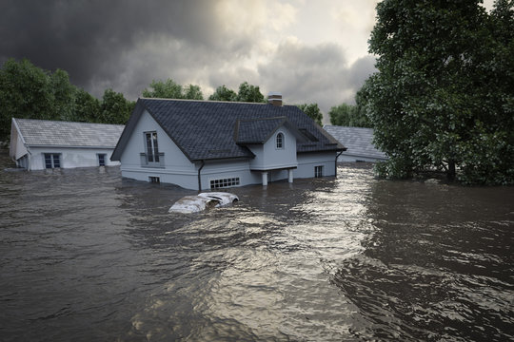
Motivation
“Why does the spatial footprint of extreme rainfall matter?”
Larger spatial footprint means larger affected area
What is size ?
Extreme rainfall event size refers to the spatial area covered by a connected extreme rainfall system.
Hydrological Impact:
Larger systems affect multiple catchments simultaneously Greater flood extent and compound flooding risk
Societal Impact
Higher exposure of infrastructure and population
Climate Science:
Future changes in rainfall extremes involves changes in size, not just intensity
“Rainfall intensity tells us how hard it rains.
ERE footprint tells us how much area is impacted.”

Slide 3
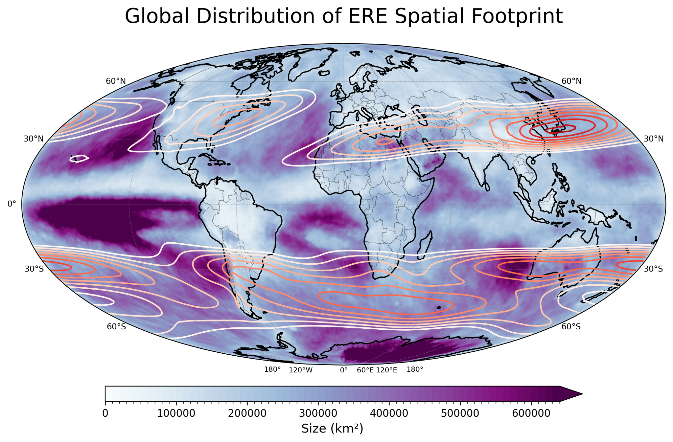
Motivation
“Are extreme rainfall systems free to grow, or dynamically constrained?”
Extreme rainfall event has “preferred spatial structure”

Slide 4




What Controls the Size of Extreme Rainfall Events (EREs)?
Large-scale atmospheric dynamics set a natural length scale for weather systems and that’s what we test against extreme rainfall.
1. The Rhines Scale (Rhines,1975)
2. Rossby radius of deformation (Eady, 1949)
characteristic velocity of the eddies
(Buoyancy/stratification)
Rotation organises the flow into waves
(rotation)
Peter B. Rhines “A characteristic scale where flow behavior changes”
Small scale flow behaves like 2D
Flow is dominated by rossby waves
Rotation starts dominating
H
L
L
k
These scales limit how large atmospheric structures can grow

Slide 5




Clues from atmospheric dynamics
Schneider and Walker,2006
Barnes and Hartmann,2012
Earth’s atmosphere operates in a weak eddy–eddy interaction regime¹,where supercriticality (S_{c})≲1.,
Eddies cannot grow arbitrarily large. Their scale is limited and set by large-scale dynamics( self limiting via interaction between stratification and temperature gradient)
The zonal efolding length of eddies peaks near the jet core²
The meridional efolding length tends to be largest near the jet exit (downstream) region.²
Large-scale dynamics (the jet structure) impose preferred scales on atmospheric eddies which the authors showed using reanalysis datasets.
Chavas and Reed,2019
Aquaplanet experiments show median Tropical cyclone size scales with the Rhines scale³• Imposes a dynamical upper limit, especially in the tropics³
Lu and Chavas, 2022
So we ask.
If large-scale eddies in atmosphere exhibit preferred length scales,
Could this information be used to understand the spatial footprint or size of precipitating systems, particularly rainfall extremes?
If a vortex is initialized larger than its vortex Rhines scale, it shrinks to an equilibrium size ~ vortex Rhines scale.⁴

Slide 6
A missing link in extreme rainfall dynamics
Studies have investigated the characteristic length scales of atmospheric eddies
(Rhines scale, Rossby radius, etc.)
Extreme rainfall events exhibit a well-defined spatial footprint and size distribution
But framework connecting the two is missing

Slide 7

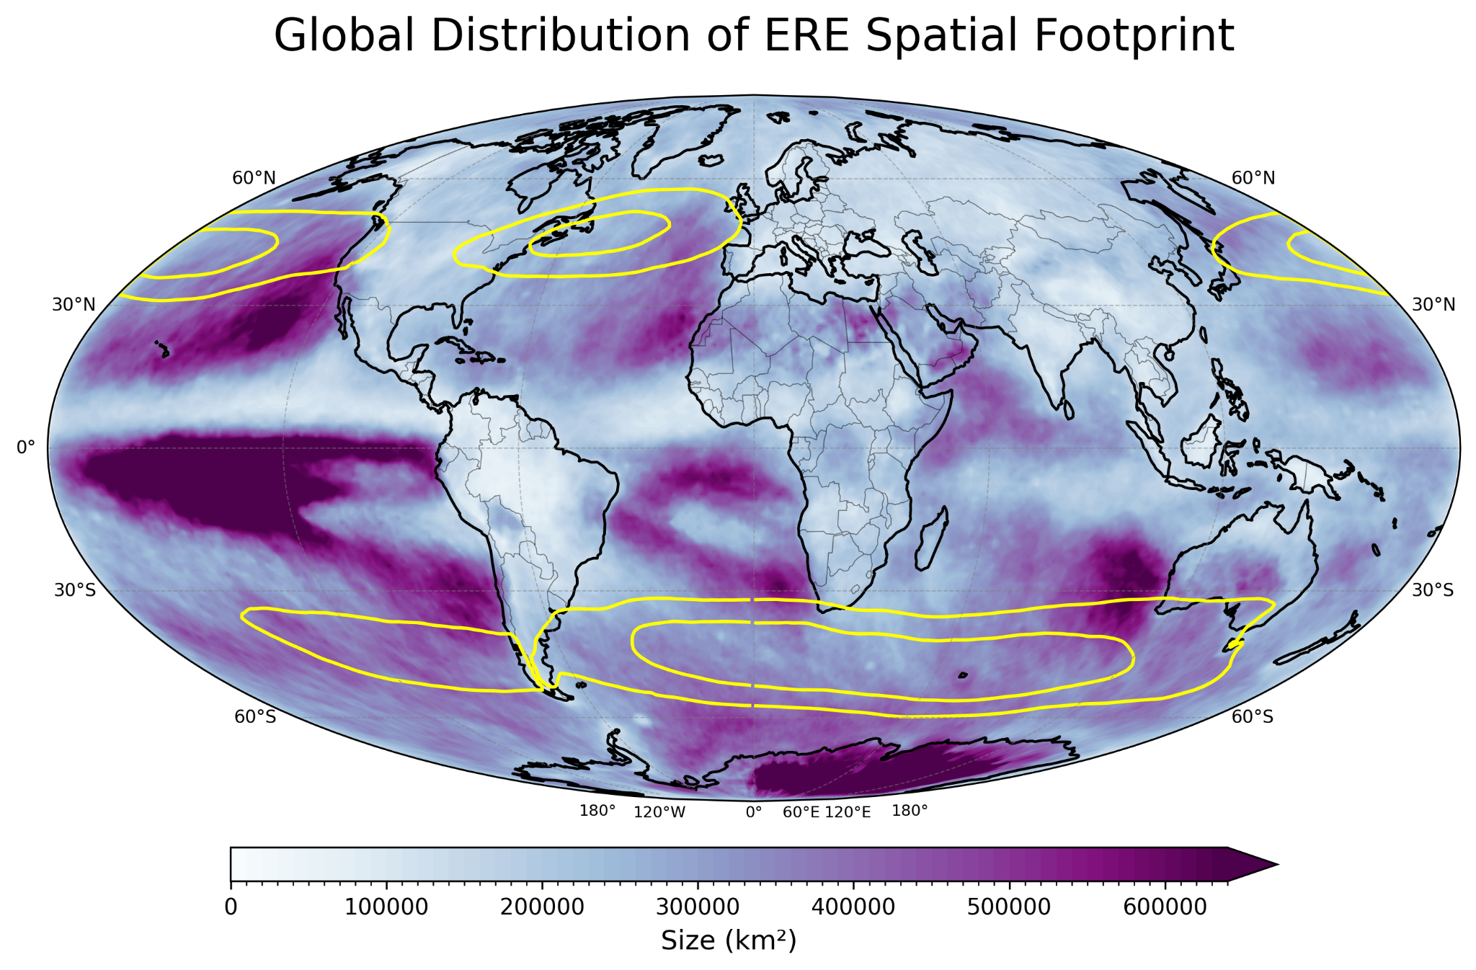
Climatology of Extreme Rainfall Event (ERE) Size
Q. Is there a pattern in ERE size distribution?
For more details:
Global distribution of Extreme Rainfall event size
Larger ERE footprints occur near jet exits and equatorward
Subtropical arid regions
Equatorward of storm tracks
Are these size distribution arbitrary, or are they constrained by the large-scale flow?

Slide 8
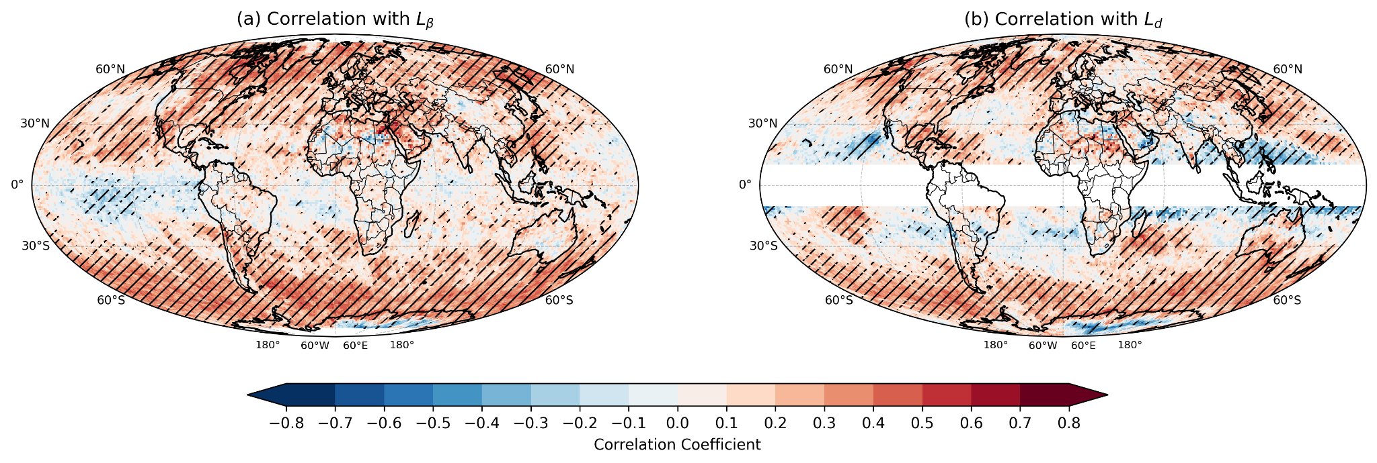
Dynamic length scales & their relation with ERE size
1. Are there signatures of dynamical control ?
Strong positive correlations in midlatitudes
Mixed / regionally dependent correlations
Stratification-based scale plays a role, but not uniformly
(Rhines Scale)
(Rossby radius of deformation)
Rhines scale follows ERE size in almost whole of extratropics,this suggests some dynamical relationship

Slide 9
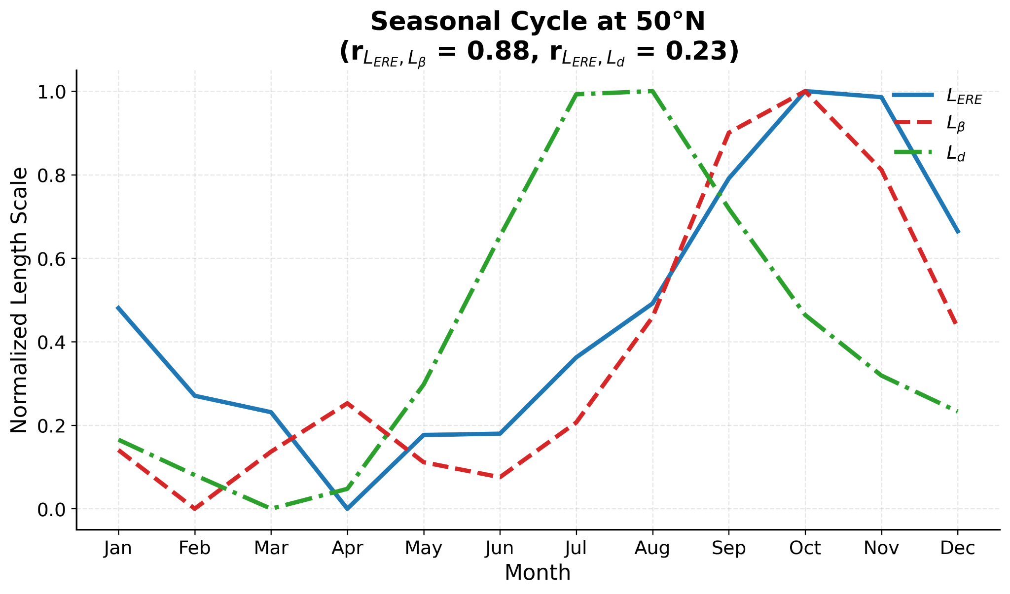
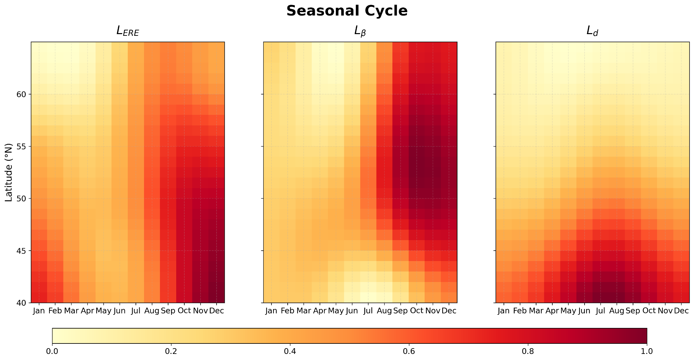
Dynamic length scales & their relation with ERE size
2.Seasonal Evolution.
ERE size co-evolves with Rhines scale in the extratropics.

Slide 10
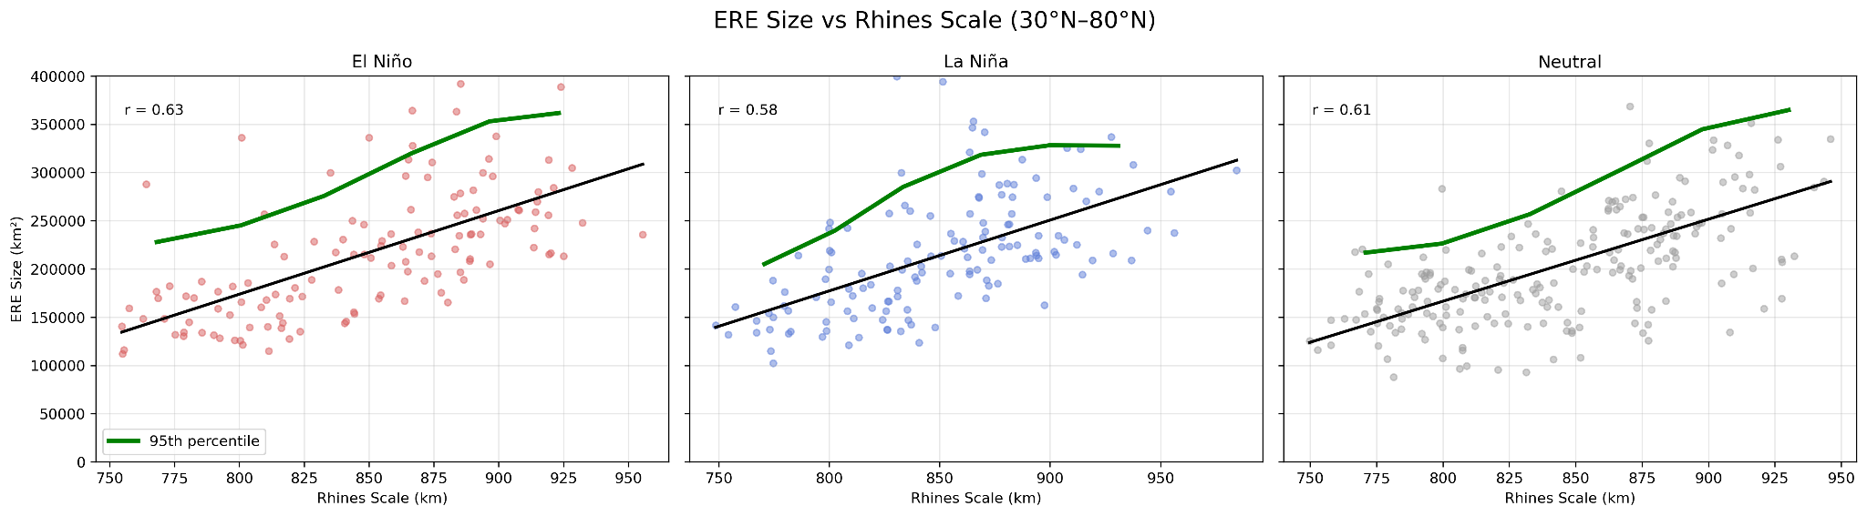
How does the relationship change during ENSO?
Rhines scale constrains the upper bound of ERE size
*Northern Hemisphere(30-80)
Significant positive relationship (r ≈ 0.6) across all ENSO phases
Upper envelope increases with Rhines scale

Slide 11
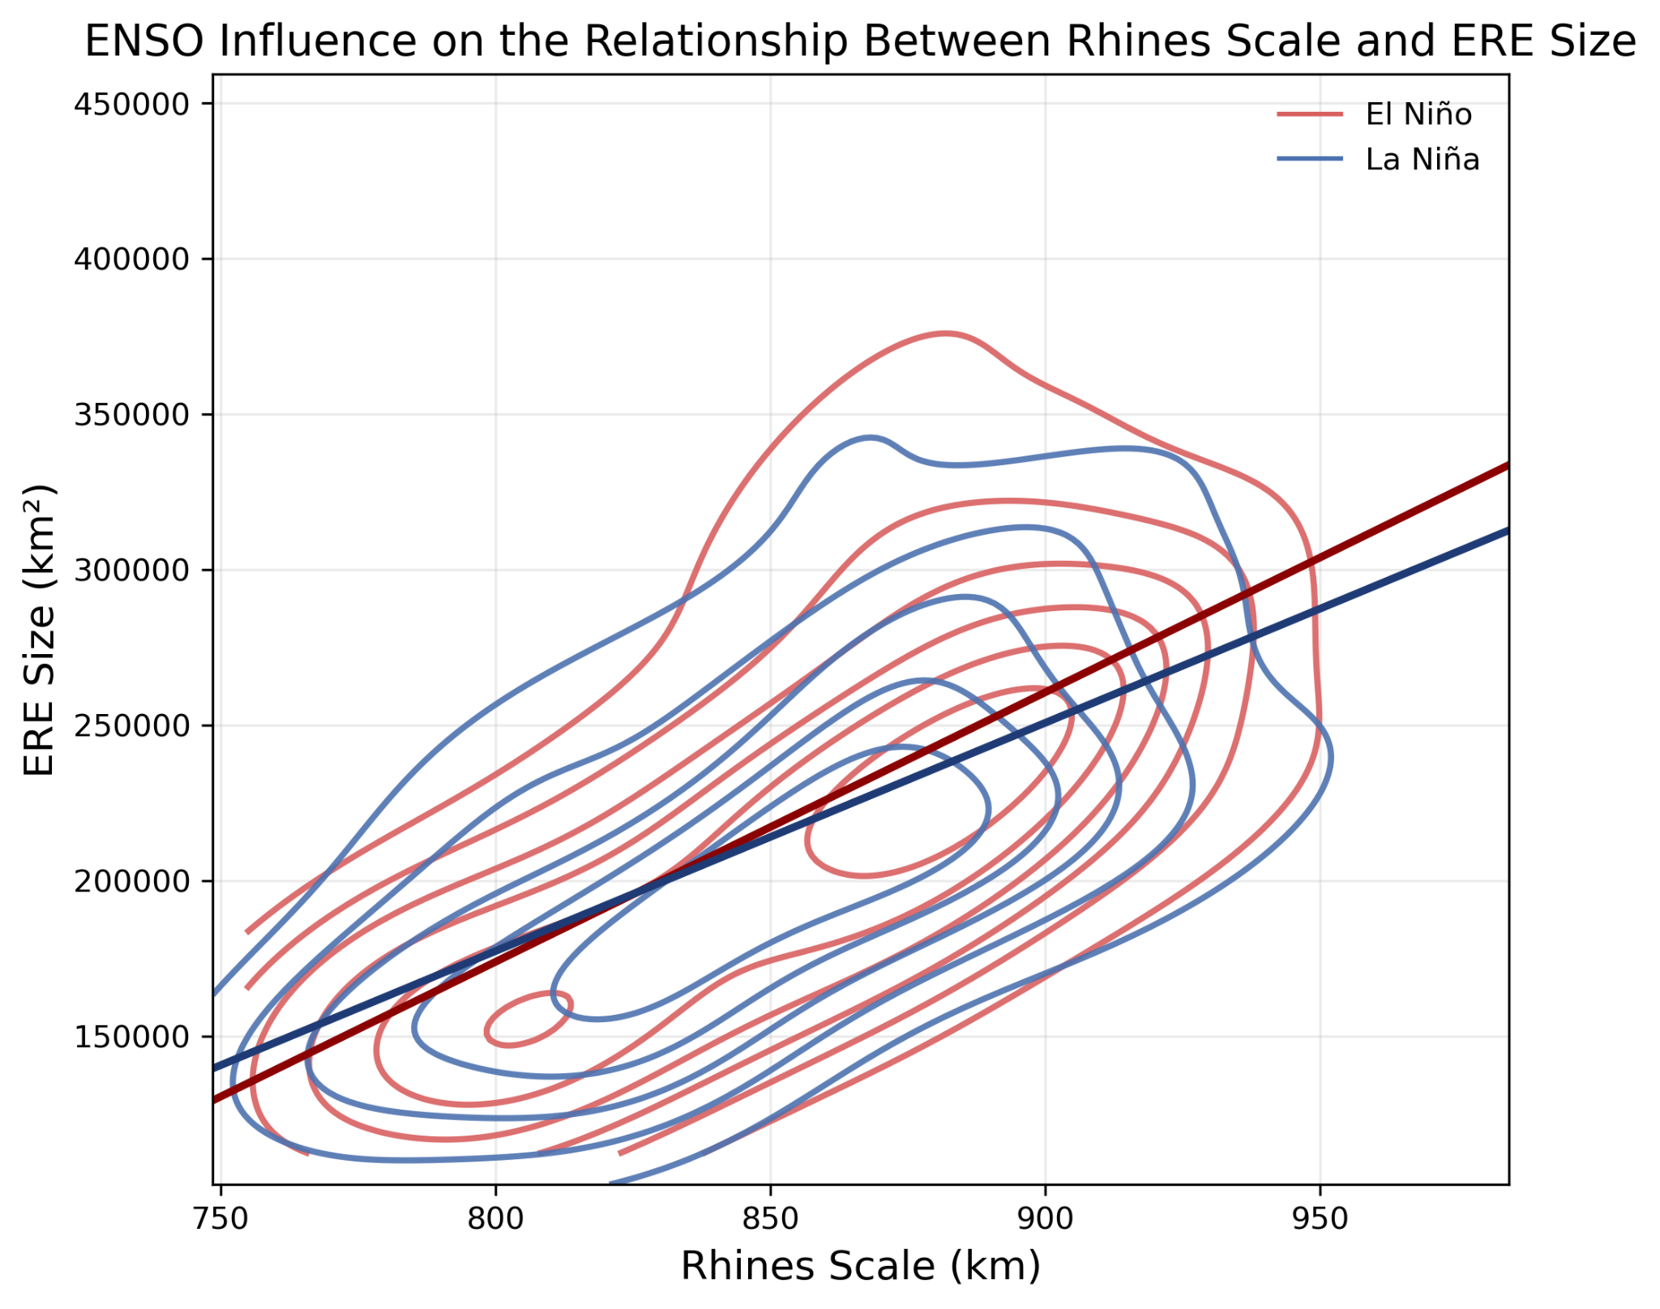
How does the relationship change during ENSO?
Stronger scaling during El Niño (~18% increase in slope)
 | El Nino | La Nina | Difference
Slope | 866.44 | 733.77 | 132.67(~18%)
90th percentile ERE size | 304190.19 | 295252.73 | 8937.46
Mean Vertical shift | 5359.41
Larger extreme size during El Nino
*Northern Hemisphere(30-80)

Slide 12
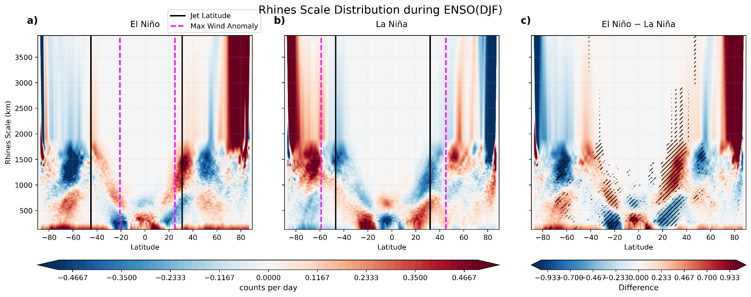
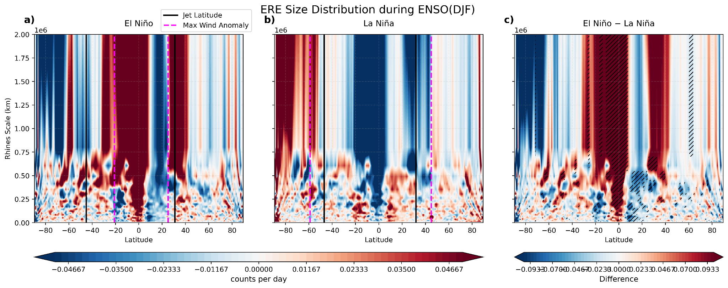
How does the distribution change during ENSO
Redistribution of Rhines scale occurrence
Dipole pattern → redistribution across phases.
ERE size redistribution follows Rhines scale changes

Slide 13
Takeaways
Where do large heavy events occur ?
→Large ERE footprints occur near jet exits, equatorward storm-track flanks, and subtropical dry regions.
What dynamical scale shows the strongest relationship?
→The Rhines scale shows the clearest and most consistent relationship with ERE size across the extratropics.
→ERE size co-evolves seasonally with the Rhines scale in Northern hemisphere extratropics
Is this relationship just a correlation?
→Possibly more than that.The upper envelope analysis suggests that the Rhines scale may act as a dynamical constraint on the maximum achievable ERE size.
Does ENSO modify this constraint?
→Yes in the Northern hemisphere extratropics, during El Niño, the ERE–Rhines scaling becomes more sensitive and larger extreme systems become more likely.
What actually changes during ENSO?
→Not just the jet latitude itself, but the latitude of maximum wind anomaly appears to organize the redistribution of both Rhines scale and ERE size during ENSO. The latitude of peaks in occurrence of both the scales closely follow these anomaly maxima.

Slide 14
References
1. Schneider, T., & Walker, C. C. (2006). Self-organization of atmospheric macroturbulence into critical states of weak nonlinear eddy–eddy interactions. Journal of the atmospheric sciences, 63(6), 1569-1586.
.2. Barnes, E. A., & Hartmann, D. L. (2012). The global distribution of atmospheric eddy length scales. Journal of climate, 25(9), 3409-3416.
3. Chavas, D. R., & Reed, K. A. (2019). Dynamical aquaplanet experiments with uniform thermal forcing: System dynamics and implications for tropical cyclone genesis and size. Journal of the Atmospheric Sciences, 76(8), 2257-2274.
4. Lu, K. Y., & Chavas, D. R. (2022). Tropical cyclone size is strongly limited by the Rhines scale: Experiments with a barotropic model. Journal of the Atmospheric Sciences, 79(8), 2109-2124.

