Slide 1
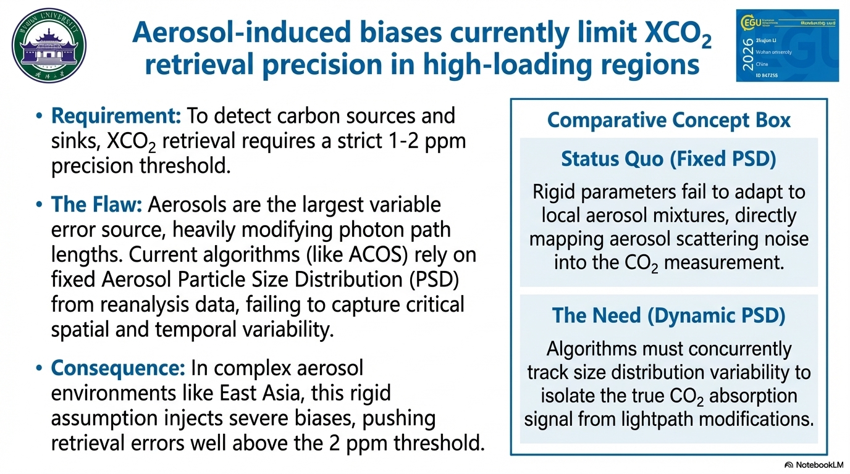

Requirement: To detect carbon sources and sinks, XCO₂ retrieval requires a strict 1-2 ppm precision threshold.
Operational algorithms utilize fixed PSD estimates derived from reanalysis data to model these effects. In reality, aerosol properties are highly variable.
The Challenge: Aerosols introduce significant uncertainties via scattering and absorption, which significantly altering atmospheric photon path lengths, and introducing large errors into satellite XCO₂ measurements.
Consequence: In complex aerosol environments like East Asia, this fixed assumption introduces severe biases, pushing retrieval errors well above the 2 ppm threshold.
In regions characterized by complex aerosol mixtures, incorporating dynamic PSD assumptions presents an opportunity to further reduce retrieval uncertainties and enhance spectral fidelity.
Notes:
Slide 1 (0:00 - 1:00) Good morning, everyone. Today, I am excited to present BASIC, our new Boosted Aerosol-Size-Integrated XCO2 retrieval algorithm.
Accurate measurement of the dry-air mole fraction of carbon dioxide, or XCO2 is critical for tracking global emissions. However, retrieving this data from satellites like OCO-2 comes with a major challenge: aerosols. Aerosols scatter and absorb light, significantly altering the photon path lengths and introducing large errors into our measurements.
While current state-of-the-art algorithms, such as ACOS, attempt to correct for this, they treat the aerosol Particle Size Distribution—or PSD—as a fixed parameter. In reality, aerosol properties are highly variable, especially in regions with complex atmospheric conditions like East Asia. By ignoring dynamic PSD, current methods introduce residual biases into the XCO2 data. To bridge this gap, we developed the BASIC algorithm.

Slide 2
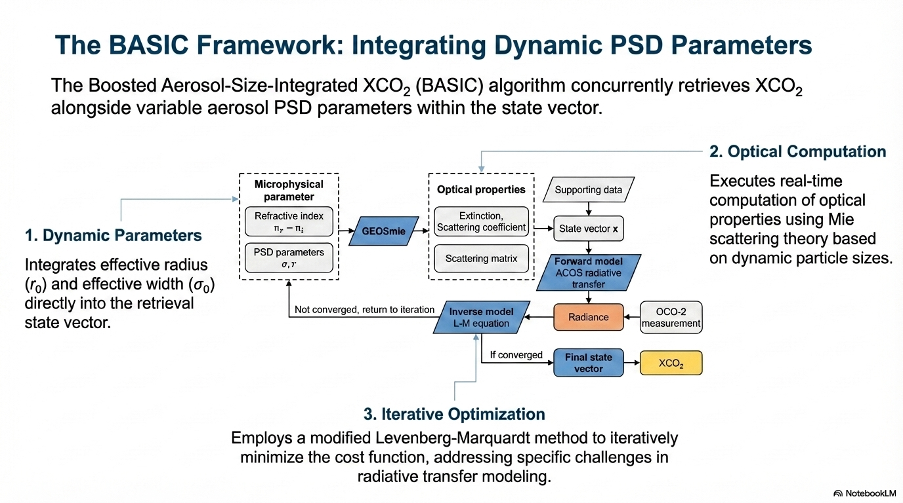
Notes:
Slide 2 (1:00 - 2:00)
Moving to the methodology, the core innovation of BASIC is that it concurrently retrieves XCO2 alongside dynamic aerosol PSD parameters from OCO-2 observations.
Unlike previous models, BASIC explicitly incorporates two key microphysical parameters into the retrieval state vector: the effective radius and the effective width of the aerosol particles. As you can see in the flowchart on the slide, our algorithm dynamically updates these parameters. During each retrieval iteration, BASIC computes the real-time aerosol optical properties—such as the scattering and extinction coefficients—based on Mie scattering theory.
We then use a modified Levenberg-Marquardt inversion method to minimize the spectral loss function. If the simulated spectra do not match the observed spectra, the PSD parameters are adjusted, and the optical properties are recalculated until convergence is achieved

Slide 3
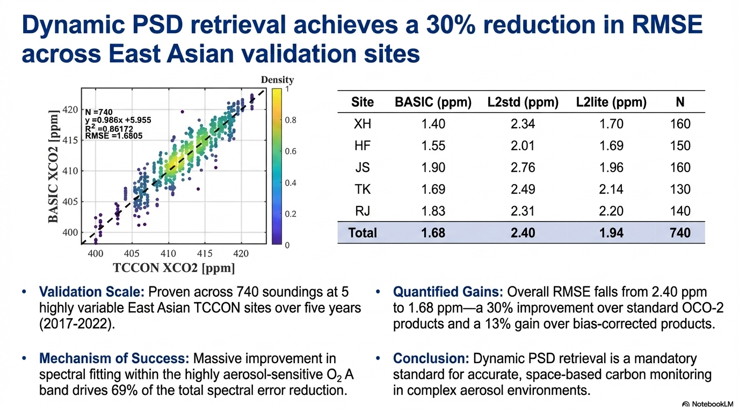
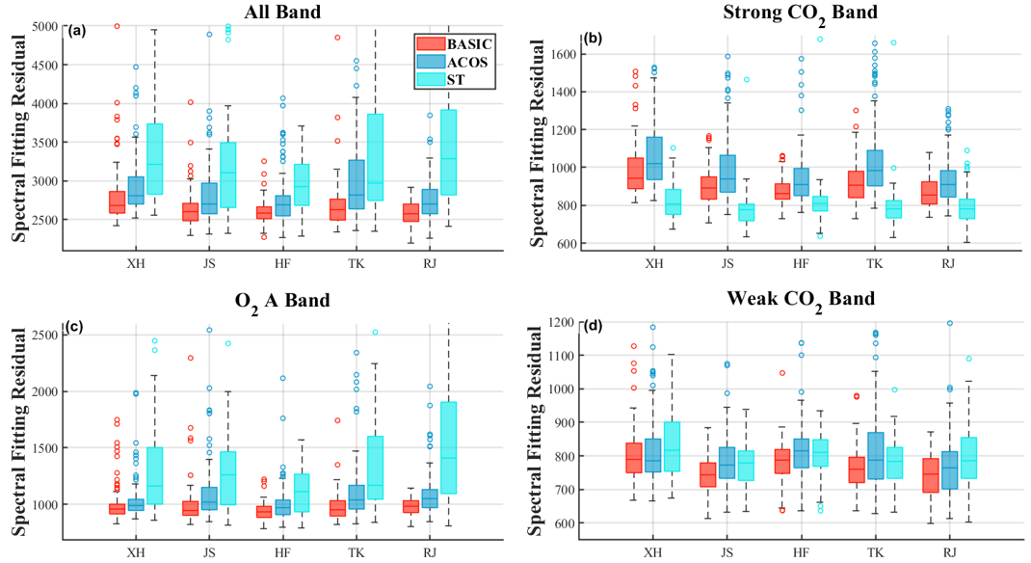
* Percentage change from the BASIC, positive values indicate increased RMSE (worse performance), negative values indicate decreased RMSE (better performance)
Notes:
Slide 3 (2:00 - 3:00)
So, how well does this perform? We validated BASIC using ground-truth data from five TCCON stations across East Asia over a five-year period.
The results are highly encouraging. Compared to the standard OCO-2 products, the BASIC algorithm reduced the overall Root Mean Square Error by 30%, bringing it down from 2.40 ppm to 1.68 ppm. Furthermore, it outperformed the bias-corrected OCO-2 products by 13%.
This improvement is largely driven by BASIC’s ability to generate forward-modeled spectra that closely match real observations. We saw the most dramatic improvements in the O2 A band, which is notoriously sensitive to aerosol interference.
In conclusion, our study demonstrates that dynamically retrieving aerosol Particle Size Distribution provides a much more accurate representation of aerosol scattering. This PSD-aware approach offers a promising pathway for achieving the high-precision XCO2 measurements needed for global climate action.

