Slide 1
Analysis of Shallow Velocity Characteristics using Vs Inversion Constrained by Seismic Reflection
Date
Presenter
Co-Author
2026/05/07
Yu-Wei Juan
Chun-Hsiang Kuo

Slide 2
Motivation
Seismic Hazard has higher correlation with Shear Waves and Surface Waves.
Seismic Tomography:
  shallow portion resolution not enough
Deep Drilling and Downhole Methods:
  Expensive, Destructive, struggle when horizontal mapping
Inversions have non-uniqueness issue

Slide 3
Methodology
Vs profile
  Inversion use Surface Wave Dispersion Curve
  from Microtremor Array Measurement (MAM)
Non-uniqueness Issue
  Constrain Layer Interfaces by Vp profile
  from Seismic Reflection

Slide 4
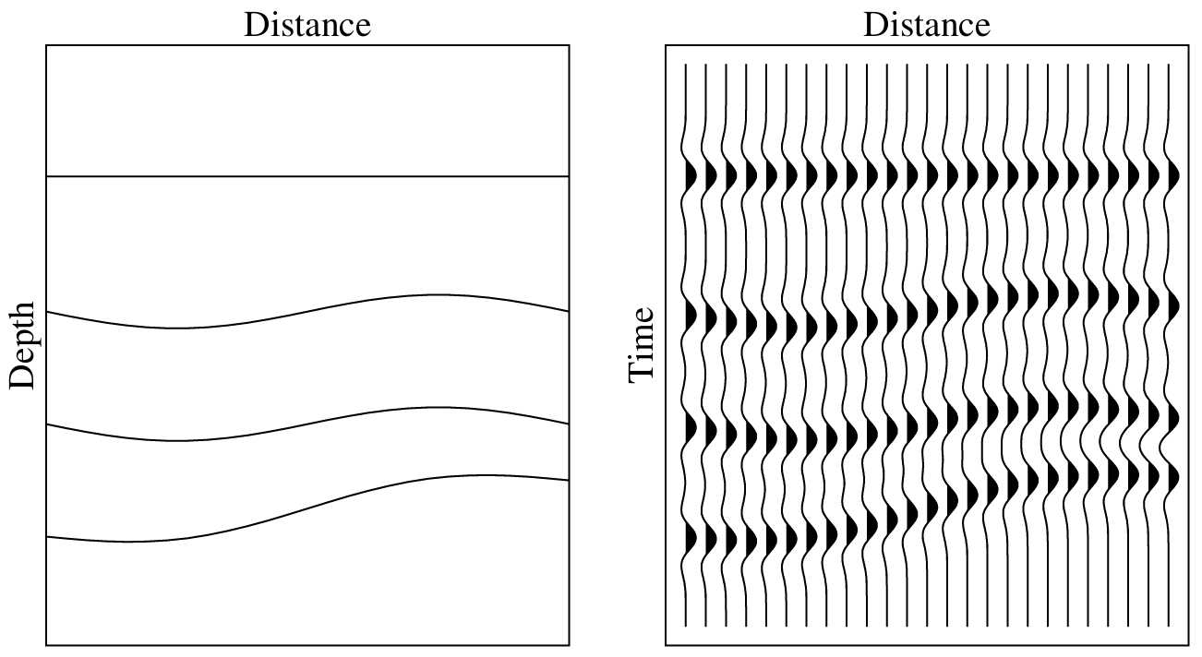
Layered Vp Model
Seismic Reflection / Reflection Seismology
  Known Active Source (TNT, vibrator) makes waves at surface
  Wave travels: Reflect at interfaces of velocity change
Figure 1. Reflection signal (right) and its ideal cross-section (left). (Peter M. Shearer, Introduction to Seismology, 2nd Edition, Figure 7.2)

Slide 5
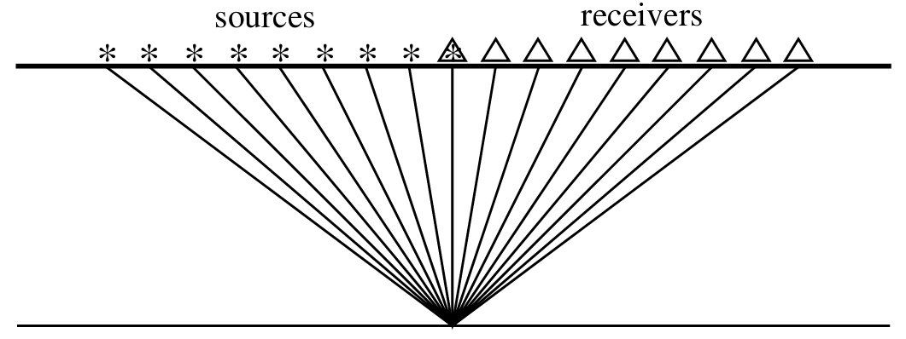
Layered Vp Model
consider Common Mid Point
Velocity Analysis
  velocity test
Normal Move-Out (NMO) Correction
  remove lateral travel time
Root-Mean-Square Velocity (Vrms)
Figure 2. Illustration of CMP with ideal horizontal medium. (Peter M. Shearer, Introduction to Seismology, 2nd Edition, Figure 7.4)

Slide 6
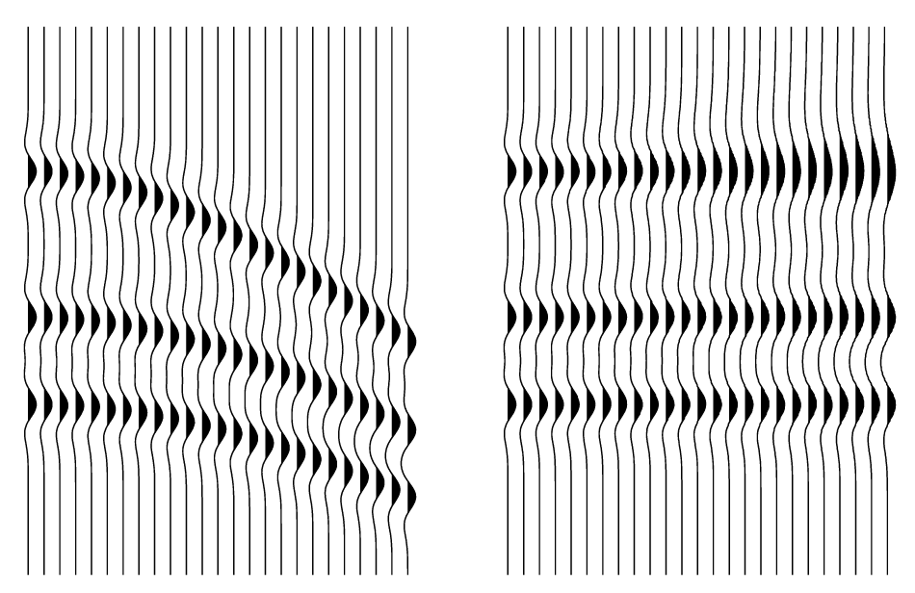
Layered Vp Model
consider Common Mid Point
Velocity Analysis
  velocity test
Normal Move-Out (NMO) Correction
  remove lateral travel time
Root-Mean-Square Velocity (Vrms)
Figure 3. Example of NMO correction. (Peter M. Shearer, Introduction to Seismology, 2nd Edition, Figure 7.5)

Slide 7
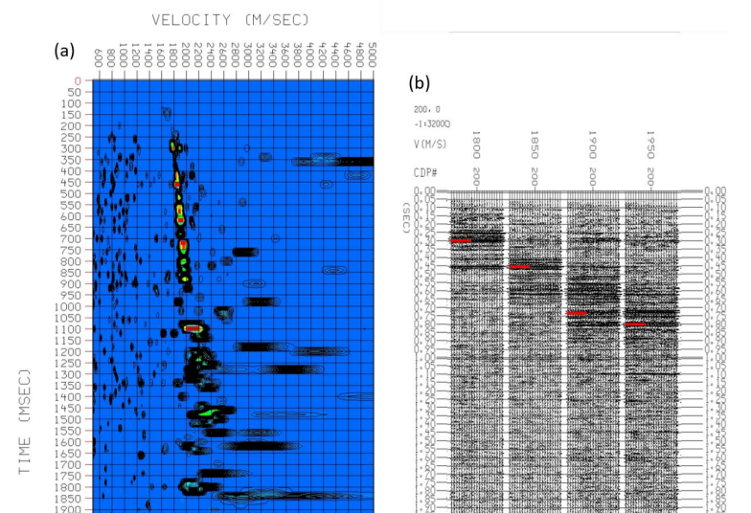
Figure 4. Example of Velocity Analysis, screenshots from Liao (2025) master degree thesis.

Slide 8
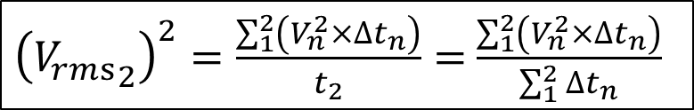






Layered Vp Model
Dix Equation (Dix, 1955)
Figure 5. Dix Equation convert Vrms into interval Vp

Slide 9
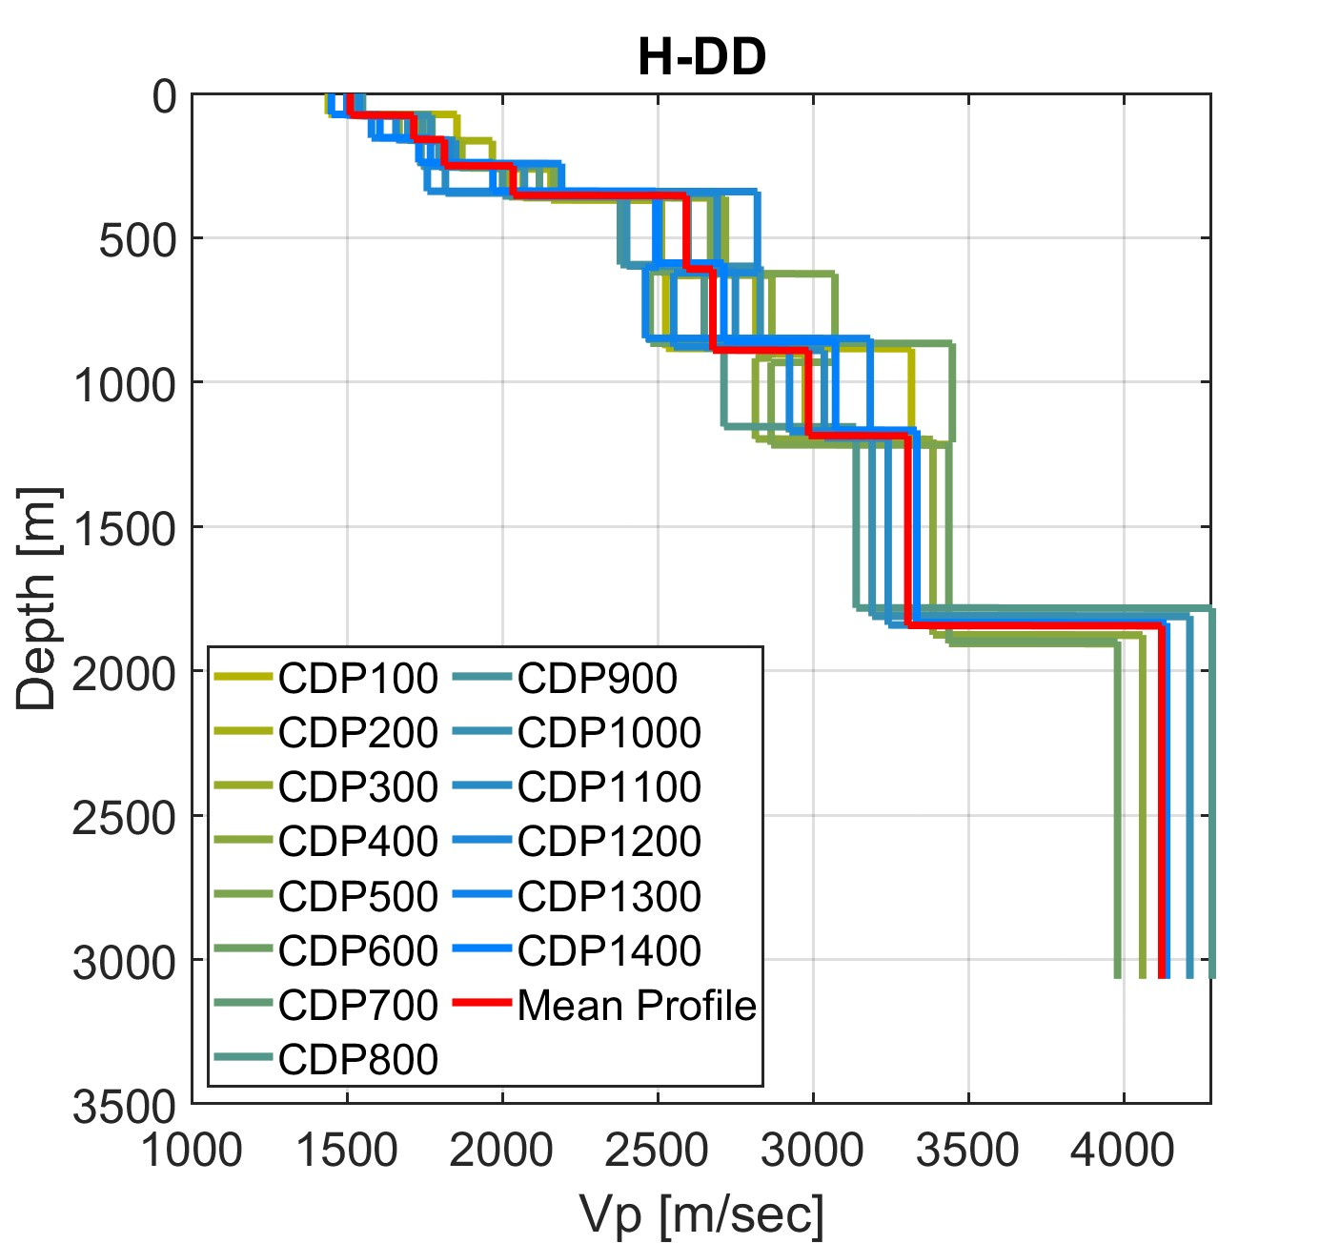
Layered Vp Model
Figure 6. Vp profiles at each CDP position in line DD.

Slide 10
Layered Vs Model
Vs model inverted from Rayleigh Wave Phase Velocity Dispersion Curve
constrained by depth of Vp interfaces
Monte Carlo sampling generate random models within parameter space
evaluate convergence: Observed vs Forward Modeling dispersion curve

Slide 11
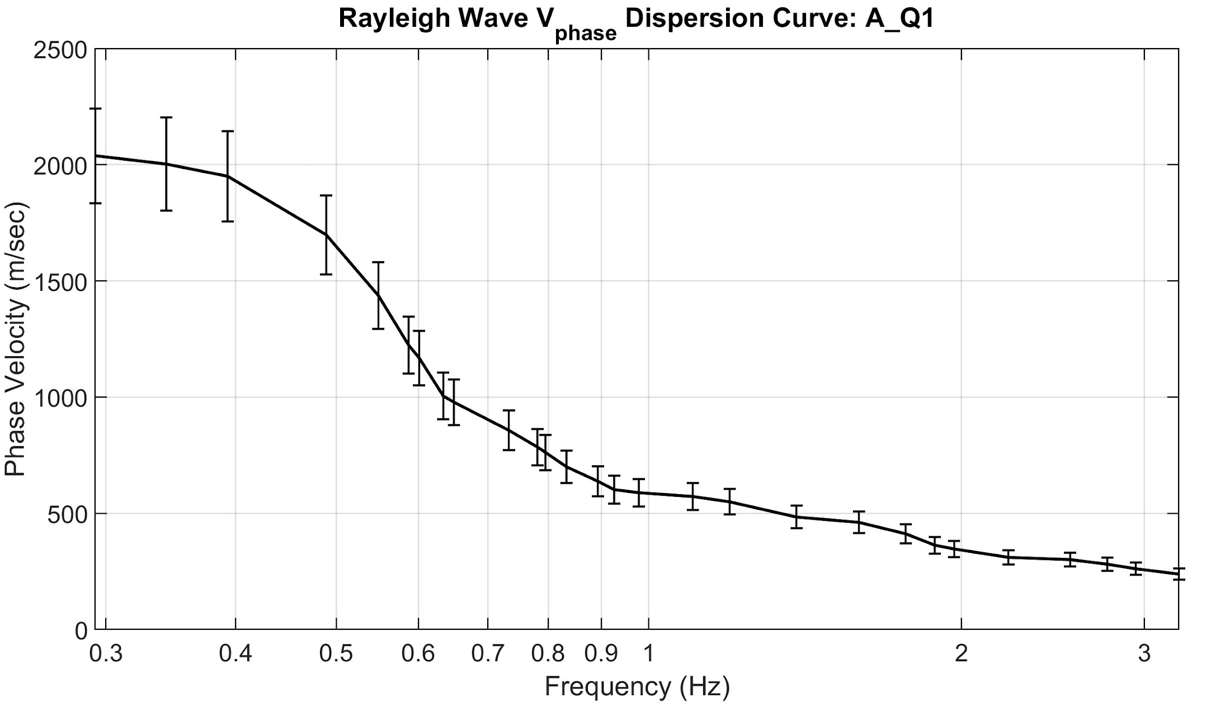
Layered Vs Model
Vs model inverted from Rayleigh Wave Phase Velocity Dispersion Curve
Figure 7. Data, Rayleigh Wave Phase Velocity Dispersion Curve
constrained by depth of Vp interfaces
Monte Carlo sampling generate random models within parameter space
evaluate convergence: Observed vs Forward Modeling dispersion curve

Slide 12
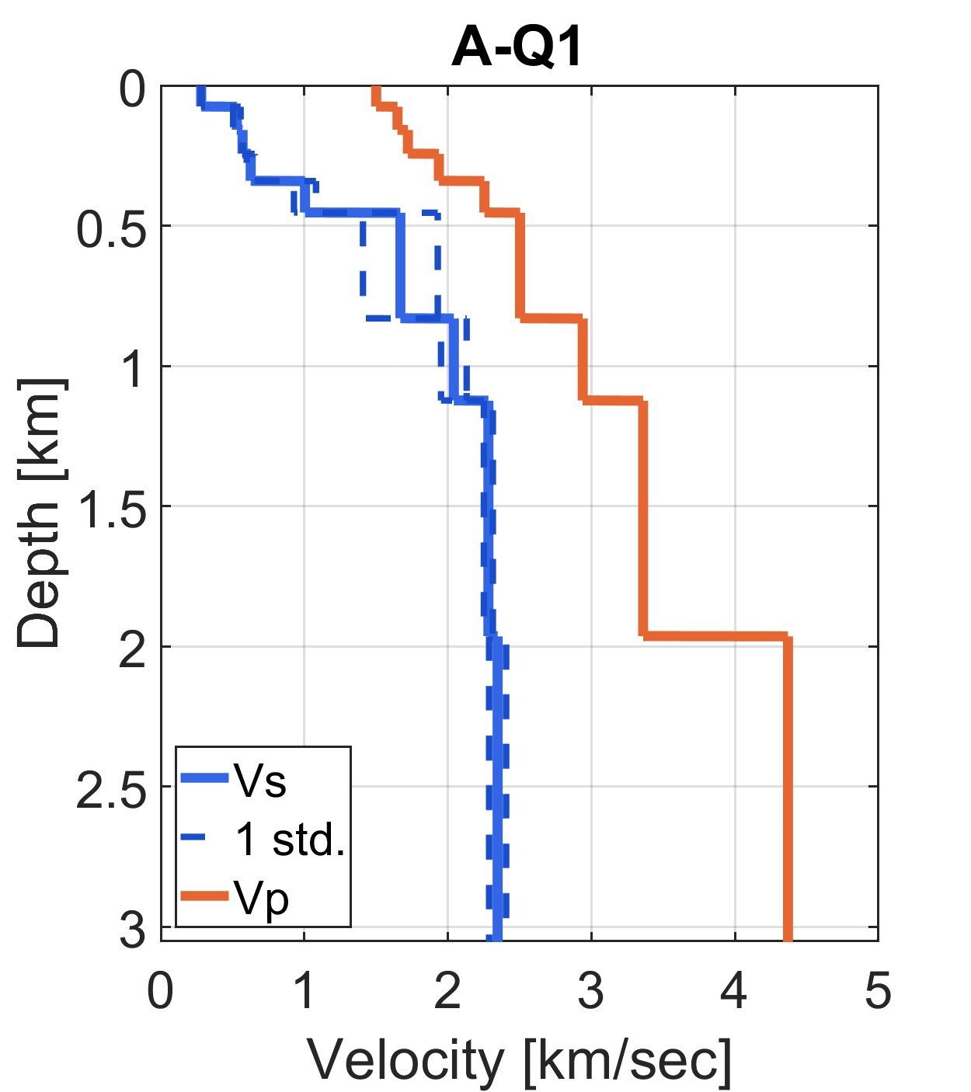
Layered Vs Model
I
Vs model inverted from Rayleigh Wave Phase Velocity Dispersion Curve
constrained by depth of Vp interfaces
Figure 8. Result Vp and Vs.
Monte Carlo sampling generate random models within parameter space
evaluate convergence: Observed vs Forward Modeling dispersion curve

Slide 13
Layered Vs Model
Vs model inverted from Rayleigh Wave Phase Velocity Dispersion Curve
constrained by depth of Vp interfaces
Monte Carlo sampling generate random models within parameter space
evaluate convergence: Observed vs Forward Modeling dispersion curve

Slide 14
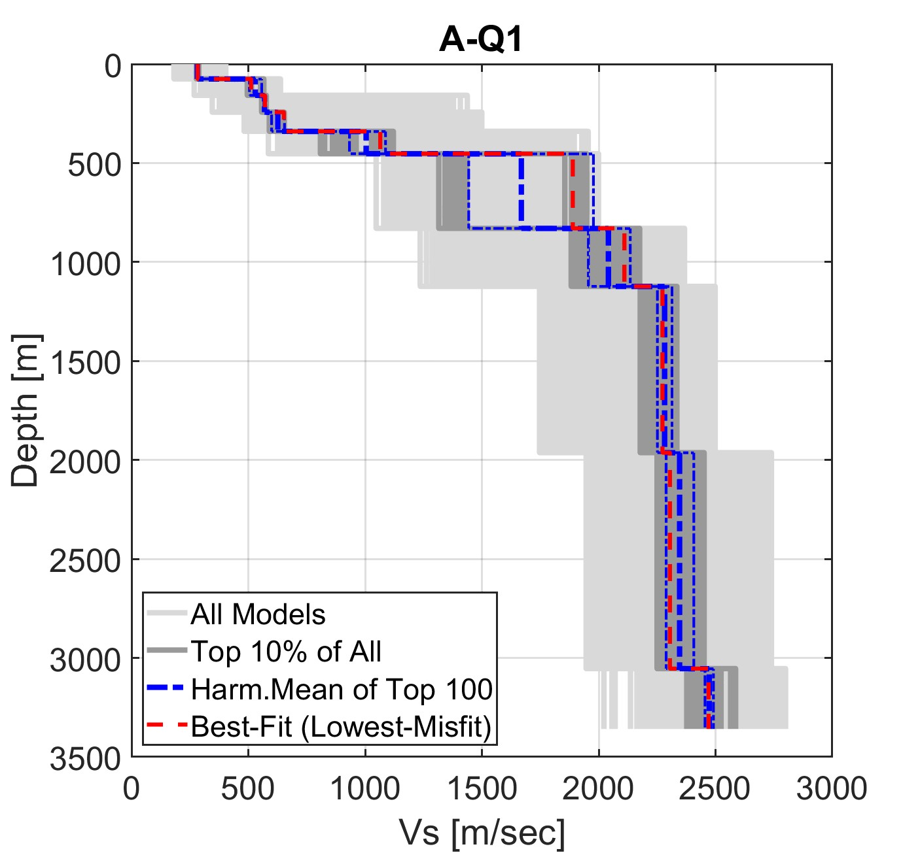
Layered Vs Model
Vs model inverted from Rayleigh Wave Phase Velocity Dispersion Curve
constrained by depth of Vp interfaces
Monte Carlo sampling generate random models within parameter space
Figure 9. All processed models.
evaluate convergence: Observed vs Forward Modeling dispersion curve

Slide 15
Layered Vs Model
Vs model inverted from Rayleigh Wave Phase Velocity Dispersion Curve
constrained by depth of Vp interfaces
Monte Carlo sampling generate random models within parameter space
evaluate convergence: Observed vs Forward Modeling dispersion curve
convergence issue: trapped in local minimum?

Slide 16
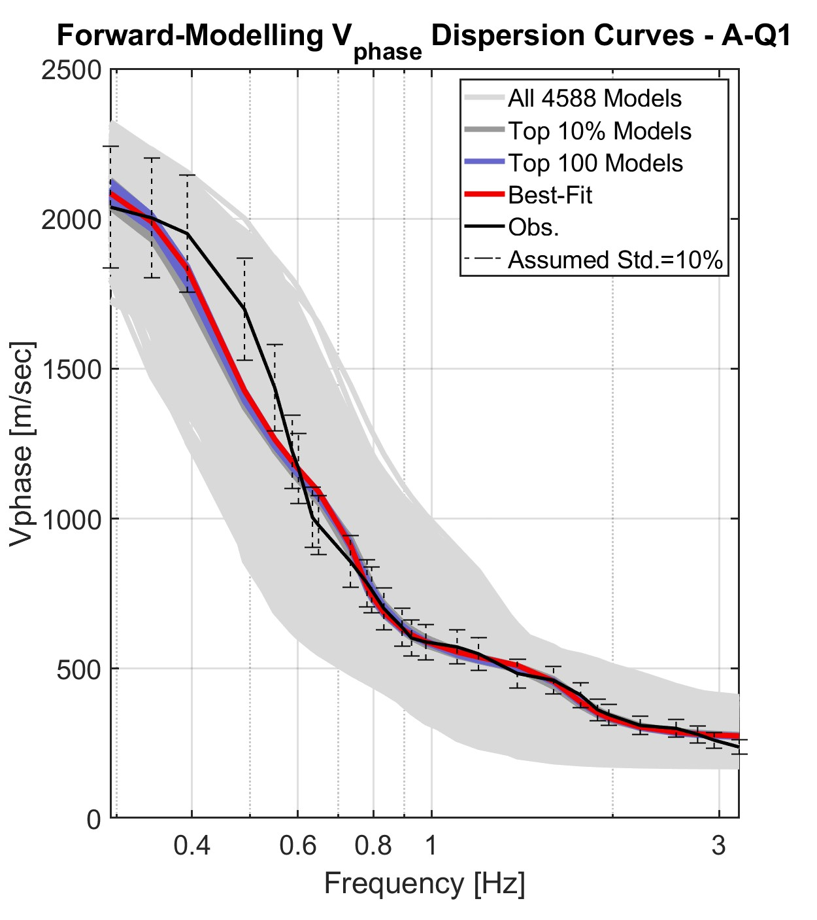
Layered Vs Model
Vs model inverted from Rayleigh Wave Phase Velocity Dispersion Curve
constrained by depth of Vp interfaces
Monte Carlo sampling generate random models within parameter space
evaluate convergence: Observed vs Forward Modeling dispersion curve
Figure 10. Observed and Forward Modeling Dispersion Curves.
convergence issue: trapped in local minimum?

Slide 17
Layered Vs Model
Vs model inverted from Rayleigh Wave Phase Velocity Dispersion Curve
constrained by depth of Vp interfaces
Monte Carlo sampling generate random models within parameter space
evaluate convergence: Observed vs Forward Modeling dispersion curve
convergence issue: trapped in Local Minimum?

Slide 18
Layered Vs Model
convergence issue: Local vs Global Minimum
Misfit
Model Space

Slide 19
Layered Vs Model
convergence issue: Local vs Global Minimum
Misfit
Model Space

Slide 20
Layered Vs Model
Vs model inverted from Rayleigh Wave Phase Velocity Dispersion Curve
constrained by depth of Vp interfaces
Monte Carlo sampling generate random models within parameter space
evaluate convergence: Observed vs Forward Modeling dispersion curve
convergence issue: trapped in Local Minimum?
run 5 inversions, select the best few models (e.g. 100 models) and calculate their mean Vs profile.

Slide 22
Study Area

Slide 23
Ilan Plain Basin
Post-collision
Sedimentary Basin
Tourism
  Hot Spring
  Cold Spring
  Co-existing Fire and Water phenomena (natural gas with groundwater wells)
Fluids and Fractures

Slide 24
Results and Discussions

Slide 25
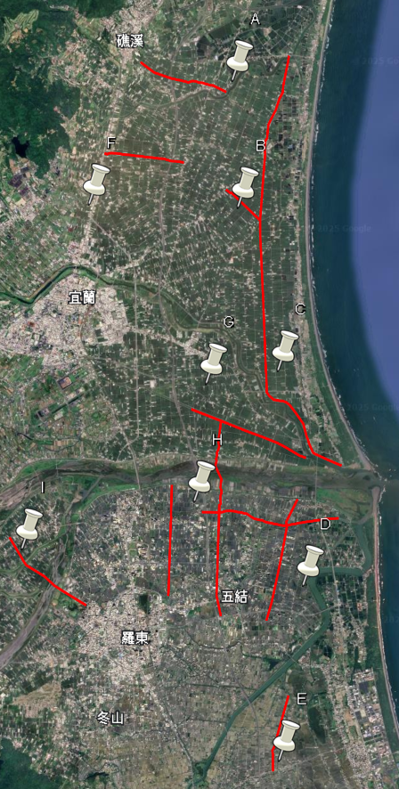
Data Set
I
Study Area: Yilan plain
Data:
  10 Microtremor Sensors of 3 different radius; 9 Sites
G
H
A
C
B
F
D
E

Slide 26
Research Information 1
I
Study Area: Ilan Plain
Data:
  10 Microtremor Sensors of 3 different radius; 9 Sites
  9 Seismic Reflection survey lines
G
H
A
C
B
F
D
Ilan Plain (Google Map Link)
https://maps.app.goo.gl/4D9vo9fFbxpwLMkn7
E

Slide 27
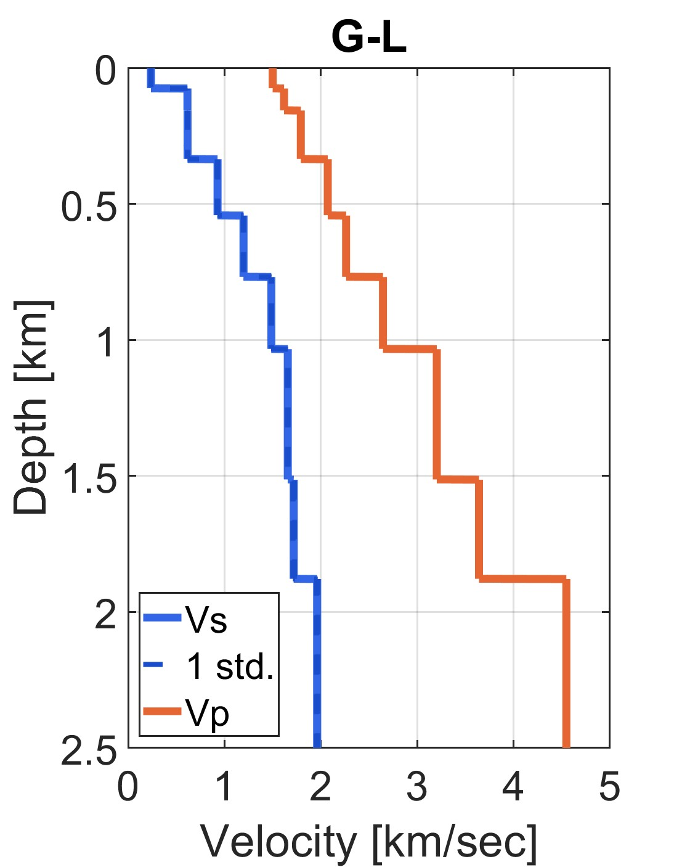
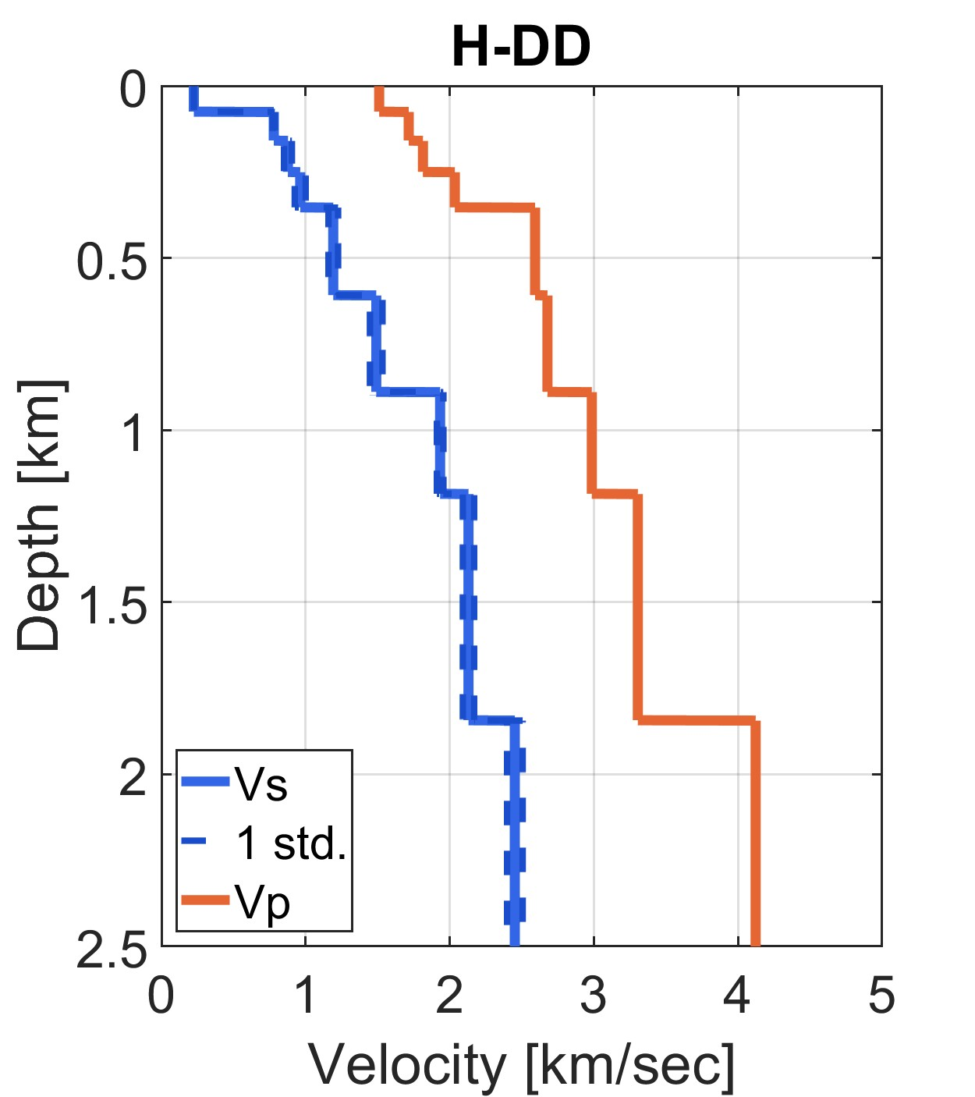
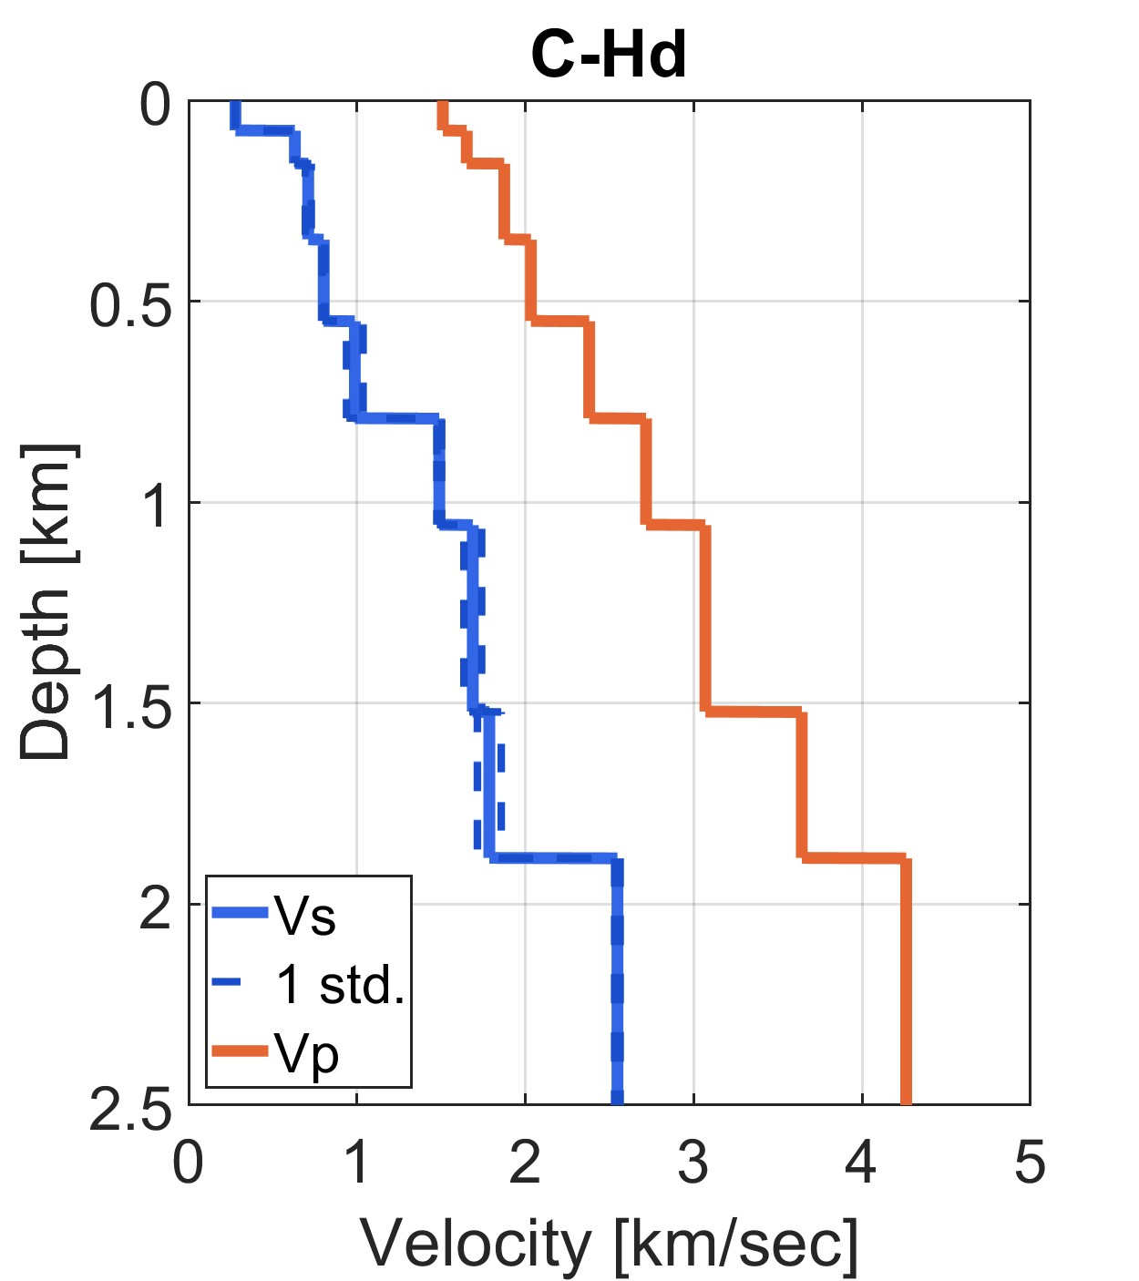
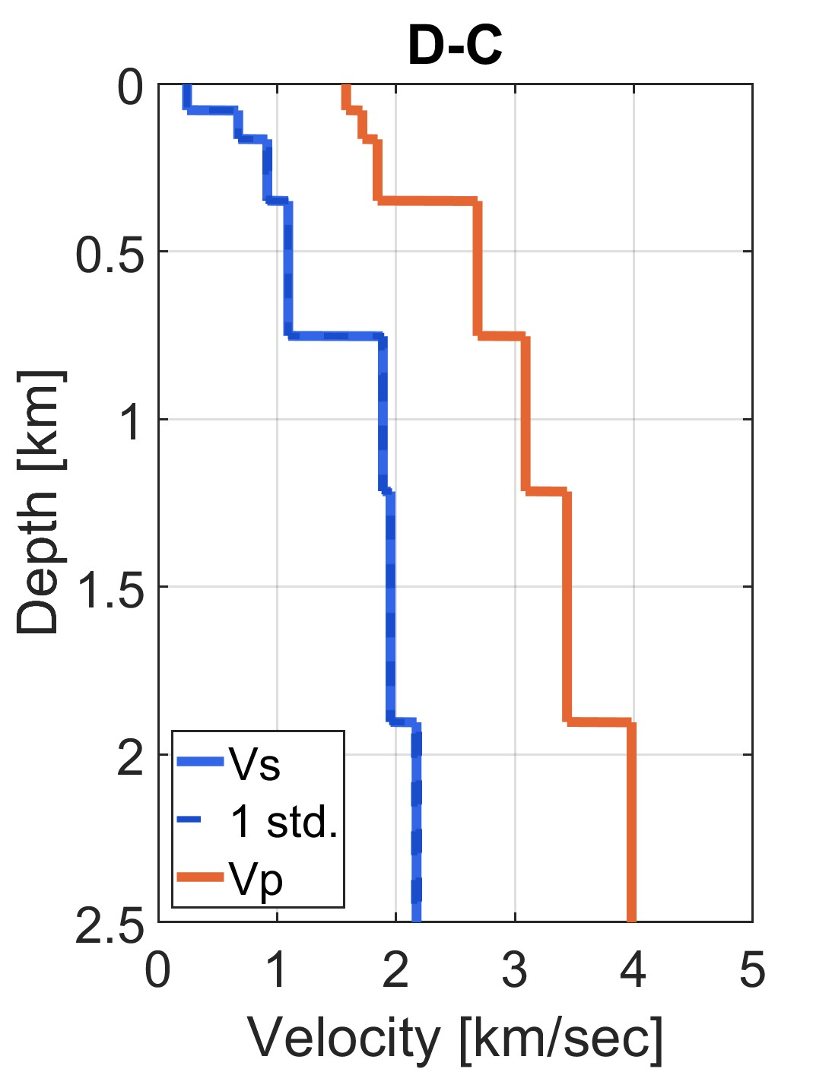
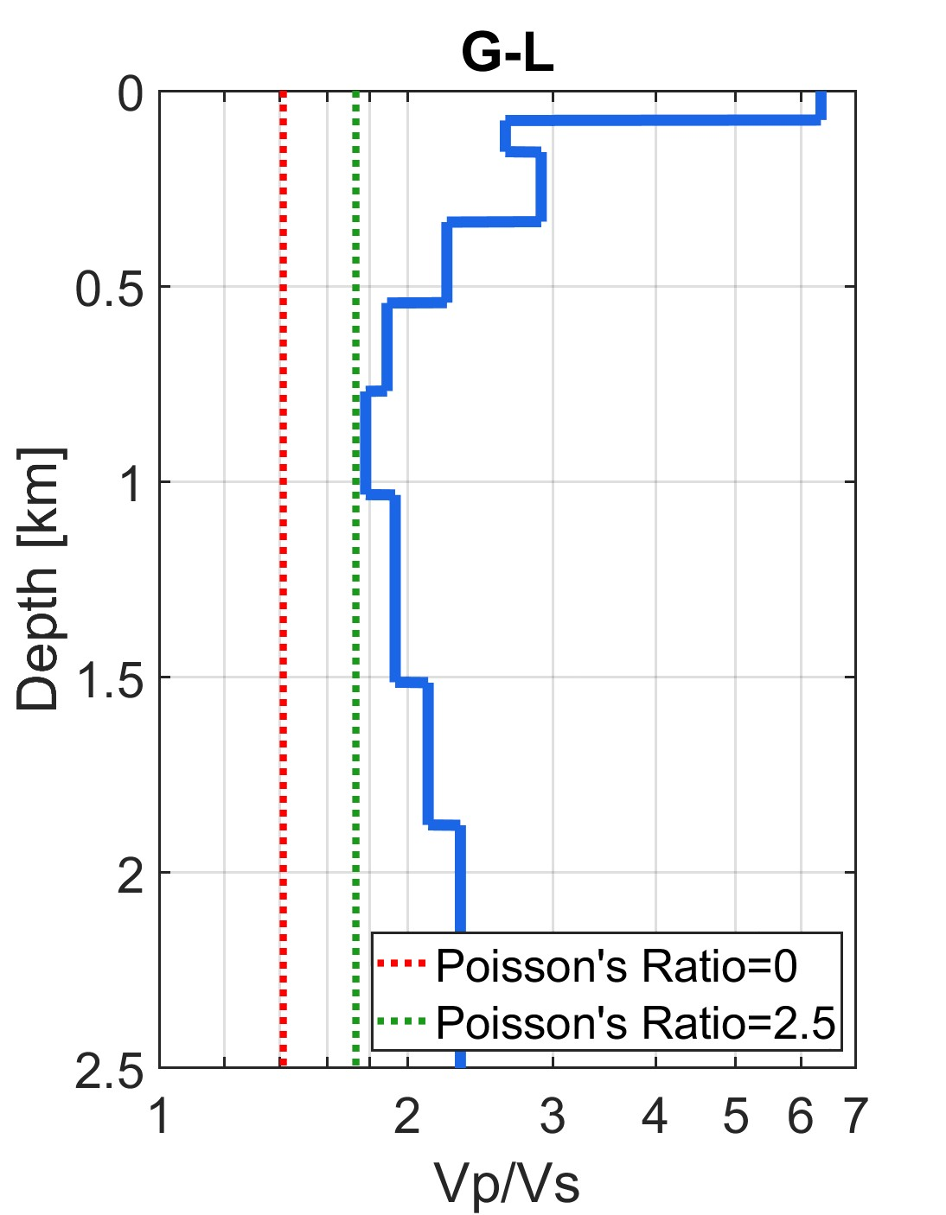
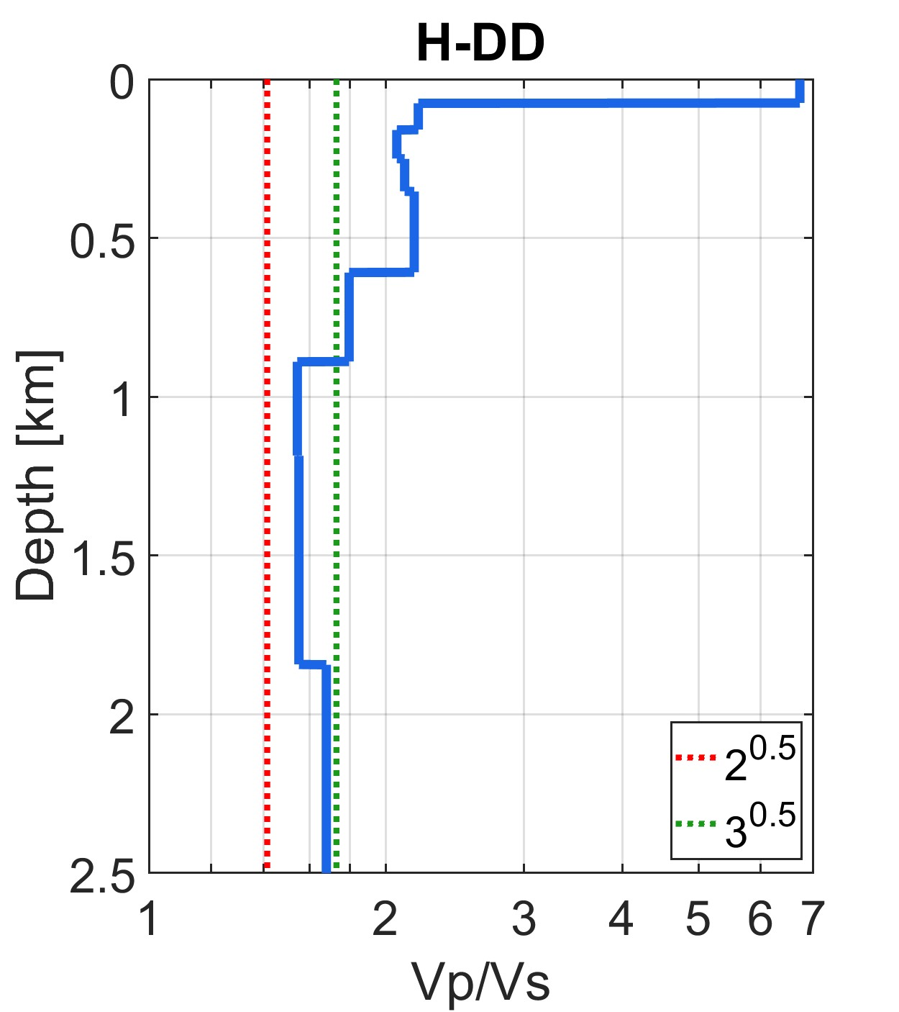
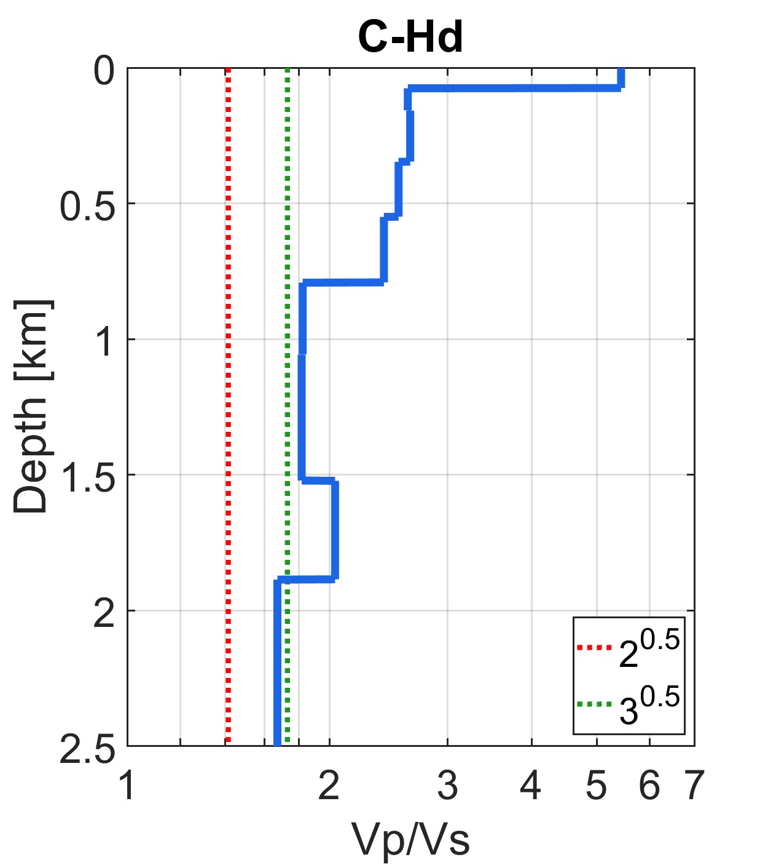
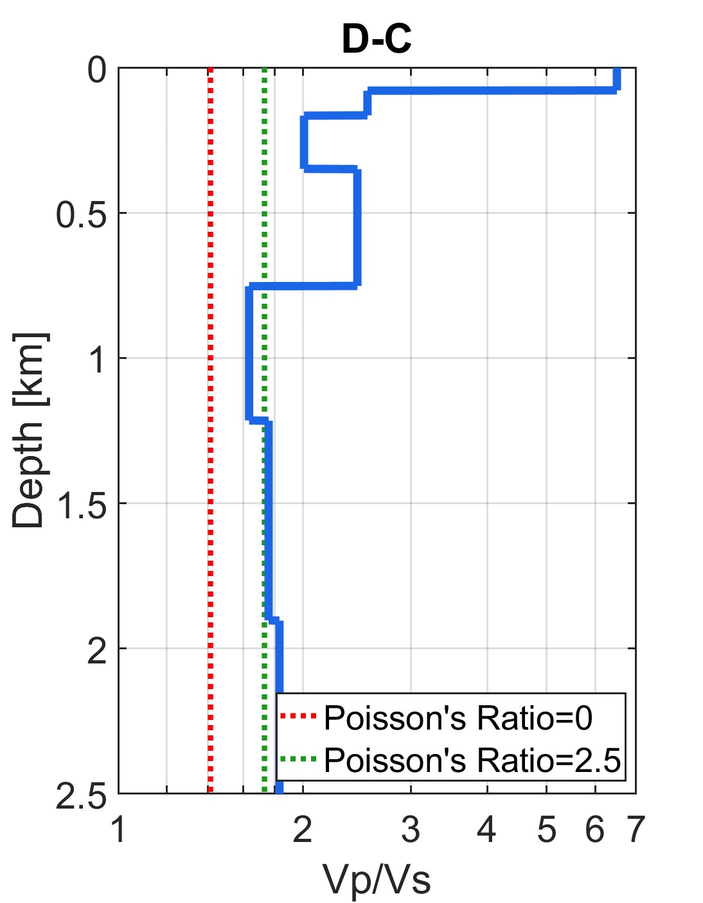

Slide 28
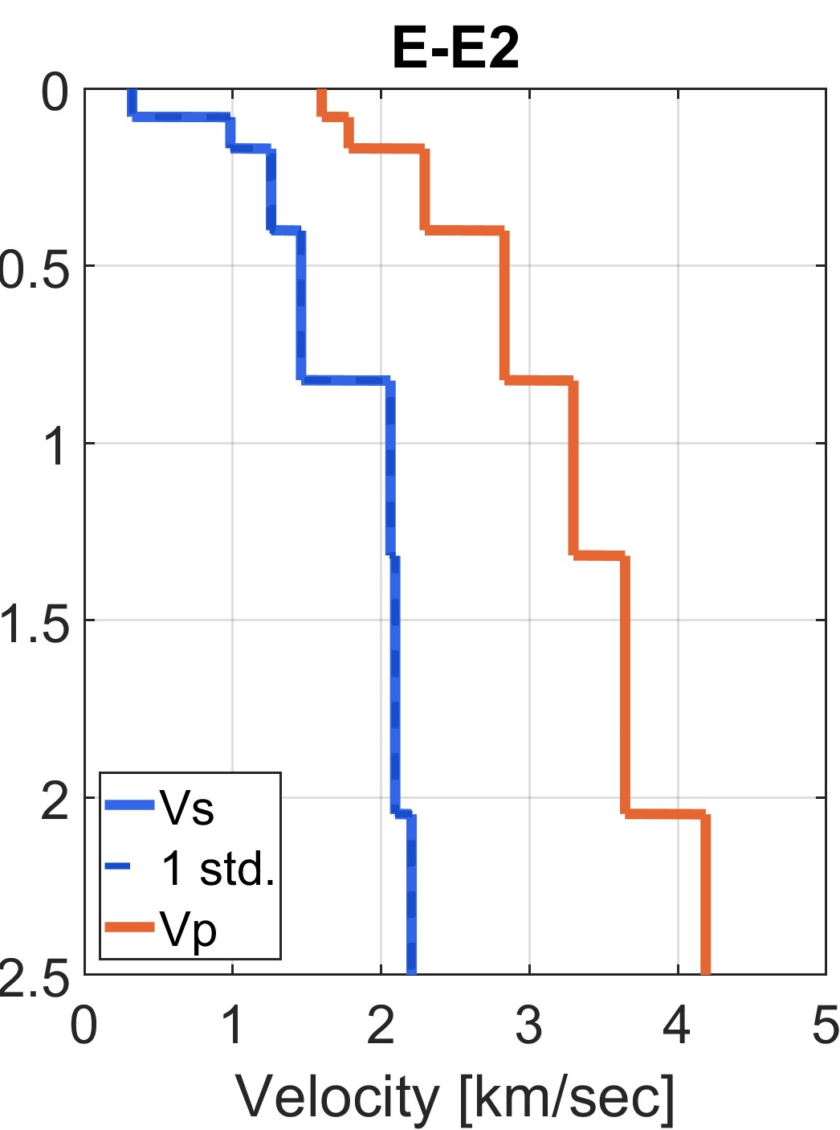
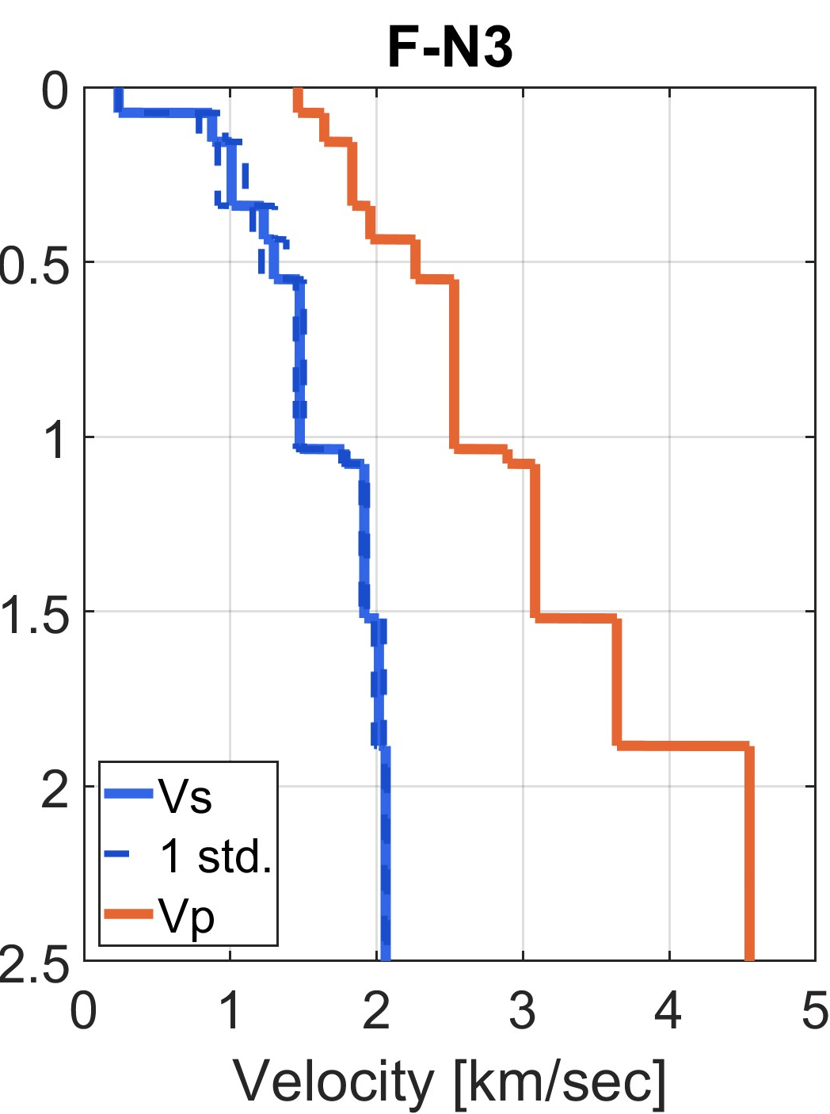
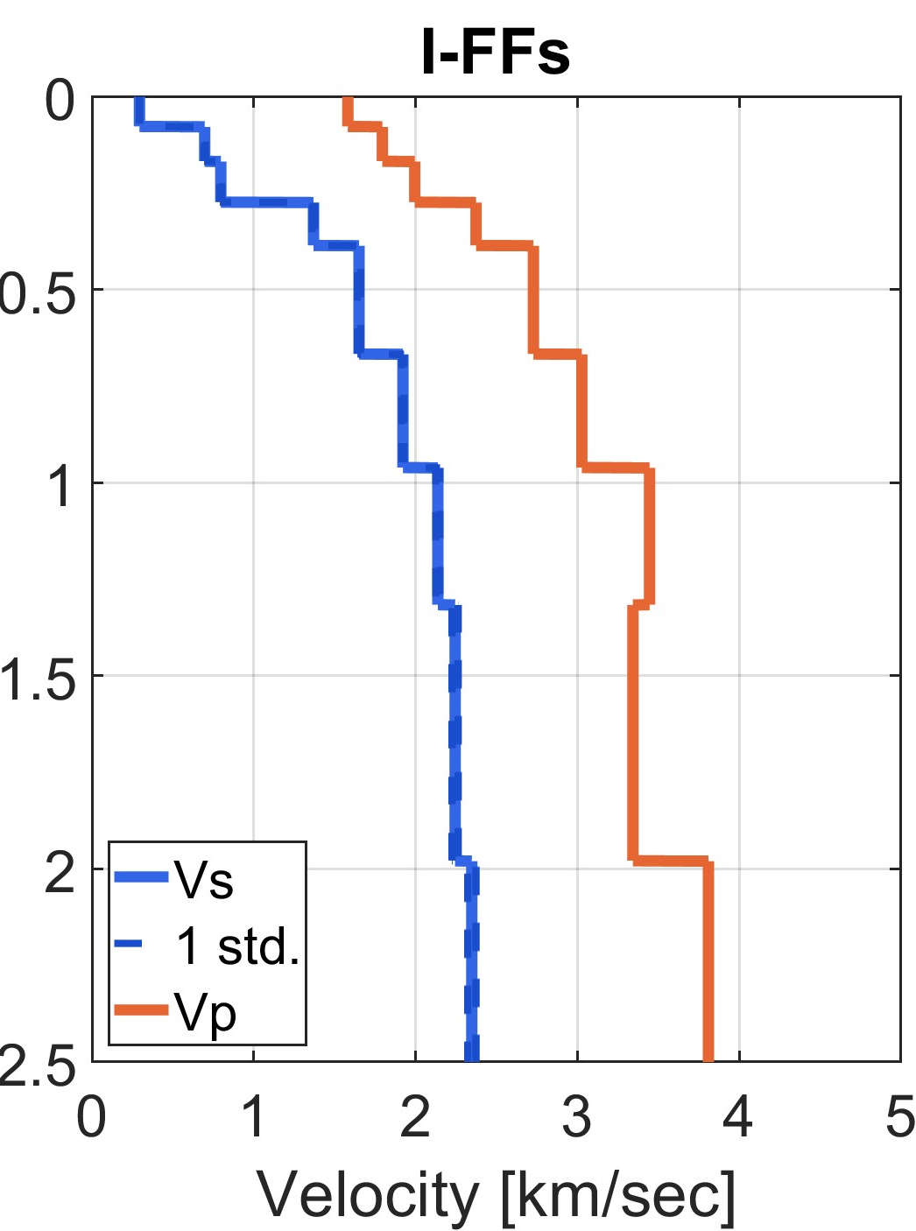
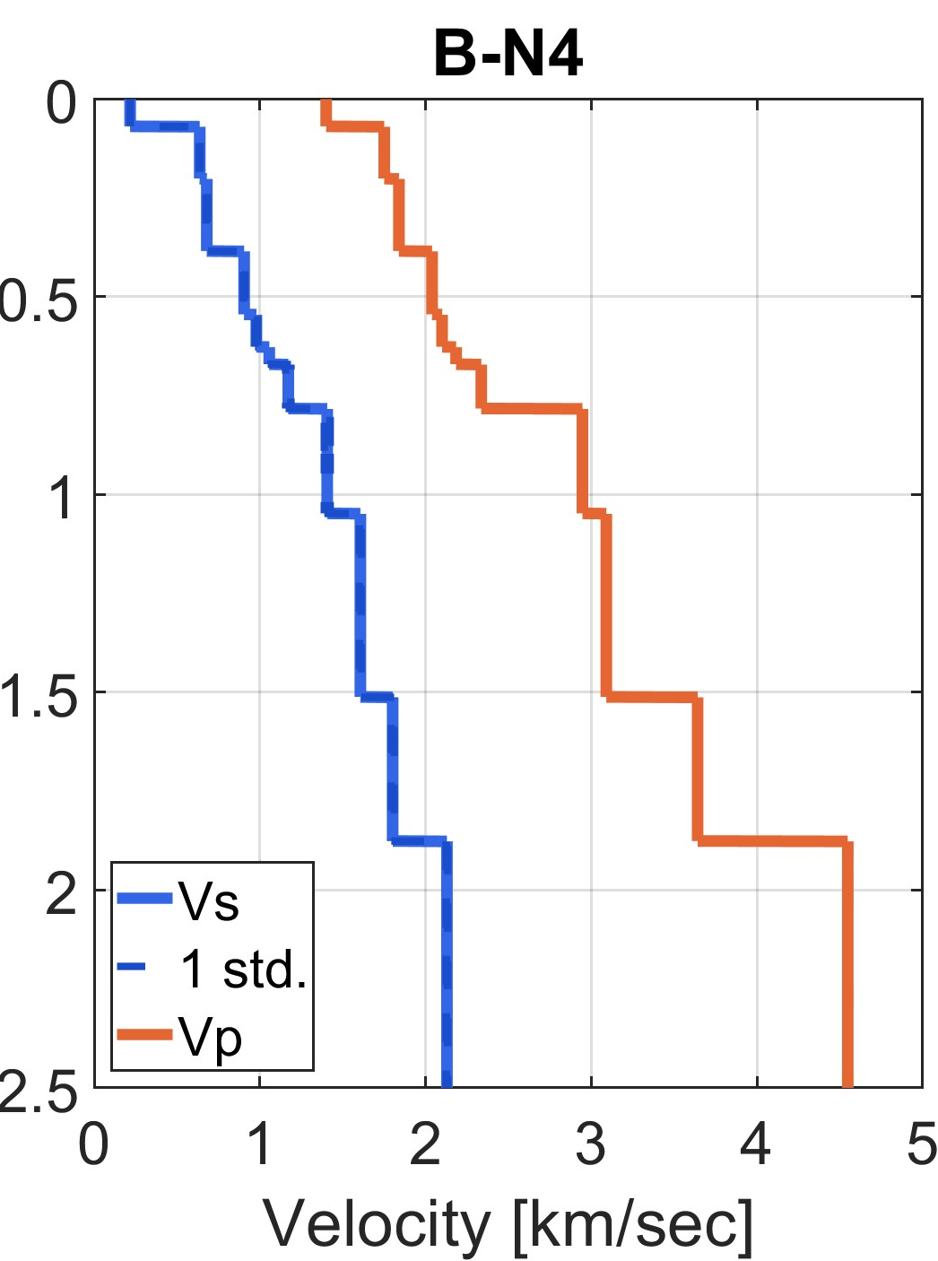
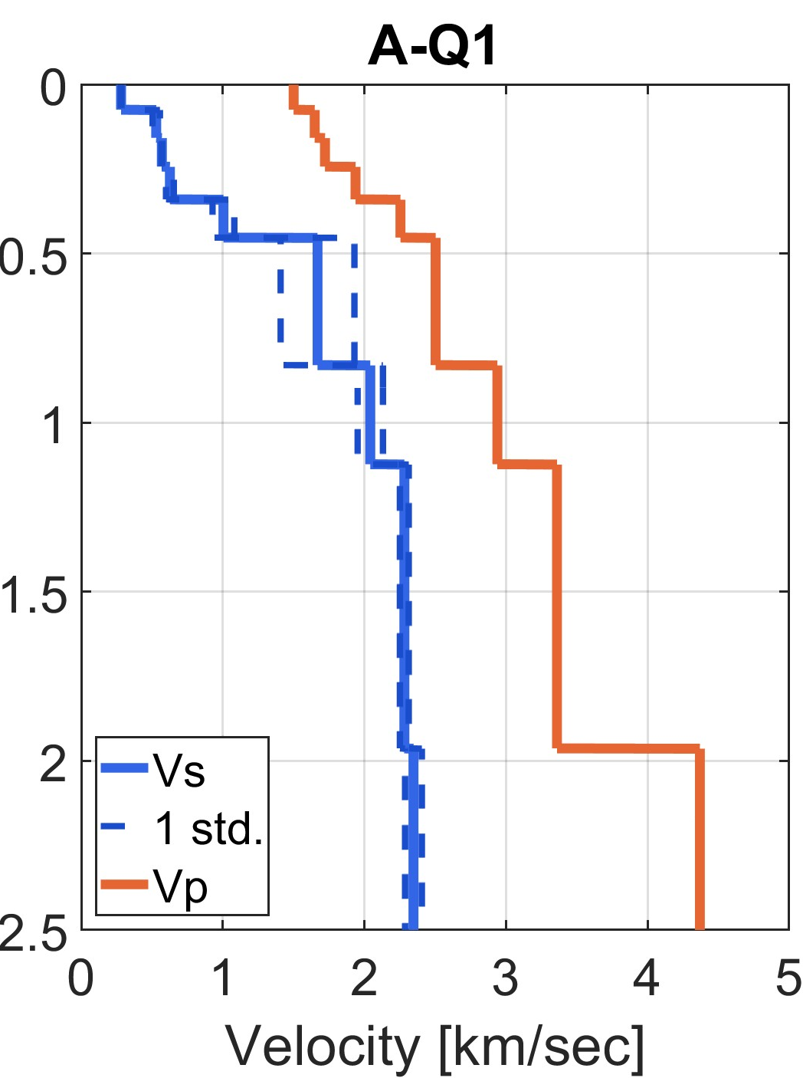

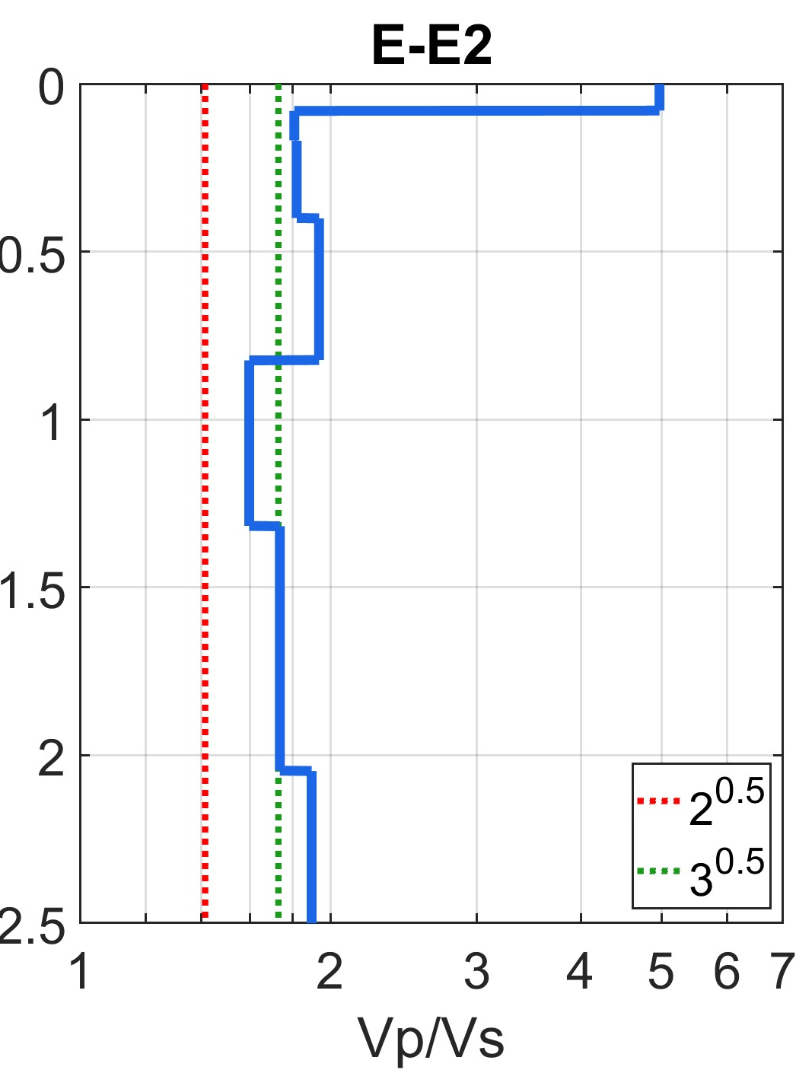
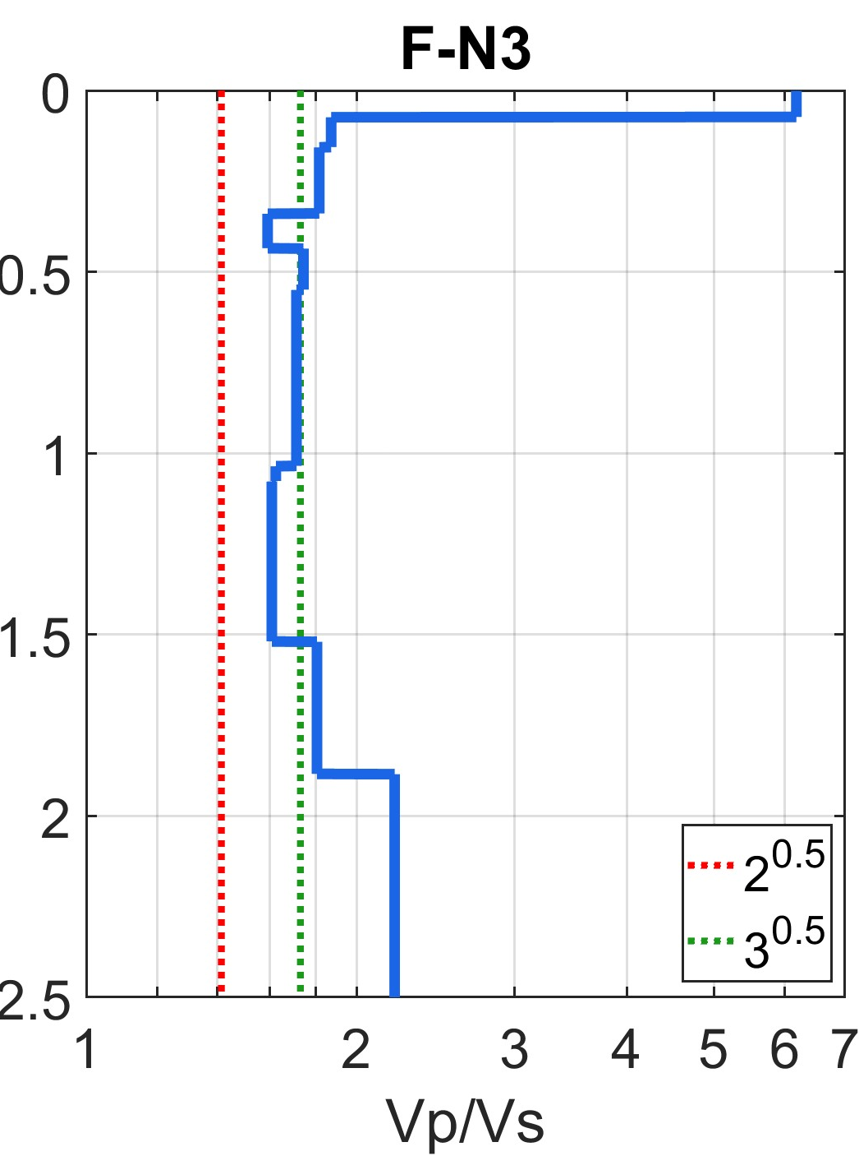
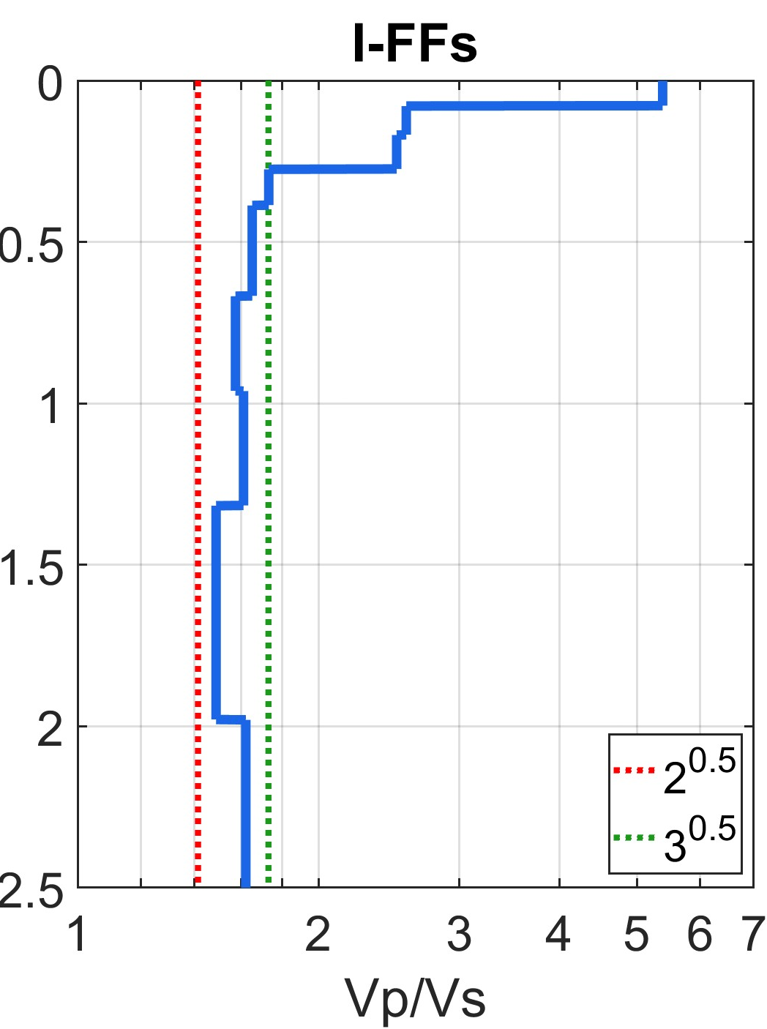
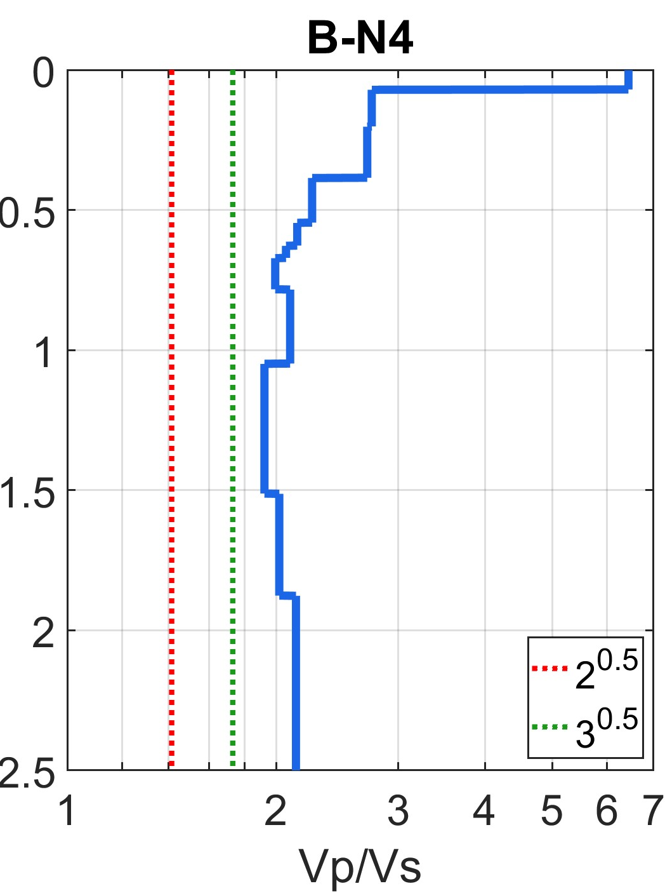
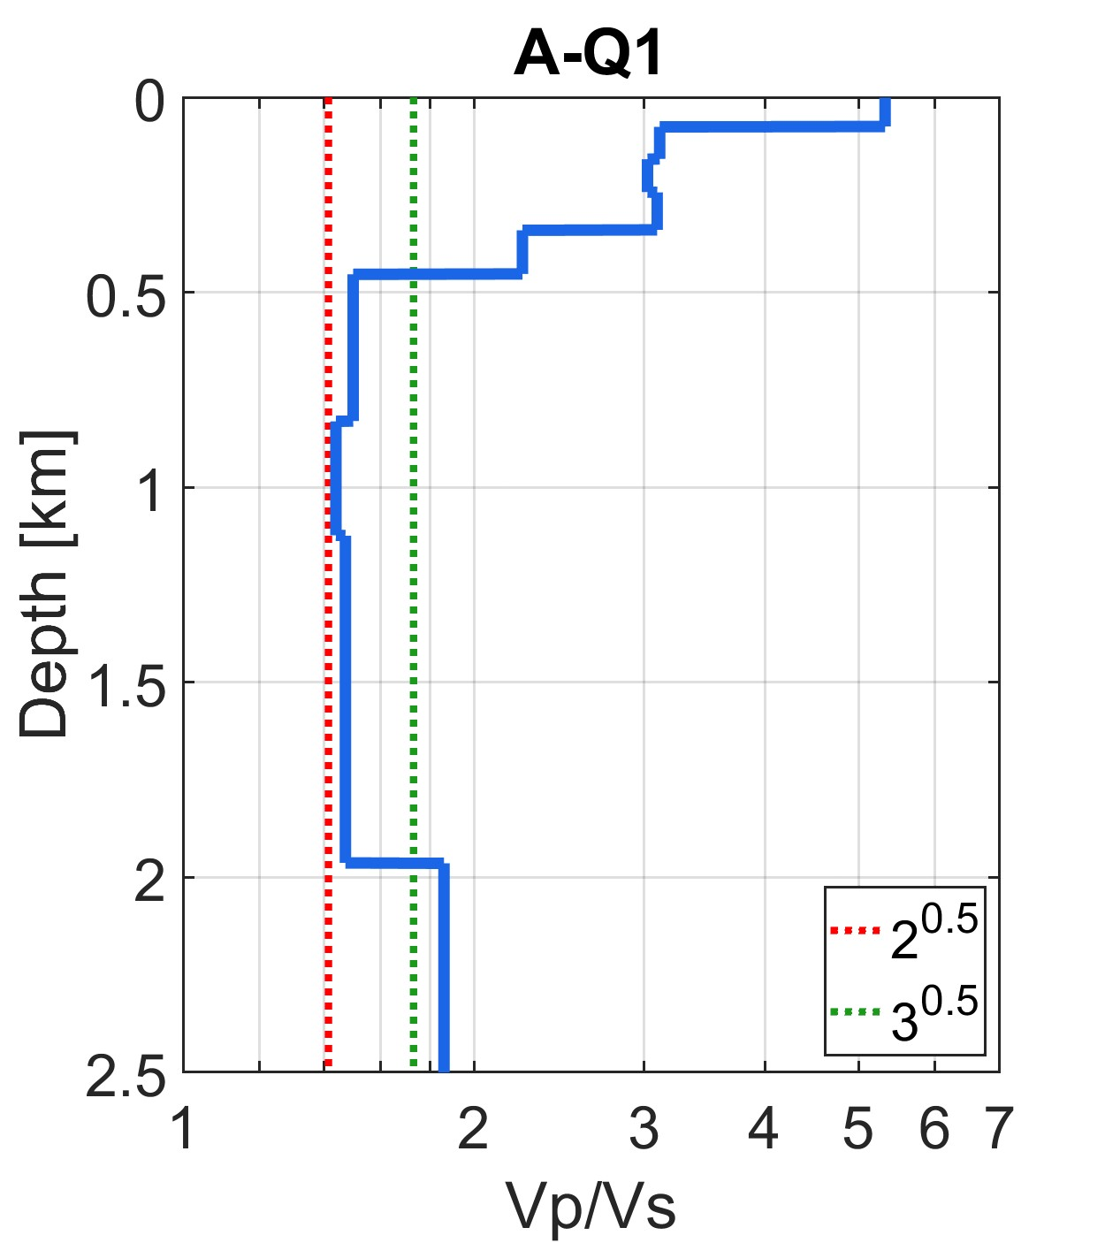

Slide 29
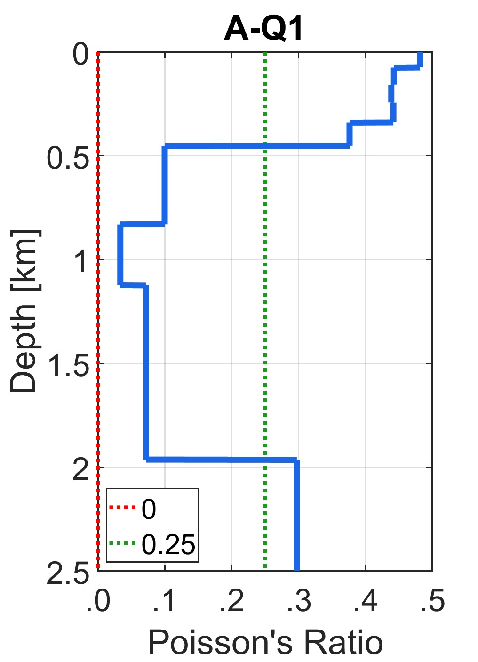
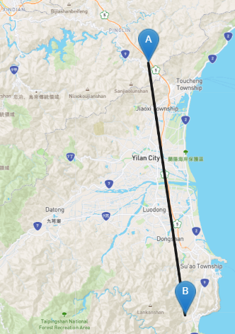
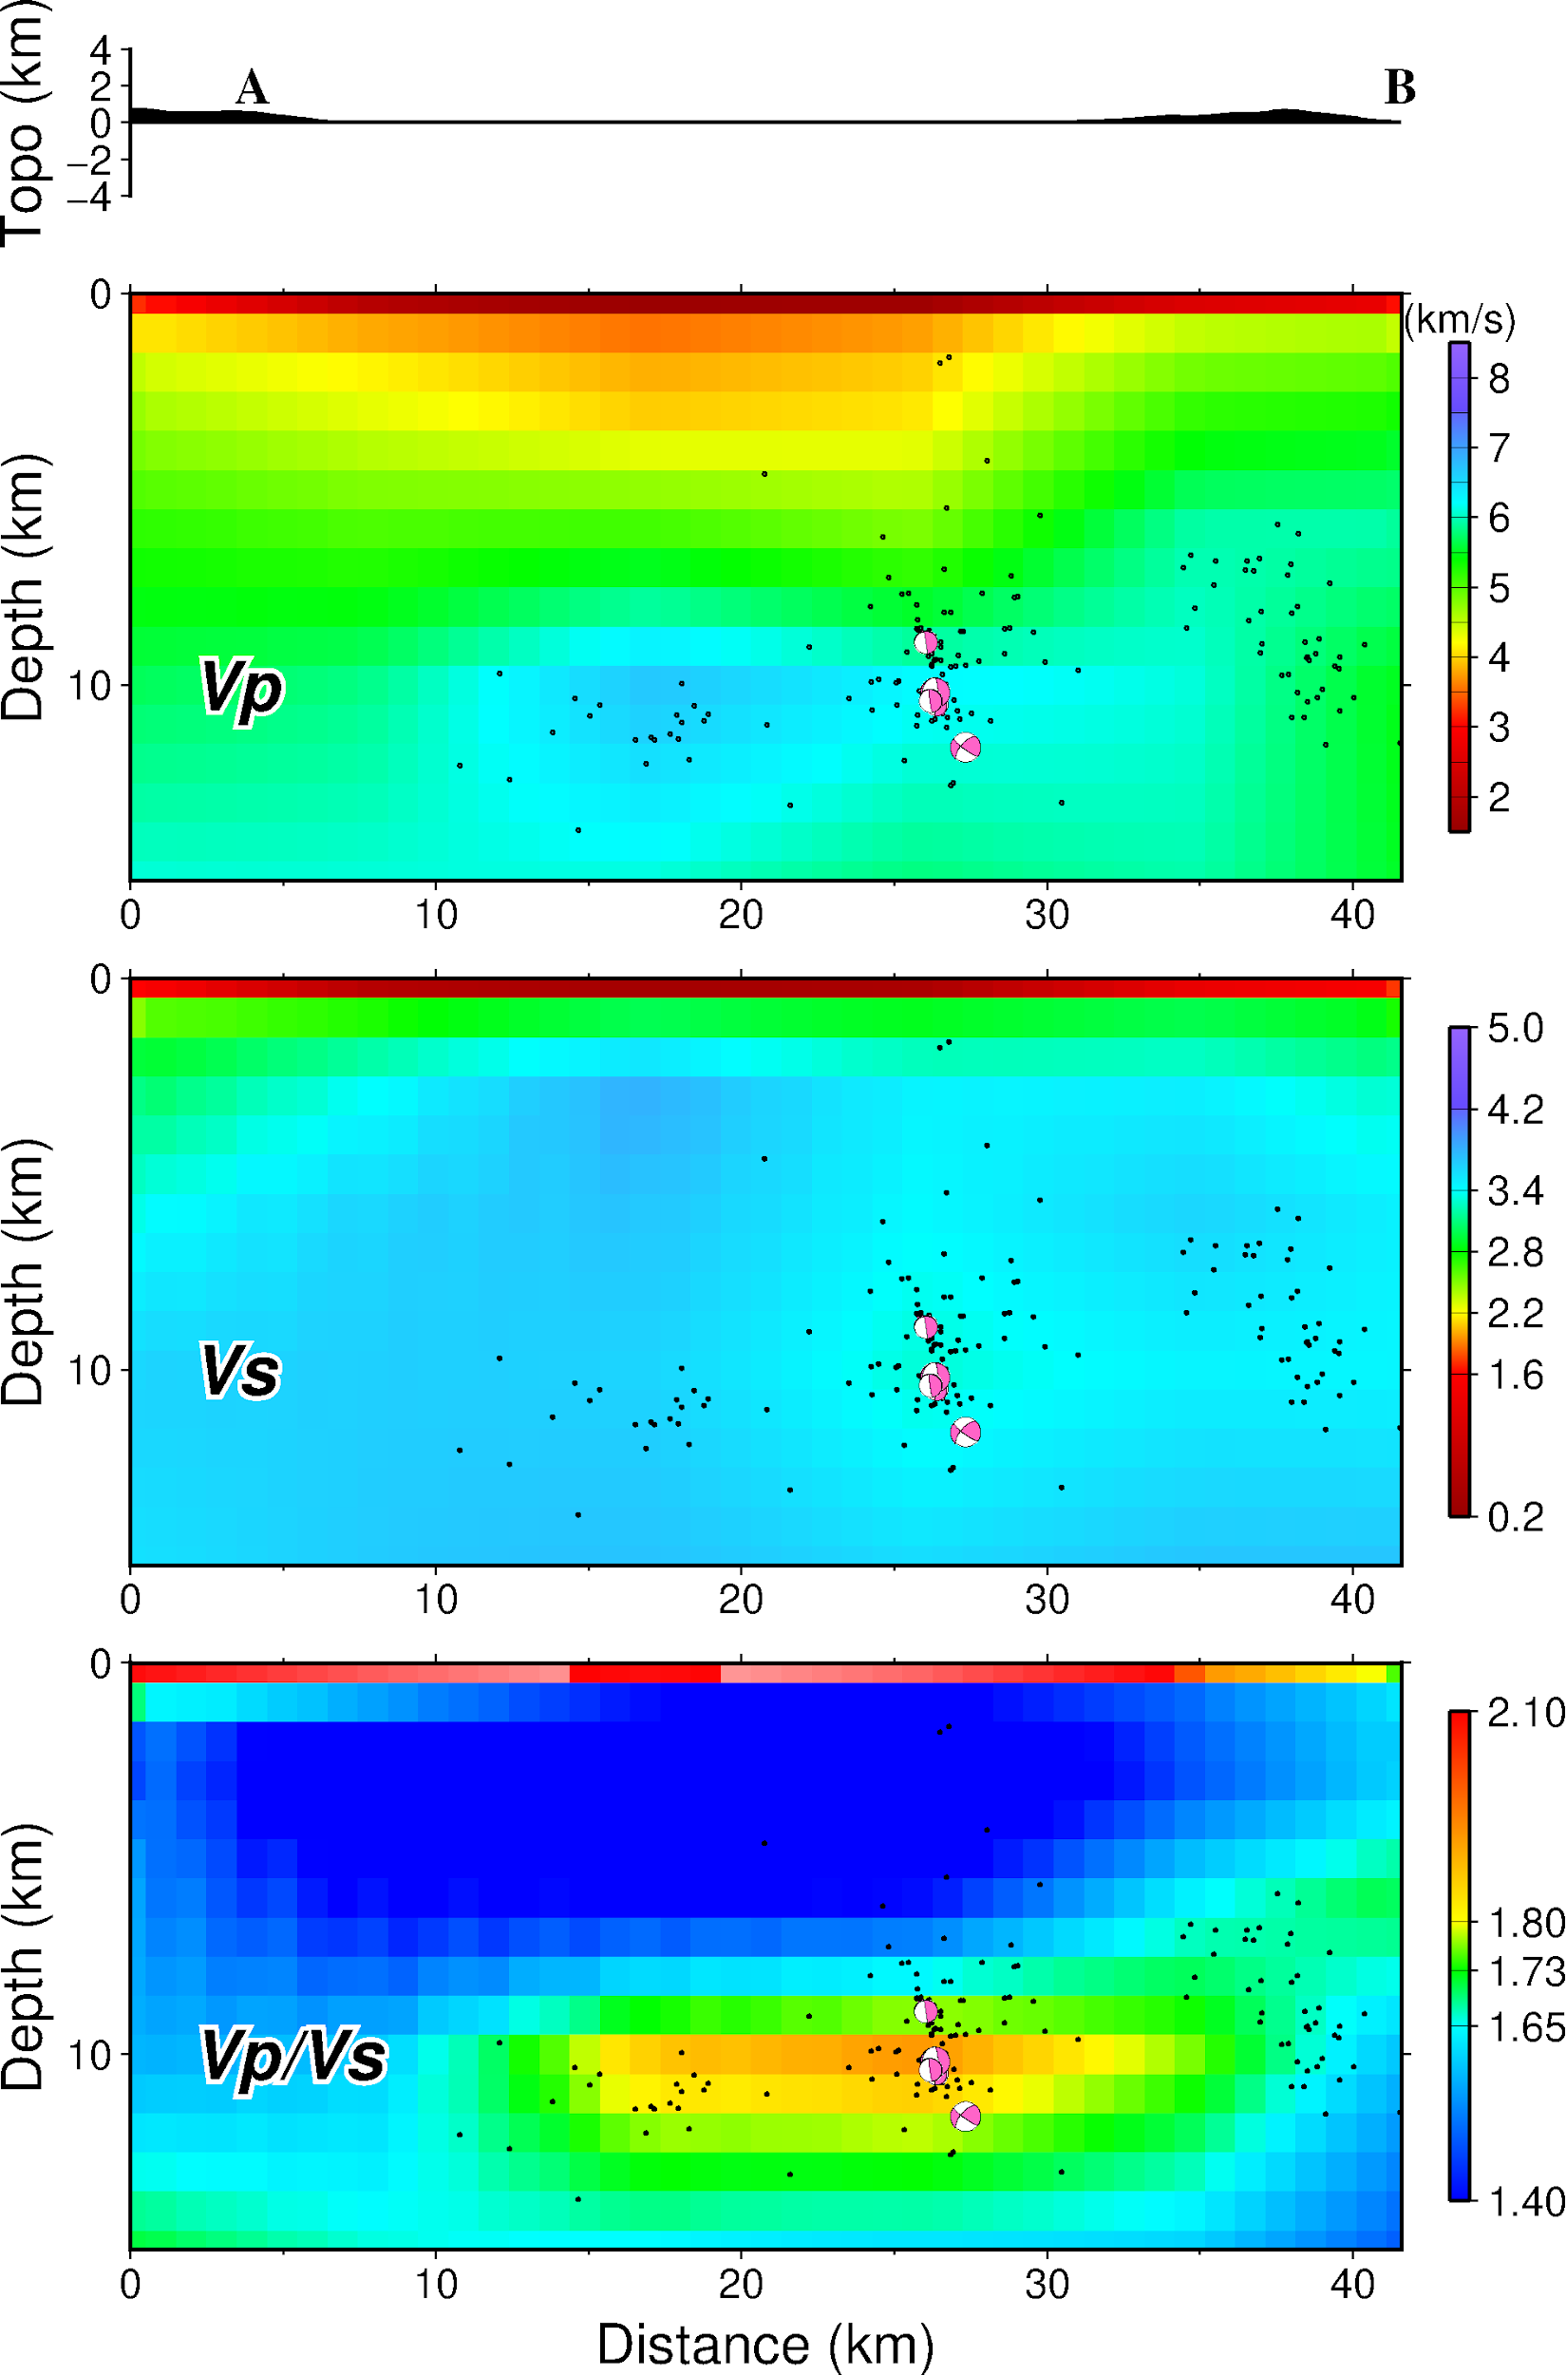
Taiwan Velocity Model
Huang et al. (2014) Vp, Vs

Slide 30
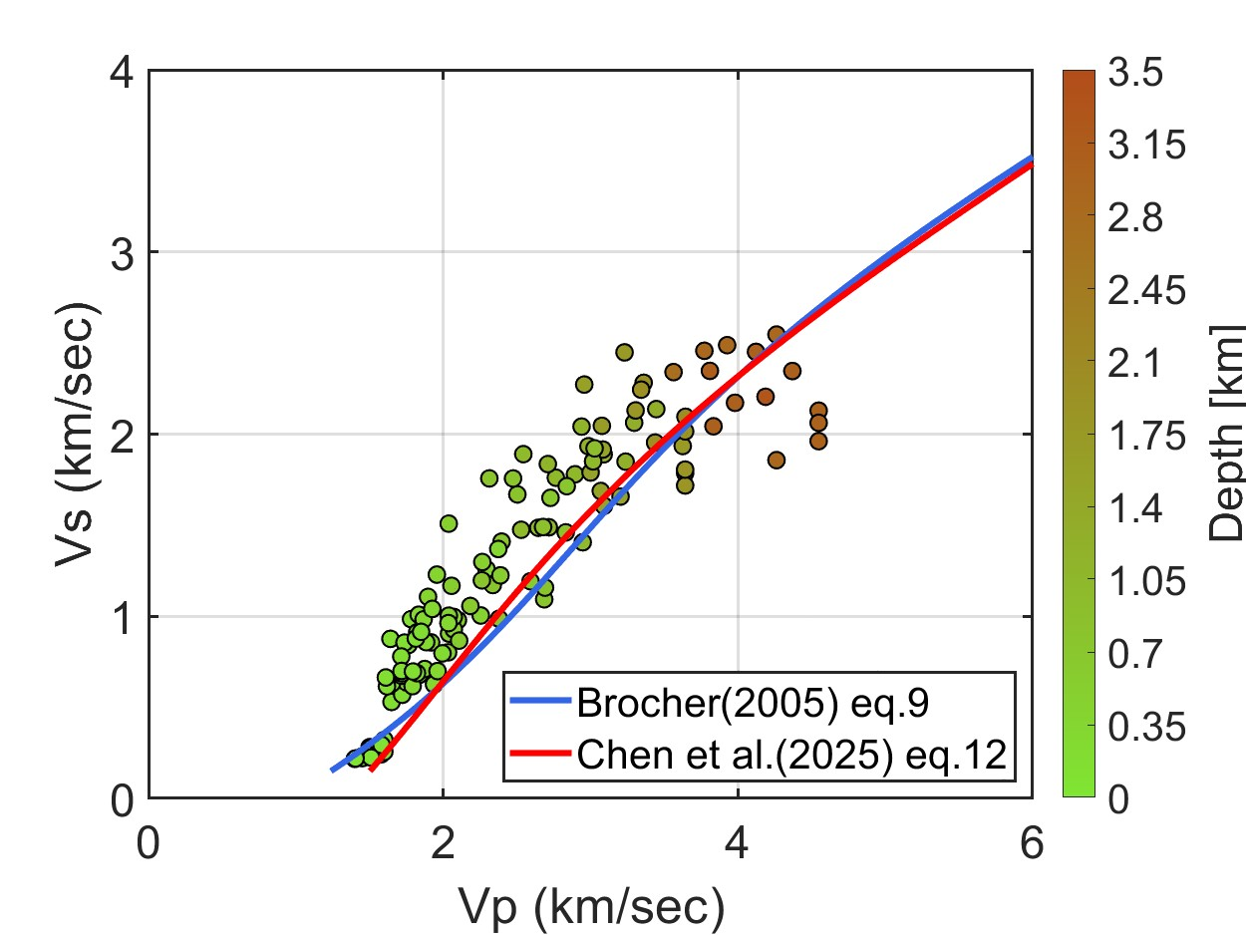
Plot Vp to Vs distribution with empirical Vp-Vs converting formulas.

Slide 31
Conclusion
Tries to give a robust framework to combine different geophysical prospecting techniques across Vp and Vs profiles.
High Vp/Vs ratios are mainly associated with thick sedimentary deposits and fluid-rich layers.
Unusually low Vp/Vs ratios may indicate fractures, cracks and degassing zones, got similar pattern with previous tomography study.
Spatial variations in Vp/Vs patterns reflect differences in sediment thickness and structural setting across the Ilan Plain Basin.

Slide 32
Future Work
Compare with additional geophysical prospecting methods to further verify the reliability of this study.
Integrate well logging, resistivity, and MT data to better constrain fluid distribution.
Further investigate the relationship between fractures, fluid migration, and geothermal activity.

Slide 33
References
Antonio, G.-J., José, P.-F., Francisco, J. S.-S., Francisco, L., Mathieu, P. (2016). A computer code for forward calculation and inversion of the H/V spectral ratio under the diffuse field assumption, Computers & Geosciences 97, 67–78, doi: 10.1016/j.cageo.2016.06.016.
Brocher, T. M. (2005). Empirical Relations between Elastic Wave speeds and Density in the Earth’s Crust. Bulletin of the Seismological Society of America, Vol. 95, No. 6, pp. 2081–2092, doi: 10.1785/0120050077.
Chen, C.-T., Yen, Y.-Y., Yen, Y.-T. (2025). Microtremor Survey and Shallow 1D Velocity Structure Analysis in the Heping Area, Hualien.

Slide 34
References
Dix, C. H. (1955). Seismic velocities from surface measurements. Geophysics, Vol. XX, No. 1, PP. 68-86, doi: 10.1190/1.1438126.
Flinchum, B. A., Grana, D., Carr, B. J., Ravichandran, N., Eppinger, B., & Holbrook, W. S. (2024). Low Vp /Vs values as an indicator for fractures in the critical zone. Geophysical Research Letters, 51, e2023GL105946. https://doi. org/10.1029/2023GL105946
Takeshi, T., Andajani, R. D., Masafumi K., Akio H., Naoshi A., Susumu A., Kuo-Chen, Guan, Z.-K., Sun, W.-F., Pan, S.-Y., Liu, Y.-H., Keigo K., Jun N. and Haruhiro I. (2025). Supercritical fluid flow through permeable window and phase transitions at volcanic brittle–ductile transition zone. Communications Earth & Environment, doi: 10.1038/s43247-025-02774-4

Slide 35
References
Textbook
Peter, M. S. (2009) Introduction to Seismology, 2nd Edition.
Thesis
黃有志（民92）。蘭陽平原場址效應及淺層S波速度構造。碩士論文，國立中央大學地球物理所。
張峻瑋（民99）。利用反射震測探討宜蘭平原南部之基盤深度及斷層分佈。碩士論文，國立中央大學地球物理所。
石政為（民100）。利用反射震測探討宜蘭平原之基盤深度及構造演化。碩士論文，國立中央大學地球物理所。
廖彥迪（民114）。透過反射震測法分析北桃園區域 是否適合作為碳封存場址。碩士論文，國立中央大學地球物理所。

Slide 36
References
Website
Antonio, G.-J., José, P.-F., Francisco, J. S.-S., Francisco, L., Mathieu, P., Maik, N. (2016). HV-inv: A software for inversion of H/V spectral ratios of ambient noise based on the Diffuse Field Approximation. https://w3.ual.es/GruposInv/hv-inv/
Taiwan Velocity Model: https://tecdc.earth.sinica.edu.tw/TWtomo/

Slide 37
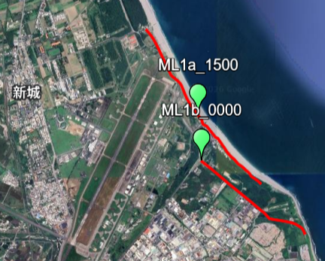
Additional Data Set 1
Study Area: MiDAS, Hualien
Data:
  10 Microtremor Sensors of 3 different radius circles; 2 Sites
  2 Seismic Reflection survey lines
MiDAS A Hole - ML1b (Google Map Link)
https://maps.app.goo.gl/LhdYxbWYEuJ1up2B6
MiDAS B Hole - ML1a (Google Map Link)
https://maps.app.goo.gl/CRUQxm2T5PNaqP4k8

Slide 38
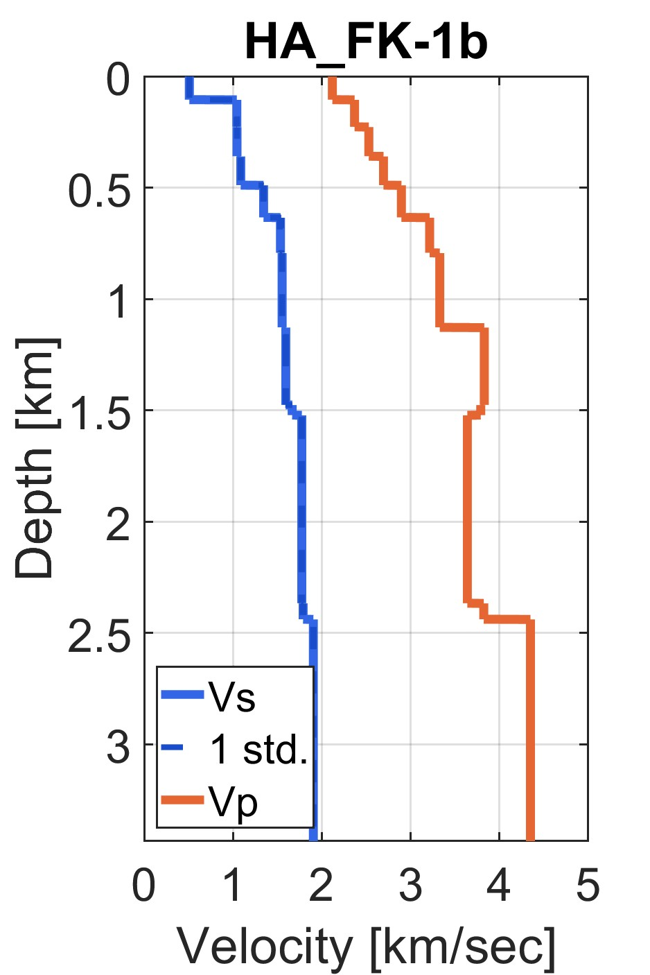
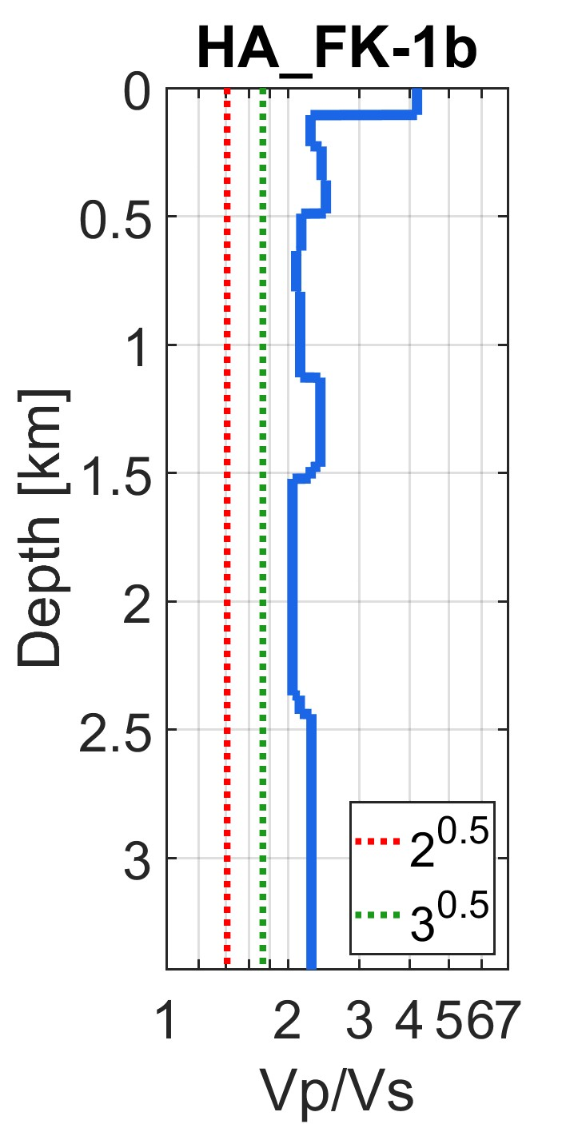
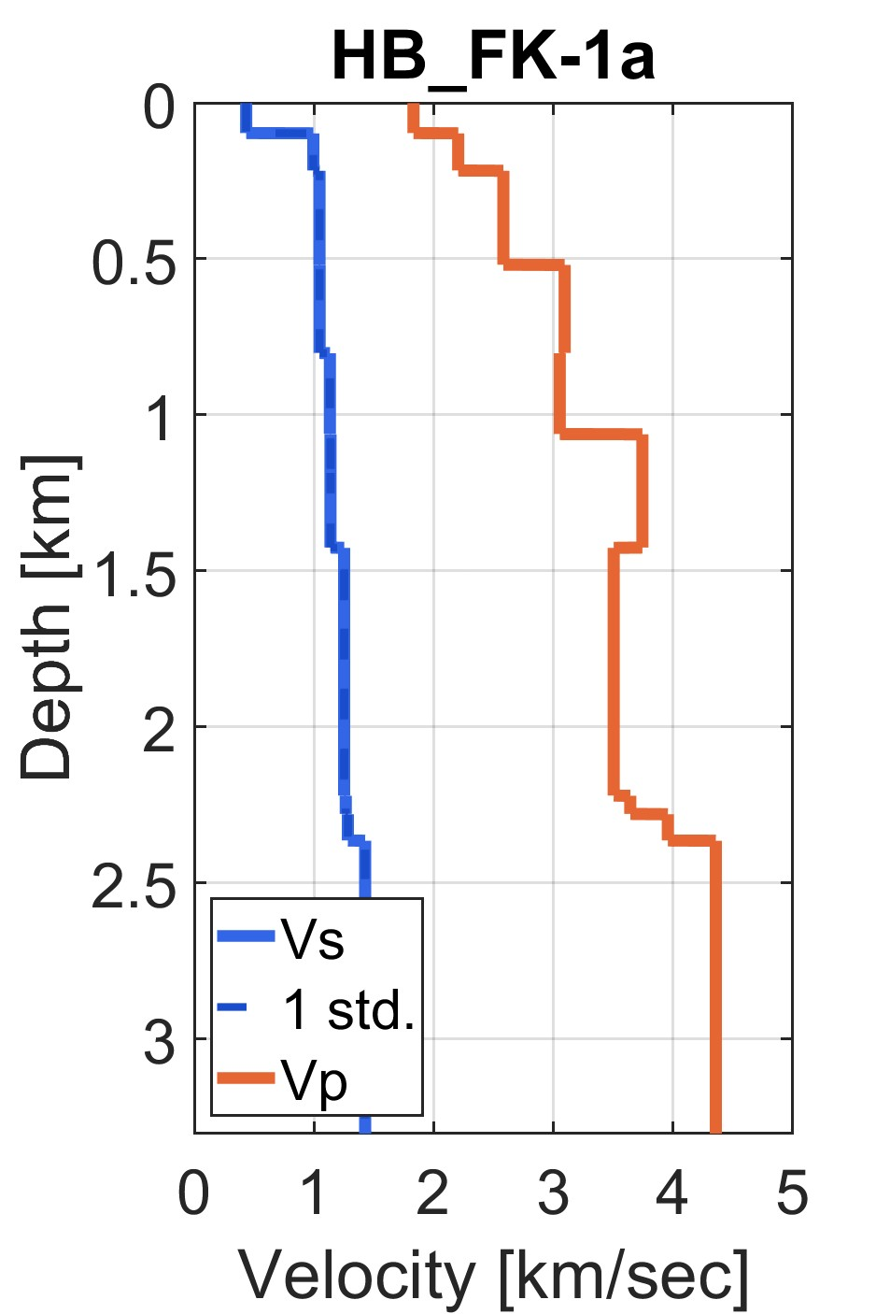
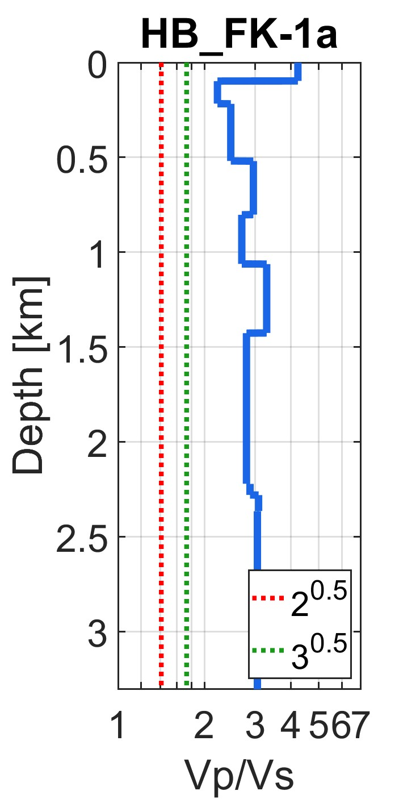

Slide 39
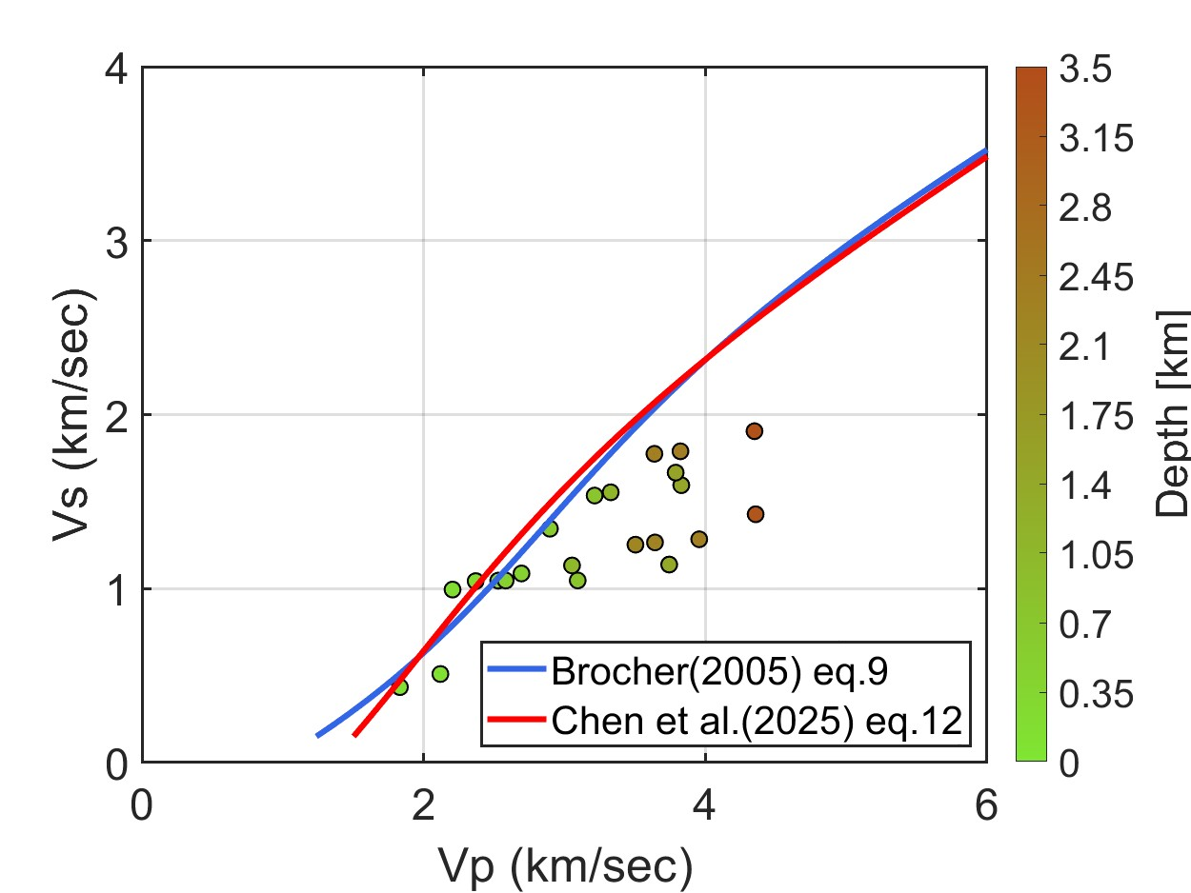
Plot Vp to Vs distribution with empirical Vp/Vs converting formulas.

Slide 40
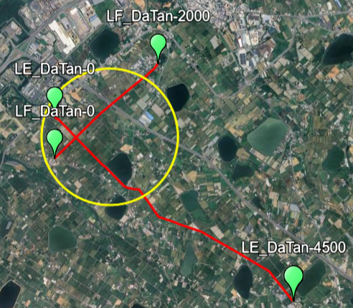
Additional Data Set 2
Study Area: Datan, Taoyuan
Data:
  10 Microtremor Sensors of 3 different radius circles; 1 Site
  2 Seismic Reflection survey lines
Datan Industrial Zone (Google Map Link)
https://maps.app.goo.gl/ypaspS1XWoLBk3Gt8

Slide 41
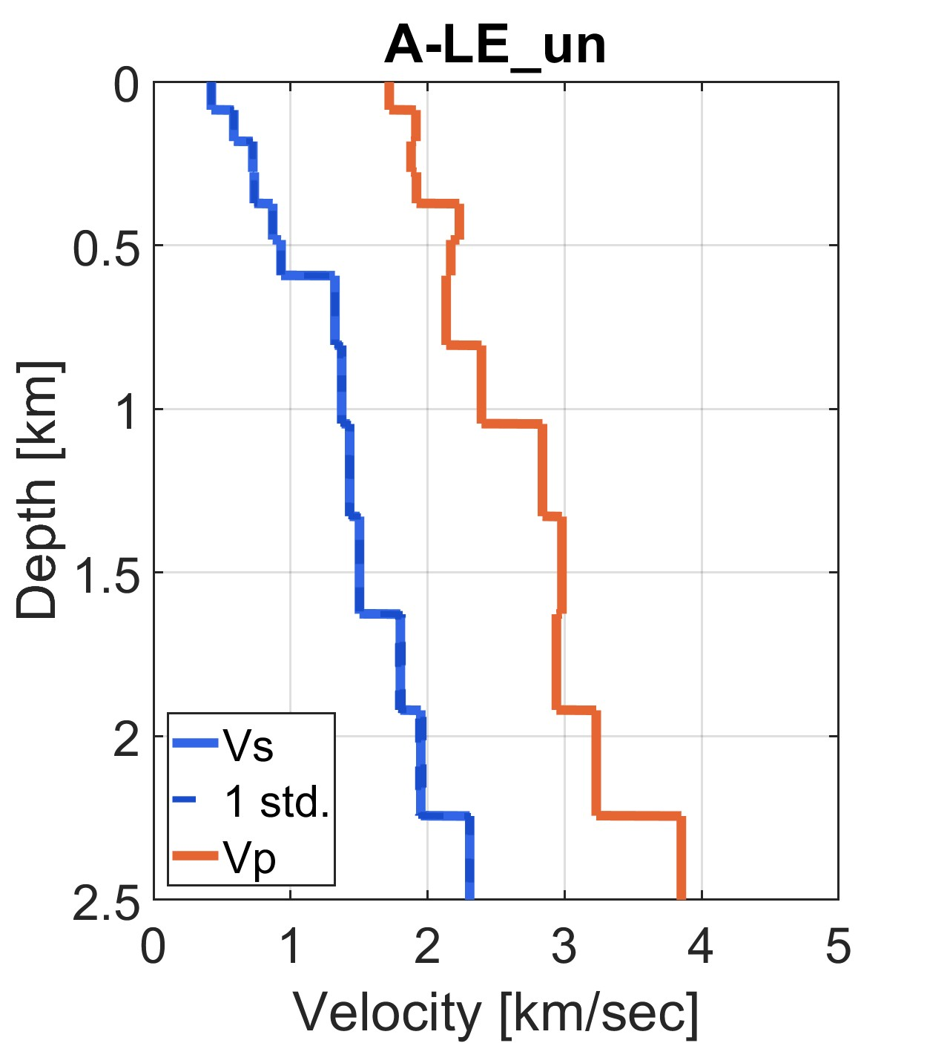
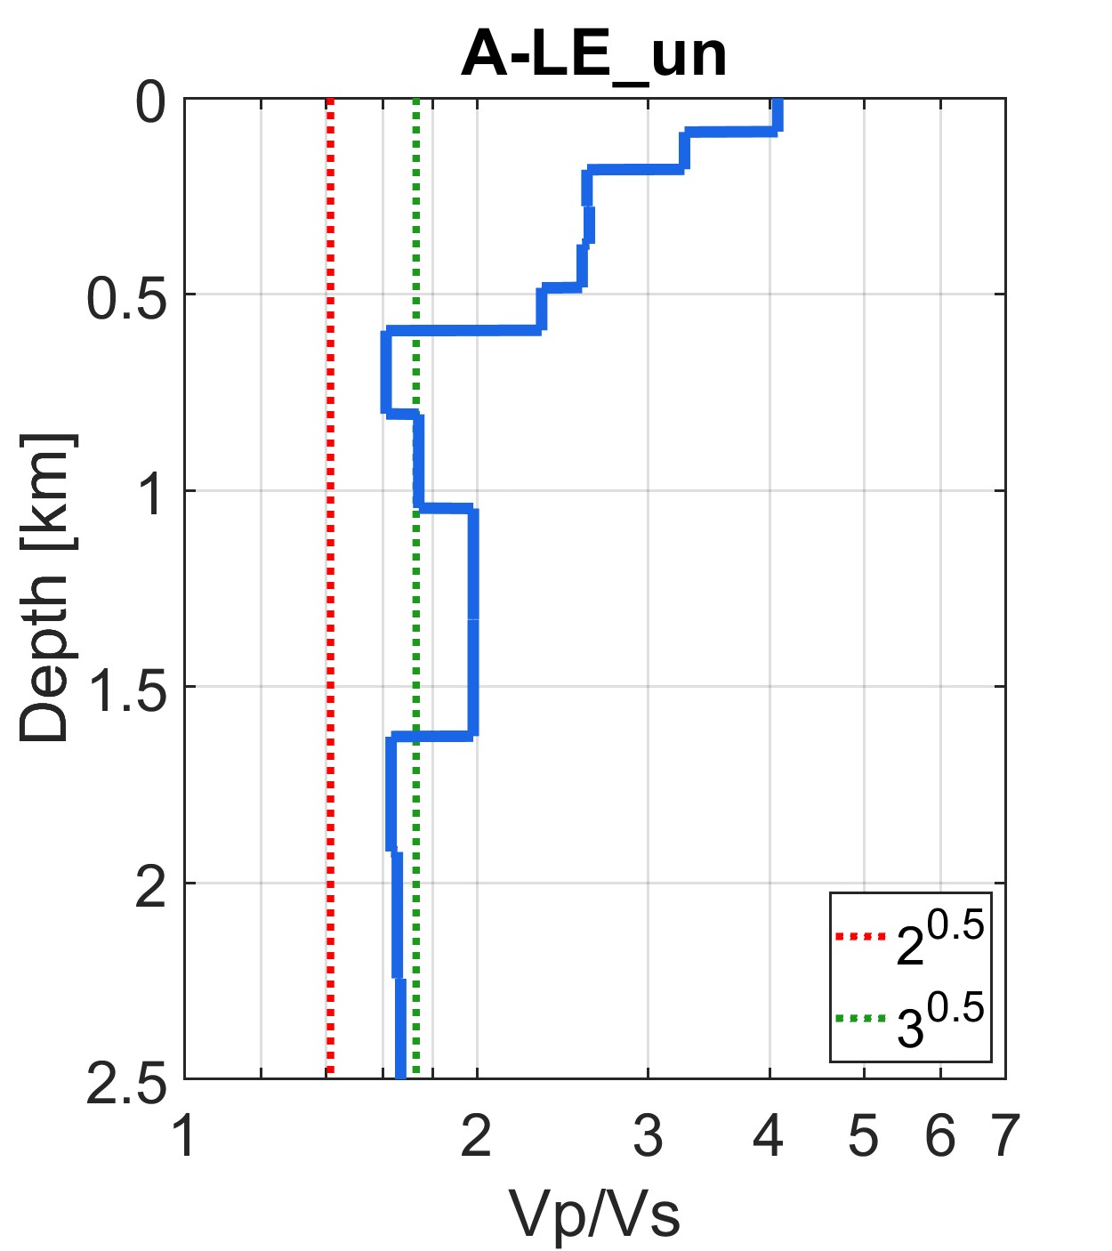
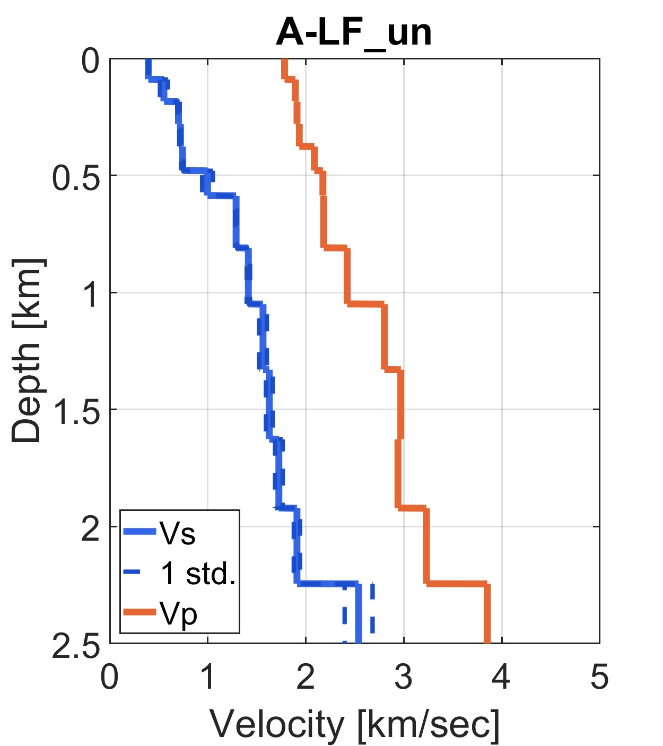
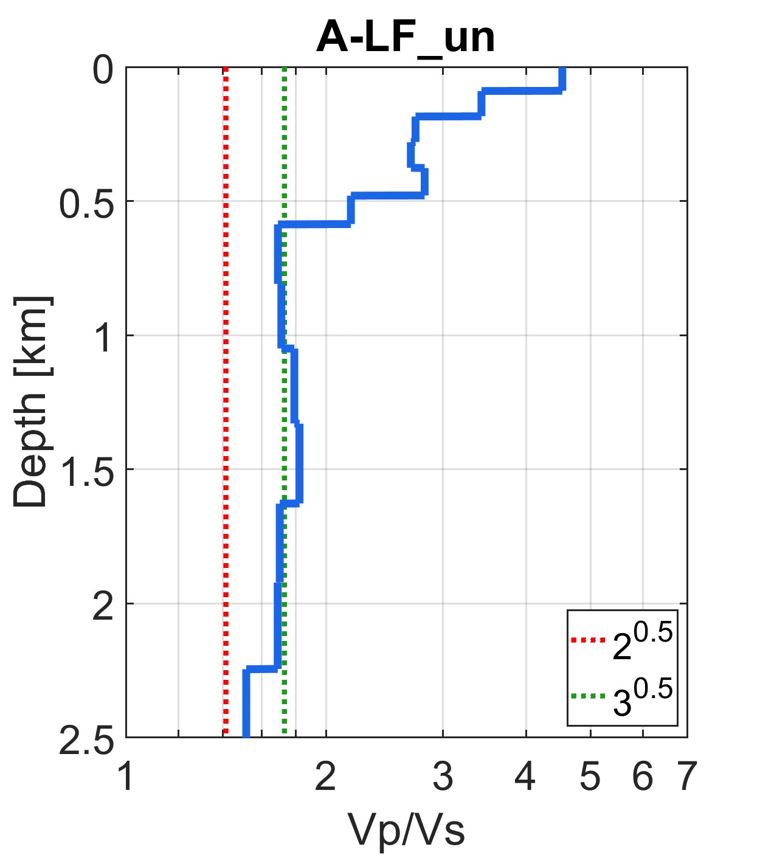

Slide 42
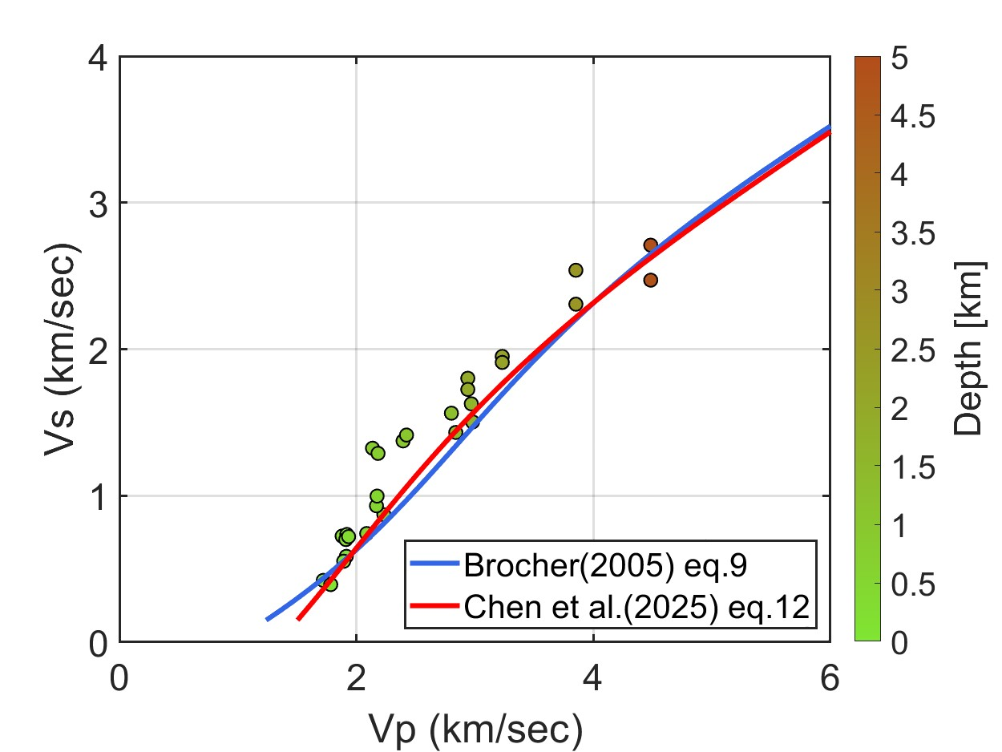
Plot Vp to Vs distribution with empirical Vp/Vs converting formulas.

