Slide 1






EGU 2026 · GENERAL ASSEMBLY · VIENNA — 04 MAY 2026
Assessment of Optical and Near-Infrared Proximal Remote Sensing
for Suspended Sediment Concentration Estimation
under Artificial and Ambient Illumination
Aung Chit Moe ¹˒²˒³˒* · Domenico Miglino ¹ · Ruodan Zhuang ¹ · Khim C. Saddi ¹˒² · Lucrezia Viscido ¹˒²
Monton Methaprayun⁴ · Naw Shareen⁴ · Tanabadee Budrach⁴ · Punpim P. Mapiam⁴
Thom Bogaard³ · Salvatore Manfreda¹˒²
¹ Dept. of Civil, Construction and Environmental Engineering (DICEA), University of Naples Federico II, Italy
² Istituto Universitario di Studi Superiori (IUSS) Pavia, Italy
³ Dept. of Water Management, Delft University of Technology, The Netherlands
⁴ Dept. of Water Resources Engineering, Faculty of Engineering, Kasetsart University, Bangkok, Thailand
* Corresponding author — aungchit.moe@unina.it
PICO Spot 2 · PICO 2.14 · EGU26-16213 · Session HS 1.14

Slide 2
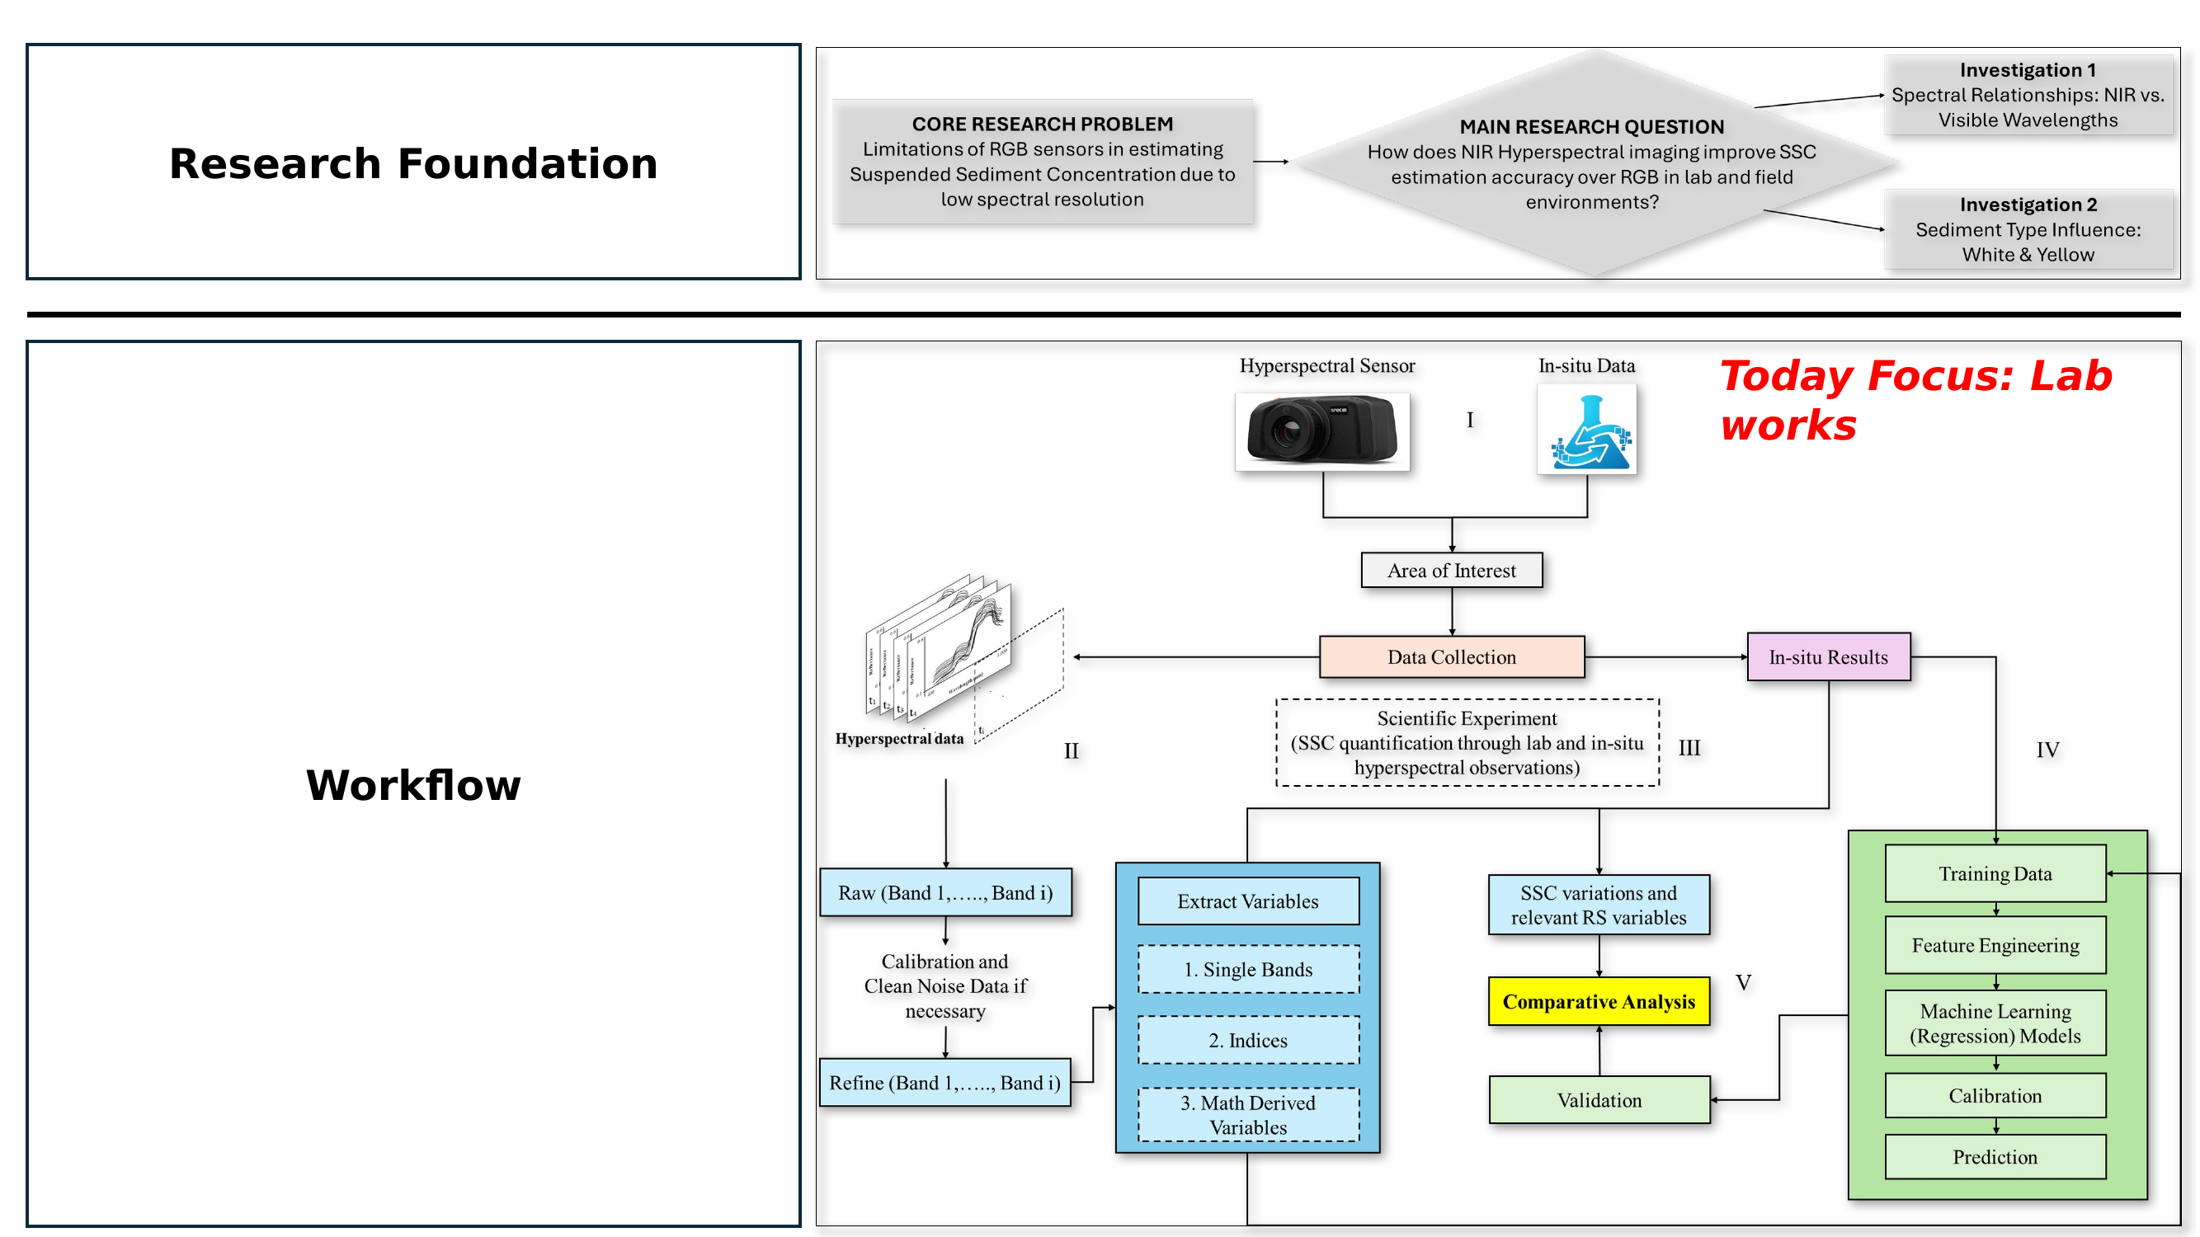
RESEARCH FOUNDATION
Why hyperspectral monitoring? — Workflow at a glance
Today's focus: laboratory campaign — spectral relationships and sediment-type influence.
EGU26 · PICO 2.14 · HS 1.14 · Innovative Technologies and Approaches in Hydrological Monitoring
2 / 14

Slide 3
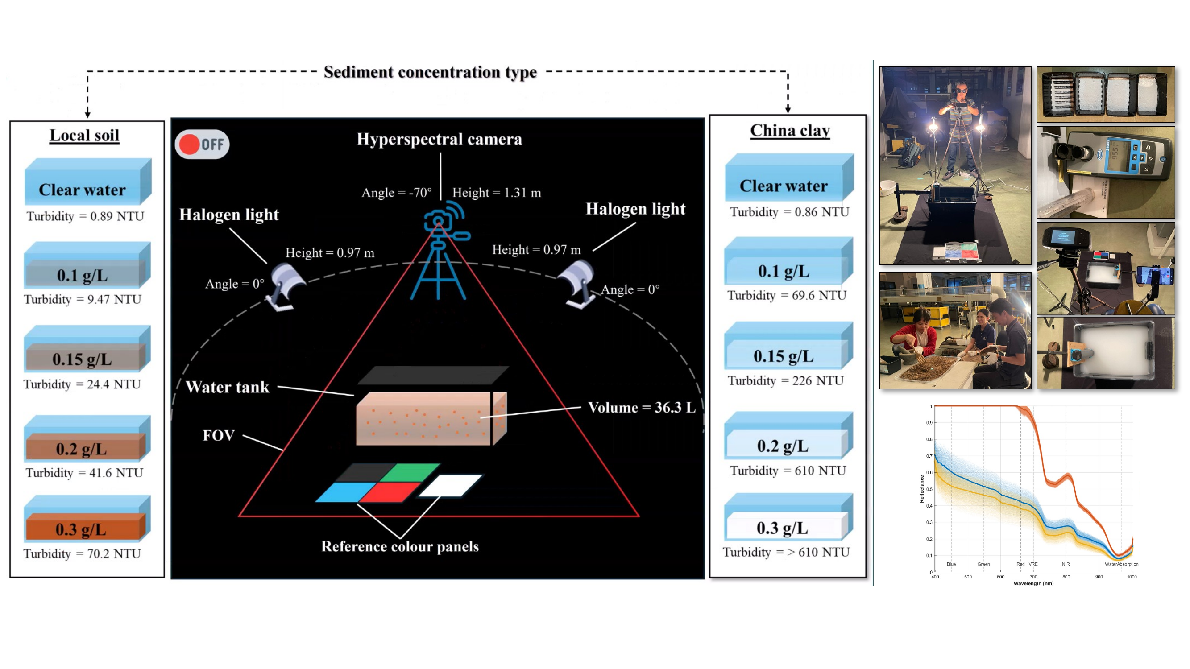
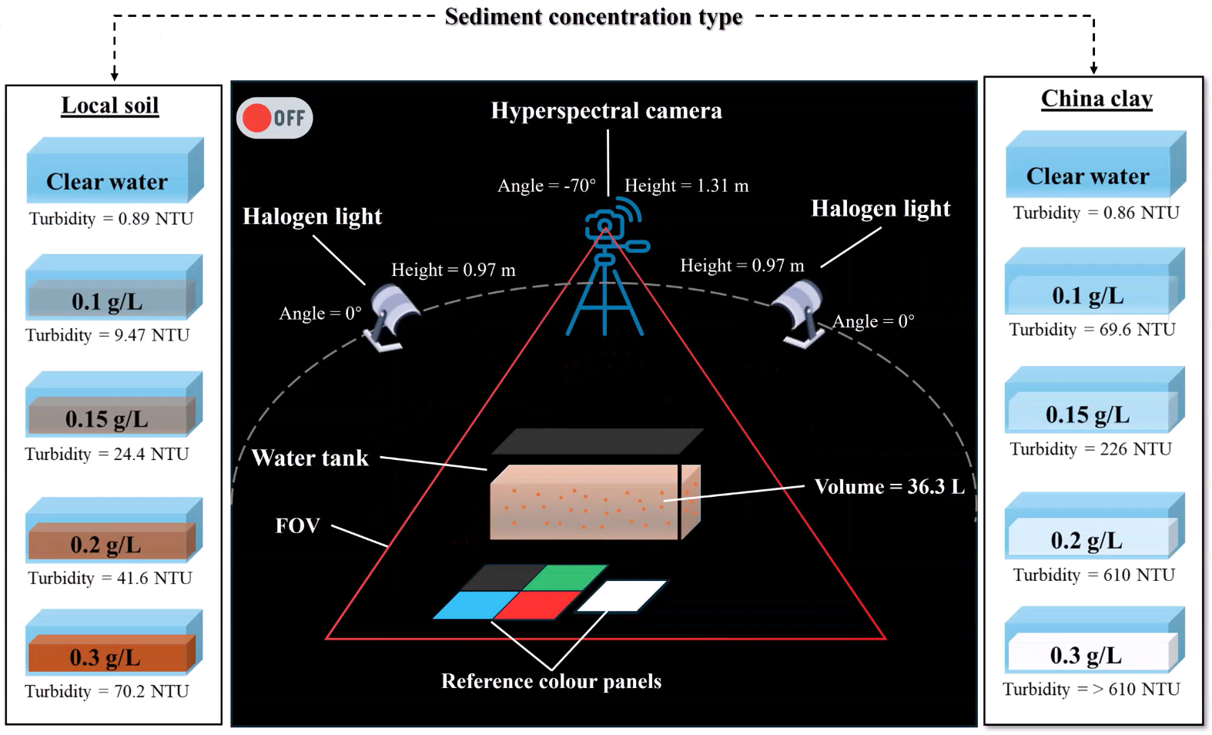
EXPERIMENTAL SETUP
Hyperspectral lab acquisition under controlled illumination
Halogen lights · 5 SSC levels for two sediment types (China clay, Local soil) · reference colour panels.
EGU26 · PICO 2.14 · HS 1.14 · Innovative Technologies and Approaches in Hydrological Monitoring
3 / 14

Slide 4
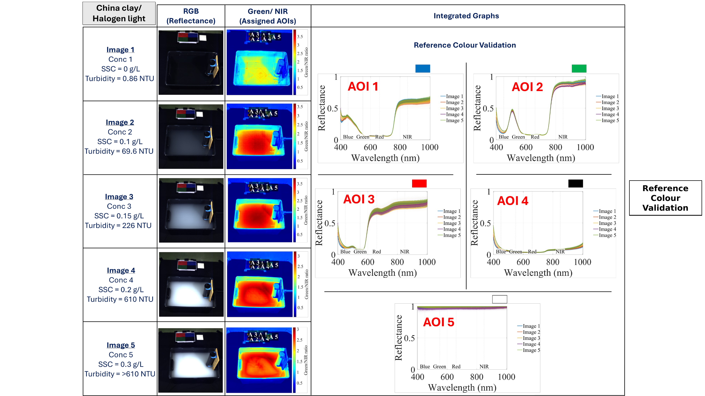
REFERENCE COLOUR VALIDATION
China clay / Halogen light — AOI-wise reflectance check
Stable spectral signatures across reference colour panels confirm radiometric calibration.
EGU26 · PICO 2.14 · HS 1.14 · Innovative Technologies and Approaches in Hydrological Monitoring
4 / 14

Slide 5
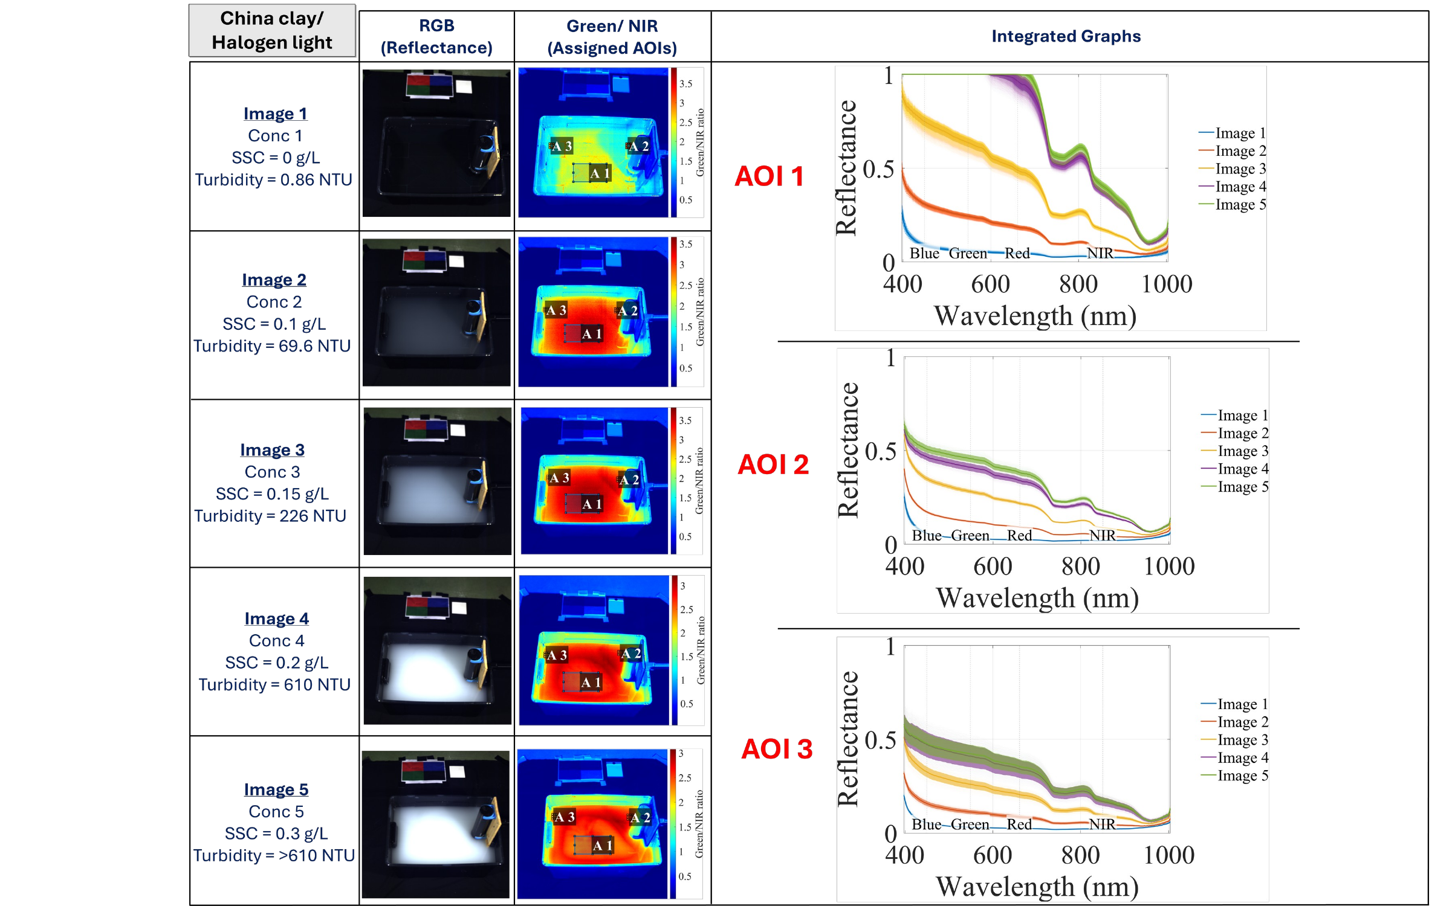

SPECTRAL SIGNATURES
China clay — reflectance per concentration range
Visible plateau and a clear NIR drop-off as concentration grows: a fingerprint of suspended mass.
EGU26 · PICO 2.14 · HS 1.14 · Innovative Technologies and Approaches in Hydrological Monitoring
6 / 14

Slide 6
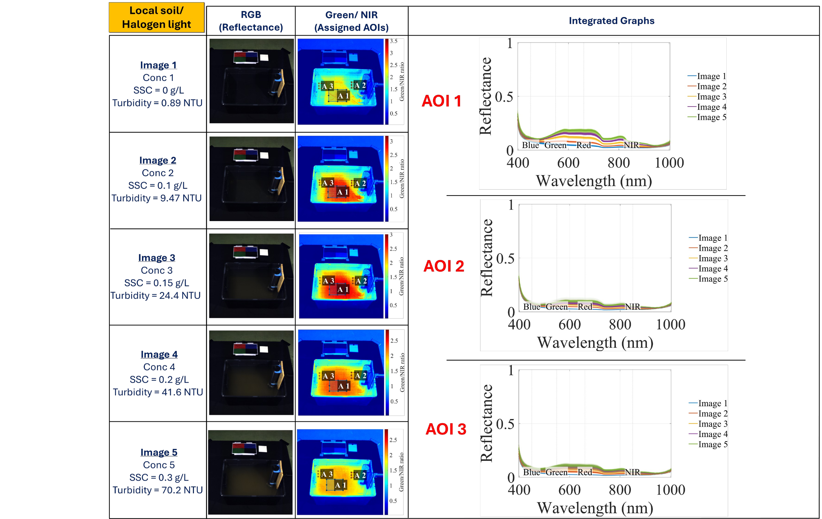
SPECTRAL SIGNATURES
Local soil — reflectance per concentration range
Yellowish sediment shifts the visible response while NIR stays sensitive to particle scattering.
EGU26 · PICO 2.14 · HS 1.14 · Innovative Technologies and Approaches in Hydrological Monitoring
7 / 14

Slide 7
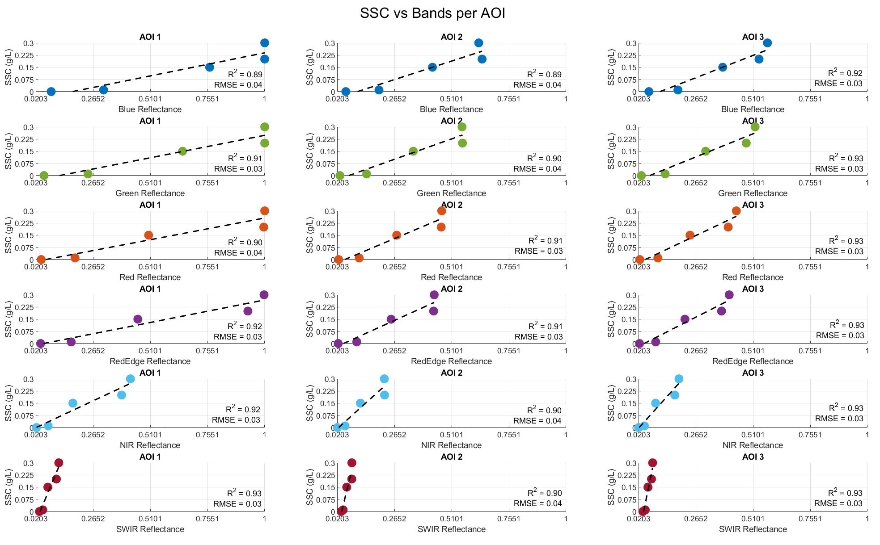

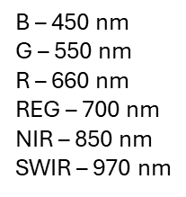
BAND SENSITIVITY · CHINA CLAY
SSC vs. band reflectance for AOI 1–3
B 450 · G 550 · R 660 · REG 700 · NIR 850 · SWIR 970 nm.
EGU26 · PICO 2.14 · HS 1.14 · Innovative Technologies and Approaches in Hydrological Monitoring
8 / 14

Slide 8
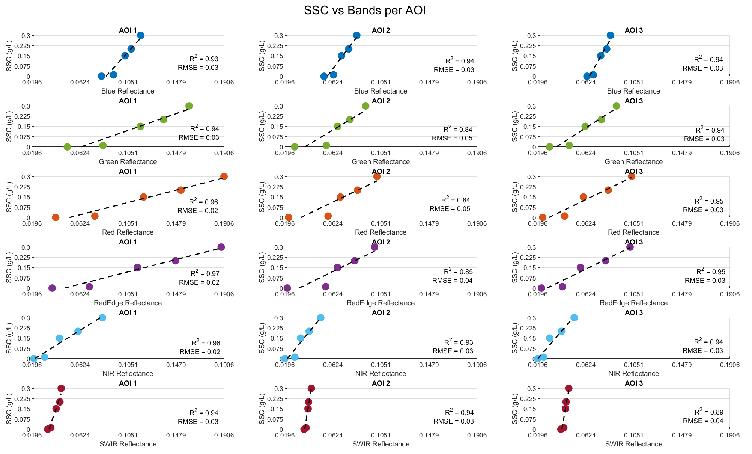

BAND SENSITIVITY · LOCAL SOIL
SSC vs. band reflectance for AOI 1–3
Same six bands; the yellow sediment shifts visible-band slopes noticeably.
EGU26 · PICO 2.14 · HS 1.14 · Innovative Technologies and Approaches in Hydrological Monitoring
10 / 14

Slide 9
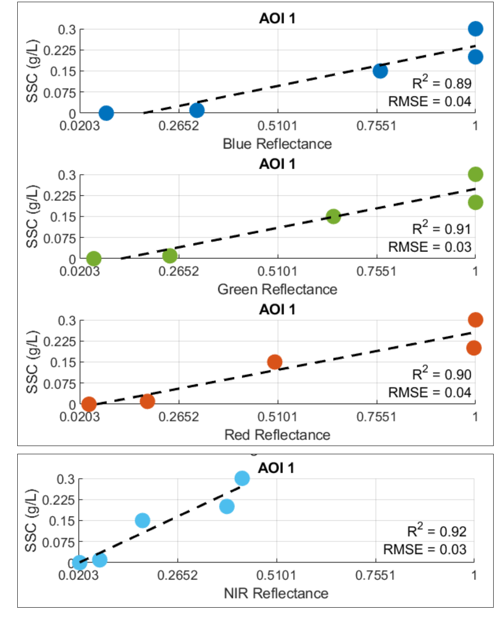
DISCUSSION · 1/2
Why NIR outperforms RGB
Physical sensitivity and linearity above the visible saturation point.
1
Physical vs. visual sensitivity
RGB responds to the visible plume colour, while NIR provides a more direct measure of physical mass concentration — minimising interference from dissolved organic matter and water colour.
2
Linearity at high turbidity
RGB signals tend to saturate at high concentrations. NIR wavelengths penetrate further into turbid water and keep a near-linear response across higher SSC ranges.
AOI 1 — China clay / Halogen light
EGU26 · PICO 2.14 · HS 1.14 · Innovative Technologies and Approaches in Hydrological Monitoring
12 / 14

Slide 10
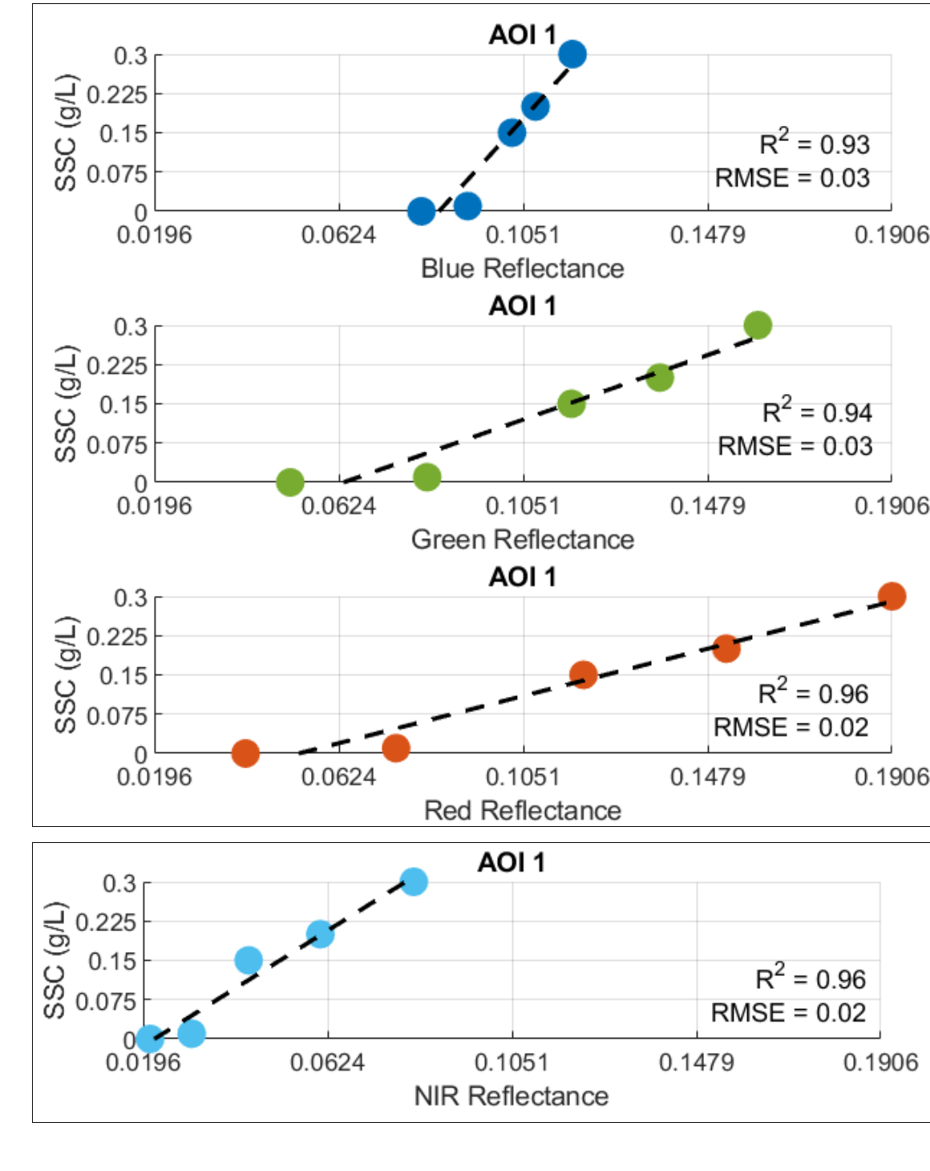
DISCUSSION · 2/2
Why NIR outperforms RGB
Material-specific response across white and yellow sediments.
3
Material-specific response
The "white" sediment (high reflectance) yields higher sensitivity than the "yellow" sediment in the visible spectrum. NIR helps normalise these material differences by focusing on scattering properties rather than visual pigments.
KEY TAKEAWAY
Across both sediment types, NIR (850 nm) delivers the most consistent SSC retrieval — higher R², lower RMSE and no saturation at high turbidity.
AOI 1 — Local soil / Halogen light
EGU26 · PICO 2.14 · HS 1.14 · Innovative Technologies and Approaches in Hydrological Monitoring
13 / 14

Slide 11
CONCLUSIONS & OUTLOOK
Future of proximal SSC remote sensing
Three directions where hyperspectral, AI and sensor fusion converge.
ML
AI
S+A
Intelligent sediment fingerprinting
Edge-AI snapshot sensors
Spectral × acoustic fusion
Machine-learning identification of sediment mineralogy (e.g. white vs. yellow) from spectral signatures — enabling automatic selection of the most sensitive NIR calibration curve.
Shifting from post-processing to on-board analytics. New snapshot hyperspectral cameras can map SSC in real time during field deployments.
Combining NIR reflectance with acoustic backscatter to de-couple the influence of particle size and sediment colour from the total concentration signal.
Thank you for your attention — questions welcome at PICO 2.14
EGU26 · PICO 2.14 · HS 1.14 · Innovative Technologies and Approaches in Hydrological Monitoring
14 / 14

