Slide 1




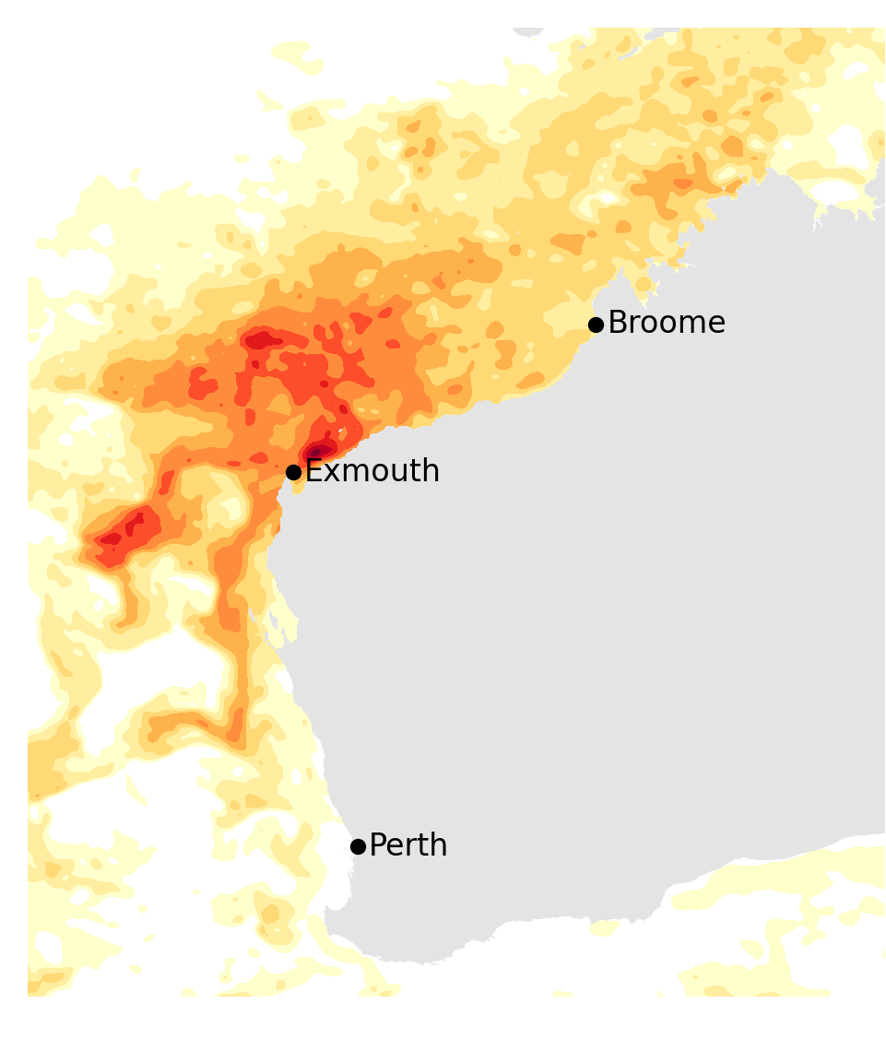
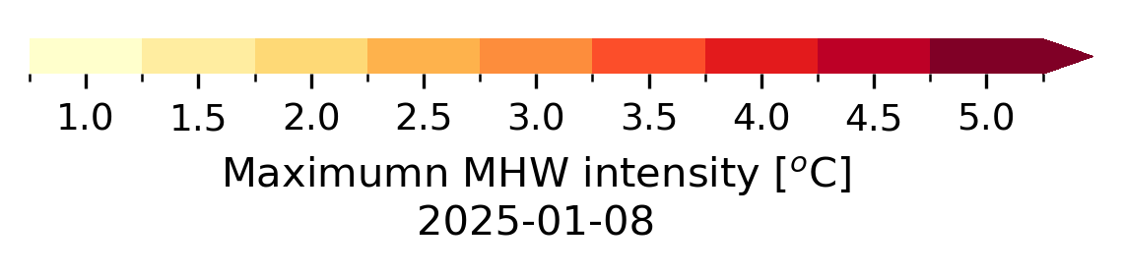
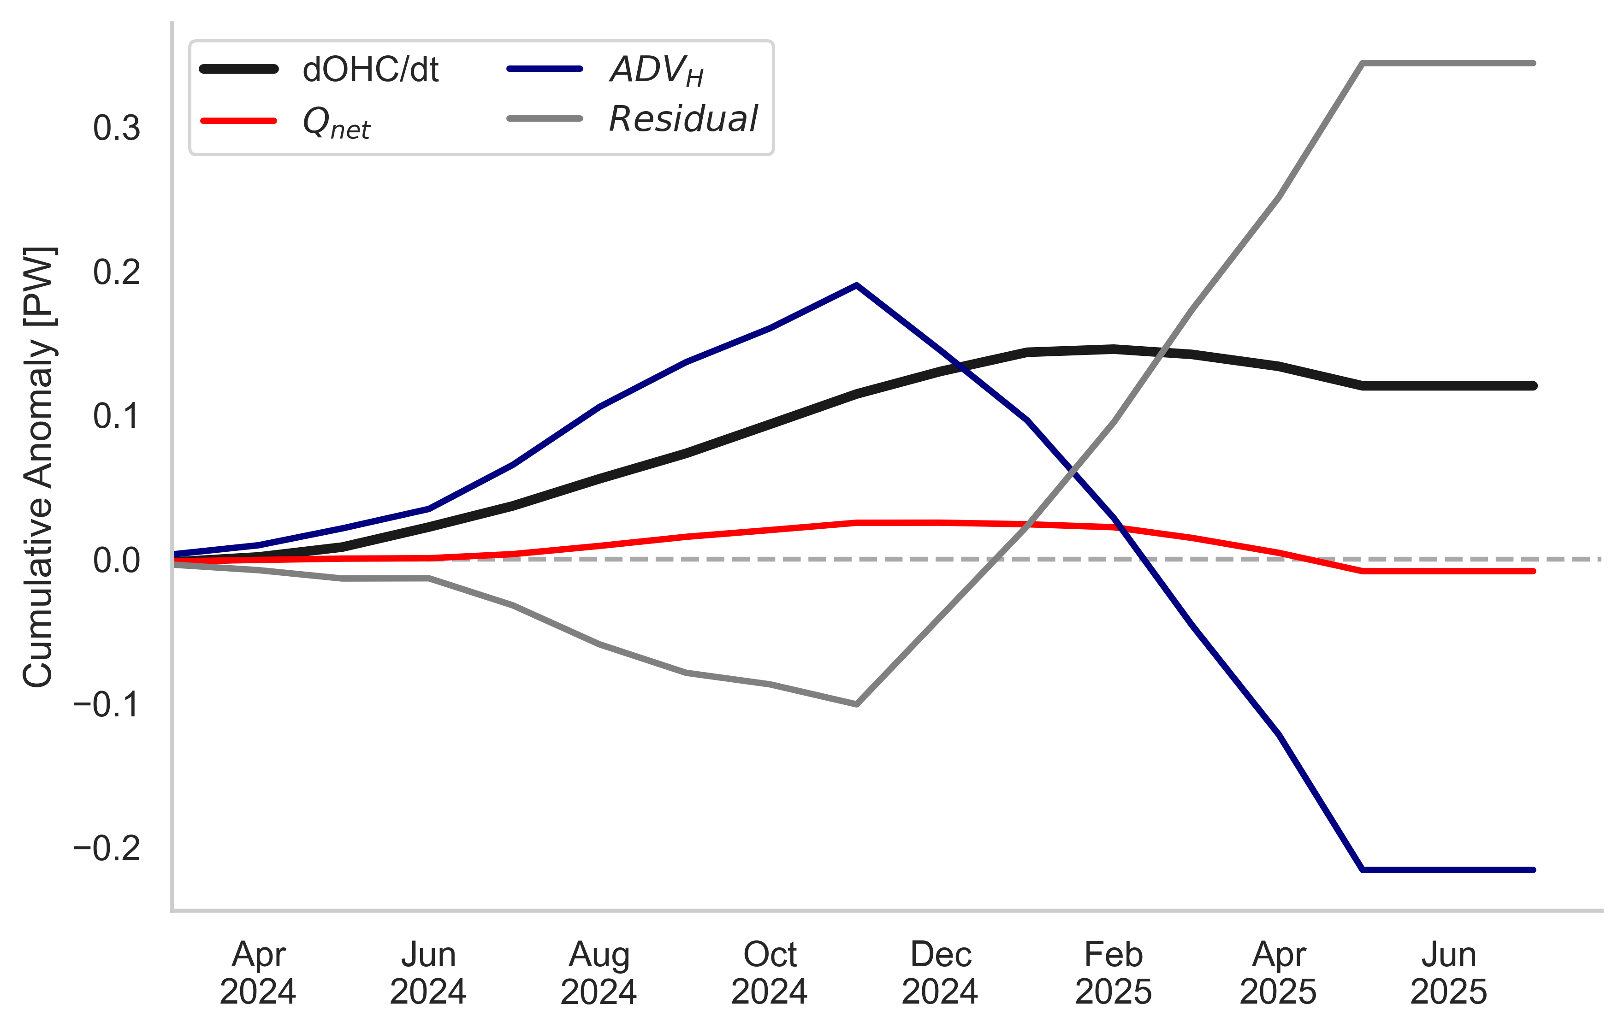
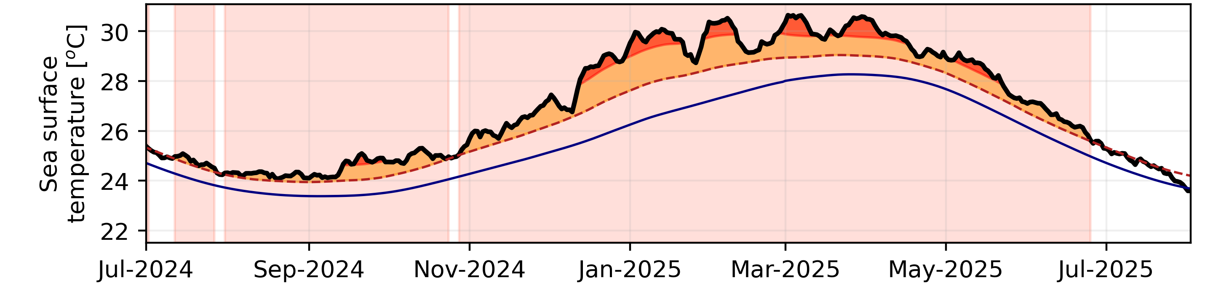
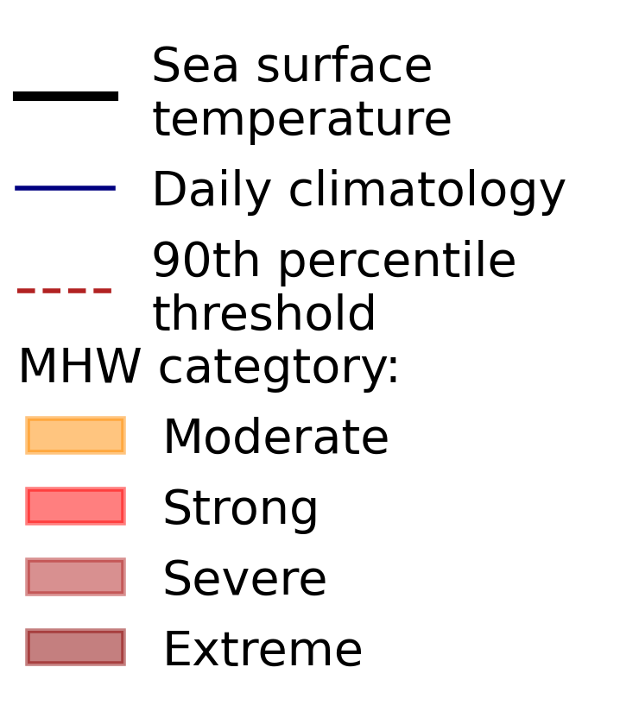

Sina Pinter ¹, PhD Candidate in Ocean Dynamics, The University of Western Australia
sina.pinter@research.uwa.edu.au
Supervisors: Nicole Jones ¹, Matt Rayson ¹, Mike Cuttler ¹, Ming Feng ²
¹ School of Earth and Oceans, and the Oceans Institute, The University of Western Australia, Perth, Australia
² CSIRO, Perth, Australia
WHAT PHYSICAL PROCESSES DROVE THE 2024/25 MARINE HEATWVAE OFF WESTERN AUSTRALIA?
Thermocline Deepening
Leads to increased subsurface heat along WA coast
Subsurface Heat Pile-Up
Down to 200m, due to Horizontal Advection
Sea Surface Temperature Rise
Due to atmospheric forcing
Weak La Niña
Provides background climate state
Local Weakened Winds
Reduce evaporative cooling
Suppressed Upwelling
Limit entrainment of cooler water
Kelvin Wave Propagation
Due to wind anomalies in western tropical Pacific
Anomalous Warm Water Inflow
Via Indonesian Throughflow
Intense, long-lasting, deep-reaching MHW
MHW lasted over 9 month
Maximum intensity over 4.5°C
Mean intensity around 2.2 °C
Over 1500 km of coastline were impacted
The MHW devastated the Ningaloo region, causing widespread coral bleaching and mortality, fish kills, algal blooms, and significant economic damage
METHOD 1: OCEAN HEAT BUDGET
$$\frac{dOHC}{dt} =Adv+Qnet+Residuals$$
Represent unresolved processes
FIGURES
Change of total thermal energy stored in upper ocean (monthly GLORYS)
Net air–sea heat exchange (short- and longwave radiation, latent and sensible heat flux, monthly ERA5)
Heat transport through region boundaries (north, south, east, west, monthly GLORYS)
Heat budget computed over upper 200 m of ocean in NWS region (114–120°E, 14–20°S, red box)
All terms computed as anomalies relative to 1993–2022 monthly climatology
Compared to regional wind stress
MHW 2024/2025
METHOD 2: KELVIN WAVE ANALYSIS
200 m isobath
NWSBRW
Analyse filtered SSH anomalies along the 200 m isobath (satellite data) to identify Kelvin wave propagation
Validate Kelvin wave signal using mooring observations via depth of the 20°C isotherm (thermocline response)
NWSROW
Figure 2: Heat budget analysis cumulative anomalies from 1. March 2024 onwards
Figure 1: Time series of MHW evolution following Hobday et al. (2016) definition, based on SST averaged over the red box region off Exmouth

Slide 2
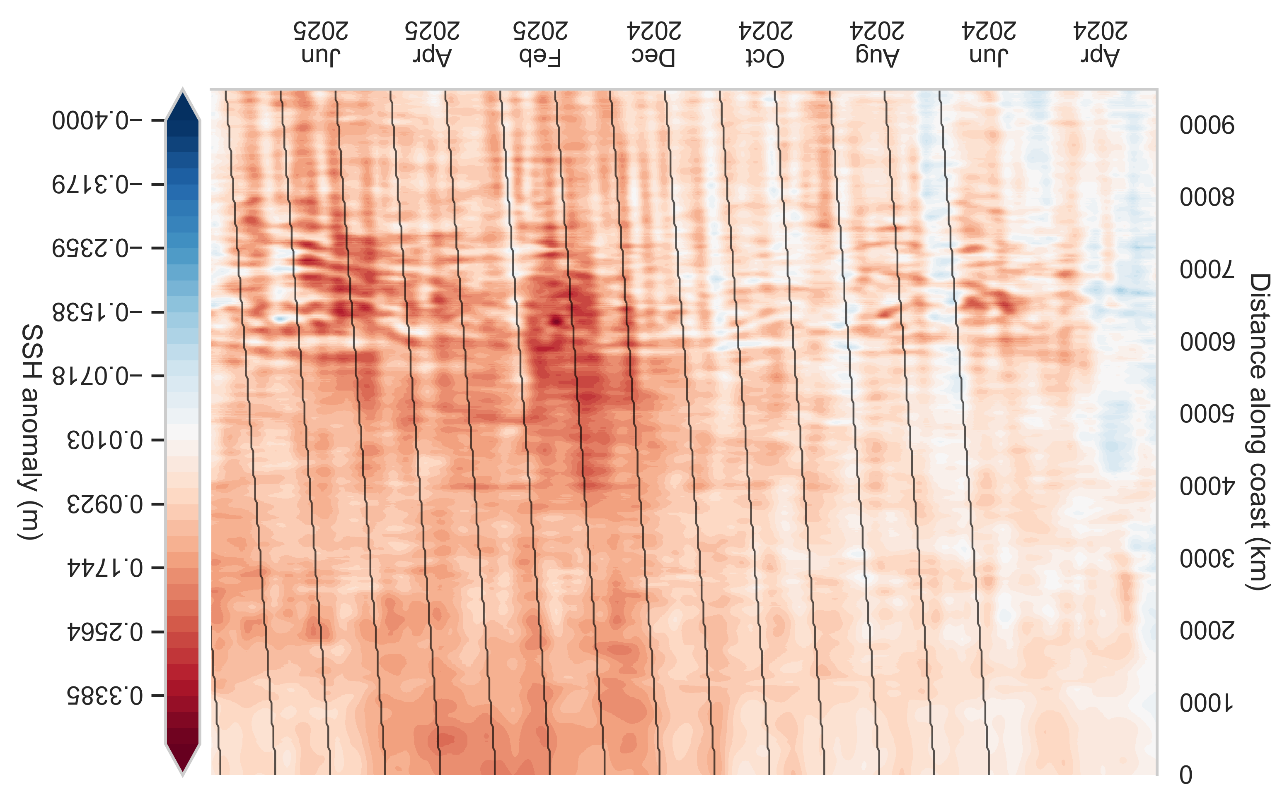
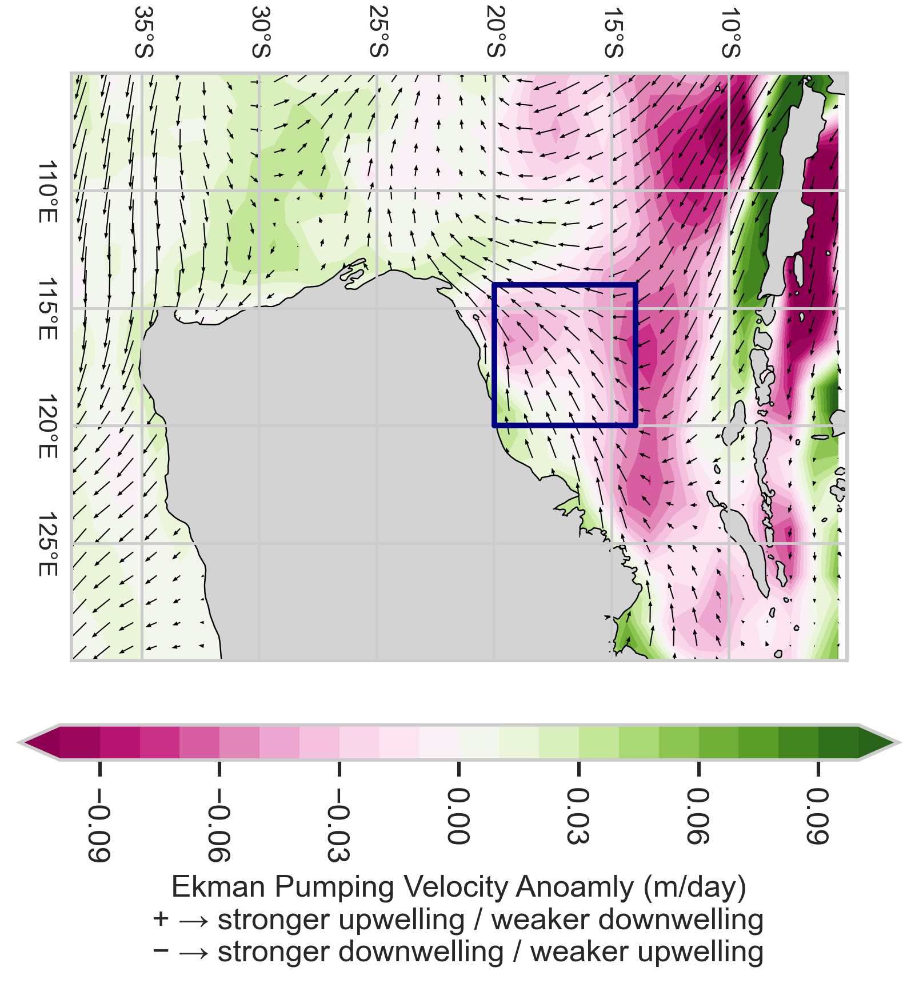
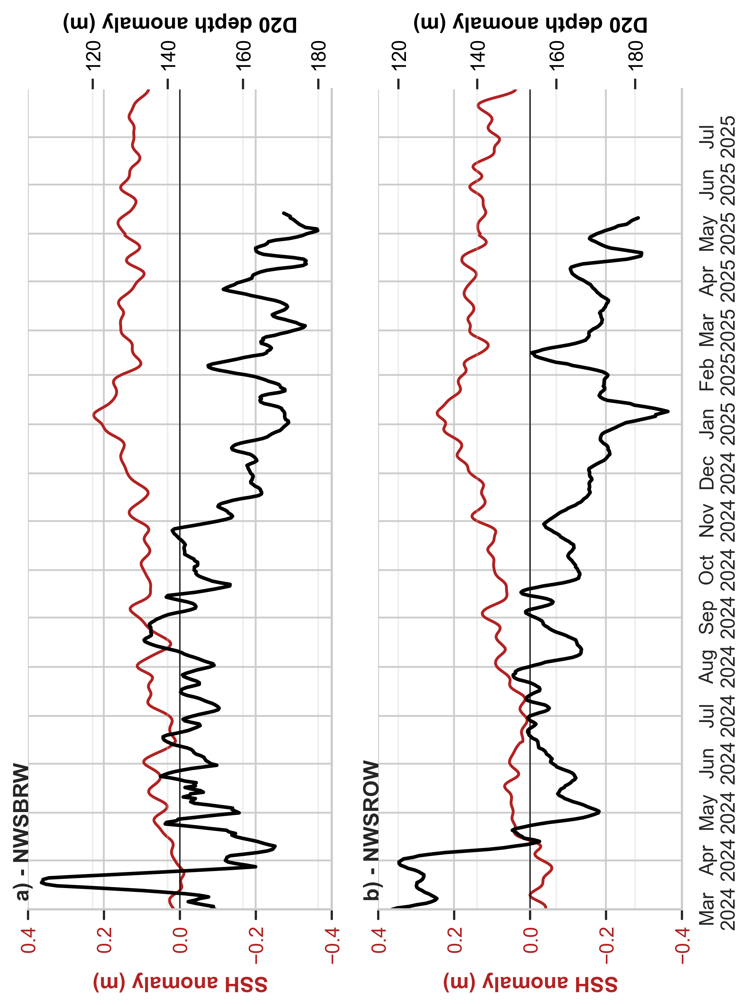
Figure 4: Kelvin Waves along the 200 m Isobath from 1 March 2024 to 1 July 2025
The full dataset spans 6 years.
Figure 3: Wind stress anomaly during October 2024 to April 2025
The full dataset spans 6 years.
Figure 5: Kelvin Wave SSH anomaly vs Mooring Isotherms from 1 March 2024 to 1 July 2025
Figure 2: Heat budget analysis cumulative anomalies from 1. March 2024 onwards

