Slide 1



Vienna, Austria & Online | 3–8 May 2026
STREAMFLOW FORECASTING USING GENETIC PROGRAMMING, LSTM, AND HYBRID META-LEARNING GP-LSTM MODEL IN MONSOON-DOMINATED BASINS
Presented By - Digvijay Singh & Prof. V Jothiprakash
        Department of Civil Engineering
        Indian Institute of Technology Bombay
Fri, 08 May, 15:25–15:35 (CEST) Room 3.16/17

Slide 2
INTRODUCTION
Complex river systems exhibits extreme seasonality
skewness 6–18 across stations, occasional >20,000 m³/s events
Short-lead daily prediction
critical for flood early warning and reservoir dispatch
physical models / deep learning models
require extensive parameter sets / lacks interpretability
Hyperparameter tuning
computationally expensive
Can GP-evolved symbolic rules be used for hyperparameter optimization and bring interpretability for best hyperparameter choices?

Slide 3
OBJECTIVE
Objective 1 - Interpretability: black-box HP search offers no insight into which regime characteristics drive architectural choices
Objective 2 - Extreme events: outlier removal improves routine prediction but degrades flood-peak simulation - both regimes matter
Opportunity - Statistical features (entropy, Hurst, spectral, flood frequency) can characterize hydrological regime richly

Slide 4
LITERATURE REVIEW
BiLSTM Hydrology - Kratzert et al. (2018, 2019): Regional LSTM, CAMELS Benchmarks
Symbolic Regression - Koza (1994); Babovic & Keijzer (2000): GP for Rating Curves and Rainfall-Runoff
Meta-Learning - Hospedales et al. (2021): Learning-to-learn; HP Adaptation Across Tasks
FNN Embedding - Kennel et al. (1992): False Nearest Neighbours for Lag Selection
CAMELS-India - Mangukiya et al. (2023): 241 Catchments, Standardised Attributes for Indian Basins
Gap: No prior work maps hydrological regime statistics to Bi-LSTM HPs via symbolic GP at multi-station Indian basin scale

Slide 5
METHODOLOGY
Lag Sequences
$Q_{t−1}$ $Q_{t−2}Q_{t−n}$
𝑸_(𝒕−𝟏) 𝑸_(𝒕−𝟐) 𝑸_(𝒕−𝒏)
GP evaluation
MAE + parsimony
Model 2
Hyperparameter Space
Model 1
GP Population
n=250 prefix trees
Crossover
Mutation
Equation
`50 Generation
Note - Tournament k=5,Ramped Half and Half, crossover p=0.70, mutation p=0.20, elitism n=5,
Hidden layer, Batch size, Learning Rate, Dropout Rate…
Optuna TPE
10 Trials
30 Epoch
Bi-LSTM Training
early stop on validation NSE
Phase-2 retrain
train+val, best epoch
Predict on Test Set
Note - Bidirectional LSTM · hidden 32–256, layers 1–3, softplus output, Adam optimizer
Model 3
Training data
1980 – 2005
Sliding windows
365d window, 90d step
32 Statistical features
ACF, Hurst, entropy…
Optuna per window
10 trials - best HP label
Meta-GP rules
GP learns f(x1…x32)-->HP
Predict HP
last training window
Final BiLSTM
meta-predicted HP
Test prediction
NSE KGE R² RMSE P-Bias
Note - 5 HP targets - hidden size, num layers , dropout , log10 lr, batch size
Data preprocessing FNN three model branches evaluation
Camel India Dataset
(1980-2018)
Outlier Removal
(Z score -|z| > 3.5)
FNN Sequence Length Selection
Adaptive
Model 1 – GP Standalone (Symbolic Regressor)
Performance metrices
NSE , KGE , R² , RMSE, P-Bias
Models Testing
Model 2 - Optuna – Bi-LSTM (TPE Hyper parameter tuning)
Model 3 - GP – Meta Bi-LSTM (Meta – Learning)

Slide 6
STATISTICAL FEATURES
Central tendency- Baseline level and typical magnitude of flow.
Mean - Average daily flow
Median - Robust central value
Mode bin - Most frequent flow class
Trimmed mean - Mean excluding 5% tails
Autocorrelation - Temporal memory structure of the series.
ACF 1-6 - Autocorrelation at lags 1 to 6 days
PACF 1–2 - Partial autocorrelation, removes indirect effects
Spectral - Frequency content of the flow signal.
Dominant freq - Peak frequency from Welch Power Spectral Density Spectral entropy - Spread of energy across frequencies
Power low - Fraction of energy in low frequencies
Power high - Fraction of energy in high frequencies
Complexity - Nonlinear and long-range properties.
Sample entropy - Irregularity of the series
Hurst exponent - Long-range dependence (>0.5 = persistent)
Trend slope - Normalised linear trend over window
Approx. entropy - Predictability estimate
Dispersion - Spread and variability of flow.
Std - Standard deviation
CV - Coefficient of variation
IQR - Interquartile range
Range - Maximum − Minimum
MAD - Median absolute deviation
Hydrological signatures - Physically meaningful catchment behaviour descriptors.
Flood freq (>p90) - Fraction of days exceeding 90th percentile
Baseflow index - Sustained low-flow fraction of total volume
Rising limb ratio - Fraction of days with increasing flow
Shape - Asymmetry and tail behaviour
Skewness - Asymmetry of distribution
Kurtosis - Heaviness of tails
Q10 - 10th percentile (low flow)
Q90 - 90th percentile (high flow)

Slide 7
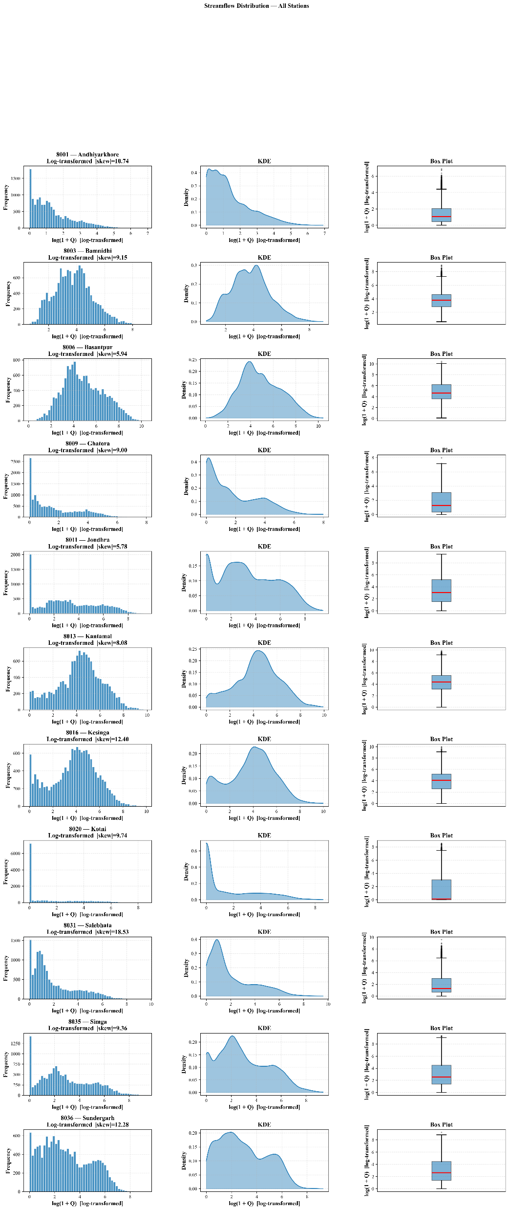
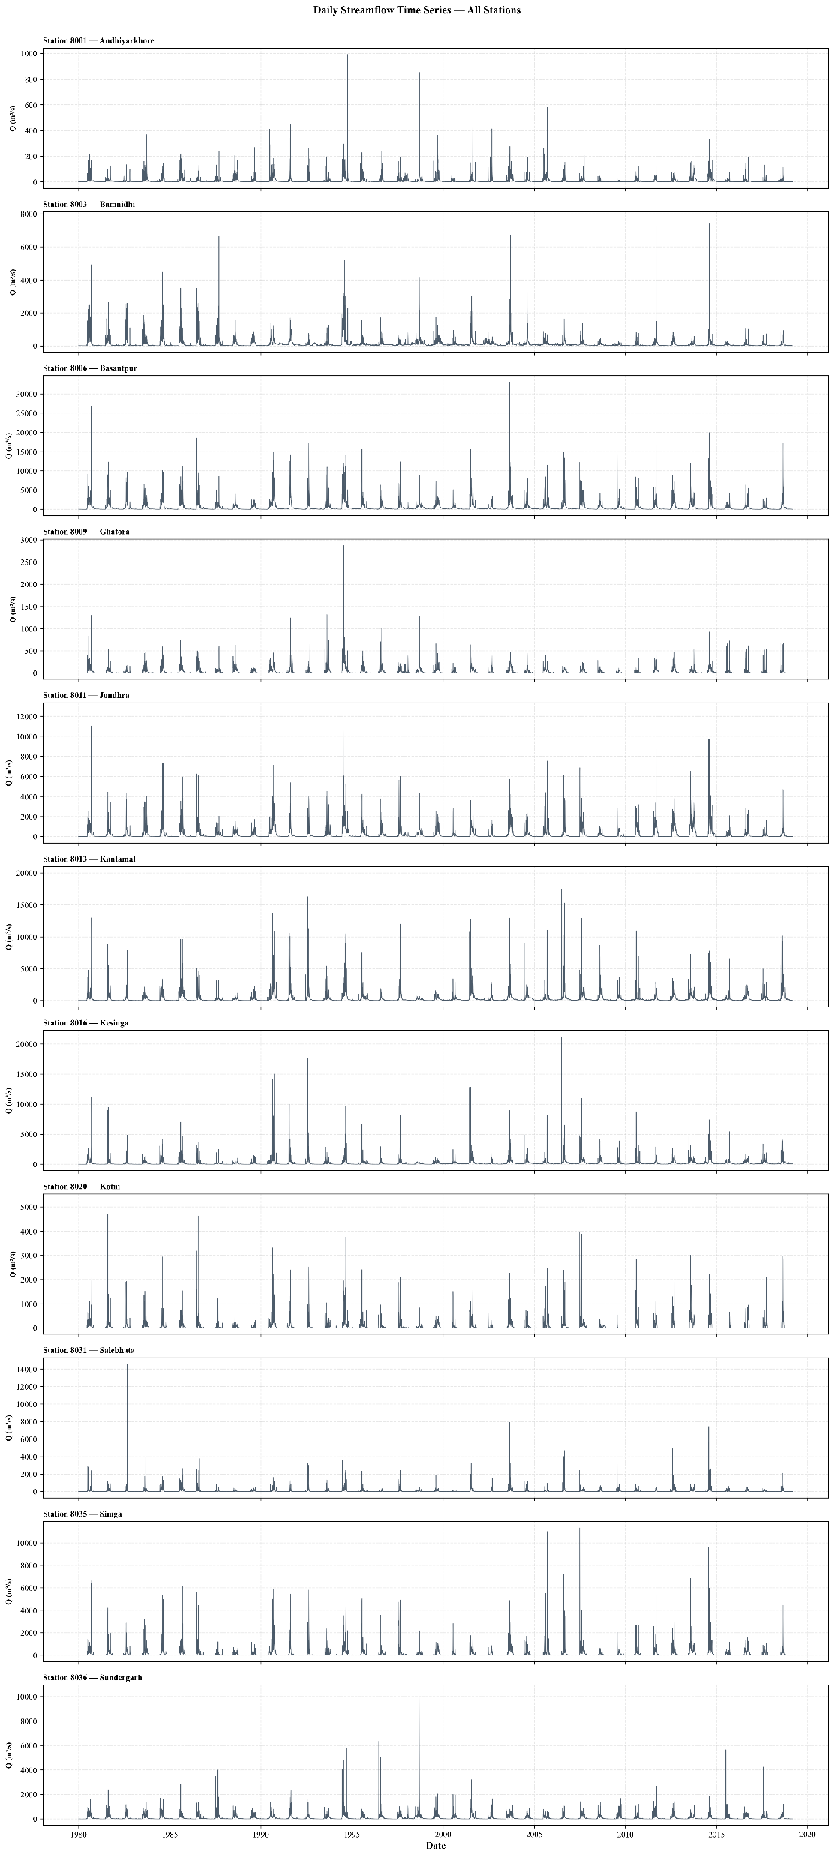
SEQUENCE LENGTH SELECTION: FALSE NEAREST NEIGHBORS
ID | Station(Mahanadi Basin) | Sequence length | Skewness
8001 | Andhiyarkhore | 10 | 10.72
8003 | Bamnidhi | 7 | 9.13
8006 | Basantpur | 7 | 5.92
8009 | Ghatora | 8 | 8.98
8011 | Jondhra | 7 | 5.77
8013 | Kantamal | 7 | 8.06
8016 | Kesinga | 8 | 12.38
8020 | Kotni | 6 | 9.72
8031 | Salebhata | 15 | 18.49
8035 | Simga | 8 | 9.34
8036 | Sundergarh | 9 | 12.26

Slide 8
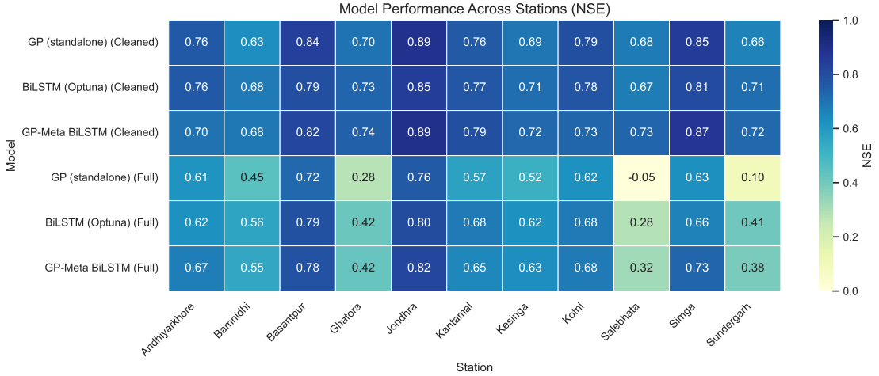
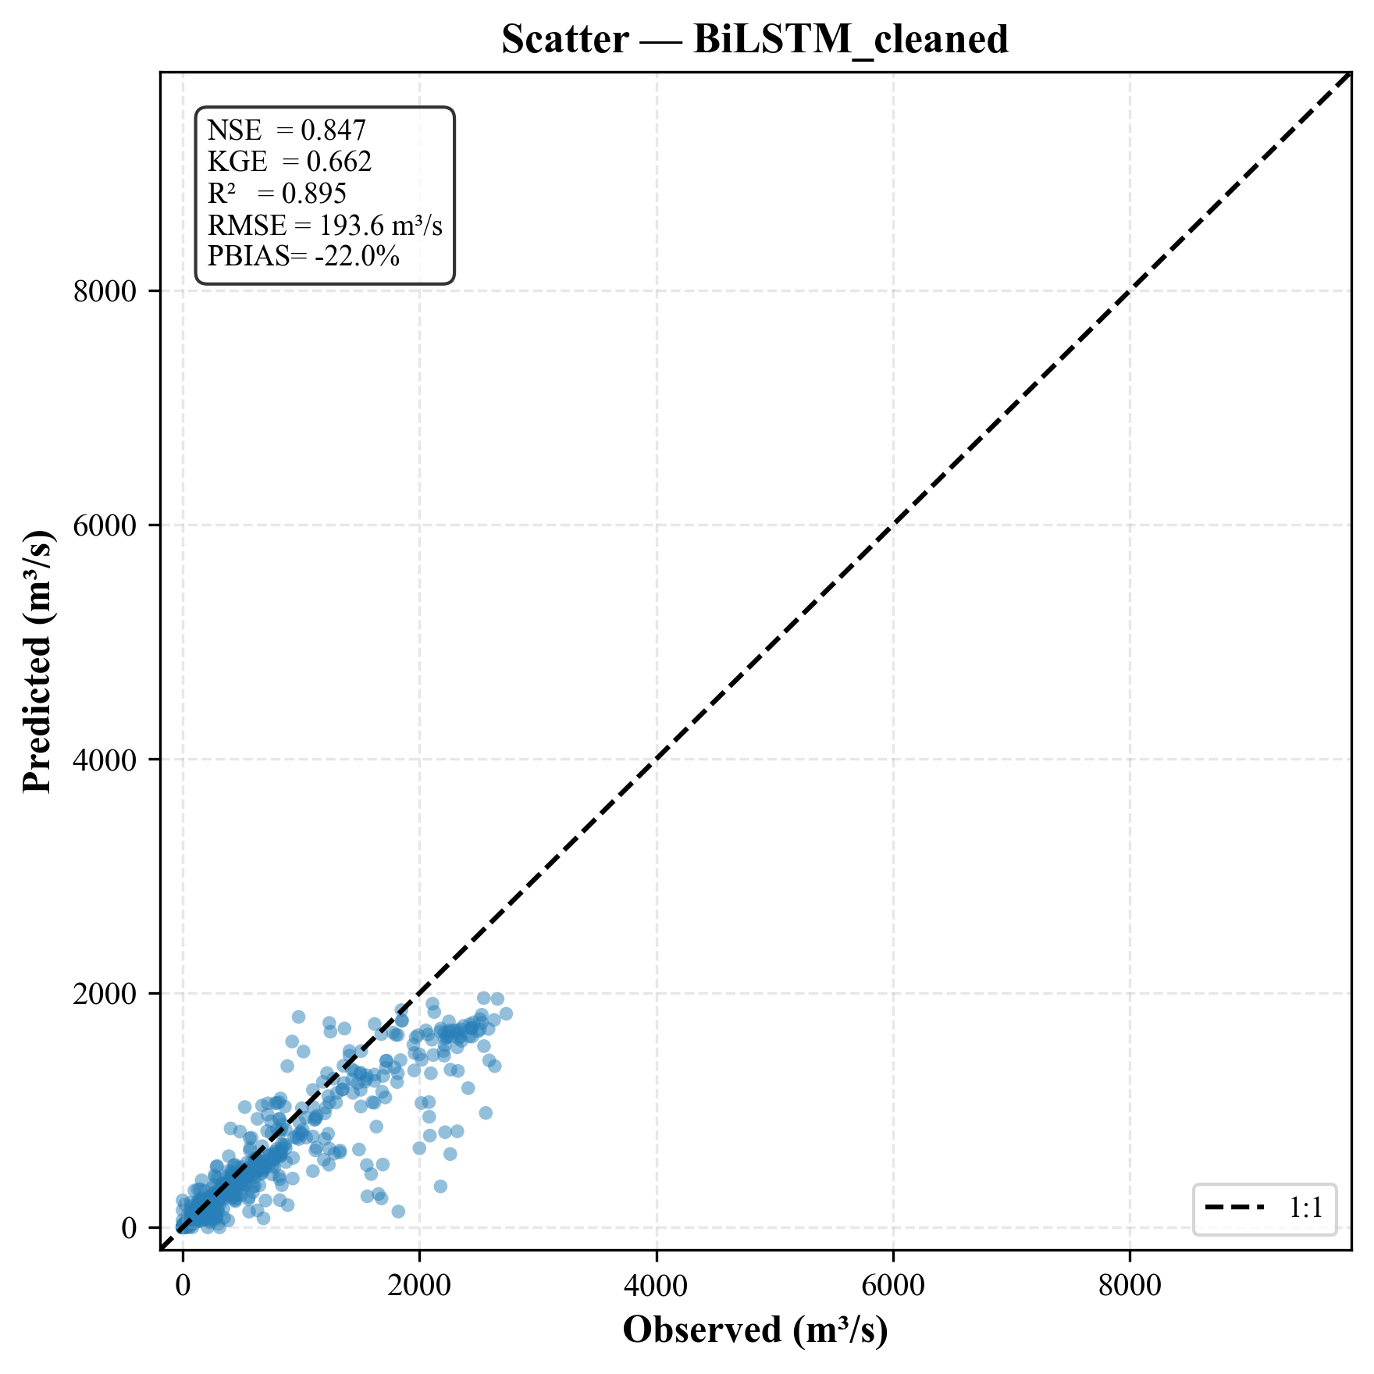
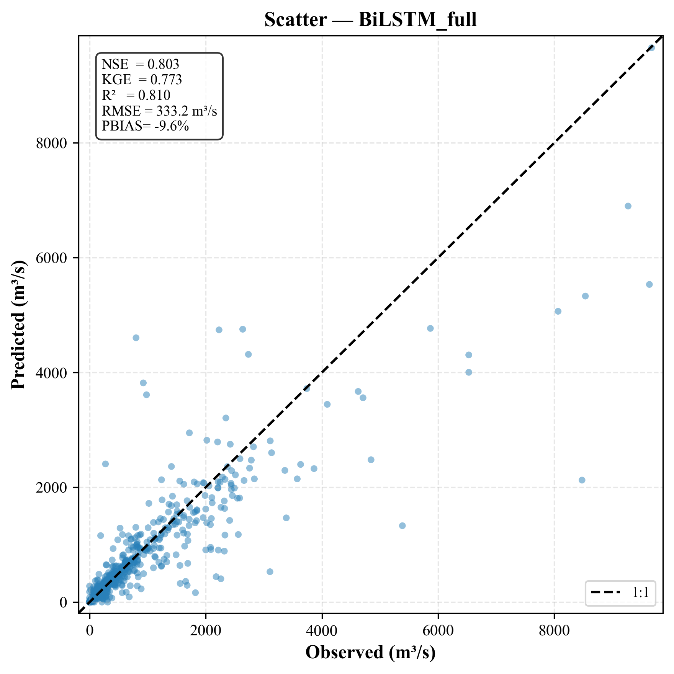
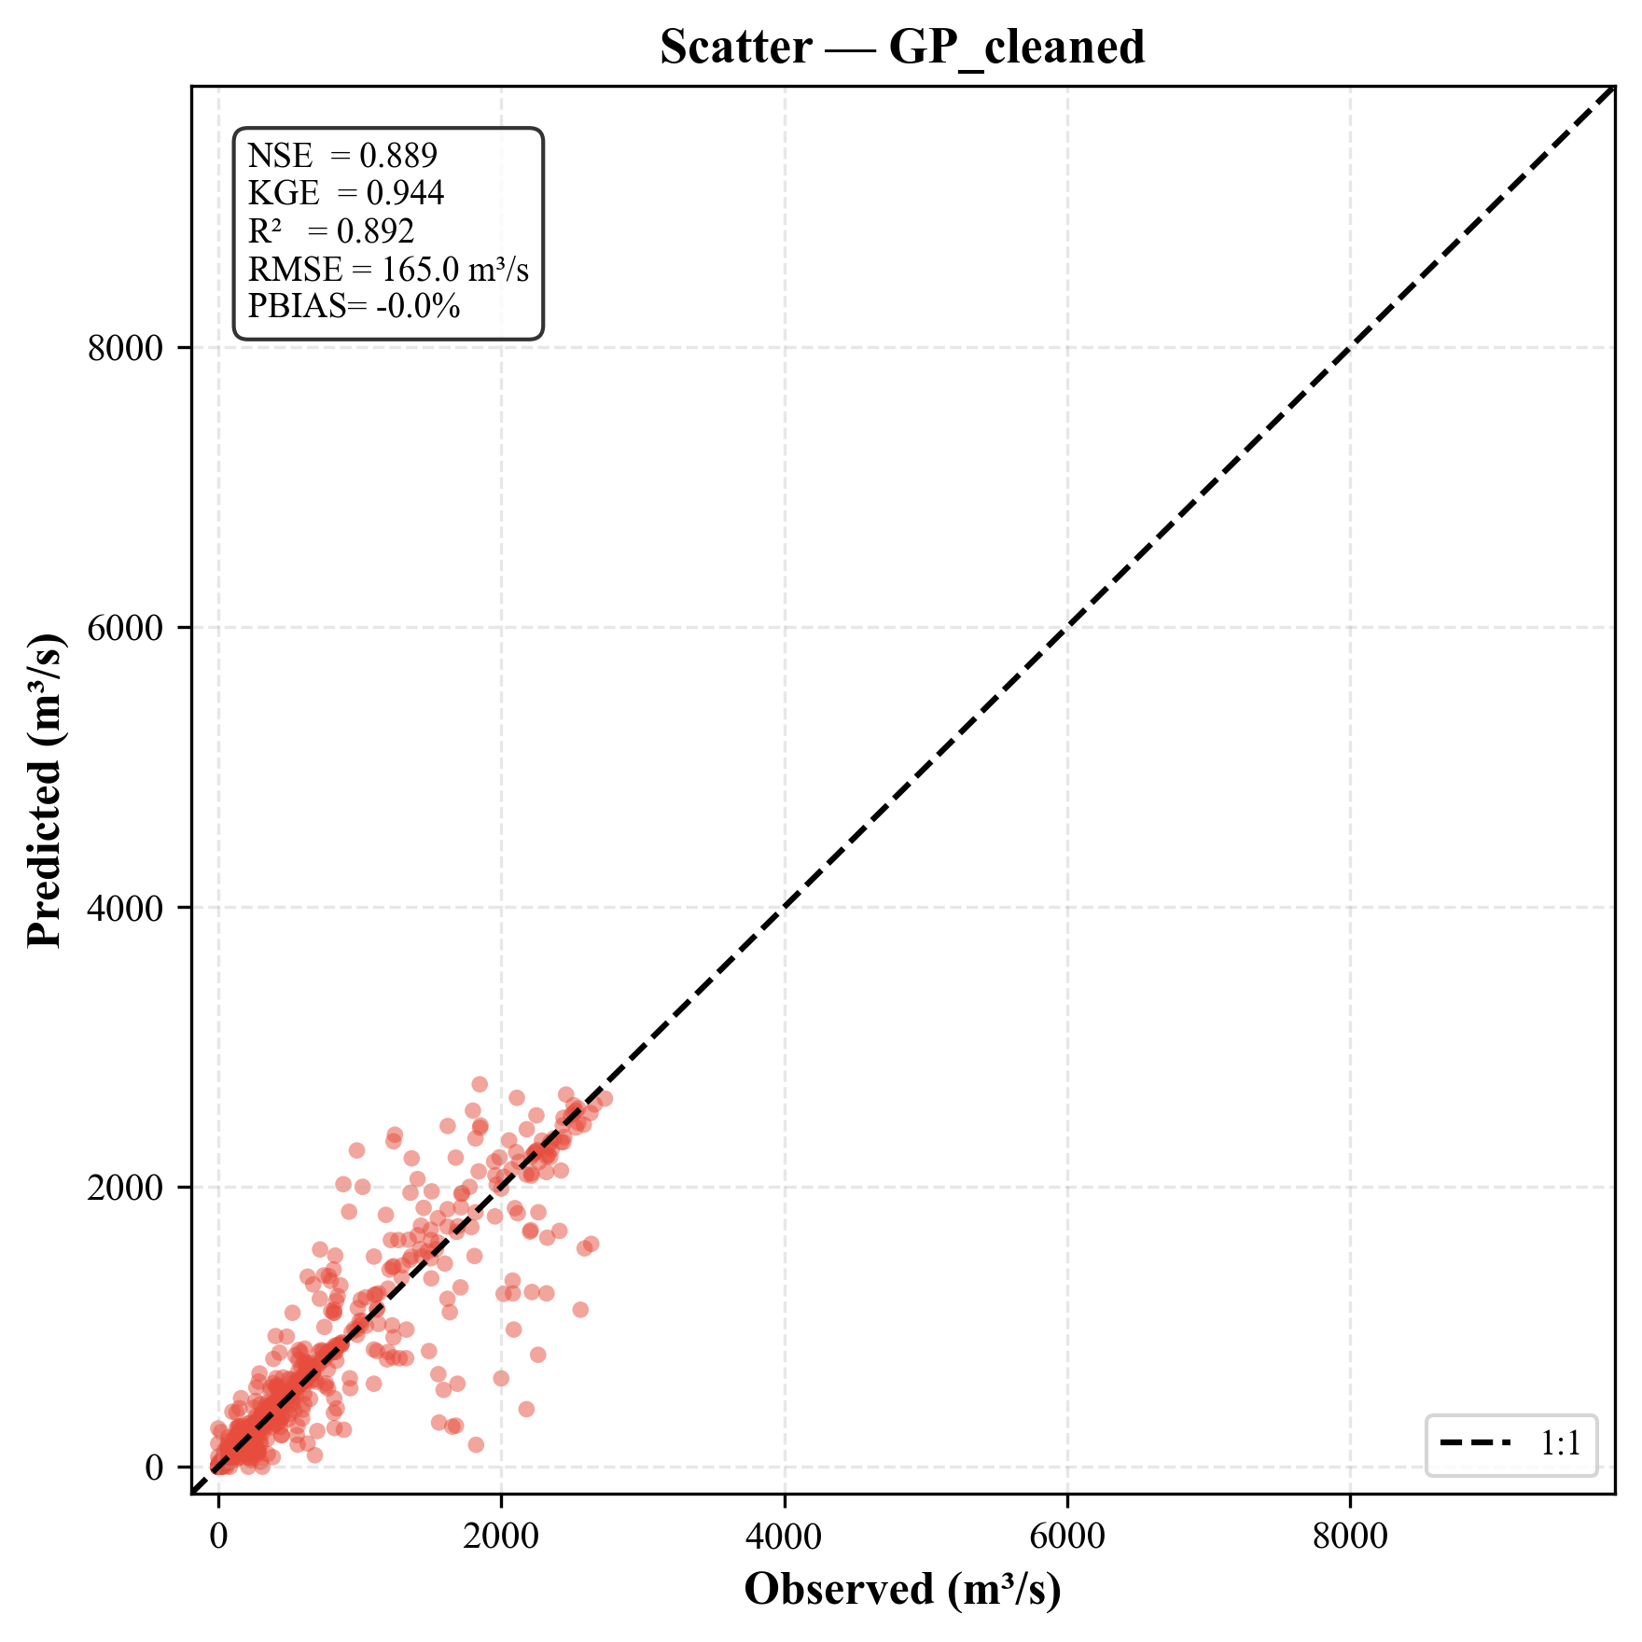
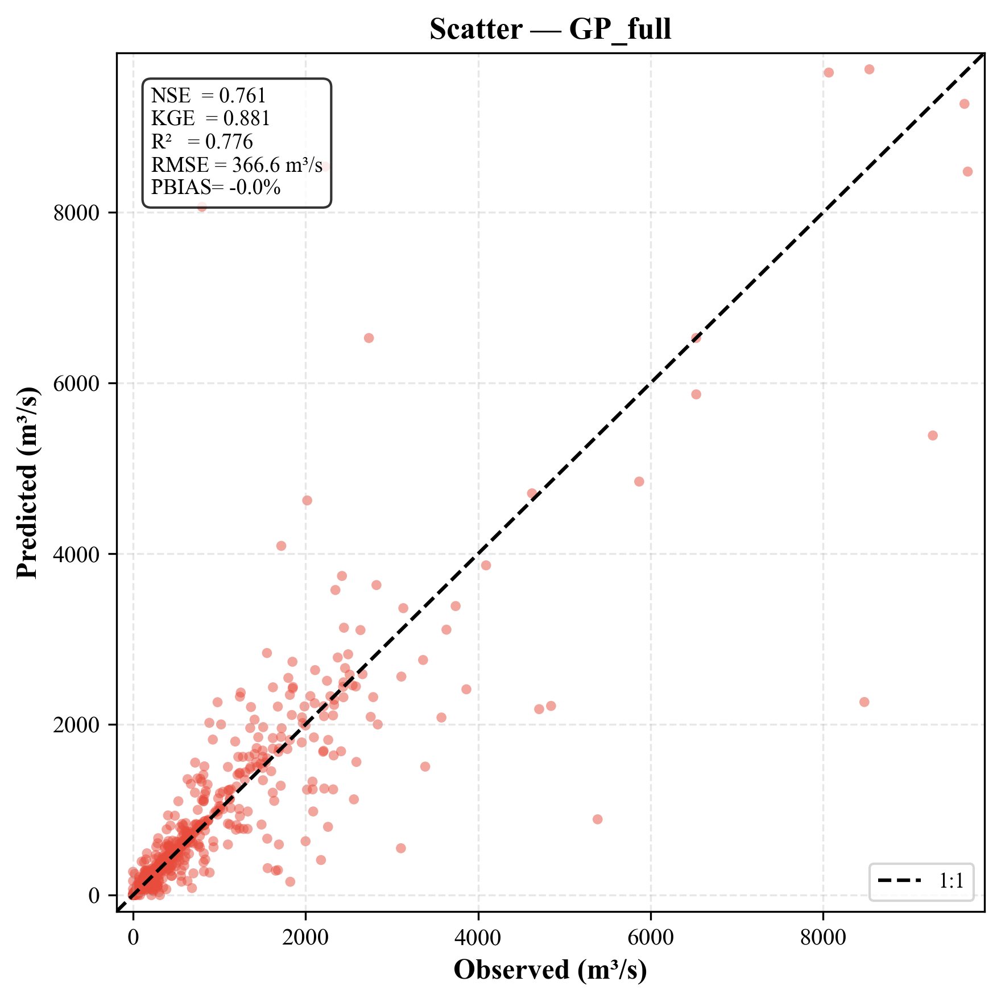
CROSS-STATION AND STATION WISE PERFORMANCE SUMMARY

Slide 9
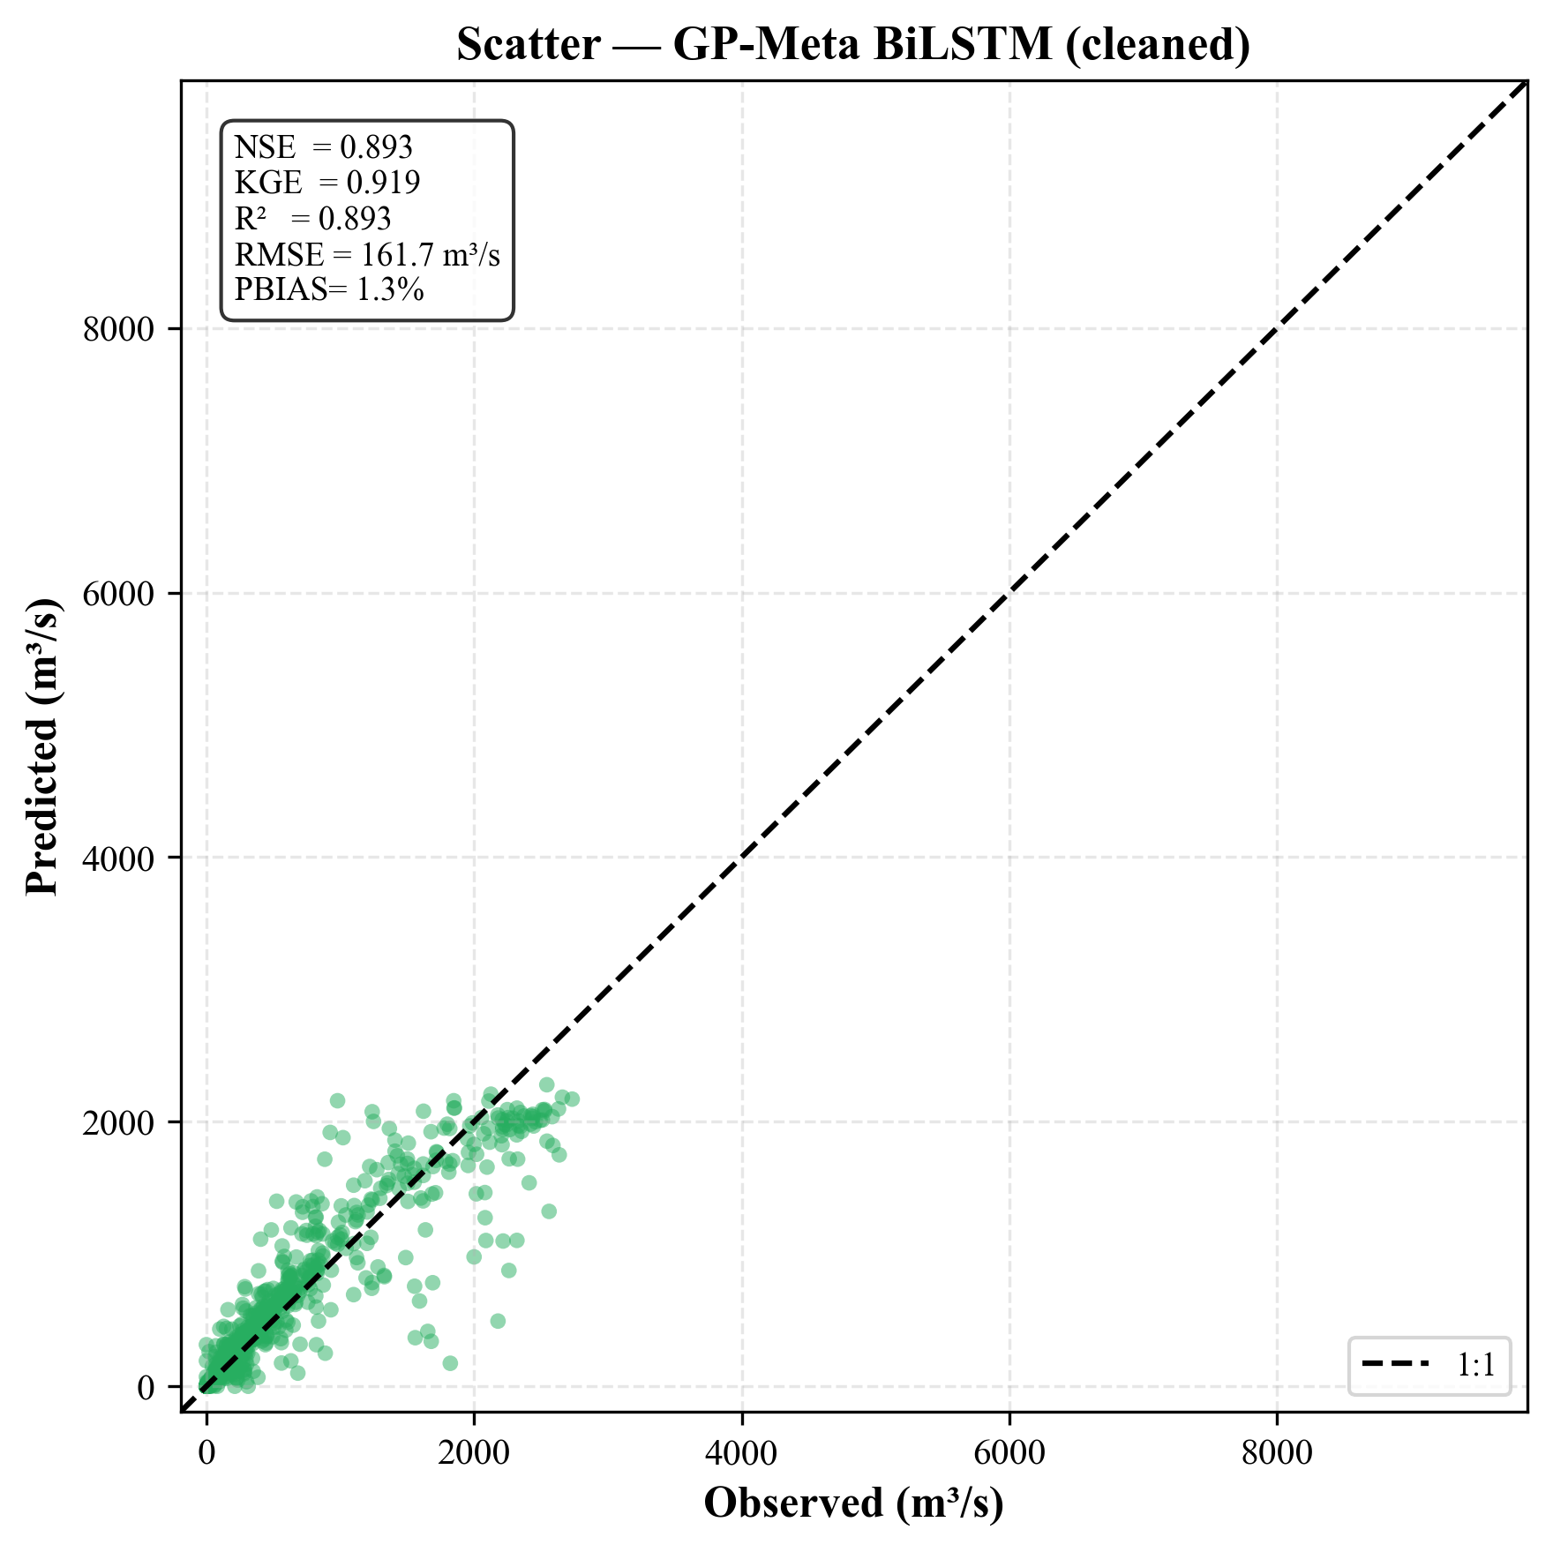
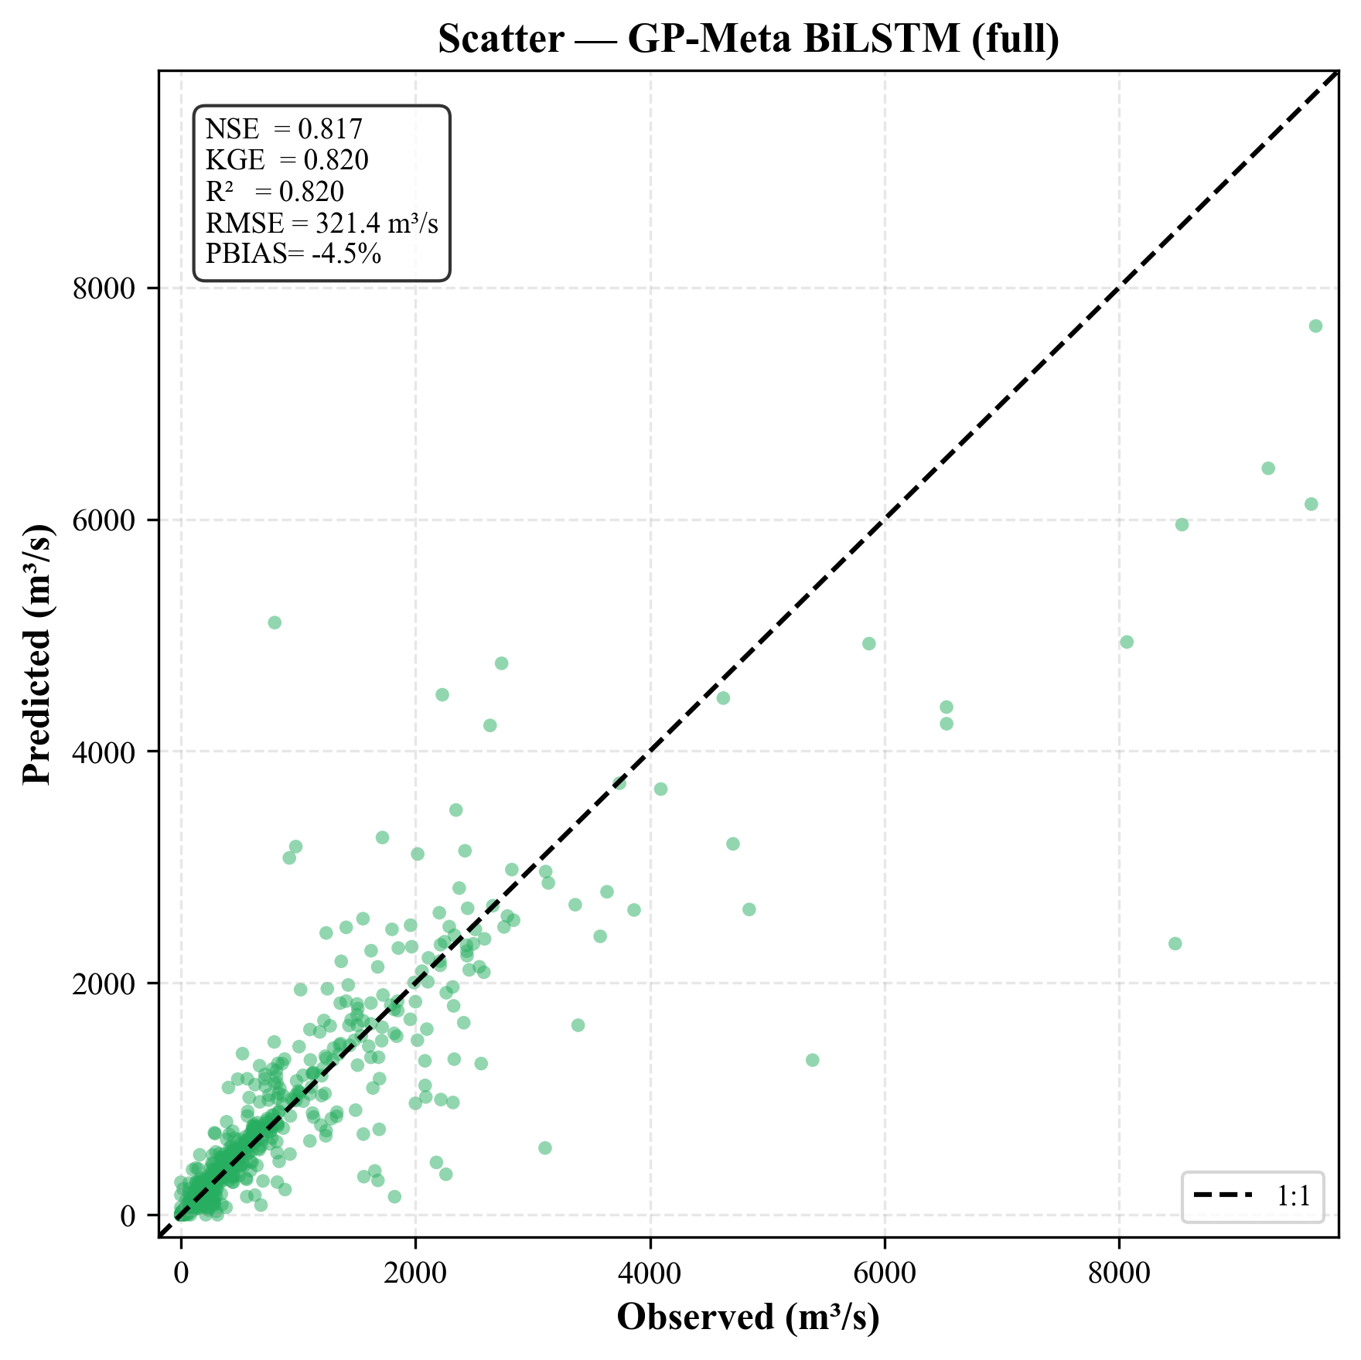
CONTINUED…
Note - cleaned refers to condition of outlier removed and full refers to the condition of outliers are being considered for generalized model evaluation

Slide 10
CROSS-STATION AND STATION WISE PERFORMANCE SUMMARY
Model | Data | NSE | KGE | RMSE (m³/s)
GP (standalone) | Cleaned | 0.750 | 0.875 | 126.8
GP (standalone) | Full | 0.474 | 0.737 | 277.8
BiLSTM (Optuna) | Cleaned | 0.751 | 0.730 | 132.8
BiLSTM (Optuna) | Full | 0.594 | 0.571 | 244.8
GP-Meta BiLSTM | Cleaned | 0.765 | 0.733 | 124.0
GP-Meta BiLSTM | Full | 0.604 | 0.622 | 243.3
Category | Station | Key Observations
Best | Jondhra | GP-Meta (cleaned): NSE = 0.893, KGE = 0.919 - exceptional performance
Runner-up | Simga | GP-Meta (cleaned): NSE = 0.871, KGE = 0.824
Competitive | Basantpur | GP (cleaned): NSE = 0.837, KGE = 0.918 - GP competitive with BiLSTM
Difficult | Salebhata | Highest skewness (18.5); GP (full): NSE = −0.051 - extreme events unresolved
Bias Analysis | All stations | GP PBIAS ≤ 0.01%; BiLSTM PBIAS up to ±35% - GP excels in mass balance
Cross-station mean → test 2013–2018 → 11 stations GP-Meta Bi-LSTM Cleaned = best overall

Slide 11
KEY FINDINGS
R = 0.00 - 0.59 across Hyperparameters and stations - weak to moderate predictive skill
Cross-station median R ≈ 0.43 (cleaned) - learning rate linked to temporal autocorrelation
$$log{10}_{lr}= (sqrt(abs((abs((dominant_freq mul (trend_slope mul std))) mul (−0.2459 mul ((2.3874 add spectral_power_low) mul spectral_entropy)))))) × 0.6181 +(−2.8046)$$
Even weak meta-GP rules (R≈0.3) can guide a useful HP configuration & performance competitive with Optuna
GP-Meta Bi-LSTM (cleaned) achieves best cross-station NSE=0.765 and RMSE=124.0, beating standalone GP (NSE=0.750) and Optuna-Bi-LSTM (NSE=0.751)
GP standalone delivers near-zero PBIAS (≤0.01%) and competitive NSE — simplest interpretable benchmark
Extreme-event performance degrades substantially (ΔNSE $≈$ 0.15–0.25 cleaned→full) — open problem across all three models

Slide 12
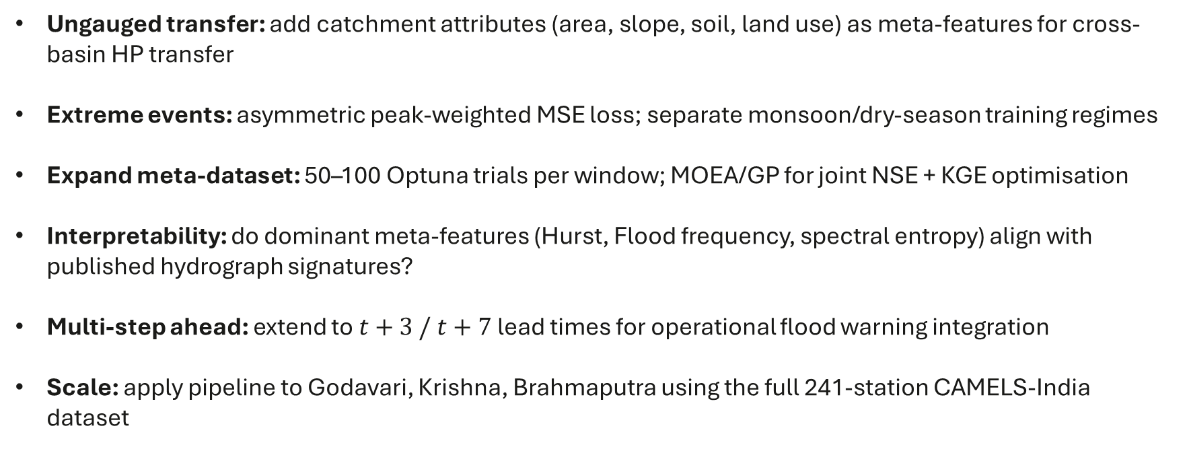
WAY FORWARD
Ungauged transfer: add catchment attributes (area, slope, soil, land use) as meta-features for cross-basin HP transfer
Extreme events: asymmetric peak-weighted MSE loss; separate monsoon/dry-season training regimes
Expand meta-dataset: 50–100 Optuna trials per window; MOEA/GP for joint NSE + KGE optimisation
Interpretability: do dominant meta-features (Hurst, Flood frequency, spectral entropy) align with published hydrograph signatures?
Multi-step ahead: extend to $t+3 / t+7$lead times for operational flood warning integration
Scale: apply pipeline to Godavari, Krishna, Brahmaputra using the full 241-station CAMELS-India dataset

