Slide 1
Spatio-temporal dynamics of topsoil moisture and the influence of tree species on pattern persistence
Dedden, L., Brzozon, J., Dumberger, S., Gassilloud, M., Göritz, A., Sulzer, M., Werner, C. & Weiler, M. Chair of Hydrology, University of Freiburg
EGU 2026 – HS2.4.1
Vienna, 7. May 2026

Slide 2
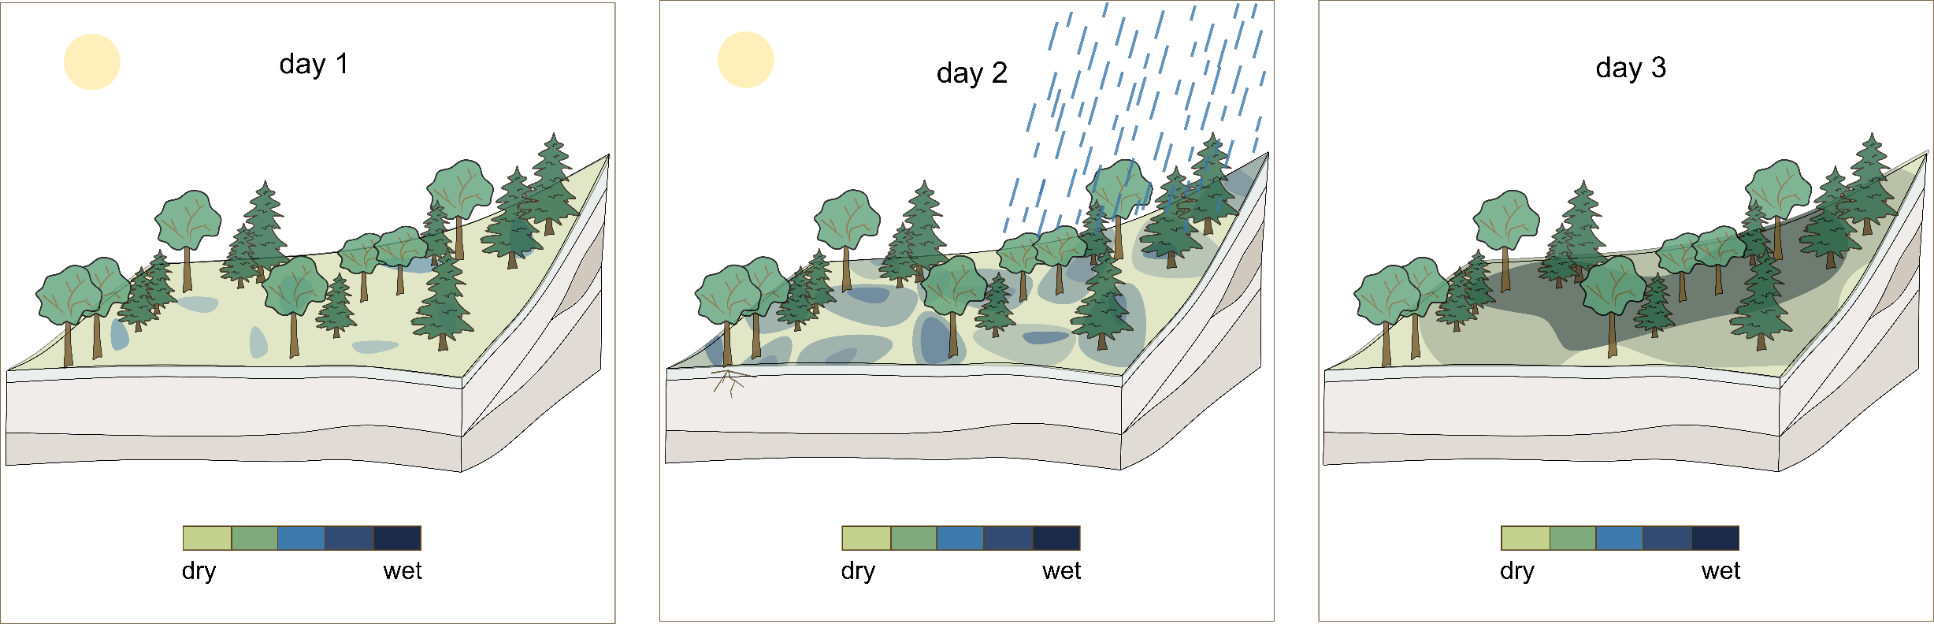


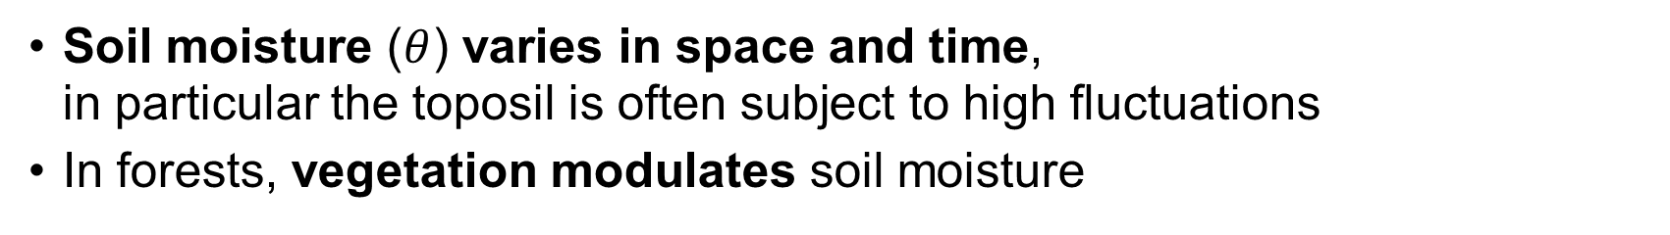
Spatio-temporal soil moisture dynamics in forests
What are the spatio-temporal patterns of topsoil moisture
under the influence of different tree species?
Soil moisture ($θ$) varies in space and time, in particular the toposil is often subject to high fluctuations
In forests, vegetation modulates soil moisture

Slide 3
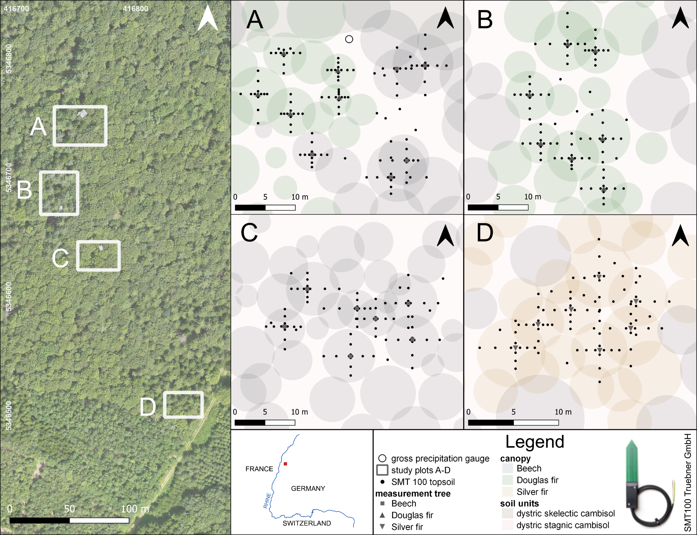




Spatio-temporal soil moisture dynamics in forests
Soil moisture network at four forest stands
400 sensors in a tree-centered monitoring network design
2.5 years of high resolution, continuous soil moisture data
Find us at PICO spot A.8!
Notes:
Spatial patterns are site-specifc and found to vary e.g with extent of observed system,
character of dominant controlling factors
Raumzeitlicher Charakter der Musteri spiegelt den/die dominierenden Faktoren wider
site-specific, local, sometimes contradictory
but evidence for forest sites at the tree-level is sparse
difficult to forumulate broadly reliabel sattements/findings or relationships
→ broadly reliable findings?

Slide 4
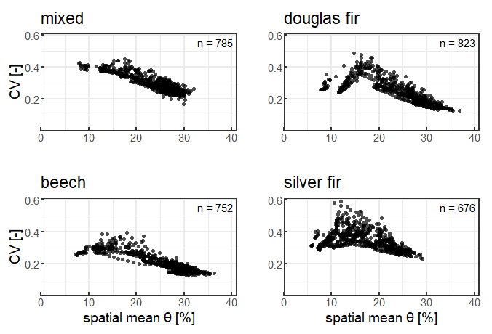
Spatio-temporal soil moisture dynamics in forests
Soil moisture network
Spatio-temporal variability of soil moisture
Find us at PICO spot A.8!

Slide 5

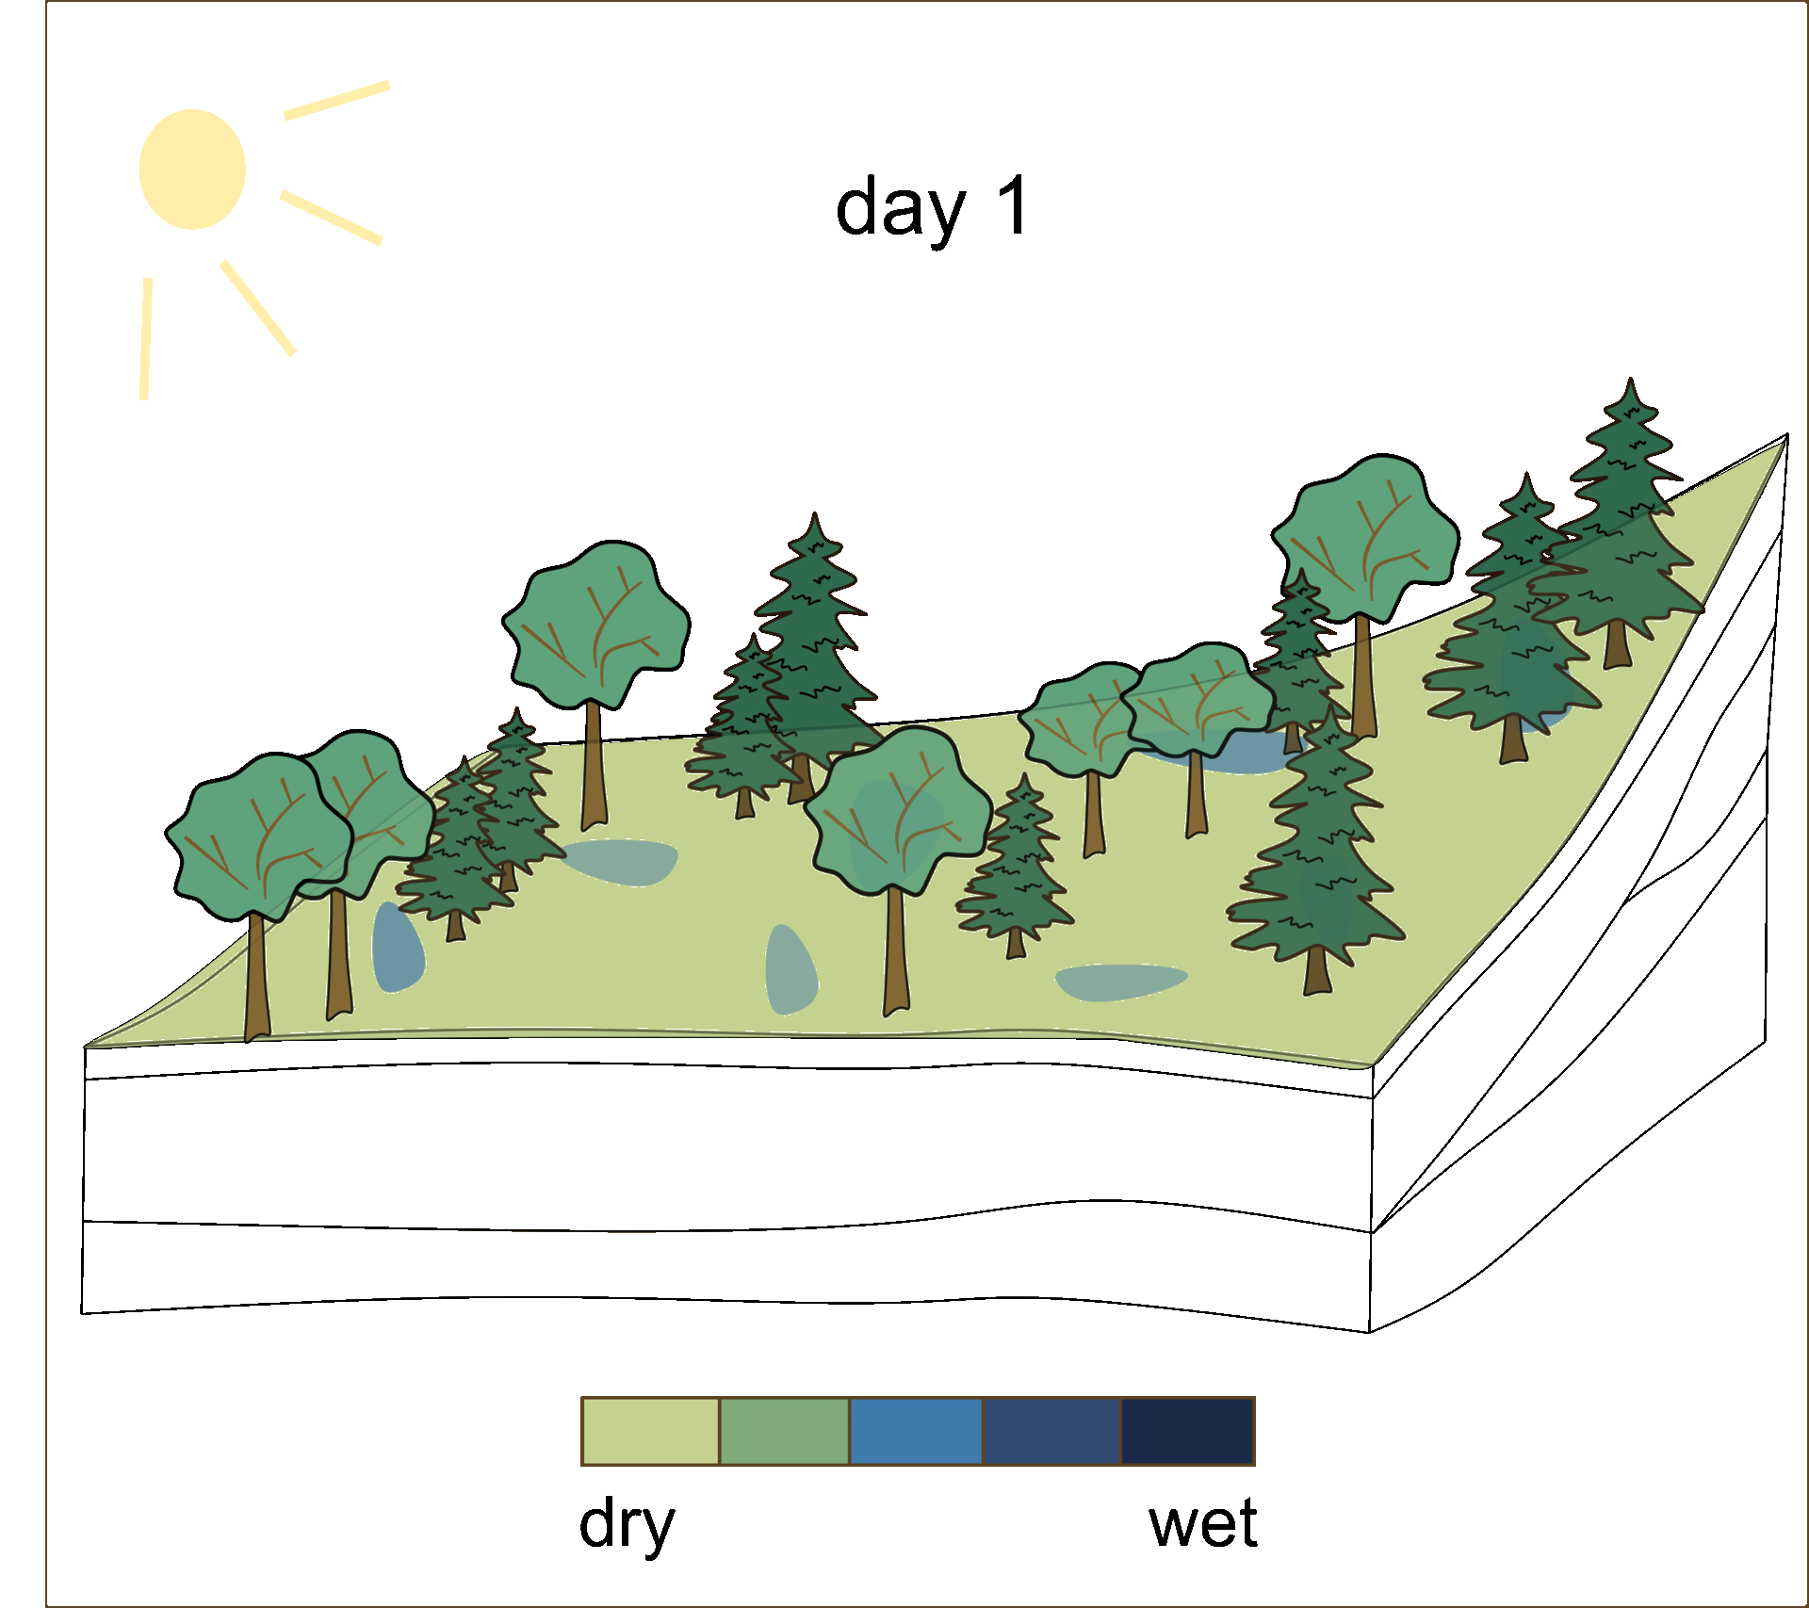



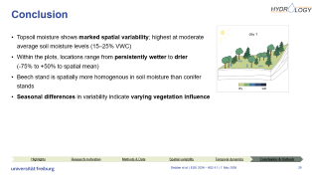
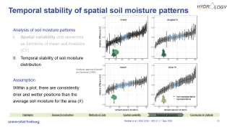
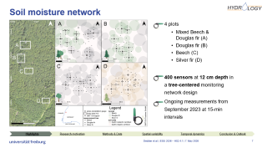
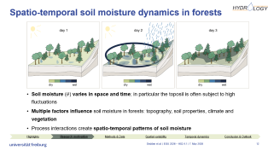
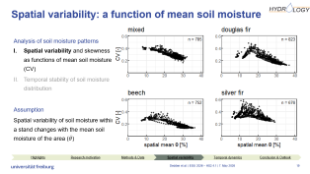
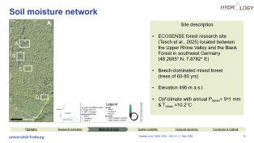
Spatio-temporal topsoil moisture dynamics in forests
Research highlighs | Research motivation | Sensor network & Dataset
Spatial variability of soil moisture | Temporal dynamics of patterns | Conclusion & Outlook
Select to continue!

Slide 6
Research objective
We investigate in detail the spatio-temporal dynamics of forest topsoil moisture at four forest stands using a 2.5-year high-resolution dataset from a dense sensor network
We quantify
soil moisture spatial variability at tree level
temporal dynamics of patterns (annual to intra-seasonal scale)
pattern differences between stands of different species
Highlights
Research motivation
Temporal dynamics
Sensor network & dataset
Spatial variability
Conclusion & Outlook
Notes:
also to improve understanding of how spatio-temporal variability affects linked processes e.g. runoff generation, tree water use
can be model input, improve forecasting, inform forest management and also sampling strategies for different systems

Slide 7
Soil moisture network
4 plots
Mixed Beech & Douglas fir (A)
Douglas fir (B)
Beech (C)
Silver fir (D)
400 sensors at 12 cm depth in a tree-centered network design
Ongoing measurements starting Sep 2023 at 15-min intervals
Highlights
Research motivation
Temporal dynamics
Sensor network & dataset
Spatial variability
Conclusion & Outlook
Notes:
Site description:
Between black forest and rhine valley
Beech-dominated mixed forest (Cfb) with elevations of 480-500 m a.s.l.
Mean annual precipitation is 911 mm and mean annual temperature 10.2°C (DWD station 14135).

Slide 8
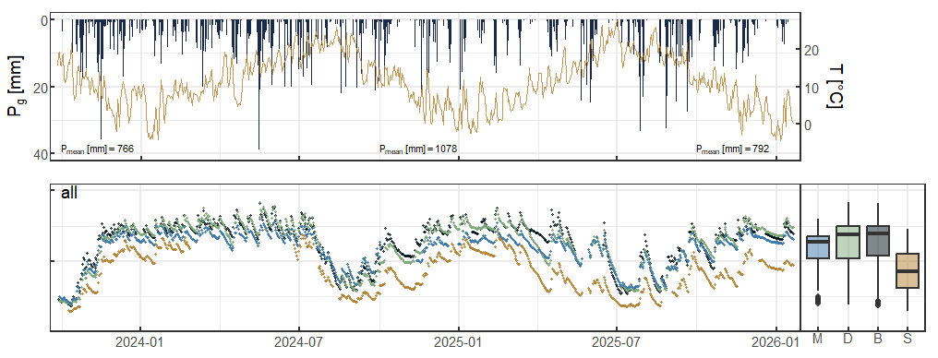
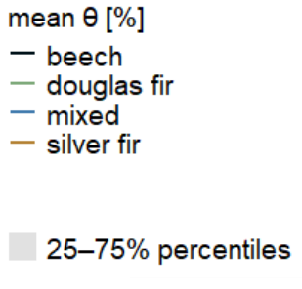

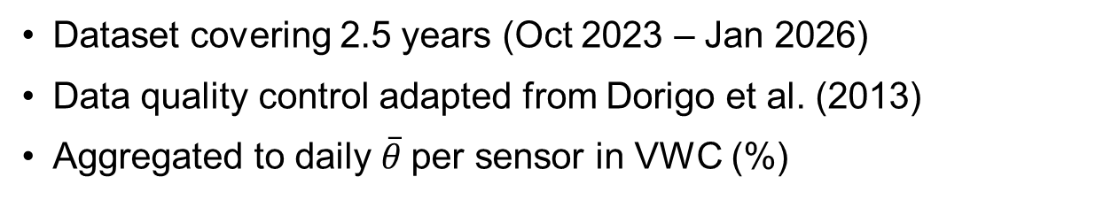
2.5 years of soil moisture at four forest plots
40
20
0
$\overline{θ}$ [%]
Dataset covering 2.5 years (Oct 2023 – Jan 2026)
Data quality control adapted from Dorigo et al. (2013)
Aggregated to daily $\overline{θ}$per sensor in VWC (%)
Highlights
Research motivation
Temporal dynamics
Sensor network & dataset
Spatial variability
Conclusion & Outlook
Notes:
Time series:
2 relatively wet years, plots follow similar overall trend, at similar range
End of winter wettest, late summer driest
Boxplot show most dominant mean SM of 20-30%, silver fir sign. Drier
Distribution: all left skewed, but silver fir appears bi-modal

Slide 9

Spatial variability of topsoil moisture
→ highest spatial variability at intermediate soil moisture levels (15-25%) for the plots Douglas fir, Silver fir and Beech
Highlights
Research motivation
Temporal dynamics
Sensor network & dataset
Spatial variability
Conclusion & Outlook
Notes:
For general understanding of soil moisture states of dry, intermediate and wet condition
-> mean spatial SM ranges from low to high
mean in relation to CV describes the spatial variability of SM within the plot for the specific day
Differences between plots: mixed and beech negative linear
Silver fir and Douglas fir convex upward curve
Beech
Different relationships due to seasonal patterns of controls
Famigliett 1998: wet: porosity, hydraulic cond, dry: aspect, elevation, clay
+ reason (hypo): wet state (controls) variability often controlled by soil hydraulic properties and lateral redistribution processes (non-local e.g. topography), with drying differences in hydraulic conductivity and porosity enhance variability to intermediate SM,
from intermediate with further drying evapotranspiration decreases variability again (with water limitation)
we lack data from dry periods, which would emphasize the left arm of curve

Slide 10
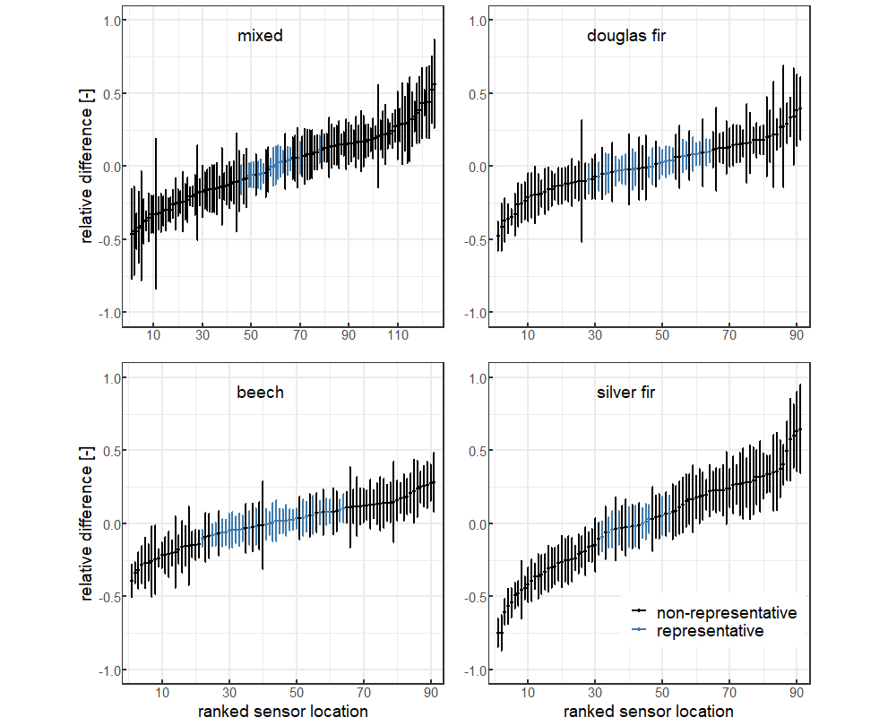
Temporal stability of topsoil moisture
→ Beech plot is spatially most homogenous,
Silver fir plot is spatially most heterogenous in soil moisture
Highlights
Research motivation
Temporal dynamics
Sensor network & dataset
Spatial variability
Conclusion & Outlook

Slide 11
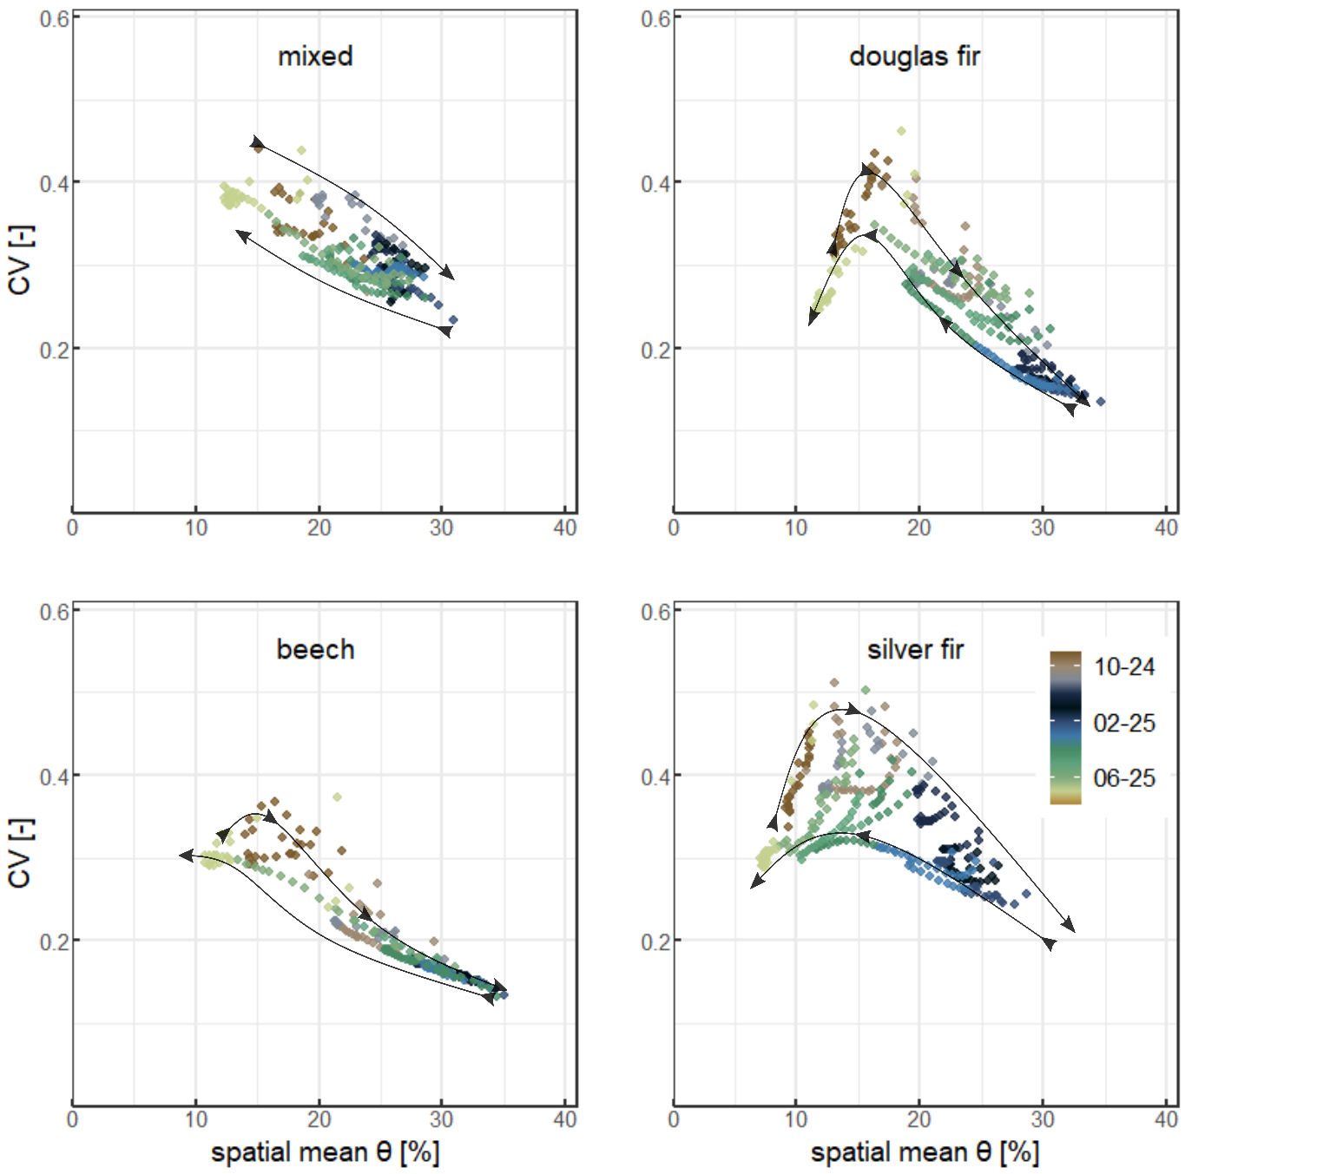




Saisonal wetting and drying cycles
Data subset: September 2024 to August 2025
For similar average soil moisture levels …
Soil moisture during autumn wetting is spatially more heterogeneous than during spring drying
→ Seasonal differences in variability indicate varying vegetation influence
Highlights
Research motivation
Temporal dynamics
Sensor network & dataset
Spatial variability
Conclusion & Outlook

Slide 12
Conclusion
Topsoil moisture shows marked spatial variability; highest at moderate average soil moisture levels (15–25% VWC)
Locations within plots range from persistently wetter to drier (-75% to +50% to spatial mean) and Beech stand is spatially more homogenous than conifer stands
Seasonal differences in variability indicate varying vegetation influence
Highlights
Research motivation
Temporal dynamics
Sensor network & dataset
Spatial variability
Conclusion & Outlook

Slide 13
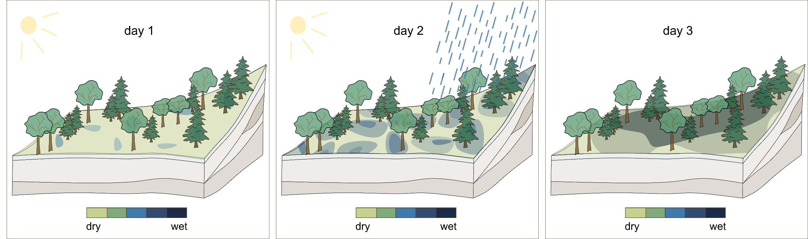
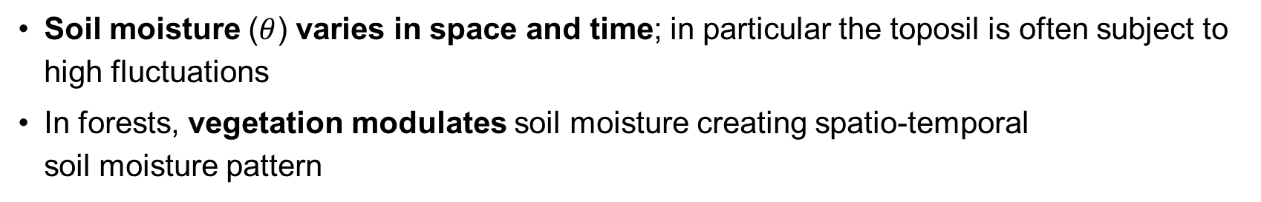
Spatio-temporal soil moisture dynamics in forests
Soil moisture ($θ$) varies in space and time; in particular the toposil is often subject to high fluctuations
In forests, vegetation modulates soil moisture creating spatio-temporal soil moisture pattern
Highlights
Research motivation
Temporal dynamics
Sensor network & dataset
Spatial variability
Conclusion & Outlook
Notes:
Spatial patterns are site-specifc and found to vary e.g with extent of observed system,
Mirror the spatio-temporal characteristics of dominant controlling factors

Slide 14


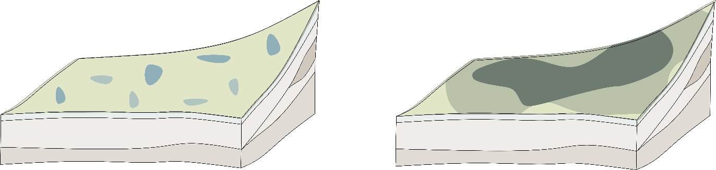
Research gap
Limited evidence of soil moisture dynamics influenced by forest vegetation
Findings are often site-specific and not broadly applicable
Observations at the tree level and at high spatial and temporal resolution are required
Evapotranspiration
Thoughfall
Stemflow
“What are spatio-temporal dynamics of soil moisture under the influence of forest vegetation?”
“How do these patterns look like for different tree species?”
space
time
Highlights
Research motivation
Temporal dynamics
Sensor network & dataset
Spatial variability
Conclusion & Outlook
Notes:
evidence for forest sites at the tree-level is sparse, focus on grass- or agricultural context
difficult to formulate broadly reliable statements/findings or relationships of vegetation-soil moisture interaction
methods: for a catchment/field we can use remote sensing-derived SM products,
small-scale variability: need of sampling (high resolution)

Slide 15
Research objectives
We investigate in detail the spatio-temporal dynamics of forest topsoil moisture at four forest stands using a 2.5-year high-resolution dataset from a dense sensor network
Quantify soil moisture spatial variability at tree level & dominant spatial patterns
Examine the temporal dynamics of patterns (annual to intra-seasonal scale)
Identify pattern differences between stands of different species
→ Knowledge of patterns contributes to understanding of controls & effects on dependent (eco)hydrological processes
Highlights
Research motivation
Temporal dynamics
Sensor network & dataset
Spatial variability
Conclusion & Outlook
Notes:
Insights of spatio-temporal dynamics are essential to determine controls and their characteristics and
also to improve understanding of how spatio-temporal variability affects linked processes e.g. runoff generation, tree water use
can be model input, improve forecasting, inform forest management and also sampling strategies for different systems

Slide 16
Soil moisture network
Site description
ECOSENSE forest research site (Tesch et al., 2025) located between the Upper Rhine Valley and the Black Forest in southwest Germany (48.2685° N, 7.8782° E)
Beech-dominated mixed forest (trees of 60-80 yrs)
Elevation 490 m a.s.l.
Cbf climate with annual P_{mean}= 911 mm & T_{mean} =10.2°C
Highlights
Research motivation
Temporal dynamics
Sensor network & dataset
Spatial variability
Conclusion & Outlook
Notes:
Site description:
Between black forest and rhine valley
Beech-dominated mixed forest (Cfb) with elevations of 480-500 m a.s.l.
Mean annual precipitation is 911 mm and mean annual temperature 10.2°C (DWD station 14135).

Slide 17
Soil moisture network
4 plots
Mixed Beech & Douglas fir (A)
Douglas fir (B)
Beech (C)
Silver fir (D)
400 sensors at 12 cm depth in a tree-centered monitoring network design
Ongoing measurements from September 2023 at 15-min intervals
Highlights
Research motivation
Temporal dynamics
Sensor network & dataset
Spatial variability
Conclusion & Outlook

Slide 18




Soil moisture network
Tree-centered network design
Isolated observation of vegetation influence due to comparable site conditions
Observation of species-specific differences with four plots
Highlights
Research motivation
Temporal dynamics
Sensor network & dataset
Spatial variability
Conclusion & Outlook
Notes:
Selected plot: very similar site condition, most adjacent plots (Douglas fir and Beech) soil properties and climate as well as topography can be assumed very similar
differences between spatial SM distribution and correlation over time may be vegetation-influenced

Slide 19

2.5 years of soil moisture at four forest plots
40
20
0
$\overline{θ}$ [%]
Dataset covering 2.5 years (Oct 2023 – Jan 2026)
Data quality control according to Dorigo et al. (2013)
Aggregated to daily $\overline{θ}$per sensor in VWC (%)
Highlights
Research motivation
Temporal dynamics
Sensor network & dataset
Spatial variability
Conclusion & Outlook
Notes:
Time series:
2 relatively wet years, plots follow similar overall trend, at similar range
End of winter wettest, late summer driest
Boxplot show most dominant mean SM of 20-30%, silver fir sign. Drier
Distribution: all left skewed, but silver fir appears bi-modal

Slide 20
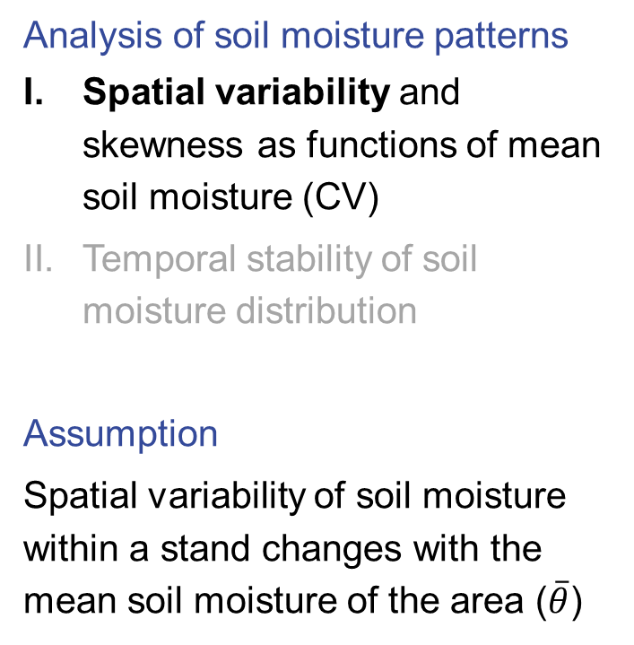
Spatial variability: a function of mean soil moisture
Analysis of soil moisture patterns
Spatial variability and skewness as functions of mean soil moisture (CV)
Temporal stability of soil moisture distribution
Assumption
Spatial variability of soil moisture within a stand changes with the mean soil moisture of the area ($\overline{θ}$)
Highlights
Research motivation
Temporal dynamics
Sensor network & dataset
Spatial variability
Conclusion & Outlook

Slide 21
Spatial variability: a function of mean soil moisture
Analysis of soil moisture patterns
Spatial variability and skewness as functions of mean soil moisture (CV)
Temporal stability of soil moisture distribution
Assumption
Spatial variability of soil moisture within a stand changes with the mean soil moisture of the area ($\overline{θ}$)
woody vegetation-dominated catchment:Brooca et al., 2010
forest headtwater cathcment: Rosenbaum et al., 2012
Highlights
Research motivation
Temporal dynamics
Sensor network & dataset
Spatial variability
Conclusion & Outlook
Notes:
For general understanding of soil moisture states of dry, intermediate and wet condition
-> mean spatial SM ranges from low to high
mean in relation to CV describes the spatial variability of SM within the plot for the specific day
Differences between plots: mixed and beech negative linear
Silver fir and Douglas fir convex upward curve
Beech
Different relationships due to seasonal patterns of controls
Famigliett 1998: wet: porosity, hydraulic cond, dry: aspect, elevation, clay
+ reason (hypo): wet state (controls) variability often controlled by soil hydraulic properties and lateral redistribution processes (non-local e.g. topography), with drying differences in hydraulic conductivity and porosity enhance variability to intermediate SM,
from intermediate with further drying evapotranspiration decreases variability again (with water limitation)
we lack data from dry periods, which would emphasize the left arm of curve

Slide 22
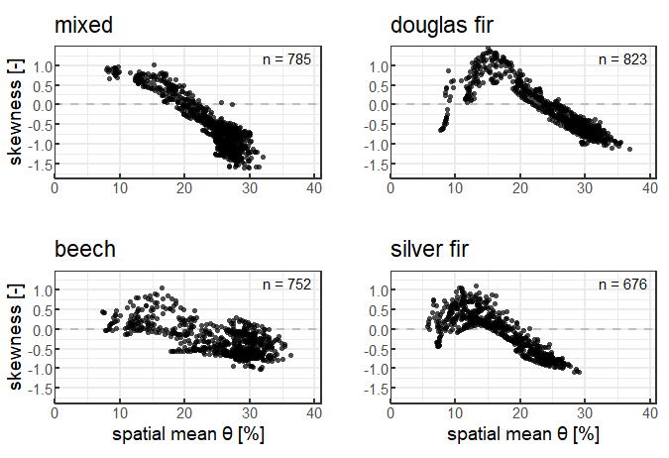
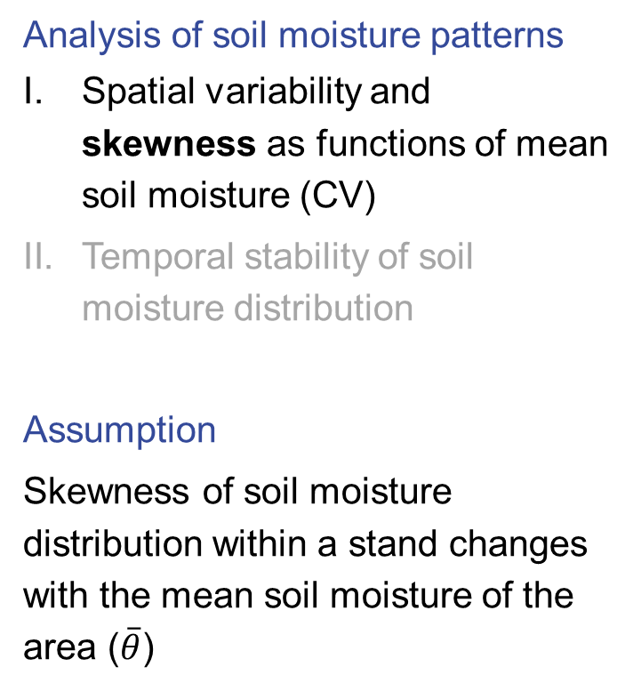
Skewness: a function of mean soil moisture
Analysis of soil moisture patterns
Spatial variability and skewness as functions of mean soil moisture (CV)
Temporal stability of soil moisture distribution
Assumption
Skewness of soil moisture distribution within a stand changes with the mean soil moisture of the area ($\overline{θ}$)
Highlights
Research motivation
Temporal dynamics
Sensor network & dataset
Spatial variability
Conclusion & Outlook

Slide 23

Skewness: a function of mean soil moisture
Analysis of soil moisture patterns
Spatial variability and skewness as functions of mean soil moisture (CV)
Temporal stability of soil moisture distribution
Assumption
Skewness of soil moisture distribution within a stand changes with the mean soil moisture of the area ($\overline{θ}$)
→ Highest spatial variability at intermediate soil moisture levels (15-25%) for Silver fir, Douglas fir and Beech stand
→ Variability to mean soil moisture relationship follows upward convex curve, only for mixed plot linear relationship
→ Relationship of skewness to mean soil moisture varies across species
Highlights
Research motivation
Temporal dynamics
Sensor network & dataset
Spatial variability
Conclusion & Outlook

Slide 24
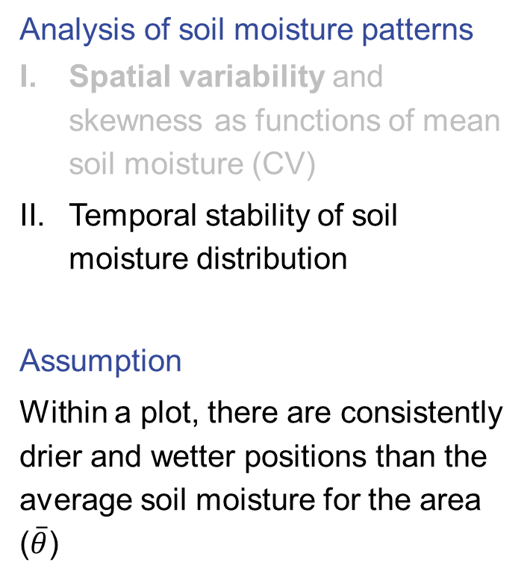
Temporal stability of spatial soil moisture patterns
Analysis of soil moisture patterns
Spatial variability and skewness as functions of mean soil moisture (CV)
Temporal stability of soil moisture distribution
Assumption
Within a plot, there are consistently drier and wetter positions than the average soil moisture for the area ($\overline{θ}$)
Analysis approach based on Vachaud (1985)
Highlights
Research motivation
Temporal dynamics
Sensor network & dataset
Spatial variability
Conclusion & Outlook
Notes:
ITS: combined SD+MD
Pattern not easy to see now, outlook is to determine factor(s) behind them; relevancy of stem distance?
Beech has shortest range in mean difference across locations (homogenous)
Silver fir has largest range in mean differences from -75& to +64%, confirms the previous results of large spatial heterogeneity within plot SD: how much do relative difference in AM vary from spatial mean over time
Most whiskers small range: mixed single locations, conifer plots for drier than average location large variability (decoupling?)
Representative locations: < 0.15 ITS (small), here in blue, if you sample id recommend to sample here!
Context: range of -40% to +25% Heathman et al. (2012), Brocca et al. (2010), -12%+16% agricultural fields, less spatial heterogeneity; and shorter time periods so smaller range of temporal dynamic captured
No clear spatial clustering: indicates vegetation-structure related influence, only with further investigation
Several persistently drier locations at stems from confers: measurement challenge in densely roots area but can also be preferential flow and increased RWU, in particular if we consider the relatively small input from stem flow for conifers contrast: stem proximity of beech trees wetter than average areas: higher input? Different rooting? Towards deeper layers?

Slide 25
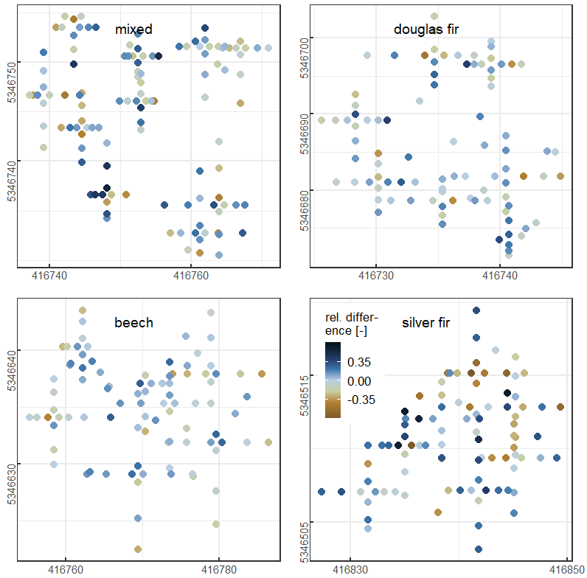
Spatial soil moisture patterns in the field
Spatial patterns of dry and wet locations?
→ Further information on vegetation structure, throughfall and soil properties required
Highlights
Research motivation
Temporal dynamics
Sensor network & dataset
Spatial variability
Conclusion & Outlook

Slide 26
Spatial soil moisture patterns in the field
Patterns of the spatial distribution of dry and wet sites?
Information on vegetation structure, throughfall and soil properties is required
→ Beech plot is spatially most homogenous in soil moisture, Silver fir plot is most heterogenous
→ More information needed to explain spatial cluster of wetter & drier positions within the plots
Highlights
Research motivation
Temporal dynamics
Sensor network & dataset
Spatial variability
Conclusion & Outlook

Slide 27
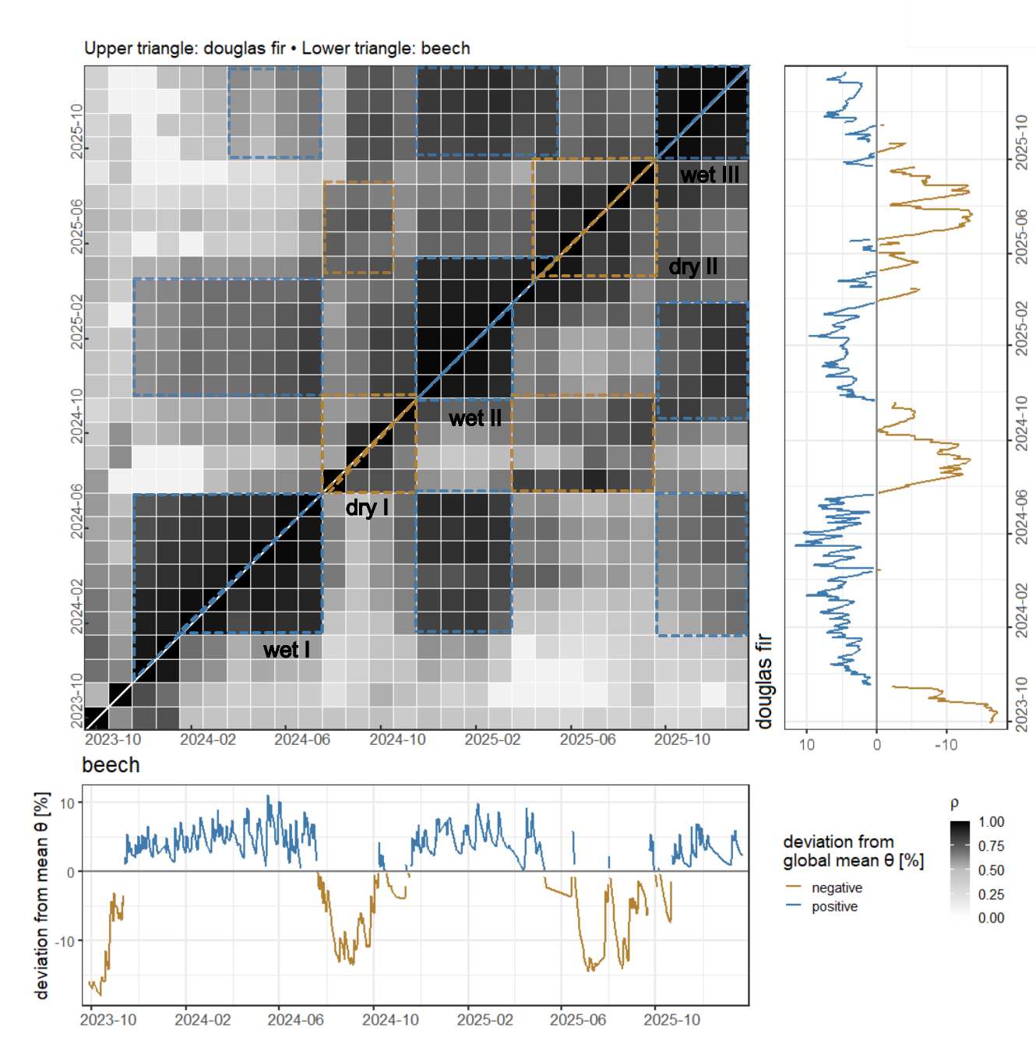
Repeating cycles as „moisture pattern memory“
Correlation matrix shows Spearman rho of autocorrelation of daily soil moisture distribution across 2.5 years for Beech and Douglas fir plot
Comparison of daily distributions in monthly timesteps
Wet periods correlate across years, a „pattern memory“ is visible
Highlights
Research motivation
Temporal dynamics
Sensor network & dataset
Spatial variability
Conclusion & Outlook
Notes:
Selected plots: very similar site condition, most adjacent plots: soil properties and climate as well as topography can be assumed very similar
So differences between spatial SM distribution and correlation over time may
Be vegetation-influenced
Maybe preferential uptake
Strong correlation between succeeding dates (2-week steps) for both dry and wet state; for wet state very long strong correlation with increasing dates (weeks to months), driest states strong correlation lost after 2 months, so for dry and intermediate moisture conditions, variability changes, soil moisture changes to different degrees (areas wet faster/slower)
Interannual cycles in time-stable soil water content (Biswas & Si 2011) where rho for observation within season but even across the same season of different years are strong

Slide 28
Saisonal wetting and drying cycles
12 month of data: September 2024 to August 2025
For similar average soil moisture levels …
Soil moisture during autumn wetting is more heterogeneous within the plots than during spring drying
→ Seasonal differences of vegetation influence
Highlights
Research motivation
Temporal dynamics
Sensor network & dataset
Spatial variability
Conclusion & Outlook

Slide 29
Saisonal wetting and drying cycles
Observation period from September 2024 to August 2025
With similar average soil moisture levels in the plots …
Soil moisture occurs during autumn wetting more heterogeneous within the plots than during spring drying
Evidence of seasonal differences in the influence of vegetation
→ Moments of similar mean soil moisture in the plot differ in spatial moisture variability according to drying and wetting cycles
→ Wet and dry phases are autocorrelated across years; phase extents are species-specific
Highlights
Research motivation
Temporal dynamics
Sensor network & dataset
Spatial variability
Conclusion & Outlook

Slide 30
Conclusion
Topsoil moisture shows marked spatial variability; highest at moderate average soil moisture levels (15–25% VWC)
Locations within plots range from persistently wetter to drier (-75% to +50% to spatial mean) and Beech stand is spatially more homogenous than conifer stands
Seasonal differences in variability indicate varying vegetation influence
Highlights
Research motivation
Temporal dynamics
Sensor network & dataset
Spatial variability
Conclusion & Outlook

Slide 31
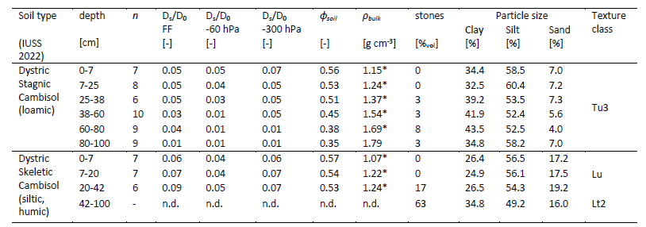
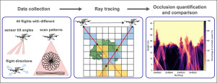
Outlook
In a correlation analysis, we use
LiDAR-derived canopy structure metrics
microtopographic maps
soil property data
soil moisture data from depth profiles
continuous ecohydrological- and meteorological measurements
to better constrain the controls of soil moisture pattern modulation,
in particular vegetation
Dumberger et al. 2026
Sulzer et al. 2025 Tesch et al. 2025
Brzozon et al. 2026
Gassilloud et al. 2025
Highlights
Research motivation
Temporal dynamics
Sensor network & dataset
Spatial variability
Conclusion & Outlook

Slide 32


Any questions?
Contact:
lea.dedden@hydro.uni-freiburg.de
ECOSENSE
project

Slide 33
References
Brocca, L., Melone, F., Moramarco, T., Morbidelli, R. (2010): Spatial-temporal variability of soil moisture and its estimation across scales, Water Resour. Res., 46.
Brzozon, J., Schwarzkopf, P., Kattenborn, T.,, Frey, J., Lang, F., Schack-Kirchner, H. (2026): Controls of spatio-temporal patterns of soil respiration in a mixed forest. bioRxiv 2026.01.21.700858. doi.org/10.64898/2026.01.21.700858
Dorigo, W.A., Xaver, A., Vreugdenhil, M., Gruber, A., Hegyiová, A., Sanchis-Dufau, A.D., Zamojski, D., Cordes, C., Wagner, W. and Drusch, M. (2013): Global Automated Quality Control of In Situ Soil Moisture Data from the International Soil Moisture Network. Vadose Zone Journal, 12. doi.org/10.2136/vzj2012.0097
Dumberger, S., Frey, Y., Stock, C., Wehlings-Schmitz, S., Wagner, D., Kühnhammer, K., Dedden, L., Weiler, M., Sulzer, M., Christen, A., Kreuzwieser, J., Wallrabe, U., Werner, C., Haberstroh, S. (2026): Seasonal dynamics and sun/shade heterogeneity of leaf gas exchange and VOC emissions inside a tall temperate forest canopy. bioRxiv 2026.01.23.701264. doi.org/10.64898/2026.01.23.701264
Gassilloud, M., Koch, B., Göritz, A. (2025): Occlusion mapping reveals the impact of flight and sensing parameters on vertical forest structure exploration with cost-effective UAV based laser scanning. International Journal of Applied Earth Observation and Geoinformation,139. doi.org/10.1016/j.jag.2025.104493
Rosenbaum, U., Bogena, H.R., Herbst, M., Huisman, J.A.., Peterson, T.J., Weuthen, W., Western, A.W., Vereecken, H. (2012): Seasonal and event dynamics of spatial soil moisture patterns at the small catchment scale, Water Resour. Res., 48, W10544, doi:10.1029/2011WR011518
Sulzer, M., Brzozon, J., Christen, A., Dedden, L., Dormann, C. F., Dumberger, S., Frey, Y., Gassilloud, M., Göritz, A., Grote, R., Haberstroh, S., Kattenborn, T., Kremer, L., Kreuzwieser, J., Kühnhammer, K., Lang, F., Lee, H., Müller, J., SchackKirchner, H., Seifert, T., Stock, C., Strack, J., Tesch, J., Wagner, D., Wallrabe, U., Weiler, M.., Werner, C. (2025): The ECOSENSE forest – enriching tower-based flux measurements of carbon and water exchange with novel distributed sensor networks, in: ARPHA Conference Abstracts, Greenhouse gases and carbon, water, and nitrogen cycles, e149267, 760. doi.org/10.3897/aca.8.e149267
Tesch, J., Kühnhammer, K., Wagner, D., Christen, A., Dormann, C., Frey, J., Grote, R., Kattenborn, T., Sulzer, M., Wallrabe, U., Weiler, M., Werner, C., Baghbani, S., Brzozon, J., Comella, L. M., Dedden, L., Dumberger, S., Frey, Y., Gassilloud, M., Gerach, T., Göritz, A., Haberstroh, S., Klüppel, J., Kremer, L., Kreuzwieser, J., Lee, H., Maack, J., Müller, J., Prucker, O., Rajak, S. K., Rühe, J., Rupitsch, S. J., Schack-Kirchner, H., Scharinger, C., Shinde, U., Steinmann, T., Stock, C., Strack, J. (2025): The ECOSENSE forest: A distributed sensor and data management system for real-time monitoring of ecosystem processes and stresses. EGUsphere. doi.org/10.5194/egusphere-2025-4979
Vachaud, G., Passerat De Silans, A., Balabanis, P., Vauclin, M. (1985): Temporal Stability of Spatially Measured Soil Water Probability Density Function. Soil Science Society of America Journal, 49. doi.org/10.2136/sssaj1985.03615995004900040006x
Werner C., Wallrabe U., Christen A., Comella L., Dormann C., Göritz A., Grote R., Haberstroh S., Jouda M., Kiese R., Koch B., Korvink J., Kreuzwieser J., Lang F., Müller J., Prucker O., Reiterer A., Rühe J., Rupitsch S., Schack-Kirchner H., Schmitt K., Stobbe N., Weiler M., Woias P., Wöllenstein J. (2024) ECOSENSE - Multi-scale quantification and modelling of spatio-temporal dynamics of ecosystem processes by smart autonomous sensor networks. Research Ideas and Outcomes 10: e129357. doi.org/10.3897/rio.10.e129357

Slide 34
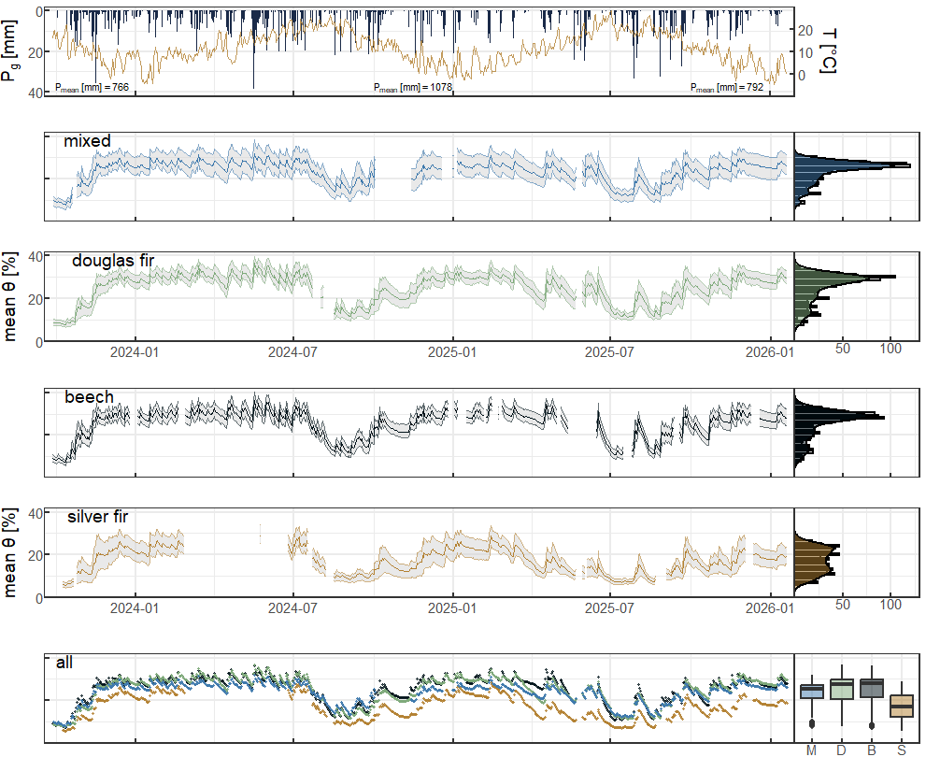
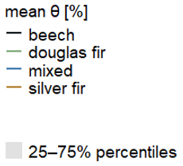
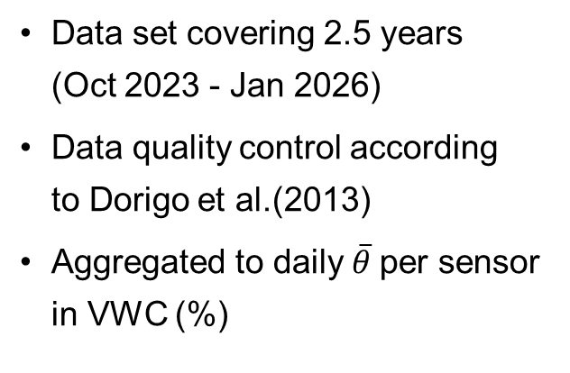
Mean soil moisture of 2.5 years at four forest plots
Data set covering 2.5 years (Oct 2023 - Jan 2026)
Data quality control according to Dorigo et al.(2013)
Aggregated to daily $\overline{θ}$per sensor in VWC (%)
Introdcution
Seasonal & species differences
Research question
Methods & Data
Spatial variaiblity
Temporal dynamics
Conclusion & Outlook
Notes:
Time series:
2 relatively wet years, plots follow similar overall trend, at similar range
End ob winter wettest, late summer driest
Boxplot show most dominat mean SM of 20-30%, silver fir sign. Drier
Distributin: all left skewed, but silver fir seems bi-modal

