Slide 1




ICWE 水環境資訊研究中心
Information Center for Water Environment
From Present-Day Validation to Future Projections: AR6 SSP Scenario Assessment of Water Availability, Irrigation Demand, and Paddy Rice Yield in the Zhuoshui River Basin Using a Water–Crop Model
Po-Hao Chu¹, Yun-Chi Chung¹, Dong-Hong Wu³, and Li-Chiu Chang^{1,2}
¹Department of Water Resources and Environmental Engineering,Tamkang University, New Taipei City, Taiwan
²Department of Artificial Intelligence,Tamkang University, New Taipei City, Taiwan
³Department of Agronomy, National Chung Hsing University,Taichung City, Taiwan
Reporter:Po-Hao-Chu Date:2026/05/07

Slide 2

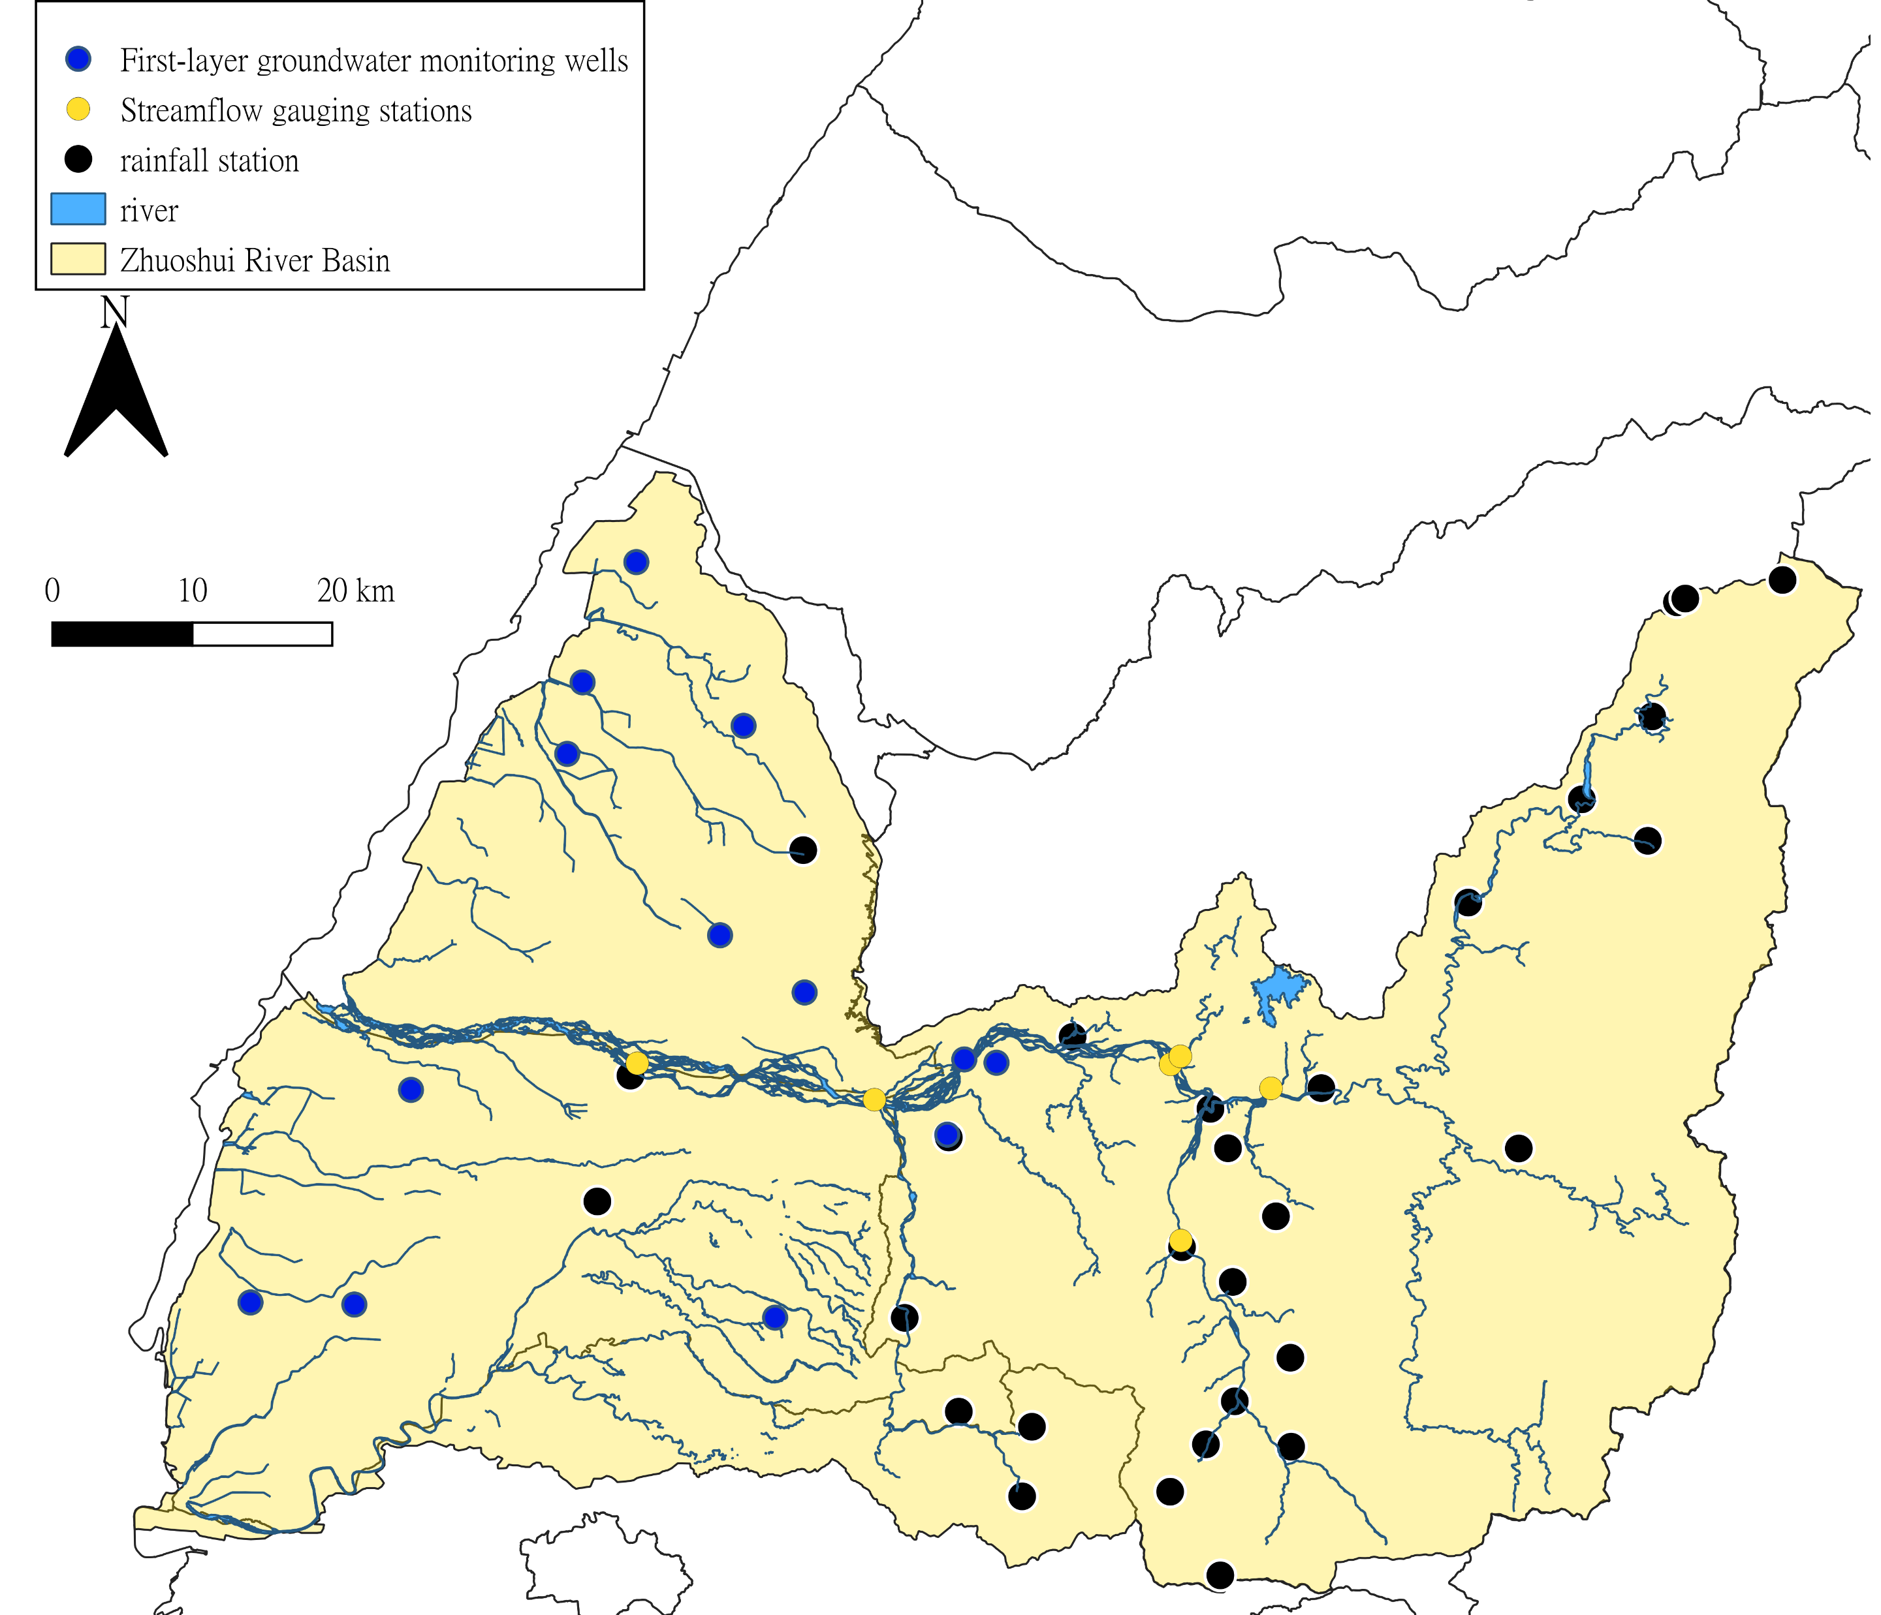
Hydrological Monitoring Stations and Data Source
Input Data Processing
Data Source: Water Resources Agency (WRA), Taiwan
Groundwater: First-layer wells averaged as relative groundwater level.
Streamflow: One key gauging station selected.(Xizhou Bridge)
Rainfall: TCCIP 3×3 grid-average historical observations.

Slide 3
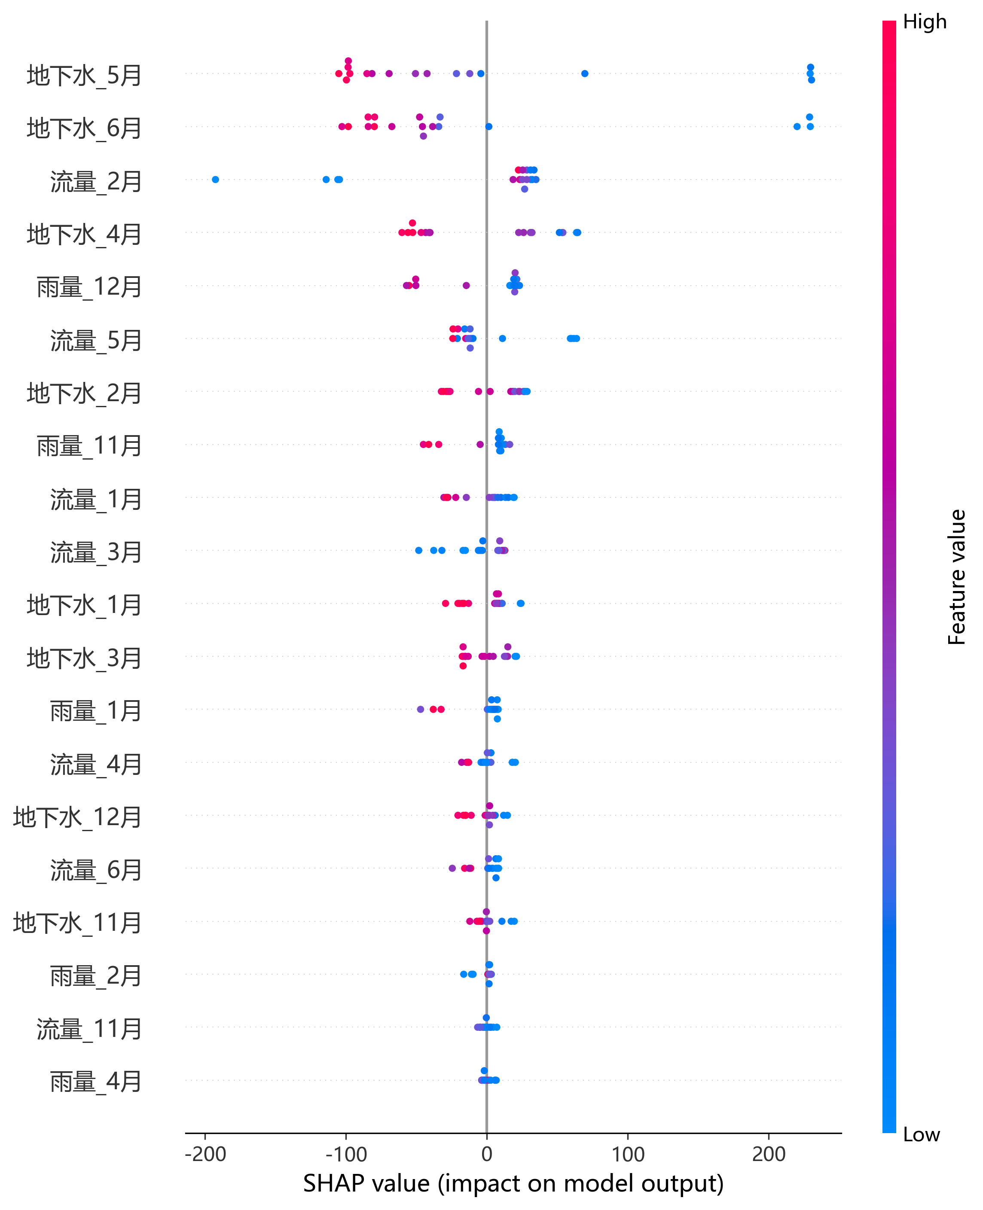
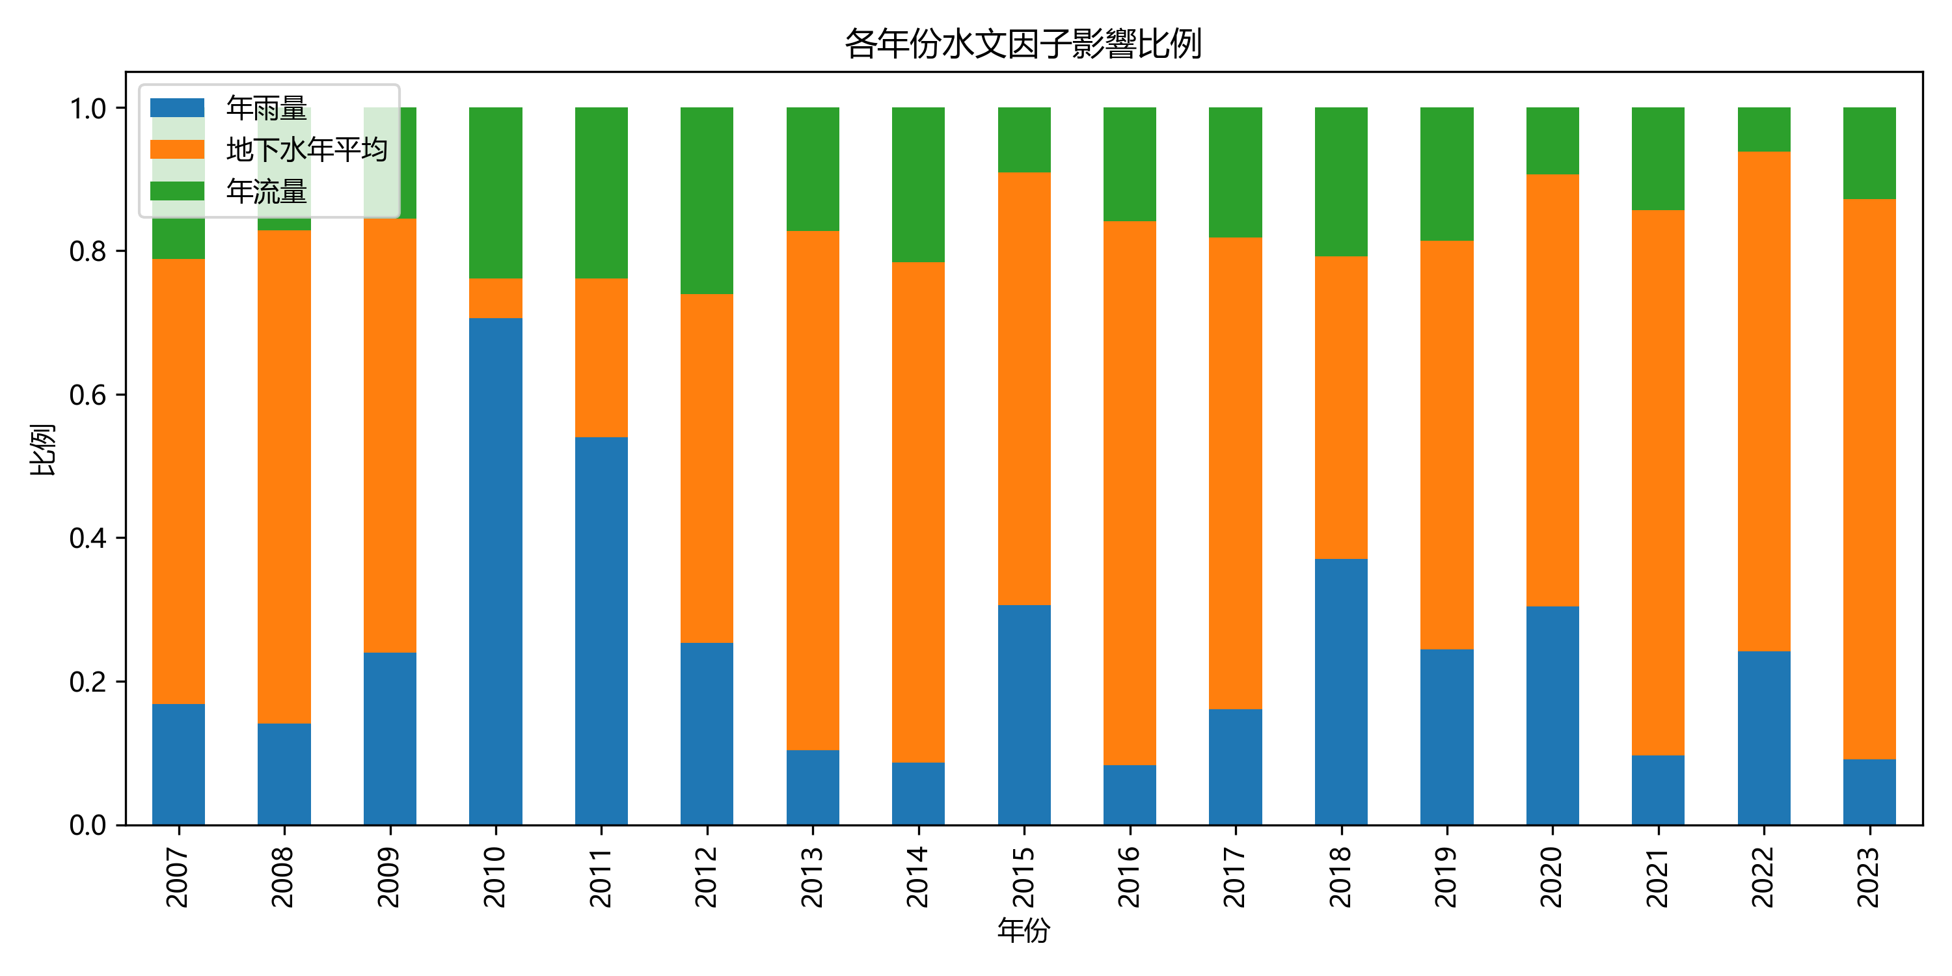

Feature Importance Analysis for Paddy Yield Prediction
$\hat{y}:$predict yield
Random Forest
$$\hat{y}=f(rain,gw,flow)$$
𝑦 ̂=𝑓(𝑟𝑎𝑖𝑛,𝑔𝑤,𝑓𝑙𝑜𝑤)
SHAP
$$\hat{y}=∅_{0}+∅_{rain}+∅_{gw}+∅_{flow}$$
𝑦 ̂=∅_0+∅_𝑟𝑎𝑖𝑛+∅_𝑔𝑤+∅_𝑓𝑙𝑜𝑤
Groundwater_May
Groundwater_June
Streamflow_Feb
GW Apr
Rainfall last Dec
Streamflow May
GW Feb
Rainfall last Dec
Streamflow Jan
Streamflow Mar
GW Jan
GW Mar
Rainfall Jan
Streamflow Apr
GW last Dec
GW June
GW last Nov
Rainfall Feb
Streamflow last Nov
Rainfall April
year | Real_yield | Predict_yield
2007 | 6283.712 | 6632.973
2008 | 7245.319 | 7040.418
2009 | 7520.427 | 7443.65
2010 | 7371.465 | 7500.232
2011 | 7795.354 | 7813.055
2012 | 7428.671 | 7454.263
2013 | 6951.794 | 6978.443
2014 | 7155.977 | 7095.043
2015 | 7632.872 | 7688.947
2016 | 7320.25 | 7141.525
2017 | 7693.519 | 7586.372
2018 | 8644.664 | 8260.036
2019 | 7519.449 | 7594.227
2020 | 7661.934 | 7709.423
2021 | 8274.9 | 8088.802
2022 | 7711.829 | 7732.926
2023 | 8339.501 | 8199.219
Annual Contribution of Hydrological Factors
Annual Contribution of Hydrological Factors
Rainfall
Ground water
Stream flow
percent
factor | contribution(%)
Ground water | 60.1
Stream flow | 26.1
rainfall | 13.8
year

Slide 4
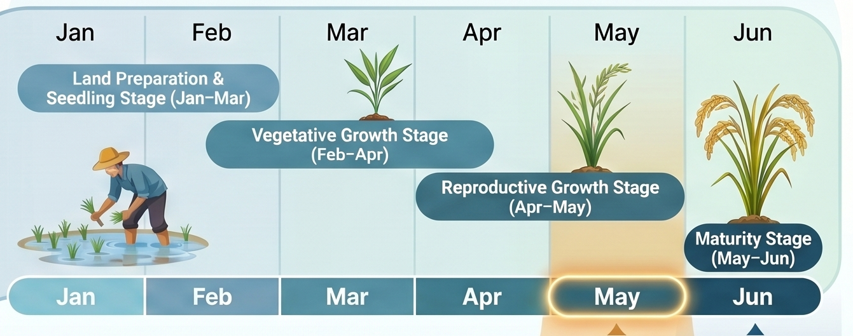
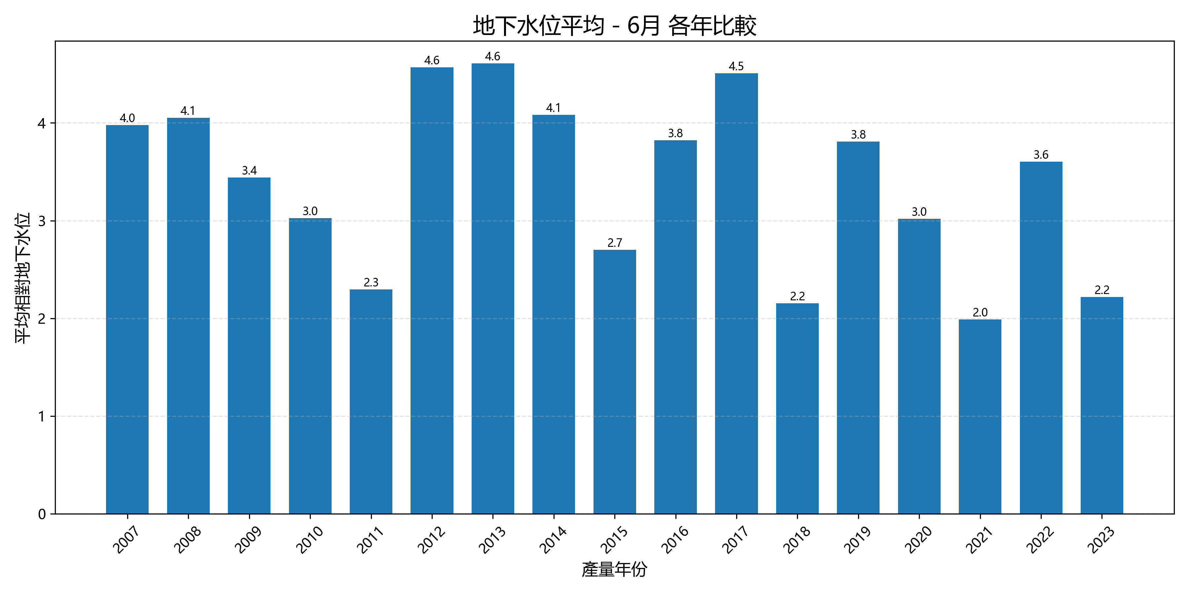
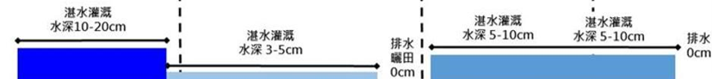
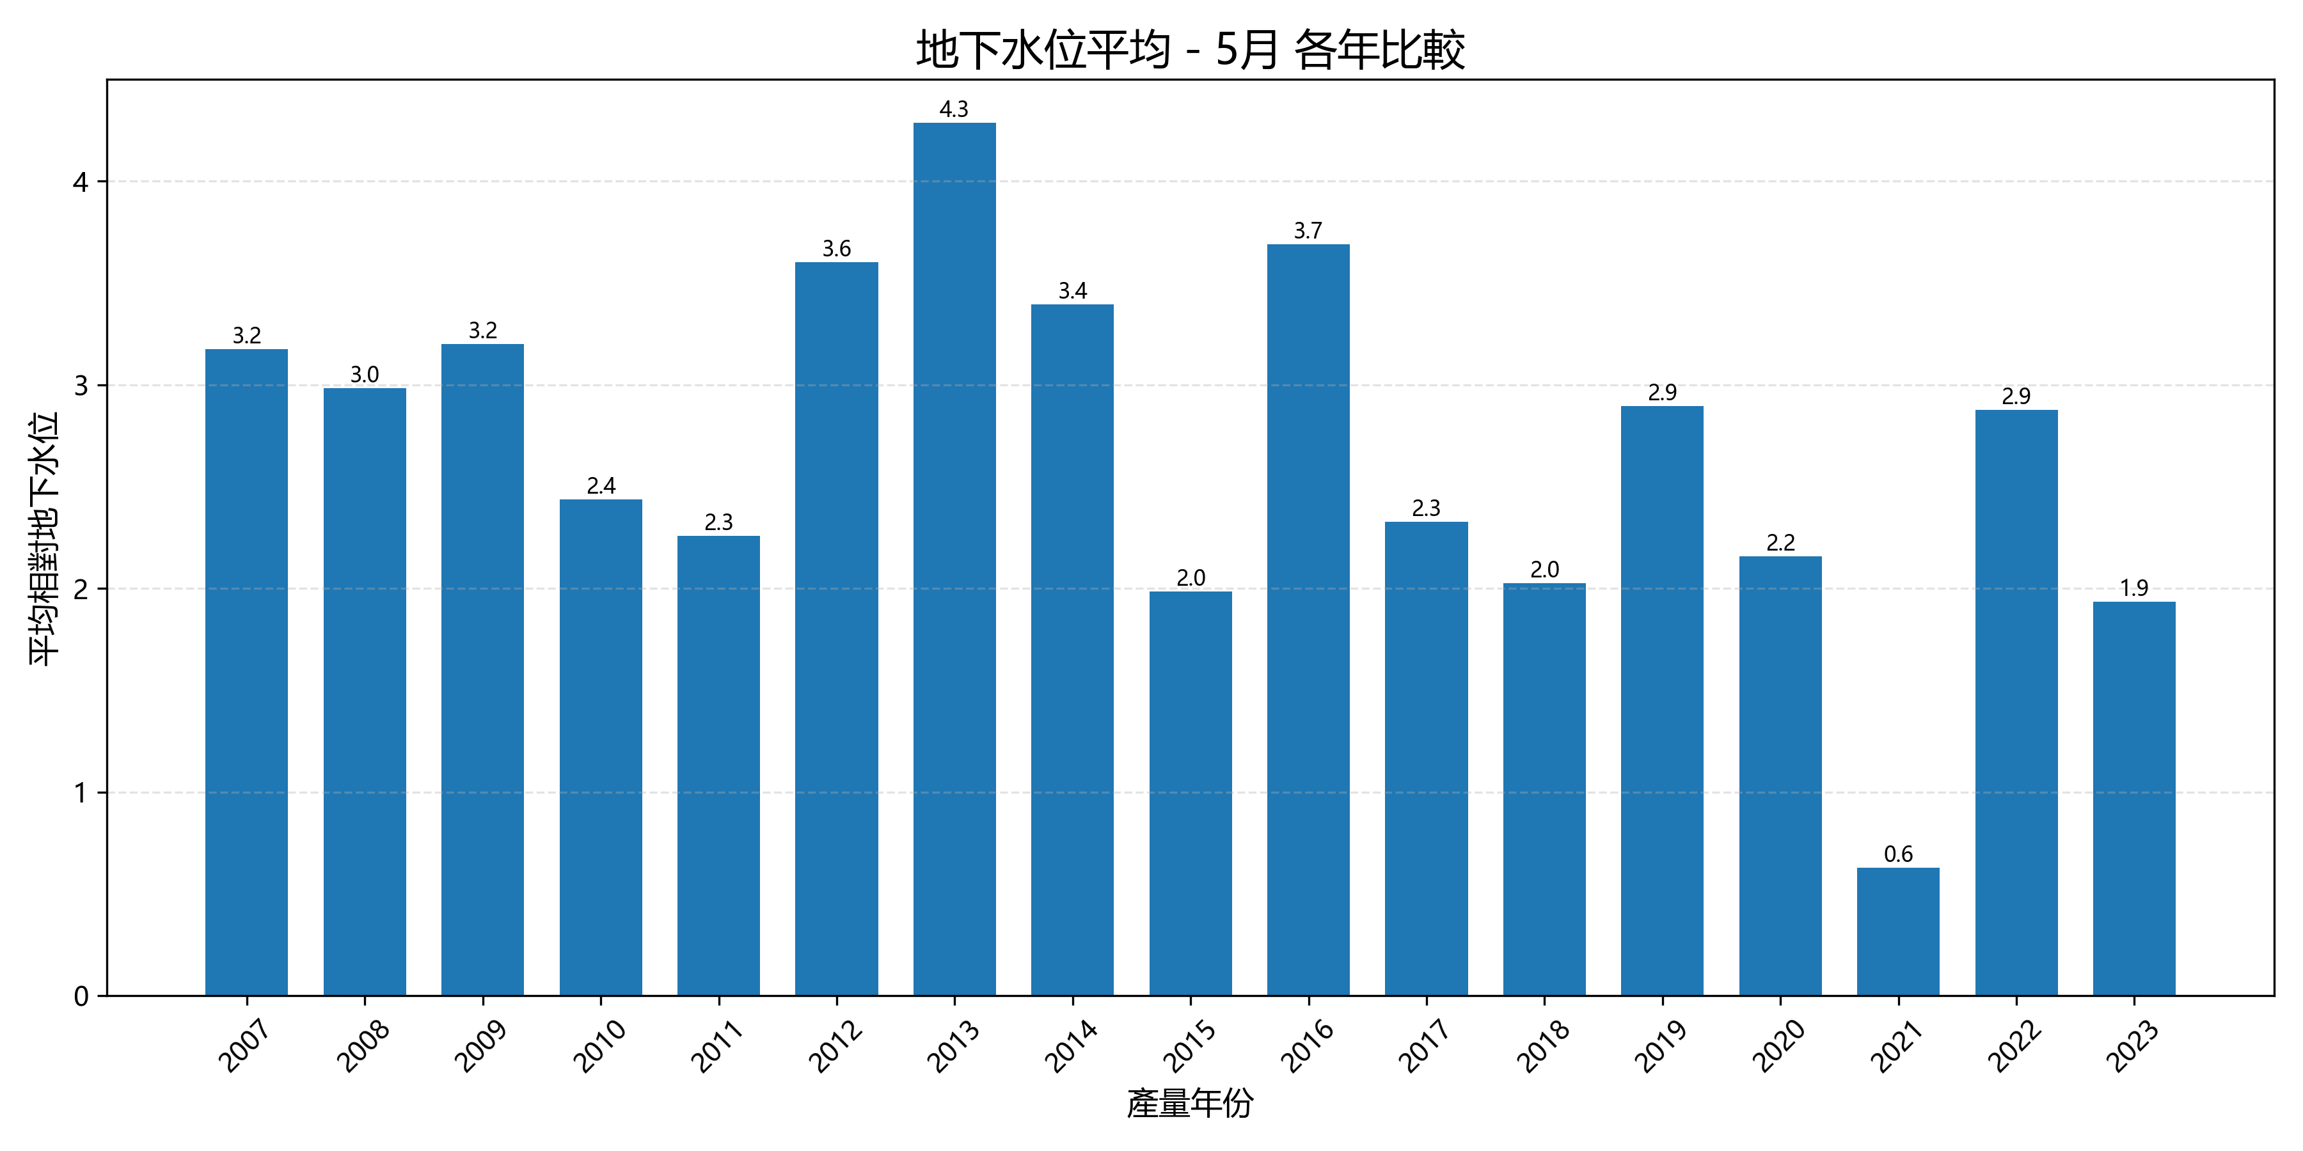
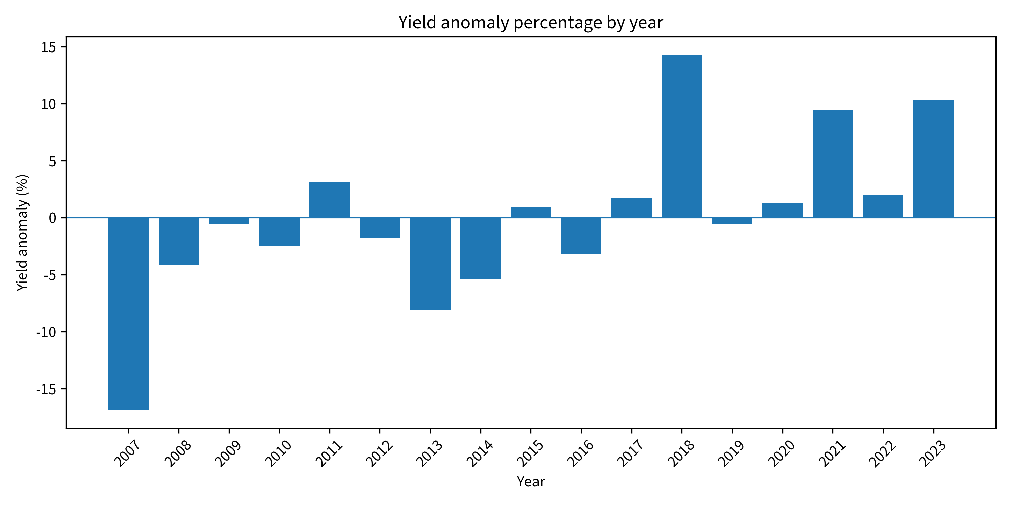
Linking SHAP-Identified Groundwater Importance to Rice Physiological Water Demand
Annual June Groundwater
Annual Contribution of Hydrological Factors
Water depth
10-20cm
Water depth
5-10cm
Water depth
3-5cm
0cm
0cm
0cm
0cm
Annual Contribution of Hydrological Factors
Annual May Groundwater

Slide 5
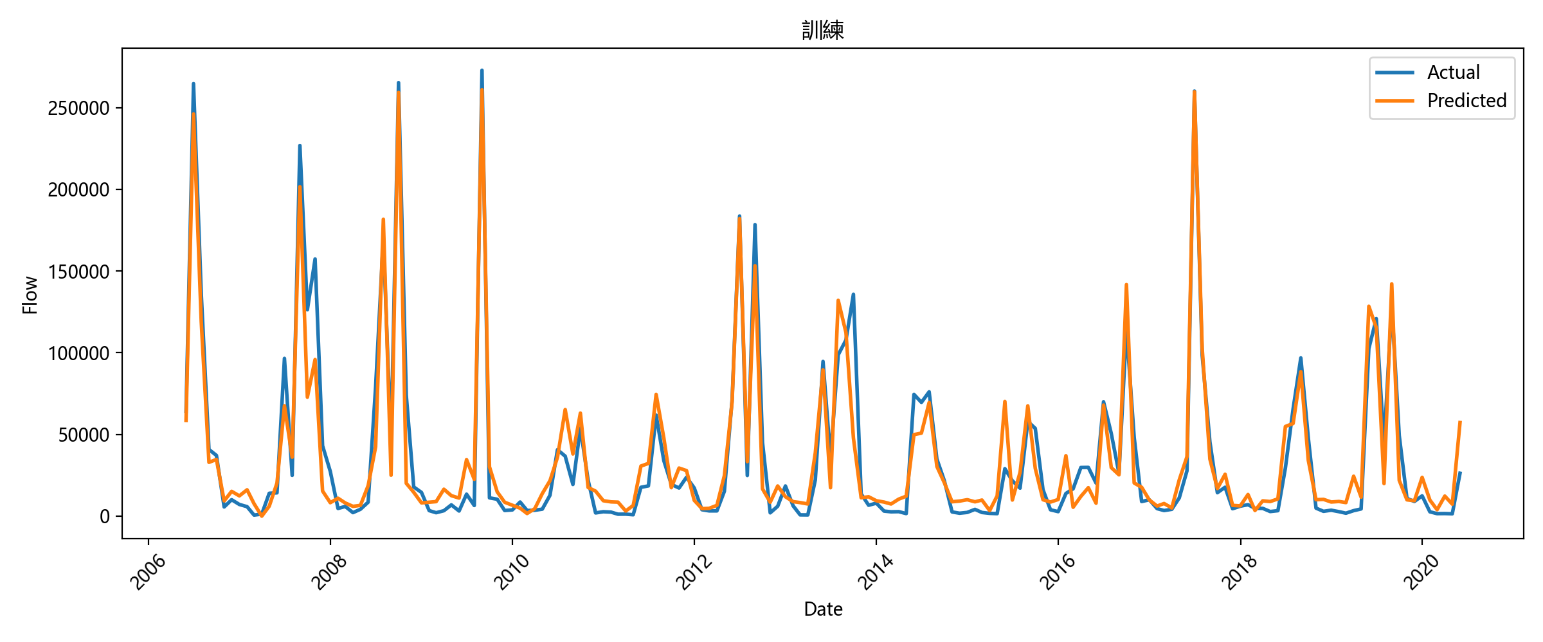
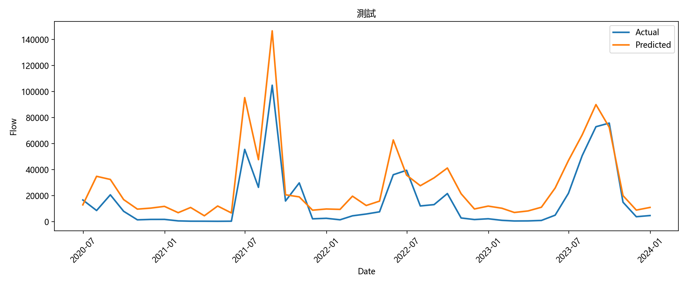
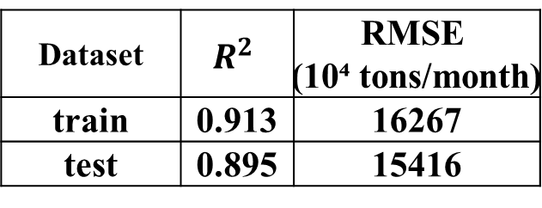
LSTM-Based Monthly Accumulated Streamflow Prediction at Xizhou Bridge Station
train
Dataset | $$R^{2}$$ | RMSE (10⁴ tons/month)
train | 0.913 | 16267
test | 0.895 | 15416
test

Slide 6
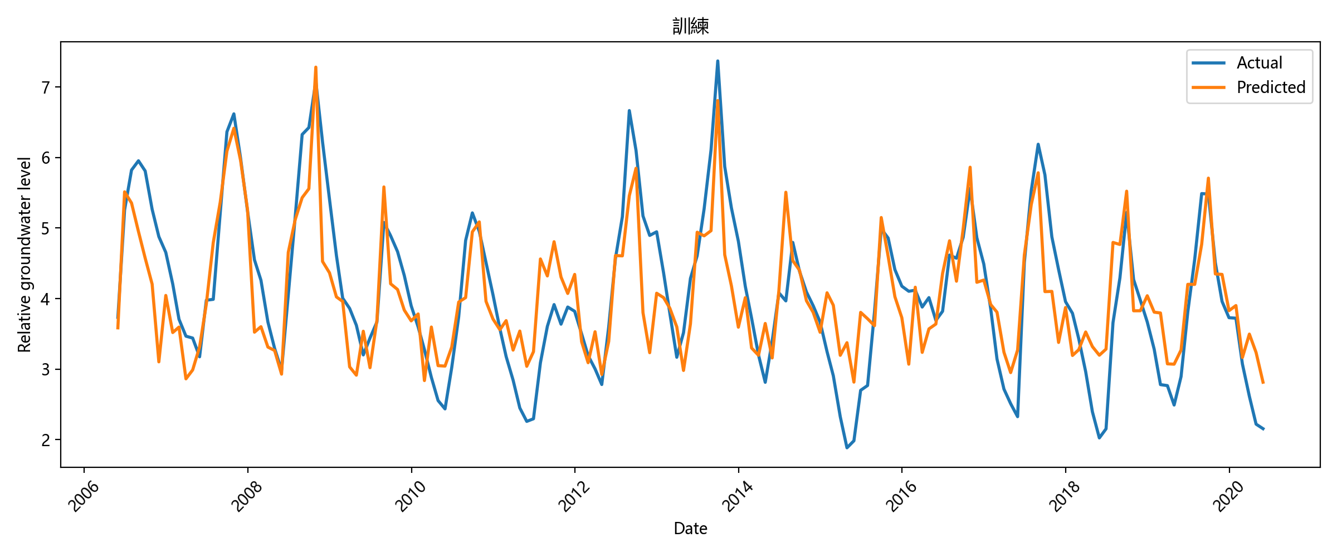
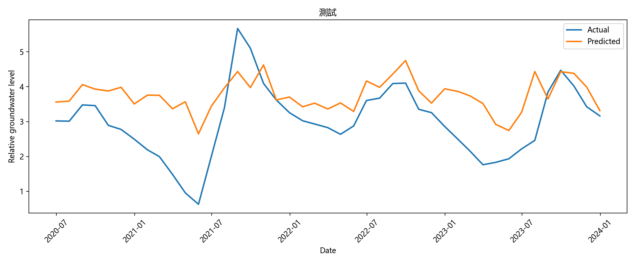
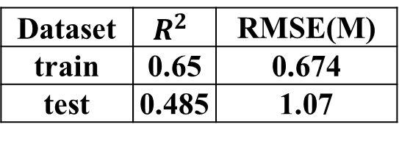
LSTM Prediction of Basin-Average First-Layer Groundwater Levels
train
Dataset | $$R^{2}$$ | RMSE(M)
train | 0.65 | 0.674
test | 0.485 | 1.07
test

Slide 7

Thank you very much!
Gmail：henry66211chu@gmail.com
School:Department of Water Resources and Environmental Engineering,Tamkang University
Professor: changlc@mail.tku.edu.tw

