Slide 1





The effect of freshwater biases on AMOC stability across the model complexity spectrum
Boot, A.A., and Dijkstra, H.A. (2026).
Under (minor) revision for Climate Dynamics.
Sharing is
encouraged
Amber A. Boot (she/they)
Technical University of Denmark (aadbo@aqua.dtu.dk)
and Henk Dijkstra
and

Slide 2

AMOC
Amber A. Boot (aadbo@aqua.dtu.dk)
Hypotheses
The AMOC can tip
Climate models have a too stable AMOC
This is (partially) related to model biases
Consequence
Climate models might underestimate AMOC tipping
Question
How do model biases, specifically freshwater biases, influence AMOC stability?
1

Slide 3
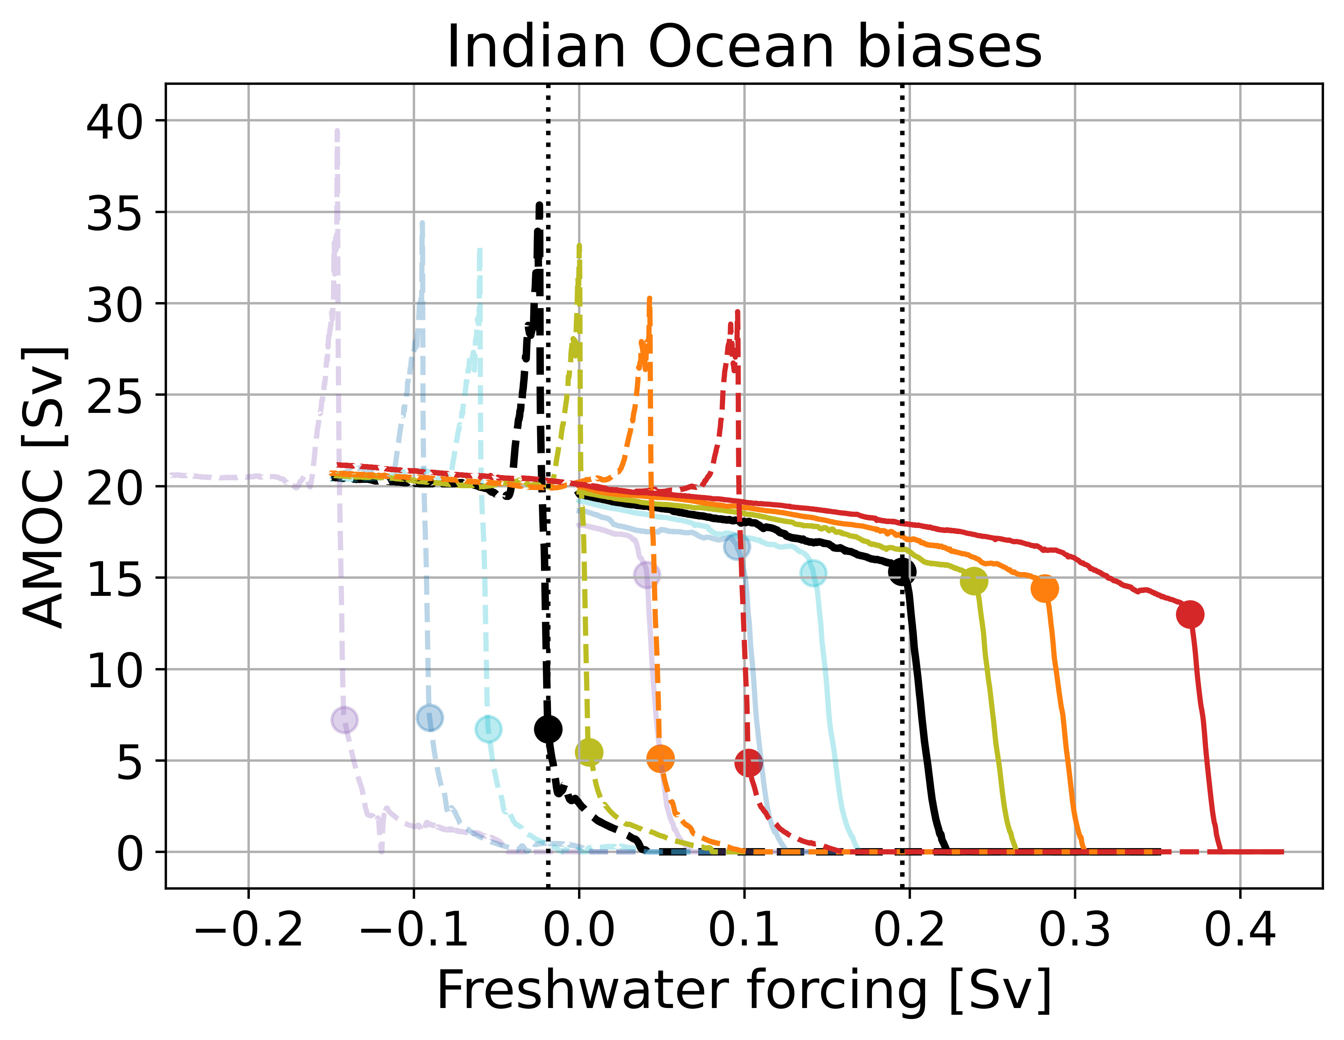
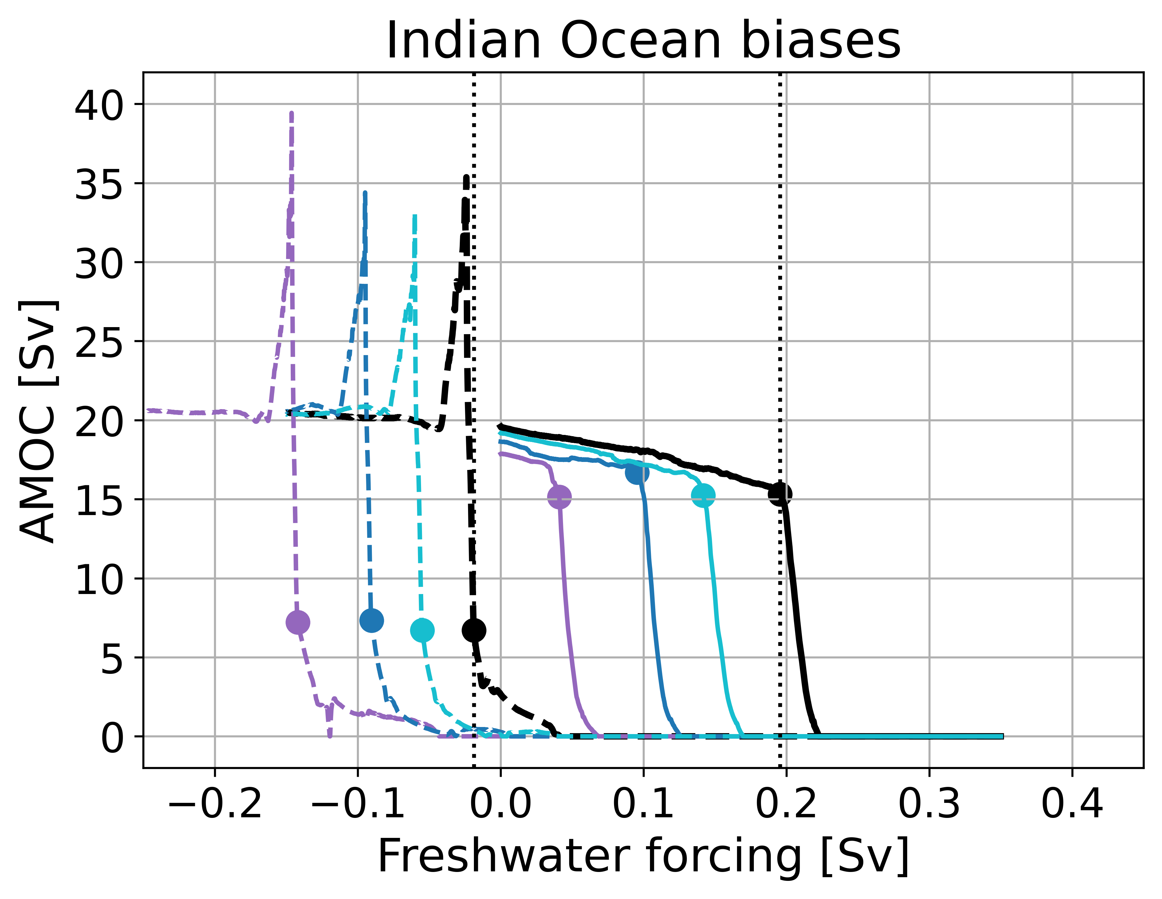
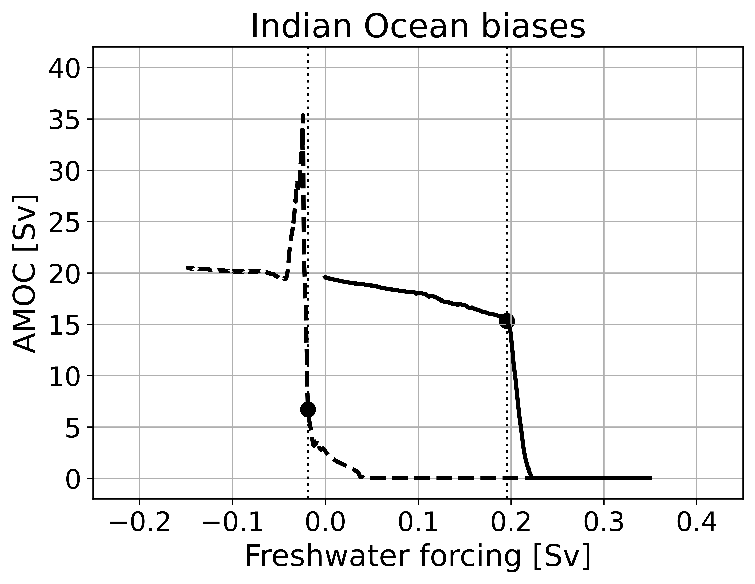

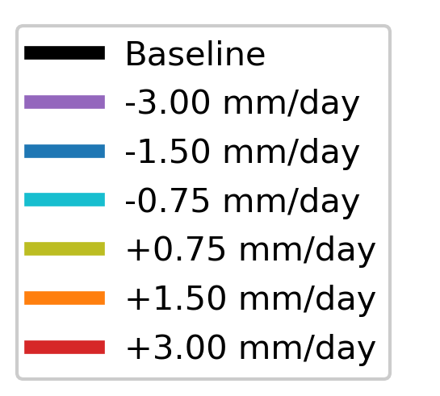
Studying AMOC stability in an EMIC
Amber A. Boot (aadbo@aqua.dtu.dk)
QE freshwater forcing in the North Atlantic (hosing)
How does this work in more complex, higher resolution models?
*Positive: fresher; negative: more saline
Boot and Dijkstra (2025). ESD.
2

Slide 4
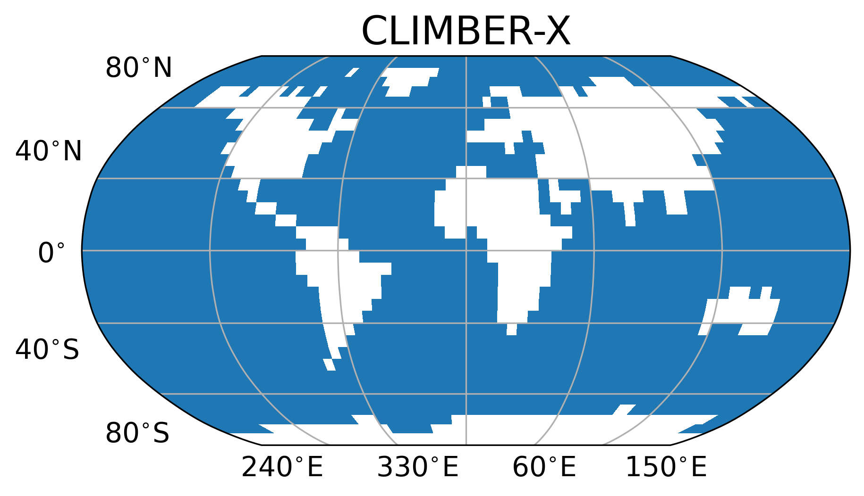
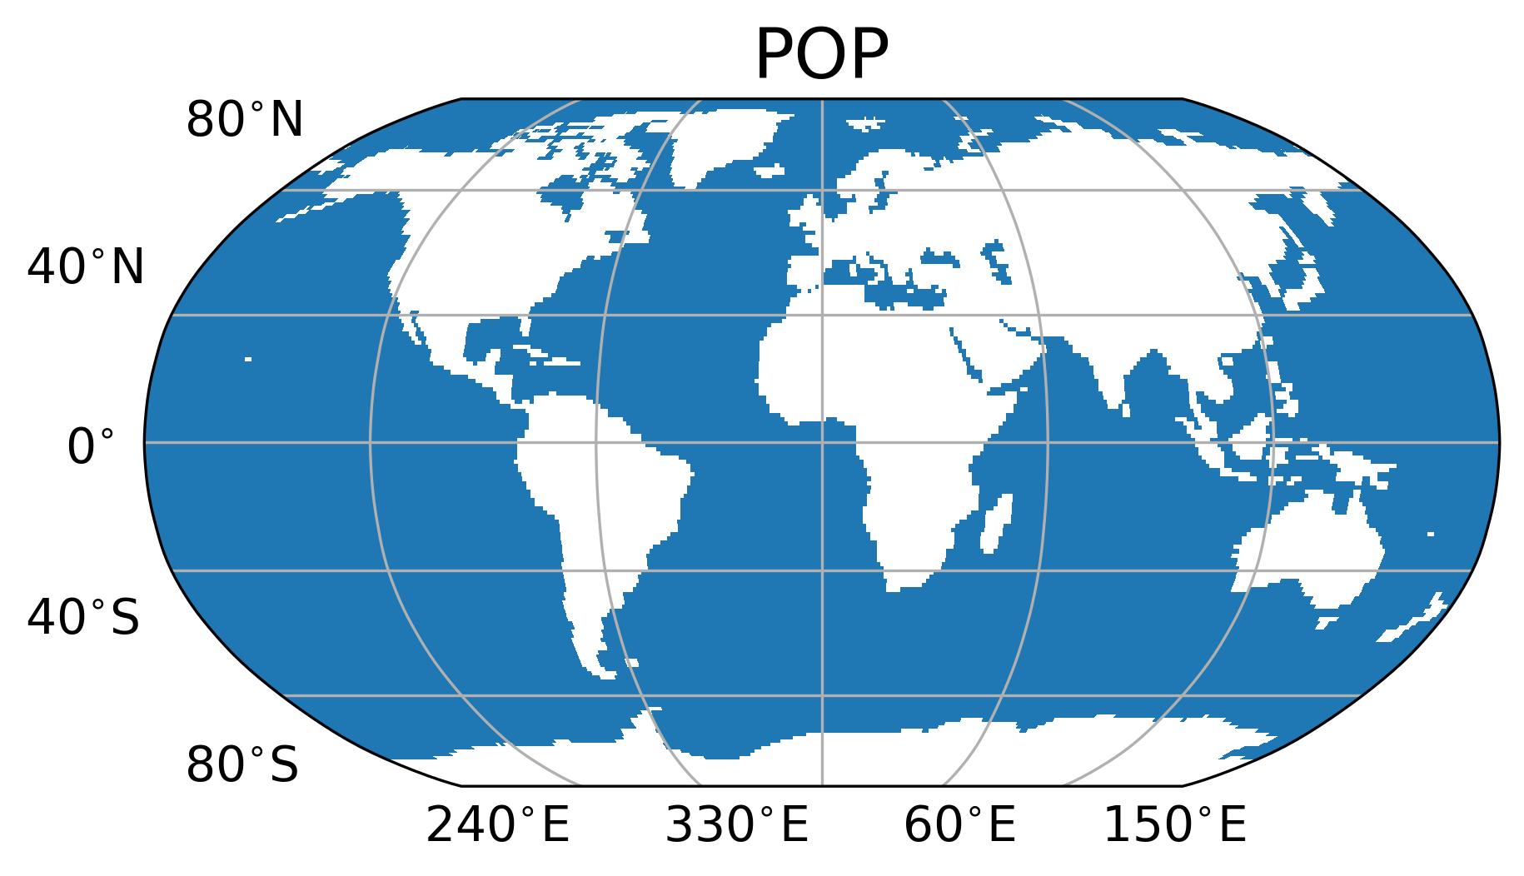
Models
Amber A. Boot (aadbo@aqua.dtu.dk)
CLIMBER-X
  EMIC
  5° resolution
POP2
  Ocean-only
  1° resolution
  Atmospheric forcing prescribed
  15x more expensive
3

Slide 5
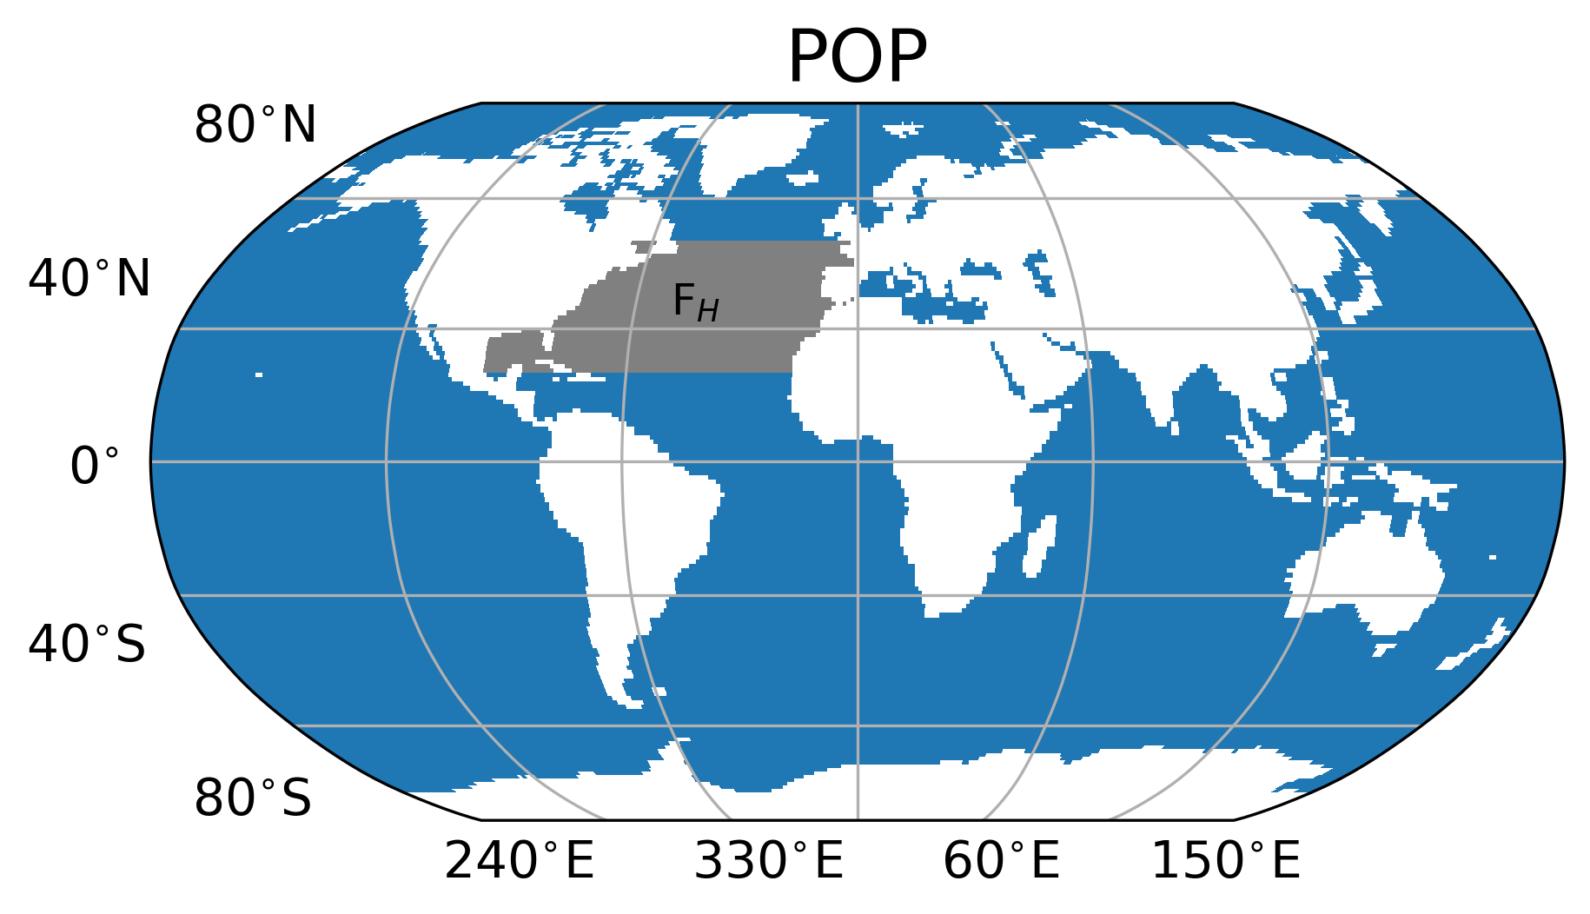
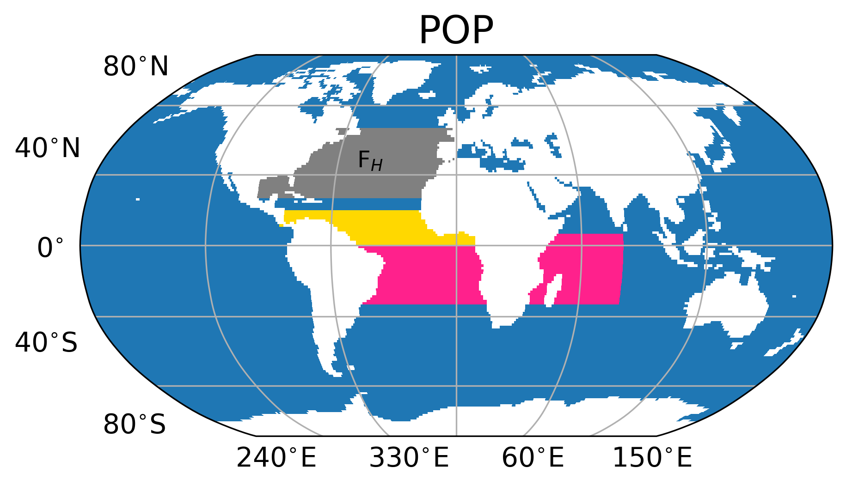
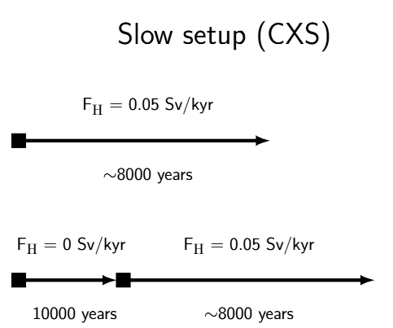
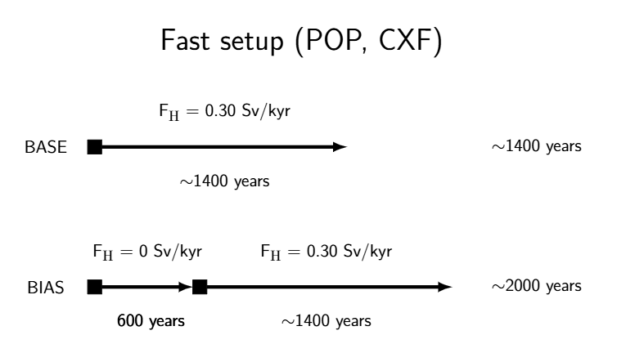
Experimental setup
Amber A. Boot (aadbo@aqua.dtu.dk)
Quasi-equilibrium hosing:
  20°N – 50°N
  0.05 Sv/kyr (CLIMBER-X)
  0.30 Sv/kyr (CLIMBER-X, POP2)
Add positive and negative biases* in the freshwater flux:
  Indian Ocean (I)
  Atlantic Ocean (A)
  Both basins (IA)
*Positive: fresher; negative: more saline
4

Slide 6
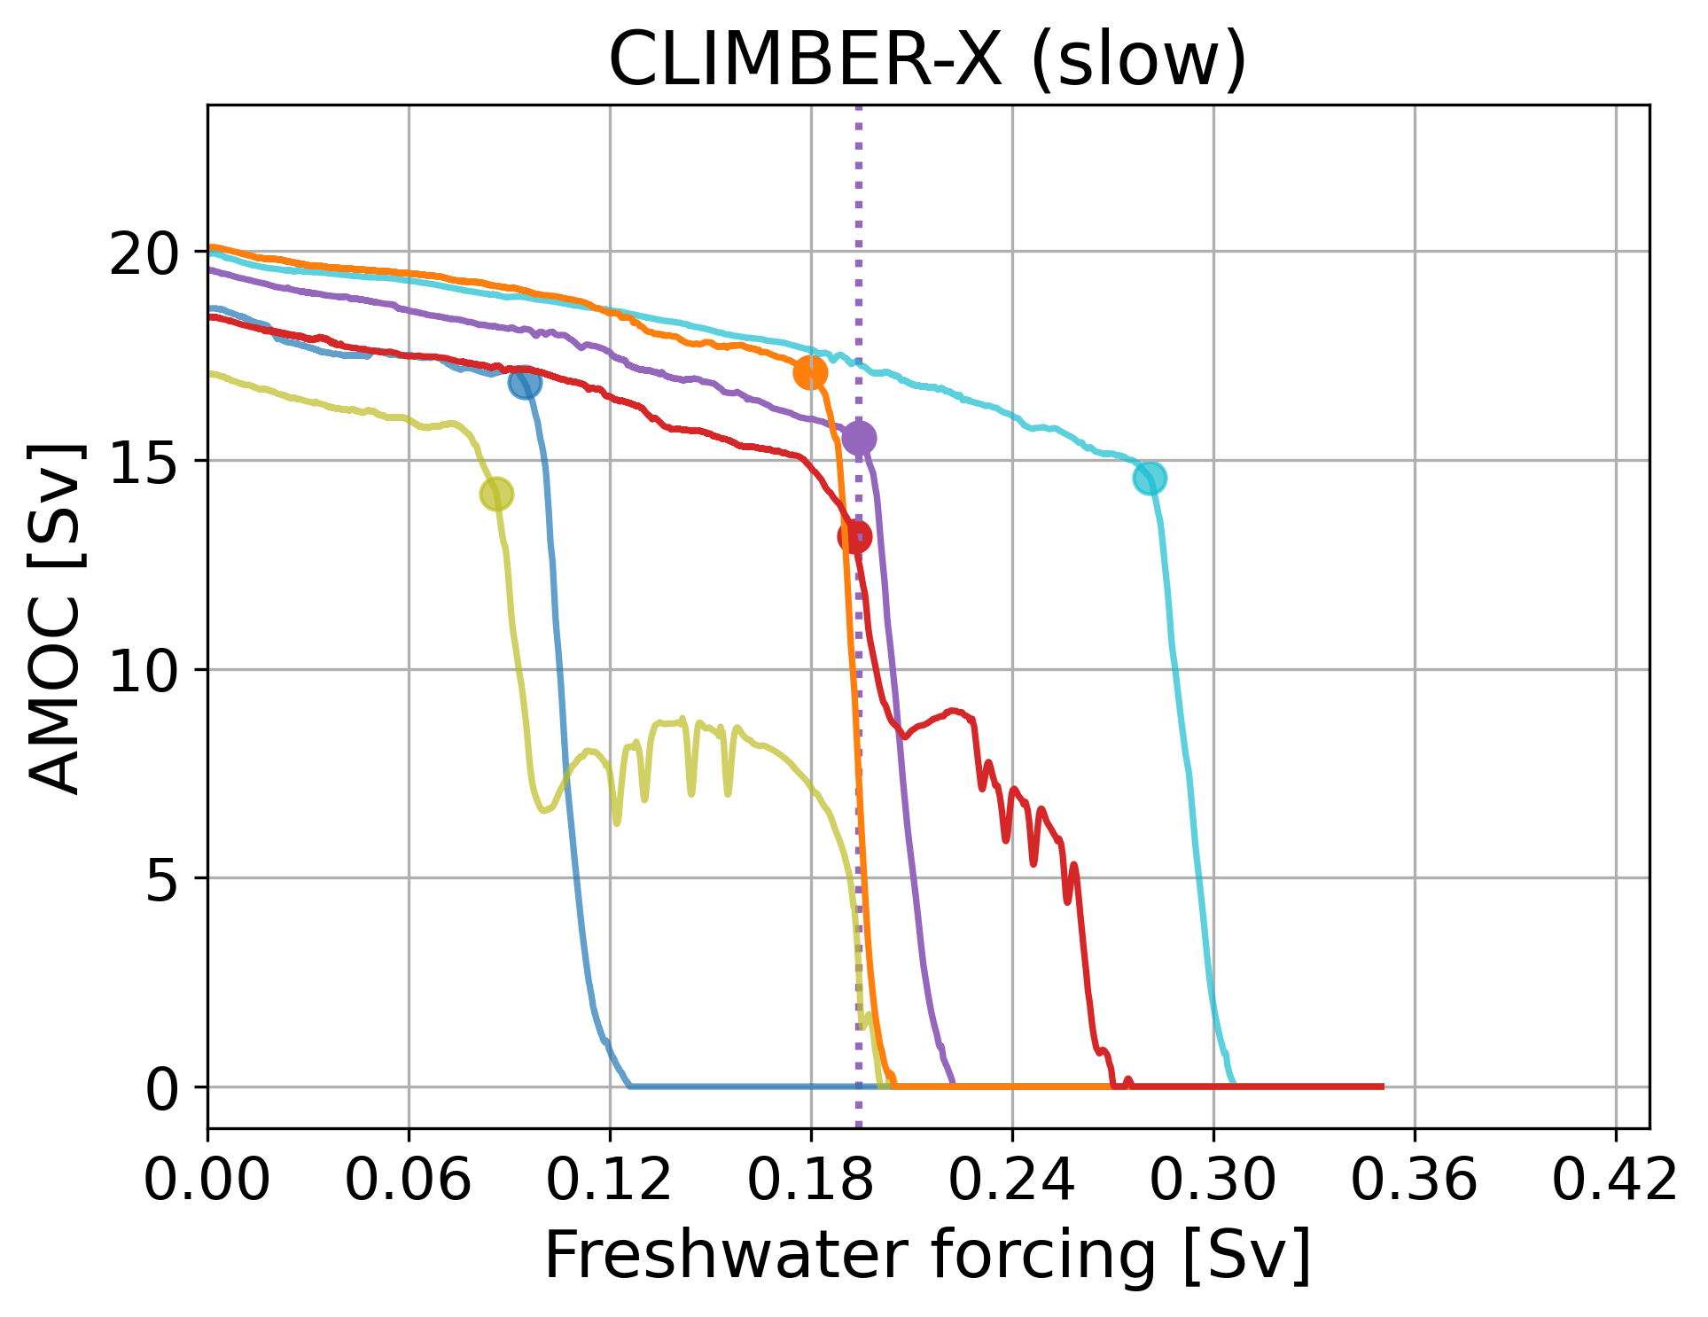
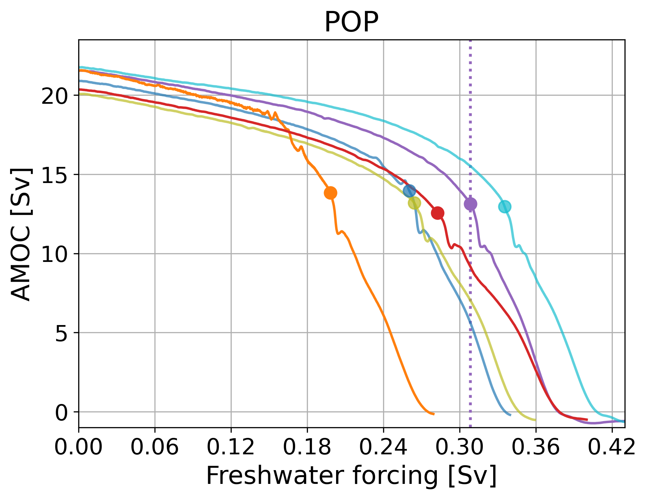
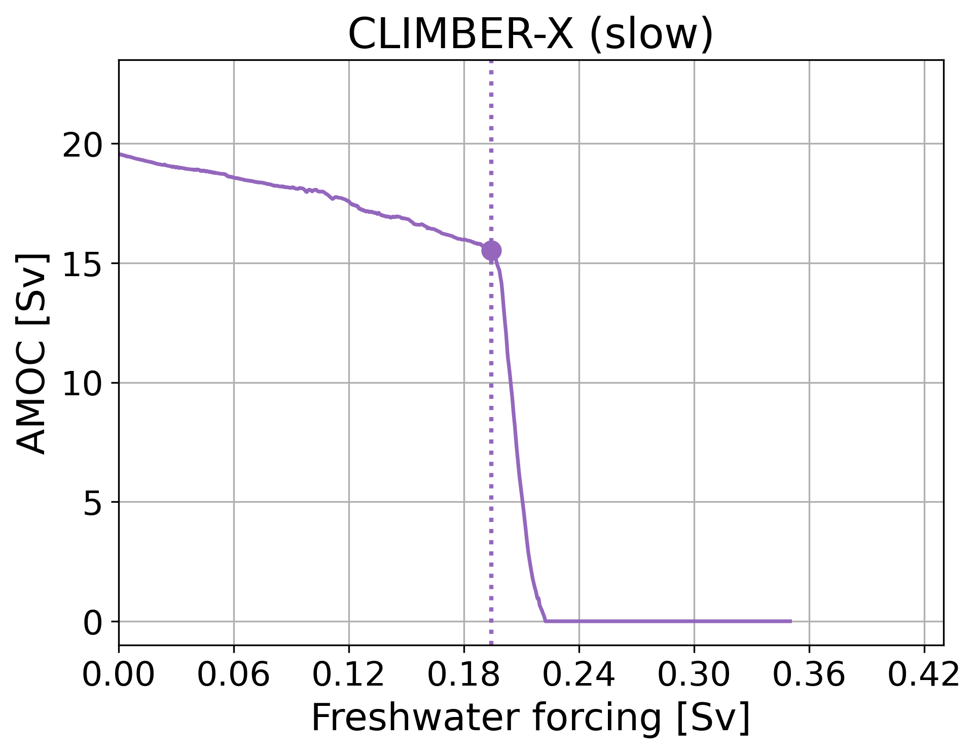
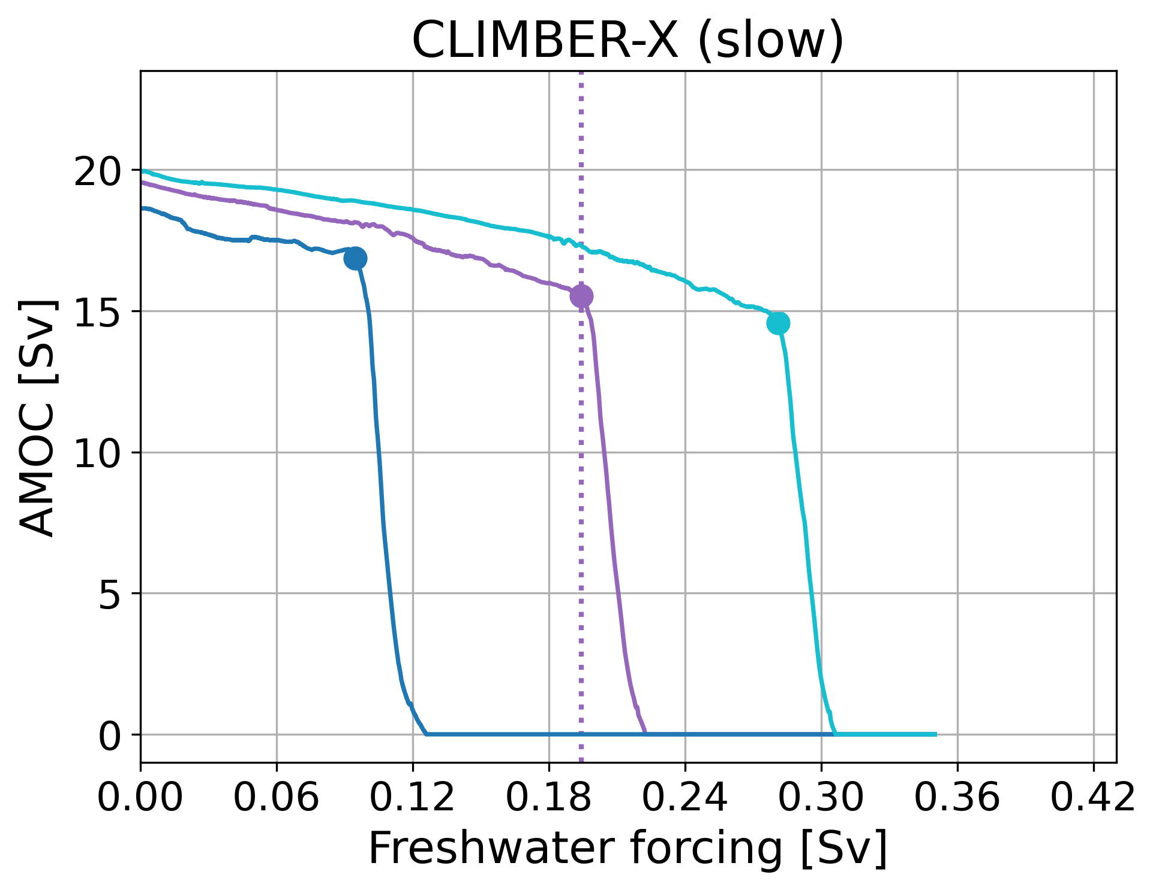
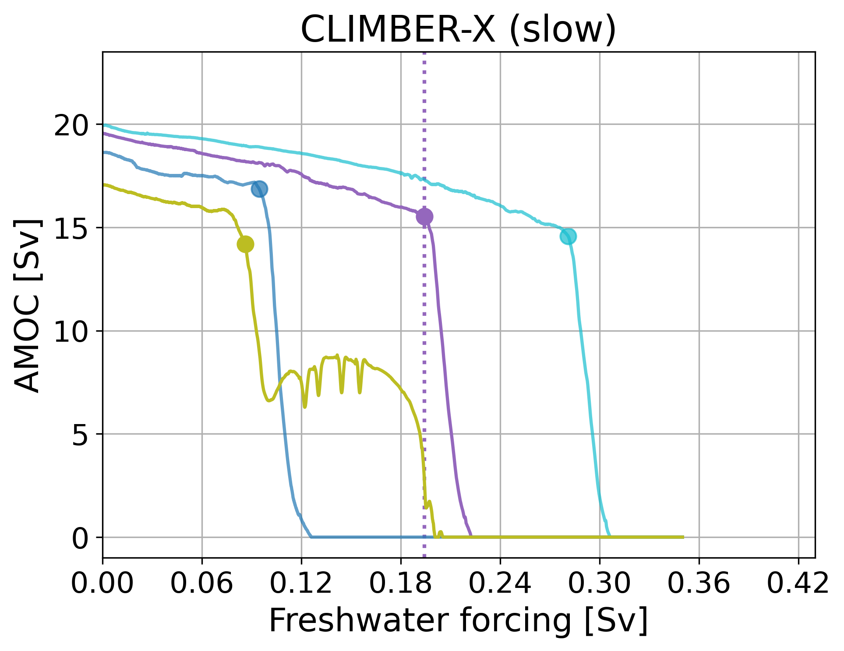
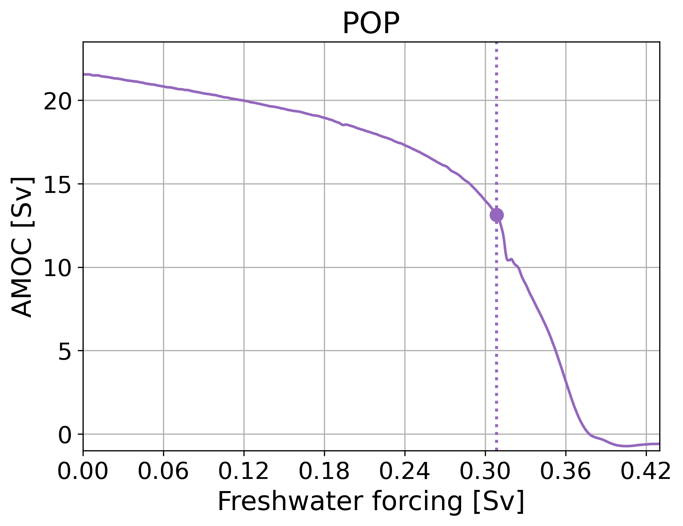
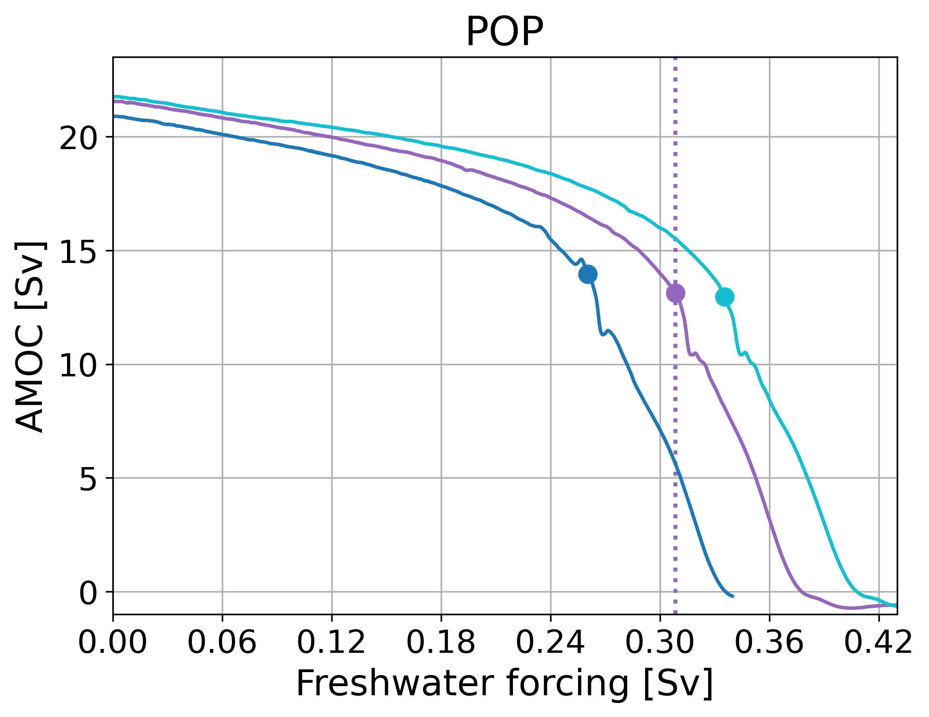
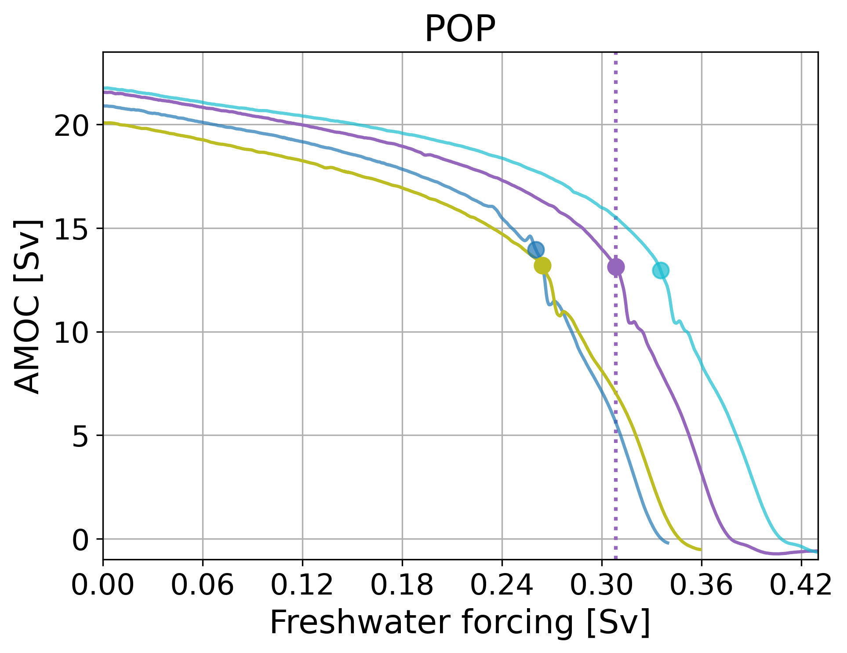
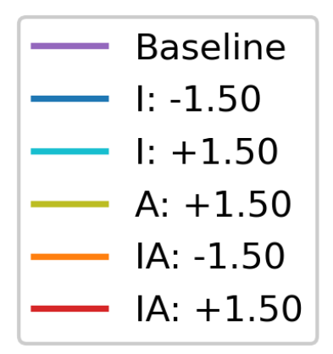
AMOC collapse
Amber A. Boot (aadbo@aqua.dtu.dk)
*Positive: fresher; negative: more saline
5

Slide 7
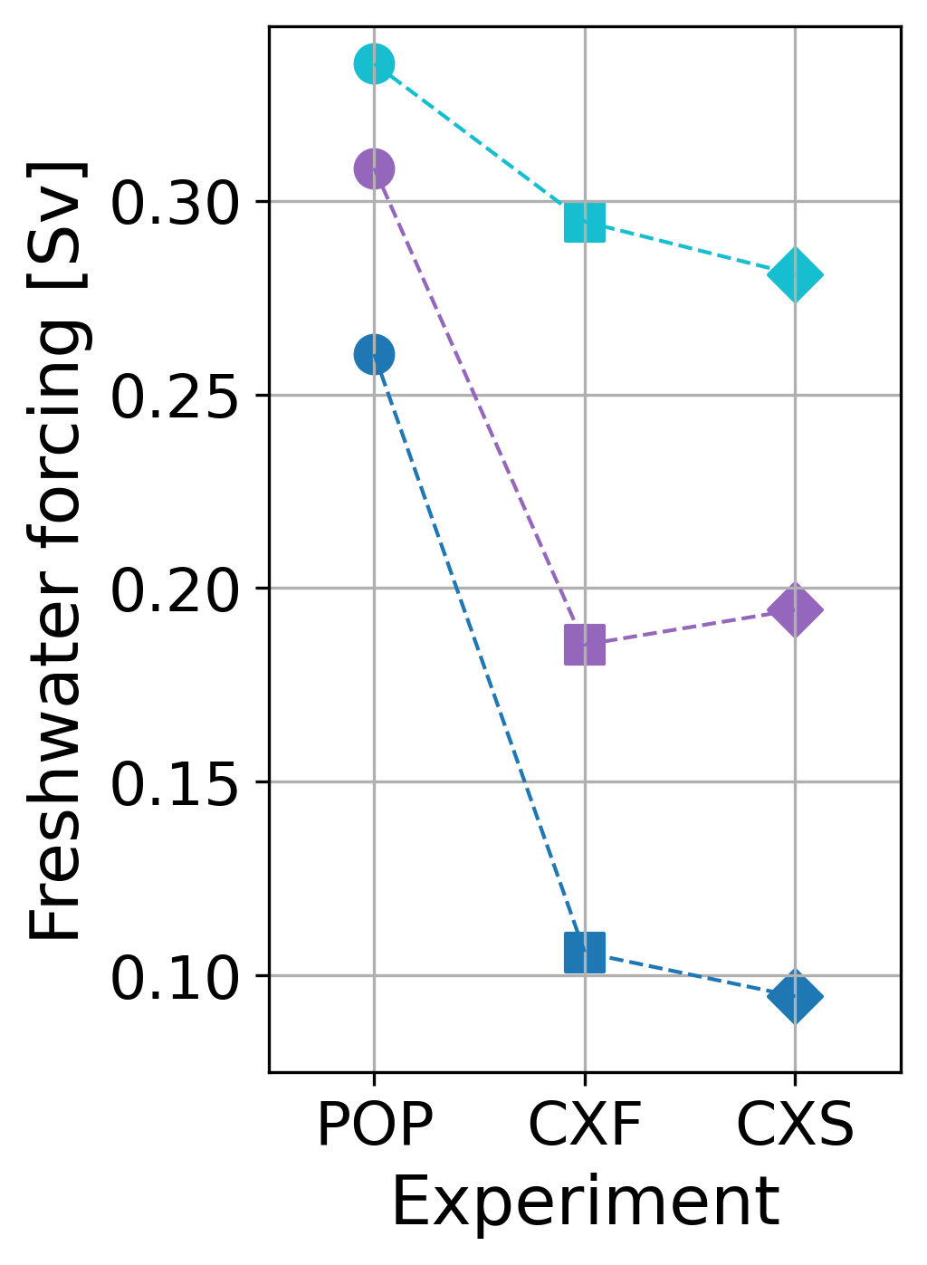
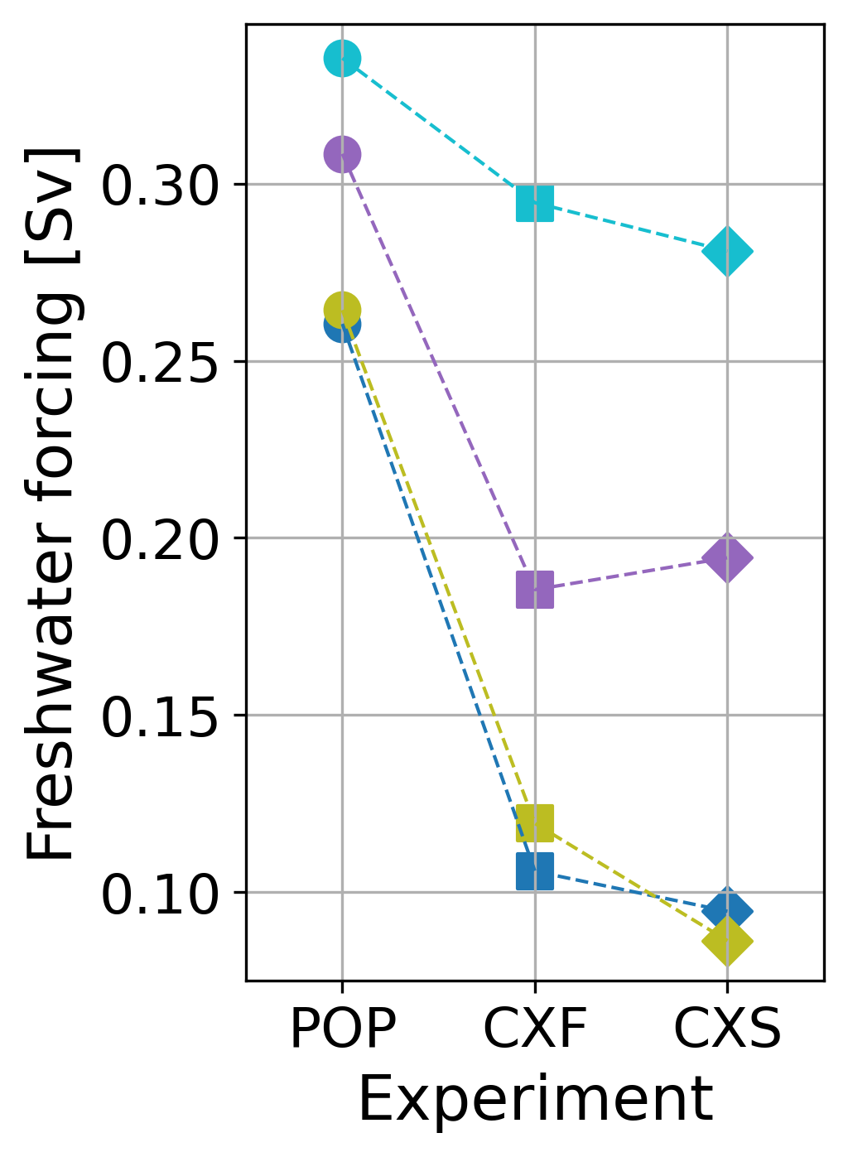
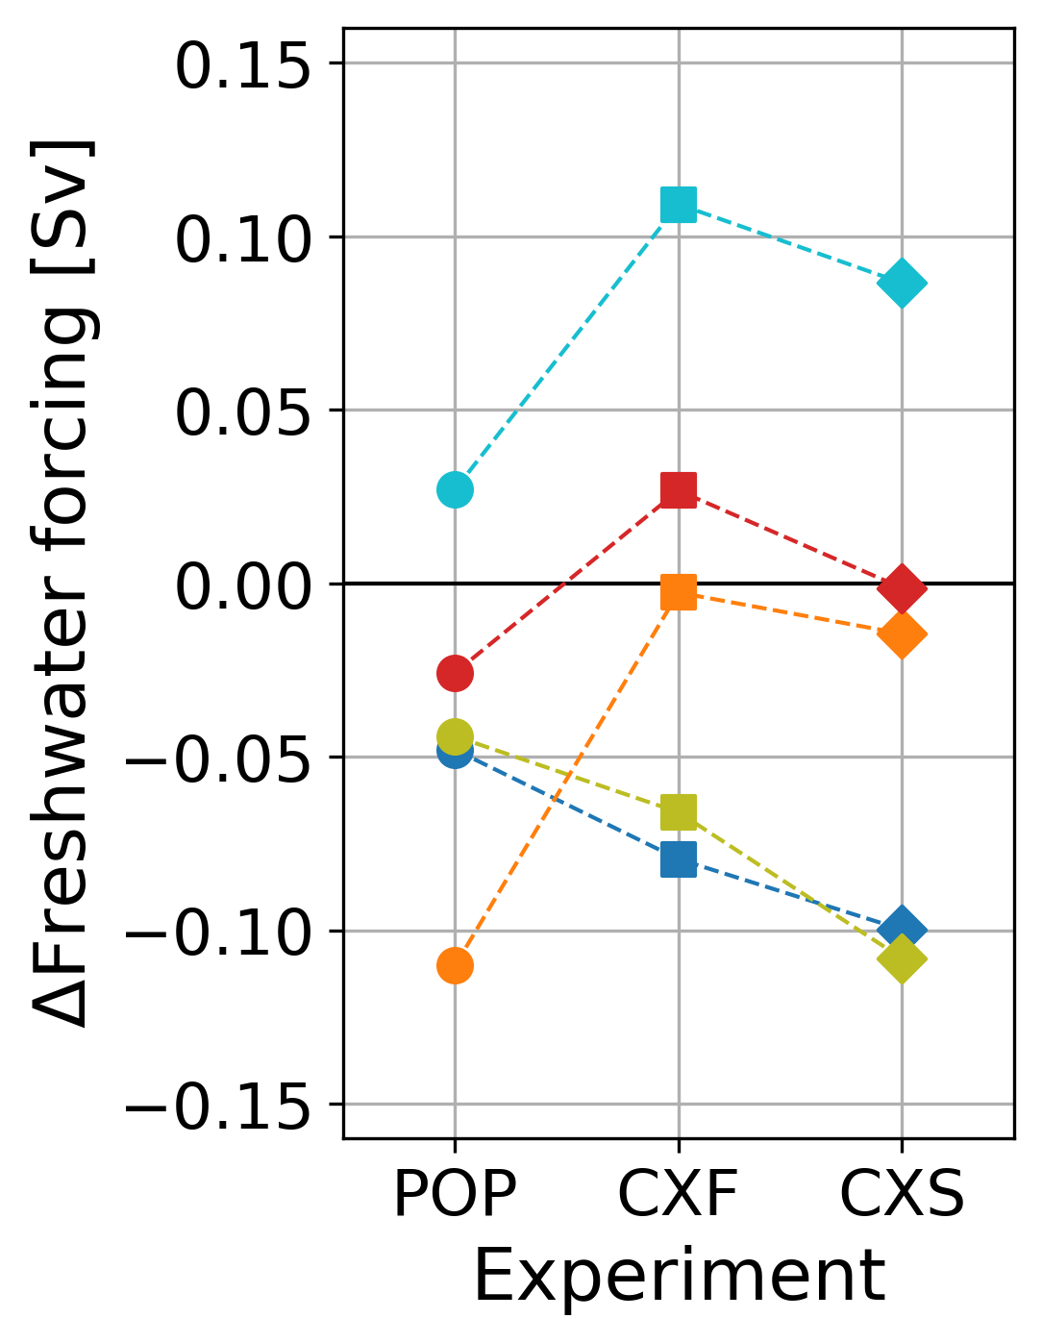
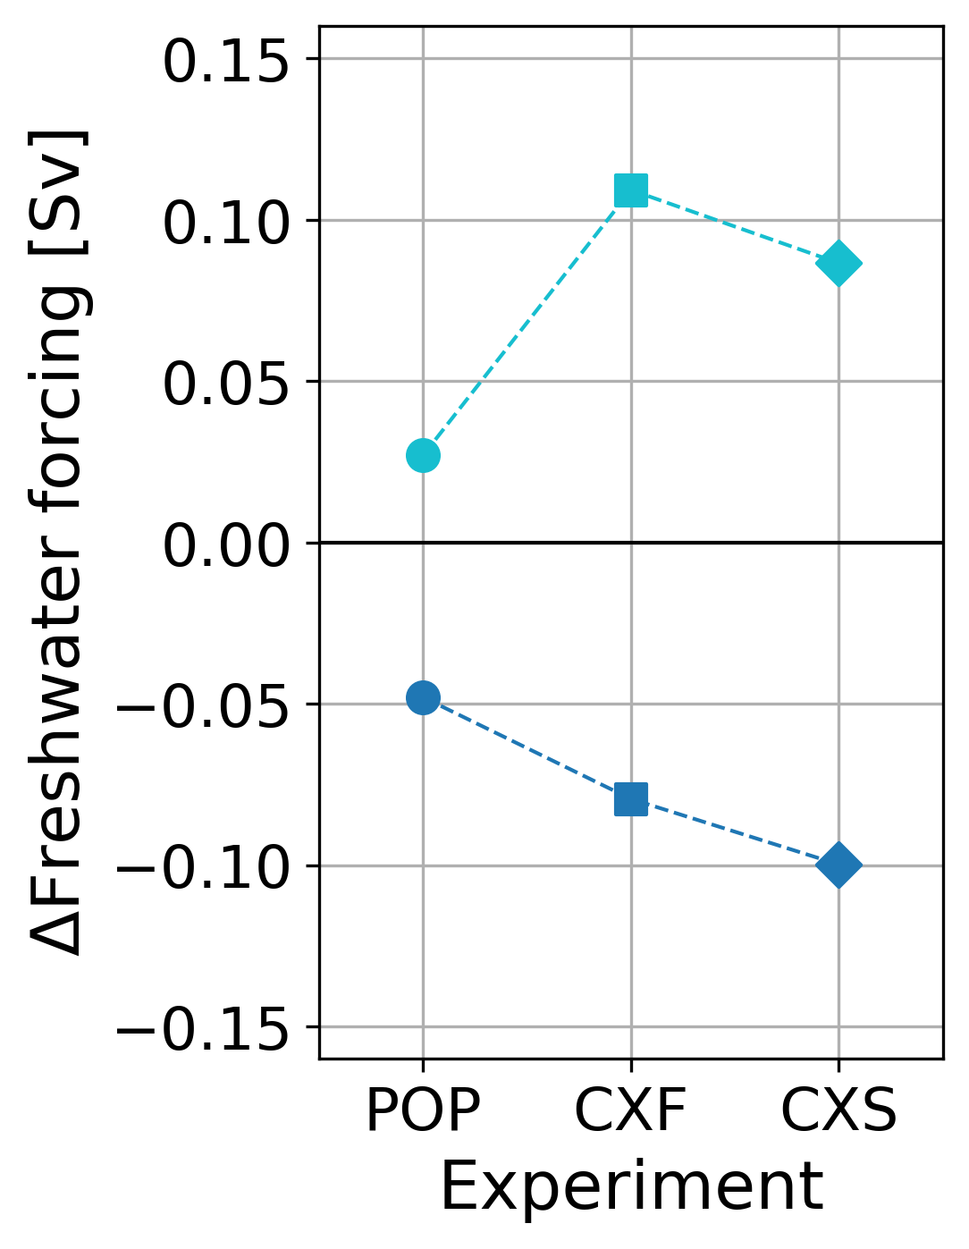
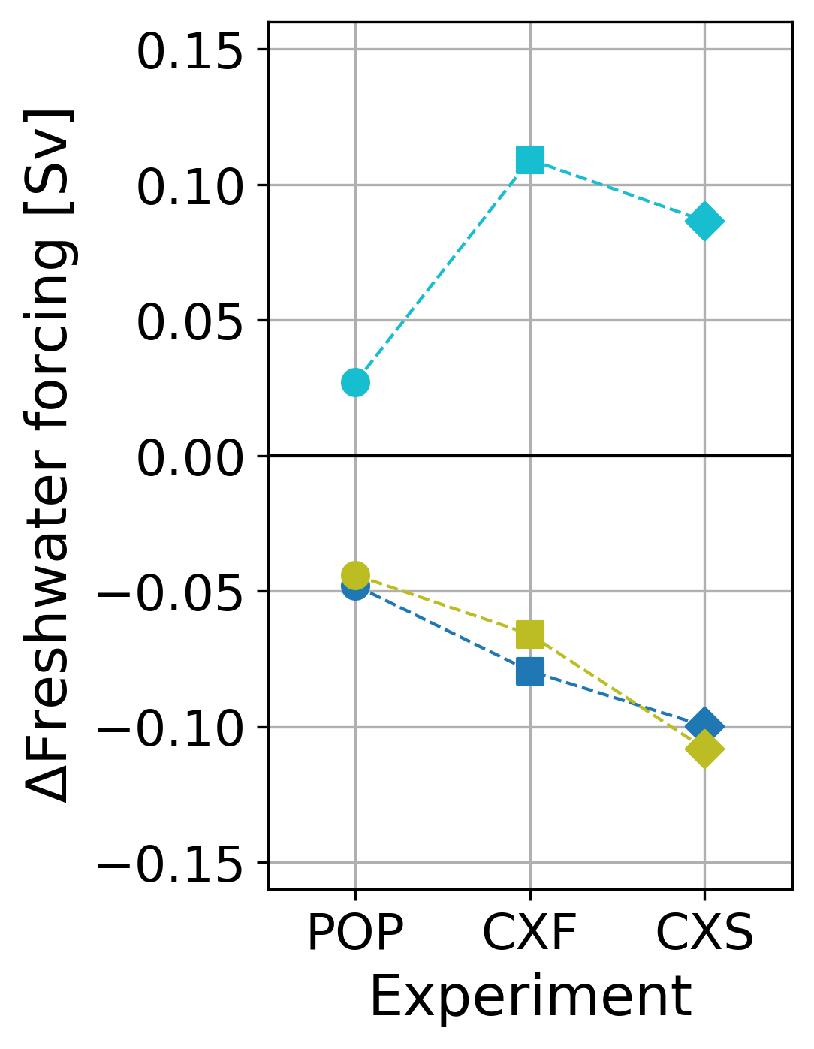
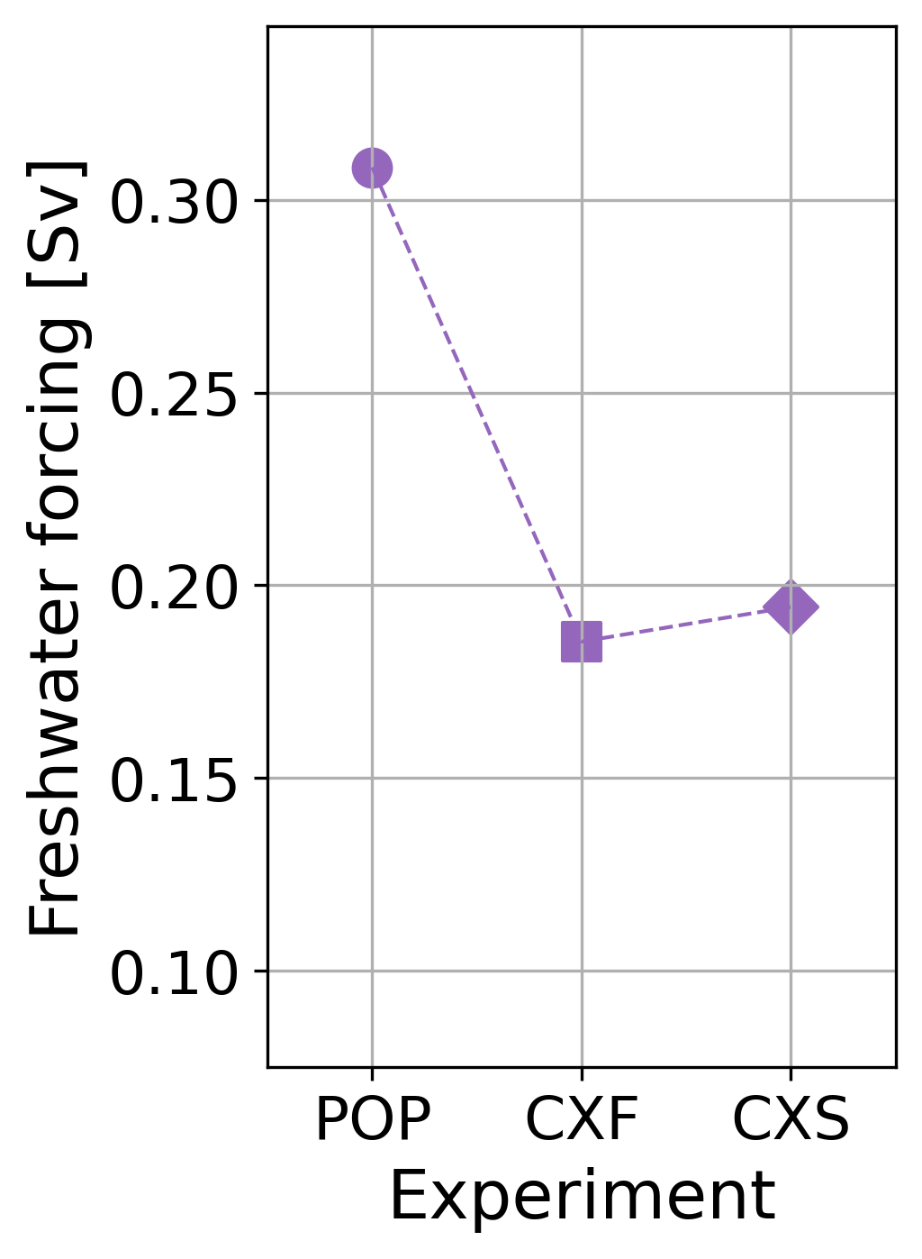
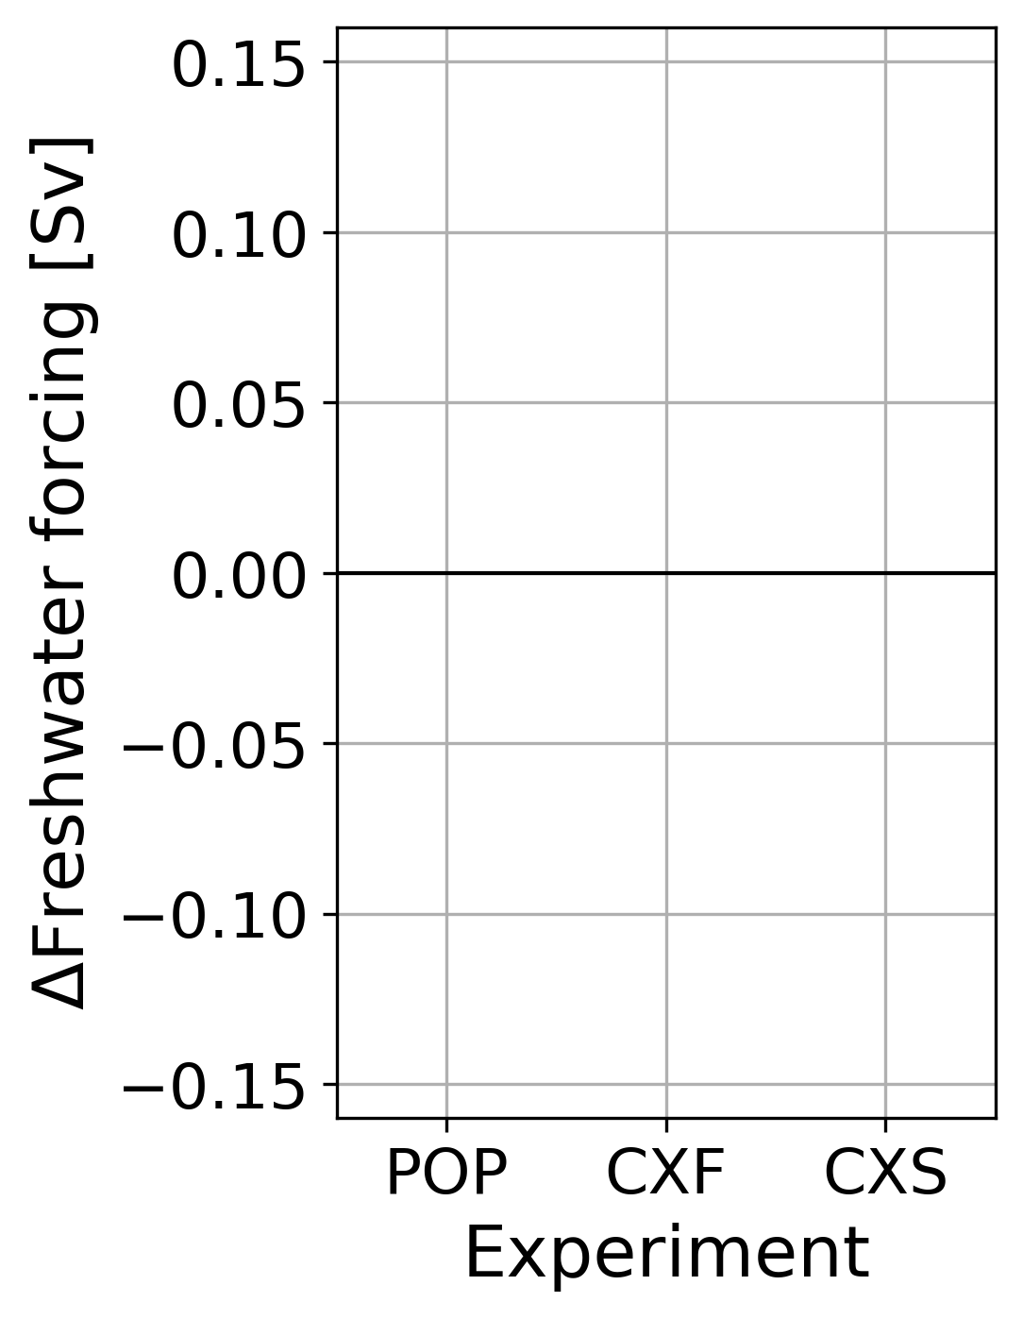
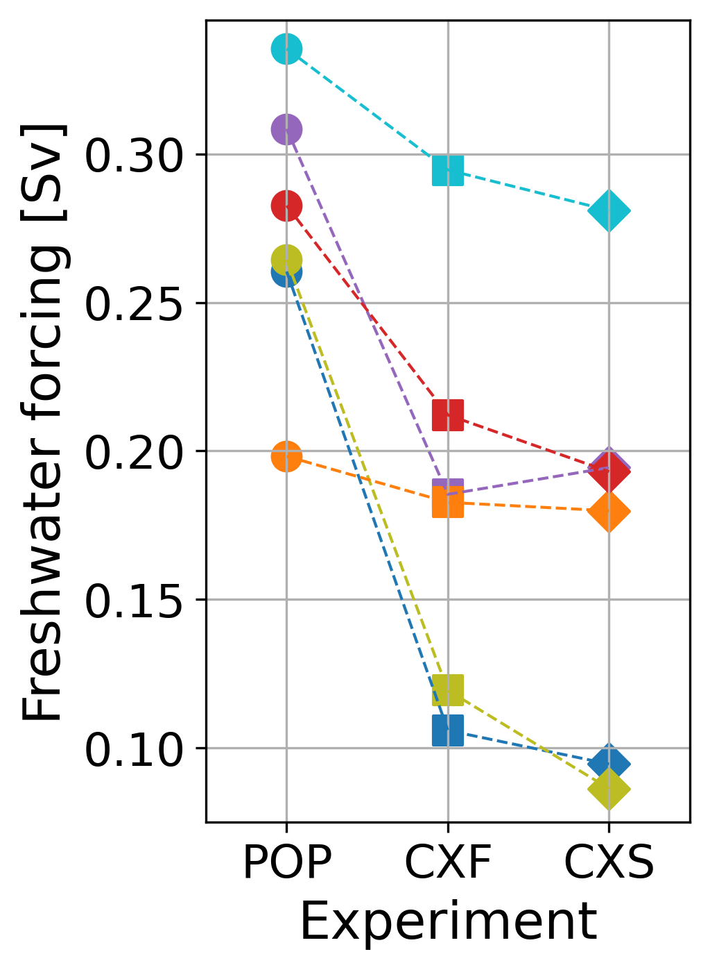
Shift in tipping point
Amber A. Boot (aadbo@aqua.dtu.dk)
6

Slide 8
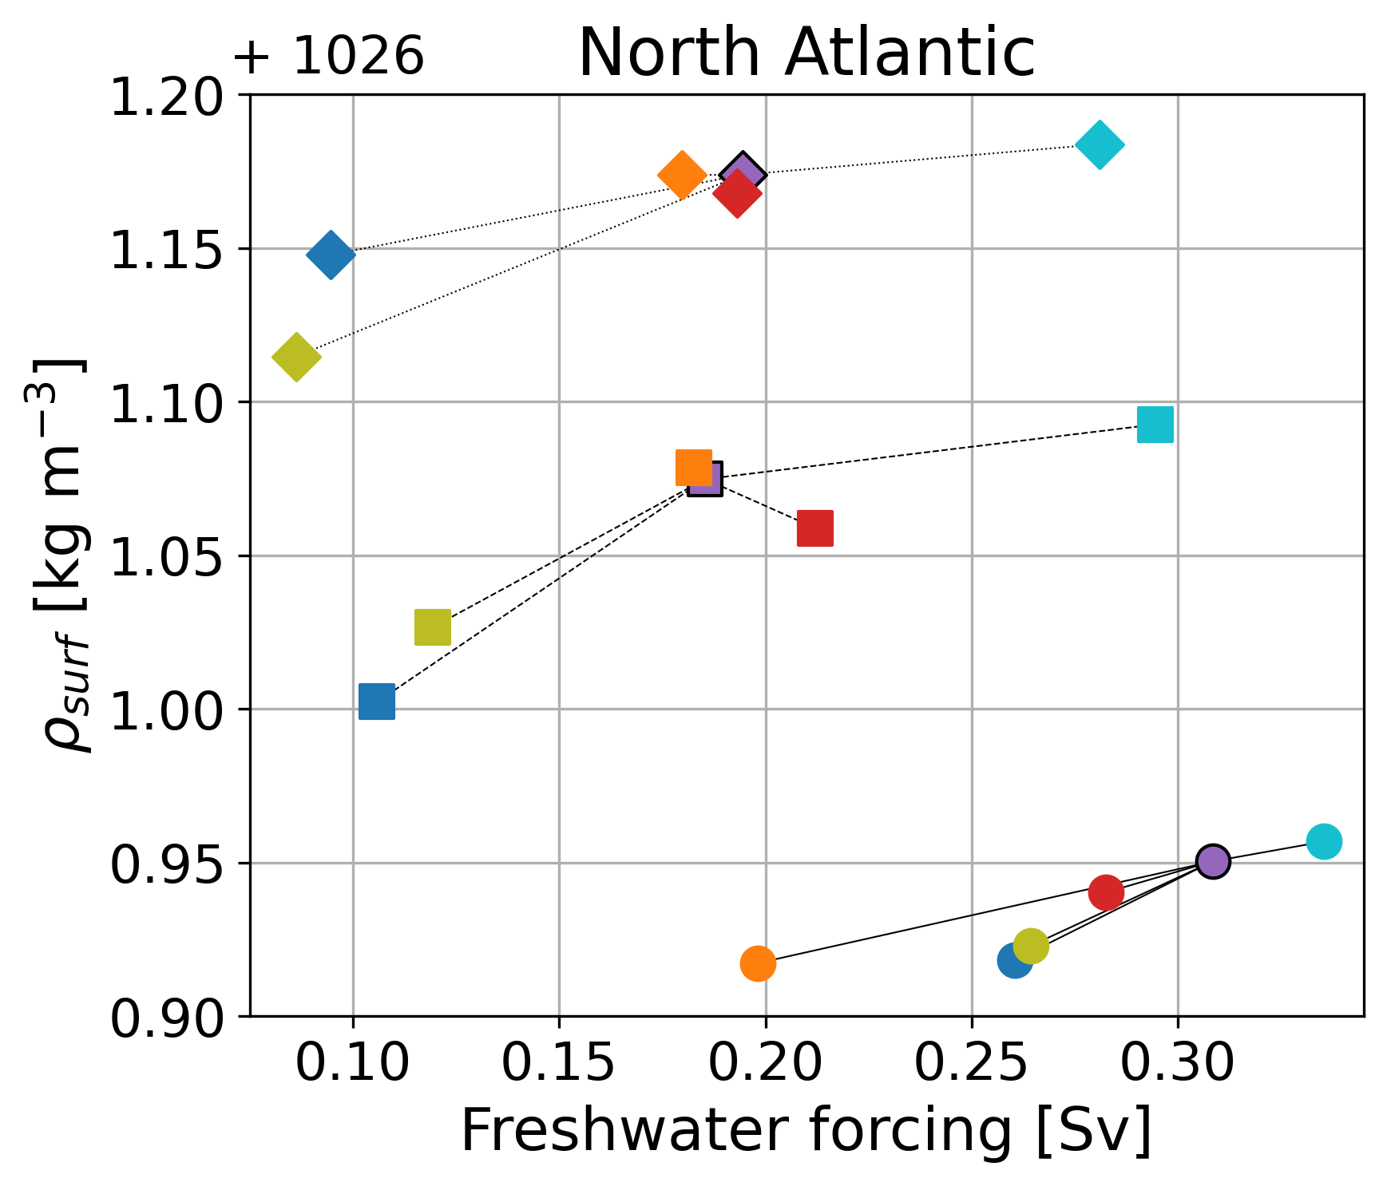
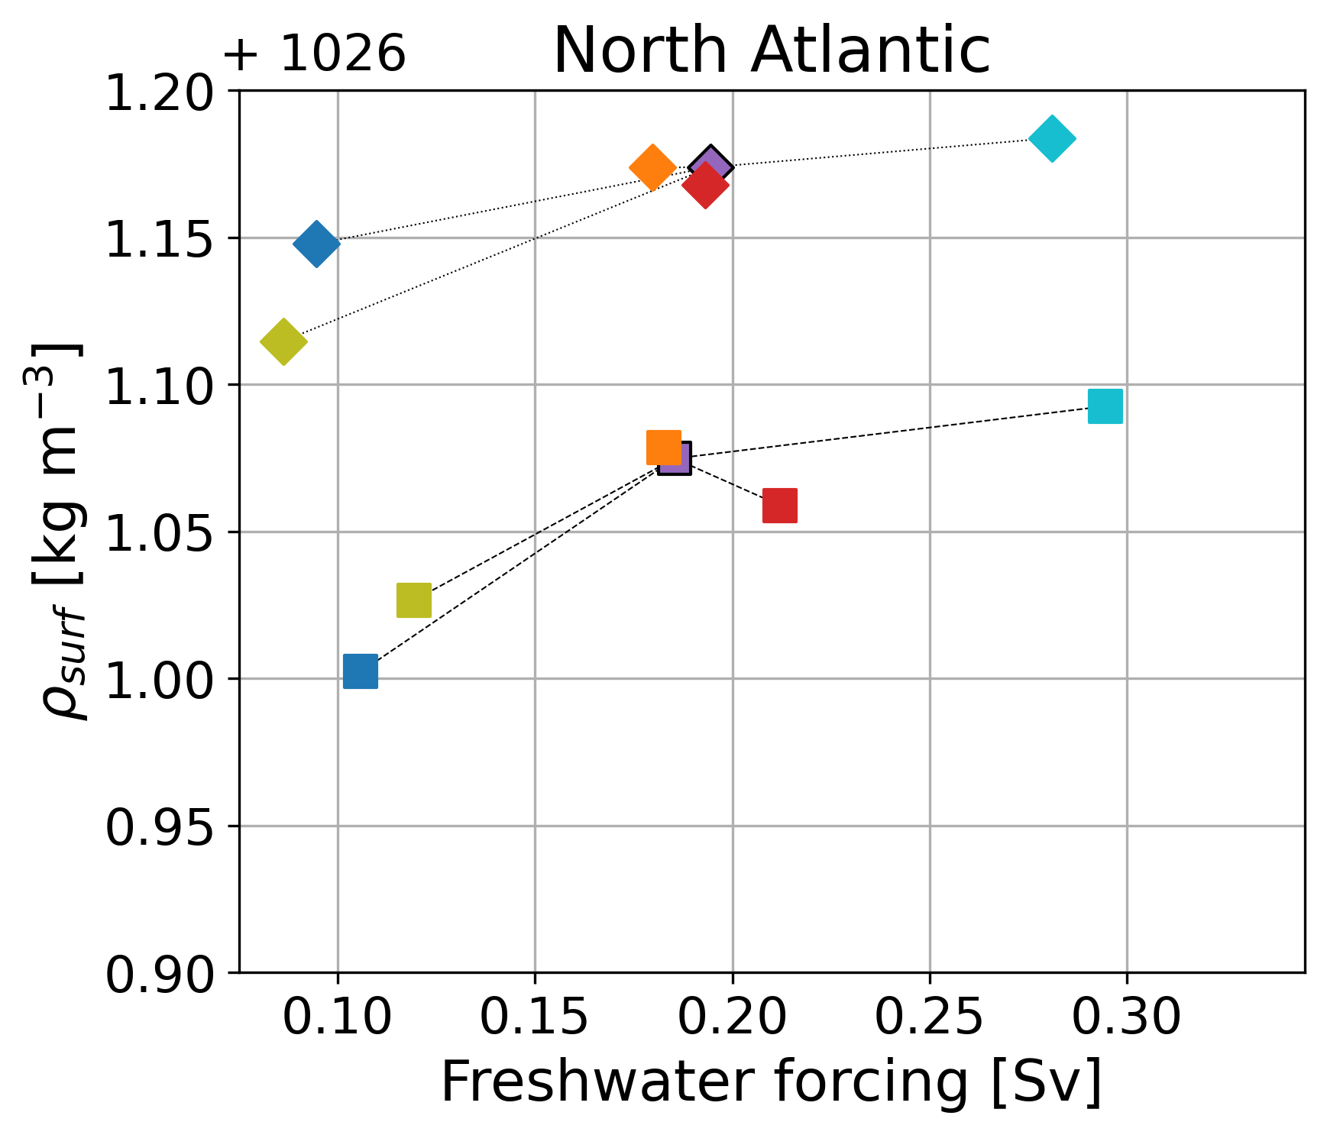
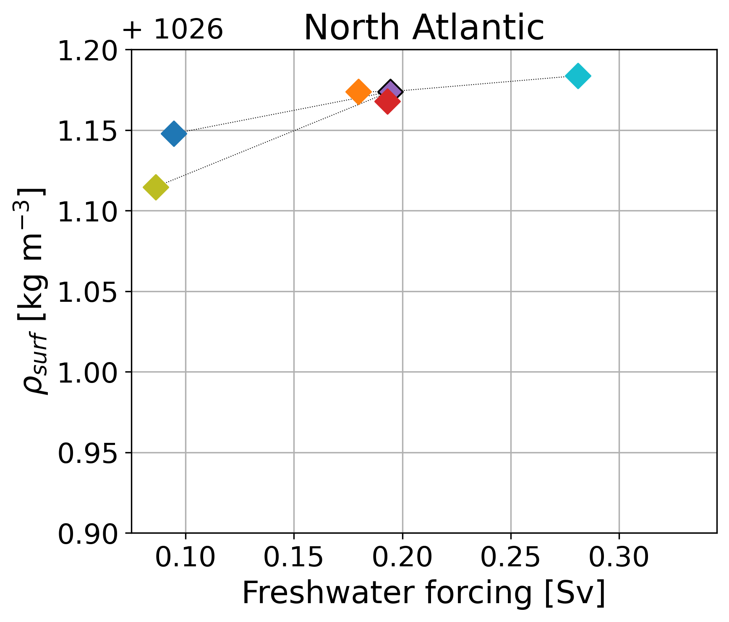
Density in the North Atlantic
Amber A. Boot (aadbo@aqua.dtu.dk)
CXS
CXF
POP
7

Slide 9



Conclusion
Amber A. Boot (aadbo@aqua.dtu.dk)
Freshwater biases influence AMOC stability
EMIC and ocean-only model qualitatively comparable
A fresher Indian Ocean results in a more stable AMOC
A fresher Atlantic Ocean results in a less stable AMOC
Change in density in the North Atlantic indicator of direction of change stability
Biases in CMIP6 ESMs suggest a too stable AMOC
Ocean-only quantitatively smaller shift in stability
ESM simulations have to be performed to confirm or reject
1. 2.
1. Boot, A.A., and Dijkstra, H.A. (2025). Physics of AMOC multi-stable regime shifts in an EMIC. Earth System Dynamics.
2. Boot, A.A., and Dijkstra H.A. (2026). The effect of freshwater biases on AMOC stability across the model complexity spectrum. Climate Dynamics. Under revision
More questions: aadbo@aqua.dtu.dk
8

