Slide 1











What happens when FAIR is built in from the start? Insights from the GOYAS Project
0000-0001-9462-4831
Fernando Aguilar Gómez, CSIC
Daniel García Díaz, Antonio López, Aina García-Espriu, and Cristina González-Haro
Implemented by

Slide 2
Most datasets are made FAIR after they exist
GOYAS asks: What if FAIR is built from the start?
Extra effort is needed in research data:
Easy to reuse?
Interoperable?
Complete metadata?
Reproducible?
Trackeable?
GOYAS FAIR-by-design helped in support data producers

Slide 3


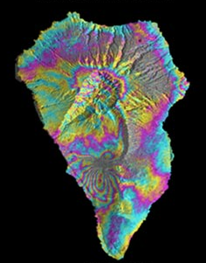
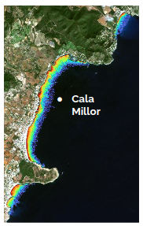
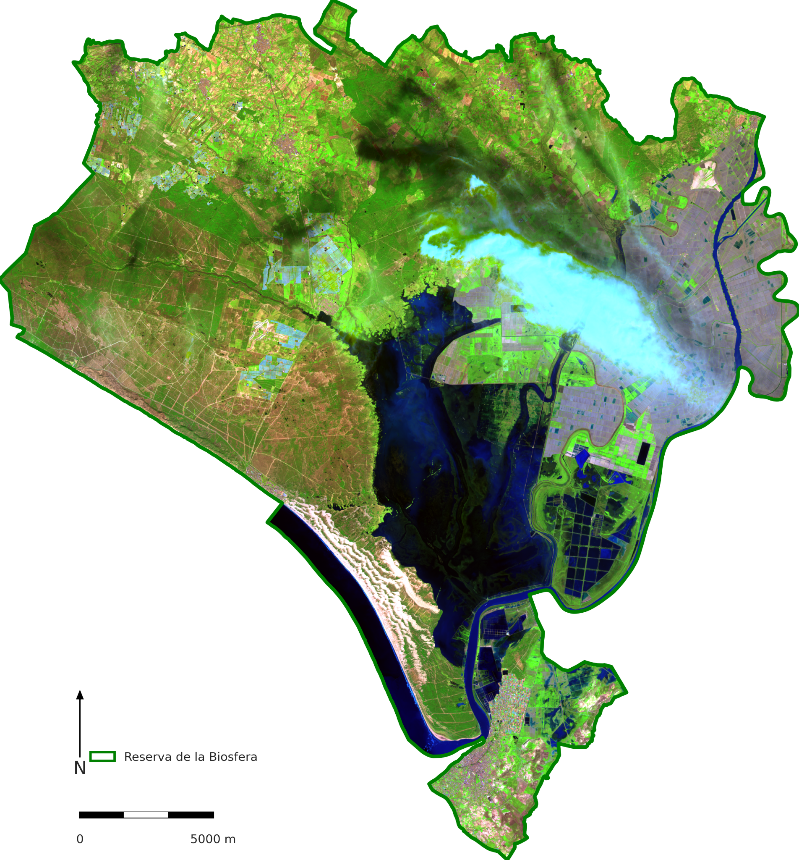
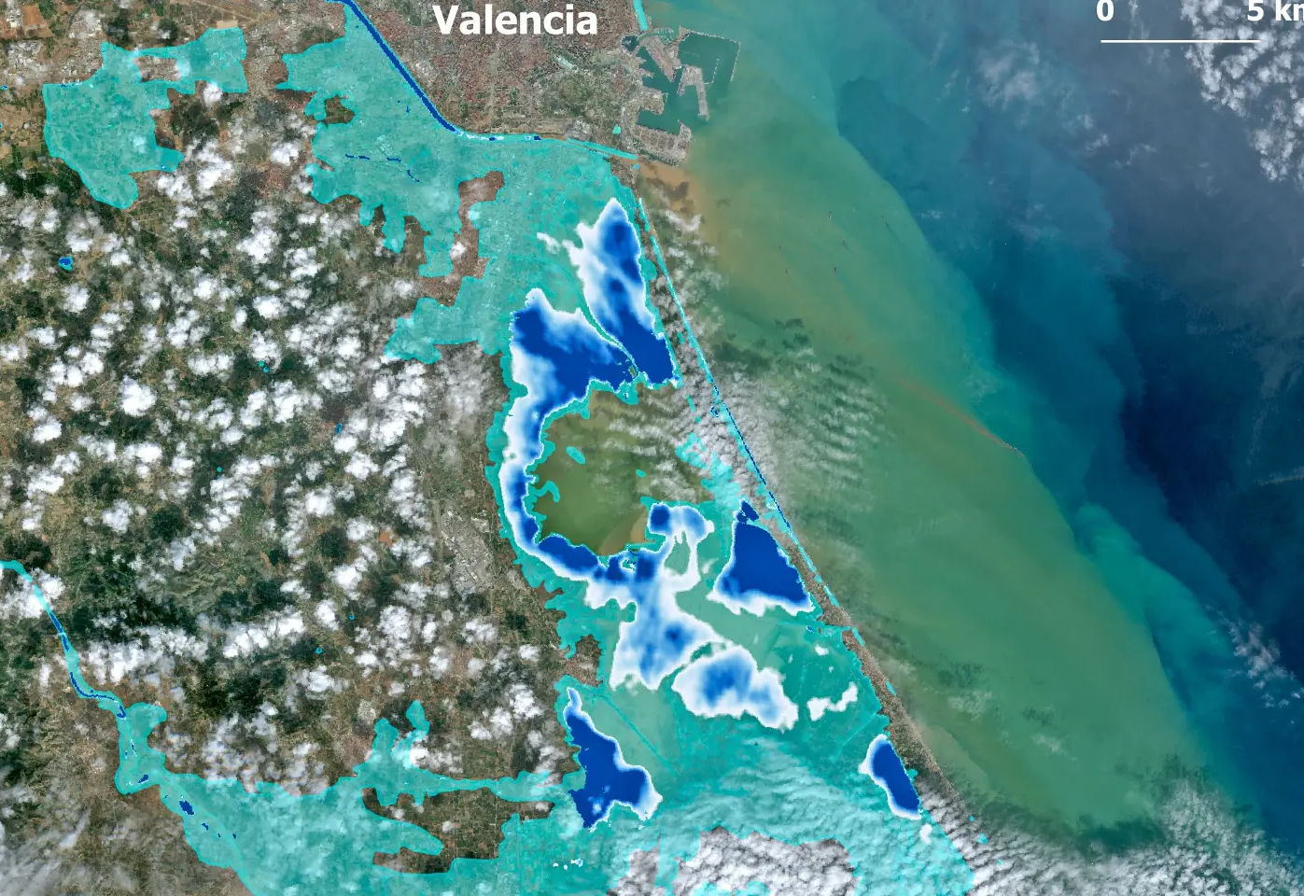
The Gap: Why GOYAS?
Geospatial Open science Yielding ApplicationS
Delivers innovative & experimental Earth Observation products to diverse stakeholders
Focus in reproducibility, transparency
Facilitate the access and publication of new FAIR data
Automatic
Formal structured data
Long-term, global
Complex publication
What about…?
Experimental, local variables
Great added value
Emergencies
Research outputs
Inundation maps
Satellite-derived bathymetry
Emergencies

Slide 4
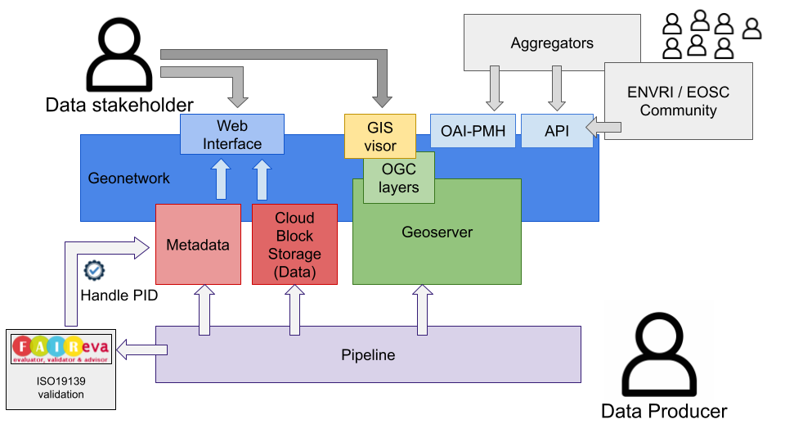
How it works

Slide 5
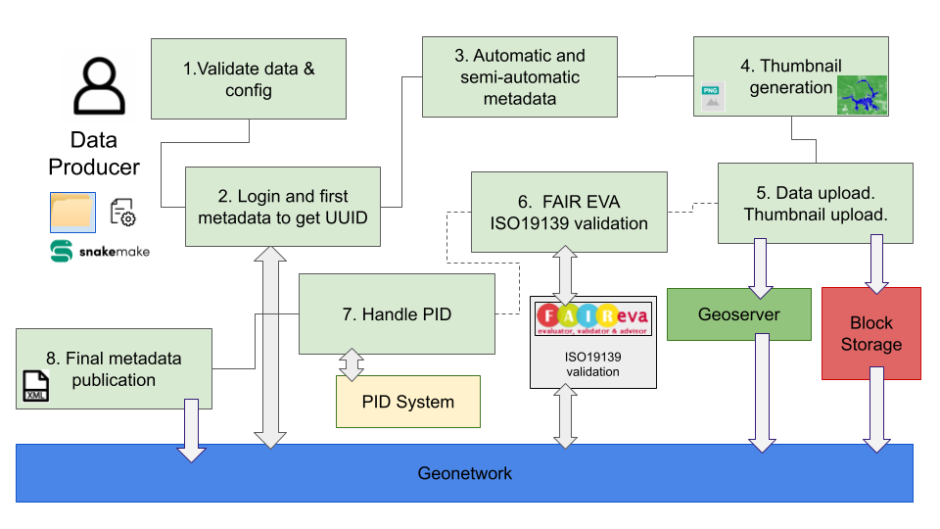
Automatic Pipeline

Slide 6
Automatic Pipeline - 4 keys
You only need your file(s) and fill a config file
2. Complex ISO 19139 composed easily
Accuracy, error
Provenance
“Geo” metadata
3. Everything if uploaded for you: File(s), thumbnail, OGC
4. Do you need a PID? First pass: FAIR tests, ISO validator

Slide 7
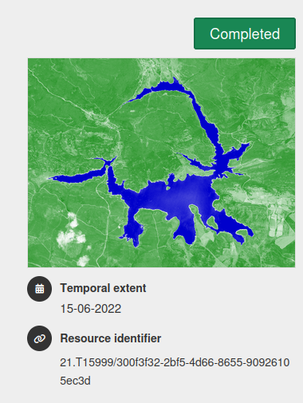
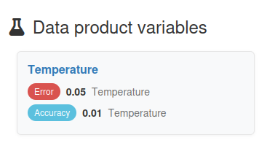
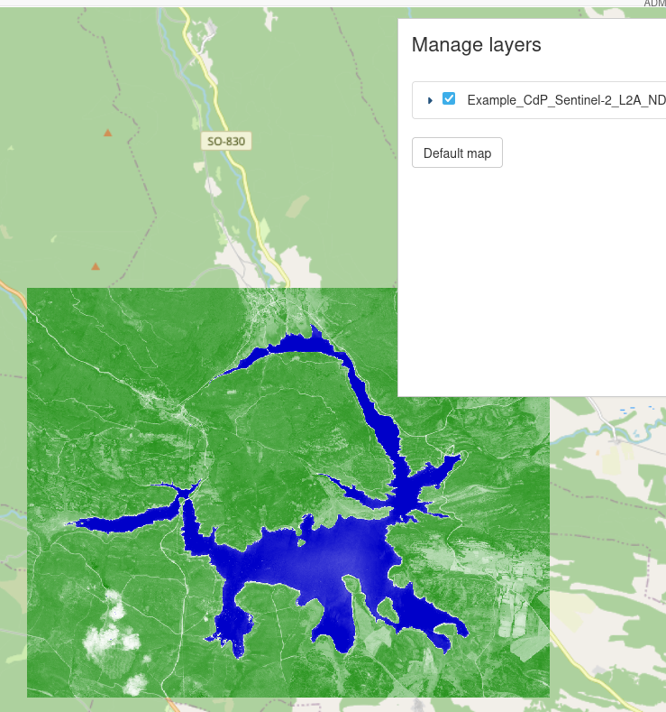
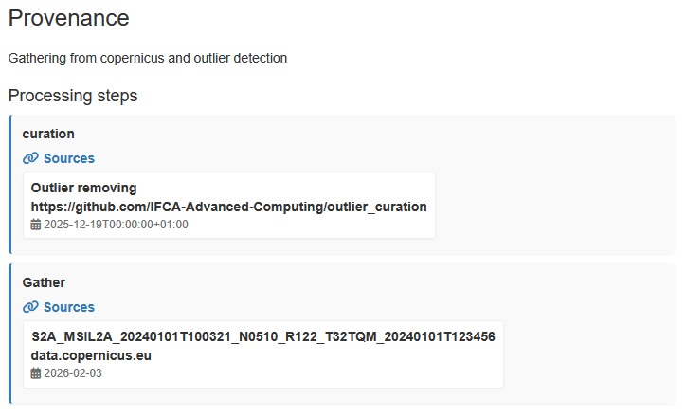
Example - goyas.csic.es

Slide 8
Key insights
FAIR from the start guides decisions and anticipates problems
FAIR is not just metadata — it requires workflows and automation
(to support data producers without increasing complexity)
FAIR and data quality must be linked
(enforced through automated checks and validation)

