Slide 1
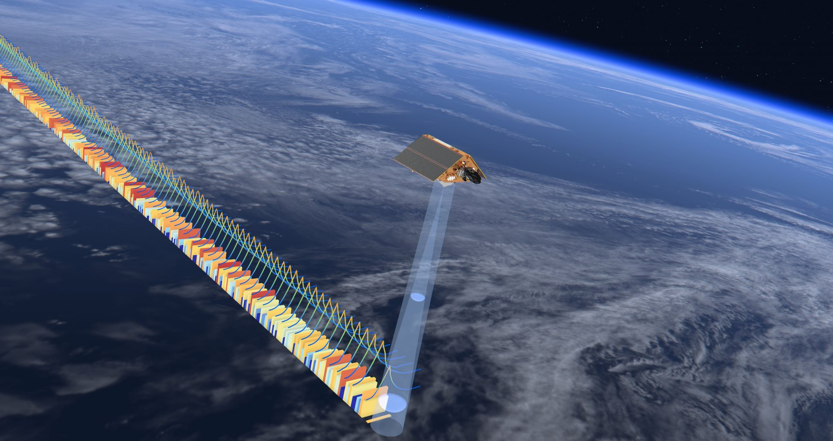


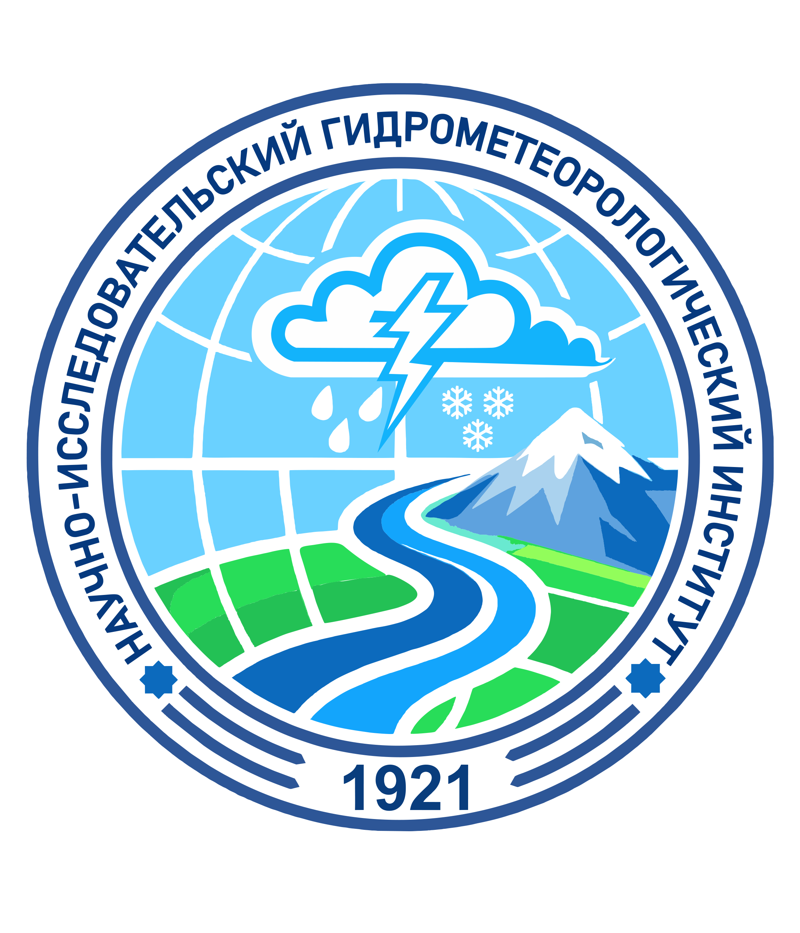
Remote Sensing–Based Monitoring
of Lake Sarikamish Water Level Dynamics
Gulomjon Umirzakov^{1,2}, Salauat Kalabaev¹, Akmal Gafurov^{1,3}, and Daniyar Turgunov^{1,4}
¹Hydrometeorological Research Institute, Central Asian University of Environmental and Climate Change Studies, Tashkent, Uzbekistan (g.umirzakov@hmri.uz)
²Center for International Development and Environmental Research (ZEU), Justus Liebig University, Giessen, Germany
³Tashkent Institute of Irrigation and Agricultural Mechanization Engineers National Research University, Tashkent Uzbekistan (a.gafurov@hmri.uz)
⁴Hydrology and meteorology department, Mirzo Ulugbek National University of Uzbekistan, Tashkent, Uzbekistan (d.turgunov@hmri.uz)

Slide 2
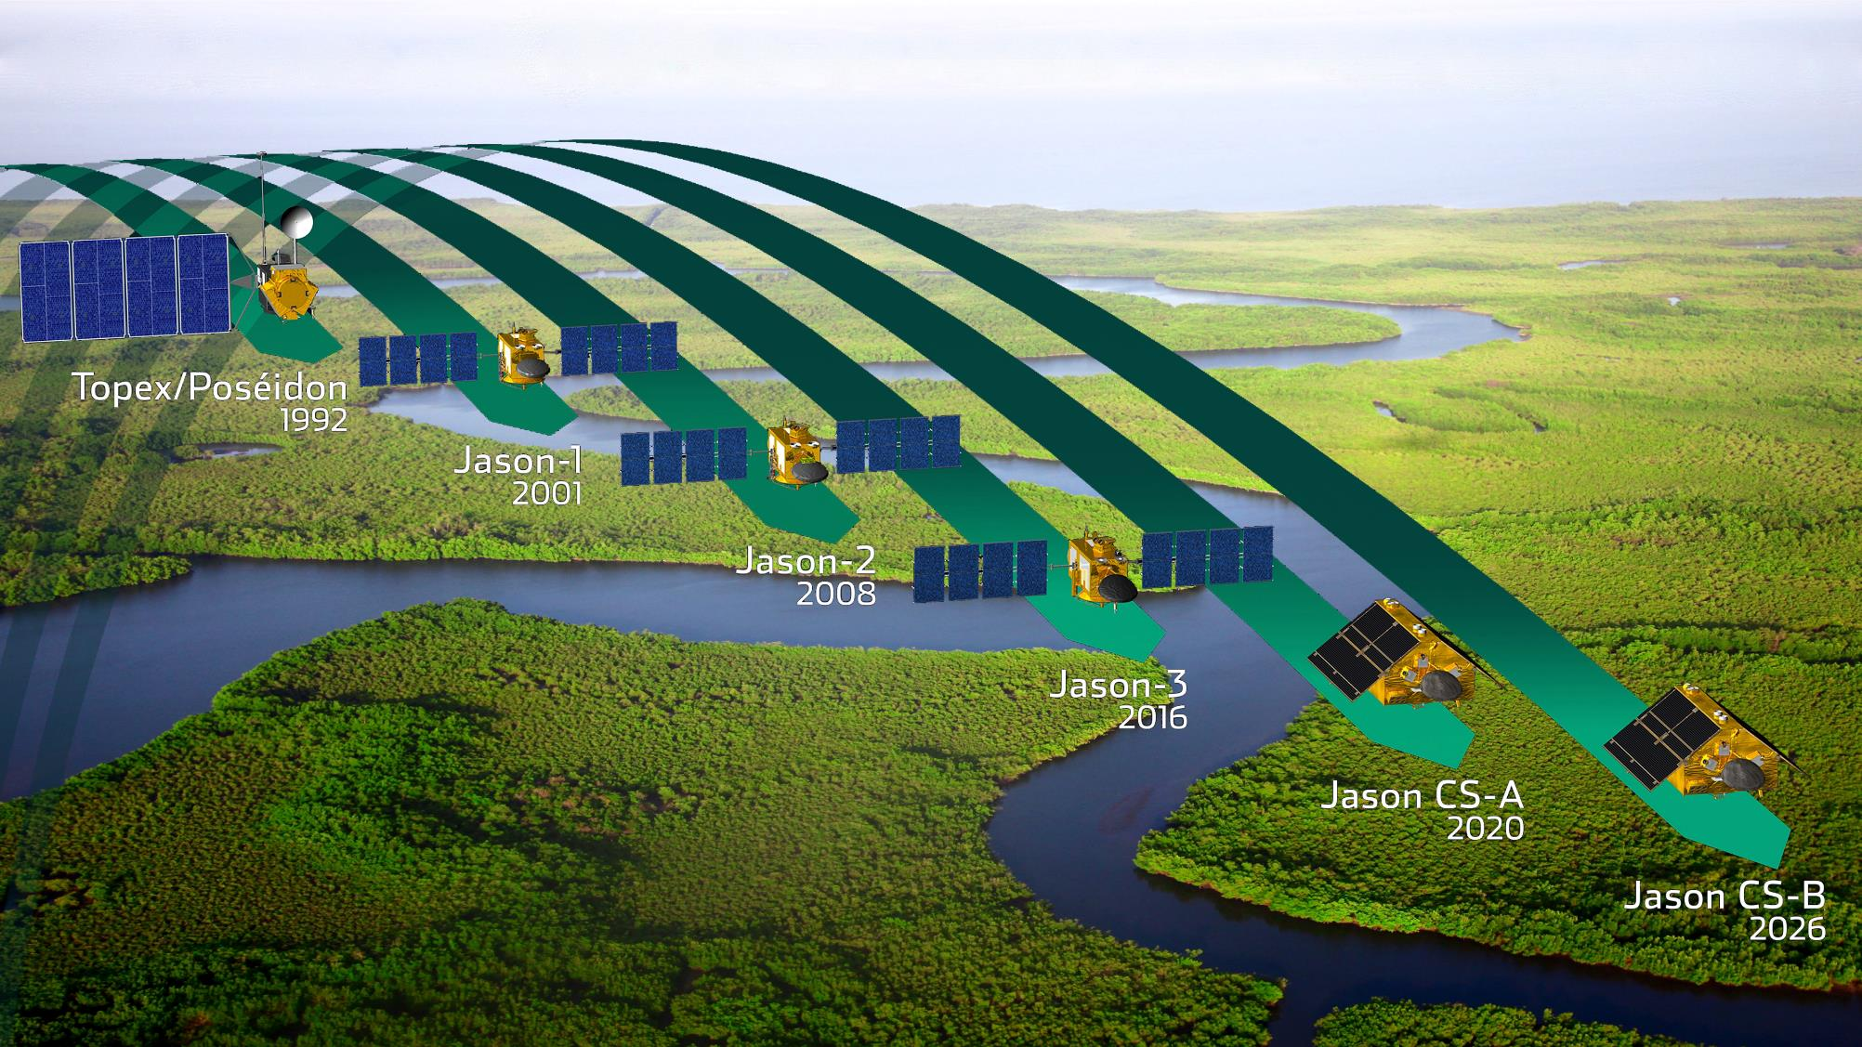
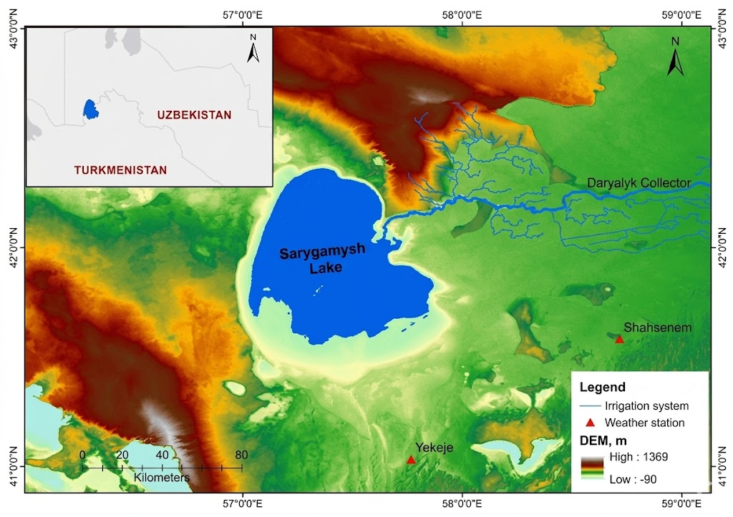
Remote sensing application
Location of Lake Sarykamysh
Radar altimetry overcomes the limitations of sparse ground-based networks caused by economic constraints.
It provides a reliable remote sensing alternative for consistent water level monitoring across all water bodies.

Slide 3
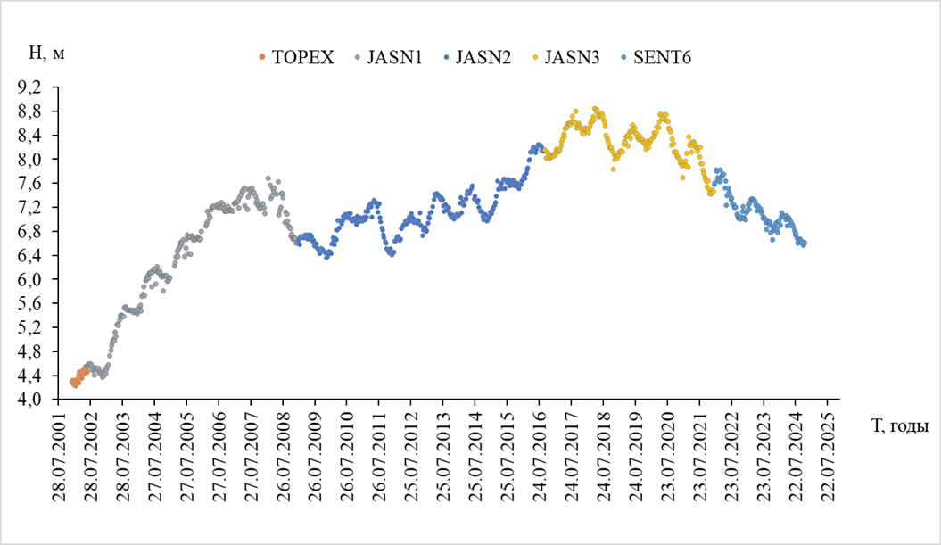
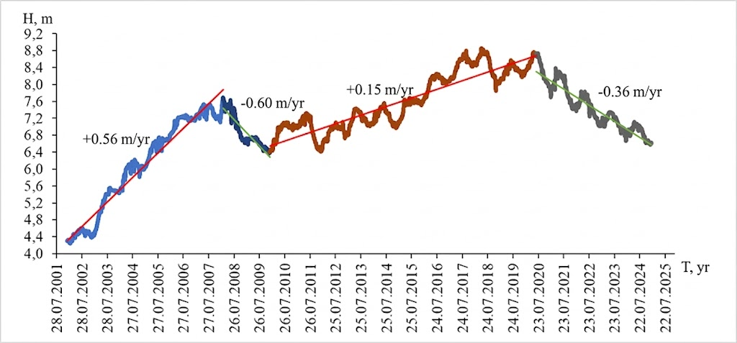
Methods
RESULTS: Water level of Lake Sarikamish
derived from different altimeters
In long-term satellite observation series, gaps or missing data are sometimes encountered. In such cases, linear interpolation, the k-nearest neighbors method, 2nd and 3rd-order polynomial interpolation, and piecewise cubic Hermite interpolation methods were tested for data recovery.
According to the results of previous studies, the linear interpolation method provides the most acceptable results for filling gaps in satellite altimetry data series [3]. Gaps in the altimetry data were filled using the linear interpolation method
Conclusion
As a result of the analysis based on altimetry data for the period 2001–2024, water level dynamics of Lake Sarikamish were characterized by phased variability.
Starting from the 2010s, the water level exhibited a trend towards a secondary rise. Average annual increase of +0.16 m/yr.
From 2020, a steady trend of annual decline in the water level has been observed in the lake.
If this trend continues, the ongoing decline in water levels could have a negative impact on the lake itself and the ecological state of the surrounding area.

