Slide 1
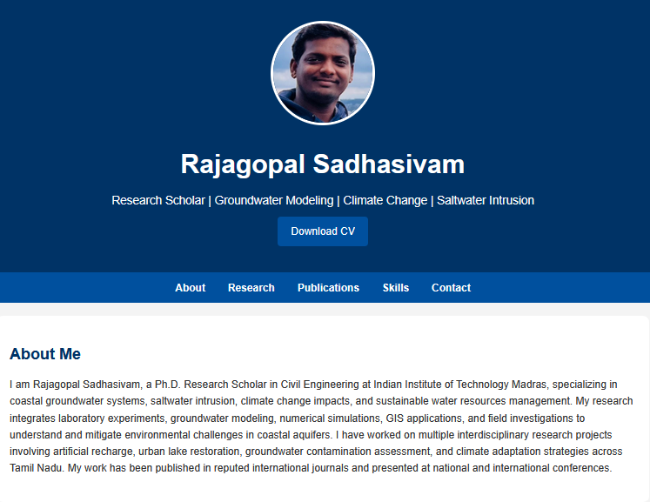
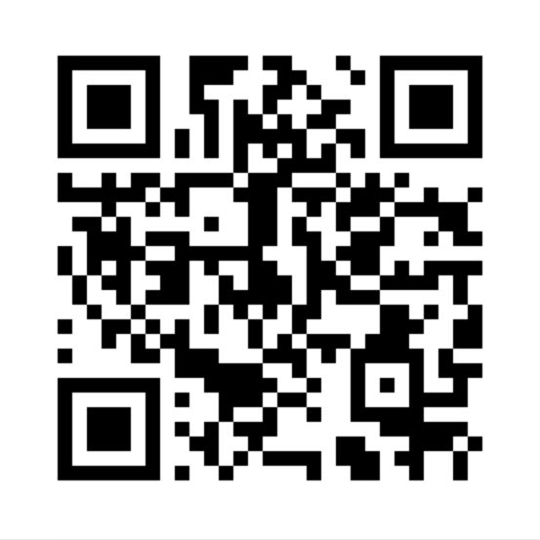
website
Contact
Email: rajagopalmsadhasivam@gmail.com
Phone: +91 9442273951
LinkedIn: www.linkedin.com/in/rajagopal-sadhasivam
ResearchGate: www.researchgate.net/profile/Rajagopal-Sadhasivam

