Slide 1







The gradual evolution of friction following a normal stress step reflects changes in contact strength, not contact area
SM4.3: EGU26-17731
Pathikrit Bhattacharya, Terry Tullis, Allan Rubin, Nick Beeler and Nir Badt

Slide 2
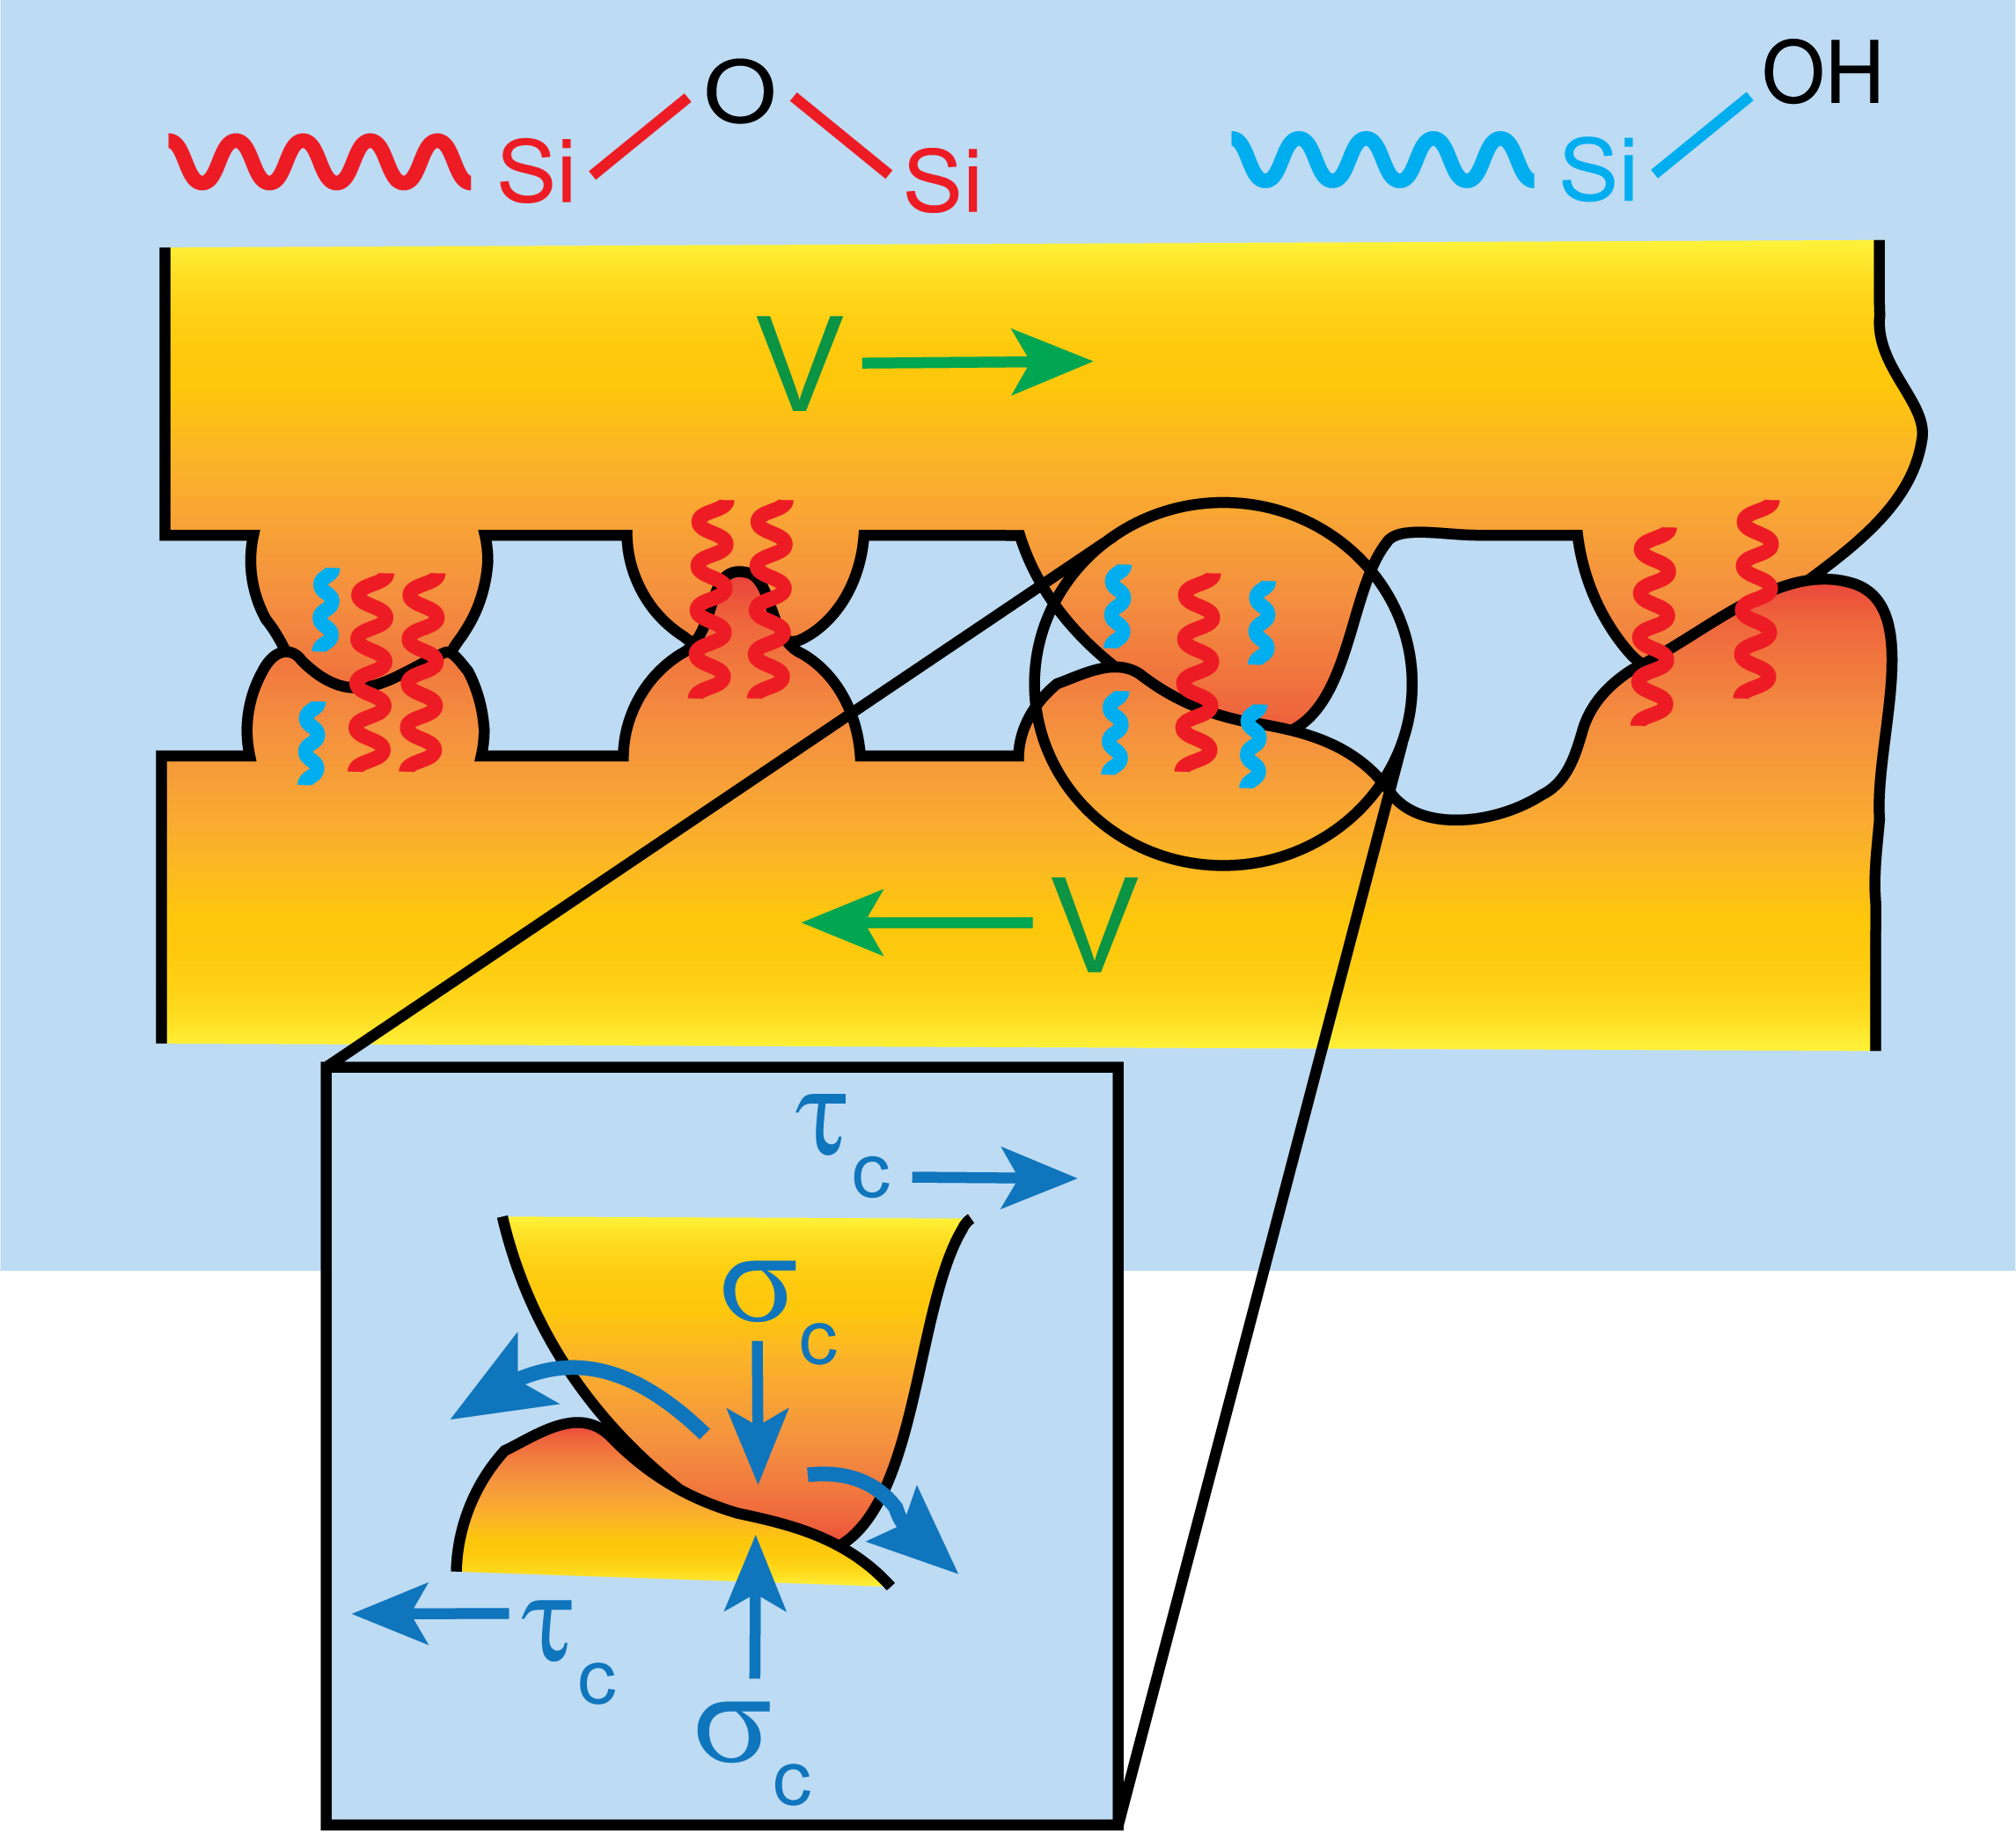

What microscopic properties control macroscopic friction?
Frictional resistance depends upon both the current macroscopic sliding rate ($V$) and the configuration of the microscopic junctions bridging the sliding interface.
Precisely what aspects of these microscopic configurational details contribute to macroscopic friction is not entirely clear – many candidates including contact area, chemical bond density, diffusion-dependent impurity concentrations.
Notes:
The fundamental question we are trying to address in this talk is what microscopic interfacial properties control macroscopic friction and, by extension, fault slip behavior. Experimental work across the last five decades has established that friction in geomaterials is controlled by the instantaneous rate of sliding and some details of the microscopic configuration of population of contacting asperities. But precisely what properties of this microscopic configuration determines friction evolution remains unclear. There are many candidates. One particularly favored candidate is contact area. Others include bond density across asperities or diffusion-controlled concentration gradients of impurities across contacts.

Slide 3
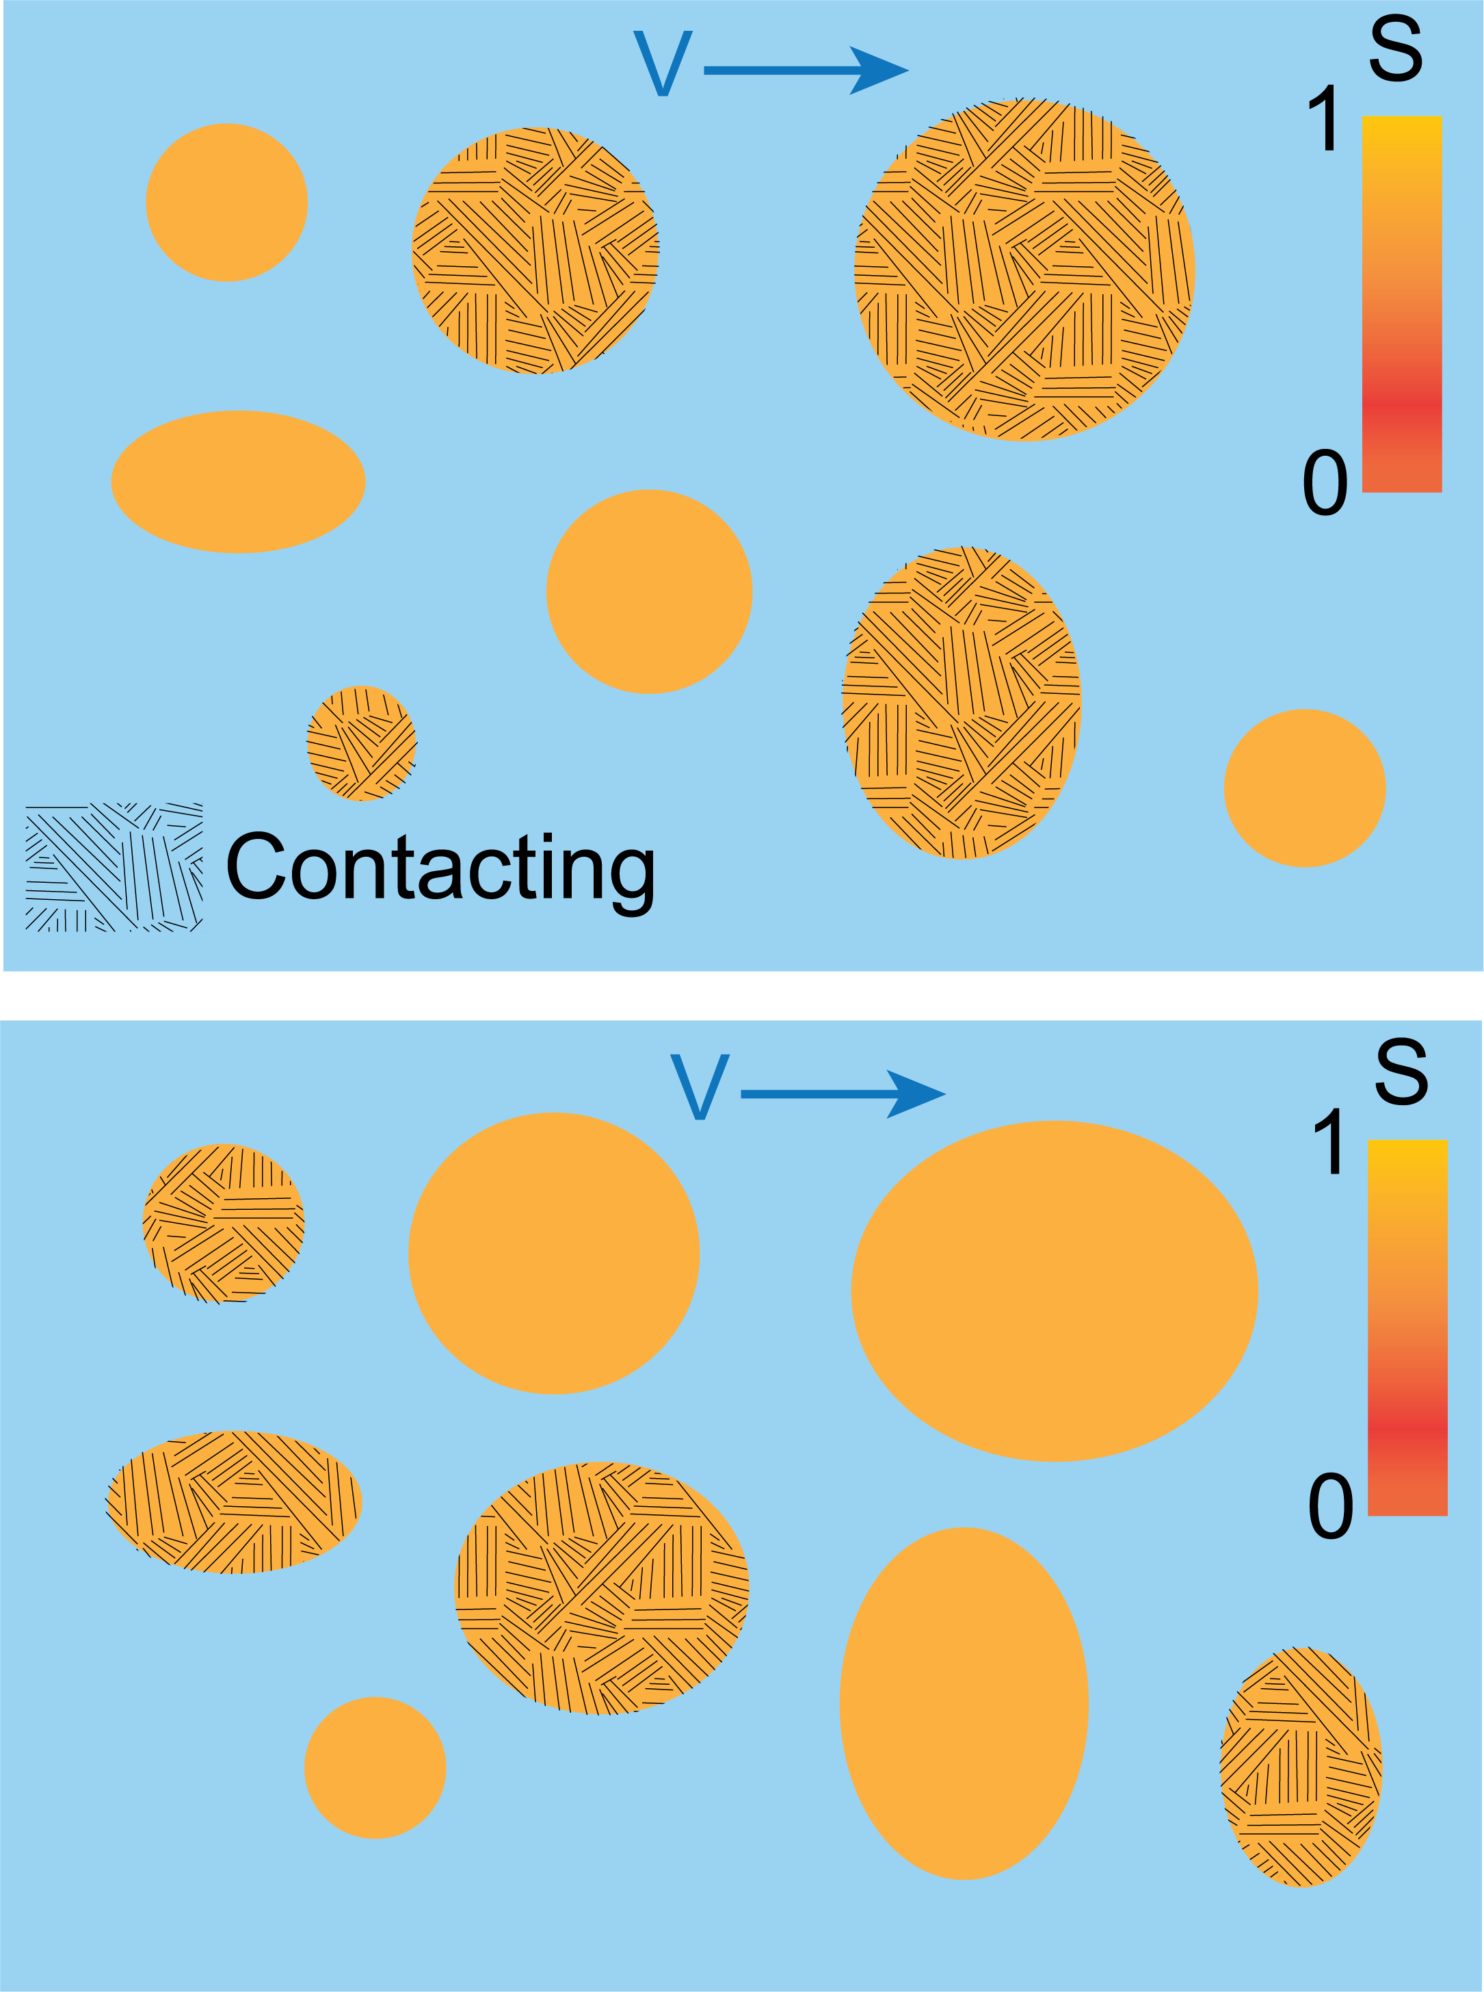



The ‘only’ contact area is important hypothesis
Bowden and Tabor (1964) argued that macroscopic friction can be quantified as:
$$τ_{f}=τ_{c}(V)A_{c}$$
where $τ_{c}$ is ‘rate-dependent’ contact strength and $A_{c}$ is normalized real contact area.
This assumes all contacts contribute equally to interfacial strength through some ‘quality’ weight $S$.
Then the evolution of contact area due to creep (dislocation glide dominated) and slip is the only microscopic configuration we care about.
$$t=t_{i}$$
$$t=t_{i}+Δt$$
Notes:
The connection between the rate and asperity configuration-dependent contributions can be formalized through a Bowden-Tabor like expression where macroscopic frictional strength tau_f is expressed as the product of contact scale shear strength tau_c and the ratio of real to nominal contact area Ac. This picture assumes all contacts contribute equally to interfacial strength. For example, in the cartoons on the right – I show the plan view of the interface at two times. The hatched contacts are in contact instantaneously. As the interface slips Ac evolves through creep due to high stresses at the contact scale and as the population of contacts in contact changes. But all contacts have the same quality - some area averaged measure of strength denoted by the color scale S. When all contacts are equally yellow – i.e. of equal quality, the only microscopic configuration whose evolution determines tau_f evolution is Ac.

Slide 4
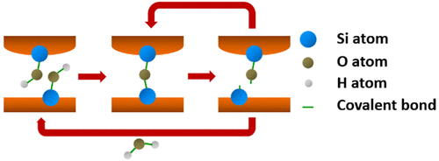
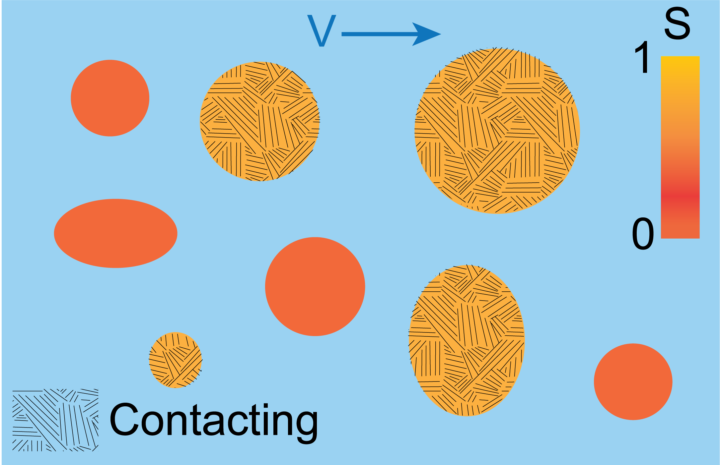
A model with contacts of different ‘quality’
Another possibility is there is some ‘history’ dependence of the contribution of contacts to strength.
At the single-asperity (or smaller) scale, there is both experimental and theoretical evidence that chemical bonding across the interface could be a viable mechanism (Li et al., 2011, Tian et al., 2019).
Li et al., 2011, Tian et al., 2019
Notes:
Experimental and theoretical work over the last decade has revealed that there is some history dependence of contact quality at the single asperity scale. One physical mechanism through which this works is the density of bonds (siloxane) on contacts. Contacts that are pre-existing have a larger bond density compared to new ones that will imminently come into contact. In the cartoon on the right, this is similar to saying that the hatched contacts are all yellow with full strength contribution but the un-hatched ones are inherently weaker when they are brought into contact. Such quality contrasts will then also determine how strong the interface is as the population of contacts evolve due to slip and as contact area growth brings new regions of the interface into contact.

Slide 5
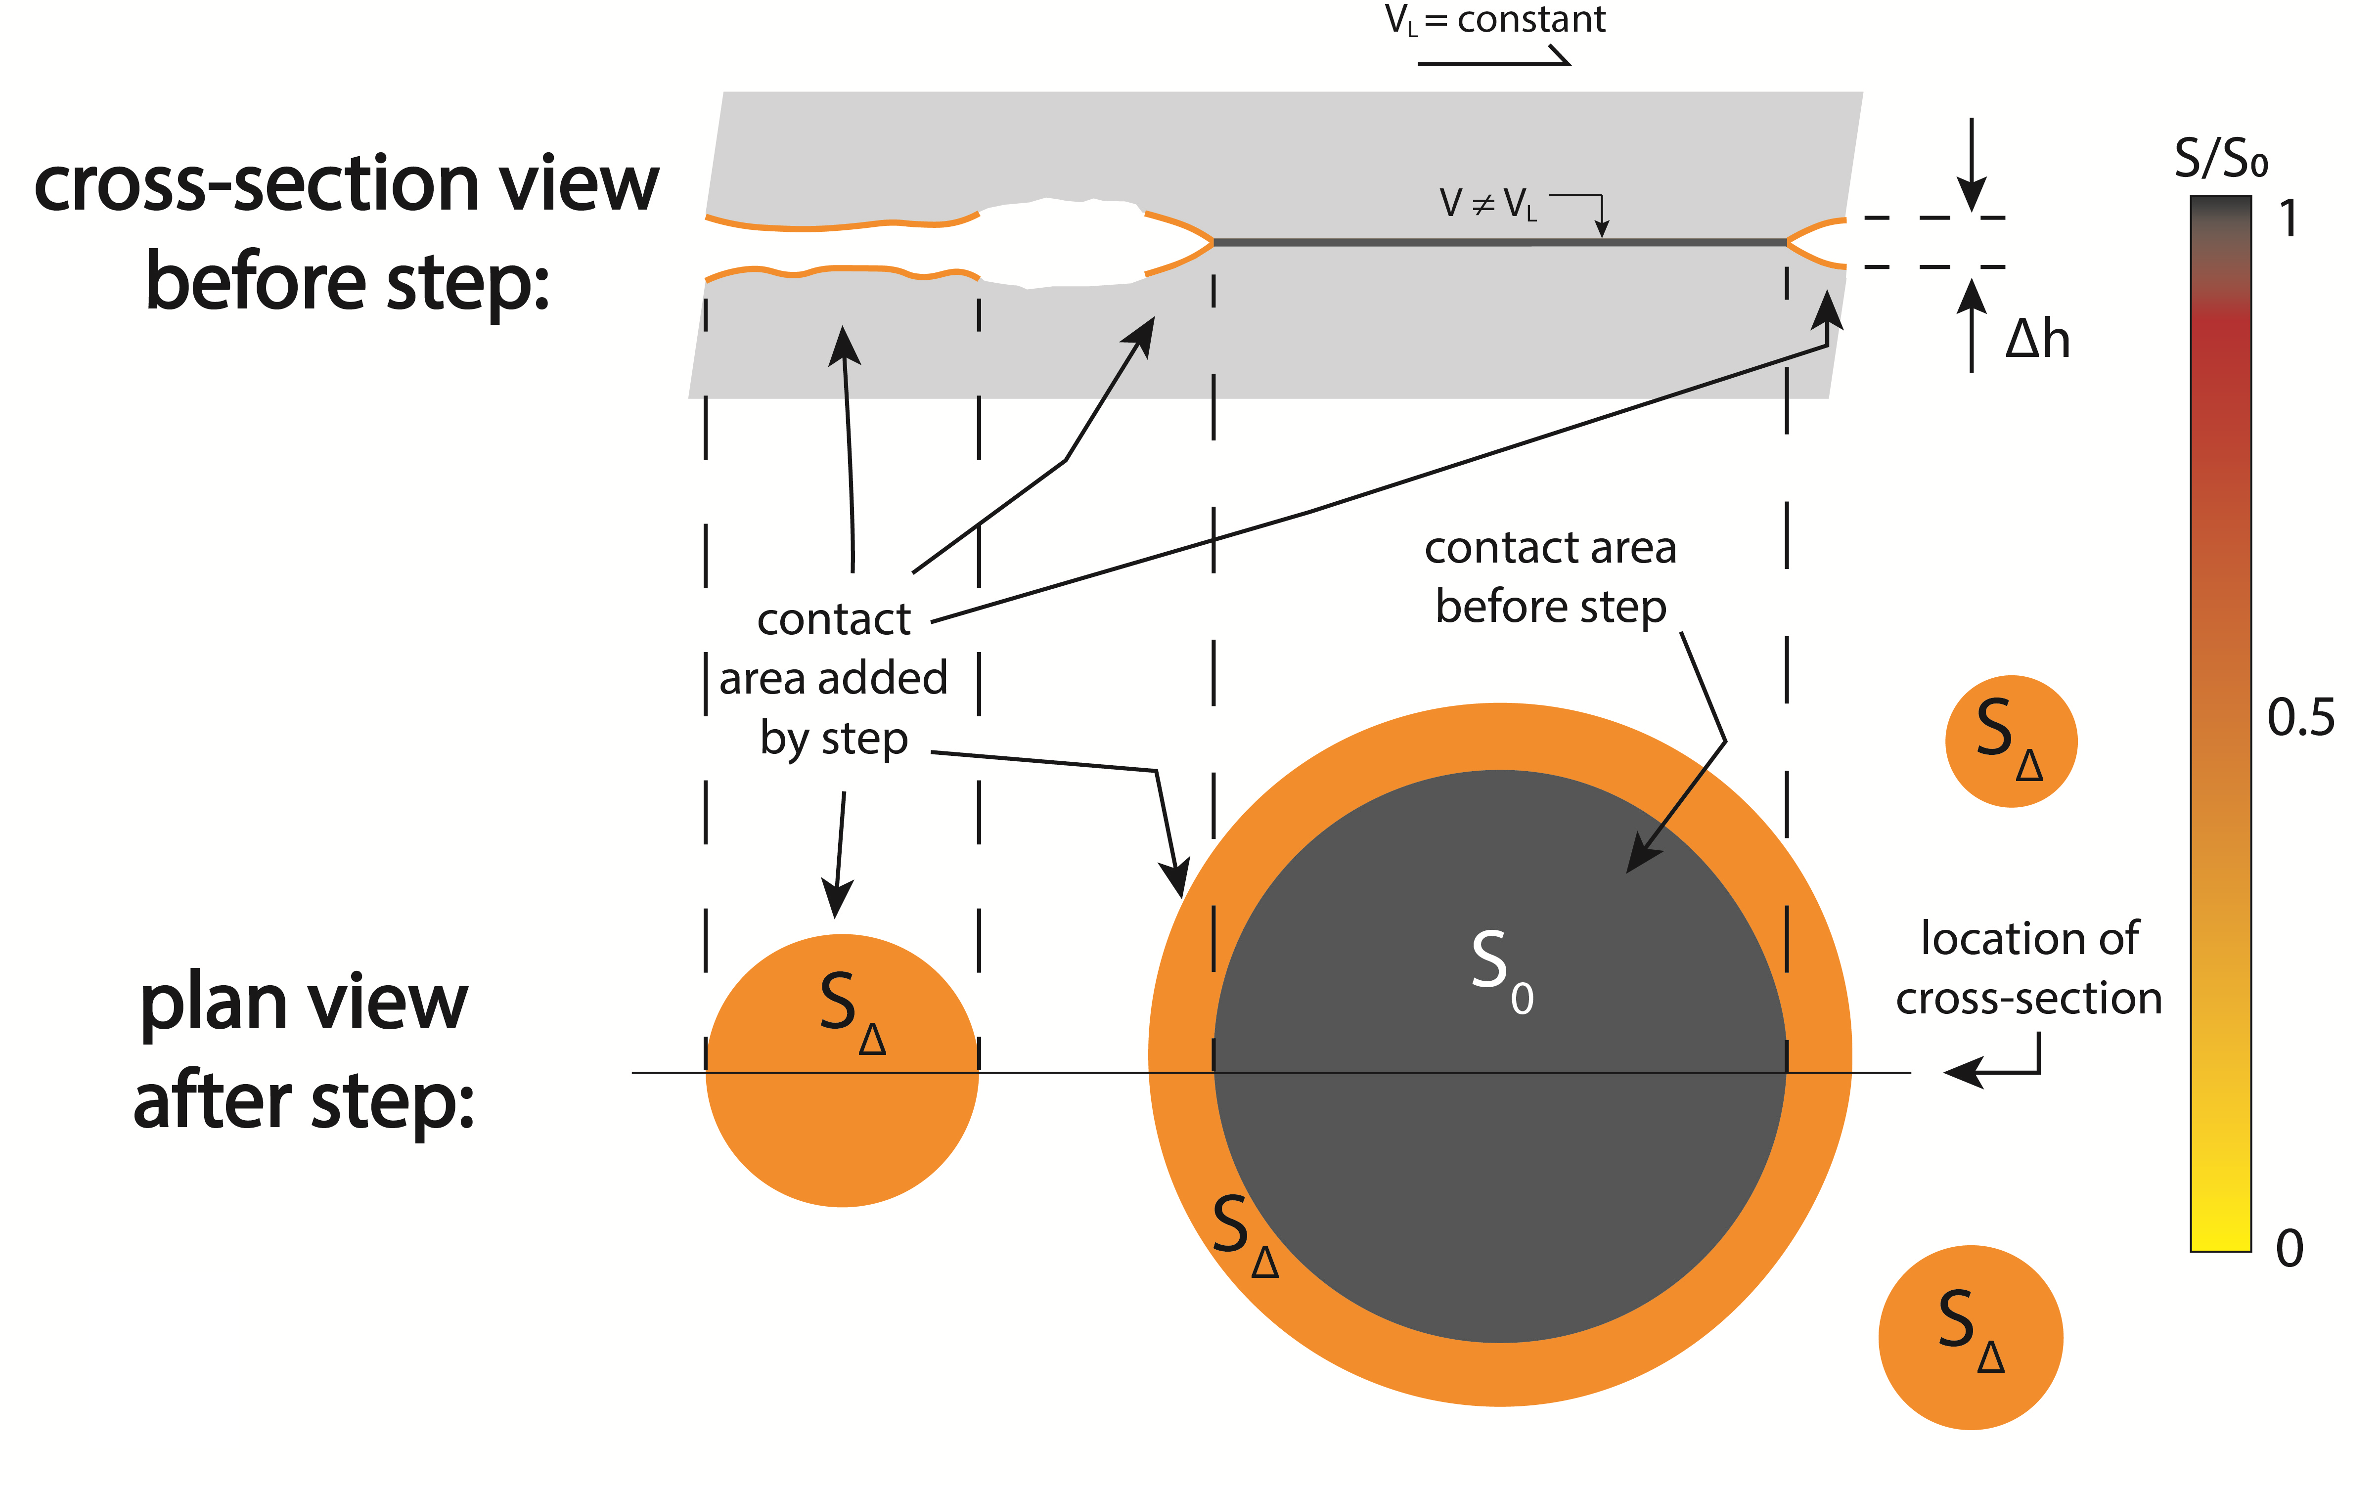
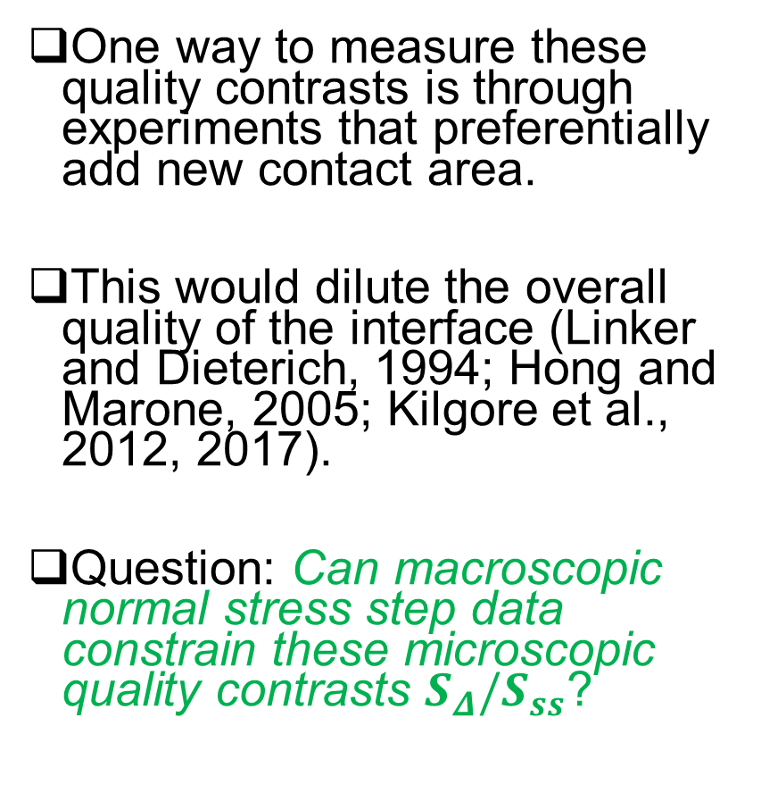

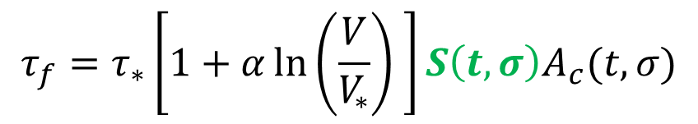
Normal stress steps and quality contrasts
One way to measure these quality contrasts is through experiments that preferentially add new contact area.
This would dilute the overall quality of the interface (Linker and Dieterich, 1994; Hong and Marone, 2005; Kilgore et al., 2012, 2017).
Question: Can macroscopic normal stress step data constrain these microscopic quality contrasts $S_{Δ}/S_{ss}$?
$$S_{Δ}/S_{ss}$$
S_{ss}(=1)
$$τ_{f}=τ_{∗}\left[1+α\ln\left(\frac{V}{V_{∗}}\right) \right]S\left(t,σ\right)A_{c}(t,σ)$$
Notes:
Any experiment that preferentially adds new contact area would in theory be able to constrain these quality contrasts. A prime example is a normal stress step increase protocol wherein a rapid change in normal stress is imposed on a sample being shared at a constant loading rate V_L. As per the cartoon on the right, this brings the new contacts in orange in contact either along the rim of old, high quality, black contacts or generates entirely new contacts. The area averaged quality thus decreases impacting the macroscopic frictional strength. This requires a rewriting of the Bowden Tabor equation with an explicit, instantaneous quality term S which itself evolves. The question is can we use data from normal stress step experiments to constrain the ratio of S_\delta to S_ss.

Slide 6
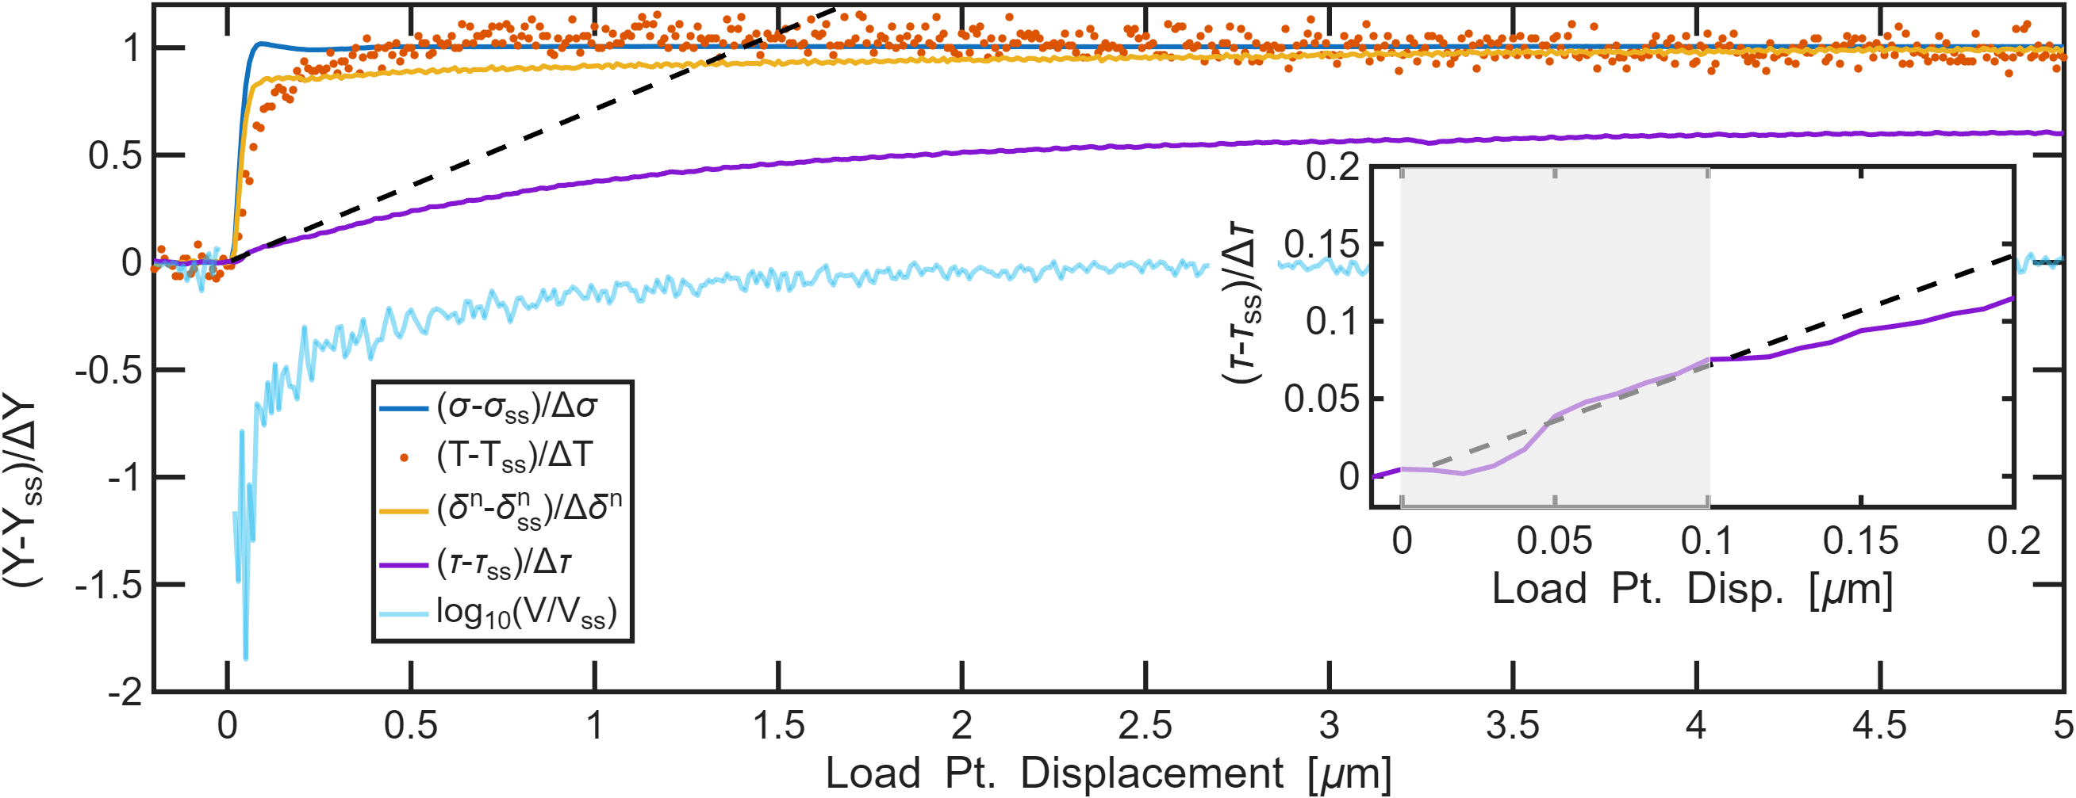


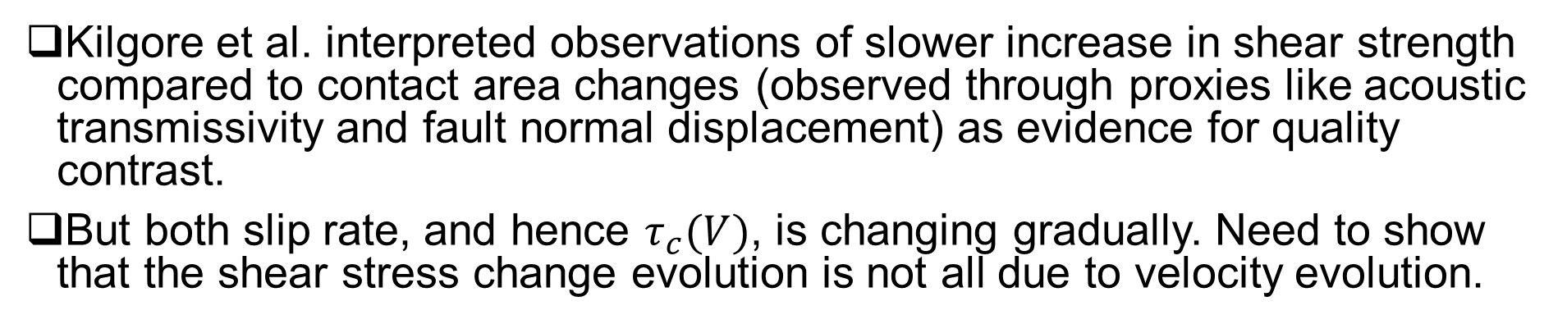
Measuring $S_{Δ}/S_{ss}$ is not trivial
6 MPa
5 MPa
V_{L}=1${μms}^{−1}$
Data from Kilgore et al., 2017
Kilgore et al. interpreted observations of slower increase in shear strength compared to contact area changes (observed through proxies like acoustic transmissivity and fault normal displacement) as evidence for quality contrast.
But both slip rate, and hence $τ_{c}(V)$, is changing gradually. Need to show that the shear stress change evolution is not all due to velocity evolution.
Notes:
The problem is measuring these contrasts is not trivial. I show here data from Kilgore et al. 2017 for 20% normal stress step increase (blue). They also measured two proxies of contact area - acoustic transmissivity (orange dots) and fault normal displacement or closure (yellow). The standout observation was that the shear strength (purple) evolved much slower than the proxies of contact area. They interpreted this as meaning that the newly added contact were of zero strength. But this interpretation is made complicated by the fact that sample slip rate (shown in cyan) is undergoing a reduction and subsequent gradual increase to its steady state value. What if the slow evolution of shear strength is entirely due to the evolution of the rate-dependent microscopic contact strength rather than quality contrasts.

Slide 7
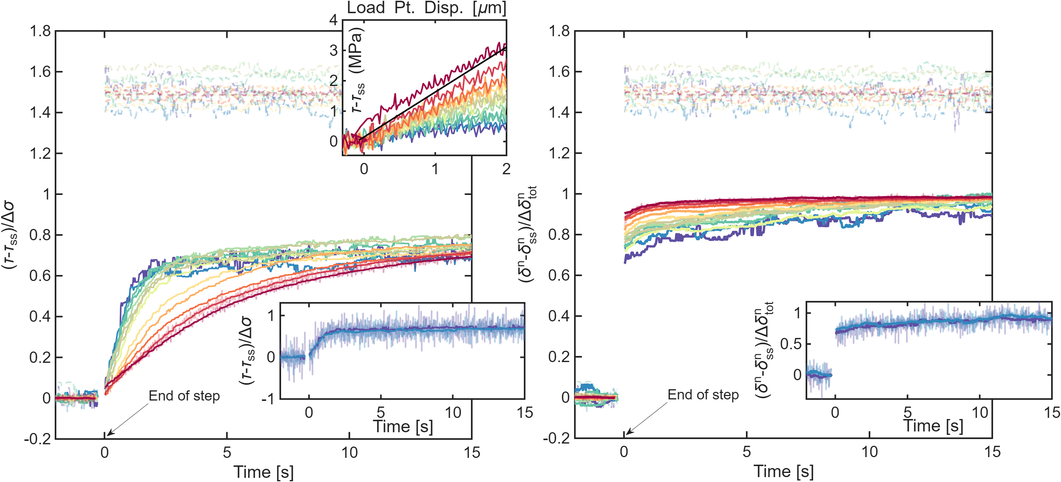

Normal stress steps on a stiff machine
$$\frac{Δσ}{σ_{ss}}$$
0.05 0.06 0.09 0.14 0.18 0.19 0.28 0.37 0.46 0.69 0.93
Experiments on the artificially-stiffened high speed rotary shear at Brown University. High stiffness allows better velocity resolution.
Notes:
To separate these effects out we need two things. First we need an experimental set up that is stiff enough that the velocity reductions are fully resolvable and can be used to quantify the effect of transient velocity changes on strength. To achieve this we carried out a series of normal stress step experiments (5 to nearly 100%) on the artificially stiffnened rotary shear at brown. The panel on the left shows shear stress and the dashed, translucent, lines show normal stress normalized between 0 and 1. On the right panel is closure again normalized. Just like the Kilgore et al. data, we see a gradual evolution of shear stress or strength but a much more rapid response for closure.

Slide 8

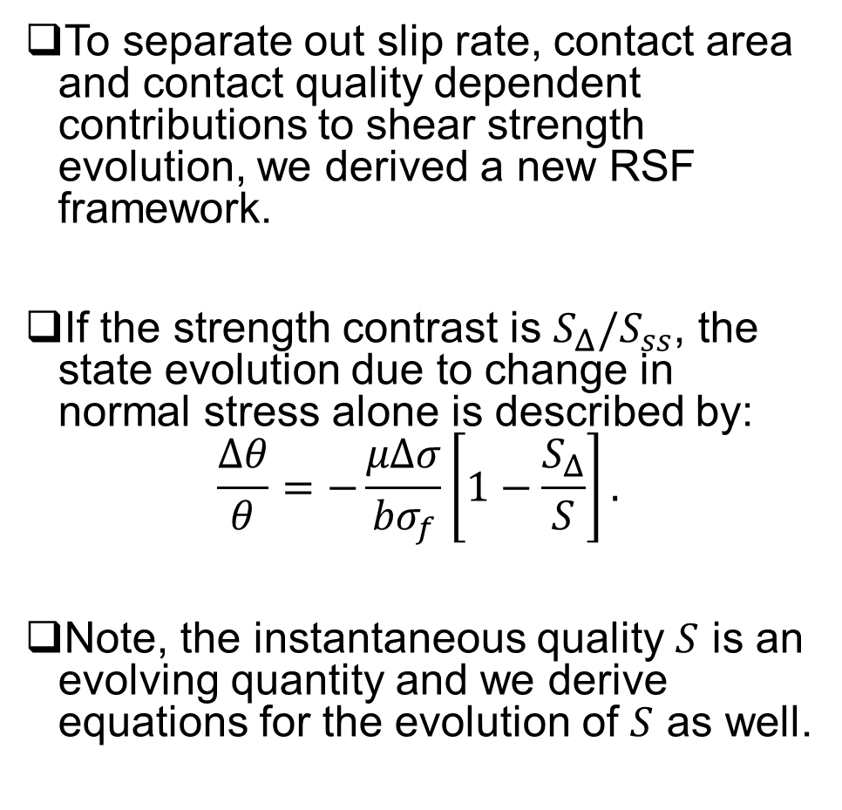
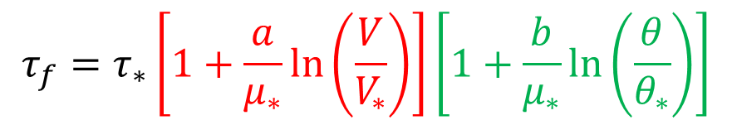




A physics-based RSF model
To separate out slip rate, contact area and contact quality dependent contributions to shear strength evolution, we derived a new RSF framework.
If the strength contrast is $S_{Δ}/S_{ss}$, the state evolution due to change in normal stress alone is described by:
$$\frac{Δθ}{θ}=−\frac{μΔσ}{{bσ}_{f}}\left[1−\frac{S_{Δ}}{S}\right].$$
Note, the instantaneous quality $S$ is an evolving quantity and we derive equations for the evolution of $S$ as well.
$$S_{Δ}/S_{ss}$$
$$S_{ss}$$
$$τ_{f}=τ_{∗}\left[1+\frac{a}{μ_{∗}}\ln\left(\frac{V}{V_{∗}}\right)\right]\left[1+\frac{b}{μ_{∗}}\ln\left(\frac{θ}{θ_{∗}}\right)\right]$$
$$τ_{c}$$
$$SA_{c}$$
Take away message: $Δθ=ΔSA_{c}$
Notes:
Secondly, we need a modelling framework that can quantify and separate out the effects of slip rate, contact area and quality. We use a modified version of the classical RSF equations for this purpose such that changes in state theta are equal changes in the product of quality and area. We derive how state changes in response to normal stress changes assuming fractional changes in contact area are instantaneously equal to fractional changes in normal stress. In this framework, quality S itself is an evolving quantity and we derive separate equations for that.

Slide 9
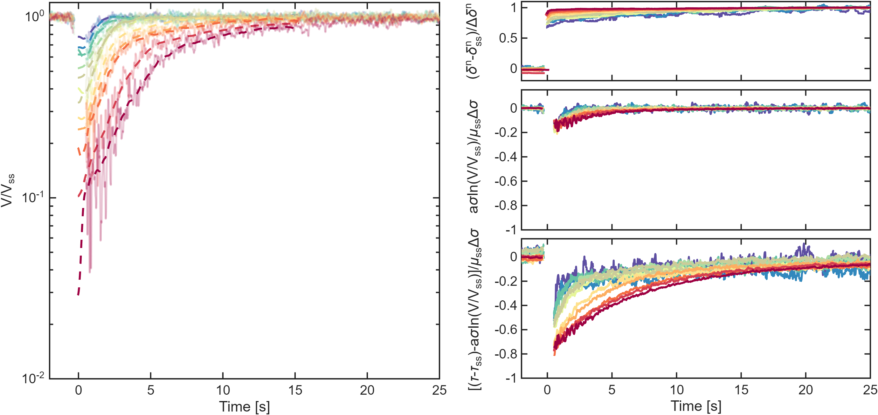
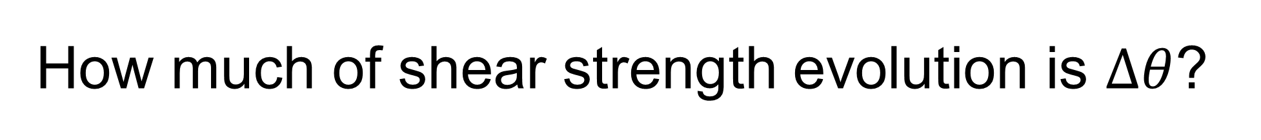
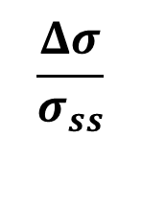
How much of shear strength evolution is $Δθ$?
B
0.05 0.06 0.09 0.14 0.18 0.19 0.28 0.37 0.46 0.69 0.93
C
A
D
$$\frac{Δσ}{σ_{ss}}$$
Notes:
Here, in panel A, I show the velocity evolution inferred from the data using the inferred apparatus stiffness (~1.48 MPa/$μ$m), shear stress and load point displacement data. The colour scheme for the velocities is the same as the data in Figure 2. The transparent curves are velocity history obtained by median smoothed differentiation of inferred slip, the dashed curves are optimal smoothing spline estimates of the velocity which are ultimately used to estimate the strength contrast. In panel C is the direct effect or slip rate dependent contribution to shear stress change normalized in such a way that adding the rate and state dependent contributions should give 1. Panel D shows the rate-dependent stuff in panel C subtracted from 1. As is clear, for the larger steps, nearly 80% of the shear stress or strength evolution is state evolution. Now compare this to panel B which is an independent proxy only for contact area change. Note how the evolution of the inferred state contribution is much slower. More importantly, the state evolution for the larger steps is slower compared to the smaller steps. This is entirely opposite to the trend seen in closure where the large steps saturate to steady state much more rapidly. This finally shows that most of the shear stress evolution is not only state evolution but this evolution is not dominated by contact area evolution.

Slide 10
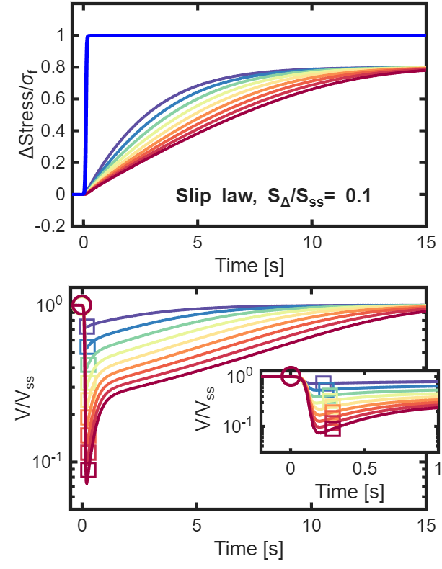
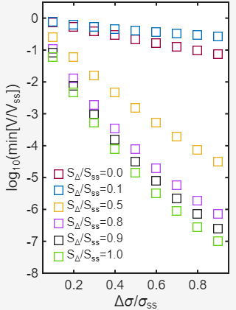


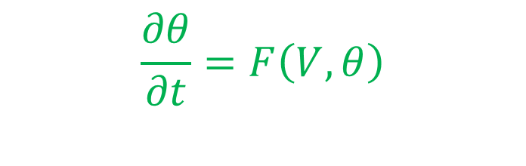


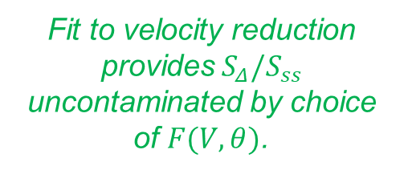
Quantitative estimation of $S_{Δ}/S_{ss}$
To model shear strength evolution in response to finite duration normal stress steps, we use full state evolution.
$$Δσ/σ_{ss}$$
0.1 0.2 0.3 0.4 0.5 0.6 0.7 0.8 0.9
A
$$\frac{dθ}{dt}=\frac{∂θ}{∂σ}\frac{dσ}{dt}+\frac{∂θ}{∂t}$$
C
$$\frac{∂θ}{∂σ}=−\frac{μθ}{bσ}\left[1−\frac{S_{Δ}}{S}\right]$$
Fit to velocity reduction provides$S_{Δ}/S_{ss}$ uncontaminated by choice of $F(V,θ)$.
$$\begin{aligned} \frac{∂θ}{∂t}=F\left(V,θ\right) \end{aligned}$$
B
Notes:
This brings us to our final task which is to quantitatively estimate S_\Delta/S_ss. To do this from real experimental data, we need to couple state evolution in response to normal stress change with state evolution at constant normal stress but with time/slip. For the latter, we use the Slip law. Panels A and B show the model prediction for S_delta/S_ss = 0.1, i.e. the new area is only 10% the quality of the pre-existing area. In panel C, I show the velocity reductions as a function of S_\Delta/S_ss. We use the velocity reduction data from our experiments to constrain S_delta/S_ss because, with the Slip law, the reduction in slip rate implies very little state evolution. So fitting the velocity reduction is only sensitive to the normal stress dependent contribution to state evolution and hence more sensitive to S_delta/S_ss.

Slide 11
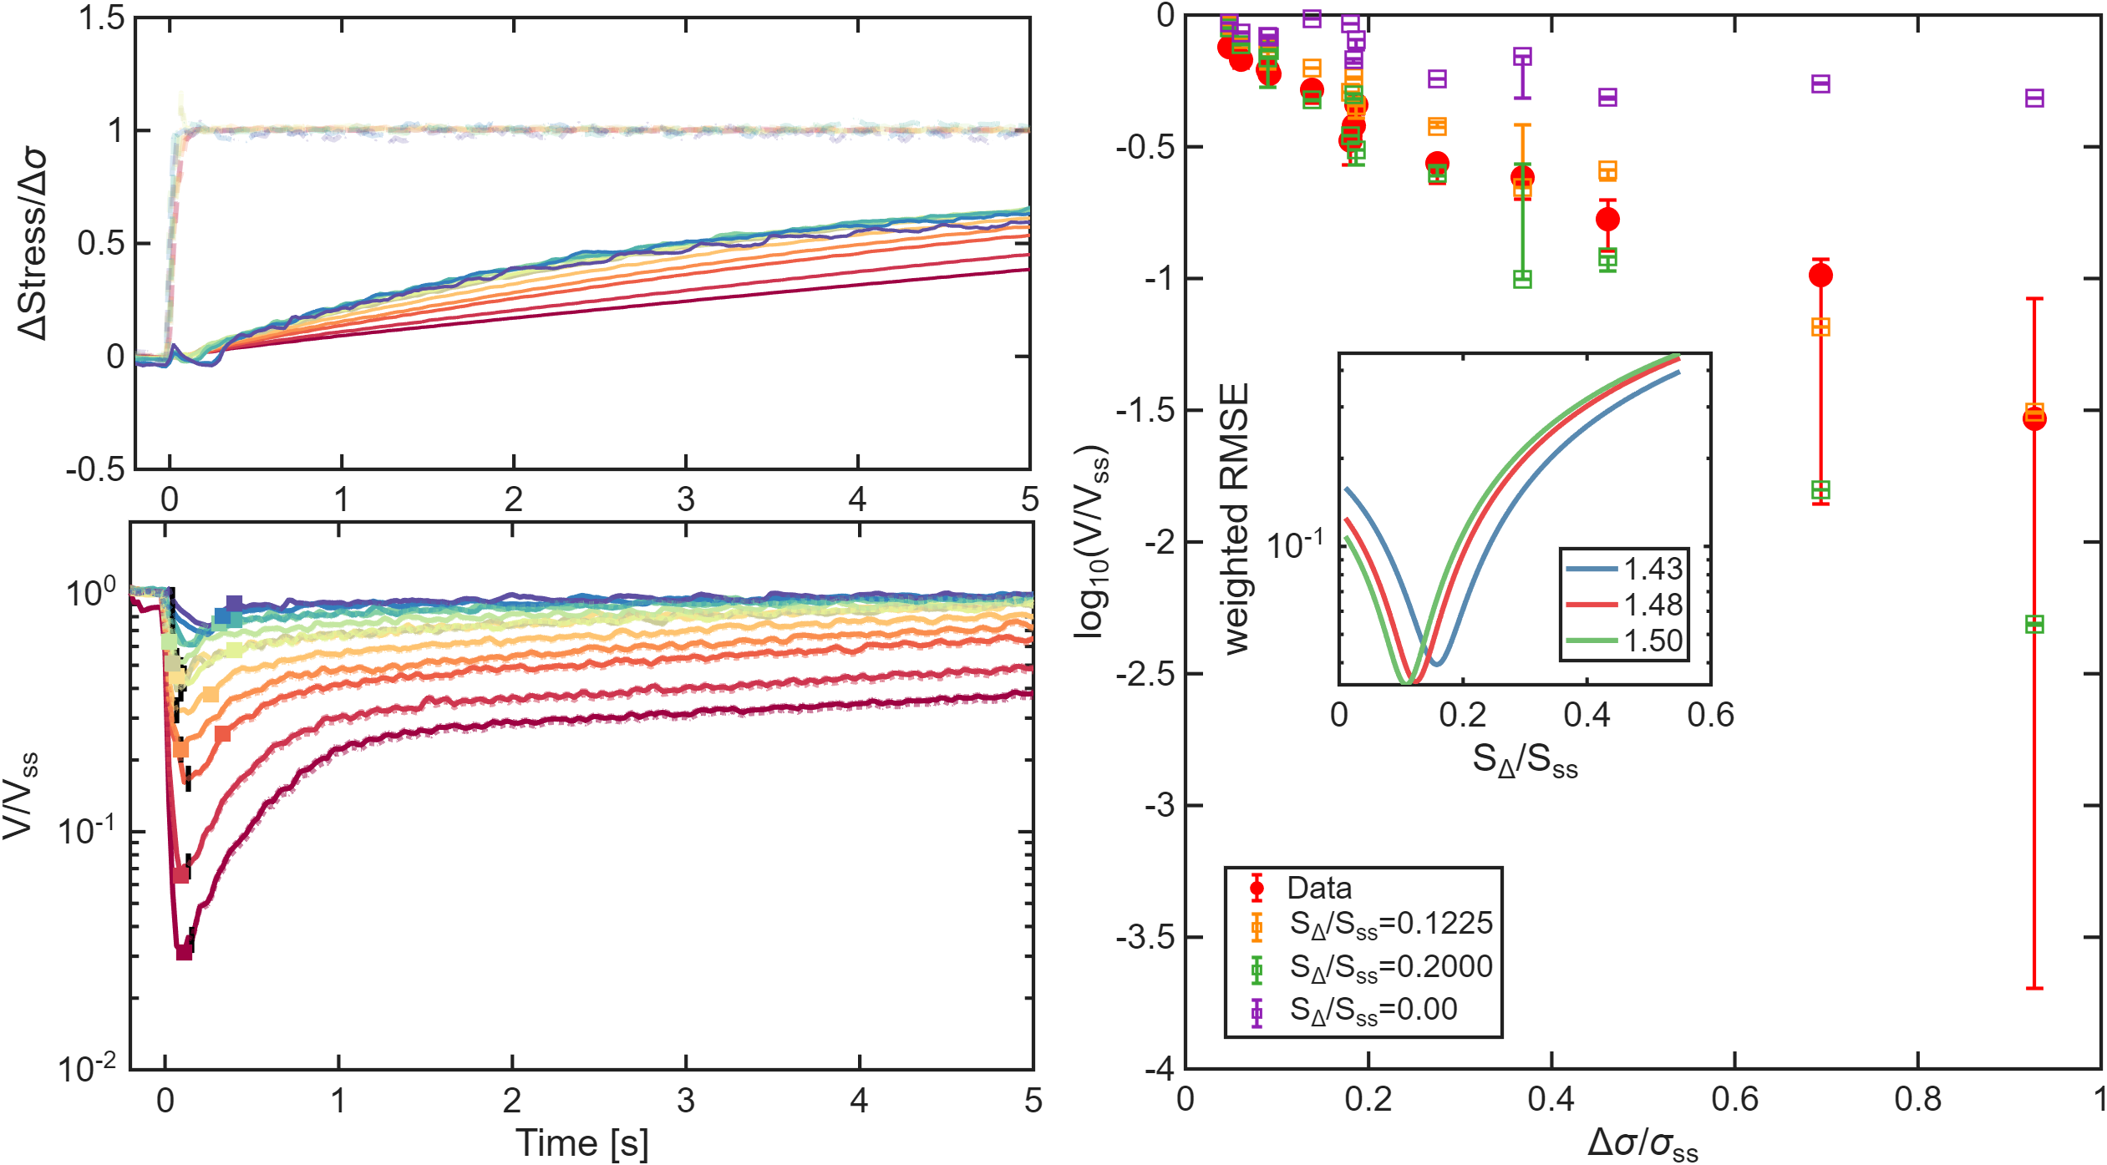

Inferring the strength contrast $S_{Δ}/S_{ss}$
B
C
A
D
Notes:
In panel A, the orange open squares show the modelled velocity reductions compared to the data shown as the filled red circles. The best fit is obtained for S_delta/S_ss around 12%. But the data clearly rule out S_delta = 0 which was the Kilgore et al. interpretation and S_delta = 1 which is the case for no quality contrast. In C and D I show the shear stress and velocity history predicted by this best fit model.

Slide 12
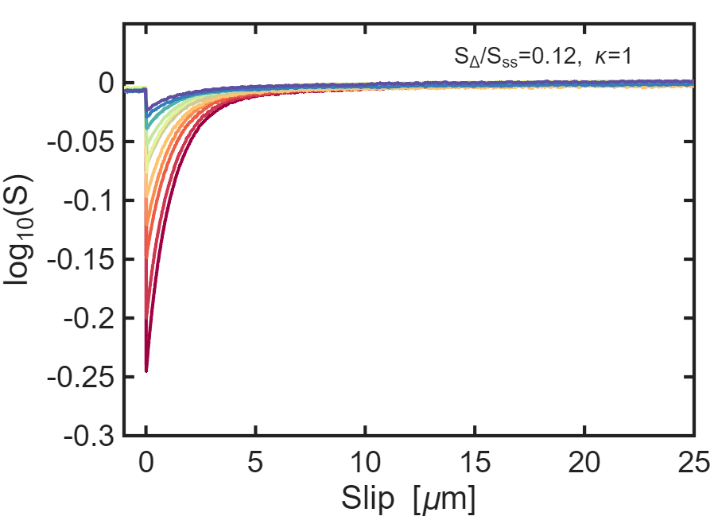
Conclusions
Large normal stress step experiments provide clear evidence that quality contrasts exist across the frictional interface and these control shear strength evolution.
We have shown that macroscopic laboratory data can self consistently be used to infer these quality contrasts.
Derived a new state evolution framework that explicitly allows for quality contrasts and quality evolution following normal stress steps.
Notes:
This brings me to the conclusions. First, moderate to large normal stress step experiments provide clear evidence that quality contrasts exist across the frictional interface and these control shear strength evolution. Second, this microscopic strength contrast can be constrained by macroscopic friction data. Finally, we derived a framework which treats contact quality S as an evolving quantity which can be independently modelled. For example, on the right I show how the predicted contact quality evolution for the best fitting model from the data.

Slide 13
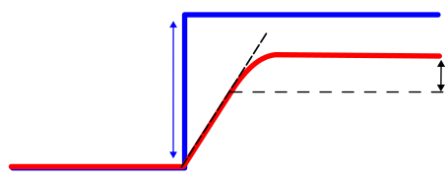
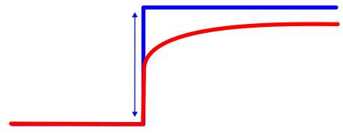














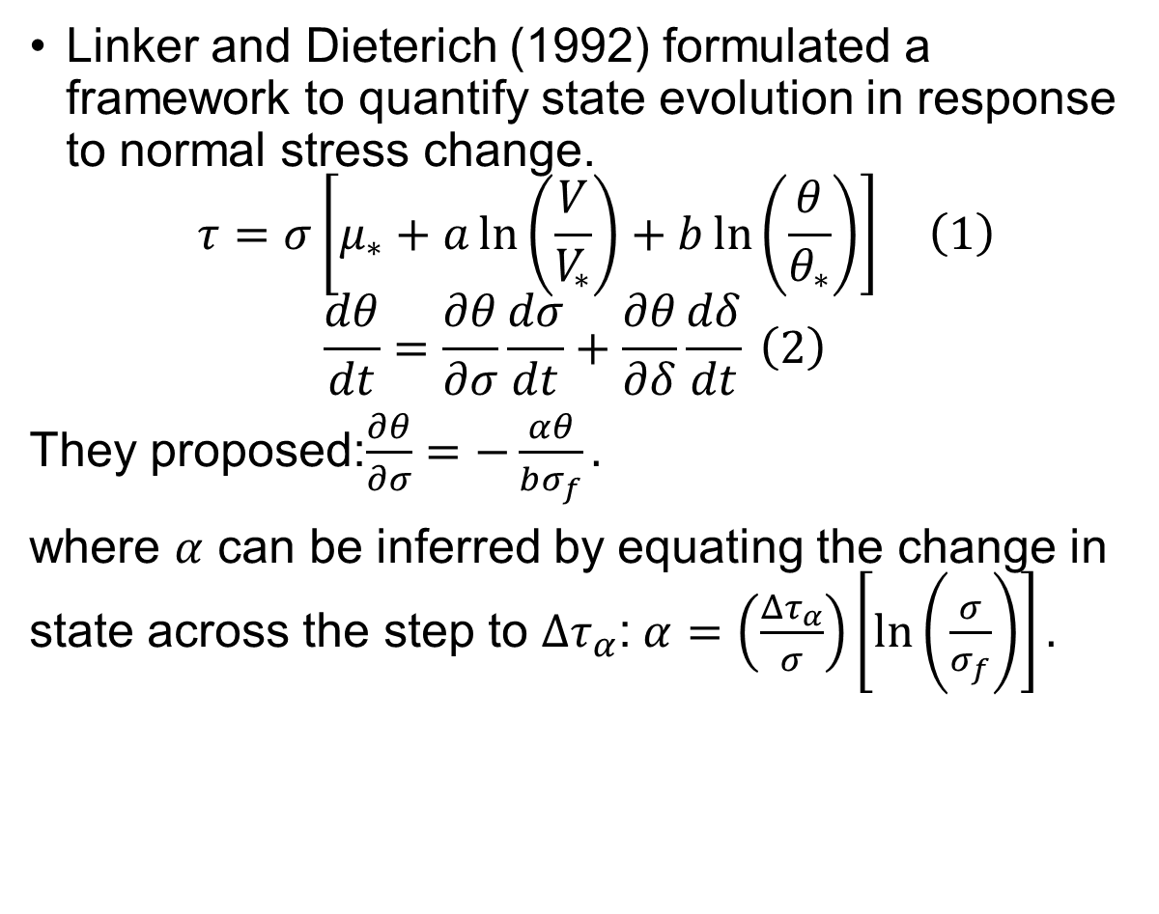

The Linker-Dieterich version
Normal Stress ($σ$)
$$σ_{f}$$
Linker and Dieterich (1992) formulated a framework to quantify state evolution in response to normal stress change.
$$\begin{aligned} τ=σ\left[μ_{∗}+a\ln\left(\frac{V}{V_{∗}}\right)+b\ln\left(\frac{θ}{θ_{∗}}\right)\right] \#\left(1\right)\end{aligned}$$
$$\begin{aligned}\frac{dθ}{dt}=\frac{∂θ}{∂σ}\frac{dσ}{dt}+\frac{∂θ}{∂δ}\frac{dδ}{dt} \#\left(2\right)\end{aligned}$$
They proposed:$\frac{∂θ}{∂σ}=−\frac{αθ}{bσ_{f}}.$
where $α$ can be inferred by equating the change in state across the step to ${Δτ}_{α}$:$α=\left(\frac{Δτ_{α}}{σ}\right)\left[\ln\left(\frac{σ}{σ_{f}}\right)\right].$
Shear Stress ($τ$)
$$τ_{f}$$
$$Δτ_{α}$$
$$Δσ$$
Elastic loading
A
$$σ_{i}$$
$$τ_{i}$$
Load point displacement
Normal Stress ($σ$)
$$σ_{f}$$
$$τ_{f}$$
Shear Stress ($τ$)
$$Δσ$$
$$σ_{i}$$
$$τ_{i}$$
Fault Slip
Assumptions:
Velocity has evolved back to steady state at point A.
State has not evolved from its post-step value till point A.

Slide 14
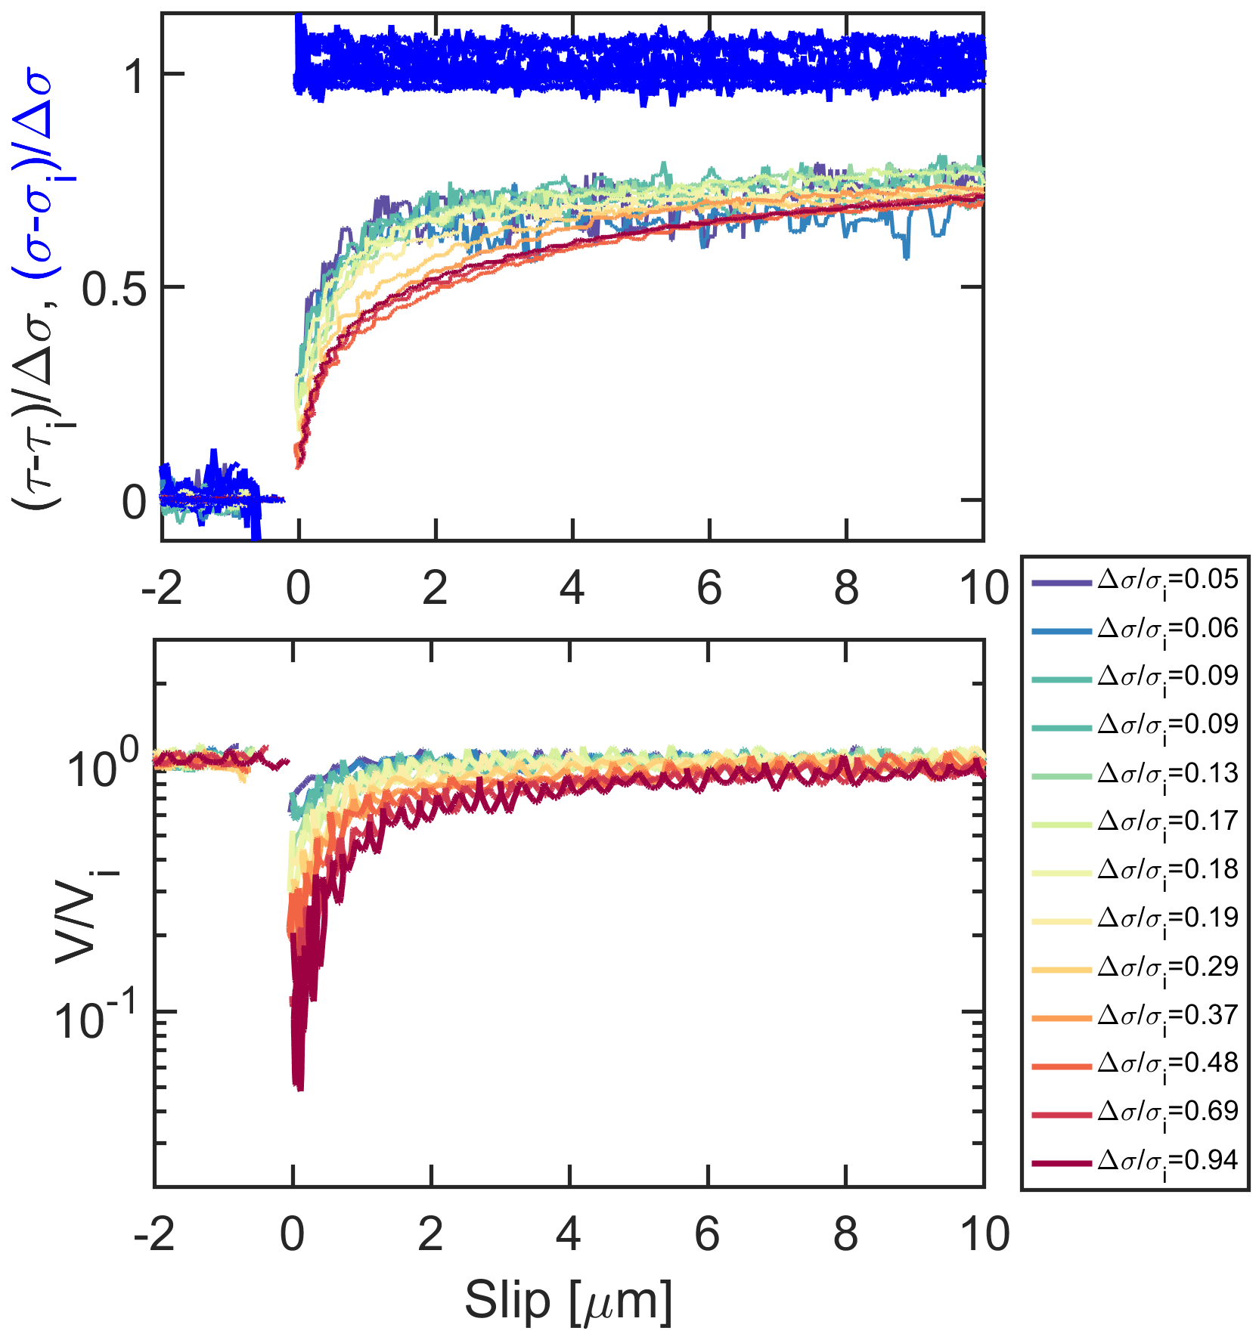
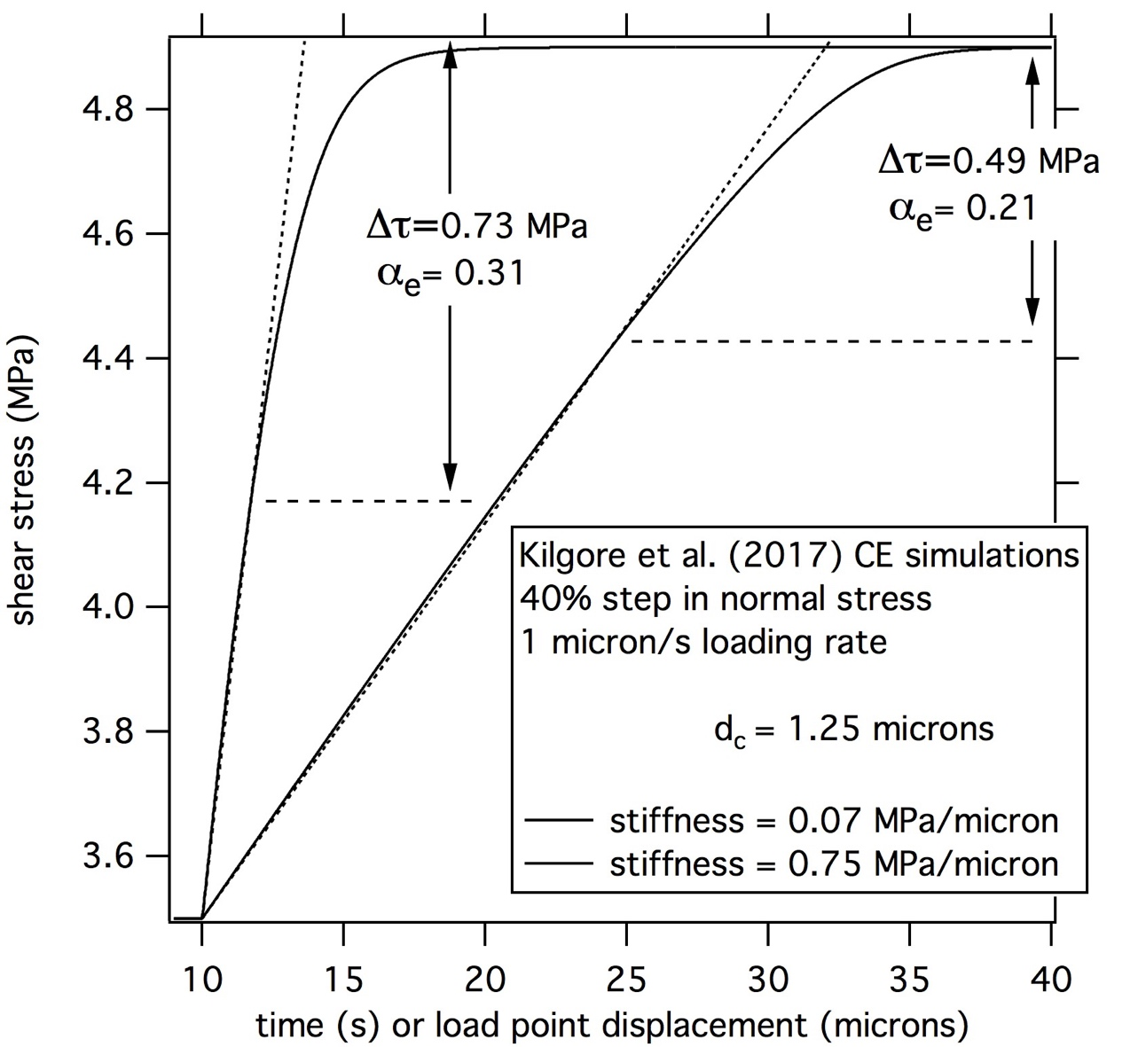
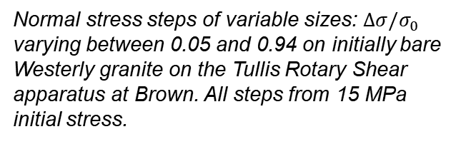
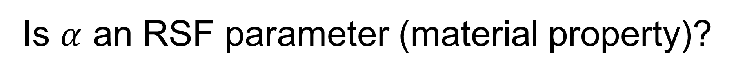
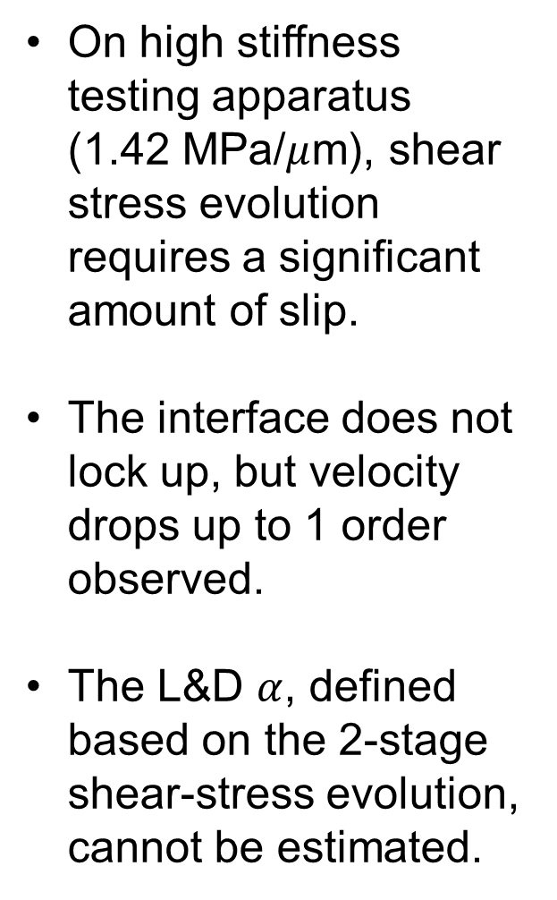
Is $α$ an RSF parameter (material property)?
On high stiffness testing apparatus (1.42 MPa/$μ$m), shear stress evolution requires a significant amount of slip.
The interface does not lock up, but velocity drops up to 1 order observed.
The L&D $α$, defined based on the 2-stage shear-stress evolution, cannot be estimated.
Normal stress steps of variable sizes: $Δσ/σ_{0}$ varying between 0.05 and 0.94 on initially bare Westerly granite on the Tullis Rotary Shear apparatus at Brown. All steps from 15 MPa initial stress.

Slide 15
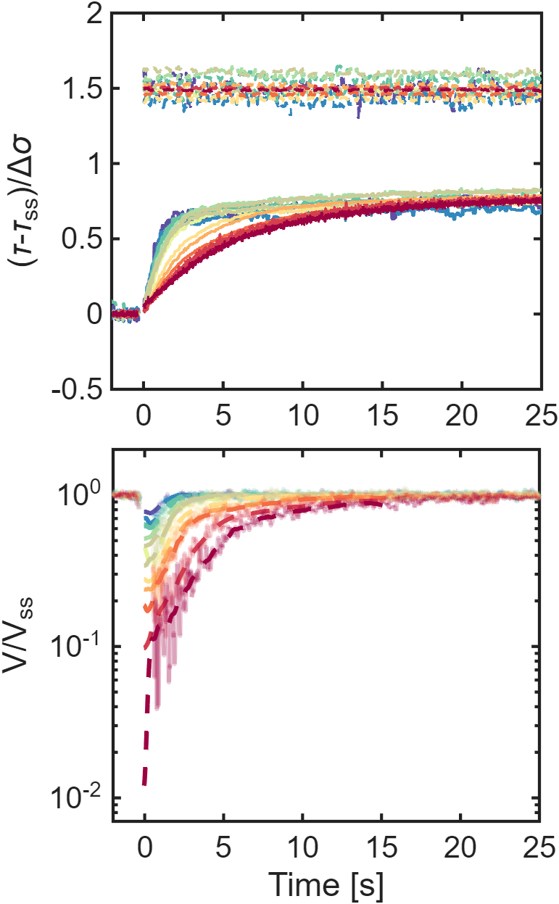
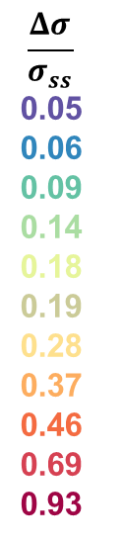



The importance of large stiffness
k = 0.095 $μm^{−1}$
k = 0.008 $μm^{−1}$
$$\frac{Δσ}{σ_{ss}}=0.6$$
Only stiff machines allow inference of interface physics
No velocity resolution

