Slide 1
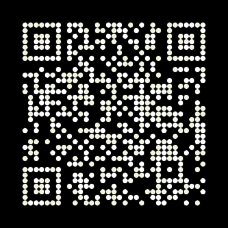
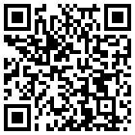
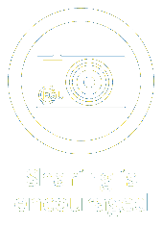
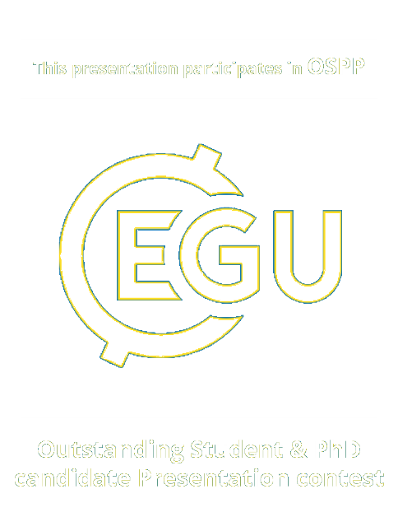
Identifying reliable in situ reference measurements for satellite root-zone soil moisture validation from the International Soil Moisture Network
Daria Ilina, Johanna Lems, Alexander Gruber, Wouter Dorigo and Raffaele Crapolicchio

Slide 2
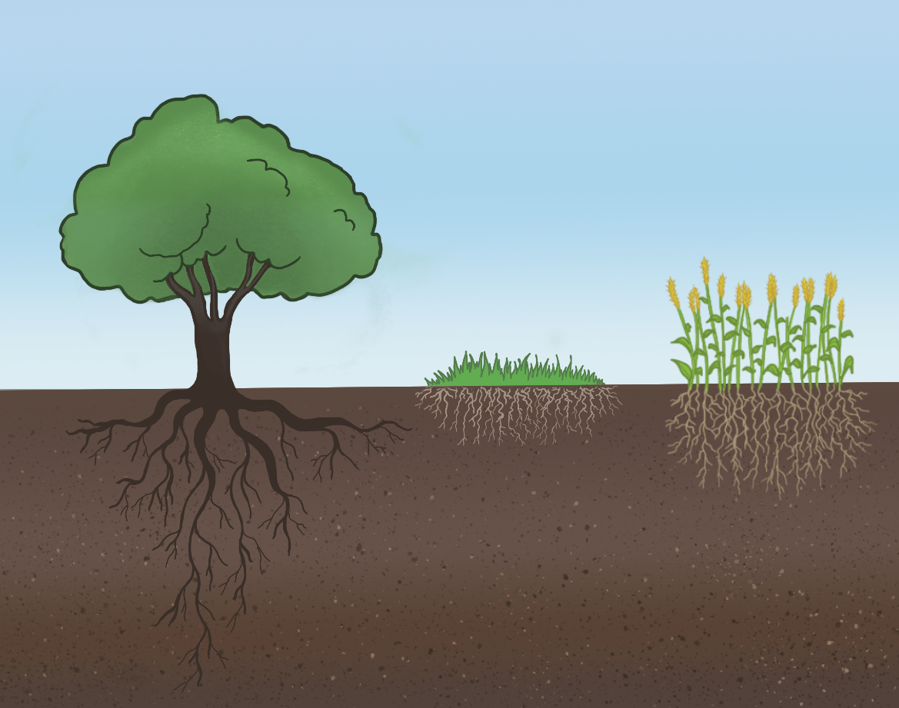
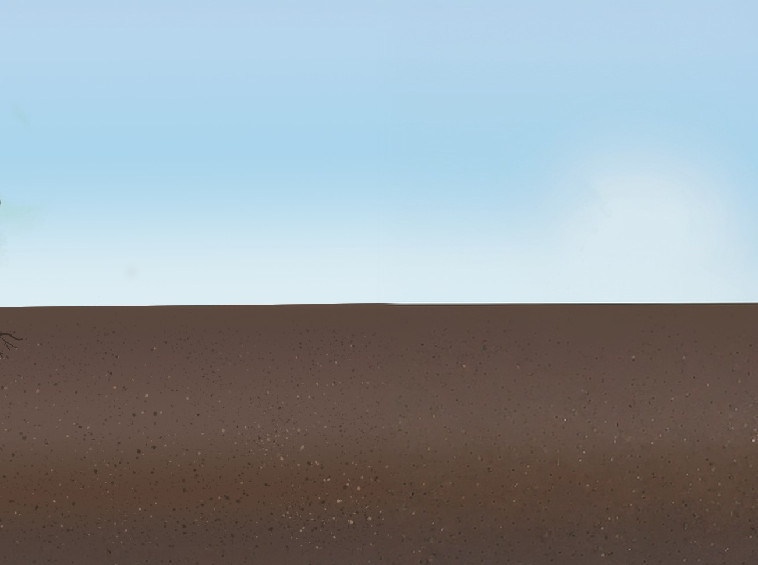
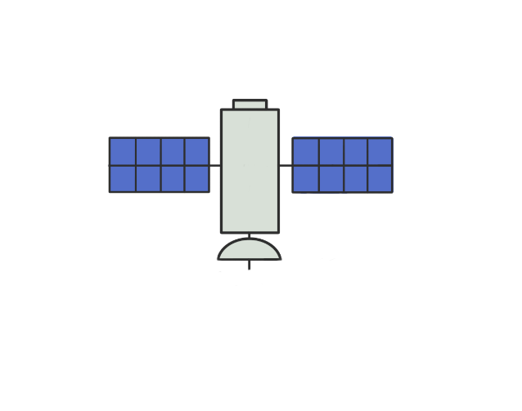
Motivation
Satellite sensors can only penetrate the ~ top 5 cm of the soil surface.
Effective drought and agricultural monitoring require data from the deeper root zone.
~ top 5 cm
Root Zone Soil Moisture (RZSM) can be derived from surface SM estimates through modelling.
We propose:
A method to identify the optimal ground reference RZSM representation from irregular in situ stations.
Validation of such RZSM products requires standardized approach
and reliable in situ reference networks.

Slide 3
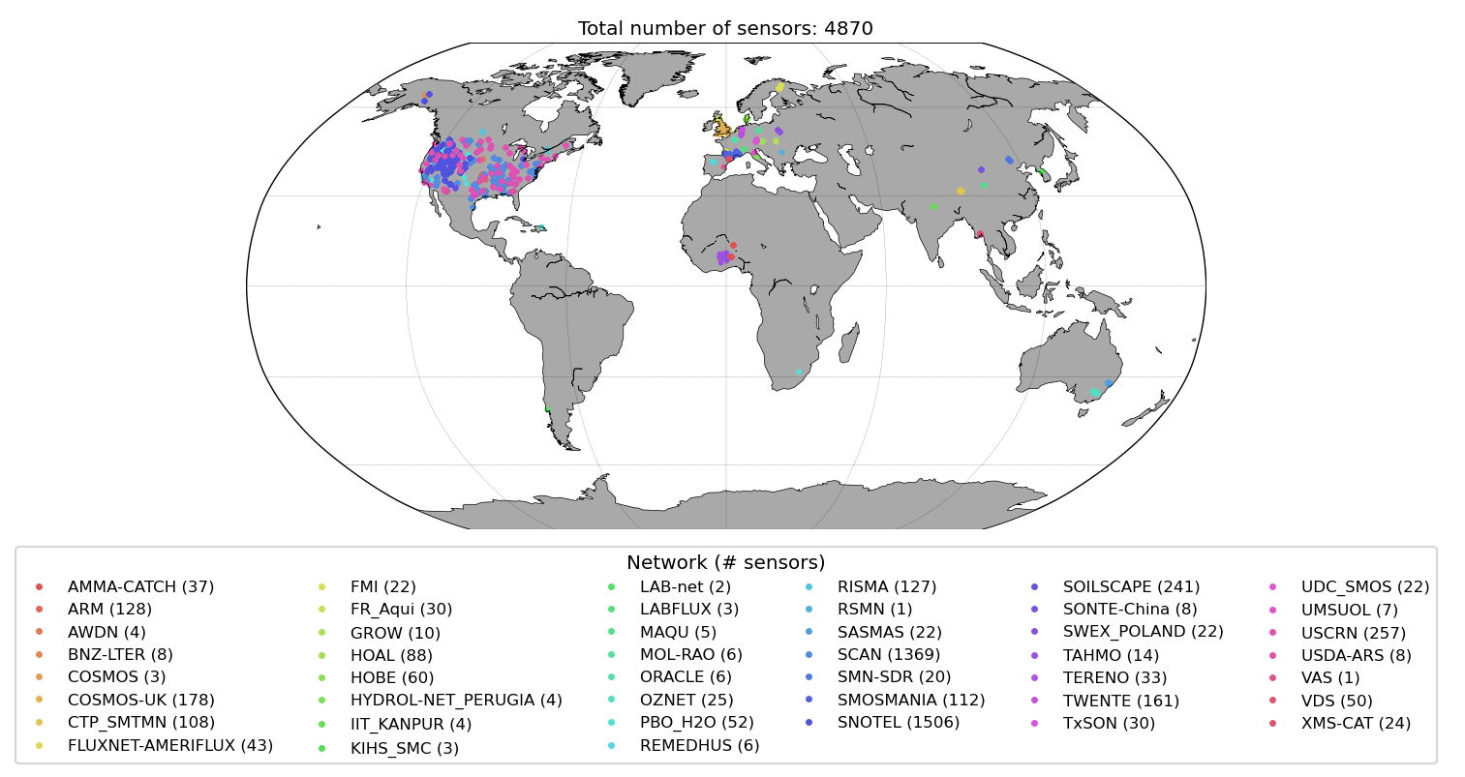
A deeper look into the ISMN
The ISMN (International Soil Moisture Network) is a collection of in situ data, it provides timeseries, metadata, and quality flags.
Most stations are located in the northern hemisphere (North America and Europe), and in agricultural areas.

Slide 4
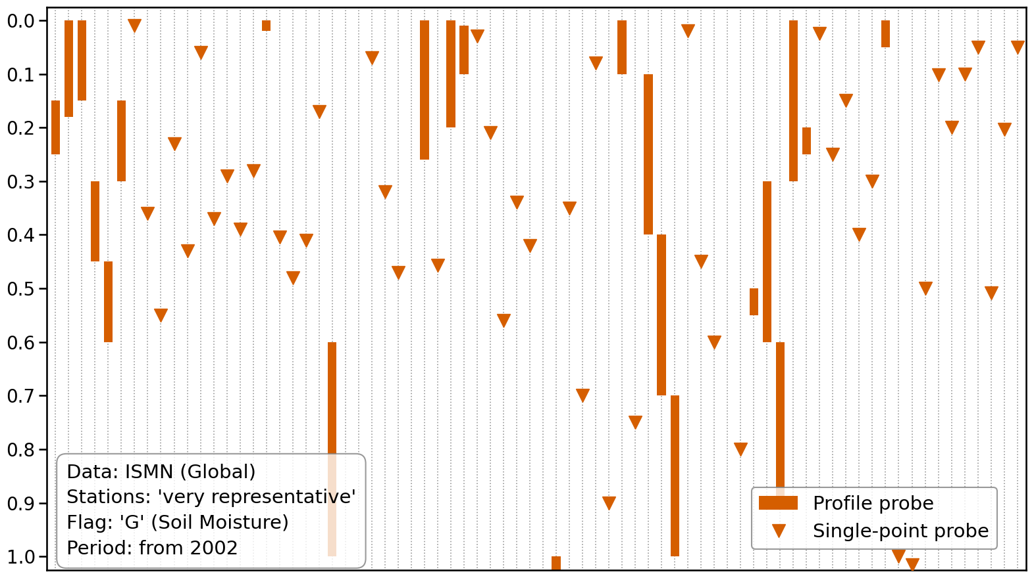
ISMN sampling depths distribution
The network provides high-resolution data, but sensor placement is vertically inconsistent.
Depth (m)
Sorted by number of observations

Slide 5
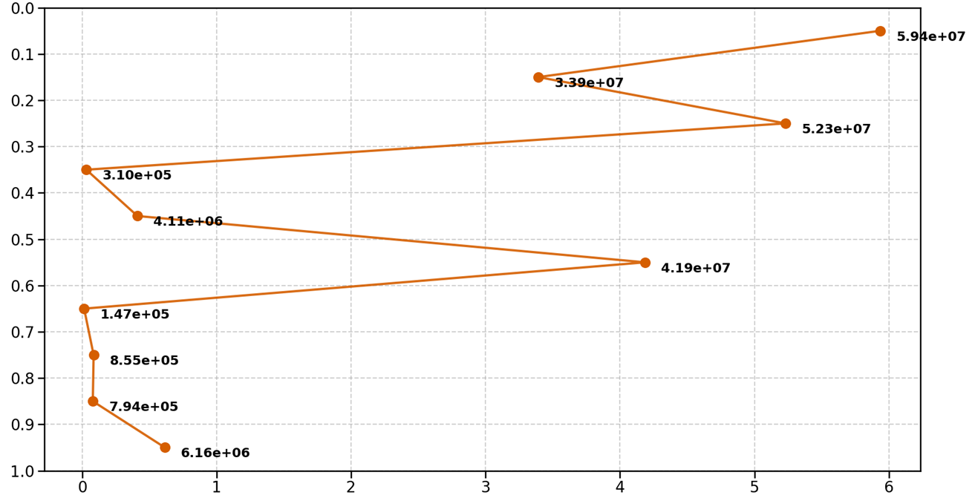
ISMN sampling depths distribution
Sensor distribution is biased toward the upper layers.
This uneven coverage limits the representativeness of the validation across the entire soil profile.
Depth (m)
1e7

Slide 6
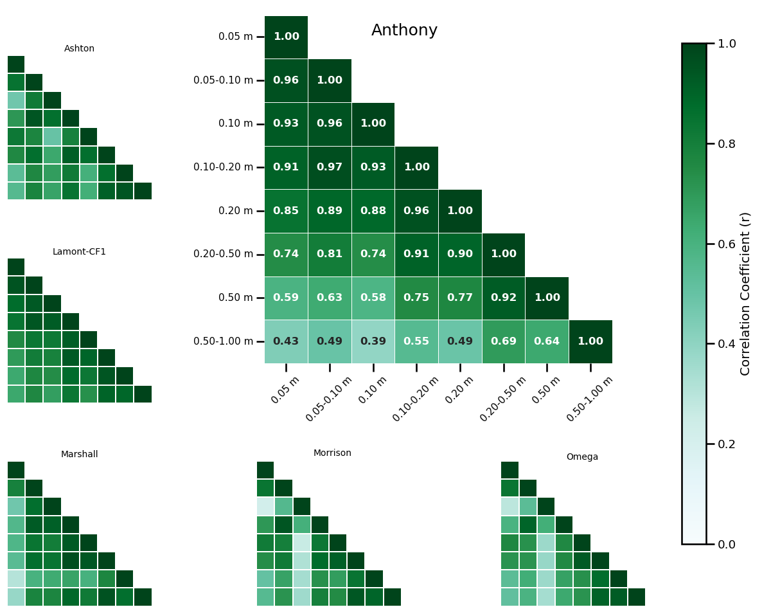
Soil layer coupling at different stations
Station “Anthony”, Network “ARM”
Soil profiles are non-uniform, correlation patterns are site-specific.
Fixed intervals might overlook local variations in soil structure and texture.

Slide 7
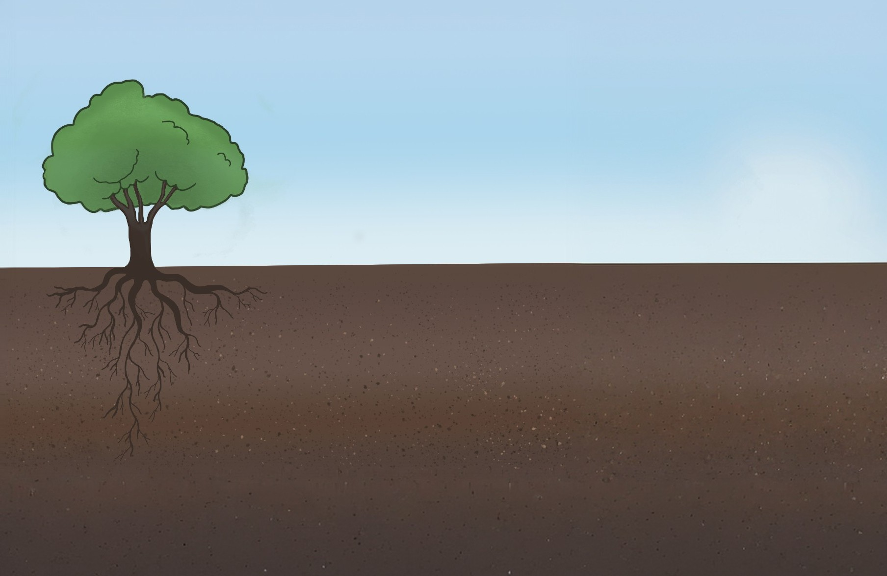
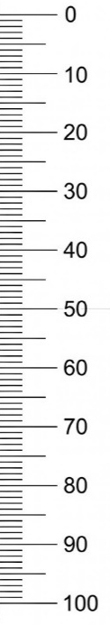
Common validation approaches
Common RZSM depth layers include 0-10 cm, 10-40 cm, 40-100 cm (e.g. ESA CCI SM RZSM*)
RZSM product 10 – 40 cm
Sensor-by-sensor approach:
RZSM product is compared to each in situ sensor individually.
Averaging approach:
Sensors within the relevant layer are grouped as a single averaged value.
* Pasik et al. 2023
https://doi.org/10.5194/gmd-16-4957-2023,%202023

Slide 8
Proposed approach: tolerance-based sensor selection
Can be applied to any model layer margins. Tolerance is calculated as % of the layer margin.
RZSM product 10 – 40 cm
“Tolerance” approach:
Expands selection margins to include sensors in close vertical proximity by slightly broadening layer boundaries. We capture more data while still representing the target soil layer.

Slide 9
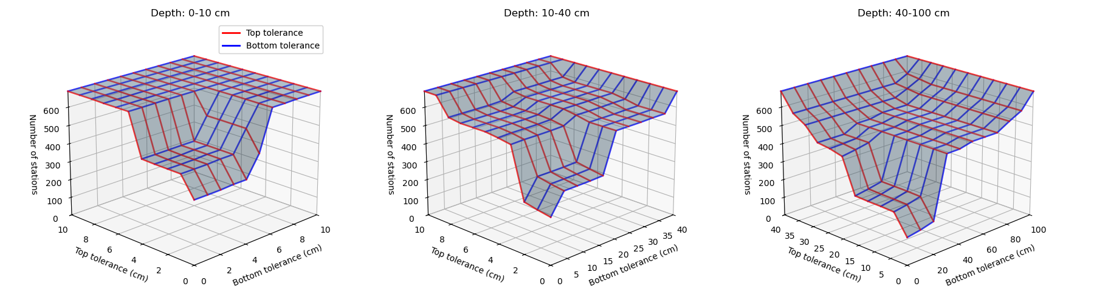
Trade off: quantity vs accuracy
High tolerance:
Larger sample size
Better temporal and spatial coverage
BUT: Higher uncertainty
Less accurate representation of specific layer depth
10-40 cm
Low tolerance:
No “outlier” depths, higher vertical precision
BUT: Small sample size
Potentially missing representative data
0-10 cm
40-100 cm
Tolerance
for 10 cm margin (cm)
Tolerance
for 40 cm margin (cm)

Slide 10


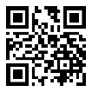

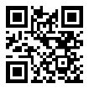
Take-home message
Innovation:
We introduced a novel tolerance-based approach to maximize in situ reference data by accounting for irregular sensor depths.
Trade-off:
Optimal balance must be tuned between sample size and depth accuracy depending on application requirements.
Implementation:
To-be integrated into the QA4SM validation platform;
join at 8:59 AM (PICO Spot 4) ☺
Discover our project::
Discover our platform::
daria.ilina@geo.tuwien.ac.at

