Slide 1





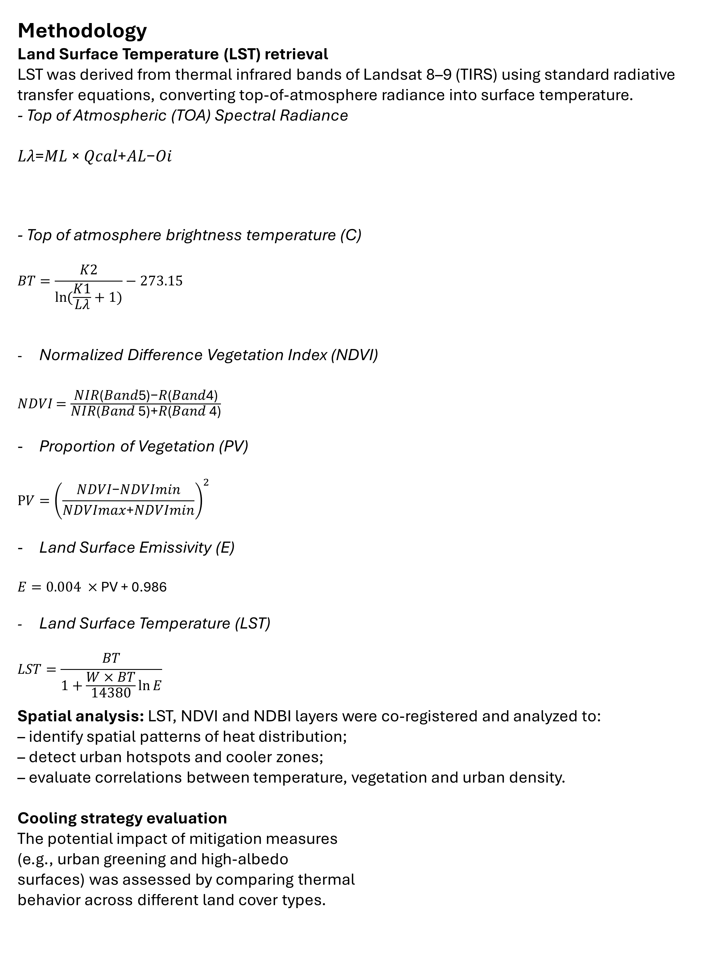
.
Satellite-Based Analysis of Urban Heat Island Dynamics under Extreme Heatwave Conditions and Mitigation Strategies in Thessaloniki
Marco Falda, Giannis Adamos, Tamara Rađenović, Chrysi Laspidou
Abstract
Urban heat Urban heat islands (UHI) and extreme heat events are increasingly critical challenges for cities in the context of climate change and rapid urbanization. This study investigates the intensity and spatial distribution of the UHI effect in Thessaloniki (Greece) during major heatwave events using Landsat 8–9 satellite imagery. Land Surface Temperature (LST) is combined with vegetation and built-up indices (NDVI and NDBI) to explore the relationship between urban morphology and thermal patterns.
A key novelty of this work lies in its city-wide approach, enabling a comprehensive analysis of the entire urban area and consistent comparison across different urban sectors. In addition, the study integrates multiple mitigation strategies within a single framework, combining nature-based solutions (e.g., urban greening, green roofs) with material-based interventions (e.g., high-albedo surfaces).
Results confirm a strong correlation between land cover and temperature, highlighting the cooling effect of vegetation and the warming impact of impervious surfaces. The findings also show that combined mitigation measures produce more effective and spatially differentiated cooling, particularly in dense urban areas, supporting integrated strategies for urban heat resilience.
to heatwaves.
Data
Landsat 8–9 (OLI/TIRS sensors) imagery for 27/07/2022, 14/07/2023 and 16/07/2024, spatial resolution: 30 m;
Urban spatial layers from OpenStreetMap.
Urban Configuration
Methodology
Land Surface Temperature (LST) retrieval
LST was derived from thermal infrared bands of Landsat 8–9 (TIRS) using standard radiative transfer equations, converting top-of-atmosphere radiance into surface temperature.
- Top of Atmospheric (TOA) Spectral Radiance
𝐿𝜆=𝑀𝐿 × 𝑄𝑐𝑎𝑙+𝐴𝐿−𝑂𝑖
- Top of atmosphere brightness temperature (C)
$$BT=\frac{K2}{\ln{(\frac{K1}{\text{L}\text{λ}}+1)}}−273.15$$
- Normalized Difference Vegetation Index (NDVI)
𝑁𝐷𝑉𝐼 $={\frac{\text{NIR}\text{(}\text{Band}\text{5)−}\text{R}\text{(}\text{Band}\text{4)}}{\text{NIR}\text{(}\text{Band}\text{ 5)+}\text{R}\text{(}\text{Band}\text{ 4)}}}^{}$
Proportion of Vegetation (PV)
$$PV={\left(\frac{\text{NDVI}\text{−}\text{NDVImin}}{\text{NDVImax}\text{+}\text{NDVImin}}\right)}^{2}$$
Land Surface Emissivity (E)
$E=0.004 ×$ PV + 0.986
- Land Surface Temperature (LST)
$$LST=\frac{BT}{1+\frac{W×BT}{14380}\ln{E}}$$
Spatial analysis: LST, NDVI and NDBI layers were co-registered and analyzed to:
– identify spatial patterns of heat distribution;
– detect urban hotspots and cooler zones;
– evaluate correlations between temperature, vegetation and urban density.
Cooling strategy evaluation
The potential impact of mitigation measures
(e.g., urban greening and high-albedo
surfaces) was assessed by comparing thermal
behavior across different land cover types.
ML = Band-specific multiplicative rescaling factor from the metadata (RADIANCE_MULT_BAND_x, where x is the band number) (ML = 3.3420 × 10−4)
Qcal = The band 10 image
AL = Band-specific additive rescaling factor from the metadata (RADIANCE_ADD_BAND_x, where x is the band number), (AL = 0.1)
Left: classification of the city into macro areas based on their functions and urban fabric (Source: Authors with QGIS)
Right: rough general overview of potential flat roofs that can be converted into green roofs (flat roofs), with the old town lacking similar structures (pitched roofs) (Source: Authors with QGIS)
K1 = Band-specific thermal conversion constant from the metadata (K1_CONSTANT_BAND_x, where x is the thermal band number) (K1 = 774.8853)
K2 = Band-specific thermal conversion constant from the metadata (K2_CONSTANT_BAND_x, where x is the thermal band number), (K2 = 1321.0789)
Satellite Imagery
(Left) Thessaloniki geographical location (red square) and (right) satellite map of the city (Source: Authors with QGIS).
Comparison between urban building distribution and recorded NDBI (left) and NDVI (right) values to assess
the spatial extent of built-up areas and potential green roof presence (Source: Authors with QGIS)
Intervention | Maximum LST Reduction (°C) | Estimated Air Temperature Reduction (°C)
Green roofs | -4.5 | -0.7
Light-colored asphalt | -7.7 | -1.9
Comparison between LST of (left) Thessaloniki in the original condition (without green roofs and light-colored asphalts) on 27 July 2022, 14 July 2023 and 16 July 2024, and (right) with mitigation strategies in the correspondent dates (−0.7 ◦C for green roofs [32] and −1.9 ◦C for lightcolored
streets [33]) (Source: Authors with QGIS).
Results
Temperature differences across sectors
The Old City and industrial area show the highest LST (up to ~29–29.2 °C), while the city center is cooler (~27–28 °C). The city center also shows the largest mitigation effect (−2.25% to −2.57%), linking lower baseline temperatures with higher intervention efficiency.
Correlation between indices and LST
Low NDVI areas (Old City, industrial zones) correspond to higher temperatures (~+1–1.5 °C vs city center). High NDBI areas show minimal cooling after mitigation (down to −0.03%), confirming that dense built surfaces both increase heat and reduce mitigation effectiveness .
Effects of mitigation measures
Mitigation is most effective in the city center (≈−2%), where urban form allows interventions (green roofs, reflective pavements). Limited reductions in the Old City (~−0.79%) and industrial area highlight the constraints imposed by urban morphology and surface characteristics.
Temperature variation within different areas of Thessaloniki in the 3 selected dates considering
the simulated effect of mitigation solutions
Acknowledgments: This work was supported by COST Action CA22162 - FUTUREMED (European Cooperation in Science and Technology), which fosters collaborative research and networking on climate resilience and environmental sustainability in the Mediterranean region. COST is supported by the EU Framework Programme Horizon Europe.

