Slide 1


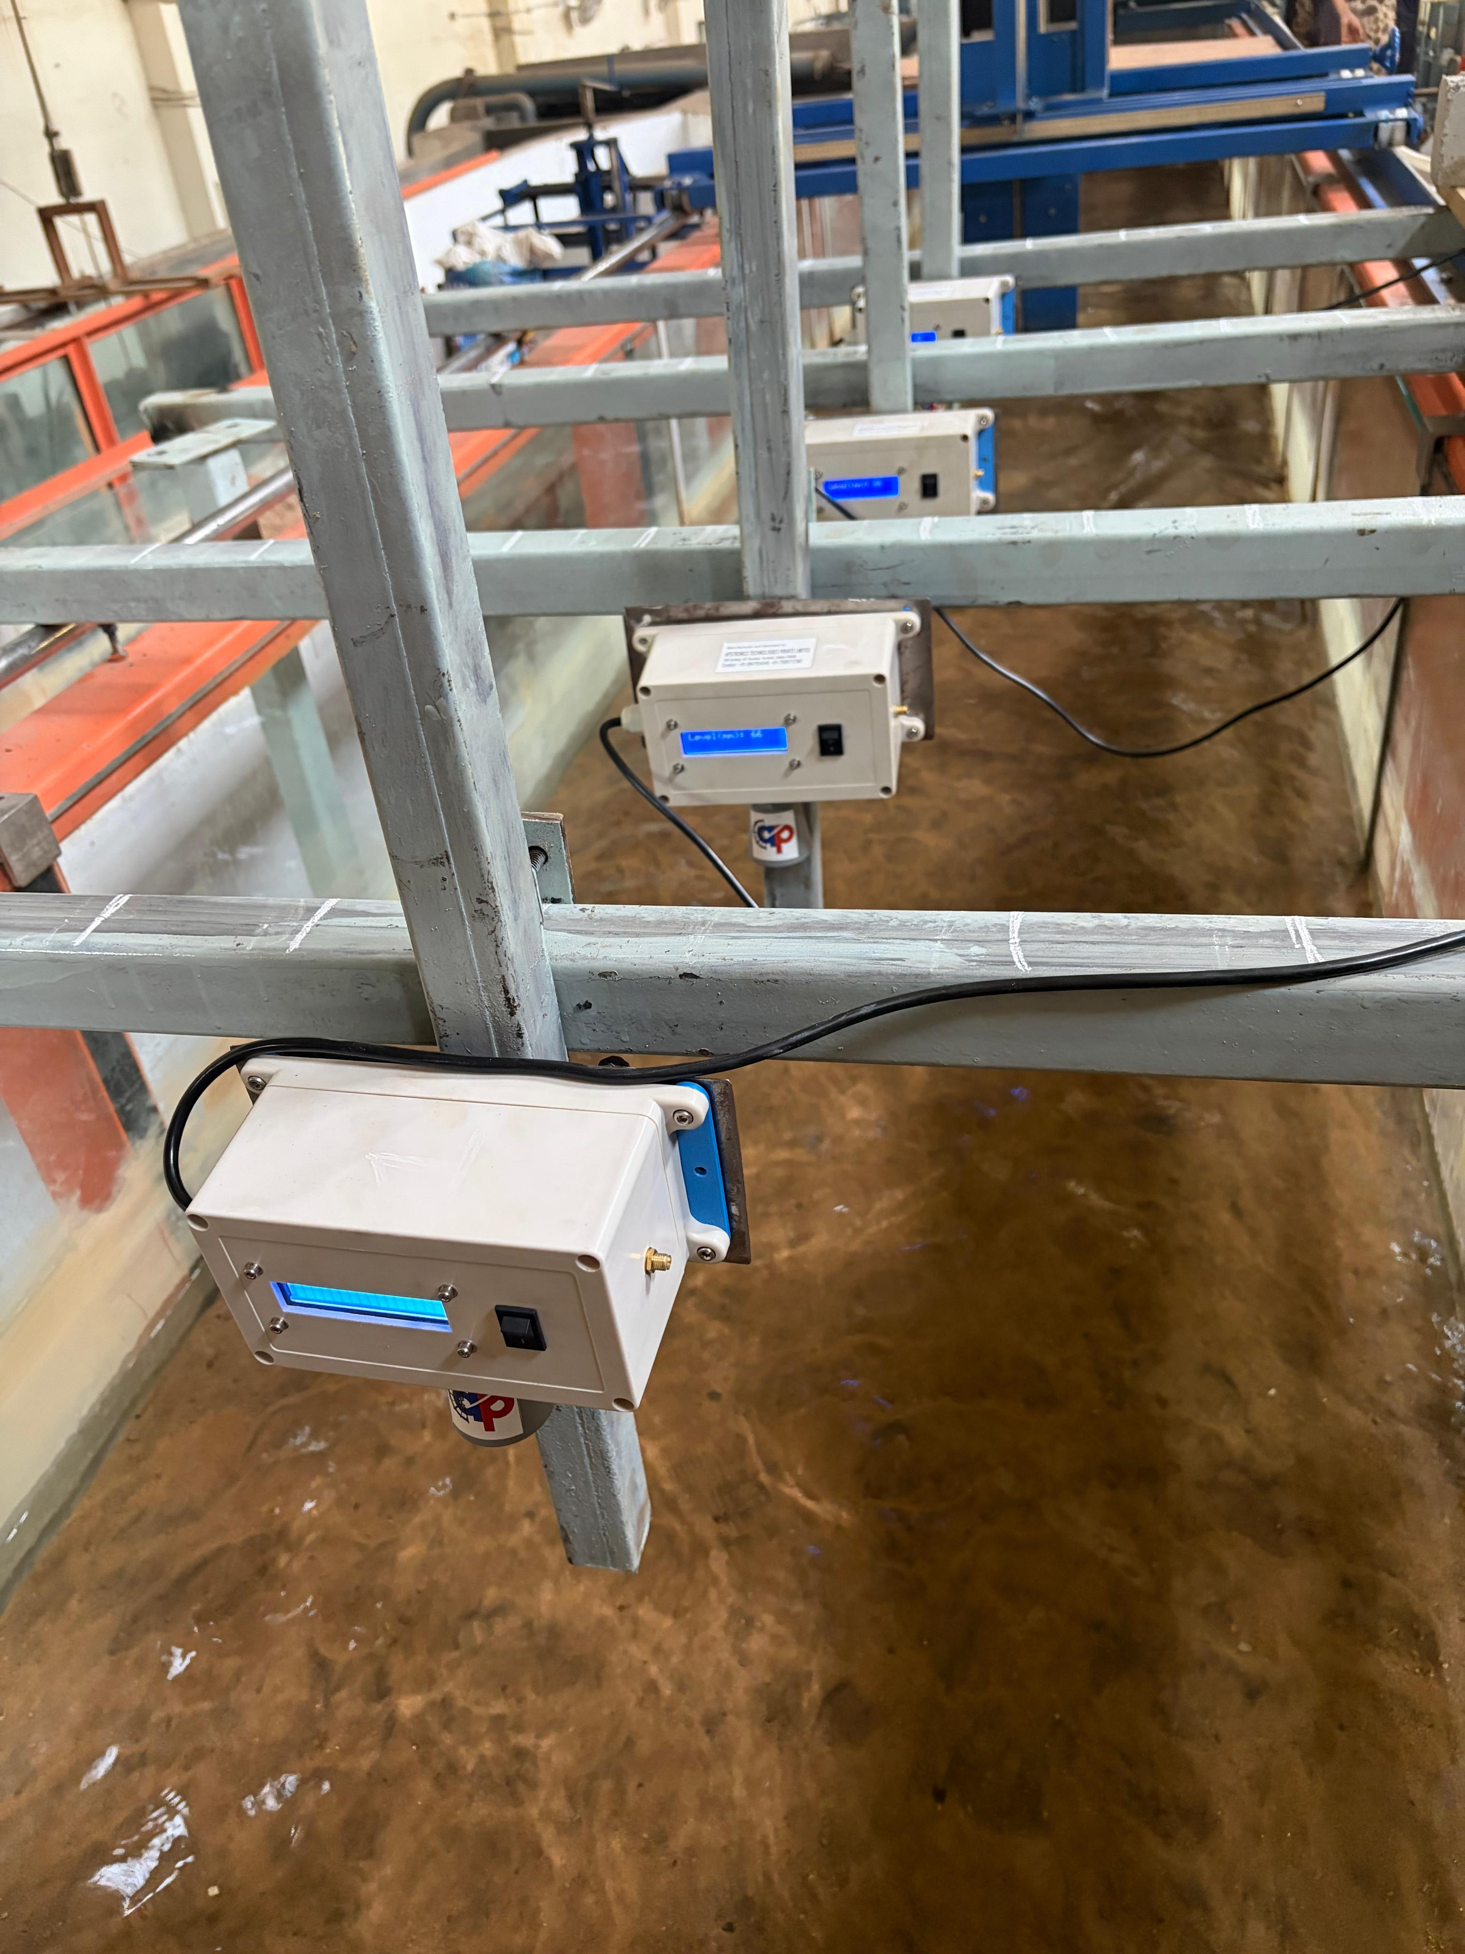
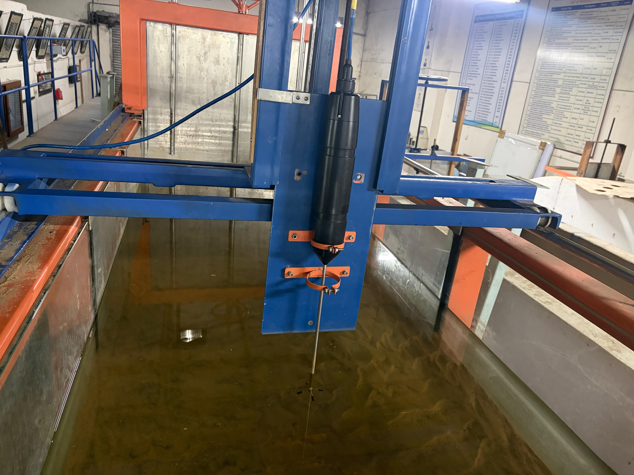
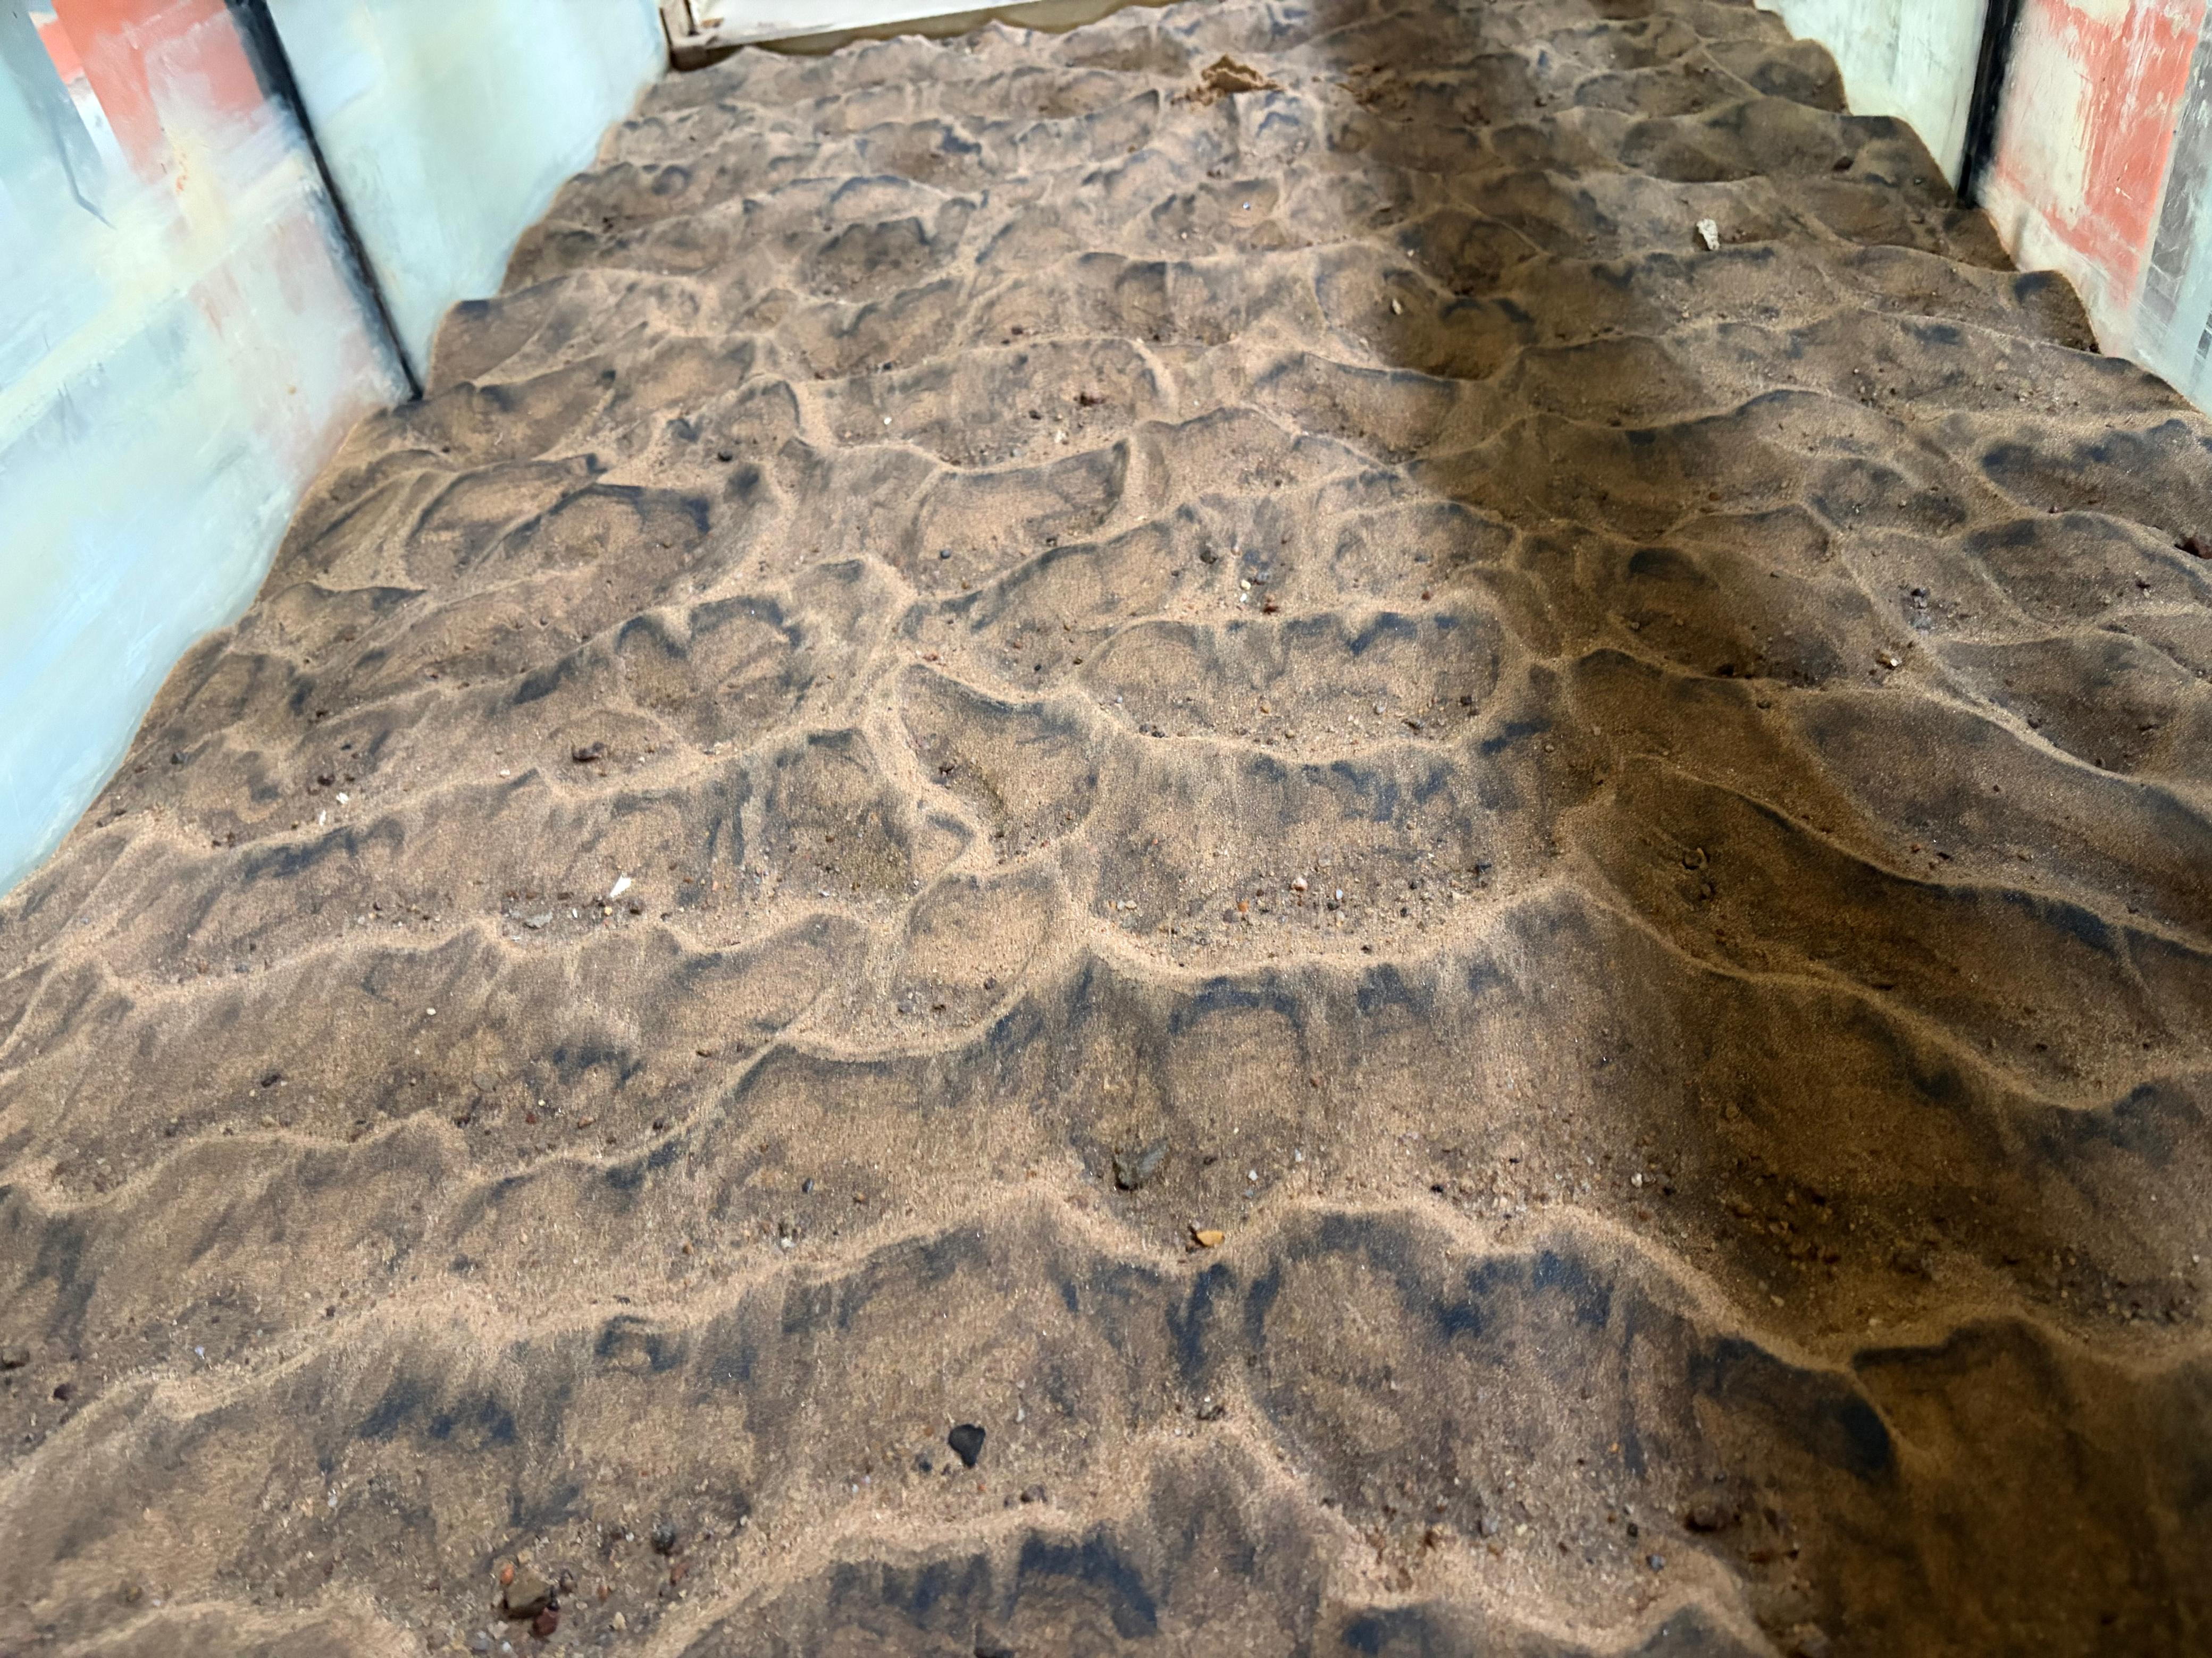
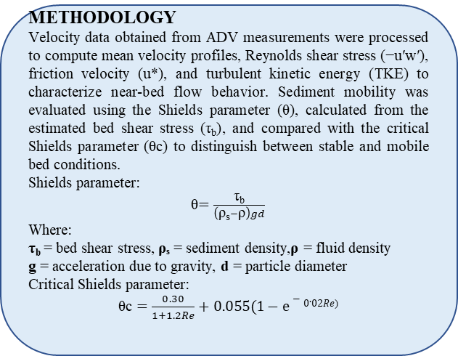
BANOTHU JYOTHI
Effects of Flow Depth and Sediment Size on Near-Bed Hydraulics and Sediment Mobility in Open-Channel Flow
Introduction: Sediment is very important in shaping river channels and affecting how water flows in open channels. River beds are usually made up of movable materials like sand, gravel, and mixed particles. When water flows over these sediments, it causes movement of particles and leads to processes such as sediment transport, formation of bedforms, and changes in river shape. Near-bed flow dynamics play a critical role in controlling sediment entrainment and mobility, yet most traditional studies rely on assumptions of uniform flow conditions and simplified sediment characteristics.
METHODOLOGY
Velocity data obtained from ADV measurements were processed to compute mean velocity profiles, Reynolds shear stress (−u′w′), friction velocity (u*), and turbulent kinetic energy (TKE) to characterize near-bed flow behavior. Sediment mobility was evaluated using the Shields parameter (θ), calculated from the estimated bed shear stress (τ_{b}), and compared with the critical Shields parameter (θc) to distinguish between stable and mobile bed conditions.
Shields parameter:
θ$=\frac{\text{τ}\text{b}}{\left(\text{ρ}\text{s}−\text{ρ}\right)gd}$
Where:
τ_{b} = bed shear stress, ρₛ = sediment density,ρ = fluid density
g = acceleration due to gravity, d = particle diameter
Critical Shields parameter:
$\text{θc}=\frac{0.30}{1+1.2Re}+0.055(1−e−0.02Re$⁾
Research gap: There is a limited understanding of the combined effects of flow depth, sediment grain size, and near-bed turbulence on sediment transport processes.
RESULTS: Sediment grain size and flow depth strongly influence near-bed hydraulics and mobility. Coarse sediment (d₅₀ = 0.81 mm) shows higher turbulence and friction velocity (u*) but lower Shields values, indicating greater resistance, while fine sediment (d₅₀ = 0.321 mm) is more easily mobilized. Increasing flow depth (12–21 cm) enhances velocity distribution and bed shear stress, especially in deeper flows. At low velocities, θ < θc indicates stable conditions, whereas at higher velocities, θ > θc leads to sediment motion.
OBJECTIVES
To analyze the effects of flow depth and sediment size on near-bed hydraulics and turbulence characteristics.
To evaluate sediment mobility using the Shields parameter.
To identify stable and mobile bed conditions under varying flow conditions.
Experimental setup: Experiments were conducted in a controlled laboratory using a recirculating hydraulic flume (15 m long, 1 m wide, and 0.8 m deep) to simulate open-channel flow conditions. A 2.5 m test section with a sand bed was prepared to represent natural sediment conditions. Two sediment sizes: fine sand (d₅₀ = 0.321 mm) and coarse sand (d₅₀ = 0.81 mm) were tested under flow depths of 12, 15, 18, and 21 cm. An Acoustic Doppler Velocimeter (ADV) was used to measure three-dimensional velocity components (u, v, w), while water surface elevation was continuously monitored.
CONCLUSIONS
Sediment mobility is governed by the combined effects of flow depth, sediment size, and velocity magnitude. Coarse sediment beds are more resistant to movement, whereas fine sediments are more sensitive to changes in flow conditions. ADV measurements provide high-resolution insights into near-bed hydraulics and sediment mobility without the need for direct sediment transport observations.

