Slide 1



Deciphering organic matter degradation in the continuous permafrost zone of Alaska based on biomarker analyses
Supplementary material
Carolin Frauhammer^{1,2}, Fabian Seemann², Guido Grosse², Lutz Schirrmeister², Hanno Meyer³, Gesina Mollenhauer⁴, Torben Windirsch², and Jens Strauss²
¹Institute of Environmental Science and Geography, University of Potsdam, Potsdam, Germany
²Permafrost Research Section, Alfred Wegener Institute, Potsdam, Germany
³Polar Terrestrial Environmental Systems, Alfred Wegener Institute, Potsdam, Germany
⁴Marine Geochemistry, Alfred Wegener Institute, Bremen, Germany

Slide 2
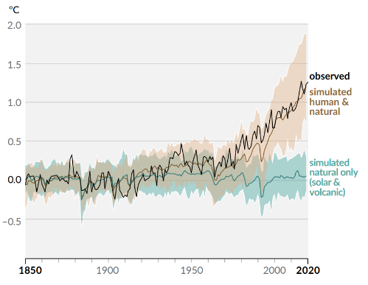
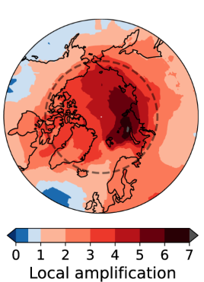
Change in global surface temperature 1850–2020
Rantanen et al. 2022
IPCC 2022
The Arctic is warming 4 times as fast as the global average
Notes:
Major component is strongly vulnerable → permafrost

Slide 3
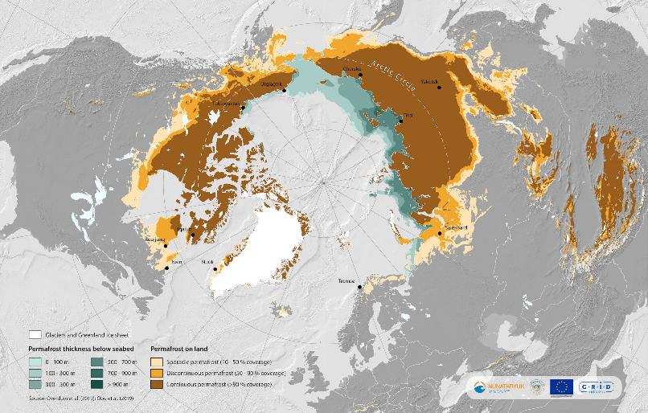
Where is permafrost? → Permafrost region covers 22 % of the terrestrial area in the Northern Hemisphere

Slide 4
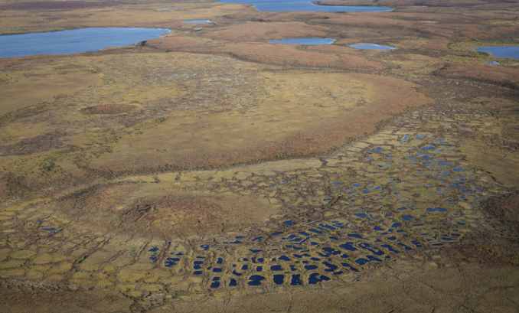
What is permafrost? → Ground temperature ≤ 0 °C for at least 2 years, frozen and unfrozen
Active layer – seasonally frozen
Permafrost –
perennial frozen
Talik
unfrozen
By Sam Cornish
After French 2007

Slide 5
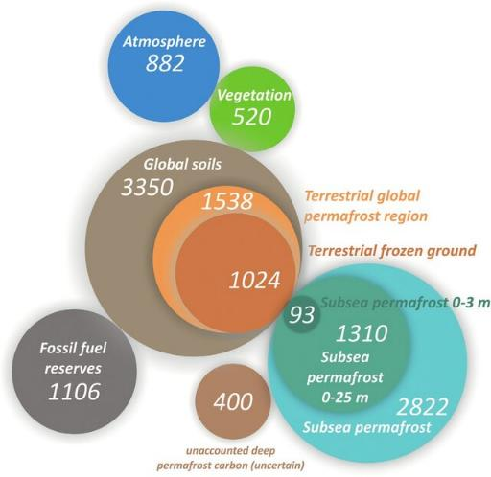
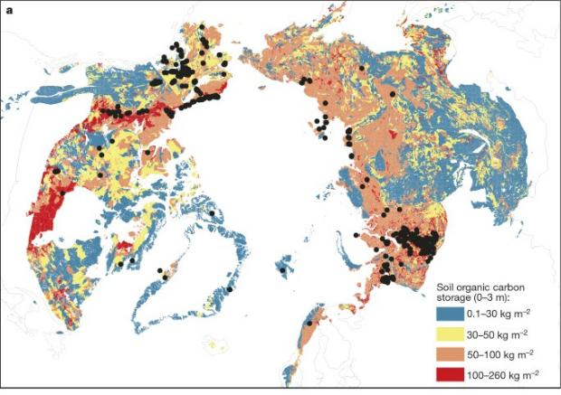
Why is this important?
air temperature
permafrost temperature
permafrost thaw
microbial activity
carbon release (CO₂ + CH₄)
+
Schuur et al. 2015
Strauss et al. 2025
Notes:
Largest terrestrial C pool with ~30 % of global land carbon in only 15 % of the area
How? sehr alter boden / lange deposition plus teilweise sehr tief → sehr großes Carbon aufkommen!
Zwar low input, but much lower output due ground conditions
Permafrost as freezer of OM for thousands of years
Ongoing deposition, recent peat accumulation and cryoturbation stabilized the OM in PF soils
→ If OM gets accessiable and mobilized due thawing and erosion, it can be decomposed by microorganisms → CO2 and CH4 release

Slide 6
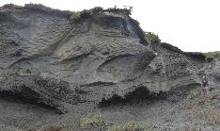
Decrease of areal extent
External forcing
Thaw depth deepening
Permafrost warming
Permafrost
degradation
River and coastal erosion
Thermokarst developement
Thermokarst developement
Notes:
Different forms of degradation → fokus on thermokarst

Slide 7


Thermokarst – permafrost landscape feature
  Permafrost thawing → melting of excess ice → surface subsidence
Thermokarst Lake formation
Thermokarst Lake growth
Thermokarst Lake drainage
After t‘Zandt et al. 2020 and Anthony et al. 2014
Notes:
Thermokarst most abundant and recognisable process

Slide 8
How does the organic matter alter in a thermokarst affected landscape?
Analysing biochemical, hydrochemical and sedimentological parameters and biomarker proxies at four landscape units along a thermokarst transect
Reconstruction of the evolution of the landscape along the transect
Characterisation of the organic matter in the four landscape units and permafrost layers
Quantity
Source
Quality
Notes:
OM change: biochemical alternation → microbial decomposition → GHG release
Using a degradation transect from the inland to the coast
Transect as marine as potential endmember → around 34 % of worlds coast in the arctic → highly and fast changing

Slide 9
Biomarker – molecular fossils to characterise the OM
→ n-alkanes
Total n-alkane content → Quality of OM
Carbon Preference Index → Alteration of OM
Average Chain Length → Origin of OM
Aquatic and waxy OM proxy → Aquatic / terrestrial influence
→ to predict the future degradation → GHG potential of the OM
H H H H H
H-C-C-C-C-C-H
H H H H H
Notes:
low sensitbility to microbial degradation, compared to other biochemical parameters
→long-chain hydrocarbons,
CPI: ratio of odd-to-enighboring even-numbered alkanes (fresh more odd numbered)
ACL: concentrated weighted mean of diff. Chain lengths

Slide 10
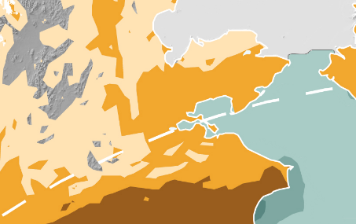
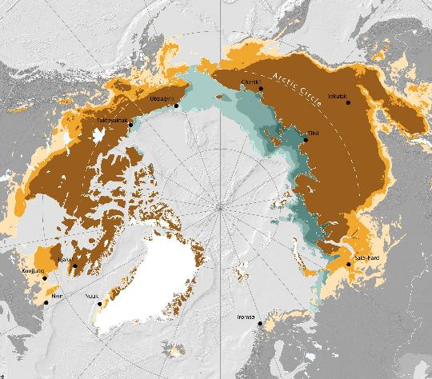
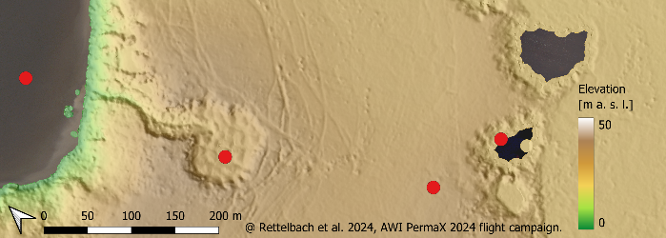

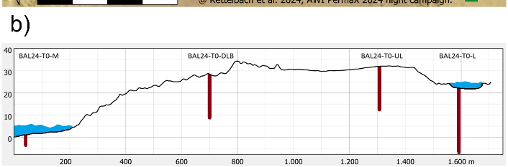
Study area sampling sites
a)
Marine Ground
Study site near Kotzebue
Drained Lake Basin
Thermokarst Lake
Upland
Marine Ground
Drained Lake Basin
..Upland.....
Thermokarst Lake
Notes:
Continuous permafrost region
Middle Pleistocene push-moraine
Marine, fluvial and glaciogenic sediments
Underlain by ice rich Yedoma → what is yedoma
Part of the major lake districts of Alaska
Yedoma: kurz was dazu sagen?

Slide 11
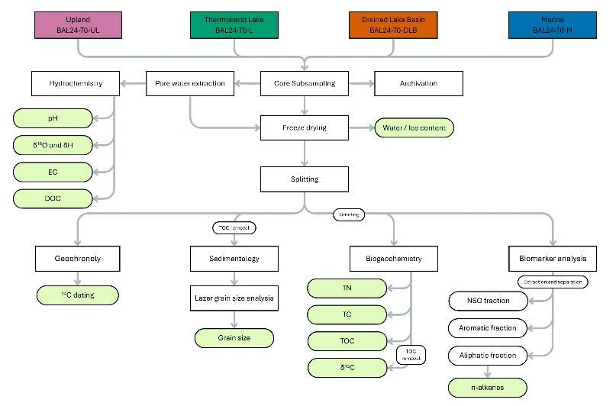
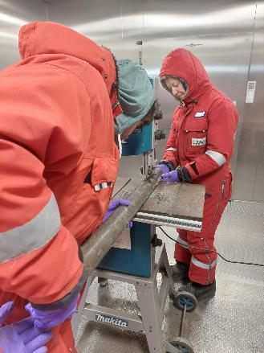
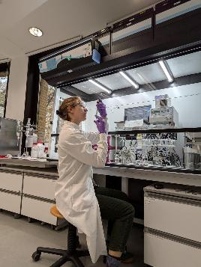
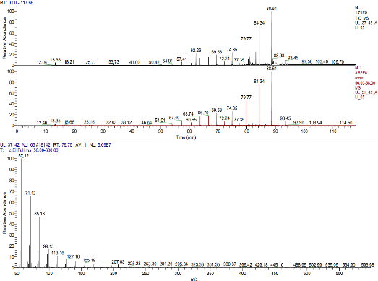
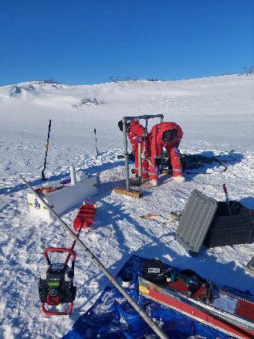
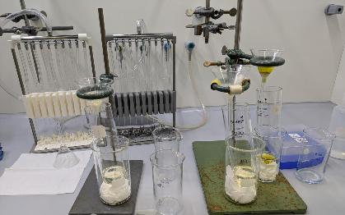
Methods
Upland
Thermokarst Lake
Drained Lake Basin
Marine Ground
Field sampling
Data analysis

Slide 12
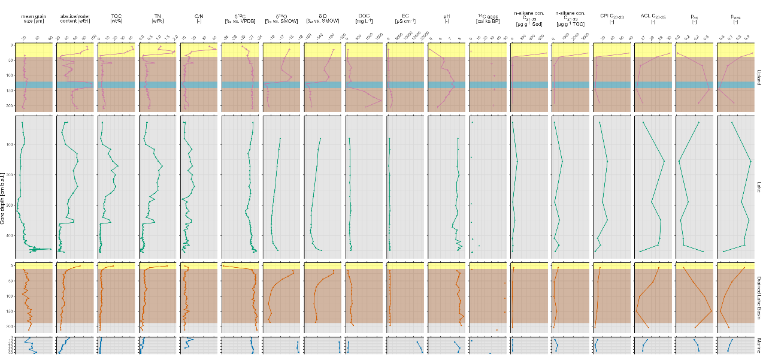
Active layer – seasonally frozen
Permafrost –
perennial frozen
Talik
unfrozen

Slide 13
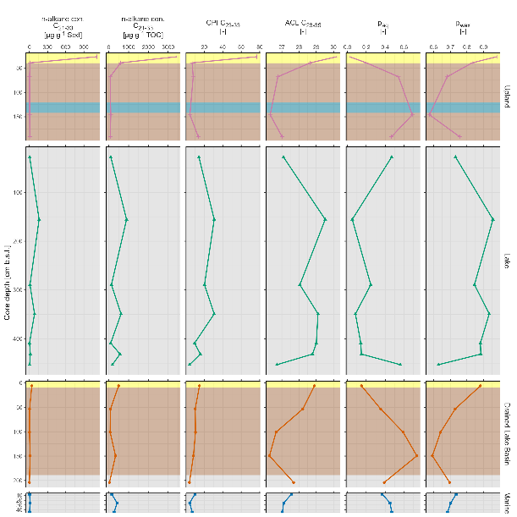
OM characteristic

Slide 14
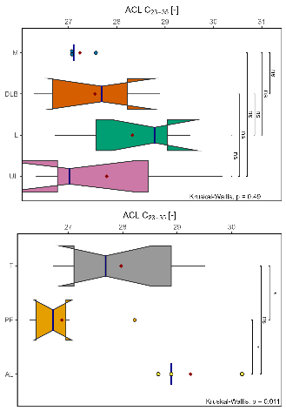
OM source
Bacteria higher land plants
Notes:
Mostly terrestrial origin
Aquatic signals at bottom indicate former thermokarst processes and acl decrease with degradation
Upland: signs of degradation, also quite low CPI → ancient thermokarst
Variations in lake due different inputs during lake phase
Short lake phase for L and DLB
Marine also terrestrial

Slide 15

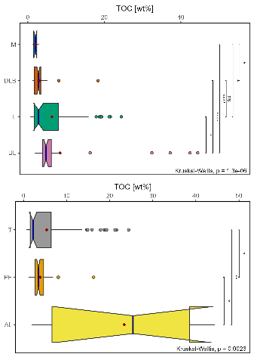
OM quantity
Notes:
Lake highest → input during lake phase. Shift from pre-lake to lake phase
Active layer highest → fresh input

Slide 16
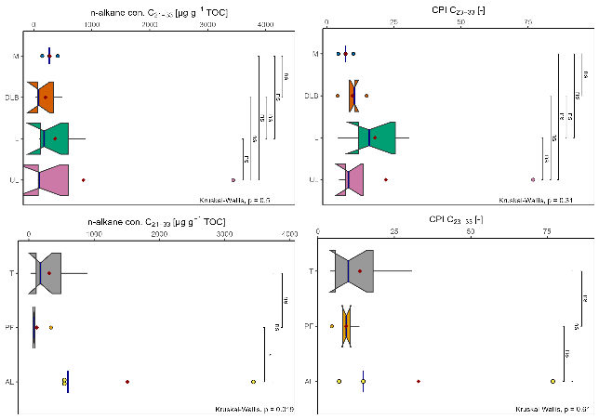
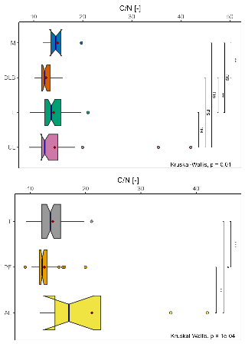
OM quality
Quality
Degradation
Notes:
UL and DLB gone trough multiple tkgenerations → former tkp → further degradation
While TKL mainly fresh OM
Upland: signs of degradation also in cryostructure
Talik and lake highest quality
Also in line with c/n

Slide 17
Landscape development
Deposition started 50 ka BP, mainly aeolian
Minor signs of ancient thermokarst processes
OM source
Same, terrestrial dominated, origin at all studied sites
→ hypothesis confirmed by sedimentology and biogeochemistry
OM quantity
Decreasing with degradation and along the transect
OM quality
Talik layers show better preserved OM than perennial frozen ground
→ Young Holocene input vs. cold-stored, degraded permafrost
High GHG potential due high ice- and carbon-amount with yet good quality for future decomposition!
Notes:
signif. Diff. Of OC (highest in UL and AL, lowest in M)
OM origin dominated terrestrial (C/N, d13C, ACL and ps)
T layers show better OM quality than cold-stored yedoma → young holocene input vs. deposition during low bioproductivity stages
high OM for all sites!
diff. In biomarker due degratation, not strong source differences → BM support same origin hypothesis

Slide 18
Additional slides

Slide 19
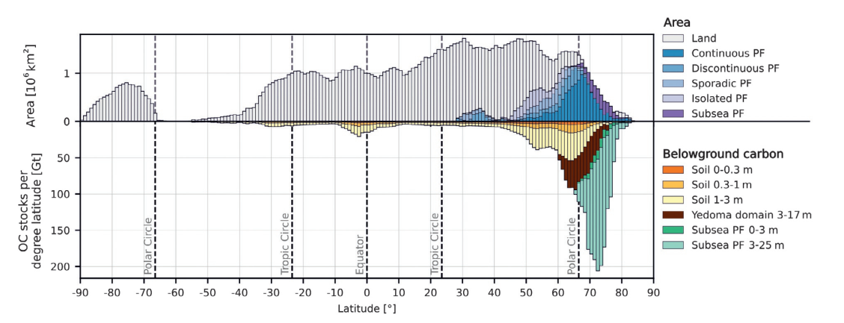
Global below ground carbon distribution
Strauss et al. 2025

Slide 20
Permafrost and the carbon cycle
Schurr et al. 2022: 55 – 232 Gt C-CO2-eq by 2010.
→ This is in the range of an industry nation as Russia, OECD, USA and China (scaled to 100 a), while these calculations do not yet include abrupt thaw processes as thermokarst, which could add another 40 % to the projections of C release
Global temperature increase by 0.29 ± 0.21 °C or 7.8 ± 5.7% for the RCP 8.5 scenario and 0.05 – 0.15 °C for RCP 4.5 (Schaefer et al. 2014)
→ C sink to C source transition
Jones 2022 states a shift from lakes to drained lake basins → potential carbon source
Notes:
Schuur et al. (2022) states that the thawing of terrestrial permafrost could release 5 – 15 % of its C pool during this century, leading to calculated net CO2 and CH4 (as CO2 equivalents) emissions by 2100 of 55 – 232 Gt C-CO2-eq. This is in the range of an industry nation as Russia, OECD, USA and China (scaled to 100 a), while these calculations do not yet include abrupt thaw processes as thermokarst, which could add another 40 % to the projections of C release

Slide 21
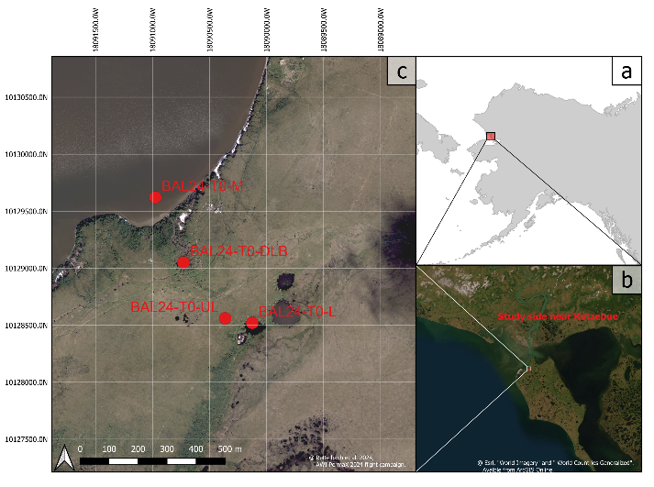
Study area map

Slide 22
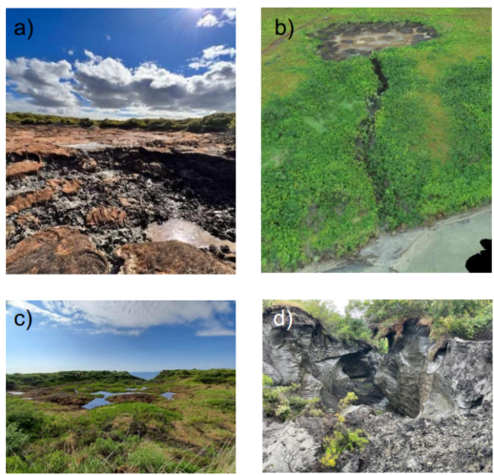
Pictures of the drained lake basin
By Susan Tessier, Ben Jones, Maija Marushchak, Lutz Schirrmeister

Slide 23
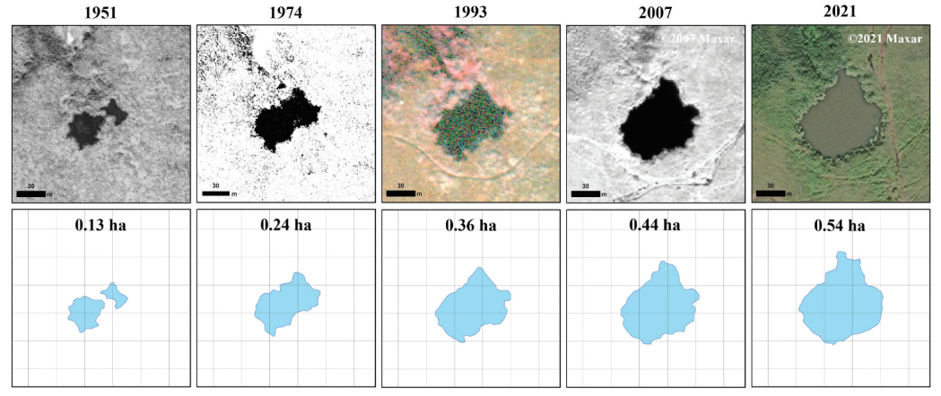
Evolution of the drained lake basin
Jones et al. 2023

Slide 24
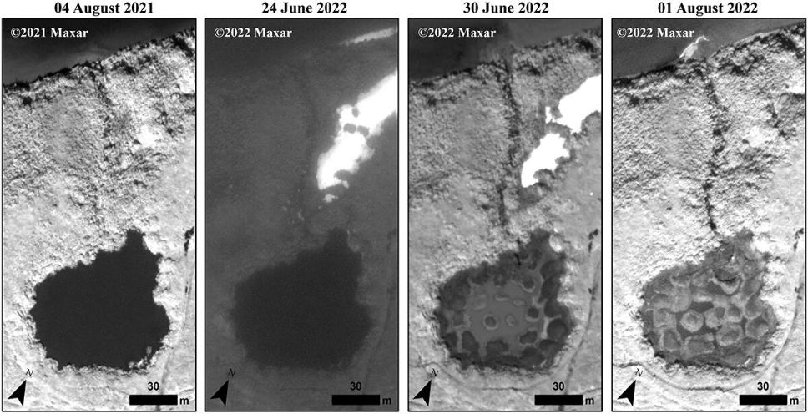
Evolution of the drained lake basin - Drainage
Jones et al. 2023

Slide 25
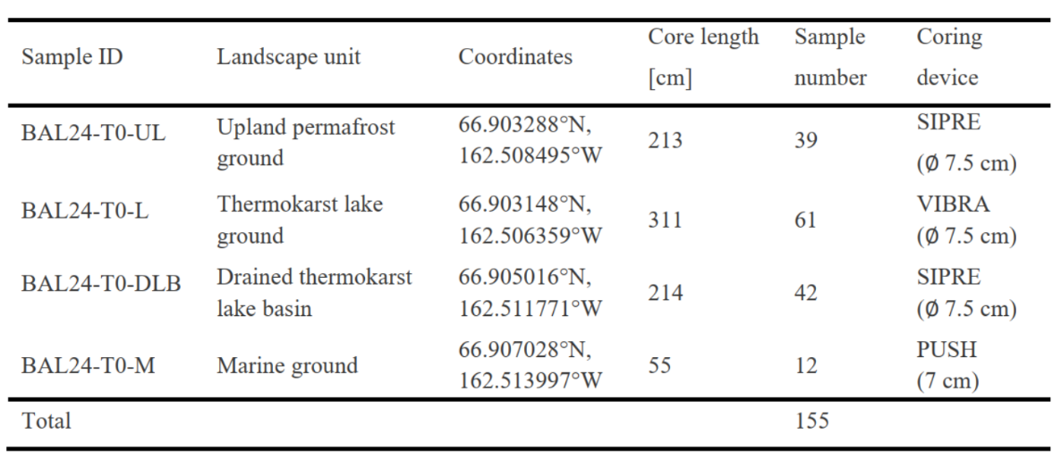
Study sites characteristics

Slide 26
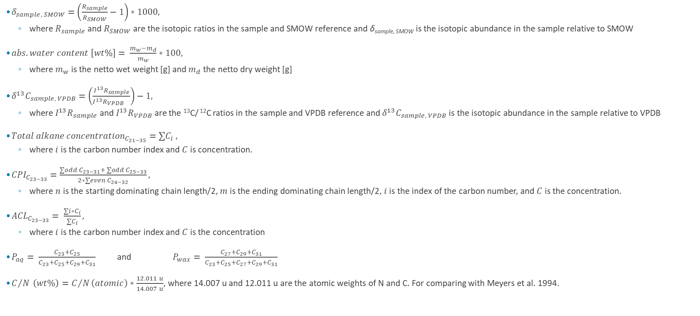
Formulas
$δ_{sample, SMOW}=\left(\frac{R_{sample}}{R_{SMOW}}−1\right)∗1000,$
  $\text{where} R_{sample} \text{and} R_{SMOW} \text{are} \text{the} \text{isotopic} \text{ratios} \text{in} \text{the} \text{sample} \text{and} \text{SMOW} \text{reference} \text{and} \text{δ}\text{sample}\text{, }\text{SMOW} \text{is} \text{the} \text{isotopic} \text{abundance} \text{in} \text{the} \text{sample} \text{relative} \text{to} \text{SMOW}$
$abs. water content \left[wt\%\right]= \frac{m_{w}−m_{d}}{m_{w}}∗100,$
  where $m_{w}$is the netto wet weight [g] and $m_{d}$ the netto dry weight [g]
$δ^{13}C_{sample, VPDB}=\left(\frac{I^{13}R_{sample}}{I^{13}R_{VPDB }}\right)−1,$
  where $I^{13}R_{sample}$and $I^{13}R_{VPDB}$are the ¹³C/ ¹²C ratios in the sample and VPDB reference and $δ^{13}C_{sample, VPDB}$is the isotopic abundance in the sample relative to VPDB
${Total alkane concentration}_{C_{21−35}}=∑C_{i} ,$
  where $i$ is the carbon number index and $C$ is concentration.
${CPI}_{C_{23−33}}=\frac{∑odd C_{23−31}+ ∑odd C_{25−33}}{2∗∑even C_{24−32}},$
  where $n$ is the starting dominating chain length/2, $m$ is the ending dominating chain length/2, $i$ is the index of the carbon number, and $C$ is the concentration.
${ACL}_{C_{23−33}}= \frac{∑i∗C_{i}}{∑C_{i}},$
  where $i$ is the carbon number index and $C$ is the concentration
$P_{aq}= \frac{C_{23}+C_{25}}{C_{23}+C_{25}+C_{29}+C_{31}}$ and $P_{wax}= \frac{C_{27}+C_{29}+C_{31}}{C_{23}+C_{25}+C_{27}+C_{29}+C_{31}}$
$C/N \left(wt\%\right)=C/N\left(atomic\right)∗\frac{12.011 u}{14.007 u}$, where 14.007 u and 12.011 u are the atomic weights of N and C. For comparing with Meyers et al. 1994.

Slide 27
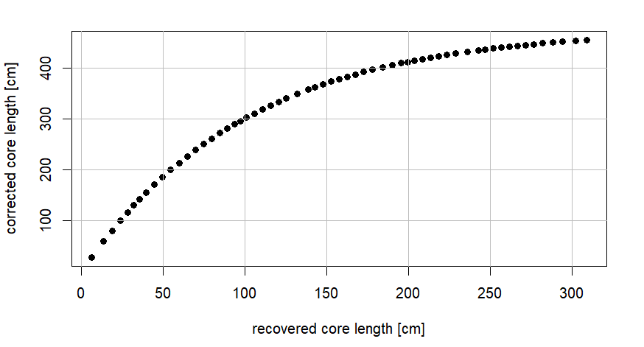
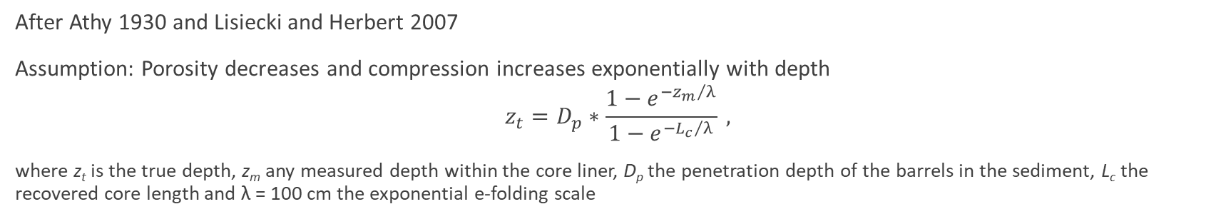
Core lenght correction with a normalized exponential depth correction
After Athy 1930 and Lisiecki and Herbert 2007
Assumption: Porosity decreases and compression increases exponentially with depth
$$z_{t}=D_{p}∗\frac{1−e^{{{−z}_{m}}/λ}}{1−e^{{{−L}_{c}}/λ}} ,$$
where z_{t} is the true depth, z_{m} any measured depth within the core liner, D_{p} the penetration depth of the barrels in the sediment, L_{c} the recovered core length and λ = 100 cm the exponential e-folding scale

Slide 28
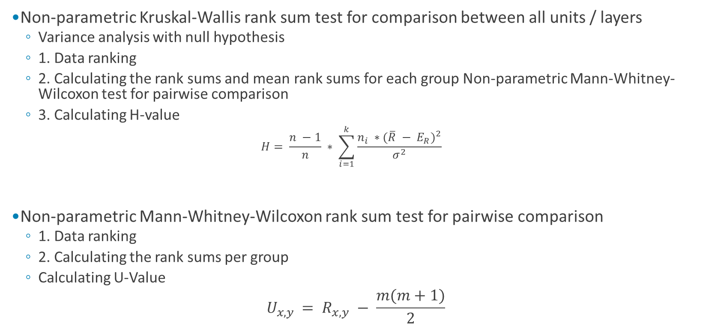
Significance testing
Non-parametric Kruskal-Wallis rank sum test for comparison between all units / layers
  Variance analysis with null hypothesis
  1. Data ranking
  2. Calculating the rank sums and mean rank sums for each group Non-parametric Mann-Whitney-Wilcoxon test for pairwise comparison
  3. Calculating H-value
    $$H= \frac{n −1}{n} ∗ \sum_{i=1}^{k}{\frac{n_{i} ∗{(\overline{R} − E_{R})}^{2}}{σ^{2}}}$$
Non-parametric Mann-Whitney-Wilcoxon rank sum test for pairwise comparison
  1. Data ranking
  2. Calculating the rank sums per group
  Calculating U-Value
  $$U_{x,y }= R_{x,y} − \frac{m(m+1)}{2}$$
Mean rank sum in the groups
Expectation of the ranks
Variance of the ranks

Slide 29
Cluster analysis
Data scaling
Principal component analysis
  for data reduction
  For all parameters and with biomarker proxies just as supplementary data
Agglomerative hierarchical clustering on principal components
  Grouping the data in clusters
Visualisation in biplots of individuals and variables
Creating boxplots of the properties of the resulting clusters
Notes:
PCA, transforms variables into smaller and uncorrelated amount of essential features, which mainly explain the variance in the data, with minimizing information lost
HCPC, into objects that are like each other while different from objects in the other clusters

Slide 30
gTOC vs gSed
gSed:
Total amount of n-alkanes in the sample
gTOC:
Relative amount in relation to the TOC

Slide 31












BAL24-T0-UL BAL24-T0-L BAL24-T0-DLB BAL24-T0-M
unfrozen
frozen
frozen
unfrozen
unfrozen

Slide 32
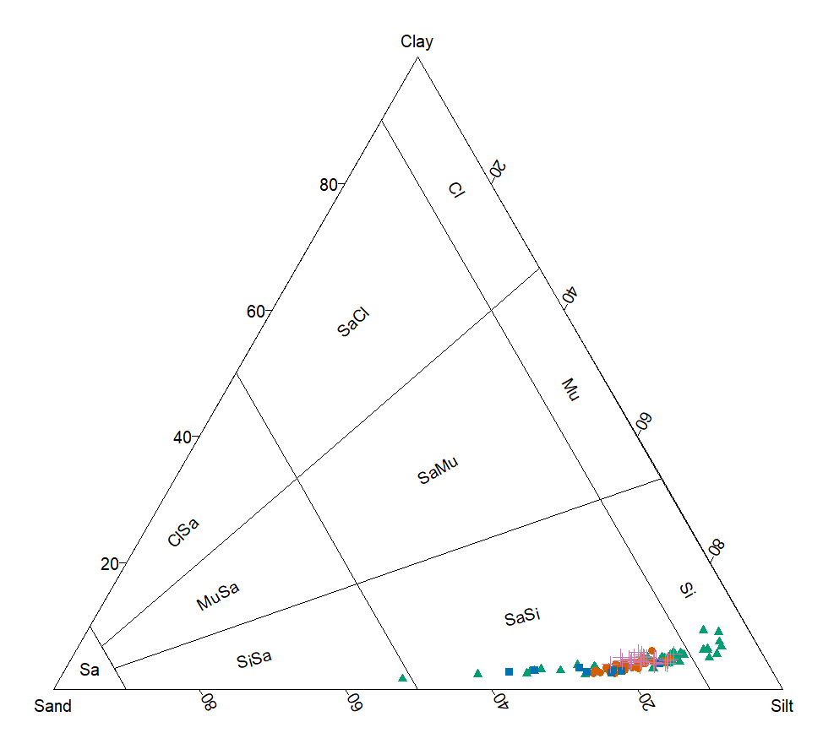
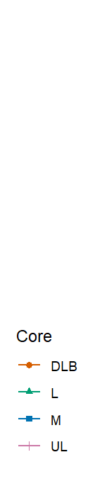
Sand-Silt-Clay diagram after Folk and Ward (1957)

Slide 33
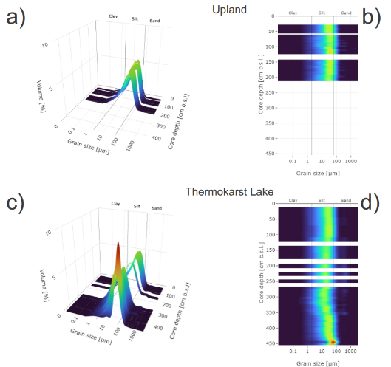
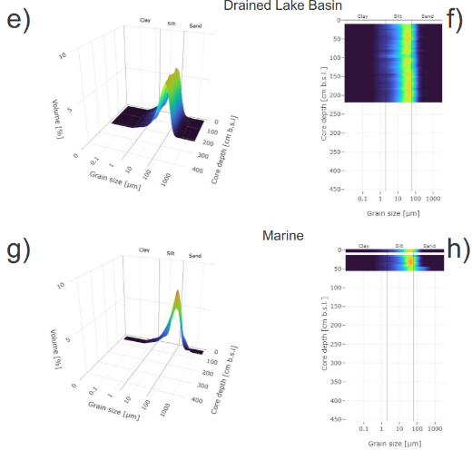
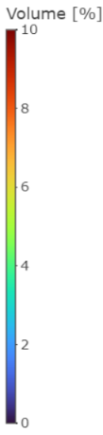
Grain size distribution
Notes:
Common sediment origin
Largely unimodal and dominated by poorly sorted coarse silt and slightly secondary peaks in medium sand → loessal origin with minor influences of ancient fluvial and reworked TK processes
similar grain size distribution for all cores → same material origin
poorly sorted coarse silt, unimodal → aeolian process dominating → loessal silts (Schirrm.)
slightly bimodal (med. Sand) → found before in this region (diff. from Sibirian sites)
Typical late Pleistocene Yedoma characteristics
plus ice oversaturated, C14 > 50 cal. Ka BP, organic.rich layers, syngenetic ice wedges, macroremains
Signs of former fluvial or thermokarst processes in depth (UL, L, M) by larger grain sizes up to pebbles, more aquatic signals in bottom → former fluvial influence also found in other studies + PF d degradation due ancient thermokarst processes indicated due C/N decrease and d13C increase with depth, low CPI and ACL, cryoturbation, ice veins, frost heave,… increase in ACL and paq

Slide 34

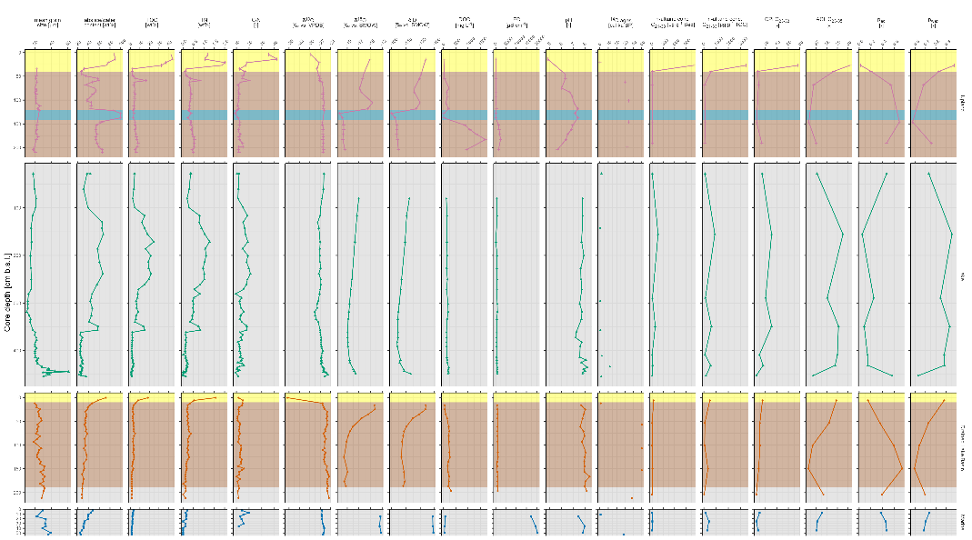







unfrozen
frozen
unfrozen
frozen
unfrozen
Notes:
Alter
SEHR viel kürzer und dann direkt nur BM
High moisture content + organic-rich layers and ages 30-50 ka BP → characteristics of alte pleistocene yedoma deposits
Upland: stable acc. 30 ka bp, syn. Ice wedge and former TK processes. Paleocryosols (mid. Weichselian ponding conditions), past thaw-freeze cycles and aquatic influence (Isotope shifts and cryoturbation)
Lake: clear transition btw. Lake and former lake phase → finer laminated sediments and higher TOC, TN → young holocene lake
DLB: oldest sediments; thaw subsidence and thus access to deep yedoma layers. Shallow modern peat layer (to recent drained). Bottom talik as relict from lake phase, while ice veins at top from renewed PF
M: terrestrial deposition and then marine overprint → predominantly terr. OM. Large basal pepples → ancient fluvial or TK processes
UL:

Slide 35
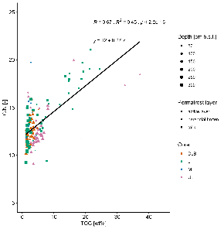
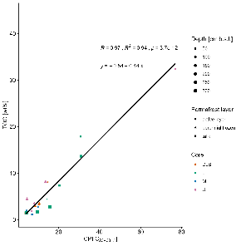
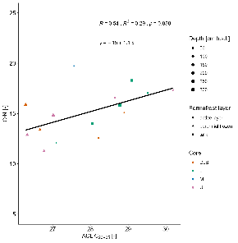
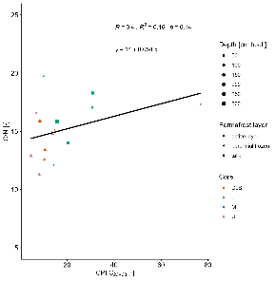
Scatter plots of selected OM degradation proxies
a) b) c) d)
The regression equations, R, R² and the p-values are each shown at the top of the plots. The samples of AL are shown as circles, of PF at triangles and of T as squares.

Slide 36
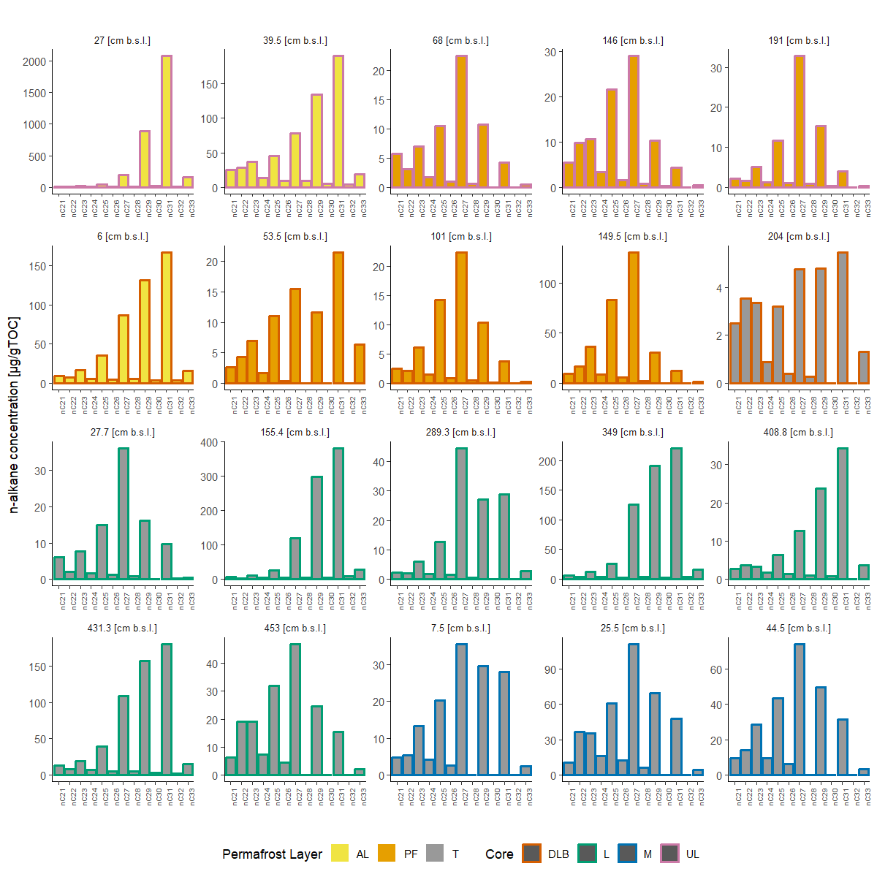
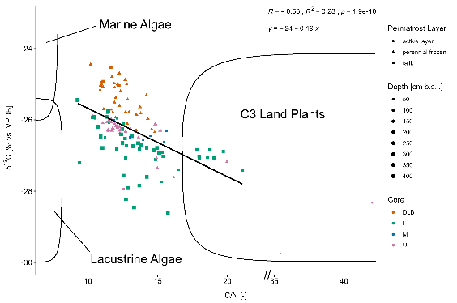
OM source
Scatter plot of δ¹³C against C/N after Meyer et al. 1997, but identifiers converted with 1.167 * atomic C/N ≈ wt% C/N. DLB sample at 0.5 cm b.s.l. is for clarify reasons not included (δ13C = -36.50 ‰ vs. VPDB and C/N = 11.68).
Notes:
between vascular land plants and algae based on C/N
the deeper, the less terrestrial the samples → but more due degradation?
quite in range of other studies (Giest)
DLB more marine, L more lacustrine → more due degradation?
BM; higher land plants → tundra vegetation

Slide 37
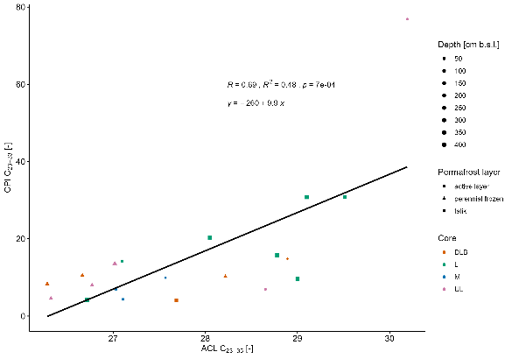
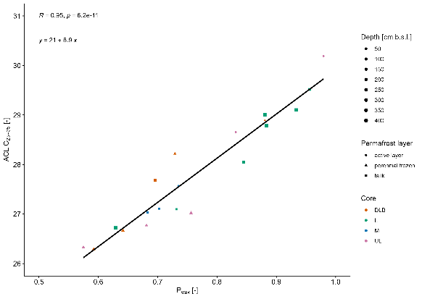
ACL more for OM source than degeneration!
terrestrial
aquatic
Scatter plot CPI against ACL. The regression equation, R, R² and the p-values are shown at the top. The samples of AL are shown as circles, of PF at triangles and of T as squares.
Scatter plot of ACL against p_{wax}. The regression equation, R, R² and the p-values are shown at the top. The samples of AL are shown as circles, of PF at triangles and of T as squares, the colours represent the cores.

Slide 38
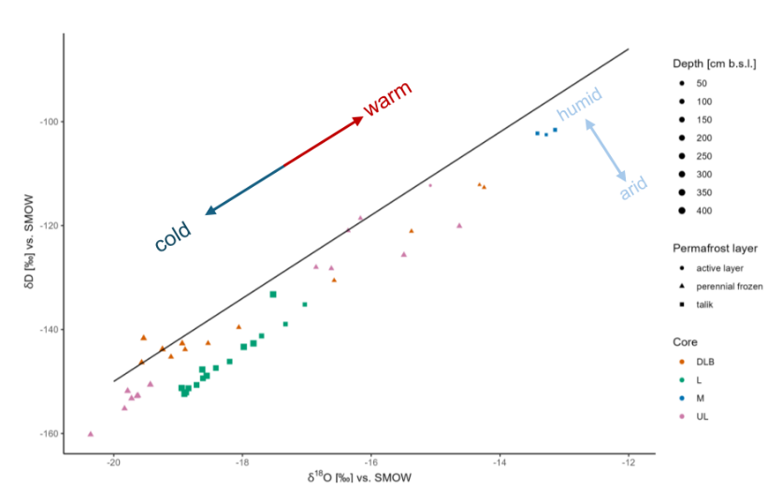
Stable water isotopes compared to the GMWL

Slide 39
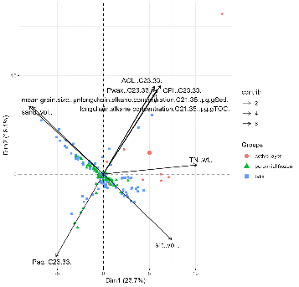
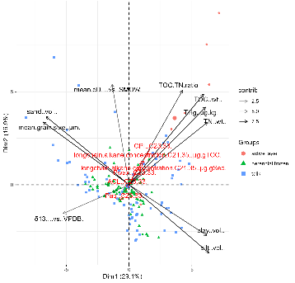

Biplots of the PCA
a) b) c)
(a) PCA with all variables, (b) and (c) PCA with biomarker proxies as supplementary variables, while (c) additionally with clusters.

Slide 40

Comparison of the clusters from the PCA

Slide 41


Contribution of the cores / layers to the three resulting clusters

Slide 42
References
Anthony, K. M. Walter; Zimov, S. A.; Grosse, G.; Jones, M. C.; Anthony, P. M.; Chapin, F. S. et al. (2014): A shift of thermokarst lakes from carbon sources to sinks during the Holocene epoch. In: Nature 511 (7510), S. 452–456. DOI: 10.1038/nature13560.
Athy, L. F. (1930): Density, Porosity, and Compaction of Sedimentary Rocks. In: Bulletin 14. DOI: 10.1306/3D93289E-16B1-11D7-8645000102C1865D.
Burn, Christopher R. (2020): Permafrost Landscape Features. In: Encyclopedia of the World's Biomes: Elsevier, S. 303–320.
French, Hugh M. (2007): The Periglacial Environment: Wiley.
IPCC (2023): Summary for Policymakers. In: IPCC (Hg.): Climate Change 2021: The Physical Science Basis. Contribution of Working Group I to the Sixth Assessment Report of the Intergovernmental Panel on Climate Change. Unter Mitarbeit von V. Masson-Delmotte, P. Zhai, A. Pirani, S. L. Connors und et al.: Cambridge University Press, S. 3–32.
Irrgang, Anna M.; Bendixen, Mette; Farquharson, Louise M.; Baranskaya, Alisa V.; Erikson, Li H.; Gibbs, Ann E. et al. (2022): Drivers, dynamics and impacts of changing Arctic coasts. In: Nat Rev Earth Environ 3 (1), S. 39–54. DOI: 10.1038/s43017-021-00232-1.
Jones, Benjamin M.; Grosse, Guido; Farquharson, Louise M.; Roy-Léveillée, Pascale; Veremeeva, Alexandra; Kanevskiy, Mikhail Z. et al. (2022): Lake and drained lake basin systems in lowland permafrost regions. In: Nat Rev Earth Environ 3 (1), S. 85–98. DOI: 10.1038/s43017-021-00238-9.
Jones, Benjamin M.; Schaeffer Tessier, Susan; Tessier, Tim; Brubaker, Michael; Brook, Mike; Schaeffer, Jackie et al. (2023): Integrating local environmental observations and remote sensing to better understand the life cycle of a thermokarst lake in Arctic Alaska. In: Arctic, Antarctic, and Alpine Research 55 (1), Artikel 2195518. DOI: 10.1080/15230430.2023.2195518.
Lisiecki, Lorraine E.; Herbert, Timothy D. (2007): Automated composite depth scale construction and estimates of sediment core extension. In: Paleoceanography 22 (4), Artikel 2006PA001401. DOI: 10.1029/2006PA001401.
Parazoo, Nicholas C.; Koven, Charles D.; Lawrence, David M.; Romanovsky, Vladimir; Miller, Charles E. (2018): Detecting the permafrost carbon feedback: talik formation and increased cold-season respiration as precursors to sink-to-source transitions. In: The Cryosphere 12 (1), S. 123–144. DOI: 10.5194/tc-12-123-2018.

Slide 43
References
Rantanen, Mika; Karpechko, Alexey Yu.; Lipponen, Antti; Nordling, Kalle; Hyvärinen, Otto; Ruosteenoja, Kimmo et al. (2022): The Arctic has warmed nearly four times faster than the globe since 1979. In: Commun Earth Environ 3 (1). DOI: 10.1038/s43247-022-00498-3.
Rettelbach, Tabea; Nitze, Ingmar; Grünberg, Inge; Hammar, Jennika; Schäffler, Simon; Hein, Daniel et al. (2024): Very high resolution aerial image orthomosaics, point clouds, and elevation datasets of select permafrost landscapes in Alaska and northwestern Canada. In: Earth Syst. Sci. Data 16 (12), S. 5767–5798. DOI: 10.5194/essd-16-5767-2024.
Schaefer, Kevin; Lantuit, Hugues; Romanovsky, Vladimir E.; Schuur, Edward A. G.; Witt, Ronald (2014): The impact of the permafrost carbon feedback on global climate. In: Environ. Res. Lett. 9 (8), S. 85003. DOI: 10.1088/1748-9326/9/8/085003.
Schuur, E. A. G.; McGuire, A. D.; Schädel, C.; Grosse, G.; Harden, J. W.; Hayes, D. J. et al. (2015): Climate change and the permafrost carbon feedback. In: Nature 520 (7546), S. 171–179. DOI: 10.1038/nature14338.
Schuur, Edward A.G.; Abbott, Benjamin W.; Commane, Roisin; Ernakovich, Jessica; Euskirchen, Eugenie; Hugelius, Gustaf et al. (2022): Permafrost and Climate Change: Carbon Cycle Feedbacks From the Warming Arctic. In: Annu. Rev. Environ. Resour. 47 (1), S. 343–371. DOI: 10.1146/annurev-environ-012220-011847.
Strauss, Jens; Fuchs, Matthias; Hugelius, Gustaf; Miesner, Frederieke; Nitze, Ingmar; Opfergelt, Sophie et al. (2025): Organic matter storage and vulnerability in the permafrost domain. In: Encyclopedia of Quaternary Science: Elsevier, S. 399–410.
Strauss, Jens; Laboor, Sebastian; Schirrmeister, Lutz; Fedorov, Alexander N.; Fortier, Daniel; Froese, Duane et al. (2021): Circum-Arctic Map of the Yedoma Permafrost Domain. In: Front. Earth Sci. 9, Artikel 758360. DOI: 10.3389/feart.2021.758360.
Zandt, Michiel H. in 't; Liebner, Susanne; Welte, Cornelia U. (2020): Roles of Thermokarst Lakes in a Warming World. In: Trends in microbiology 28 (9), S. 769–779. DOI: 10.1016/j.tim.2020.04.002.

