Slide 1
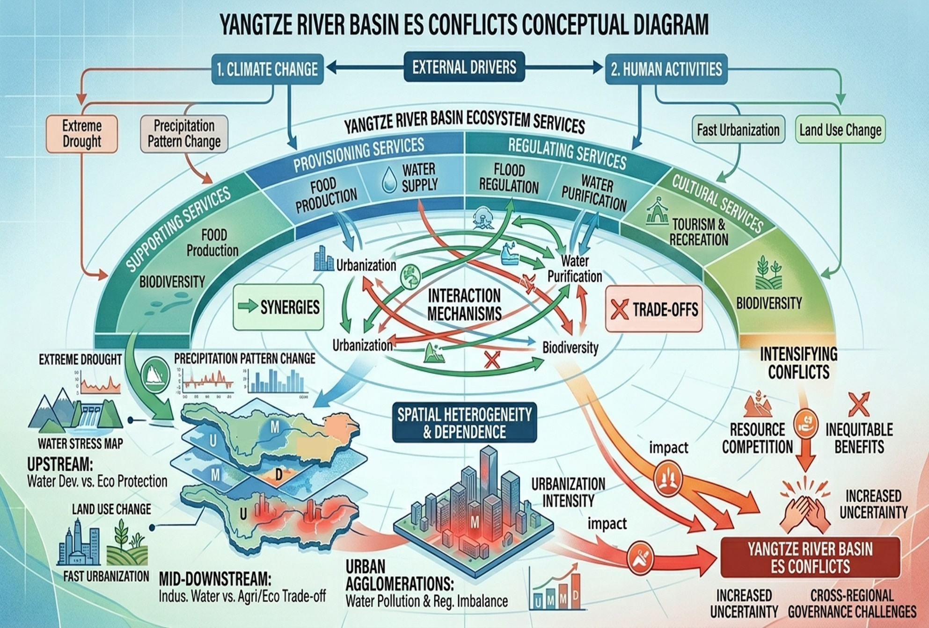
Ecosystem service interactions and their driving factors based on a geospatially explainable framework: A case study in the Yangtze River Basin, China
What are patterns of ecosystem services and their interactions in the Yangtze River Basin?
Do external drivers exert regionally differentiated?

Slide 2
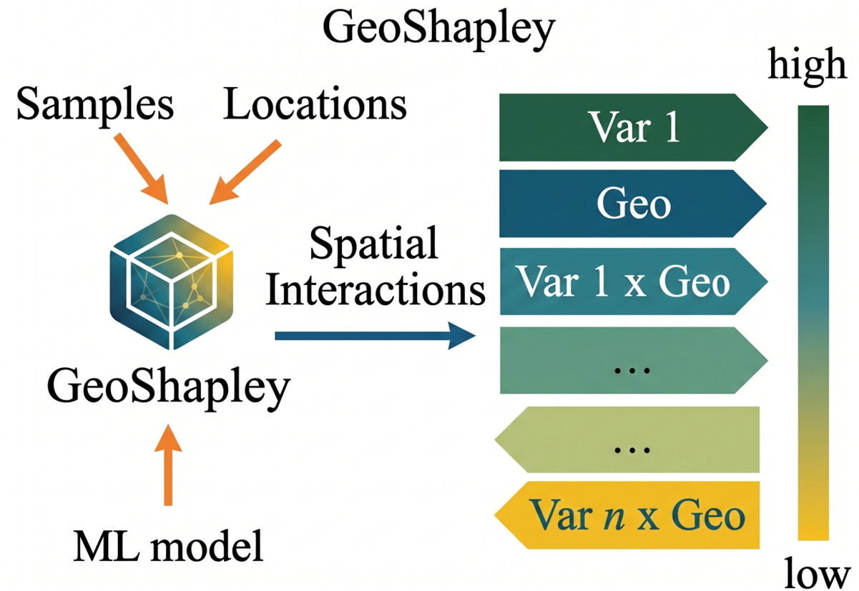
Methods
•
InVEST, RUSLE, CASA Model
• Food supply (FS) • Water yield (WY)
• Water purification (WP)
• Soil conservation (SC)
• Carbon sequestration (CS)
• Habitat quality (HQ)
GWR Method:
• Ecosystem service interactions
(synergies and trade-offs)
GeoShapley Method:
• Interpretation of nonlinearity and spatial heterogeneity
•
•

Slide 3
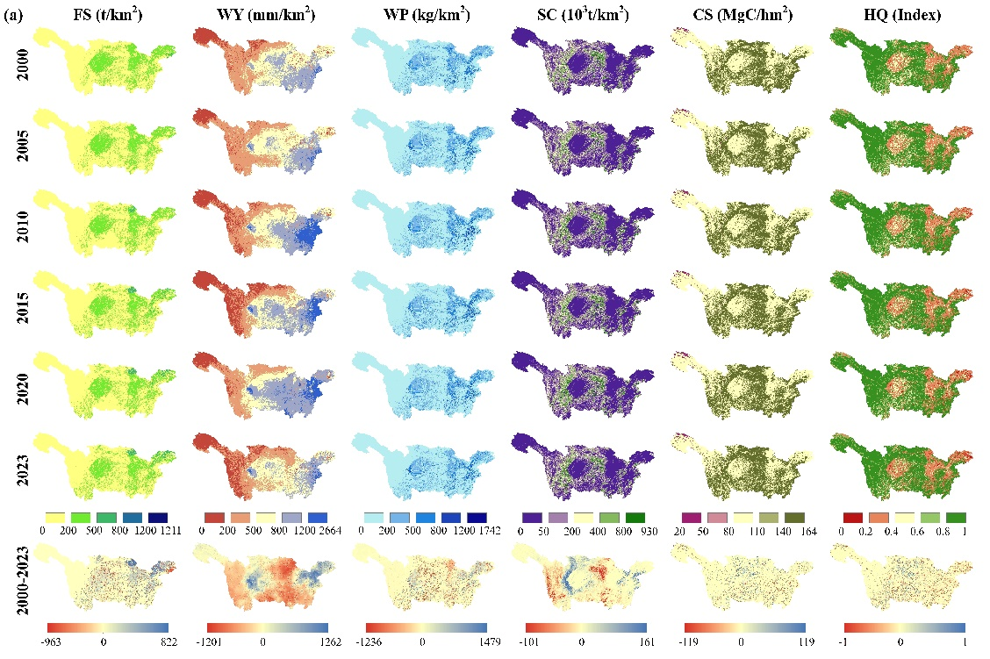
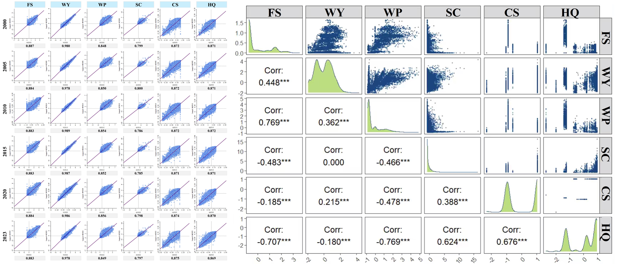
Current results
Spatiotemporal patterns and interactions of six key ecosystem services
Variations
Interactions
Spatiotemporal characteristics of ESs
Synergies and trade-offs in ecosystem services
(e.g., 2023)
▶
The Moran’s indices are all positive and remain at relatively high levels, indicating that these six ecosystem services exhibit distinct spatial clustering patterns.
▶
From 2000 to 2023, the supply of FS and CS increased, whereas WY and WP declined. SC and HQ exhibited relatively minor changes.
▶
In 2023, FS–WP, CS–HQ, and SC–HQ exhibited strong synergistic effects, whereas significant trade-offs were observed between HQ and FS/WP, as well as between SC and FS/WP.
▶
With the exception of HQ, values for other ESs are generally lower in the northwest, yet relatively higher in the central and eastern regions.

