Slide 1
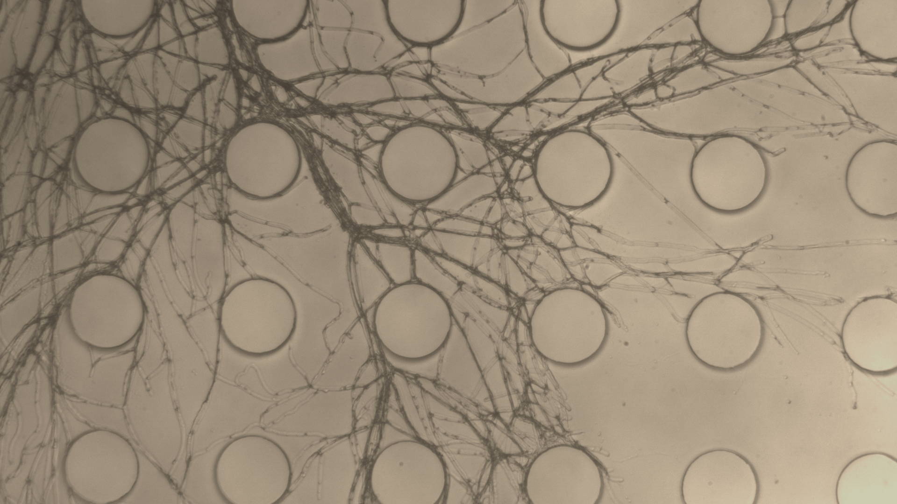

MICROBE - MICROHABITAT INTERACTIONS
EXPANDING THE TOOLBOX OF MICROFLUIDIC SOIL CHIPS
FOR BIOPHYSICAL INTERACTIONS AND MICROBIAL COMMUNITY DYNAMICS
EDITH HAMMER.BIOL.LU.SE
LUND UNIVERSITY
WWW.SOILCHIP.WIXSITE.COM/SOILCHIP
@EDITHCHAMMER

Slide 2
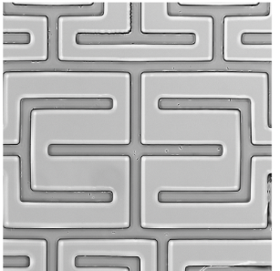
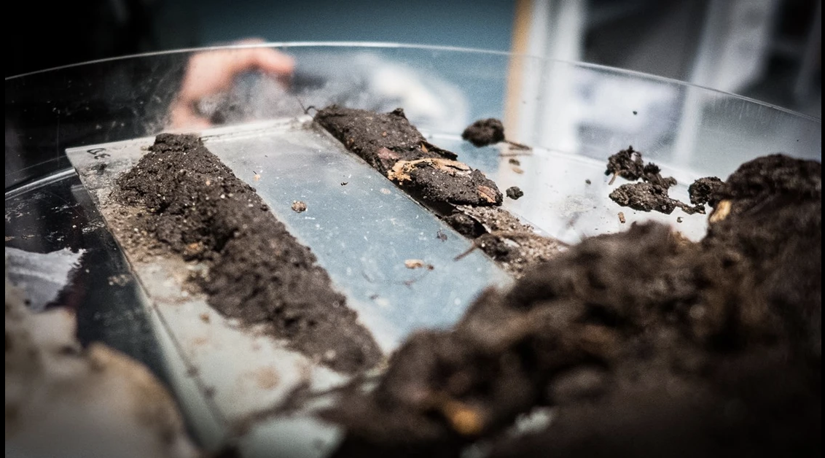
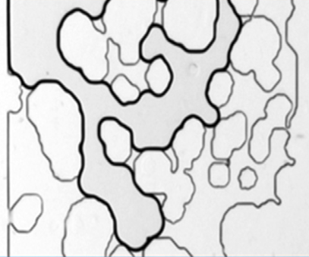
Arellano 2023
Deng 2015
Mafla Endara 2021
Notes:
To address this microheterogeneity we developed microfluidic chip systems that we call soil chips – trnasparant microlabyrinths – geometrical or CT-derived natural - that simulate the soil pore structure so we can study its effect under the microscope – like a window into the soil, or a balcony.

Slide 3
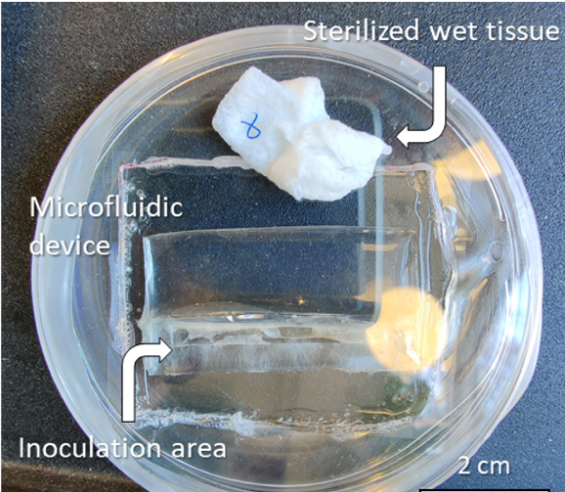
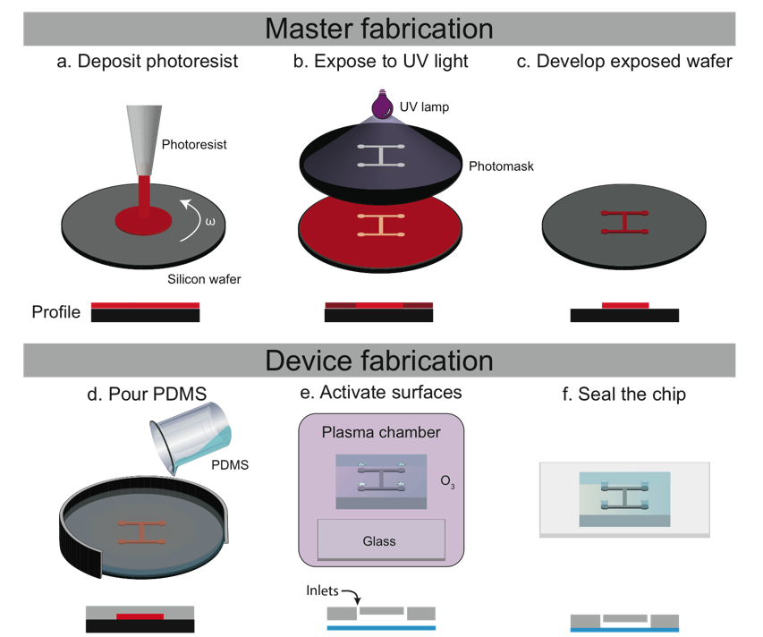
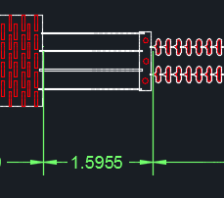
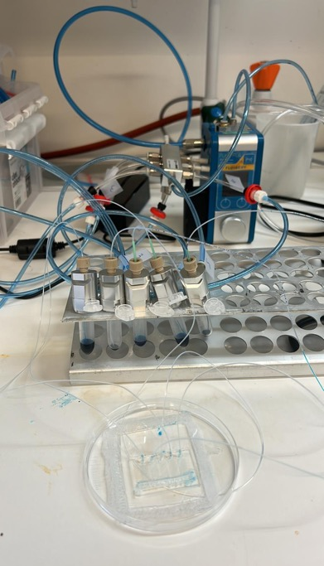
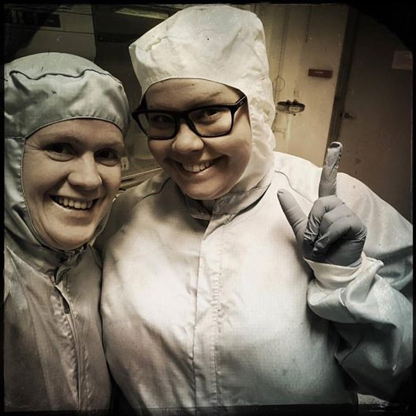
Soil Chips
Design drawn in AutoCAD
Arellano et al. 2023
Aleklett et al. & Hammer 2018 ISMEJ
#distractinglysexy
Zou et al. in prep
Notes:
In essence, we computer design a structure that matches our question, we build a stamp of it, and pour a two-component polymer over it to get a transparent rubber imprint of the microstrucutre.

Slide 4
The path of least resistance
Aleklett, et al., Hammer ISME J 2018
Notes:
These soil chips can be really useful – we can simulate physical structure, chemical gradients or patchiness, and combine, we can investigate ecological questions related to spatial fragmentation, and even put in rootlets to study rhizosphere interactions.

Slide 5
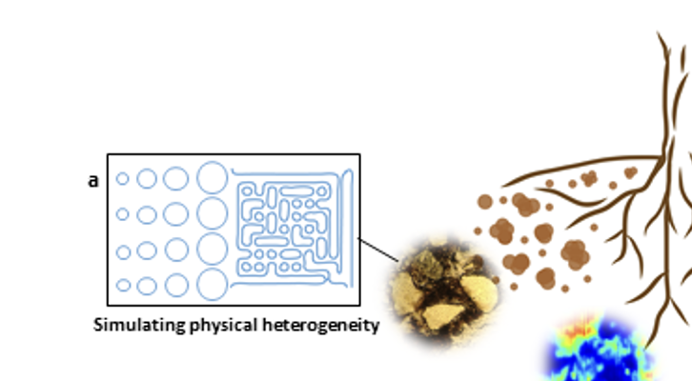
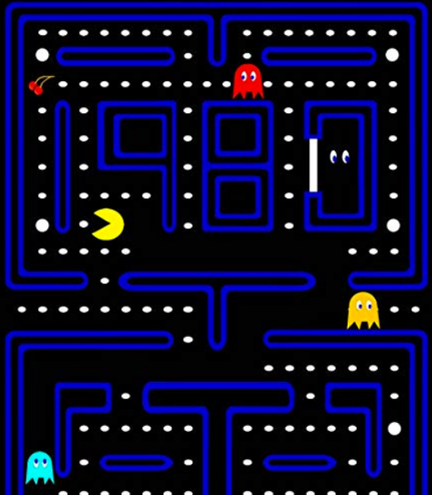
What is spatial availability for microbes?
Can organic matter “hide” in the soil pore space?
Notes:
These soil chips can be really useful – we can simulate physical structure, chemical gradients or patchiness, and combine, we can investigate ecological questions related to spatial fragmentation, and even put in rootlets to study rhizosphere interactions.

Slide 6
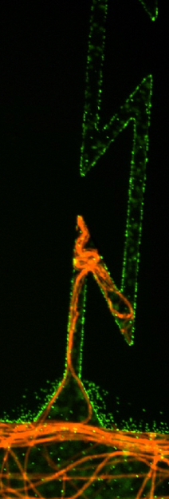
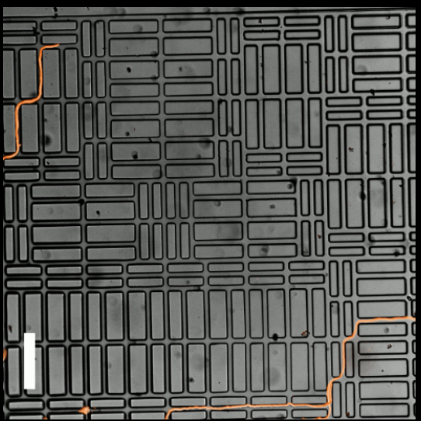
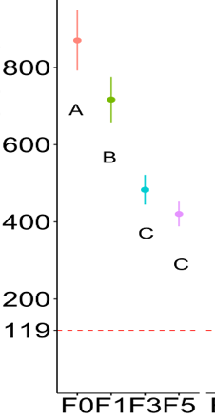
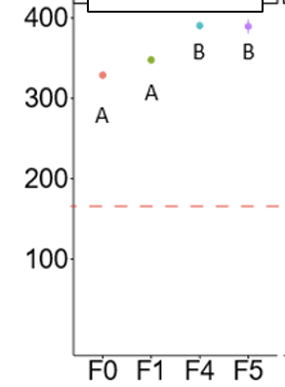
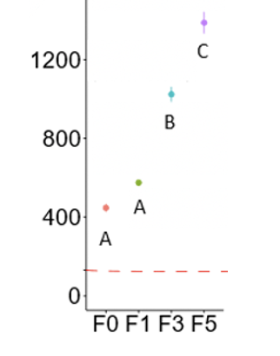


Fungi
Bacteria
OC degradation
--> Increasing spatial complexity
Arellano et al. 2021 Nat ComBiol
Arellano et al. 2023 Current Biology
Coprinopsis cinerea and Pseudomonas putida in microspaces
Arellano et al. 2025 Microbiol Spectrum
Notes:
Beginnings of biofilm formation? Decreased enzyme diffusion? This is in the absence of any air gaps.

Slide 7
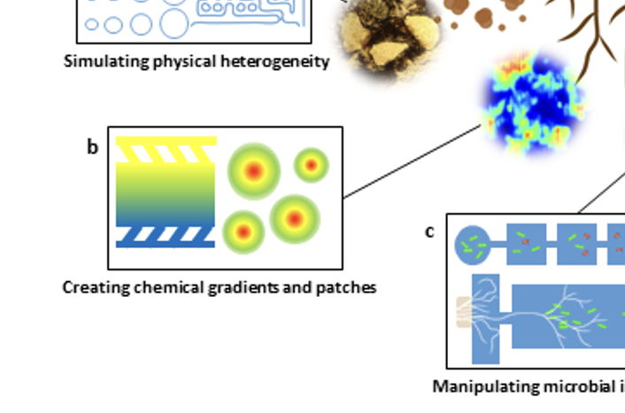
Notes:
These soil chips can be really useful – we can simulate physical structure, chemical gradients or patchiness, and combine, we can investigate ecological questions related to spatial fragmentation, and even put in rootlets to study rhizosphere interactions.

Slide 8
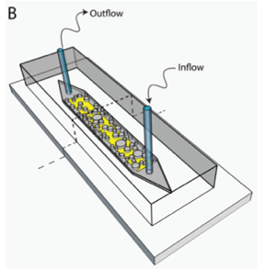
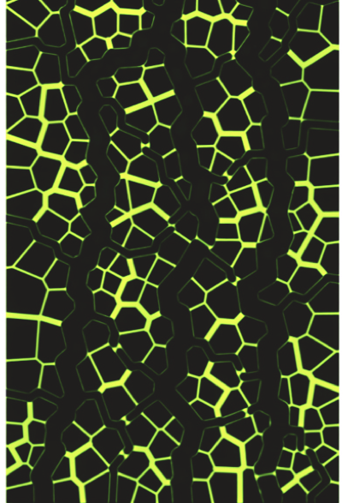
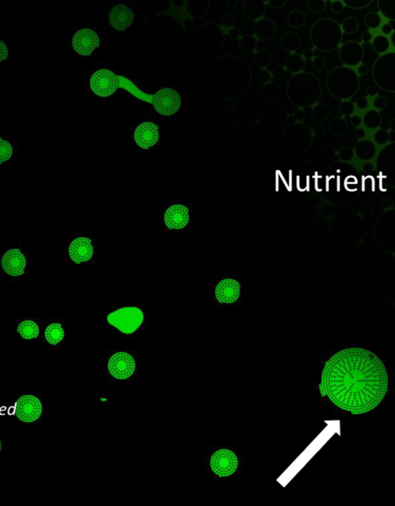
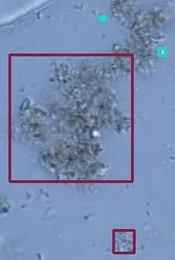
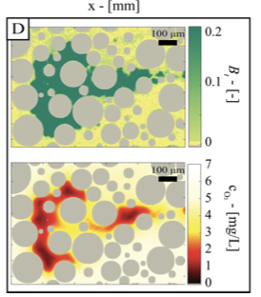
CHEMISTRY OF MICROHABITATS
Water saturation
Patchy resource distribution
Anoxic microsites
Necromass build-up
-4.3 kPa
Franklin et al. 2025
Zou et al. in prep
Ceriotti et al. 2022
Bencké et al. in prep

Slide 9
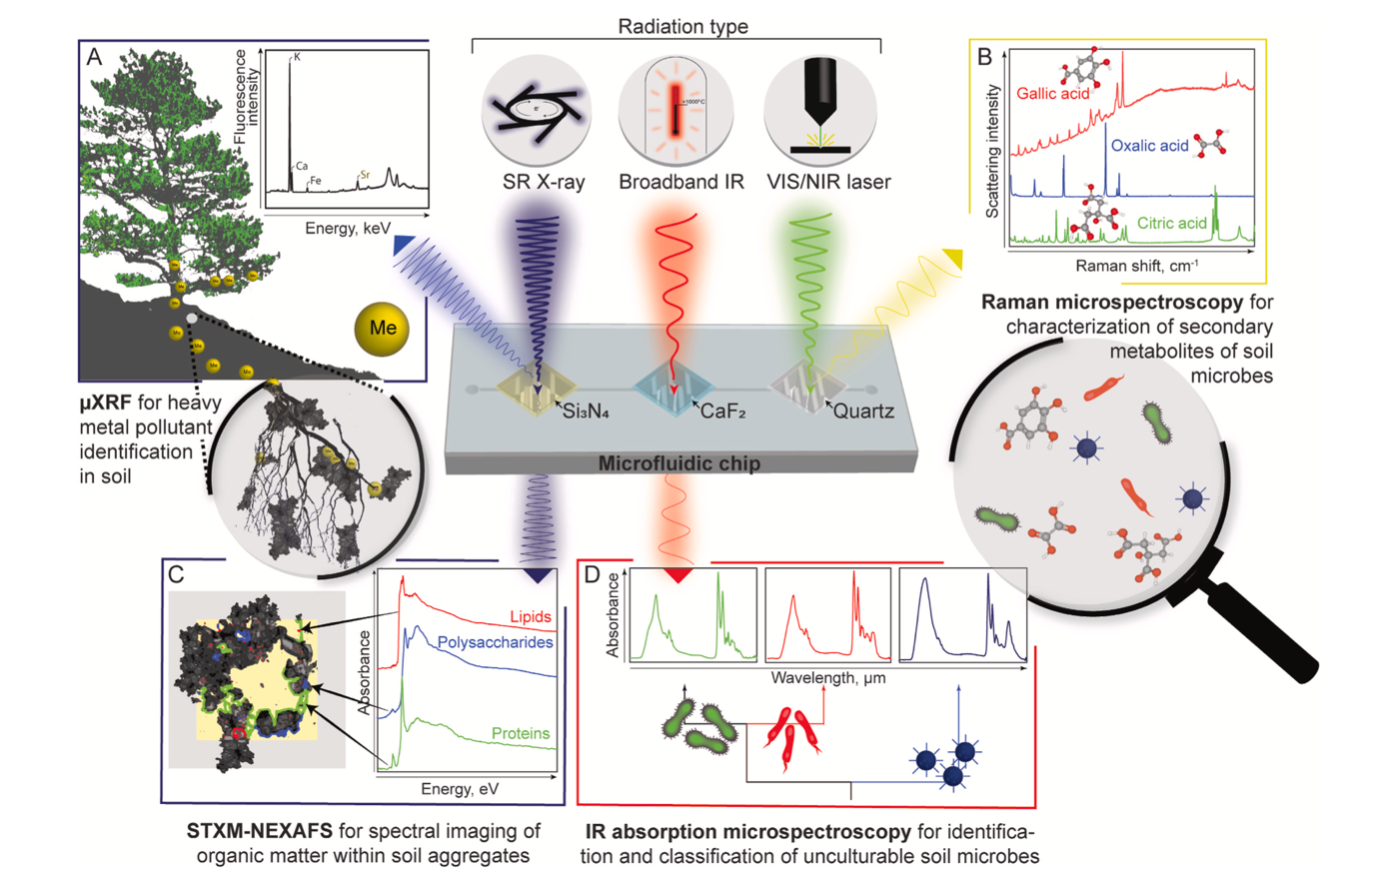
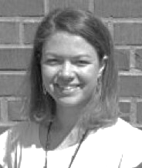
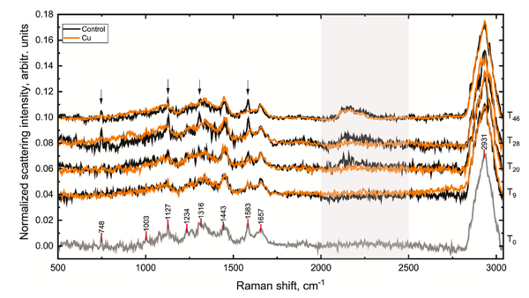
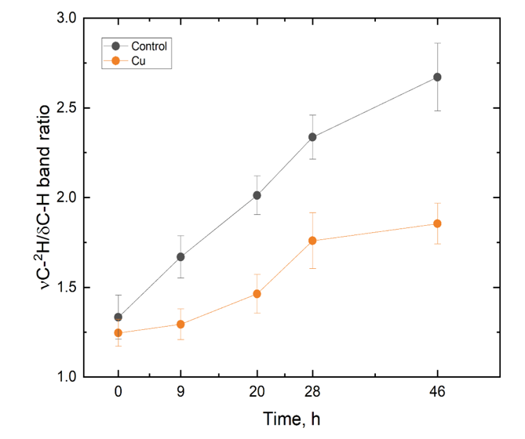
RAMAN
Milda Pucetaite
Hyphal uptake of ²H sugar
Pucetaite et al. 2021 SBB
CHEMISTRY IN MICROHABITATS
Pucetaite et al. 2026 FunBio
Notes:
More detailed chemical information via analytical light. Physiological information via isotope uptake into organisms

Slide 10
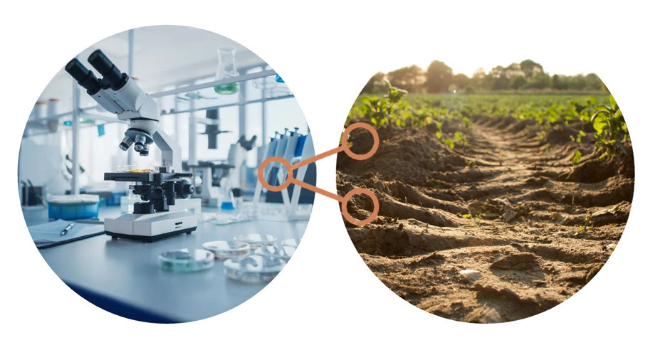
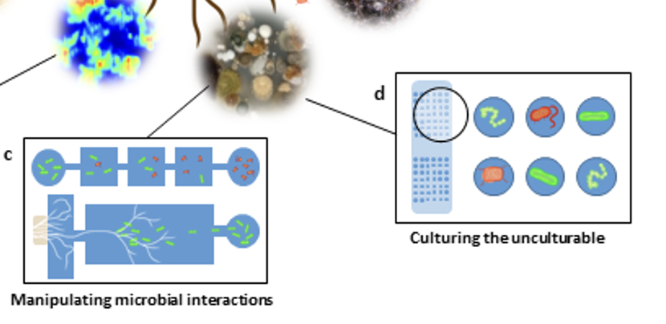
Notes:
Germanium

Slide 11

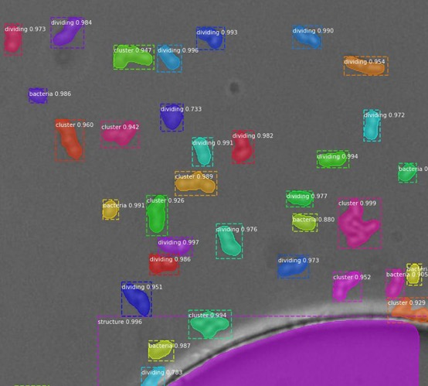
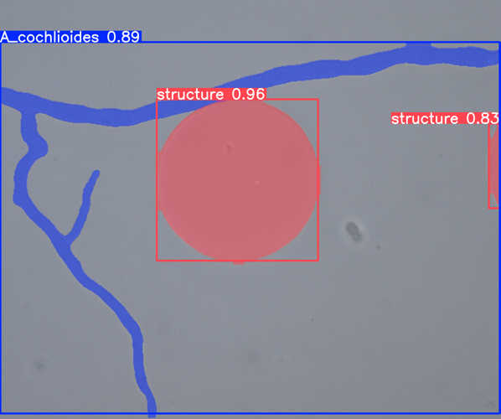
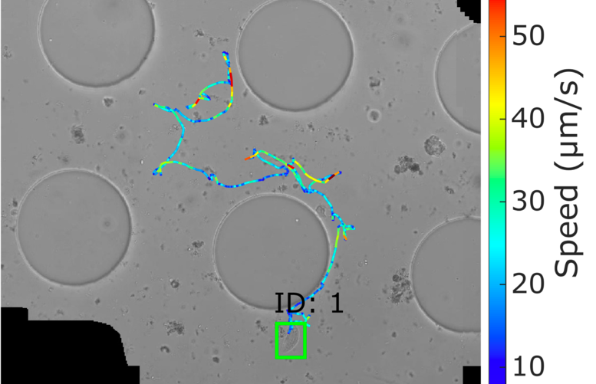
Joe Hanbang Zou
Deep-learning based image- and video recognition
Prokaryotes
Fungi
Protists
Zou et al. 2024 Ecol Informatics
Karlsson, Forsbacka et al. in prep.
Zou et al. 2026
Notes:
We need to quantify things without labels – clickers but go crazy. One of the good uses of AI – count and recognize – segment and classify
If we want to work with real soil microbial communities and go label-free, we get a whole lot of image material to work with, and we needed help from our new friend AI with the data evaluation. So we are developing image recognition algorithms for bacteria, fungi and protists, segmentation and classification of the organisms and the solid chip structures, helping us count and study what the organisms are doing.
I’m going to show you a couple of examples what we can do with this.

Slide 12
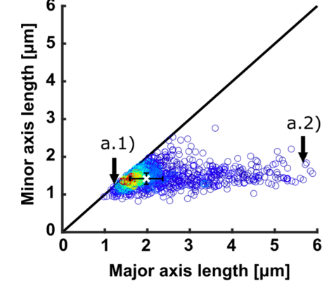
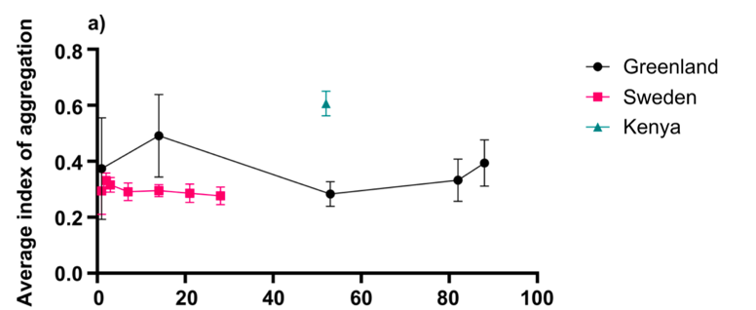
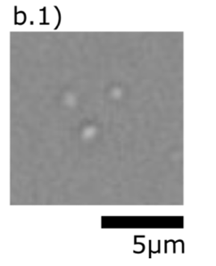
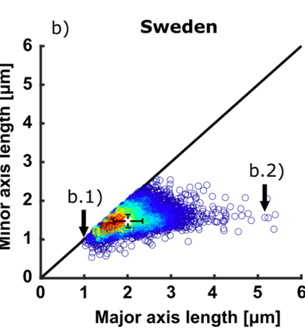
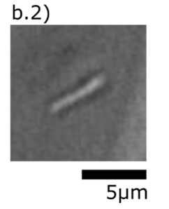
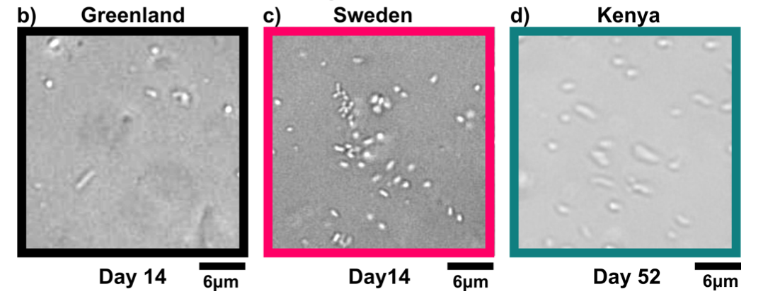
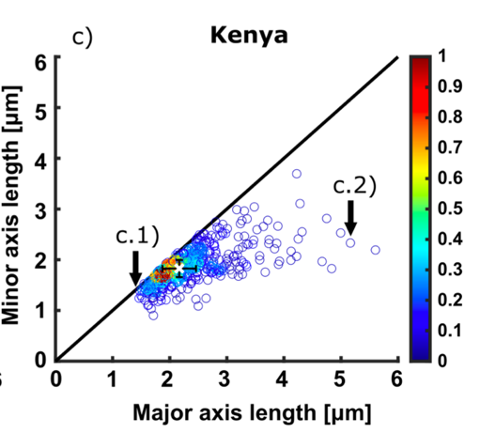
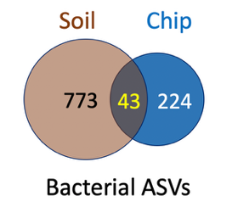
Joe Hanbang Zou
Greenland
Bacterial morphodiversity
Spatial distribution
Sweden
Kenya
Zou et al. 2024 Ecol Informatics
Notes:
But we get more information than just cell numbers when we segment: we get cell size and shape, giving us information about cellular growth in addition to population growth, and diversity information about morphotypes of the taxons and the community in their sum.
Greenland cells are on average smaller and more elongated ones than those from Sweden and Kenya – here of course no functional comparison but a proof of concept. More so, we also get coordinates for each cell and can thus determine their spatial distribution of the populations – how aggregatedly they grow, in equally spaced biofilm formaitons or solitarily.
Greenland: More bacilli, Kenya more cocci

Slide 13
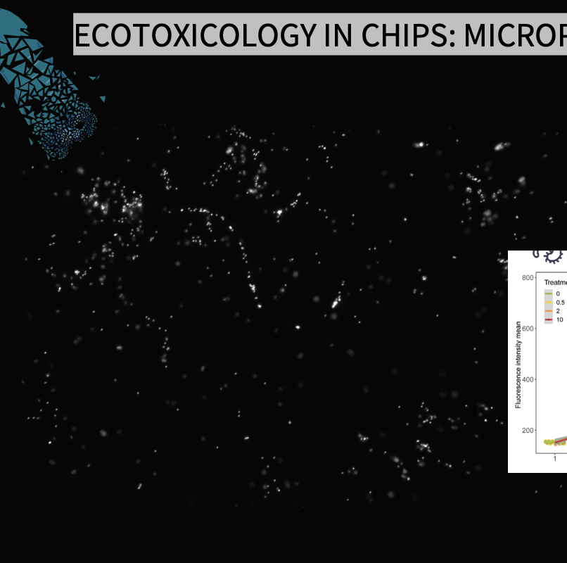
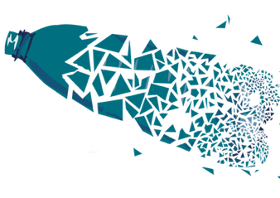
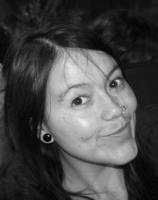
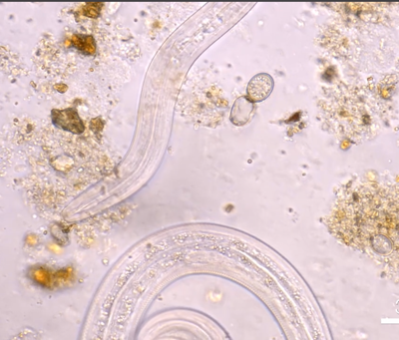
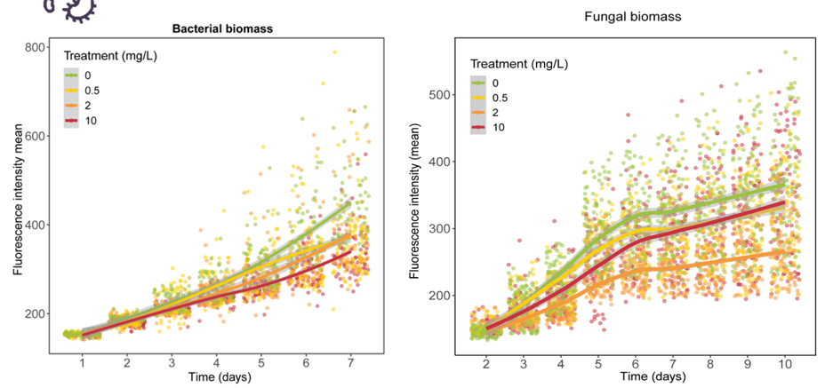
ECOTOXICOLOGY IN CHIPS: MICROPLASTICS
P. Micaela Mafla Endara
Mafla Endara et al. Sci Tot Env 2023
Notes:
Mjölmaskar bryter ned frigolit forskare i stanford söker efter MO som är ansvarig
http://www.iflscience.com/environment/plastic-eating-mealworms-could-help-reduce-landfill-waste

Slide 14
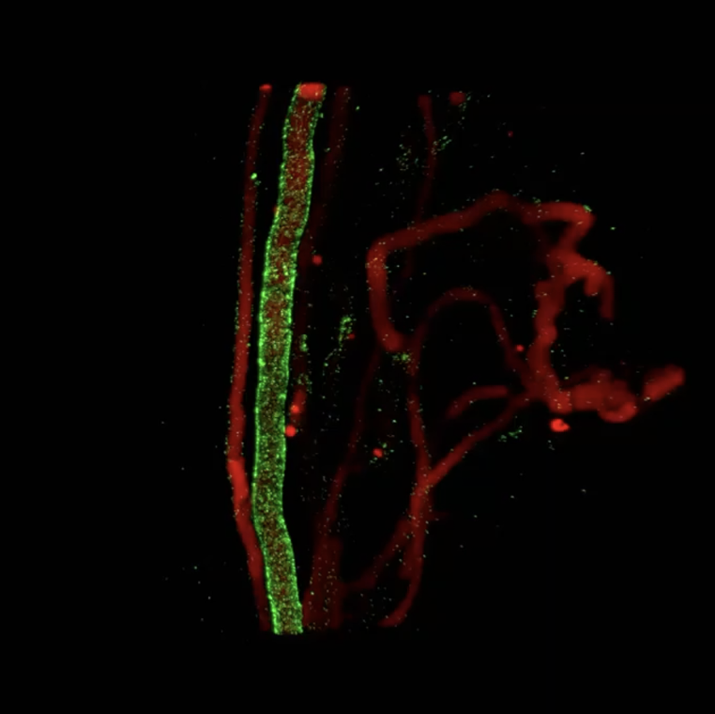
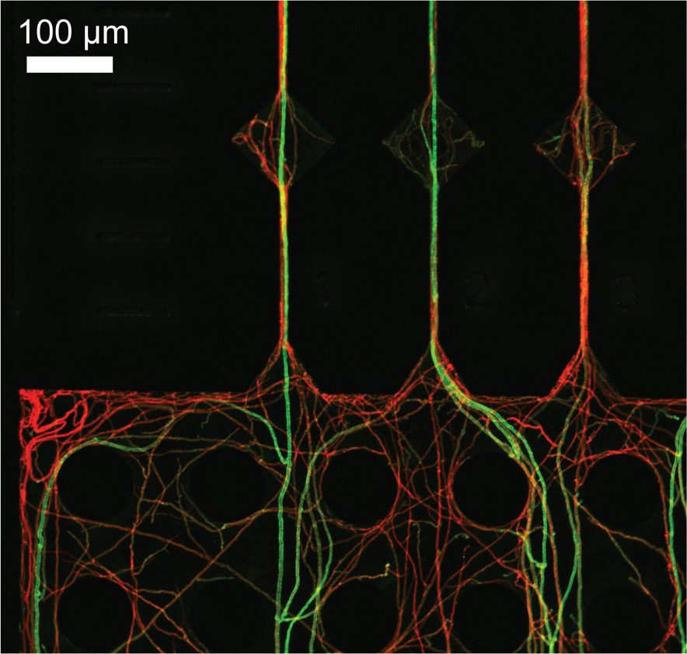

C. cinerea
Mafla Endara et al. 2023 SciTOTEN

Slide 15
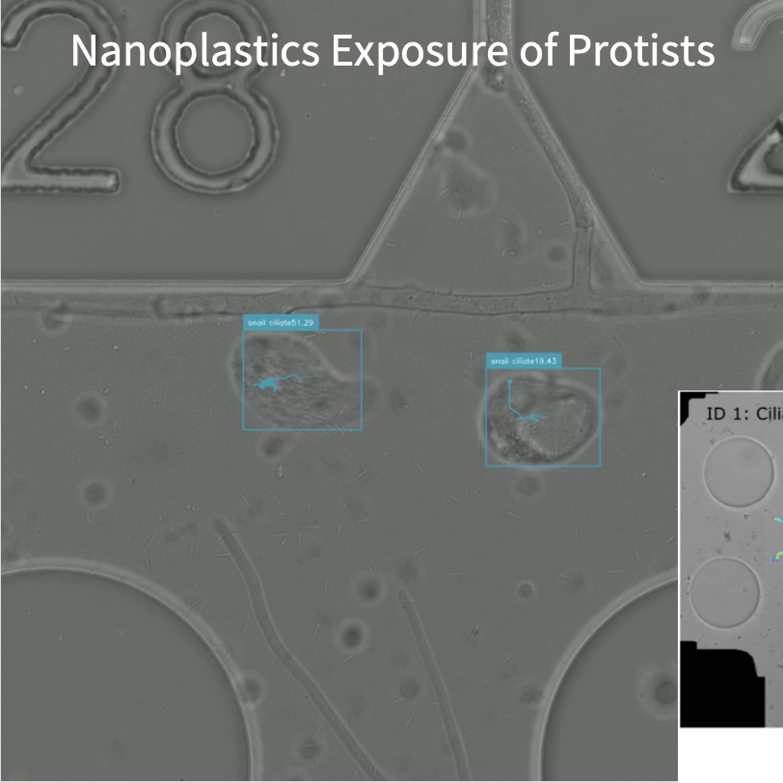
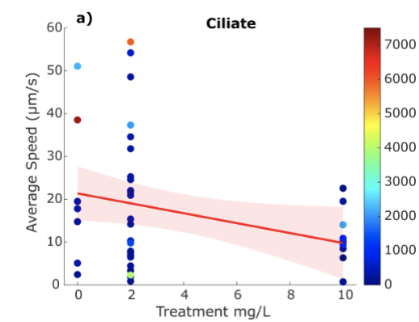
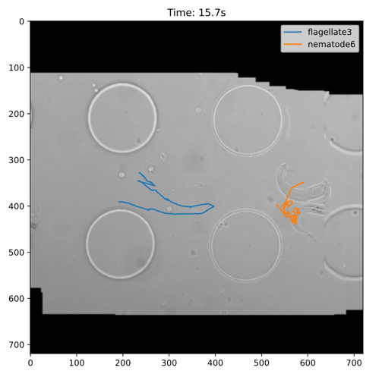
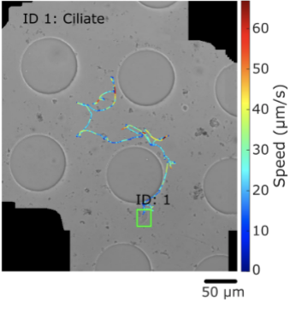
Nanoplastics Exposure of Protists
Zou et al. 2026
Notes:
Protists!
We have been studying the effect of nanoplastics on soil microbes in a couple of studies, and noticed that sometimes protists behaved strangely under high plastic levels. Therefore we wanted to investigate this systematically, and developed object tracking plus classification, for videos from protists that were exposed to different levels of nanoplastics. We found that ciliates and flagellates were moving more slowly under high NP, amoebae unaffected. This tracking algorithm will let us do more behavioural studies, as can otherwise be done with macroscopic organisms. We eg. observed a ciliate going around lalala until it got dangerously close to a nematode, realized its presence like 30 ym from it, turned around and run straight off.

Slide 16



Trophic network interactions
Francois Maillard
Shoot a top predator?
Maillard et al. 2026 ISME
Notes:
But we get more information than just cell numbers when we segment: we get cell size and shape, giving us information about cellular growth in addition to population growth, and diversity information about morphotypes of the taxons and the community in their sum.
Greenland cells are on average smaller and more elongated ones than those from Sweden and Kenya – here of course no functional comparison but a proof of concept. More so, we also get coordinates for each cell and can thus determine their spatial distribution of the populations – how aggregatedly they grow, in equally spaced biofilm formaitons or solitarily.
Greenland: More bacilli, Kenya more cocci

Slide 17
Francois Maillard
Bacteria are not significanlty affected
Maillard et al. 2026 ISME
Notes:
But we get more information than just cell numbers when we segment: we get cell size and shape, giving us information about cellular growth in addition to population growth, and diversity information about morphotypes of the taxons and the community in their sum.
Greenland cells are on average smaller and more elongated ones than those from Sweden and Kenya – here of course no functional comparison but a proof of concept. More so, we also get coordinates for each cell and can thus determine their spatial distribution of the populations – how aggregatedly they grow, in equally spaced biofilm formaitons or solitarily.
Greenland: More bacilli, Kenya more cocci

Slide 18
Francois Maillard
Flagellates increase
Competitive release?
Maillard et al. 2026 ISME
Notes:
But we get more information than just cell numbers when we segment: we get cell size and shape, giving us information about cellular growth in addition to population growth, and diversity information about morphotypes of the taxons and the community in their sum.
Greenland cells are on average smaller and more elongated ones than those from Sweden and Kenya – here of course no functional comparison but a proof of concept. More so, we also get coordinates for each cell and can thus determine their spatial distribution of the populations – how aggregatedly they grow, in equally spaced biofilm formaitons or solitarily.
Greenland: More bacilli, Kenya more cocci

Slide 19




SOIL CHIPS
Hypothesis building & Inspiration
Single factor
Study and manipulate physico-spatial, chemical and
biological conditions
Field tool
“Windows to the soil”
Notes:
One of the most awesome things at work nowadays is that I can actually SEE what I’m working on., when usually, results for us soil ecologists are numbers or lists of taxon names.
We developed these windows to the soil, microfluidic soil chips that are transparent pore spaces that can be incubated in soil. Organisms move or grow into them voluntarily and then we can study what they do, what enzymes they produce, interactions with each other and the pore space, and also their diversity. Like macroecologists would do- look and monitor what is there, because we can actually see them.

Slide 20






