Slide 1
The Junggar Basin lies in the northwestern China (Figure 1a), covering approximately an area of 130,000 km². This basin is a triangular basin and lies at the juncture of the Kazakhstan, Siberia and Tarim cratons. The study area is located in the western part of the basin (Fig. 1b), covering an area of over 32,000km², with a cumulative thickness reaching up to 14,000 m .This region has undergone multiple tectono sedimentary stages , including the Hercynian , Indosinian , Yanshanian , and Himalayan periods.
This study aims to achieve a multidimensional and automated quantification of multi-stage and multi-scale faul networks based on 3D seismic data from the study area. The analysis includes geometric characteristics and topological parameters (Fig. 1c). Constructing fracture topology networks allows quantitative analysis of connectivity across tectonic stages and favorable vertical migration pathways , offering insights into hydrocarbon migration prediction.
Figure1.(a) Location of Junggar Basin in China.(b)the structural units and oil and gas seeps in the Junggar Basin,including the location soft hesamples collected during this study . (c) Different colors of fault lines represent faults formed in different tectonic periods: green for the Hercynian Period, purple for the Indosinian-Yanshanian Period, and blue for the Himalayan Period.

Slide 2
Hercynian Period
Largest fault system (20–100 km, max ~100 km). NE/near-EW-trending through-going faults form the basin’s tectonic framework, dominating long-term hydrocarbon accumulation.
Indosinian-Yanshanian Period
Medium-small faults (5–40 km) with the highest density. Complex strikes(NE/NW/ SN) indicate reactivation / modification of early faults, controlling trap formation and secondary migration.
Himalayan Period
Smallest fault scale (2.5–22.5 km, mostly <10 km). Sparse, isolated late-stage adjustment faults, with weak modification effects on hydrocarbon accumulation.
Figure 2. Fault networks of the Hercynian, Indosinian-Yanshanian, and Himalayan periods (from left to right, respectively). Line colors (purple → blue → green → yellow) and numerical labels denote fault lengths, with the color scale expressed in meters.

Slide 3
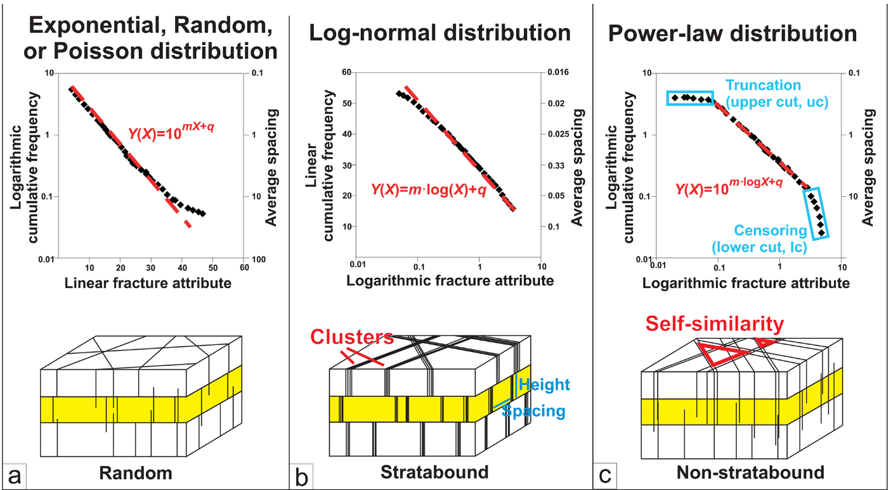
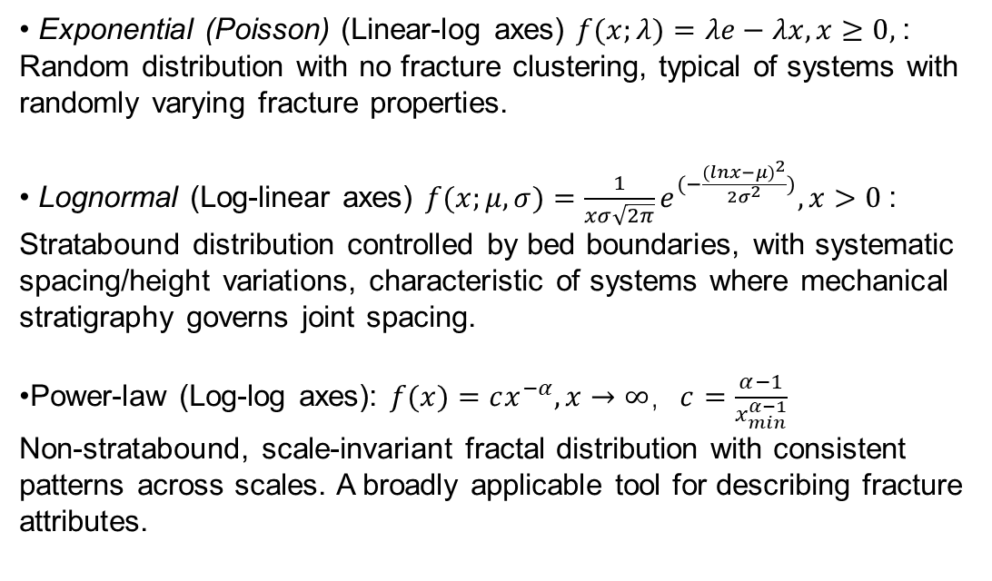
Fault Length Distributions: Three Common Distributions for Fault Attributes
• Exponential (Poisson) (Linear-log axes) $f(x;λ)=λe−λx,x≥0,$:
Random distribution with no fracture clustering, typical of systems with randomly varying fracture properties.
• Lognormal (Log-linear axes) $f(x;μ,σ)=\frac{1}{xσ\sqrt{2π}}e^{(−\frac{(lnx−μ)^{2}}{2σ^{2}})},x>0$:
Stratabound distribution controlled by bed boundaries, with systematic spacing/height variations, characteristic of systems where mechanical stratigraphy governs joint spacing.
•Power-law (Log-log axes): $f(x)=cx^{−α},x→∞，c=\frac{α−1}{x_{min}^{α−1}}$
Non-stratabound, scale-invariant fractal distribution with consistent patterns across scales. A broadly applicable tool for describing fracture attributes.
Figure 3.Red dashed lines denote the best fits for fault attributes (length and aperture). Panels (a–c) show overall distribution plots for exponential, log-normal, and power-law distributions, respectively. Each panel includes the corresponding best-fit equation (top) and a schematic diagram of its physical significance (bottom) (Dichiarante, 2020; Hooker et al., 2013).
Figure 4. The length distributions of Himalayan fault traces and segments fit the Lognormal
distribution, indicating stratigraphic horizon control on faults of this period.

Slide 4
Hercynian (Left)
Nodes: Well-developed X/Y-type intersection nodes with strong fault cutting and through-going capability.
Branches: Dominated by CC-throughgoing and CI-semi-connected branches, with a distinct fault framework.
Connectivity: Continuous high-value CB zones. It is the fault system with the optimal connectivity in the study area and acts as the main pathway for long-distance hydrocarbon migration.
Indosinian-Yanshanian (Middle)
Nodes: High proportion of Y-type bifurcation nodes with the highest node density among the three periods, showing clustered distribution.
Branches: Dominated by II-isolated and CI-semi-connected branches, with weak overall fault through-going performance.
Connectivity: CB values show patchy distribution with good local connectivity, controlling secondary hydrocarbon migration and trap reconstruction.
Himalayan (Right)
Nodes: Predominantly I-type end nodes, with no effective intersection nodes developed.
Branches: Almost all are II-isolated branches, lacking through-going faults.
Connectivity: Extremely low CB values and poor network connectivity, only exerting weak late-stage adjustment effects on hydrocarbon accumulation.
Figure 5 illustrates the topological characteristics of fault networks during different tectonic periods, arranged from left to right as the Hercynian, Indosinian-Yanshanian, and Himalayan periods respectively. Three node types are identified(top), namely X-crossing node, Y-bifurcation node and I-end node, while fault branches are classified into CC-throughgoing branch, CI-semi-connected branch and II-isolated branch. P22 is a dimensionless parameter that quantifies the development intensity of faults(middle).The color scale corresponds to Connections per Branch (CB,bottom), which is adopted as the quantitative evaluation index of fault network connectivity.

Slide 5
Thank You for Your Attention!

