Slide 1

A multi-temporal Very High-Resolution optical satellite remote sensing framework for post-disaster reconstruction monitoring
Nikolaos Stasinos, Emmanouil Salas, Michail-Christos Tsoutsos, Katerina-Argyri Paroni, Katerina Pissaridi, and Charalampos (Haris) Kontoes
National Observatory of Athens | IAASARS | Operational Unit BEYOND Centre
EGU Symposium | 3–8 May 2026

Slide 2
Why Long-Term Monitoring Matters?
Long-term monitoring is essential to:
  Evaluate recovery processes
  Improve urban resilience
  Reduce future vulnerability
Especially critical in:
  Coastal regions
  Recurrent extreme events

Slide 3
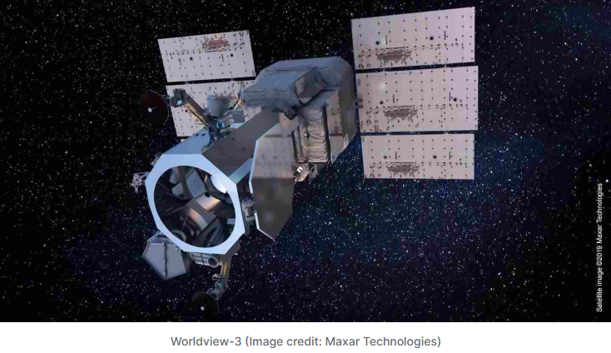
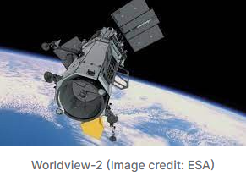
Objective and Data
Develop a remote sensing framework
Use multi-temporal VHR satellite imagery
Perform building-level reconstruction monitoring
Enable quantitative and temporal analysis
Very High Resolution (VHR) imagery:
  WorldView-2
  WorldView-3
Multi-temporal acquisitions

Slide 4
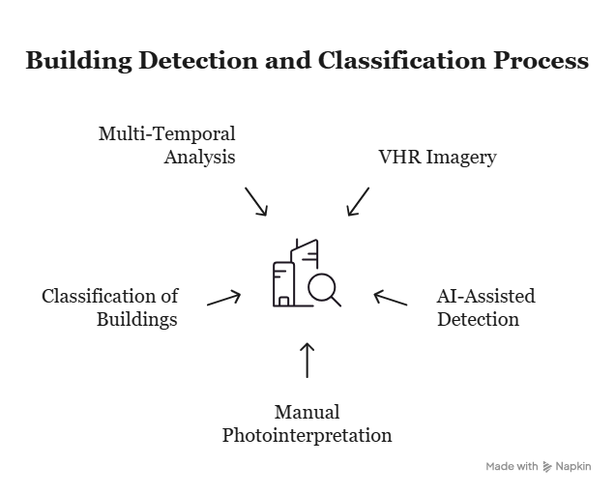
Framework Overview

Slide 5
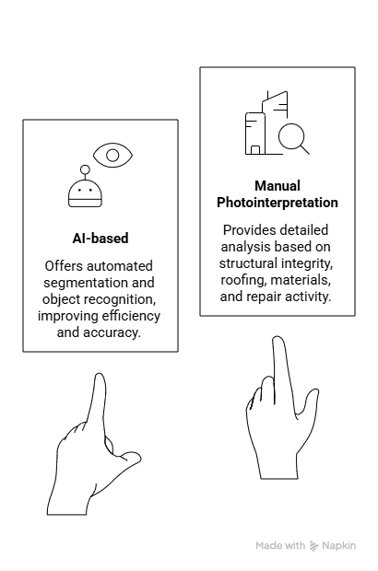
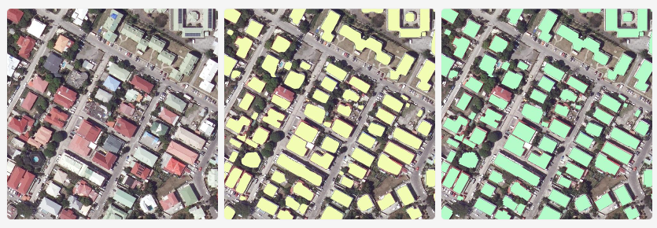
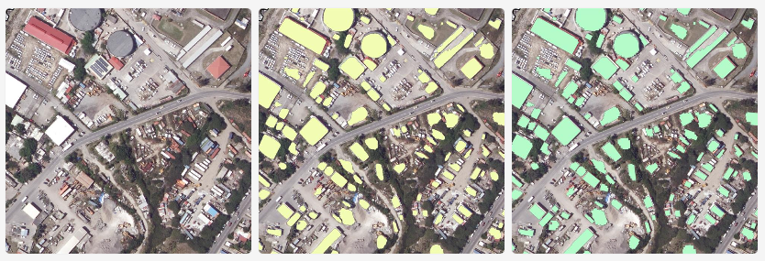
Building Detection and Interpretation

Slide 6
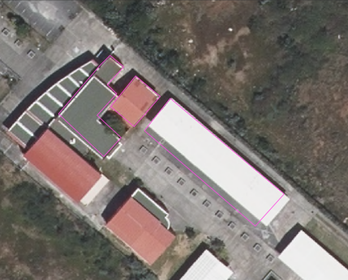
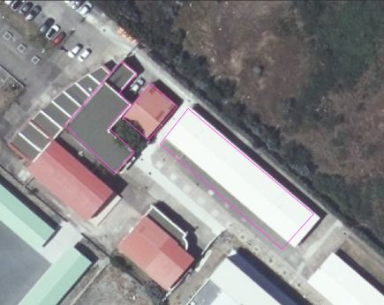
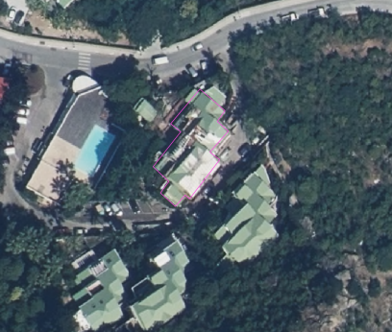
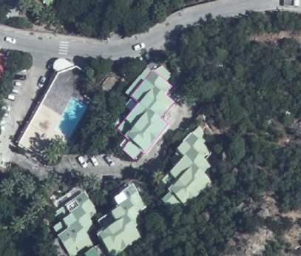
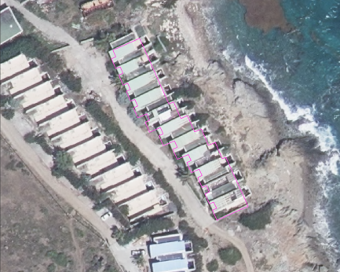
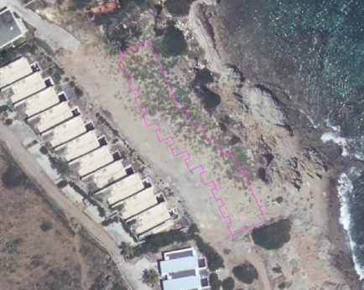
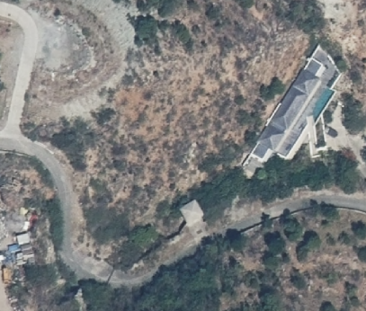
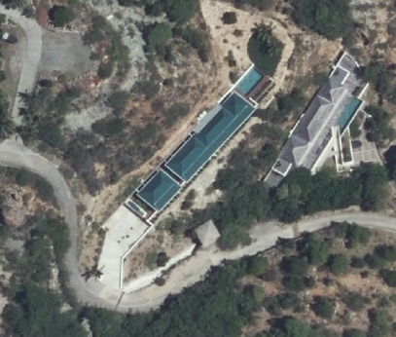
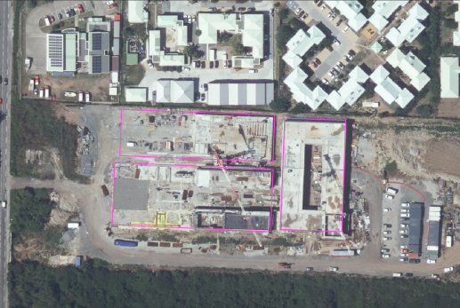
Classification Scheme
Photointerpretation Keys
Unchanged
Removed
Under
reconstruction
Reconstructed
Newly built

Slide 7
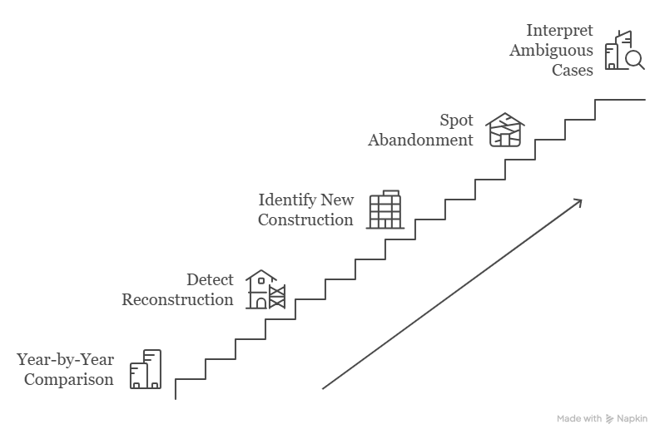
Temporal Analysis

Slide 8
Handling Uncertainty
Multi-temporal VHR imagery (2023–2025)
Images selected within +/- 1 month seasonal window
Multi-image strategy to address:
  Cloud cover
  Visual obstructions
Priority to:
  Cloud-free scenes
  Supplementary images to fill gaps
Multi-date interpretation for:
  Ambiguous reconstruction cases
  (Removed or Under construction structures)
Overlapping seasonal imagery ensures:
  Consistency
  reliable analysis

Slide 9
Key Contribution and Impact
Building-level reconstruction monitoring
Hybrid AI + manual approach
Multi-temporal framework
Robust and reliable classification
Transferable framework
Scalable to different regions (especially coastal regions)
To supports:
Urban planning
Resilience evaluation
Disaster risk reduction

Slide 10
Conclusion
VHR imagery enables building-level reconstruction monitoring
Multi-temporal analysis captures recovery dynamics over time
Hybrid approach (AI + photointerpretation) ensures accuracy and reliability
Framework is scalable and transferable

Slide 11


Thank You
Contact:
Nikolaos Stasinos (n.stasinos@noa.gr)

