Slide 1
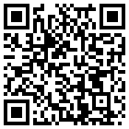
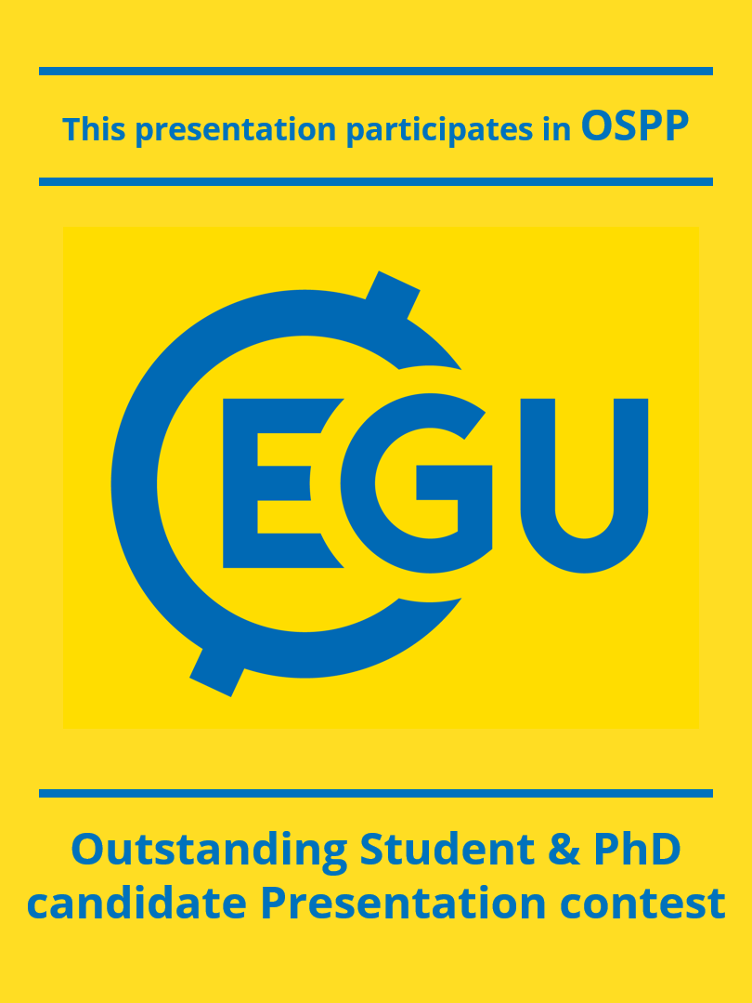




Mapping environmental radioactivity: integrating portable gamma ray spectrometry into experiential science education
Scan for abstract
Ghulam Hasnain *, Mohamed Abdelkader, Matteo Alberi, Annalea Corallo, Luca Maria De Vita, Arianna Diegoli, Nedime Irem Elek, Engin Can Esen, Rachele Grazzi, Fabio Mantovani, Cristina Mattone, Kassandra Giulia Cristina Raptis, Caterina Spadetto, Anna Trevisan

Slide 2
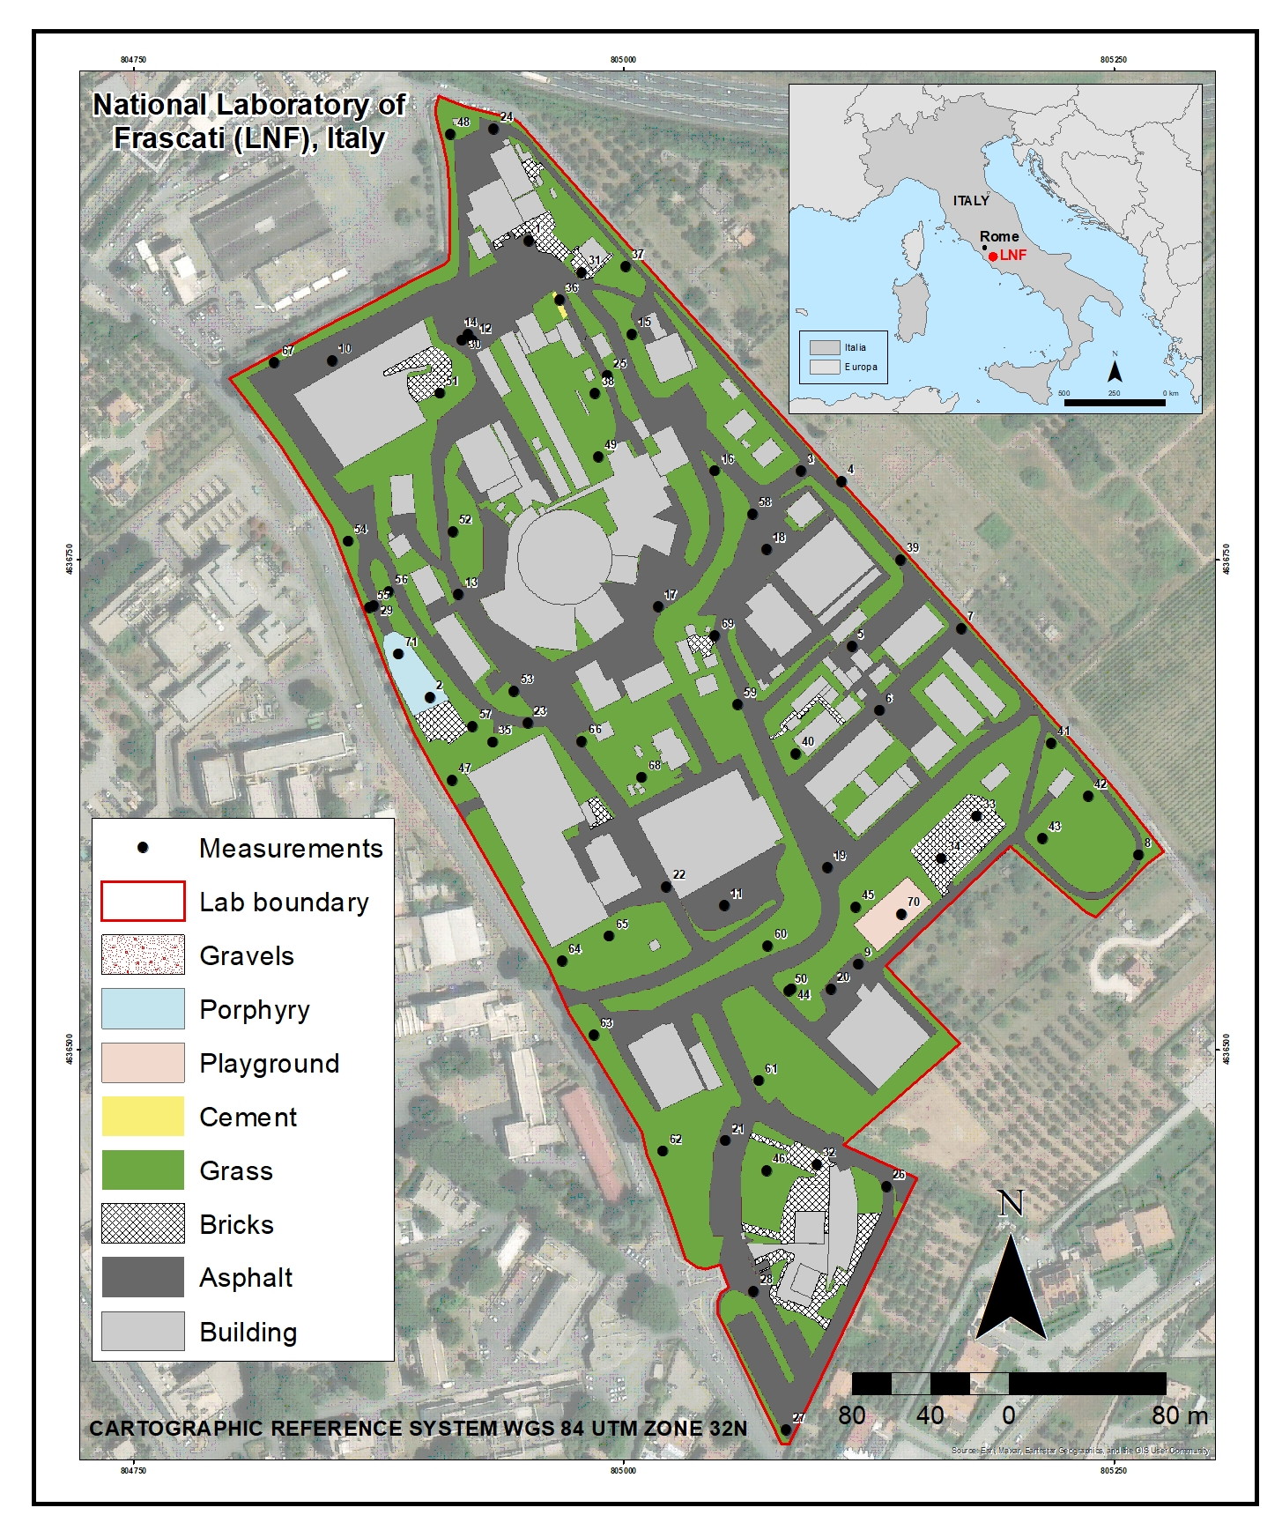
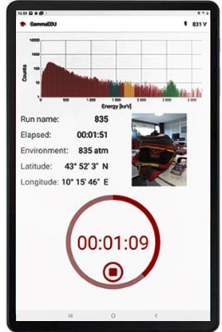
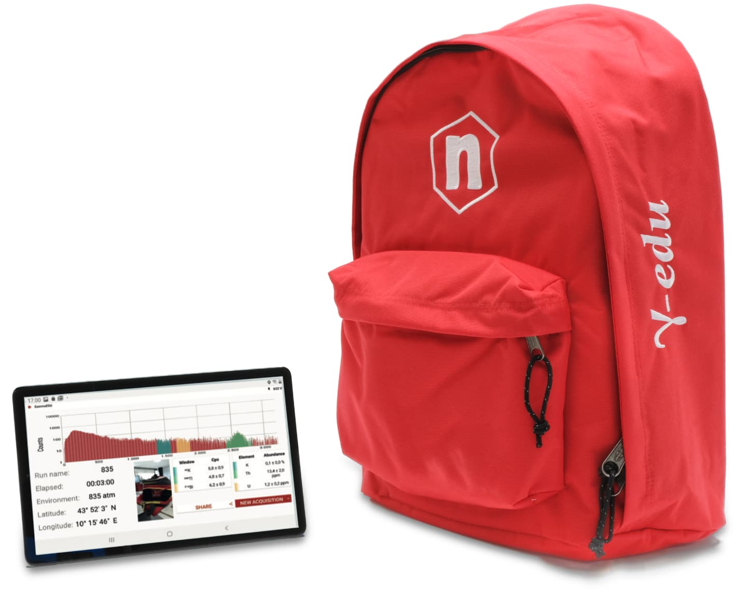
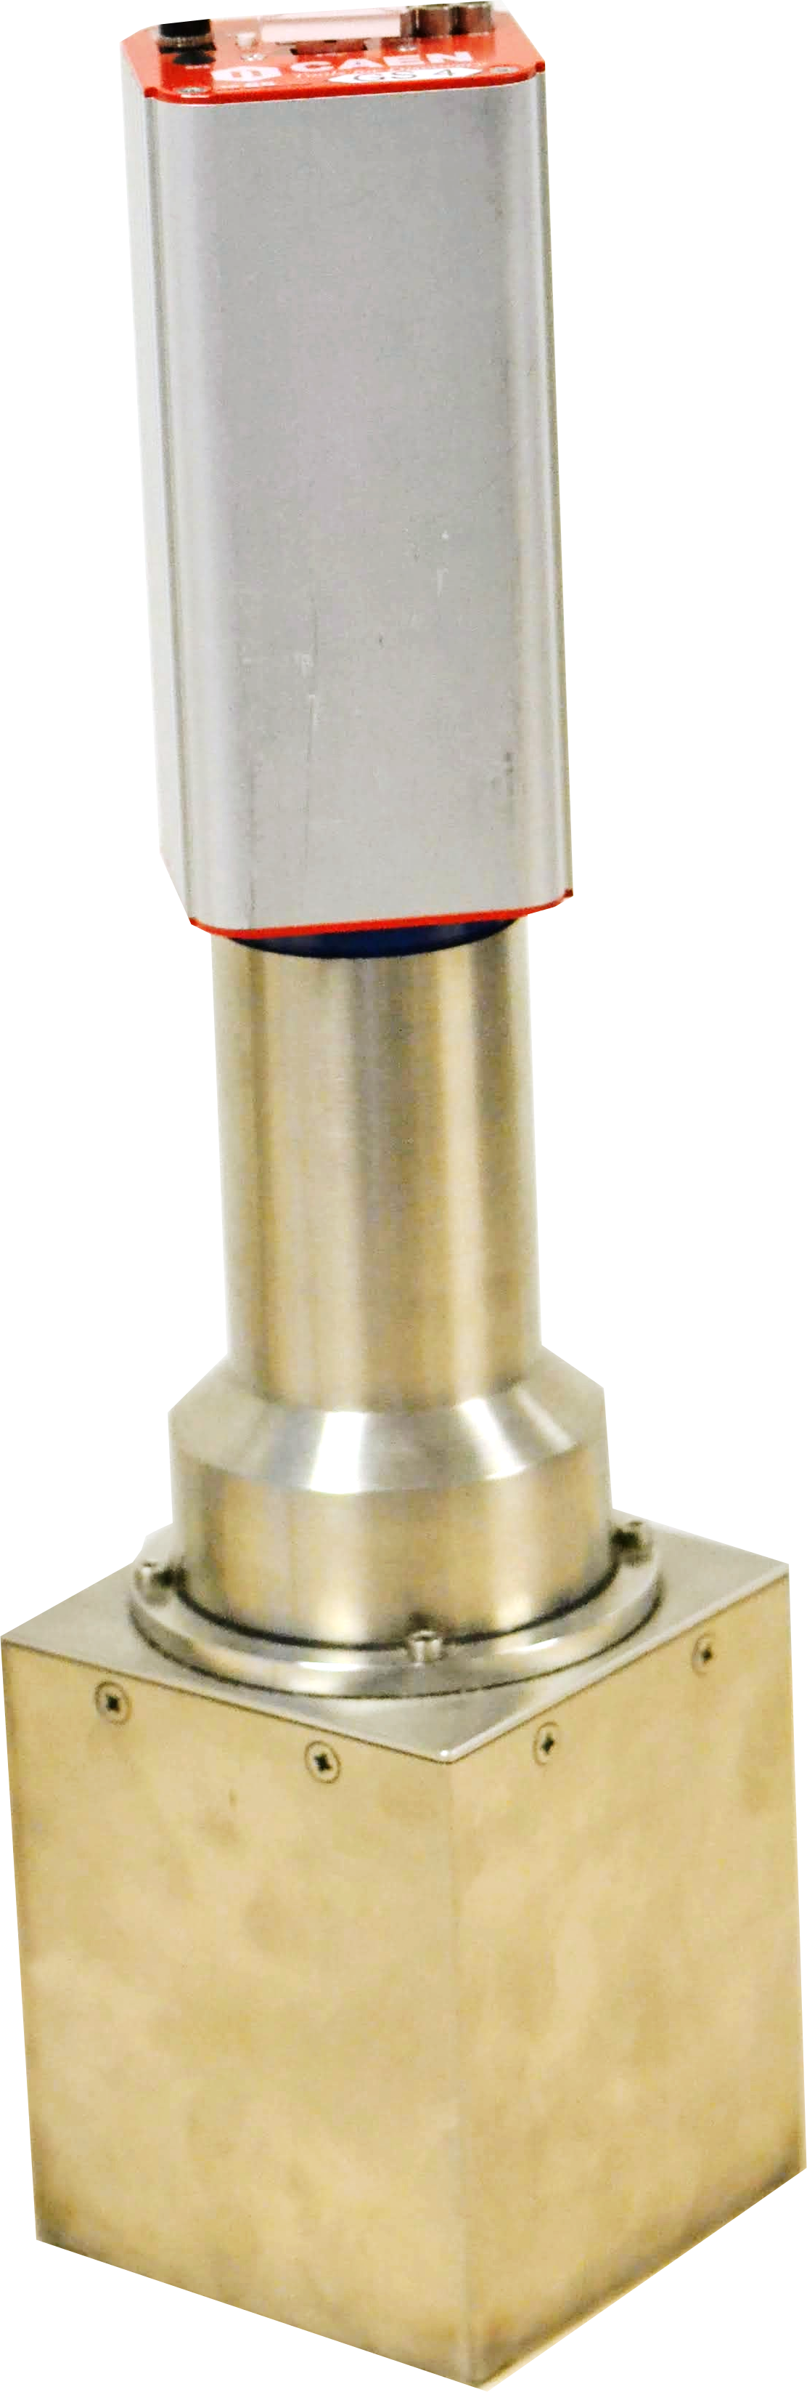
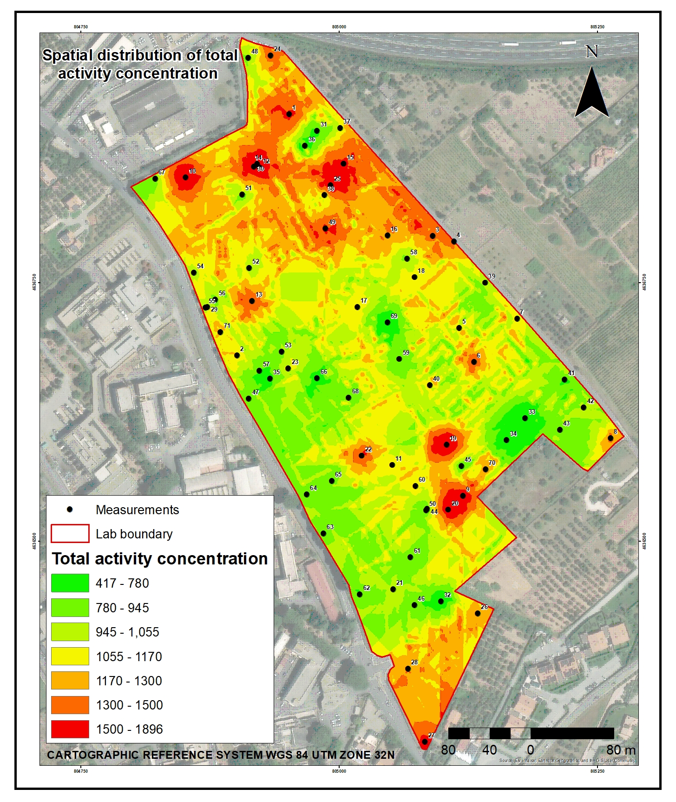
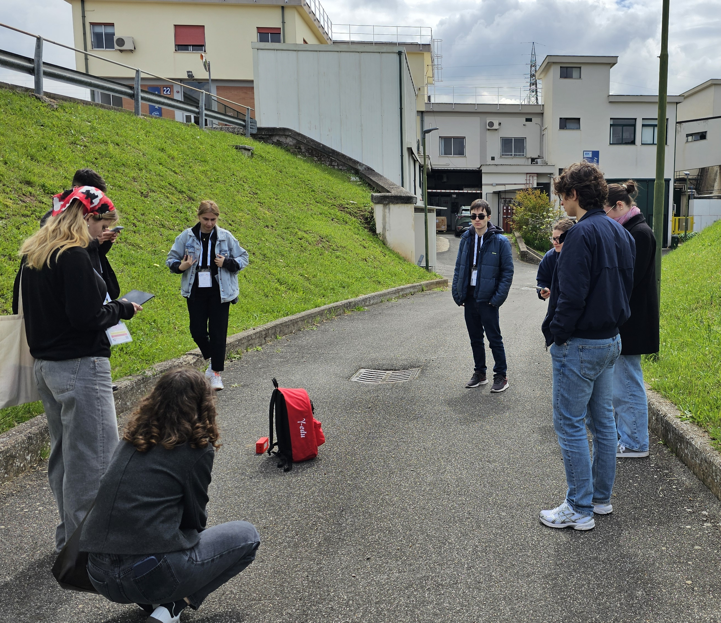
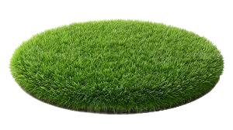
Mapping the invisible
Digitization of surface type
Participants: 40 high school students (8 countries)
Location: National Laboratory of Frascati (LNF)
Goal: Make invisible environmental radioactivity visible
csv
Survey strategy
Study area : 0.12 km² (LNF)
Instrument: GammaEDU Backpack detector
Targeted surface type : 7
Hands-on survey
Total measurements: 71
Acquisition time: 7 mins/measurement
Acquire: real-time spectra & coordinates
Collocated Co-Kriging
Spatial analysis
Transform tabular data into spatial data
Use Collocated Co-Kriging interpolation
Create the spatial distribution
Visualizing data
Classified data into 5 classes via a Jenks–Quantile hybrid scheme
Mapped total activity concentration and abundance of K, U, and Th
Field of
view : 70 cm

Slide 3
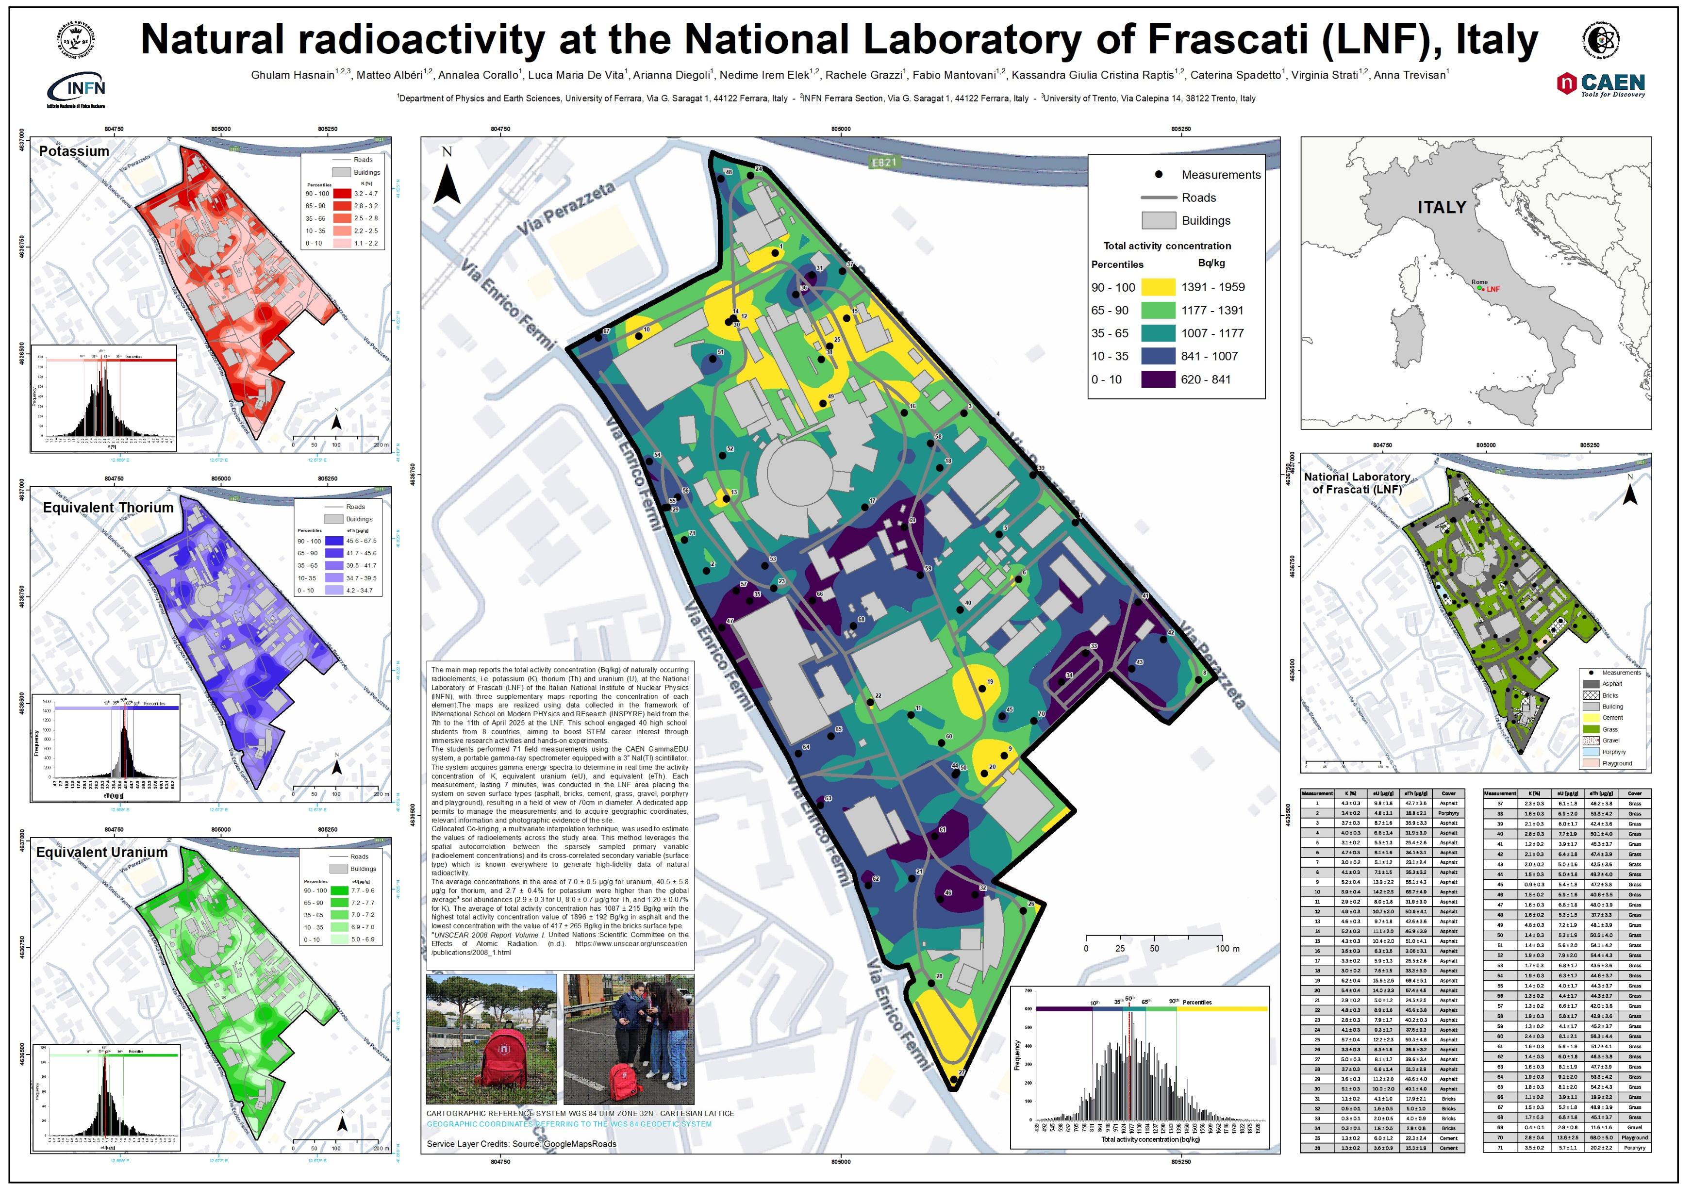
Findings & educational impact
Key findings:
The average activity concentration was 1087 ± 215 Bq/kg, the highest in asphalt and lowest in bricks .
Educational impact:
Students gained hands-on experience across experimental lifecycle.
Strengthened radioactivity understanding by visualizing it in the form of map and reduce the anxiety and stress.
Bridged theory-practical gap, boosting motivation and engagement
Making radioactivity visible, measurable, and teachable.
Screen: PICO3.3

