Slide 1




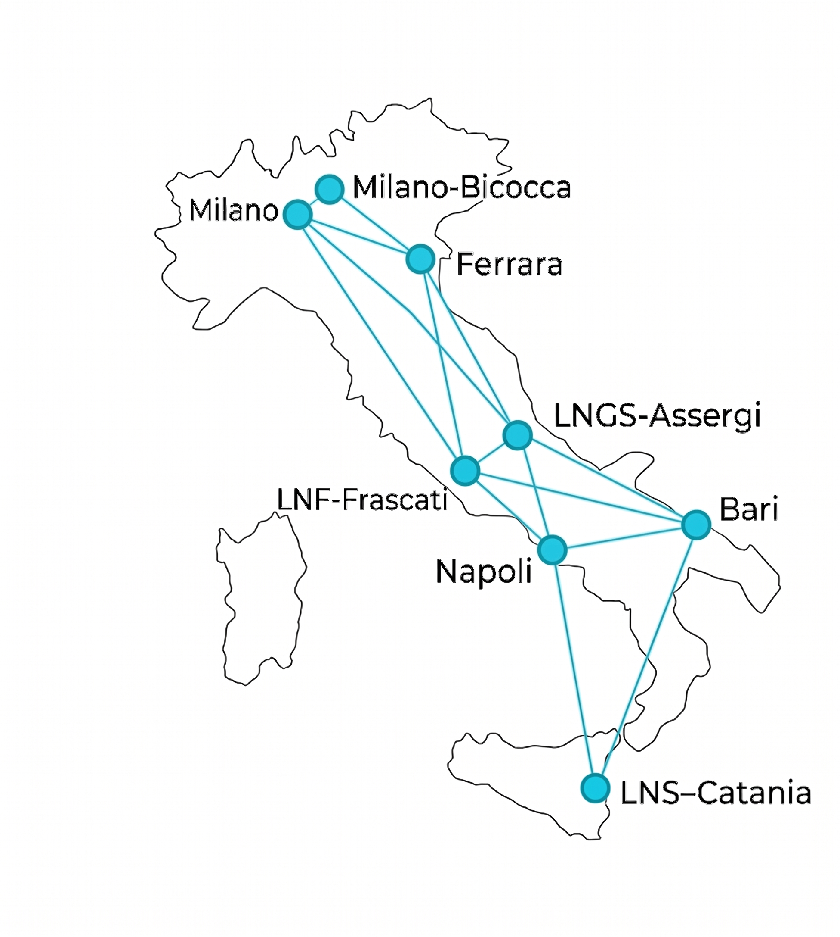


EyeRAD: an INFN network for airborne radioactivity
monitoring
Nedime Irem Elek
Department of Physics and Earth Sciences, University of Ferrara & INFN Ferrara
on behalf of the EyeRAD Collaboration
Flavia Groppi, Monica Sisti
Scan for abstract
Session NH8.1 | EGU General Assembly 2026

Slide 2
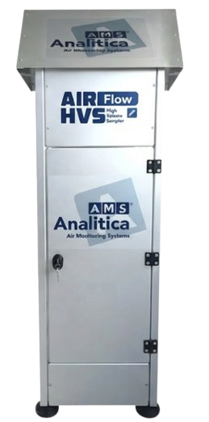
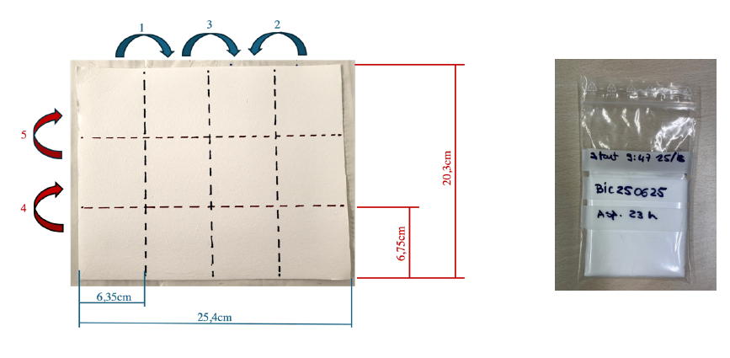
Protocol & measurement process
Network Setup
Air Sampling
1
1
Defining shared method for data consistency.
Physically disentangling radon from signals.
Monitoring radioactivity via gamma spectrometry.
HPGe, NaI(Tl), CeBr₃
Target radionuclides; ²¹⁰Pb, ⁷Be, ¹³¹I and ¹³⁷Cs.
AirFlow High Volume Sampler.
1000 L·min⁻¹ flow rate.
~1.4×10³ m³ per session
23-hour session.
Glass fiber filters (99% efficiency for 0.3 μm).
Fixed intervals:
2h → 5h → 24h → 48h → 72h
Session NH8.1 | EGU General Assembly 2026

Slide 3
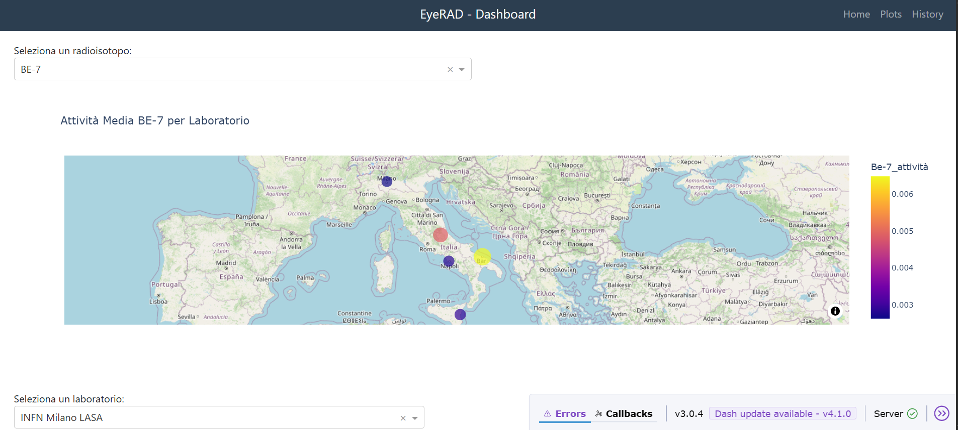
Key results & achievements
Analytical Sensitivity (MDA)
🌐 eyerad-infn.it
¹³¹I
1–3 × 10⁻⁵ Bq/m³
¹³⁷Cs
1–3 × 10⁻⁵ Bq/m³
²¹⁰Pb
Open access · All results & metadata publicly available
~10⁻² Bq/m³
☞
The full story is on the screen.. Come to see 3.10!
🗺️
☢️
🏛️
Interactive Map
Radioisotope Filter
Lab Selection
Session NH8.1 | EGU General Assembly 2026

