Slide 1



Vienna, Austria & Online | 3-8 May 2026
The evolution of flood risk in Italy across two centuries: disentangling risk drivers to understand past trends and future issues
Authors : Luciano Pavesi (1,3), Jose Luis Salinas (2), Stefano Zanardo (2), Maximiliano Sassi (2), Arno Hilberts (2), Elena Volpi (3), Aldo Fiori (3)
¹now at Department of Civil Engineering and Computer Science, University of Rome Tor Vergata, Via Politecnico 1, 00133, Rome, Italy (luciano.pavesi.609286@uniroma2.eu)
²Moody's RMS, London, United Kingdom
³Department of Civil, Computer Science and Aeronautical Technologies Engineering, Roma Tre University, Rome, Italy
PICO | Friday, 08 May, 09:01–09:03 (CEST) - PICO spot 4, PICO 4.13

Slide 2
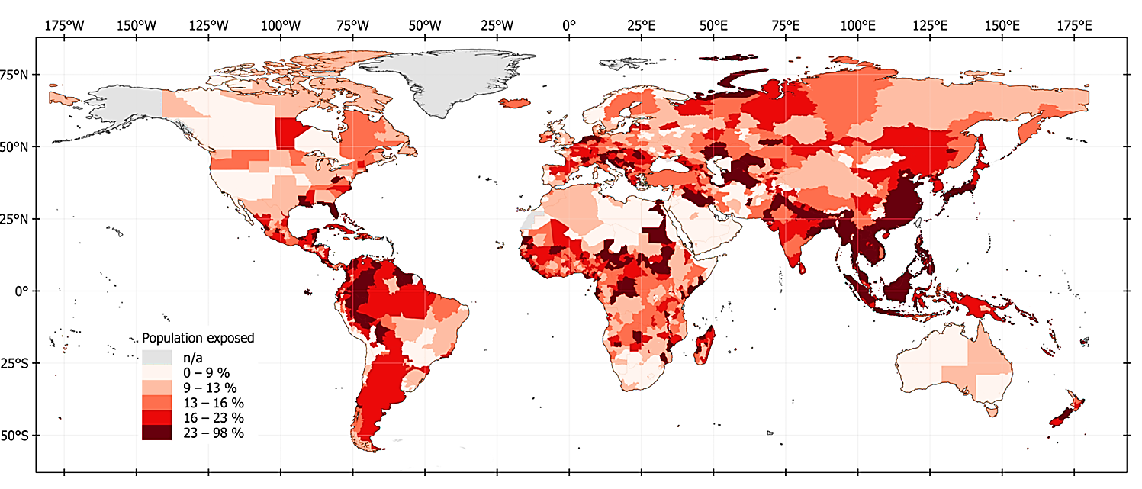
Vienna, Austria & Online | 3-8 May 2026
1,81 bilions of people are already exposed to flood risk (23 % of global population)
Research question:
In a context of climate change & population growth in flood-prone areas, which one is the role of these drivers on flood risk in Italy?
Climate change and rapid urbanization in flood zones will drive up flood risks
IPCC reports affirms the needs of addressing the intensifying impacts of climate change
PICO | Friday, 08 May, 09:01–09:03 (CEST) - PICO spot 4, PICO 4.13

Slide 3
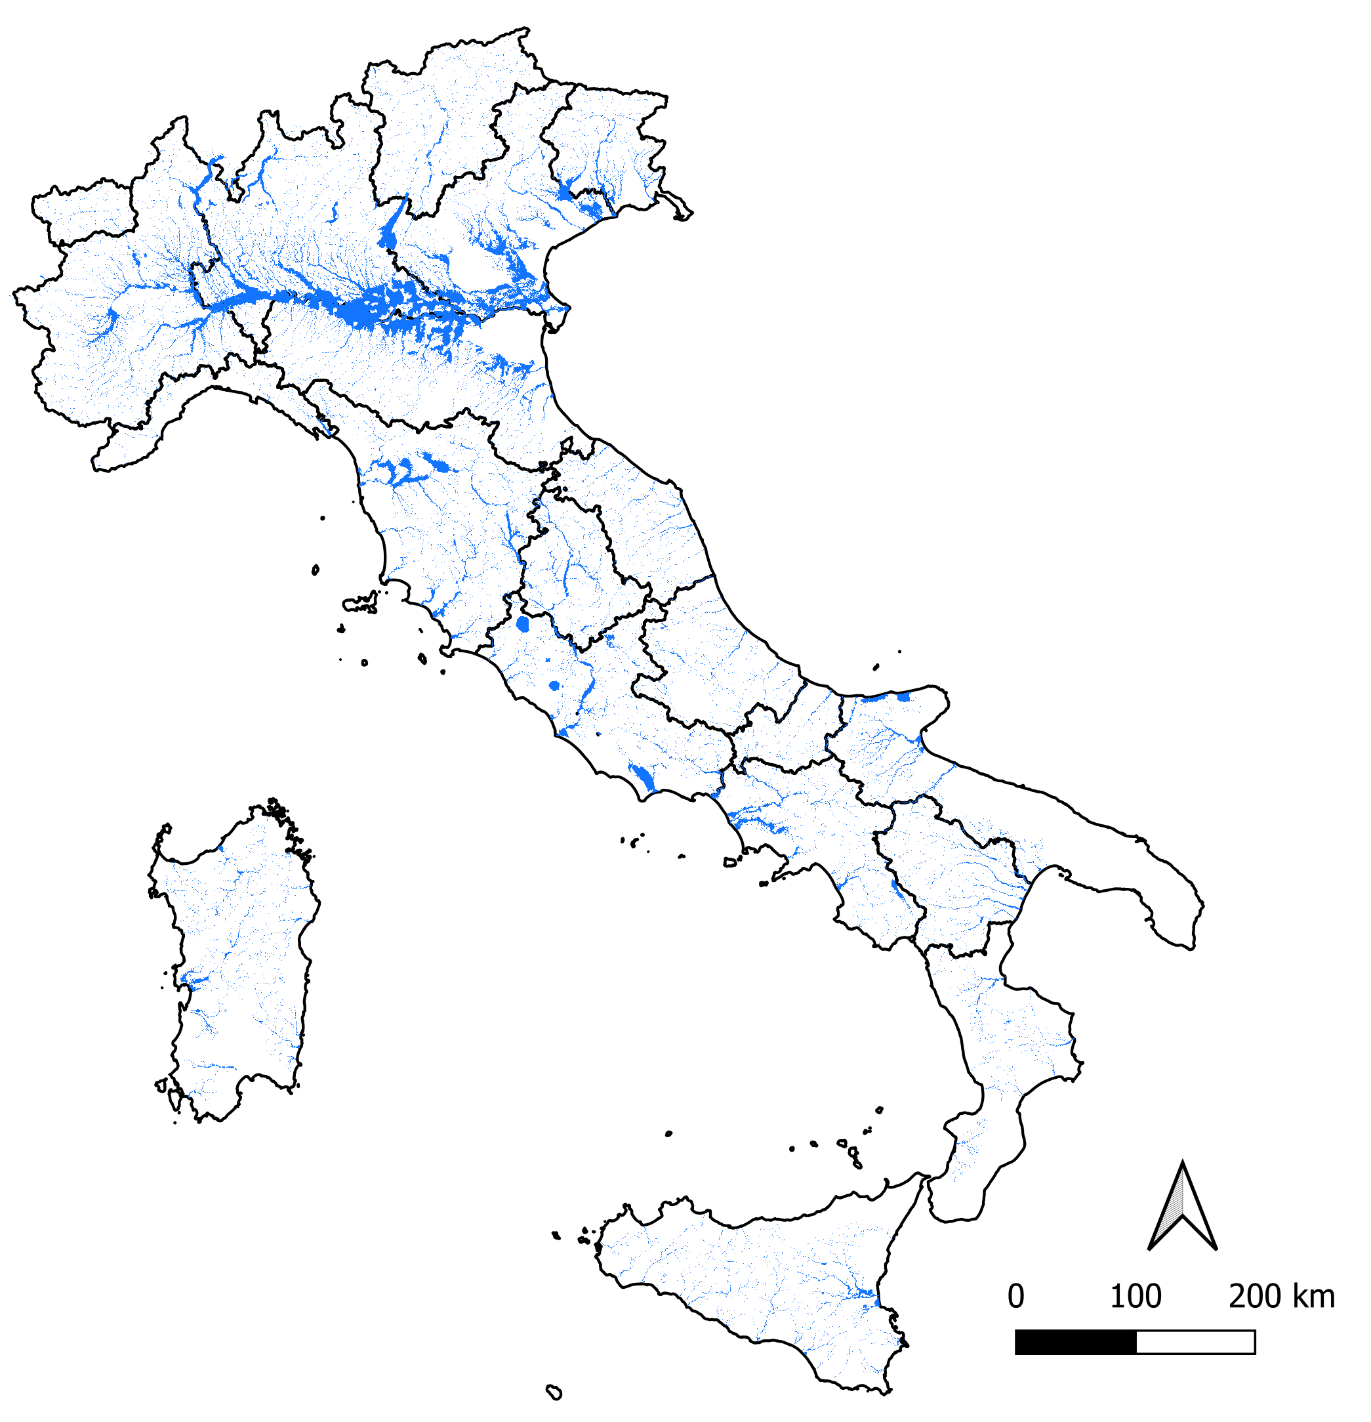
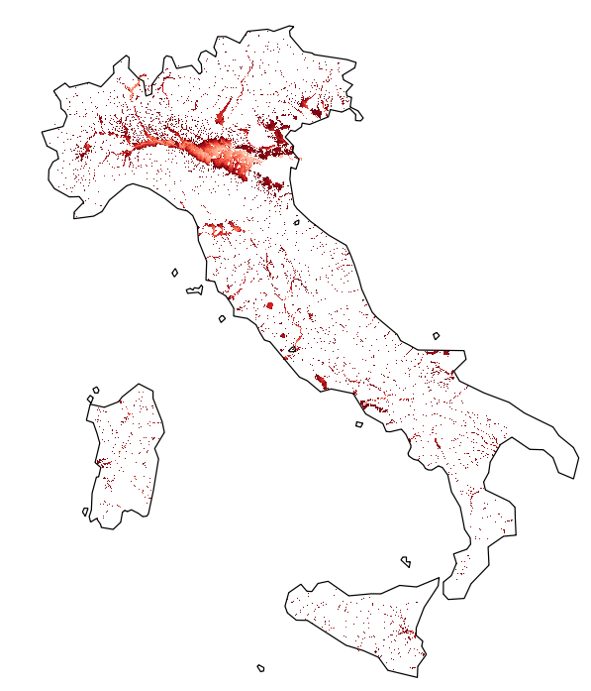

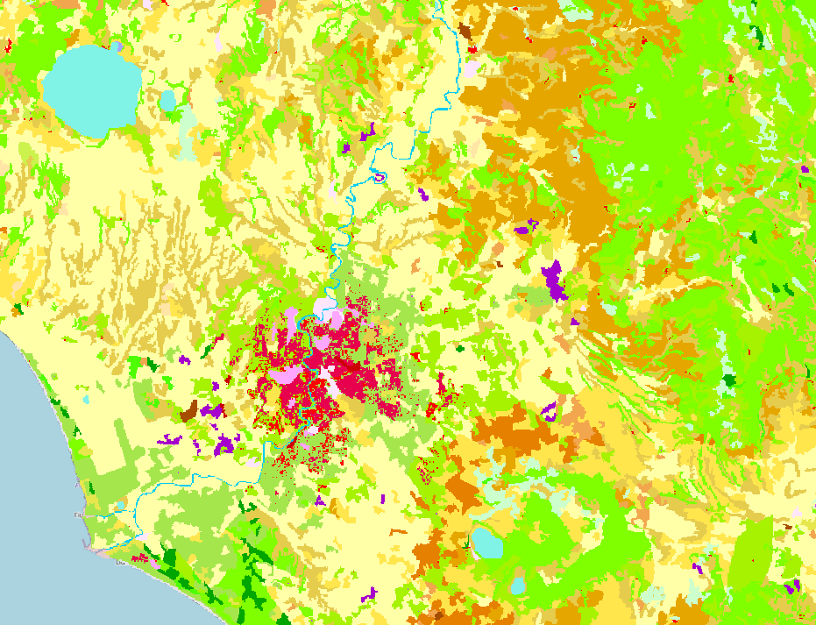
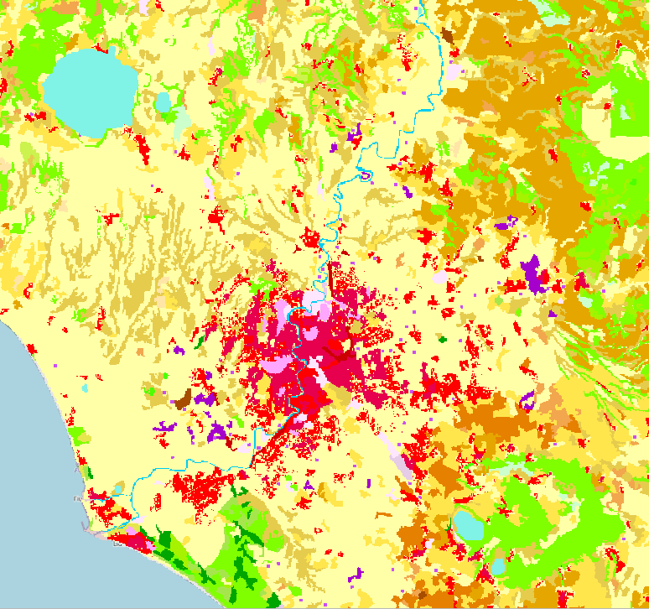
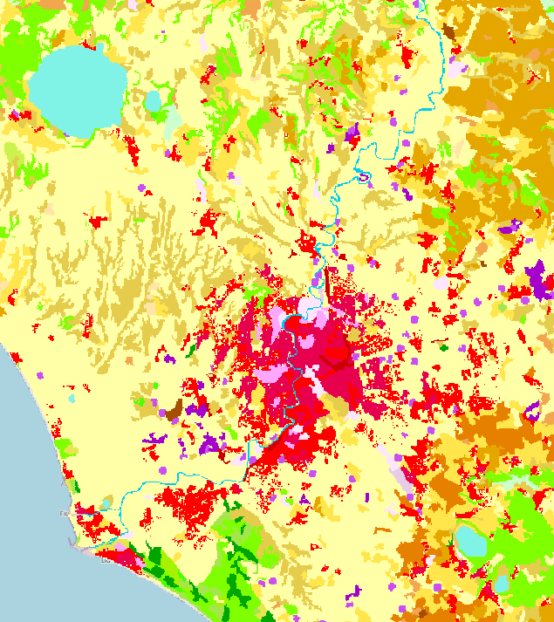
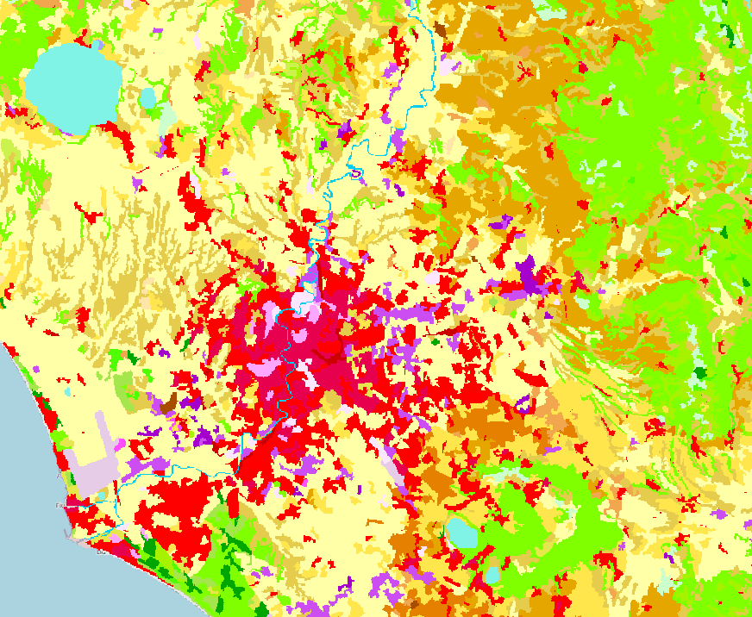
Vienna, Austria & Online | 3-8 May 2026
Can we create a 'portrait' of the history of flood risk in Italy to understand which one is the role of these drivers on flood risk ?
RESCUE Hazard Maps – (Changes in Climate)
Static Vulnerability
PA (Population Affected) is computed by varying one driver at a time against the reference period:
PC (Population Change only):
flood maps fixed at reference period → only population varies → ΔPA from demographic dynamics
CC (Climate Change only):
population fixed at reference period → only flood maps vary → ΔPA from changing hazard
CC + PC (Combined effect):
both population and flood extent vary → captures interaction between drivers
1
0
h (m)
Dynamic exposure (Changes in population)
Paprotny, D., Mengel, M. Population, land use and economic exposure estimates for Europe at 100 m resolution from 1870 to 2020. Scientific Data, 10, 372. https://doi.org/10.1038/s41597-023-02282-0 (2023).
Jones, B., Balk, D., Leyk, S., Montgomery, M., and Engin, H. (2020). Projecting Global Population Grids to 2100: Final Report. European Commission. https://human-settlement.emergency.copernicus.eu/documents/Projecting%20Global%20Population%20Grids%20to%202100.pdf.
1870
2000
2030
2100
PICO | Friday, 08 May, 09:01–09:03 (CEST) - PICO spot 4, PICO 4.13

Slide 4
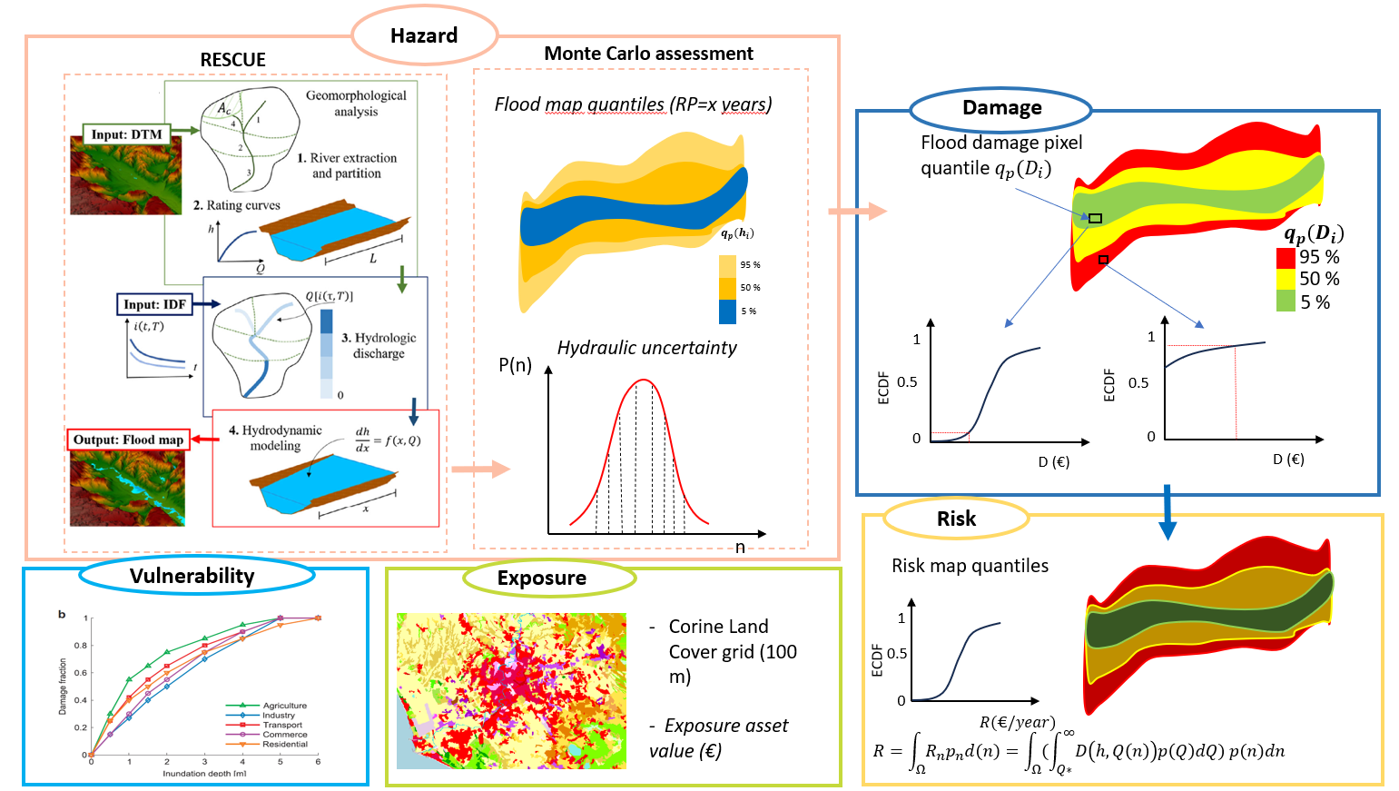
Vienna, Austria & Online | 3-8 May 2026
HAZARD & RISK model: RESCUE – Flood Risk
Pavesi, L., D'Angelo, C., Volpi, E., & Fiori, A. (2022). RESCUE: A geomorphology-based, hydrologic-hydraulic model for large-scale inundation mapping. Journal of Flood Risk Management, 15(4), e12841. https://doi.org/10.1111/jfr3.12841
PICO | Friday, 08 May, 09:01–09:03 (CEST) - PICO spot 4, PICO 4.13

Slide 5
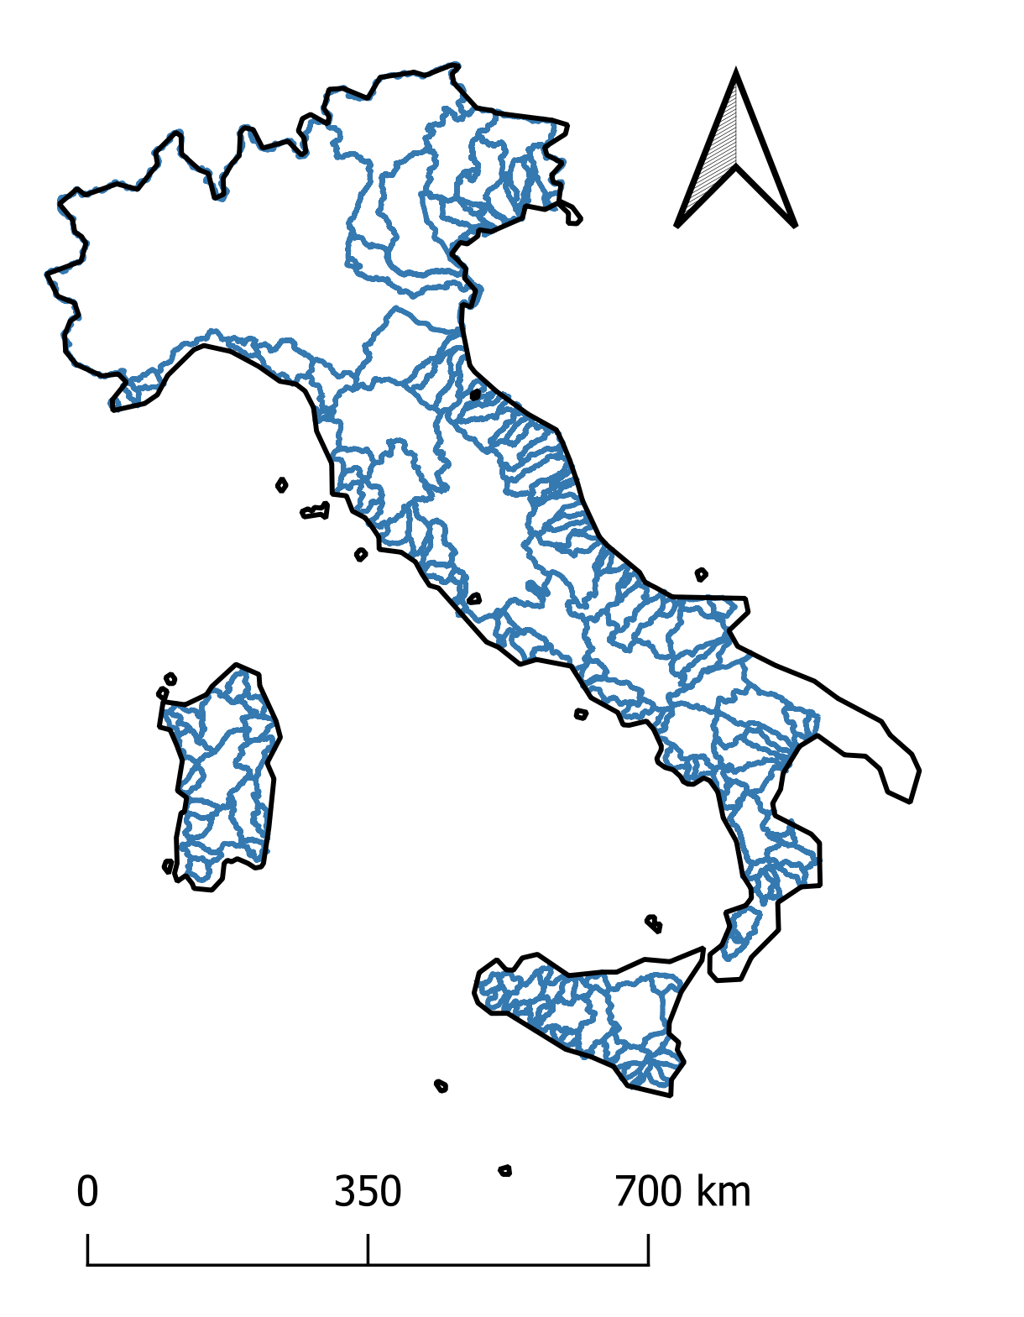
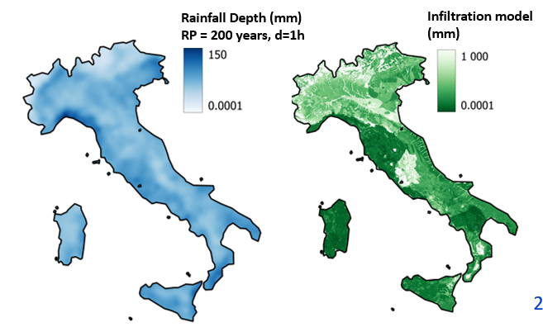
Vienna, Austria & Online | 3-8 May 2026
Hydrological INPUT DATA
Main river basins
Analysis on 137 main Italian watersheds
Medium Probability Hazard (MPH) Scenario (i.e. RP = 200 years)
Rainfall & Infiltration hydrological data given by FOCA dataset
Claps, P., Evangelista, G., Ganora, D., Mazzoglio, P., and Monforte, I.: FOCA: a new quality-controlled database of floods and catchment descriptors in Italy, Earth Syst. Sci. Data, 16, 1503–1522, https://doi.org/10.5194/essd-16-1503-2024, 2024.
PICO | Friday, 08 May, 09:01–09:03 (CEST) - PICO spot 4, PICO 4.13

Slide 6
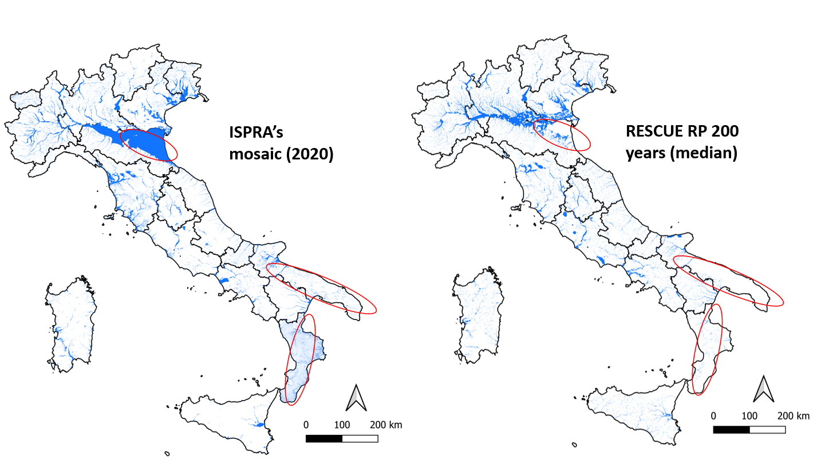
Vienna, Austria & Online | 3-8 May 2026
Validation with Official Flood Maps
PICO | Friday, 08 May, 09:01–09:03 (CEST) - PICO spot 4, PICO 4.13

Slide 7
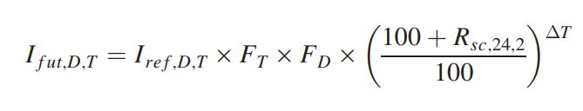
Vienna, Austria & Online | 3-8 May 2026
To simulate future period scenarios we need to understanding how the subdaily extreme rainfall will change in the future – The Changes in Climate are assessed with this formulation:
From General Circulation Models (GCM) provide climate projections and update the input IDF curves of RESCUE
projected future rainfall intensity of duration D and return period T
reference period rainfall intensity of duration D and return period T
i (mm/h)
adjustment factor for return period T > 2 years; (range 1 – 1.5)
adjustment factor for return period D < 24 h; (range 1 – 1.5)
RP 200 y fut. period
rainfall scaling (%/°C) for the 24-h 2-year return period rainfall event
RP 200 y ref. period
1
3
6
12
24
D (h)
projected change in seasonal mean temperature (°C).
Martel, J. L., Brissette, F. P., Lucas-Picher, P., Troin, M., & Arsenault, R. (2021). Climate change and rainfall intensity–duration–frequency curves: Overview of science and guidelines for adaptation. Journal of Hydrologic Engineering, 26(10), 03121001.
PICO | Friday, 08 May, 09:01–09:03 (CEST) - PICO spot 4, PICO 4.13

Slide 8
Vienna, Austria & Online | 3-8 May 2026
Reference period: 1950-2000 (based on FOCA database availability)
PERIODS OF THE ANALYSIS
HISTORICAL PERIOD
REFERENCE PERIOD
NEAR FUTURE
FAR FUTURE
1870 - 1949
1950 - 2000
2001 - 2050
2051 - 2100
Hazard
Hazard
Hazard
Hazard
Flood maps from the climate of reference period
Flood maps from the climate of reference period
Flood maps from the CLIMATE CHANGE MODEL
Flood maps from the CLIMATE CHANGE MODEL
Vulnerability
V = 1 for any given water depth
Vulnerability
V = 1 for any given water depth
Vulnerability
V = 1 for any given water depth
Vulnerability
V = 1 for any given water depth
Exposure
Exposure
Exposure
Exposure
Historical population dataset HANZE 2.0
Historical population dataset HANZE 2.0
Historical population dataset HANZE 2.0
+ GHSL projections
GHSL projections
PICO | Friday, 08 May, 09:01–09:03 (CEST) - PICO spot 4, PICO 4.13

Slide 9
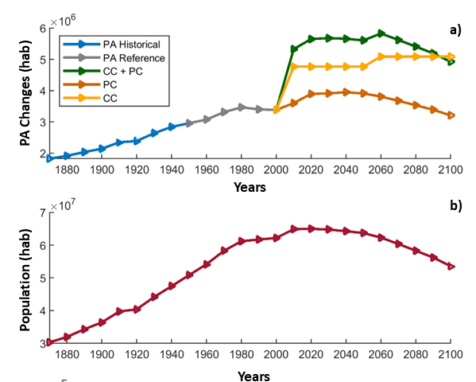
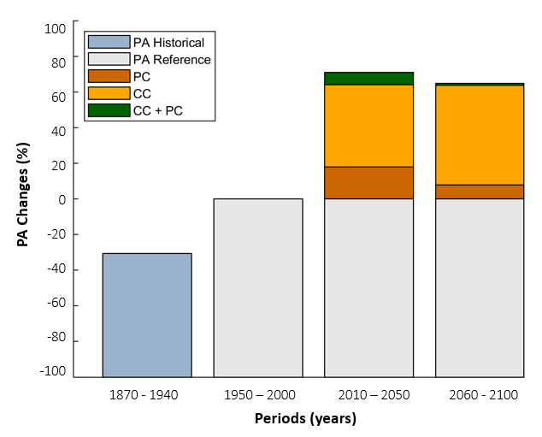
Vienna, Austria & Online | 3-8 May 2026
Main Results: In the past Climate Projection from CMIP6 models explain NO changes in Climate so the main driver is the population growth in flood prone areas but in the future Changes in Climate will became the dominant driver
7 %
1 %
46 %
56 %
18 %
7 %
-31 %
PICO | Friday, 08 May, 09:01–09:03 (CEST) - PICO spot 4, PICO 4.13

Slide 10
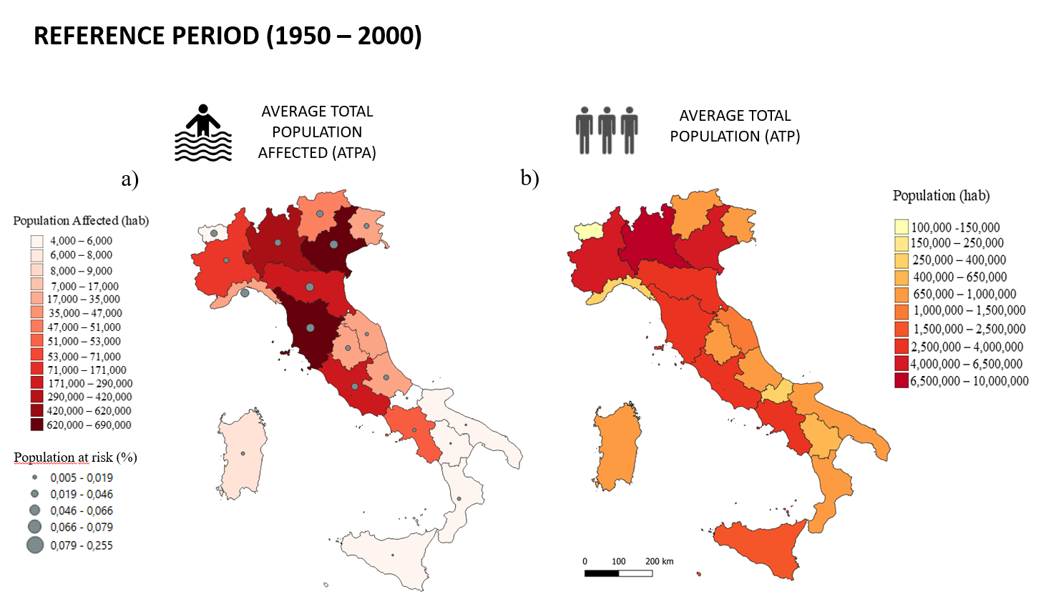
Vienna, Austria & Online | 3-8 May 2026
PICO | Friday, 08 May, 09:01–09:03 (CEST) - PICO spot 4, PICO 4.13

Slide 11
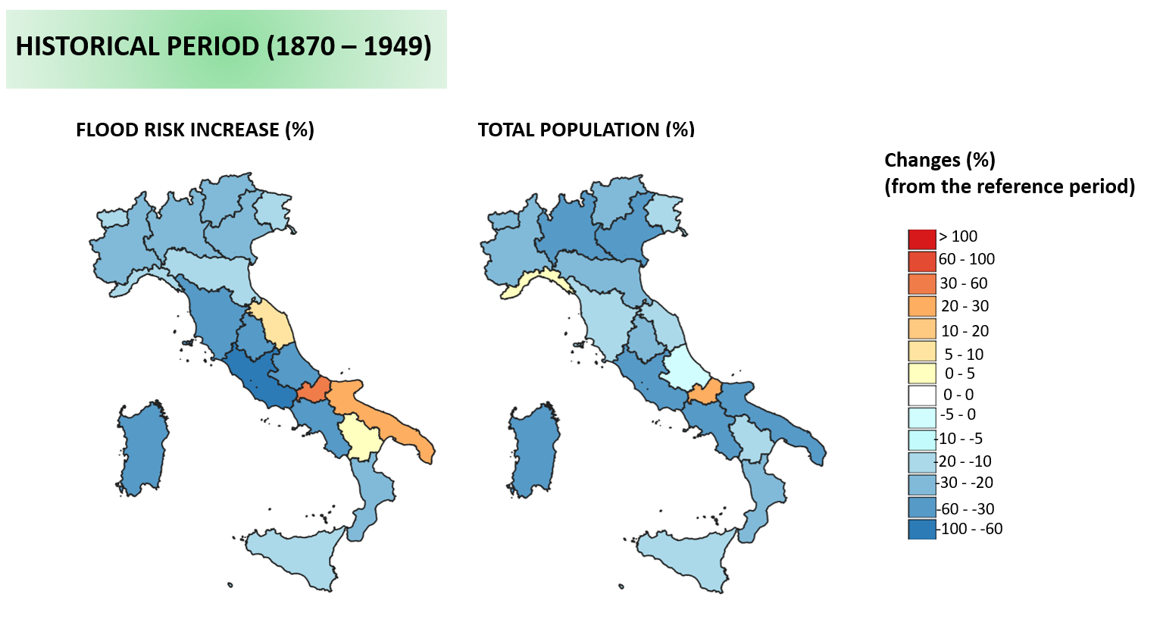
Vienna, Austria & Online | 3-8 May 2026
PICO | Friday, 08 May, 09:01–09:03 (CEST) - PICO spot 4, PICO 4.13

Slide 12
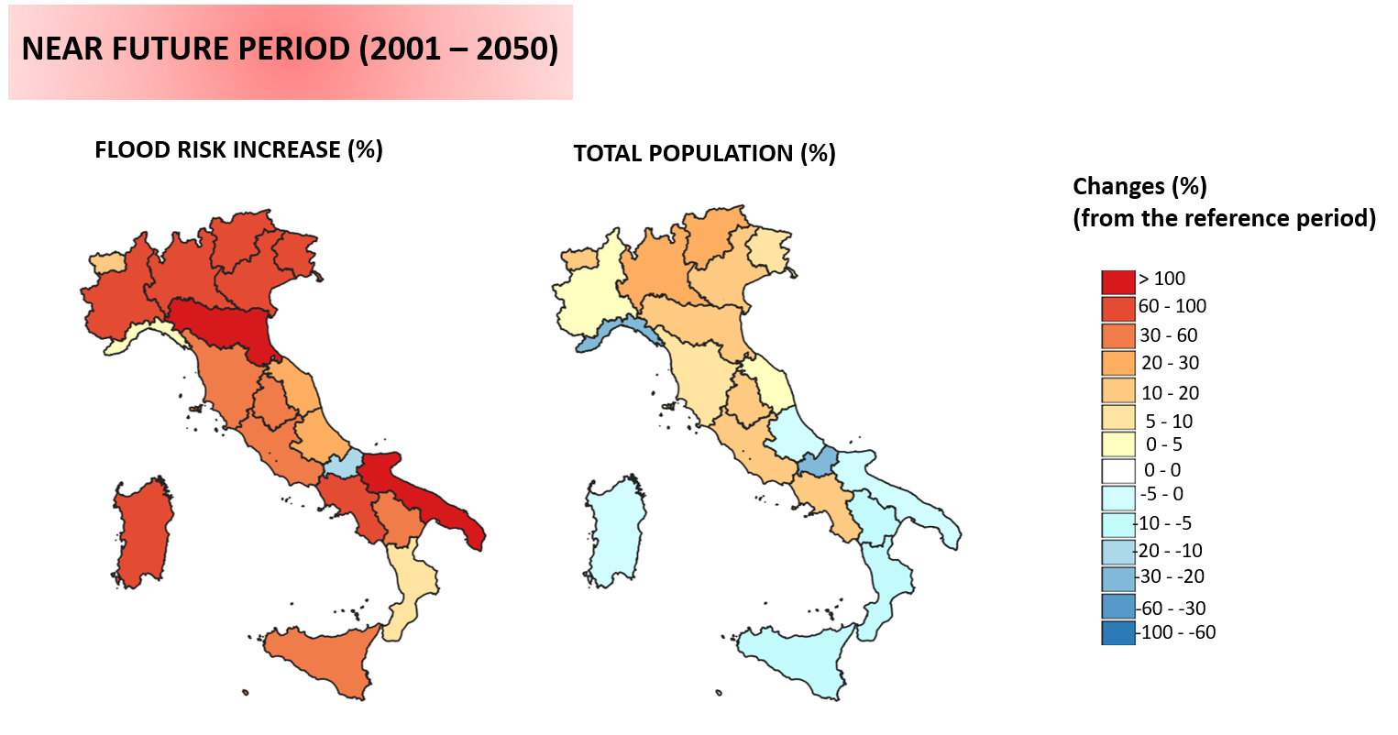
Vienna, Austria & Online | 3-8 May 2026
PICO | Friday, 08 May, 09:01–09:03 (CEST) - PICO spot 4, PICO 4.13

Slide 13
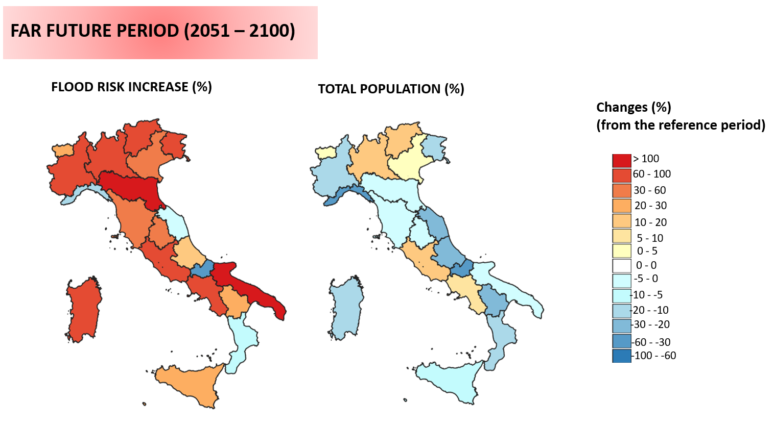
Vienna, Austria & Online | 3-8 May 2026
PICO | Friday, 08 May, 09:01–09:03 (CEST) - PICO spot 4, PICO 4.13

Slide 14
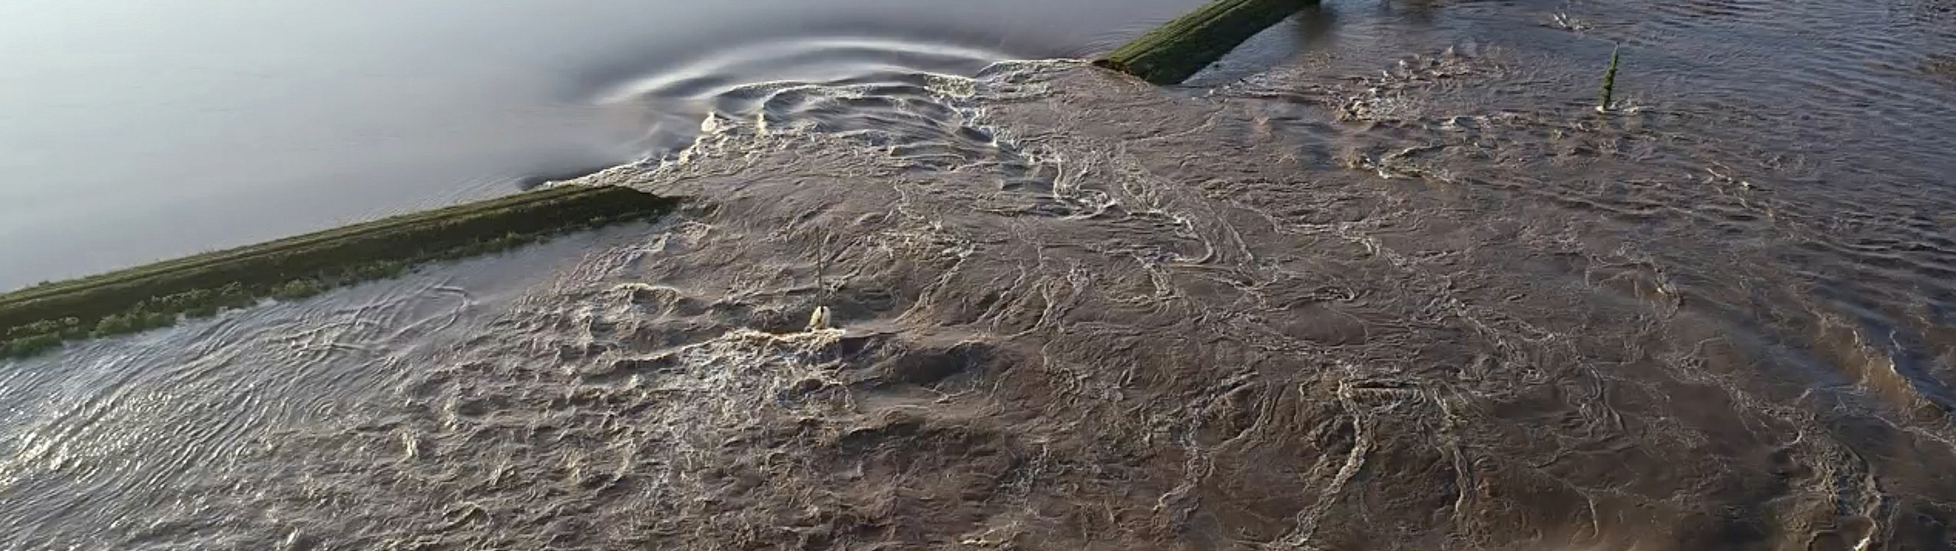
Vienna, Austria & Online | 3-8 May 2026
CONCLUSIONS
DRIVERS OF RISK
NEAR FUTURE (2001-2050) :
CENTER-NORTH ITALY COMBINED EFFECT OF POPULATION GROWTH IN ECONOMIC GROWTH AREAS AND CLIMATE CHANGE EFFECT
ISLANDS - SOUTHERN ITALY : CLIMATE CHANGE IS THE MAIN CAUSE OF A GROWING RISK
DRIVERS OF RISK
PAST (1870-1949):
SMALLER POPULATION (LESS RISK)
&
POPULATION CONCENTRATED IN RURAL AREAS AND NOT IN CITIES
DRIVERS OF RISK
FAR FUTURE (2051-2100):
CLIMATE CHANGE IS THE MAIN CAUSE OF GROWING RISK IN ITALY
ITALY NEEDS TO INVEST IN CLIMATE CHANGE ADAPTATION
Pavesi L., Salinas Jose Luis, Zanardo Stefano, Sassi Maximiliano, Hilbert Arno, Volpi Elena, Fiori Aldo: The portrait of flood risk in Italy: Past, present and future, from 1870 to 2100 (2026). Geophysical Research Letters (under review)
PICO | Friday, 08 May, 09:01–09:03 (CEST) - PICO spot 4, PICO 4.13

