Slide 1
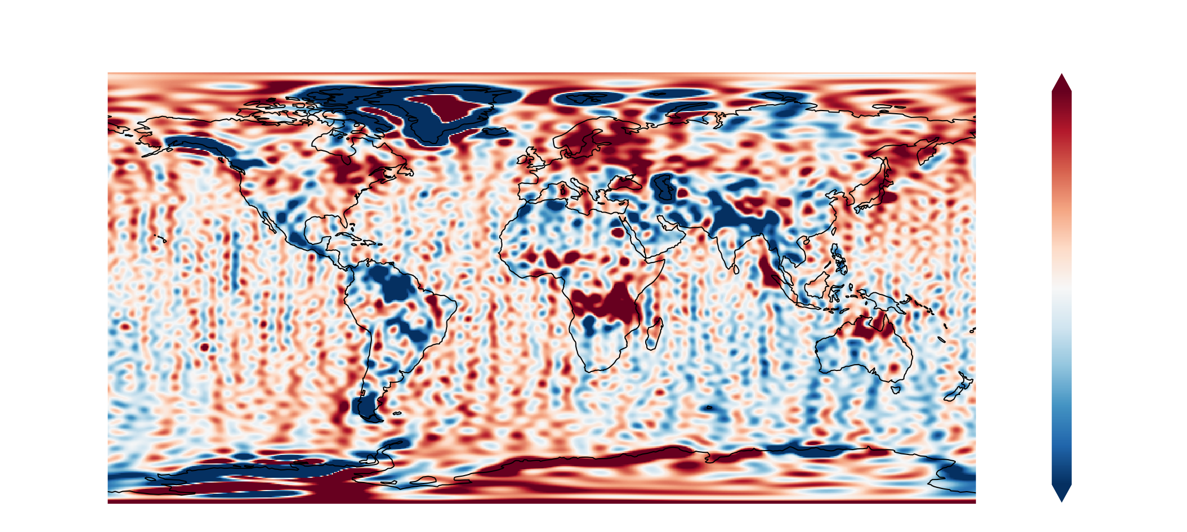
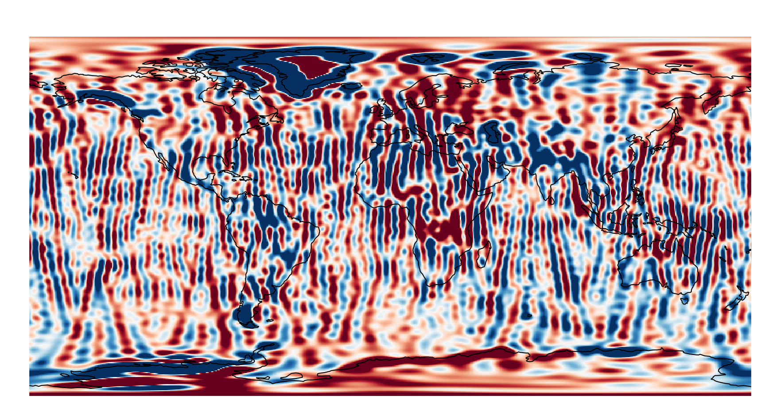

A new approach to tackling stripes in gravity field solutions using directional gradient regularization

Slide 2
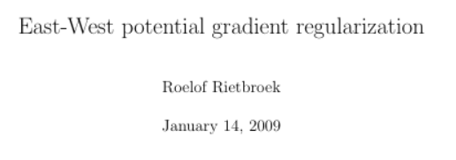
Reviving an ‘old’ Idea
Yet another filter?
Gaussian
Swenson-Wahr
Anisotropic DDK (Kusche et al. 2009)
Using time-variable regularization with full error-covariance (e.g. Horvath et al. 2018)
This talk: isotropic constraint → anisotropic constraint (east-west/north-south gradient supression)
Found an old latex doc..

Slide 3
From diagonal to block-diagonal regularization
Diagonal → Block-diagonal regularization
Full normal equation systems from ITSG GRACE/GRACEFO, nmax=96
Selection: 4 specific good/bad months, in terms of condition number, for GRACE and GRACEFO resp.)

Slide 4
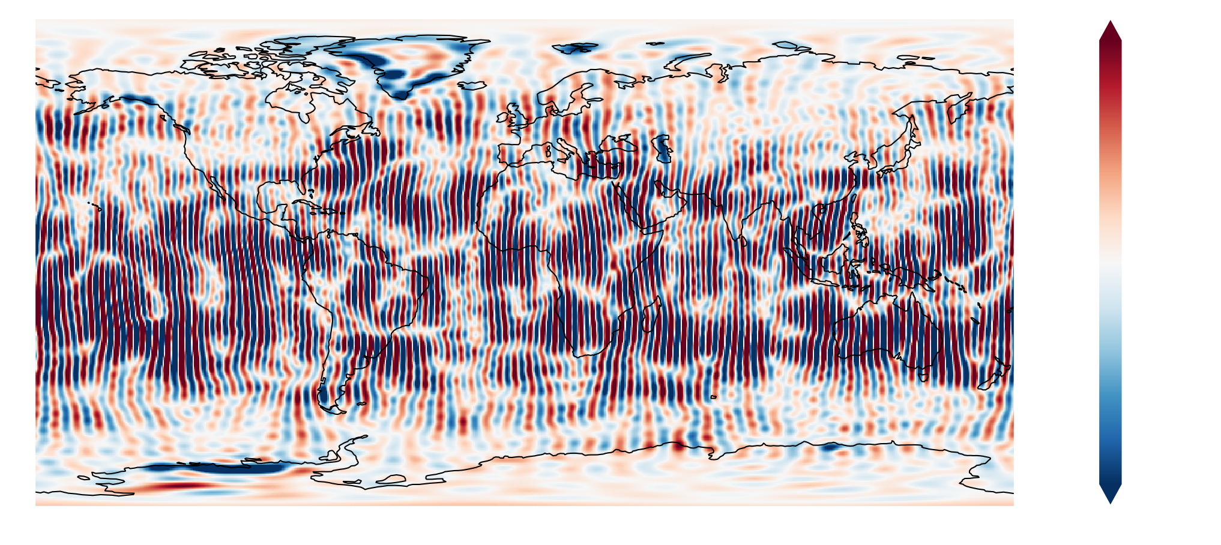
Ironing (minimizing) wrinkles
Constrain mean power of potential *gradients*

Slide 5
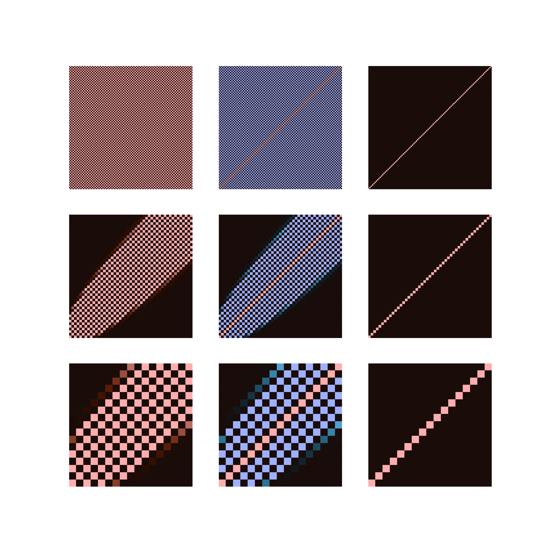
Constrain horizontal gradients
Order (m) blocks at 450km height
Power of horizontal gradient at orbit height
East-West
North-South
Diagonal regularization
Matrix ~ n*(n+1)
Vector of
Stokes coefficients
Block diagonal checkerboard matrices

Slide 6
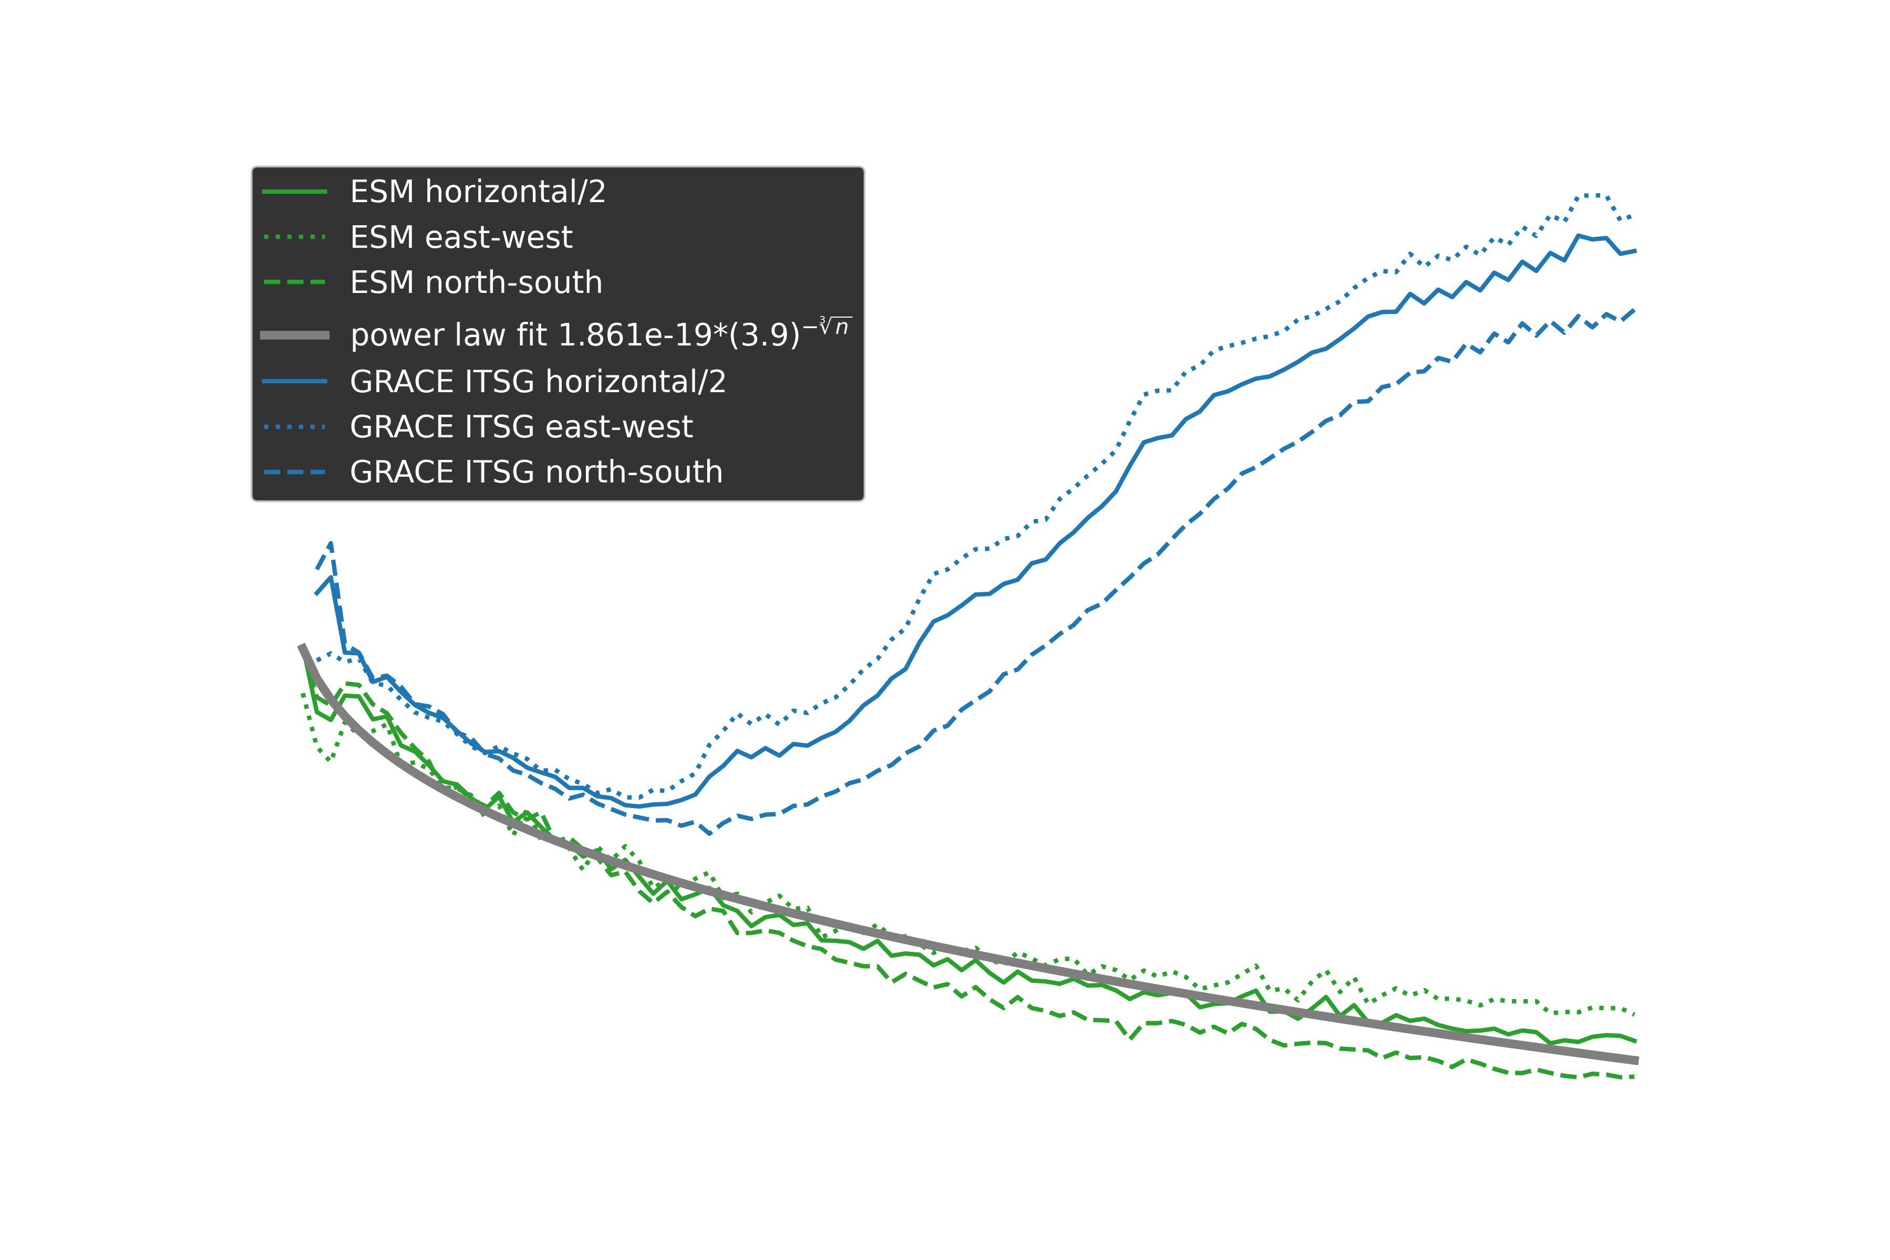
Degree weighing of gradients
Compute (degree) gradient powers
Fit a cubic curve to non-seasonal atmo+hydro+ocean+ice from Earth System Model (Dobslaw et al)
Use as (inverse) degree weighing:

Slide 7
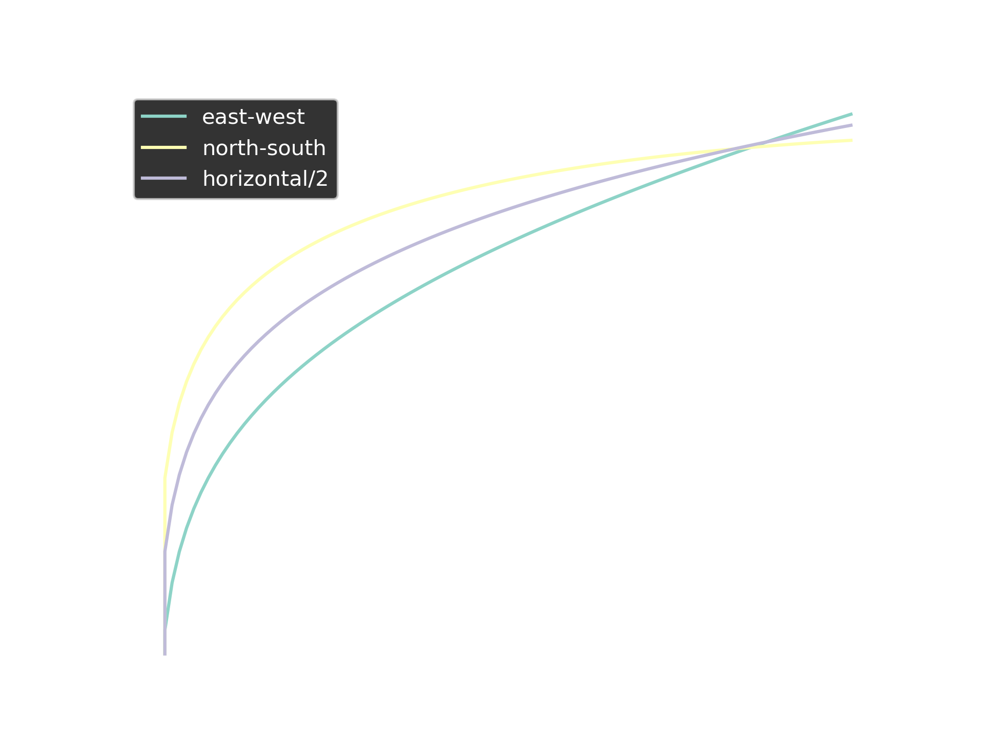
Further adaptions
Allow relative degree wise weighing
→ Different upward continuation for EW and NS
Overall (alpha)/relative (beta) weighing ES and NS gradients
hns=550km
hnom=450km
hew=350km

Slide 8
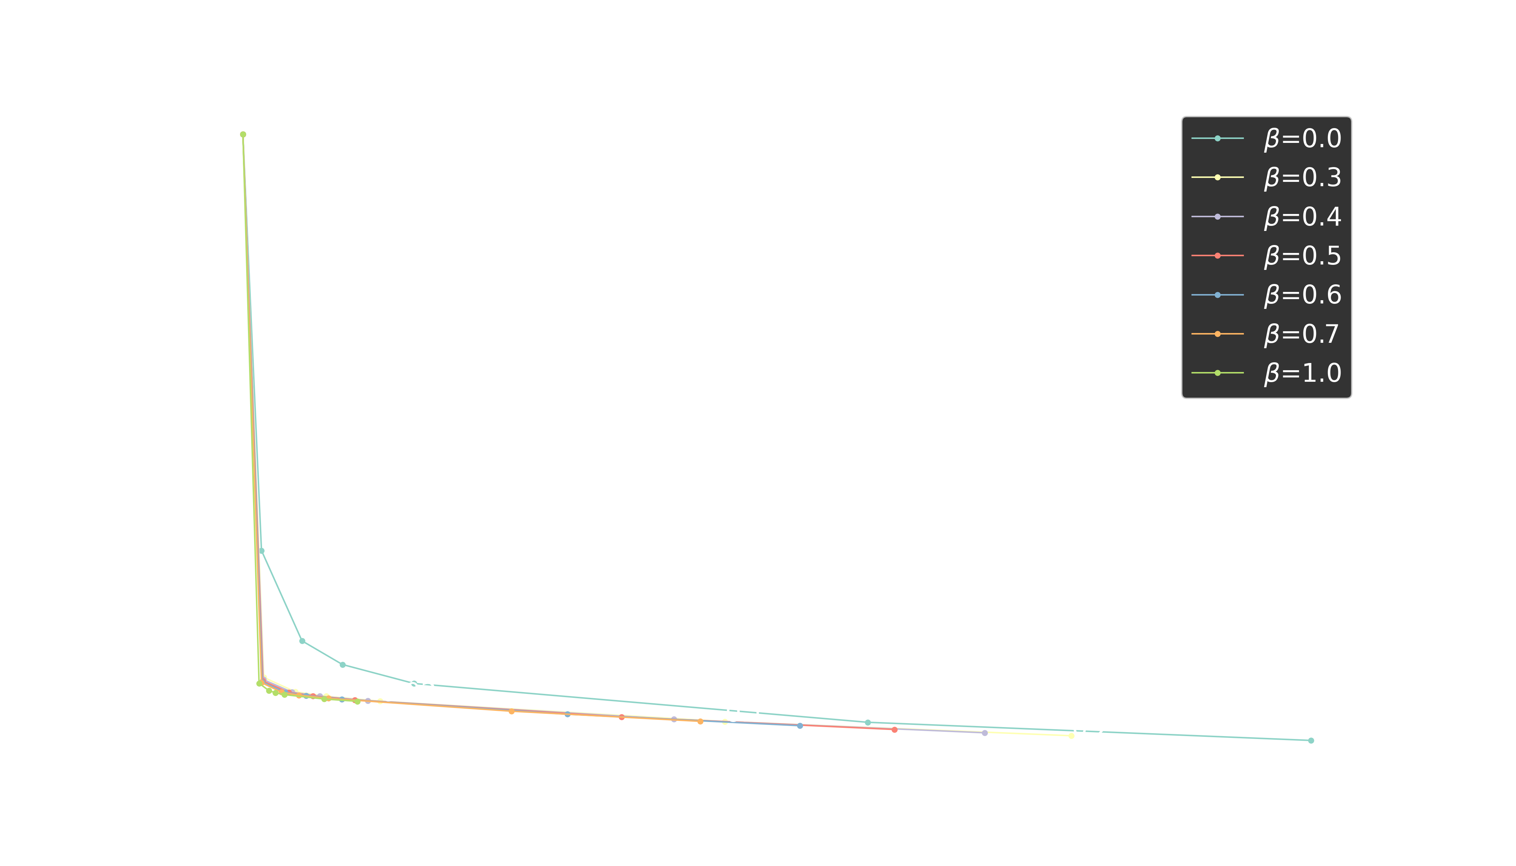
Find ‘optimal’ weighing
100% North-South
100% East-West
Corner: compromise between
Bias wrt observations (larger LtPL) &
norm of solution vector
α?

Slide 9
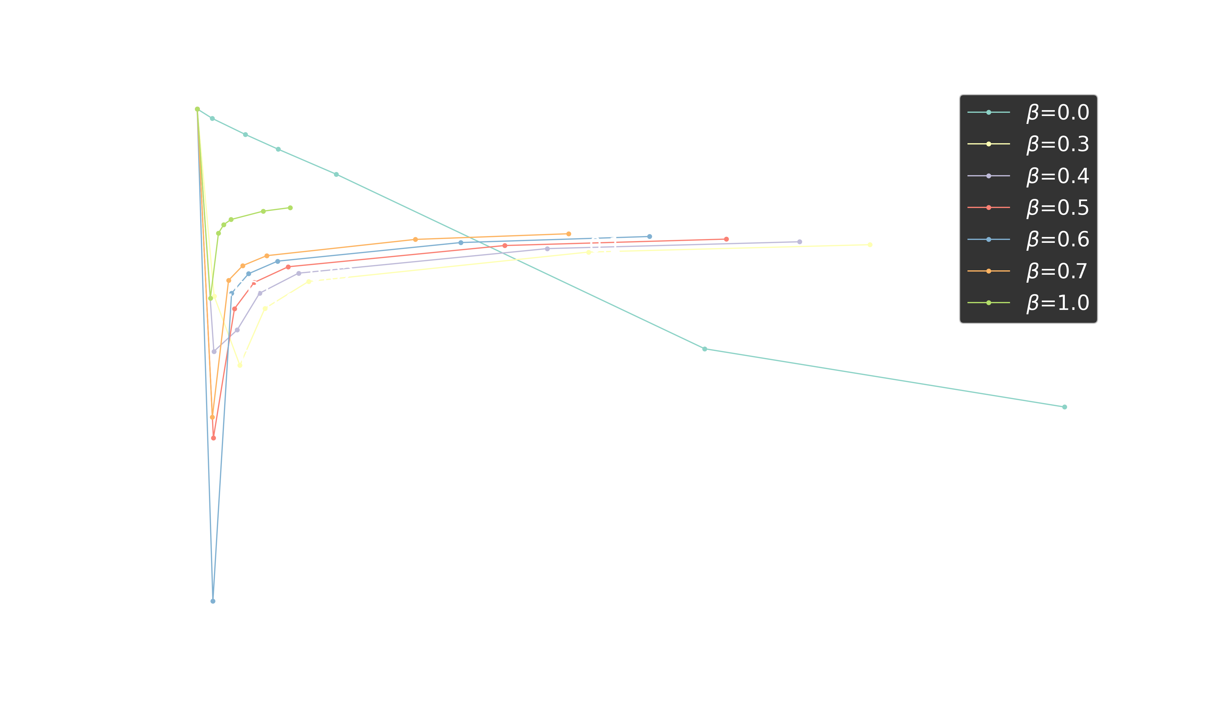
Gradient ratio L-curve
Stripes (either
EW or NS dominant)
Similar power in EW and NS
100% North-South
100% East-West
No optimimum for pure NS reg.
Horizontal (!) stripes for pure EW reg.
Beta=0.3 stays lower for widest range of alpha

Slide 10
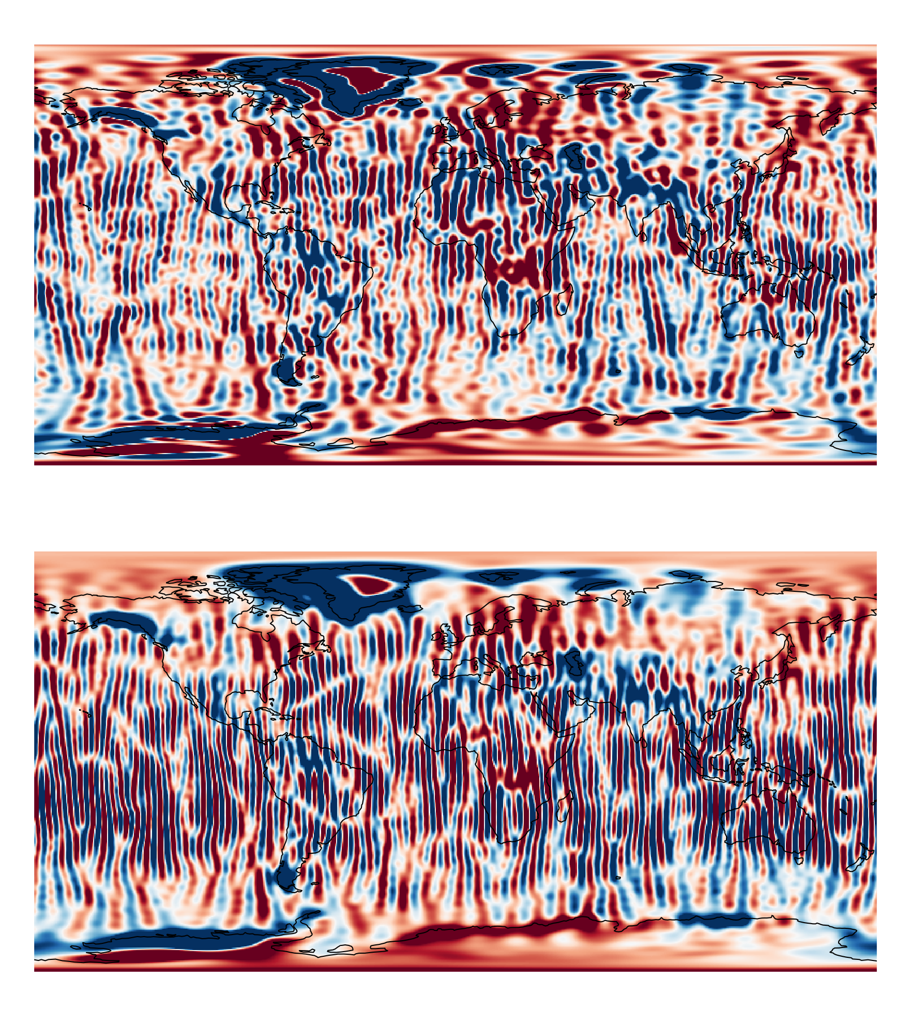
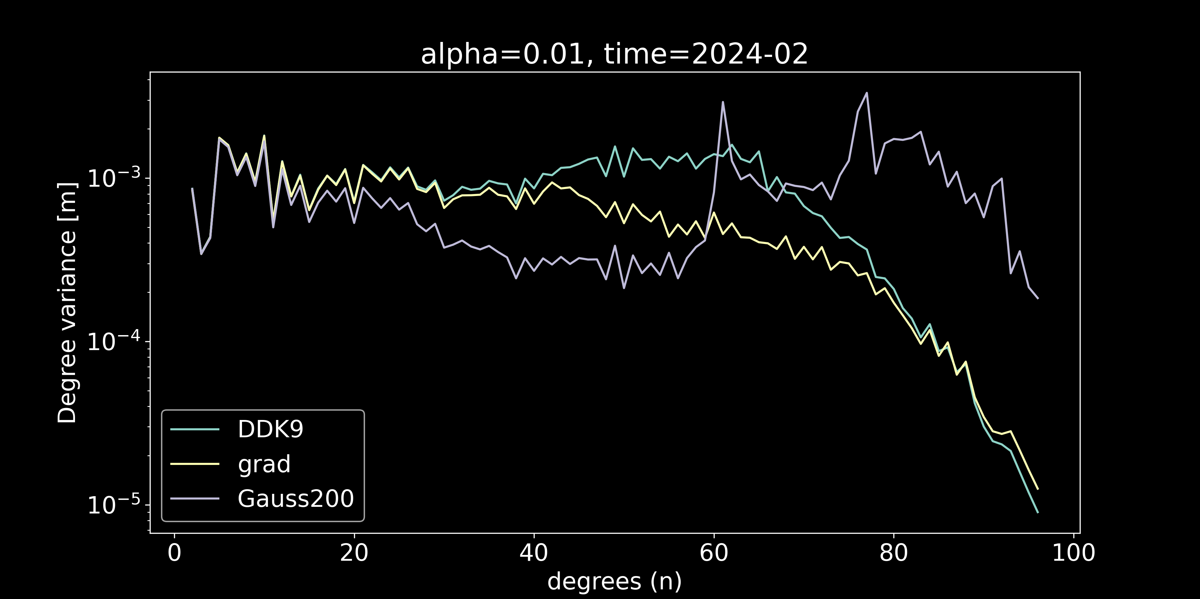
Effect on Terrestrial water storage
TWS degree variance
DDK9: Too much power
in midrange
Gauss: Too much/too little damping
in low/high range
Grad regularization:
Monotonic decline

Slide 11
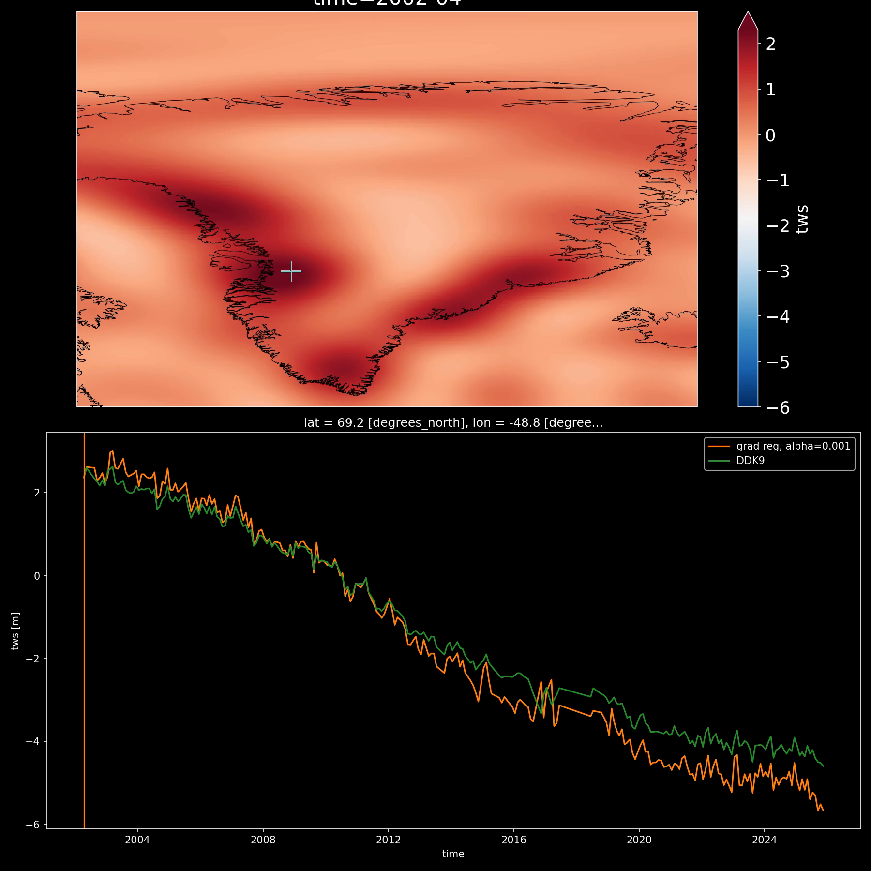
Ilulissat Glacier Example
Large signal → permit even lower regularization strength (alpha=1e-3)
Regularization shows potential for retrieval of stronger trends
Spatial anomalies centered on Ilulissat/other glacier locations

Slide 12




Conclusions/Outlook
North-South and East-West potential gradient regularization → block diagonal checkerboard regularization matrices
Use power law obtained from ESM Earth System Model to describe degree varying
Both North-South and East-west constraint needed (N-S constraint needs to be stronger than E-W)
Regularization results in monotonic decline of TWS signal degree variance compared to DDK9/Gaussian (200km halfwidth), with comparable resolution
Some cases may permit even weaker regularization (e.g. high latitude glacier change)
Manuscript in prep., code is/will be part of:
https://github.com/strawpants/xinv
https://github.com/ITC-Water-Resources/shxarray

Slide 13
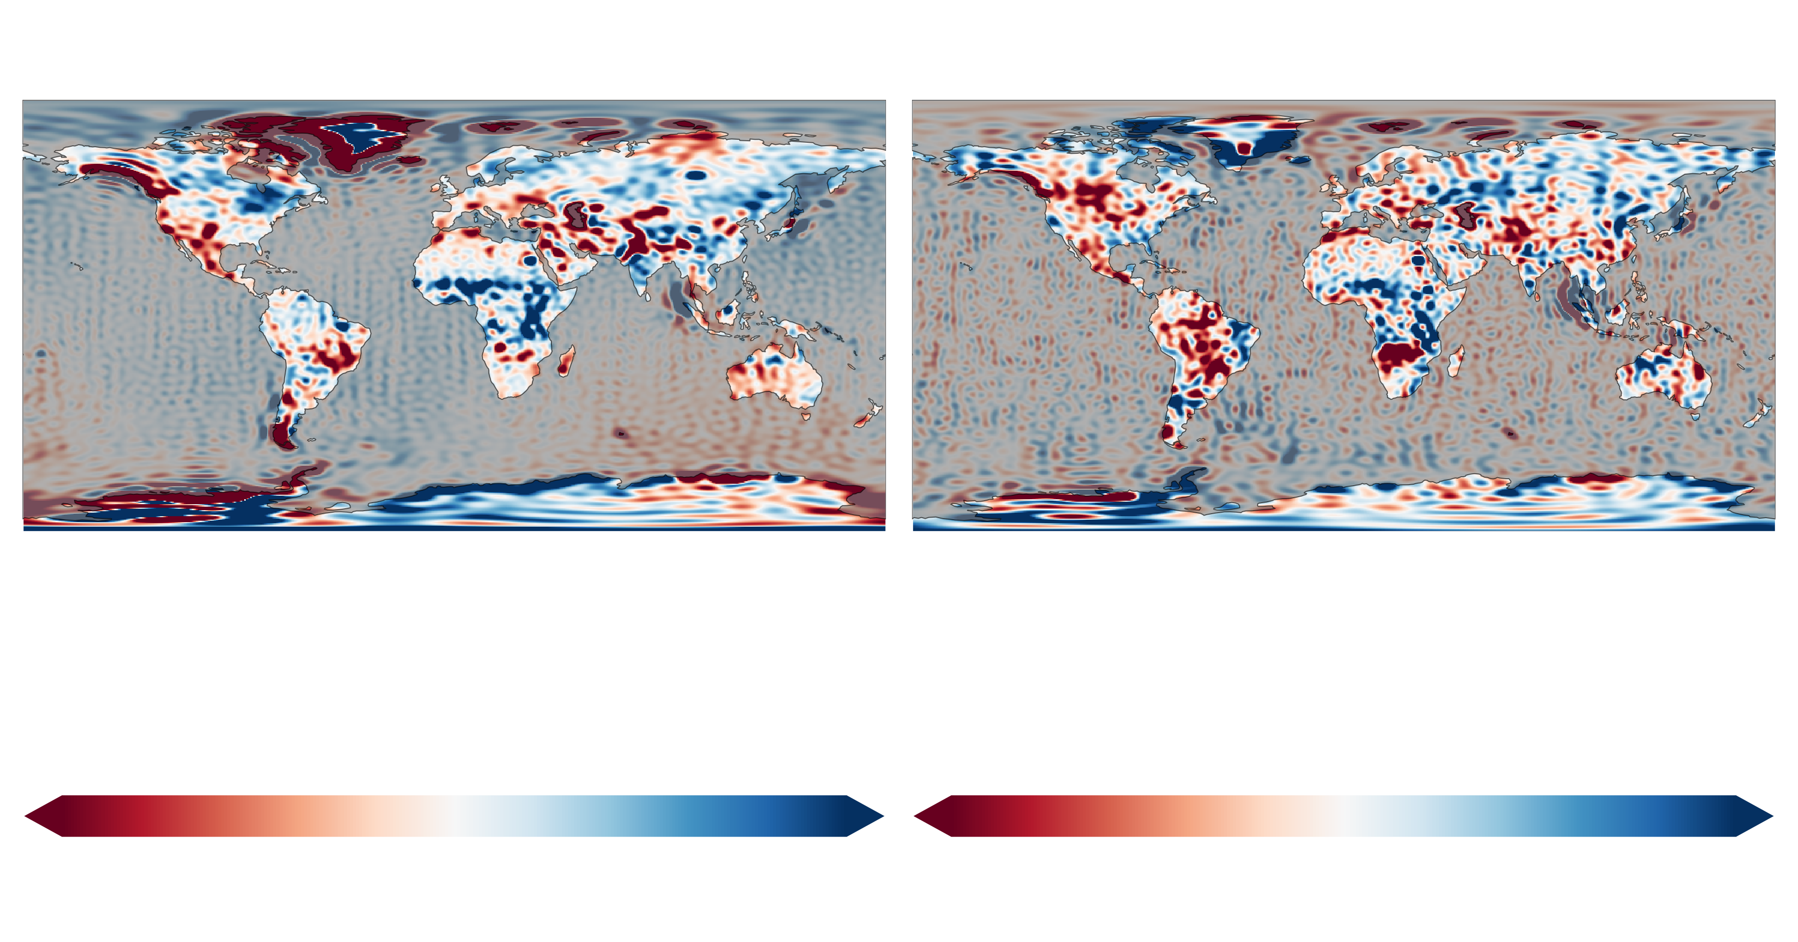
Bonus!

