Slide 1
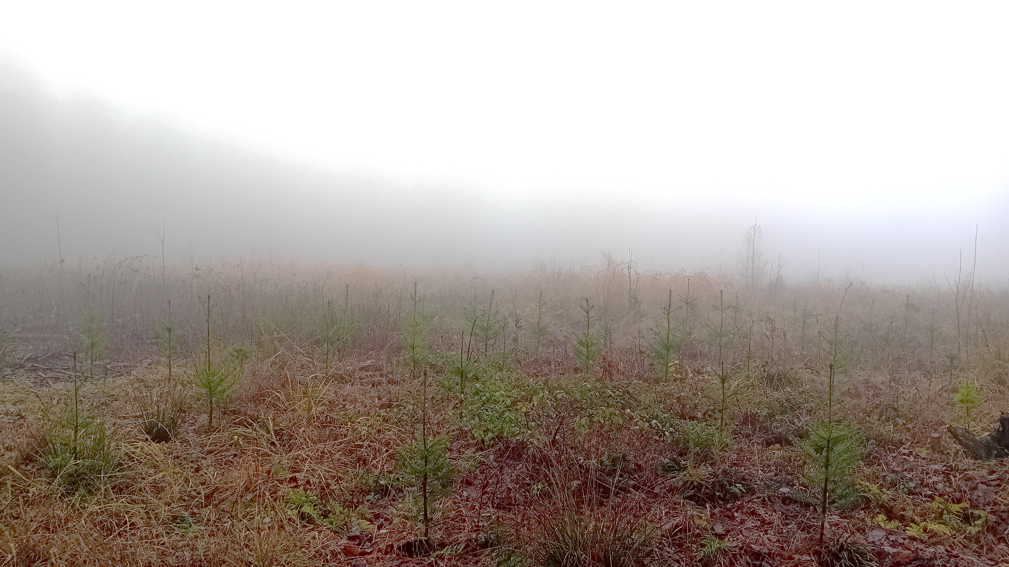
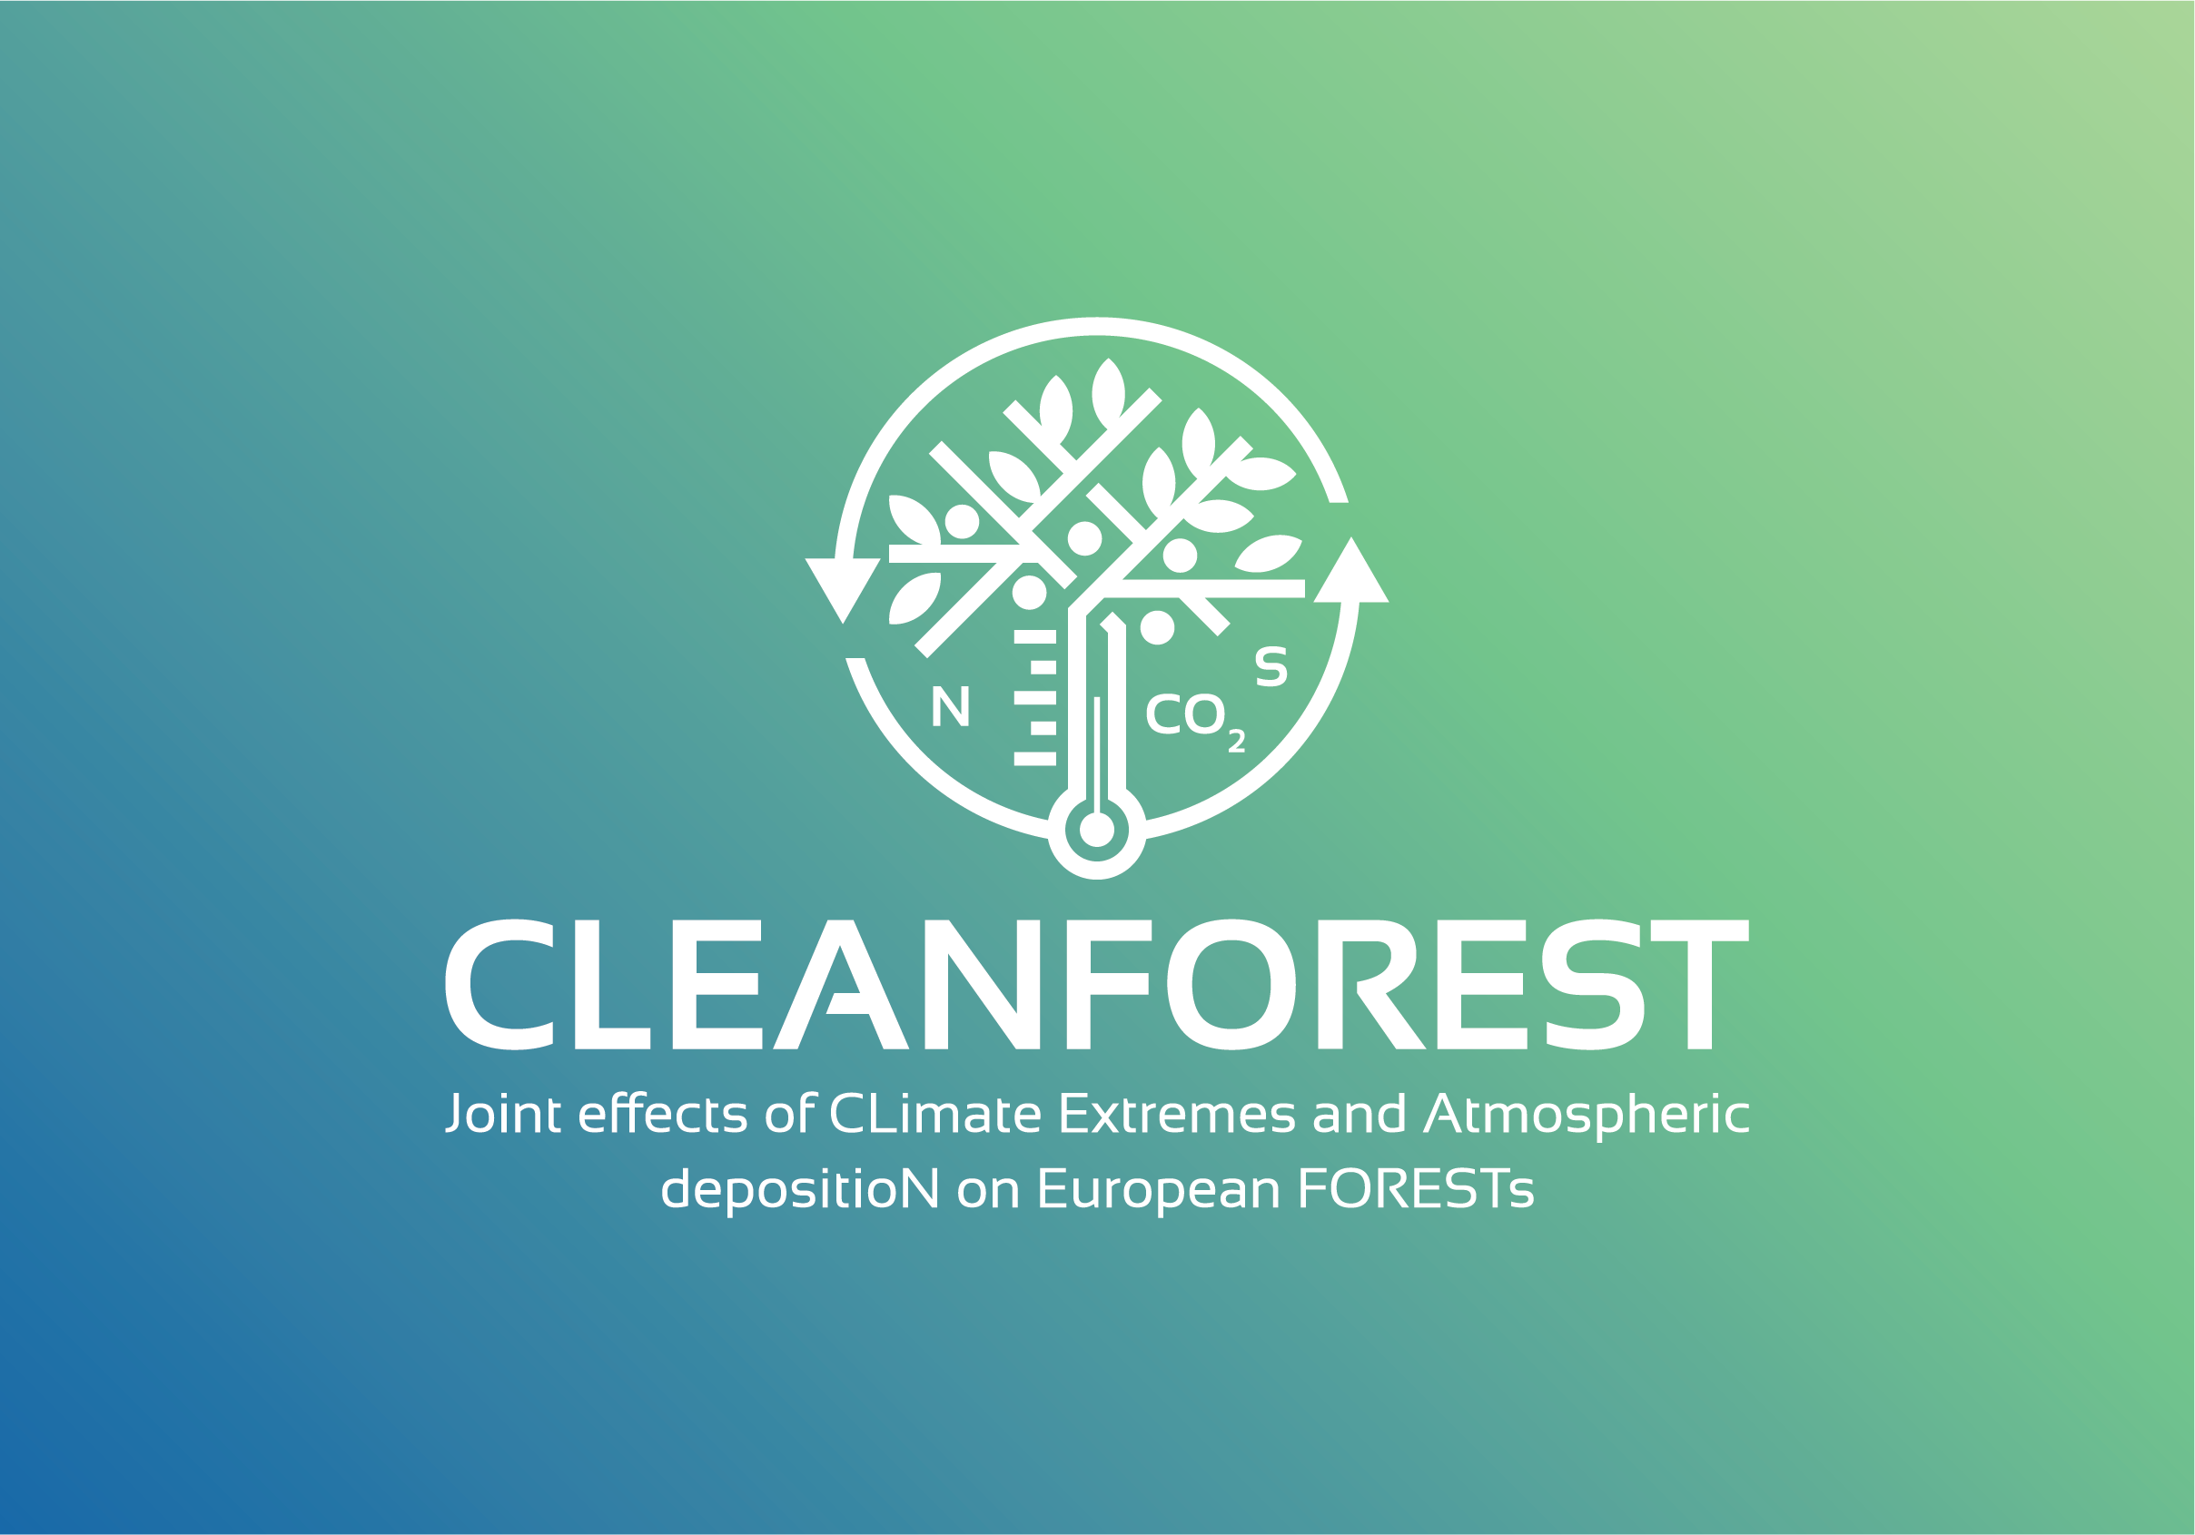


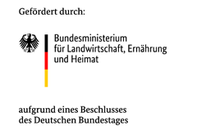


This PICO is based upon work from COST Action CA21138 (CLEANFOREST) “Joint effects of CLimate Extremes and Atmospheric depositioN
on European FORESTs”, supported by COST (European Cooperation in Science and Technology).
Towards a better understanding of tree seedling establishment and its use for forest rejuvenation in Central European forests
PICO4.12
Timo Busse, Frederic Krieger, Fabian Weikl, Benjamin D. Hafner, Astor Toraño Caicoya, Richard L. Peters, Thorsten E. E. Grams
TUM School of Life Sciences, Technical University of Munich
Which fine-scale site conditions enable
tree seedlings to establish?

Slide 2
This PICO is based upon work from COST Action CA21138 (CLEANFOREST) “Joint effects of CLimate Extremes and Atmospheric depositioN
on European FORESTs”, supported by COST (European Cooperation in Science and Technology).
Understanding of tree seedling establishment for forest rejuvenation in CE forests
PICO4.12
Timo Busse et al. (TU Munich)
Over 500 million € are being spent to rejuvenate forests
in Germany from 2024 to 2028^{[1]}.
Up to 80 % of tree seedlings die within the first year after planting
on extreme sites^{[2]}.
What can we do?
[1]: Schulz (2024) – Half a billion euros to flow into Germany‘s forests – euractiv, accessed 01.05.2026 https://www.euractiv.com/news/half-a-billion-euros-to-flow-into-germanys-forests/
[2]: BaySF (2024) – Oral communication with forest workers

Slide 3
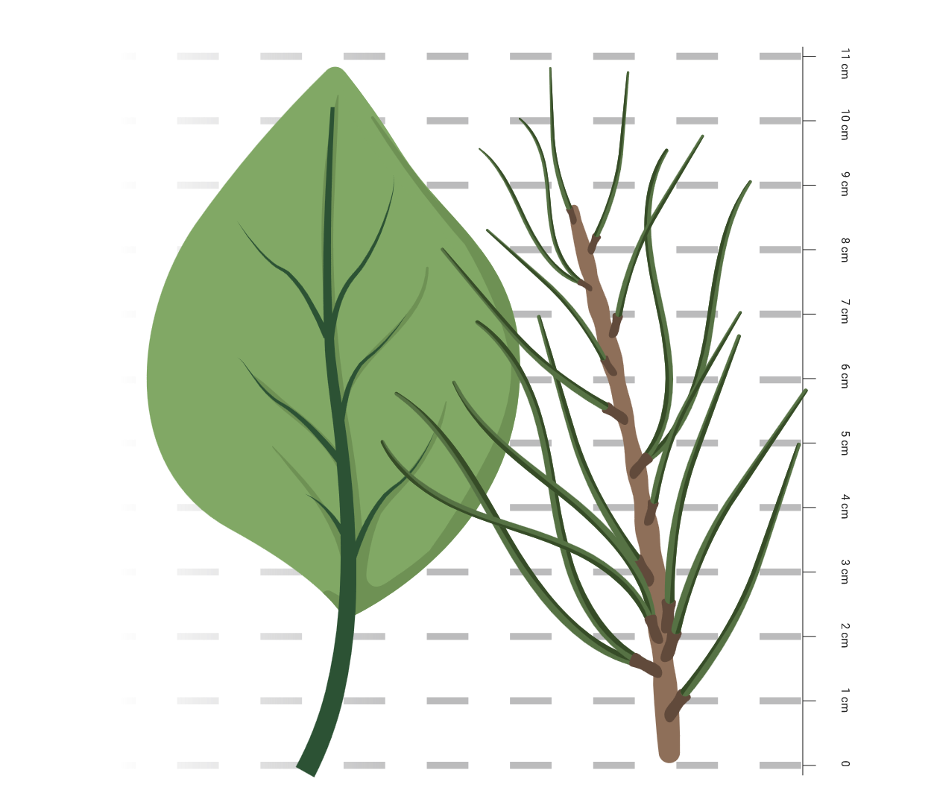
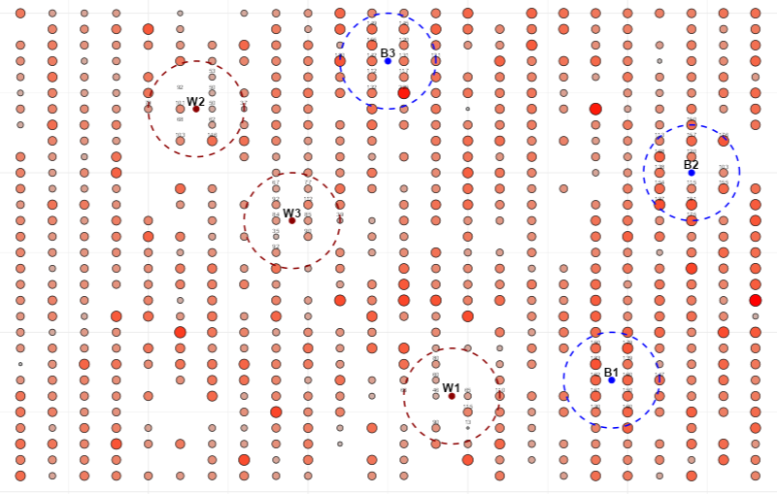
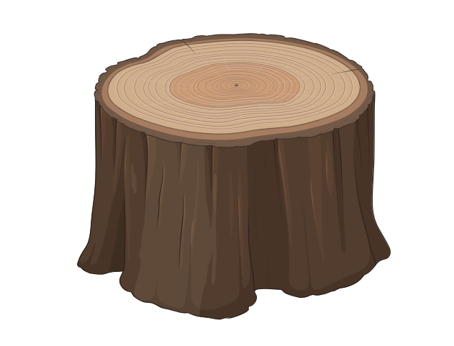


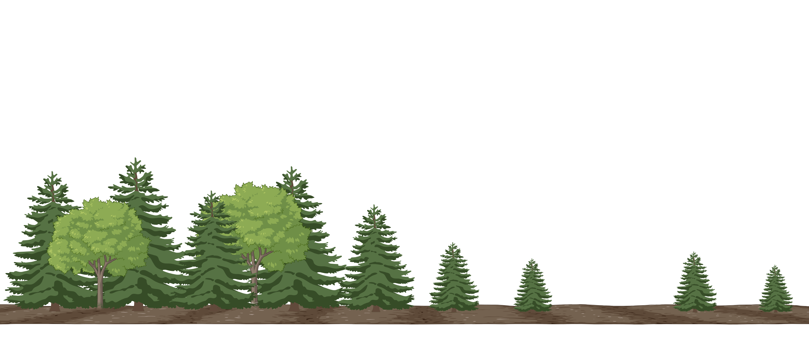

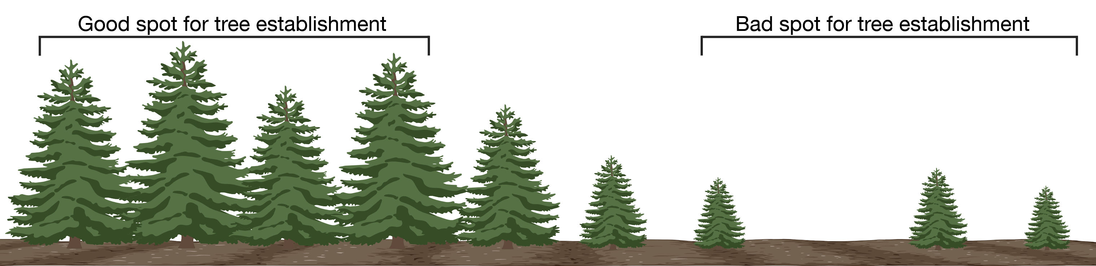



This PICO is based upon work from COST Action CA21138 (CLEANFOREST) “Joint effects of CLimate Extremes and Atmospheric depositioN
on European FORESTs”, supported by COST (European Cooperation in Science and Technology).
Understanding of tree seedling establishment for forest rejuvenation in CE forests
PICO4.12
Timo Busse et al. (TU Munich)
¹³C

Slide 4
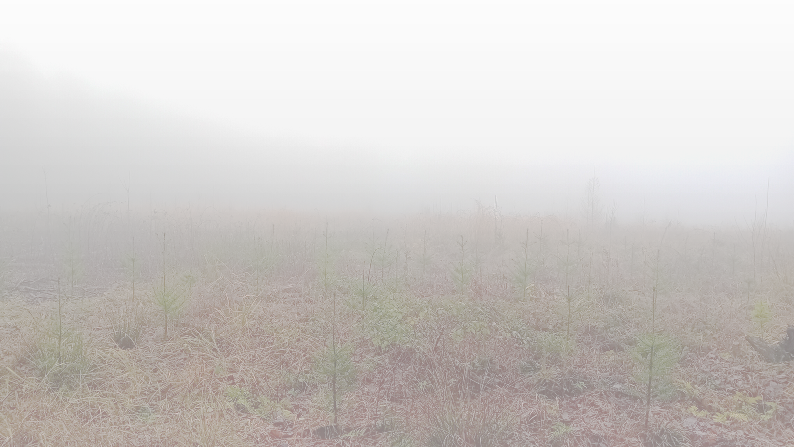
This PICO is based upon work from COST Action CA21138 (CLEANFOREST) “Joint effects of CLimate Extremes and Atmospheric depositioN
on European FORESTs”, supported by COST (European Cooperation in Science and Technology).
Towards a better understanding of tree seedling establishment and its use for forest rejuvenation in Central European forests
Timo Busse, Frederic Krieger, Fabian Weikl, Benjamin D. Hafner, Astor Toraño Caicoya, Richard L. Peters, Thorsten E. E. Grams
TUM School of Life Sciences, Technical University of Munich
Overview
Hotspots of tree seedling establishment
First results of a case study
This Button takes
you to the overview
of the sections
The Arrows bring
you to the next or
previous slide
Complementary experiment
Crosslinks are marked with
this color
Conclusion and Outlook

Slide 5
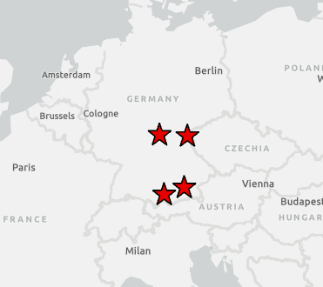
Hotspots of tree seedling establishment
Sites
We are using an established, large-scale experiment involving over 500,000 tree seedlings in Central Europe. The tree species of interest are F. sylvatica, P. menziesii, A. alba and Q. petraea.
Two-year-old tree seedlings were planted in rows of 1 m x 2 m from 2017 to 2022. Each experimental plot comprises 720 individuals
(30 rows, 24 columns) and is defined as an experimental unit.
coordinate central
europe
Hotspot – App
Using the Shiny package in R, we programmed an app that generates circles with a radius of variable diameter, maximising or minimising the mean height of the seedlings within each circle, respectively. We currently plan to implement a function that restricts the search for hotspots and coldspots of seedling establishment to areas with similar levels of sunlight.
Stars indicate the locations of the already existing
experiment (blue = the experimental site picked
for the case study presented here, red = other
experimental sites)

Slide 6
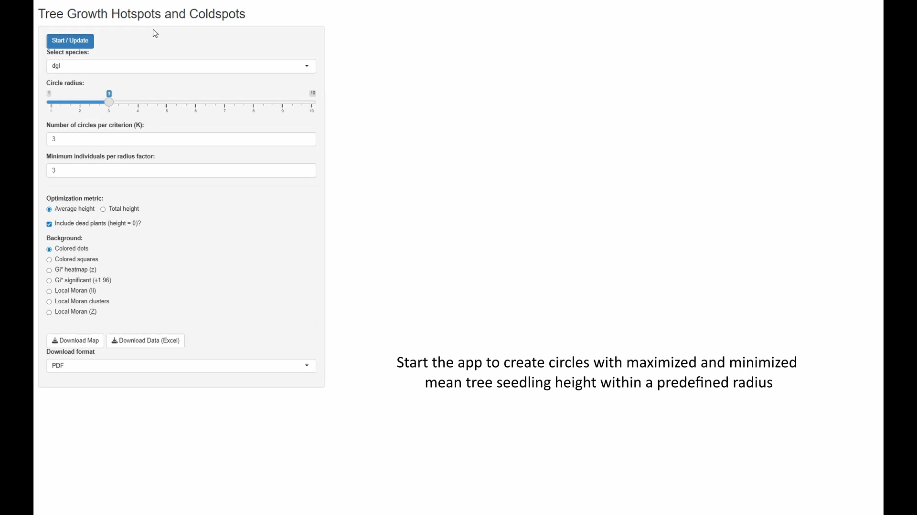
Hotspots of tree seedling establishment

Slide 7
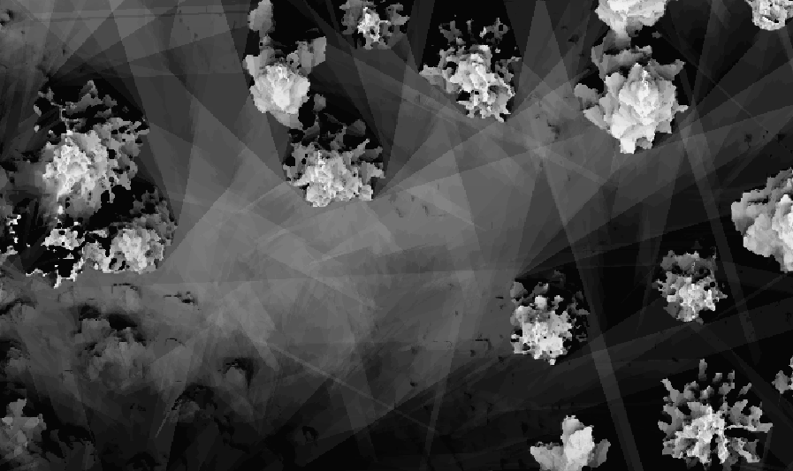
Hotspots of tree seedling establishment
Light correction
To control for variations in light intensity due to overstory density, we first create a digital surface model (DSM) for each experimental plot. This is based on a 3D point cloud derived from near-infrared (NIR) imaging from UAV flights. Using the RGrass package in R, we then approximate the amount of light received by each seedling at its respective position throughout the vegetation period. We then check for a relationship between seedling height and sun radiation exposure. We are currently developing a new version of the app to restrict hotspots and coldspots for seedling establishment to similar light conditions.
Map of a site with sparse overstory (tree crowns visible) and
estimated total incoming global radiation throughout the
vegetation period;
bright pixels indicate high radiation sums (kWh m⁻²),
dark pixels indicate low sums

Slide 8
Site selection and Hypotheses
Site selection
In an initial case study using an earlier version of
the app, we examined a plot of 720 Douglas fir trees
planted in 2022 on a relatively dry site in northern
Bavaria. The area lacks overstory due to a bark
beetle outbreak. We measured the height of each
seedling manually and then identified the three best
and three worst circles based on mean seedling height.
n = 10
n = 14
n = 10
n = 10
n = 9
n = 13
Hypotheses
The difference in height between the trees
is caused by different levels of
  competition with natural abundant trees
  drought stress they experience
The circles with the highest average tree
height do also show a higher number of
tree stumps in close spatial proximity
compared to the circles with the lowest
average height
Boxplots of tree seedling height by circle, from best (B1) to worst (W1), n = number of living trees inside each circle. The lack of overlap between the best and worst circles indicates that the
app can distinguish small groups of trees with differing establishment success

Slide 9
Case Study: Testing Competition
Data collection
The presence or absence of woody vegetation greater than the height of the tree of interest was assessed for radii of 75 cm and 150 cm.
Results
The proportion of seedlings under competition is higher in the worst-growing circles, indicating that competition negatively affects establishment. However, the relatively high share of seedlings without competing woody vegetation (>40%) in the worst and second-worst circles suggests that additional factors also constrain growth there.

Slide 10
Testing drought stress
Sampling and Analysis
We sampled the uppermost south-facing twig of 66 trees and collected only current-year needles in December 2025. Needles were handpicked and analyzed for density, drymass, and length
(n = 40 per tree). δ¹³C of needle drymass of the 26 trees without observed competition was measured using IRMS coupled with
an elemental analyzer, needle nitrogen content determined simultaneously.
Results
Boxplots of needle density and mean needle
length between trees in the circles support the
hypothesis that drought stress is an important factor in how tree seedlings establish themselves on our site.

Slide 11
Testing drought stress
Sampling and Analysis
We sampled the uppermost south-facing twig of 66 trees and collected only current-year needles in December 2025. Needles were handpicked and analyzed for density, drymass, and length
(n = 40 per tree). δ¹³C of needle drymass of the 26 trees without observed competition was measured using IRMS coupled with
an elemental analyzer, needle nitrogen content determined simultaneously.
Results
Needle δ¹³C did not differ between trees inside the good
and bad circles, providing no support for the hypothesis
that drought stress is a key driver of seedling establishment
at this site.
Needle nitrogen content showed a slight tendency to be
higher in taller seedlings within the best-growing circles,
suggesting that nutrient availability may influence seedling
establishment at this site, what we did not account
for previously.

Slide 12
Testing stump density
Data collection
We quantified the number of stumps (>10 cm diameter at cutting height) within each circle. In addition to the original 3 m radius, stumps were also recorded within a 5 m radius to account for potential effects from stumps outside the core area.
Results
Most stumps were found in the best-growing circles, with the pattern more pronounced for large stumps (>50 cm diameter at cutting height). This supports the hypothesis that proximity to stumps benefits the establishment of Douglas fir seedlings.

Slide 13
What did we learn?
The app used for sampling site selection performs reliably in open conditions without overstory
Competition appears to negatively influence seedling establishment in the worst-growing circles, but it does not fully explain the observed patterns
While some drought-related traits (needle length, density) suggest drought stress as a driver for establishment, δ¹³C showed no differences among seedlings within the circles, weakening this hypothesis
Needle nitrogen content varied among trees, possibly reflecting differences in nutrient availability, though this requires further investigation
Tree stumps, particularly those of large diameter, may support seedling establishment in dry environments

Slide 14
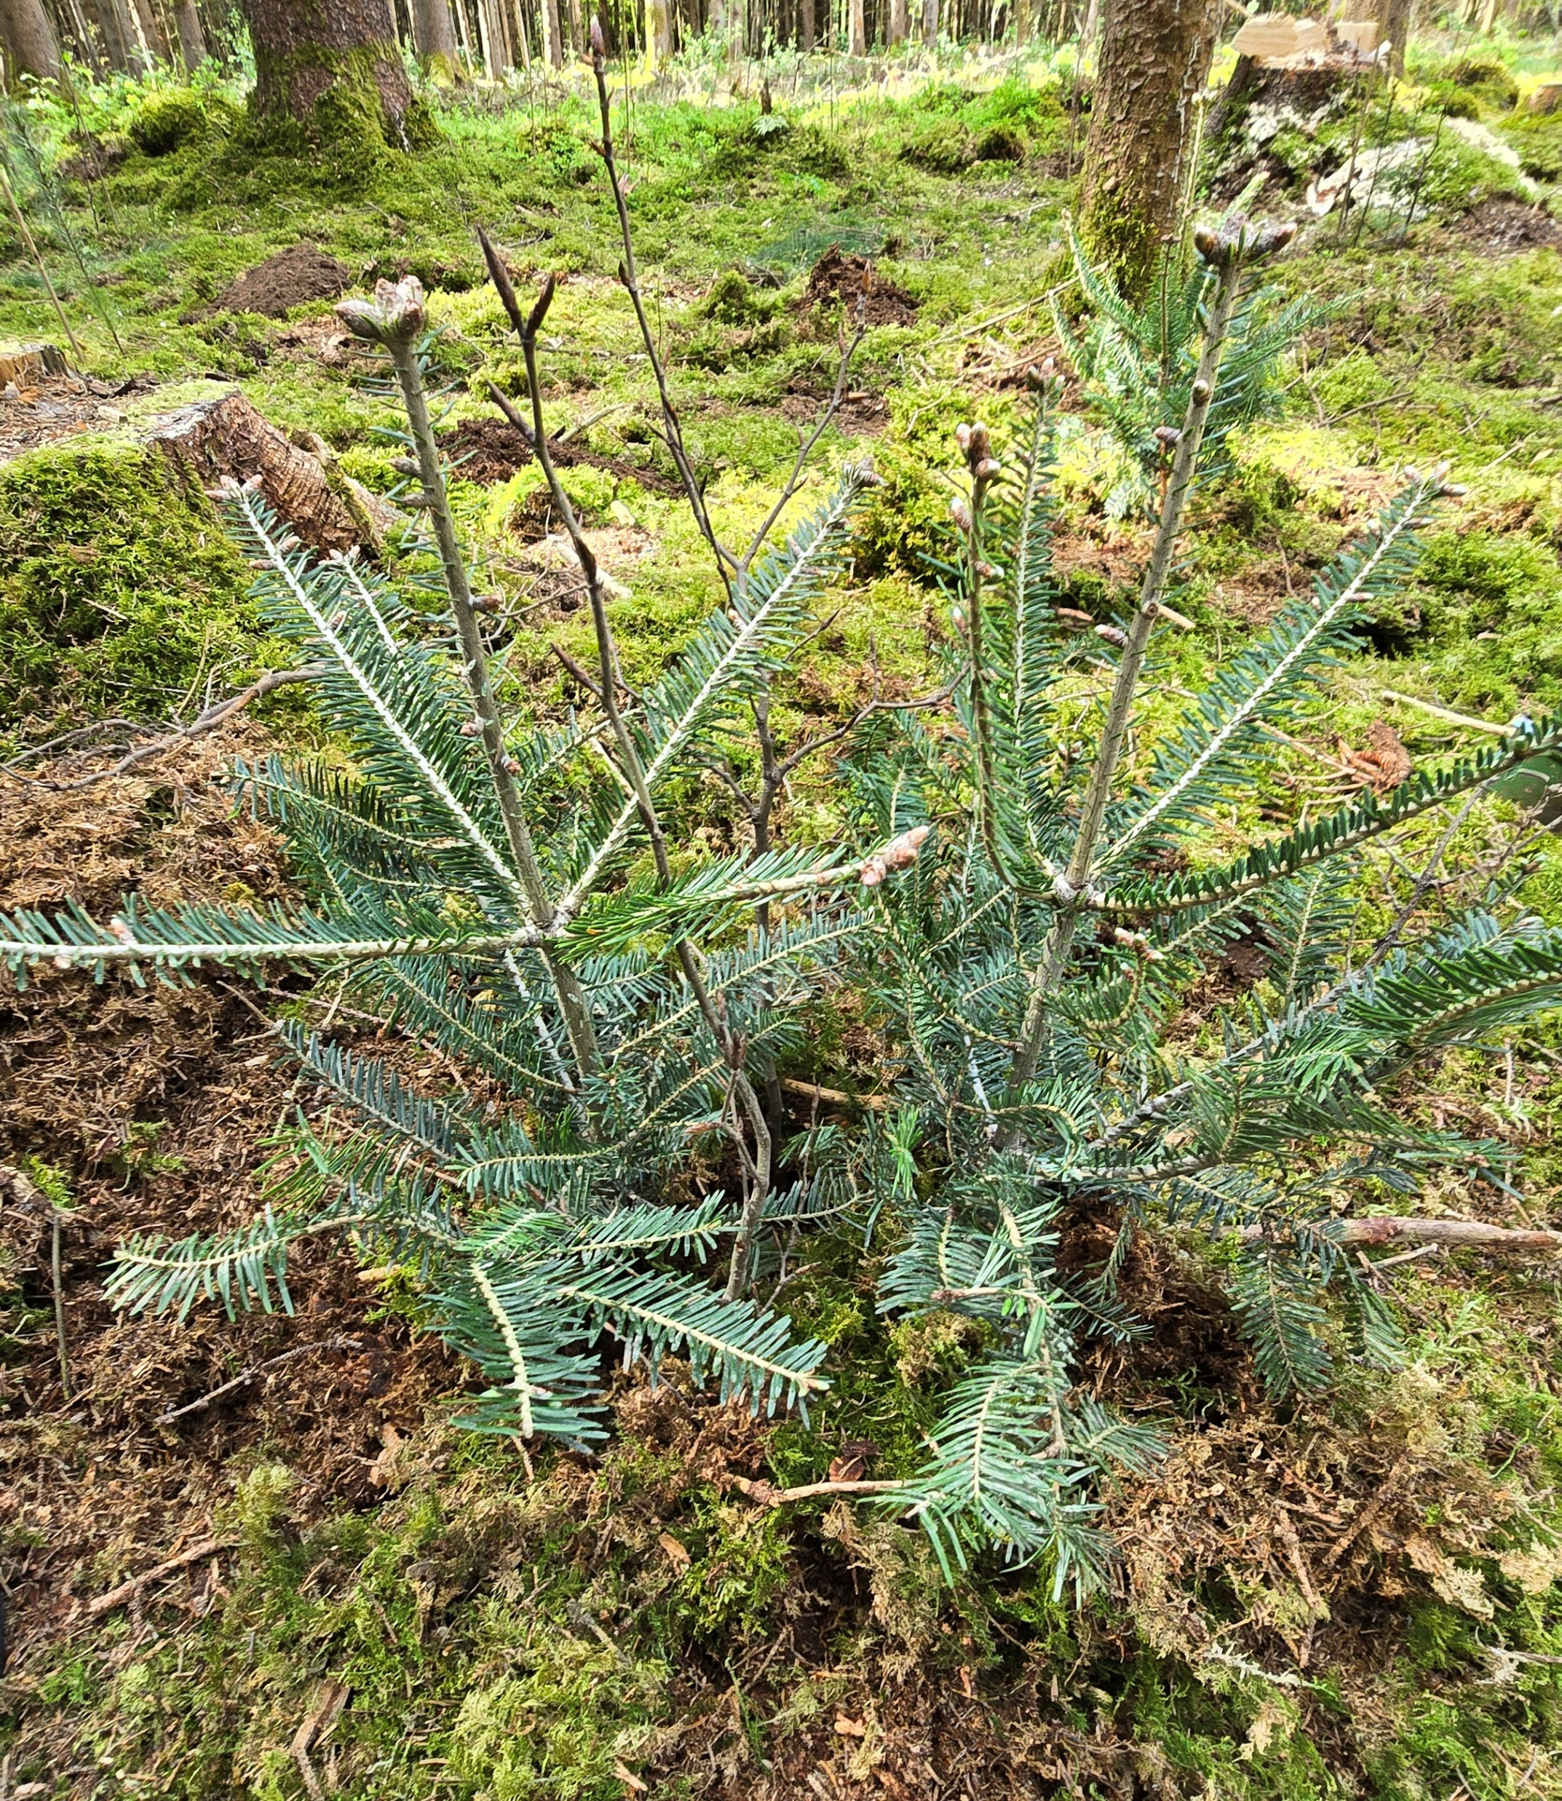
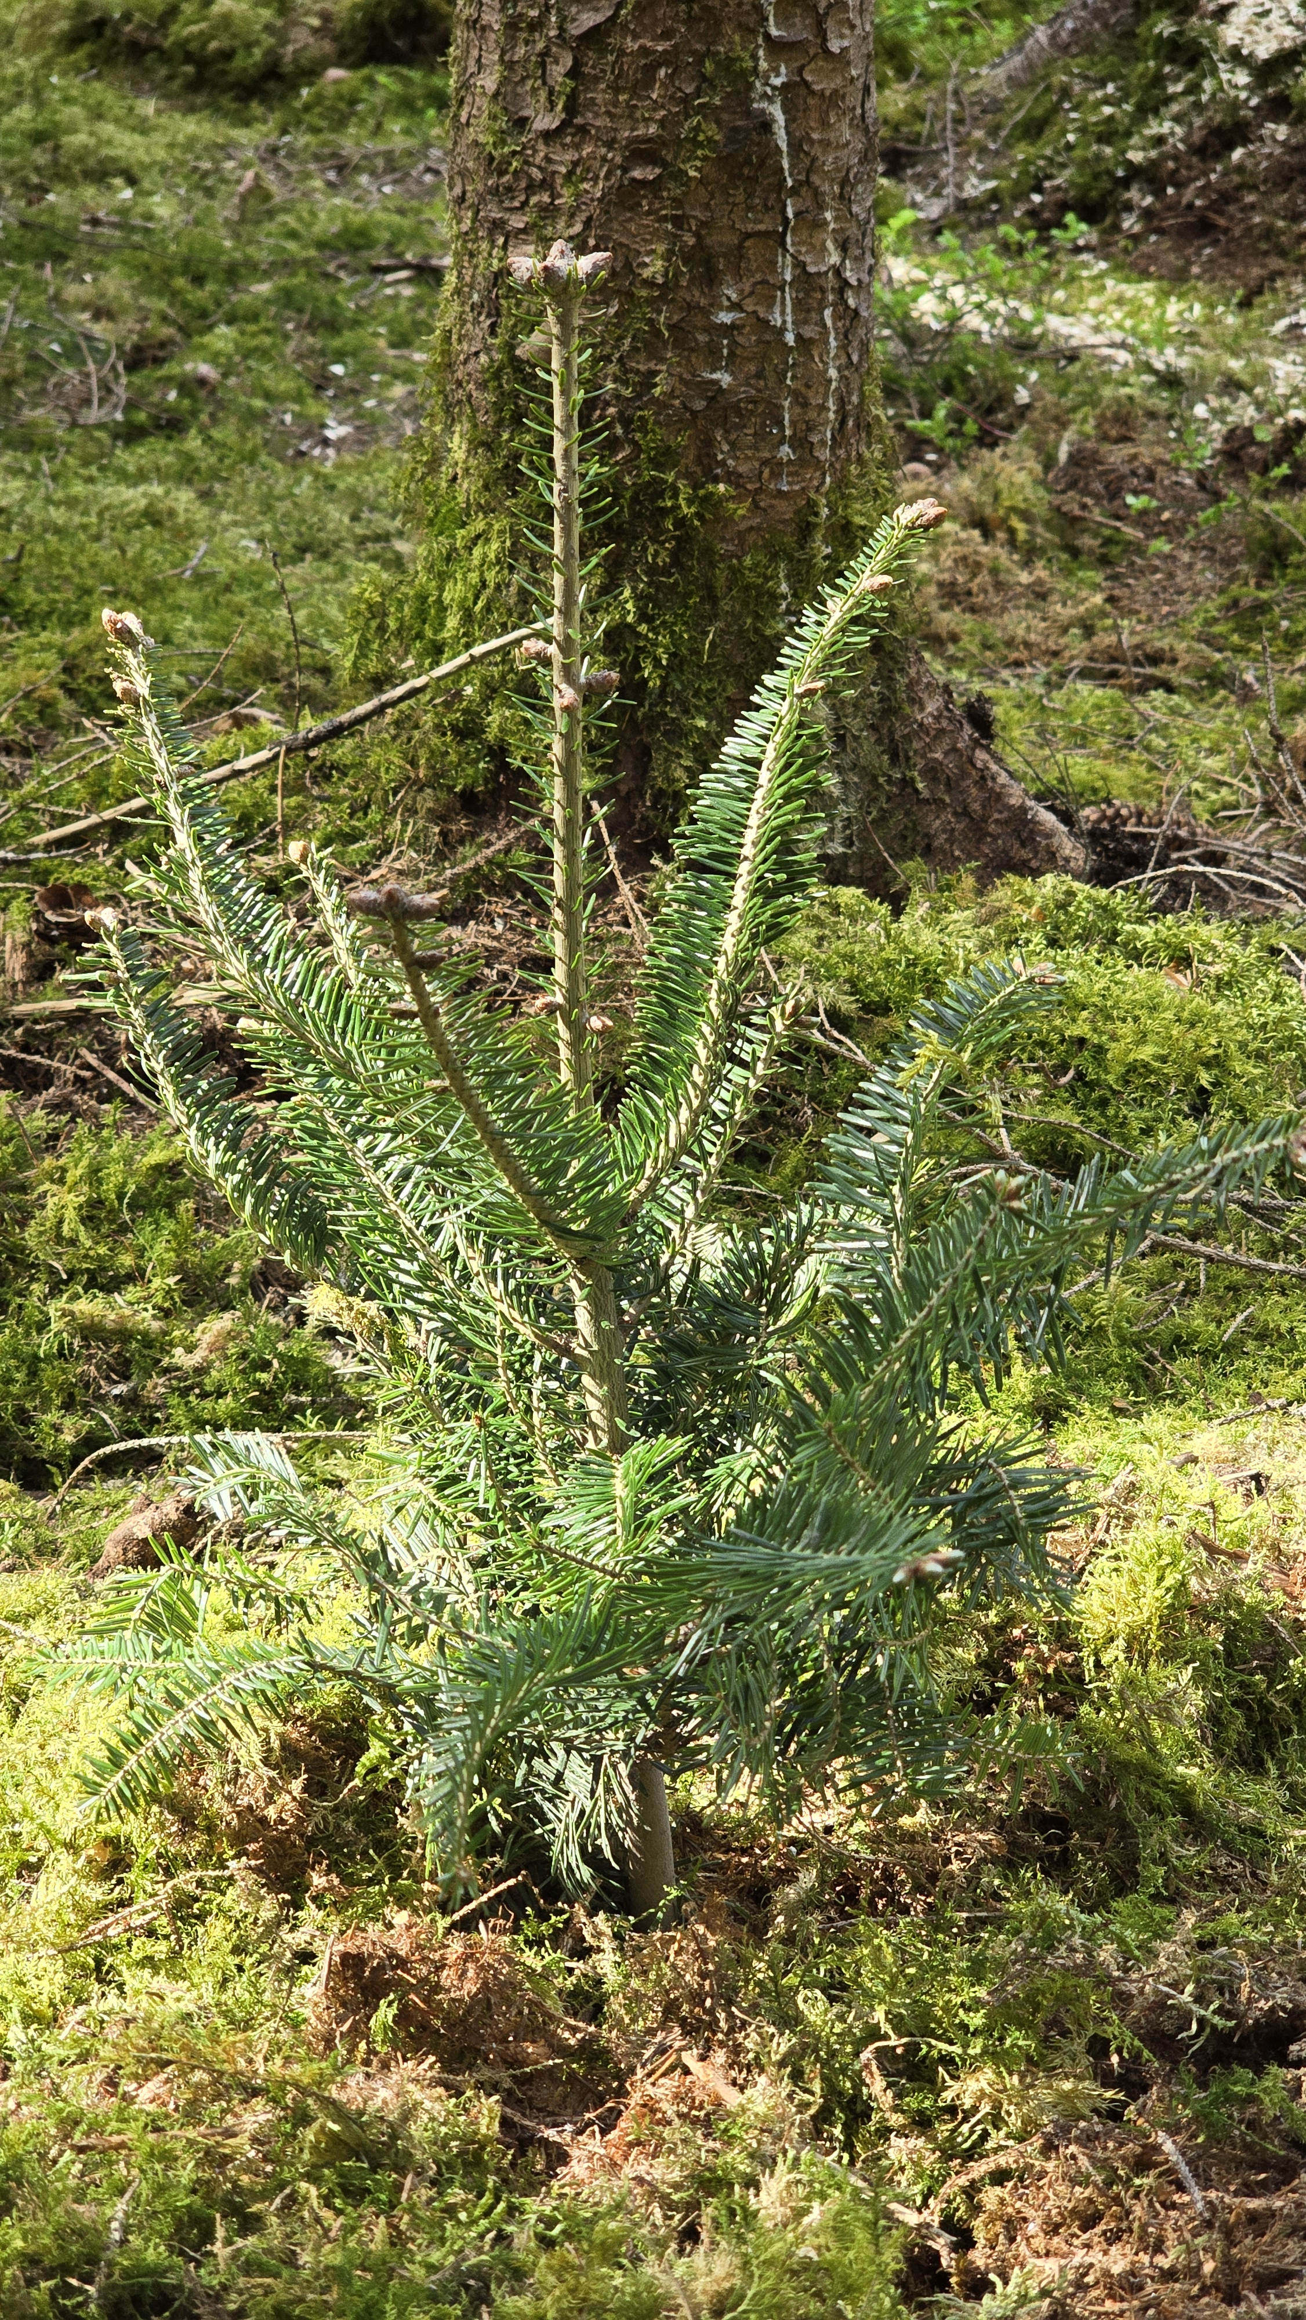
Complementary experiment
The Ebersberg Experiment: Using tree mixture in planting processes
Hypothesis
Species combinations with complementary
rooting patterns support each other during
early establishment.
Methods
We planted c. 1,300 seedlings in different
species mixtures (F. sylvatica, A. alba,
P. menziesii, Q. petraea) and are currently
analyzing their physiological responses in
the first and second year after planting.
Single trees planted conventionally serve
as controls. By the end of 2026, the trees
will be excavated to assess rooting patterns.
vs.
Conventionally planted
tree seedling
(1 x A. alba)
Experimental planting of four tree
seedlings (2 x A. alba, 2 x F. sylvatica)
in a single planting hole

Slide 15
Conclusion and Outlook
We developed an app to identify areas of good and poor seedling establishment
We are currently integrating a UAV-derived light correction which will be implemented into the app to improve future sampling campaigns
Preliminary results indicate that tree seedling establishment is driven by multiple factors. In addition to aboveground competition, drought stress shows mixed effects, while nutrient availability may also contribute. Tree stumps appear to support early establishment.
Future work will examine additional factors, especially the soil microbiome and soil water availability at the study sites
Complementary experiments, especially with respect to tree mixture, are running at the moment

