Slide 1

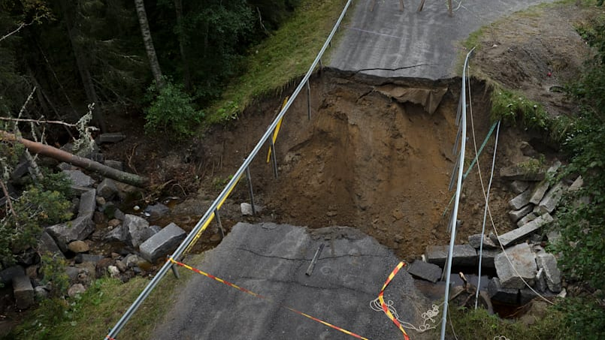
Using flood impact data for evaluating hydrometeorological warnings in Sweden
J. Svatoš, S. Karimi, R. van de Beek, J. Olsson, N. Hjerdt

Slide 2

25 years of impact data
~10 000 records of emergency service responses and flood-affected roads
Flood warning system
What type of flood events are handled well and how can it be improved?

Slide 3
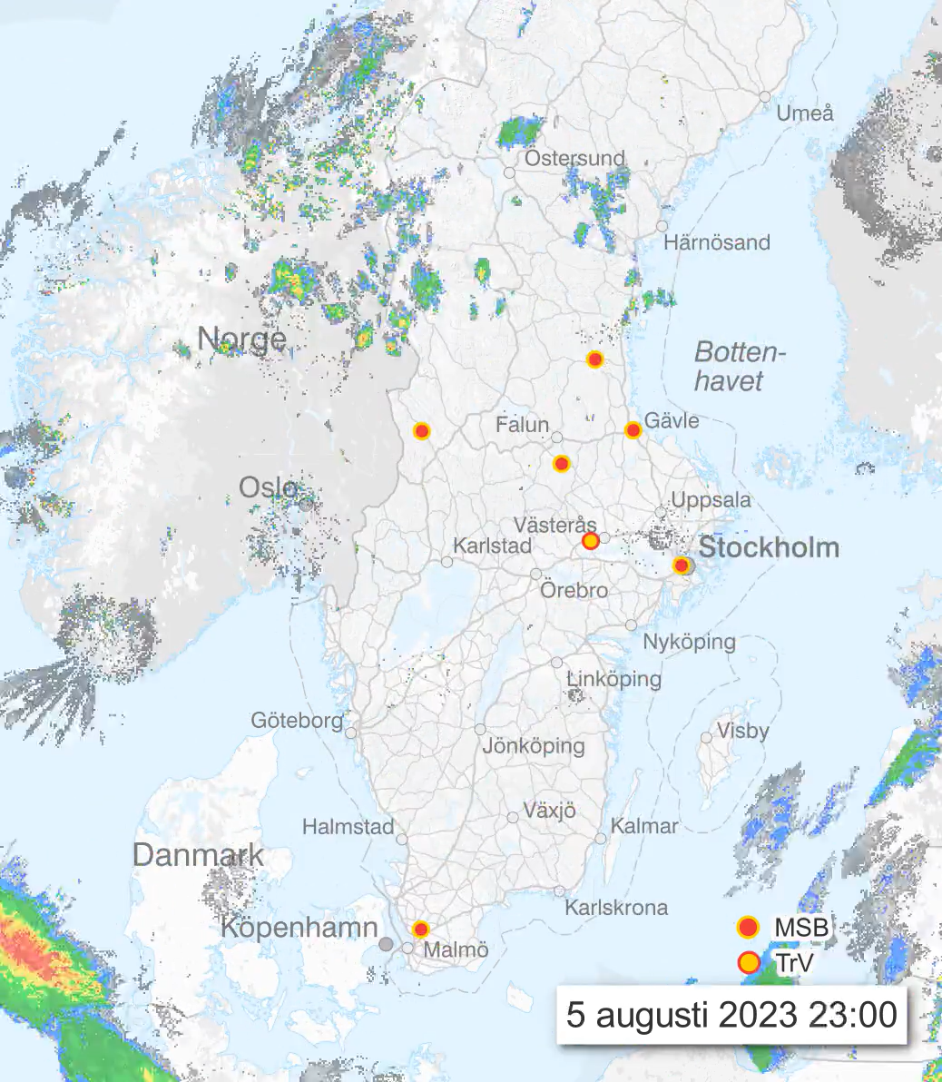
25 years of impact data
~10 000 records of emergency service responses and flood-affected roads
Flood warning system
What type of flood events are handled well and how can it be improved?

Slide 4
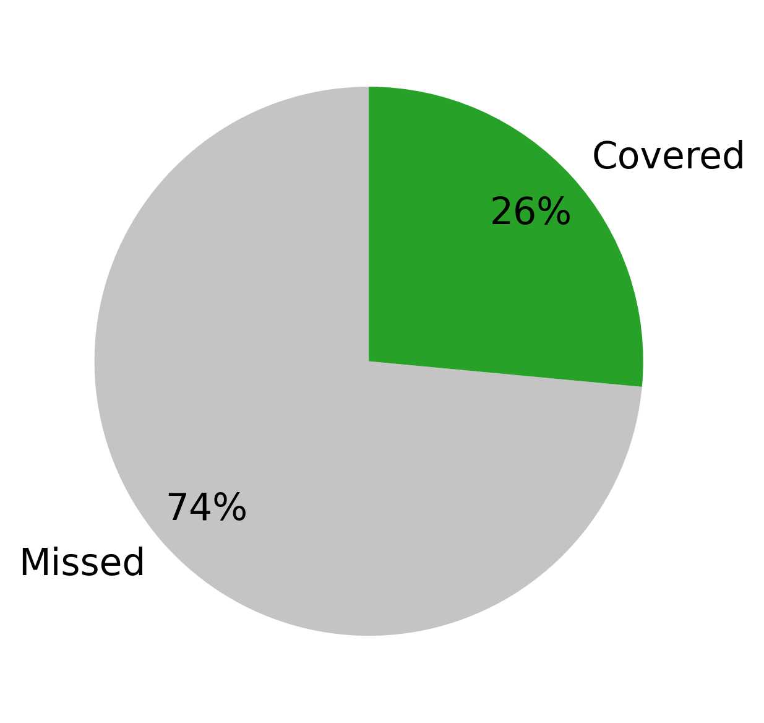
Very few impacts explained by warnings

Slide 5
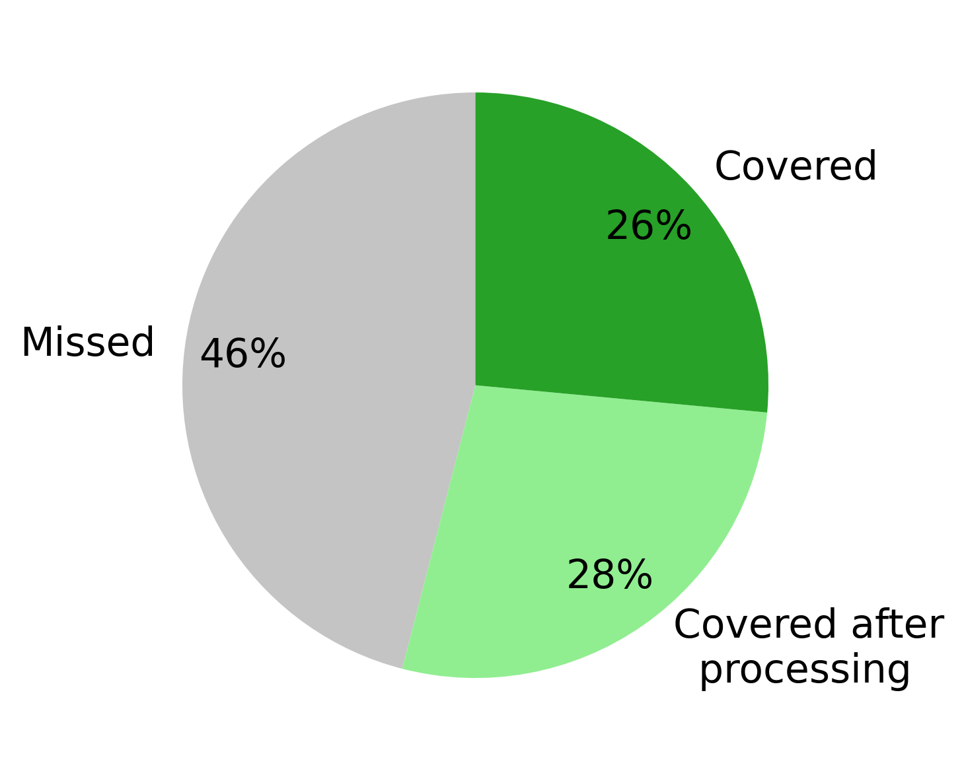
Very few impacts explained by warnings
Lessons learnt:
Filter impact data
Use sub-daily hydrological model
Focus on outputs beyond streamflow

Slide 6




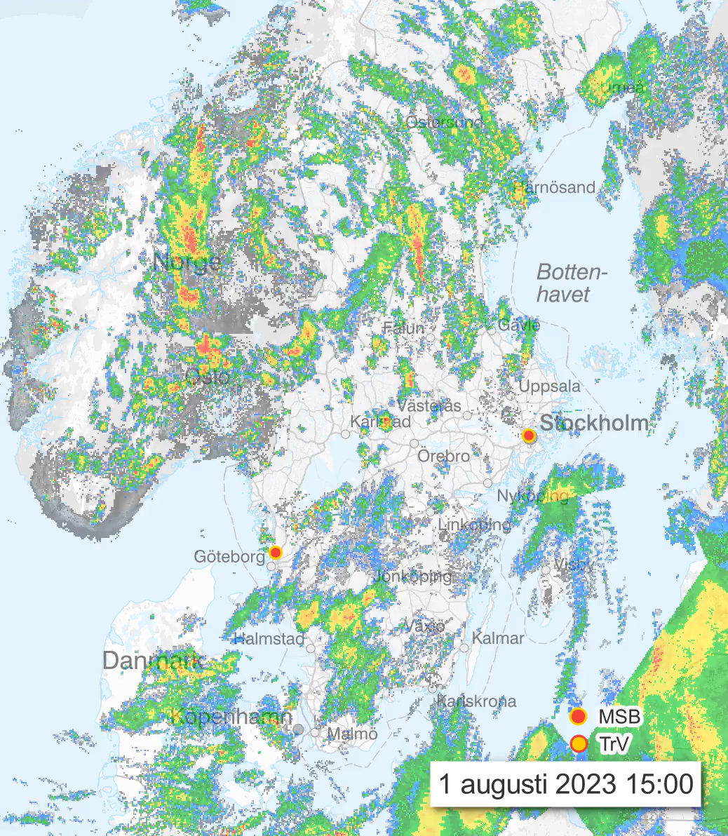
Insights on using flood impact data for evaluating hydrometeorological warnings in Sweden
J. Svatoš, S. Karimi, R. van de Beek, J. Olsson, N. Hjerdt
Do flood warnings correspond with recorded impacts?
How to use impact data to improve the warning system?
Benefit of filtering impact data
Methodology
Evaluation of the existing warning system
Benefit of sub-daily hydrological model
Case study:
Västernorrland cloudburst September 2025
Conclusion
Benefit of outputs beyond streamflow

Slide 7
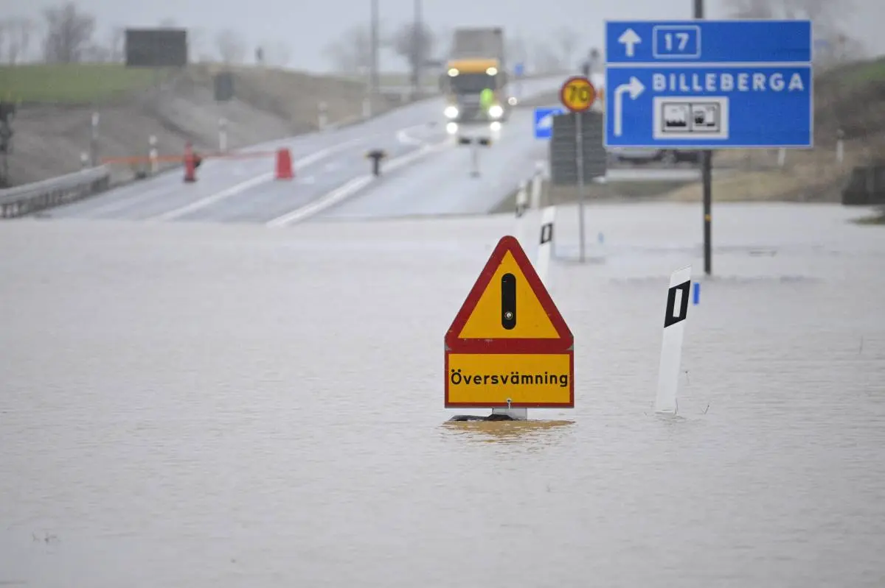
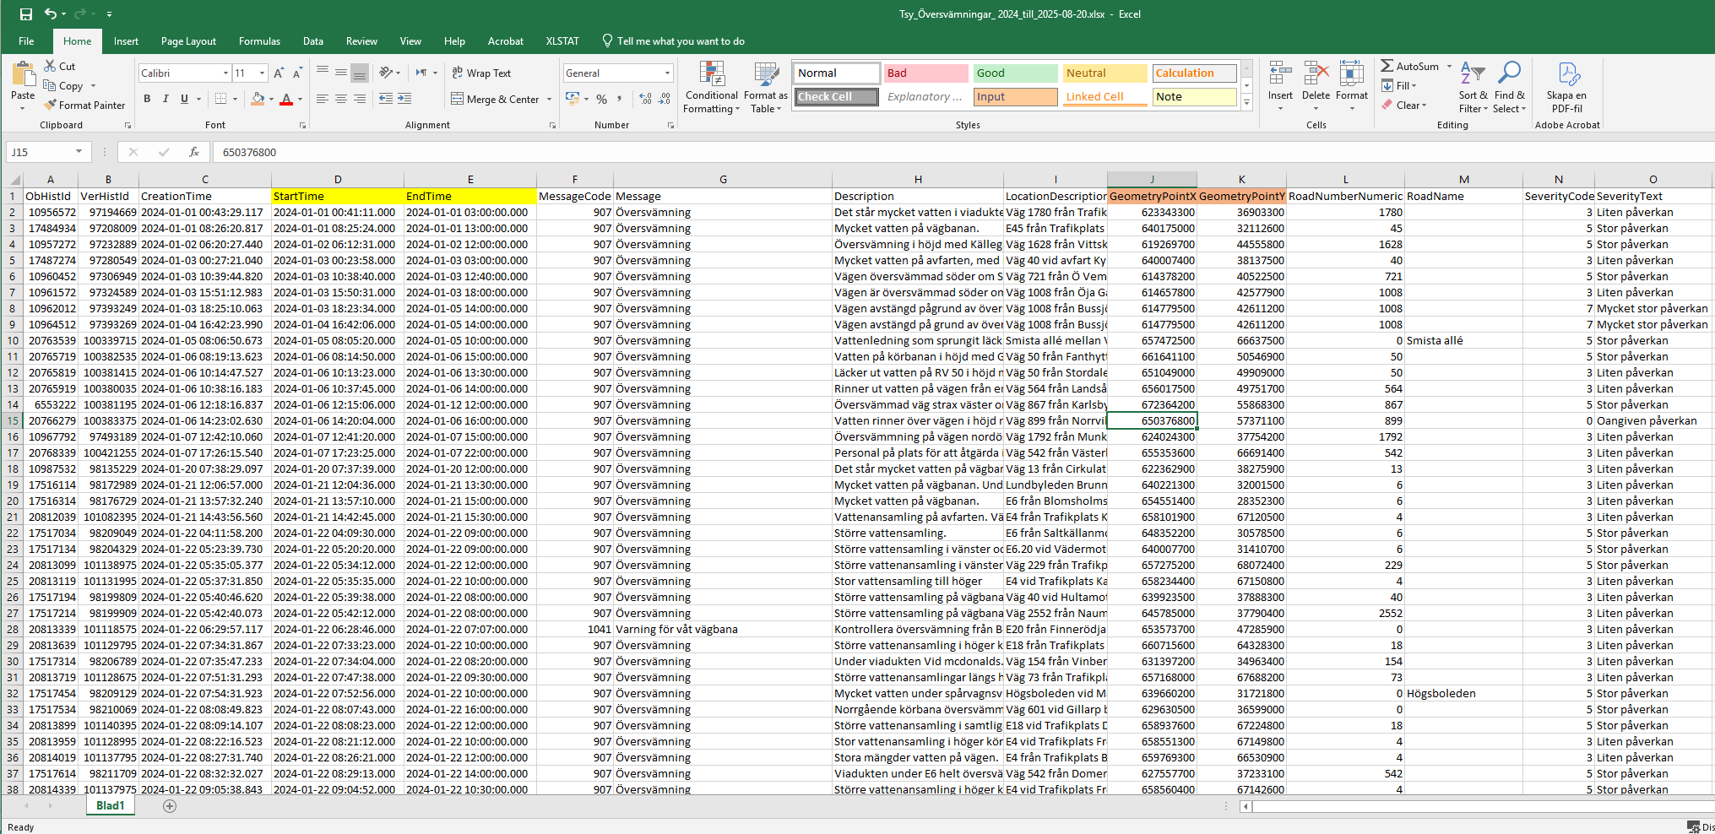
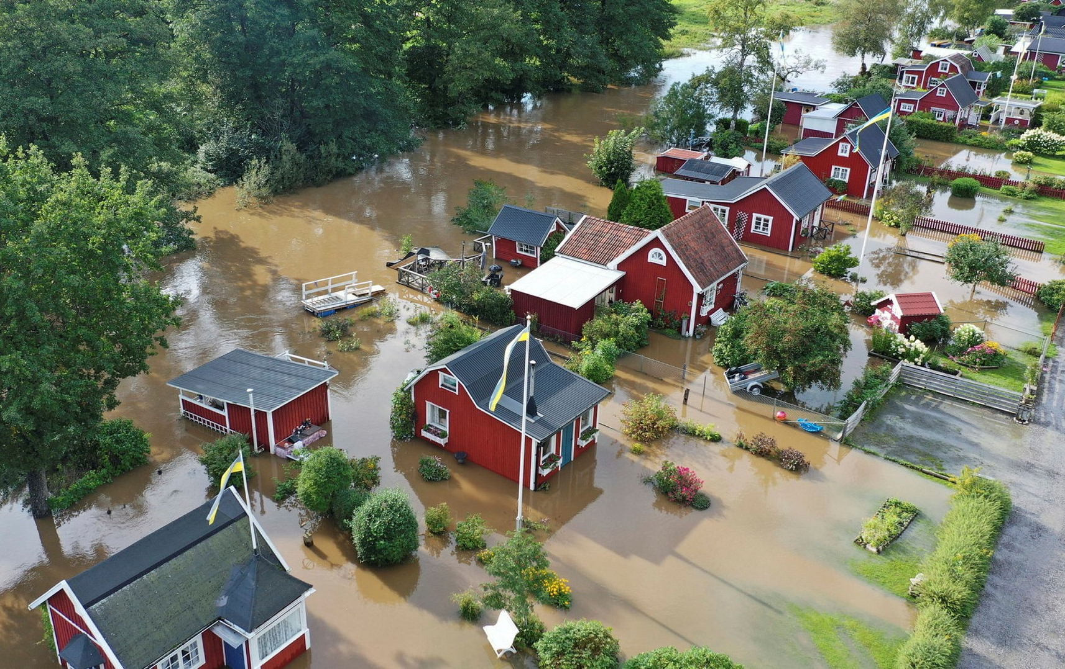
Home
Methodology
Evaluation
Impact filtering
Sub-daily model
Beyond streamflow
Case study
Conclusion
Flood impact data
Flood-affected roads (TrV)
Severity code: 1-7
(little – very large impact)
Time
Coordinates
Emergency service responses (MSB)

Slide 8
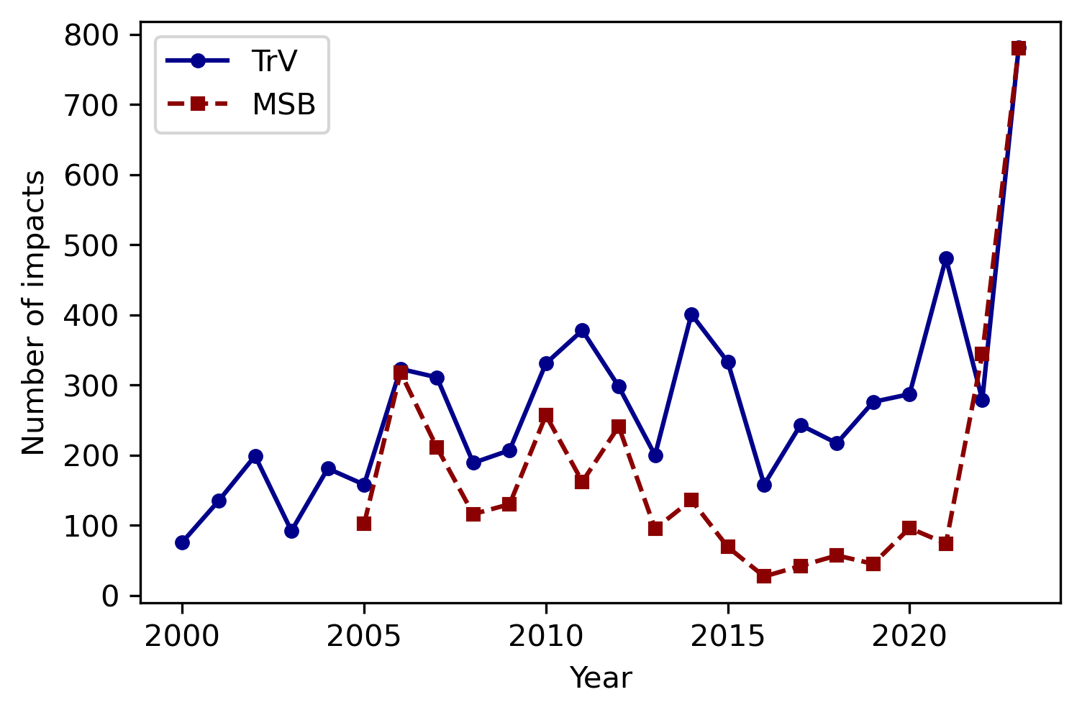
Flood impact data
Home
Methodology
Evaluation
Impact filtering
Sub-daily model
Beyond streamflow
Case study
Conclusion
Flood-affected roads (TrV)
In total ~10 000 records over 25 years
Emergency service responses (MSB)

Slide 9
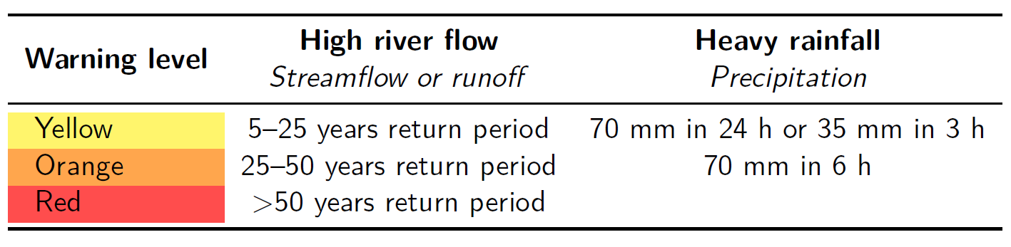
Flood-related warnings at SMHI
Home
Methodology
Evaluation
Impact filtering
Sub-daily model
Beyond streamflow
Case study
Conclusion
This study considered if hindcast data exceeded thresholds on the day of impact or the day before in the subcatchment of the impact, not if warnings were actually issued
Click here for a comparison of exceeded thresholds and issued warnings

Slide 10
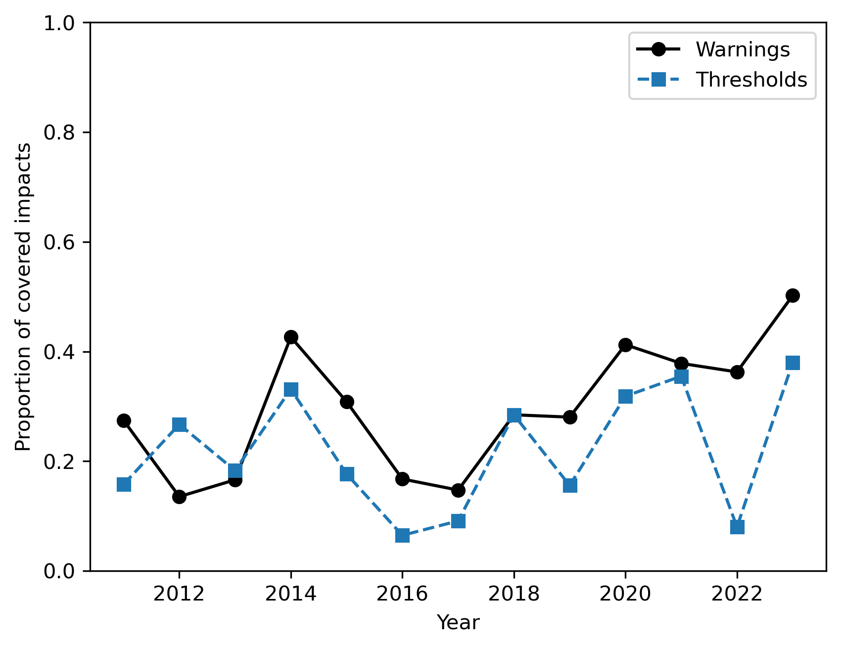
Home
Methodology
Evaluation
Impact filtering
Sub-daily model
Beyond streamflow
Case study
Conclusion
Comparison of exceeded thresholds and issued warnings
Overall between 2011-2023
  34% impacts covered by warnings
  26% impacts exceeded thresholds
Warnings have become more accurate over time, especially with the introduction of an impact-based approach in 2021
Differences also due to lower threshold levels until 2021, hydrological model improvements and using forecast vs. hindcast data
Thresholds were used in this study for consistency in methodology

Slide 11
Hydrometeorological data
Home
Methodology
Evaluation
Impact filtering
Sub-daily model
Beyond streamflow
Case study
Conclusion
Operational S-HYPE hydrological model ^{[1]}
  ~40 000 subcatchments (median size 7 km²)
  Daily (6-6UTC) and hourly model runs with identical parameters^{[2]} and precipitation data^{[3]}
  Hourly model is still in testing phase for operational forecasting
  Outputs: simulated streamflow (COUT) and total generated runoff (CRUN)
Return periods calculated by fitting annual maxima from 1991-2020 to a Gumbel distribution by method of moments^{[4]}
CRUN serves as a proxy for small streams not explicitly modelled in S-HYPE

Slide 12
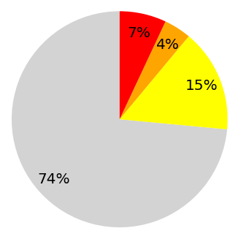
How many recorded impacts were covered by the existing SMHI flood warning system?
Home
Methodology
Evaluation
Impact filtering
Sub-daily model
Beyond streamflow
Case study
Conclusion
Highest exceeded threshold per impact:
Yellow
Orange
Red
None
Count: 9836

Slide 13
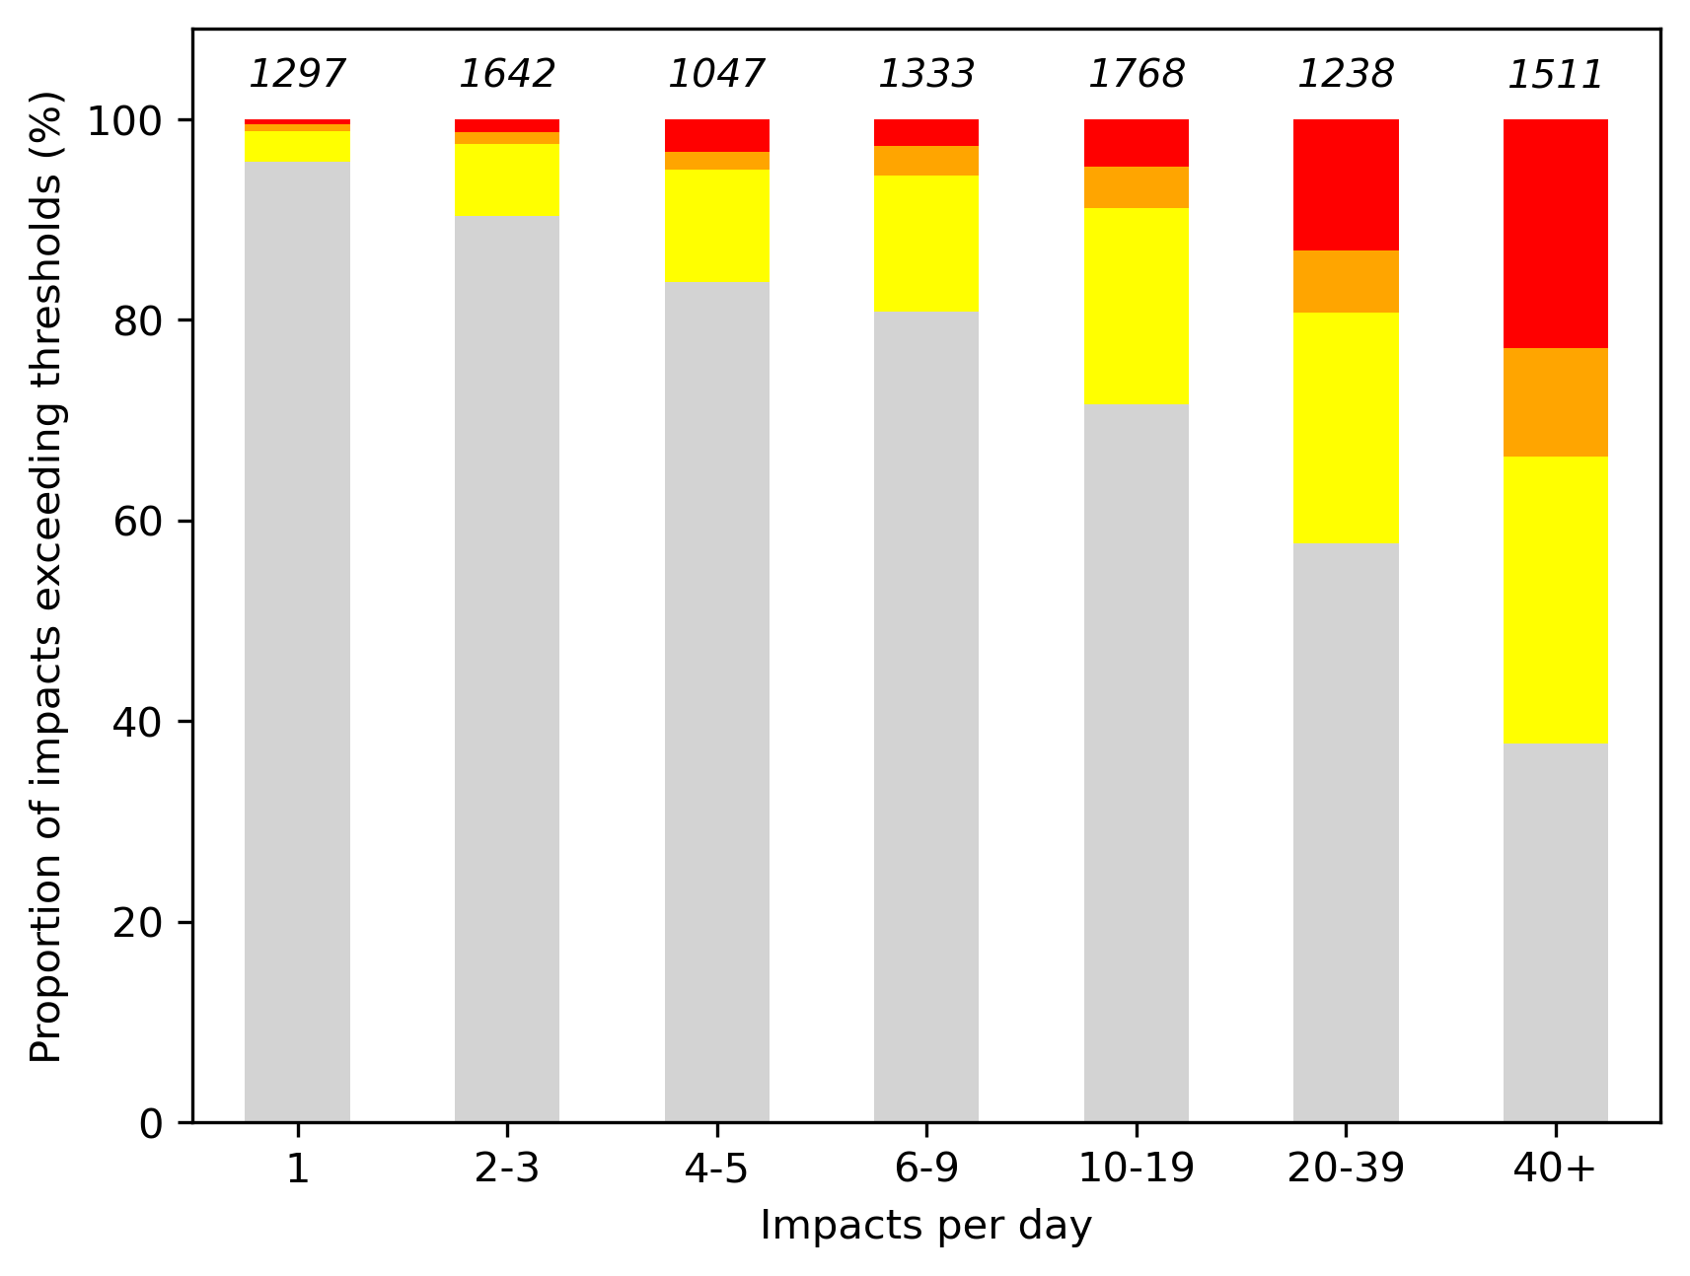
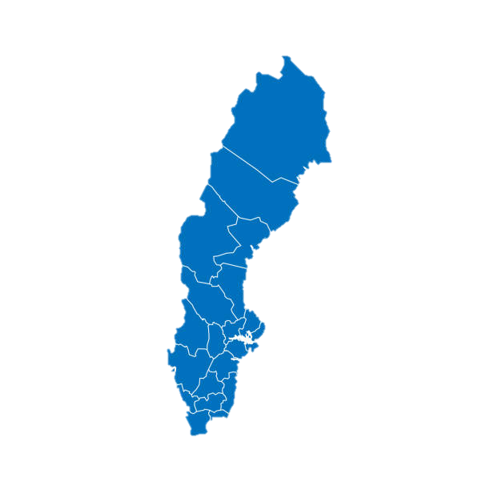
Larger flood events were explained better
Home
Methodology
Evaluation
Impact filtering
Sub-daily model
Beyond streamflow
Case study
Conclusion

Slide 14
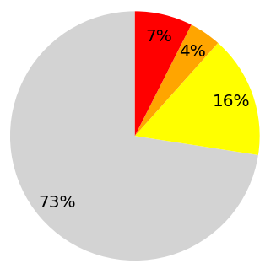
Minor benefit of removing non-severe impacts
Home
Methodology
Evaluation
Impact filtering
Sub-daily model
Beyond streamflow
Case study
Conclusion
When impact severity classified as no or little impact
Count: 9836
Count: 8411

Slide 15
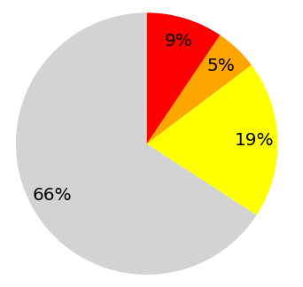
Major benefit of removing isolated impacts
Home
Methodology
Evaluation
Impact filtering
Sub-daily model
Beyond streamflow
Case study
Conclusion
When distance to nearest other impact on the same day > 100 km
Count: 9836
Count: 7104

Slide 16
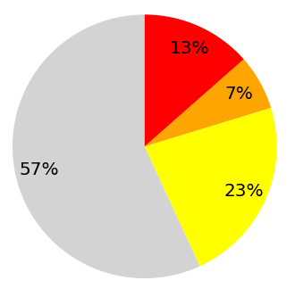
Proposed impact filtering technique:
Home
Methodology
Evaluation
Impact filtering
Sub-daily model
Beyond streamflow
Case study
Conclusion
Use only severe non-isolated impacts when ≥ 4 in a day
Count: 9836
Count: 4269

Slide 17
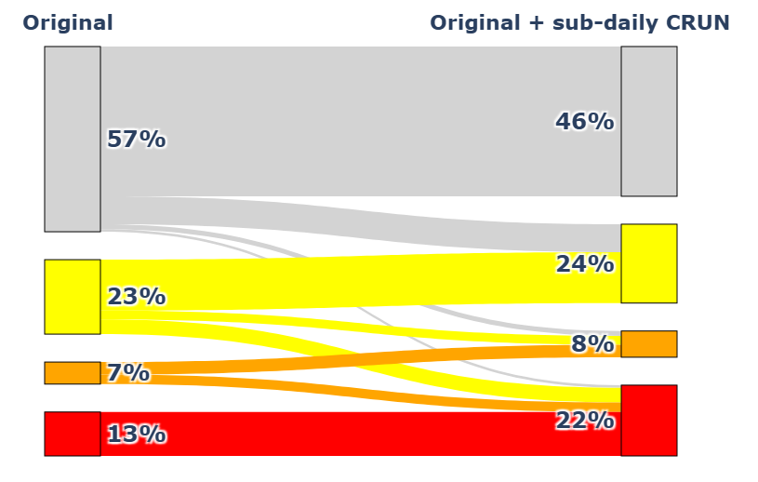
Major benefit of applying sub-daily model
Home
Methodology
Evaluation
Impact filtering
Sub-daily model
Beyond streamflow
Case study
Conclusion
Added max return period of CRUN from 1h, 3h, 6h, 12h, 24h accumulations

Slide 18
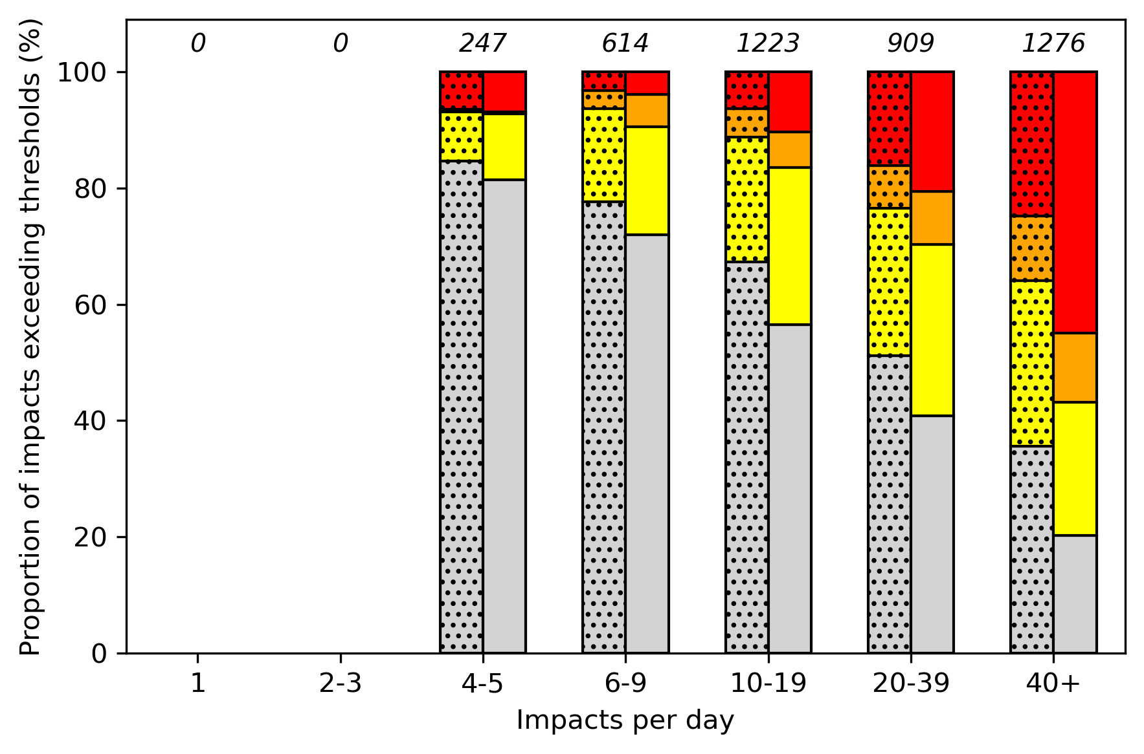
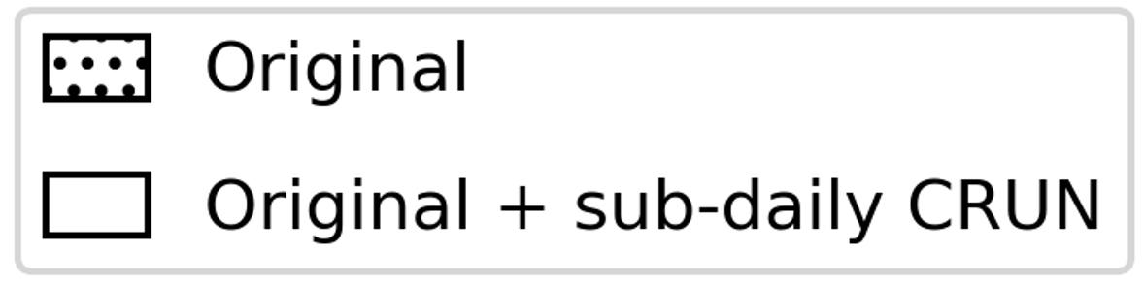
More red warnings explain large flood events
Home
Methodology
Evaluation
Impact filtering
Sub-daily model
Beyond streamflow
Case study
Conclusion

Slide 19
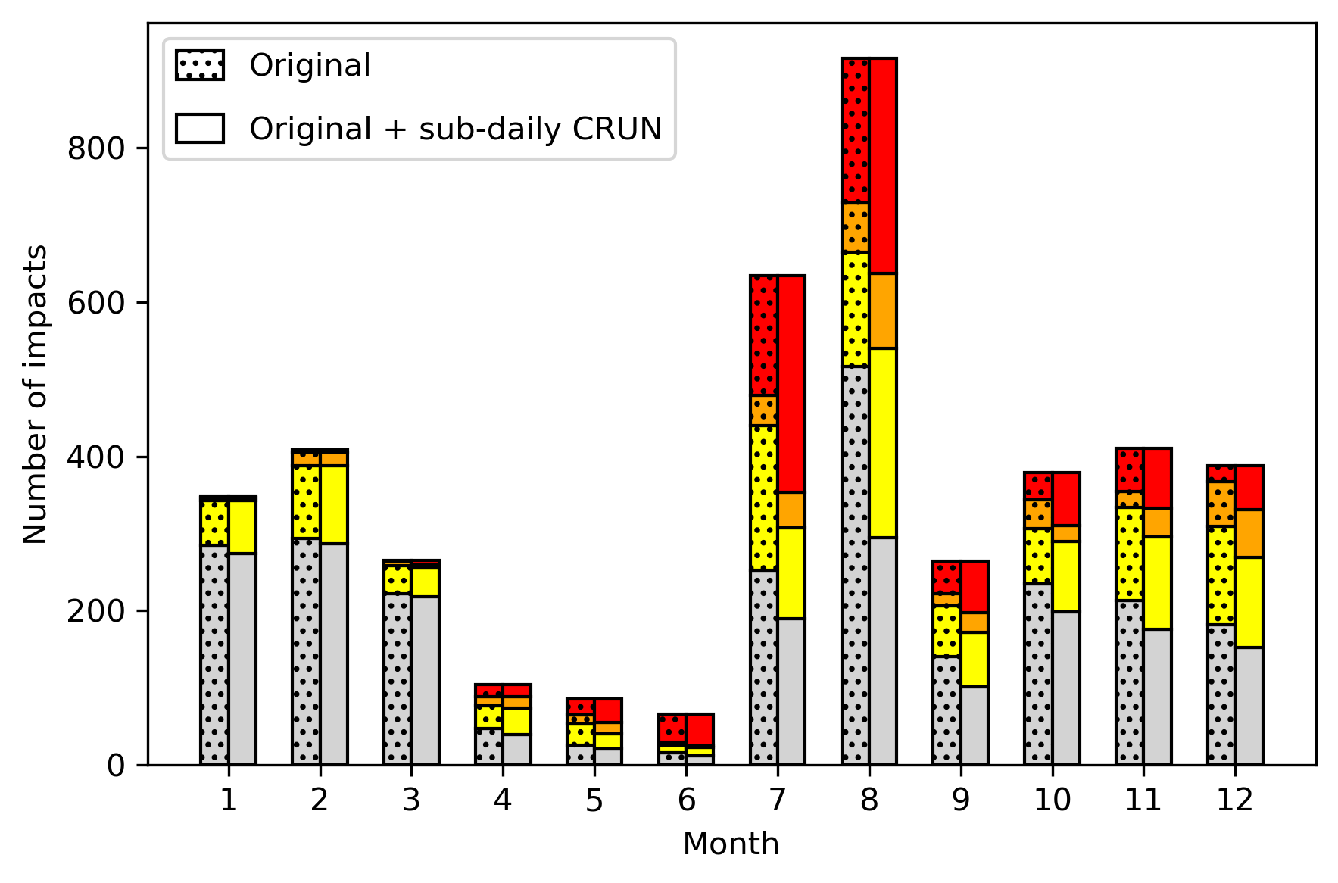
Improvement primarily in summer
Home
Methodology
Evaluation
Impact filtering
Sub-daily model
Beyond streamflow
Case study
Conclusion
Proportion of unexplained impacts in August decreased from 56% to 32%
Unexplained winter impacts remained above 70%

Slide 20
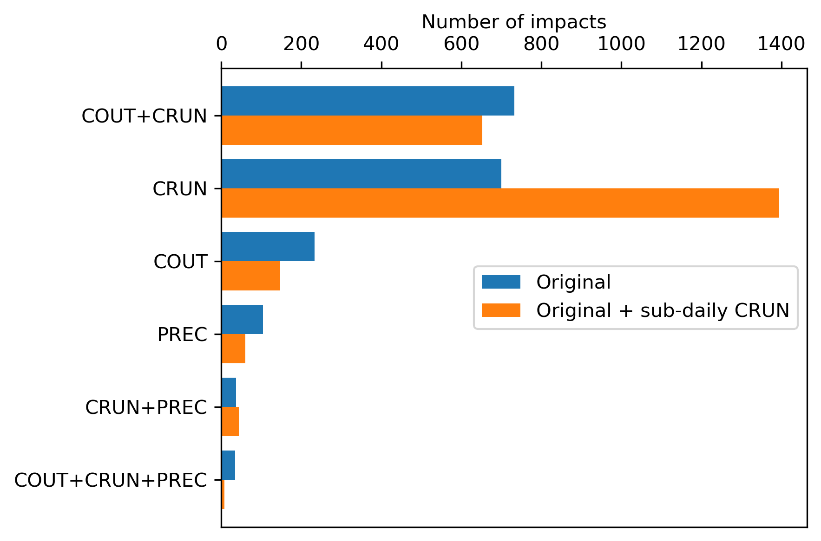
Relative importance of output variables
Home
Methodology
Evaluation
Impact filtering
Sub-daily model
Beyond streamflow
Case study
Conclusion
CRUN (total runoff) was a more important predictor of impacts than COUT (streamflow)
Precipitation thresholds explain <5% impacts

Slide 21
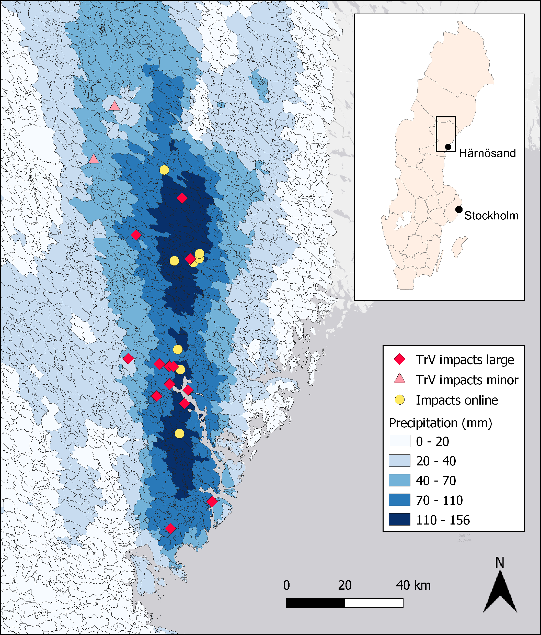
Västernorrland 6-7 September 2025
Home
Methodology
Evaluation
Impact filtering
Sub-daily model
Beyond streamflow
Case study
Conclusion
More than 100 mm of rainfall
40 destroyed roads, 2 derailed trains
Only yellow warning issued

Slide 22
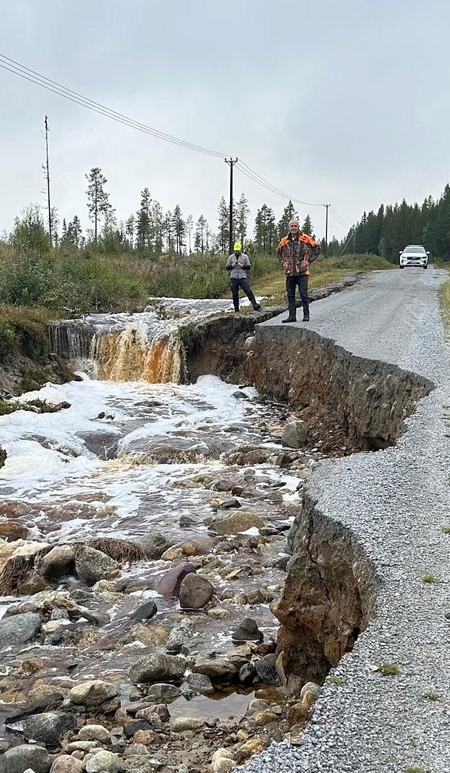
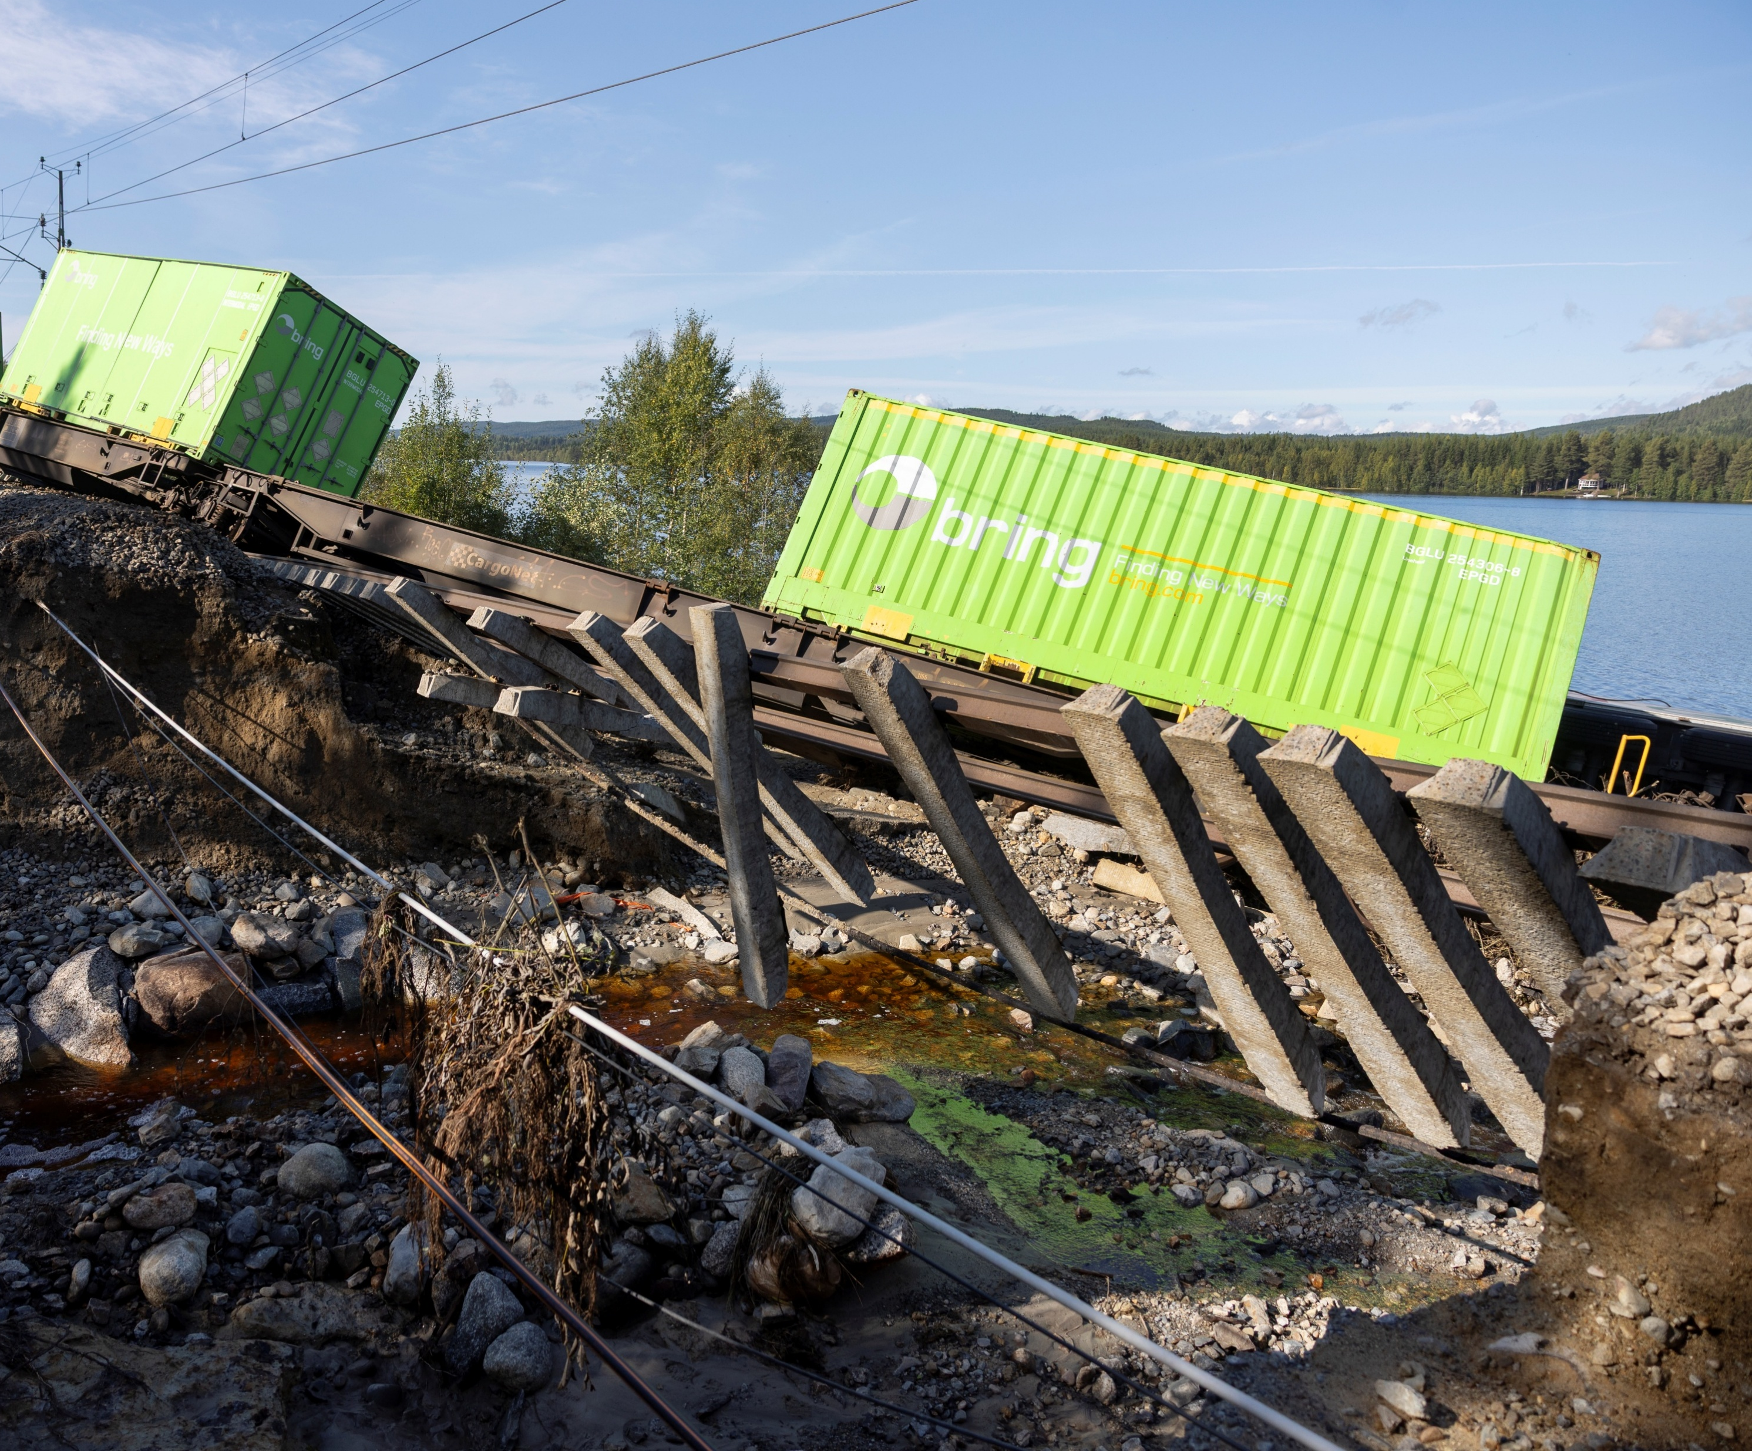
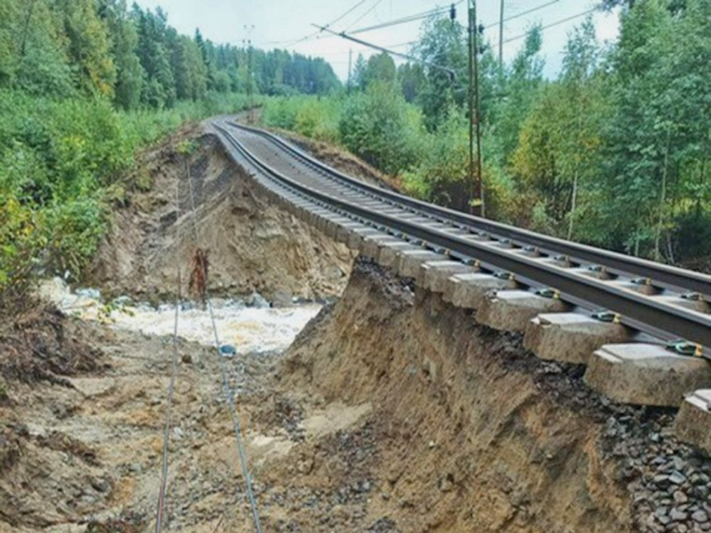
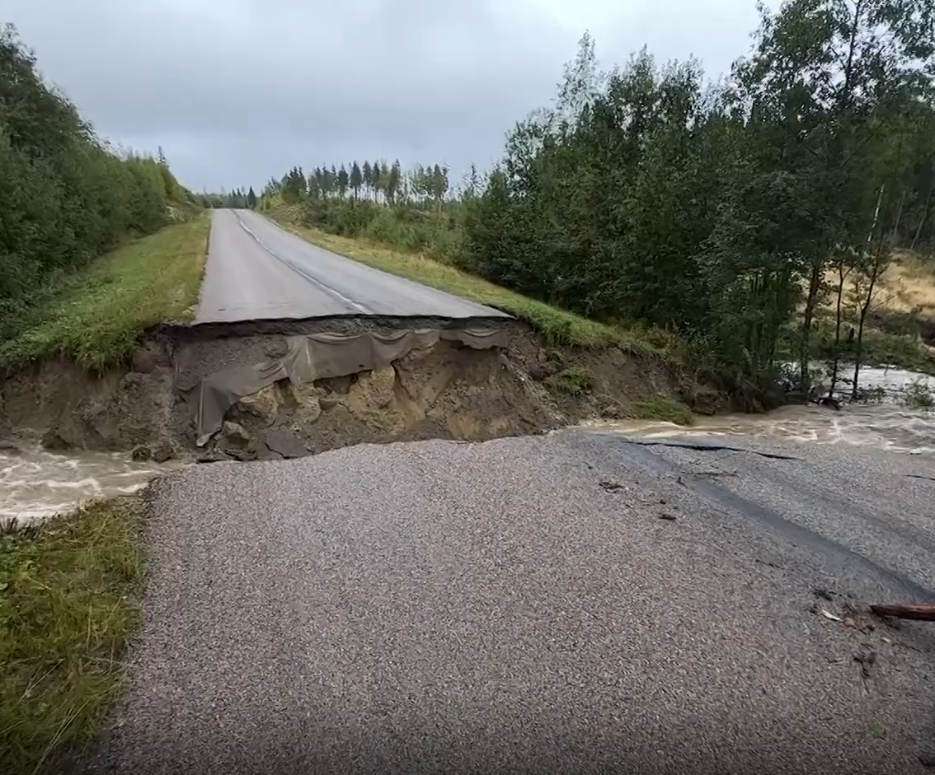
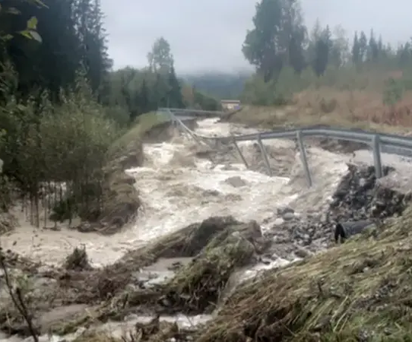
Home
Methodology
Evaluation
Impact filtering
Sub-daily model
Beyond streamflow
Case study
Conclusion

Slide 23
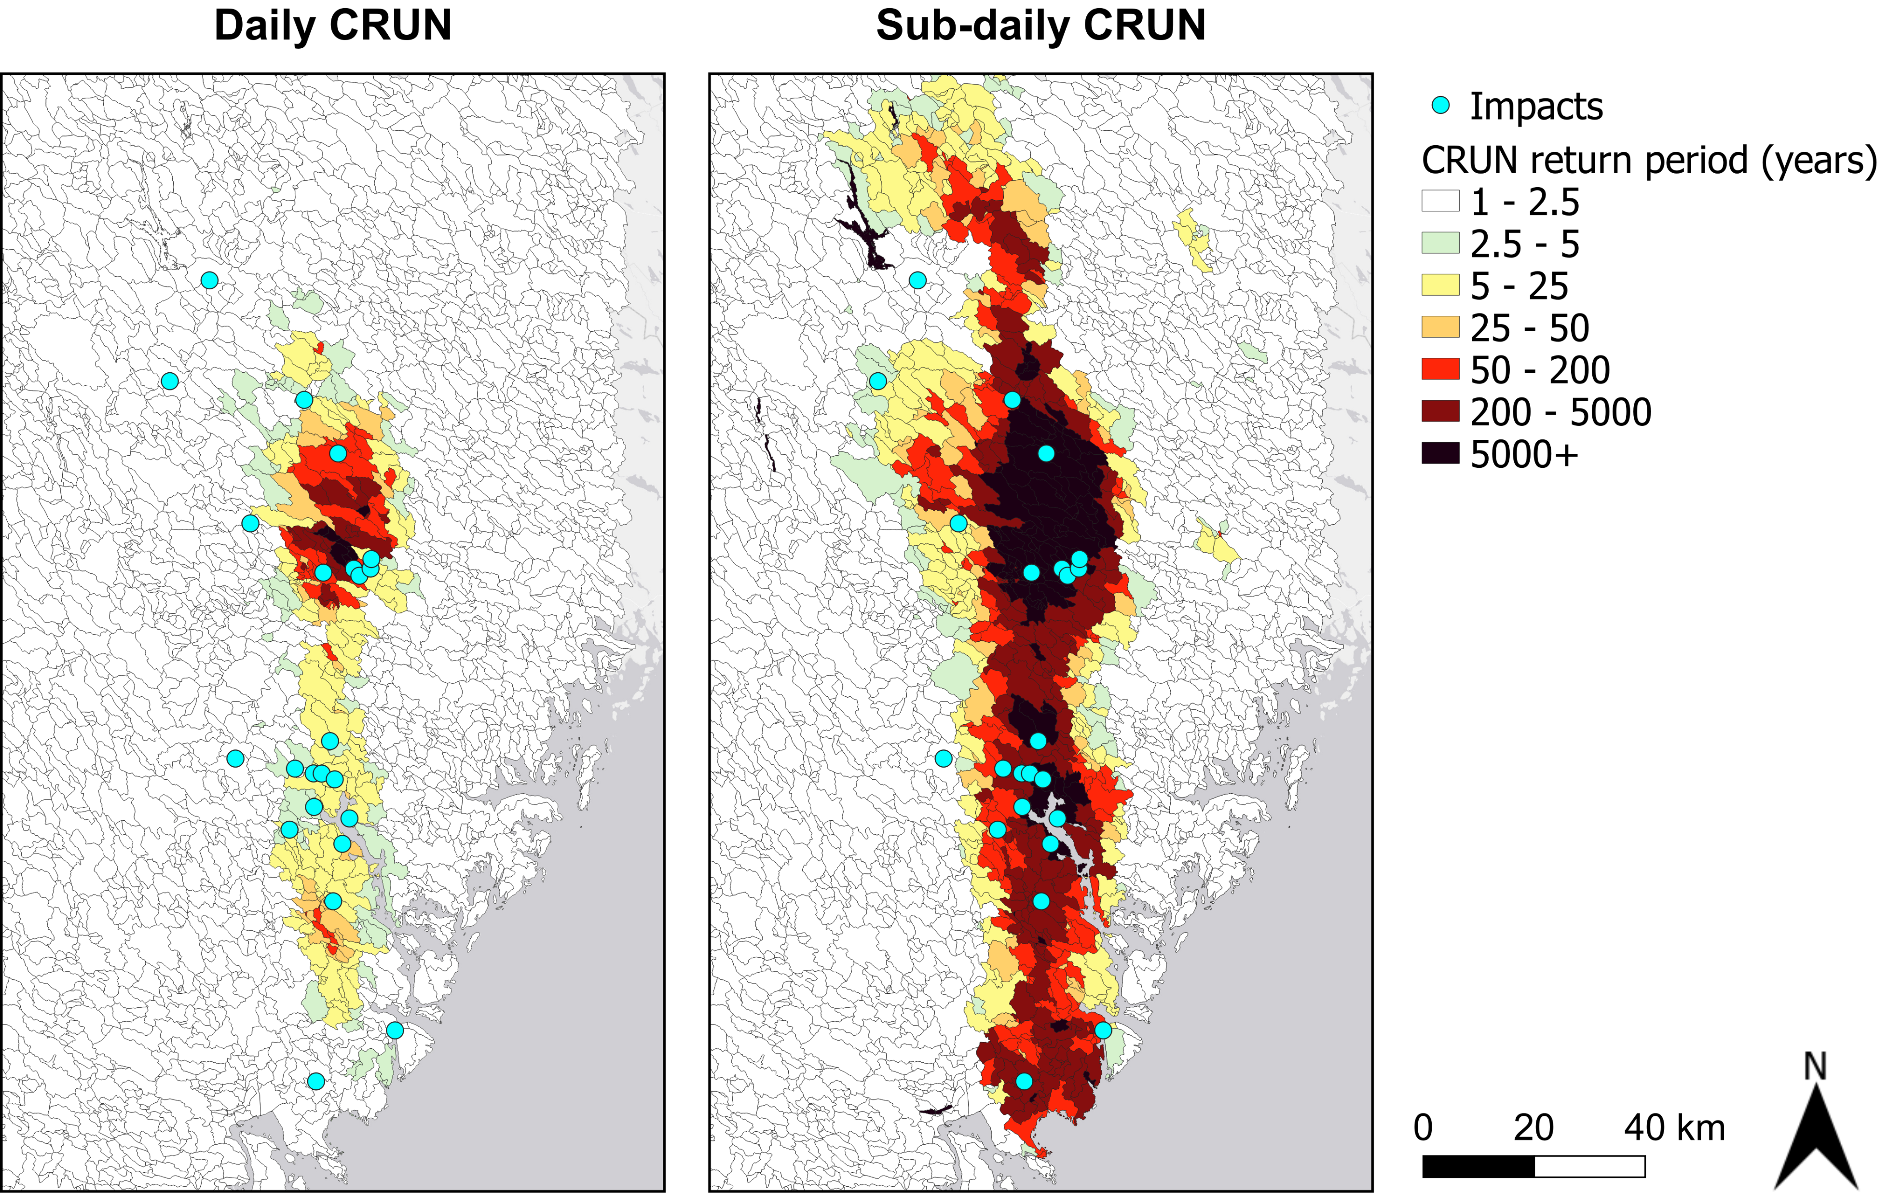
Daily model considerably underestimated magnitude
Home
Methodology
Evaluation
Impact filtering
Sub-daily model
Beyond streamflow
Case study
Conclusion

Slide 24
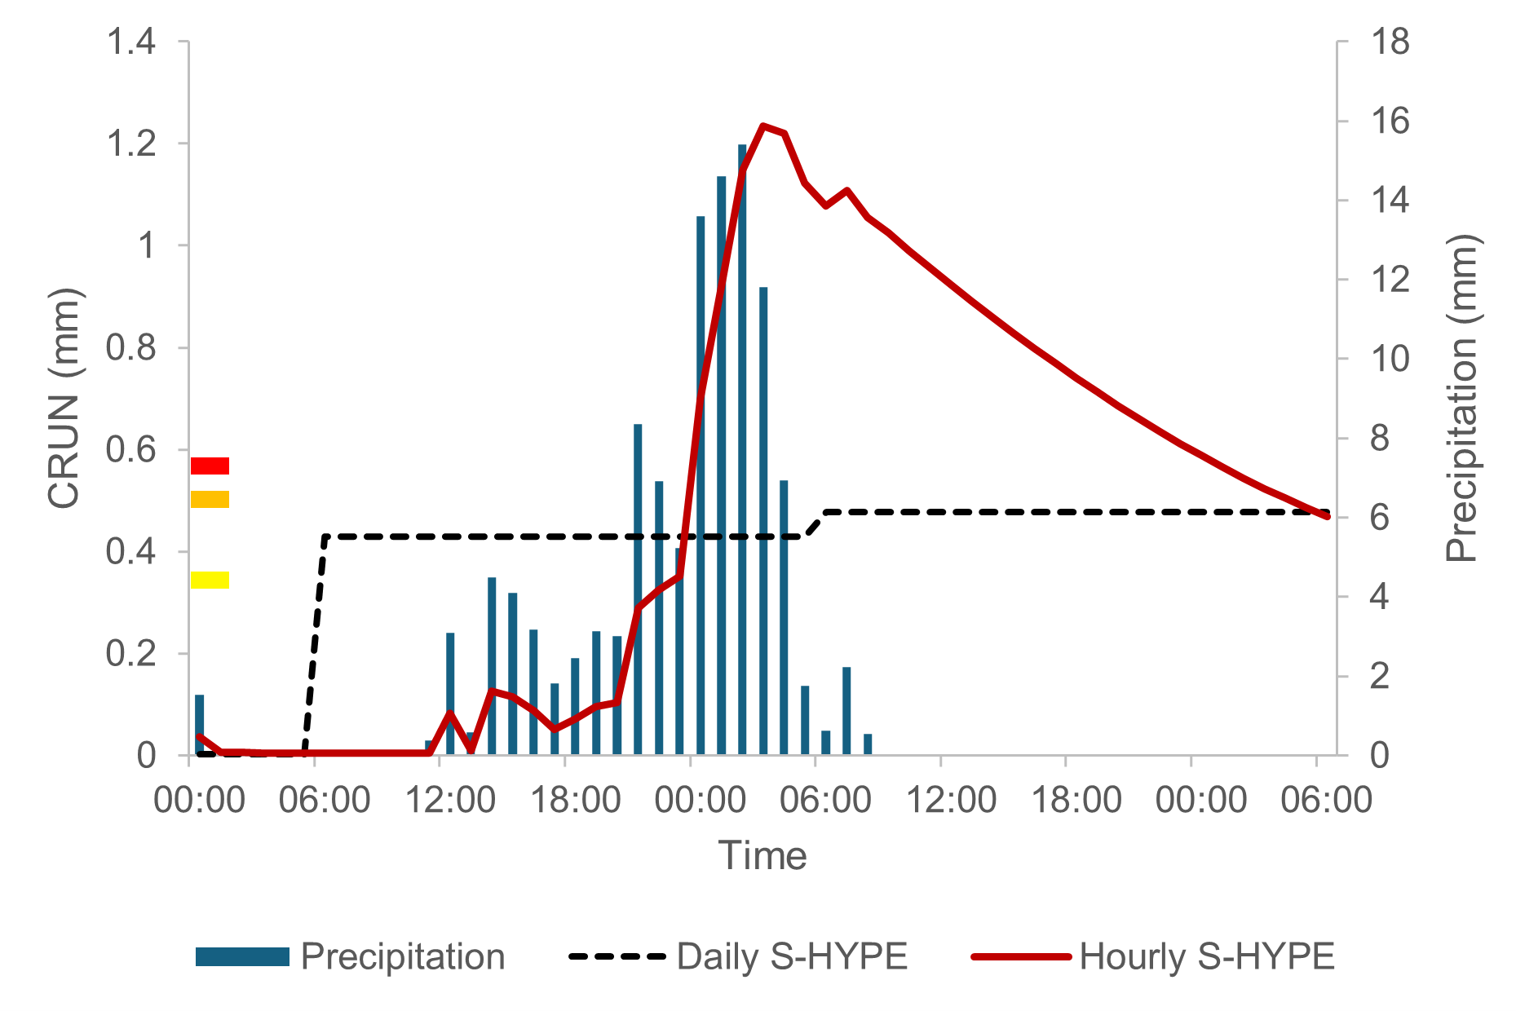
Sub-daily runoff is necessary to capture sub-grid flashy streams which cause many impacts
Home
Methodology
Evaluation
Impact filtering
Sub-daily model
Beyond streamflow
Case study
Conclusion

Slide 25

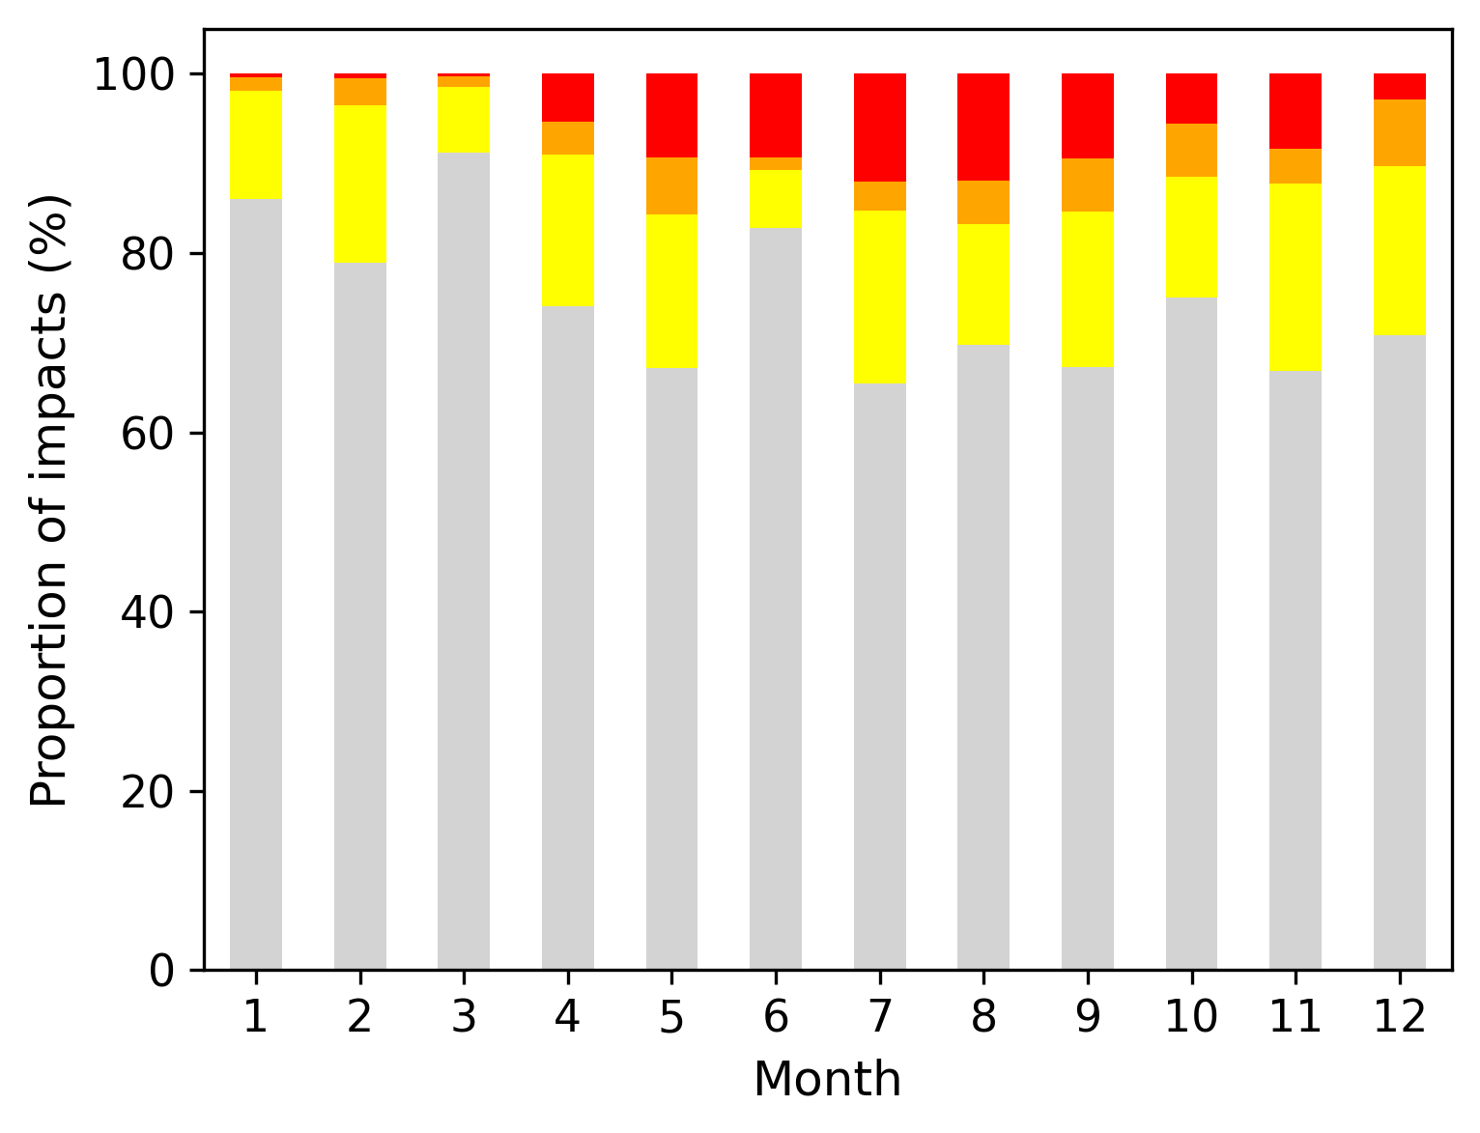
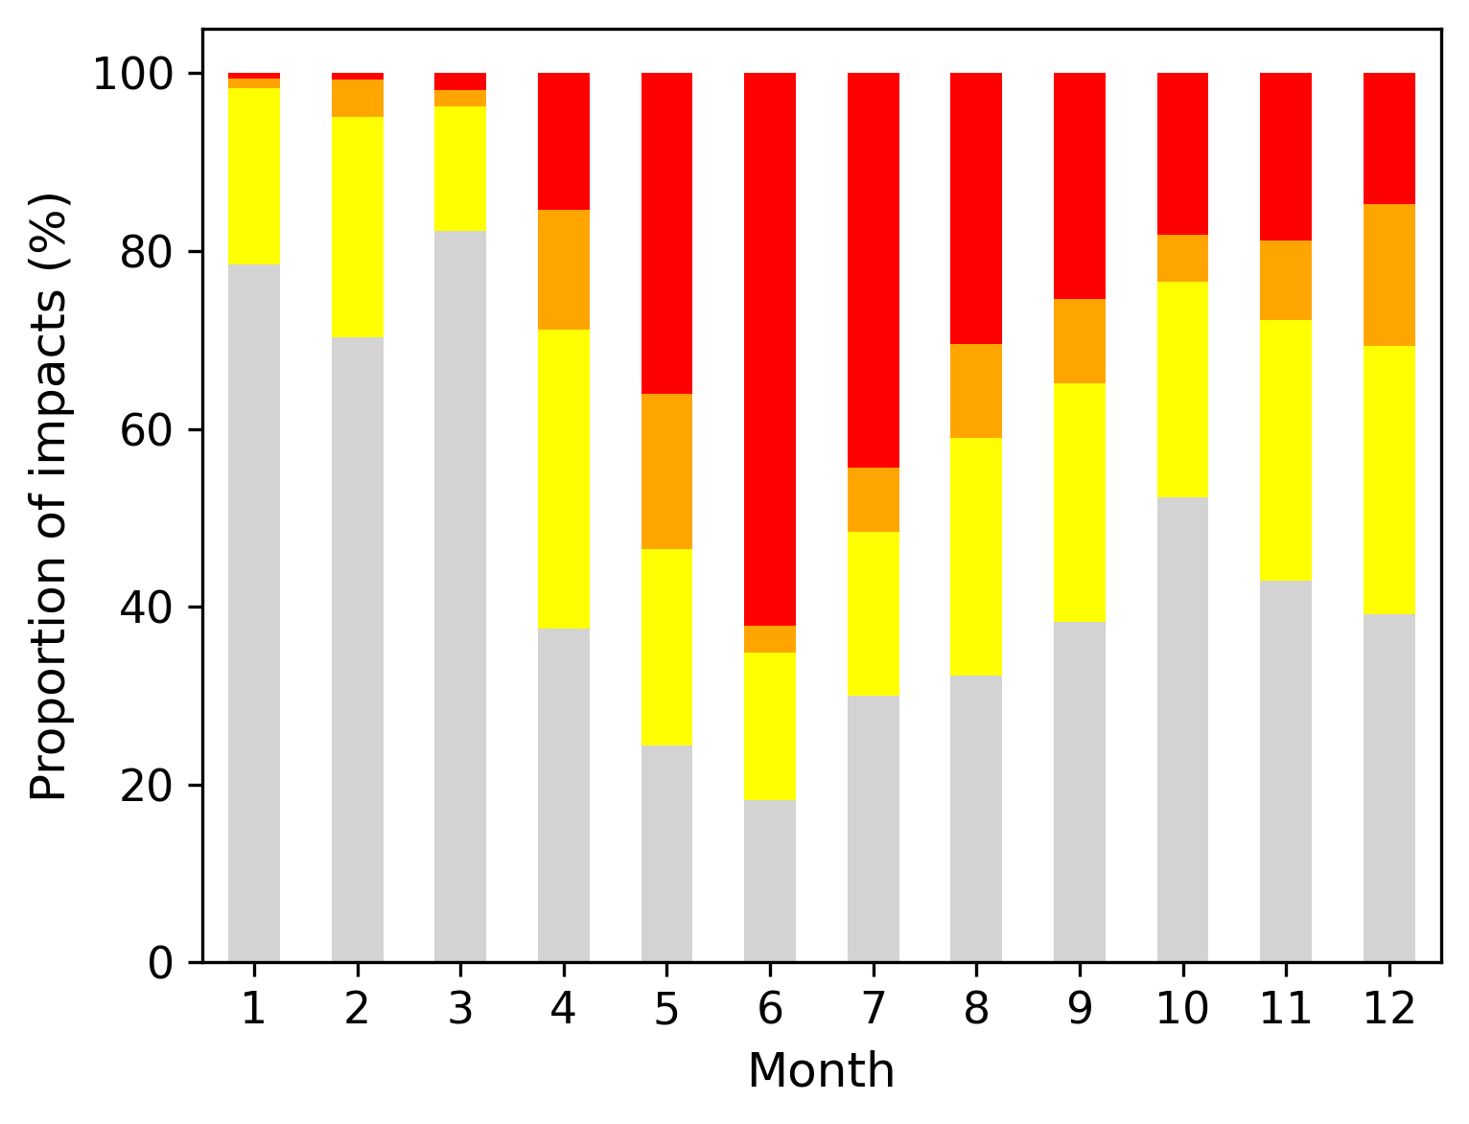
Conclusion
Home
Methodology
Evaluation
Impact filtering
Sub-daily model
Beyond streamflow
Case study
Conclusion
Important to filter only relevant impacts
Sub-daily runoff is effective in explaining summer cloudbursts
Impacts from winter processes (urban melt, rain-on-snow) still not represented well in the S-HYPE model
Abstract page
Contact:
jiri.svatos@ec.europa.eu
niclas.hjerdt@smhi.se
www.linkedin.com/in/jiri-svatos
Original methodology
New methodology

Slide 26
References
[1] Lindström et al. (2010). Development and testing of the HYPE (Hydrological Predictions for the Environment) water quality model for different spatial scales. Hydrology Research, 41(3-4), 295-319.
[2] Fuentes-Andino et al. (2022). Exploring the potential for parameter transfer from daily to hourly time step in the HYPE model for Sweden. Hydrological Sciences Journal, 67(13), 1988-2001
[3] https://www.smhi.se/data/nederbord-och-fuktighet/nederbord/griddad-nederbord--och-temperaturdata
[4] Bergstrand et al. (2014). Nationwide hydrological statistics for sweden with high resolution using the hydrological model s-hype. Hydrology Research, 45(3), 349–356.

