Slide 1

Open-source Fluorescence Sensing with a Turbidity Correction Model for Community-based Freshwater Monitoring
Riccardo G. Cirrone - PhD. Student
DBCF – University of Siena
DISTEM – University of Palermo

Slide 2
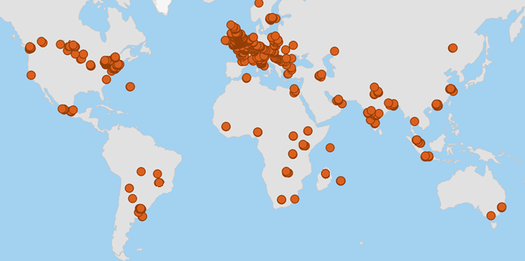



Communities and sensors
Impact of CS: data integration
Challenges: debate on data quality (ex. accuracy, reliability)
Citizen Science

Slide 3

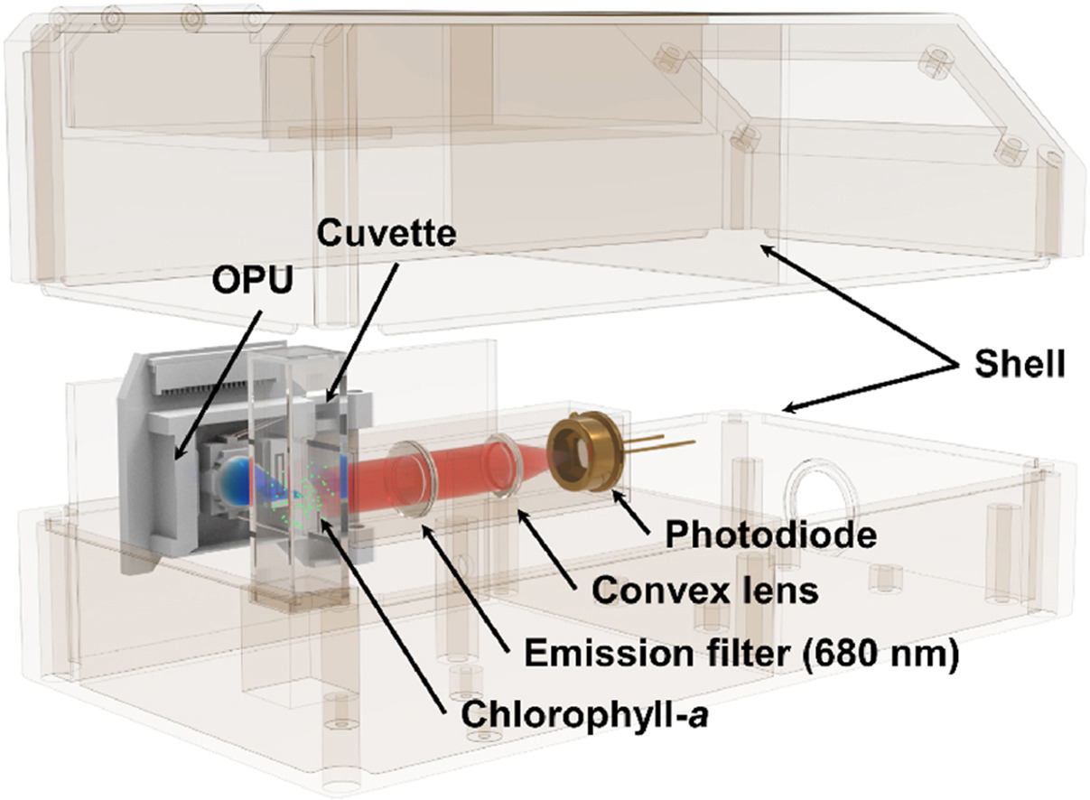
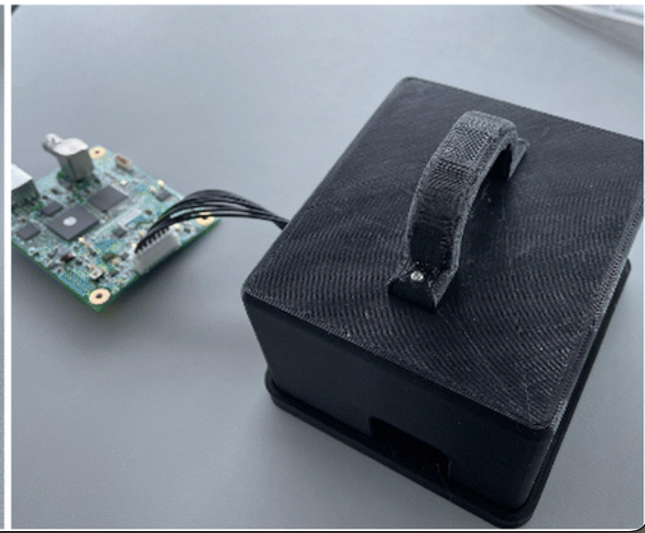
State of the art
Low-cost (160 – 500 €)
Data transmission
Insufficient validation
Chen et al. Talanta (2024)
Power et al. Analytical Methods (2023)

Slide 4
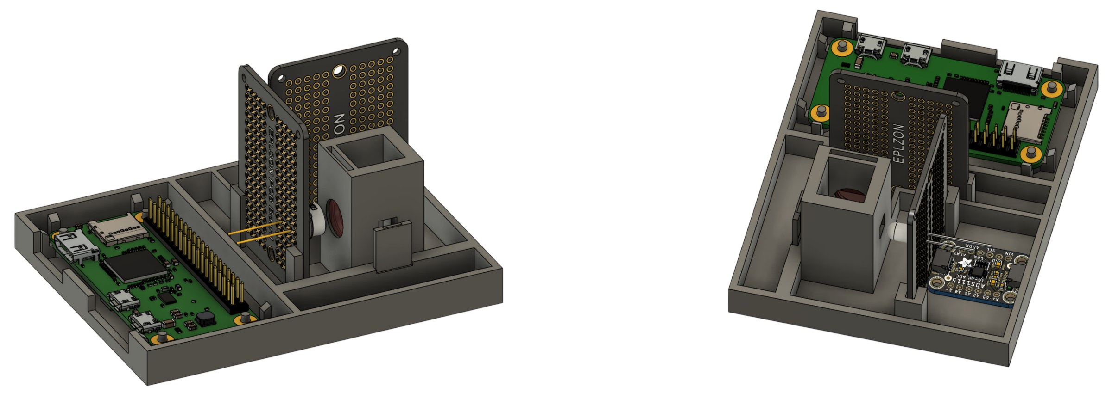
The technological concept
Microcomputer
Chip LED 430nm
Optical filter
IR LED
Photodiode
16-bit ADC

Slide 5
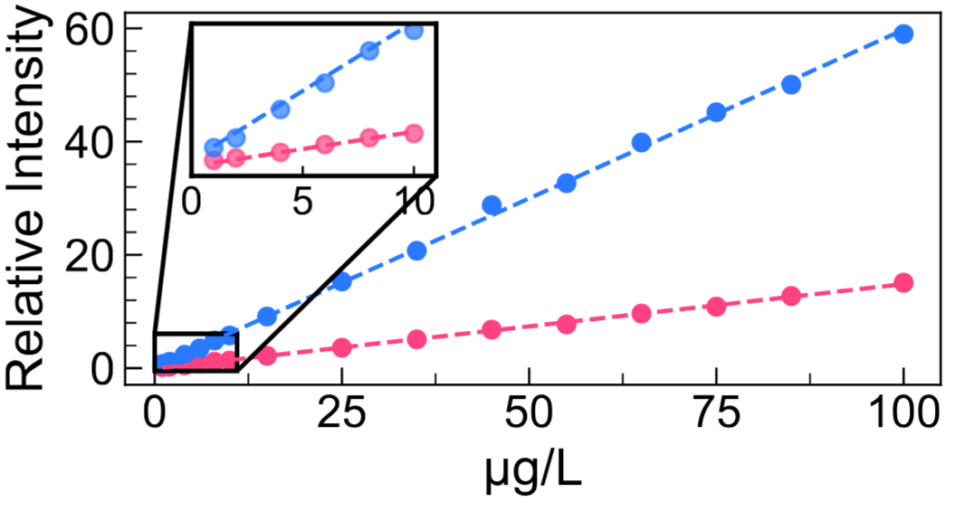
Proof of concept
-- Cary Eclipse --
-- Low-cost sensor --
High linearity also in the range 1-10 ppb
6+ calibration curves
Intra-day and inter-day experiments

Slide 6
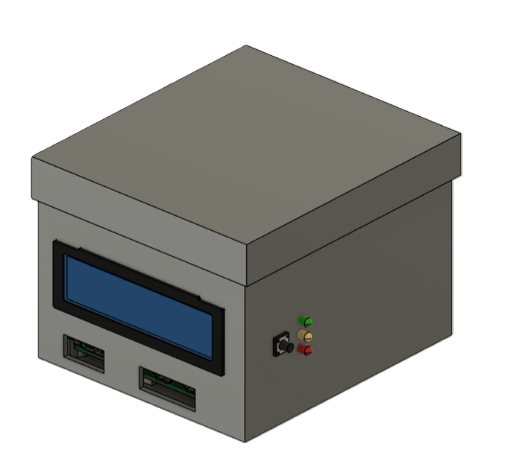
Analytical performance
Parameter | Chlorohyll-a | Turbidity
Relative bias (%) | < 6% | 7%
RSD (%) | < 1.5% | 7%
LOQ | 0.28 µg/L | 7.28 NTU
6 cm
7.5 cm
9 cm
Cost - 99€
https://github.com/LowCostSensor/FROG-sensor

Slide 7
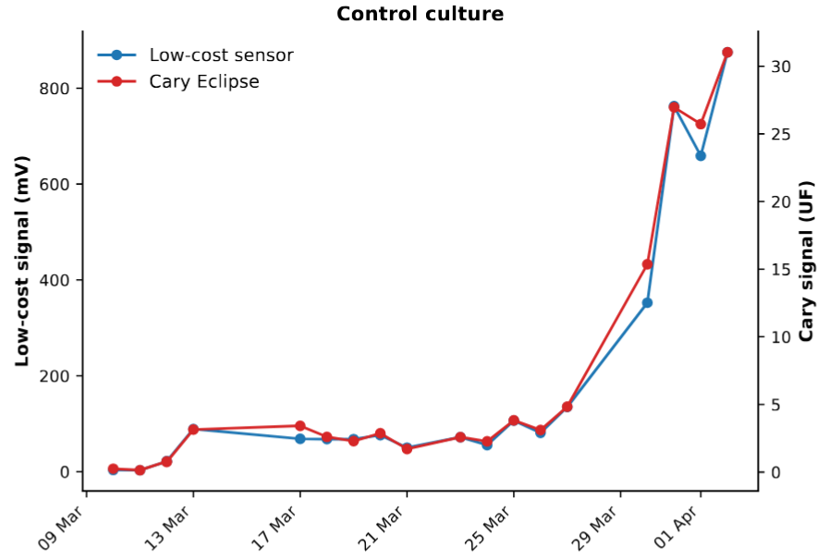
Following temporal dynamics
Following phytoplankton biomass growth
Consistency with a benchtop instrument

Slide 8
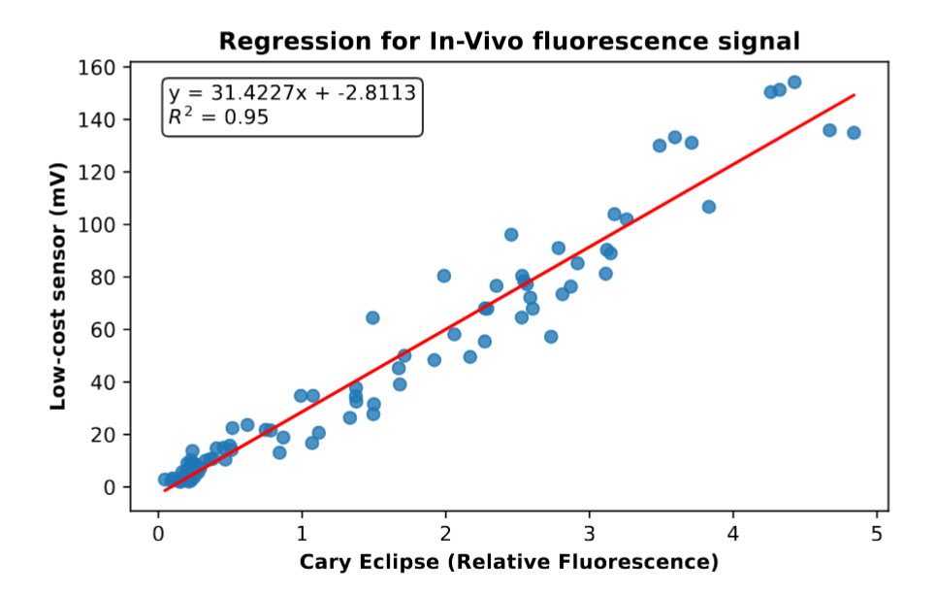
In-vivo testing and correction model
More than 60 real samples
Chlorohyll within 1-100 µg/L

Slide 9
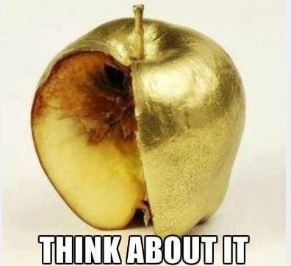
In-vivo testing and correction model
Dataset | RMSE (μg/L) | Bias (%) | RPD%
Raw data | 12.71 | 26.48 | 24.43
Linear model (training) | 5.30 | 2.99 | 15.92
Linear model (5-fold validation) | 5.47 | 2.79 | 16.00
Still site-specific due to physiological conditions

Slide 10

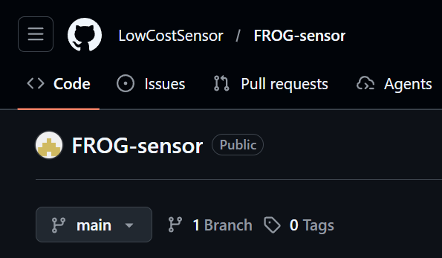
Conclusions
Low cost (100 €)
Portability for field use
Open data
Lab and field testing
ONGOING Challenges
1. Site-specific calibration
2. Additional parameters for correction

