Slide 1

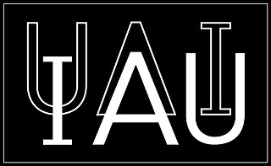




On the corrections to precession and nutation models that can be implemented to reduce their uncertainties at the short term
José M. Ferrándiz, Alberto Escapa, Maria Karbon, Santiago Belda

Slide 2
Context -
The last IERS/GGOS Unified Analysis Workshop (UAW2026) was held in March 2026 and hosted a Session on Updates to the IERS Conventions
The outcomes include to "Update precession and nutation models in chapter 5" – named "Transformation between the International Terrestrial Reference System and the Geocentric Celestial Reference System" - https://geodesy.science/wp-content/uploads/06_IERS_Conventions_Outcomes.pdf
This update is based on the proposal issued by the IAU/IAG JWG on Consistent Improvement of Earth's Rotation Theory (CIERT) in line with recent IAG and IAU resolution. It can be summarized as applying certain corrections to the official precession and nutation (PN) models (IAU2006 and IAU2000) that can be implemented in the short term to reduce the deviations between observations and models in a consistent way and explain their variance further.
These corrections are
Updating the precession model to the IAU2006_J2 (Liu & Huang, A&A Dec. 2025)
Replacing the rigid-earth planetary nutations by consistent non-rigid-earth ones, what can be approximated by correcting the latter with the main analytically derived non-rigid planetary Oppolzer terms
Using semi-empirical corrections to the amplitudes of some nutation periods, obtained by fitting to VLBI observations and statistically significant https://geodesy.science/wp-content/uploads/02_UAW2026_IERS_chapter_updates.pdf

Slide 3
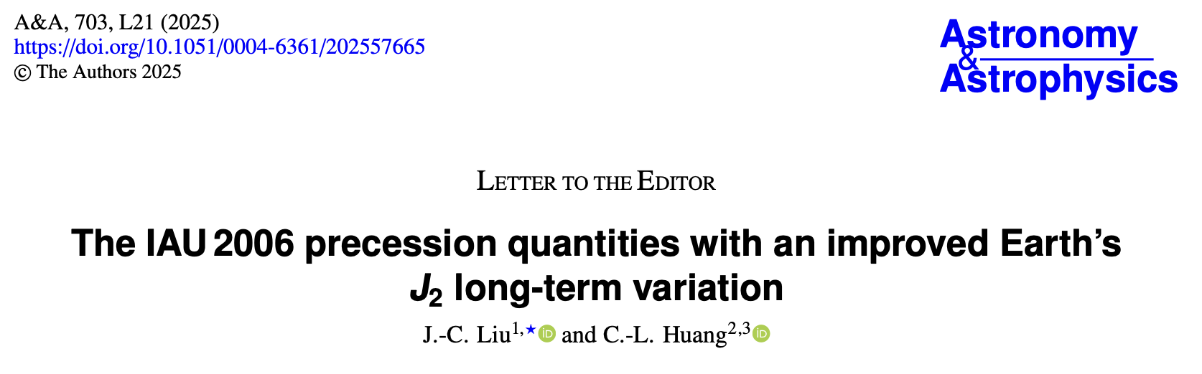
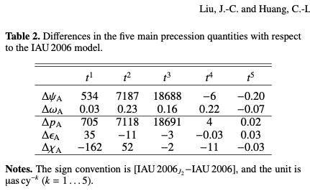
1. The IAU2006_J2 update of the precession model based on the observed J₂ variation
Liu and Huang recently published an update of IAU2006 (A&A, Dec. 2025) assuming a J₂ quadratic time variation as observed, and provided corrections ready to be applied
Figure: dX deviation is growing: today it amounts 340 𝝻as and will exceed 450 𝝻as in 5 years Notice the precession theory itself can be considered as kept, because only some "numbers" (model coefficients) are updated, not the approach. Also, dY is not affected
Notes:
Recently Liu and Huang published an update of IAU2006 (A&A, Dec. 2025) assuming a J₂ variation quadratic in time, and provided corrections ready to be applied (see the table below)
In the figure we can see that the dX deviation is growing: today it amounts 340 𝝻as and will exceed 450 𝝻as in 5 years
Notice the precession theory itself can be considered as kept, because only some "numbers" (model coefficients) are updated, not the approach. Also, dY is not affected

Slide 4
The IAU2006_J2 update of the precession model: Effect on dX accuracy
The effect is clearly seen in the VLBI solutions, correcting for precession (= using IAU2006_J2) the dX unwanted curvature desappears. On the right, the WRMS for dX from the IVS quarterly combined solution ivs24q4X for the 1984-2025 period is shown splitting it from 1 up to 16 parts - following the powers of 2. Uncorrected: top row, corrected: bottom

Slide 5
Precession model update: Supplemental corrections
Prior to the J₂ model update, most research on improving precession centered on revising its linear component.
This is still the only approach applicable to dY. Trying it for dX is also worth it, since the constant term of the precession parameter H_{d} cannot be inferred from J₂ yet and is the main component of dX rate
Linear fits of CPO solutions result in smaller but significant corrections for the dX rate and also for the dX and dY offsets, with a significant WRMS decrease
The plots below show results for dY. They display the WRMS computed for the entire period 1984-2025 and several subintervals. Left: original ivs24q4X, right: linear precession corrected. The WRMS reduction is evident

Slide 6
Precession model update: Account of effects on WRMS for some VLBI solutions
Tables below show the decrease of the WRMS of several VLBI solutions after applying:
first the IAU2006_J₂ correction (only to dX) (last but 1 column)
then, adding corrections to rates & offsets, fit to each VLBI solution (last column)
The long-term combined solution from IVS is highlited, and gives the lowest WRMS (units: 𝝻as)

Slide 7
2 & 3. Corrections for updating the nutation model IAU2000
The performance of the nutation corrections agreed at the UAW 2026 is shown next
Let us recall they can be cast into two types
Corrections to the planetary nutations made up by the main Oppolzer terms for a two-layer non-rigid earth, taken from a recent analytical solution (namely, a refinement of the 2018 Hamiltonian one by Ferrándiz et al)
semi-empirical corrections to the amplitudes of a reduced number of forced nutations, most of which belong to the lunisolar block
Of the many approaches developed within the IAU/IAG JWG CIERT, this set achieved the highest WRMS reduction for the tested VLBI solutions

Slide 8
Improvement of dX accuracy/repeatability by the PN model corrections
In blue there is the ivs24q4X combined IVS solution after applying all the corrections for precession and nutation. WRMS decreases from 200+ to about 120 𝝻as in 1984-2025
Top: corrected; bottom: uncorrected. Be aware of the various vertical ranges

Slide 9
Improvement of dY accuracy/repeatability by the PN model corrections
In blue there is the ivs24q4X combined IVS solution after applying all the corrections for precession and nutation. WRMS decreases from 170 to about 120 𝝻as in 1984-2025
Top: corrected; bottom: uncorrected. Pls be aware of the various vertical ranges

Slide 10
Effect of Precession & Nutation corrections on the WRMS for several solutions
Tables below show the decrease of the WRMS of several VLBI solutions after applying:
first, only the precession corrections,
Then, the nutation corrections - fitted to each solution (units: 𝝻as)
The long-term combined IVS solution is highlighted. It gives the lowest WRMS, close to 120 𝝻as

Slide 11
Final comments and remarks - 1
Precession and nutation angles are commonly expressed by the coordinates (X, Y) of the Celestial Intermediate Pole (CIP) in the geocentric celestial reference frame (GCRF) – the CIP paradigm
(X, Y) are the largest EOP but they can be approximated by deterministic theories with high accuracy (IAU2000/IAU2006 are the current conventional ones)
CPO are defined as differences (dX, dY) between the observed CIP coordinates (X, Y) and and its nominal position (X_{model}, Y_{model}) according to a given PN model. Therefore, they depend on the PN model unlike (X, Y)
The CPO gather all the deficiencies of the adopted PN models/theories, along with a slate of unknown or poorly modeled effects, as well as random variations. A reference for the magnitude of their variability is around 200-300 𝝻as in WRMS
These effects can be investigated more thoroughly if the CPO variability attributable to the PN model can be reduced. This is a compelling scientific justification for improving the models
Since the updated model significantly reduces the CPO unexplained variability, it is expected to advance practical applications such as Free Core Nutation research, CPO prediction, analysis of VLBI intensive sessions, or interpolation of solutions to yield denser and/or evenly spaced time series
Once again, the more accurate and consistent a model or theory is, the more useful it is for science and applications

Slide 12
Final comments and remarks - 2
Some additional coments from a more practical standpoint:
the IVS and IERS monitor and report the values of dX = X_{observed} – X_{IAU} dY = Y_{observed} – Y_{IAU} , and (X, Y) are recovered from them
When the model is updated as agreed at the UAW2026, let's say to (X_{UPD}, Y_{UPD}), the corresponding CPO must be updated to dX_{UPD} = X_{observed} – X_{UPD} dY_{UPD} = Y_{observed} – Y_{UPD}
If the model update is performed by adding corrections (𝚫X, 𝚫Y) to the IAU model, so that X_{UPD} = X_{IAU} + 𝚫X, etc the updated CPO are related to the standard ones by the same corrections (with reversed sign), dX_{UPD} = dX_{IAU} - 𝚫X, etc
Therefore, any existing standard CPO solution (dX_{IAU} , dY_{IAU} ) can be strightforward transformed into updated CPO by simply subtracting the corrections added to the IAU model Note the difference of this indirect procedure with the results of a direct CPO estimation from VLBI data must be mainly numerical and not larger than some 𝝻as
When analyzing VLBI sessions, remember that the IAU PN model must be updated with the corrections to compute the rotation matrix at (X_{UPD,} Y_{UPD}). Additionally, CPO values used as apriori must be updated by subtracting corrections. For instance, the conventional C04 CPO should be transformed into the updated C04 by subtracting 𝚫X and 𝚫Y from dX and dY.

Slide 13
THANK YOU!
Research supported by Generalitat Valenciana (SEJIGENT/2021/001), the European Union—NextGenerationEU (ZAMBRANO 21-04) and by Spanish Project PID2020-119383GB-I00 funded by Ministerio de Ciencia e Innovación (MCIN/AEI/10.13039/501100011033/).

