Slide 1




Estimating Vulnerable Carbon in Thawing Northern High-Latitude Permafrost using CMIP6 Climate Projections Imran Nadeem¹, Nebojsa Nakicenovic², Asma Yaqub¹, Boris Sakschewski³, Sina Loriani³, Govindasamy Bala⁴, Thejna Tharammal⁴, Caroline Zimm², and Hafsa Aeman⁵ ¹Institute of Meteorology and Climatology, BOKU University, Vienna, Austria ²International Institute for Applied Systems Analysis, Laxenburg, Austria ³Potsdam Institute for Climate Impact Research, Potsdam, Germany ⁴Indian Institute of Science, Bangalore, India ⁵International Water Management Institute, Lahore, Pakistan
Notes:
Work done in phase 1 of Earth Commision in collaboration with IIASA and PIK

Slide 2
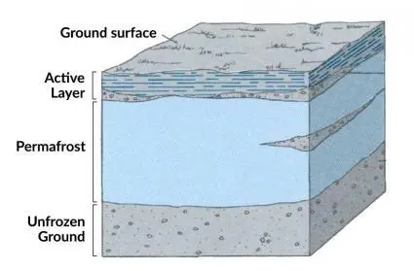
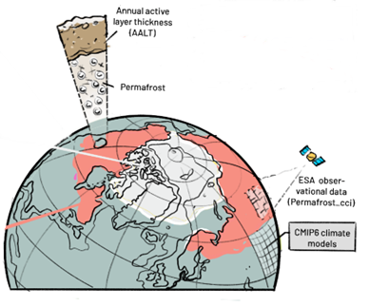
Introduction:
Permafrost, defined as ground that remains frozen (T < 0 °C) for an extended period, typically for at least two years, covers nearly a quarter of the Northern Hemisphere land region.
The annual active layer thickness (ALT), defined as the maximum annual thaw depth of permafrost, was estimated using data from 34 models participating in the CMIP6 for four future scenarios SP1-2.6, SSP2-4.5, SSP3-7.0, and SSP5-8.5
Estimates of vulnerable carbon, referring to organic carbon in thawed permafrost, are derived based on projected future changes in bias-corrected ALT (Re-constructed ALT).
Validation using Simulations done with Lund-Potsdam-Jena managed Land; LPJmL simulates soil temperature, freeze–thaw cycles, permafrost dynamics, and soil carbon fluxes for comparison with ALT estimates
Notes:
Vulnerable carbon # Released Carbon

Slide 3
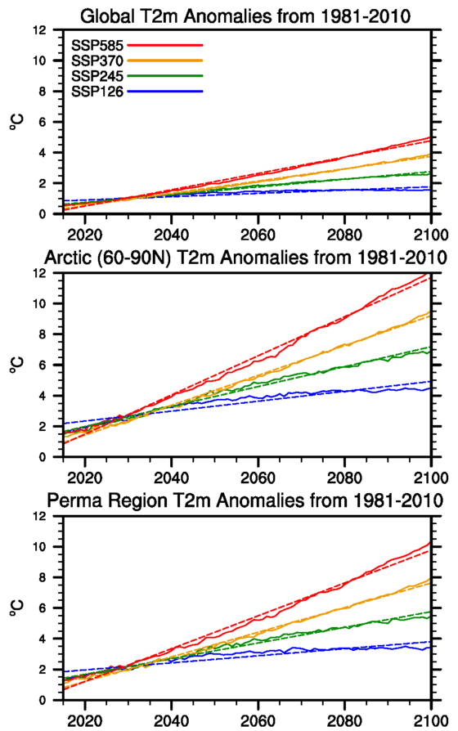
Global Temperature Change vs. Permafrost Region Temperature Change
Arctic amplification, defined as the ratio of high-latitude temperature change to global mean surface temperature change, accelerates the thawing of permafrost as the region experiences faster warming, releasing trapped greenhouse gases and further amplifying climate change.
While the Arctic experiences 3- to 4-times more warming than the global average, the permafrost region shows more than double the warming compared to the global average.
Notes:
Dotted line = Regression Line

Slide 4





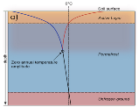



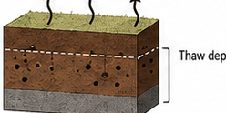
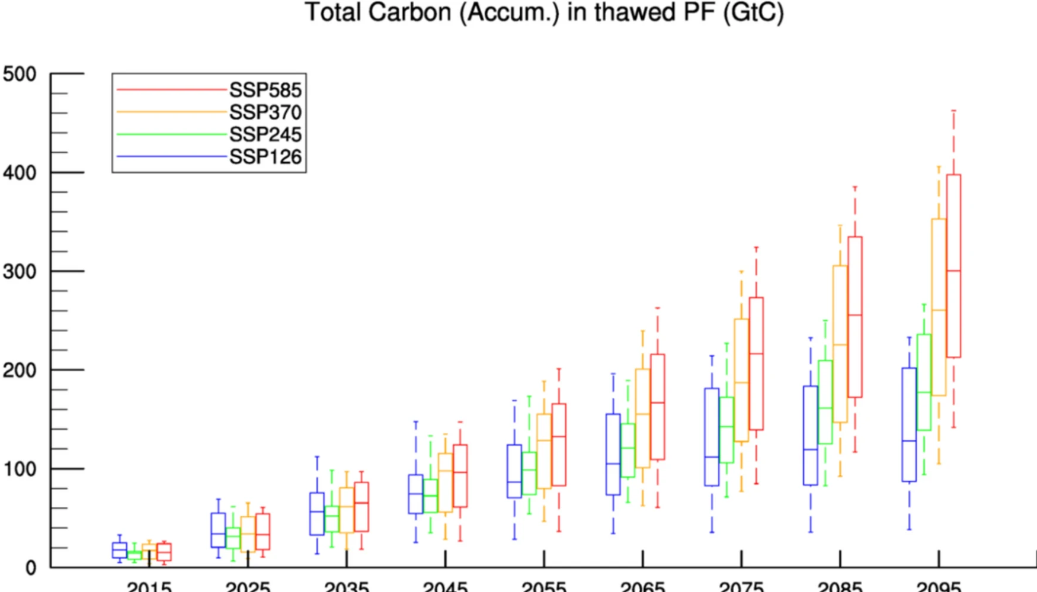
Workflow for estimating vulnerable permafrost carbon
Background
Validation
Amplified warming:
Global → Arctic → Permafrost regions
Compare reconstructed ALT with LPJmL simulated ALT; 50th percentile) gives best fit
Input data
Future thaw projection
34 CMIP6 models
4 SSP scenarios
Observed CCI Permafrost data from ESA
Annual and decadal ALT / thaw–depth changes until 2100
across the full spread of CMIP6 models
Problem ( Most CMIP6 GCMs lack permafrost physics)
3D carbon profile development
Direct ALT from CMIP6 soil temperature
≠ observed ALT (biased / mismatch)
3D soil organic carbon profile up to 10m depth
5 cm vertical resolution
based on multiple existing values in the literature
Key concept
ALT sensitivity to MAAT (Chadburn et al. 2017)
using thaw data up to 3 m
Vulnerable carbon estimation
Sensitivity selection
Thaw–depth change → 3D SOC profile
→ carbon newly exposed to thaw
→ accumulated vulnerable permafrost carbon
Select 5th, 50th, and 95th percentiles
to cover full spread
Bias-adjusted ALT reconstruction (based on MAAT)
Final output / uncertainty
Future ALT = Observed ALT
+ local warming × ALT sensitivity (modified from Burke et al. 2013)
Future projections of ALT and vulnerable carbon
on a decadal basis across CMIP models till 2100
ALT_future = ALT_obs + ΔT (local warming) × ALT_sensitivity

Slide 5
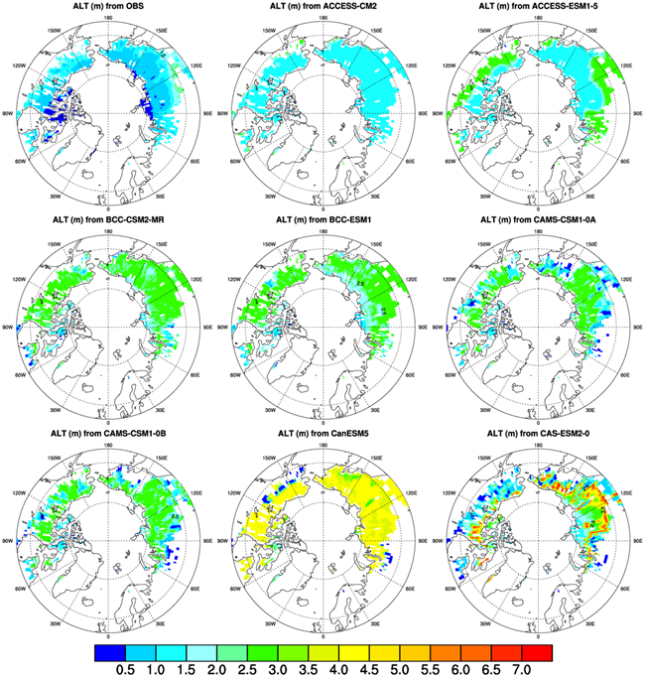
Direct ALT Calculation from Soil Temperatures Leads to Unrealistic Values
ALT from CMIP6 monthly mean soil temperature for each model grid.
Thaw depth = deepest layer with T ≥ 0 °C (per month)
Permafrost if max ALT < 3 m (or model max depth < 3 m)
This represents “near-surface” permafrost (Koven et al., 2013)
ALT masked using observed ESA CCI Permafrost data
Notes:
Permafrost region is masked using mask created with observation. A common issue is that these models can produce excessive warming at depth, which artificially deepens the simulated active layer.

Slide 6
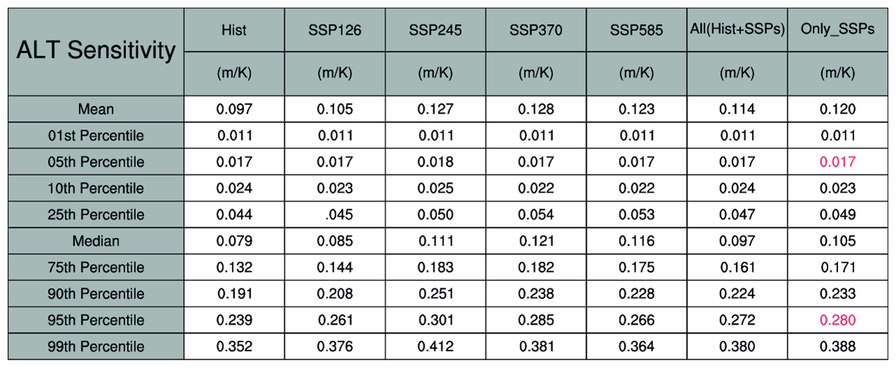
Calculation of Bias Corrected ALT using ALT Sensitivity
At a large scale, the presence of permafrost is predominantly controlled by the mean annual air temperature (MAAT) (Chadburn et al., 2017). As neither CMIP5 nor CMIP6 models (Burke et al., 2013) include permafrost-carbon feedback, the physical state of the permafrost has to be quantified from bias-adjusted ALT.
This study uses three values of ALT sensitivity (5th, median, and 95th percentiles) to capture the full range of uncertainty in future ALT estimations.

Slide 7
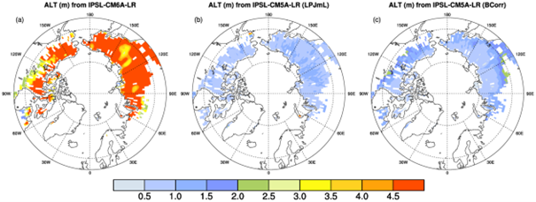
Calculation of Bias Corrected ALT using ALT Sensitivity at grid level.
ALT time series are then reproduced for each grid by combining the previously calculated ALT with ALT_{sensitivity} based on local mean near-surface air temperature change (Burke et al., 2013). The equation used for reconstruction of the ALT time series is:
ALT_{max}(t,x,y) = ALT_{max}(t-1,x,y) + ALT_{sensitivity}[T_{local}(t,x,y) – T_{local}(t-1,x,y)]
where ALT_{max}(t=0, x,y) = ALT^{b}_{max}(x,y)
Here T_{local} is the local air temperature, t is the time, and x,y identifies each grid cell that has permafrost. The base ALT^{b}_{max} is the maximum ALT for the period 2011–2015 calculated from the observational data.

Slide 8
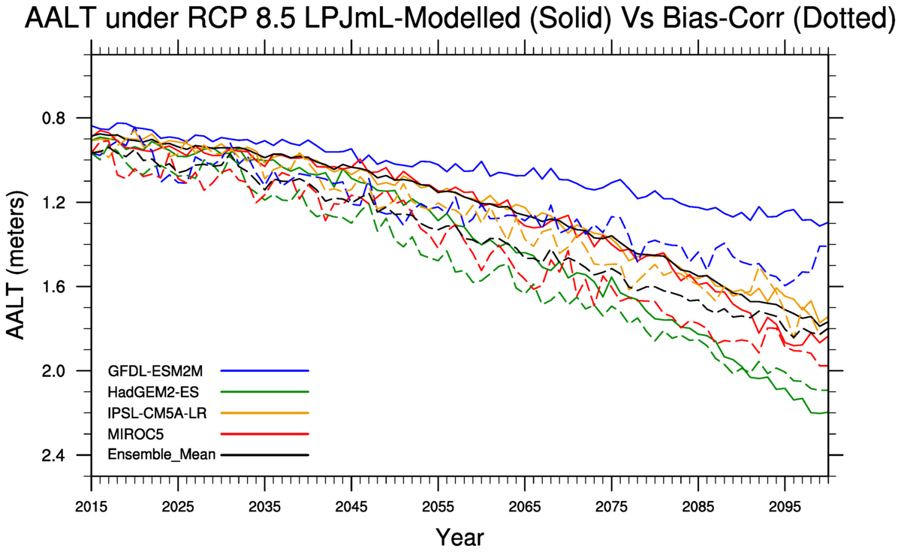
Validation of Bias Corrected ALT using median value of ALT_{Sensitivity}

Slide 9
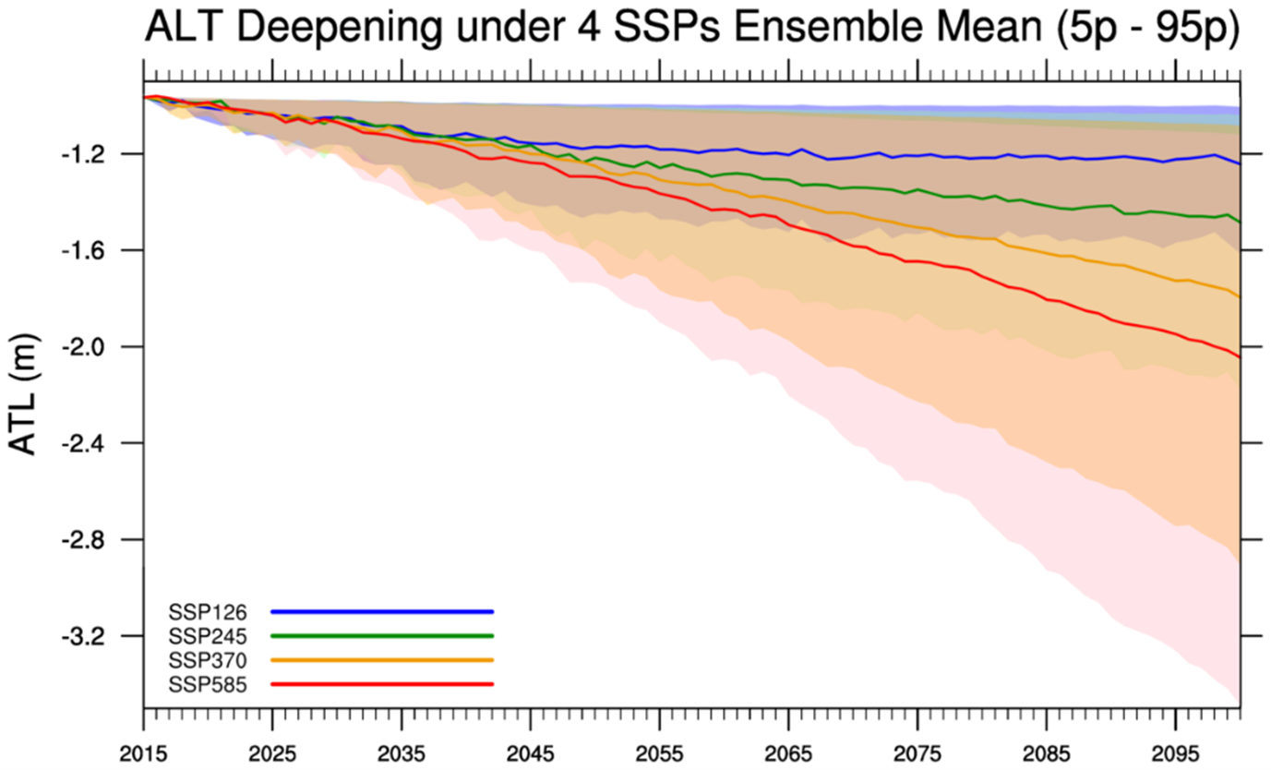

Slide 10
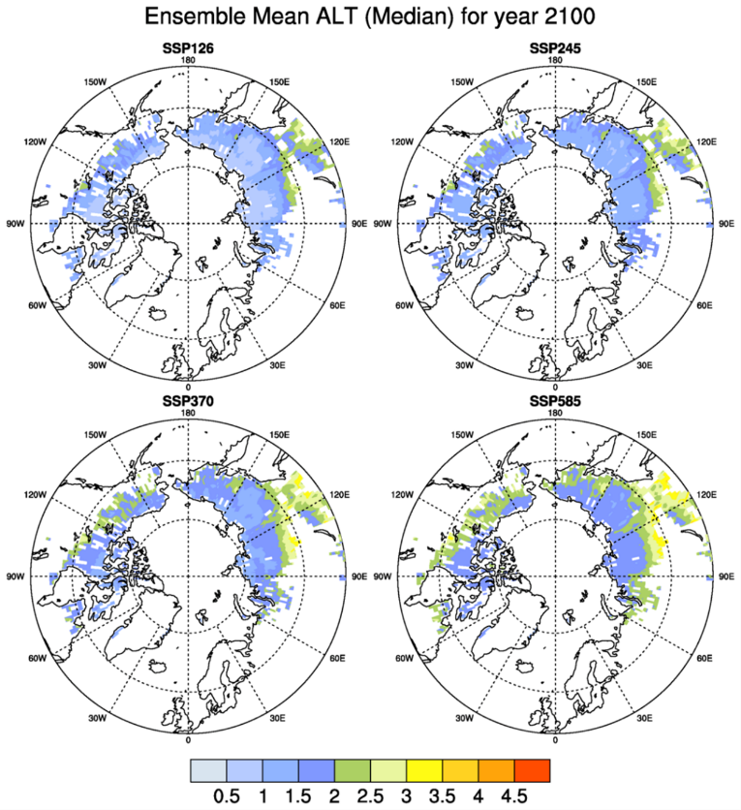
ALT Projections for 2100 under Various Scenarios using median value of ALT_{Sensitivity}

Slide 11
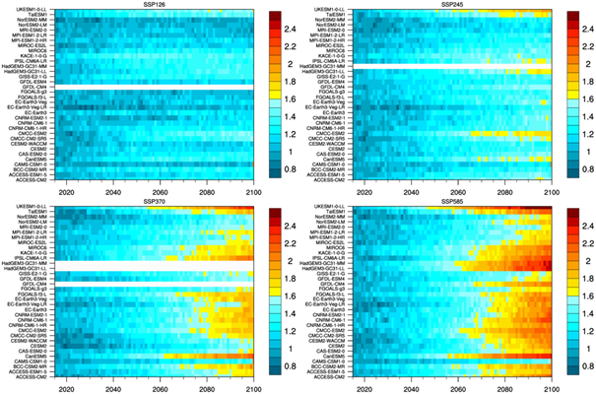
Temporal development of ALT thickness for 34 model, under four scenarios based on median value of ALT_{Sensitivity}

Slide 12
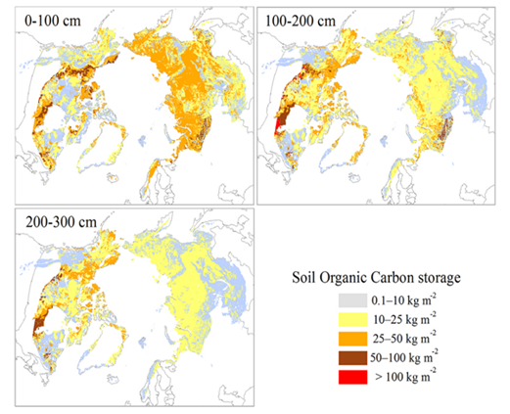
Carbon stock estimates (3D profile with 5cm vertical resolution)
We used spatial distribution data of soil organic carbon (SOC) for depths up to 3 meters (Hugelius et al., 2014) and estimates for deeper layers from (Strauss et al., 2017) and others.
A quadratic regression model is applied to these values, ensuring consistency in total SOC from 0 to 10 meters.
We further interpolates SOC at 5 cm intervals and spatially distributes the carbon based on observed horizontal patterns, providing detailed estimates of vulnerable carbon in thawing permafrost for future climate scenarios
Depth below ground (m) | Carbon per m (GtC) | Accum. Carbon (GtC)
0 - 1 | 472 | 472
1 – 2 | 355 | 827
2 - 3 | 207 | 1034
3 - 4 | 123 | 1157
4 - 5 | 105 | 1262
5 - 6 | 88 | 1350
6 - 7 | 70 | 1420
7 - 8 | 53 | 1473
8 - 9 | 35 | 1508
9 - 10 | 18 | 1526
Source: Hugelius et al., 2014

Slide 13
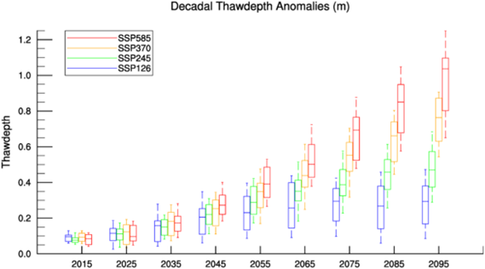
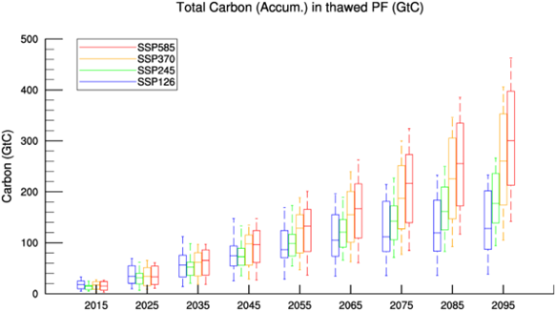
Thawdepth & Corresponding Vulnerable Carbon based on median value of ALT_{Sensitivity}

Slide 14
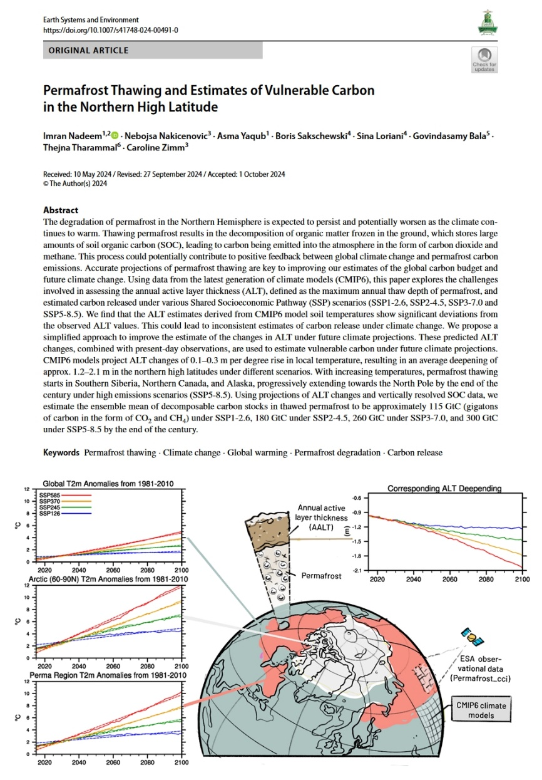
Conclusions
CMIP6 models project changes in active layer thickness (ALT) of 0.1–0.3 meters per degree rise in local temperature, leading to an average deepening of 1.2–2.1 meters in northern high latitudes by the end of the century.
Estimated decomposable carbon stocks in thawed permafrost are 115 GtC under SSP1-2.6 (~10 years of current global anthropogenic carbon emissions), 180 GtC under SSP2-4.5 (~16 years), 260 GtC under SSP3-7.0 (~22 years), and 300 GtC under SSP5-8.5 (~26 years) by 2100.
The release of 115–300 GtC from thawing permafrost could significantly contribute to climate change by increasing atmospheric concentrations of CO2 and CH4, leading to positive feedback loops.
Improving climate models to better capture subsurface processes and soil temperature profiles is essential for more accurate predictions of permafrost thaw and its global carbon budget impacts.

Slide 15
Workflow for estimating vulnerable permafrost carbon
Background
Validation
Amplified warming:
Global → Arctic → Permafrost regions
Compare reconstructed ALT with LPJmL simulated ALT; 50th percentile) gives best fit
Input data
Future thaw projection
34 CMIP6 models
4 SSP scenarios
Observed CCI Permafrost data from ESA
Annual and decadal ALT / thaw–depth changes until 2100
across the full spread of CMIP6 models
Problem ( Most CMIP6 GCMs lack permafrost physics)
3D carbon profile development
Direct ALT from CMIP6 soil temperature
≠ observed ALT (biased / mismatch)
3D soil organic carbon profile up to 10m depth
5 cm vertical resolution
based on multiple existing values in the literature
Key concept
ALT sensitivity to MAAT (Chadburn et al. 2017)
using thaw data up to 3 m
Vulnerable carbon estimation
Sensitivity selection
Thaw–depth change → 3D SOC profile
→ carbon newly exposed to thaw
→ accumulated vulnerable permafrost carbon
Select 5th, 50th, and 95th percentiles
to cover full spread
Bias-adjusted ALT reconstruction (based on MAAT)
Final output / uncertainty
Future ALT = Observed ALT
+ local warming × ALT sensitivity (modified from Burke et al. 2013)
Future projections of ALT and vulnerable carbon
on a decadal basis across CMIP models till 2100
ALT_future = ALT_obs + ΔT (local warming) × ALT_sensitivity

Slide 16
