Slide 1



EGU 2026
A Dual-Model Approach to Better
Generalize Individual Tree Water Use
From sensor-specific magnitude to ecologically transferable transpiration estimates
Deep Prakash Sarkar, Rafael Poyatos, Anke Hildebrandt, Sung-Ching Lee, Basil Kraft, Jacob A. Nelson
Scan for paper / contact
Notes:
Hello, I'm Deep Sarkar from the Max Planck Institute for Biogeochemistry. Today I'll present a dual-model approach for generalizing individual tree water use across the SAPFLUXNET network. This is joint work with Rafael Poyatos, Anke Hildebrandt, Sung-Ching Lee, Basil Kraft, and Jacob Nelson.

Slide 2
MOTIVATION
Trees move most of the water that leaves the land
FROM ECOSYSTEM TO TREE
~ 40 %
of land-surface precipitation
returns to the atmosphere
as plant transpiration
Atmosphere
global water + carbon cycle
Ecosystem ET
eddy-covariance, footprint
Hidden
inside the eddy-covariance signal —
ET is measured well, but transpiration
is not separable from soil evaporation
Stand transpiration
partitioned, hard to validate
Tree-level sap flow
direct in-situ observation
Sap flow
the only direct, continuous,
tree-level transpiration observation
we have
SAPFLUXNET
~2,500 trees · global
◀ we work here
TREEFLOW · EGU 2026
2 / 19
Notes:
Tree transpiration returns roughly forty percent of land precipitation to the atmosphere. Eddy covariance gives us ecosystem ET, but transpiration cannot be cleanly separated from soil evaporation at the flux-tower scale. Sap flow remains our only direct, continuous, tree-level transpiration observation. SAPFLUXNET aggregates around 2,500 trees from 190 sites — and that is the scale at which we work.

Slide 3
01
PART ONE
The Problem
Sap-flow data is rich, but heterogeneous —
and machine learning struggles to generalize across it.
TREEFLOW · EGU 2026
3 / 19
Notes:
Let me first frame the problem with this data.

Slide 4
THE DATA DILEMMA
Sensors agree on shape, disagree on magnitude
Heat Balance
Thermal Dissipation
Heat Pulse
Total heat balance around the
stem section.
Sensitive to stem geometry.
Granier method — most widely used.
Underestimates at high flow rates;
calibration is species-specific.
Probe wounds disrupt local heat
and water transport — worsens with
time since installation.
Diurnal shape is robust.
Absolute magnitude is not.
✓
when peak occurs, how curve rises and falls
captured well across all sensors
✕
how much water actually moves
biased by sensor type, wounding, wood anatomy
Flo et al. (2019) Agric. For. Meteorol. 271: 362–374
TREEFLOW · EGU 2026
4 / 19
Notes:
Three sap-flow methods dominate the network — heat balance, thermal dissipation, and heat pulse. Each has known biases: thermal dissipation underestimates at high flow rates and is species-specific; heat pulse is sensitive to wound effects; heat balance depends on stem geometry. Flo and colleagues showed in 2019 that diurnal shape is consistent across these methods, but absolute magnitude is not. This sensor-driven magnitude bias is the central challenge for any cross-site model.

Slide 5
THE GENERALIZATION GAP
ML works at one site — and collapses across sites
Within-site
Across sites (leave-trees-out)
0.85 – 0.95
0.30 – 0.45
R²
≈
collapses
by half
R²
≈
Train and test on the same site:
impressive accuracy. Temporal
autocorrelation does the heavy lifting.
Models tested on unseen sites,
species, or sensor types collapse.
They learn sensor-specific magnitude
artefacts.
Takeaway: Magnitude estimation, not shape, is the bottleneck for global transferability.
TREEFLOW · EGU 2026
5 / 19
Notes:
The consequence shows up clearly in machine-learning evaluation. When we train and test within a single site, R-squared sits between 0.85 and 0.95 — but most of that performance is temporal autocorrelation. When we hold out entire trees and sites in a leave-trees-out scheme, R-squared collapses to between 0.30 and 0.45. The model has been learning sensor- and site-specific magnitude artefacts rather than the underlying physiology. The takeaway is that magnitude estimation, not diurnal shape, is the bottleneck for global transferability.

Slide 6
02
PART TWO
The Approach
Decouple shape from magnitude.
Let each model do what it's good at.
TREEFLOW · EGU 2026
6 / 19
Notes:
Our approach is to decouple the two — let each sub-model do what it is best suited for.

Slide 7
MODEL ARCHITECTURE
Single model vs Dual model: a different decomposition
SINGLE MODEL · baseline
DUAL MODEL · ours
XGBoost
Magnitude · Random Forest
predicts physical envelopes from static info
predicts raw sap flow directly
sap_q90 90th-percentile peak
sap_nt nighttime baseline
ŝap = f( weather, static features )
Temporal · XGBoost
3D weather (ERA5 hourly)
predicts a normalized shape from weather
Static tree & site features
ŝap_q = ( sap − sap_nt ) / ( sap_q90 − sap_nt )
Engineered climate features
→ unitless, comparable across trees
Re-assembly ŝap = ŝap_q · (q90 − nt) + nt
↘ Learns sensor-specific magnitude artefacts.
Fails to transfer across sites and species.
↗ Shape and magnitude carry independent error budgets — the regression doesn't have to absorb both.
TREEFLOW · EGU 2026
7 / 19
Notes:
On the left is the baseline: a single XGBoost predicting raw sap flow directly from weather and static features. It must learn shape and magnitude jointly, which is where it overfits to sensor artefacts. On the right is our dual formulation. Two random forests predict the magnitude envelope from static information only — sap_q90 captures the daytime peak, sap_nt the nighttime baseline. A separate XGBoost predicts a normalized sap flow between those bounds, driven by weather. We re-assemble by denormalization. Shape and magnitude carry independent error budgets — the temporal regression no longer has to absorb both.

Slide 8
FEATURE ENGINEERING
Site-specific climate features for the magnitude models
Fixed calendar months fail across hemispheres. We define an active season per site, then extract physiologically meaningful peak and baseline forcing.
Climatic envelope
Peak demand
Baseline regime
long-term · climatology shape
feeds both
active 90-day window per site
→ sap_q90
nocturnal regime · drought floor
→ sap_nt
LONG-TERM WATER BUDGET
ACTIVE-SEASON DETECTION
STRICT NIGHTTIME MASK
MAP — mean annual precipitation
90-day rolling mean of VPD climatology
SSRDC < 1 W/m² no twilight contamination
CV(P) — inter-annual variability
wraps cross-calendar (SH: Dec – Feb)
NOCTURNAL FORCING
MULTIVARIATE FUNCTIONAL PCA
INSIDE THE ACTIVE WINDOW
mean night VPD — water-loss driver
Seasonal · VPD, T_air, SSRD, SWVL
q95 daytime VPD — atmospheric pull
mean night wind — aerodynamic conductance
Diurnal · VPD, T, SSRD, wind
q95 daytime SSRD — energy ceiling
STRESS THRESHOLDS
INTERPRETATION
mean SWVL — concurrent water supply
10th-pct SWVL — drought baseline
PC1 — energy / demand intensity
WHOLE TIMELINE
max consecutive days with P < 1 mm
PC2 — hemispheric phase / coupling
max daily VPD — heatwave magnitude
Why this matters: the magnitude RFs see hemisphere-aware, physiologically matched predictors — not raw calendar averages.
TREEFLOW · EGU 2026
8 / 19
Notes:
The features feeding those magnitude RFs are physiologically meaningful and hemisphere-aware. The shared climatic envelope uses mean annual precipitation, its inter-annual variability, and multivariate functional PCA on seasonal and diurnal climatologies — the leading PCs capture mean energy input and seasonal phase. For peak demand, we detect a site-specific 90-day active window from a rolling-mean VPD climatology, wrapping across calendar boundaries for Southern-Hemisphere sites. Inside that window we extract q95 daytime VPD and SSRD, and mean soil water. For the nocturnal baseline, a strict SSRDC threshold below one watt per square metre defines true night; from there we extract mean nighttime VPD and wind, plus drought-floor metrics.

Slide 9
EVALUATION PROTOCOL
Spatially-aware cross-validation removes the leakage shortcut
The naive split
SCHEMATIC
Random tree-level splits leave nearby trees in both folds. The model memorises the local microclimate; reported R² is inflated.
Trees clustered into spatially-connected groups
Our split
1
Build a proximity graph
scipy cKDTree on tree (lat, lon).
Edges connect trees within radius r.
2
Find connected components
scipy.sparse.csgraph.connected_components groups physically nearby trees together.
3
Assign whole components to folds
No nearby tree appears in both train and test → zero spatial autocorrelation leakage.
Each cluster → one fold
Test fold never shares a cluster with train
TREEFLOW · EGU 2026
9 / 19
Notes:
Evaluation matters as much as the model. Random tree-level splits leave nearby trees in both folds; the model memorises microclimate and reports an inflated R-squared. We instead build a proximity graph on tree coordinates with a cKDTree, find connected components, and assign whole components to folds. Trees from the same physical cluster never appear in both train and test — eliminating spatial autocorrelation as a leakage path.

Slide 10
03
PART THREE
Results
How the dual model behaves on a global,
leave-trees-out evaluation.
TREEFLOW · EGU 2026
10 / 19
Notes:
Now to the results.

Slide 11
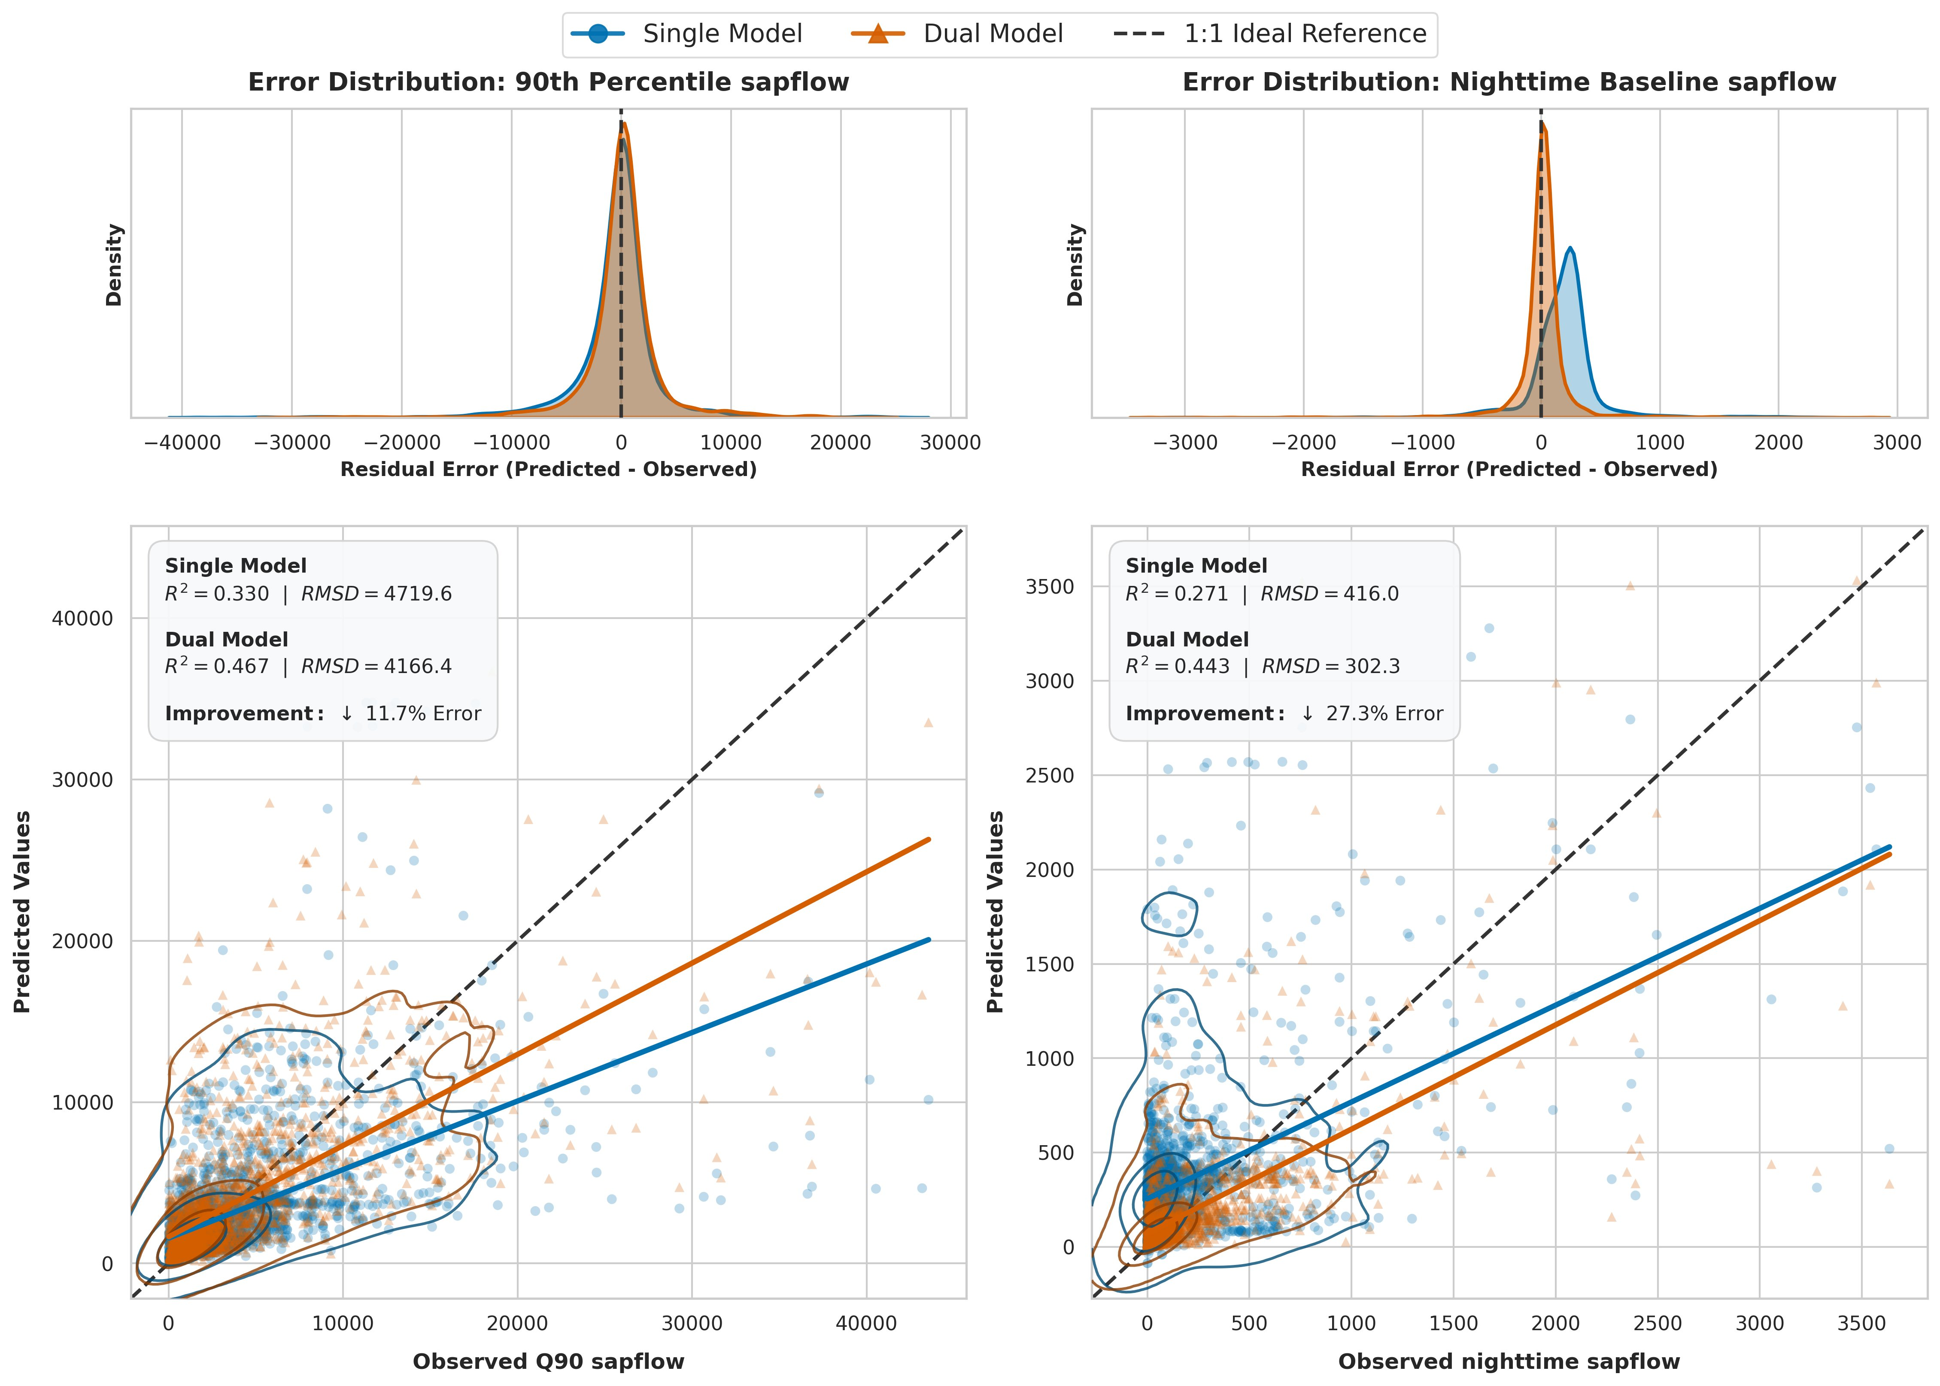
HEADLINE GAINS
Where the dual model improves the magnitude problem
+ 42 %
− 12 %
− 27 %
R² explained variance
RMSD on peak sapflow
RMSD on nighttime baseline
(peak Q90 sapflow)
(global, leave-trees-out)
(largest gain — magnitude)
PEAK MAGNITUDE
NIGHTTIME FLOW
Single-model regression line
stays well below 1:1.
Dual model recovers the slope.
Single model has a clear
positive bias — sees flow
when there is none.
Dual model is centered on 0.
TREEFLOW · EGU 2026
11 / 19
Notes:
Three numbers from a global leave-trees-out evaluation. Explained variance on the daytime peak — sap_q90 — improves by forty-two percent. RMSD on peak sap flow drops by twelve percent. The largest gain is on the nighttime baseline — twenty-seven percent reduction in RMSD. The lower panels show why. For peak sap flow on the left, the single-model regression line stays well below the 1-to-1 ideal — it systematically under-predicts; the dual model recovers the slope. For nighttime flow on the right, the single model has a clear positive bias — predicting flow when there is none — while the dual model is centred on zero.

Slide 12
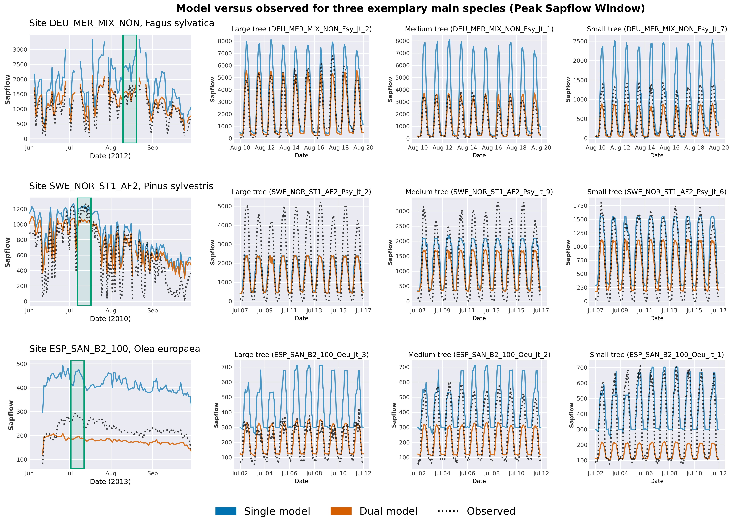
TIME-SERIES VIEW
Three exemplar species · peak sapflow window
Fagus sylvatica
Pinus sylvestris
Olea europaea
DEU · temperate deciduous
SWE · boreal conifer
ESP · Mediterranean evergreen
TREEFLOW · EGU 2026
12 / 19
Notes:
To check that this is not an aggregation artefact, we look at three contrasting species: a temperate deciduous beech site in Germany, a boreal Scots pine site in Sweden, and a Mediterranean olive site in Spain. Across large, medium, and small individuals within each site, the dual-model trace tracks the observed diurnal cycle more closely than the single model — particularly during the peak of the active season, where the magnitude bias of the single model is most visible.

Slide 13
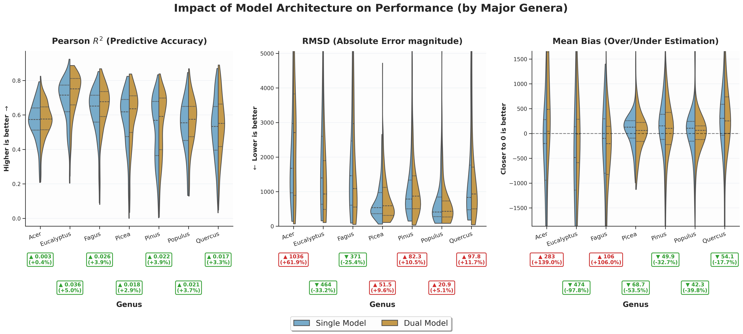
BREAKDOWN — TAXONOMY
Performance by major genera
Pearson R² · RMSD · Mean bias for the seven most-sampled genera in SAPFLUXNET.
Takeaway: Dual model improves R² across all genera; biggest RMSD gains for Fagus, Pinus and Populus.
TREEFLOW · EGU 2026
13 / 19
Notes:
The breakdown by genus shows the gain is not concentrated in one taxon. R-squared improves across all seven major genera. The largest RMSD reductions are on Fagus, Pinus, and Populus — fast-growing, well-sampled groups where the single model had previously over-fit local sensor artefacts.

Slide 14
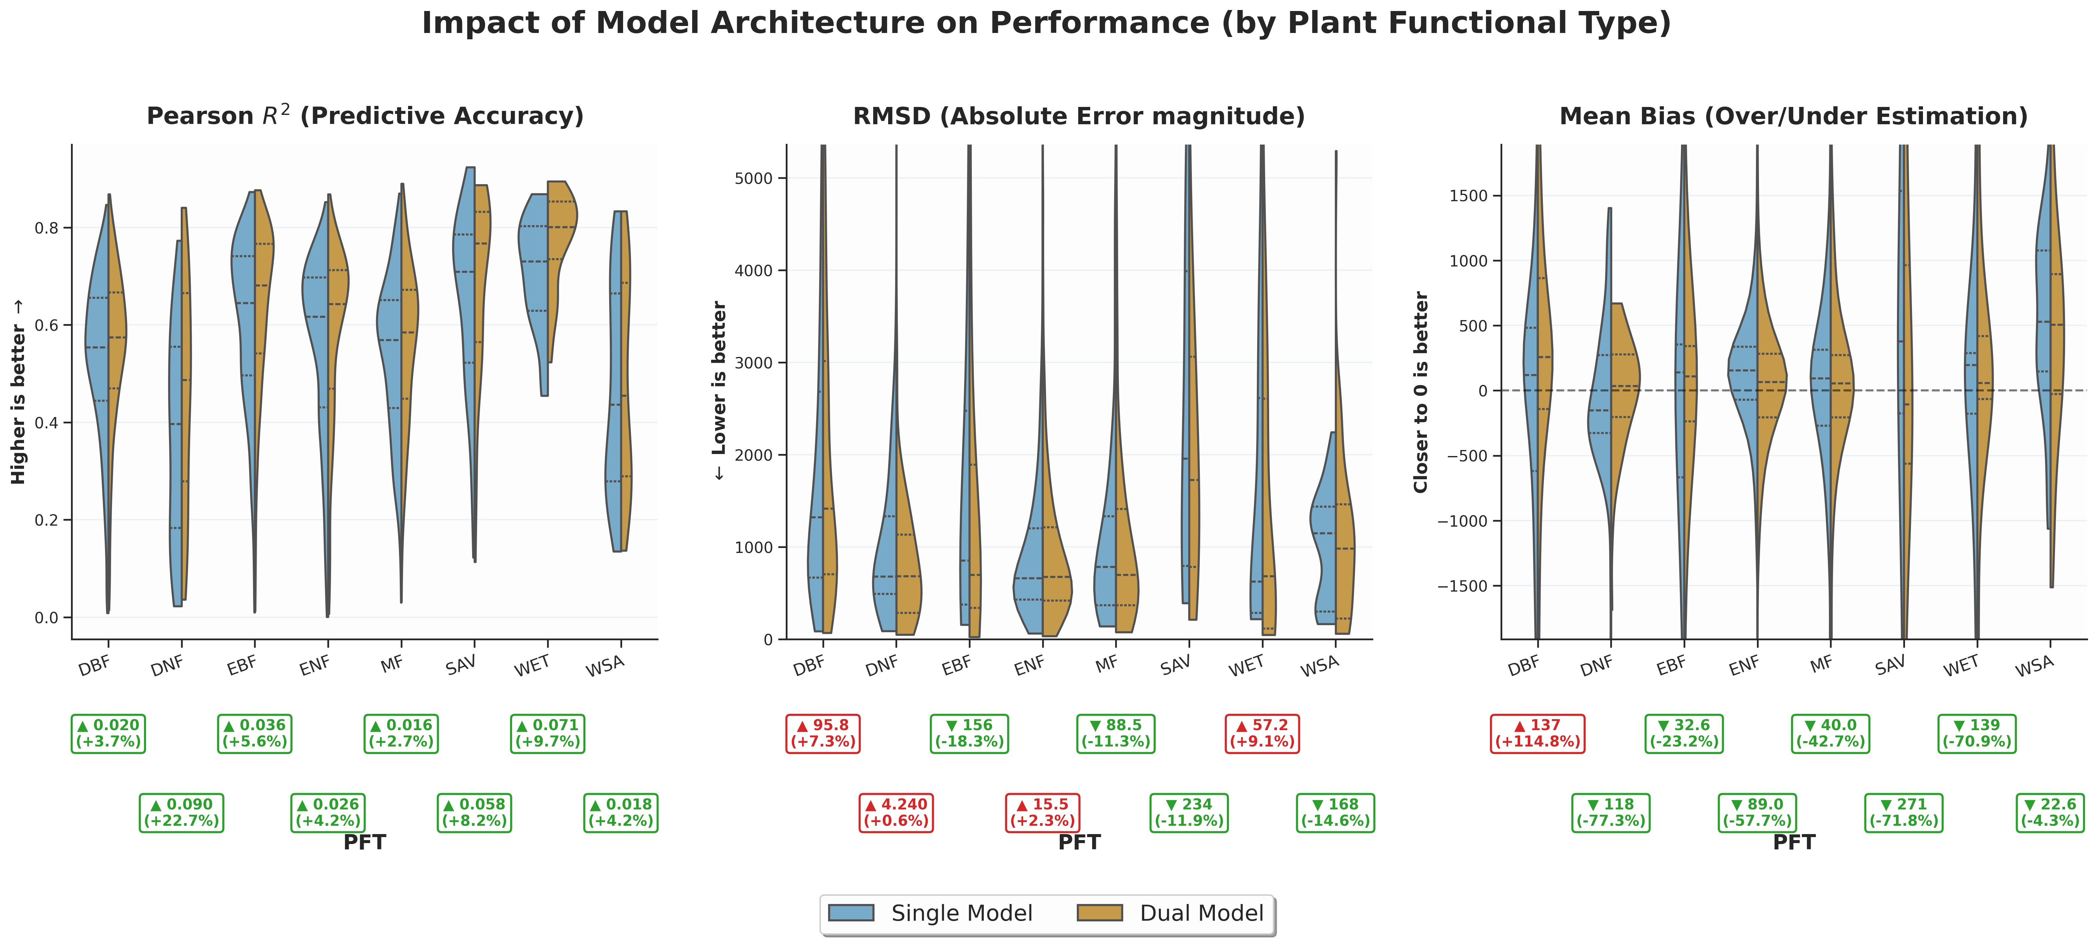
BREAKDOWN — PLANT FUNCTIONAL TYPE
Performance by Plant Functional Type
DBF · DNF · EBF · ENF · MF · SAV · WET · WSA — biome-level functional groupings.
Takeaway: Gains are largest in evergreen needleleaf and woody savanna — biomes where magnitude variability dominates.
TREEFLOW · EGU 2026
14 / 19
Notes:
By plant functional type, gains are largest in evergreen needleleaf forest and woody savanna. These are biomes where magnitude variability dominates — strongly seasonal in the savanna, and structured by individual-tree size differences in the conifer forests. Bias reduction is consistent across functional types.

Slide 15
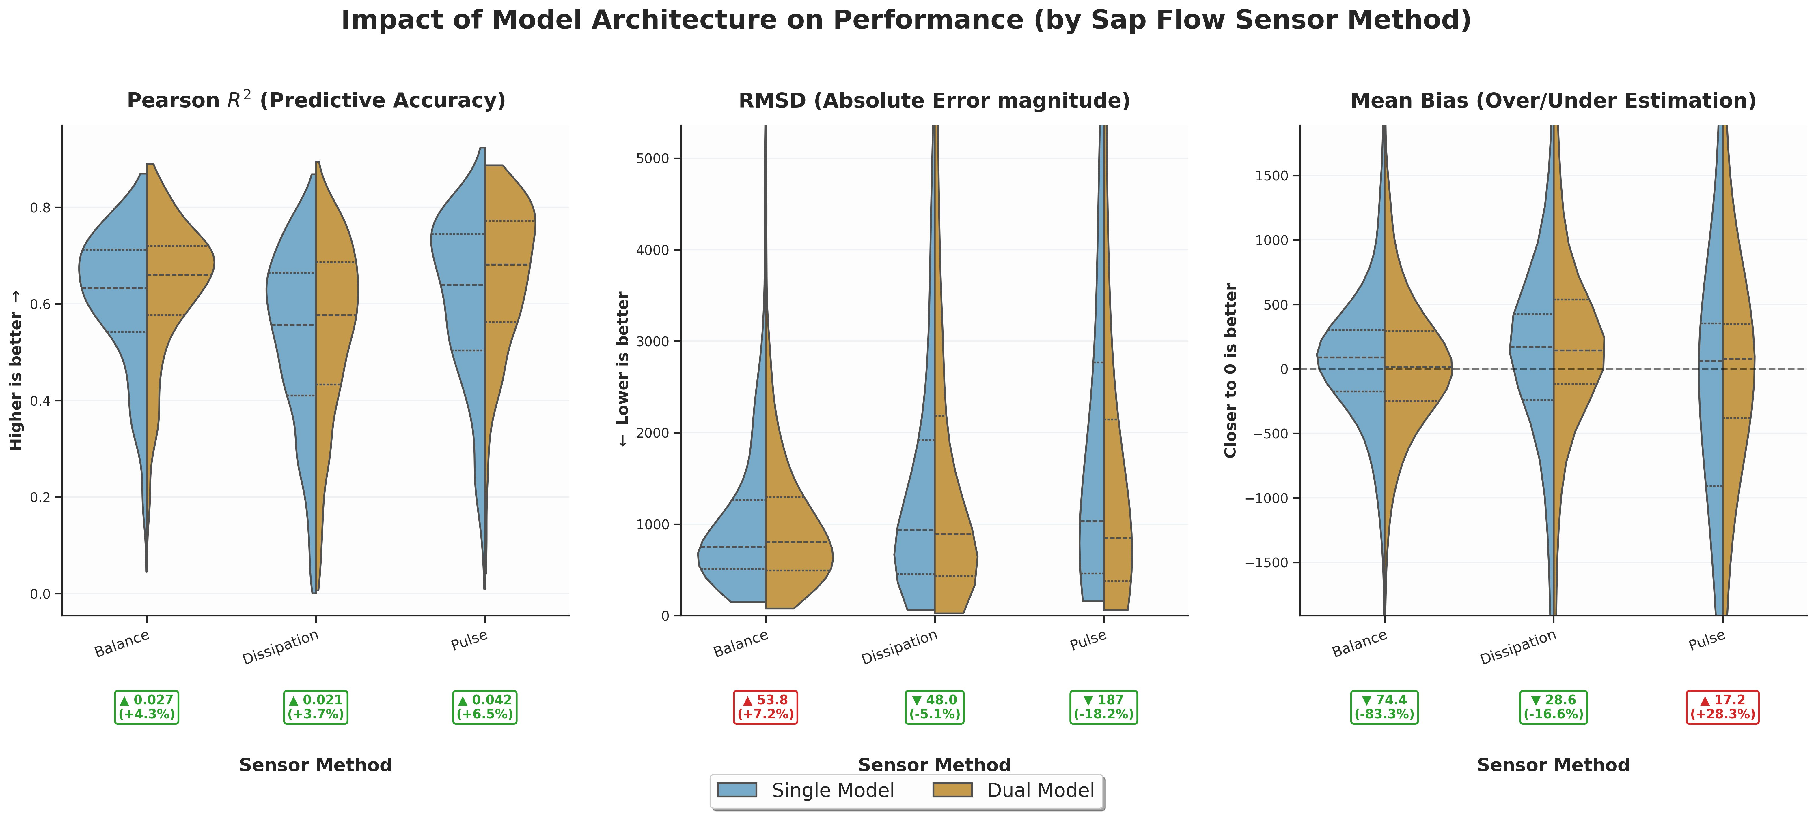
BREAKDOWN — SENSOR METHOD
Performance by sap-flow sensor method
Heat Balance · Thermal Dissipation · Heat Pulse — three measurement principles, three error patterns.
Takeaway: Largest bias reduction on Heat-Balance sensors (−83 %); shape-only learning generalises across measurement principles.
TREEFLOW · EGU 2026
15 / 19
Notes:
By sensor method, the largest bias reduction — around eighty-three percent — comes on heat-balance sensors, which had the strongest geometry-driven offsets. Thermal dissipation and heat pulse also improve. The dual model isolates shape learning from sensor magnitude bias, and that property generalises across the three measurement principles.

Slide 16
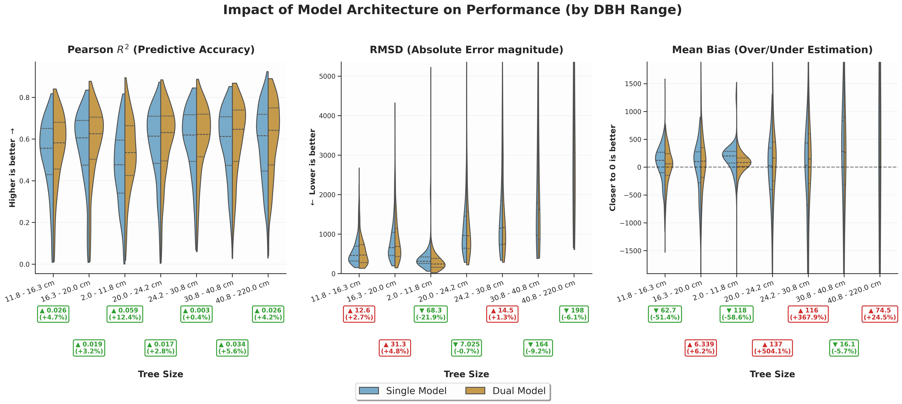
BREAKDOWN — TREE SIZE
Performance by stem diameter (DBH)
Seven DBH bins from saplings (≤ 12 cm) to giants (> 40 cm).
Takeaway: Mid-sized trees benefit most; the largest DBH class is data-thin and remains the residual challenge.
TREEFLOW · EGU 2026
16 / 19
Notes:
By stem diameter, mid-sized trees benefit most. The largest DBH class — trees above forty centimetres — is data-thin in SAPFLUXNET and remains the residual challenge for both models. This is a sample-size limitation rather than a methodological one.

Slide 17
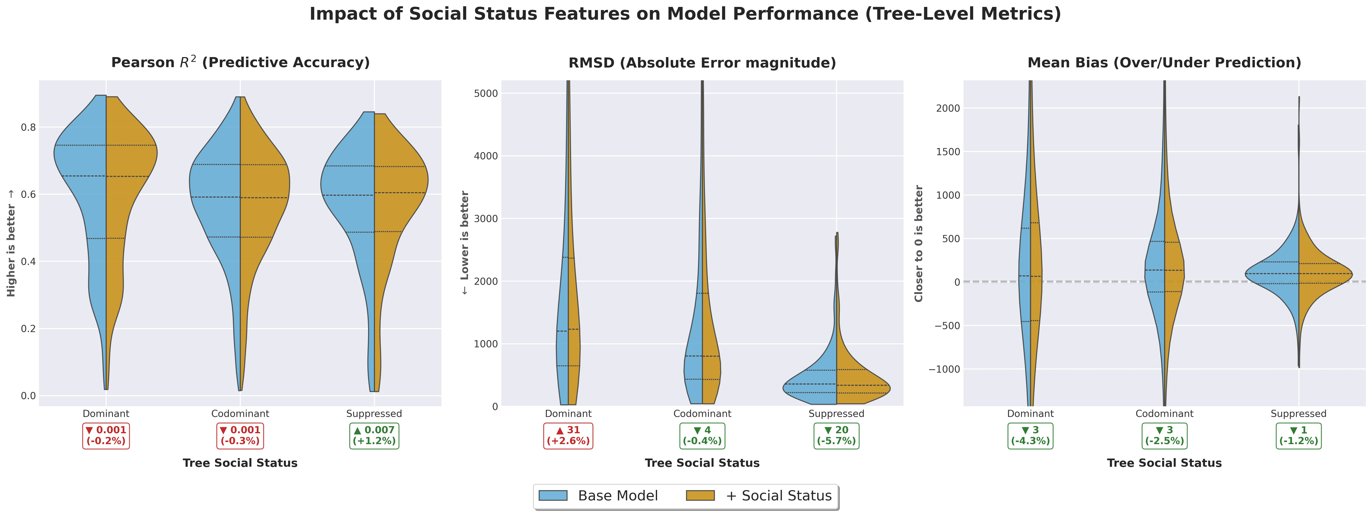
RESIDUAL DIAGNOSIS
What does the residual signal still hide?
EXPLORATORY TEST. Tree social status was not used as a feature in our working model — we added it post-hoc to ask whether residual variance still hides systematic biological signal.
WHAT WE FIND
Residual room is small.
Suppressed trees
+1.2 % R², −5.7 % RMSD
the hardest class — and where extra info helps the most
Bias reduction
consistent across all three classes
(−1 % to −4 % mean bias)
Dominant / Codominant
essentially flat — the model already gets these well
→ within-stand competition is the next residual signal worth chasing.
TREEFLOW · EGU 2026
17 / 19
Notes:
To diagnose what residual variance still hides, we ran a post-hoc test: re-training with tree social status — dominant, codominant, suppressed — added as a feature. Suppressed trees see a 1.2 percent gain in R-squared and a 5.7 percent drop in RMSD. Bias reduction is consistent across all three classes. Dominant and codominant categories are essentially flat — the model already captures them. Within-stand competition is the next residual signal worth chasing.

Slide 18
OUTLOOK
Three directions forward
1
Add memory to the temporal model
XGBoost is memoryless. Move to LSTM / Transformer to capture multi-day drought carry-over, VPD accumulation, and stomatal lag.
2
Upscale to global gridded coverage
Replace measured features with remote-sensing proxies (canopy height, LAI, wood-density priors). Drive the temporal model with gridded ERA5.
3
Benchmark against flux-tower ET
Aggregate to stand transpiration. Compare against eddy-covariance partitioning. Close the loop between tree hydraulics and ecosystem water balance.
DATA
REANALYSIS
COMPUTE
SAPFLUXNET community · 180+ contributors
ERA5 (ECMWF Copernicus) · SoilGrids (ISRIC)
Max Planck Institute for Biogeochemistry, Jena
Notes:
Three directions forward. First, the temporal model is currently memoryless — moving to an LSTM or Transformer should capture multi-day drought carry-over and stomatal lag. Second, replacing measured static features with remote-sensing proxies — canopy height, LAI, wood-density priors — would let us drive the framework at gridded resolution from ERA5. Third, aggregating predictions to stand transpiration and benchmarking against eddy-covariance ET partitioning closes the loop with ecosystem-scale water balance.

Slide 19



THANK YOU
Questions welcome
Thank you for your time. Your feedback is appreciated.
SCAN FOR FEEDBACK
Deep Prakash Sarkar
Doctoral Researcher
Department Biogeochemical Integration (BGI)
Cross-Scale Terrestrial Ecophysiology · Global diagnostic models
IMPRS for Global Biogeochemical Cycles
EMAIL
dsarkar@bgc-jena.mpg.de
PHONE
+49 3641 57-6229
Your feedback shapes the next iteration
AFFILIATION
Max Planck Institute for Biogeochemistry, Jena
Notes:
Thank you for your attention. I welcome your questions. The QR code links to my contact details and a feedback form.

