Slide 1

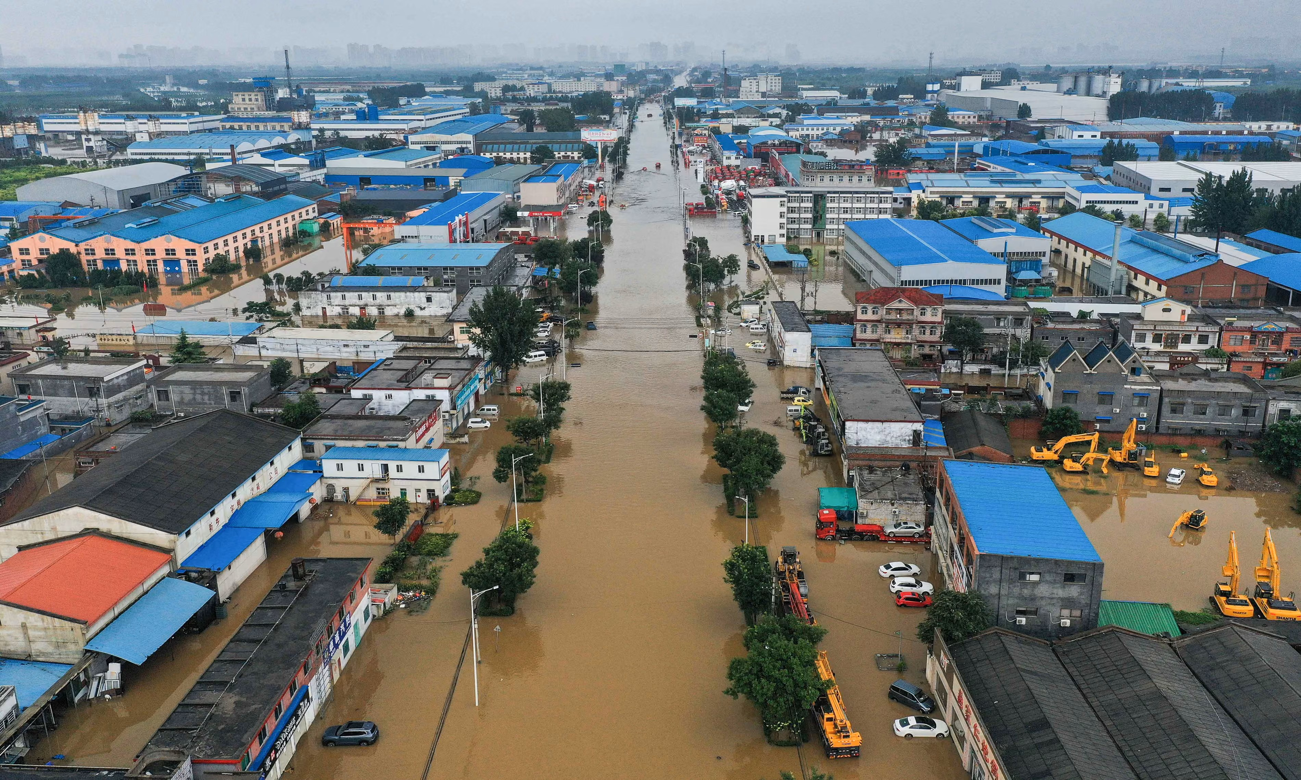
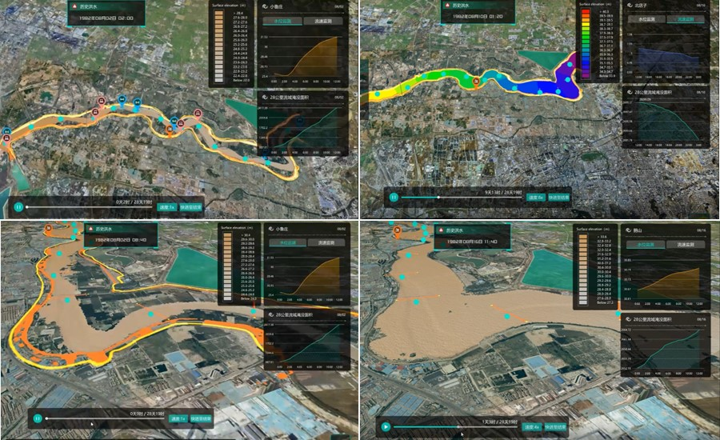
HS4.6 Real-time flood forecasting and early warning systems: data analytics, modelling, and applications
Conveners team:
Tim aus der Beek, Kourosh Behzadian, Saman Razavi, Farnad Nasirzadeh, Friedrich Boeing^{ECS}, Giada Cerato^{ECS}, Farzad Piadeh
4 May 2026 (16:15 - 18:00)

Slide 2
Multi‑Source Data & Modelling
IoT Sensors River gauges, rain gauges, smart meters
Remote Sensing Radar, LiDAR, satellites, drones
Crowd‑Sourced Citizen reports & social media
Traditional Methods & Limitations
Physics‑Based Models Solve governing equations; require detailed calibration
Statistical Models Empirical relations & regression methods
Conceptual Models Simplified hydrological representations
Limitations of traditional approaches: • High computational costs and long runtimes • Limited adaptability to heterogeneous data • Underperform under extreme & changing climates

Slide 3



Contemporary Approaches for Flood Risk Management
ML and DL frameworks
They fuse heterogeneous data sources to improve lead time, robustness, and accuracy of forecasting under uncertainty.
Digital Twin & Immersive Visualisation VR/AR/MR They make flood information tangible and engaging better with stakeholder and improve knowledge retention and self‑efficacy
NLP & Large Language Models
NLP Pre‑processing Tokenisation, cleaning, feature extraction
LLM Classification Fine‑tuned GPT‑based models
Categories & Alerts Impact categories & situational awareness
Unstructured Reports Social media, local storm reports

Slide 4
Current Challenges & Gaps
Data Reliability Sensor drift, missing data & noise
Computational Demand Real‑time processing & scalability
Interoperability Standards & platform integration
Interpretability Black‑box AI models & transparency
Inclusivity Accessible warnings for diverse communities
Behaviour Change Immersion alone is not enough

Slide 5


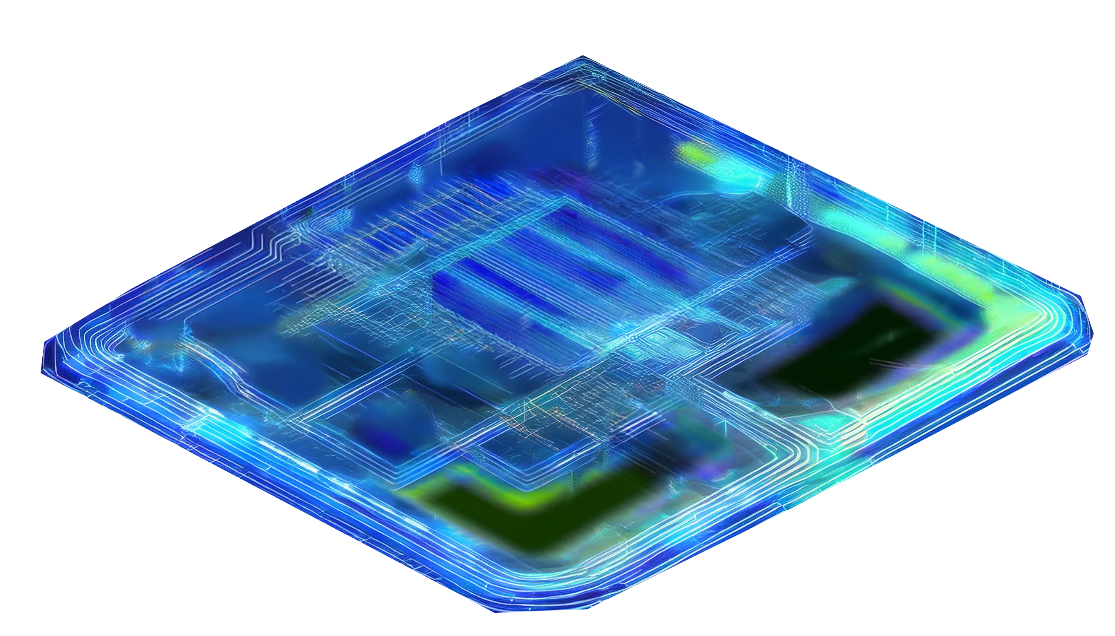







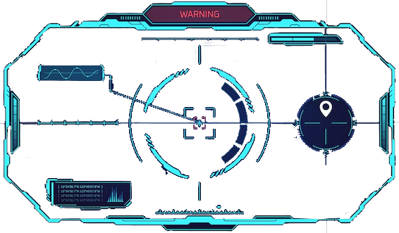
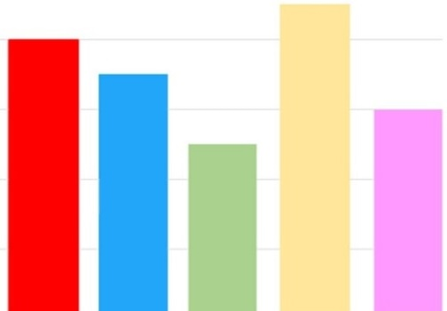
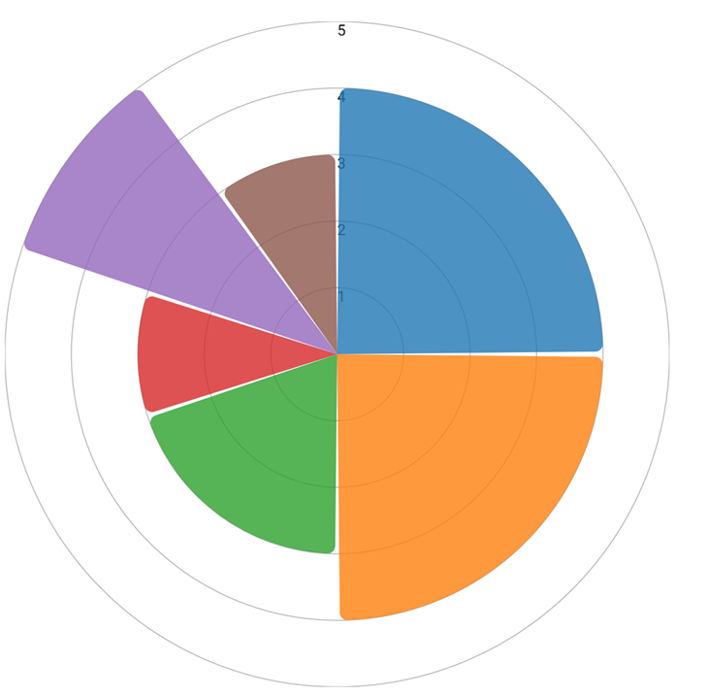
Integrated Framework for Real-Time Flood Forecasting and Early Warning with Digital technologies
Dynamic Risk Mapping
Digital Twin-Enabled Decision Support System
Spatio-temporal Real-time Modelling of Flood Forecasting
Urban infrastructure layer
Medium risk
High risk
High risk
Recurrent machine learning
water level forecasting
Satellite
Demographic layer
High flood risk area
Radar
High risk
Medium risk
Rain gauge
Medium flood risk area
Digital twin platform
Catchment layer
Low flood risk area
Sensors
Hybrid deep learning-physical modelling
Dashboard of early warning system
Low risk
Catchment
Water infrastructure layer
High risk
Economic layer
High risk
CSO
High risk
Planning and Design of Infrastructure & Community Resilience
Real-time Data Integration
Multifactorial Analysis
Risk Mapping
Scenario Simulation
Built environment adaptation scenarios
Asset management
dashboard
Impact scenario analysis
Agent condition
Prompt action suggestion

Slide 6
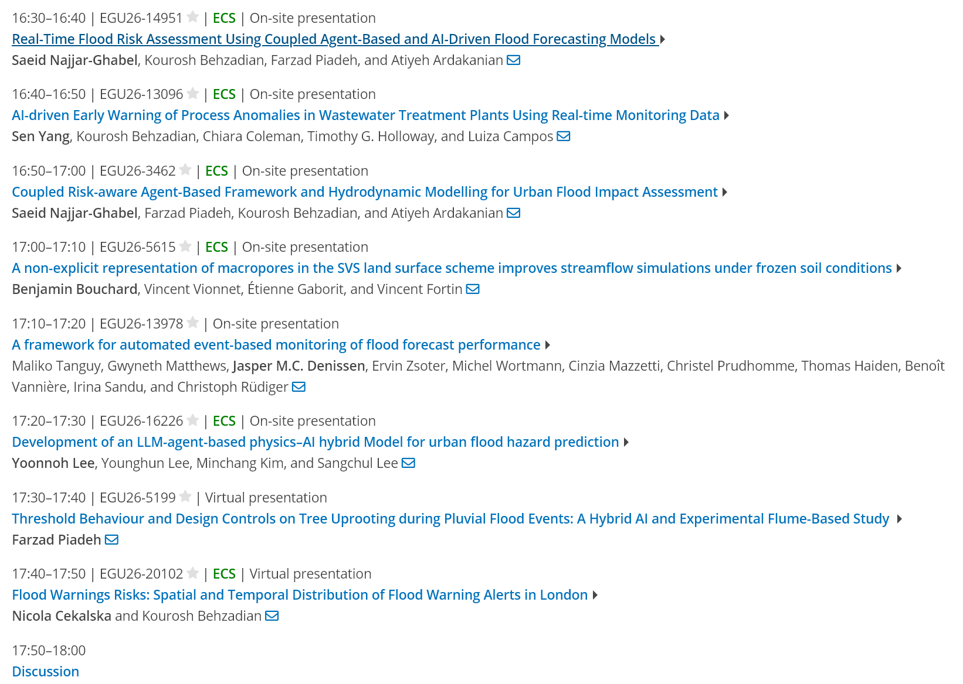
Oral Presentations

