Slide 1
EGU 2026 · Oral Presentation
Refining IMERG Validation
by Accounting for Rain Gauge
Representativeness Errors
Li Yue¹ · Han Bowei¹² · Chen Lin² · Zhou Renjun¹ · Li Rui¹
¹ USTC, School of Earth and Space Science | ² National Satellite Meteorology Center
Session: Precipitation – Measurement, Climatology, Remote Sensing, and Modelling
Li Yue · USTC · EGU 2026 · Precipitation Remote Sensing
1 / 9

Slide 2
Are Gauges Really Ground Truth?
Motivation & Research Gap
🌧 Point Measurement
🛰 IMERG Grid Average
Rain gauge measures at a
single point
Covers ≈ 100–400 cm²
Used as 'ground truth'
for an area of ~100 km²
IMERG retrieves
area-averaged precipitation
0.1° × 0.1° grid cell
≈ 100 km²
Representativeness Error is introduced
when using sparse gauges
to approximate this area mean
≠
Mismatch!
●
1 gauge
Ignoring gauge representativeness error leads to systematic overestimation of IMERG's apparent inaccuracies.
Li Yue · USTC · EGU 2026 · Precipitation Remote Sensing
2 / 9

Slide 3
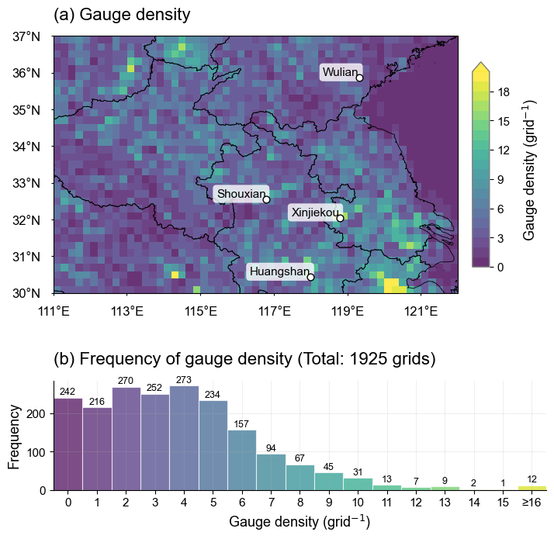
Study Area & Datasets
Jianghuai Monsoon Region, Eastern China
📍 Figure 1
Gauge Density Map
(Jianghuai Region)
7,253 stations
2020–2024
0.2° grid
Study Area
Gauge Network
Jianghuai, E. China
858,000 km²
7,253 gauges
8.45 / 1,000 km²
(4× WMO standard)
IMERG Product
Period
V07 Final Run
0.5-hr / 0.1°
Aggregated to 0.2°
2020 – 2024
(5 years)
Li Yue · USTC · EGU 2026 · Precipitation Remote Sensing
3 / 9

Slide 4

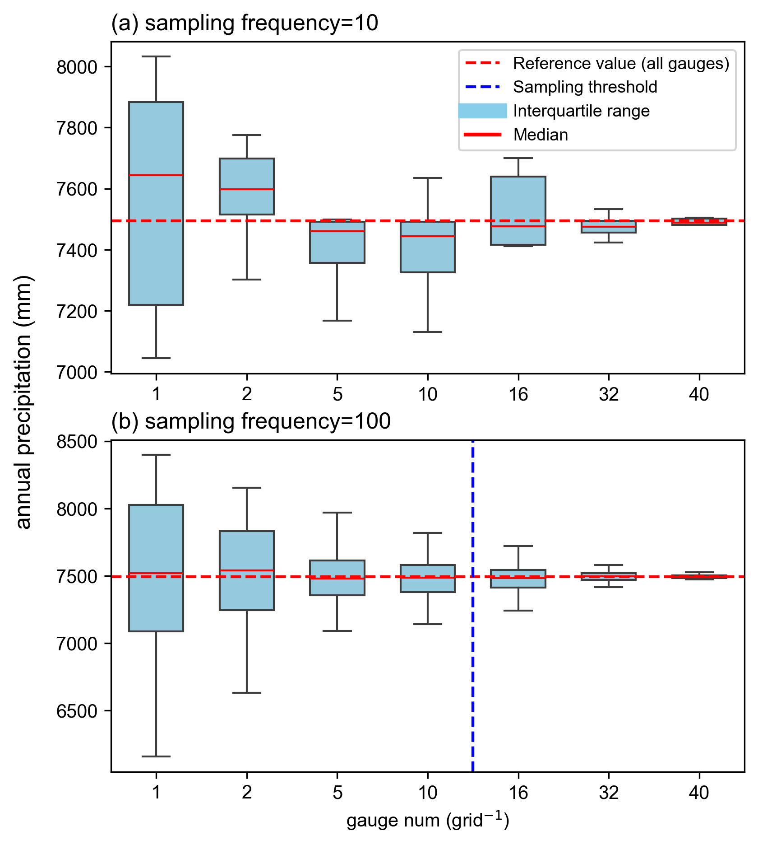
Determining the Minimum Gauge Threshold: K = 16
Subsampling experiment in the densest grid cell (N = 41 gauges, F = 100 repetitions)
📊 Figure 3b
Boxplot: Estimated vs. True
Annual Precipitation
(F = 100 repetitions)
Blue dashed line → K = 16
Red dashed line → Ground truth
Critical Threshold
K = 16
← 75th
gauges per 0.2° grid
← boxes converge to truth
↑
ground truth from all 41 gauges
← 25th
✔ n < 16
Estimates deviate significantly
and unpredictably
✔ n ≥ 16
Stable, reliable area-mean
precipitation estimate
Li Yue · USTC · EGU 2026 · Precipitation Remote Sensing
4 / 9

Slide 5
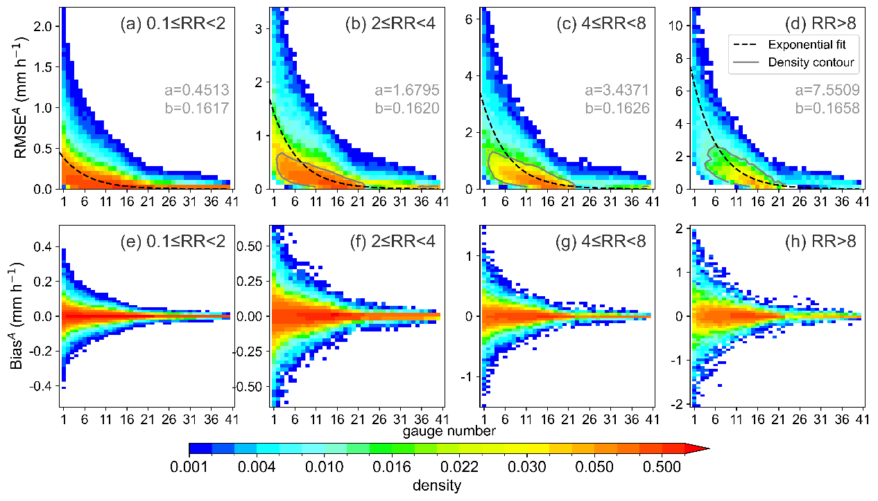
Dual Dependence of Gauge Representativeness Error
RMSE^{A} decreases with gauge count (n) and increases with rainfall intensity (RR)
📈 Figure 4
RMSE^A vs. Gauge Count
for different Rainfall Intensity bins
Gray contours → high-density regions
Dashed curves → exponential fits
(all pass significance test)
Core Equation
a coefficient increases with RR: heavier rain → larger initial error
RMSE^{A} = a · e^{−b·n}
a, b = fitted coefficients
n = number of gauges
More gauges →
Error decays
exponentially
Heavier rain →
Error grows
substantially
Li Yue · USTC · EGU 2026 · Precipitation Remote Sensing
5 / 9

Slide 6
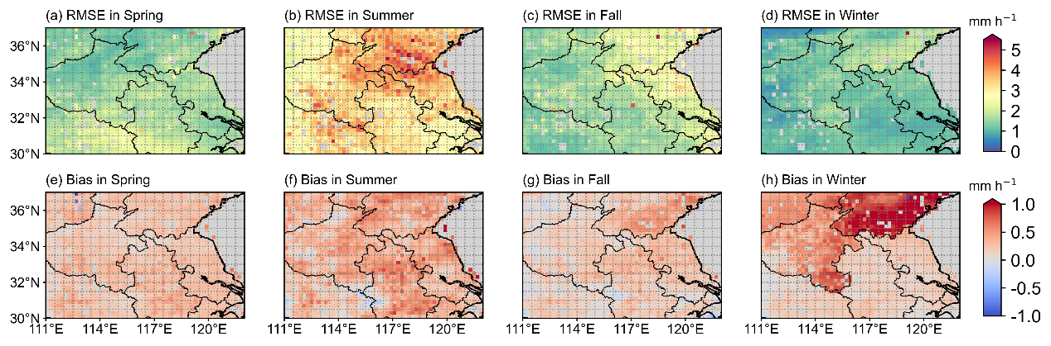
Direct IMERG–Gauge Comparison: Seasonal RMSE and BIAS
Sparse gauge regions show larger discrepancies — but is that IMERG's fault?
🗺 Figure 6 (top row)
Seasonal RMSE spatial maps (Spring / Summer / Fall / Winter)
▶ Summer RMSE highest in NE area (sparse gauges)
▶ Average RMSE: 1.65 / 3.35 / 1.84 / 1.26 mm h⁻¹
Key Finding
MEAN
RMSE
r = −0.33
1.65 mm/h
3.35 mm/h
1.84 mm/h
1.26 mm/h
IMERG–gauge RMSE
vs. gauge density
(summer, p < 0.001)
Denser gauges
→ smaller
IMERG–gauge gap
Not IMERG's fault;
gauge reference
is less reliable!
Li Yue · USTC · EGU 2026 · Precipitation Remote Sensing
6 / 9

Slide 7
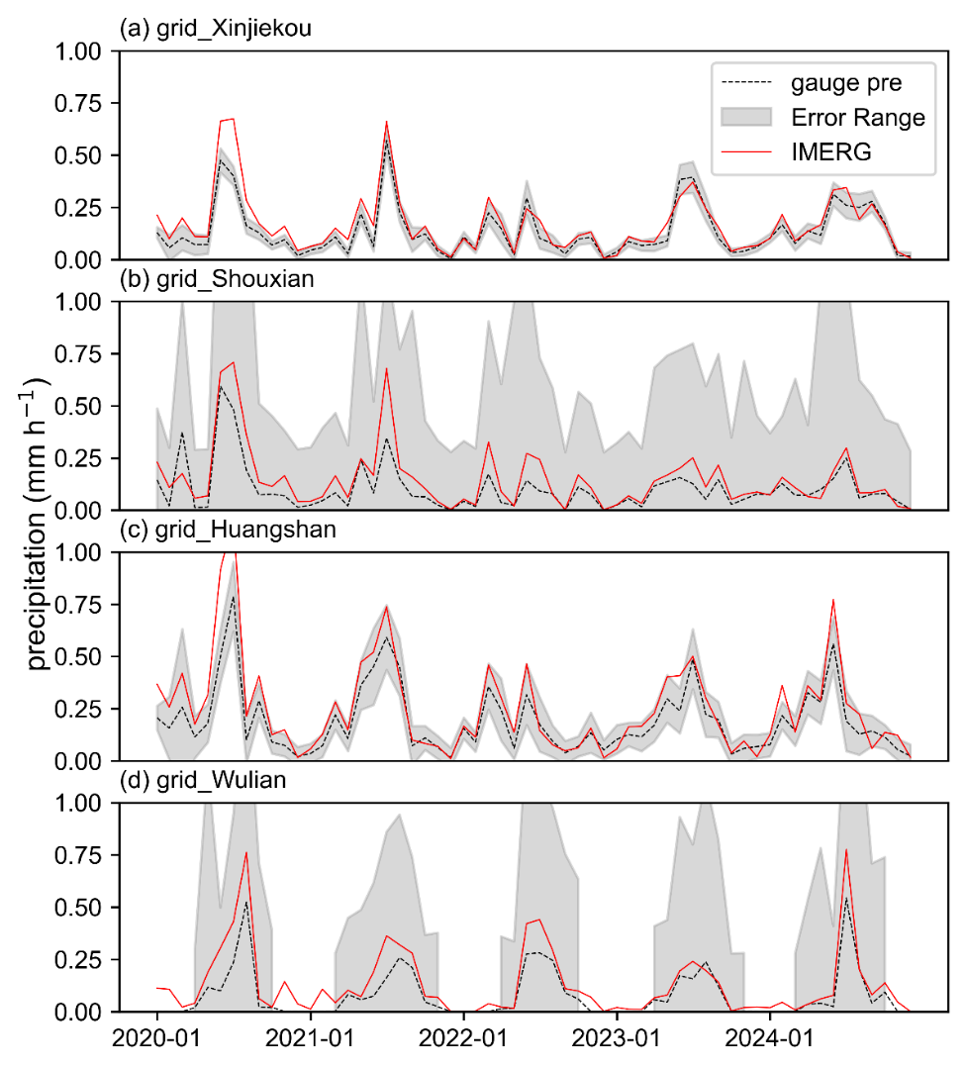
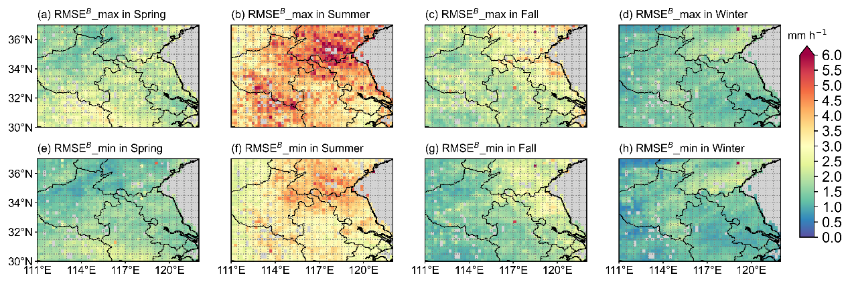
Refined IMERG Retrieval Error Bounds
Decomposing total discrepancy: RMSE = RMSE^A (gauge) + RMSE^B (IMERG retrieval)
Error Decomposition
📈 Figure 9
Time series: Monthly IMERG (red) vs.
Gauge (black) ± error band (gray)
For 4 sites:
• Xinjiekou (20 gauges)
• Shouxian (3 gauges)
• Huangshan (14 gauges)
• Wulian (3 gauges)
Wider band → sparser gauges
But IMERG often within band!
(n=20)
RMSE = RMSE^{A} + RMSE^{B}
Bounds:
max{0, RMSE − RMSE^{A}} ≤ RMSE^{B} ≤ RMSE + RMSE^{A}
(n=3)
← gauge representativeness error range
📊 Figure 7
Spatial distribution of RMSE^B_max (top) and RMSE^B_min (bottom)
across four seasons
▶ Summer RMSE^B_min substantially smaller
than conventional RMSE — especially Shandong & Dabie Mts.
Shandong & Dabie Mt
↓
(n=14)
(n=3)
Li Yue · USTC · EGU 2026 · Precipitation Remote Sensing
7 / 9

Slide 8
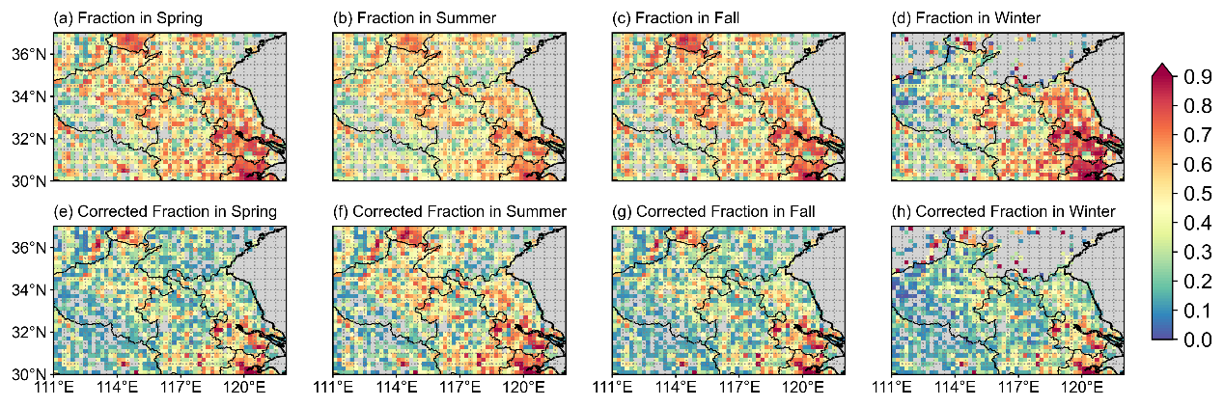
How Much of the reported IMERG–gauge Discrepancy is Truly Significant?
One-sample t-tests at each grid cell: conventional (error-free gauges) vs. gauge-error-corrected approach
🗺 Figure 10
Fraction of hours with statistically significant IMERG–gauge differences (p < 0.05)
Top row: Conventional (assume error-free gauges) | Bottom row: Gauge-error-corrected
Spring / Summer / Fall / Winter
Incorporating Gauge Representativeness Error
fraction of significant hour
Spring
Summer
Fall
Winter
−16%
−6%
−16%
−17%
reduction in
significant hours
reduction in
significant hours
reduction in
significant hours
reduction in
significant hours
Li Yue · USTC · EGU 2026 · Precipitation Remote Sensing
8 / 9

Slide 9
Conclusions
01
Minimum Gauge Threshold
K = 16 gauges per 0.2° grid required for reliable area-mean precipitation estimates.
02
Exponential Error Decay
Gauge representativeness errors follow an exponential decay with density, amplified by rainfall intensity.
03
Gauge Scarcity as a Driver
not IMERG algorithm deficiency — is one of the driver of apparent satellite–gauge discrepancies.
04
Up to −17% False Flags
Incorporating gauge errors reduces falsely flagged significant discrepancies by 6–17% across seasons.
The gauge network quality is just as critical as the satellite algorithm itself. Validation must account for both.
Li Yue · USTC · EGU 2026 · Precipitation Remote Sensing
9 / 9

