Slide 1

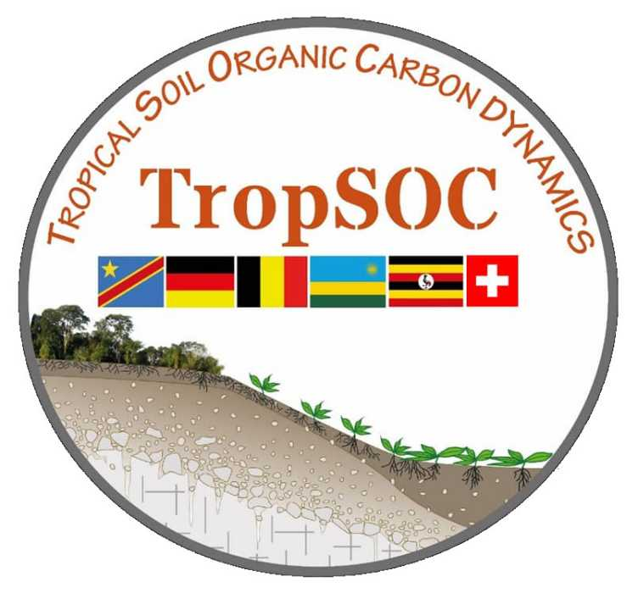






Department of Earth and Planetary Sciences
Reconstructing soil exchangeable Calcium in central Africa during the Late Holocene Rainforest Crisis using a new biomarker lipid tool
Anirban Kumar Mandal*, Marco Griepentrog, Sebastian Doetterl, Timothy I. Eglinton, Clayton R. Magill, Julia Winterberg, Julie Lattaud, Mike C. Rowley, Gaelle Wanlin, Laura Summerauer, Cindy De Jonge
* Geological Institute, ETH Zurich, Switzerland (anirban.mandal@eaps.ethz.ch)
EGU 2026 | Session CL5.2 | 5th May
SUPPLEMENTARY
Notes:
Good Morning everyone! My name is Anirban K Mandal and I am a third year PhD student at ETH Zurich. Today I will present a talk on developing a new biomarker tool to reconstruct soil calcium during the late Holocene rainforest crisis period in central africa

Slide 2
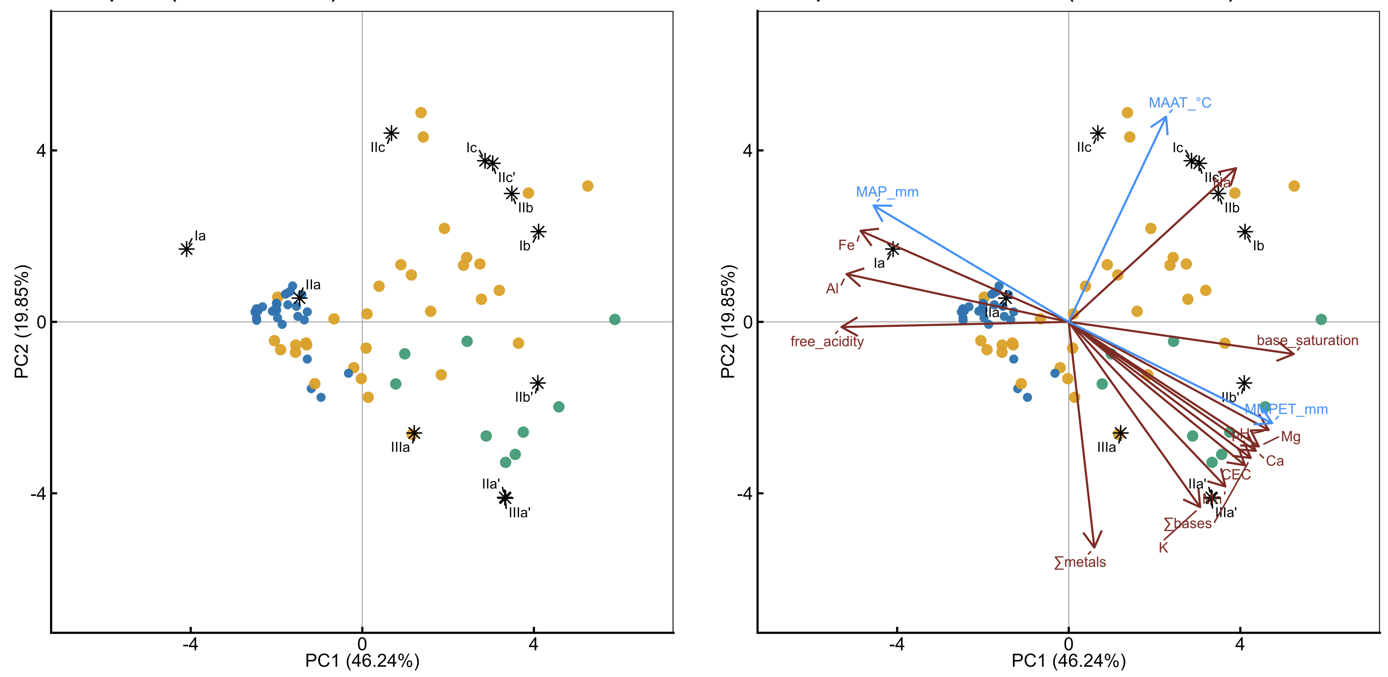
PCA based on standardized fractional abundances of branched GDGTs. Environmental variables plotted a posteriori

Slide 3
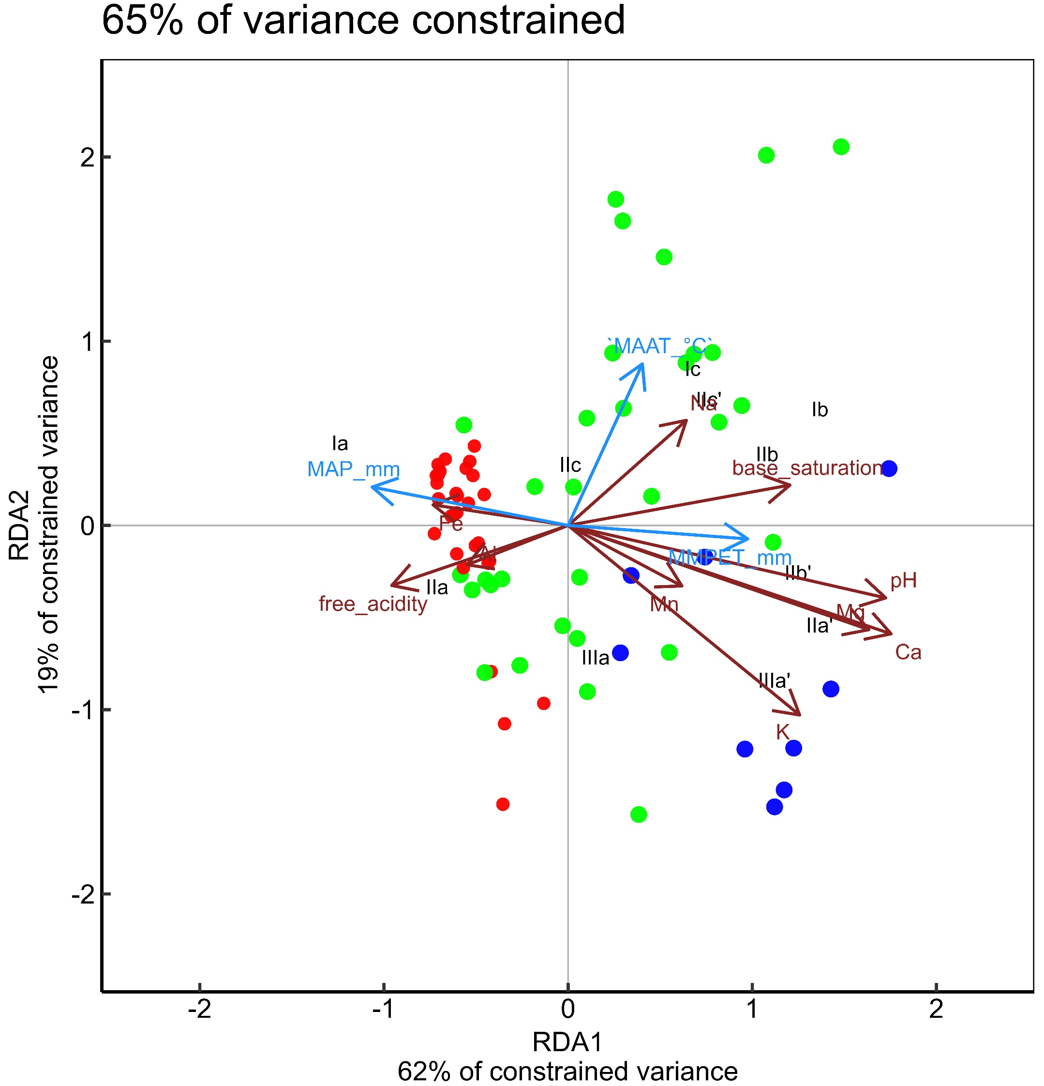
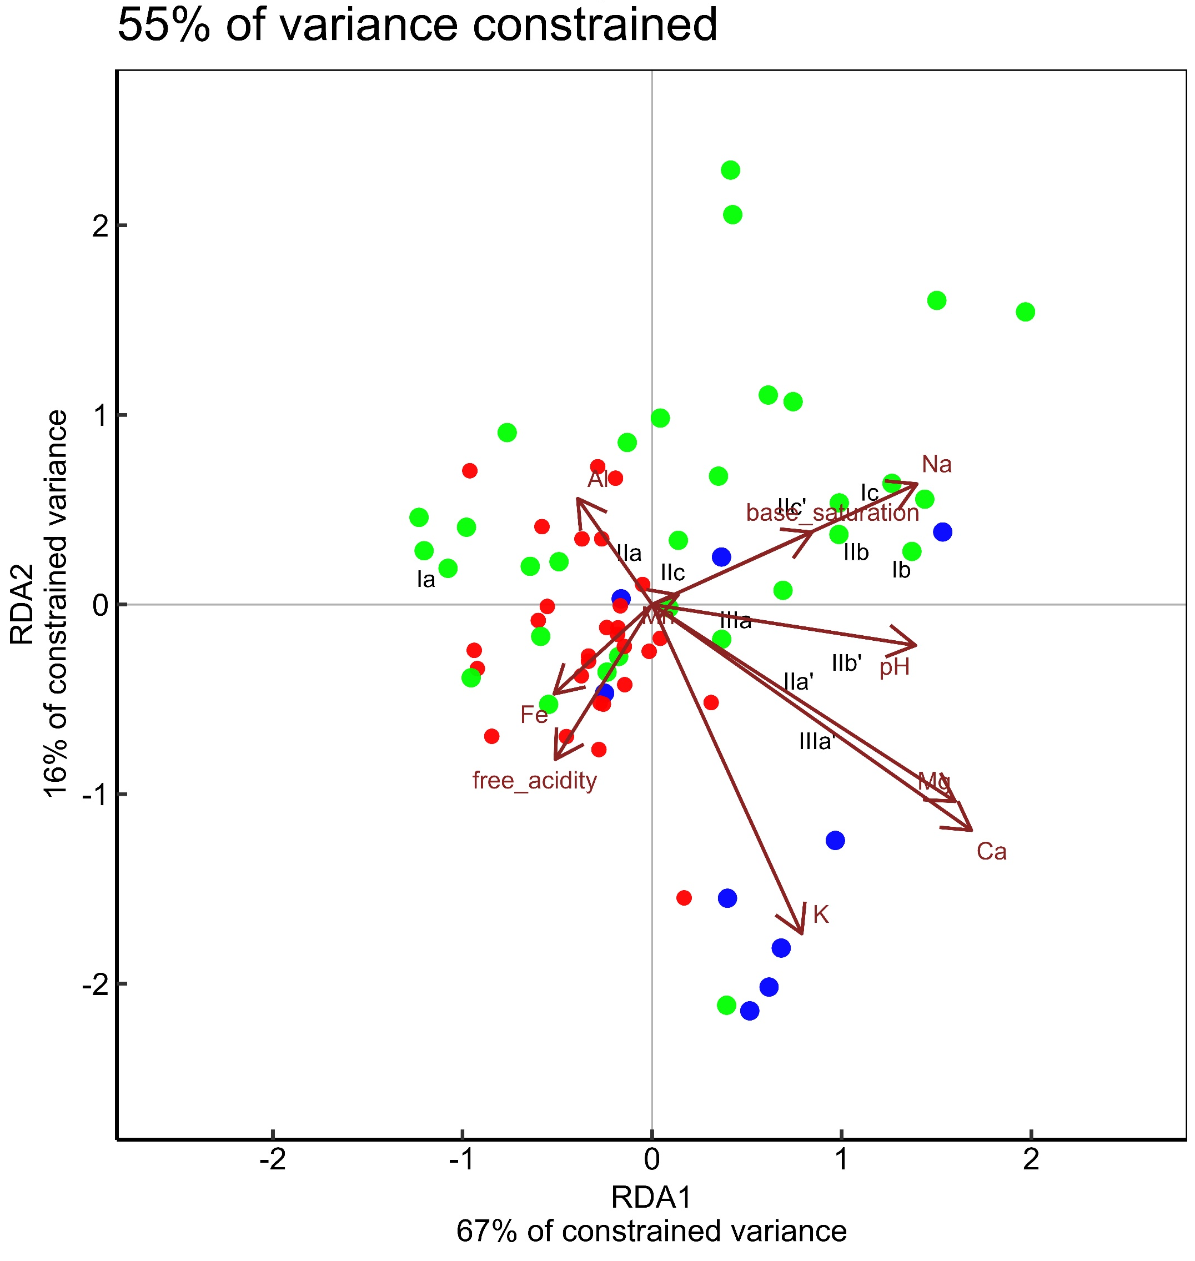
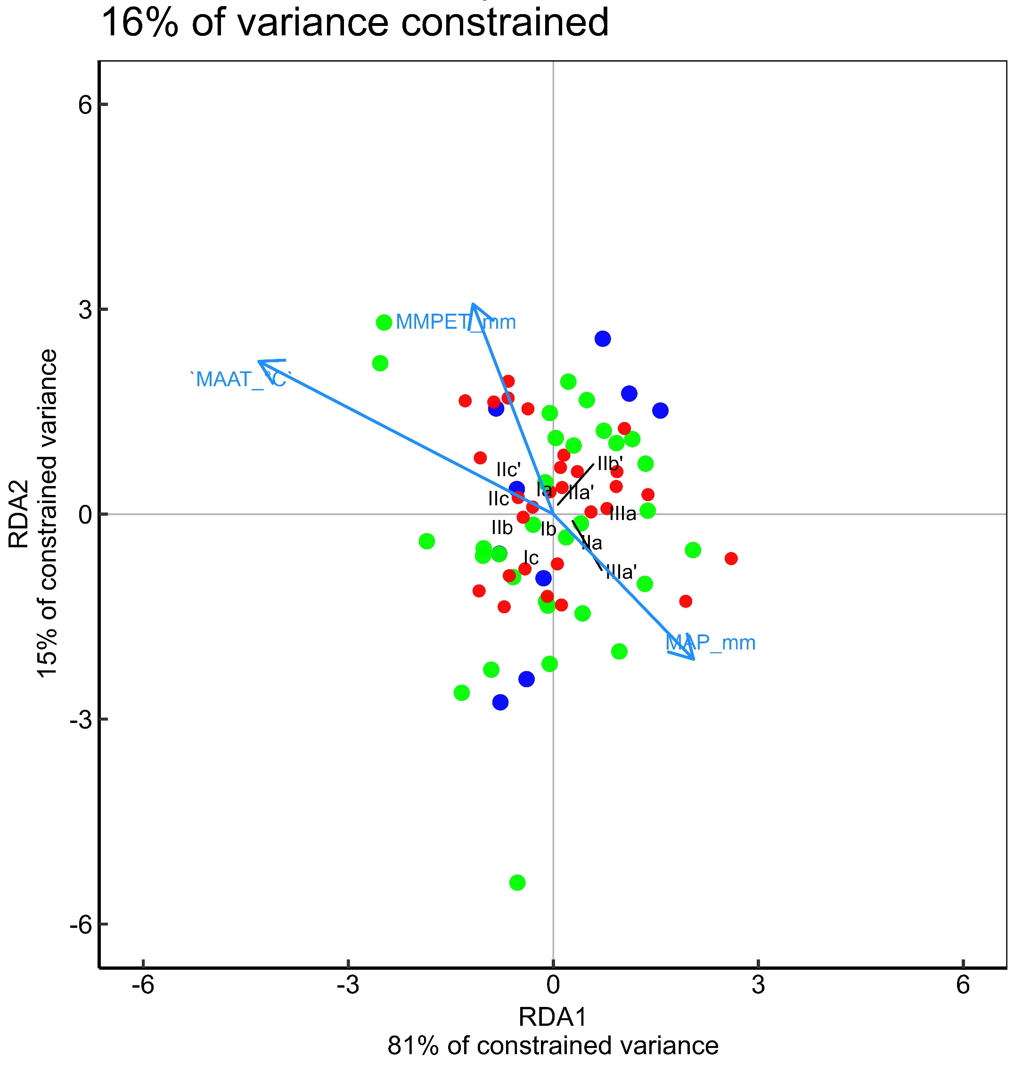
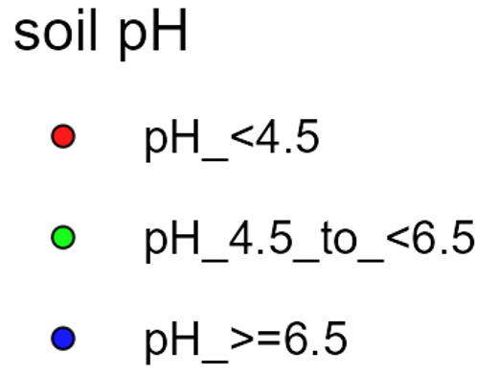
variable | Df | AIC | F | P | Signif
Ca | 1 | 1792.453 | 34.52579 | 0.001 | ***
Summed bases | 1 | 1805.043 | 32.82204 | 0.001 | ***
CEC | 1 | 1834.991 | 30.02816 | 0.001 | ***
pH | 1 | 1842.447 | 32.01462 | 0.001 | ***
Mg | 1 | 1881.926 | 28.00052 | 0.001 | ***
K | 1 | 1975.488 | 18.10537 | 0.001 | ***
base_saturation | 1 | 2055.078 | 14.12215 | 0.001 | ***
MAP_mm | 1 | 2085.828 | 10.95396 | 0.001 | ***
MMPET_mm | 1 | 2096.969 | 9.932394 | 0.001 | ***
free_acidity | 1 | 2111.102 | 8.799302 | 0.001 | ***
MAAT_Â°C | 1 | 2146.655 | 5.334501 | 0.003 | **
(cation = cmolc/kg)

Slide 4
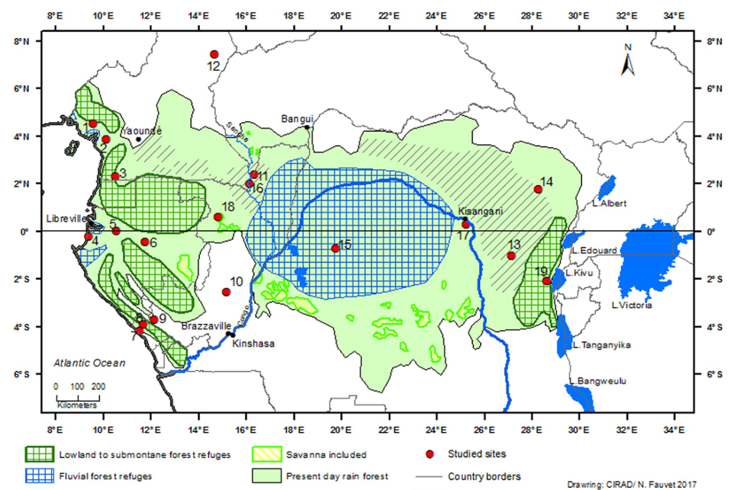
Yangambi
(Maley et al., 2018)

Slide 5
References:
Von Fromm, Sophie F., et al. "Controls on timescales of soil organic carbon persistence across sub‐Saharan Africa." Global Change Biology 30.1 (2024): e17089.
Stocker, Benjamin David, et al. "Holocene peatland and ice-core data constraints on the timing and magnitude of CO2 emissions from past land use." Proceedings of the National Academy of Sciences 114.7 (2017): 1492-1497.
Halffman, Robin, et al. "Soil chemistry, temperature and bacterial community composition drive brGDGT distributions along a subarctic elevation gradient." Organic Geochemistry 163 (2022): 104346.
De Jonge, Cindy, et al. "The influence of soil chemistry on branched tetraether lipids in mid-and high latitude soils: Implications for brGDGT-based paleothermometry." Geochimica et Cosmochimica Acta 310 (2021): 95-112.
De Jonge, Cindy, et al. "The impact of soil chemistry, moisture and temperature on branched and isoprenoid GDGTs in soils: A study using six globally distributed elevation transects." Organic Geochemistry 187 (2024): 104706.
Maley, Jean, et al. "Late Holocene forest contraction and fragmentation in central Africa." Quaternary Research 89.1 (2018): 43-59.
Garcin, Yannick, et al. "Early anthropogenic impact on Western Central African rainforests 2,600 y ago." Proceedings of the National Academy of Sciences 115.13 (2018): 3261-3266.

